Slide 1
Digitalisation of cross-border social security
State of play and ways to move forward

Slide 2
EESSI

Slide 3
EESSI – Overview
Electronic Exchange of Social Security Information
EU Regulations (EU) 883/2004 and (EU) 987/2009 governed by the Administrative Commission for the Coordination of Social Security Systems
  https://eur-lex.europa.eu/eli/reg/2004/883/oj/eng
  https://eur-lex.europa.eu/eli/reg/2009/987/oj/eng
Government-to-Government (G2G) platform via TESTA (Trans-European Services for Telematics between Administrations) connects ~3,400 national social security institutions across 32 countries (EU, Iceland, Liechtenstein, Norway, Switzerland and the UK) to handle cross-border administrative social security cases digitally
covers 8 core domains including Accidents at Work & Occupational Diseases, Family Benefits, Pensions, Sickness, Unemployment, Applicable Legislation, Horizontal and Recovery

Slide 4
EESSI – Overview
operationalisation of workflows by Business Use Cases (BUCs)
standardised data exchange via Structured Electronic Documents (SEDs) embedded within BUCs replacing legacy (paper or email) E-forms and enforcing uniform validation
federated architecture via secure National Access Point, National Gateway and local case management tool JINA (before RINA) maintaining strict end-to-end encryption and GDPR compliance

Slide 5
EESSI – Why digital coordination matters
free movement of citizens: ensures seamless social security coverage for workers, families and retirees moving across Europe
accelerated case resolution: replaces slow mail or paper based exchanges with real-time digital workflows enabling national institutions to resolve cross-border claims, verify coverage and pay out benefits much faster
error & fraud reduction: automated data validation eliminates manual data entry errors and prevents fraudulent cross-border social security claims
guaranteed data protection: secure end-to-end encryption through national Access Points ensures full GDPR-compliance when transmitting sensitive personal data across borders
operational efficiency: standardised schemas and routing via the EESSI-Institution Repository eliminate administrative overhead handling high volumes of international files

Slide 6
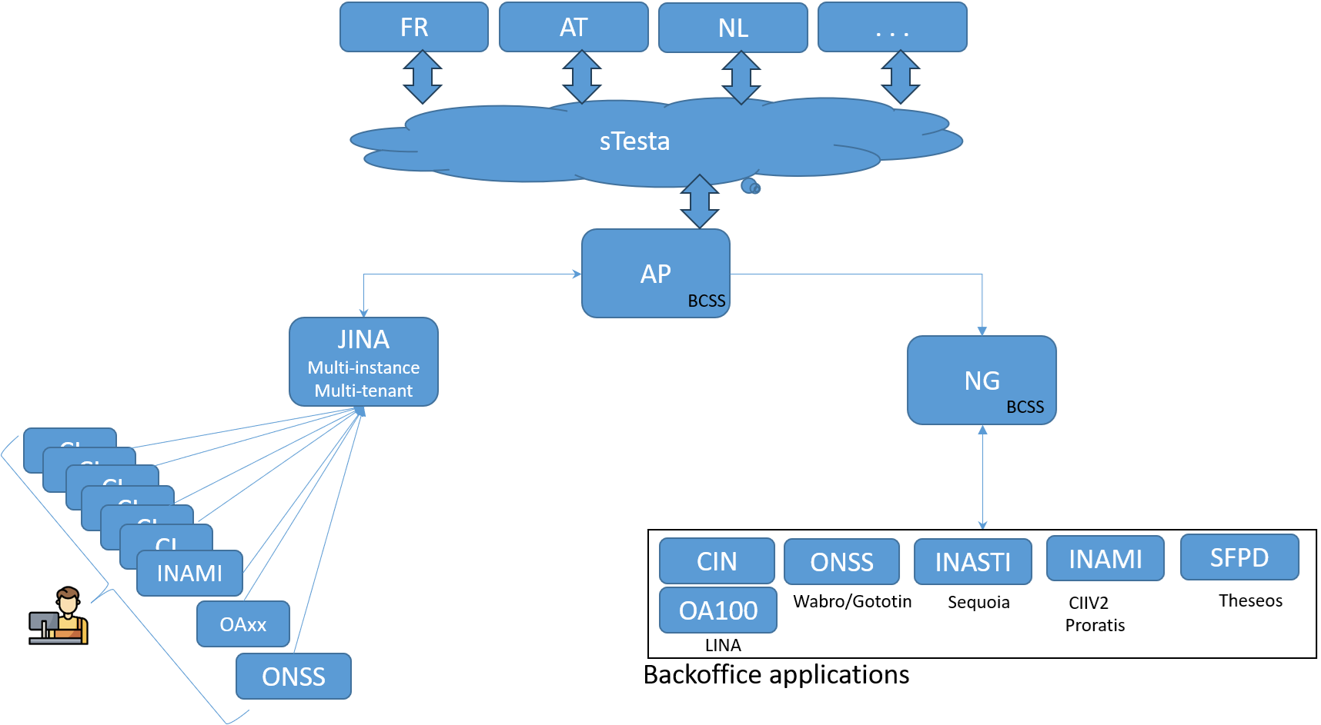
EESSI – BE architecture
one single national Access Point (AP) handling all incoming and outgoing messages (hosted by CBSS)
National Gateway (NG) for connecting directly the back offices of the BE institutions to the EESSI platform for handling high volumes (hosted by CBSS)
cluster supporting almost 100 separated tenants of JINA accessible for all Belgian institutions (managed by Smals)

Slide 7
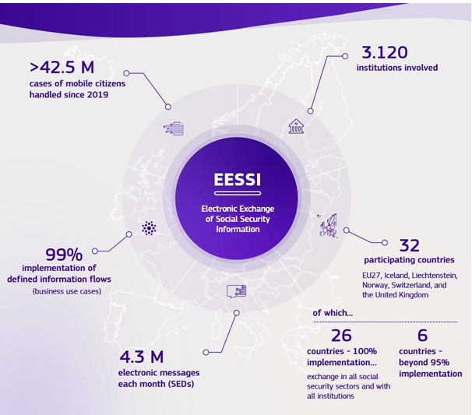
EESSI – Facts & figures

Slide 8
EESSI – Facts & figures
progressive growth in message exchanges since startup in July 2019
stabilisation at an average of 4 million messages per year
total number of cases since startup (status as of September 2026):
  2,085,032 cases created by Belgian institutions
  5,076,758 cases assigned from abroad to a Belgian institution
 | 2019 | 2020 | 2021 | 2022 | 2023 | 2024 | 2025 | (Est.)2026
Accidents at work / occupational diseases | 10 | 378 | 2.095 | 4.069 | 4.231 | 4.322 | 4.536 | 4.425
Family benefits | 0 | 0 | 2.118 | 129.967 | 217.252 | 221.475 | 242.182 | 247.446
Pensions | 16.239 | 232.139 | 1.393.713 | 2.391.768 | 2.513.709 | 2.662.021 | 2.899.958 | 3.088.535
Sickness | 76 | 48.395 | 199.158 | 417.002 | 526.235 | 583.798 | 597.157 | 685.023
Unemployment | 9 | 594 | 1.929 | 4.007 | 8.658 | 13.767 | 16.582 | 17.897
Applicable legislation | 3.338 | 136.938 | 265.090 | 385.859 | 427.603 | 452.877 | 462.520 | 491.325
Horizontal | 71 | 2.758 | 5.535 | 17.343 | 29.529 | 39.971 | 55.426 | 37.580
Recovery | 2.186 | 19.471 | 22.971 | 28.642 | 40.735 | 47.956 | 43.222 | 45.126
Total | 21.929 | 440.673 | 1.892.609 | 3.378.657 | 3.767.952 | 4.026.187 | 4.321.583 | 4.617.356

Slide 9
Complementary EU initiatives

Slide 10
Single Digital Gateway Regulation (SDGR)
Regulation (EU) 2018/1724 https://eur-lex.europa.eu/eli/reg/2018/1724/oj
Member States make available key administrative procedures fully online
  e.g. the request for determination of applicable legislation (output = electronic PDA1)
  e.g. the request of a European Health Insurance Card (output = electronic EHIC)
Government-to-Citizen (G2C) and Government-to-Business (G2B)
Once Only Technical System (OOTS):
  enables EU public administrations to securely exchange official evidence directly between Member States
  eliminating the need for citizens and businesses to manually submit documents
YourEurope portal https://europa.eu/youreurope/index_en.htm
BE social security portal Settling in Belgium https://settlinginbelgium.be/en

Slide 11
European Digital Identity Framework
eIDAS 2.0 Regulation (EU) 2024/1183 Regulation - EU - 2024/1183 - EN - EUR-Lex
introduces the European Digital Identity Wallet (EUDI Wallet)
enabling citizens to prove their identity, to authenticate themselves, to download electronic documents and to scan signed QR-codes on downloaded documents
Belgium has taken a pioneering role in the EU rollout by launching MyGov.be
  Welcome - MyGov.be
  official national app functioning as a digital wallet
  integrating public services, eBox messages and official certificates in preparation for full EUDI compliance

Slide 12
European Digital Identity Framework
social security use cases in production via MyGov
  ISI+-card
    issued by BE insurance institutions to children under 12 and persons not having a Belgian eID
    to verify the cardholder's identity within the Belgian healthcare system and allowing healthcare providers to retrieve their insurance eligibility and coverage status
  social status
    allows citizens to easily prove their social statuses
    streamlining access to supplementary benefits
use cases under development:
  European Health Insurance Card (EHIC)
  European Parking Card (EPC) & European Disability Card (EDC)

Slide 13
European Health Data Space
Regulation (EU) 2025/327 https://eur-lex.europa.eu/eli/reg/2025/327/oj/eng
main objectives
  empower citizens by better access & control over their health across Member States (primary use)
  enable reuse of health data (anonymised/pseudonymised) for research, policymaking, innovation & public health (secondary use)
  ensure interoperability: common standards for electronic health records, data formats and secure exchange
phased rollout
  2029: first 3 data types (patient summaries, ePrescriptions/eDispensations)
  2031: 3 more data types (clinical lab results, medical imaging results, discharge letters)

Slide 14
Ways to move forward

Slide 15
Some expectations of EU-citizens
I can prove my insurance status any time, any place
  citizens traveling to another EU Member State must be able to attest their insurance status to benefit from health care at the same rate as they were insured in the country of stay, even in absence of the physical card
my medical prescriptions should be valid everywhere
  access to digital prescriptions and recognition of prescriptions in another Member State
health care providers abroad should know my essentials
  secure sharing of essential health records (e.g. patient summaries, allergies, test results) for continuity of care across Member States
systems should just work
  systems must support seamless verification and data exchange between Member States
quickly, without any paperwork and in an integrated way
  reduce administrative burden for the citizen

Slide 16
Meeting EU-citizens’ expectations
disclosure of authentical sources across Member States
  online consultation & verification in authentical sources of Member State of residence by service provider (e.g. health care provider) in Member State of stay
  best approach levering trusted sources and avoiding citizens’ burden
  not realistic in short or even medium term
second best: use of EUDI wallet
  completed large scale pilots on EHIC & PDA1 https://www.dc4eu.eu/
  EBSI based solution by VECTOR https://www.ebsi-vector.eu/en/
  ePrescription
    POTENTIAL https://www.digital-identity-wallet.eu/
    myHealth at myHands https://myhealthmyhands.eu/
  European Social Security Pass (ESSPASS): expands on earlier pilots and proof-of-concept projects to digitise European social security documents (like the EHIC & PDA1) for cross-border verification via the EUDI Wallet

Slide 17
Meeting EU-citizens’ expectations
additional: easy-to-implement solution for electronic attestation of attributes
  PDF-document + QR-code as proposed by the Ad-hoc group on the digitalisation of the European Health Insurance Card
  inclusive solution as not every citizen will use the EUDI wallet
  sustainable solution replacing paper/plastic documents
  reusable solution for other use cases
    same technical solution as EU Digital Covid Certificates used during COVID-19 pandemic to facilitate free movement (over 2.3 billion certificates) EU Digital COVID Certificate - European Commission
    trust infrastructure embedded within the Global Digital Health Certification Network of the WHO and recommended by the EC https://eur-lex.europa.eu/legal-content/EN/TXT/?uri=CELEX:32023H1339
  proof of concept: Provisional Replacement Certificate of the European Health Insurance Card (ePRC/eEHIC)

Slide 18
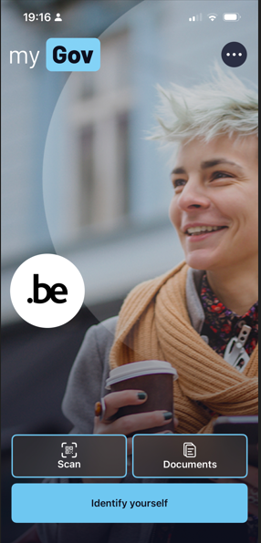
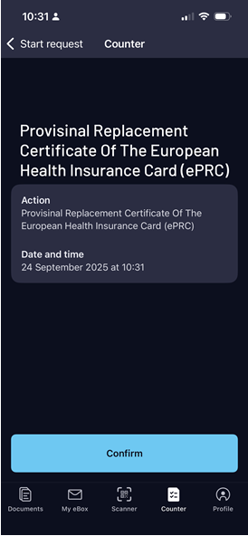
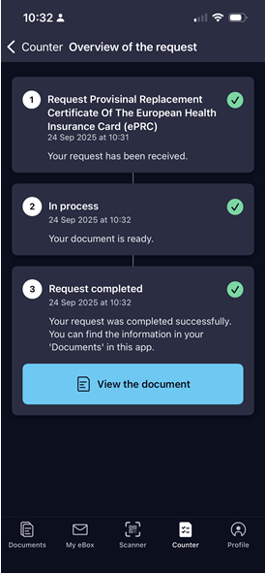
Proof of Concept ePRC/eEHIC
MyGov.be-look & feel

Slide 19
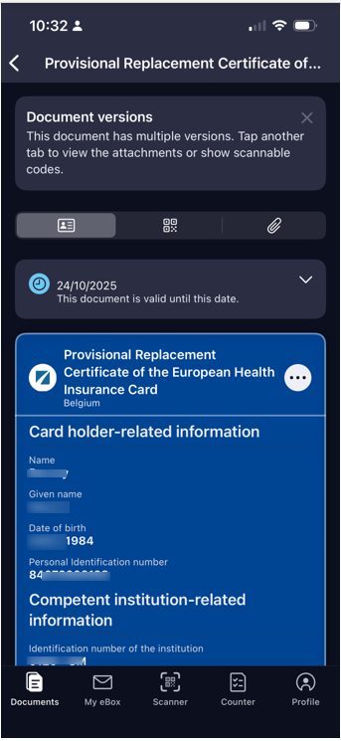
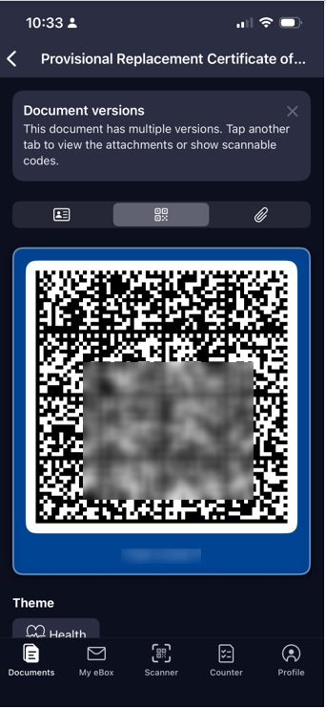
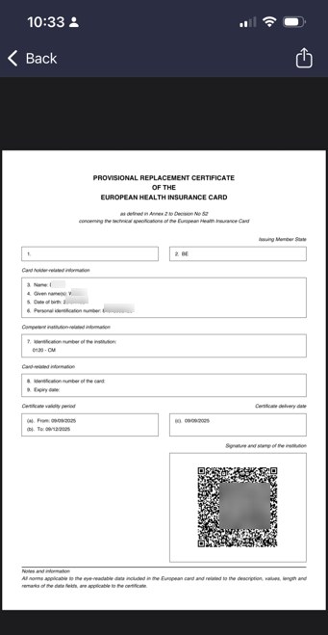
Proof of Concept ePRC/eEHIC
MyGov.be-look & feel

Slide 20
EU digital ecosystem
need for a global, integrated architecture
  across DGs of the European Commission
  based on a common conceptual framework
  no technology driven choice of components and services used, but use of ICT components and services as enabler and means for meeting business requirements
  need for the organisation of a set of integrated services on a pan-European level
  need for the EC to provide for modular, generic, domain agnostic, interoperable and reusable components/services: develop once, use many
    e.g. global European digital certification network or expansion of WHO global digital certification network to other sectors than health
    following the example of the EHDS Regulation: MyHealth@EU - central digital health services/infrastructure for cross-border exchange (testing environment, terminology server, ...)

Slide 21
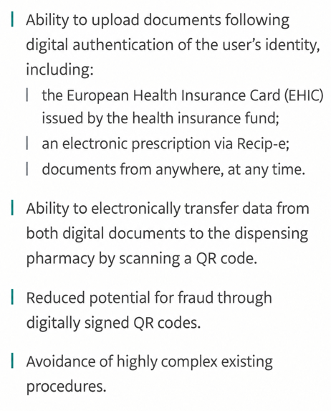
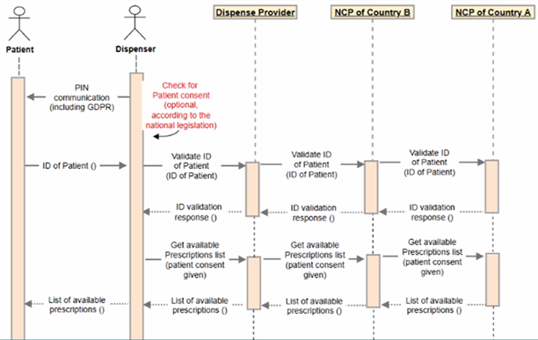
Multi-sectoral use cases

