Slide 1
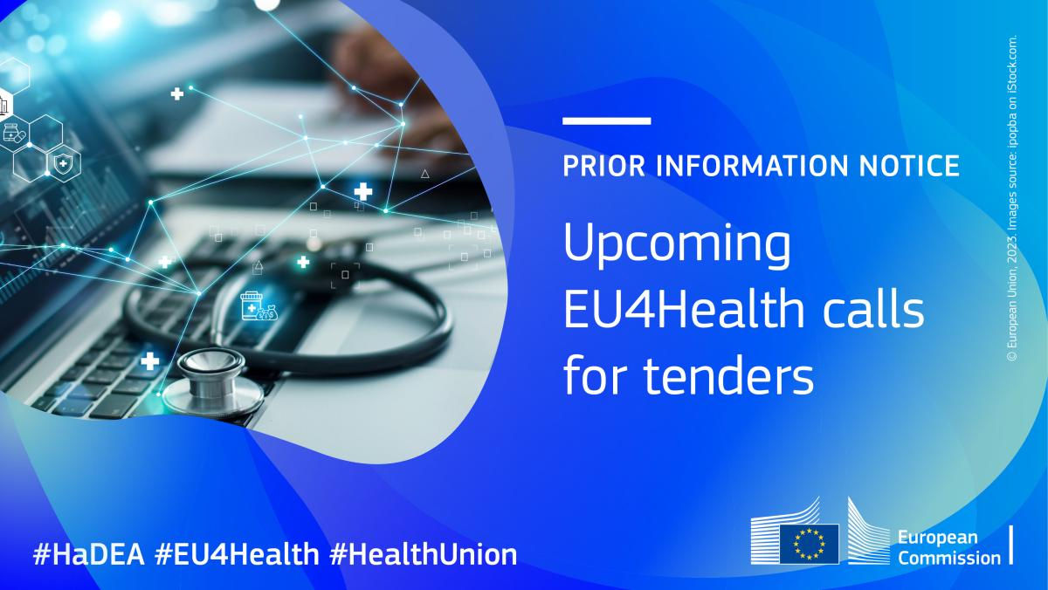
Strategic alignment with regional vaults
BE-NCPeH
Belgium’s integration into MyHealth@EU & EHDS compliance
Kris Van Aken
19 June 2026
BE-NCPeH – EHDS
Patient Summary

Slide 2
Meeting objective
  Start collaboration (not just info session)
    Start collaboration between BE‑NCPeH and regional data vaults to move from awareness to shared action
    Align on EHDS obligations
    Define approach for Patient Summary
    Engagement from regional vaults
  Aimed result
    Architectural choice of direction
    Engagement vaults

Slide 3
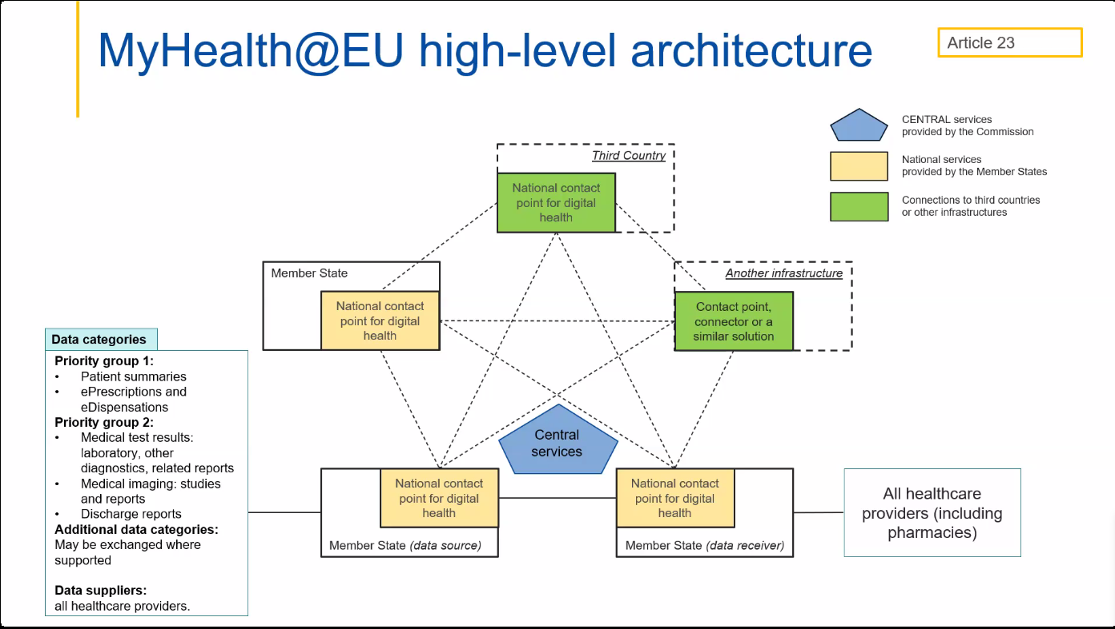

Slide 4
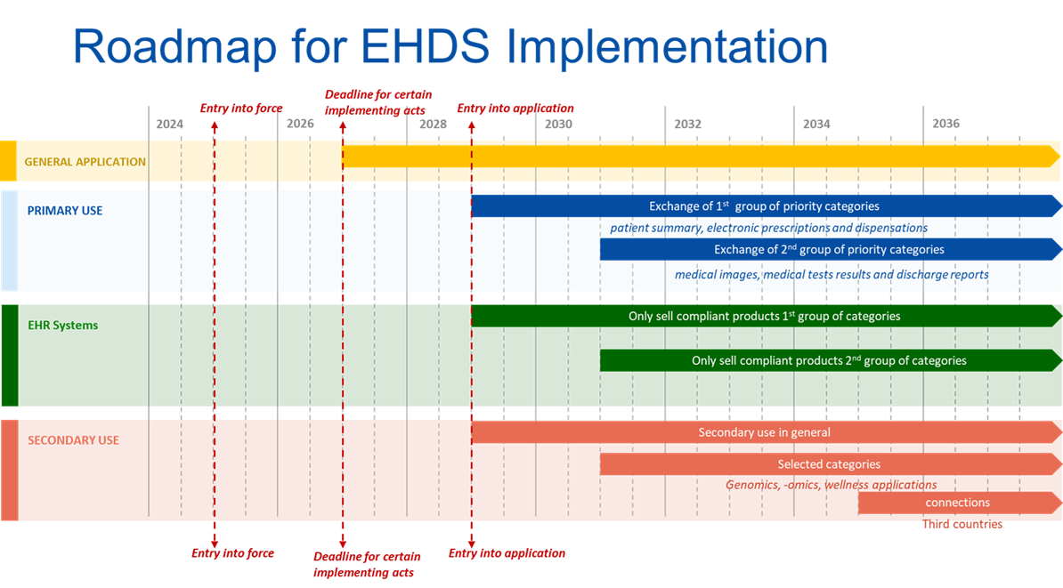

Slide 5
Use Case Patient Summary
  Minimal EU-dataset: allergies, medication, diagnoses, vaccinations
  Based on IPS (International Patient Summary) + HL7 FHIR
  (emergency) care abroad ; Continuity of care cross-border
  Belgian situation
    SUMEHR as content basis
    Gaps: harmonisation, structuring, EU-format compliance
  Core question: how do we make the Belgian Patient Summary EU-ready?

Slide 6
EU-Patient Summary vs BE CareSets
  The future European Patient Summary (PS) will be built from data originating from the Belgian CareSets
  eHealth and RIZIV are closely monitoring EHDS developments to ensure that CareSet Data Elements remain as compatible as possible with the emerging EHDS specifications
  Particular attention is being paid to
    Data Element definitions
    Terminology bindings (SNOMED CT, LOINC, etc.)
    FHIR profiles and interoperability requirements
    Semantic consistency across CareSets
  Current challenge: the detailed EHDS implementation specifications are not expected before Q1 2027, limiting the possibility for definitive national alignment before that date
Notes:
Goal of this session: agree on direction for Q3, and assign owners/dates for Q1, Q2 and Q4

Slide 7
EU-Patient Summary vs BE CareSets
Period | Activity
Until Q1 2027 | Publication of final EHDS implementation specifications
Q2–Q3 2027 | Gap analysis and adaptation of Belgian CareSets
End Q3 2027 | Publication of updated Belgian CareSet specifications
Q4 2027 onward | Implementation by software vendors, vaults and healthcare institutions
Following phases | Testing, deployment and change management
  Important consideration
  Several CareSets are already deployed in production environments (e.g. vaccination). Any EHDS-driven evolution will require
    Adaptation of existing implementations
    Migration planning where necessary
    Testing and certification activities
    Significant change management across the Belgian ecosystem
  The main challenge is therefore not only the publication of new specifications, but also the coordinated transition from existing national implementations to EHDS-aligned versions
Notes:
Goal of this session: agree on direction for Q3, and assign owners/dates for Q1, Q2 and Q4

Slide 8
Open questions for Patient Summary
  Q1 - Routing: how does a request find the right vault ?
  Q2 - Sourcing model: dynamic or document based patient summary? (critical path)
    → Ownership: who is accountable for PS content & quality?
Notes:
Goal of this session: agree on direction for Q3, and assign owners/dates for Q1, Q2 and Q4

Slide 9
Routing to the correct vault
  The issue
    A request must be routed to the applicable regional vault; the mechanism for "finding the right door" is not yet agreed
    Quid (de)pseudonymization ?
  Options on the table
    A. eHealth performs routing itself via Metahub Reference Directory and integrates directly with the correct regional vault
    B. eHealth performs routing itself via ConsultRN and integrates directly with the correct regional vault
    C. One vault applies a "no wrong door" principle and routes each request to the correct regional vault
  Status & decision
    Pseudo-awareness work is in progress at Vitalink; status at AbruMed and RSW to be confirmed
    Decision needed from: vaults / eHealth - choose A, B or C

Slide 10
PS sourcing model (critical path)
  The issue
    NIHDI and the vaults need to make a fundamental business decision: on what basis is the Patient Summary built? This choice determines the data model, vault architecture and governance for everything downstream
  Options on the table
    A. Dynamic, on-the-fly: PS assembled in FHIR at request time from available data elements in vault
    B. Document-based: (SUMEHR logic), GP (Global Medical Record holder) pushed and assembled towards the vaults
    C. Phased: phase 1 document-based (SUMEHR → FHIR PS), evolving in phase 2 to data-driven, on-the-fly
  Linked governance question
    Who is responsible for the content?
    Who is responsible for the data quality?
  Decision needed
    RIZIV-INAMI + vaults to choose A, B or C. All other open questions follow from this choice

Slide 11
Project governance & roadmap
  Governance proposal
    Federal: BE-NCPeH as coordinating party
    Regional vaults : taskforce per vault
    Architecture board: joint ownership & decision making
  Roadmap & timeline
    Q1 2027: Analysis, alignment, gap-assessment
    Q2-Q3 2027: Architecture design & standardisation
    2027-2028: Development & datamapping
    Q3 2028 : EU compliance testing
    Q1 2029 : Go-live

Slide 12
Conclusions & next steps
  Conclusions
    EHDS is an obligation (EU Regulation)
    Patient Summary in first wave
    Regional vaults are essential in the architecture
  Next steps
    Launch taskforce (next month)
    Plan workshops per vault (Q3 2026)
    Deliverables NCPeH project phase 1: gap-analyse & architecture proposition
  Expected from vaults
    Nominate SPOC
    Confirm availability for taskforce

Slide 13
Agreed next steps
  Spocs
    VL: Stijn Longin, Hanne Vuegen
    WL: Laurent Mercier, Emilie Bogaerts; Isabelle Polet (tbc)
    BXL: Vincent Melis + tbc
  Taskforce will be launched
    Kris + JM will plan the first meeting

Slide 14
Useful links
  BeSafeShare on eSanté Portal:
    https://www.ehealth.fgov.be/fr/page/caresets-projet-be-safeshare
  EHDS DataElements mapping with CareSets (draft)
    https://docs.google.com/spreadsheets/d/1DvOjXpn1kEHUFWPg3cjnNfwXK9gjSHUXvtI0BZEzL5I/edit?pli=1&gid=1769291494#gid=1769291494
  EHDS explanations
    https://www.ehealth.fgov.be/fr/page/ehds-european-health-data-space-le-reglement-europeen-relatif-a-lespace-europeen-des-donnees-de-sante

