Slide 1

G-CLOUD, THE DIGITAL COMMUNITY
OF THE (FEDERAL) GOVERNMENT
Slide version 2026-05-15

Slide 2

AGENDA
What is G-Cloud ?
Organization and governance
Sample of the G-Cloud portfolio
Some current challenges
Focus on some initiatives
Concrete, measurable results !

Slide 3
WHAT?
Since 2014
Turning smart ideas, collaboratively into strategies and new services
Building upon expertise, shared services and reusable components offered by multiple participants
Robust execution of services, that are continuously improved

Slide 4
G-Cloud: what ?
“the big picture”
Procurement
Collaboration
Efficiency
Programme of synergy projects for and by the government
Projects
Services
Knowledge
& expertise
Cost
Quality

Slide 5
G-Cloud: principles of good governance through effective governance bodies and transparent information flow
Government
G-Cloud Operations & Programme Board
G-Cloud Strategic Board
FPS’s/PPS’s
(e.g. horizontal FPS, FPS FIN,
Belnet, ... )
Public institutions for Social Security, Public Interest Organisation (e.g. Crossroads Bank for Social Security, ... )
Association of FPS’s/PPS’s/ Public Institutions for Social Security (Smals)
Private ICT firms led by FPS/Public Institutions for Social Security
3 Colleges
(Federal Public Services,
Public Institutions for Social Security,
Public Interest Organisations)
SIT
(ICT-managers of these organisations)
Service Owners
& Activity Leads

Slide 6
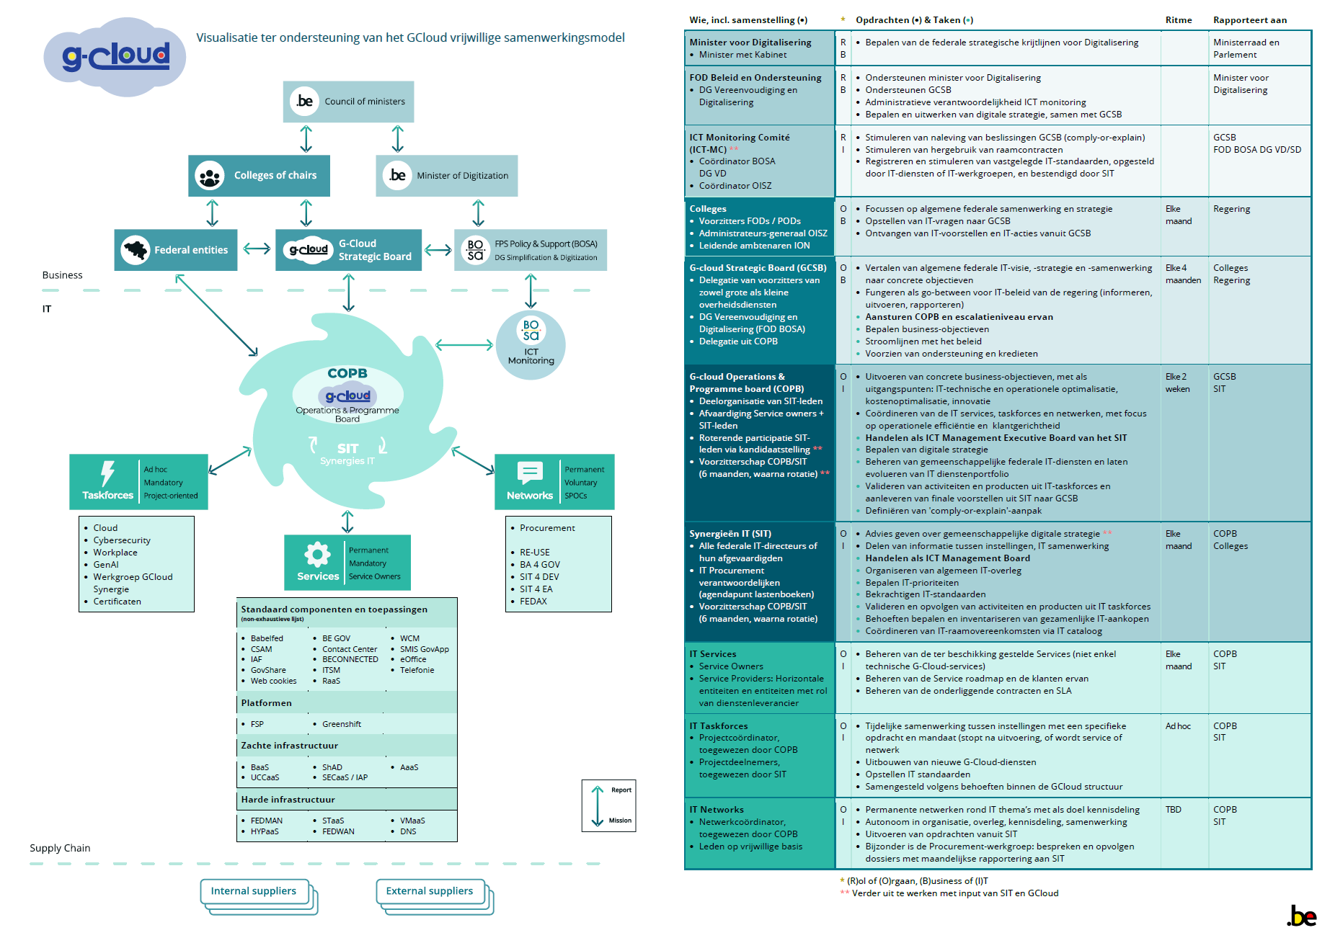
G-Cloud: organisation and governance
BUSINESS
ICT
Complete model available on G-Cloud Boards Sharepoint
PARTNERS

Slide 7

G-Cloud: different collaborative roles in participation
Engaged voluntary partnerships between federal governmental organizations
On different types of collaborative activities
  + services + competence centers + task forces
  + tenders + knowledge sharing + decision making
  + …
1. Providers
2. Consumers
By and for the participants of the community
3. Evaluation & steering
5 collaborative key roles within G-Cloud
1) engaged providers of collaborative activities
2) loyal consumers of collaborative activities
3) adequate evaluation & steering of portfolio of activities
4. Detection & development of potential synergies
4) swift detection and development of synergies and activities
5) solid support of the collaborative activities
5. Supporting services
enabling smooth collaboration

Slide 8
G-Cloud: collaborative activities → portfolio management
COMPUTE INFRASTRUCTURE & PROCESSES
Service: VMaaS, STaaS, HYPaaS (servers & storage)
GreenShift (software containers)
RedShift/Blue shift (Oracle & IBM stack)
Yellow shift (Microsoft stack)
Strategy: Hybrid cloud
Systematic evolution to cloud maturity VMware exit
Competence center: Cloud Center of Excellence
Contract: OCRE 2024 (public cloud infra)
DIGITAL ASSETS PROTECTION:
Service: IAP + (network services)
SECaas 2 (network services)
Policy: FISP (info security policy)
Taskforce: Digital certificates
SECURED COMMUNICATIONS
Service: Belnet FEDsender (secured big file comm)
BEAM secured chat (secured chat)
DATA CENTER
Consolidation: 40 data centers ➔ 4 data centers
Strategy: Federal data centers 2030
LANGUAGE SERVICES
Service: BabelFed (translation tool)
EC-AI language services (language tools by EU)

Slide 9
G-Cloud: collaborative activities → portfolio management
IDENTIFICATION & AUTHORISATION:
Service: Federal Authentication Service (FAS)
Remote Signing Services
ARTIFICIAL INTELLIGENCE
Service: AI maturity model
AI chatbot for customer services
Pulse AI services (user feedback services)
Policy: AI guideline
Taskforce: AI chatbot for customer services
PoC’s: Knowledge sharing
PERSONAL WALLET
Service: MyGov.be
BUSINESS INTELLIGENCE / DATAWAREHOUSE
Strategy: SAS exit strategy to Python / Altair / …
Taskforce: Knowledge sharing
OFFICE COLLABORATION PLATFORM
Service: E-Office (M365 tenant), BURaaS
Study: MS365 alternatives

Slide 10
G-Cloud: some current challenges
Diversity of organizations, processes & requirements
Smart balance between harmonization, meeting specific needs & innovation => modular, service oriented architecture
Avoid unnecessary duplication => more comply, less explain
Build strategic resilience
Growing unpredictability of external markets
Align agility & flexibility with procedures
Common data strategy
Realistic valorization of possibilities of AI
Internalisation of skills => valorisation of competence centers

Slide 11

HIGHLIGHT ON CRUCIAL G-CLOUD ACTIVITIES
Focus

Slide 12
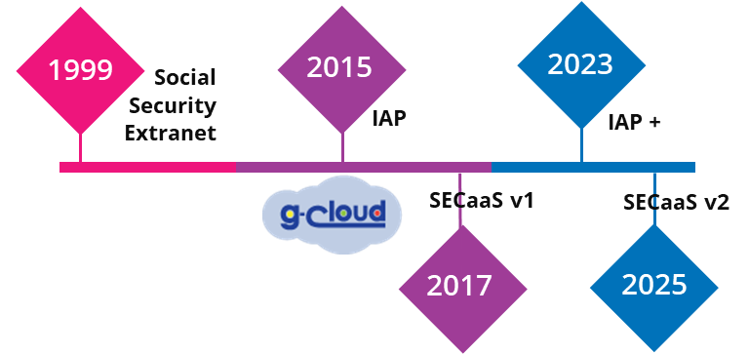
G-Cloud: information & cybersecurity
FOCUS
SECURITY SERVICES WITHIN G-CLOUD EVOLVE & ADAPT …
To cope with growing security risks
To include protection of new services
To cooperate with partners (e.g. CCB)
To cover a broad range of institutions

Slide 13
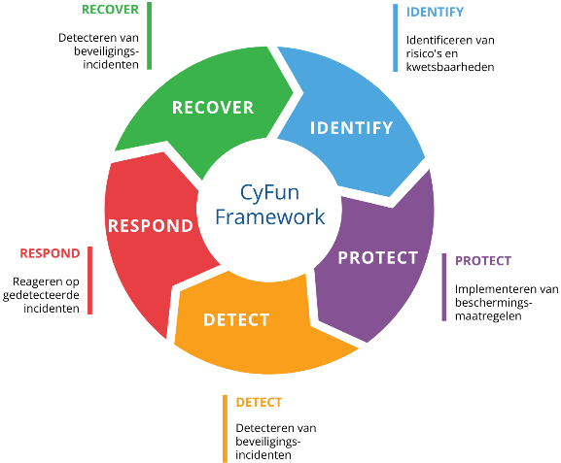
G-Cloud: information & cybersecurity
FOCUS
MAXIMUM RISK MITIGATION
Security requires an integrated approach on multiple levels, by multiple stakeholders
G-Cloud provides technical security services and solid collaboration recommendations
  NIS2 regulation
  Obligations by EU
  CyFun (Cyber Fundamentals), ISO 27K
  Guidance by CCB
  IAP+ and SecaaS 2
  Recommended adoption of G-Cloud technical security services
  Organizational process strengthening
  Responsibility of individual organizations
  Repeated internal security controls
  Responsibility of individual organizations
  Periodic single audit principle
  CCB offers auditing services on approved G-Cloud security services

Slide 14
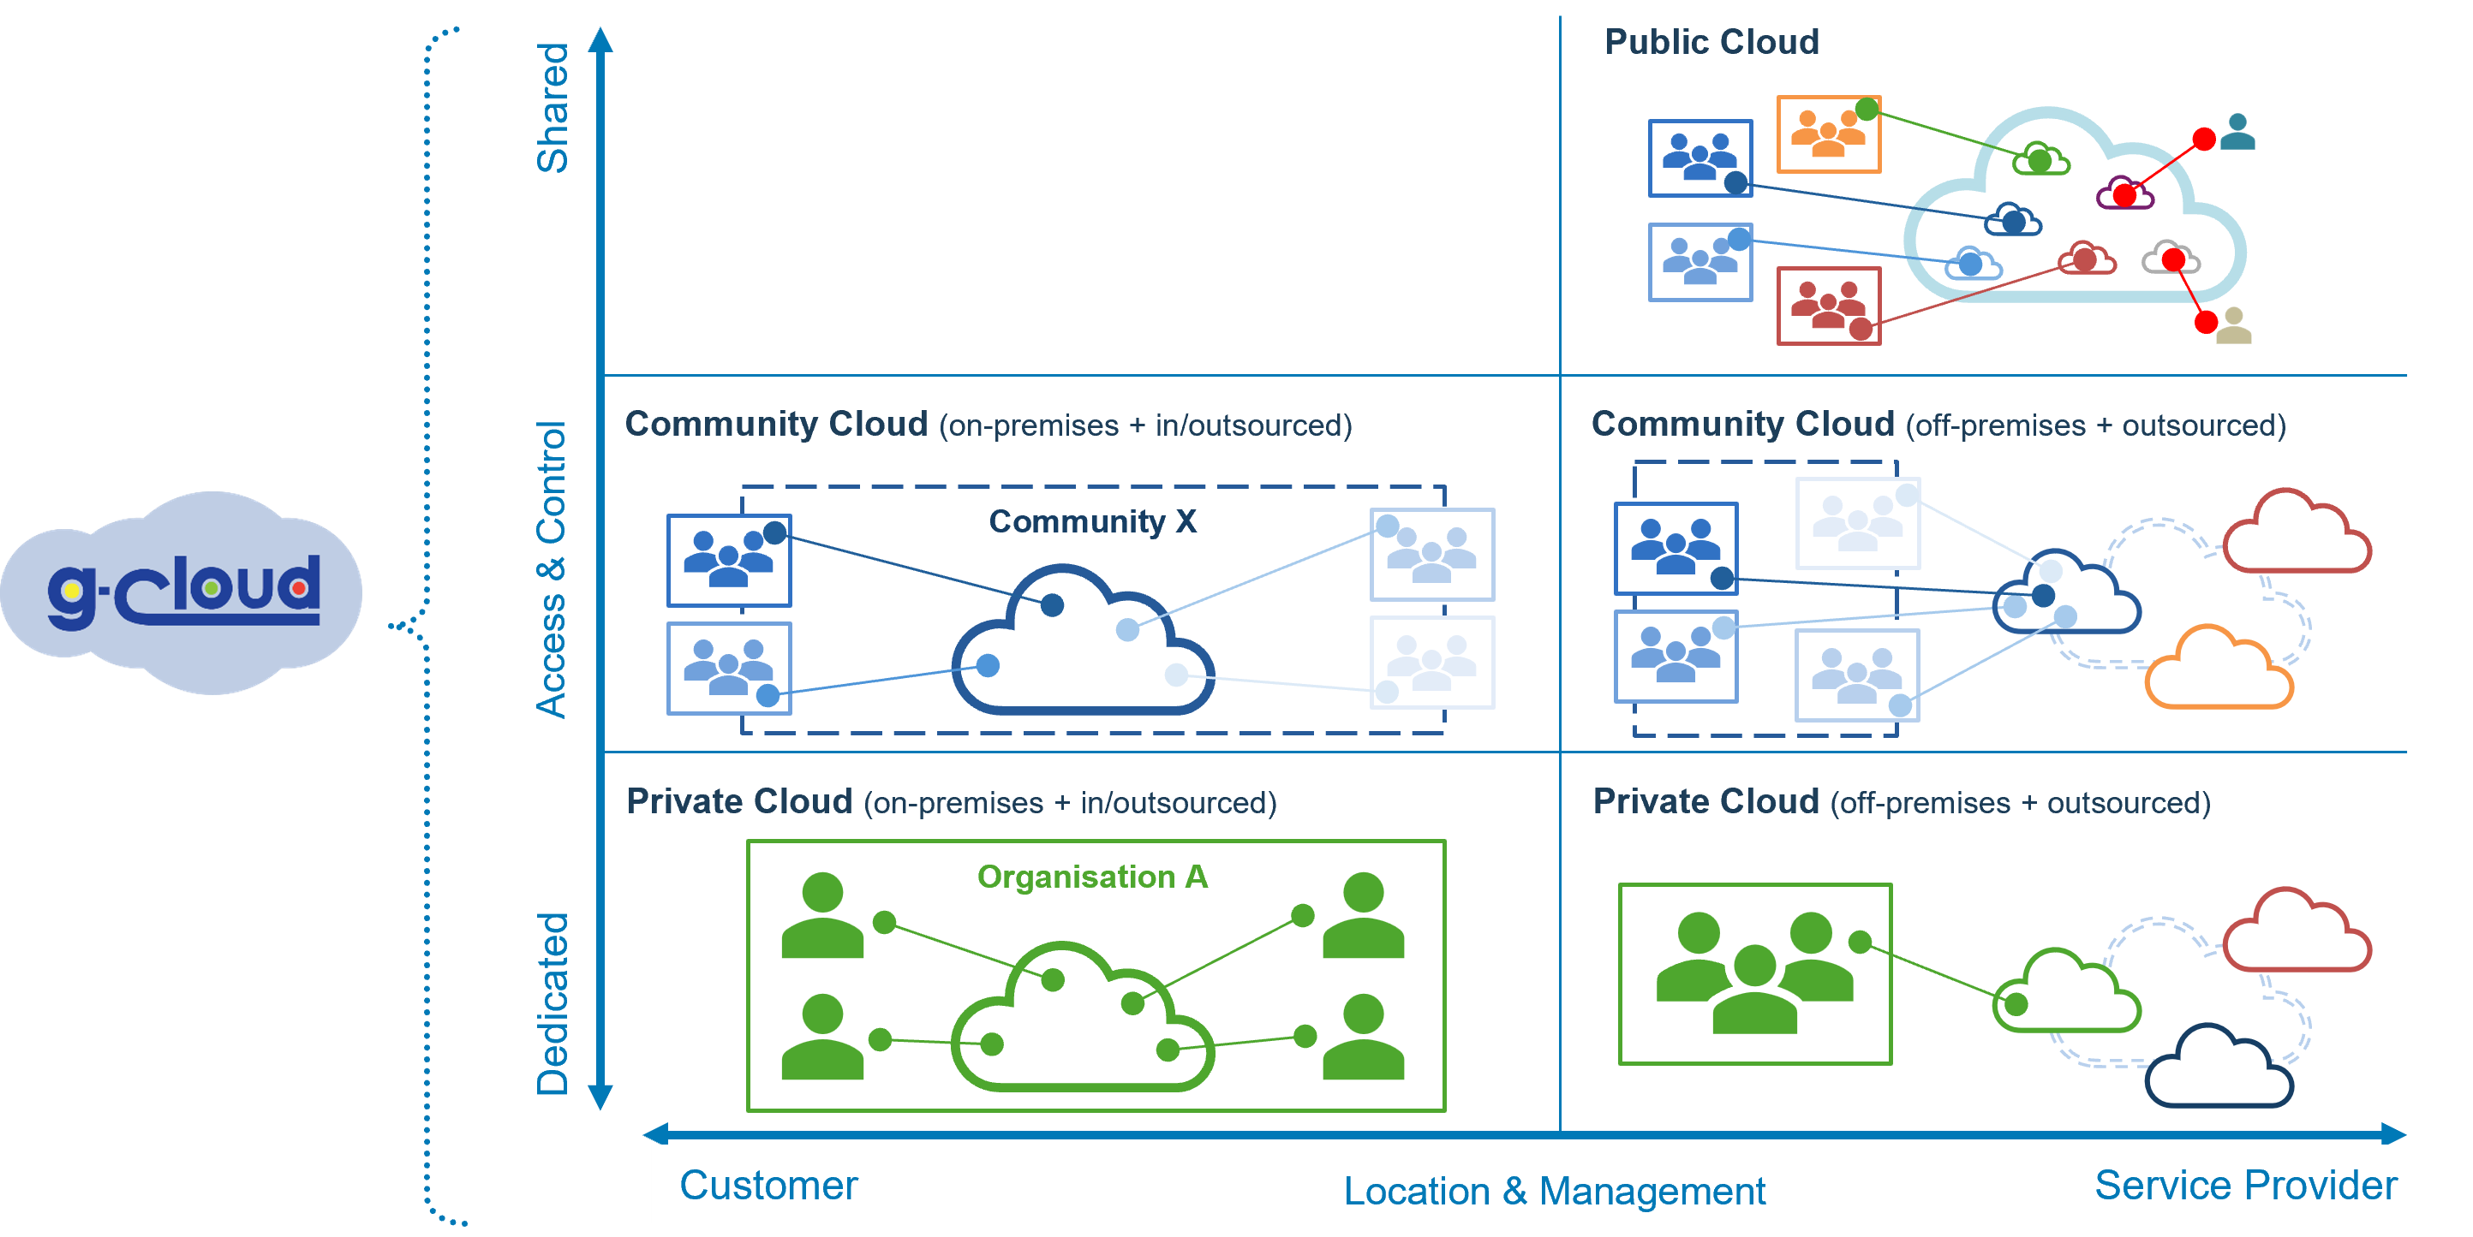
G-Cloud: smart cloud strategy
“Based on the Federal Smart Cloud Strategy the Cloud Centre Of Excellence coaches organizations in their choices to move to the best cloud options for their application landscape”

Slide 15
G-Cloud: response to structural volatility on hardware market
FOCUS
CONTEXT:
2020 - 2022: COVID period Temporary increase of hardware prices
2022 - 2023: post COVID Normalisation of hardware prices
2024 ➔ … : AI infra boom Structural hardware shortages and increases of hardware prices ➔ expectation: this will not disappear any time soon
IMPACT AND RISKS:
Contractors cannot respect conditions of framework contractor (delivery time & pricing guarantees)
Shortage on storage, CPUs, RAM, risks (on the mid to long term) to severely slow down:
  extensions and replacements of datacenter compute & storage capacity
  evolutions and replacement of personal compute equipment

Slide 16
G-Cloud: response to structural volatility on hardware market
FOCUS
MEASURES & RECOMMENDATIONS TO MITIGATE THE RISKS:
Prolongation of hardware lifecycle
Decreases the overall need for new hardware
(to the extent possible, without compromising continuity)
Prioritization of hardware renewals according to business criticality
Encourages organizations to prioritize their business processes to determine if hardware replacement can be delayed
Launch of new “multi-contractor” tender
Increases competition between contractors to ensure the lowest price during the lifecycle of the contract
(work in progress, details of approach will be communicated)

Slide 17
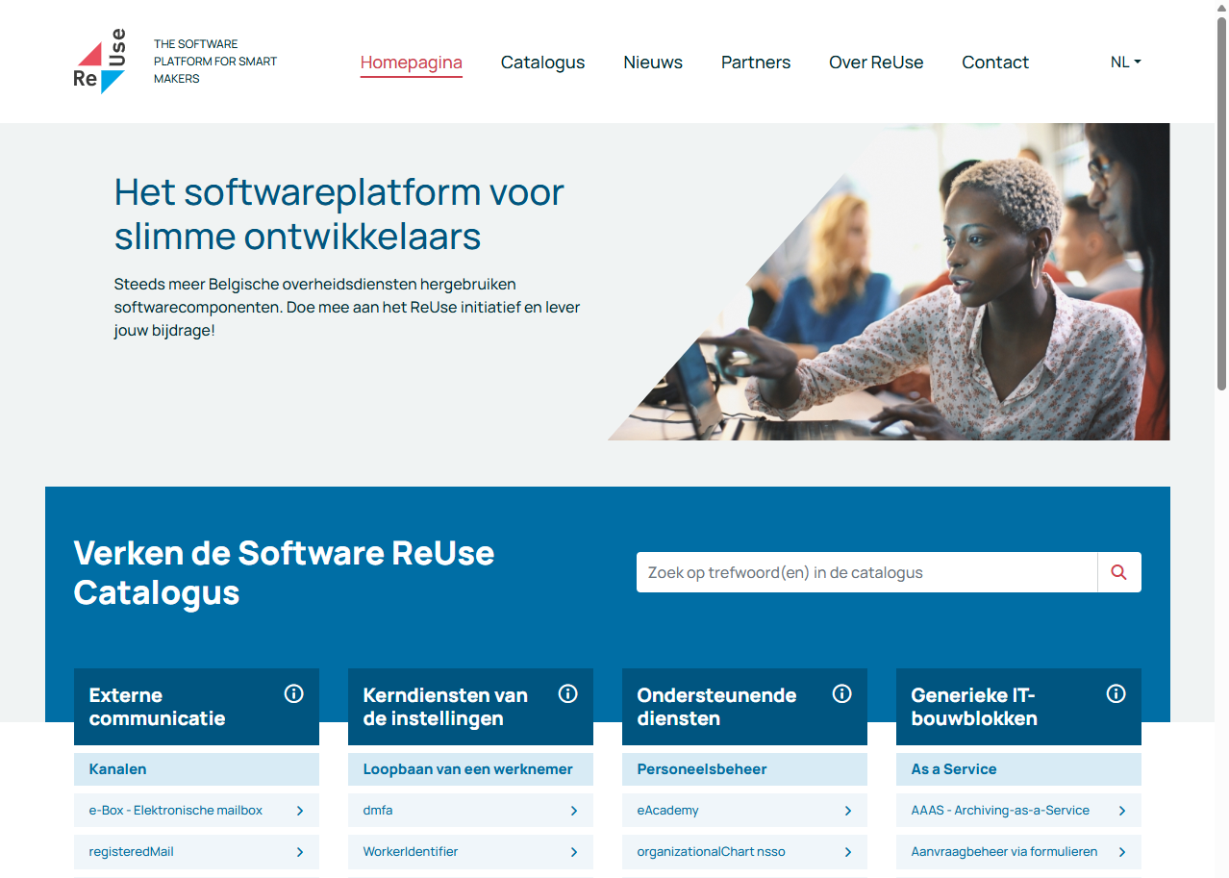


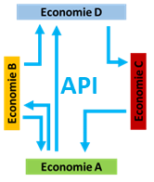
G-Cloud: strategic reuse
FOCUS
STRATEGIC, PROACTIVE & DURABLE EFFORTS
REUSE CATALOG:
  ➔ find reusable components
ict-reuse.be
BELGIF:
  ➔ standardize protocols and vocabulary
API GATEWAY:
  ➔ publish and use reusable data through API’s
FAST REACTION TIME… COST & EFFORT SAVINGS…

Slide 18


G-Cloud: strategic reuse
“Promoting and encouraging strategic reuse of data, software, architectural concepts and methodologies across organizations paves the way to an interoperable Belgian Federal Government”
FOCUS
Example 1: IDENTITY, USER & ACCESS MANAGEMENT (IUAM)
This architectural authorization model allows all applications inside the social security ecosystem to be highly secured, while allowing flexible application role management distributed to many different stakeholders. Different applications reuse software components, and operational processes are harmonized, while data control remains in hands of the authorized data owners
Example 2: COVID
During the outbreak of COVID in 2020 the business processes for the coordination of covid testing in Belgium between different stakeholders (test centers, laboratories, doctors an nurses, citizens, … ) could be put rapidly in place reusing many components and processes & platforms of different service providers, among which: IUAM, API gateway, entities prescription, DataEncryptor, address book, ConsultRN, mandate
66%
Cost Reduction 2025
> € 45.000.000​
54%
Reused
ROI
Example 3: SINGLE PERMIT
This business process allowing employees and employers to request the necessary residency permits for non-European citizens across the different Belgian regions. The process was built reusing components from Social Security (NSSO, CBSS) and FSP Foreign Affairs

Slide 19
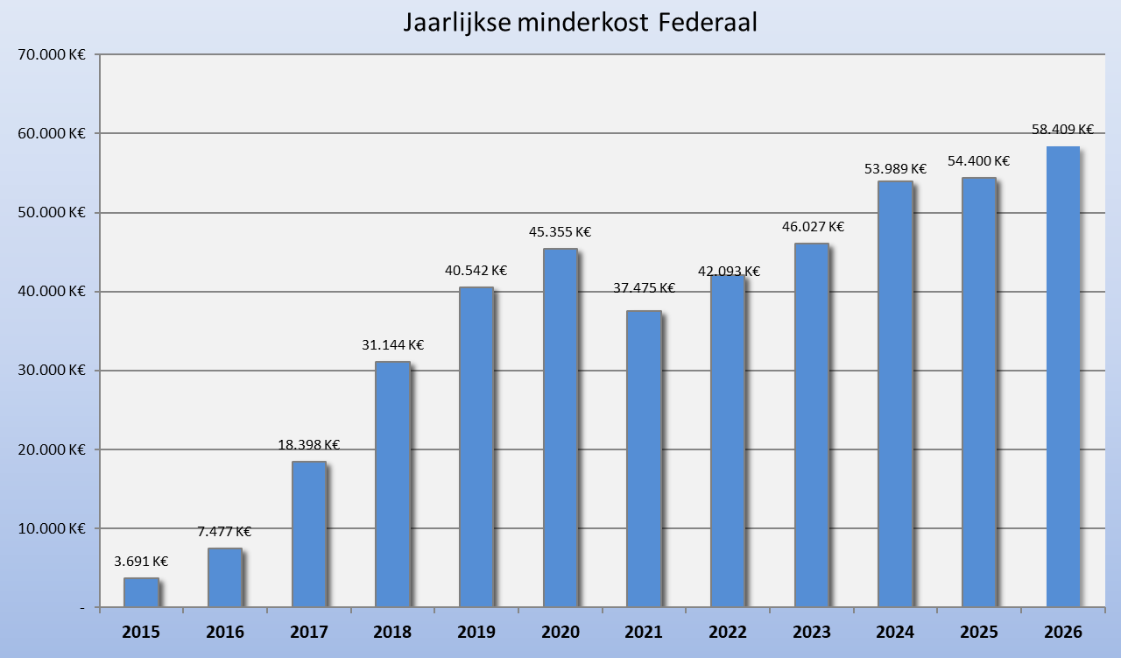
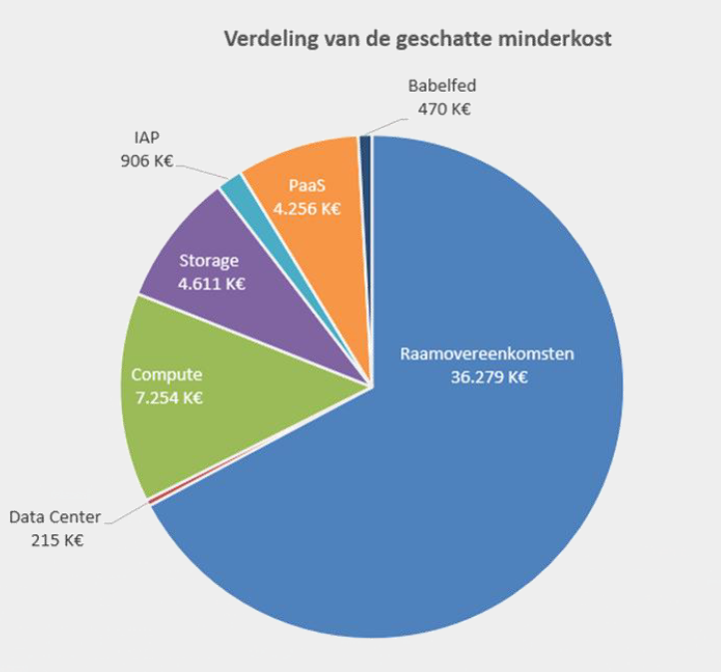
G-Cloud: concrete, measurable results!
Raamovereenkomsten
€ 36.279.000
Frame agreements (aankoopcentrales)
remain the biggest measurable contributor
to Federal cost-effectiveness on ICT
Discover the activity report: https://gcloud.belgium.be/fr/news

Slide 20
WE BUILD
G-CLOUD TOGETHER
www.gcloud.belgium.be
info@gcloud.belgium.be

Slide 22
G-Cloud: synergy radar
Mutual sensoring:
  what happens ?
  which needs arise ?
  what external evolutions we see ?
COORDINATED BY
G-CLOUD GOVERNANCE BODIES
attribute different organizations
with the best competencies
through collaborative roles
to different tasks
to effectively complete
diverse missions
for all participants
Mutual signal processing:
  which domains are involved ?
  what’s the importance ? (for all / any of us)
  what mutual competences do we have ?
  define right activities to tackle it !!
Aligned & coordinated response:
  distribute roles to the right actors
  coordination of aligned durable responses
  follow-up & reporting on active responses

Slide 23
G-Cloud: continuous challenges, need continuous attention
1. Diversity of organizations, processes & requirements
  Understanding the diverse landscape within the federal government on levels of business & IT processes, used technology, current competences of people, requires continuous consultation and alignment on multiple organizational levels, in order to identify and develop high quality solutions, have the biggest possible reach for the lowest cost.
3. Growing unpredictability of external markets
  Recent technological and geo-political evolutions makes external markets - on which we heavily depend - react adversely. Prices are unexpectedly augmented, materials get scarce.
  Risks of vendor lock-in, with huge negative financial impacts especially where complex process integrations exist, require pro-active and strategic alignment on common exit scenarios.
2. Legacy implementations, contracts & competencies
  Phasing out legacy systems, contracts and competencies requires a strategic longterm approach, in respect of business continuity cost-efficiency and organizational aspects.
4. Align agility & flexibility with procedures
  Given the strict legal and budgetary frameworks in which we are operating, it is key to build strong alliances with other governmental departments with whom we share the common goals to support the governmental business in an adequate, agile and cost-effective manner.

Slide 24
G-Cloud: continuous challenges, need continuous attention
5. Smart balance between harmonization & innovation
  Harmonization & standardization, - among other advantages - facilitates interoperability, exchange of experiences, reduces the number of contracts to manage and leads to cost efficiencies through diminished fragmentation.
  When too far driven however, it risks to lead to stagnation, lock-in and undermines the creation of innovative new value.
  Finding and keeping the right balance is one of the biggest challenges in fastmoving technological multi-organization environments that requires constant attention & alignment and strategic planning and execution.
6. Harvesting & transforming existing solutions
  All organizations have always invested in good systems, processes and competences to meet the needs of their own businesses.
  Building upon these experiences and reusing proven concepts and solutions is paramount to cost-optimized harmonization.
  Mutual deep understanding of each other’s solutions requires well coordinated dialogue to deliver future proof architectures.

Slide 25
G-Cloud: continuous challenges, need continuous attention
7. Avoid unnecessary duplication, build strategic resilience
  Having only one solution for each functionality in the whole Federal government would - on the short term - be the most cost-efficient approach.
  However, external factors beyond our control, require that we – as a united governmental body - need to be able to respond and guarantee business continuity, in case of unexpected sudden and/or long-lasting events.
  Preparing for such events pro-actively might require well-thought and strategic functional and contractual overlaps between solutions, to enable swift reactions without compromising governmental processes.
8. Resources: coordinators, architects, secretaries, …
  Many excellent resources & competences are available in the whole community, lots of them heavily occupied on delivering high quality solutions for the individual organization.
  However, cost-reducing widely accepted multi-organization solutions require excellent analysis, architecture, coordination and administrative support beyond single institutions.
  Activating and coaching federal resources to develop the broader synergy mindset and stimulating them to collaborate on mutual solutions is the key to more, better, and cost-reducing synergies.

Slide 26
G-Cloud: collaboration enabling services
FOCUS
A cross-organizational group of motivated coordinators take the day-to-day lead in the coordination to create and preserve the collaboration climate
Organizing regular structural consultations
Production and distribution of adequate and comprehensive information
Managing portfolios of activities and their status
Monitoring and reporting on activities conditions
Preparation and approval of recommendations, strategies and policies
Starting-up and new initiatives
Negotiations with external stakeholders
Organization of requirements analysis
Management of the information sharing platform
Management of community memberships
…
GOAL: obtaining tangible cost-reducing results, while delivering high-quality services and stimulating a collaborative climate, where excellent solutions can grow to ever-rising maturity and broad adoption

Slide 27
Van G-Cloud naar Digital Excellence
Governance, strategie en sturing

Slide 28
Oprichting van de Digital Strategic Board (DSB)
De kern van een nieuwe federale governance-structuur voor digitale slagkracht
Notes:
Welkom bij deze toelichting over de strategische verschuiving binnen de federale digitale overheid: de transitie 'Van G-Cloud naar Digital Excellence'. Vandaag neem ik jullie mee in de manier waarop we de governance, strategie en sturing fundamenteel gaan herzien. De spil in dit verhaal is de oprichting van de Digital Strategic Board, kortweg de DSB. Dit orgaan vormt de kern van een nieuwe federale structuur die niet alleen onze digitale slagkracht moet vergroten, maar die er primair op is gericht om onze middelen efficiënter, doelmatiger en transversaal in te zetten

Slide 29
Van vrijwilligheid naar mandaat
Huidig Model
Nieuw DSB Model
Gebaseerd op de "Coalition of the Willing"
Focus op "More Comply, Less Explain"
Vrijwillige samenwerking
Centraal strategisch bestuursorgaan
Vaak gelimiteerde slagkracht
Bindende federale standaarden
Versnippering van middelen
Gezamenlijke keuzes zijn verplicht
Notes:
Als Inspectie van Financiën bent u als geen ander vertrouwd met de risico's van versnippering. Ons huidige federale IT-landschap leunt nog te vaak op een 'Coalition of the Willing' : vrijwillige samenwerking waarbij entiteiten zelf kiezen of ze aansluiten. Dit leidt onvermijdelijk tot suboptimale slagkracht en een versnippering van schaarse overheidsmiddelen.
Met het nieuwe DSB-model stappen we resoluut over naar een filosofie van 'More Comply, Less Explain'.

Slide 30



Noodzaak tot samenwerking
De versnippering van middelen en expertise remt innovatie. De overgang naar de Digital Strategic Board (DSB) is essentieel voor:
Vermijden van
duplicatie
Verhogen van
interoperabiliteit
Snelle reactie op
tech-trends
Notes:
De DSB wordt het centrale strategische bestuursorgaan dat bindende federale standaarden oplegt. Gezamenlijke keuzes worden verplicht ; we gaan van vrijblijvendheid naar een duidelijk mandaat. Voor u is dit essentieel: door deze sturing vermijden we dat verschillende FOD's parallel dezelfde oplossingen inkopen en financieren. We vermijden duplicatie, verhogen de interoperabiliteit en kunnen sneller anticiperen op technologische trends.

Slide 31



Digital Strategic Board | Kerntaken
Strategische sturing
Prioritering
Validatie
Verzekeren van samenhang in
IT-projecten over alle federale
organisaties heen
Vastleggen van de transversale
federale roadmap en portfolio van
digitale werven
Goedkeuren van standaarden,
referentie-architecturen en investeringsvoorstellen
Notes:
Hoe vertaalt dit zich in operationele kerntaken? De DSB focust op drie assen: ten eerste Strategische sturing, om de samenhang van IT-projecten over alle federale organisaties heen te bewaken. Ten tweede Prioritering: we leggen één transversale federale roadmap vast. Niet alles kan immers tegelijkertijd gefinancierd worden; we moeten keuzes maken op basis van federale prioriteiten. Ten derde Validatie: de DSB keurt referentie-architecturen en investeringsvoorstellen goed.

Slide 32



Digital Strategic Board | Structuur
De Digital Strategic Board wordt ondersteund door de FOD BOSA
Het DG Vereenvoudiging en Digitalisering is verantwoordelijk
voor de voorbereiding en coördinatie van de strategie.
De DG wordt hierbij ondersteund door het Digital Strategic Office (DSO)
Notes:
Het DG Vereenvoudiging en Digitalisering coördineert de strategie, ondersteund door een lean expertiseteam: het Digital Strategic Office
Om te concluderen: een efficiëntere structuur en minder overlegorganen zijn een absolute voorwaarde, maar structuur alleen is niet genoeg. Dit model valt of staat met de bereidheid van onze beleidsvoerders om hun volle verantwoordelijkheid te nemen binnen deze Digital Strategic Board.
Voorstel om een afgevaardigde van het kabinet Begroting en het kabinet Digitalisering af te vaardigen in de DSB.

Slide 33
Digital Strategic Office (DSO)
Het DSO is de drijvende kracht achter de Digital Strategic Board
Analyse van digitale trends
Monitoring van de federale strategie
Coördinatie tussen diensten
Inhoudelijke onderbouwing
Notes:
Het Digital Strategic Office (DSO), staat in voor trendwatching, monitoring en de inhoudelijke onderbouwing.

Slide 34
Van G-Cloud naar Digital Excellence
Cybersecurity – CISO as a service
Notes:
Een belangrijk transversaal dossier is cybersecurity.

Slide 35
Federale informatieveiligheidsstrategie
Beheer
Duurzaam
Veilig
Waakzaam
Veerkracht
Afstemming op wettelijke kaders (NIS2, Cyfun) en risicosturing
Efficiënte, structurele en gezamenlijke investeringen
Bescherming netwerken, informatie en perimeter
Transparante architectuur voor dreigingsdetectie
Identificatie kritieke diensten en efficiënte waarschuwings-ketens
Transversale capaciteit & CISO as a service
De noodzakelijke brug om deze assen operationeel te maken voor
entiteiten zonder interne schaal of expertise
Notes:
De gemeenschappelijke cybersecuritystrategie (2024-2026) voor de federale overheid heeft als doel het historisch versnipperde landschap om te vormen tot een eengemaakt en slagkrachtig digitaal verdedigingsstelsel. Deze strategie is niet langer een louter technische aangelegenheid, maar een strategische voorwaarde voor de autonomie en legitimiteit van de staat in een tijd van toenemende geopolitieke dreigingen.
De kernonderdelen van deze strategie zijn als volgt onder te verdelen:
De strategie rust op vijf pijlers die de transitie van decentralisatie naar coördinatie moeten begeleiden:
Governance: Garanderen dat cybersecurity-doelstellingen zijn uitgelijnd met federale prioriteiten en wettelijke kaders zoals NIS2.
Strategische en Duurzame Keuzes: Het transversaal afdekken van risico's om verspilling door parallelle investeringen te vermijden.
Veiligheid: Adequate bescherming van informatie, netwerken en de externe perimeter van federale diensten.
Waakzaamheid: Het detecteren van vulnérabiliteiten en dreigingen via een gemeenschappelijke architectuur.
Veerkracht: Het vermogen van de overheid om snel te reageren op en te herstellen van cyberincidenten.
Governance en de Rol van de Federale CISO
Om de strategie te operationaliseren, wordt een versterkte governancestructuur opgezet

Slide 36


CISO as a service | drijvende kracht achter de federale informatieveiligheidsstrategie
Van reactieve
cyberveiligheid
Naar eengemaakte
informatieveiligheid
Focus op netwerk- en systeembescherming
Gefragmenteerde aanpak per entiteit
IT-verantwoordelijkheid (vaak bij CIO/CTO)
Bescherming van de volledige informatielevenscyclus
Transversale aanpak ter bescherming vitale overheidsfuncties
Bestuurlijke verantwoordelijkheid en risicosturing
Notes:
Federale CISO: Er wordt een federale CISO aangesteld als centraal strategisch expert en adviseur die toeziet op de uitvoering van de transversale cyberstrategie en fungeert als escalatiepunt bij grootschalige incidenten.
CISO-cel (CyberGov): Deze cel binnen de FOD BOSA biedt operationele ondersteuning, ontwikkelt centrale templates en voert maturiteitsmetingen uit om risicoprofielen per entiteit in kaart te brengen.
Complementariteit met het CCB: Het Centrum voor Cybersecurity België (CCB) blijft de nationale autoriteit voor normering en toezicht, terwijl de federale CISO-cel zich richt op de operationele begeleiding van de federale diensten.
3. CISO-as-a-Service (CISOaaS)
Een specifiek speerpunt is het CISOaaS-model, dat vooral is gericht op kleinere federale entiteiten die vaak de middelen missen om zelf een volwaardig cybersecuritybeleid uit te voeren. Door expertise en middelen te delen, krijgen deze organisaties toegang tot gespecialiseerde profielen en tools (zoals SECaaS 2 of IAP) die anders te duur of onbereikbaar zouden zijn.
4. Operationele Bouwstenen en Standaardisatie
De strategie dwingt uniformiteit af door gebruik te maken van gemeenschappelijke fundamenten:
CyberFundamentals (CyFun): Dit framework van het CCB is het absolute referentiekader voor alle federale administraties om de conformiteit met NIS2 aan te tonen.
Shared Services: Er wordt maximaal ingezet op collectieve oplossingen zoals Internet Access Protection (IAP) en het raamcontract SECaaS2 (Security-as-a-Service).
Centraal SOC: De uitbouw van een gedeelde monitoring- en SOC-capaciteit (Security Operations Center) verhoogt de collectieve weerbaarheid tegen een fractie van de huidige kosten.
5. Economische Impact en Baten
Uit een spending review bleek dat de federale maturiteit momenteel onvoldoende is om de risico's te dekken en dat uitgaven bij ongewijzigd beleid exponentieel zouden stijgen.
Kostenbesparing: Door contracten te bundelen en dubbel werk bij audits en pentesten te vermijden, wordt een jaarlijks besparingspotentieel tot 3,2 miljoen euro geraamd (bij een sturend ambitieniveau).
Vermeden Schade: De grootste winst zit in het vermijden van kosten door incidenten (bijv. ransomware), die de publieke dienstverlening wekenlang kunnen lamleggen.
Samenvattend verschuift cybersecurity van een versnipperde, reactieve technische discipline naar een geïntegreerd strategisch werkdomein waarbij centrale investeringen leiden tot gedecentraliseerde baten voor alle federale diensten en de burger

Slide 37
CISO as a service | flexibele capaciteit
Veel entiteiten missen budget, schaal of expertise om een fulltime CISO aan te werven. CISOaaS kan hier een oplossing bieden met hoogwaardige, flexibele capaciteit bij schaarste:
Voldoet aan toenemende NIS2-vereisten
Bestuurlijk risicomanagement
Volwassen governance
Notes:
Echter, we botsen op een reële markt- en budgetrealiteit: kleinere federale entiteiten hebben simpelweg de schaal of de budgetten niet om zelf een volwaardig cybersecurity-team op te zetten. Daarom introduceren we CISO as a Service (CISOaaS). BOSA bouwt een transversale capaciteit op die fungeert als een flexibele, hoogwaardige pool voor entiteiten die zelf de kritieke massa missen. Dit is een zeer efficiënte inzet van overheadbudgetten.“
CISOaaS
Hiermee realiseren we een fundamentele paradigmeshift. We bewegen weg van de traditionele, gefragmenteerde en reactieve aanpak per entiteit, die duur is en gaten laat vallen, naar een eengemaakte, transversale informatieveiligheid.
In plaats van dat elke instelling een eigen, dure CISO-vacature in de markt probeert te zetten in een gierende schaarstemarkt , biedt CISOaaS een modulair antwoord. Het garandeert dat alle deelnemende federale entiteiten met een minimum aan individuele kosten toch onmiddellijk voldoen aan de strenge wettelijke NIS2-vereisten en over een volwassen governance beschikken.

Slide 38


CISO as a service | robuuste federale governance
CyberGov Cel
Complementair
CISOaaS Core Team
Centrale eenheid onder FOD BOSA
Coördineert en volgt op
Samenwerking CCB, Defensie en SIT
CCB: normering
CISOaaS: operationele implementatie
Lean team van senior professionals
Gegarandeerde continuïteit
NDA’s, screening en gedragscodes
Notes:
De governance is strak geregeld via een centrale CyberGov Cel bij de FOD BOSA
Dit initiatief is volledig complementair aan bestaande instanties : het Centrum voor Cybersecurity Belgium (CCB) houdt zich bezig met de normering en de grote lijnen, terwijl ons CISOaaS-team instaat voor de concrete, operationele implementatie op de werkvloer van de FOD’s.
Het Core Team is bewust 'lean' gehouden en bestaat uit doorgelichte topspecialisten om continuïteit en discretie te garanderen

Slide 39
Van G-Cloud naar Digital Excellence
Data
Notes:
Governance, Strategie & Sturing
Belangrijke pijlers:
Cybersecurity (CISO as a Service)
Data Strategie
Innovatie & Artificiële Intelligentie (AI)
Harmonisatie & Hergebruik:Wallet als herbr comp

Slide 40



Federale datastrategie | Visie 2035
Overheden, burgers en bedrijven kunnen op basis van kwalitatieve en toegankelijke data weloverwogen beslissingen nemen
De overheid zorgt voor veilige, toegankelijke en kwalitatieve data, afgestemd op reële behoeften en conform de geldende wetgeving
Data is transparant, herbruikbaar en beschikbaar voor alle betrokkenen, die ook beschikken over een basiskennis van data en haar waarde
Notes:
Naast cybersecurity is data onze belangrijkste grondstof.
Eind vorig jaar hebben we de contouren geschetst van de Federale Datastrategie met een horizon richting 2035.
Het doel is helder: data mag niet langer opgesloten zitten in silo's van afzonderlijke administraties.
De overheid moet zorgen voor veilige, kwalitatieve en herbruikbare data.
Door data als een transversaal goed te benaderen, verhogen we de efficiëntie van onze dienstverlening drastisch en leggen we de basis voor een datagedreven overheid waarin beleidsbeslissingen worden genomen op basis van feiten en sluitende cijfers.

Slide 41
Federale datastrategie | Taskforce
Eind 2025 ging de Taskforce voor een geïntegreerde datastrategie van start. Deze taskforce is samengesteld uit:
  Vijf federale bronbeheerders
    (FOD Economie, FOD IBZ, FOD Financiën, FOD Mobiliteit, FOD Justitie)
  Drie federale dienstenintegratoren
    (FOD BOSA, KSZ, eHealth)
  Data-experten
    (NGI, Belspo, OpenData)
De werkzaamheden van deze taskforce omvatten:
  Ontwikkeling van een geïntegreerde datastrategie
  Aanwerving van een federale chief data officer
Notes:
Om deze strategie concreet vorm te geven, is eind 2025 een taskforce opgericht.
Hierin zitten de belangrijkste actoren rond de tafel: de vijf grote federale bronbeheerders, waaronder uiteraard ook de FOD Financiën, de drie dienstenintegratoren (BOSA, KSZ en eHealth) en specifieke data-experts.

Slide 42

Federale datastrategie | Methode
Gefaseerde aanpak om stelselmatig tot beter op elkaar afgestemde datastrategieën en globaal dataverhaal voor België te komen
Q2 2026
Q3 2026
Q4 2026
Geïntegreerde datastrategie voor
de federale publieke sector
Alignering van federale en
regionale datastrategieën
Verdieping van publiek-private interactie en samenwerking
Notes:
Hun eerste opdracht is de oplevering van de geïntegreerde federale datastrategie in dit lopende kwartaal (Q2 2026).
Daarna volgt de logische stap om dit te aligneren met de gewesten in Q3, om zo dubbel werk en tegenstrijdige standaarden tussen de federale overheid en de regio's te vermijden.
In Q4 verbreden we dit naar de publiek-private interactie.

Slide 43
Federale datastrategie | Federale CDO
Aanstelling van een federale Chief Data Officer (CDO) die
  de verdere werkzaamheden van de taskforce coördineert
  een geïntegreerde datagovernance-structuur opzet
  owner is van de federale datastrategie
  stakeholders ondersteunt bij de uitrol van het actieplan
  een CDO-netwerk uitbouwt
Notes:
Om de continuïteit en de effectieve uitvoering van dit plan te bewaken, voorzien we de aanstelling van een Federale Chief Data Officer (CDO).
Deze persoon wordt de strategische eigenaar van de datastrategie en zal het CDO-netwerk tussen de verschillende FOD's uitbouwen.

Slide 44
Federale datastrategie | Datagovernance
Data Force
CDO-netwerk & OpenData Comité
Federaal Data Comité
Bepaalt visie, strategie, actieplan, strategische keuzes en prioriteiten.
Data Cel
Federal
CDO
Digital Strategic Board
Valideert strategie, actieplan, strategische keuzes en prioriteiten
Technisch netwerk
Valideert technische keuzes en prioriteiten voor data (beheer, uitwisseling, infrastructuur), security & privacy
Owner datastrategie,
coördinatie, advies, ondersteuning bij uitrol actieplan
Ondersteuning FCDO, competence center
Ondersteuning datastrategie, uitvoering actieplan, alignering databeheer, extended competence center
Notes:
Op deze slide ziet u hoe de datagovernance naadloos aansluit op de bestaande en nieuwe overlegorganen. Dit zorgt ervoor dat beslissingen over data-architectuur en data-infrastructuur direct gekoppeld zijn aan de algemene budgettaire en strategische validatie van IT-projecten.

Slide 45
Van G-Cloud naar Digital Excellence
Innovatie & artificiële intelligentie
Notes:
Naast data kunnen we niet om Artificiële Intelligentie heen.
AI biedt enorme kansen om de efficiëntie van de interne werking van onze overheidsdiensten te verhogen.
Maar we moeten dit doen binnen een strikt budgettair, ethisch en wettelijk kader

Slide 46
Federale AI-strategie
De federale AI-strategie versnelt innovatie binnen een veilig, soeverein en ethisch kader.
Het is de strategische motor achter
  een moderne, klantgerichte overheid
  een efficiënte interne werking van overheidsdiensten
  een data-gedreven beleid

Slide 47

Federale AI-strategie | Pijlers
Drie pijlers garanderen een verantwoorde AI-aanpak
Europese AI-Act
AI-Charter
Human in the loop
Risico-gebaseerde classificatie
van AI-systemen. Wettelijke verplichting rond
AI-geletterdheid.
Ondertekend door meer dan 40 federale organisaties. Transparantie, datakwaliteit, ethiek en duurzaamheid.
AI fungeert als ondersteunend element. Controle en eindverantwoordelijkheid blijven
altijd bij de mens.
Notes:
Onze federale AI-strategie rust op drie pijlers: volledige compliantie met de Europese AI-Act , de operationalisering van het Federale AI-Charter dat inmiddels door meer dan 40 federale organisaties is ondertekend , en het principe van 'Human in the loop'. AI is een ondersteunend element om processen te versnellen, maar de finale controle en de eindverantwoordelijkheid blijven te allen tijde bij de mens liggen. Dit minimaliseert de operationele en juridische risico's.

Slide 48
Federale AI-strategie | BOSA als motor
De FOD BOSA transformeert geïsoleerde AI-experimenten naar een gecoördineerde, schaalbare aanpak.
Observatorium
Lab & Guardrails
Use Case Program
Federaal AI-register
Centrale registratie van AI-toepassingen conform de AI Act
Maturiteitsmeting
In kaart brengen van AI-adoptie
per entiteit
Trendwatching
Monitoring van technologische en regelgevende ontwikkelingen
Model Governance
Afdwingen richtlijnen (AI Charter)
en uitvoeren van risicoanalyses
Do-Tank
Begeleiding van proof of concepts
en technische bestekken
Network
Delen van best practices via AI4GOV, hackathons
Van POC naar productie
Succesvolle experimenten opschalen
voor federale uitrol
Transversale focus
Prioriteit aan use cases die over meerdere beleidsdomeinen bruikbaar zijn
Centrale componenten
Ontwikkeling van generieke AI-bouwstenen voor hergebruik
Notes:
Vanuit financieel oogpunt is dit wellicht de belangrijkste slide over AI.
Tot nog toe zagen we her en der geïsoleerde, ad-hoc AI-experimenten binnen verschillende overheidsdiensten.
Dat is duur en inefficiënt. BOSA neemt hier de rol op van centrale motor om dit te transformeren naar een gecoördineerde, schaalbare aanpak.
Hoe doen we dat? Door het opzetten van een centraal Federaal AI-register conform de AI Act , maar vooral via de 'Do-Tank' en de ontwikkeling van centrale componenten.
Ontwikkeling van generieke AI-bouwstenen die hergebruikt kunnen worden door alle FOD’s.
We geven strikt prioriteit aan transversale use cases die over meerdere beleidsdomeinen heen bruikbaar zijn.
Dit voorkomt dat elke FOD apart dure licenties of software-ontwikkeling moet financieren

Slide 49



Federale AI-strategie | Transversale use cases
Veilig generatief
AI-aanbod (GenAI)
AI voor IT-ontwikkeling & Support
AI voor administratieve processen
Werkprocessen ondersteunen
Automatisch notuleren en vertalen van vergaderingen (o.a. via MS Teams Premium
Samenvatten, herschrijven en analyseren
van complexe dossiers (Conversational AI)
Impact: aanzienlijke tijd vrijmaken voor taken
met hogere toegevoegde waarde, snellere
doorlooptijden van dossiers
Interne IT-capaciteit versterken
Generatie van code en geautomatiseerd
testen van software
Bug review en documentatieondersteuning
Beslissingsondersteuning & controle
Procurement: geautomatiseerde analyse van
bestekken en opsporen van onvolledige dossiers
Dienstverlening: slimme verwerking van klachten
en voorbereiding van antwoorde op
(parlementaire) vragen
Controle: geavanceerde ondersteuning bij
detectie van fiscale en sociale fraude
Notes:
Wat levert dit concreet op? We focussen op drie domeinen van transversale toepassingen: administratieve processen zoals het automatisch samenvatten en analyseren van complexe dossiers; AI voor onze eigen IT-ontwikkeling via automatische codegeneratie en softwaretests ; en beslissingsondersteuning, bijvoorbeeld bij de geautomatiseerde controle van aanbestedingsbestekken of bij geavanceerde fraudedetectie in de fiscale en sociale sfeer.
Als je bijvoorbeeld inzoomt op het gebruik van AI voor IT-ontwikkeling en ondersteuning, is de verwachte impact niet min: we mikken op een productiviteitswinst van 10%, wat een financieel potentieel vertegenwoordigt van meer dan 15 miljoen euro per jaar. Bovendien versterkt en versnelt deze technologie de business case voor de internalisering van federale IT-profielen, waardoor we op termijn minder afhankelijk worden van dure externe IT-consultants.

Slide 50
Van G-Cloud naar Digital Excellence
European Digital Identity Wallet | MyGov.be
Notes:
Een ander paradepaardje dat illustreert hoe we schaalvoordelen realiseren is MyGov.be, onze federale app die dienst doet als de toegangspoort tot de European Digital Identity Wallet.
Sinds de lancering als digitale sleutel in oktober 2025 kent de app een enorm succes : we tellen inmiddels meer dan 630.000 gebruikers.

Slide 51



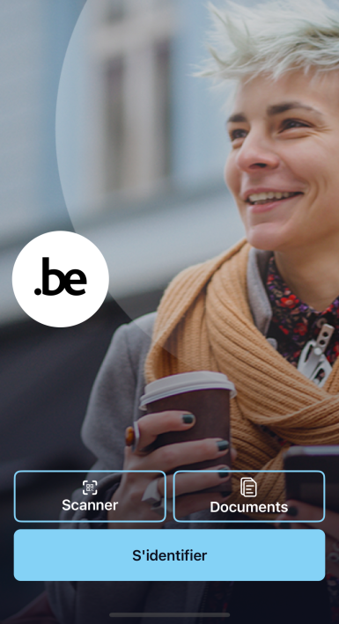
MyGov.be | Dienst
Functionaliteiten
Officiële documenten consulteren
Identificeren en authentiseren
My eBox raadplegen
Online procedures opstarten
Digitale sleutel
Sinds oktober 2025 is MyGov.be beschikbaar als digitale sleutel.
Beschikbare documenten
Uitreksels huwelijks- en geboorteakten
ISI+-kaart
Sociale statuten (My Benefits)
Identiteits- en rijbewijsgegevens
Inschrijvingsbewijzen voertuigen
Statistieken
+630 000 gebruikers van de app
+400 000 aanvragen identiteitsgegevens
+273 000 aanvragen rijbewijsgegevens
Notes:
Via de app kunnen burgers attesten consulteren, hun My eBox raadplegen en online procedures opstarten, ...

Slide 52
MyGov.be | Open architectuur
Partners
BIZA
MINFIN
eHealth
JUSTITIE
FEDPOL
RIZIV
...
Identity services
IDENTITY
INTERFACE
Communication
MESSAGE
INTERFACE
User journeys
PROCEDURE
INTERFACE
Secure documents
eWALLET
INTERFACE
FAS
eSIGN
eSEAL
SDG
eBOX
...
Service portfolio
BOSA ECOSYSTEEM
Notes:
Dankzij de open architectuur koppelen we moeiteloos met de brondatabanken van Justitie, Binnenlandse Zaken, Financiën en de sociale zekerheid.
Dit is een directe valorisatie van bestaande federale data-infrastructuur, vertaald naar een efficiënte en moderne burgerdienst.
MyGov.be is een antwoord op een verscheidenheid aan zakelijke behoeften:
het versterken van digitale transformatiecapaciteiten op mobiele apparaten
het maximaliseren van ROI door hergebruik van bestaande bouwstenen
het overnemen van Europese wetgeving
Het bevat een open/pluggable architectuur die verschillende werkingsmodi in de applicatie mogelijk maakt, naadloos en transparant voor de eindgebruiker.

Slide 53






MyGov.be | Relatie BOSA-bouwstenen
eIDAS Regulation
(eID)
Electronic Identity Card
(eID)
Federal Auth. Service
(FAS)
Federal Trust Services
(FTS)
Fed. Service Platform
(FSP)
MyGov.be
The Wallet
Electronic Mailbox
(eBox)
Electronic Counter
Services
Beleidsmatige ondersteuning, notificaties en compliance management
Technische en wettelijke ondersteuning voor eID-certificaten
Authenticatie voor websites van openbare diensten
Elektronisch tekenen en verzegelen voor digitale processen
Beveiligde uitwisseling van data en documenten tussen diensten
Geïntegreerd aanbod diensten via mobiel platform
Officiële communicatie tussen overheden en burgers
End-to-end elektronische processen en digitale procedures
EU Trusted List
eid.belgium.be
fas.belgium.be
sign.belgium.be
fsp.belgium.be
mygov.be
ebox.belgium.be
Service Portals
Erkenning via KB
Scope European Digital Identity Wallet conform eIDAS-revisie 2024
Notificatie door lidstaten van elektronische identificatiemiddelen in de EU, op basis van de eIDAS-verordening (authenticatie)
Scope MyGov.be zoals verwacht door
Belgische overheid
Notificatie van Certified Qualified Trust Service Providers gebaseerd op eIDAS regelgeving
Notes:
Deze app heeft geen miljoenen gekost aan compleet nieuwe systemen; het is een integratieplatform dat maximaal rendeert op bestaande BOSA-bouwstenen.
Het maakt gebruik van het Federal Service Platform (FSP) voor data-uitwisseling , de FAS/CSAM voor authenticatie , de eBox voor communicatie en de Federal Trust Services voor digitaal tekenen.
Dit maximaliseert de Return on Investment (ROI) van deze platformen.

Slide 54
MyGov.be | Actieplan 2026-2027
MyGov.be voorbereiden om een gecertificeerde EUDIW te worden
Mogelijk maken om attesten te tonen, bijvoorbeeld voor leeftijdsverificatie
Aanpassen van de regelgeving zodat identiteitskaarten en rijbewijzen die via MyGov.be zijn gedownload, dezelfde wettelijke waarde hebben als hun fysieke versies
Integreren van de GovApp.be-functionaliteiten (ontvangen van digitale notificaties van overheidsinstanties, bijv. BE-Alert)
Uitbreiden van het aantal documenten dat kan worden gedownload via MyGov.be:
  Europese ziekteverzekeringskaart (EZVK)
  Europese handicapkaart
  Vaccinatiecertificaten (bijv. gele koorts);
  ...
Onderzoek naar de uitbreiding functionaliteiten van de eBox burger
Notes:
Het actieplan voor 2026-2027 voorziet de evolutie naar een volwaardig gecertificeerde Europese Wallet.
We breiden de documenten uit met onder andere de Europese ziekteverzekeringskaart en zorgen voor de wettelijke verankering zodat de digitale documenten exact dezelfde rechtsgeldigheid krijgen als de fysieke kaarten.

Slide 55
European Digital Identity Wallet | Scope voor private / commerciële sector
Betalingen
Veilig online afrekenen. Gebruik je wallet om jezelf te identificeren en betalingen te autoriseren.
Bankrekening openen
Digitaal onboarden zonder kantoorbezoek. Verifieer je identiteit direct bij een nieuwe aanvraag.
Onderwijsdiploma's
Bewaar en deel geverifieerde diploma's en certificaten op een veilige manier.
SIM-kaart registratie
Snelle identiteitsverificatie voor het activeren van nieuwe mobiele abonnementen of simkaarten.
Reizen & Boekingen
Moeiteloos inchecken bij hotels en vluchten boeken met een geverifieerde identiteit.
Contracten ondertekenen
Rechtsgeldige gekwalificeerde elektronische handtekeningen voor al je zakelijke documenten.
Medicijnen ophalen
Haal eenvoudig je voorgeschreven medicijnen op bij apotheken binnen de hele EU.
Sociale zekerheid
Toon verzekeringsdekking aan en krijg toegang tot zorg in het buitenland (zoals de EHIC).
Leeftijdsverificatie
Bewijs dat je 18+ bent voor specifieke diensten zonder je volledige identiteit te onthullen.
Notes:
Tot slot kijken we over de grenzen van de publieke sector heen.
De Europese eIDAS V2-verordening verplicht dat deze Wallet ook in de private en commerciële sector gebruikt kan worden.
Denk aan digitaal onboarden bij banken zonder kantoorbezoek , het huren van een wagen of inchecken bij hotels , het veilig ondertekenen van commerciële contracten , of eenvoudige privacy-vriendelijke toepassingen zoals anonieme leeftijdsverificatie
Samengevat: door strakke governance via de DSB , centrale schaalvoordelen via CISOaaS en de AI Do-Tank , en maximale valorisatie van onze platformen zoals MyGov.be, bouwen we aan een digitale overheid die niet alleen performanter is voor de burger, maar die ook financieel en operationeel perfect beheersbaar en doelmatig is.

Slide 56

Vormingsdag Inspecteurs van financiën
Journée de formation Inspecteurs de finance
22 mei 2026
22 mai 2026

Slide 57
Agenda
Detachering via Egov/Smals
Wie zijn ze?
Waarom?
Wat is het?
Meerwaarde
Détachement via Egov/Smals ?
Qui sont ils??
Pourquoi ?
Quoi ?
Valeur ajoutée

Slide 58

Wat is dit verhaal niet?
Ce que ce récit n'est pas ?
Geen IT strategie
Andere sprekers
Andere opdracht
Geen beleidsstandpunt
Geen vergelijking tussen entiteiten
Gaat niet over Intramuros werking Smals
Projecten
Shared services
Raamcontracten
…
Pas de stratégie informatique
  Autres intervenants
  Autre mission
Pas de position politique
Pas de comparaison entre les entités
Pas le fonctionnement d'Intramuros Smals
Projets
Shared services
Contrats-cadres
…

Slide 59
Wat is dit verhaal dan wel?
Qu’est-ce que ce récit est, alors ?
Toelichting over:
Wie Egov Select en Smals zijn mbt detachering
Waarom zij relevant blijven
Hoe zij werken
Wat zij doen
Meerwaarde
Explication de :
Qui sont Egov Select et Smals concernant le détachement ?
Pourquoi ils restent pertinents
Comment ils fonctionnent
Ce qu’ils font
Valeur ajoutée

Slide 60
Wie zijn Egov Select en Smals mbt detachering?
Qui sont Egov Select et Smals en ce qui concerne les détachements ?
Wettelijk verankerd
  Smals: KSZ wet
  Egov Select: wet van 17 juli 2001
  Uitzondering op de uitzendarbeid
2 vzw’s
  2 bestuursorganen
  Wederzijdse bestuurders
  Vertegenwoordigers van verschillende overheidsinstellingen
Zelfde loon- en arbeidsvoorwaarden
  Zelfde CAO’s en loonpakketten
  Zelfde ondernemingsraad en CPBW
  Contracten onbepaalde duur!
  Geen concurrentie
Ancrage juridique
  Smals : loi Banque-Carrefour de la sécurité sociale
  Egov Select : loi du 17 juillet 2001
  Exception au travail intérimaire
2 ASBL
  2 organes de gestion
  Administrateurs réciproques
  Représentants de différentes institutions publiques
Mêmes conditions de rémunération et de travail
  Mêmes conventions collectives et grilles salariales
  Même conseil d'entreprise et CPBW
  Contrats à durée indéterminée !
  Pas de concurrence

Slide 61
Wie zijn Egov Select en Smals mbt detachering?
Qui sont Egov Select et Smals en ce qui concerne les détachements ?
  Werken enkel voor (federale) overheidsdiensten
  Smals: OISZ
  Egov Select: federale overheidsdiensten
Zelfstandige groepering van personen (kostendelende vereniging)
  Geen winstoogmerk
  Opgericht door en voor de overheid
  Lage kosten
  Geen BTW
Travailler uniquement pour les services publics (fédéraux)
Smals : OISZ
Egov Select : services publics fédéraux
Groupement autonome de personnes (association à frais partagés)
Sans but lucratif
Créé par et pour les pouvoirs publics
Faibles coûts
Pas de TVA

Slide 62
Waarom blijft detachering via Egov Select en Smals relevant?
Pourquoi le détachement via Egov Select et Smals reste-t-il pertinent ?
Structurele digitalisering van de overheid
Verdere automatisatie en digitalisatie
Regeerakkoord
Internalisering consultants
Aanhoudende schaarste IT-profielen
Arbeidsmarkt IT beweegt
Knelpuntenberoep
Nood aan continuïteit in IT teams
Duurzame tewerkstelling
Kostenbeheersing
Numérisation structurelle du gouvernement
Poursuite de l'automatisation et de la numérisation
Accord de coalition
Internalisation des consultants
Pénurie persistante de profils informatiques
Le marché du travail informatique en pleine évolution
Profession en pénurie
Besoin de continuité au sein des équipes IT
Emploi durable
Maîtrise des coûts

Slide 63
Wat is detachering wel en niet?
Qu’est-ce que le détachement est et n’est pas ?
WEL:
IT profielen ter beschikking voor onbepaalde duur
Inzet enkel bij overheidsdiensten
Niet-commercieel kader
Structurele capaciteit
Volledige teamintegratie
NIET:
Korte opdrachten
Projectmatige pieken
Klassieke consultancy
OUI :
Profils IT disponibles pour une durée indéterminée
Déploiement uniquement dans les services gouvernementaux
Cadre non commercial
Capacité structurelle
Intégration complète de l’équipe
NIET:
Missions courtes
Pics d'activité liés à des projets
Consultance classique

Slide 64
Wanneer welk model?
Quand utiliser quel modèle ?
Ambtenaar- contractueel | Werkenvoor.be – indien voldoende kwalitatieve laureaten
Specifieke en tijdelijke expertise | Externe consultants
Structurele capaciteit | Gedetacheerden via Smals- Egov
Kennisopbouw | Gedetacheerden via Smals-Egov
Fonctionnaire - contratuel | Trravaillerpour.be – s’il y a suffisamment de lauréats qualitatifs
Expertise spécifique et temporaire | Consultants externe
Capacité structurelle | Détachés via Smals- Egov
Acquisition de connaissances | Détachés via Smals-Egov
Complementaire structuren!
Text FR
Des structures complémentaires

Slide 65
Meerwaarde van detachering
Valeur ajoutée du détachement
Stabiliteit in teams
Minder verloop
Continuïteit van projecten
Minder afhankelijkheid van externe markt
Expertise binnen halen
Beheersing kostprijs
Ontlasting werving, selectie, payroll
‘In house’ model => geen overheidsopdracht nodig
Stabilité dans les équipes
Moins de roulement
Continuité des projets
Moins de dépendance au marché externe
Faire venir une expertise
Contrôle des coûts
Allègement du recrutement, de la sélection et de la gestion salariale
Modèle « in house » = > aucun contrat marché public requis

Slide 66
Volledige integratie in IT diensten
Intégration complète dans les services IT
Het zijn geen consultants
Zelfde werking als interne medewerkers
Geen leverancier-klant relatie
Kennisopbouw binnen de overheid
Kennisbehoud
Herbruikbaarheid tussen projecten
Ce ne sont pas consultants
Même opération que les employés internes
Aucune relation fournisseur-client
Développement des compétences au sein de l’administration
Rétention des connaissances
Réutilisabilité entre les projets

Slide 67
Implicaties voor controle en financiën
Implications pour le contrôle et les finances
Voorspelbare kosten
Transparant model
Langetermijnperspectief
Minder versnippering
Coûts prévisibles
Modèle transparent
Perspective à long terme
Moins de fragmentation

Slide 68
Conclusie
Conclusion
Complementaire partner voor volledige overheid
Wettelijk verankerd
Duurzame tewerkstelling
Beheersing kosten
Kennis opbouw en behoud
Stabiliteit
Partenaire complémentaire pour l ’ensemble des pouvoirs publics
Ancrage juridique
Emploi durable
Contrôle des coûts
Acquisition et rétention des compétences
Stabilité

Slide 69
Vragen? Question?

