Slide 1
The Crossroads Bank of Social Security, the eHealth-platform, the G-Cloud and Smals

Slide 2
About me (°1961)
education: law, ICT, ICT auditing, management, personal coaching
professional activities
  Crossroads Bank for Social Security
    1986-1991: originator as an advisor to the Minister of Social Affairs and the Prime Minister
    since 1991: CEO
  Data Protection Authority
    1991-2022: external member
  Federal Ministry of ICT
    2000-2001: originator as an advisor to the Minister of ICT (ao conception of electronic identity card)
  Smals (non for profit operational ICT association of public institutions of social security and health)
    since 2004: CEO (ao originator of G-Cloud initiative)
  eHealth platform
    2007-2008: originator as an advisor to the Minister of Public Health
    since 2008: CEO
    2020-2021: enterprise architect of Belgian information systems to fight the COVID-19 pandemic (testing, tracing, vaccination) and contributor to development of components on EU and WHO level

Slide 3
Setting the scene

Slide 4
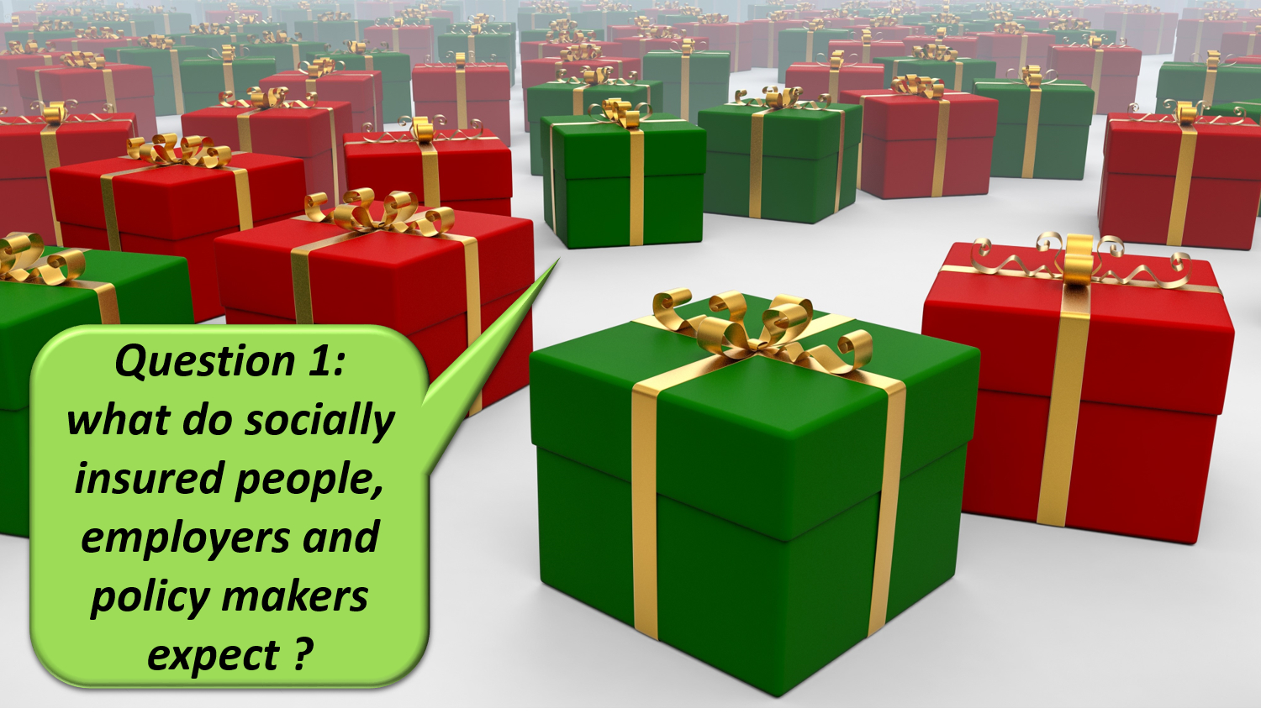

Slide 5


Slide 6


Slide 7
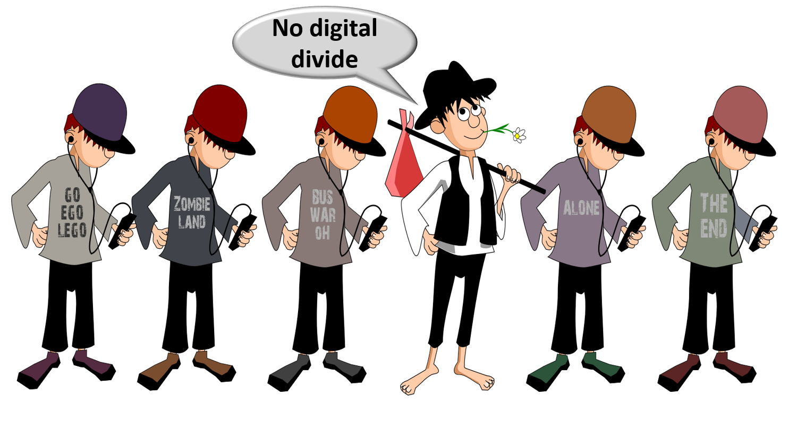

Slide 8


Slide 9


Slide 10


Slide 11


Slide 12


Slide 13


Slide 14
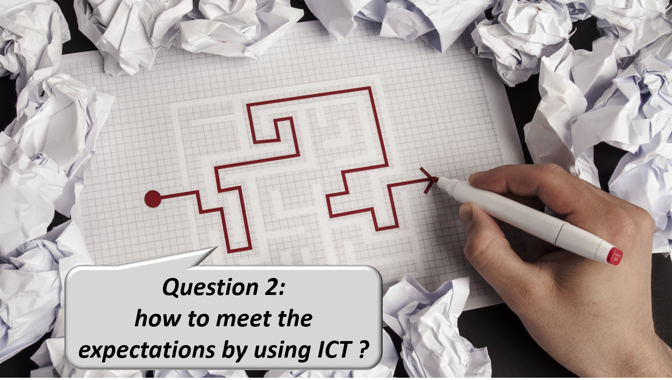

Slide 15


Slide 16


Slide 17


Slide 18


Slide 19
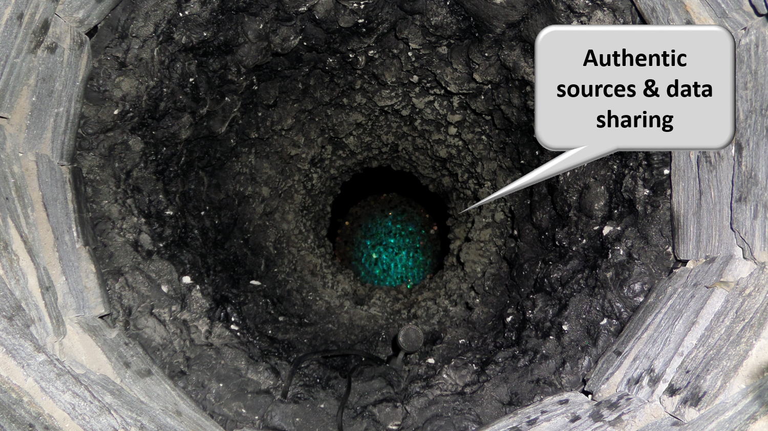

Slide 20


Slide 21


Slide 22


Slide 23


Slide 24
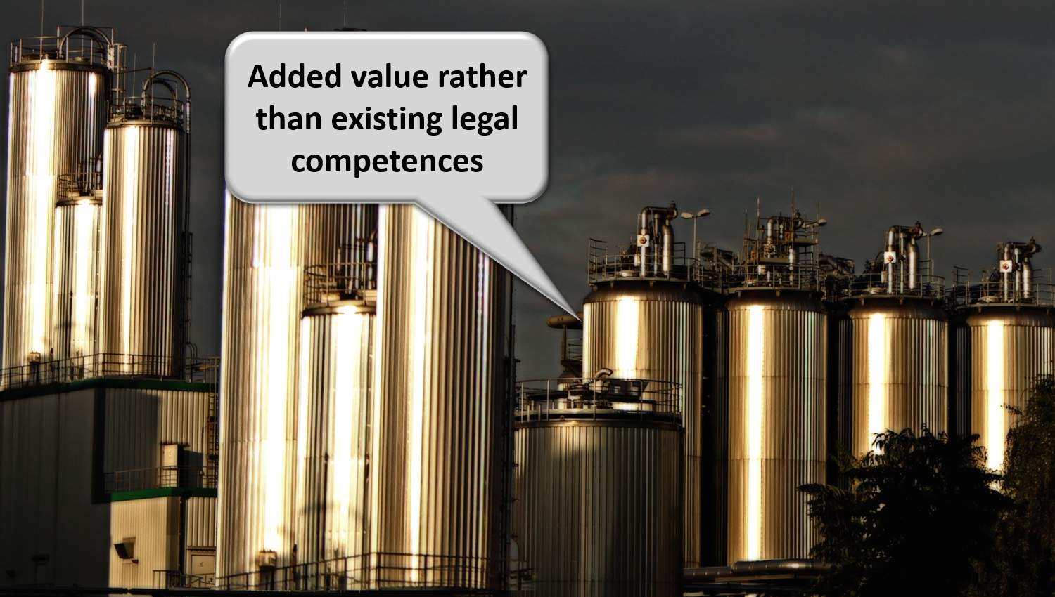

Slide 25


Slide 26
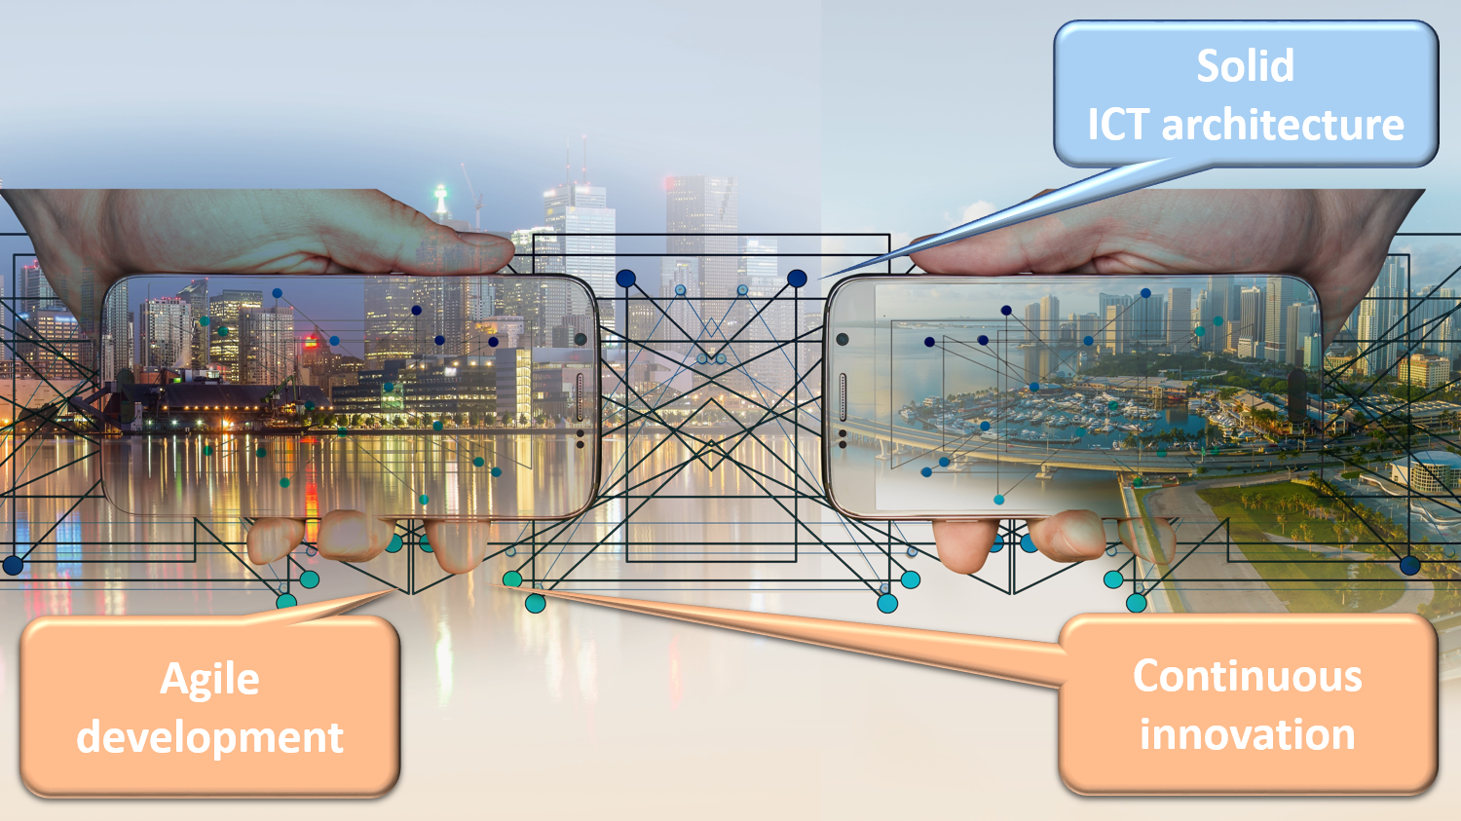

Slide 27
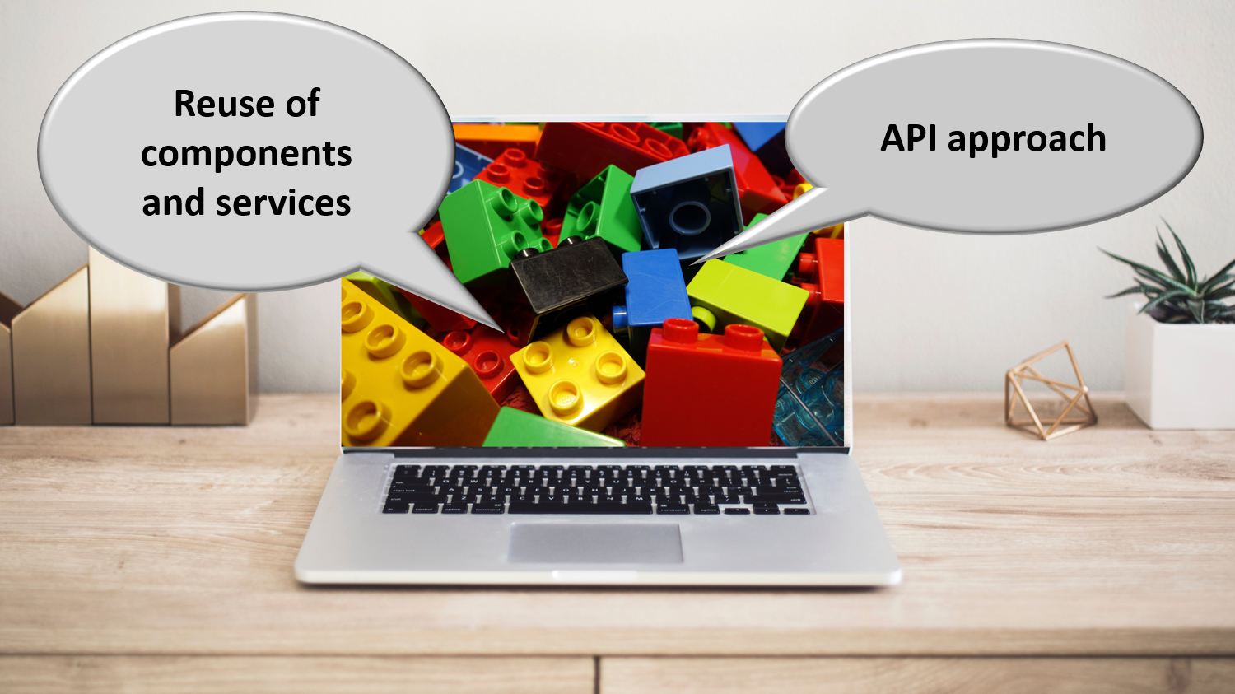

Slide 28
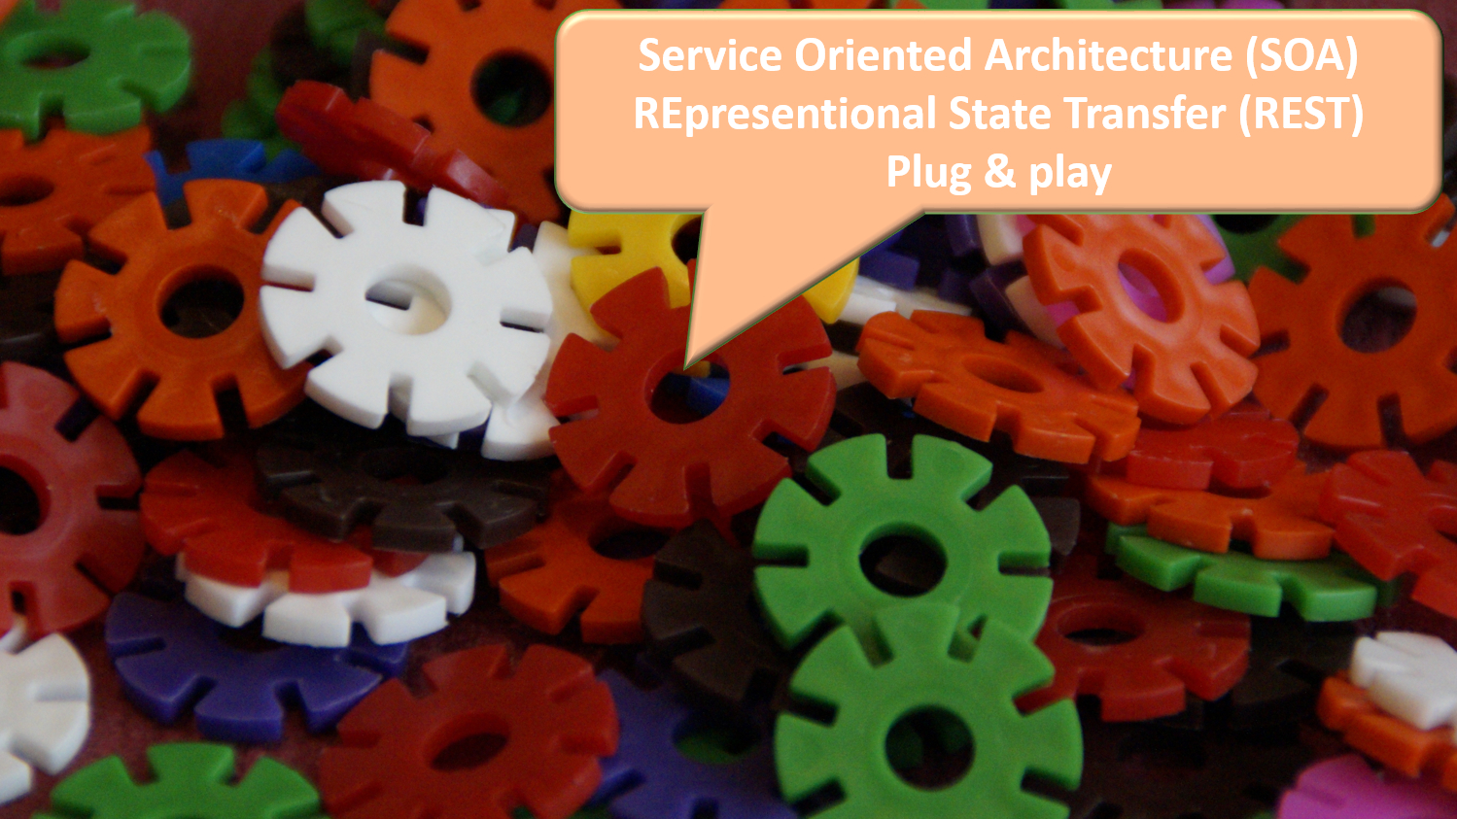

Slide 29


Slide 30


Slide 31


Slide 32


Slide 33


Slide 34


Slide 35

Notes:
Let the computer do what it is good at and thereby make time available for human support where necessary. And remember: the network always wins

Slide 36
Business architecture principles related to information management and information security

Slide 37
Information management
information is being modelled
  in such a way that the model fits in as closely as possible with the real world
  in order to allow multifunctional use of information
information is collected from citizens and companies only once by the public sector as a whole
  via a channel chosen by the citizens and the companies
  preferably from application to application
  and with the possibility of quality control by the supplier before the transmission of the information
the collected information is validated once
  according to established task sharing criteria
  by the actor that is most entitled to it or by the actor which has the greatest interest in correctly validating it

Slide 38
Information management
a task sharing model is established indicating which actor stores which information as an authentic source, manages the information and maintains it at the disposal of the authorized users
information can be flexibly assembled according to ever changing legal concepts
every actor has to report probable errors of information to the actor that is designated to validate the information
every actor that has to validate information according to the agreed task sharing model, has to examine the reported probable errors, to correct them when necessary and to communicate the correct information to every known interested actor
once collected and validated, information is stored, managed and exchanged electronically to avoid transcribing and re-entering it manually

Slide 39
Information management
electronic information exchange can be initiated by
  the actor that disposes of information
  the actor that needs information
  the organisation that manages the interoperability framework
electronic information exchanges take place on the base of a functional and technical interoperability framework that evolves permanently but gradually according to open market standards, and is independent from the methods of information exchange
available information is used for
  the automatic granting of benefits
  prefilling when collecting information

Slide 40
Information security
security, availability, integrity and confidentiality of information is ensured by integrated structural, institutional, organizational, HR, technical and other security measures according to agreed policies
personal information is only used for purposes compatible with the purposes of the collection of the information
personal information is only accessible to authorized actors and users according to business needs, legislative or policy requirements
the access authorization to personal information is granted by an Information Security Committee, designated by Parliament, after having checked whether the access conditions are met
the access authorizations are public

Slide 41
Information security
every actual electronic exchange of personal information has to pass an independent trusted third party and is preventively checked on compliance with the existing access authorizations by that trusted third party
every actual electronic exchange of personal information is logged, to be able to trace possible abuse afterwards
every time information is used to take a decision, the information used is communicated to the person concerned together with the decision
every person has right to access and correct his/her own personal data
every actor in the social sector disposes of an information security officer with an advisory, stimulating, documentary and control task

Slide 42
Useful legislative changes
legal translation of
  the common principles on information management
  the common principles on information security and privacy protection
  the obligation to use unique identification keys
creation of a public institution (eg CBSS, eHealth-platform) that acts as a driving force
  mission and tasks
  governance
  financing principles
creation of a control committee on information security and privacy protection
probative value of electronic information storage and exchange
punishment of abuse of the system
gradually, coordination or harmonisation of basic legal concepts
gradually, adaptation of business processes set out in the law

Slide 43



Enterprise architecture on national level: framework
Holistic
Vision & strategy
Vertical
Domains
Social security
Health
Other
Customer Centricity
Only Once
Employment
Illnes
Health care
Taxes
…
Services
Holiday
Pension
Medical costs
Family allowance
Care
Health risks
Medicines
Defense
Mobility
Horizontal
Processes
Generic & reusable
Interopera-bility
Architectural-principles
Building Blocks
Generic & reusable
Standards
Legacy vs innovation
Privacy by design

Slide 44
Crossroads Bank of Social Security

Slide 45

Stakeholders of the Belgian social sector
> 11.800.000 citizens
> 230.000 employers
about 3.000 public and private institutions (actors) at several levels (federal, regional, local) dealing with
  collection of social security contributions
  delivery of social security benefits
    child benefits
    unemployment benefits
    benefits in case of incapacity for work
    benefits for the disabled
    re-imbursement of health care costs
    holiday pay
    old age pensions
    guaranteed minimum income
  delivery of supplementary social benefits
  delivery of supplementary benefits based on the social security status of a person

Slide 46
Basic information
established by law in 1990, see https://www.ksz-bcss.fgov.be/nl/juridisch-kader
board of directors composed of representatives of stakeholders
  trade unions
  employers’ organisations
  self-employed organisations
  (public) social security institutions
84 employees
annual budget of 19,5 million euro

Slide 47
Mission
driving force and coordinator of e-government in the social sector, particularly
  encouraging actors in the Belgian social sector to
    provide effective and efficient services with minimal costs and minimal administrative formalities for all parties involved, and where possible on their own initiative
    in a manner that is optimally tailored to the various end users of the services
    through the continuous improvement of their (mutual) processes and relationships by using new technologies
    based on a common, mutually agreed vision
  promoting information security and privacy protection by the actors in the Belgian social sector, in order to ensure that all parties involved can legitimately trust the system
  make integrated, cross-sectoral policy-supporting data available to policymakers and researchers
see https://www.ksz-bcss.fgov.be/nl/over-de-ksz/opdrachten-en-doelstellingen

Slide 48
Responsibilities
visionary & change manager
architect & operator
security provider
task distributor
  agreeing on the task distribution regarding data storage and quality standards
programme manager
coordinator
communicator
see https://www.ksz-bcss.fgov.be/nl/over-de-ksz/opdrachten-en-doelstellingen#strategische-doelstellingen

Slide 49
Architect & operator
no central data storage, but an agreed division of tasks between the actors within and outside the social sector with regard to collection, validation and management of information and with regard to electronic storage of information in authentic sources
a network between all 3,000 social sector actors with a secure connection to the internet, the federal MAN, regional extranets, extranets between local authorities and the Belgian interbanking network
a unique identification key
  for every citizen
  for every company
  for every establishment of a company

Slide 50
Architect & operator
220 electronic services for mutual information exchange amongst actors in the social sector, defined after process optimization
  nearly all direct or indirect (via citizens or companies) paper-based information exchange by > 800 paper forms between actors in the social sector has been abolished
  in 2025, > ~2,15 billion electronic messages were exchanged amongst actors in the social sector, which saved as many paper exchanges
electronic services for citizens
  maximal automatic granting of benefits based on electronic information exchange between actors in the social sector
  33 electronic services via an integrated portal and/or mobile applications

Slide 51
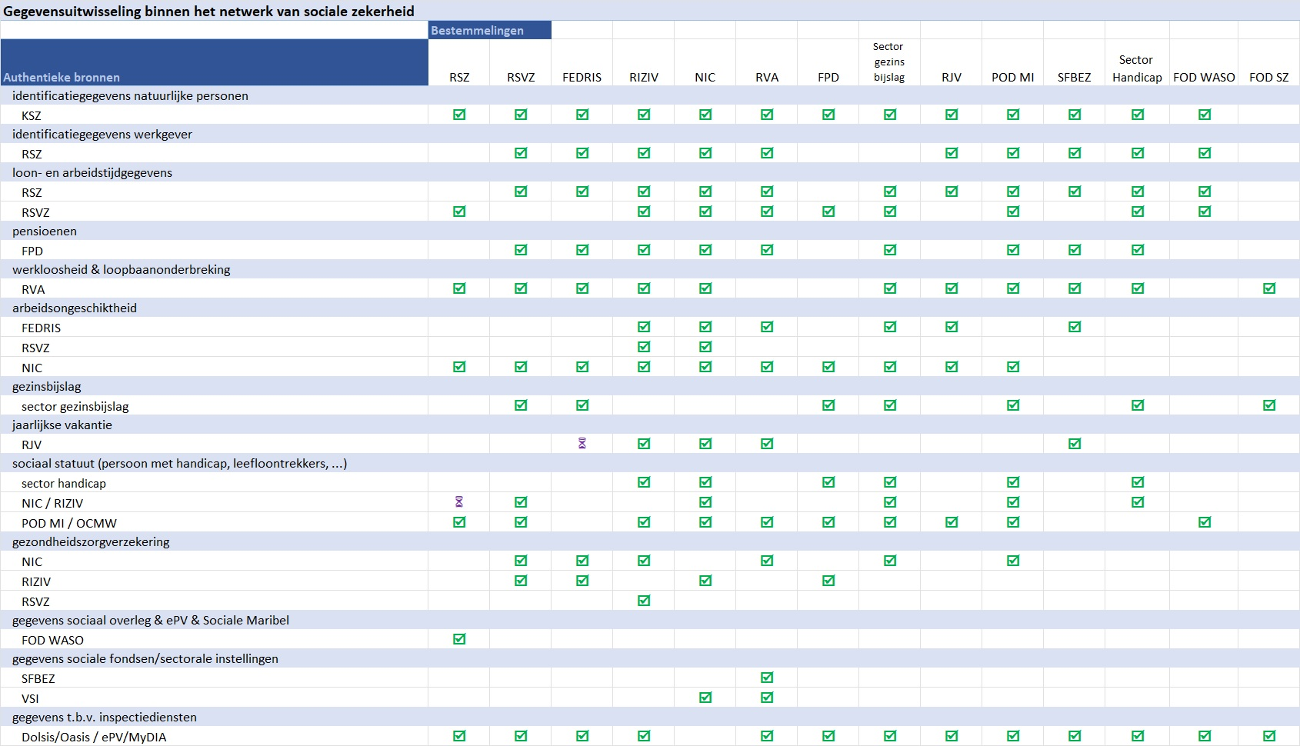

Slide 52
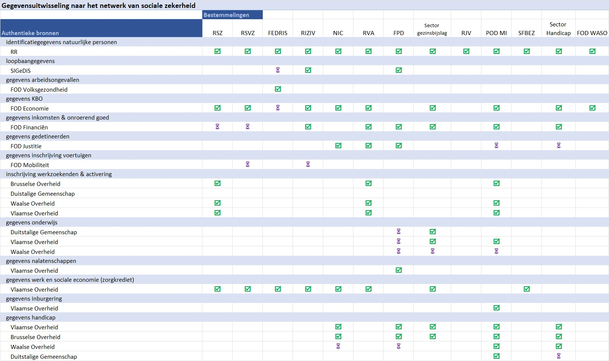

Slide 53
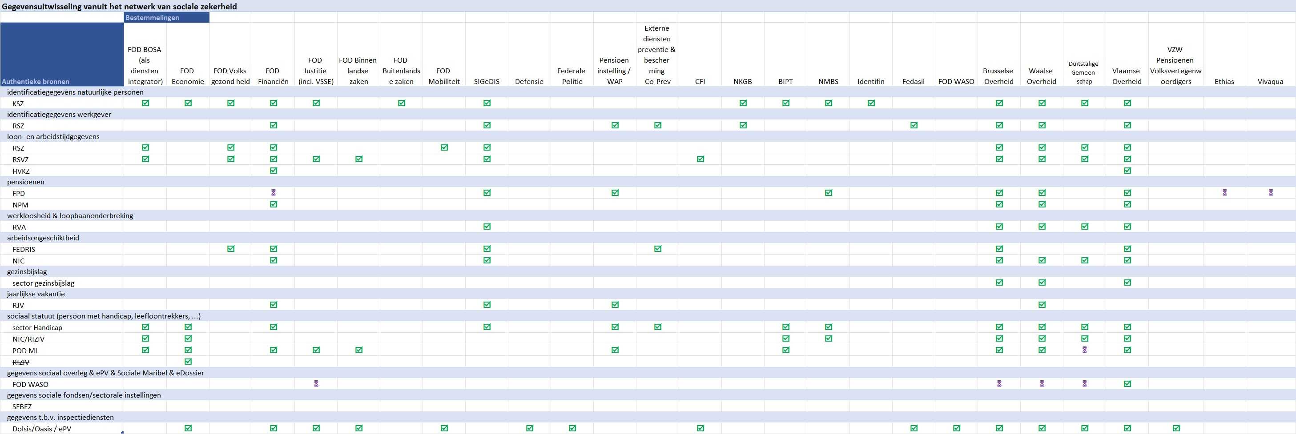

Slide 54
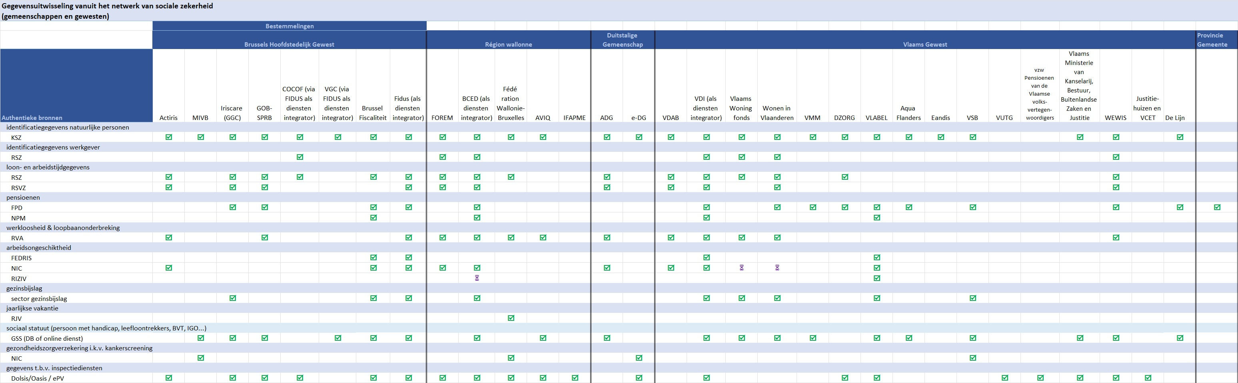

Slide 55
Maximum automatic granting of additional rights
‘social statute' for about 2 million citizens in Belgium
  limited income
  handicap, physical or mental disability
  child with special needs
citizens with social statute receive 'additional rights‘
  social rate for gas, electricity, water, telecom
  public transport
  housing
  tax reduction, free waste collection
  reduction for socio-cultural activities, sports
  ...

Slide 56
Principles
factual information available from one or more actor(s) is made available to other actors who, on that basis, automatically grant rights to the citizen without him/her having to submit an application for this
standardized services to respond as much as possible to information requests and avoid/reduce multiple developments, both for the data providers (authentic sources) and for the entities granting benefits
reduction in
  the number of statutes used and their complexity
  data exchanges
  the number of administrative formalities and paper certificates requested from this vulnerable population group

Slide 57
Lego brick philosophy
Authentic source (NR & CBSS)
Date of birth
Residence
Family composition
Social statutes
Public Social Security Institutions
Additional right
Granting authority
Income guarantee for elderly
Elderly care budget
Guaranteed income
…
Reduction of provincial tax
Province of East Flanders
Public Social Welfare Centers
Living wage
Equivalent living wage
Ministries
Integration allowance disabled people
…
Sickness funds
Income
Increased healthcare costs allowance

Slide 58
Lego brick philosophy
Authentic source (NR & CBSS)
Date of birth
Residence
Family composition
Social statutes
Public Social Security Institutions
Additional right
Granting authorities
Income guarantee for elderly
Elderly care budget
Guaranteed income
…
Social rate for gas & electricity
FPS Economy & utility companies
Public Social Welfare Centers
Living wage
Equivalent living wage
Ministries
Integration allowance disabled people
…
Sickness funds
Income
Increased healthcare costs allowance

Slide 59
MyBenefits, recently integrated in MyGov
mobile app & web application
which allows citizens to consult and prove their social statuses on the date of the day itself in order to assert their rights with the various authorities that grant additional benefits
which allows the awarding authority to verify the social statutes
    actors who typically do not cooperate directly with the CBSS (e.g. sports, child care, museums, leisure centers, amusement parks, etc.)
    actors who do not (yet) have an automatic data flow (e.g. pro bono legal assistance, municipal tax reduction, ...)
which allows authorities granting additional benefits in the culture, sports and entertainment sector to report them, and citizens to consult them

Slide 60
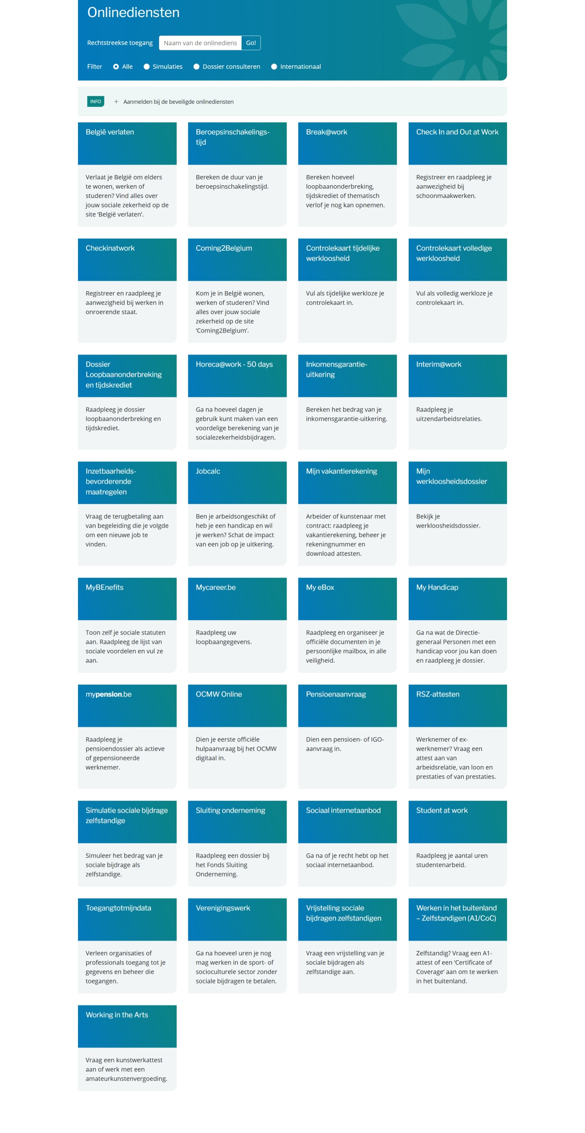
Social security portal for citizens

Slide 61
Results
more than 50 electronic services for employers, either based on the electronic exchange of structured messages or via an integrated portal site
  50 social security declaration forms for employers have been abolished
  in the remaining 30 (electronic) declaration forms the number of headings has on average been reduced to a third of the previous number
  declarations are limited to 3 events
    immediate declaration of recruitment and discharge (only electronically)
    quarterly declaration of salary and working time (only electronically)
    occurrence of a social risk (electronically or on paper)
  in 2025, more than 50 million electronic declarations were made by all 250,000 employers, 98 % of which from application to application

Slide 62








Quartely declaration salary & working time
simplification
Activity 3
Activity 2
Activity 1
employer
one electronic
declaration
RSZ
RIZIV
RVA
old age pension
FPD
Family
Benefits
Belgium
holiday pay
RJV

Slide 63
Declaration of social risks
types of social risks
  child benefits
  incapacity for work ((labour) accident, (occupational) disease, …)
  unemployment
  old age pension
3 possible moments of declaration
  start of the social risk
  recurrence or continuation of the social risk
  end of the social risk
structure of the declaration
  identification data
  if necessary, salary and working time data not yet declared via a quarterly declaration (mini-declaration)
  specific data concerning the social risk

Slide 64
Architect & operator
an integrated portal site and mobile applications containing
  electronic transactions for citizens, employers and professionals
  simulation environments
  information about the entire social security system
  harmonized instructions and information model relating to all electronic transactions
  a personal page for each citizen, each company and each professional
an integrated multimodal contact centre supported by a customer relationship management tool
a data warehouse containing statistical information with regard to the labour market and all branches of social security

Slide 65
Distributed information servers
information servers
  directory of data subjects at the CBSS
  basic identification data of citizens at the National Register and the complementary KSZ Register
  basic identification data of companies at the Company Register
  employer’s directory (WGR) at the RSZ
  work force register at the RSZ
  career database at Sigedis
  database of contribution certificates
services offered
  interactive consultation
  batch consultation
  automatic communication of updates

Slide 66
Pre-processed messages
pre-processed messages
  beginning/end of labour contract, beginning/end of self-employed activity
  contribution certificates medical care (employees, self-employed, beneficiaries of social security allowances)
  unemployment benefits
  benefits in case of career break
  benefits in case of incapacity for work ((labour) accident, (occupational) disease)
  reimbursement of health care costs
  child benefits
  old age pensions
  holiday pay
  benefits for the disabled
  guaranteed minimum income – social welfare
  derived rights (e.g. tax reduction/exemption, free public transport, ...)
  migrant workers
  …
services offered
  interactive consultation
  batch consultation
  automatic communication of messages

Slide 67
Useful tool: the reference directory
reference directory
  directory of available services/information
    which information/services are available at any actor depending on the capacity in which a person/company is registered at each actor
  directory of authorized users and applications
    list of users and applications
    definition of authentication means and rules
    definition of authorization profiles: which kind of information/service can be accessed, in what situation and for what period of time depending on in which capacity the person/company is registered with the actor that accesses the information/service
  directory of data subjects
    which persons/companies have personal files at which actors for which periods of time, and in which capacity they are registered
  subscription table
    which users/applications want to automatically receive what information/services in which situations for which persons/companies in which capacity

Slide 68
Advantages
gains in efficiency
  in terms of cost: services are delivered at a lower total cost due to
    a unique information collection using a common information model and administrative instructions
    a lesser need to re-encoding of information by stimulating electronic information exchange
    a drastic reduction of the number of contacts between actors in the social sector on the one hand and companies or citizens on the other
    a functional task sharing concerning information management, information validation and application development
    a minimal administrative burden
  according to a study of the Belgian Planning Bureau, rationalization of the information exchange processes between the employers and the social sector implies an annual saving of administrative costs of about 1.7 billion € a year for the companies

Slide 69
Advantages
gains in efficiency
  in terms of quantity: more services are delivered
    services are available at any time, from anywhere and from several devices
    services are delivered in an integrated way according to the logic of the customer
  in terms of speed: the services are delivered in less time
    benefits can be allocated quicker because information is available faster
    waiting and travel time is reduced
    companies and citizens can directly interact with the competent actors in the social sector with real time feedback

Slide 70
Advantages
gains in effectiveness: better social protection
  in terms of quality: same services at same total cost in same time, but to a higher quality standard
  in terms of type of services: new types of services, e.g.
    push system: automated granting of benefits
    active search of non-take-up using data warehousing techniques
    controlled management of own personal information
    personalized simulation environments
better support of social policy
more efficient combating of fraud

Slide 71
Programme manager
annual survey among all stakeholders regarding new needs, identifying priorities
coordination with other stakeholders involved
leads to annual portfolio
for 2025 (138 projects) see https://www.ksz-bcss.fgov.be/sites/default/files/assets/over_de_ksz/Priorities_2026.pdf
in addition, room for (limited) change requests

Slide 72
eHealth-platform

Slide 73

Stakeholders of the Belgian health sector
> 11.800.000 citizens
> 100.000 healthcare providers (physicians, dentists, clinical labs, pharmacists, physiotherapists, home nurses, …)
> 300 health care institutions (hospitals, rest and care homes, …)
sickness funds
public institutions
  federal level (Ministry of Public Health, National Institute for Health and Disability Insurance (RIZIV - INAMI), Federal Agency for Medicines and Health Products, …)
  regional level

Slide 74
Basic information
established by law in 2008, see https://www.ehealth.fgov.be/ehealthplatform/nl/wetgeving
board of directors composed of representatives of stakeholders
  healthcare providers
  healthcare organisations
  sickness funds
  patient organisations
  public institutions responsible for healthcare at various government levels
users’ committee
40 employees
annual budget of 18,2 million euro

Slide 75
Mission
to promote and support a well-organised, electronic information exchange among all actors in the (health) care sector
with necessary guarantees related to
  information security
  protection of the personal data of the patients and the health care providers
  professional secrecy
in order to
  optimise the quality and continuity of health care provision
  optimise patient safety
  simplify the administrative formalities for all (health) care actors
  (pro-)actively support health care policy making and evaluation
see https://www.ehealth.fgov.be/ehealthplatform/nl/missie

Slide 76
Responsibilities
visionary & change manager
architect & operator
security provider
standard setter, task distributor & registrar
  establishing the functional and technical ICT norms, standards, specifications and basic architecture
  agreeing on the task distribution regarding data storage and quality standards
  registration of software for the management of electronic patient files
programme manager
trusted third party for the pseudonymisation and anonymisation of personal data in support of scientific research and policy
coordinator
see https://www.ehealth.fgov.be/ehealthplatform/nl/opdrachten

Slide 77








Architect & operator
Patients, health care providers
and health care institutions
Site Ministry
Software health care professional
Software health care institution
VAS
Site RIZIV
VAS
eHealth-portal
MyCareNet
VAS
VAS
VAS
Users
Basic services
eHealth-platform
Network
AS
AS
AS
AS
AS
AS
Suppliers
Notes:
77
77

Slide 78






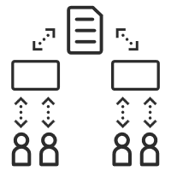

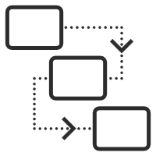


Architect & operator: basic services
eHealth-
certificats
Integrated user and access management system
Timestamping
System for end-to-end encryption
eHealthBox
Management of loggings
Reference directories (hub-metahub system)
Portal
Coordination of the electronic processes
Consultation of National register and CBSS registers
Coding and anonymising
see https://www.ehealth.fgov.be/ehealthplatform/nl/technische-documentatie

Slide 79












eHealth: some results
Medical history search via SumEHR
Guidelines and advice available online
Medication schedule
Health
advantages
Electronic prescriptions
Consultation of laboratory results
Electronic referral letters

Slide 80





eHealth: some results
Pricing,
billing
Updating the SumEHR, the medication schedule, ...
Adminis- trative
advantages
Creating and sending certificates
Registrations
Sending a report to the GMF holder

Slide 81
2025 – some results
Informed consent
Number of transactions
eHealthBox
11.512.704 registered consents
19.018.497.753 in 2025 (+ 11,42%)
112.876.714 messages sent (SOAP)
917.260 messages sent (REST)
eHealthBox > eBox
Performance & accessibility
12.301.272 messages
100 % of the KPIs are being met

Slide 82

Programme manager: action plan 2025-2027
Basic services
1
The BIHR Work Environment
2
“Moonshot”
More mature eHealth architecture and landscape in line with the strategic and operational objectives of the 2025-2027 Action Plan
Specific eHealth projects
3A
Digitalisation component within programmes
3B

Slide 83
Key concept: Belgian Integrated Health Record (B-IHR)
an environment where
  citizens/patients have a clear overview of their own health (care) and welfare data
  everyone who takes care of that person has access to all the information that is important for providing high-quality care
everyone involved can actively contribute to keeping the information up to date and accurate
better systems for registering, structuring and organising all available information, with greater added value for healthcare
supporting intensive (secondary) reuse of data for
  scientific research, development and innovation
  policy support
  population management
more information at https://www.frankrobben.be/wp-content/uploads/2023/03/B-IHR.pdf

Slide 84
Other objectives
to concretize integrated care programmes and the principles of the cooperation agreement
administrative simplification
workload management for healthcare providers
training
implementation in the workplace
MyHealth as an inter-federal portal
literacy and inclusion
innovation
m-health
readjustment of incentives and financing
revision of relationship with software suppliers

Slide 85
Egov 3.0

Slide 86
Egov 3.0 program
World is in permanent change
concepts are evolving: worker statuses, working hours, forms of employment, households, … =>
  Dimona (fast data) lacks sufficient detail
  DMFA (detailed data) is not available quick enough
increasing mobility of workers requires linking data and databases across borders
digital revolution: smartphone, apps, online services, speech technology, cloud, AI,…
growing attention and awareness of the importance of privacy issues
digitization versus the digital divide
increasing risks related to information security

Slide 87

Towards a sustainable digital social security
2. Unique data model, data transparency and autonomy
1.User centricity
3. Simplifying regulations and processes
4. Across policy levels
5. Digitale inclusion
6. Data sharing in real time and making 'first time right' decisions
7. Automatic granting of rights
8. Future-proof enterprise architecture

Slide 88


New data layer
Modern interfaces
(portal, API …)
New
datalayer
INPUT
OUTPUT
Salaries, performance, contributions
Salaries, performance, contributions
Employer
Frequency linked to the payroll calculation moment
Salaries, performance
Derived data
Employer
Citizen
Application of regulations
View employer - employee
Service provider
Factual data
Career database
Multifuncitonal usage
Service provider
Limited aggregation, fine granularity
Services with added value
OISZ
Consolidated employee view
Collaborating
institutions
Federal
Partners
Central business rules
Regional
Partners

Slide 89
New data layer
move towards event-driven operations
decoupling the moment of data transmission from the moment of usage
usable for
  eliminating existing obligations (eg obligation of employer to maintain individual account, DMFA, …)
  creating new, faster services (eg holiday certificates, unemployment - C4, …)
  quotas updated in real time (eg student work, …)
  cost control
  improved insights (for policy preparation, scientific research, …)
less administrative burden and uncertainty for employers and employees

Slide 90

G-CLOUD, THE COMMUNITY
CLOUD OF THE GOVERNMENT

Slide 91
G-Cloud: what ?
Procurement
Collaboration
Efficiency
Programme of synergy projects for and by the government
Projects
Services
Knowledge
& expertise
Cost
Quality

Slide 92

Collaboration & community vision: by the government, for the government
strong focus on engagement, ‘together we are stronger’
focused on, but not limited to, federal government (FPS, public institutions for social security, public interest organisations, etc.)
common service providership/ownership
not limited to governance aspects
in close partnership and collaboration with the private sector through public procurement
“G-Cloud first” policy

Slide 93


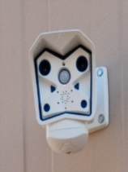



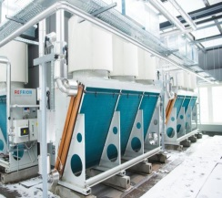
Synergy projects?
Example | DATA CENTRE CONSOLIDATION
FROM
  approx. 40 data centres
  ≠ scale
  legacy, complexity
  high-cost connectivity/data centre
  ≠ service levels
  power & cooling limits
  separate supervision
TO
  approx. 4 data centres
  large scale
  standardised
  high-speed fibre interconnection
  24x7 services
  future-proof power & cooling
  shared supervision

Slide 94






















Cloud deployment types
Access & Control
Public Cloud
Shared
Community Cloud (on-premises + in/outsourced)
Community Cloud (off-premises + outsourced)
Community cloud :
only for the government:
comparable goals
comparable requirements
comparable compliance rules
Community X
Dedicated
Private Cloud (on-premises + in/outsourced)
Private Cloud (off-premises + outsourced)
Organisation A
Customer
Service Provider
Location & Management

Slide 95
Responsibilities in Cloud ?
IaaS, PaaS and SaaS are services provided in both the G-Cloud community cloud (on-premises) and the public cloud (off-premises).
Smals and the public cloud service providers are responsible for the underlying tiers
public cloud providers operate globally and are commercially driven
Smals and G-Cloud operate nationally and are synergy-driven
cost advantage is only one element in the equation; standardisation and uniformity are equally important
Traditional
IaaS
PaaS
SaaS
Application
Application
Application
Application
Database
Database
Database
Database
Runtime
Runtime
Runtime
Runtime
Middleware
Middleware
Middleware
Middleware
OS
OS
OS
OS
Virtualization
Virtualization
Virtualization
Virtualization
Servers
Servers
Servers
Servers
Storage
Storage
Storage
Storage
Networking
Networking
Networking
Networking
Data centre
Data centre
Data centre
Data centre
Managed by you
Managed by the service provider

Slide 96
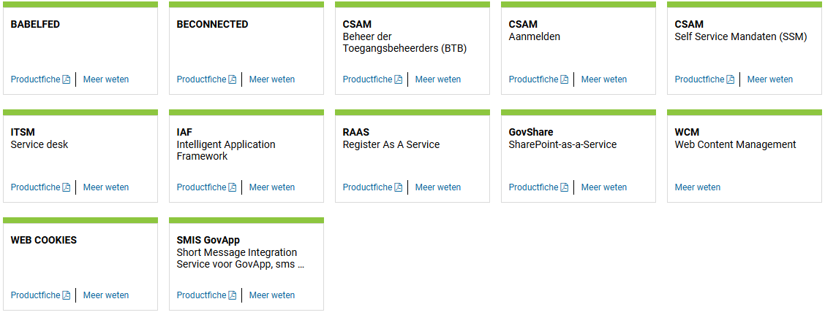

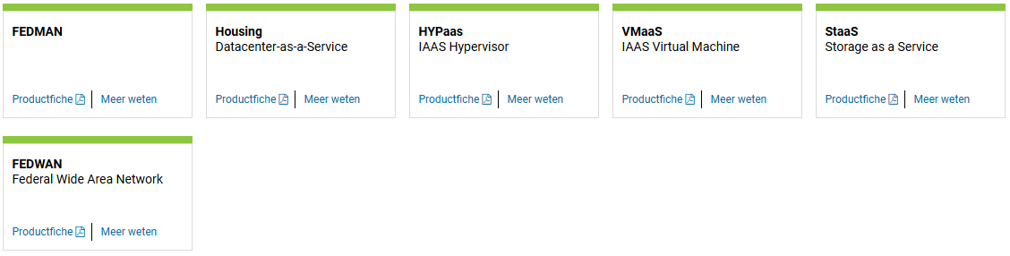
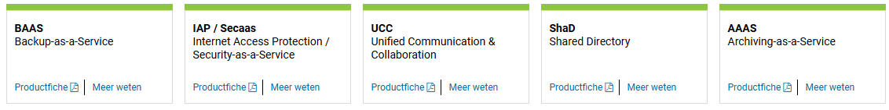
G-Cloud service portfolio (1 of the 4 synergy axes)

Slide 97
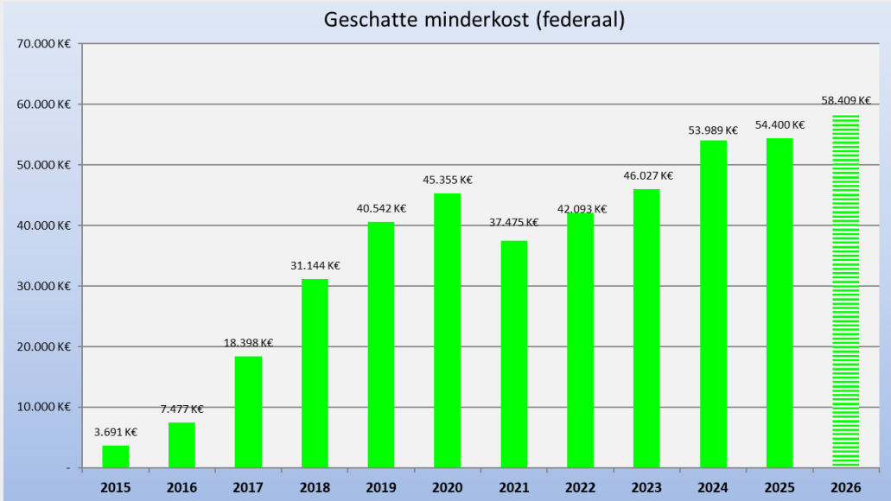
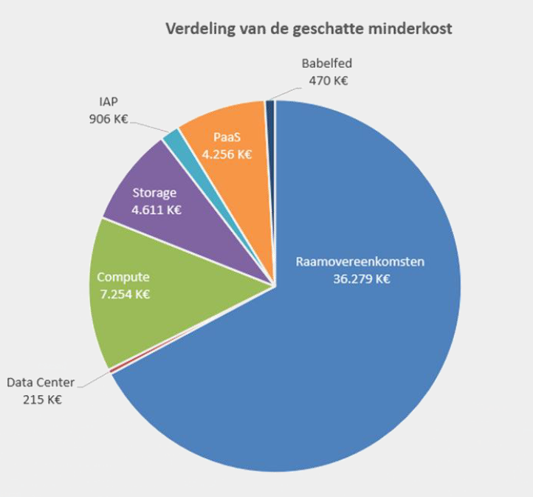
Concrete, measurable results!
Discover the activity report: https://gcloud.belgium.be/fr/news

Slide 98
G-Cloud organisation and governance
Government
G-Cloud Operations & Programme Board
G-Cloud Strategic Board
FPS’s/PPS’s
(Horizontal FPS, FPS FIN, Belnet, ...)
Public institutions for social security, Public interest organisation (Crossroads Bank for Social Security,...)
Association of FPS’s/PPS’s/ Public institutions for social security
Private ICT firms led by FPS/Public institutions for social security
3 Colleges (FPS’s, public institutions for social
security, public interest organisations)
SIT (ICT-managers of FPS’s, public institutions
for social security, public interest organisations)
Service
owners

Slide 99
Service owners
there is a service owner for every service in the G-Cloud portfolio
  Smals, Belnet, NIHDI, FPS Finance
this service owner provides clarity on
  service description
  service level agreement (SLA)
  cost model
  escalation sheet
  service delivery (or contact with the external party)
a large number of services in the lower tiers are provided by Smals and are widely used
  e.g. data centre, storage, greenshift, etc.
  management has been professionalised and standardised across the members who use these services
agreed single audit principle

Slide 100
WE BUILD G-CLOUD TOGETHER
www.gcloud.belgium.be
info@gcloud.belgium.be

Slide 101
Smals vzw

Slide 102

Statutory mission and some figures
founded in 1939 as a not-for-profit association of Belgian social security institutions for delivering in-house expertise and consulting
statutory mission: “Smals supports and assists social security and healthcare institutions - and other public services on their demand - in their information management so that they can provide effective and efficient services to their users. Smals offers in-depth knowledge and skills, to generate mutually beneficial economies of scale and to drive additional value creation, while stimulating ICT reuse”
member institutions are free to choose whether they wish to use Smals' services (no monopoly)
2350 employees – huge cooperation with private sector (> 1,000 external experts)
annual turnover 578 million euro’s
see https://www.smals.be/nl

Slide 103
Legal framework
companies and associations code
article 17bis Crossroads Bank for Social Security (CBSS) Act
  for the authorisation of association of public institutions
  for the obligatory not-for-profit form
  for the principle of cost-sharing
  for the legal authorisation of secondment of specialised staff
article 30 Public Procurement Act
  for the possibility of direct assignment of contracts by the members ('in-house‘ construction)
article 2, 1°, c) Public Procurement Ac
  for the subjection of Smals to the Public Procurement Act

Slide 104
Governance
general Assembly
  all members (> 300)
  3 categories with degressive voting rights according to importance/contribution, grosso modo
    A: Public Social Security & Health Institutions
    B: Federal Public Services & Federated Entities
    C: Public Centers of Social Welfare
governance board
  20 directors, nominated by
    Category A, B and C members: 11, 2 and 1 directors respectively
    General Assembly as a whole: 4 directors
    Minister for Social Affairs: 1 director
    Minister of the Budget: 1 director
strategic committee
  11 directors
  executive committee
audit committee, reporting to the governance board
  6 directors
  3 external members

Slide 105
Control
members (essence of 'in-house‘ construction)
  directly through the General Assembly (appointment of directors, budget, costing, accounts, etc.)
  indirectly through the Governance Board
  are themselves public institutions or government departments under the authority of a minister
  the 2 ministers (through nominated directors)
internal procedures, including
  internal audit department
  risk management
  strategic objectives
company auditor
Court of Audit
  structural cooperation on finance and thematic studies, e.g. public procurement

Slide 106
Portfolio
applications
  supporting development of digital strategies
  business analysis
  business Process Reengineering (BPR)
  software development
  methodology
  reusable components
  data quality
  usability
  information security
  mobile device management
  web development
  operations
  change management
R&D
infrastructure
  data center services
  hosting
  information networks
  server infrastructure
  storage services
  ITIL framework
support services
  CRM
  communication agency (Bucom)
  contact center (Eranova)
  print & mail
  framework contracts
staffing

Slide 107
Some achievements
contributes significantly to G-Cloud and software reuse
cost sharing facilitates collaboration between public institutions (data center, portals, user management, 24/7 monitoring of services, etc.).
generates economies of scale
provides institutions with hard-to-find expertise on ICT and information security
offers expertise in ICT public procurement, facilitating access of private ICT service providers to the public sector
stimulates innovation thanks to small R&D department (see https://www.smalsresearch.be/)

Slide 108
Conclusion

Slide 109
Conclusion
in the development of information systems in the social and health sector, the emphasis has been placed for years on a solid, sector-wide enterprise architecture
  sharing of infrastructure and platforms
  reuse of data, services and components described in a publicly accessible catalogue
    modular, generic, domain agnostic, interoperable and reusable components/services
    develop once, use many
  an integrated service to end users, supported by APIs
  participatory governance in the development of the systems, up to the level of policy makers
  based on a common conceptual framework
no technology driven choice of components and services used, but use of ICT components and services as enabler and means for meeting business requirements

Slide 110
Critical success factors
clear division of tasks with policymakers
  policy preparation and loyal policy implementation: public organisations
  policy-making: policymakers
management by representatives of stakeholders => buy-in and trust
covering the entire, coherent field of action
  various government levels
  cooperating organisations
  private service providers
responsabilisation and clear division of tasks between service integrators

Slide 111
Critical success factors
multidisciplinarity
  domain
  ICT (architecture)
  programme & service management
  information security & privacy protection
solid overarching enterprise architecture
shared services & reuse
balance between effective and efficient service and data protection
  data protection by design
  Information Security Committee

Slide 112
Service Oriented Architecture (SOA)
what ?
  “Service Oriented Architecture (SOA) is a paradigm for organizing and utilizing distributed capabilities that may be under the control of different ownership domains. It provides a uniform means to offer, discover, interact with and use capabilities to produce desired effects consistent with measurable preconditions and expectations. This style of architecture promotes reuse at the macro (service) level rather than micro levels (eg. objects). It also makes interconnection of existing ICT assets trivial” (OASIS Reference Group)
characteristics
  service-oriented
  modular
  interoperable (based on open standards or open specifications)
  extensible
  layered
  based on reuse of components and data

Slide 113
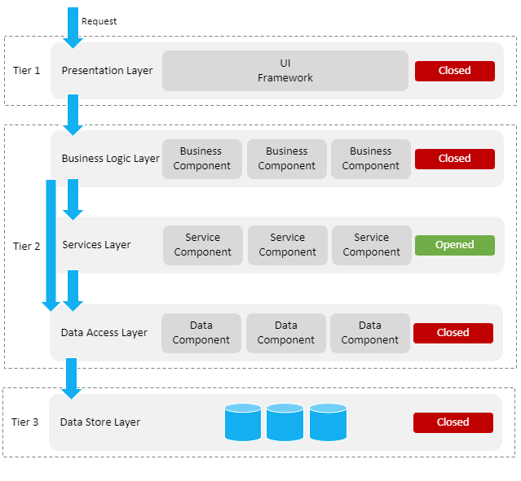
Layered, service oriented architecture
presentation layer, e.g.
  web applications
  mobile applications
business logic layer, e.g.
  workflow
services layer, e.g.
  user & access management service
  communication service
  blockchain
data store layer, e.g.
  authentic sources
  personal vaults
  local storage on mobile device

Slide 114
Across layers
interoperability standards
  technical: oa APIs (Application Programming Interface)
  semantic
security, eg
  access authorisation
  logging
  business continuity
configuration, eg
  capacity management
  load balancing

Slide 115
Advantages of layered, service oriented architecture
multifunctional reuse possibility
  lower cost
  higher quality
  quicker time to market
  better user experience
reduced dependency of components
  easier and less costly maintenance
easier unit testing because each component can be tested individually
  but need for sound integration and performance testing

Slide 116
Example: identity, user & access management (IUAM)
objectives to be reached: to be able to (digitally)
  identify all relevant entities (physical persons, companies, applications, machines, …)
  authenticate the identity of all entities
  know the relevant characteristics of the entities
  know the relevant relationships between entities
  know that an entity has been mandated by another entity to perform a legal action
  know the authorizations of the entities
in a sufficiently certain and secure way
in as much relations as possible (C2C, C2B, C2G, B2B, B2G, …)
multichannel (web application, mobile application, …)
using open interoperability standards

Slide 117
Policy Enforcement Model (XACML)
Action on application
DENIED
Policy
Enforcement
(PEP)
Action on application
PERMITTED
User
Application
Action on application
Decision
request
Decision
reply
Policy
Decision
(PDP)
Information
request/reply
Policy
retrieval
Information
request/reply
Policy management
Policy
Administration
(PAP)
Policy
Information
(PIP)
Policy
Information
(PIP)
Manager
Policy repository
Authentic source
Authentic source

Slide 118


User and access management

Slide 119









Example: COVID-testing
CTPC Code
EMF software
Doctors
Nurses
CTPC
Test location
Collectivities
eHealth Box
Laboratories
Tracing business process engine

Slide 120




Example: COVID testing - reuse
CTPC Code
Integrated software
IUAM
API gateway
IUAM
API gateway
eHealthBox
ETEE
Doctors
Nurses
CTPC
Test centers
DataEncryptor
Seals
Entities prescriptions
Addressbook
ConsultRN
DossierNumberGeneration
CentralPersonnelFile
DmfA
Laboratories
Mandate

Slide 121


Let us learn from success stories!

