Slide 1
eHealth (primary use) in Belgium
brief overview
Belgian Integrated Health Record (B-IHR) for integrated care
Belgian roadmap towards EHDS

Slide 2
















Overview of the Belgian eHealth landscape

Slide 3












Actual status
Patient summary (SumEHR)
Guidelines and advice available online
Medication schedule
Health
advantages
Electronic prescriptions
Consultation of laboratory results
Electronic referral letters

Slide 4





Actual status
Pricing,
billing
Updating the patient summary, the medication schedule, ...
Adminis- trative
advantages
Creating and sending certificates
Registrations
Sending a report to the GMF holder

Slide 5
Some figures
Informed consent
Number of transactions
eHealthBox
11.512.704 registered consents (97,3%)
19.018.497.753 in 2025 (+ 11,42%)
112.876.714 messages sent (SOAP)
917.260 messages sent (REST)
eHealthBox > eBox
Performance & accessibility
12.301.272 messages
100 % of the KPIs are being met

Slide 6







Architecture
Patients, health care providers
and health care institutions
Site Ministry
Software health care professional
Software health care institution
VAS
Site RIZIV
VAS
eHealth-portal
MyCareNet
VAS
VAS
VAS
Users
Basic services
eHealth-platform
Network
AS
AS
AS
AS
AS
AS
Suppliers
Notes:
6
6

Slide 7











Basic services
eHealth- certificats
Integrated user and access management system
Timestamping
System for end-to-end encryption
eHealthBox
Management of loggings
Reference directories (hub-metahub system)
Portal
Coordination of the electronic processes
Consultation of National register and CBSS registers
Coding and anonymising

Slide 8
B-IHR concept (Belgian Integrated Health Record)
an environment where
every individual has a clear and integrated view of all their own health (care) and welfare data
everyone who takes care of that that person has access to all the information that is important for providing high-quality and continuous care
everyone involved can actively contribute to keeping the information up to date and accurate
services are available to easily record, manage, structure, and share the information
services are available to support every person involved in decision-making
data can be intensively used, with the necessary data protection guarantees, for
scientific research, development, and innovation
policy support
population management
more info at https://www.frankrobben.be/wp-content/uploads/2023/03/B-IHR.pdf

Slide 9
Some key points
‘seamless’ entry of high-quality, structured information into electronic health records (EHRs)
supporting components: trilingual SNOMED CT terminology server in EHR systems, with mapping to ICPC-3, ICD-11, ICF, and ICHI, among others
quality control
one-time data entry: deriving data for secondary use from EHR systems (new registry policy)
operationalization based on care episodes
optimization of one-time data storage
medications (prescription, dispensing, medication schedule) (VIDIS (Virtual Drug Information System))
well-coordinated health vaults
unlocking information
dashboards for primary use
secondary use
care sets in line with European standards (see below, EHDS)

Slide 10
B-IHR working environment (BWO A)
15 categories with corresponding care sets in accordance with the FHIR R4 standard and including value sets (SNOMED CT, LOINC, DICOM)
list of problems
clinical data
lab results
imaging
medication overview
vaccinations
allergies
implants
(tele)monitoring data
social factors
family context
life goals
advance directives
care plan & team
BelRAI assessment

Slide 11
B-IHR working environment (BWO B)
operationalisation based on care episodes
the entirety of records
by the relevant healthcare providers, the healthcare users and, where applicable, informal carers
relating to a specific condition or health issue
from the moment the health care user first seeks professional help
up to and including the last contact regarding this condition or health issue
in the initial phase
GPs
pharmacists
nurses
physiotherapists
social workers
co-creation

Slide 12
Other components of the eHealth action plan
concretization of integrated care programs
generalization of digital referral and care instructions (UHMEP (Unaddressed Health Message Exchange Platform))
generalization of digital discharge letters
administrative simplification, including through the reduction and digitization of certificates (e.g. Mult-eMediatt)
workload management for healthcare providers
training
innovation
m-health
support for implementation in the workplace
MyHealth.be as an inter-federal portal
literacy and inclusion
readjustment of incentives and financing
revision of relationship with software suppliers

Slide 13
EHDS: links to documentation
Official Journal of the European Union:
https://eur-lex.europa.eu/legal-content/en/TXT/?uri=OJ%3AL_202500327
website of the European Commission regarding EHDS
https://health.ec.europa.eu/ehealth-digital-health-and-care/european-health-data-space-regulation-ehds_en
extract of slides of the European Commission showed at webinars

Slide 14
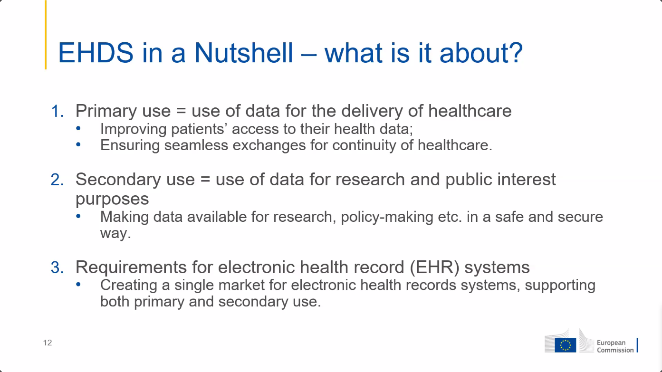
14

Slide 15
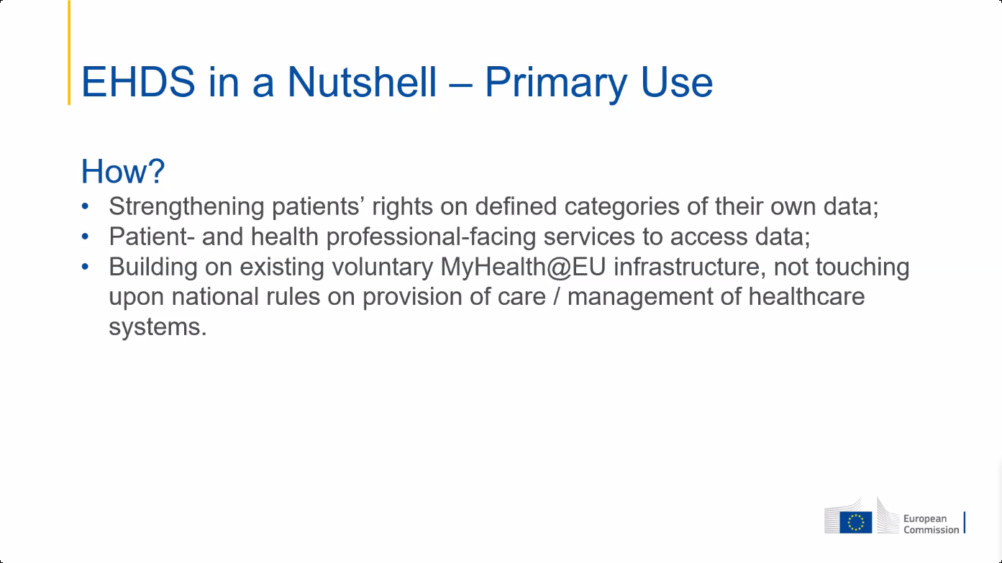

Slide 16
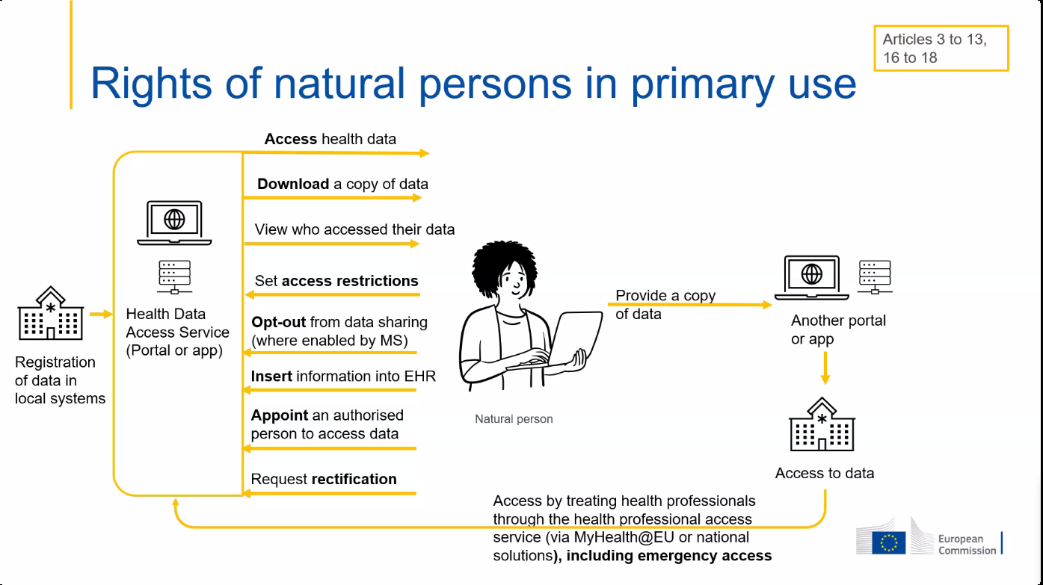
16

Slide 17
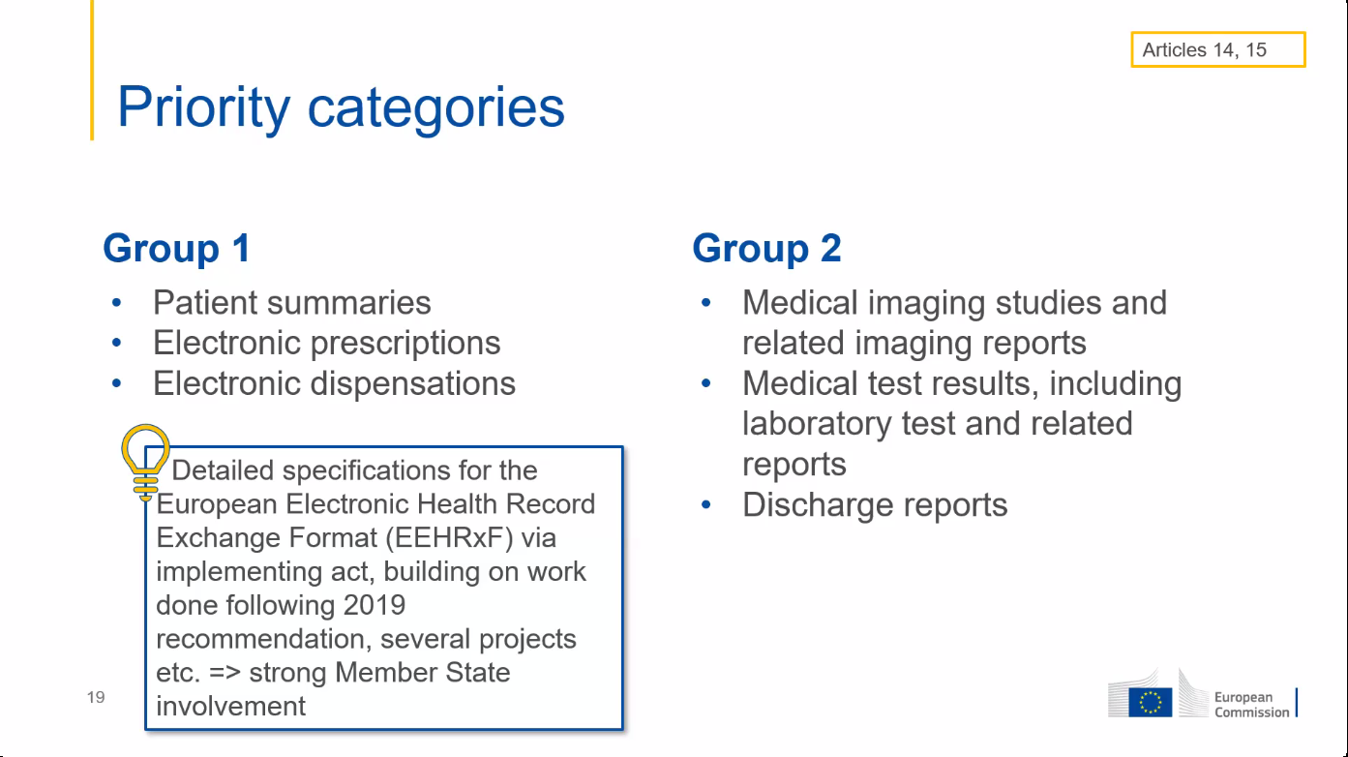
17

Slide 18
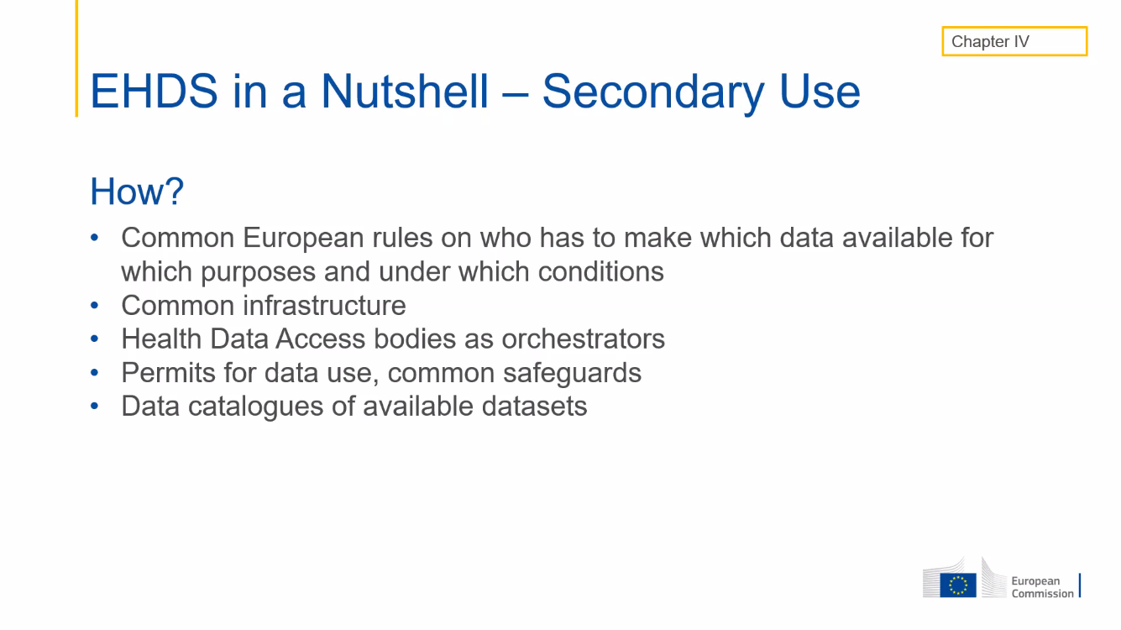

Slide 19
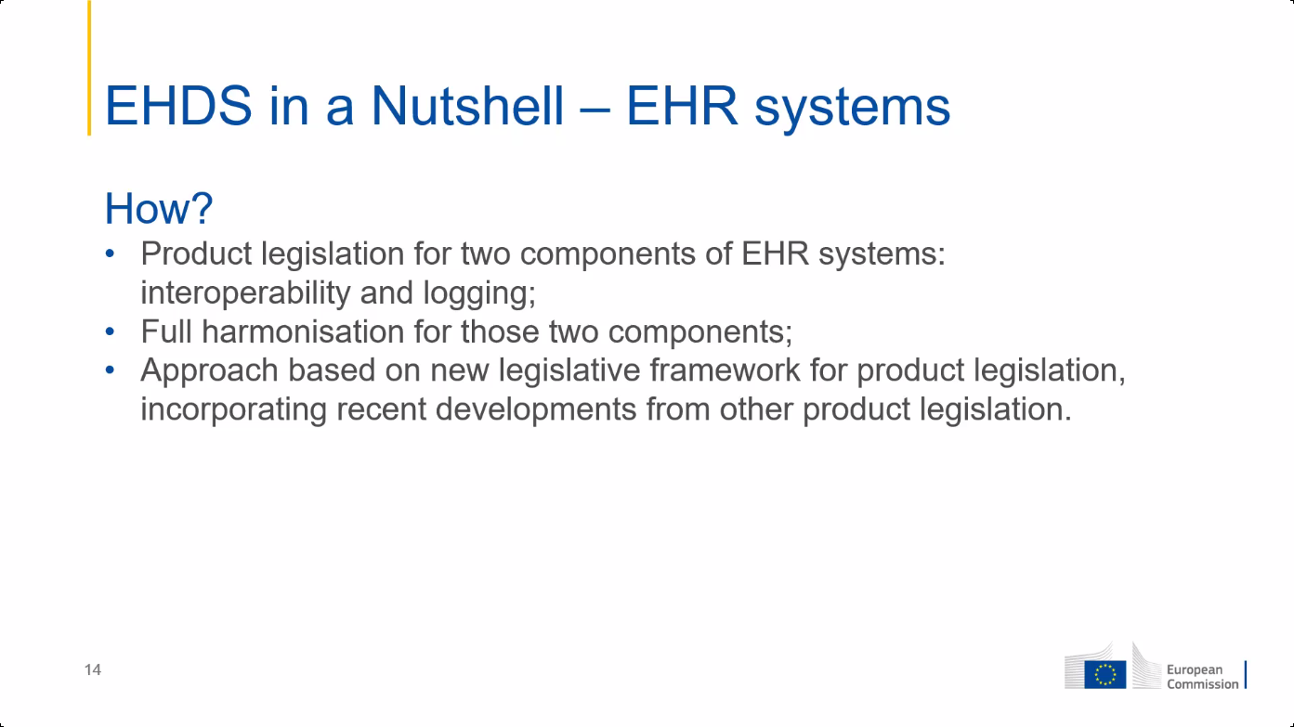
19

Slide 20
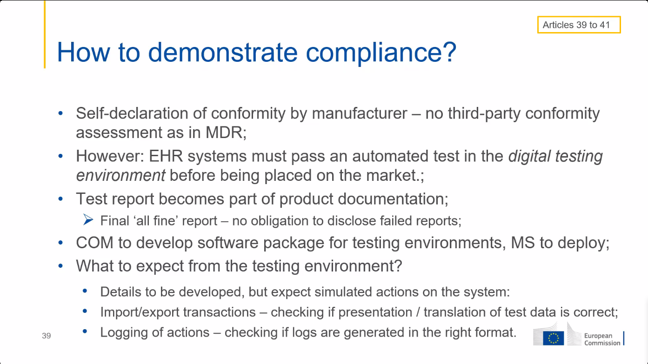
20

Slide 21
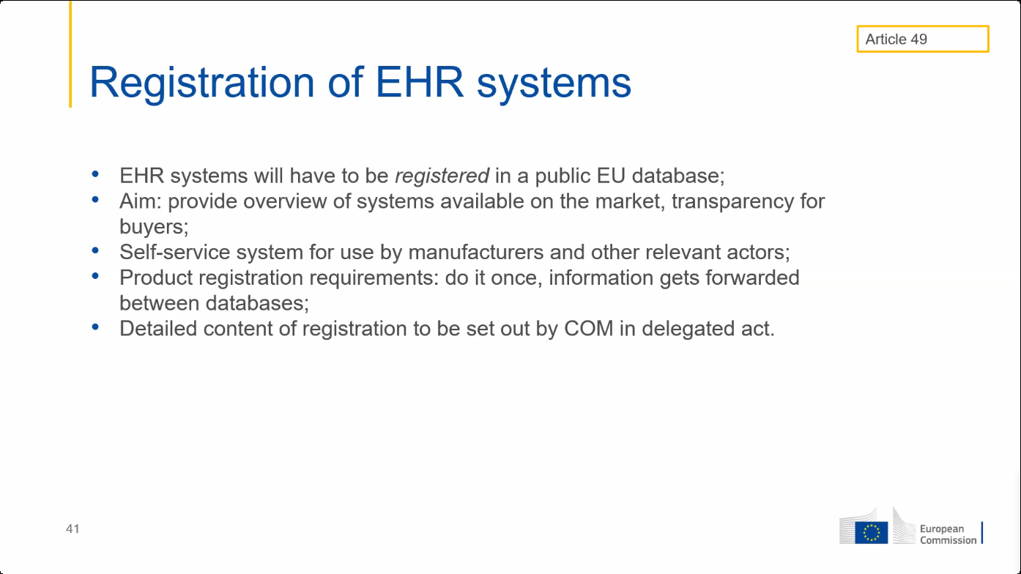
21

Slide 22
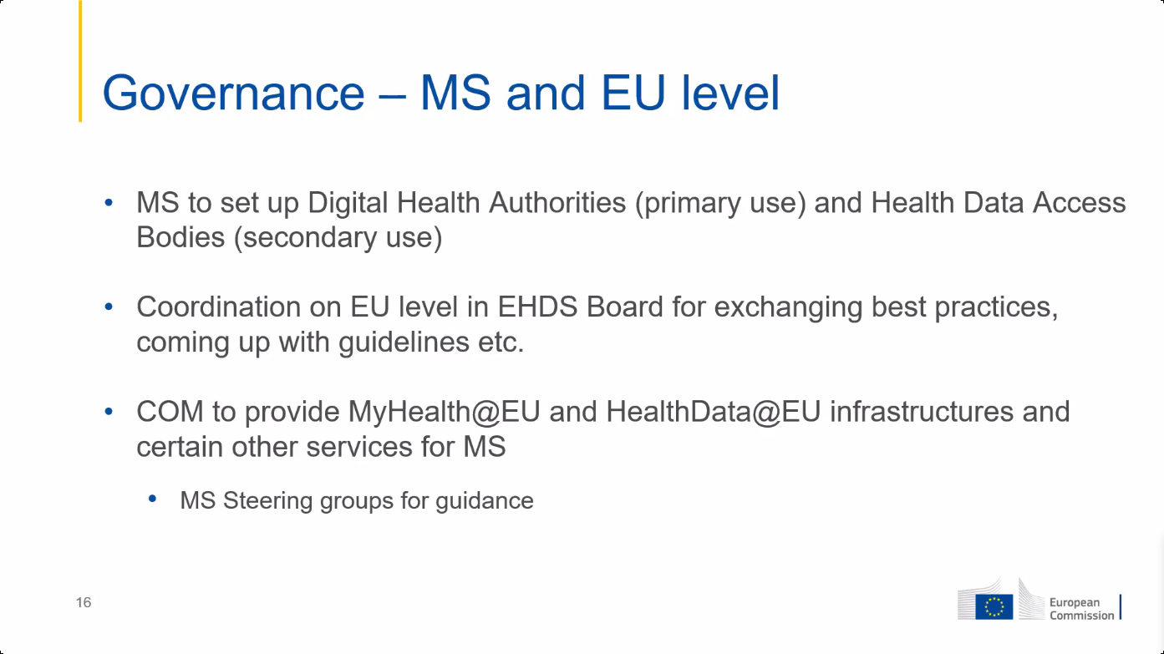
22

Slide 23
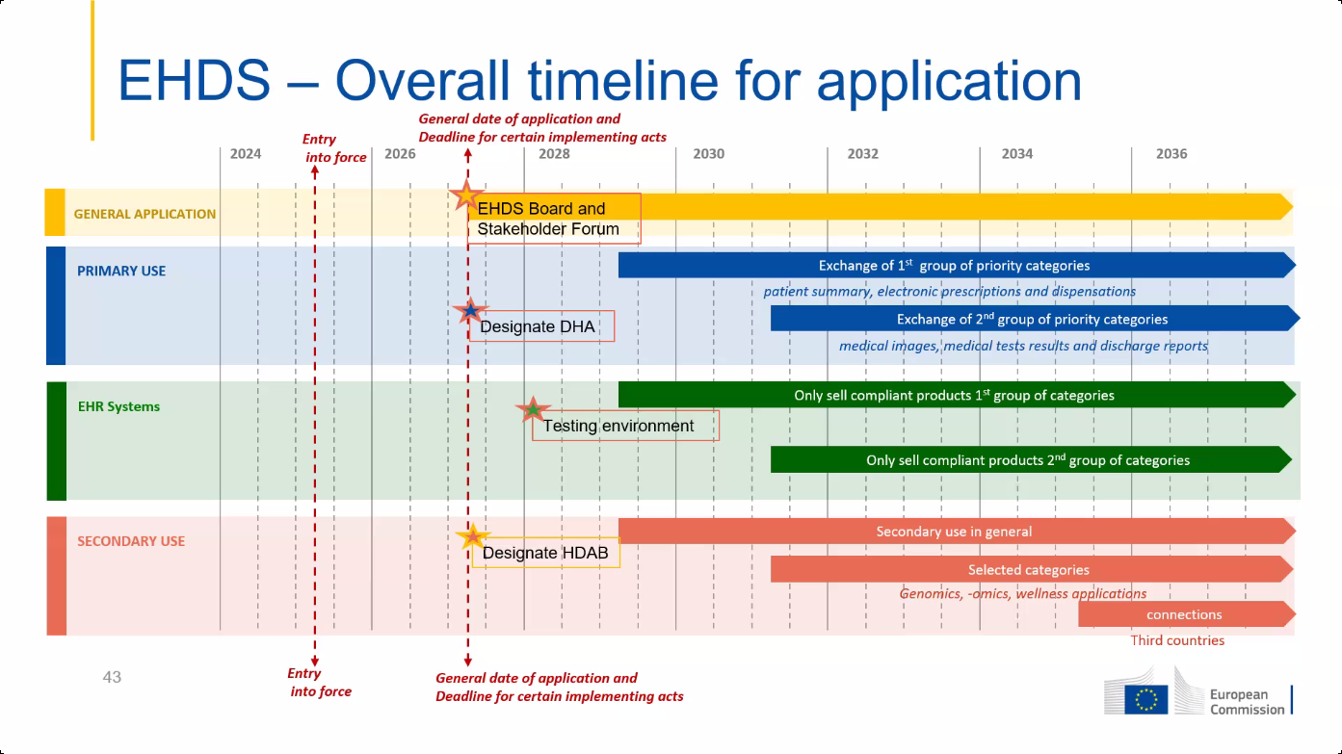
23

Slide 24
Some important provisions of EHDS
software packages must meet EU standards to be placed on the EU market
EHR harmonised components (art. 25)
EU declaration of conformity (art. 39)
European digital testing environment (art. 40)
European Commission shall develop a European digital testing environment and make the software supporting this environment available as open source
Member States (MS) shall operate a testing environment, preferably by reusing the software developed by the European Commission
legal basis for European governance and coordination (art. 96)
the European Commission shall provide the development, maintenance, hosting and operation of the infrastructures and central services required to support the functioning of the EHDS

Slide 25
Central services mentioned in art. 96 (primary use)
interoperable, cross-border identification and authentication mechanism for natural persons and health professionals
a central interoperability platform for digital health (‘MyHealth@EU’) to provide services to support and facilitate the exchange of personal electronic health data between the national contact points
supplementary services that facilitate telemedicine, mobile health, access by natural persons to existing translations of their health data, exchange or verification of health-related certificates
eg multilingual EU terminology server containing all semantic value sets used in the defined FHIR R4 resources ?
eg coordination of end-to-end encryption of health data ?
eg pseudonimization service ?

Slide 26
General principles for Belgian implementation
need for timely adoption of unambiguous, unique and directly implementable European technical specifications for every message type, concretized in FHIR R4 resources
patient summary
electronic prescription
electronic dispensation
medical imaging studies and related imaging reports
medical test results, including laboratory and other diagnostic result and related reports
discharge report

Slide 27
General principles for Belgian implementation
need for one unambiguous and unique European structured semantic value set (no mere free text !) for every data element where this is relevant, preferably
SNOMED CT
LOINC
DICOM
ISO
software packages must meet EU standards to be placed on the EU market
EHR harmonised components (art. 25)
EU declaration of conformity (art. 39)

Slide 28
General principles for Belgian implementation
concepts used
MS A: MS from which information must be provided
MS B: MS from where a health professional or a healthcare requests information
Belgium is MS A: conversion to the European standard is done as close as possible to the source of information
if information is available in one or a limited number of central databases, by the controller of the database, e.g.
patient summary in health vaults
electronic prescriptions in Recip-e
if available in PHR, by the software of the controller of the PHR
Belgium is MS B: conversion to the national standard is done by the software package of the user

Slide 29
General principles for Belgian implementation
the interoperable, cross-border identification and authentication mechanism for healthcare users, health professionals and health institutions mentioned in article 96 1 (a) shall ensure that
the healthcare user is correctly identified with person identification data determined by MS A,
the identity of the entity that wants to access personal data (health professional, health institution or healthcare user) is correctly authenticated by an electronic identification means with the level of assurance high within the meaning of the eIDAS regulation, including the European digital identity wallets (EUDI wallets)
the qualification as a health professional or health institution is correctly determined by MS B and communicated to MS A in accordance with an uniform European classification
the healthcare relationship between the healthcare user and the health professional or health institution is correctly determined by MS B and its existence is confirmed to MS A

Slide 30
General principles for Belgium implementation
based on this information, MS A can apply the national access authorisation rules adopted in accordance with European regulations
all functionalities of the EUDI wallets are valorized to simplify exchange processes
citizens must be confident that personal health data is only accessible to health professionals who have a healthcare relationship with them and the data minimization principle enshrined in GDPR must be respected => cross-border exchange of data should be established without the NCPs necessarily having access to personal health data

Slide 31
Principles regarding electronic prescriptions
creating a prescription is done in accordance with the law of the MS where the prescription is created
executing a prescription is done in accordance with the law of the MS where the prescription is executed

Slide 32

MyGov.be: Belgian EUDI wallet

Slide 33
MyGov.be: Belgian EUDI wallet
digital wallet compliant with the European eIDAS Regulation 2.0
actual features
digital identity authentication based on information in the National Register
access to eBox citizen
uploading and storage of legally valid digital documents, with the option of offline verification
scanning of digitally signed QR codes, also available in PDF format
digital documents that can already be uploaded
COVID vaccination certificates
isi+ card for children
birth and marriage certificates
social status (MyBEnefits)
vehicle registration certificate
identity card data
driving license data

Slide 34
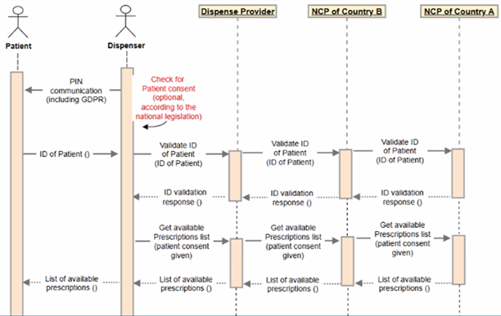
MyGov.be in support of EHDS
the possibility to upload, after digital identity authentication,
the European Health Insurance Card (EHIC) at health insurance funds
electronic prescriptions via Recip-e
anywhere and at any time
the possibility to electronically transfer data from both digital documents to the dispensing pharmacy by scanning a QR code
less opportunities for fraud thanks to digitally signed QR codes
avoids highly complex existing procedures

Slide 35
Some concerns regarding implementing acts
implementing acts shall permit to meet the requirements of EHDS Regulation while
ensuring feasibility for EU manufacturers, including SMEs
avoiding cost increase for health professionals and MS
implementing acts can only lay down detailed rules ensuring uniform conditions for the implementation of the EHDS Regulation, if and when this is necessary, but not (indirectly) add requirements
full respect of the principle of
EU declaration of conformity
use of the digital testing environments for the assessment of harmonized software components of EHR systems
=> no other certification mechanisms

Slide 36
Open source European digital testing environment
is available at the moment of the publication of the implementing acts defining the technical and semantic specifications and allowing conformity testing in the following areas
harmonized components
technical and semantic interoperability
minimal quality (e.g. correct handling of typical use cases)
identification and authentication mechanism
exchange of evidence of the qualification as health professional and of the healthcare relationship
need for method for mutual recognition of conformity tests between MS

Slide 37
To do’s
scanning of any necessary legal adjustments
well-coordinated Belgian representation in various working groups
monitoring good architecture, beyond primary & secondary use
good mutual integration of European and Belgian architecture
loyal implementation at the right time to maintain credibility/authority
sensible use of European funding

