Slide 1
European Health Data Space Regulation (EHDS Regulation), particularly with regard to primary use

Slide 2
Links to documentation
Official Journal of the European Union:
https://eur-lex.europa.eu/legal-content/en/TXT/?uri=OJ%3AL_202500327
website of the European Commission regarding EHDS
https://health.ec.europa.eu/ehealth-digital-health-and-care/european-health-data-space-regulation-ehds_en
extract of slides of the European Commission showed at webinars

Slide 3
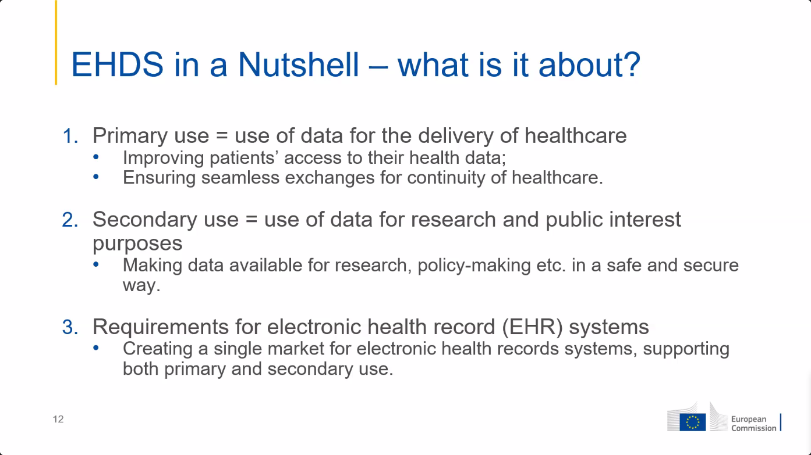

Slide 4
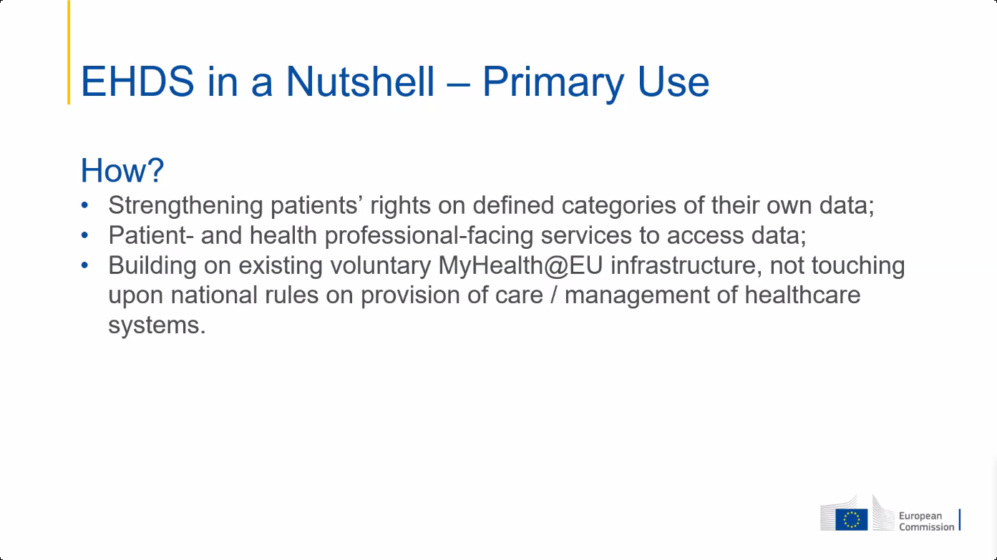

Slide 5
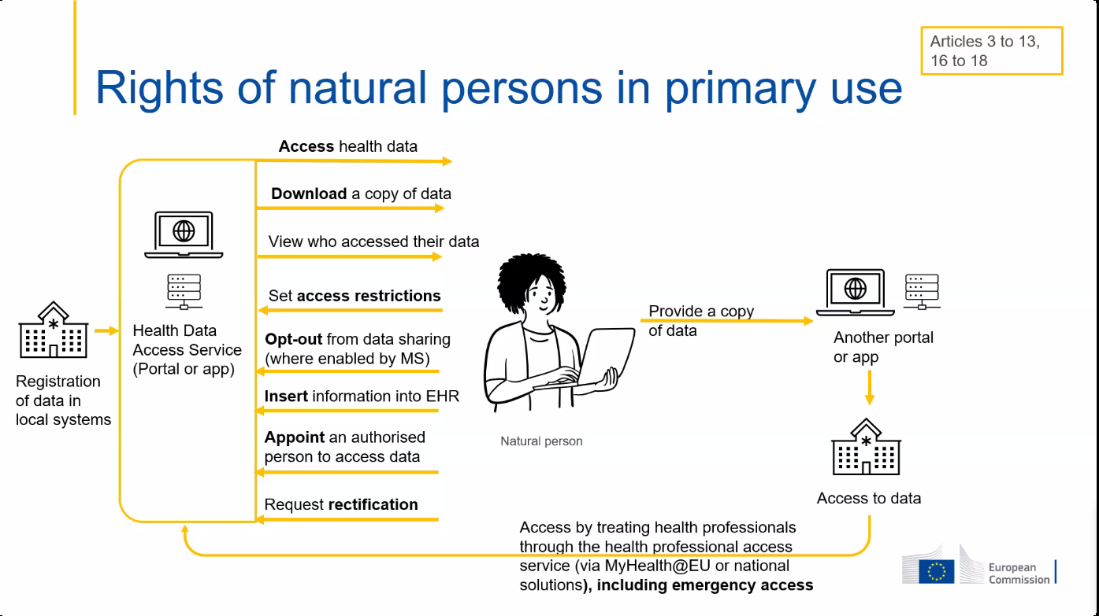

Slide 6
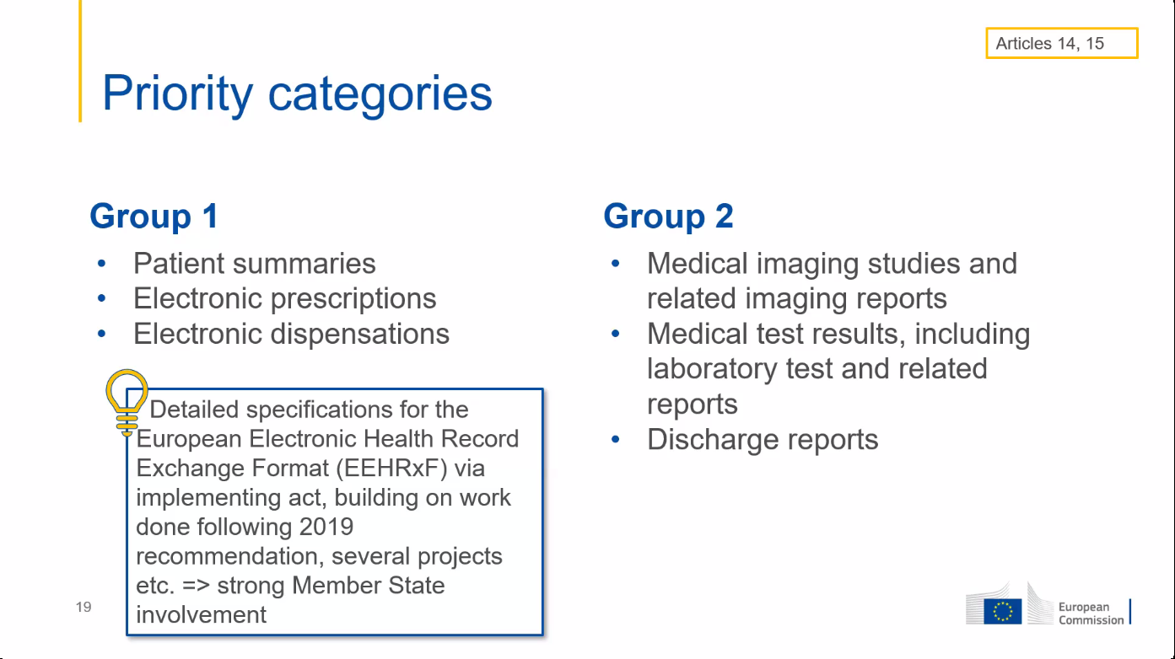

Slide 7
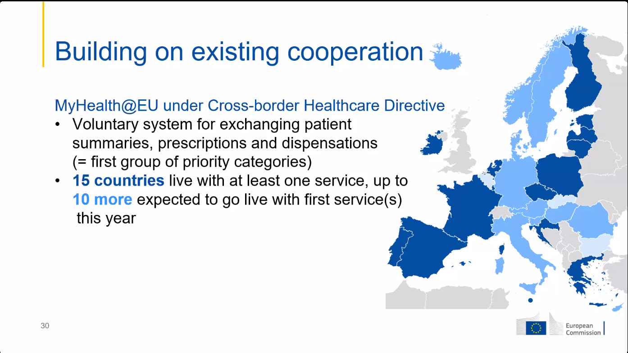
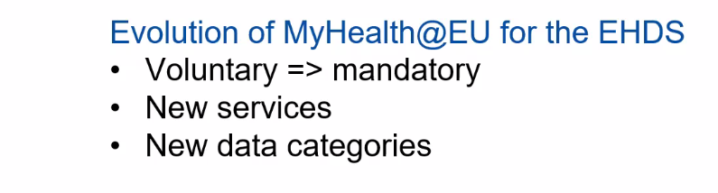

Slide 8
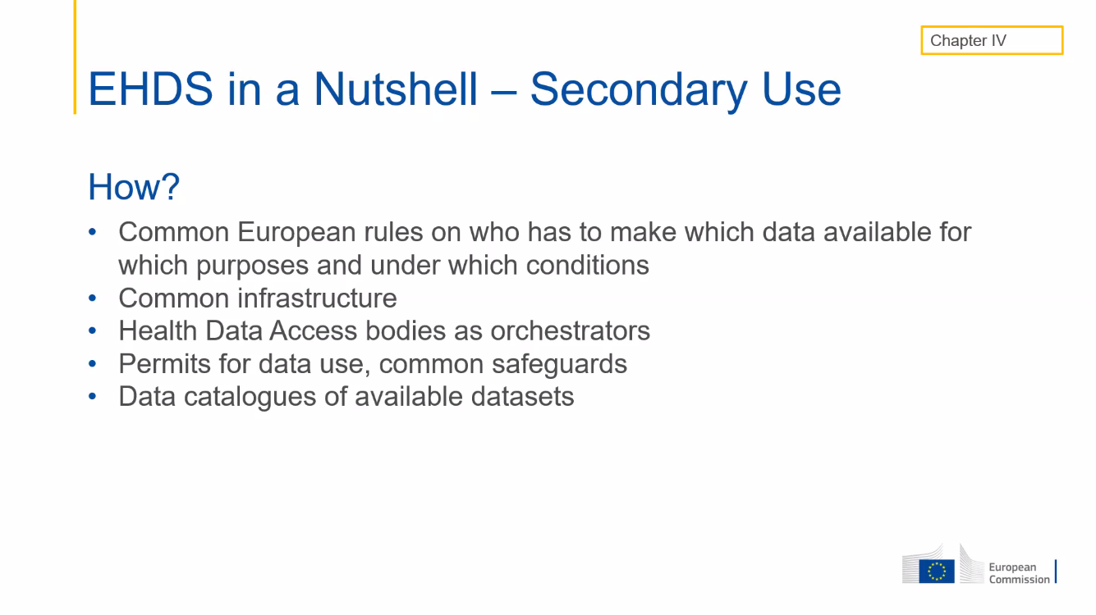

Slide 9
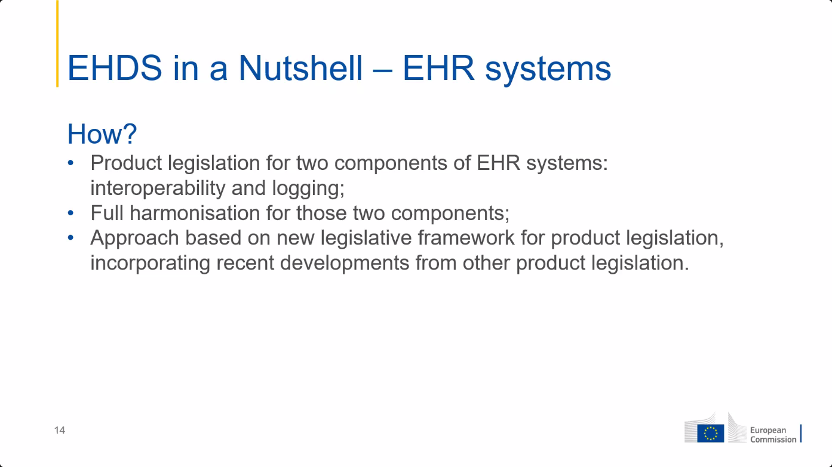

Slide 10
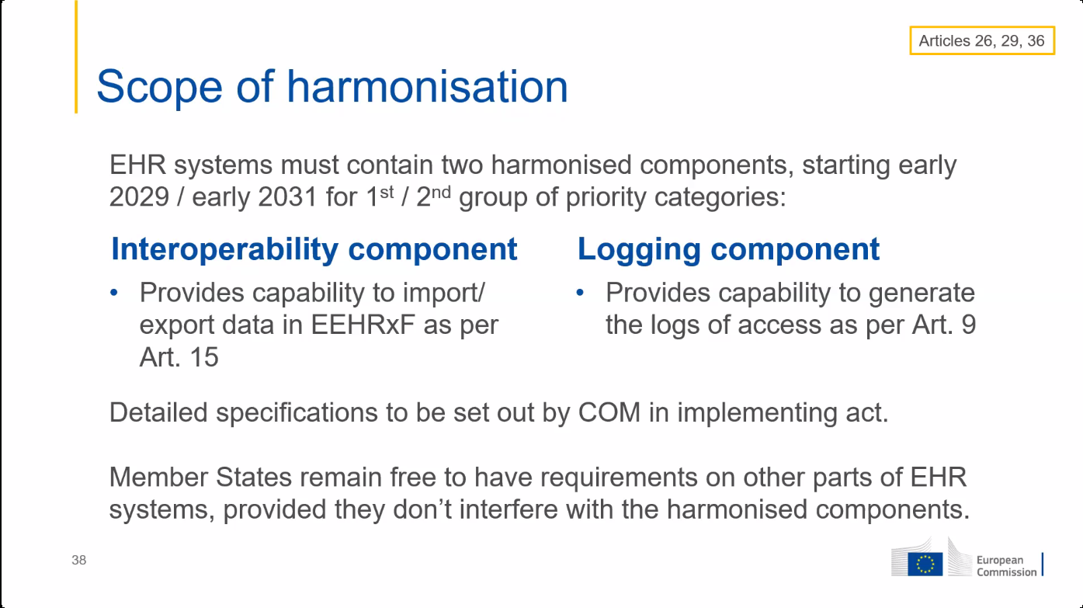

Slide 11
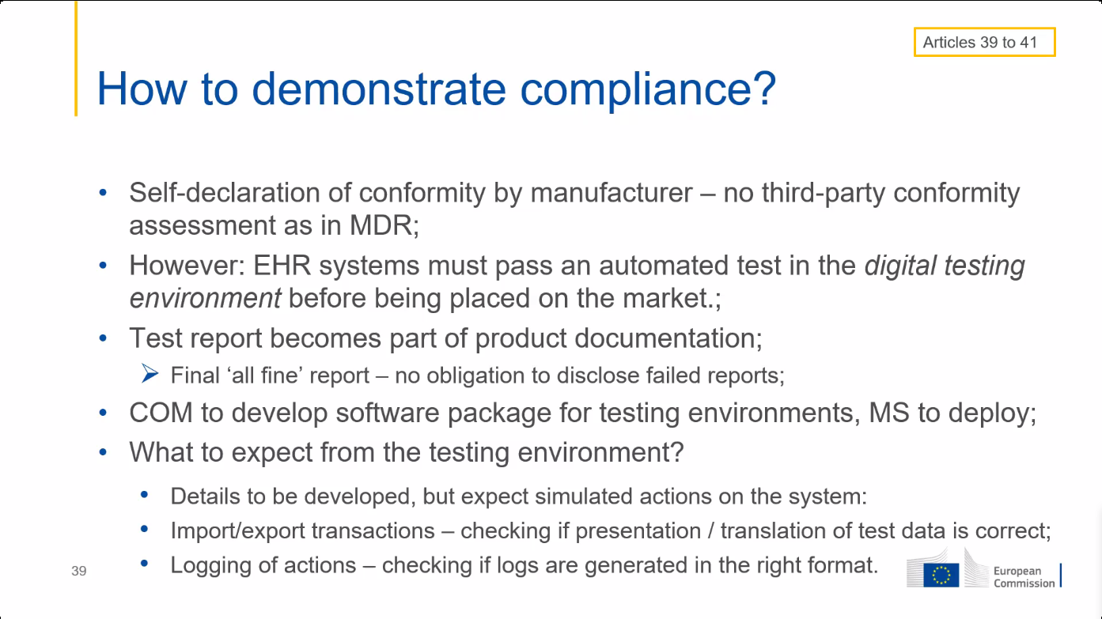

Slide 12
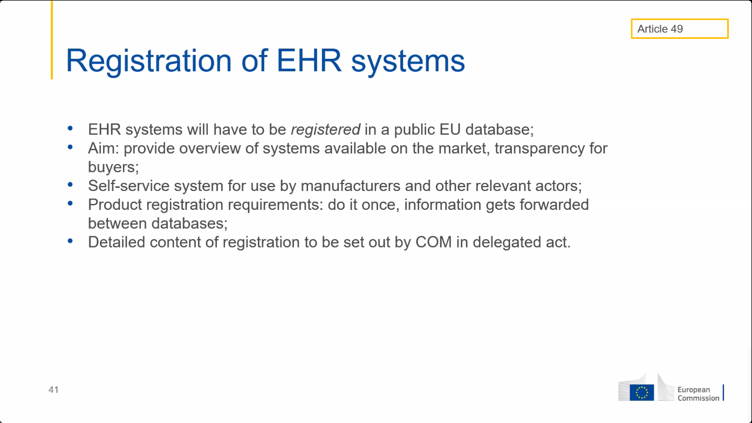

Slide 13
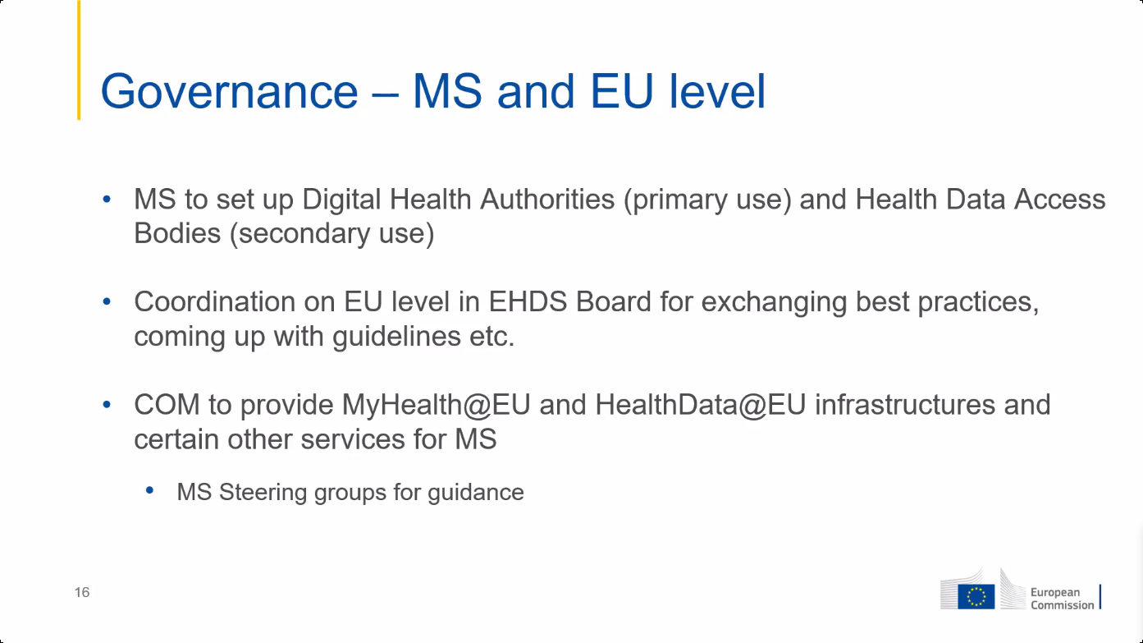

Slide 14
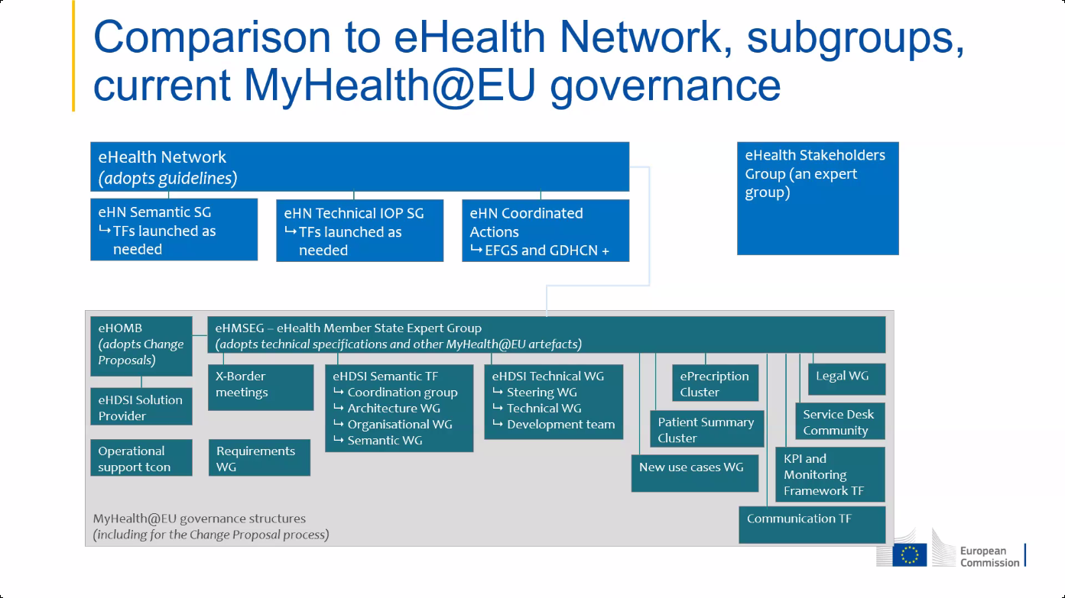

Slide 15
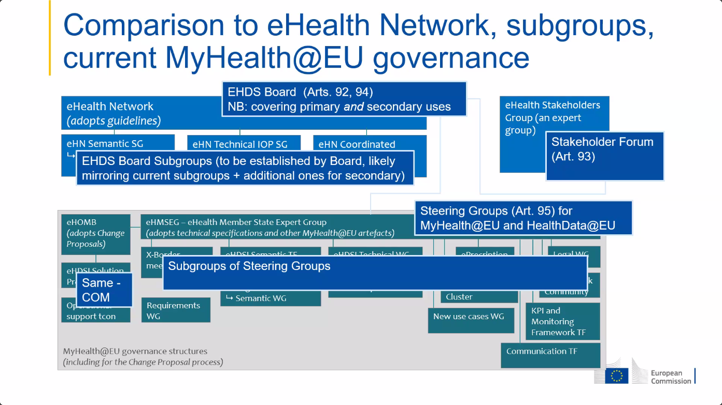

Slide 16
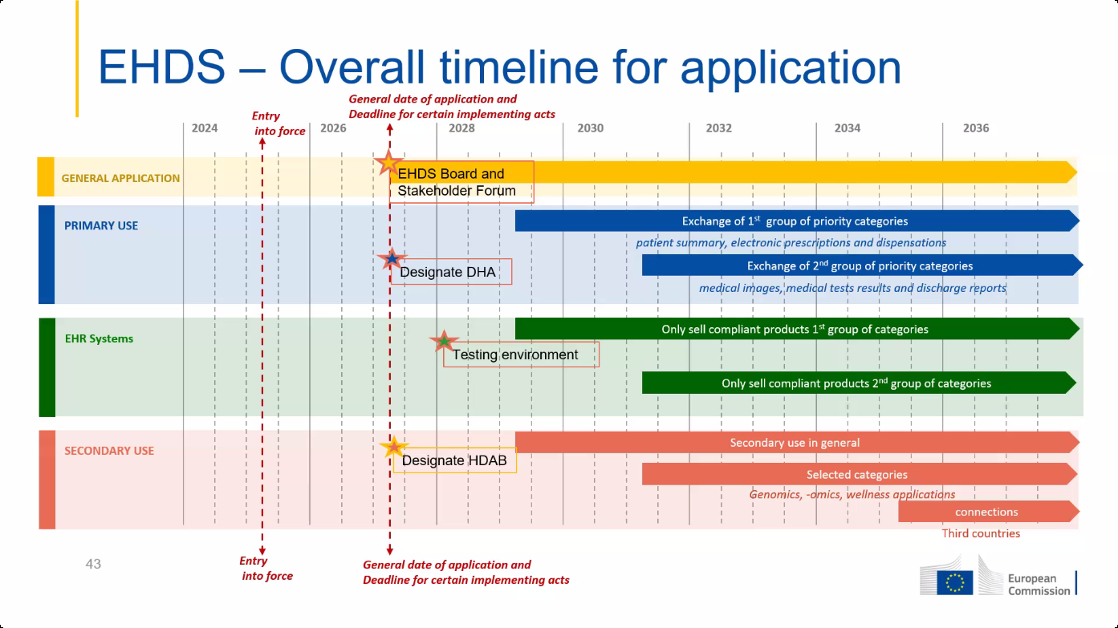

Slide 17
Some important provisions of EHDS
software packages must meet EU standards to be placed on the EU market
EHR harmonised components (art. 25)
EU declaration of conformity (art. 39)
European digital testing environment (art. 40)
European Commission shall develop a European digital testing environment and make the software supporting this environment available as open source
Member States (MS) shall operate a testing environment, preferably by reusing the software developed by the European Commission
legal basis for European governance and coordination (art. 96)
the European Commission shall provide the development, maintenance, hosting and operation of the infrastructures and central services required to support the functioning of the EHDS

Slide 18
Central services mentioned in art. 96 (primary use)
interoperable, cross-border identification and authentication mechanism for natural persons and health professionals
a central interoperability platform for digital health (‘MyHealth@EU’) to provide services to support and facilitate the exchange of personal electronic health data between the national contact points
supplementary services that facilitate telemedicine, mobile health, access by natural persons to existing translations of their health data, exchange or verification of health-related certificates
eg multilingual EU terminology server containing all semantic value sets used in the defined FHIR R4 resources ?
eg coordination of end-to-end encryption of health data ?
eg pseudonimization service ?

Slide 19
General principles for Belgian implementation
need for one unique European technical FHIR standard for every message type
essential patient summary (~ SumEHR)
electronic prescription
electronic dispensation
medical imaging studies and related imaging reports
medical test results, including laboratory and other diagnostic result and related reports
discharge report

Slide 20
General principles for Belgian implementation
need for one unique European structured semantic value set (no mere free text !) for every data element where this is relevant, preferably
SNOMED CT with mapping to ICPC-3, ICD-11, ICF and ICHI, among others
LOINC
DICOM
ISO
maximum alignment of Belgian care sets with European standards

Slide 21
General principles for Belgian implementation
concepts used
MS A: MS from which information must be provided
MS B: MS from where a health professional or a patient requests information
if an electronic message from Belgium (as ‘Member State A’) has to be sent across borders, conversion to the European standard is done as close as possible to the source of information
if information is available in one or a limited number of central databases, by the controller of the database, e.g.
patient summary in health vaults
electronic prescriptions in Recip-e
if available in PHR, by the software of the controller of the PHR
if an electronic message is received across borders in Belgium (as “Member State B”), conversion to the national standard is done by the software package of the user

Slide 22
General principles for Belgian implementation
the interoperable, cross-border identification and authentication mechanism for natural persons and health professionals mentioned in article 96 1 (a) shall ensure that
the healthcare user is correctly identified with person identification data determined by MS A
the identity of the health professional and/or healthcare institution is correctly authenticated by an electronic identification means with a reliability level of ‘substantial’ within the meaning of the eIDAS regulation, including the European digital identity wallets (EUDI wallets)
the qualification as a health professional or healthcare institution is correctly determined by MS B and communicated to MS A in accordance with an uniform European classification
the healthcare relationship between the healthcare user and the health professional is correctly determined by MS B and its existence is confirmed to MS A
based on this information, MS A can apply the national access authorisation rules adopted in accordance with European regulations
valorization of all functionalities of the EUDI wallets to simplify exchange processes

Slide 23
General principles for Belgian implementation
prescription for medicinal products is issued in accordance with the law of the Member State in which it is issued
dispensing of a prescription for medicinal products is carried out in accordance with the law of the Member State in which it is dispensed
need for mapping CNK-ATC code

Slide 24
Strategic decision to be made
choice of methodology to enable cross-border exchange of personal health data without the NCPs having access to the personal health data
implementation of the necessary central services to support the chosen methodology, e.g.
support for end-to-end encryption (e.g. coordinated disclosure of public keys of addressees in MS) and/or
a blinded pseudonymisation service (i.e. a service that supports (de)pseudonymisation by the data exchanging health professionals without the possibility for the provider of this service to find out the identity of the healthcare user)

Slide 25
Some concerns regarding implementing acts
implementing acts shall permit to meet the requirements of EHDS Regulation while
ensuring feasibility for EU manufacturers, including SMEs
avoiding cost increase for health professionals and MS
implementing acts can only lay down detailed rules ensuring uniform conditions for the implementation of the EHDS Regulation, if and when this is necessary, but not (indirectly) add requirements
full respect of the principle of
EU declaration of conformity
use of the digital testing environments for the assessment of harmonized software components of EHR systems
=> no other certification mechanisms

Slide 26
Open source European digital testing environment
is available at the moment of the publication of the implementing acts defining the technical and semantic specifications and allowing conformity testing in the following areas
harmonized components
technical and semantic interoperability
minimal quality (e.g. correct handling of typical use cases)
identification and authentication mechanism
exchange of evidence of the qualification as health professional and of the healthcare relationship
need for method for mutual recognition of conformity tests between MS

Slide 27
To do’s
scanning of any necessary legal adjustments
well-coordinated Belgian representation in various working groups
monitoring good architecture, beyond primary & secondary use
good mutual integration of European and Belgian architecture
loyal implementation at the right time to maintain credibility/authority
sensible use of European funding

