Slide 1


Challenges in Governmental ICT
From collaborative advantage to thriving ecosystems
CIOnet Belgium Annual Event – 20 January 2026
frank.robben@mail.fgov.be
@FrRobben
frank.robben.be
ksz.fgov.be
ehealth.fgov.be
smals.be

Slide 2

My professional experience
Building on solid expertise & experience in Legal, ICT & Management
Policy making support
Running large ICT organizations
Creating ICT ecosystems
Privacy advocacy

Slide 3


BUILDING
COMPETITIVE ADVANTAGES
PRIVATE
PUBLIC
SECTOR Dynamics
SECTOR Dynamics
Profit driven
Benefits driven
Market focus
Broad society focus
Competitive
BUILDING
COLLABORATIVE ADVANTAGES
Cooperative
Limited audience
Inclusive
Microeconomic
Macroeconomic
Shareholders
Collective ownership
Innovation
Innovation² ?
Notes:
Unlike the private sector, ICT investments in the public sector are not aimed at achieving any competitive advantage. Instead we aim for achieving cooperative advantages – for all of society, citizens and businesses. The aim is not to increase market share, or to maximize profit. It is to reach societal objectives, set by policy, through efficient and effective services.
This can best be achieved by creating ecosystems, with the government in a coordinating role. The entire society, including private companies and civil society organizations, can help. By offering integrated ICT services and achieving our societal objectives together. In the public sector, we look at the ICT domain from a macroeconomic and a macrosocial perspective. And we put emphasis on digital inclusion, because absolutely everyone must be able to use the services easily.

Slide 4



Consistent strategy
ICT as A COST CENTER
ICT as STRATEGIC INVESTMENT
Cost Avoidance Through
Shared Services
Enabling Ecosystems for Sector-Wide Strategic Advantage
Notes:
A sound investment strategy has at least two dimensions: cost consciousness and value creation. Working with taxpayer’s money, we always need to ensure the cost-efficient use of ICT. A second, equally important dimension is the use of ICT as an enabler for the development of ecosystems. This allows significant value to be created across an entire sector of society. And to achieve societal objectives as effectively as possible.

Slide 5


COST-focus:
Economies of Scale
Common ICT infrastructures
Shared ICT services
Re-use software components, API’s…
Communities of practice
Notes:
Cost efficiency in e-government, is achieved through the use of common infrastructure, the development of shared services and the systematic reuse of software components that, once developed, can be used for multiple purposes.

Slide 6


VALUE-focus:
Reducing complexity
Only once-principle
Legal constructs
Factual information
Authentic data sources
Data duplication
Secure exchange
Ecosystems approach
Notes:
Effectiveness in achieving our social objectives is based on the development of ecosystems. These ecosystems need to respect fundamental principles such as ‘only once’, the single collection and reuse of factual information. They also need to clearly define responsibilities in terms of quality control and data storage: who is the authentic data source? Other actors should not duplicate any data, but set up secure data exchanges, based on technical and semantic interoperability standards. And above all, we should dare to optimize processes across sectors and institutions. And to simplify regulations. Let me give a few examples.

Slide 7
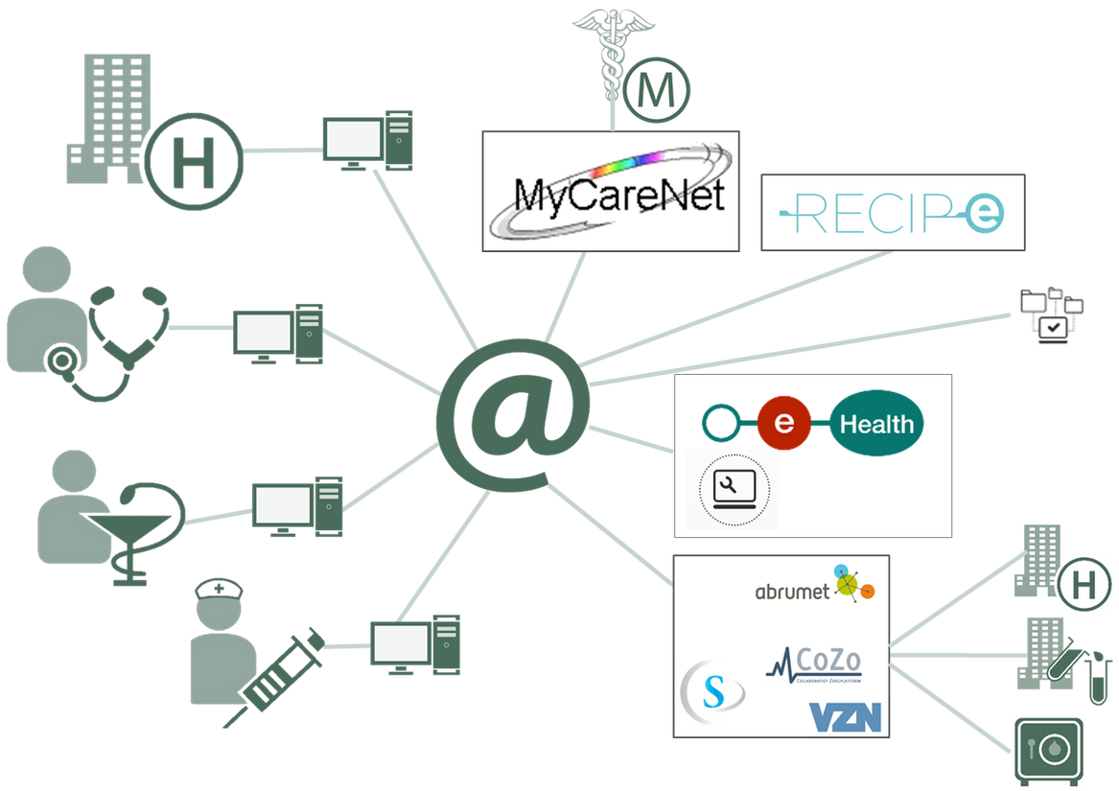

Example: eHealth-ecosystem
High adoption rate
High transactions volume
>17.000.000.000 in 2024
High adoption rate
>11.400.000 citizens informed consent 96,7% of BE population
Offering essential tools to
Medical professionals, Hospitals
Government agencies, Software vendors...
Notes:
Let’s start with health care in Belgium. As you can see on the screen, a lot of actors are active in the Belgian health sector. Since many years, everyone agrees that high-quality healthcare must be multidisciplinary, continuous and patient-centric. All relevant information and decision support systems should be readily available to healthcare providers who are in a therapeutic relationship with the patient, both for medical care and for prevention. However, until 10-15 years ago, there was very little awareness about the importance of keeping and exchanging well-structured electronic health records. So, the federal government established the eHealth-platform in 2010. And now, 15 years later, we see health data records being exchanged on average 1,500 times per patient per year! More than 96% of our population has given their informed consent. And the absence of serious complaints indicates a very high level of trust in the system.

Slide 8



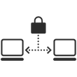



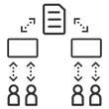

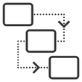



Common ICT services & ecosystem approach
Value added services (medical actors, civil society, commercial actors…)
Basic ICT services (government funded platform, compulsory)
eHealth
certificate
services
Integrated
user & access management
Timestamping
End-to-end
encryption
Secure
electronic
messaging
Logging
Directory & index
Web Portal
Process
orchestration
National Register lookup
Pseudonymise
& anonimise
Notes:
How did we get here? No central database containing all the health data of all Belgian citizens has been created. Instead, the government has invested in basic ICT services, offered to the entire ecosystem – such as end-to-end encryption, a cornerstone for secure data exchange, integrated user and access management, a time stamping service, referral directories that indicate where relevant data can be found… We also have reliable evidence-based knowledge bases to support diagnostics, treatment and prevention. This enables health care institutions or independent software providers to focus their resources on developing value-added functionalities for the healthcare professionals.

Slide 9


Real world benefits
General practitioner
Overview - Summary Electronic Health Record
Consulting patient’s medical history & antecedents
Consulting lab results, medical imagery, etc
Single Sign-On = MORE TIME for actual patient care
Fully privacy proof
Referral to specialist, hospital…
Electronic referral & scheduling
Electronic messaging (eHealth-box)
Consulting patient’s medical history & antecedents
AVOIDING REDUNDANT medical examinations
Global medical care = better care, more efficient
Especially for chronic illness treatment (1 in 4)
Notes:
As a result, since 2024, Belgium is ranked first in the European Commission's eHealth ranking. Every healthcare provider, in a therapeutic relationship with a patient, has access to the summary electronic health record. This contains information about the patient's medical situation – allergies, vaccination status, current medication, relevant medical history. He or she has also access to lab results, medical imaging results and discharge and follow-up reports provided by other healthcare providers. Prescriptions for medication are created digitally. In the near future, also referral letters and sick leave certificates will be created digitally, and made available to the receiver.
Patients now only pay a small part of the expense, while the healthcare provider is reimbursed directly by the health insurance fund, through a third-party payment system. And the patient is no longer burdened with the paperwork.
Healthcare providers have science based decision support for diagnostics and treatment, directly embedded in their software packages. And relevant data – on for example, allergies – are used to safeguard the patient’s safety.
All of this is done securely and with single sign-on. Years ago, my general practitioner used to have separate credentials to access the results servers for each individual clinical lab and hospital. Precious time was lost during a medical consultation for gathering all the relevant information. Now she has all the relevant information integrated on-screen and ready-to-use when I enter her office. She can now focus primarily on providing high quality care.
The eHealth-platform costs around 17 million EUR per year to operate. Medical data sharing avoids at least one redundant blood test and one other lab test for every chronically ill patient. This alone represents a saving of 250 million EUR in expenditure without compromising the quality of care. The benefits in terms of patient safety and superior care quality are harder to calculate financially, but they undoubtedly represent a multiple of this amount.

Slide 10






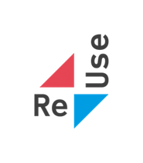
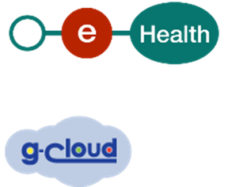

Belgian e-government achievements
1990 -
now
2003 -
now
2016 -
now
SIS-CARD
eID
ICT ReUse
INITATIVE
EHEALTH-PLATFORM
CROSSROAD BANK
FOR SOCIAL SECURITY
MULTIFUNCTIONAL
DECLARATION
DMFA
G-CLOUD
1998
2003
2008 -
now
2019 -
now
Structured & secure data exchange between 3000 actors dealing with social security contributions & social benefits
Social Information System Card
Electronic
Identity Card
Single, factual quarterly declaration to ALL social security institutions for >240.000 employers in Belgium
Secure data exchange platform for Belgian healthcare actors
Infrastructure-focused ICT collaboration between institutions
Catalogue of reusable software components & API’s
Notes:
Throughout my career, I had the privilege of setting up and managing institutions in accordance with the dual investment strategy mentioned earlier. For example, the creation of the Crossroads Bank for Social Security and the introduction of the multifunctional declaration of wages and working time resulted in the unified online quarterly collection of factual data on citizens and their employers. Their information is shared securely with more than 3,000 Belgian entities responsible for different aspects of social protection. Rights are granted automatically whenever possible, based on a single notification of each relevant life event. Years ago, the Federal Planning Bureau estimated that this reform has drastically reduced the administrative burden, saving our society more than 1.5 billion euros annually, each year again. Operating the Crossroads Bank costs less than 20 million euros each year.
Introducing the electronic identity card in 2003 was a cornerstone for the digital transformation of many processes involving citizens and businesses, also in the private sector.
More recently, the introduction of the G-Cloud in 2016, and the Reuse initiative in which many components are made available as open source, is saving at least another 100 million euros per year in avoided ICT expenditure.

Slide 11


Partnering with private sector ICT-players
Governmental
vision & strategy
Public policy
NOT ONLY PUBLIC TENDERS
Many collaborative models available:
Price comparison
Framework agreement
License / Concession
Public-Private partnership (PPP)
‘Open government services’
Platform & API Economies
Private Entrepeneurship
Private Entrepeneurship
Private Entrepeneurship
Private Entrepeneurship
Ecosystems
Notes:
In my opinion, the government should focus on its core tasks: setting out societal objectives through policy making, establishing good governance structures, offering participation and accountability to all the major stakeholders, defining standards for quality, security and interoperability, and offering foundational ICT services enabling the growth of ecosystems. This will allow end users and private ICT partners to develop and offer their own ICT services, while contributing to the global societal and policy objectives. Cooperation between the public and private sector can take many forms, as you can see on the screen, ranging from public procurement, to concessions, private-public partnerships, and platform economies.

Slide 12







Critical success factors
Complex governance
Privacy & other fundamental rights
Information silos
Digital divide
Citizens’ digital literacy
Lack of alignment between legal & technical & practical concepts
Employment status for civil servants unfit for recruiting ICT staff
Specific financing & purchasing rules
Strategic sovereignty
Notes:
Be aware, working in e-government also comes with specific challenges. Some critical success factors in this regard are complex governance, avoiding information silos, respecting privacy and fundamental rights, investing in digital literacy, taking into account specific financing rules, ICT staffing, alignment between legal-technical-practical and (digital) sovereignty.

Slide 13





Future: lookout
LEGISLATION - AS - CODE
MOBILE FIRST
ARTIFICIAL
INTELLIGENCE
INFORMATION SECURITY
www.smalsresearch.be/ai-maturity-model
Notes:
Lastly, let’s talk about some future opportunities. I dare to dream they will lead to more results in the years to come. During the COVID pandemic, we created regulation in the form of decision tables for issues like testing, vaccination and quarantine regulations. The decision tables were converted into software immediately – in few hours, few days at most. Legislation-as-code, so to speak. This could also be done in many other policy domains. It would benefit the quality of new regulations, and ensure their smooth introduction.
Artificial intelligence offers a huge potential, if we learn to apply it in agile and ethically correct ways, in meaningful use cases, while also putting proper guardrails on the self-explaining properties of the systems. In healthcare, for example, we already have a vector database with scientifically validated best practices and with patient information leaflets for all registered pharmaceuticals. A small scale pilot project demonstrated that unlocking this information through a chatbot could result in very important time savings and quality improvements. Medical doctors could evaluate the most appropriate treatment for their patients, while also closely monitoring patient safety.
Obviously, information security-by-design is important for maintaining trust in the systems. And mobile applications also carry a huge potential. For example.

Slide 14
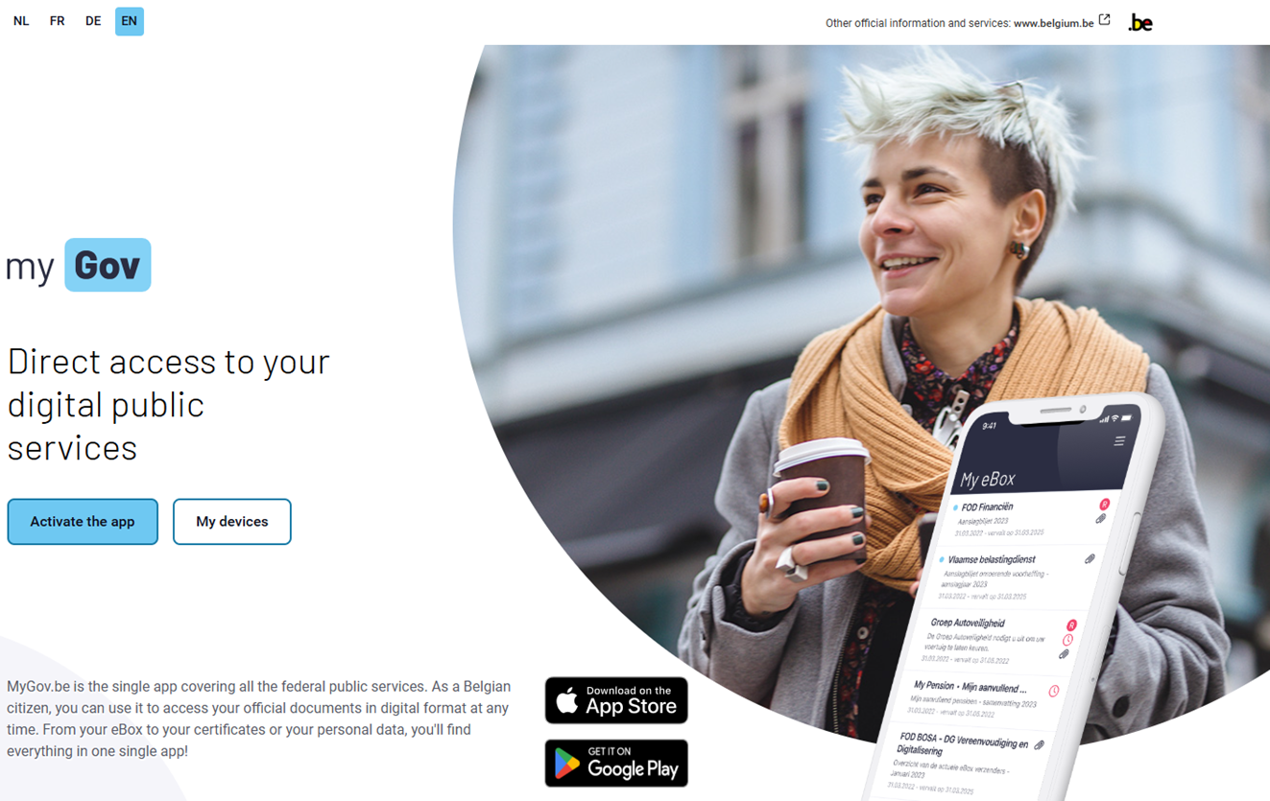
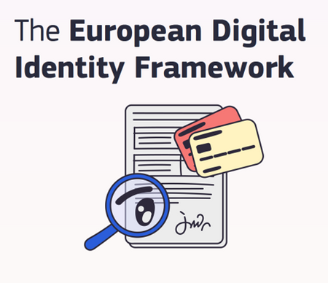
eIDAS – European Digital Identity Wallet
Notes:
I’m a strong believer in ‘MyGov’, the digital identity wallet launched last year by the colleagues of federal public service BOSA. The app has an enormous potential, comparable to what the Crossroads Bank for Social Security or the eHealth platform have been able to achieve. Additionally, the European eIDAS regulation requires all EU member states to offer such a digital identity wallet to their citizens, by the end of this year. This means European interoperability is already guaranteed.

Slide 15
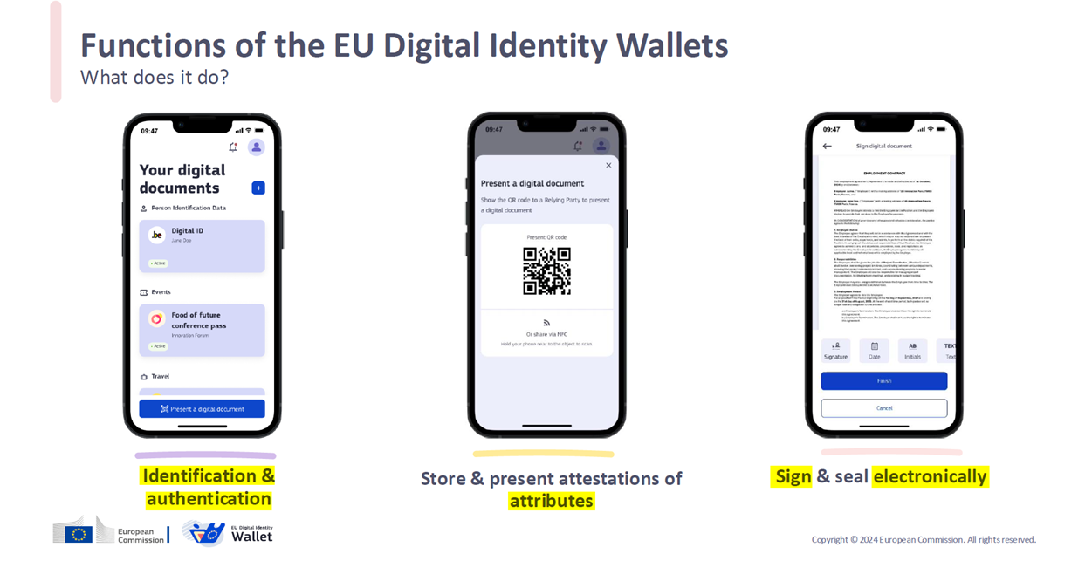
eIDAS – European Digital Identity Wallet
Notes:
The wallet contains embedded functionality to digitally authenticate yourself, to prove certain attributes and to digitally sign.

Slide 16



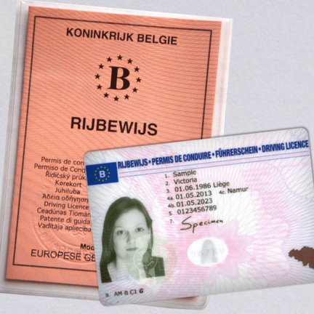




1
Instant Messaging
2
Automating back-office processes
eIDEAS European Digital Identity Wallet
3
Documents anywhere, anytime
4
Scanning tool
Notes:
Yet there is more. The wallet already allows you to receive instant messaging in an integrated way, to consult your ‘My eBox’, to use online services, to download trustworthy digital documents, anywhere at any time, or to scan a digitally signed QR code from a digital document someone else is showing you from their wallet.
This makes the ‘MyGov’ wallet an important new enabler for added value, also for the private sector. The Belgian government will ensure that official documents such as identity cards, driving licenses, car documents, children's ISI+ cards, European health insurance cards, a proof of social status – needed to unlock secondary social benefits – can be downloaded in a legally valid digital form. A lot of back office processes can also take place through data sharing, giving feedback to citizens via My eBox, which they can already consult in the digital identity wallet. I have no doubt about the many opportunities for process optimization in many other sectors, such as banking, insurance or education. In Belgium, or cross-border.

Slide 17
“Together, we invest and innovate for collective prosperity”
frank.robben@mail.fgov.be
@FrRobben
frank.robben.be
ksz.fgov.be
ehealth.fgov.be
smals.be
Notes:
To conclude, I invite all of you to imagine the potential of the next generation ecosystems. Let’s invest and innovate together for collective prosperity.

Slide 18
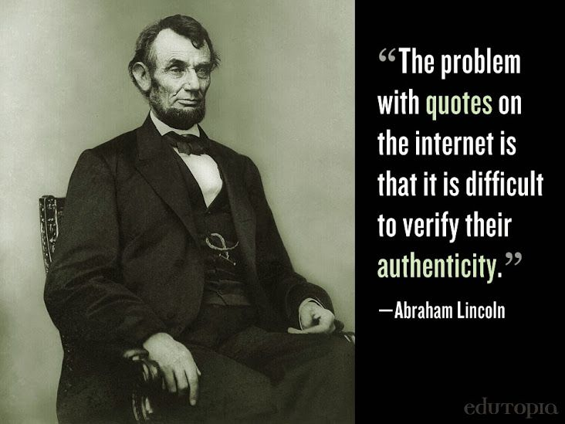
frank.robben@mail.fgov.be
@FrRobben
frank.robben.be
ksz.fgov.be
ehealth.fgov.be
smals.be
Notes:
I made this quote myself, as president Lincoln had already warned against hallucination

