Slide 1
European Health Data Space Regulation (EHDS Regulation), particularly with regard to primary use

Slide 2
Links to documentation
  Official Journal of the European Union:
    https://eur-lex.europa.eu/legal-content/en/TXT/?uri=OJ%3AL_202500327
  website of the European Commission regarding EHDS
    https://health.ec.europa.eu/ehealth-digital-health-and-care/european-health-data-space-regulation-ehds_en
  extract of slides of the European Commission showed at webinars

Slide 3
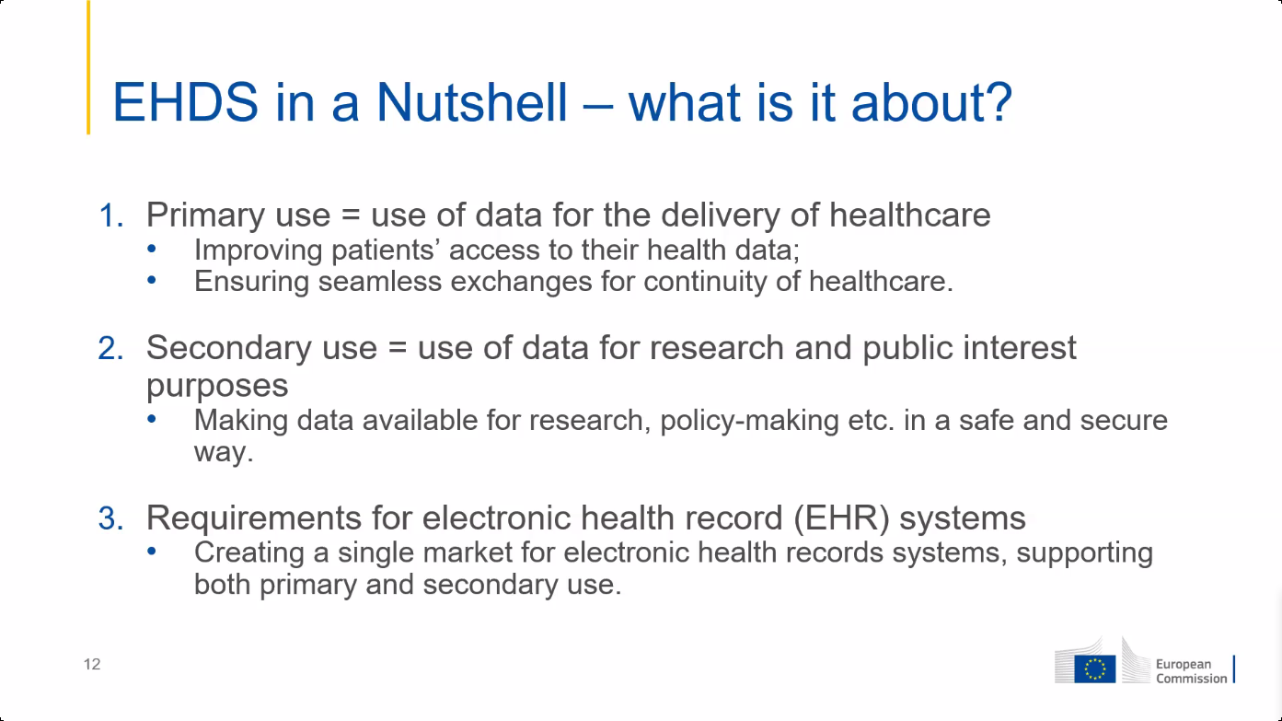

Slide 4
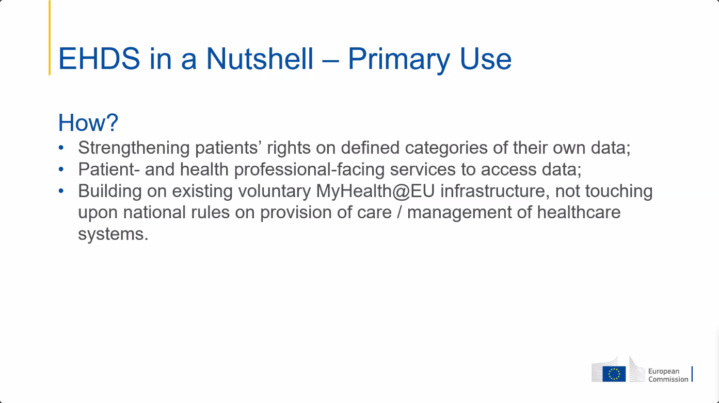

Slide 5
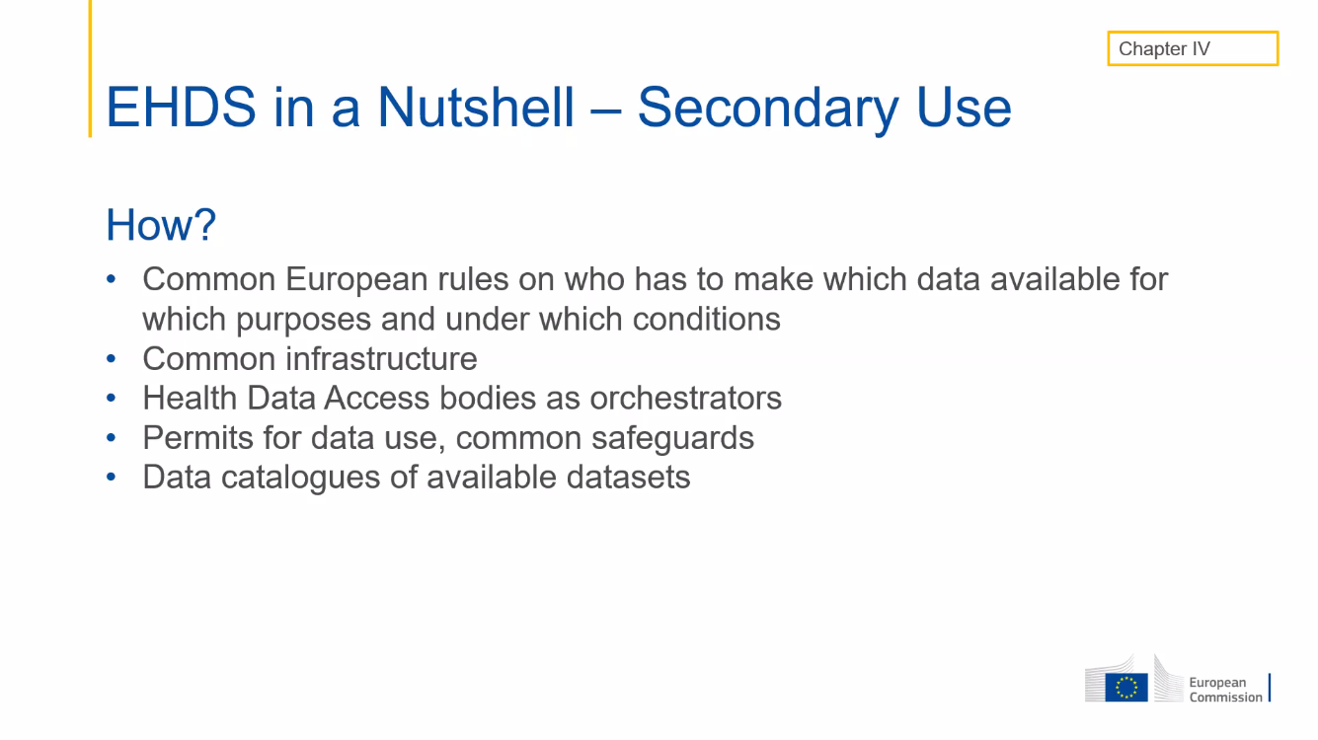

Slide 6
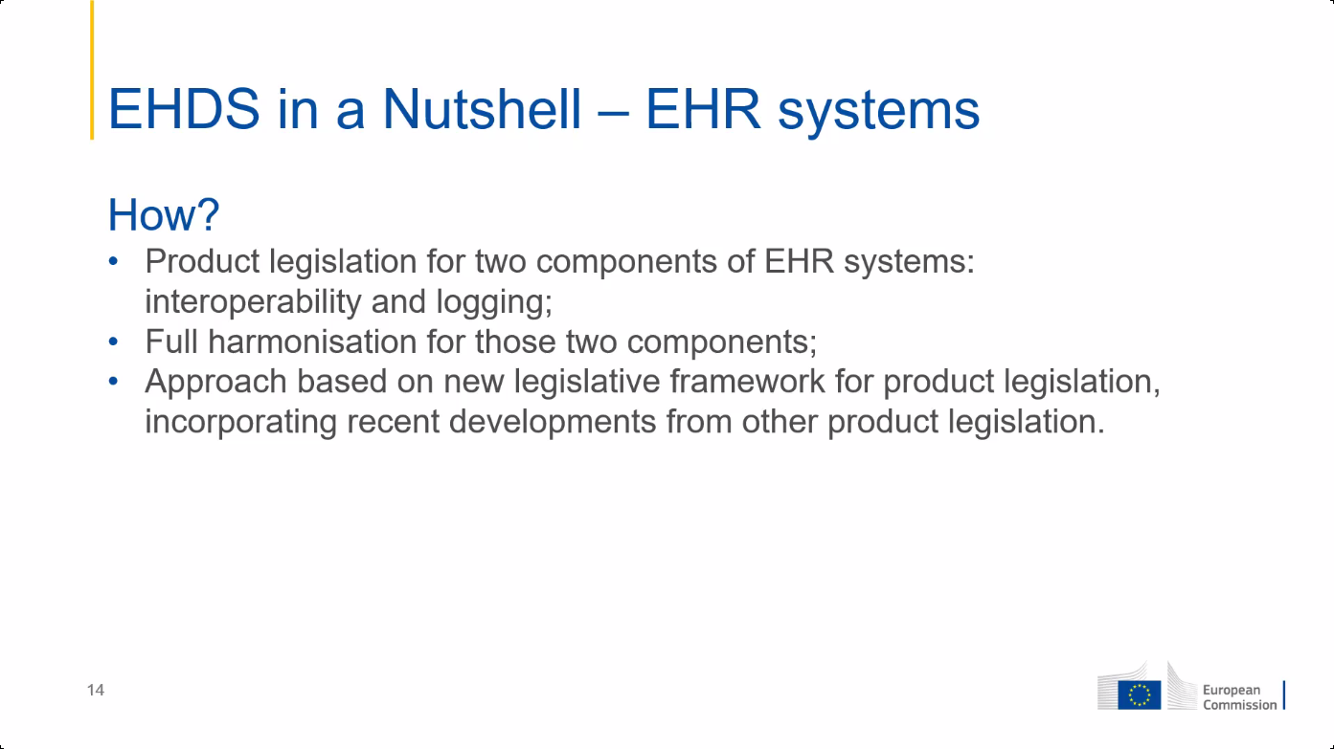

Slide 7
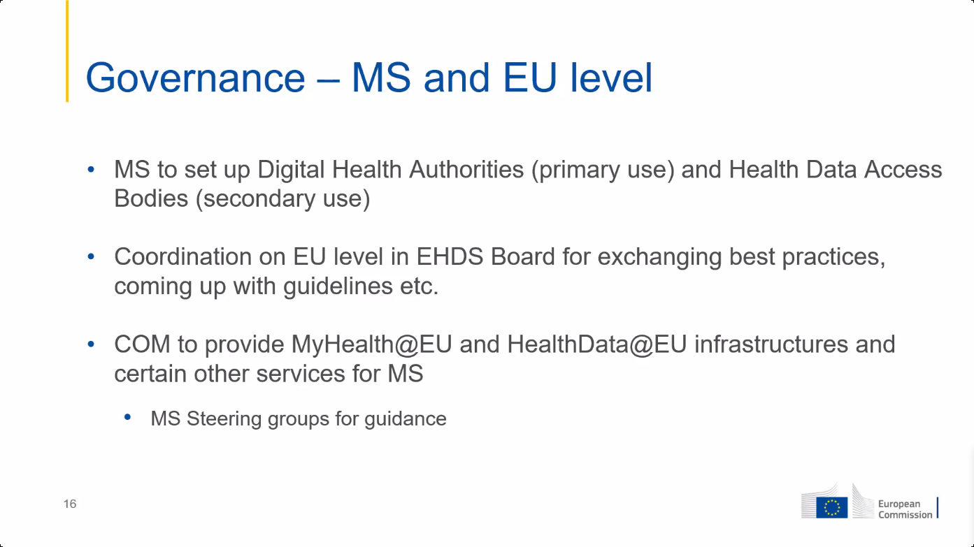

Slide 8
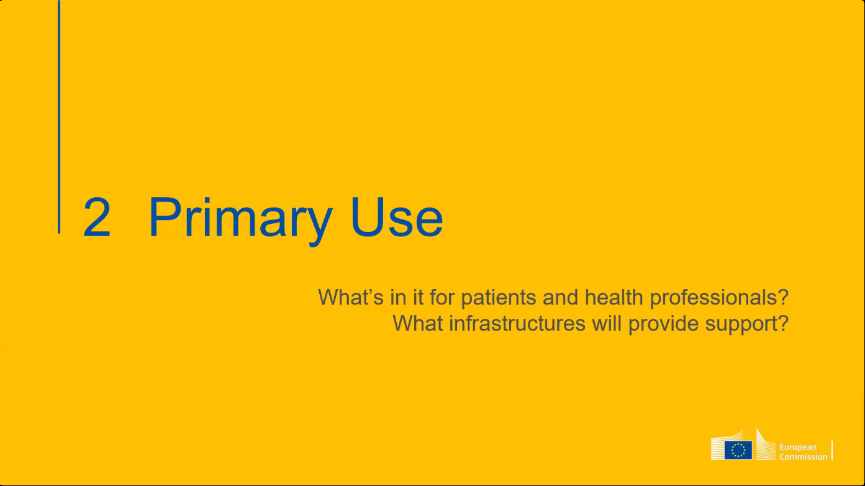

Slide 9
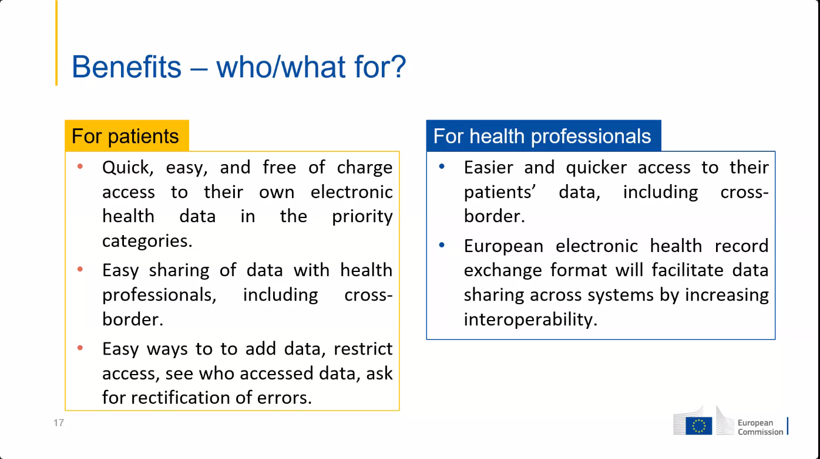

Slide 10
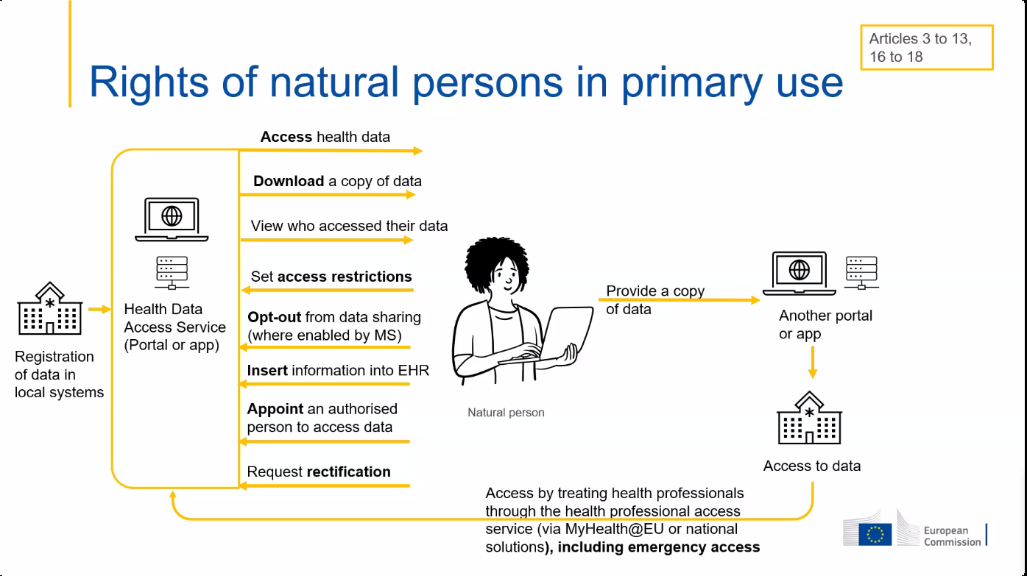

Slide 11
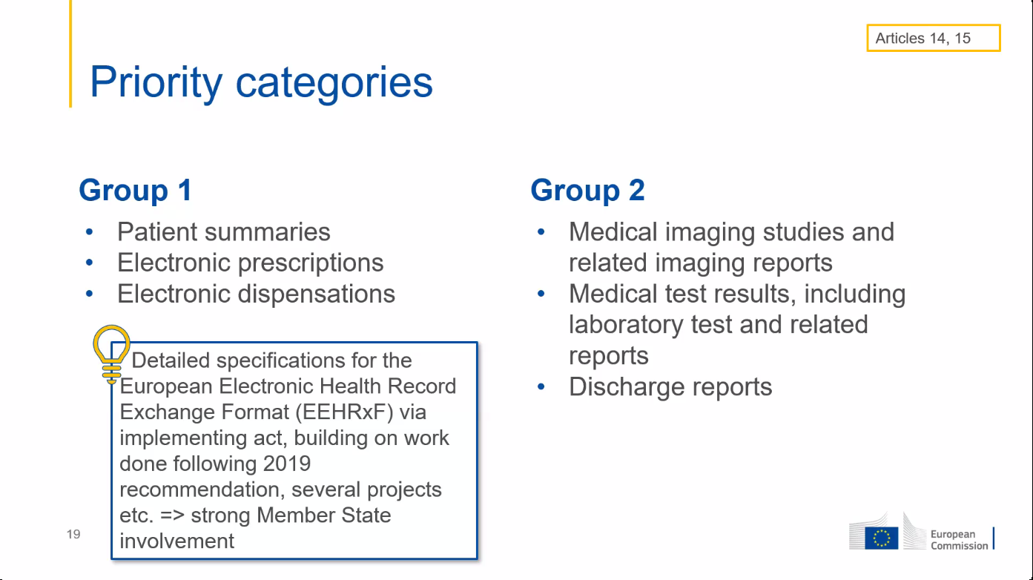

Slide 12
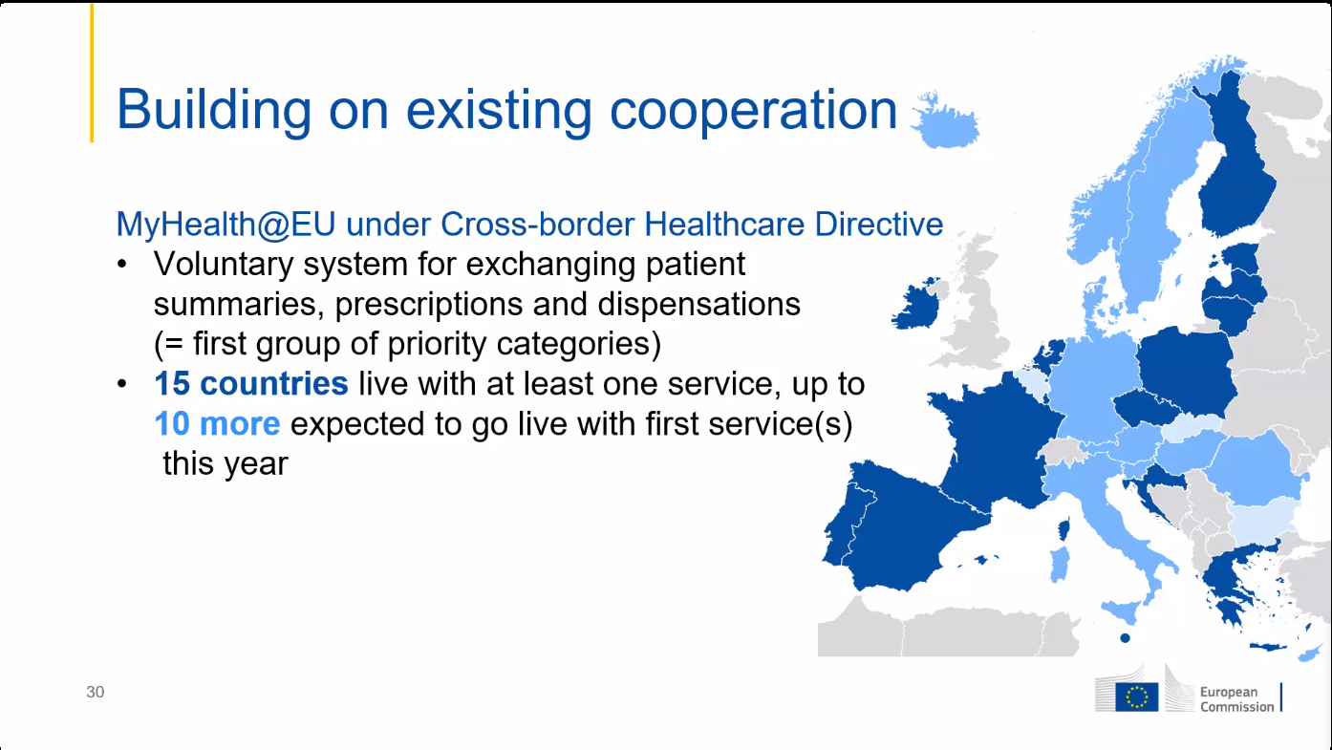
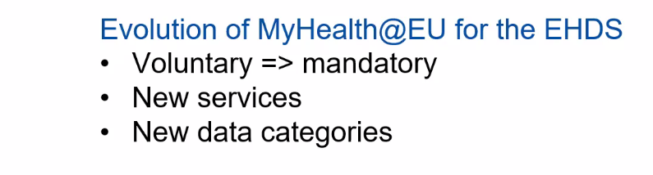

Slide 13
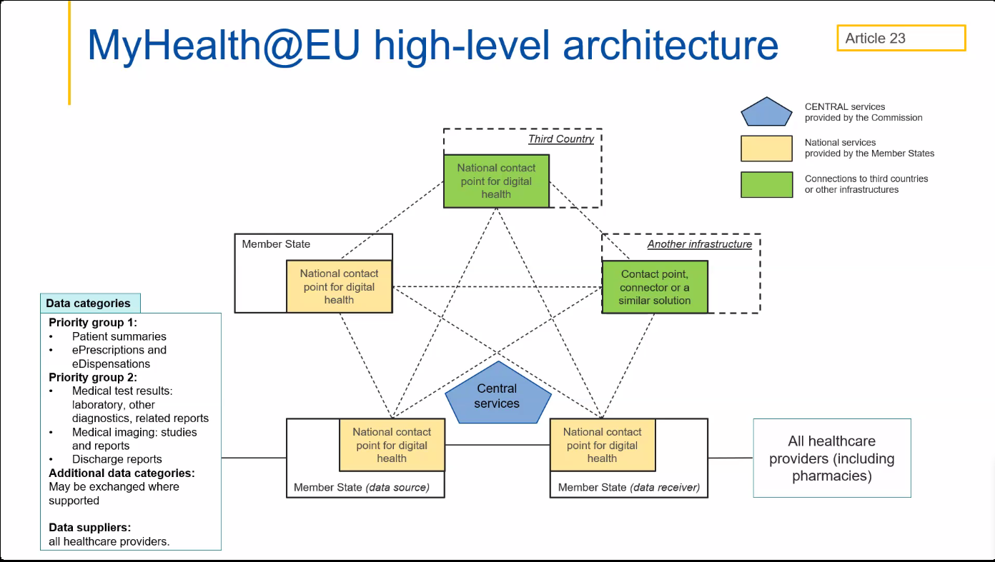

Slide 14
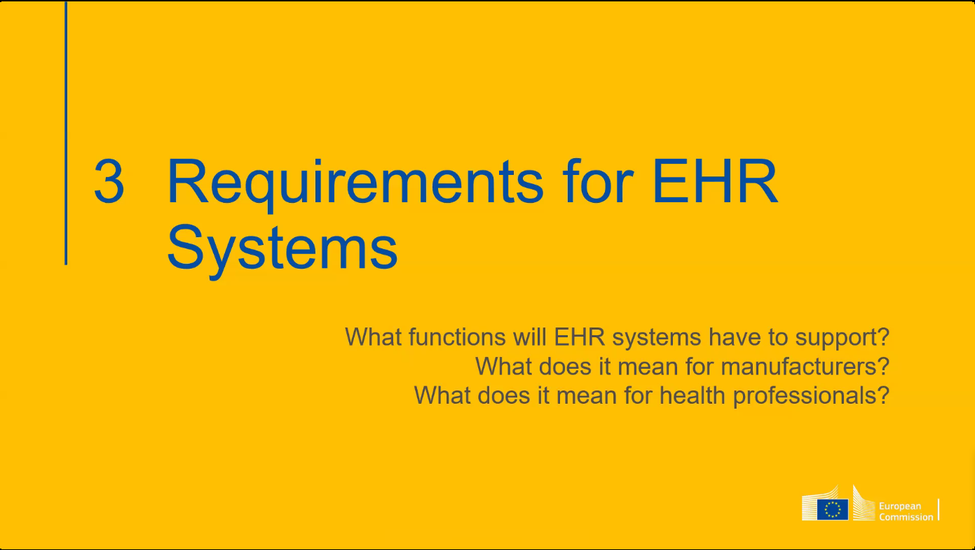

Slide 15
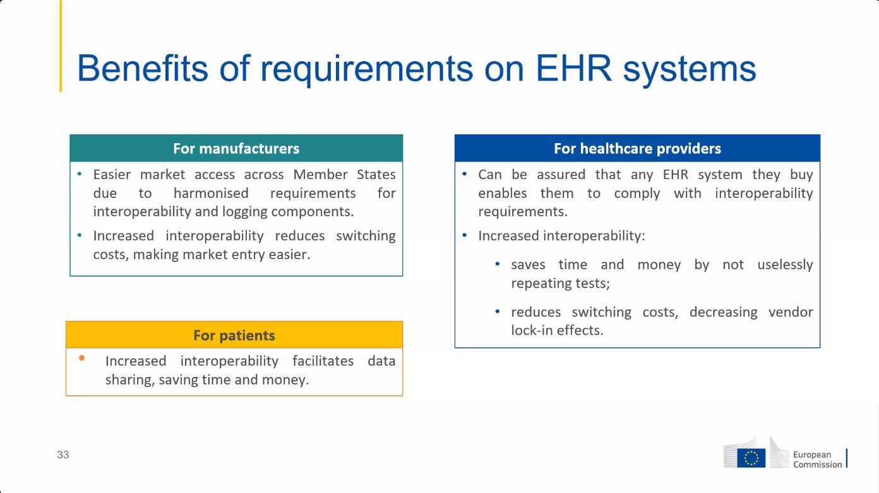

Slide 16
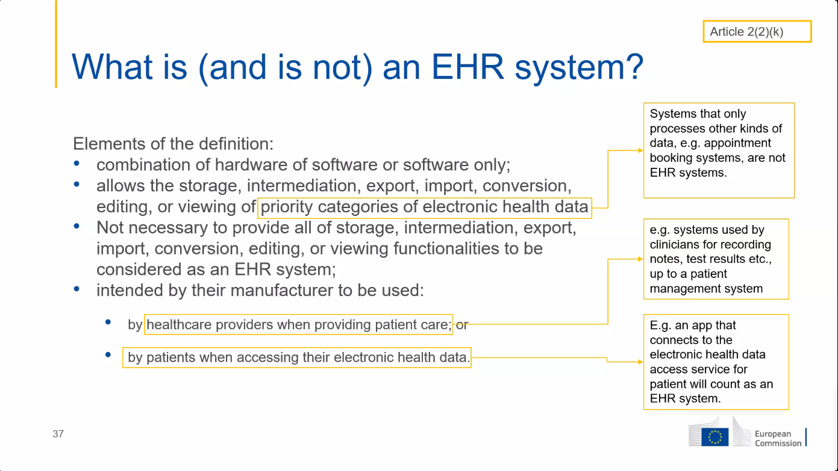

Slide 17
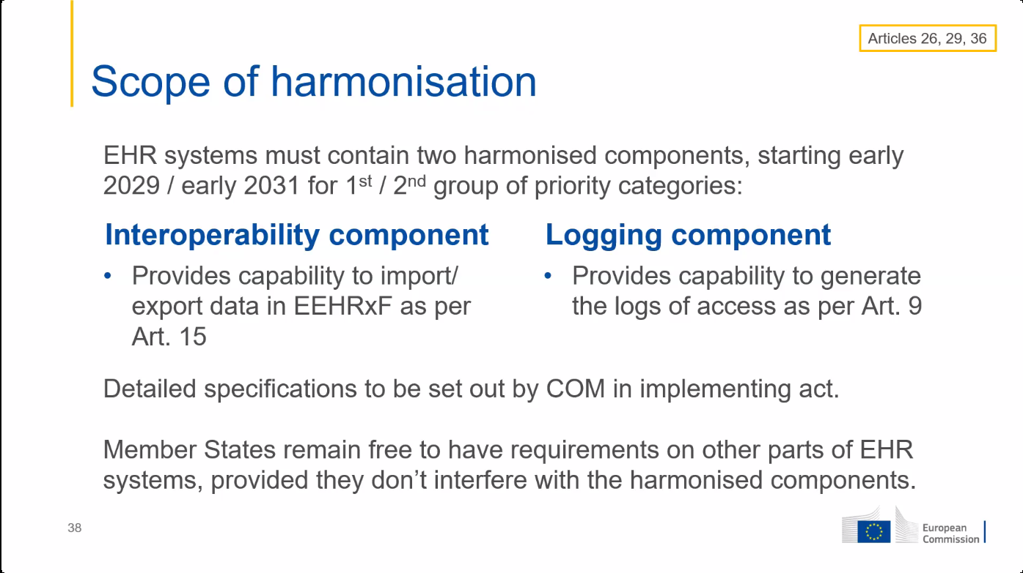

Slide 18
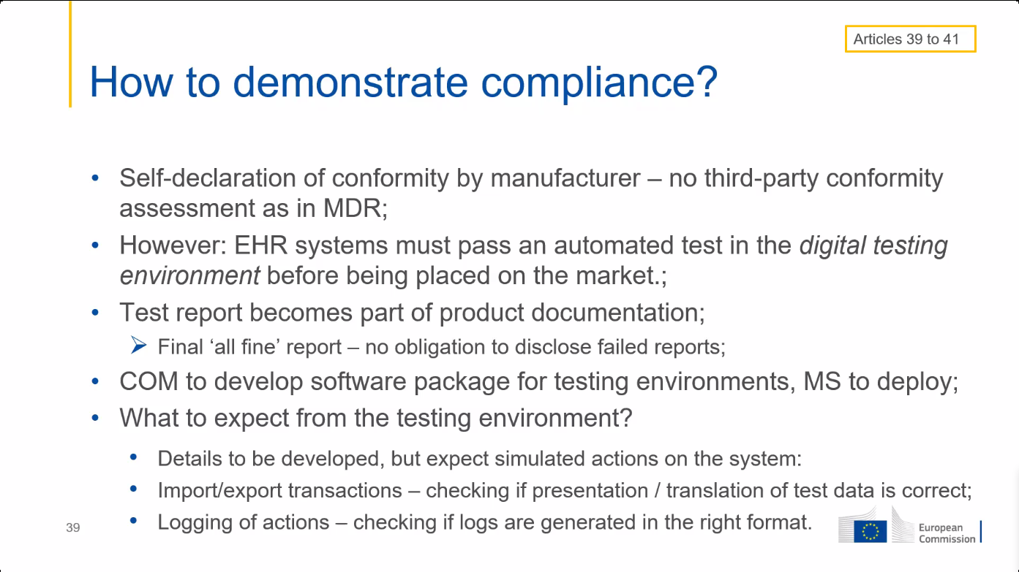

Slide 19
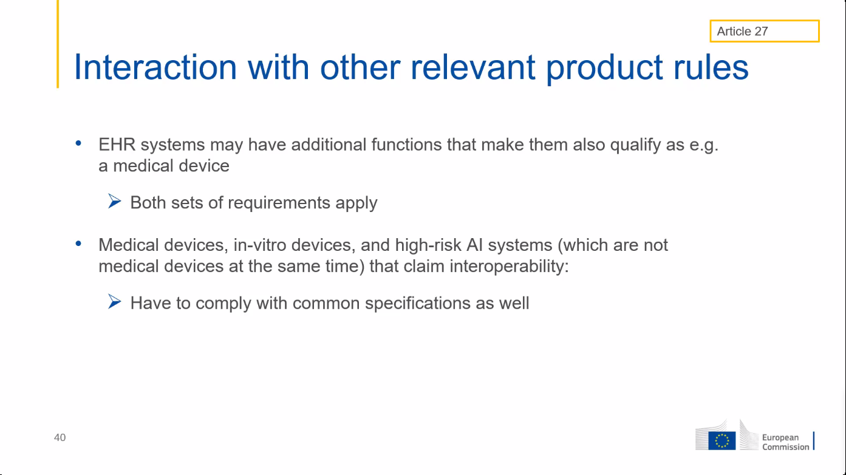

Slide 20
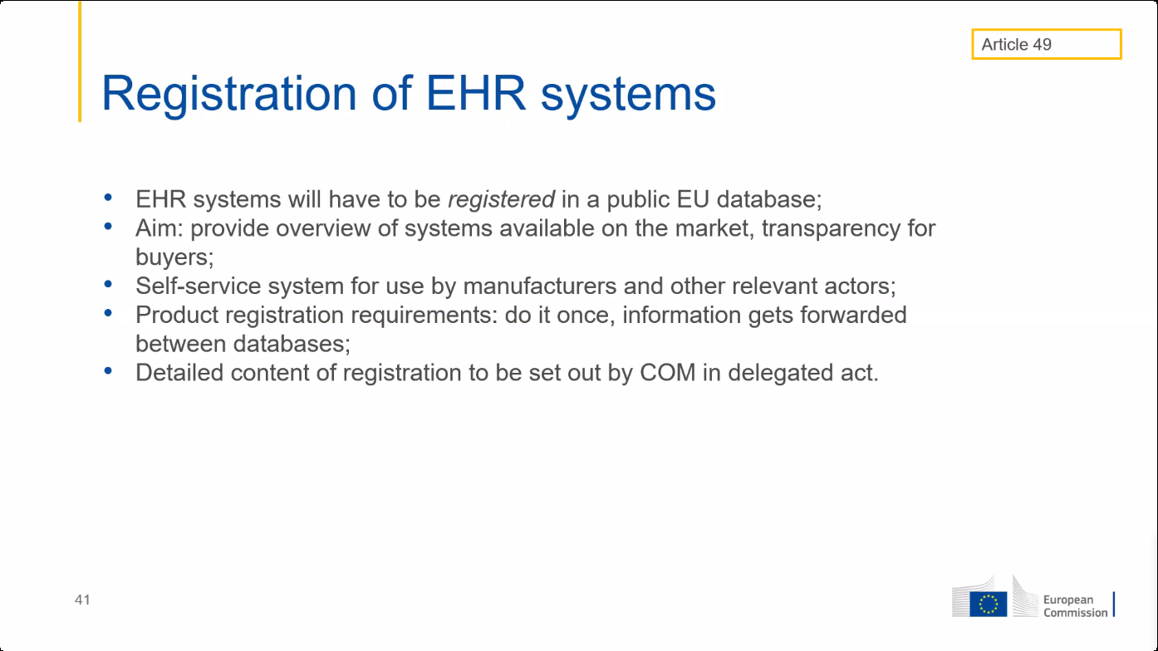

Slide 21
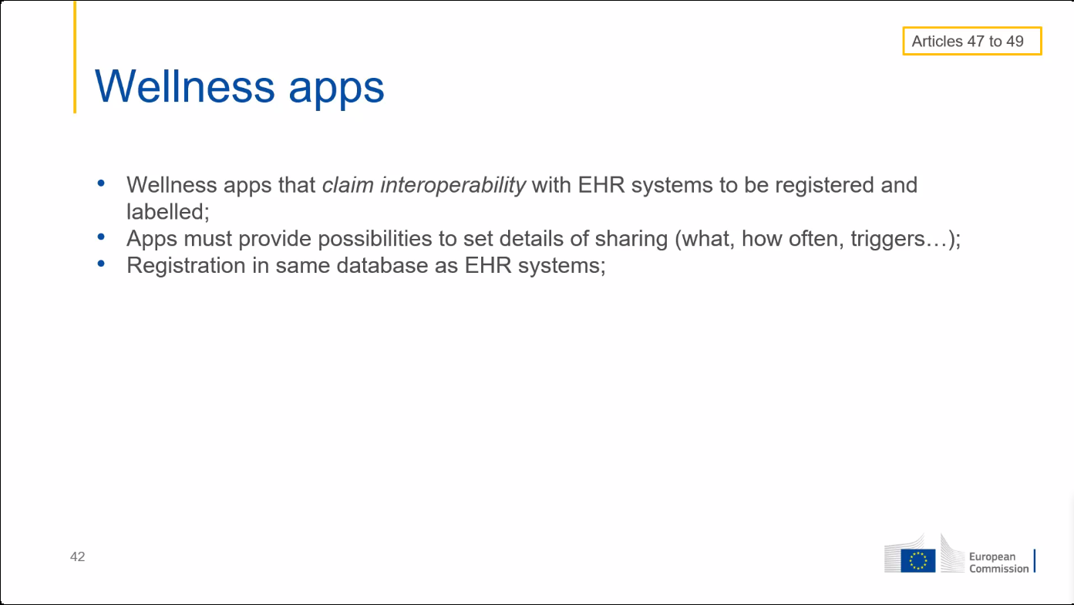

Slide 22
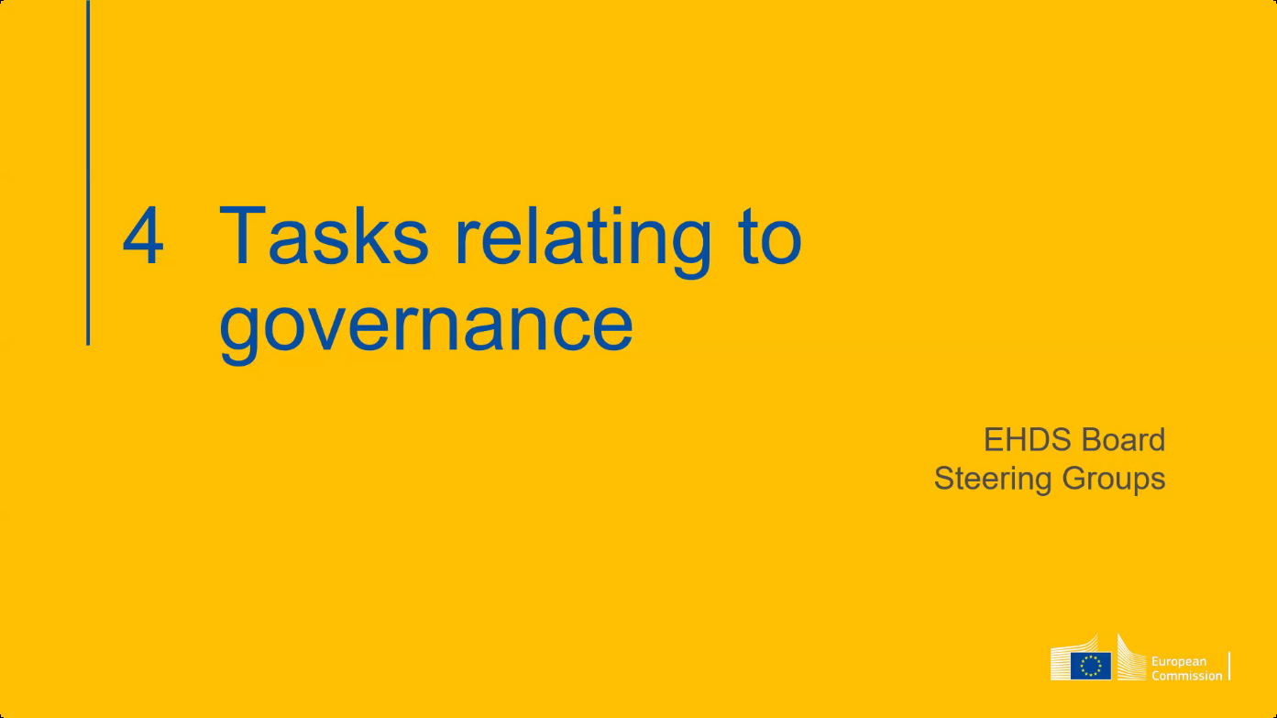

Slide 23
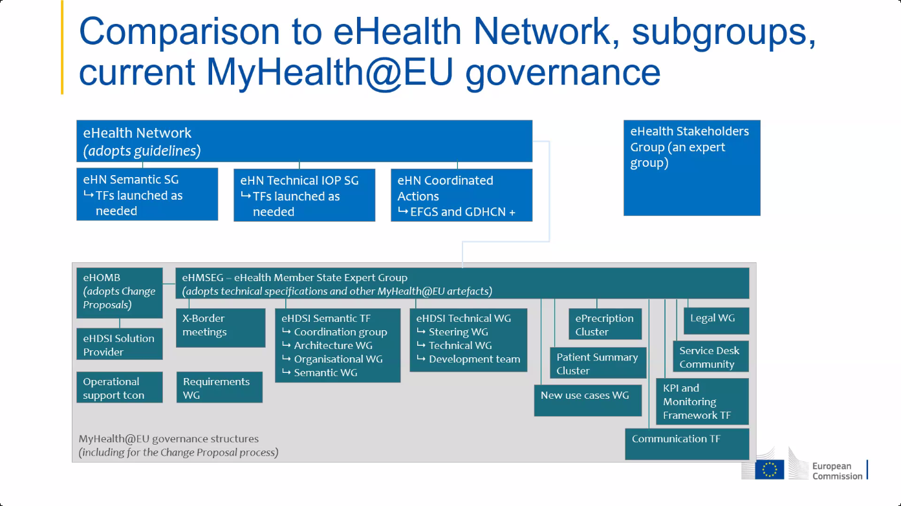

Slide 24
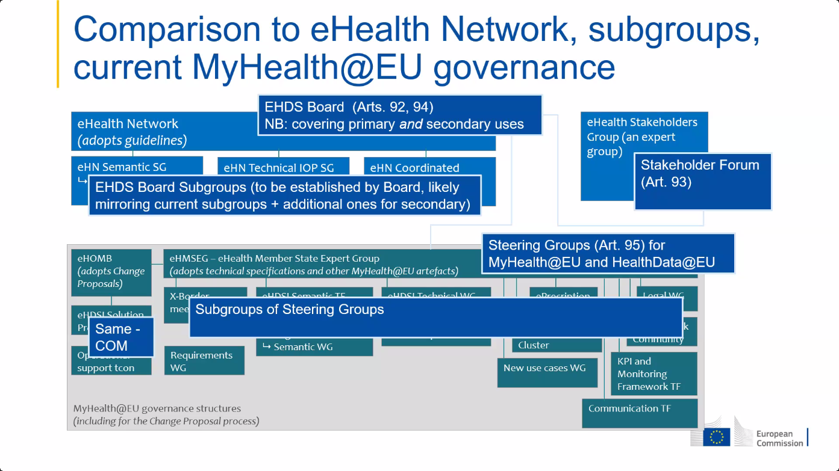

Slide 25
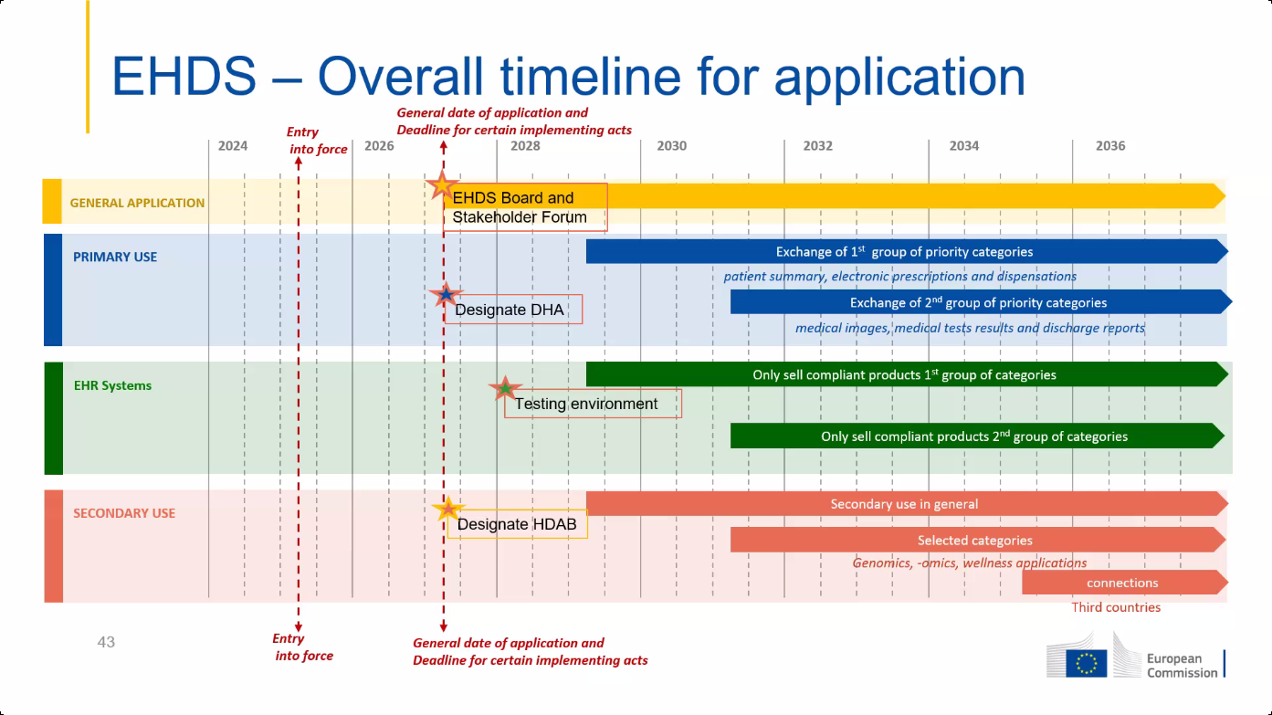

Slide 26
Some important provisions of EHDS
  software packages must meet EU standards to be placed on the EU market
    EHR harmonised components (art. 25)
    EU declaration of conformity (art. 39)
  European digital testing environment (art. 40)
    European Commission shall develop a European digital testing environment and make the software supporting this environment available as open source
    Member States (MS) shall operate a testing environment, preferably by reusing the software developed by the European Commission

Slide 27
Some important provisions of EHDS
  legal basis for European governance and coordination (art. 96)
    the European Commission shall provide the development, maintenance, hosting and operation of the infrastructures and central services required to support the functioning of the EHDS

Slide 28
Central services mentioned in art. 96 (primary use)
  interoperable, cross-border identification and authentication mechanism for natural persons and health professionals
    based on eIDAS 2.0 and XACML ?
  a central interoperability platform for digital health (‘MyHealth@EU’) to provide services to support and facilitate the exchange of personal electronic health data between the national contact points

Slide 29
Central services mentioned in art. 96 (primary use)
  supplementary services that facilitate telemedicine, mobile health, access by natural persons to existing translations of their health data, exchange or verification of health-related certificates
    eg multilingual terminology server ?
    eg coordination of end-to-end encryption of health data ?
    eg pseudonimization service ?

Slide 30
General principles for Belgian implementation
  need for one unique European technical FHIR standard for every message type
    patient summary
    electronic prescription
    electronic dispensation
    medical imaging studies and related imaging reports
    medical test results, including laboratory and other diagnostic result and related reports
    discharge report

Slide 31
General principles for Belgian implementation
  need for one unique European structured semantic value set (no mere free text !) for every field where this is relevant, preferably
    SNOMED CT
    LOINC
    ...
  software packages must meet EU standards to be placed on the EU market
    EHR harmonised components (art. 25)
    EU declaration of conformity (art. 39)

Slide 32
General principles for Belgian implementation
  in case of cross-border sending of a message, conversion to the European standard is done as close as possible to the source of information
    if information is available in one or a limited number of central databases, by the controller of the database, e.g.
      patient summary in health vaults
      electronic prescriptions in Recip-e
    if available in PHR, by the software of the controller of the PHR
  in case of cross-border receiving of a message in Belgium, conversion to the national standard is done by the software package of the user

Slide 33
General principles for Belgian implementation
  authentication of the identity of a healthcare user or healthcare provider is done with the means labelled with the eIDAS-qualification ‘high’ of the MS of residence of the healthcare user or healthcare provider
  need for link with healthcare user identifier in the MS where information is requested
  access rights to information are granted in accordance with the rules laid down in the MS where access to the information is requested
  need for mapping between categories of healthcare providers across MS

Slide 34
General principles for Belgian implementation
  cross border exchange can be set up without NCP having access to personal health data => data minimization principle from GDPR requires NCP not to have mandatory access to personal health data
    possibility 1
      translation of health information content into European semantic standard is done before the message is sent
      the message is sent encrypted to the recipient
      the recipient decrypts the message and translates the content from the European semantic standard into the language understandable by the recipient
    possibility 2
      the message is pseudonymized
      translation of health information content into European semantic standard and from European standard into the language understandable by the recipient is done on pseudonymized health data
      the recipient depseudonymizes

Slide 35
Principles regarding electronic prescriptions
  creating a prescription is done in accordance with the law of the MS where the prescription is created
  executing a prescription is done in accordance with the law of the MS where the prescription is executed

Slide 36
Need for a global, integrated architecture and reuse
  need for
    global, integrated architecture across DGs of the European Commission
    based on a common conceptual framework
  need for modular, generic, domain agnostic, interoperable and reusable components/services: develop once, use many
  no technology driven choice of components and services used, but use of ICT components and services as enabler/means for meeting business requirements
  need for the availability of a set of basic services on a pan-European level, with possible reuse of some national best practices

Slide 37
Usefulness of basic services at the EU level
  facilitates secure cross-border exchange of personal data
  reduces costs
  speeds up time to market
  structurally increases data protection safeguards
  facilitates compliance monitoring

Slide 38
European testing environment: compliance criteria
Technical interoperability, eg
  structure of messages
  authentication methods
Semantic interoperability, eg
  identification
  value sets
Quality, eg
  correct handling of use cases
  use of evidence based medicine guidelines
Security & data protection, eg
  confidentiality
  availability
  traceability

Slide 39
European testing environment: proposal
  test environment developed by the European Commission for certified automated testing of compliance with established criteria on
    technical interoperability
    semantic interoperability
    quality
  use of the tools established in GDPR, eIDAS Regulation and NIS-2 directive for information security and data protection accountability
    data processing impact assessment (DPIA)
    respect of defined eIDAS security levels
    respect of defined cyber security measures

Slide 40
Example: Belgian testing environment
  defining compliance test criteria
    detailed test cases
  onboarding implementers
    software vendors, health care providers, health care institutions, …
  executing the compliance test campaign
    testers have 24/7 access
    testers can visualize the test plan
      technical view (JSON)
      business view (HTML and/or PDF)
    testers have to send all defined test cases via REST API
    testers can track their progression via a personal dashboard
    supervisors can follow up the progression of all implementers
    testers receive a certification

Slide 41
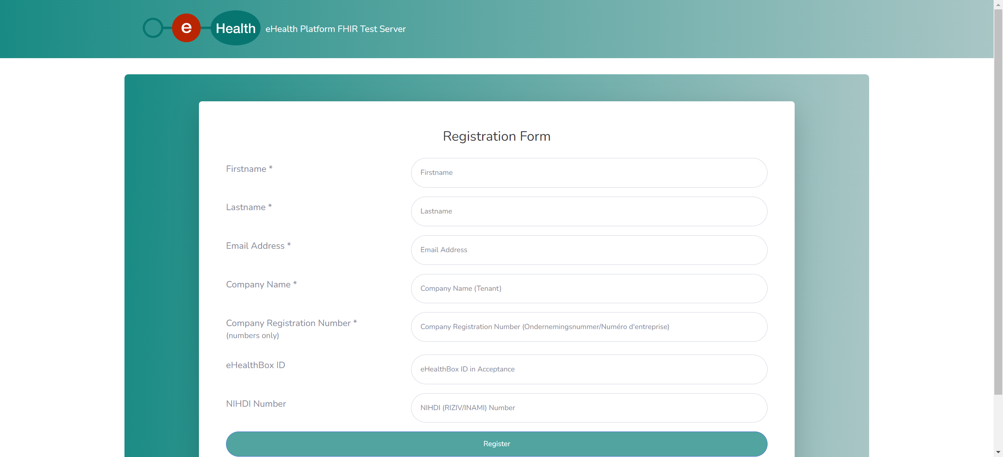
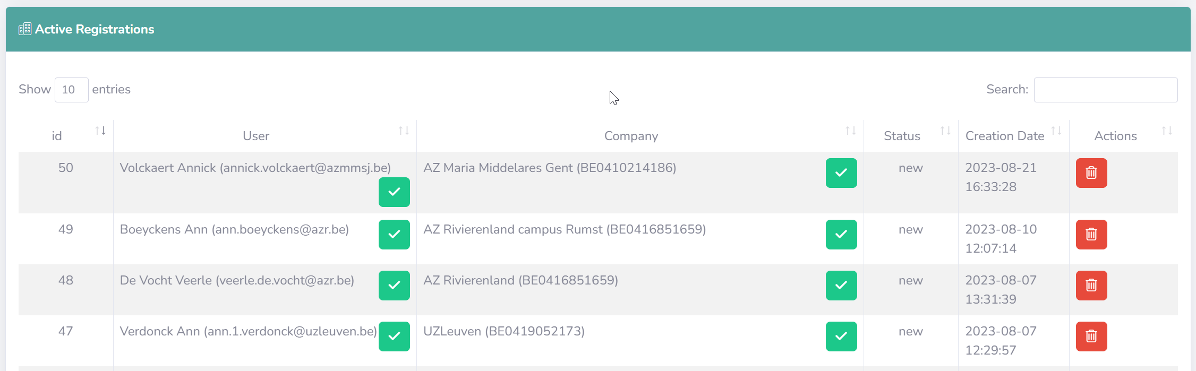
Test server – administration – registration

Slide 42
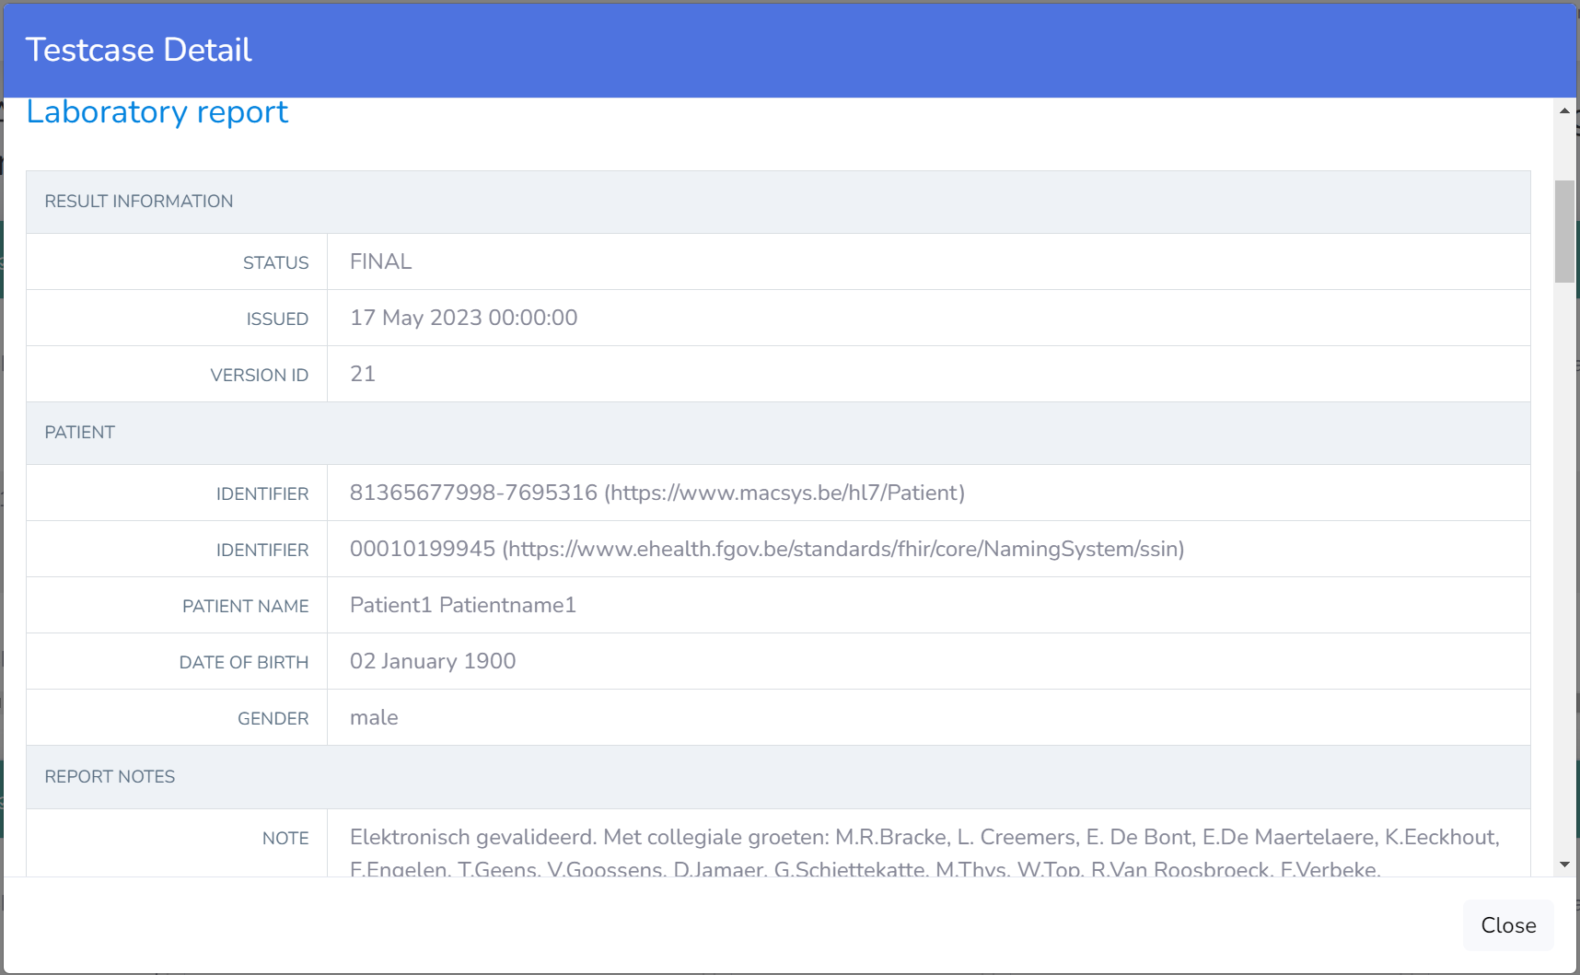
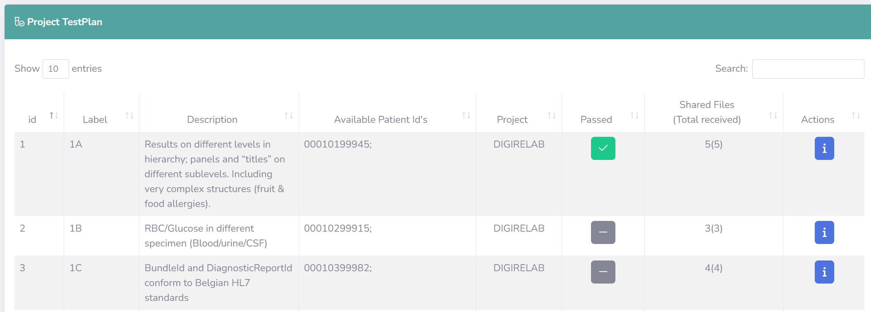
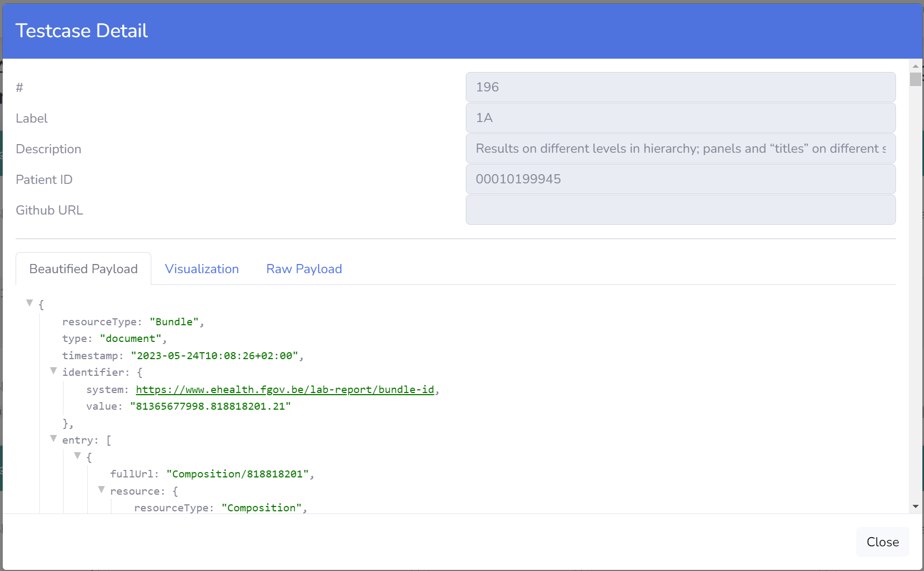
Test server – self service approach

Slide 43
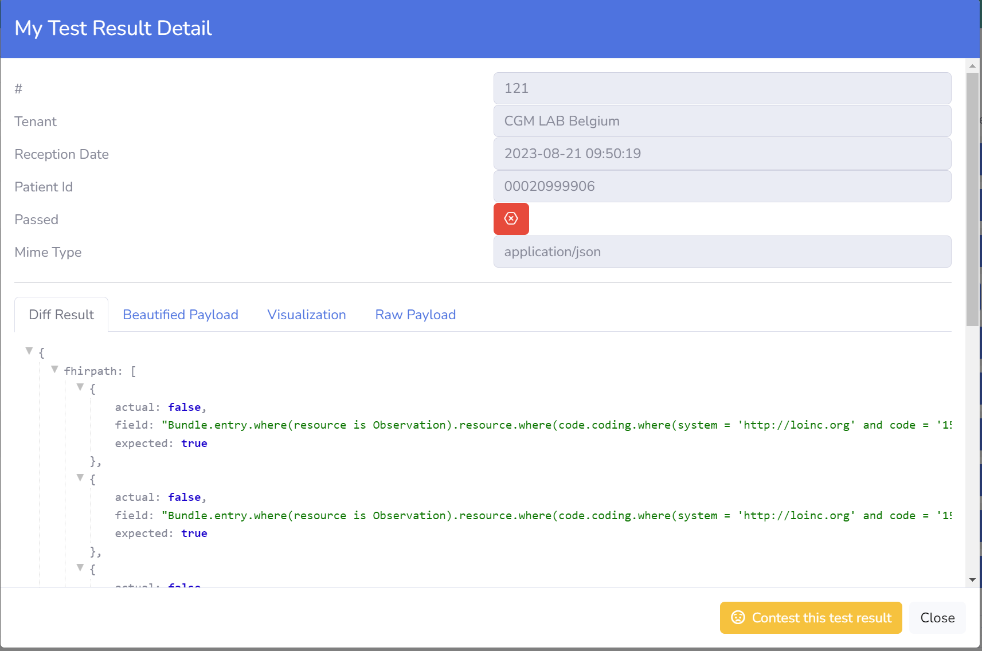
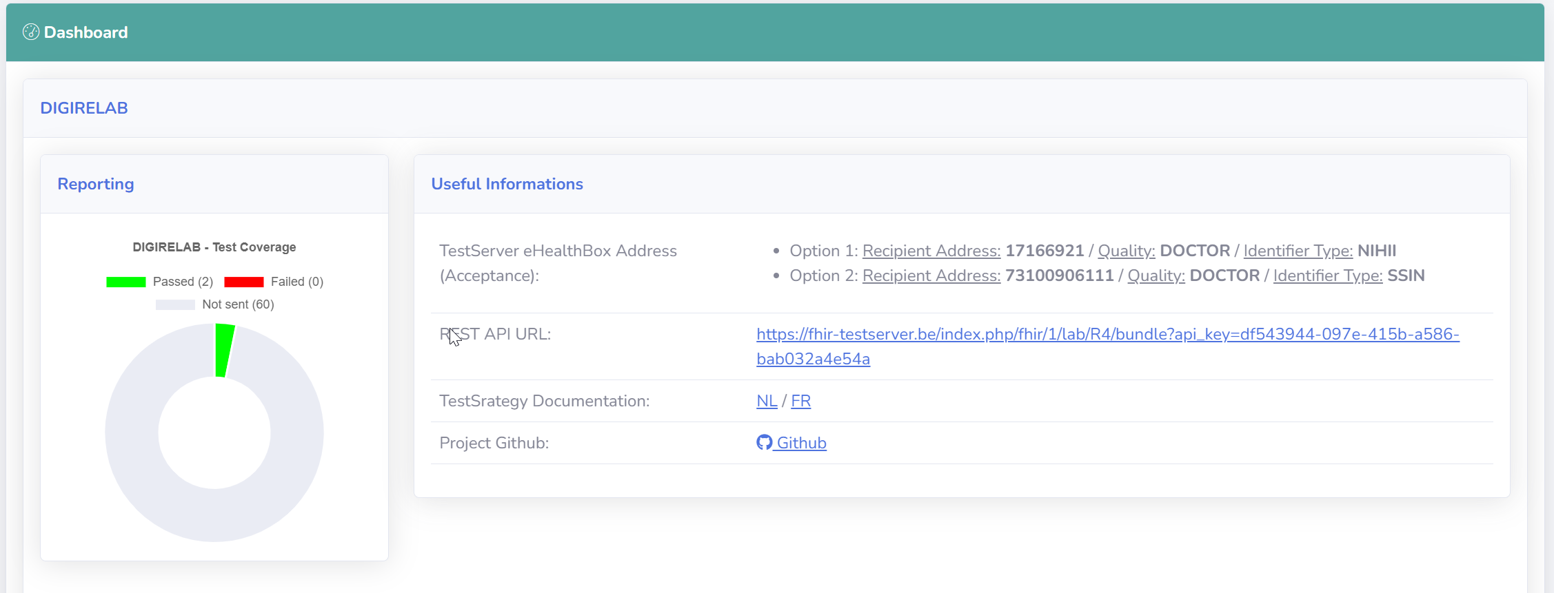
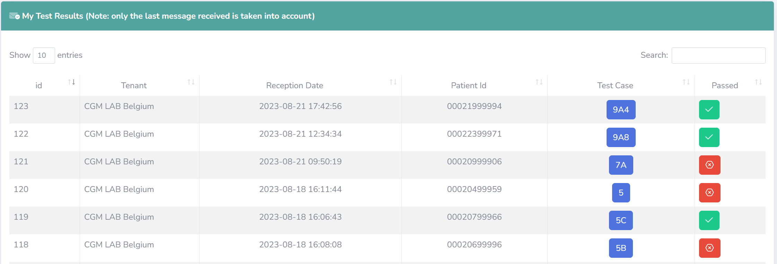
Test server – self service approach

Slide 44
To do’s
  scanning of any necessary legal adjustments
  well-coordinated Belgian representation in various working groups
  monitoring good architecture, beyond primary & secondary use
  good mutual integration of European and Belgian architecture
  loyal implementation at the right time to maintain credibility/authority
  sensible use of European funding

