Slide 1
Some important provision of EHDS

Slide 2
Some important provisions of EHDS
software packages must meet EU standards to be placed on the EU market
  EHR harmonised components (art. 25)
  EU declaration of conformity (art. 39)
European digital testing environment (art. 40)
  European Commission shall develop a European digital testing environment and make the software supporting this environment available as open source
  MS shall operate a testing environment, preferably by reusing the software developed by the European Commission
legal basis for European governance and coordination (art. 96)
  the European Commission shall provide the development, maintenance, hosting and operation of the infrastructures and central services required to support the functioning of the EHDS

Slide 3
Central services mentioned in art. 96 (primary use)
interoperable, cross-border identification and authentication mechanism for natural persons and health professionals
  based on eIDAS 2.0 and XACML ?
a central interoperability platform for digital health (‘MyHealth@EU’) to provide services to support and facilitate the exchange of personal electronic health data between the national contact points
supplementary services that facilitate telemedicine, mobile health, access by natural persons to existing translations of their health data, exchange or verification of health-related certificates
  eg multilingual terminology server ?
  eg coordination of end-to-end encryption of health data ?
  eg pseudonimization service ?
Notes:
based on eIDAS 2.0 and XACML ? > see Recital 21 (reference to Regulation (EU) No 910/2014 )

Slide 4
Central services mentioned in art. 96 (secondary use)
HealthData@EU to support and facilitate the cross-border access to electronic health data for secondary use
central platform for HealthData@EU by providing information technology services needed to support and facilitate the exchange of information between health data access bodies as part of HealthData@EU
a secure processing environment
  secure containers (eg Kapseli (Finland)) ?
a federated EU dataset catalogue connecting the national dataset catalogues

Slide 5
General principles for Belgian implementation primary use

Slide 6
General principles
need for one unique European technical FHIR standard for every message type
  patient summary
  electronic prescription
  electronic dispensation
  medical imaging studies and related imaging reports
  medical test results, including laboratory and other diagnostic result and related reports
  discharge report
need for one unique European structured semantic value set (no mere free text !) for every field where this is relevant, preferably
  SNOMED CT
  LOINC

Slide 7
General principles
in case of cross-border sending of a message, conversion to the European standard is done as close as possible to the source of information
  if information is available in one or a limited number of central databases, by the controller of the database, e.g.
    patient summary in health vaults
    drug prescriptions in Recip-e
  if available in PHR, by the software of the controller of the PHR
in case of cross-border receiving of a message in Belgium, conversion to the national standard is done by the software package of the user
cf. software packages must meet EU standards to be placed on the EU market
  EHR harmonised components (art. 25)
  EU declaration of conformity (art. 39)

Slide 8
General principles
authentication of the identity of a healthcare user or healthcare provider is done with the means labelled with the eIDAS-qualification ‘high’ of the MS of residence of the healthcare user or healthcare provider
need for link with healthcare user identifier in the MS where information is requested
access rights to information are granted in accordance with the rules laid down in the MS where access to the information is requested
need for mapping between categories of healthcare providers across MS

Slide 9
General principles
cross border exchange can be set up without NCP having access to personal health data => data minimization principle from GDPR requires NCP not to have mandatory access to personal health data
possibility 1
  translation of health information content into European semantic standard is done before the message is sent
  the message is sent encrypted to the recipient
  the recipient decrypts the message and translates the content from the European semantic standard into the language understandable by the recipient
possibility 2
  the message is pseudonymized
  translation of health information content into European semantic standard and from European standard into the language understandable by the recipient is done on pseudonymized health data
  the recipient depseudonymizes

Slide 10
Principles regarding electronic prescription
creating a prescription is done in accordance with the law of the MS where the prescription is created
executing a prescription is done in accordance with the law of the MS where the prescription is executed

Slide 11
Need for global, integrated architecture and reuse

Slide 12
Some basic international requirements
correct identification of every entity (citizens, companies, organisations, …)
  standardize patient identification methods to ensure consistent data access and exchange
  implement a system to coordinate patient identification keys across participating countries
correct routing of information request/provision
  coordinate a repository of information on where to locate patient data in each country
interoperability standards
  technical
  semantic
privacy and information security management
  user and access management (ao authentication of identity, attributes and (health) care relationships)
  end-to-end encryption

Slide 13
Need for a global, integrated architecture
need for
  global, integrated architecture across DGs of the European Commission
  based on a common conceptual framework
need for modular, generic, domain agnostic, interoperable and reusable components/services: develop once, use many
no technology driven choice of components and services used, but use of ICT components and services as enabler and means for meeting business requirements
need for the availability of a set of basic services on a pan-European level, with possible reuse of some national best practices

Slide 14
Usefulness of basic services at the EU level
facilitates secure cross-border exchange of personal data
reduces costs
speeds up time to market
structurally increases data protection safeguards
facilitates compliance monitoring

Slide 15
Towards an European testing environment

Slide 16
Compliance criteria
Technical interoperability, eg
  structure of messages
  authentication methods
Semantic interoperability, eg
  identification
  value sets
Quality, eg
  correct handling of use cases
  use of evidence based medicine guidelines
Security & data protection, eg
  confidentiality
  availability
  traceability

Slide 17
European Testing Environment
test environment developed by the European Commission for certified automated testing of compliance with established criteria on
  technical interoperability
  semantic interoperability
  quality
use of the tools established in the General Data Protection Regulation (GDPR), eIDAS Regulation and NIS-2 directive for information security and data protection accountability
  data processing impact assessment (DPIA)
  respect of defined eIDAS security levels
  respect of defined cyber security measures

Slide 18
Example: Belgian testing environment
defining compliance test criteria
  detailed test cases
onboarding implementers
  software vendors, health care providers, health care institutions, …
executing the compliance test campaign
  testers have 24/7 access
  testers can visualize the test plan
    technical view (JSON)
    business view (HTML and/or PDF)
  testers have to send all defined test cases via REST API
  testers can track their progression via a personal dashboard
  supervisors can follow up the progression of all implementers
  testers receive a certification

Slide 19
Test server – unit testing
Validation template
Business
case
(Word description)
Reference
(FHIR) instance
Validation process
Test case
Visualisation
(html/pdf)
Sender
Software
Generated
(FHIR) instance

Slide 20
Test server – end to end testing
FHIR Test server
Sender
Software
Generated
(FHIR) instance
REST API
Successful
test instances
Cherry Picking
Receiver
Software
Provided
(FHIR) Instance
Test result declaration

Slide 21
Test server architecture
Tester
Test server
REST API
(FHIR)
instance
Validation Process
eHealthbox Connector
ValidationTemplates
eHealthPlatform
Dashboard
Reference test list
Test coverage
Test result
Validation Results
https://fhir-testserver.be/index.php/login

Slide 22
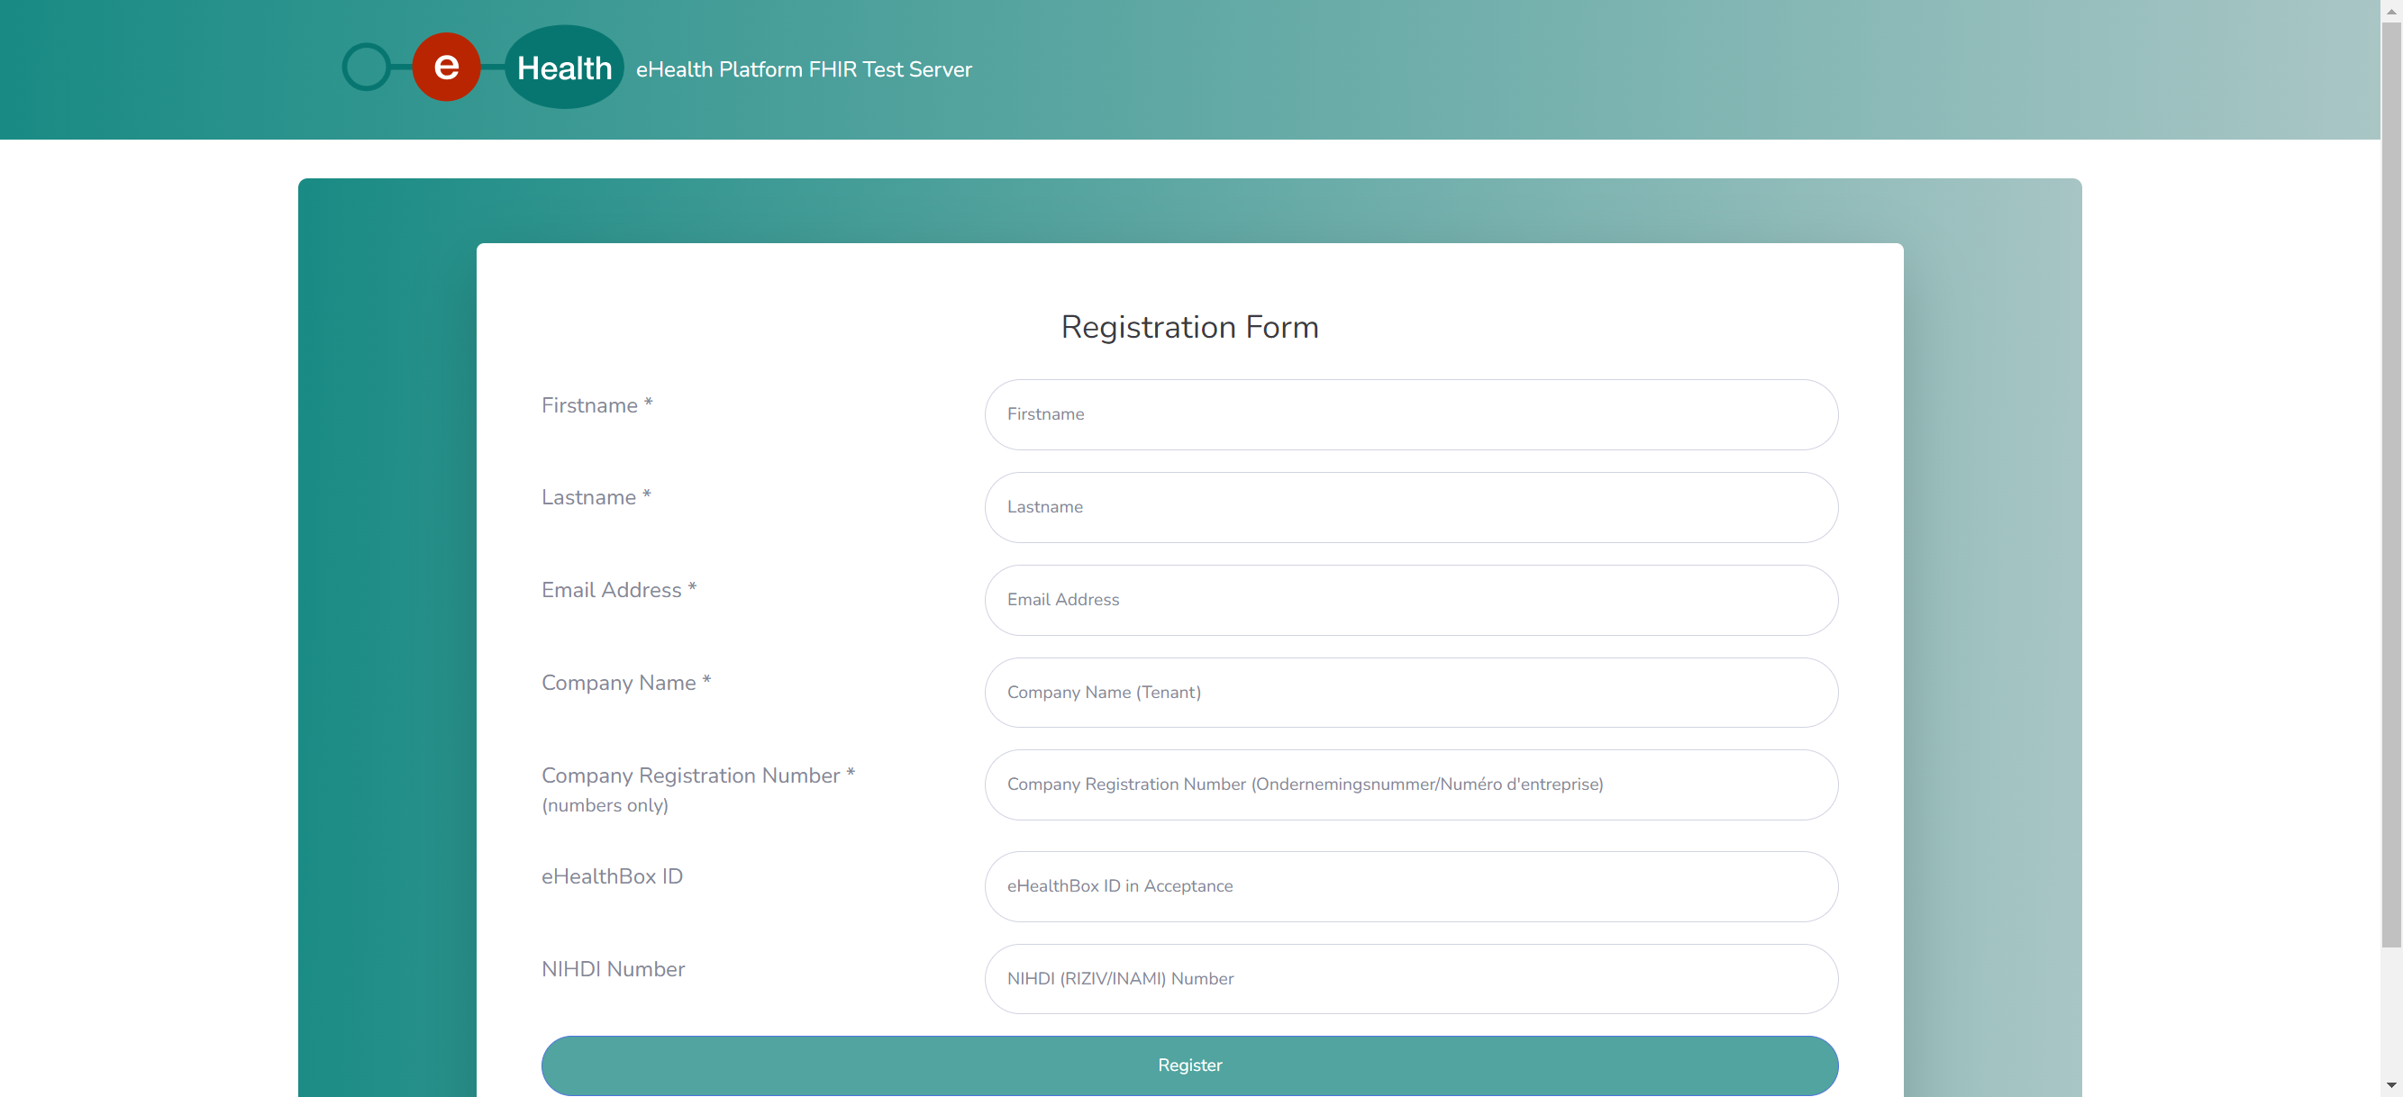
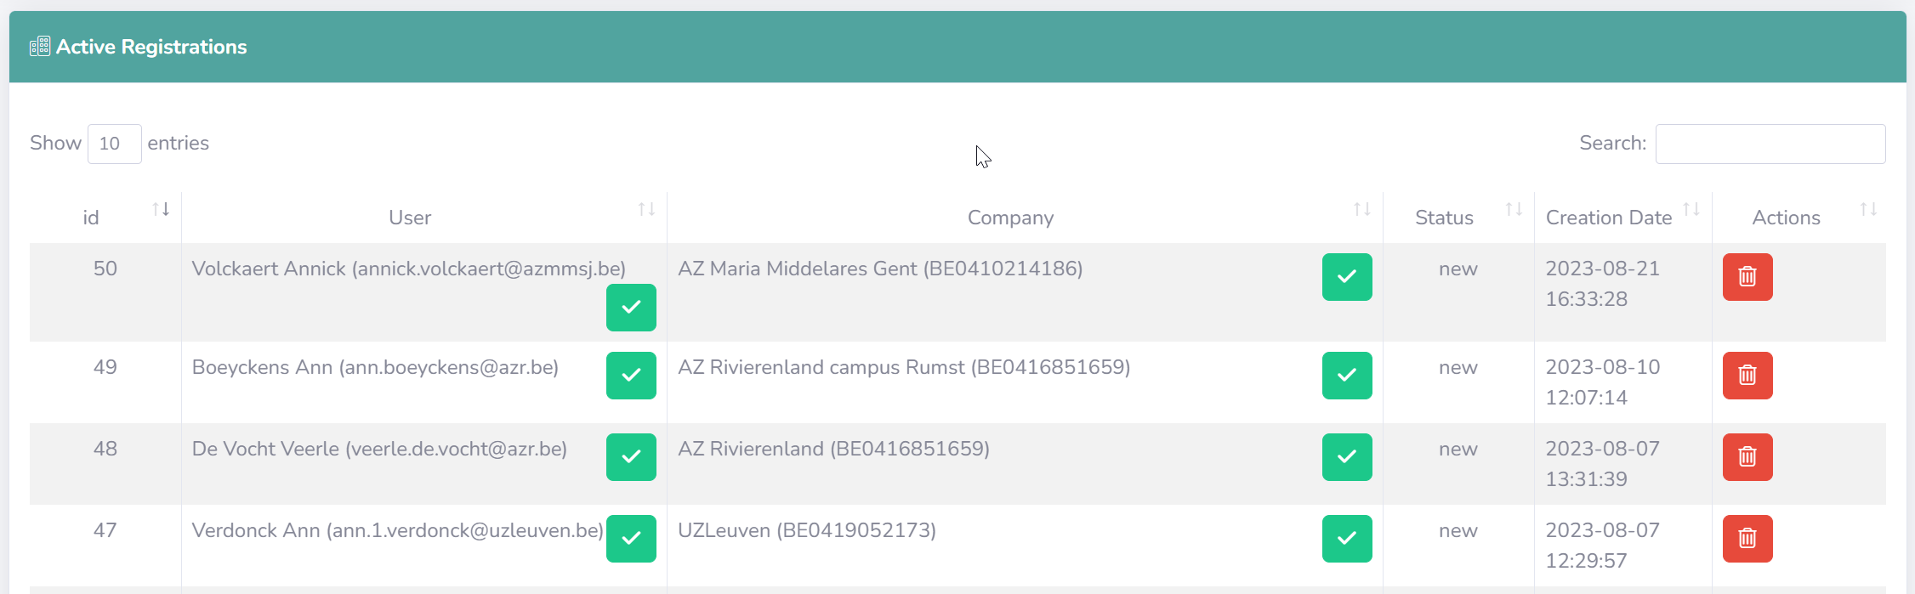
Test server – administration – registration

Slide 23
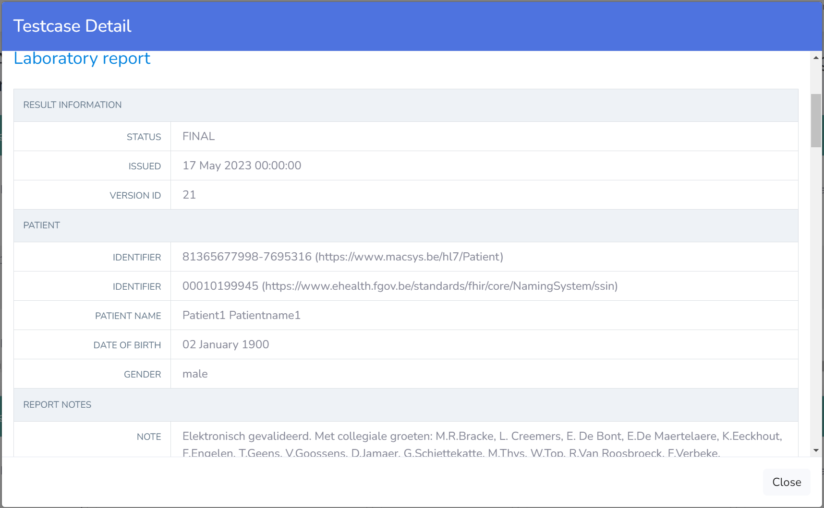
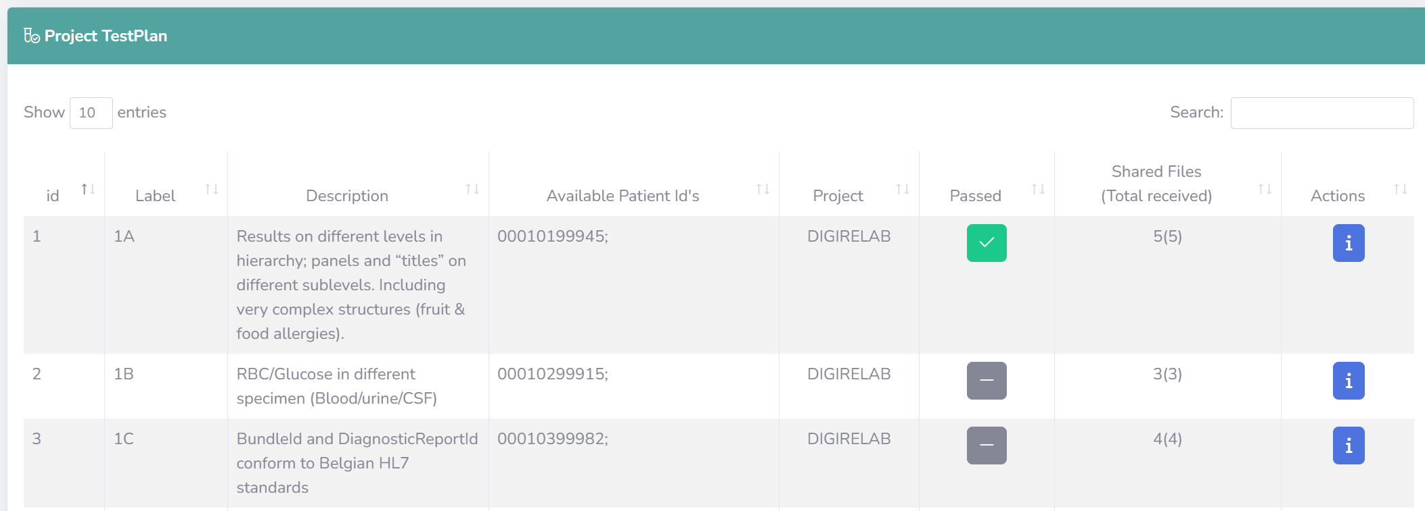
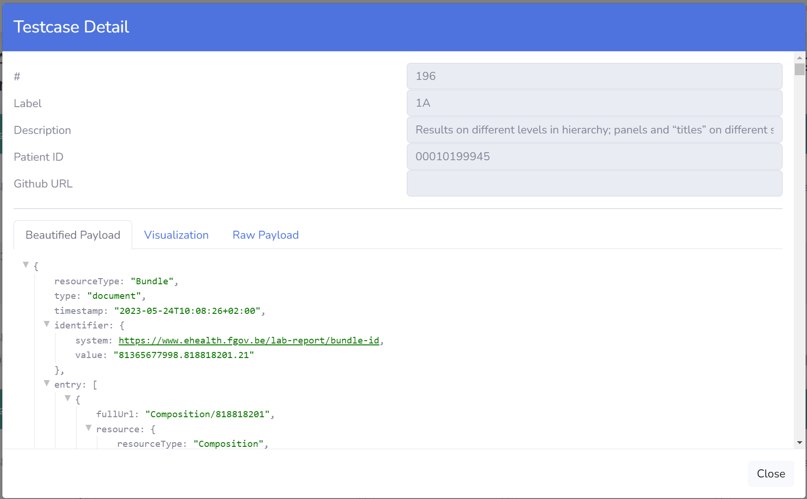
Test server – self service approach

Slide 24
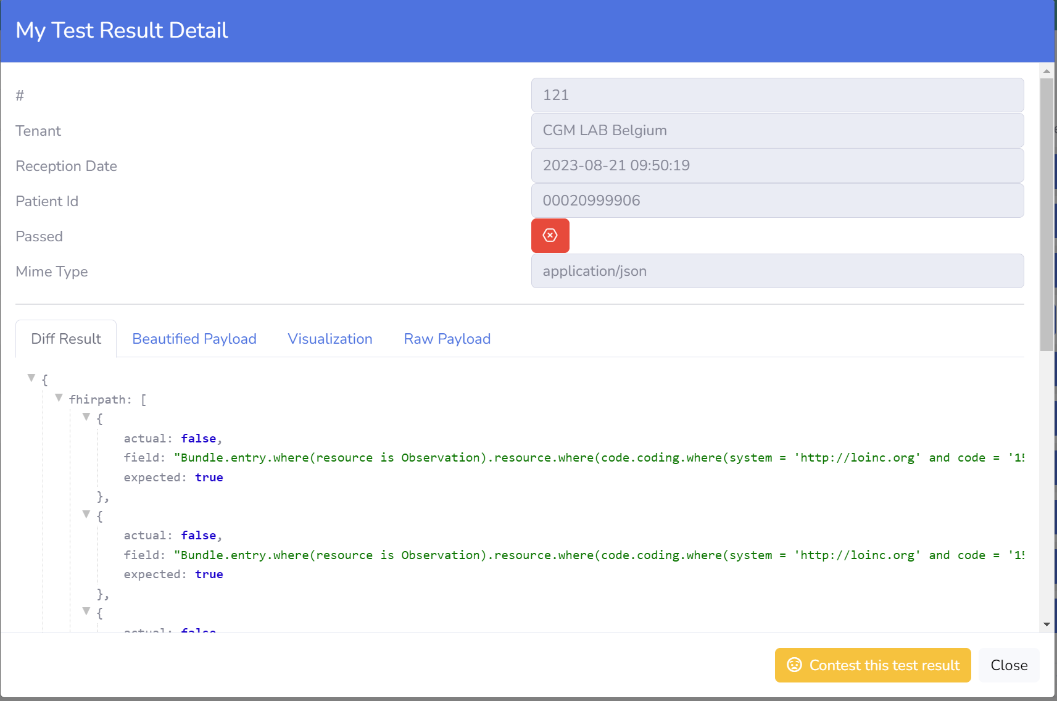
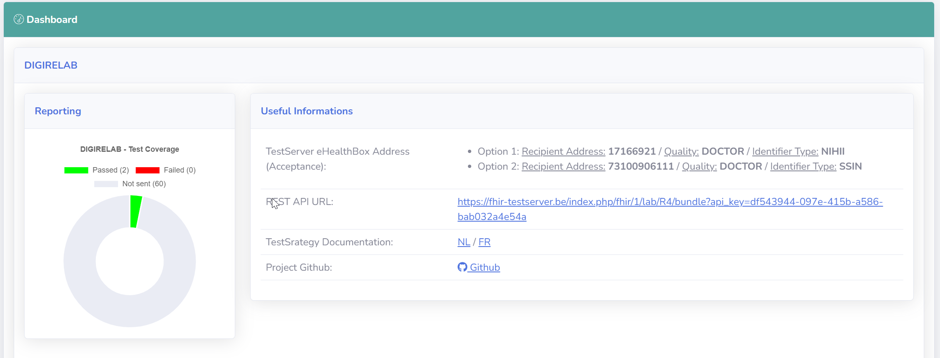
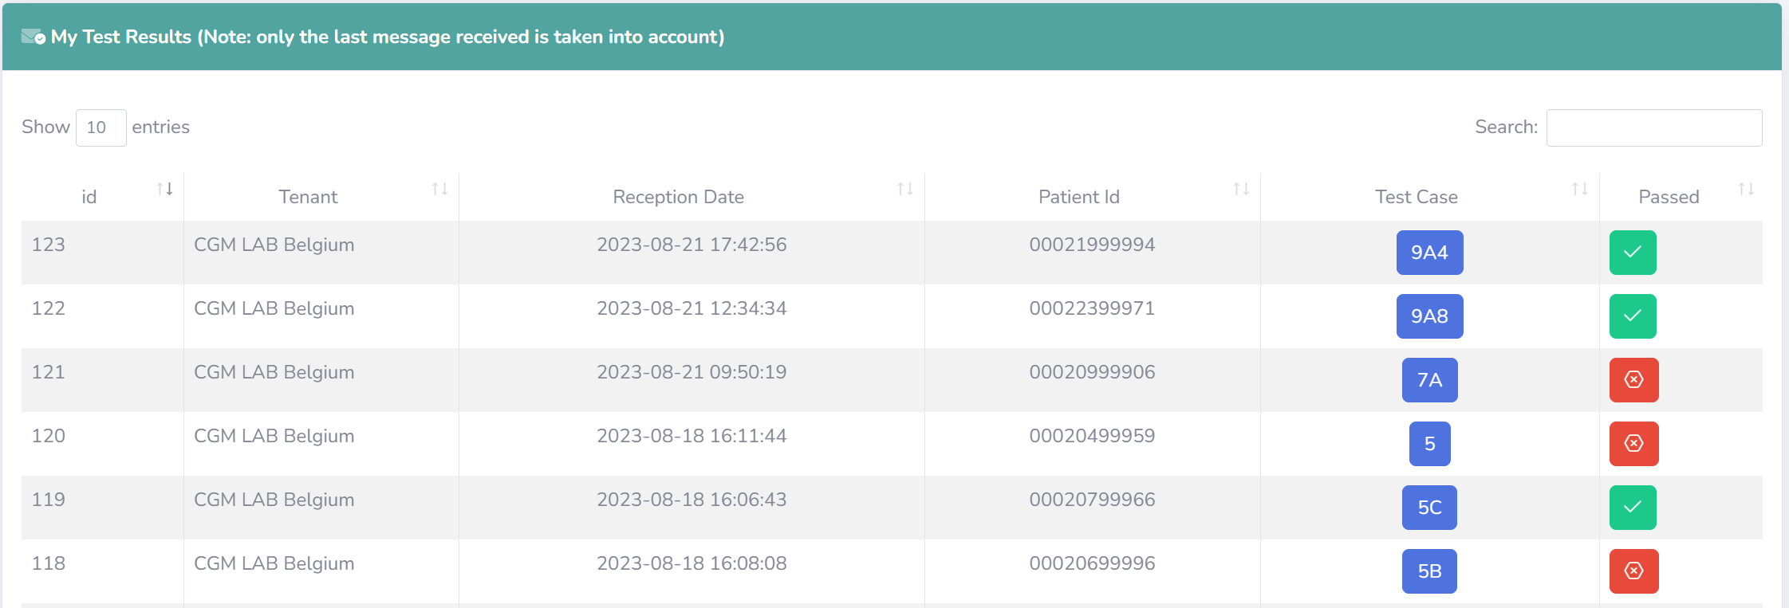
Test server – self service approach

Slide 25



frank.robben@mail.fgov.be
@FrRobben
https://www.frankrobben.be
https://www.ksz.fgov.be
https://www.ehealth.fgov.be

