Slide 1
Some important provisions of EHDS

Slide 2
Some important provisions of EHDS
software packages must meet EU standards to be placed on the EU market
  EHR harmonised components (art. 25)
  EU declaration of conformity (art. 39)
European digital testing environment (art. 40)
  European Commission shall develop a European digital testing environment and make the software supporting this environment available as open source
  MS shall operate a testing environment, preferably by reusing the software developed by the European Commission
legal basis for European governance and coordination (Art. 96)
  the European Commission shall provide the development, maintenance, hosting and operation of the infrastructures and central services required to support the functioning of the EHDS

Slide 3
Central services mentioned in art. 96 (primary use)
interoperable, cross-border identification and authentication mechanism for natural persons and health professionals
  based on eIDAS 2.0 and XACML ?
a central interoperability platform for digital health (‘MyHealth@EU’) to provide services to support and facilitate the exchange of personal electronic health data between the national contact points
supplementary services that facilitate telemedicine, mobile health, access by natural persons to existing translations of their health data, exchange or verification of health-related certificates
  eg multilingual terminology server ?
  eg coordination of end-to-end encryption of health data ?
  eg pseudonimisation service ?
Notes:
based on eIDAS 2.0 and XACML ? > see Recital 21 (reference to Regulation (EU) No 910/2014 )

Slide 4
Central services mentioned in art. 96 (secondary use)
HealthData@EU to support and facilitate the cross-border access to electronic health data for secondary use
central platform for HealthData@EU by providing information technology services needed to support and facilitate the exchange of information between health data access bodies as part of HealthData@EU
a secure processing environment
  secure containers (eg Kapseli (Finland)) ?
a federated EU dataset catalogue connecting the national dataset catalogues

Slide 5
Important question: role of NCP primary use
software packages must meet EU standards to be placed on the market
  technical interoperability
  semantic interoperability
  security
transformation to EU standards can be done in software packages => is there still a necessity for NCP to have access to content of exchanged health data ? quid data minimisation principle of GDPR ?

Slide 6
Need for global, integrated architecture and reuse

Slide 7
Some basic international requirements
correct identification of every entity (citizens, companies, organisations, …)
  standardize patient identification methods to ensure consistent data access and exchange
  implement a system to coordinate patient identification keys across participating countries
correct routing of information request/provision
  coordinate a repository of information on where to locate patient data in each country
interoperability standards
  technical
  semantic
privacy and information security management
  user and access management (ao authentication of identity, attributes and (health) care relationships)
  end-to-end encryption

Slide 8
Need for a global, integrated architecture
need for
  global, integrated architecture across DGs of the European Commission
  based on a common conceptual framework
need for modular, generic, domain agnostic, interoperable and reusable components/services: develop once, use many
no technology driven choice of components and services used, but use of ICT components and services as enabler and means for meeting business requirements
need for the availability of a set of basic services on a pan-European level, with possible reuse of some national best practices

Slide 9
Usefulness of basic services at the EU level
facilitates secure cross-border exchange of personal data
reduces costs
speeds up time to market
structurally increases data protection safeguards
facilitates compliance monitoring

Slide 10
Towards an European testing environment

Slide 11
Compliance criteria
Technical interoperability, eg
  structure of messages
  authentication methods
Semantic interoperability, eg
  identification
  value sets
Quality, eg
  correct handling of use cases
  use of evidence based medicine guidelines
Security & data protection, eg
  confidentiality
  availability
  traceability

Slide 12
European Testing Environment
test environment developed by the European Commission for certified automated testing of compliance with established criteria on
  technical interoperability
  semantic interoperability
  quality
use of the tools established in the General Data Protection Regulation (GDPR), eIDAS Regulation and NIS-2 directive for information security and data protection accountability
  data processing impact assessment (DPIA)
  respect of defined eIDAS security levels
  respect of defined cyber security measures

Slide 13
Example: Belgian testing environment
defining compliance test criteria
  detailed test cases
onboarding implementers
  software vendors, health care providers, health care institutions, …
executing the compliance test campaign
  testers have 24/7 access
  testers can visualize the test plan
    technical view (JSON)
    business view (HTML and/or PDF)
  testers have to send all defined test cases via REST API
  testers can track their progression via a personal dashboard
  supervisors can follow up the progression of all implementers
  testers receive a certification

Slide 14
Test server – unit testing
Validation template
Business
case
(Word description)
Reference
(FHIR) instance
Validation process
Test case
Visualisation
(html/pdf)
Sender
Software
Generated
(FHIR) instance

Slide 15
Test server – end to end testing
FHIR Test server
Sender
Software
Generated
(FHIR) instance
REST API
Successful
test instances
Cherry Picking
Receiver
Software
Provided
(FHIR) Instance
Test result declaration

Slide 16
Test server architecture
Tester
Test server
REST API
(FHIR)
instance
Validation Process
eHealthbox Connector
ValidationTemplates
eHealthPlatform
Dashboard
Reference test list
Test coverage
Test result
Validation Results
https://fhir-testserver.be/index.php/login

Slide 17
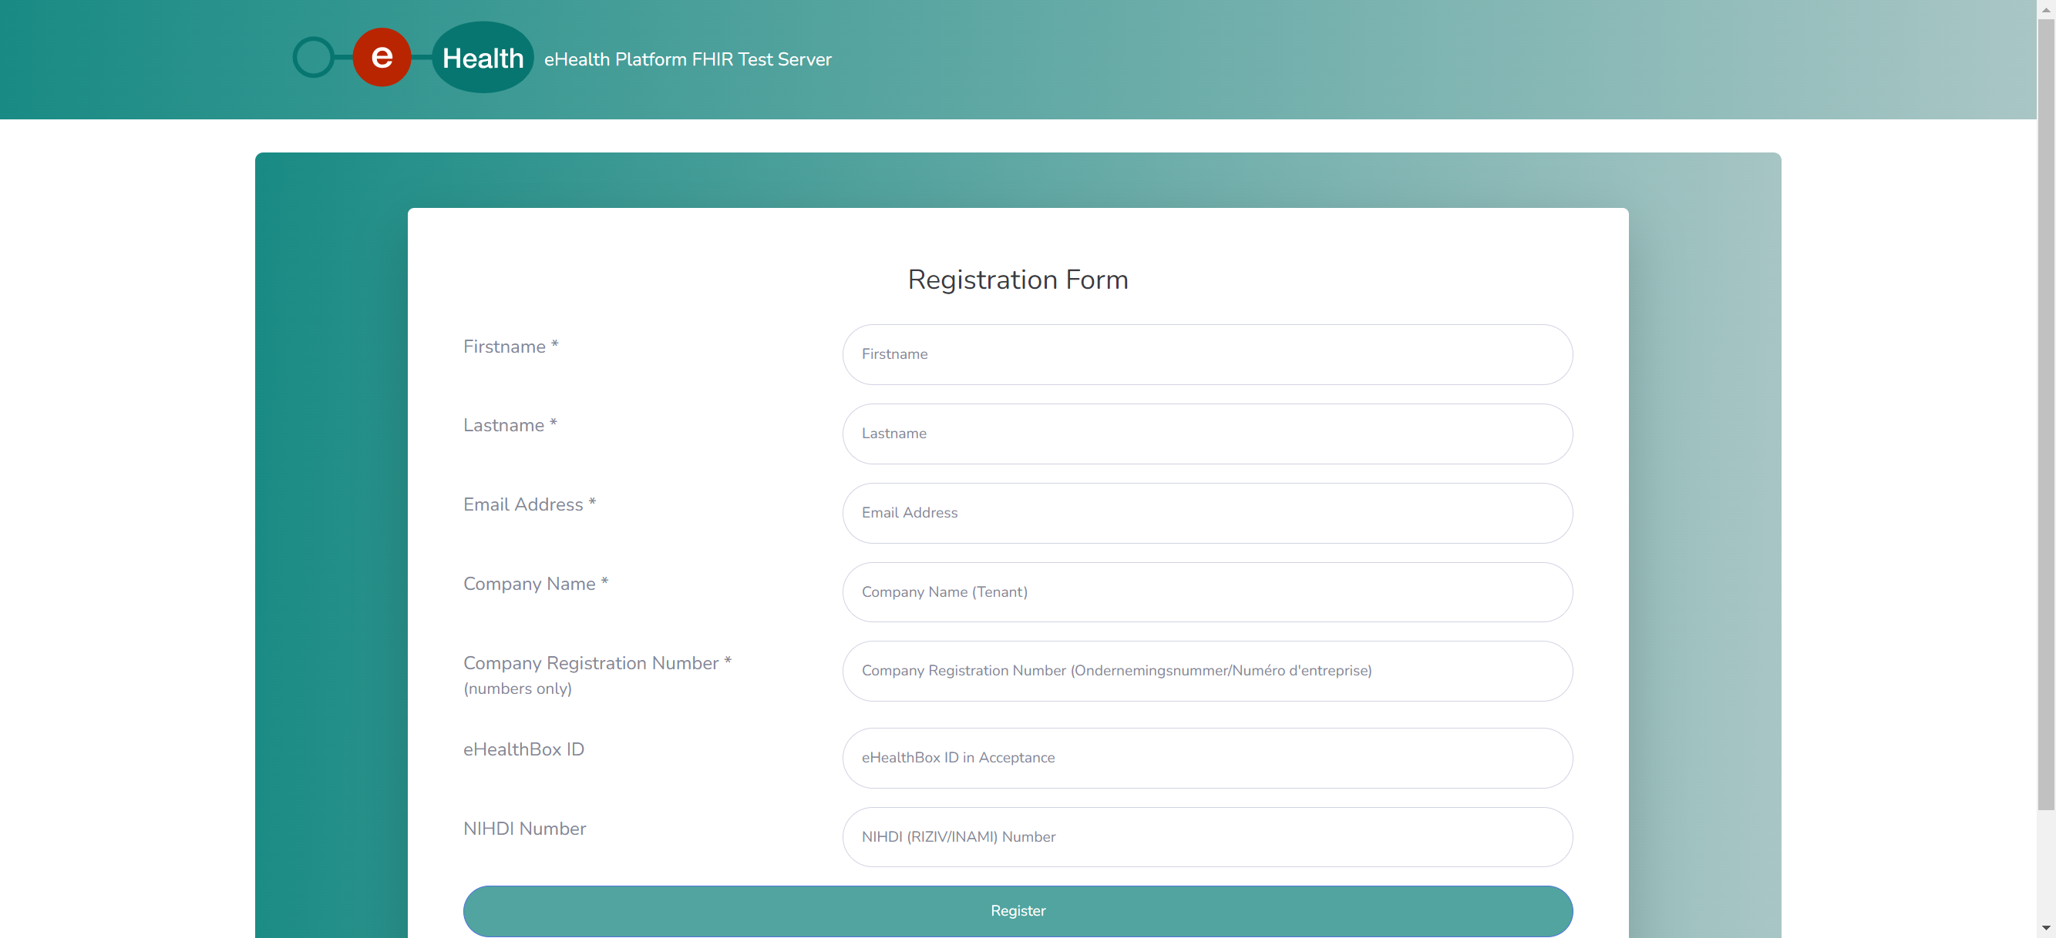
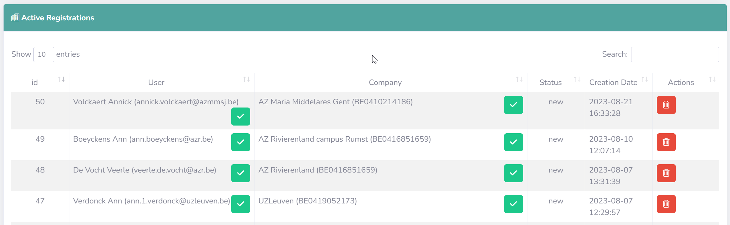
Test server – administration – registration

Slide 18
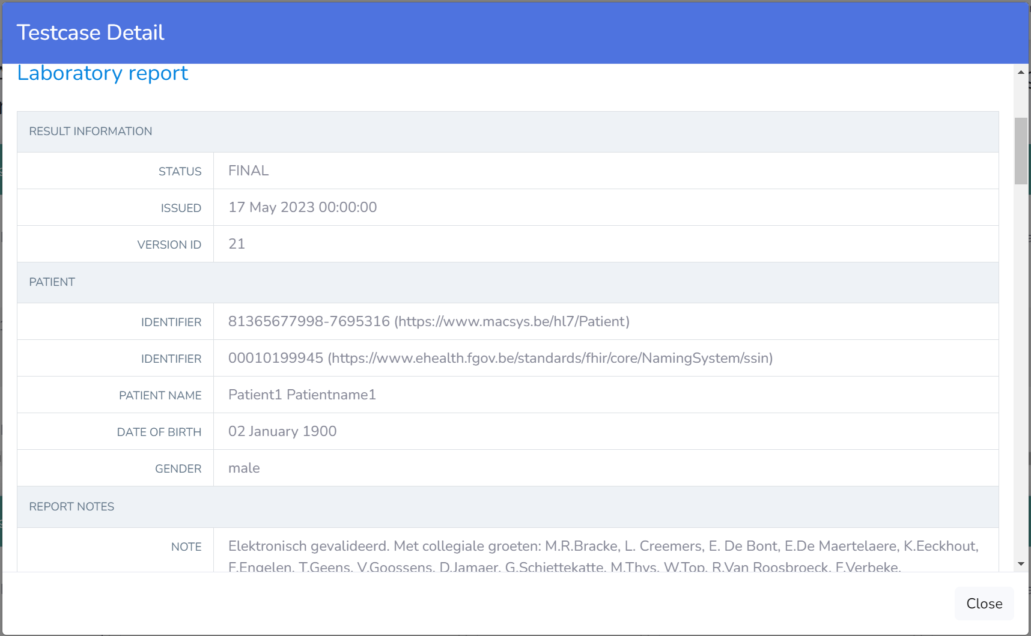
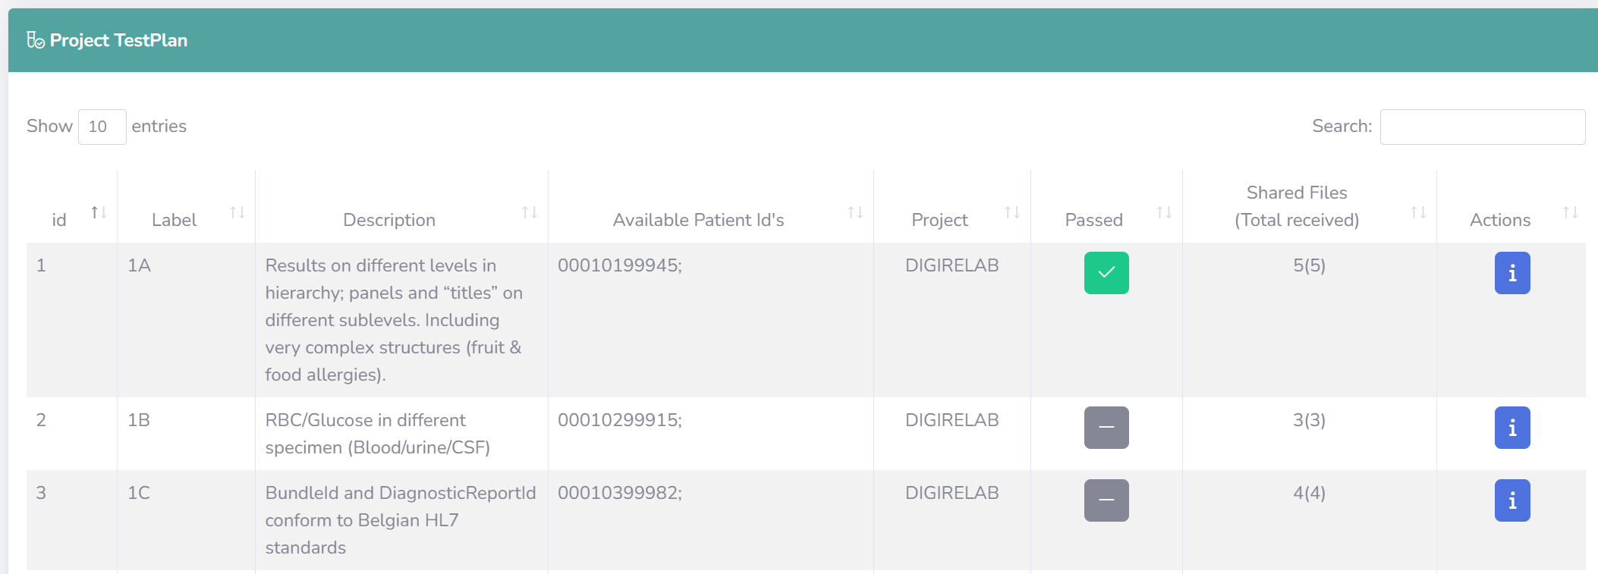
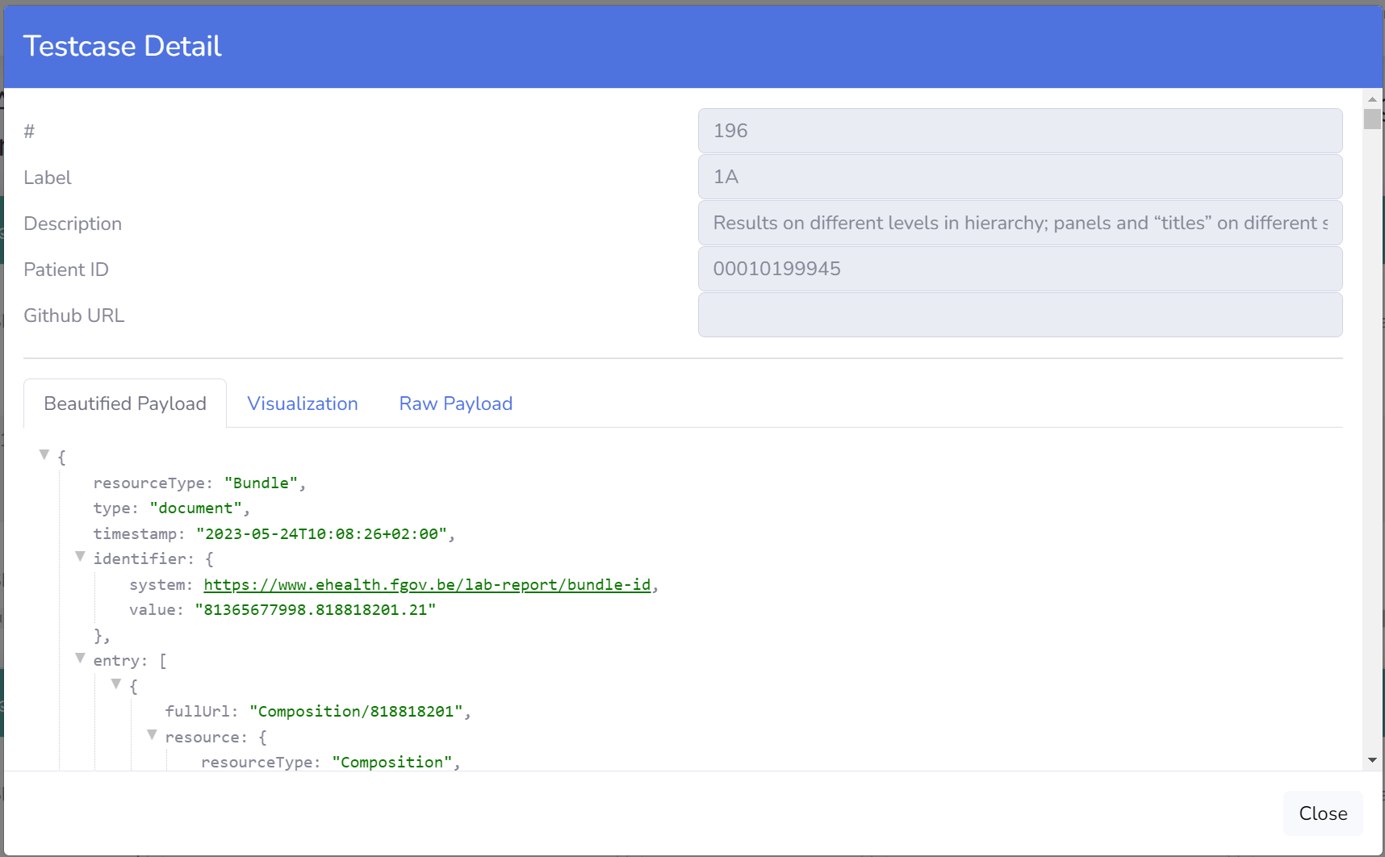
Test server – self service approach

Slide 19
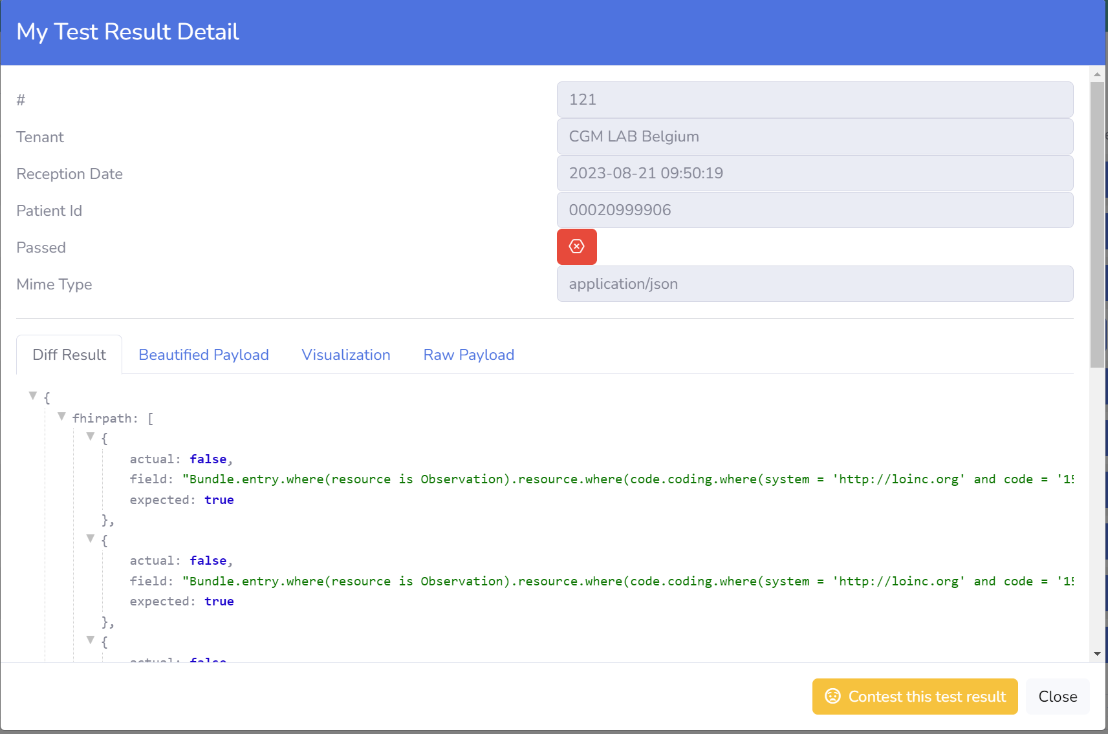
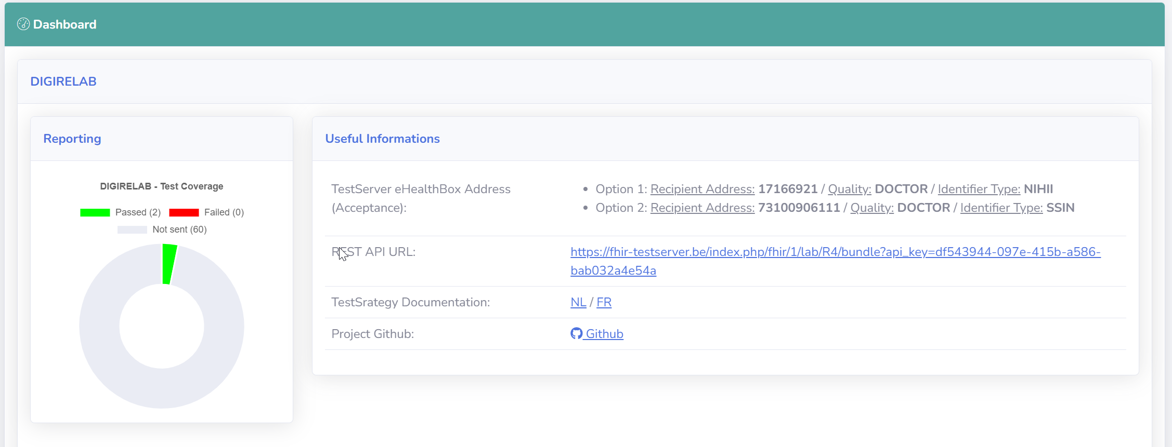
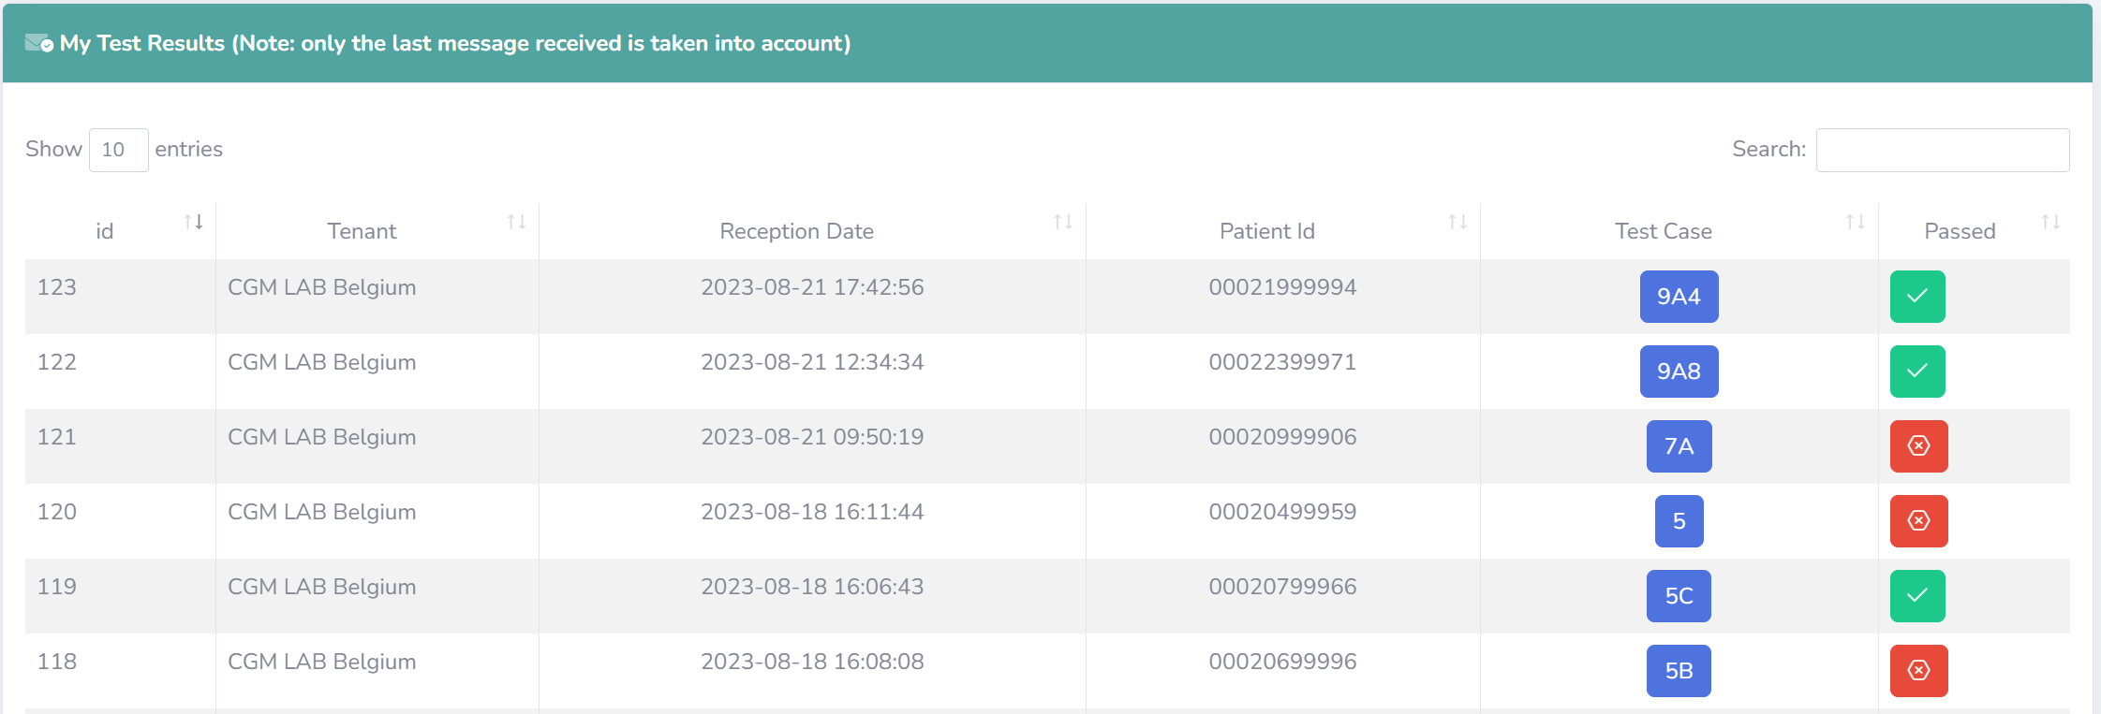
Test server – self service approach

Slide 20



frank.robben@mail.fgov.be
@FrRobben
https://www.frankrobben.be
https://www.ksz.fgov.be
https://www.ehealth.fgov.be

