Slide 1

Digital Testing Environments in Belgium eHN Coordinated Actions
December 4th 2024
Jean-Michel Polfliet
Head of Standardization Team (eHealth Platform Belgium)

Slide 2

EHDS Context
Art 26a EHDS: European digital testing environment
  European Commission shall develop a European digital testing environment and make the software supporting this environment available as open source
  MS shall operate a testing environment, preferably by reusing the software developed by the European Commission
Let’s not reinvent the wheel, but reuse existing components

Slide 3
Compliance criteria
Technical interoperability, eg
  structure of messages
  authentication methods
Semantic interoperability, eg
  identification
  value sets
Quality, eg
  correct handling of use cases
  use of evidence based medicine guidelines
Security & data protection, eg
  confidentiality
  availability
  traceability

Slide 4
Proposal: European Testing Environment
Test environment at the European Commission for certified automated testing of compliance with established criteria on
  technical interoperability
  semantic interoperability
  quality
Use of the tools established in the General Data Protection Regulation (GDPR), eIDAS Regulation and NIS-2 directive for information security and data protection accountability
  data processing impact assessment (DPIA)
  respect of defined eIDAS security levels
  respect of defined cyber security measures

Slide 5
Main Features Belgian Digital Testing Environment
We follow a layered, progressive approach that includes
  Open Interop Sandbox
  pre-Homologation Server
  Interoperability Test Server
  Belgian Homologation Process

Slide 6
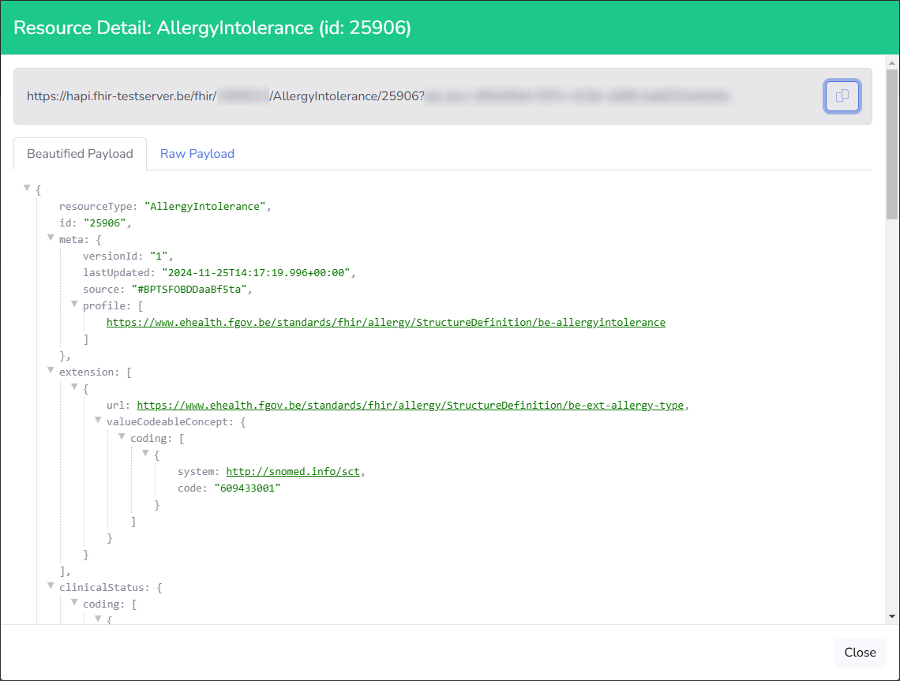
Open Interop Sandbox
Format validation + Sharing (Knowledge Base)
Allows registered Tenants to validate
and share FHIR Resources
  All FHIR resources are “public”

Slide 7
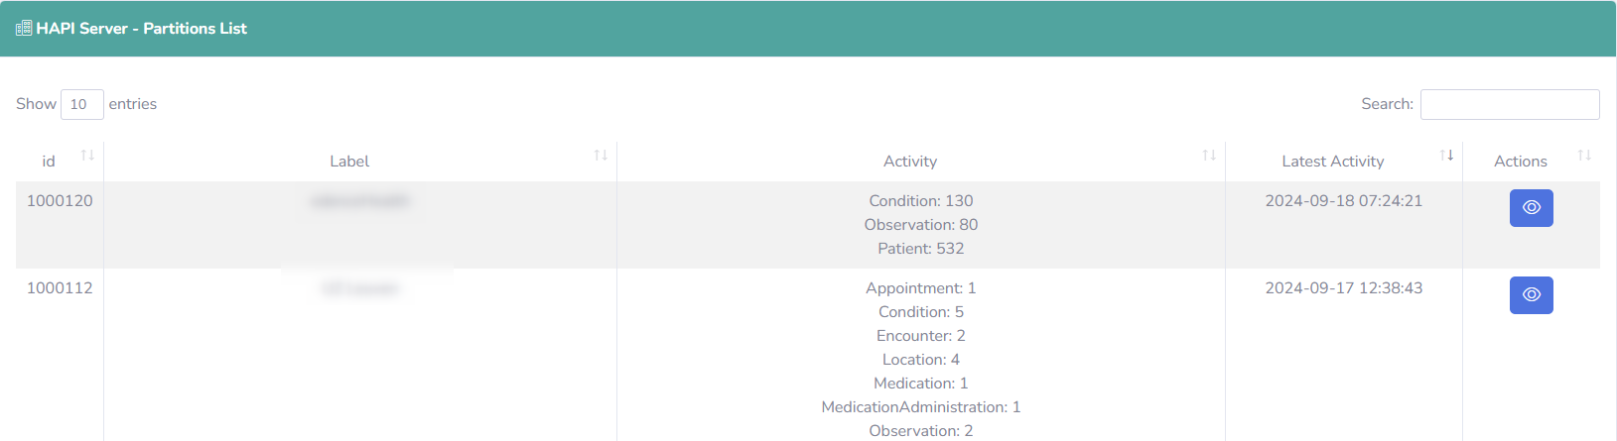
Open Interop Sandbox
Reporting available for Supervisors and Testers
  Measures the number of resources sent by each Tenant

Slide 8
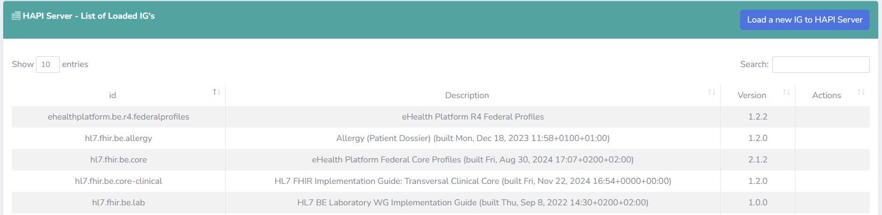
Open Interop Sandbox
Powered by HAPI Server
  Adapted with an Access Layer (Tenant ID + API-Key)
Production and Build FHIR IGs available

Slide 9
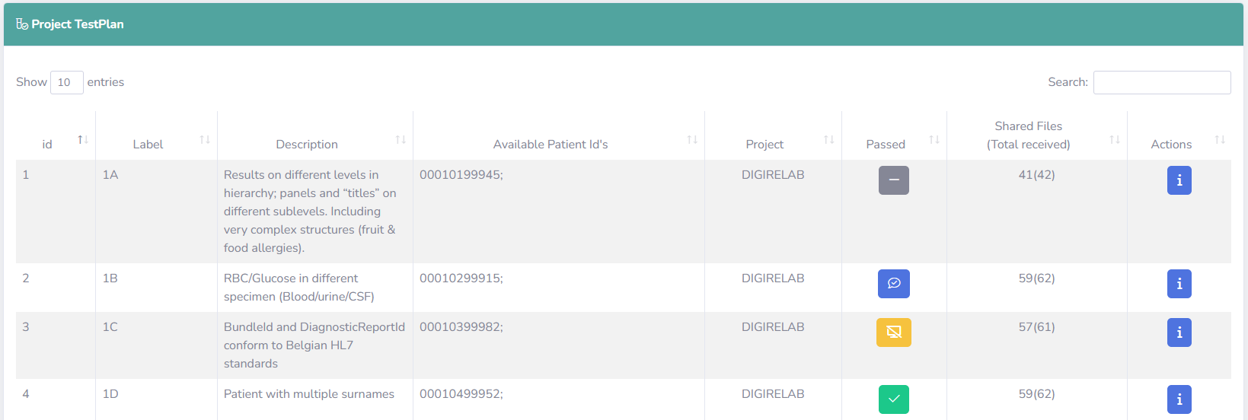
pre-Homologation Server
Format and Content Validation + Sharing (Knowledge Base)
Test plan based on specific Medical Use Cases
  Provided as FHIR Reference Resources

Slide 10
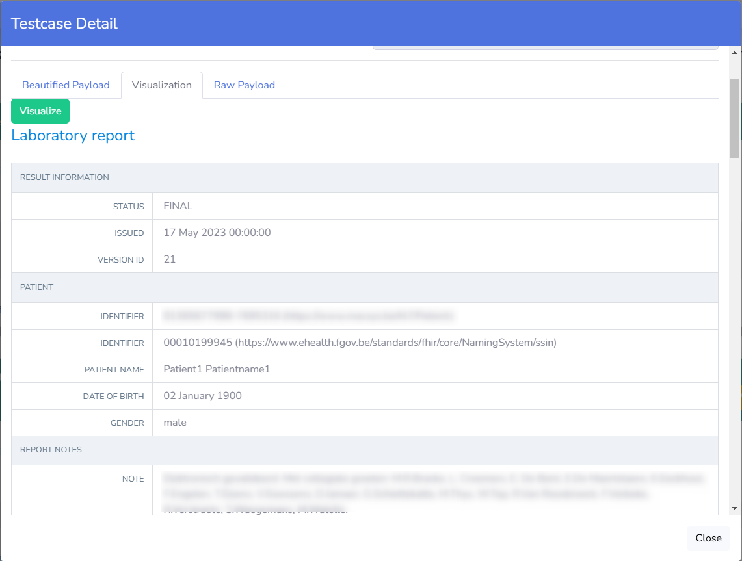
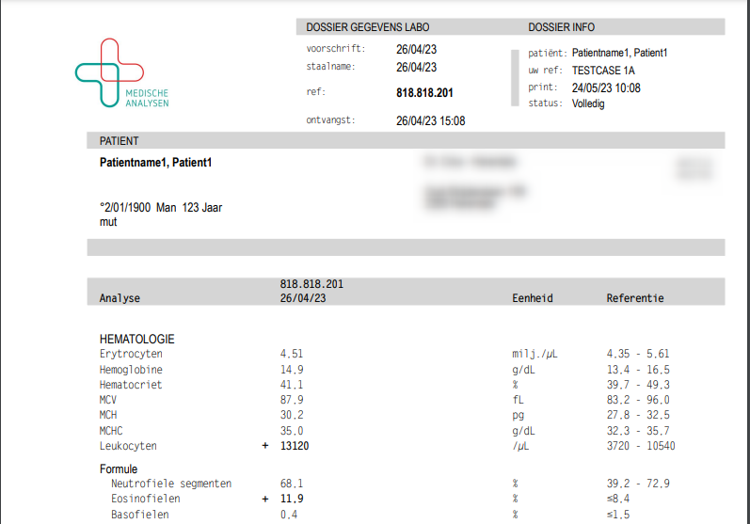
pre-Homologation Server
Submitted resources must exactly match the expected outcome
  Testcases are self-documented on the platform

Slide 11
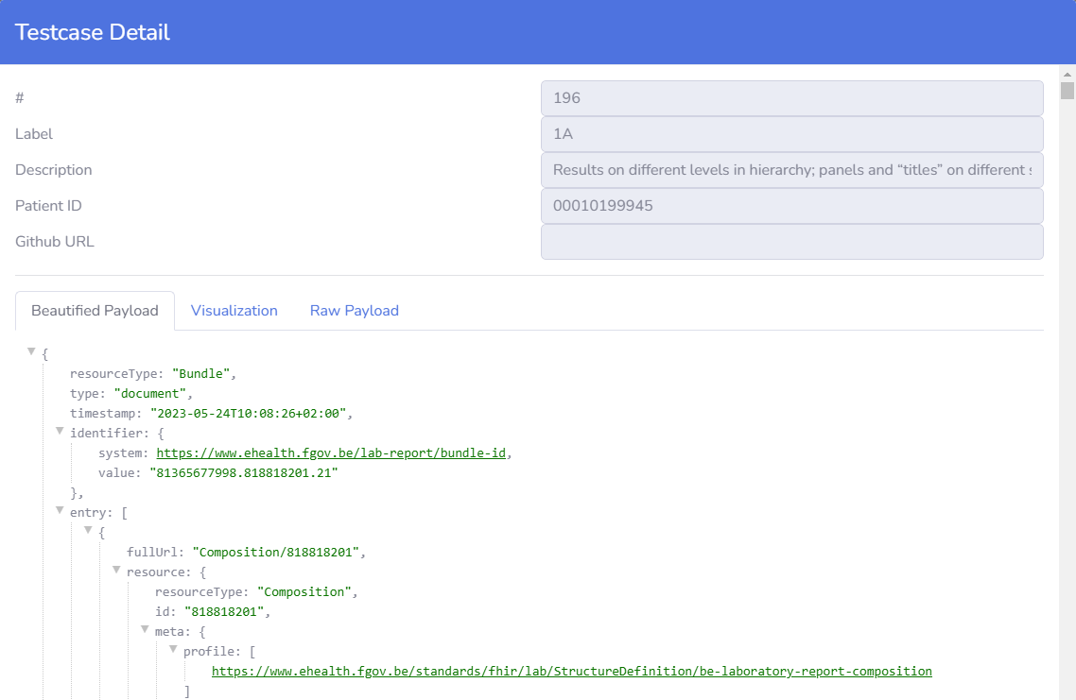
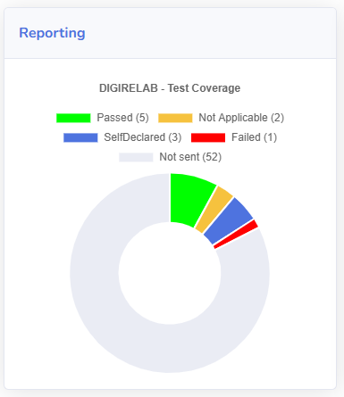
pre-Homologation Server
Submitted resources must exactly match the expected outcome
  Testcases are self-documented on the platform
  Exceptions are defined (i.e.: Timestamps, Practitioners, ..)

Slide 12
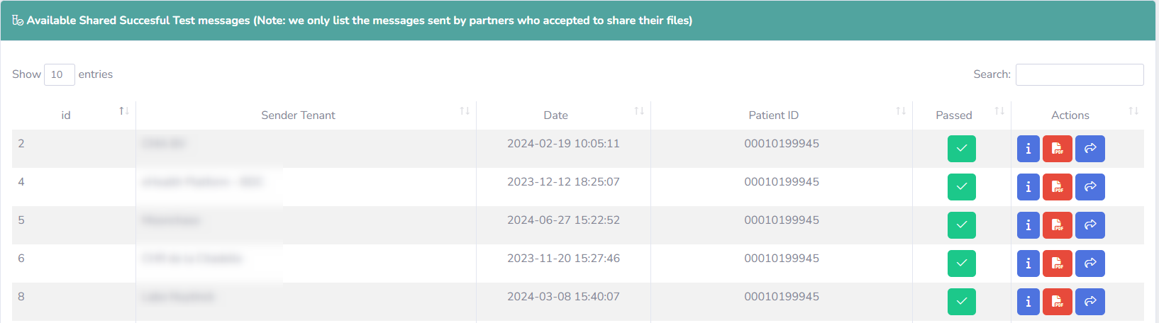
pre-Homologation Server
All FHIR resources are “public” (with opt-out principle)

Slide 13
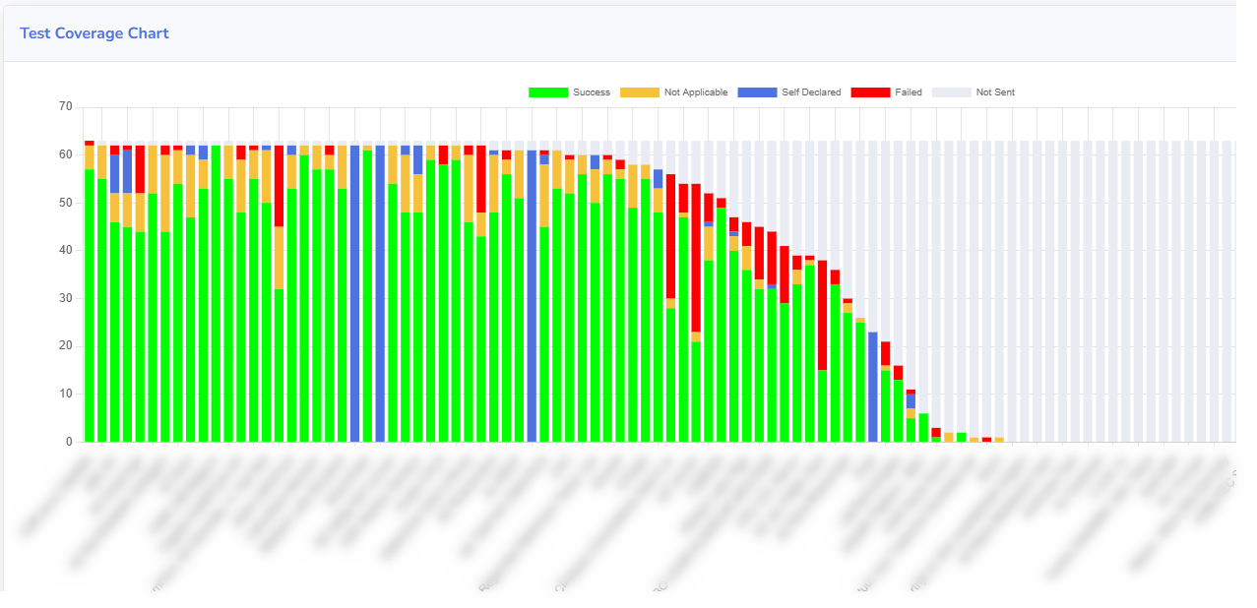
pre-Homologation Server
Supervisor Dashboard allows Test Campaign Follow-up
Note: “Open Interop Sandbox” resources can be used as reference files

Slide 14
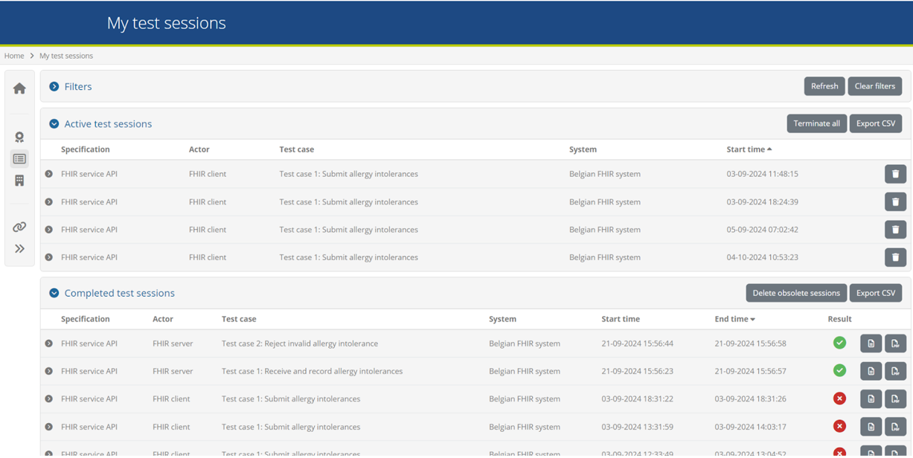
Interoperability Test Server
Format, Content and Workflow Validation
Based on ITB

Slide 15
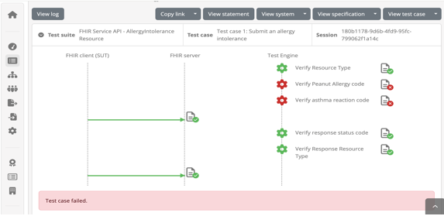
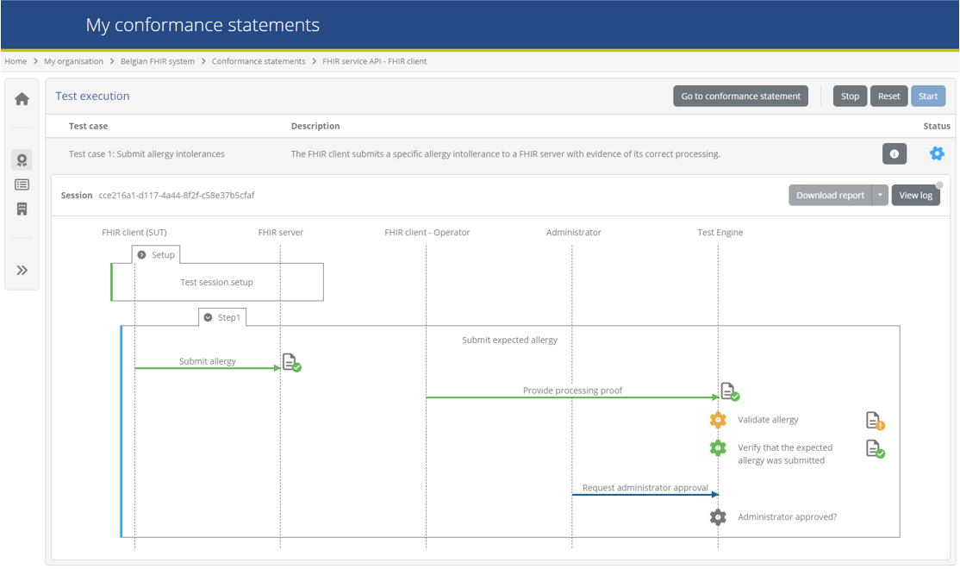
Interoperability Test Server
Client-Server approach
Specific end-to-end tests scenarios
Aligned with EHDS

Slide 16
Belgian Homologation Process
  Format, Content, Workflow Validation + Belgian/Regional Integrations
  Country Specific validation solutions like:
    I.AM Connect
    Pseudonymization
    Timestamping
    Certification

Slide 17
Main Principles
SelfService - 24/7 availability
Designed for Non-Technical testers
  i.e.: HTML FHIR Visualization Tool available
Integrable with Country-Specific Services
  open for country- specific Docker integrations

Slide 18
Q & A

