Slide 1

A testimony on the implementation of information security and data protection in data exchange in the Belgian health sector

Slide 2
Outline
Context
Holistic vision on information security and data protection
Some concrete measures
  structural and institutional measures
    overview
    Information Security Committee
  organizational measures
    Information Security Department and DPO
    minimal information security standards
    Data Protection Impact Assessment (DPIA)
    unique file
  technical measures, eg
    integrated user and access management (UAM)
    circles of trust
Conclusion

Slide 3
Context
Stakeholders of the Belgian health sector
  > 11.764.000 citizens
  > 100.000 healthcare providers (physicians, dentists, clinical labs, pharmacists, physiotherapists, home nurses, …)
  > 300 health care institutions (hospitals, rest and care homes, …)
  sickness funds
  public institutions
    federal level (Ministry of Public Health, National Institute for Health and Disability Insurance (RIZIV - INAMI), Federal Agency for Medicines and Health Products, …)
    regional level

Slide 4
Context – eHealth platform
eHealth platform is a public institution whose mission is
  to promote and support a well-organised, electronic information exchange among all actors in the (health) care sector
  with necessary guarantees related to
    information security
    protection of the personal data of the patients and the health care providers
    professional secrecy
By doing this, the eHealth platform
  optimises the quality and continuity of health care provision
  optimises patient safety
  simplifies the administrative formalities for all (health) care actors
  (pro-)actively supports health care policy making and evaluation

Slide 5
Context – eHealth platform: 10 tasks
Developing a vision and of a strategy regarding eHealth
Being the motor of the necessary changes for the implementation of the vision and the strategy regarding eHealth
Organizing the cooperation between all governmental institutions charged with the coordination of electronic service provision
Determining functional and technical norms, standards, specifications and basic architecture with regard to eHealth
Registering software for the management of electronic patient files

Slide 6
Context – eHealth platform: 10 tasks
Managing and coordinating the ICT aspects of information exchange with regard to electronic patient files and electronic care prescriptions
Conceiving, designing and managing a cooperation platform for secure information exchange with relevant basic services
Reaching agreements about division of tasks and about quality standards, and checking that the quality standards are being fulfilled
Acting as an independent trusted third party (TTP) for the encoding and anonymization of personal information regarding health
Promoting and coordinating programmes and projects

Slide 7








Context – eHealth platform: architecture
Patients, health care providers
and health care institutions
Site Ministry
Software health care professional
Software health care institution
VAS
Site RIZIV
VAS
eHealth-portal
MyCareNet
VAS
VAS
VAS
Users
Basic services
eHealth-platform
Network
AS
AS
AS
AS
AS
AS
Suppliers
Notes:
7
7

Slide 8
Context – eHealth platform: basic services
Coordination of the electronic processes
Portal
Integrated user and access management system
Management of loggings
System for end-to-end encryption
eHealthBox
Timestamping
Coding and anonymising
Consultation of National register and CBSS registers
Reference directories (hub-metahub system)

Slide 9










Context – eHealth platform
47.578 Healthcare professionals have a eHealth certificate
> 93,6 %
of Belgian citizens have given
an informed consent for data sharing
118 million
messages/year
via eHealthBox
2023
Electronic prescriptions
20.596.000.000
digital transactions
16 million/month from doctors
5.562.891
Belgian patients with
Summary Electronic Health Records
28.000 prescribing doctors
average of 11,5 millions prescriptions handled by pharmacists
  36.525.073
  documents consulted in general hospitals
2,192,127
Belgian patients with
Medication schedule

Slide 10
Global vision
Modern technologies can bring enormous benefits and added value, but they must be deployed with the right safeguards for the fundamental right to data protection
International treaties and the Belgian constitution provide for a whole series of fundamental rights: in addition to the right to data protection, there is also the right to a fair trial, the right to social protection, the right to high-quality healthcare, ...
Citizens can expect the government to ensure their right to data protection in a way that also respects their other fundamental rights
Possible drawbacks should be avoided, but benefits should not be unnecessarily obstructed
Risk management and data protection-by-design and a multidisciplinary approach are key concepts in this

Slide 11

Use case: support security of the information
Use case : the exchange of medical information between the different actors of healthcare provides an optimization of speed and quality in the healthcare while it contributes to direct savings
  different actors need to trust each other when exchanging this sensitive information
  access to this information needs to be controlled
  level of security needs to be guaranteed by all users of this information.
Development of minimum security standards
Facilitating this work group to develop the standard
Publishing
Availability of the ISO 2700x standard for hospitals
Development of implementation guidelines fopr these minimal standards
Early Warning for threats to hospitals
CCB warns eHealth platform in case of reported threats and vulnerabilities
eHealth Platform coordinates information flow to hospitals
Extends support into other initiatives such as “wehelpourhospitals.be
eHealth Platform is distributing as well general messages as tailor made messages to hospitals based on the type of information with proven results

Slide 12
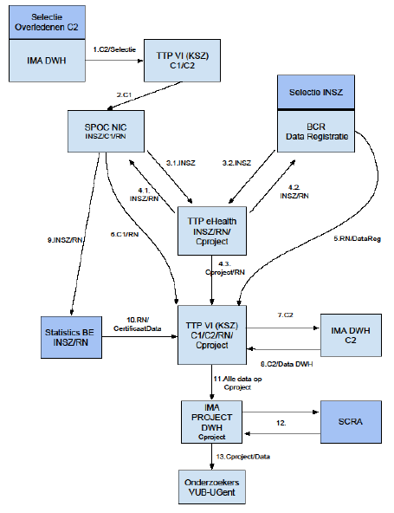
Use case : protect the privacy of the individuals
eHealth Platform has the role of “trusted third party”
Supports the preparation of medical and social information for policy and scientific research while preserving the privacy of the concerned individuals
Gives access to pseudonymized or anonymized information to policy makers and researchers
Multiple layers of security with pseudonymization of the information and data minimization
Sample of used Personal Data Preserving Techniques
pseudonymization of sources and results
pseudonimization during processing avoiding readable identifiers linked to information
aggregation
small cell risk analysis
encryption of data

Slide 13

Use case: development of application safeguarding the privacy
Fundamental right to health
  capability of early warning of a high risk contact with an infected person
    part of the exit strategy of the Corona Task Force
  increase of speed of alert
  increase exhaustiveness of the contact tracing while controlling the costs
Fundamental right to data protection
  protection of the privacy
  limiting information transferred to public institutions
Coronalert solution: data protection by design
  based on DP3T solution
    limited exchange of anonymous information
    risks determined by personal handheld device without feedback to central system
  linked to health databases while preserving the privacy on central platform

Slide 14
Vision on information security
Security, availability, integrity and confidentiality of information is ensured by integrated structural, institutional, organizational, HR, technical and other security measures, according to agreed policies
Personal information is only used for purposes compatible with the purposes of the collection of the information
Personal information is only accessible to authorized actors and users according to business needs, legislative or policy requirements
The access authorization to personal information is granted by an Information Security Committee, designated by Parliament, after having checked whether the access conditions are met
The access authorizations are public

Slide 15
Vision on information security
Every actual electronic exchange of personal information is logged, to be able to trace possible abuse afterwards
Every person has the right to access and correct his/her own personal data
Every health institution disposes of an data protection officer with an advisory, stimulating, documentary and control task

Slide 16
Structural and institutional measures
No central data storage
Availability of free of charge, basic information security services
  user- & access management
  encryption
  logging
  reference directories
  …
Independent Information Security Committee designated by the Parliament

Slide 17
Information Security Committee (ISC)
Not a supervisory authority as defined by GDPR
Set up by law of September 5th 2018
Composition
  Chamber Social Security and Health
  Chamber Federal Government
  independent members designated by Parliament
Tasks
  delivering deliberations with normative value (=> legal certainty for the data controllers) regarding
    the exchange of personal data
    the processing of pseudonymized and anonymous data
  retaining and publishing of deliberations
  defining good practices
  supporting DPOs
  publishing a yearly activity report

Slide 18
Considerations in the deliberations
Lawfulness and purpose limitation
  is the processing serving a legitimate purpose?
  are the purposes of the processing well defined ?
Data minimization
  is the processing using the minimal dataset to achieve the purposes ?
  storage limitation
Integrity and confidentiality
  measures on how to guarantee both parameters
Transparency for the data subjects

Slide 19
Lawfulness principle
Article 5 1 (a) GDPR: “Personal data shall be processed lawfully, fairly and in a transparent manner in relation to the data subject (‘lawfulness, fairness and transparency’)”
Consideration 41 GDPR: “Where (GDPR) refers to a legal basis or a legislative measure, this does not necessarily require a legislative act adopted by a parliament, without prejudice to requirements pursuant to the constitutional order of the Member State concerned. However, such a legal basis or legislative measure should be clear and precise and its application should be foreseeable to persons subject to it, in accordance with the case-law of the Court of Justice of the European Union (the ‘Court of Justice’) and the European Court of Human Rights”
Important role of the Information Security Committee composed of independent, multidisciplinary people designated by Parliament delivering very detailed and public decisions with normative value

Slide 20
Organizational measures
Information security department headed by DPO with each health care institution
Specialized information security service providers
Need for compliance with minimal information security and data protection standards (minimale normen / normes minimales), based on the cyber security fundamentals elaborated by the Belgian Centre for Cyber Security (CCB)
Information security working parties developing information security policies
Data Protection Impact Assessments (DPIA)
Unique file (dossier unique / uniek dossier)

Slide 21
Organizational measures
Yearly assessment of compliance with minimal security standards
  questionnaire sent out to all hospitals
  checked by the security service of the eHealth-platform
  reviewed in the Information Security work group
Security requirements reviewed on regular basis
Internal audits with continuous improvement plans => independent auditor reporting on findings

Slide 22
Information Security Department
Legal obligation for hospitals since 1993
  assignment of a DPO
  advices controller on privacy and security
  can be assigned additional tasks as long as this does not conflict with the mission of a DPO
Role of the information security department
  each institution has to set up a security department
    stimulates information security
    documents the information security related topics
    checks on compliance
    reports on information security and privacy
  the DPO the is head of the security department

Slide 23
Role of the DPO eHealth platform
Leads the security department of thr eHealth platform
All tasks as specified in article 39 of GDPR
Stimulates the elaboration of minimal security standards
Advises on GDPR compliance
  informs management and co-workers on compliance needs
  supports in setting up the record of processing
  participates in running the DPIA
  plans for regular review of the DPIA
Supports in information security incident and threat management
Plans internal audits

Slide 24
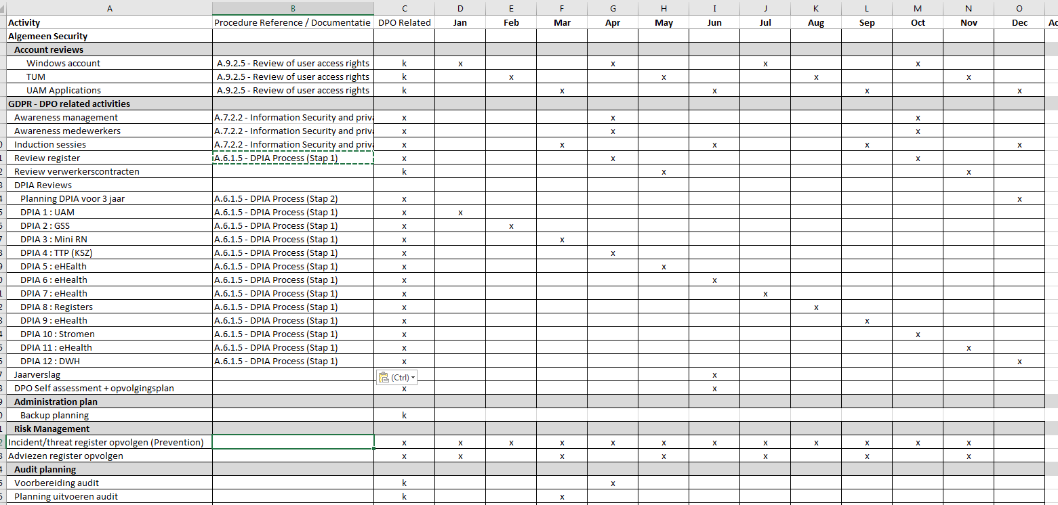
Role of the DPO
It is about ad hoc tasks…
  advice upon request
  incident management
… and planned works
  DPIA review planning
  check on registers
  …

Slide 25
Minimal standards
Developed by information security working parties => buy in !
Approved by the independent Information Security Committee
Based on ISO 27000 standards, adapted for health care
Defines 15 areas of security
Enforced, gradually, for all health care institutions
Extended with policy guidelines
  minimal standards refer to policy guidelines for more detail
  policy guidelines provide support for concrete implementation

Slide 26
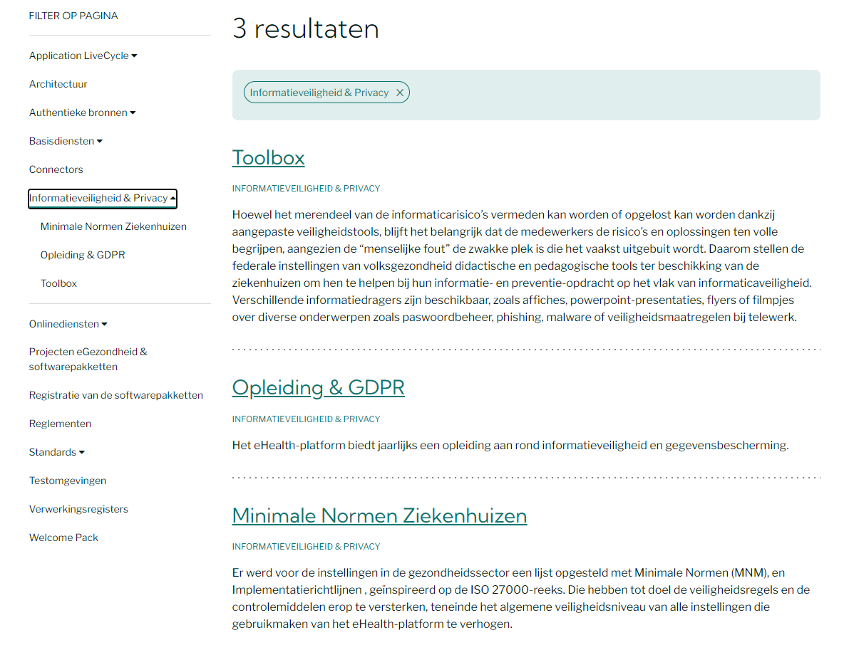
https://www.ehealth.fgov.be/ehealthplatform/nl/search?search_facet%5B0%5D=platform_search_facet:AV6A1mFuF8ajCJOhPdV-

Slide 27
Topics covered by minimal information security standards
Basic principles
Information security policies
Organisation of information security
  internal organisation
  mobile equipment and remote working
Security measures for employees and co-workers
Management of company assets
Access control (logical)
Encryption
Physical security

Slide 28
Topics covered by minimal information security standards
Operations management
Protecting communications
Procurement, design, development and maintenance of systems
Supplier management
Incident management
Business continuity
Compliance

Slide 29
Minimal standards: data classification
5 levels of data sensitivity classification
  4 -> top secret
  3 -> secret, high classified
  2 -> confidential, classified
  1 -> unclassified, sensitive
  0 -> unclassified, public
Each type of data is linked to a sensitivity classification
  see next slide
Each type of classification has the data handling guidelines
  how to transport,
  use in test, development, acceptance,
  authentication level for access,
  ….

Slide 30
Data Protection Impact Assessment (DPIA)
A Data Protection Impact Assessment (DPIA) is a process to help you identify and minimize the data protection risks
A DPIA is completed for every processing that is likely to result in a high risk to individuals; this includes some specified types of processing
It is also good practice to do a DPIA for any other major project which requires the processing of personal data
The DPIA must
  describe the nature, scope, context and purposes of the processing
  assess necessity, proportionality and compliance measures
  identify and assess risks to individuals
  identify measures to mitigate those risks

Slide 31
Data Protection Impact Assessment (DPIA)
To assess the level of risk, one must consider both the likelihood and the severity of any impact on individuals. High risk could result from
  a high probability of some harm
  a lower probability of serious harm
The DPIA implicates the DPO and, where appropriate, individuals and relevant experts; any processors may also need to assist
If a high risk is identified, the supervisory authority must be implicated before starting the processing

Slide 32
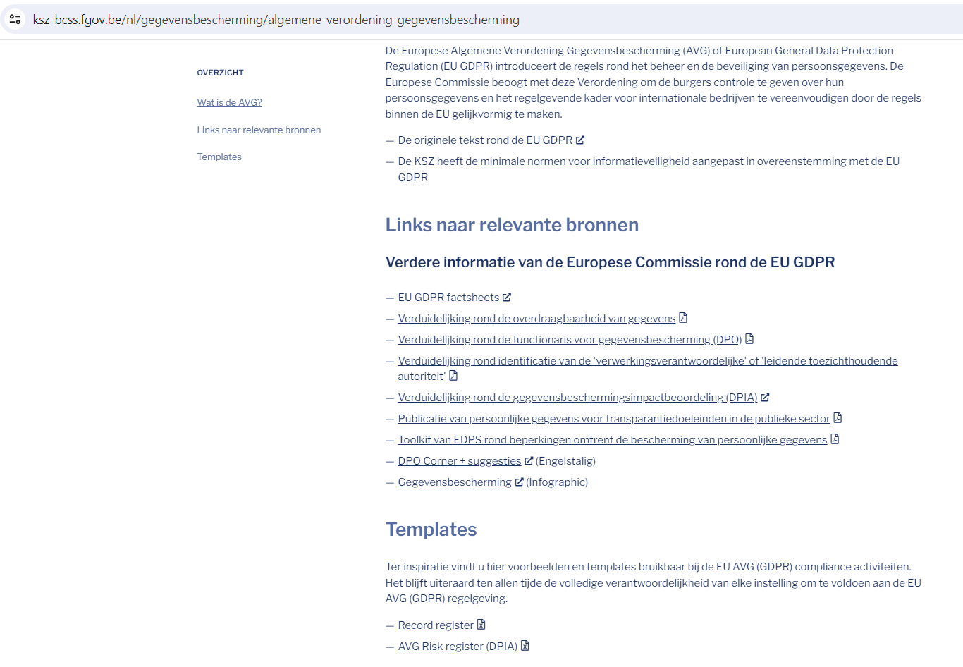
Executing the DPIA
CBSS has developed a template for executing the DPIA
https://www.ksz-bcss.fgov.be/nl/gegevensbescherming/algemene-verordening-gegevensbescherming

Slide 33
First sheet: basic screening
Basic screening determines whether a DPIA is required
Developed based on following criteria
  article 35 GDPR
  consideration 75 GDPR
  recommendation of the Belgian Data Protection Authority
  Working Party 29 – guidelines for DPIA
As soon as 2 risks are present, the DPIA is required

Slide 34
Second sheet: risk assessment & management
If a DPIA is required, perform a risk assessment of the processing
  check what risks in the tool are relevant for the processing
  the controller participates in this part of the exercise
Next, describe the existing information security and data protection measures in the DPIA
Consider the residual risks
If the residual risks are above the acceptable level, try to apply additional information security and data protection measures in order to get the residual risk under the acceptable level of risk
In case residual risks above acceptable level cannot be remediated, the controller has to consult the Data Protection Authority before starting the processing

Slide 35
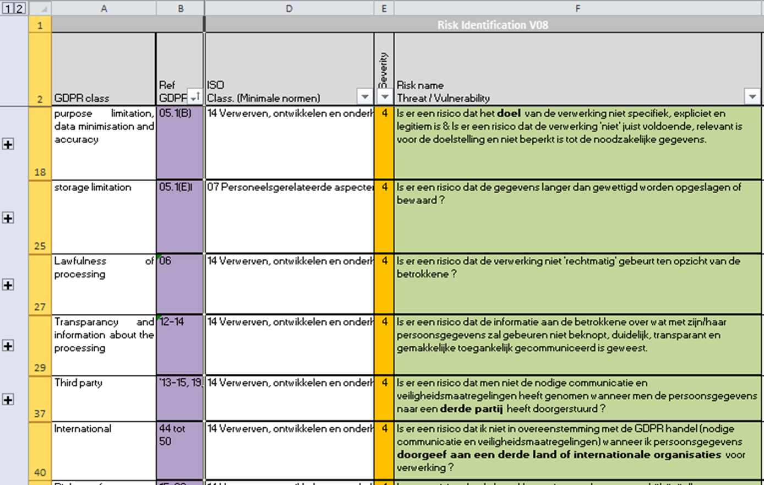
Template: list of risks based on GDPR

Slide 36
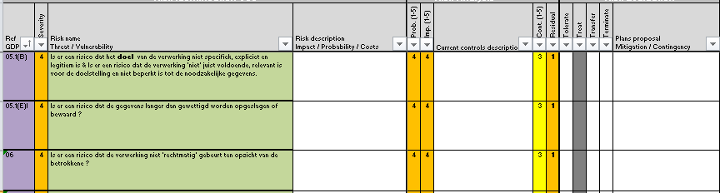
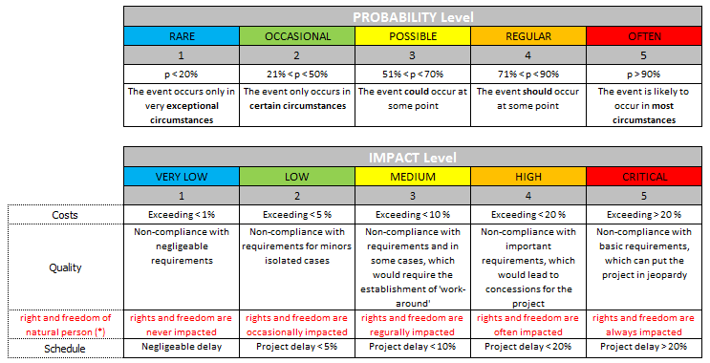
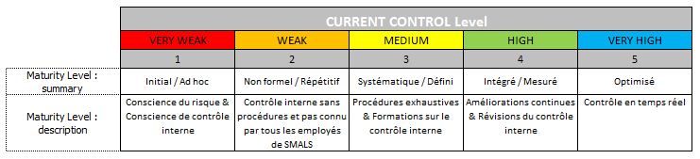
Template: risk evaluation
Initial risks and risk mitigation
(security controls)
Remaining risks

Slide 37
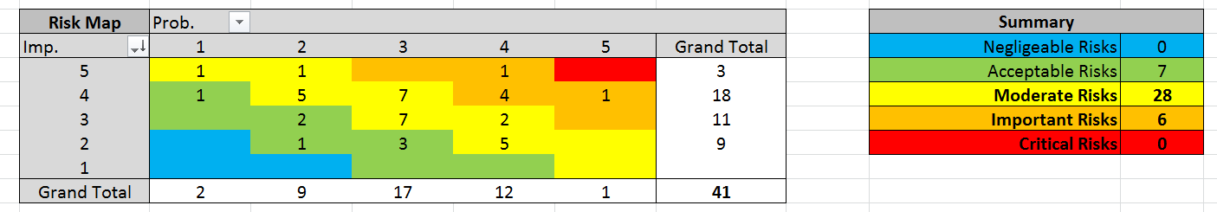
Template: heat maps initial risk

Slide 38
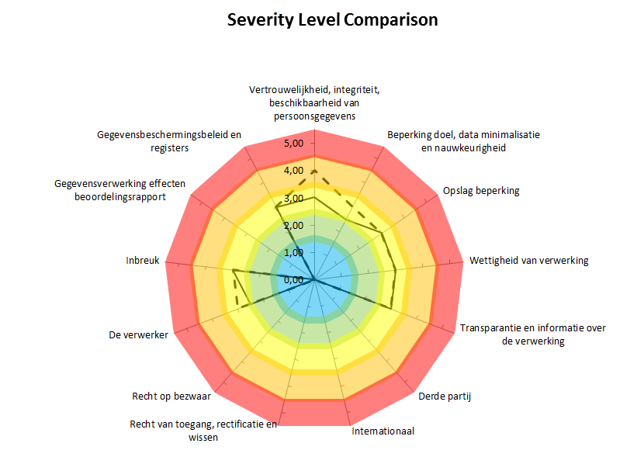
Template: intermediate result

Slide 39
Template: end result

Slide 40
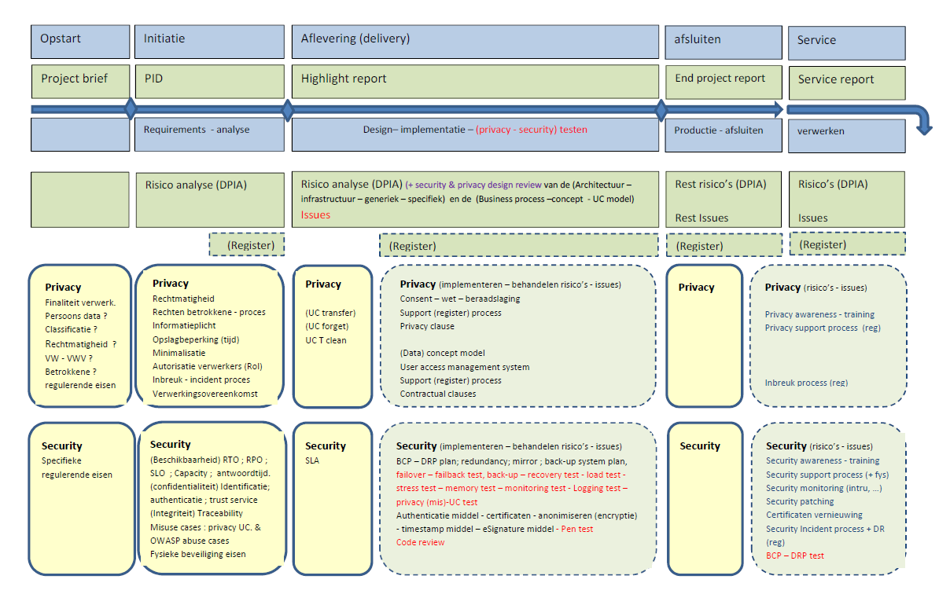
DPIA: as from start up of project to delivery

Slide 41
DPIA and production services
During the lifecycle of a service, it is advised to regularly review the DPIA
  changing conditions
  major changes to technology
  changing risks on the market
eHealth platform does review the DPIAs every 3 years

Slide 42
Unique file
Goals
  centralizing all information required to approve the service prior to commissioning the service in line with guidelines regarding information security and data protection
  meeting the documentation requirement of GDPR
Content
  purposes of the processing
  high level technical design
  categories of data subjects and data
  types of users
  security measures, ao
    user authentication level
    user authorization system
    user activity logging
  DPIA if available
Elaborated for every new service
Updated and approved for major changes to existing services

Slide 43
Technical measures: eHealth platform basic services
Coordination of the electronic processes
Portal
Integrated user and access management system
Management of loggings
System for end-to-end encryption
eHealthBox
Timestamping
Coding and anonymising
Consultation of National register and CBSS registers
Reference directories (hub-metahub system)

Slide 44

eHealth certificates
Provided free of charge by the eHealth platform to
  healthcare providers and healthcare institutions
  developers of software for healthcare providers and healthcare institutions
Functionalities
  possibility for the healthcare provider or the healthcare institution to authenticate their software when accessing web services, for example by requesting an access token allowing access to these services
  ability to encrypt and decrypt messages, e.g. when using the eHealthBox
  together with the matching password, fallback for the authentication of a healthcare provider whenever authentication with his eID is not possible

Slide 45
eHealth certificates
Can be requested and installed through an application that can be downloaded from the website of the eHealth Platform
  https://www.ehealth.fgov.be/nl/beroepsbeoefenaars-in-de-gezondheidszorg/diensten/beheer-van-de-ehealth-certificaten
If password is lost, the existing certificate must be revoked and a new certificate should be requested (to be paid for if too frequent)
More information
  https://www.ehealth.fgov.be/ehealthplatform/nl/service-ehealth-certificaten

Slide 46

Integrated user and access management
Ensures that healthcare providers and institutions can only access
  the services they are authorised to
  regarding the individuals for whom they are authorised to do so
Access rules are established by law and by the authorisations of the Information Security Committee
Steps
  user identification
  authentication of the user’s identity
  verification of qualifications (e.g. doctor, pharmacist)
  verification of relationships (e.g. (health) care relationship with patient)
  authorisation
More information
  https://www.ehealth.fgov.be/ehealthplatform/nl/service-i.am-identity-access-management

Slide 47
UAM: user expectations
One-time registration of identity, characteristics, relationships and mandates
Single sign on for as many public and private sector applications as possible
  authentication of the identity
  verification of relevant characteristics, relationships and mandates
Electronic means for authentication of identity that can be used on as much devices as possible
Minimal cost of
  registration procedures
  electronic means for authentication of identity
  use of electronic means for authentication of identity

Slide 48
Division of tasks
Registration of the identity of
  citizens: municipalities
  companies: company counters
Official identification document for citizens
  delivered by the municipalities (eID)
Means for the electronic authentication of identity
  free choice for user between means offered
    by the government or
    by the private sector, recognized by the government
  free of charge for user

Slide 49
Division of tasks
Registration of characteristics, relationships and mandates relevant for eGovernment or eHealth
  by public or private bodies designated by government
  with quality assurance
Authentic sources containing characteristics, relationships and mandates relevant for eGovernment or eHealth
  managed by public or private bodies designated by government
  with SLA’s
  according to a federated model
  accessible by UAM
    for eGovernment and eHealth applications
    for private sector applications
Authorization is the responsibility of each service provider

Slide 50
Integrated user and access management

Slide 51
Policy Enforcement Point (PEP)
Intercepts the request for authorization with all available information about the user, the requested action, the resources and the environment
Passes on the request for authorization to the Policy Decision Point (PDP) and extracts a decision regarding authorization
Grants access to the application and provides relevant credentials
Action on application
DECLINED
Policy
Enforcement
(PEP)
Action on application
ALLOWED
User
Application
Action on application
Decision
request
Decision
answer
Policy Decision
(PDP)

Slide 52
Policy Decision Point (PDP)
Based on the request for authorization received, retrieves the appropriate authorization policy from the Policy Administration Point(s) (PAP)
Evaluates the policy and, if necessary, retrieves the relevant information from the Policy Information Point(s) (PIP)
Takes the authorization decision (permit/deny/
not applicable) and sends it to the PEP
Policy
Enforcement
(PEP)
Decision
request
Decision
answer
Fetch
Policies
Policy
Decision
(PDP)
Information
Question/Answer
Information
Question/Answer
Policy
Administration
(PAP)
Policy
Information
(PIP)
Policy
Information
(PIP)

Slide 53
Policy Administration Point (PAP)
Environment to store and manage authorization policies by authorized person(s) appointed by the application managers
Puts authorization policies at the disposal of the PDP
Fetch
Policies
Policy
Decision
(PDP)
Authorisation management
Policy
Administration
(PAP)
Administrator
Policy repository

Slide 54
Policy Information Point (PIP)
Puts information at the disposal of the PDP in order to evaluate authorization policies (authentic sources with characteristics, relationships, mandates, etc.)
Policy
Decision
(PDP)
Information
Question/Answer
Information
Question/Answer
Policy
Information
(PIP)
Policy
Information
(PIP)
Authentic source
Authentic source

Slide 55
Federated architecture
Sector/country A
Sector/country B
Sector/country C
USER
USER
USER
APPLICATIONS
APPLICATIONS
APPLICATIONS
Authen
-
Authorisation
Authen
-
Authorisation
Authen
-
Authorisation
tication
PEP
WebApp
tication
PEP
WebApp
tication
PEP
WebApp
Role
XYZ
Role
XYZ
Role
XYZ
Mapper
Mapper
Mapper
Role
Role
Role
Mapper
Mapper
Mapper
DB
DB
DB
PDP
Role
PAP
PDP
Role
PAP
PDP
Role
PAP
Role
Provider
‘’Kephas’’
Role
Provider
‘’Kephas’’
Role
Provider
‘’Kephas’’
Provider
DB
Provider
DB
Provider
DB
PIP
PIP
PIP
PIP
PIP
PIP
PIP
PIP
PIP
Attribute
Attribute
Attribute
Attribute
Attribute
Attribute
Attribute
Attribute
Attribute
Provider
Provider
Provider
Provider
Provider
Provider
Provider
Provider
Provider
Management
Management
DB
DB
Management
DB
RIZIV
DB
DB
UMAF
DB
Judicial
exut-
ers
XYZ
DB
Mandates
XYZ
VAS
Mandates
XYZ
VAS
XYZ
VAS

Slide 56
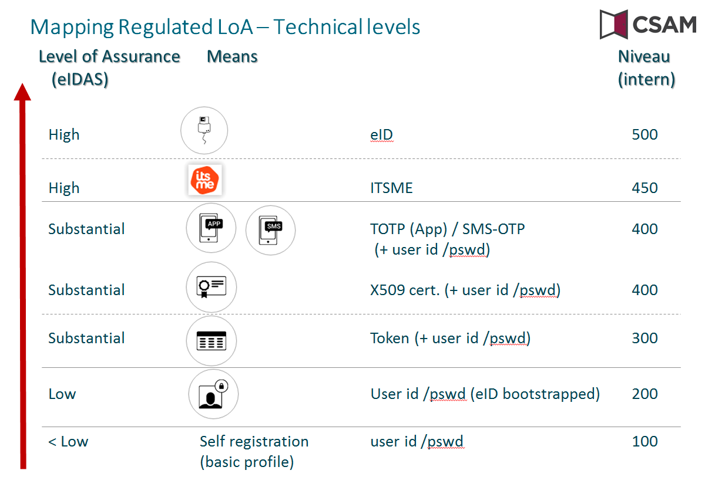

Authentication of identity: different levels
/ MyGov.be

Slide 57
Informed consent to data sharing,
(health) care relationship and access matrix
A healthcare provider or institution can only access the health data of a healthcare user that are available at a third party if
  the healthcare user has given his informed consent to share health data
  the healthcare provider or institution has a (health) care relationship with the healthcare user
    the rules on how a care relationship is proved are established in regulations for the different types of care providers and institutions
  the healthcare provider is not excluded by the healthcare user from accessing his health data
  if the health data in question can be accessed by the type of healthcare provider concerned (the so-called access matrix)
    the access matrix is defined in a regulation

Slide 58
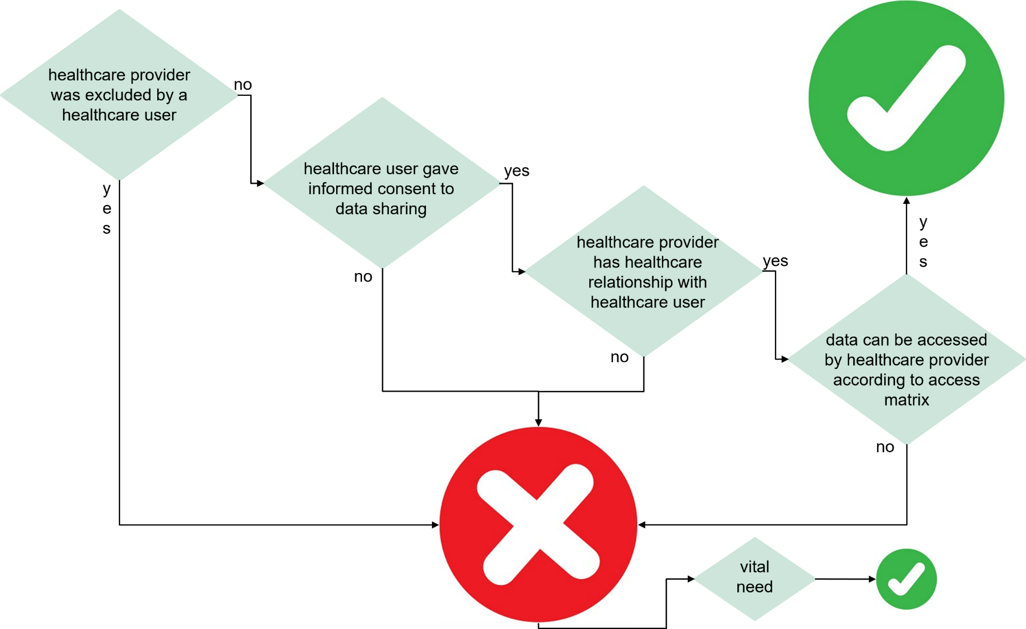
Access to health data through the eHealth platform for healthcare delivery

Slide 59
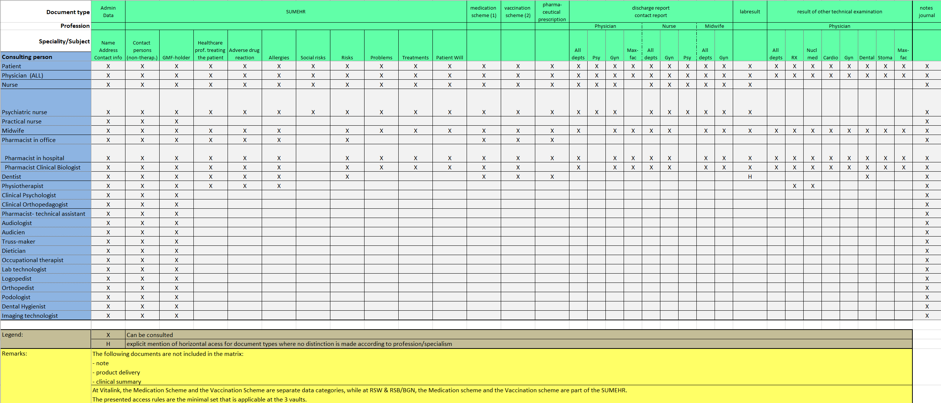
Current access matrix

Slide 60
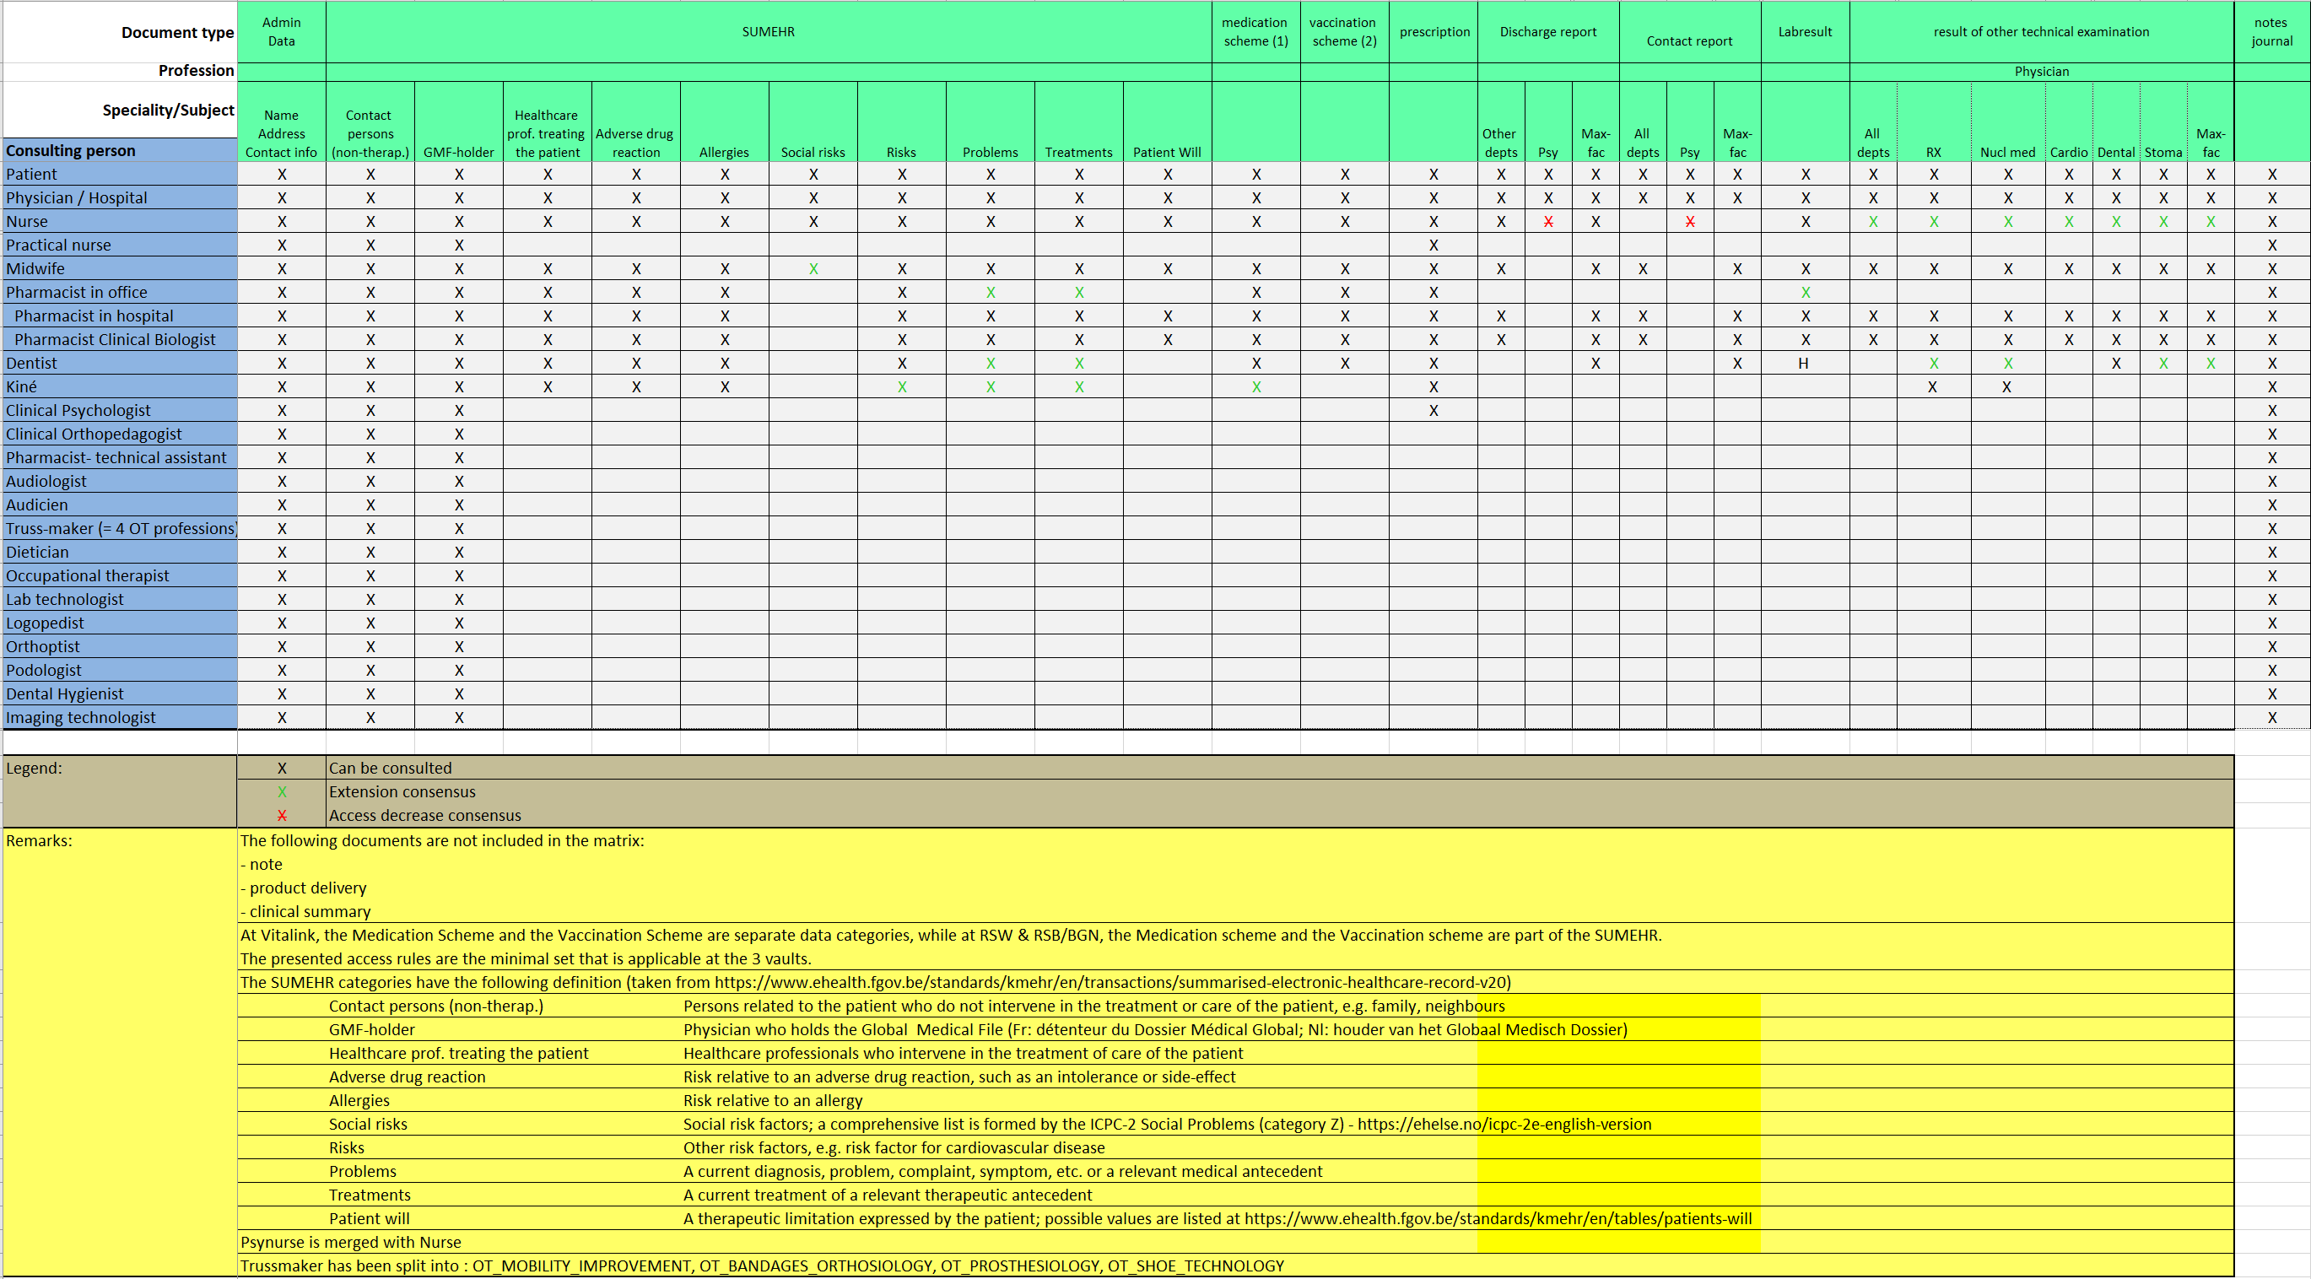
New access matrix (not yet implemented)

Slide 61
Circles of trust
Agreements between actors about
  who is responsible of carrying out which authentications and verifications on the basis of which means
  how the results of the authentications and verifications are securely stored and exchanged electronically between the actors involved
  who is responsible of logging access (attemps) to the services and applications
  how it is ensured that a complete reconstruction of loggings can take place to determine which natural person has used which service in relation to which person , when and for what purposes
  the retention period of the loggings, as well as the way in which these can be consulted by those who are entitled to do so

Slide 62
Circles of trust
Group of users of an organisation
  for which that organisation organises information security measures in a number of areas and monitors their appropriate compliance
  so that other organisations can have reasonable confidence that these information security measures are complied with
  and thus no longer need to organise or monitor these measures themselves
Regulation establishing criteria for the application of a circle of trust by an organisation in the context of health data exchange
  see https://www.ehealth.fgov.be/ehealthplatform/nl/reglementen

Slide 63
Criteria circles of trust
Principles of legality and purpose limitation
  register of processing operations
  specification of the legal grounds for processing health data
Principle of proportionality
  sufficiently fine-grained modulation of access rights (what, about whom, during which time period)
User and access management
  authentication of healthcare provider’s identity
  verification of the relevant characteristics and relationships of the healthcare provider
Logging
  internal logging
  audit trail

Slide 64
Criteria circles of trust
Information, education and awareness-raising
Internal control and sanctions
Compliance with deliberations Information Security Committee
Enforcement
  registration in the authentic source CoBRHA as an organisation organising a circle of trust
  public documentation
  external control

Slide 65

End-to-end encryption
Services allowing encryption of messages addressed to healthcare providers or institutions
Are applied, for instance, when using the eHealthBox service or electronic prescriptions (Recip-e)
2 services
  ETKDepot for encryption to a known recipient (asymmetric encryption)
  KGSS for encryption to an unknown recipient (symmetric encryption)
More information
  https://www.ehealth.fgov.be/ehealthplatform/nl/service-systeem-voor-end-to-endversleuteling

Slide 66
Encryption known recipient
Healthcare actor
Person or entity
eHealth platform
Internet
1
3
Connector or
other software to
generate key pair
Authenticates sender
4
2
Identification
certificate
Identification certificate
Stores
public key
Sends
public key
Web service
Register key
2
Public keys
repository
Stores private key
in a secure way

Slide 67
Encryption known recipient
Message originator
eHealth platform
Internet
1
Identification certificate
Web service
Ask public key
2
Identification
certificate
Asks for public key
Authenticates sender
4
Send message
Any protocol
3
Encrypts
message
Sends
public key
Identification
certificate
Message recipient
Public keys
repository
5
Stored
private
key
Decrypts message

Slide 68
Encryption unknown recipient
Key
Management
/ Depot
Encrypted with public key of user 1
Encrypted with public key of user 2
Symmetric key
Symmetric key
2 sends key
5 receives key
User 1
Originator
1 asks for key
User 2
Recipient
4 justifies right to
obtain key
4 justifies right to
obtain message
3 sends encrypted message
Encrypted with public key of Message depot
5 receives message
Encrypted with public key of User 2
Message encrypted with
symmetric key
Messages
Depot
Message encrypted with
symmetric key
Message encrypted with
symmetric key

Slide 69

Timestamping
System allowing to keep a record of the existence of a document and its content on a given date
Nobody, not even the owner of the document, can change the document or timestamp unnoticed afterwards
More information https://www.ehealth.fgov.be/ehealthplatform/nl/elektronische-datering-timestamping

Slide 70


Timestamping: example
1
prescription A
prescription B
electronic
signature
5
2
Hashcode A
Hashcode B
3
6
Timestamp bag
4
Archive
Electronic
timestamping
6
Archive

Slide 71
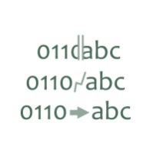
Pseudonymisation
Various options
  encoding
    data provider and eHealth platform know certain non-pseudonymised data and the pseudonym
    data recipient knows only the pseudonym and no non-pseudonymised basic data
    e.g. Central Traceability Register (CTR) > protection of data at rest
  Trusted Third Party platform
    data provider knows certain basic non-pseudonymised data and not the pseudonym
    data recipient knows the pseudonym and no non-pseudonymised basic data
    eHealth platform knows both (temporarily)
    e.g. Health Data
  new service
    data provider knows certain basic non-pseudonymised basic data and not the pseudonym
    data recipient knows the pseudonym and no non-pseudonymised basic data
    eHealth platform knows neither
    e.g. referral prescriptions, data in the Vitalink vault
 | Data provider |  | eHealth platform |  | Data recipient
 | BASIC DATA | PSEUDONYM | BASIC DATA | PSEUDONYM | BASIC DATA | PSEUDONYM
Encoding | X | X | X | X |  | X
TTP | X |  | X | X |  | X
NEW | X |  |  |  |  | X

Slide 72

Reference directory (hub-metahub)
Indication of specific places where health data regarding a given healthcare user are available
These places may currently be
  a hub (network of healthcare institutions), which also keeps a reference directory indicating in which healthcare institutions within that network health data regarding a given patient are available
  a health vault (Vitalink, Intermed or Brusafe)
More information
  https://www.ehealth.fgov.be/ehealthplatform/nl/verwijzingsrepertorium

Slide 73
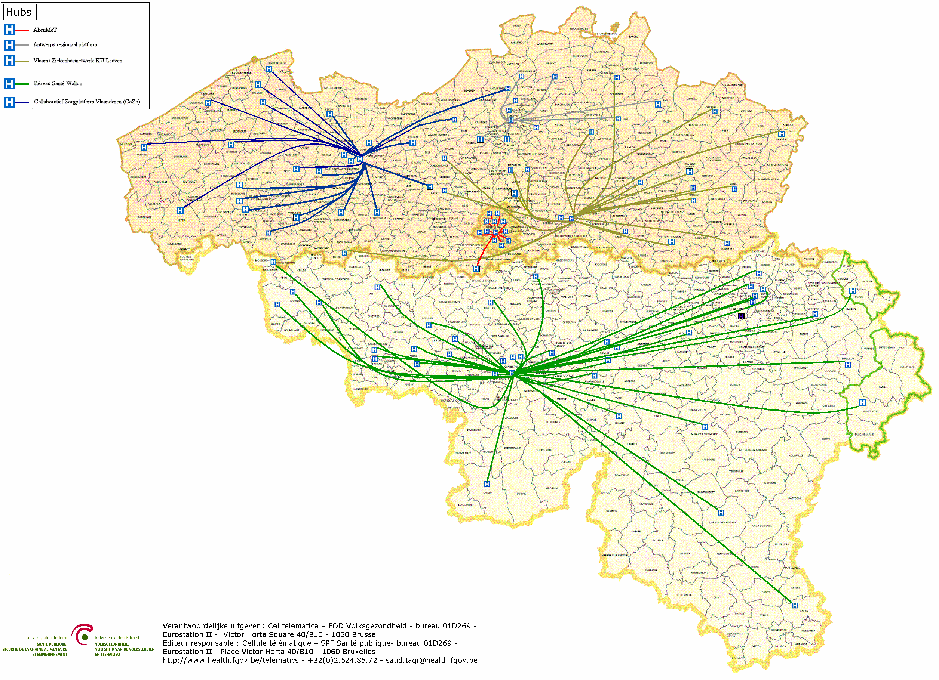

Reference directory (hub-metahub)
        4 hubs
        Collaboratief Zorgplatform (Cozo)
        Vlaams Ziekenhuisnetwerk KU Leuven (VZN)
        Réseau Santé Wallon (RSW)
        Réseau Santé Bruxellois (RSB)
        4 hubs
        Collaboratief Zorgplatform (Cozo)
        Vlaams Ziekenhuisnetwerk KU Leuven (VZN)
        Réseau Santé Wallon (RSW)
        Réseau Santé Bruxellois (RSB)

Slide 74






Reference directory (hub-metahub)
3. Retrieve data from hub A
A
1: Where can we find data?
2: In hub A and C
4:
All data available
3: Retrieve data from hub C
C
B

Slide 75




Extramural data: vaults
A
InterMed
BruSafe
C
B

Slide 76
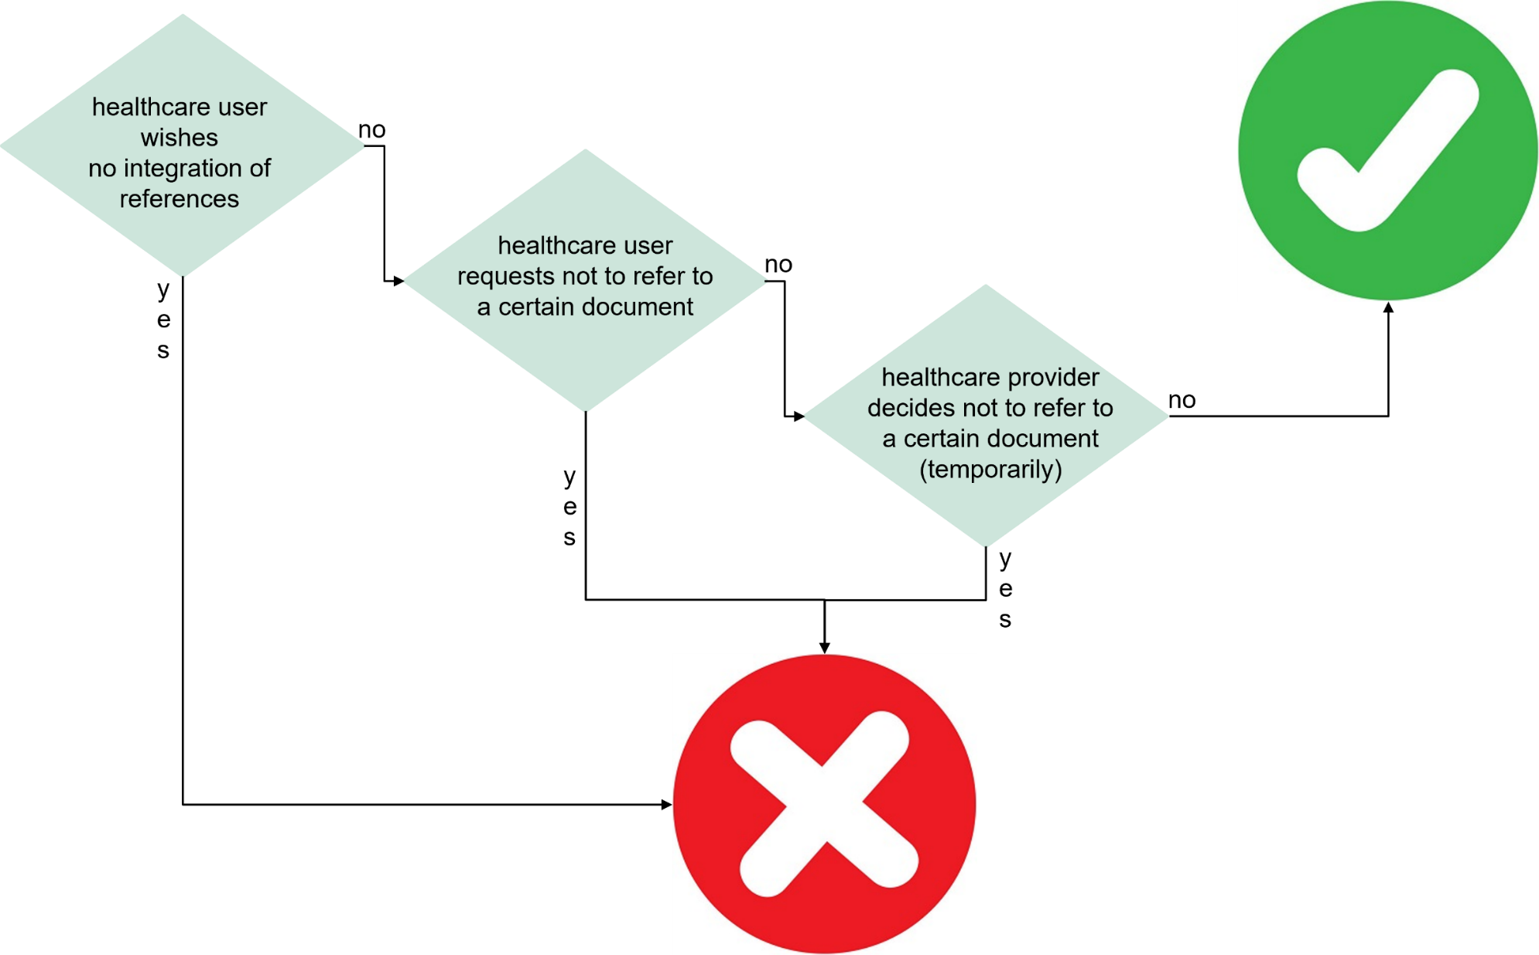
Integration of references in reference directory

Slide 77

eHealthBox
Secure electronic mailbox specifically designed for healthcare providers and institutions
Goal: enable secure, asynchronous, electronic communication of health data between Belgian healthcare actors
Capacity of 10 Mb since we do not want it to be used as an archive - possibility of sending links to images on a server
Available as
  a web service (accessible through a software)
  web application (accessible through a browser)
More information
  https://www.ehealth.fgov.be/ehealthplatform/nl/beveiligde-elektronische-brievenbus

Slide 78

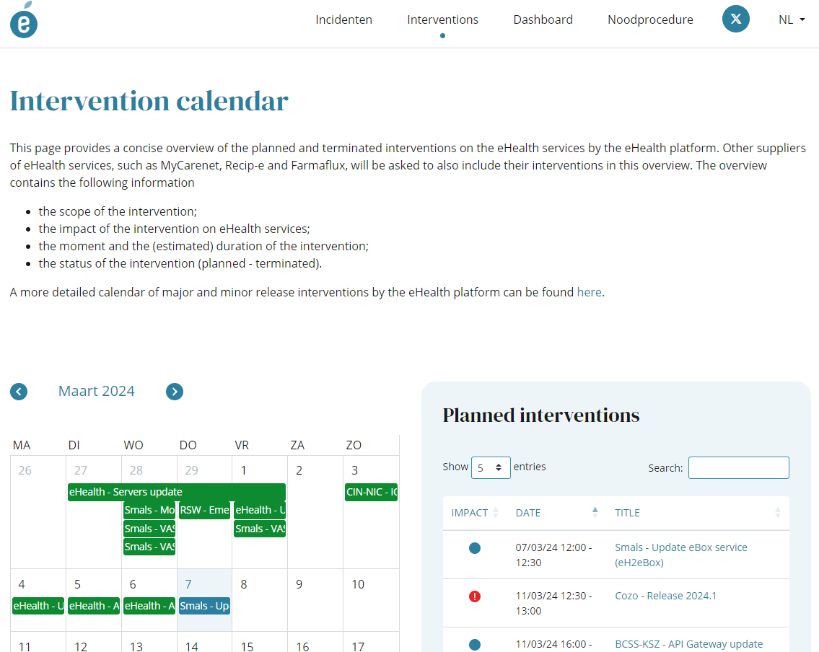
Status website
www.status.ehealth.fgov.be

Slide 79
Business Continuity Procedures
Method
  functional requirements that must always be met are defined in consultation with end-user representatives
  elimination of all single points of failure (SPOF) across environments (for every critical component there is an alternative in another environment)
  implementation plan with iterations
  communication through website https://www.status.ehealth.fgov.be/
  training via éénlijn, e-Santé Wallonie, eHealth Academy
  integrated dashboard on service status (availability, performance)
  feedback mechanisms on effective use of BCP

Slide 80
Business Continuity Procedures
Objective: operational business continuity procedures (BCP) for each type of end user
  (GP) doctors
  pharmacists
  urgent care centers
The list of BCPs is currently under review with a view to expansion (physiotherapists, dentists, etc.).

Slide 81
How does this all fit together?
Plan
  delivering deliberations by the Information Security Committee
  setting up information security departments
  elaborating minimal information security standards
  performing Data Protection Impact Assessments (DPIA)
  composing ‘unique files’
Do
  implementing information security measures according to minimal information security standards, DPIA, unique file and deliberations of the Information Security Committee
  using user & access management system
  logging access to services and applications
Check
  reactualizing DPIA regularly
  checking on compliance with minimal information security standards
  checking correct implementation of information security measures
  analyzing loggings
Act
  implementing additional measures where compliance level is not reached or where risks are not acceptable

Slide 82
Conclusion
Focus has to be put on a good balance between
  effectiveness and efficiency of information systems
  information security and data protection
  => based on risk analysis
Information security and data protection need a holistic approach and are translated into a number of measures
  structural measures
  organizational measures
  technical measures
  legal measures
Promoting information security and data protection by design

Slide 83



frank.robben@ehealth.fgov.be
@FrRobben
https://www.ehealth.fgov.be
https://www.ksz.fgov.be
https://www.frankrobben.be

