Slide 1
26th eHealth Network
19 June 2024

Slide 2
European Health Data Space Regulation
ensuring data sharing across the EU
  secure
    specifies and complements the rights laid down in the GDPR (art. 1)
    data permits for secondary use (art. 46)
  interoperable
    European electronic health record exchange format (art. 6)
      technical
      semantic
    software packages must meet EU standards to be put on the EU market
      EHR harmonised components (art. 13a)
      EU declaration of conformity (art. 26)
    European digital testing environment (art. 26a)
      European Commission shall develop a European digital testing environment and make the software supporting this environment available as open source
      MS shall operate a testing environment, preferably by reusing the software developed by the European Commission
  legal basis for European governance and coordination (Art. 66a)
    the European Commission shall provide the development, maintenance, hosting and operation of the infrastructures and central services required to support the functioning of the EHDS

Slide 3
Need for global, integrated architecture and reuse

Slide 4
Some basic international requirements
correct identification of every entity (citizens, companies, organisations, …)
  standardize patient identification methods to ensure consistent data access and exchange
  implement a system to coordinate patient identification keys across participating countries
correct routing of information request/provision
  coordinate a repository of information on where to locate patient data in each country
interoperability standards
  technical
  semantic
privacy and information security management
  user and access management (ao authentication of identity, attributes and (health) care relationships)
  end-to-end encryption

Slide 5
Need for a global, integrated architecture
need for
  global, integrated architecture across DGs of the European Commission
  based on a common conceptual framework
need for modular, generic, domain agnostic, interoperable and reusable components/services: develop once, use many
no technology driven choice of components and services used, but use of ICT components and services as enabler and means for meeting business requirements
need for the organisation of a set of basic services on a pan-European level, with possible reuse of some national best practices

Slide 6
Usefulness of basic services at the EU level
facilitates secure cross-border exchange of personal data
reduces costs
speeds up time to market
structurally increases data protection safeguards
facilitates compliance monitoring

Slide 7
Let’s not reinvent the wheel, but work together
share and reuse existing assets
  common vision on information management and information security
  data modelling
  business processes
  software components and API’s
  procurement and licences
  infrastructure
align and collaborate
  promote and rely on mature business concepts
  enforce proven semantic, technical and security standards
  share knowledge and techniques
  exchange good practices
  co-creation with all actors involved
  limit number of working groups

Slide 8
Belgian eHealth-platform: basic services & API’s
Coordination of the electronic processes
Portal
Integrated user and access management system
Management of loggings
System for end-to-end encryption
eHealthBox
Timestamping
Coding and anonymising
Consultation of National register and CBSS registers
Reference directories (hub-metahub system)

Slide 9
Towards an European testing environment

Slide 10
Compliance criteria
Technical interoperability, eg
  structure of messages
  authentication methods
Semantic interoperability, eg
  identification
  value sets
Quality, eg
  correct handling of use cases
  use of evidence based medicine guidelines
Security & data protection, eg
  confidentiality
  availability
  traceability

Slide 11
European Testing Environment
test environment at the European Commission for certified automated testing of compliance with established criteria on
  technical interoperability
  semantic interoperability
  quality
use of the tools established in the General Data Protection Regulation (GDPR), eIDAS Regulation and NIS-2 directive for information security and data protection accountability
  data processing impact assessment (DPIA)
  respect of defined eIDAS security levels
  respect of defined cyber security measures

Slide 12
Example: Belgian testing environment
defining compliance test criteria
  detailed test cases
onboarding implementers
  software vendors, health care providers, health care institutions, …
executing the compliance test campaign
  testers have 24/7 access
  testers can visualize the test plan
    technical view (JSON)
    business view (HTML and/or PDF)
  testers have to send all defined test cases via REST API
  testers can track their progression via a personal dashboard
  supervisors can follow up the progression of all implementers
  testers receive a certification

Slide 13
Test server – unit testing
Validation template
Business
case
(Word description)
Reference
(FHIR) instance
Validation process
Test case
Visualisation
(html/pdf)
Sender
Software
Generated
(FHIR) instance

Slide 14
Test server – end to end testing
FHIR Test server
Sender
Software
Generated
(FHIR) instance
REST API
Successful
test instances
Cherry Picking
Receiver
Software
Provided
(FHIR) Instance
Test result declaration

Slide 15
Test server architecture
Tester
Test server
REST API
(FHIR)
instance
Validation Process
eHealthbox Connector
ValidationTemplates
eHealthPlatform
Dashboard
Reference test list
Test coverage
Test result
Validation Results
https://fhir-testserver.be/index.php/login

Slide 16
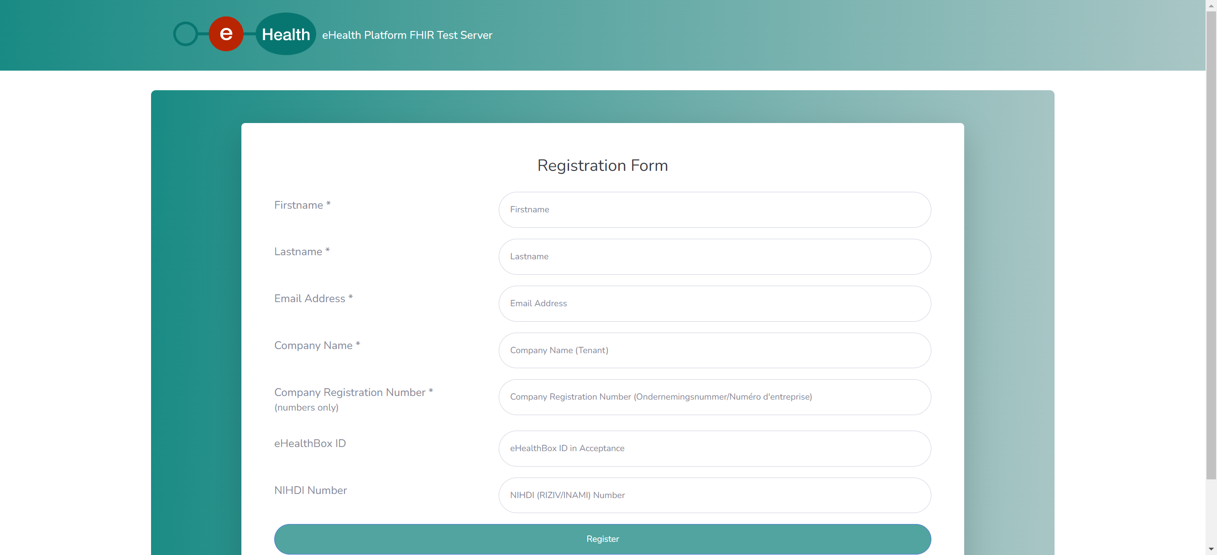
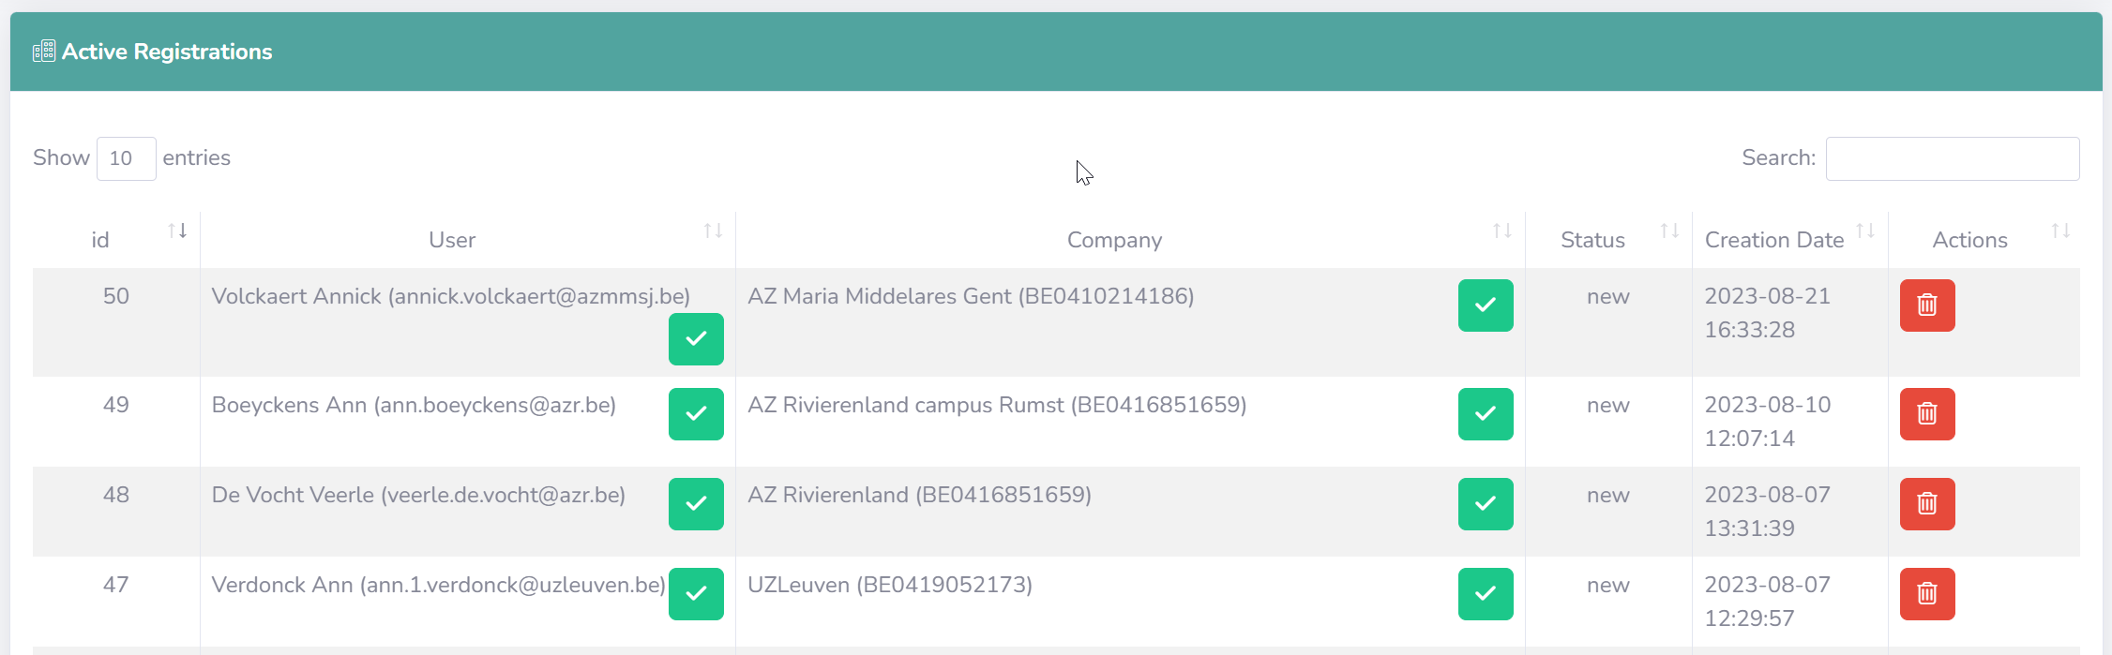
Test server – administration – registration

Slide 17
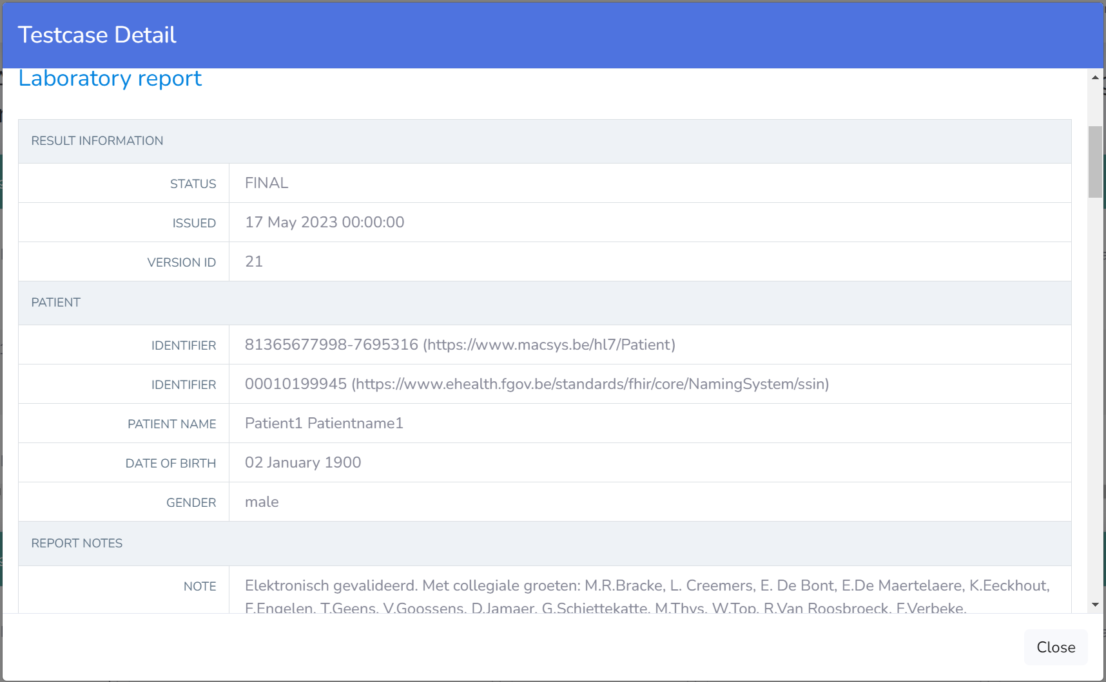
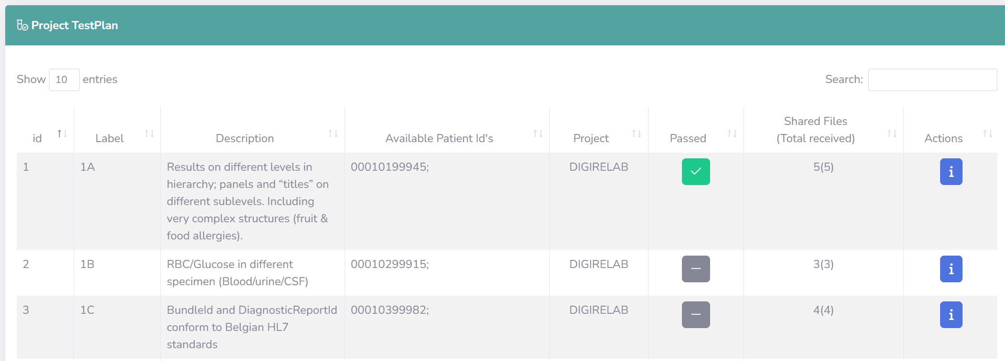
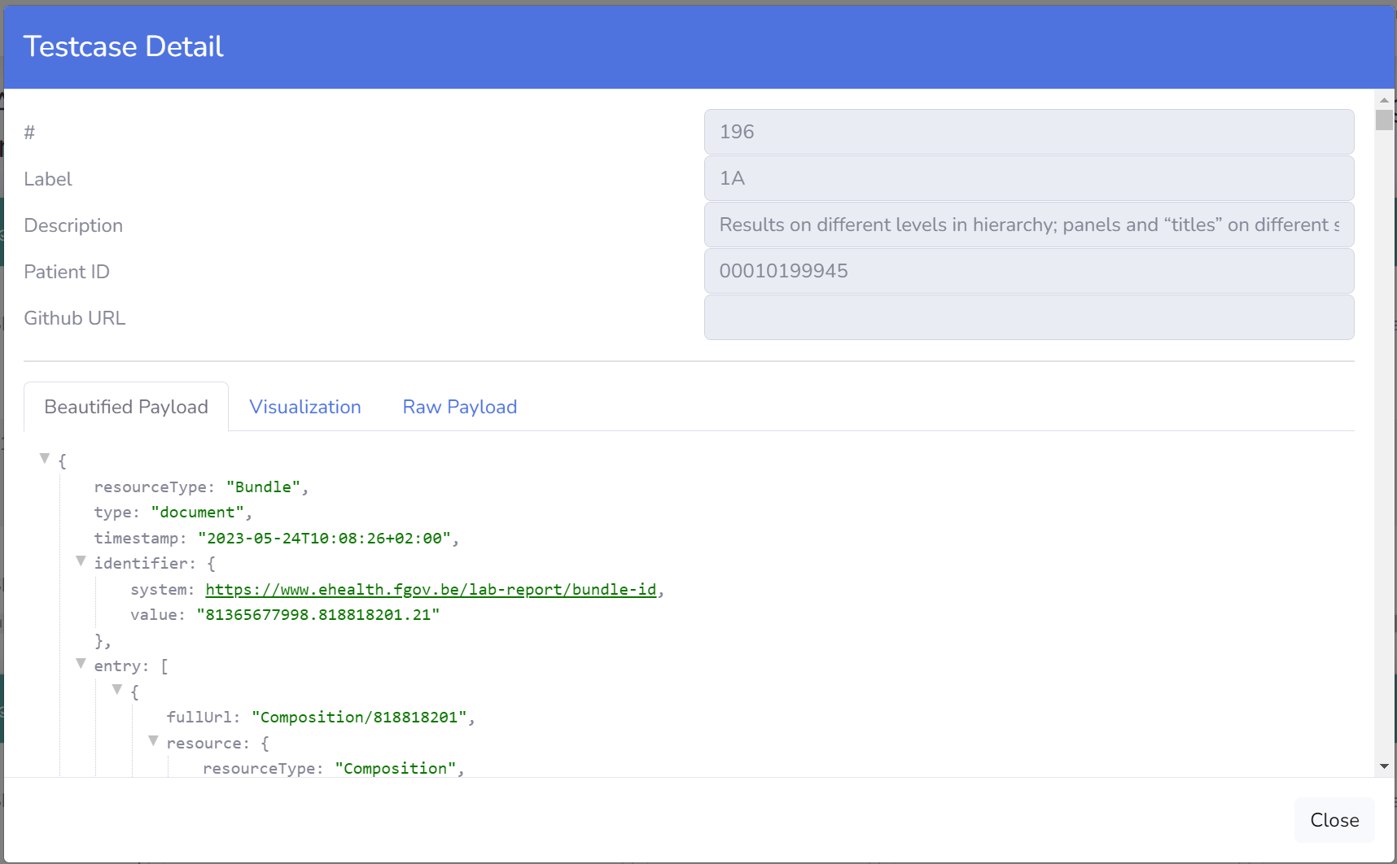
Test server – self service approach

Slide 18
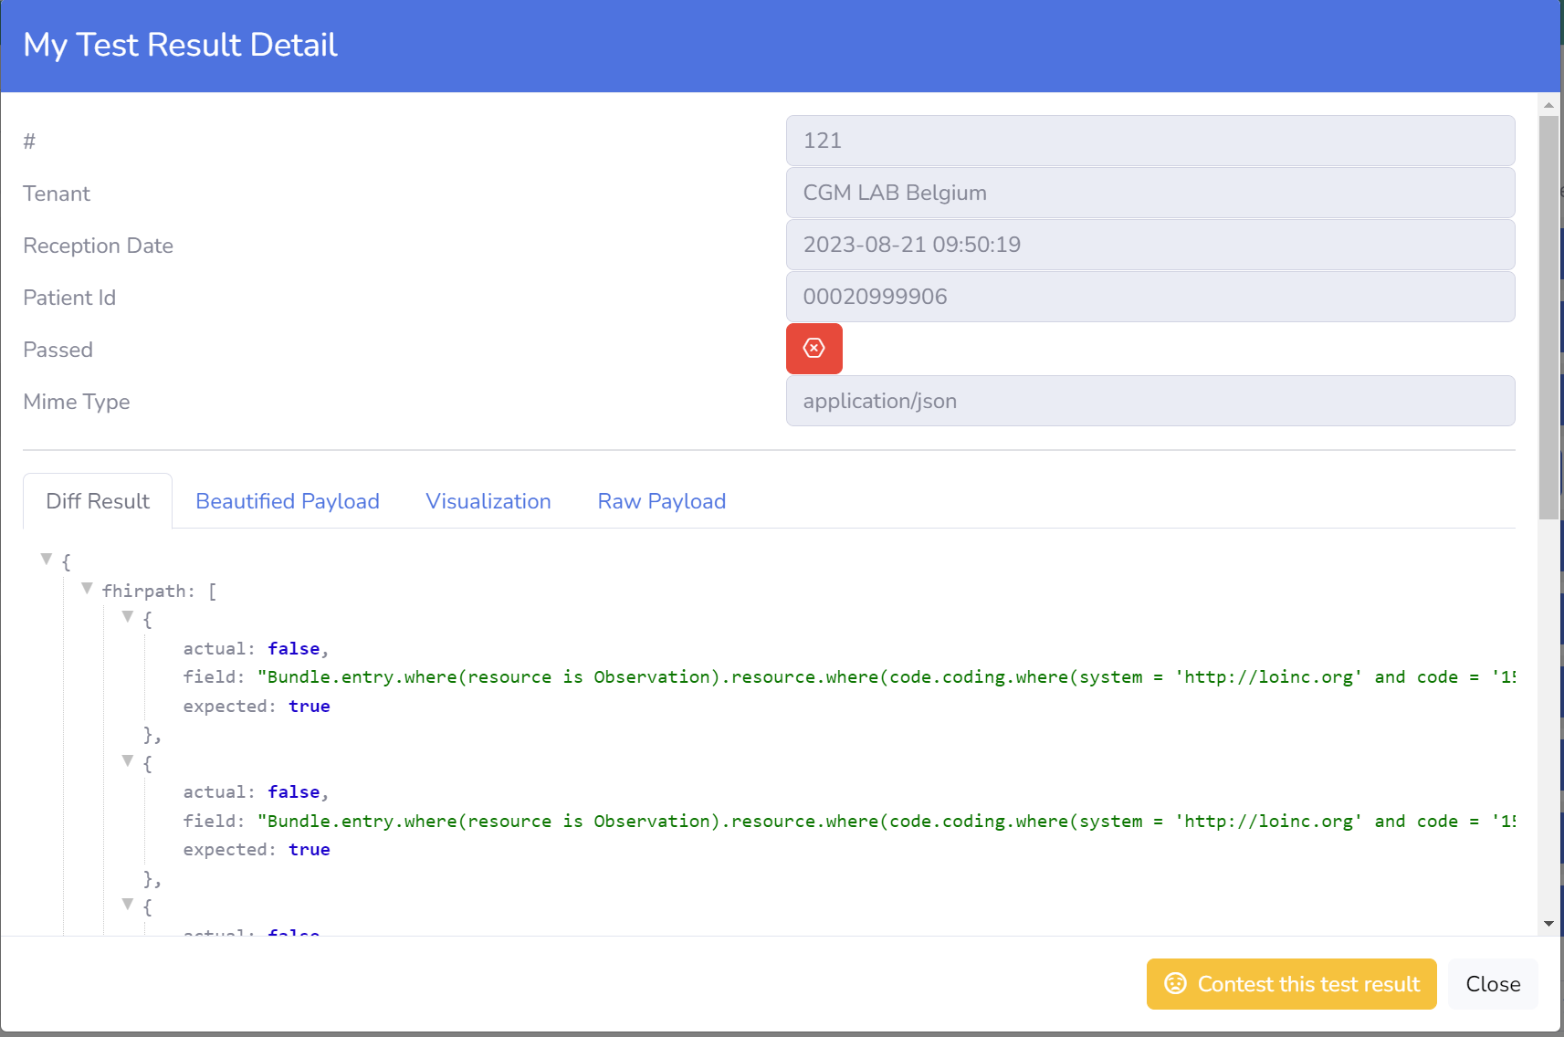
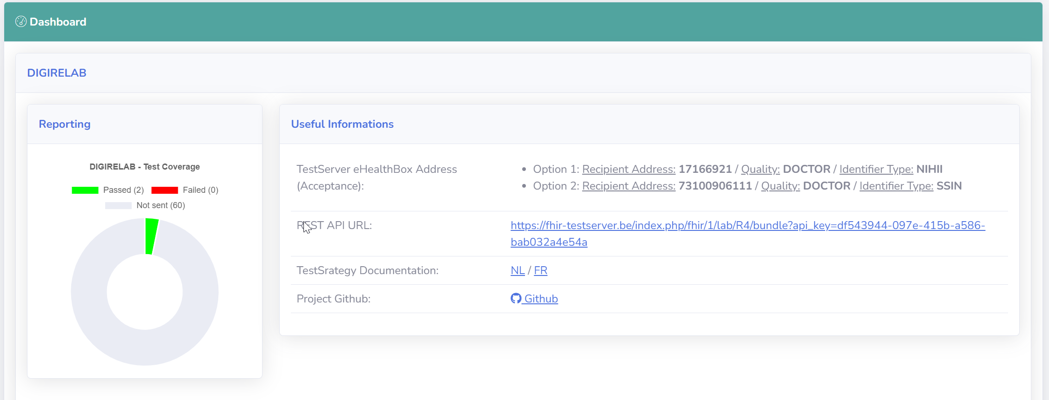
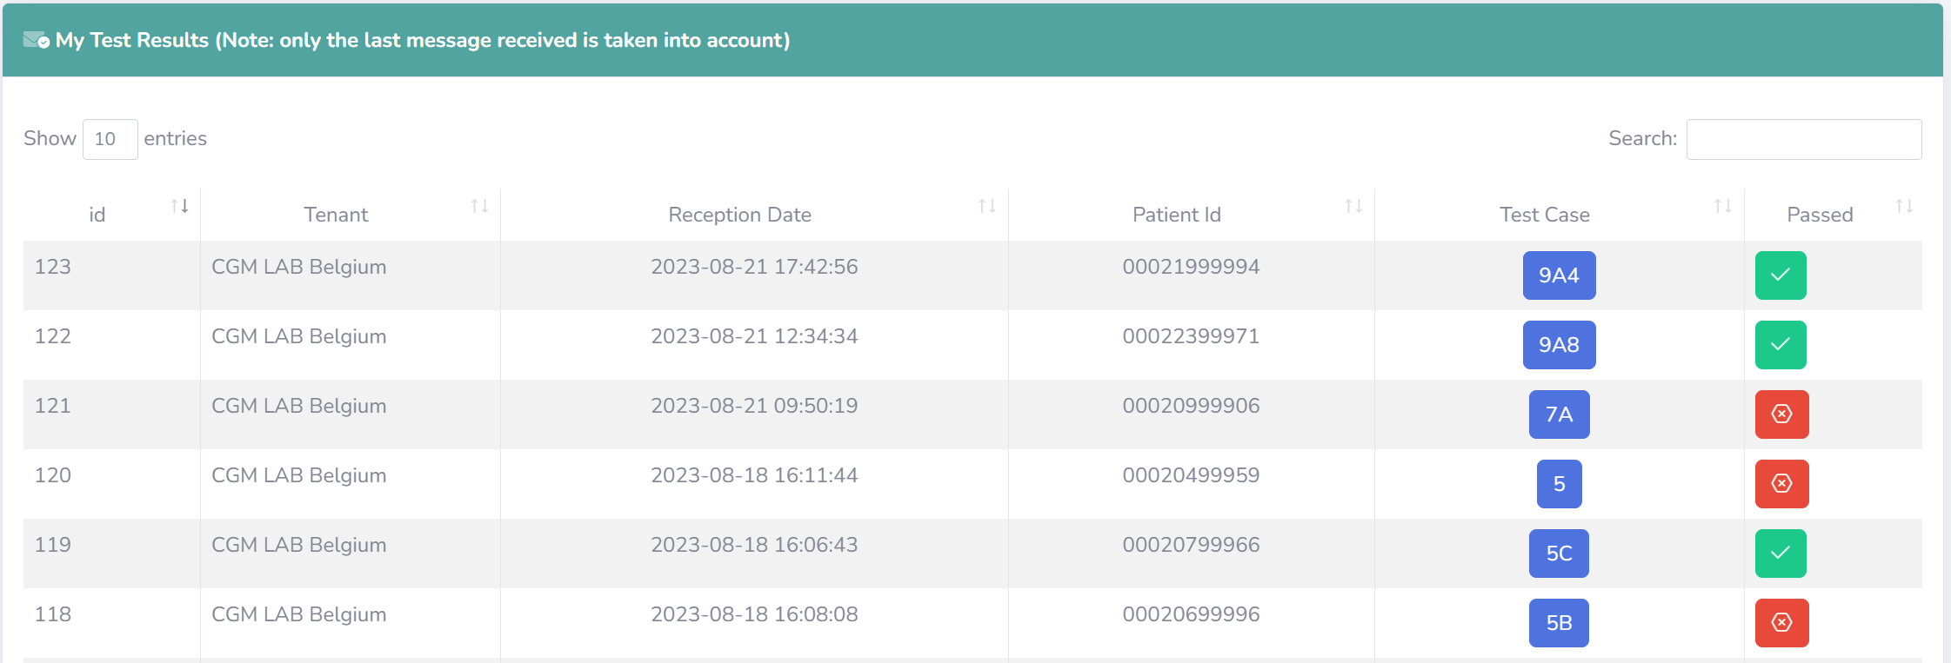
Test server – self service approach

Slide 19



frank.robben@mail.fgov.be
@FrRobben
https://www.frankrobben.be
https://www.ksz.fgov.be
https://www.ehealth.fgov.be

