Slide 1
eHealth: needs, European Health Data Space and status questionis in Belgium

Slide 2
Some evolutions in health care
more chronic care instead of merely acute care
remote care (monitoring, assistance, consultation, diagnosis, operation, ...), and home care
multidisciplinary, transmural and integrated care
patient-centric care and patient empowerment
rapidly evolving knowledge => need for reliable and coordinated management and access to knowledge
threat of excessively time-consuming administrative processes
thorough support of health care policy and research requires thorough, integrated and anonymized information
cross-border mobility
need for cost control

Slide 3
The reported evolutions require...
cooperation between all actors in health care
efficient and secure electronic communication amongst all actors in health care
high quality, multidisciplinary electronic health records
care pathways
optimized administrative processes
technical and semantic interoperability
guarantees with regard to
information security
privacy protection
respect for the professional secrecy of health care providers

Slide 4
Electronic communication also stimulates …
quality of care and patient safety
avoidance of wrong care and medication
incompatibility between medicines
contra-indications against certain medicines or treatments for a specific patient (eg allergies, diseases, …)
avoidance of errors in concrete care provision and administration of medicines
availability of reliable databases on good treatment practices and decision support scripts
more opportunity for multidisciplinary consultations and second opinions
avoidance of unnecessary multiple examinations => less stress for the patient and avoidance of unnecessary additional costs

Slide 5
European Health Data Space Regulation
support electronic processing of health data with the aim of
empowerment of healthcare users
providing qualitative, continuous and integrated care (primary use)
stimulating research, policy support & evaluation, and innovation (secondary use)
ensuring data sharing across the EU
secure
General Data Protection Regulation continues to apply
permits for secondary use
interoperable
EU standards
technical
semantic
software packages must meet EU standards to be offered on the EU market
free, open source testing environment offered by European Commission
legal basis for supporting basic services offered by the European Commission

Slide 6
Objectives of the Belgian eHealth-platform
how?
through a well organized, mutual electronic service provision and information exchange amongst all actors in health care
with the necessary guarantees on the level of information security, privacy protection and professional secrecy
what?
optimization of the quality and continuity of the provision of health care
optimization of the patient safety
simplification of the administrative formalities for all actors in health care
proper support of health care policy and research

Slide 7
eHealth in Belgium: architecture
Patients, health care providers
and health care institutions
Site Ministry
Software health care professional
Software health care institution
VAS
Site RIZIV
VAS
eHealth-portal
MyCareNet
VAS
VAS
VAS
Users
Basic services
eHealth-platform
Network
AS
AS
AS
AS
AS
AS
Suppliers

Slide 8
eHealth-platform: basic services & API’s
Coordination of the electronic processes
Portal
Integrated user and access management system
Management of loggings
System for end-to-end encryption
eHealthBox
Timestamping
Coding and anonymising
Consultation of National register and CBSS registers
Reference directories (hub-metahub system)

Slide 9
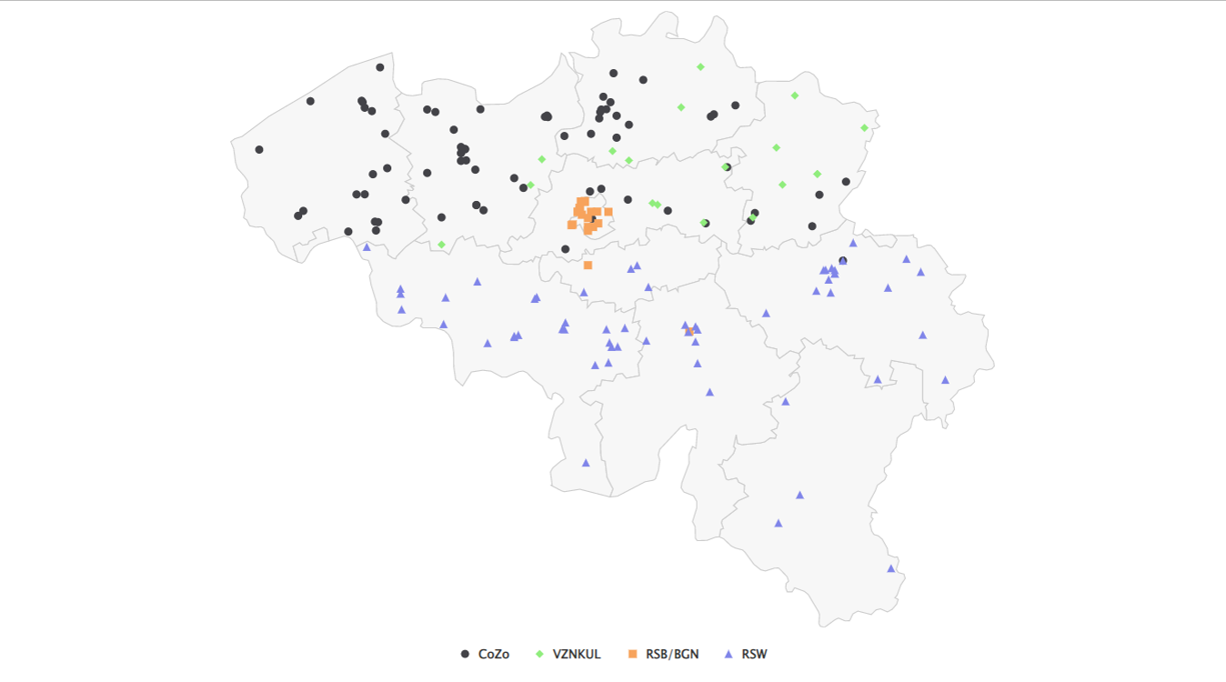
Hubs & metahub

Slide 10
Hubs & metahub
3. Retrieve data from hub A
A
1: Where can we find data?
4: All data available
2: In hub A and C
3: Retrieve data from hub C
C
B

Slide 11
Health vaults
A
InterMed
BruSafe
C
B

Slide 12
eHealth in Belgium: some results
Medical history search via SumEHR
Guidelines and advice available online
Medication schedule
Health
advantages
Electronic prescriptions
Consultation of laboratory results
Electronic referral letters

Slide 13
eHealth in Belgium: some results
Pricing,
billing
Updating the SumEHR, the medication schedule, ...
Adminis- trative
advantages
Creating and sending certificates
Registrations
Sending a report to the GMF holder

Slide 14
eHealth in Belgium: some results
47.578 Healthcare professionals have a eHealth certificate
> 93,6 %
of Belgian citizens have given
an informed consent for data sharing
118 million
messages/year
via eHealthBox
2023
Electronic prescriptions
20.596.000.000
digital transactions
16 million/month from doctors
5.562.891
Belgian patients with
Summary Electronic Health Records
28.000 prescribing doctors
average of 11,5 millions prescriptions handled by pharmacists
36.525.073
documents consulted in general hospitals
2,192,127
Belgian patients with
Medication schedule

Slide 15
frank.robben@mail.fgov.be
@FrRobben
https://www.frankrobben.be
https://www.ksz.fgov.be
https://www.ehealth.fgov.be

