Slide 1

Smals & Open Source
26/03/2024
Challenges
Dirk Deridder
Notes:
Ik geef meer duiding rond:
de beweegredenen van Smals om te werken met open source
de grootte orde van open source die we gebruiken (eigenlijk is de betalende open source maar een klein %)
de uitdagingen rond open source (oa beveiliging en zoals gebleken door de log4J vulnerability gebruiken grote vendoren zoals vmware, oracle, … ook open source in hun systemen)
de nood om goed na te denken over verschillende aspecten van open source (oa de demographics van de contributoren, men spreekt vaak over “community”, maar veel zaken worden onderhouden door 1 individu)
hoe wij open source een plaats willen geven in public cloud om “portability” te garanderen overheen hyperscalers (azure, aws, google, …)
hoe de verschillende initiatieven (g-cloud, reuse, EA, …) eigenlijk geïnspireerd zijn op het concept open source & community
hoe deze initiatieven een logische opbouw vormen om binnen onze micro-community verder te springen
Open source, a driving force in our digital society, must step into the limelight once more. It's not just about promoting its adoption or principles; understanding its inner workings and the community dynamics is crucial. By harnessing the power of micro-communities, we can fully leverage open source to enhance public sector services. However, open source is currently under continuous threat, requiring a renewed commitment to its protection and advancement.
As a tight-knit public sector family, we must elevate our efforts by reimagining how we engage with open source in a systematic manner. Now is the time to step up our game by forging bonds and building bridges to uphold the principles of openness and community-driven development that lie at the heart of open source.
Let's work together to reimagine and shape a sustainable digital future for the public sector.

Slide 2


Smals
Belgian In-house ICT Service Provider/Integrator
For and by the Public Sector
Nonprofit organization
2,122 collaborators
Operates as a shared service center for
319 government organizations
  Infrastructure management
  Software development
  Data management
  Security services
  …
Main role: enabler for government ICT
Established in 1939
https://www.smals.be/nl/content/activiteitenverslag-2022

Slide 3
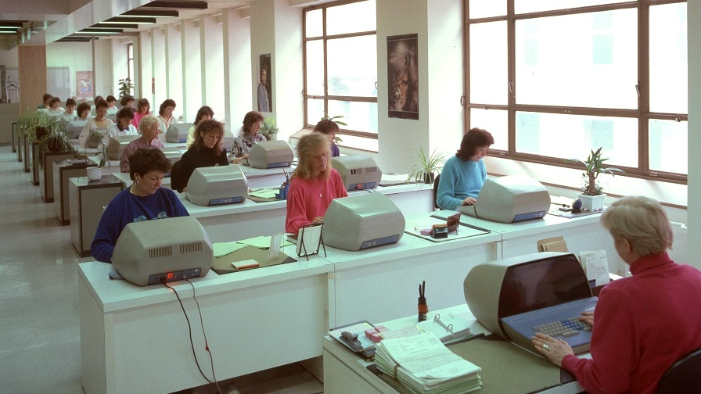
Pre-COVID...
Maatschappij voor Mekanografie ter
Toepassing van de Sociale Wetten
Société de Mécanographie à
l'Application des Lois Sociales

Slide 4
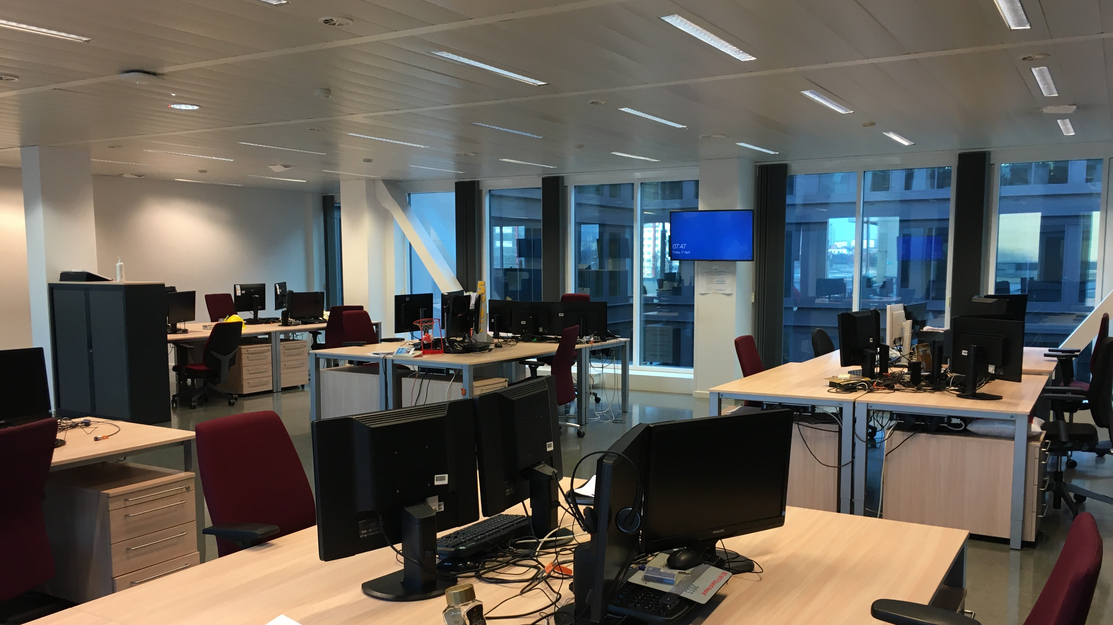

Post-COVID...
a.k.a. how the open source community
has been working for eons ☺

Slide 5


Supporting cross-institution ICT Initiatives
G-Cloud Programme (2015-…) – gcloud.belgium.be
  For and by public institutions
  Focus on infrastructure services & platforms, shared procurement, …
Software ReUse Programme (2019-…) – ict-reuse.be
  For and by public institutions
  Focus on components, authentic data sources, API’s, …
Full Stack Approach (2021-…)
  Enterprise Architecture across public institutions
  Focus on architectural principles, processes, building blocks, …
Public Cloud Computing & AI (2023- … Accelerated)
  Emphasis on security, business continuity, cloud portability, data sovereignty
  Strong governance

Slide 6
Smals & Open Source
Challenges
Progress 50%
Dirk Deridder

Slide 8
Why is Smals interested in open source?
Alignment with our Vision, Culture, and Mindset
  Principal values & drivers resonate with how we look at the ICT world
Quality-driven Community
  Fostering a quality-driven mindset to ensure operational stability and robustness
Open standards
  Adoption of open standards to facilitate longevity and to mitigate vendor lock-in
Business Continuity Assurance by Embracing ‘Free(dom)’ technology
  Utilizing free technology & the freedom to operate
  Counter ‘Machiavellian Licensing Plots’ and balance the power of proprietary vendors
Creative Nexus
  It is where innovation magic happens

Slide 9


Committed to high quality standards
Quick & easy 15 seconds braindump:
→ Hence, we require enterprise versions/support
5-10 technologies
Linux, Openshift, JBoss, AMQ,…
…
Commercial and Hybrid Open Source Technology

Slide 11
Committed to high quality standards
Bit more comprehensive & less easy 5 minute braindump…
7-zip | Argocd | Docker | Git | InfluxDB | Kibana
Acm | AsciiDoc | Dokuwiki | Gitea | Inspec | Linux
ActiveMQ | AWX | Eclipse | GitLab | Java | Log4J
Alerta | Camel | EclipseLink | Gpg4win | Java Spring Boot | Mattermost
Angular | CEPH | ElasticSearch | Grafana | Jenkins | Maven
Ansible | Checkmk | Emacs | Grafana Loki | JFrog Artifactory | Minio
Apache | Chef Inspec | Firefox | gVim | JMeter | MySQL
Apache JMeter | Cloudform | Fluentd | HAProxy | JPA | NEO4J
Apache Nifi | Curl | Foreman | Hashicorp Consul | Kafka | Netbeans
Apache Zookeeper | DBeaver | Gatling | Hashicorp Vault | Keepass | NGINX
Notepad++ | OpenFT | OpenSearch | Open Text | Percona | Postgress EDB
OBS Studio | OpenJDK | OpenStack | Oracle Linux | PHP | Prometheus
PlantUML | Podman | PostgreSQL (non-EDB) | Python | Red Hat JBoss | Redis
Rundeck | Sonarqube | Testlink | WSL | Red Hat Linux | Renovate
Satellite | Stolostron | Vaultwarden | Zabbix | Red Hat Openshift | Restic
SecureID | Symfony | PuTTY | ZAProxy | Red Hat Openstack | Ruby
Selenium | Telegraf | WinSCP | Zend | Red Hat Satellite | React
Signal | Testkube | Wordpress | Red Hat AMQ | Prometheus Node Exporter | Prometheus AlertManager
100-120 technologies
…
→ Apparently, we don’t always require enterprise versions/support
… adding Community-Driven Open Source Technology

Slide 12
Open source is
more often than not
invisible

Slide 13
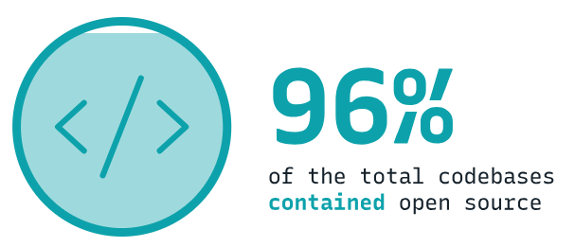
Open Source is everywhere @Smals
It depends on what you include:
  Products, Platforms, Tools, Libraries,
  Drivers, Code snippets, …
OSSRA report finding (2024)
  Open source components and libraries
  are the backbone of nearly every application across all industries
  96% of total codebases contain open source
Almost all codebases
Proprietary vendors would not exist without open source !
Even if you only believe half of it… this is still an impressive number !

Slide 14
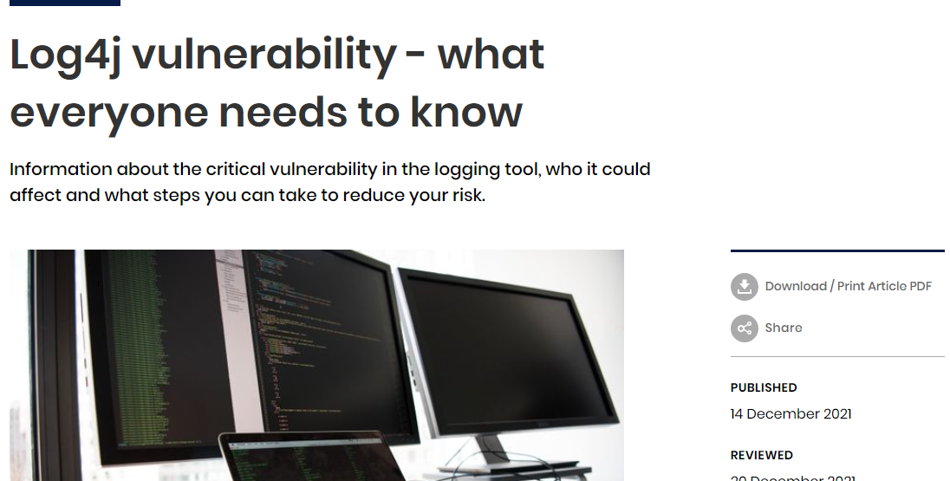
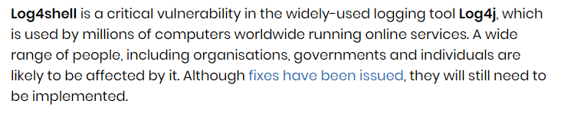

Slide 15
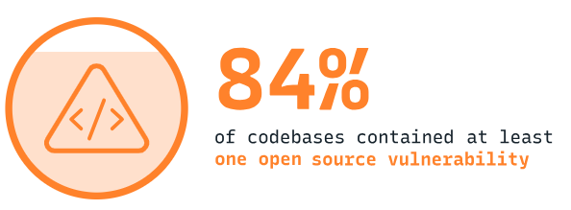
Thanks vulnerability, for the insight ☺☹
It is highly unlikely that your system doesn’t
contain open source elements
Your code contains more than you know
  Their code also contains more than they know
  Since they are suppliers, they should know !
OSSRA report finding (2024)
  84% of codebases contained
  at least 1 open source vulnerability
  91% of codebases were found to contain
  components 10 versions or more behind
It is highly certain that your code
contains (un)discovered vulnerabilities
  Regardless of whether it is open source or not…
Almost all codebases
Visibility is thus a top priority

Slide 16
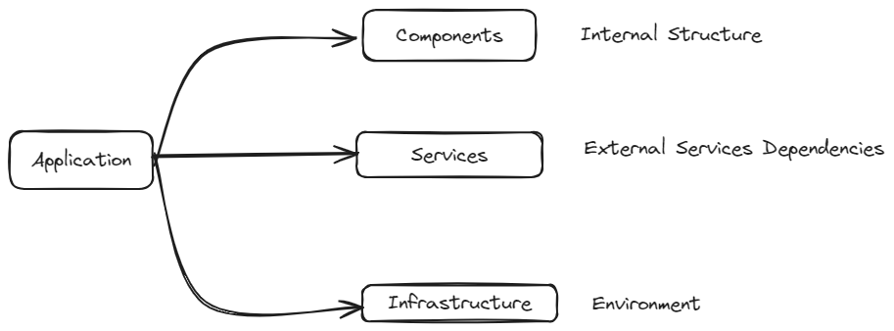
xBOM to the rescue?
Bill of Materials for
  Software (SBOM), SaaS (SaaSBOM), Hardware (HBOM), Machine Learning (ML-BOM), …
  Include all direct and transitive components
  Include the dependency relations between them
OWASP CycloneDX Software Bill of Materials (SBOM) Standard
  Open source Component Analysis platform
  Identifies risks in the software supply chain
Primary use cases
  Vulnerability identification, license compliance, outdated component analysis
Main drivers @ Smals?
  Cybersecurity, ISO/IEC27001, NIS2
  Lifecycle management
  Log4J reality check

Slide 17
xBOM to the rescue?
{
"creationInfo": {
"created": "2024-02-07T08:09:00Z",
"creators": [
"Organization: Red Hat Product Security (secalert@redhat.com)"
],
"licenseListVersion": "3.8"
},
"dataLicense": "CC0-1.0",
"documentDescribes": [
"SPDXRef-227f7b84-025c-45ae-bb43-bf5ec09cc13b"
],
"documentNamespace": "https://access.redhat.com/security/data/sbom/beta/spdx/RHOSE-4.9.Z",
"name": "RHOSE-4.9.Z",
"packages": [
{
"copyrightText": "NOASSERTION",
"downloadLocation": "registry.redhat.io/openshift/ose\u002Dcluster\u002Dnode\u002Dtuning\u002Doperator:v4.9.0\u002D202203081819.p0.gce0b3ae.assembly.stream",
"externalRefs": [
{
"referenceCategory": "SECURITY",
"referenceLocator": "cpe:/a:redhat:openshift:4.9::el8",
"referenceType": "cpe22Type"
},
{
"referenceCategory": "PACKAGE_MANAGER",
"referenceLocator": "pkg:oci/ose-cluster-node-tuning-operator@sha256:c05025965a23568d177f84e30adda1f2b4677a54baf1a0f1a67005a2cfd7cb52?repository_url=registry.redhat.io/openshift/ose-cluster-node-tuning-operator&tag=v4.9.0-202203081819.p0.gce0b3ae.assembly.stream",
"referenceType": "purl"
}
],
"filesAnalyzed": false,
"homepage": "registry.redhat.io/openshift/ose\u002Dcluster\u002Dnode\u002Dtuning\u002Doperator",
"licenseComments": "Licensing information is automatically generated and may be incomplete or incorrect.",
"licenseConcluded": "NOASSERTION",
"licenseDeclared": "NOASSERTION",
"name": "cluster\u002Dnode\u002Dtuning\u002Doperator\u002Dcontainer",
"originator": "NOASSERTION",
"packageFileName": "NOASSERTION",
"SPDXID": "SPDXRef-0340ec67-499d-45dd-9f3f-0aaaac33696e",
"supplier": "Organization: Red Hat",
"versionInfo": "v4.9.0-202203081819.p0.gce0b3ae.assembly.stream"
},
Component Identification: Lists all components, including libraries, modules, etc.
Version Information: Specifies versions or commit hashes of each component.
Metadata: Provides details like description, author, and release date for each component.
Licensing Information: Indicates the licenses under which components are distributed.
Dependencies: Documents both direct and transitive dependencies.
Vulnerability Information: Includes known vulnerabilities with severity ratings and remediation guidance.
Provenance Information: Identifies the source from which each component was obtained.
Checksums or Hashes: Offers cryptographic hashes for verifying component integrity and authenticity
Can we treat the OS community as “yet another supplier”?
Notes:
https://access.redhat.com/security/data/sbom/beta/spdx/

Slide 18
xBOM doesn’t solve everything !
Position in Technology Landscape?
  Understanding its role and relevance within our technology ecosystem, what value does it bring
Criticality and Reliability?
  Assessing the potential impact if it malfunctions or if it requires replacement
Characteristics and Attributes?
  Evaluating various aspects such as its complexity, size, maturity, and other –ities
Contributors and Community?
  Determining the number of active contributors and their demographics
Availability of Support?
  Confirming the availability of support channels, either commercial or in-house
Release Cadence and Update Frequency?
  Analyzing the frequency of releases and updates is a quality indication, yet some components are simply “done”
Track Record?
  Reviewing the history of bugs, vulnerabilities, fixes, and overall performance/score in the community
Visibility and Recognition?
  Identifying if it's recognized or on the radar of major industry players …
Software development/use practices require a security-by-design approach that goes beyond the old normal

Slide 19
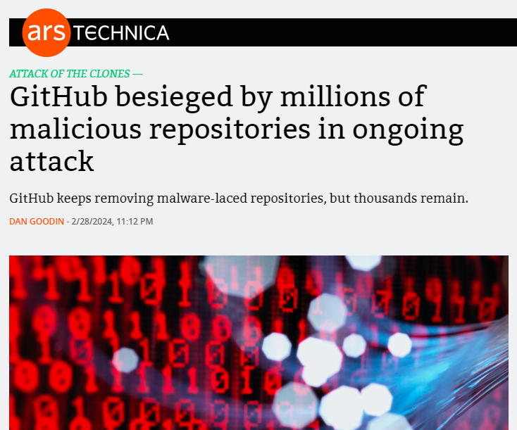

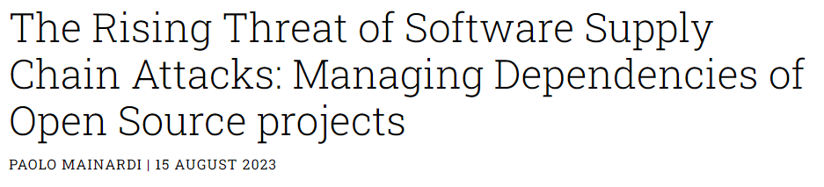
Notes:
https://arstechnica.com/security/2024/02/github-besieged-by-millions-of-malicious-repositories-in-ongoing-attack/

Slide 20
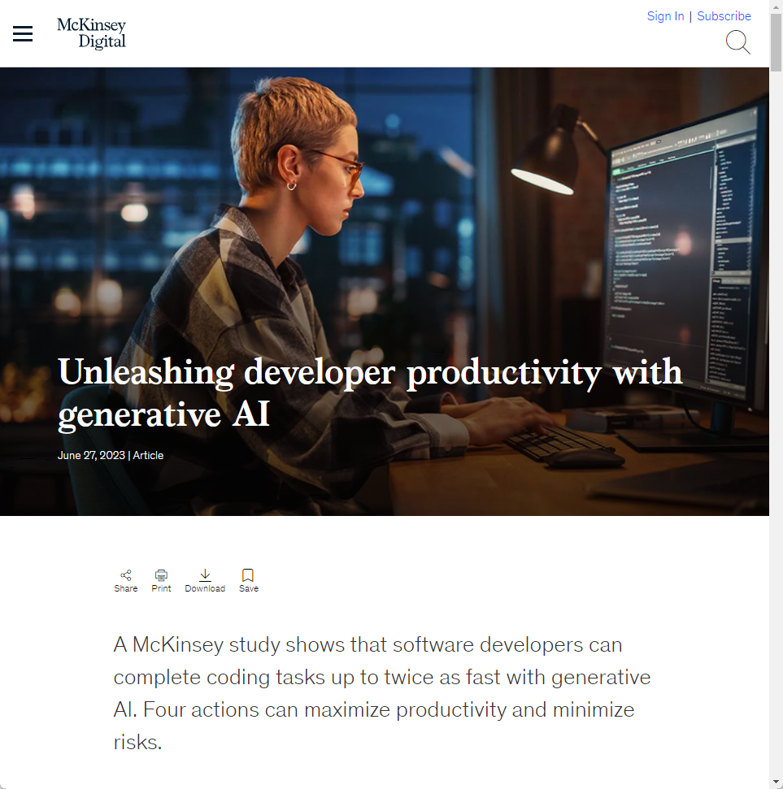
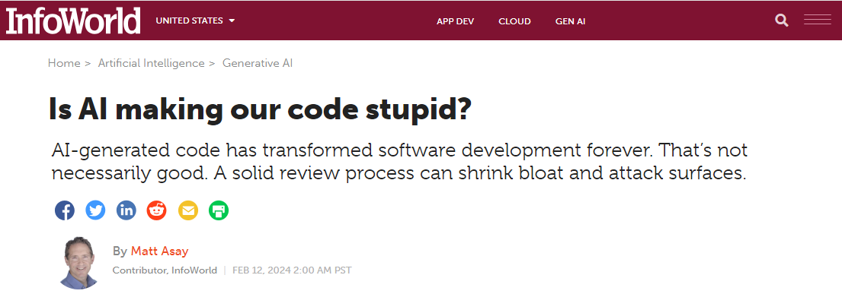
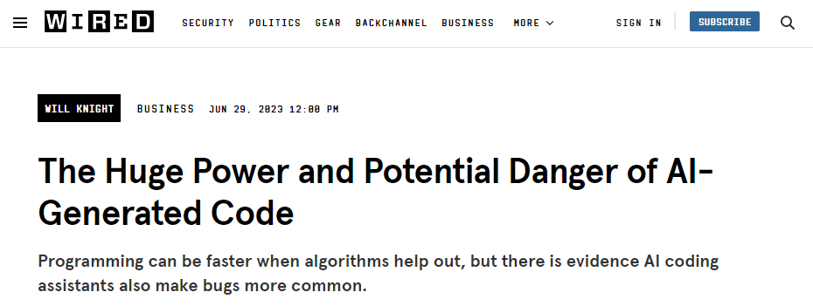
Notes:
https://www.infoworld.com/article/3712685/is-ai-making-our-code-stupid.html
https://www.wired.com/story/fast-forward-power-danger-ai-generated-code/
https://www.mckinsey.com/capabilities/mckinsey-digital/our-insights/unleashing-developer-productivity-with-generative-ai

Slide 21

Questionable Open Source Practices…
in the proprietary, commercial/hybrid community
RANT MODE: ON
Exploiting Open Source
  Opportunistic use of the term "open source" to mask profit-driven motives
Profit Over Principles
  Prioritizing profit margins over openness and community-driven innovation
Hollow Commitments
  Paying lip service to open source ideals while prioritizing profit over principles, community, and collaboration
Deceptive Marketing Tactics
  Manipulate the perception of openness to push proprietary models
Betrayal of Community
  Leech of the goodwill of the open source community without contributing back or upholding its values
Undermining Open Standards
  Interoperability standards are not the objective
Tech Oligarchy
  Large tech companies exerting undue influence over the direction and governance of open source projects, stifling innovation and diversity.
As a community we should condemn these practices, but also come up with ideas for sustainable business models

Slide 22
Yet still, we aren’t against open source use?
We follow at the same time a strategic and an opportunistic approach
We continuously evaluate its use
We continuously balance proprietary versus commercial/hybrid versus community-driven OS
Drivers?
  Financial & procurement considerations (cost, scale of deployment, tendering, …)
  Enterprise risk mitigation (vendor lockin, business continuity, …)
  No-brainer (linux, core tools, drivers, …)
  Didn’t even know it was open source
When we follow a dual vendor approach, open source is typically the alternative
  This is a major challenge: Lack of enterprise (low & high level) “features” hamper wide-scale adoption
We think believe hope open standards will bring us 99% of portability (on premise)
  Or at least more than 0%
  Proven in the past that proprietary → open source is a lot harder than the other way round
We trust our people to make the right choices and to be smart
We definitely want to see an increase in its usage,
employing an embedded ,disciplined, and methodological approach
  The future looks bleak if we don’t come up with a revived/revised/reimagined open source concept

Slide 23
Open source
is and remains a
Strategic Asset

Slide 24
Supporting cross-institution ICT Initiatives
G-Cloud Programme (2015-…) – gcloud.belgium.be
  For and by public institutions
  Focus on infrastructure services & platforms, shared procurement, …
Software ReUse Programme (2019-…) – ict-reuse.be
  For and by public institutions
  Focus on components, authentic data sources, API’s, …
Full Stack Approach (2021-…)
  Enterprise Architecture across public institutions
  Focus on architectural principles, processes, building blocks, …
Public Cloud Computing & AI (2023- … Accelerated)
  Emphasis on security, business continuity, cloud portability, data sovereignty
  Strong governance

Slide 25
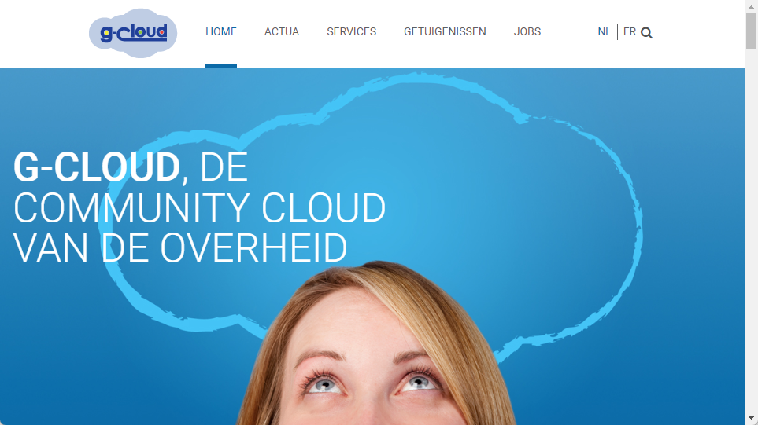
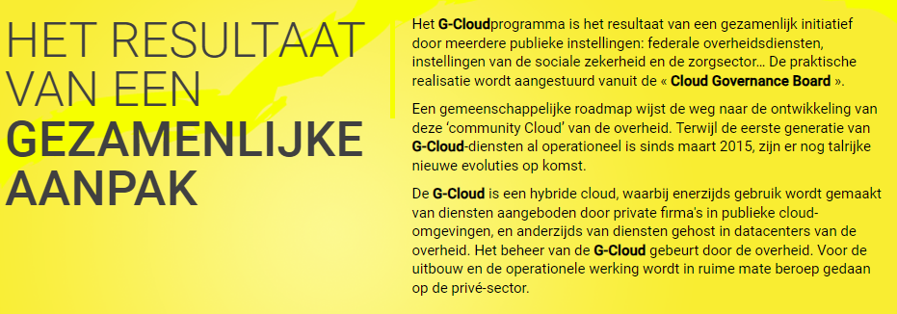
https://gcloud.belgium.be/

Slide 26
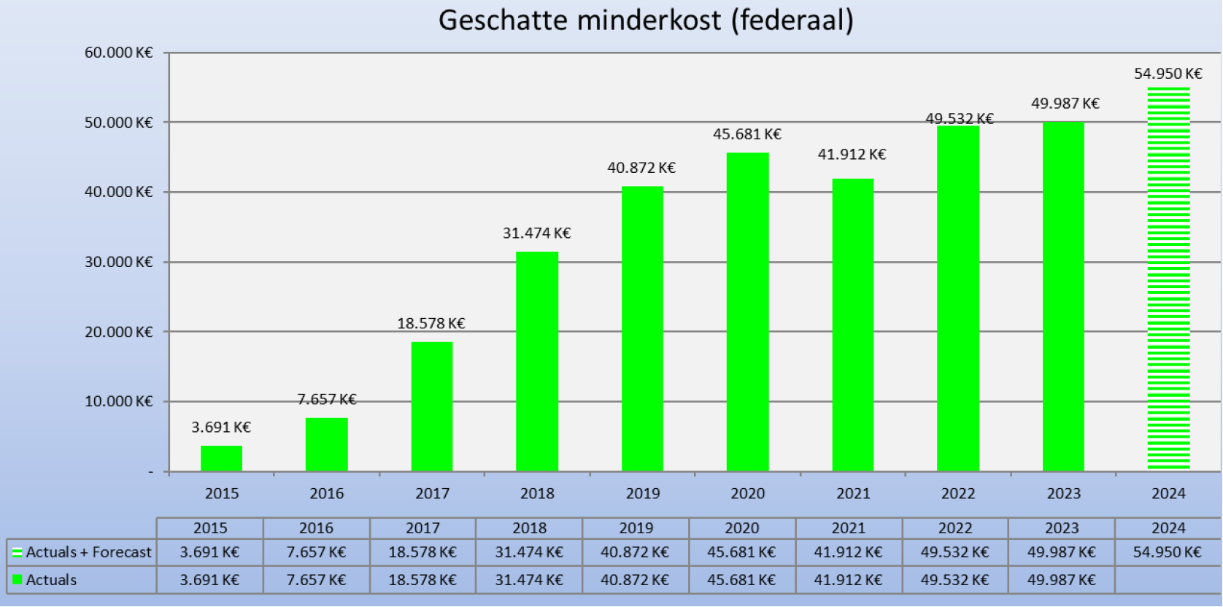
G-Cloud – Sharing ICT infrastructure
Programme of synergy-driven initiatives
  Services, Projects, Procurement, Knowledge Sharing
  Active cross-institution ICT Community
Hybrid community cloud model
  Private Community Cloud running
  from government-operated datacenters
Public cloud?
  Already the case for
  special purpose needs
  Moving forward as a community for
  general purpose needs
  Joint taskforce defining vision, strategy,
  policies, guidelines, architecture, …
Avoided spending (federal)
Even if you only believe half of it… this is still an impressive number !

Slide 27
Public Cloud & Open Source?
How to maximize potential public cloud “value”
  And minimize potential public cloud “disvalue” for your organization?
  This (dis)value depends heavily on your specific situation
  An important multi-dimensional exercise of ICT maturity
We think believe hope open standards will bring us 99% of portability (off premise)
  Or at least more than 0%
  Cloud Portability comes with a cost however and it limits your options
  Requires careful consideration
We do believe it paves the way to step up the operational stability / quality
  Going public cloud means you need to get your act together – are you ready?
  It will be beneficial for the on premise maturity as well
Hybrid Cloud increases complexity
  Optimizing your on premise installation for efficiency and effectiveness is a different beast
  Technology evolution/delivery models are often optimized for a public cloud model and a profit-driven industry
  Example: Vertical scaling (in the datacenter) versus Horizontal scaling (of the software)
Is open source still relevant / viable in an XaaS-only world?
  Open source should cover a new strong concept of “open services” and “open cloud”

Slide 28
Ok, so then Smals is a top contributor?
Our core business is not “technology product development”
  We (ab)use technology to (retro)fit the needs of our context
  Like most organisations we are mainly on the consumer side
  Abstractions that are (re)usable for the rest of the world pop up occasionally but are not the norm
Practical open source contribution in general is not for everyone
  Less than 1% of the population is capable to directly contribute in a meaningful way
  Coding competency, paying with your time, figuring your way around the code base and culture, …
We do pay others to contribute for us
  e.g. RedHat, Postgres EDB, …
Contributions in any form remain a major challenge
  In general, not limited to open source
  Even for in-house contributions to our own transversal micro-cosmos of libraries, platforms, …
  It’s no free(dom) lunch
We do however contribute to a vibrant micro-community…

Slide 29
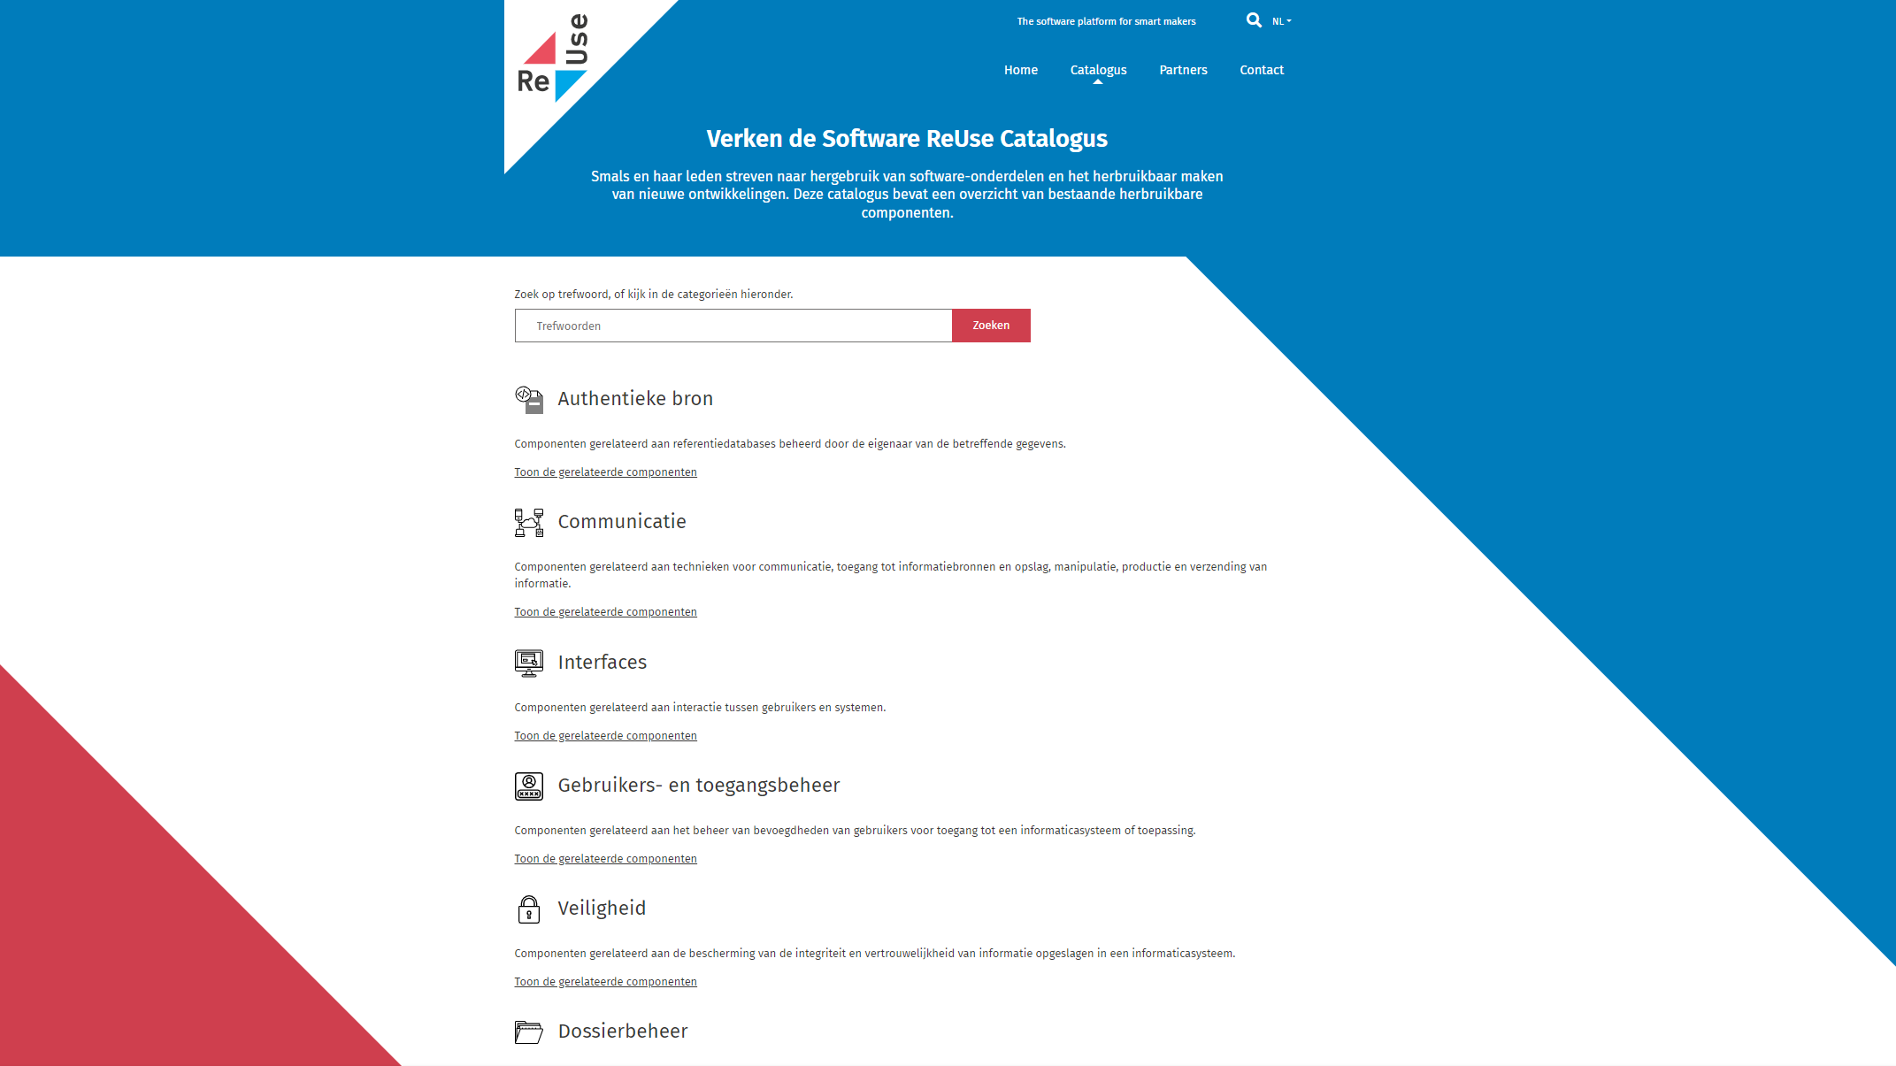
https://ict-reuse.be/

Slide 30


Reuse of software & business components
Orginated within Belgian public social security & Smals
  Open to other federal public services
Synergy around (technical) business components
  Avoid multiple development of redundant components
  Save costs & effort
Catalogue of reusable components
Active micro-community
Regardless of whether development takes place by
  The institution's own ICT department, Smals, subcontractors
50%
66%
ROI
6%
Reused
reusable
Business specific
custom code:
28%
→ Total ROI 2022: € 32.000.000
Even if you only believe half of it… this is still an impressive number !

Slide 31
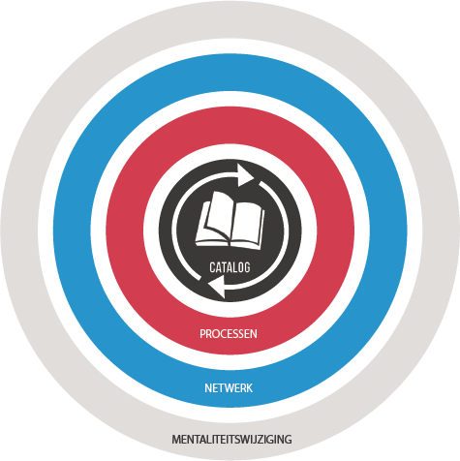
Every stakeholder
can easily find the most common reusable elements in a centralized catalogue
Processes
and tools are put in place to identify, register, implement, monitor and measure reuse throughout the project lifecycle
Human
networks are maintained and developed on all levels (CEO’s, CIO’s, business owners, business analysts, architects) in order to keep maximum visibility on reuse potential
A culture
develops where
reuse is adopted and the creation of reusable products is promoted,
31
An ambitious endeavor to reimagine open source practices in our public sector context, with similar challenges!

Slide 32



Enterprise Architecture : framework
Holistic
Vision & strategy
Vertical
Domains
Social security
Health
Other
Customer Centricity
Only Once
Employment
Illnes
Health care
Taxes
…
Services
Holiday
Pension
Medical costs
Family allowance
Care
Health risks
Medicines
Defense
Mobility
Horizontal
Processes
Generic & reusable
Interopera-bility
Architectural-principles
Building Blocks
Generic & reusable
Standards
Legacy vs innovation
Privacy by design

Slide 33
Open source is an
inspiration for our own
Community

Slide 34
Some Principal values & drivers of Smals
Sustainable ICT solutions and services
Community empowerment
Collaborative innovation
Overarching “enterprise” architecture vision for public sector ICT
Quality driven with a particular focus on business continuity and security
Data ethics and data protection as a fundamental cornerstone in our approach
Digital inclusion and citizen-centricity as the default
Cost-Conscious and lean mindset to maximize value for our community …
Synergetic, giving rise to a whole that is greater than the simple sum of its parts
Enabler, ensuring indirect positive benefits for society
Invisible, leaving the spotlight to our members
Open Source Mindset
Approved

Slide 35
Key takeaways…
Open source is the invisible engine of our digital society
  We must focus on making it visible again
  Not only to promote it, but also to know what’s inside our trusted engine
Micro-communities can make a difference
  We must tap into the collective intelligence of the public sector community to deliver better services to citizens
  It's about building bridges
  We are all part of the public sector family: Together we stand strong(er)
Open source is more than just software
  It's about building a culture of openness, collaboration, and trust
  It’s about building a methodological approach covering all aspects that keep us awake
  With great freedom comes great responsibility
Join existing communities, create new ones - every type of contribution matters
Reimagine open source in the broadest sense
Ensure that trust in open source and the public sector doesn’t dwindle
Make a future of XaaS sustainable for the public sector by pushing open services and open cloud
Install a structural, methodological approach for public sector to embed open source in our digital landscape

Slide 36

Thank you !
If you have any questions, do not hesitate to contact me,
dirk.deridder@smals.be
gcloud.belgium.be
ict-reuse.be
www.smals.be

