Slide 1


Compliance testing
frank.robben@mail.fgov.be
@FrRobben
https://www.frankrobben.be
https://www.ksz.fgov.be
https://www.ehealth.fgov.be
eHealth Platform
January 2024

Slide 2
Compliance: elements and result
Elements
  notification of software
  software meets compliance criteria
  documentation is available (application architecture, user, …)
  declaration of liability
Result
  access to the market
Note
  additional country specific quality label (optional, not mandatory for the software to obtain)

Slide 3
Compliance criteria
Technical interoperability, eg
  structure of messages
  authentication methods
Semantic interoperability, eg
  identification
  value sets
Quality, eg
  correct handling of use cases
  use of evidence based medicine guidelines
Security & data protection, eg
  confidentiality
  availability
  traceability

Slide 4
Security and data protection
Aspects
  confidentiality (eg user & access management, encryption)
  integrity
  availability (eg business continuity)
  traceability
  non-repudation
Need for integrated measures
  technical measures
  organizational measures
  HR-related measures

Slide 5
Security and data protection
Existing regulation
  General Data Protection Regulation 2016/679
  eIDAS Regulation 910/2014
  NIS (Network and Information Systems) Directive 2016/1148
  NIS 2 (Network and Information Systems) Directive 2022/2555
  Regulation (EU) 2019/881 on ENISA (the European Union Agency for Cybersecurity) and on information and communications technology cybersecurity certification (Cyber Security Act)

Slide 6
Equilibrium to be sought
Sufficient garantees regarding to compliance
Room for
  entrepreneurship
  agile development
  smooth innovation
Controlling overhead costs and administrative burden, especially for PME’s
Consistent regulation and avoidance of multiple, overlapping regulations

Slide 7
Proposal
Test environment at the European Commission for certified automated testing of compliance with established criteria on
  technical interoperability
  semantic interoperability
  quality
Use of the tools established in the General Data Protection Regulation (GDPR), eIDAS Regulation and NIS 2 directive for information security and data protection accountability
  data processing impact assessment (DPIA)
  respect of defined eIDAS security levels
  respect of defined cyber security measures

Slide 8
Usefulness of basic services at the EU level
Facilitates secure crossborder exchange of personal data
Reduces costs
Speeds up time to market
Structurally increases data protection safeguards
Facilitates compliance monitoring

Slide 9
Example: identity, user & access management (IUAM)
be able to (electronically)
  identify all relevant entities (physical persons, companies, application, machines, …)
  authenticate the identity of all entities
  know the relevant characteristics of the entities
  know the relevant relationships between entities
  know that an entity has been mandated by another entity to perform a legal action
  know the authorizations of the entities
in a sufficiently certain and secure way
in as much relations as possible (C2C, C2B, C2G, B2B, B2G, …)
multichannel (web application, mobile application, …)
using open interoperability standards

Slide 10
Example: IUAM: international XACML standard
Action on application
DENIED
Policy
Enforcement
(PEP)
Action on application
PERMITTED
User
Application
Action on application
Decision
request
Decision
reply
Policy
Decision
(PDP)
Information
request/reply
Policy
retrieval
Information
request/reply
Policy management
Policy
Administration
(PAP)
Policy
Information
(PIP)
Policy
Information
(PIP)
Manager
Policy repository
Authentic source
Authentic source

Slide 11











A

Slide 12
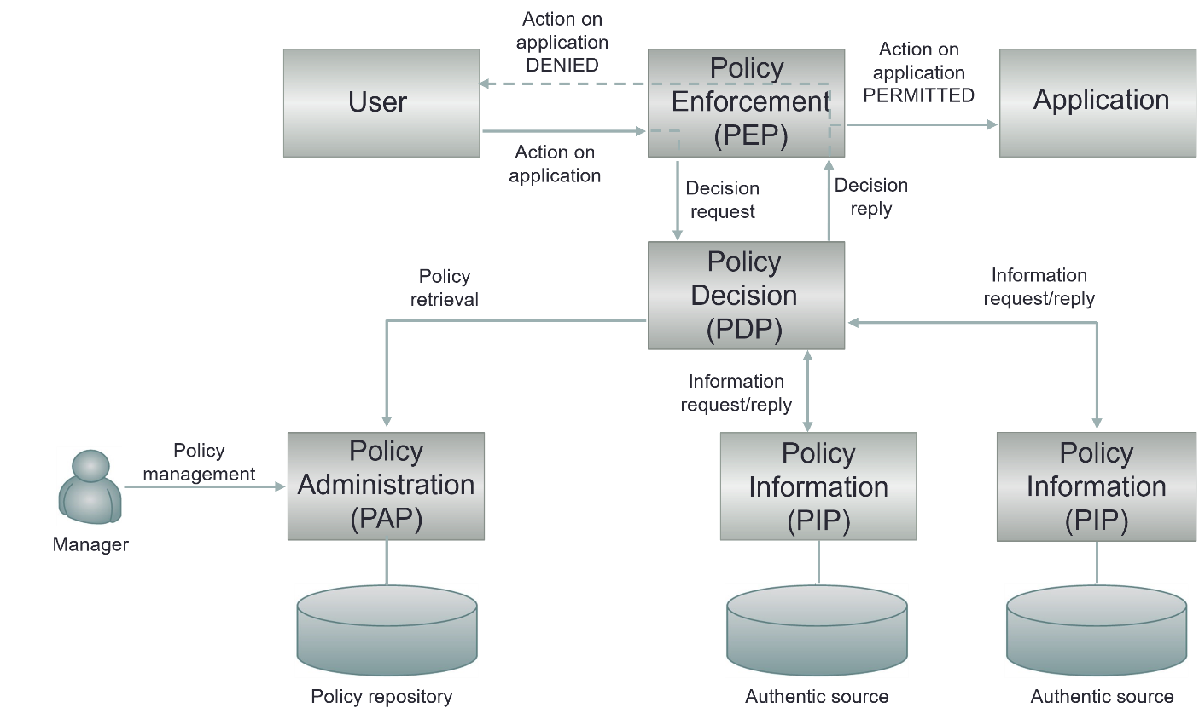
Example: IUAM : crossborder

Slide 13
Example: Belgian testing environment
Defining compliance test criteria
  detailed test cases
Onboarding implementers
  software vendors, health care providers, health care institutions, …
Executing the compliance test campaign
  testers have 24/7 access
  testers can visualize the test plan
    technical view (JSON)
    business view (HTML and/or PDF)
  testers have to send all defined test cases via REST API
  testers can track their progression via a personal dashboard
  supervisors can follow up the progression of all implementers
  testers receive a certification

Slide 14
Test server – unit testing
Validation template
Business
case
(Word description)
Reference
(FHIR) instance
Validation process
Test case
Visualisation
(html/pdf)
Sender
Software
Generated
(FHIR) instance

Slide 15
Test server – end to end testing
FHIR Test server
Sender
Software
Generated
(FHIR) instance
REST API
Successful
test instances
Cherry Picking
Receiver
Software
Provided
(FHIR) Instance
Test result declaration

Slide 16
Test server architecture
Tester
Test server
REST API
(FHIR)
instance
Validation Process
eHealthbox Connector
ValidationTemplates
eHealthPlatform
Dashboard
Reference test list
Test coverage
Test result
Validation Results
https://fhir-testserver.be/index.php/login

Slide 17
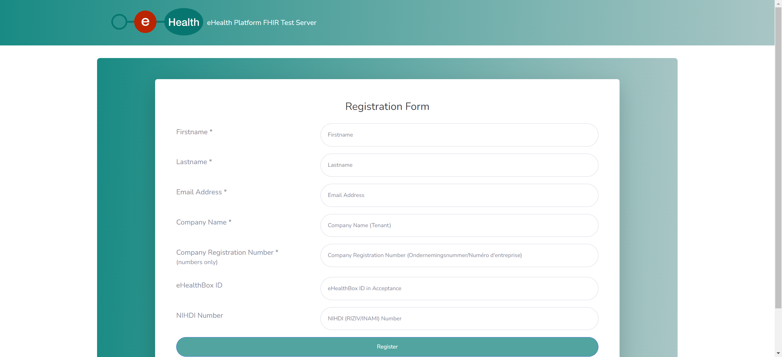
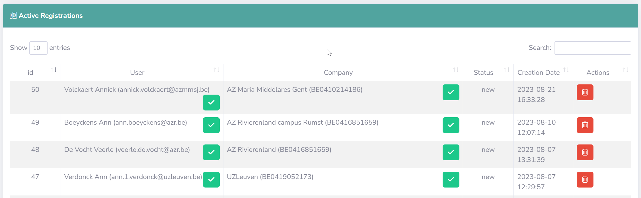
Test server – administration – registration

Slide 18
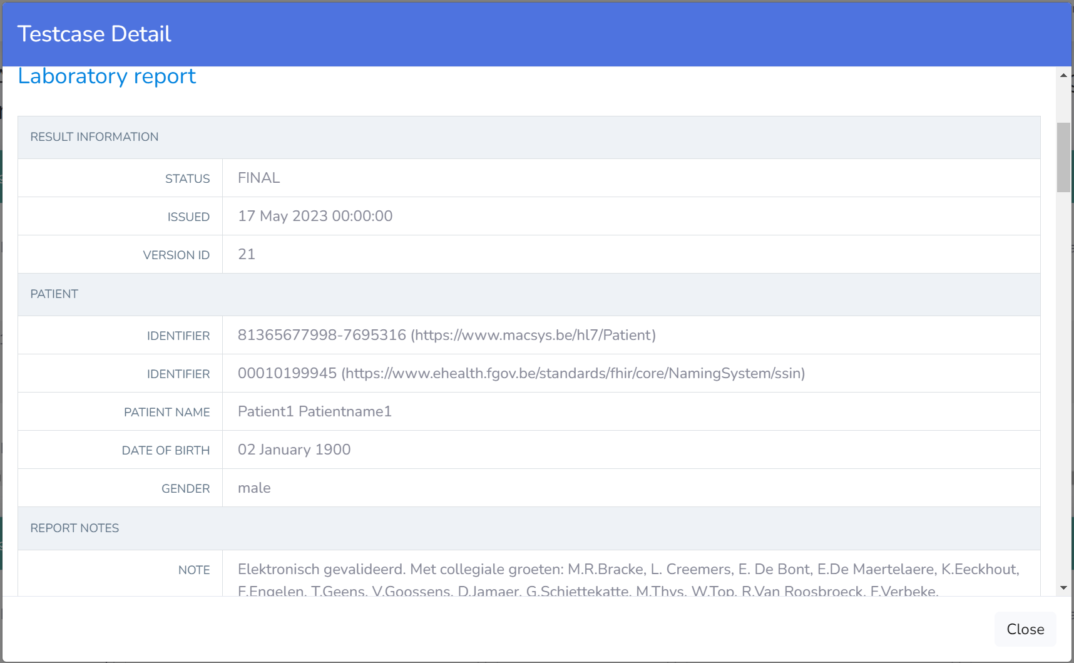
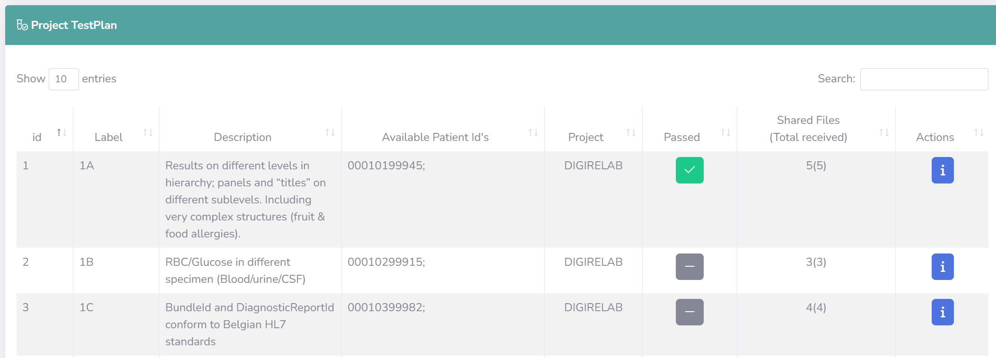
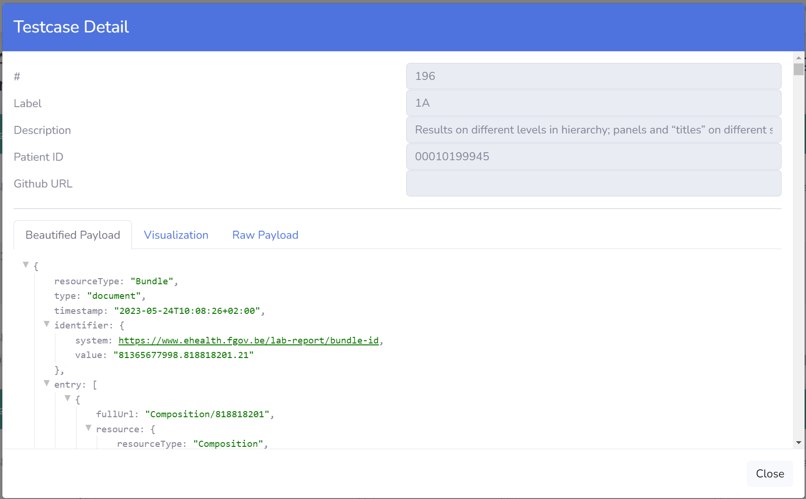
Test server – self service approach

Slide 19
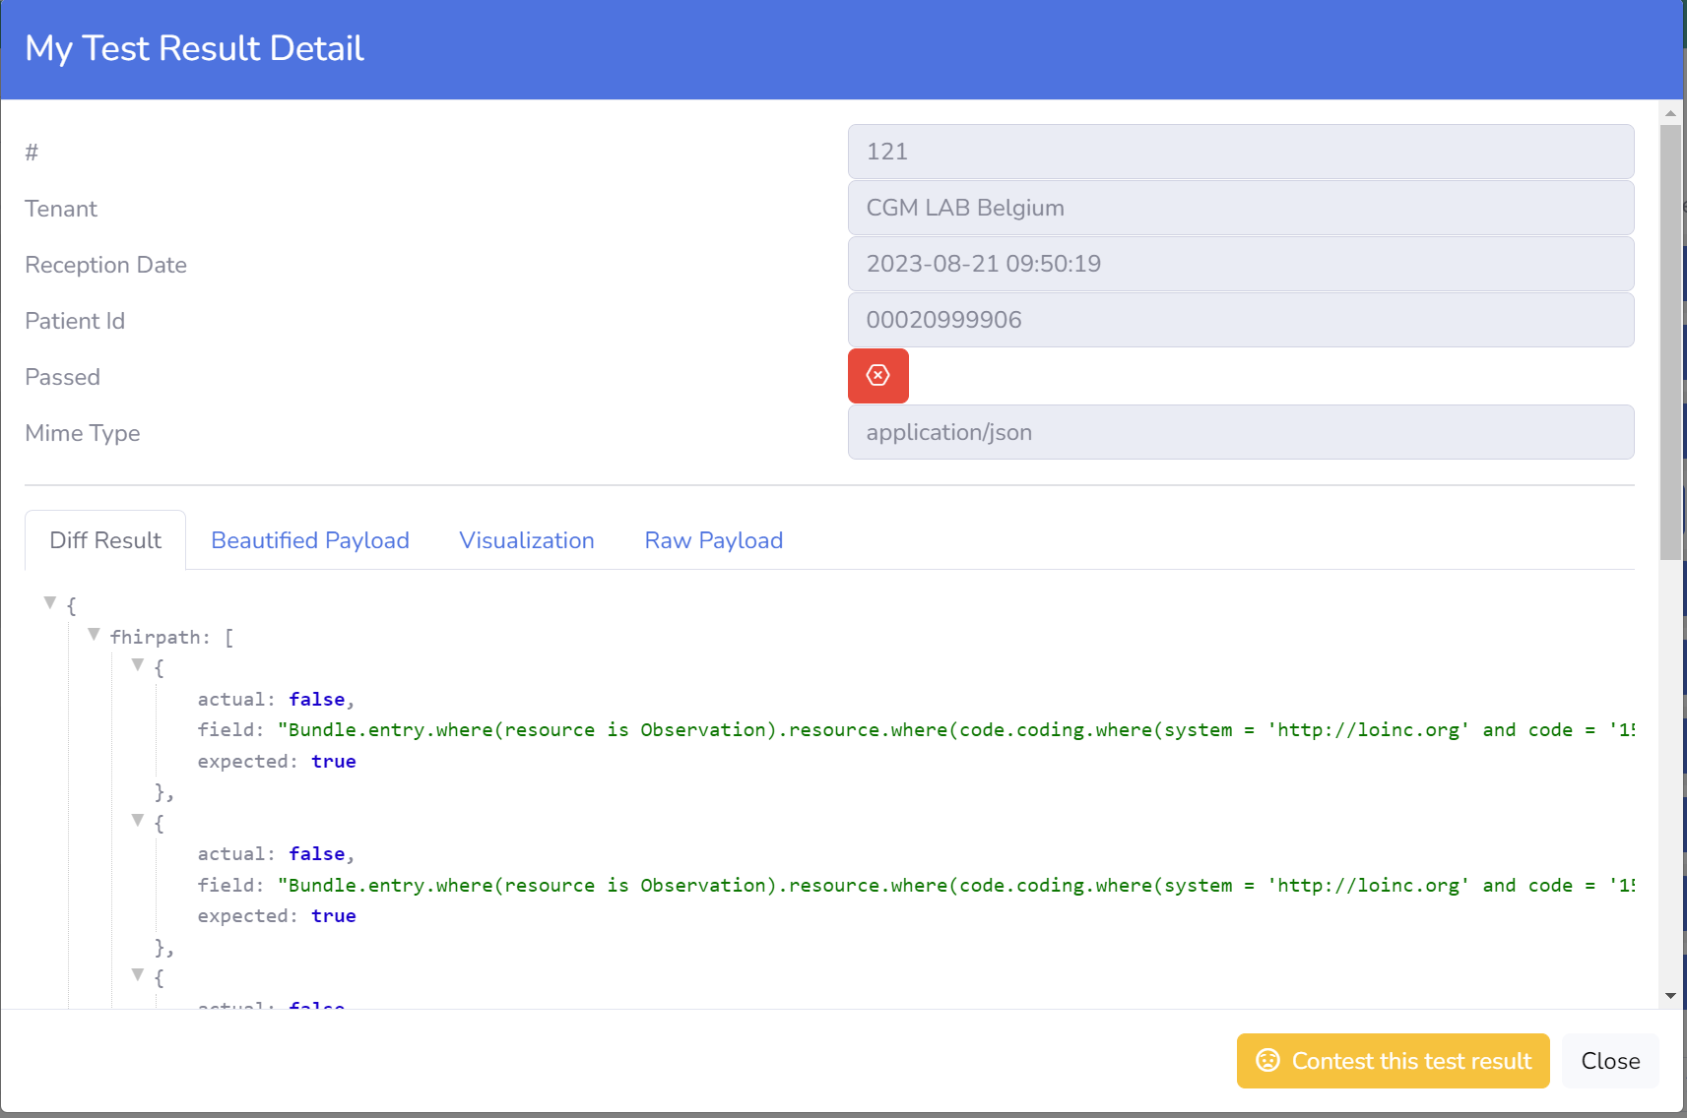
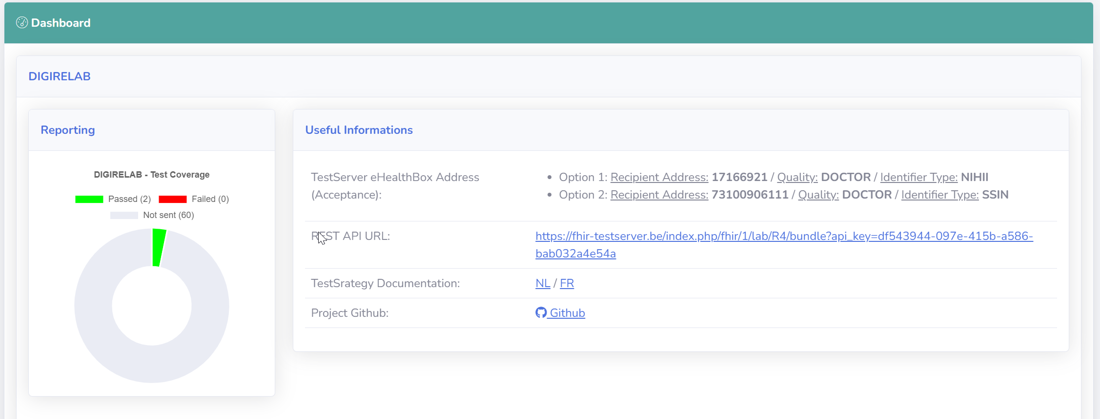
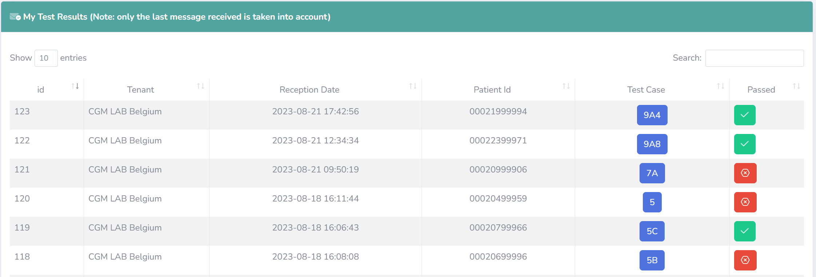
Test server – self service approach

Slide 20
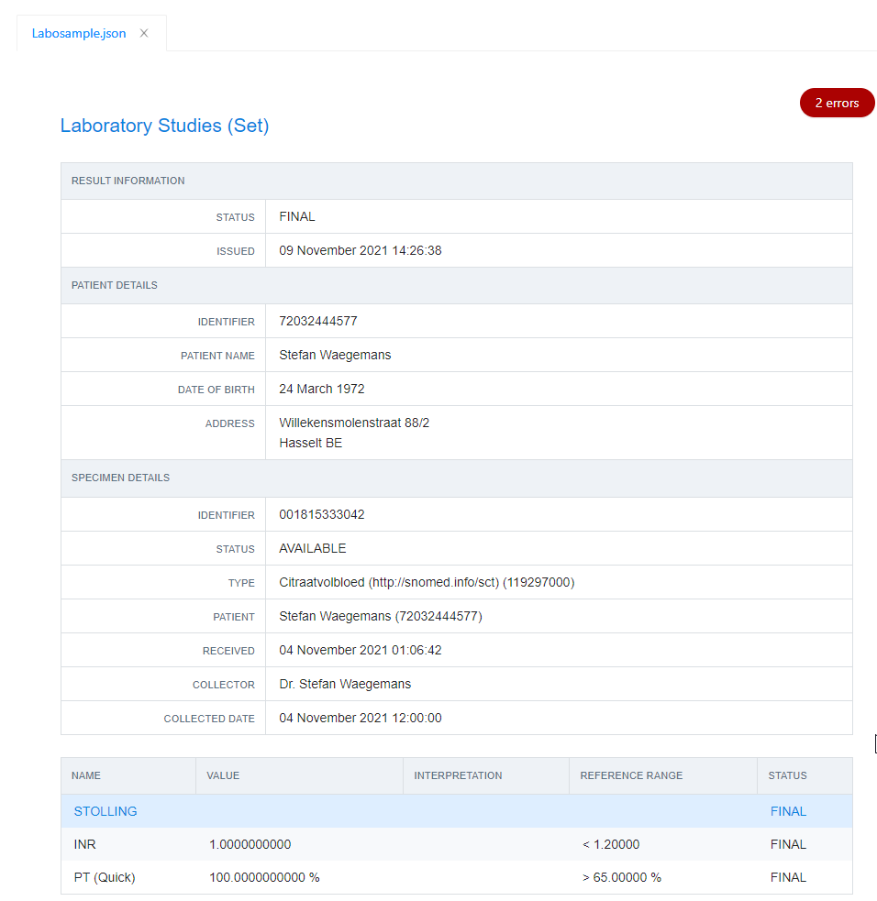
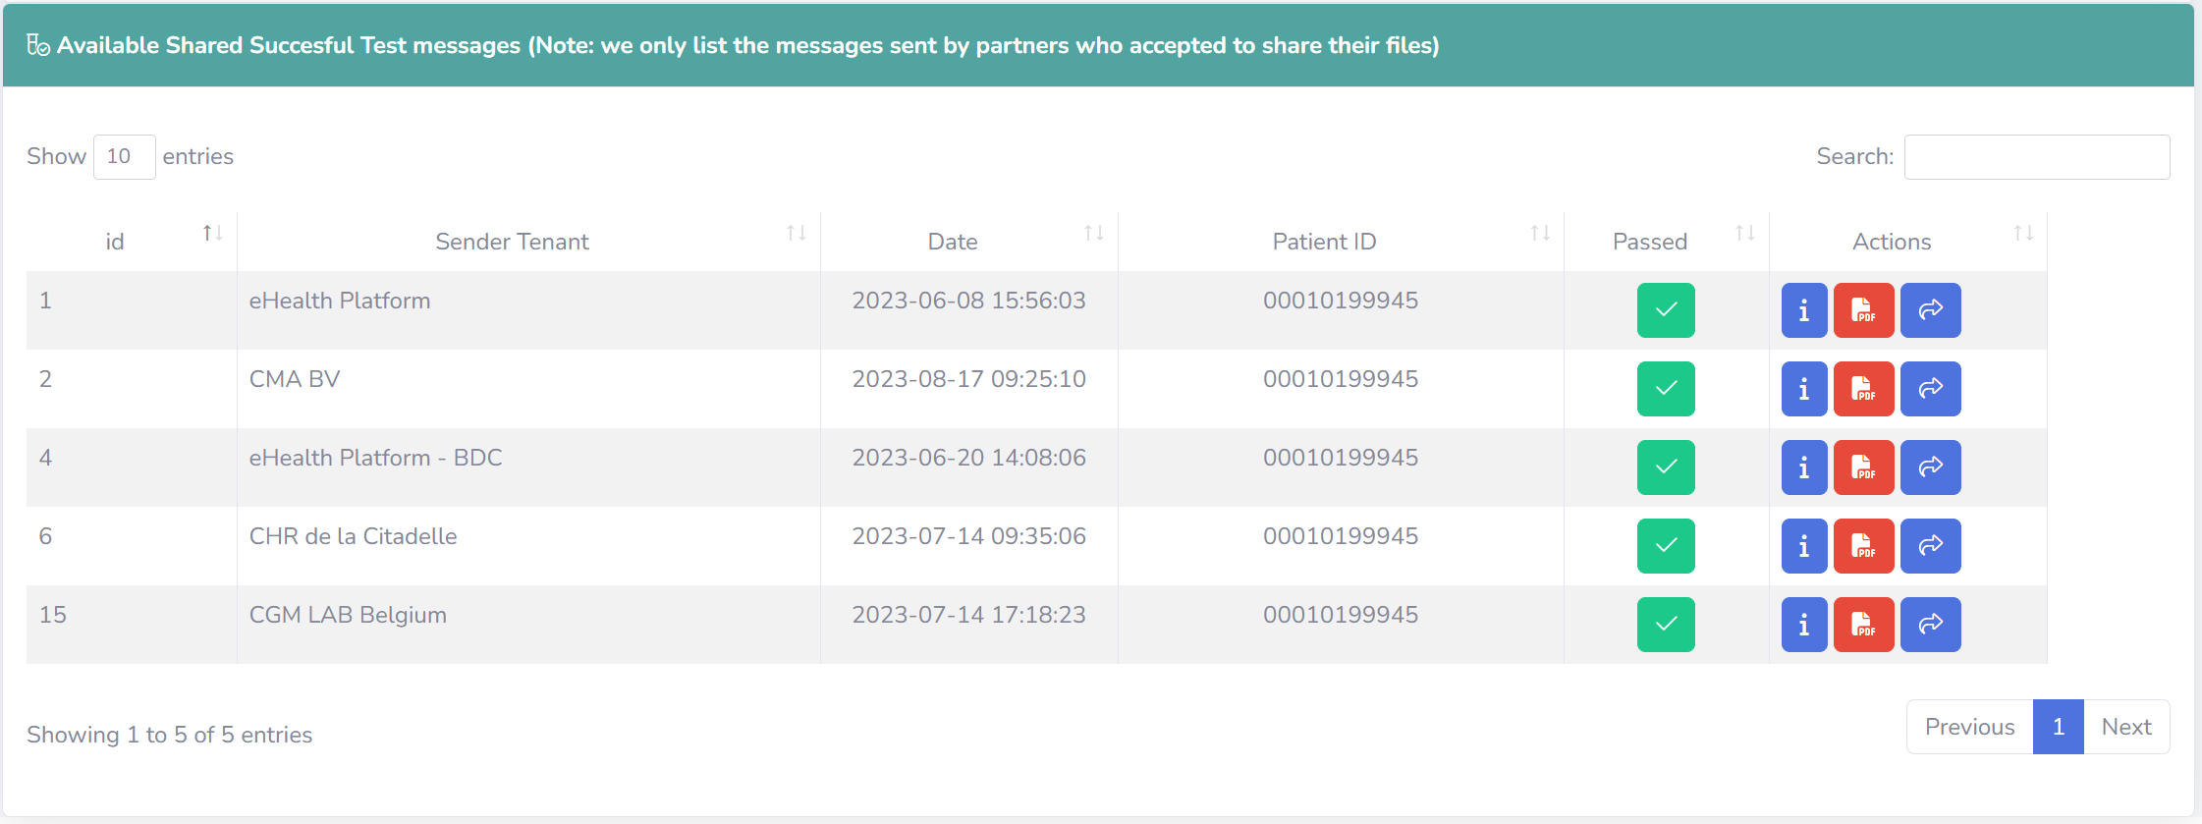
Test server – global overview

Slide 21

frank.robben@mail.fgov.be
@FrRobben
https://www.frankrobben.be
https://www.ksz.fgov.be
https://www.ehealth.fgov.be

