Slide 1
Sound electronic information management as a critical success factor for effective and efficient social protection and health care

Slide 2
About me (°1961)
education: law, ICT, ICT auditing, management, personal coaching
professional activities
Crossroads Bank for Social Security
1986-1991: originator as an advisor to the Minister of Social Affairs and the Prime Minister
since 1991: CEO
Data Protection Authority
1991-2022: external member
Federal Ministry of ICT
2000-2001: originator as an advisor to the Minister of ICT (ao conception of electronic identity card)
Smals (non for profit operational ICT association of public institutions of social security and health)
since 2004: CEO (ao originator of G-Cloud initiative)
eHealth platform
2007-2008: originator as an advisor to the Minister of Public Health
since 2008: CEO
2020-2021: enterprise architect of Belgian information systems to fight the COVID-19 pandemic (testing, tracing, vaccination) and contributor to development of components on EU and WHO level

Slide 3
Setting the scene

Slide 4
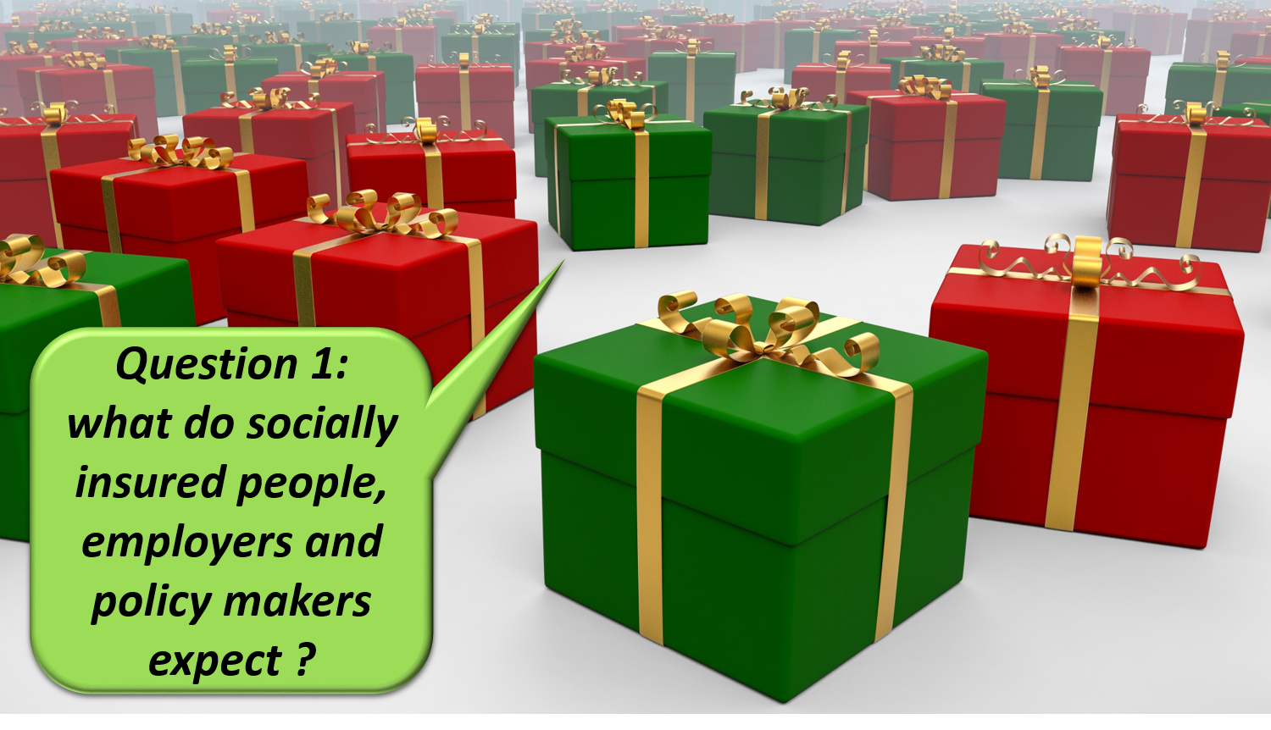

Slide 7
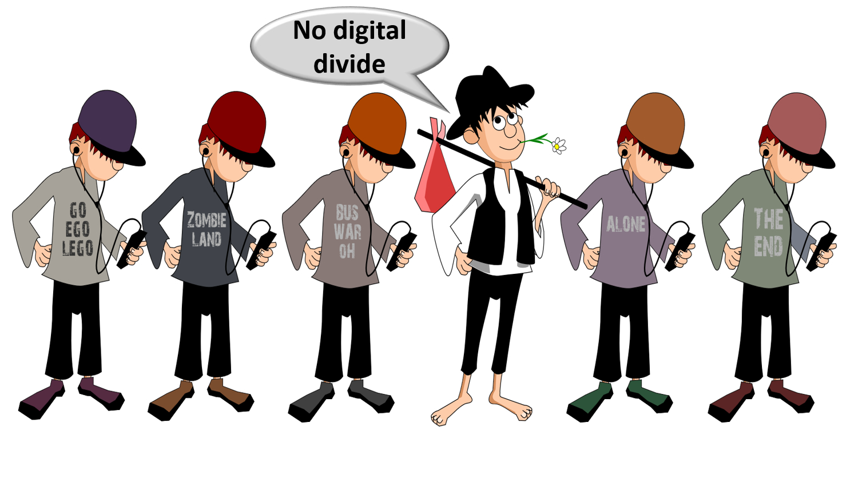

Slide 24
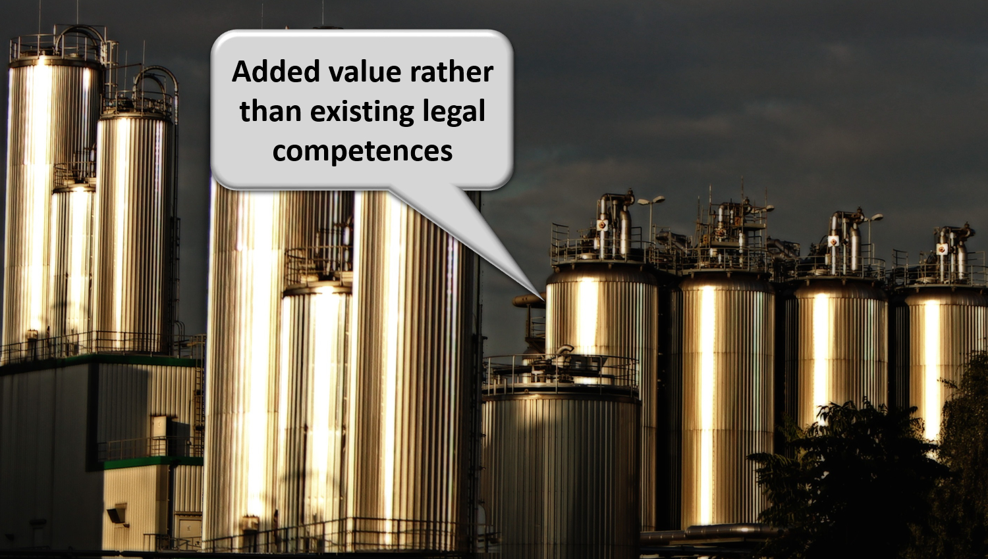

Slide 35
Notes:
Let the computer do what it is good at and thereby make time available for human support where necessary. And remember: the network always wins

Slide 36
Application in the Belgian social sector

Slide 37
Stakeholders of the Belgian social sector
> 11,500,000 citizens
> 230,000 employers
about 3,000 public and private institutions (actors) at several levels (federal, regional, local) dealing with
collection of social security contributions
delivery of social security benefits
child benefits
unemployment benefits
benefits in case of incapacity for work
benefits for the disabled
re-imbursement of health care costs
holiday pay
old age pensions
guaranteed minimum income
delivery of supplementary social benefits
delivery of supplementary benefits based on the social security status of a person

Slide 38
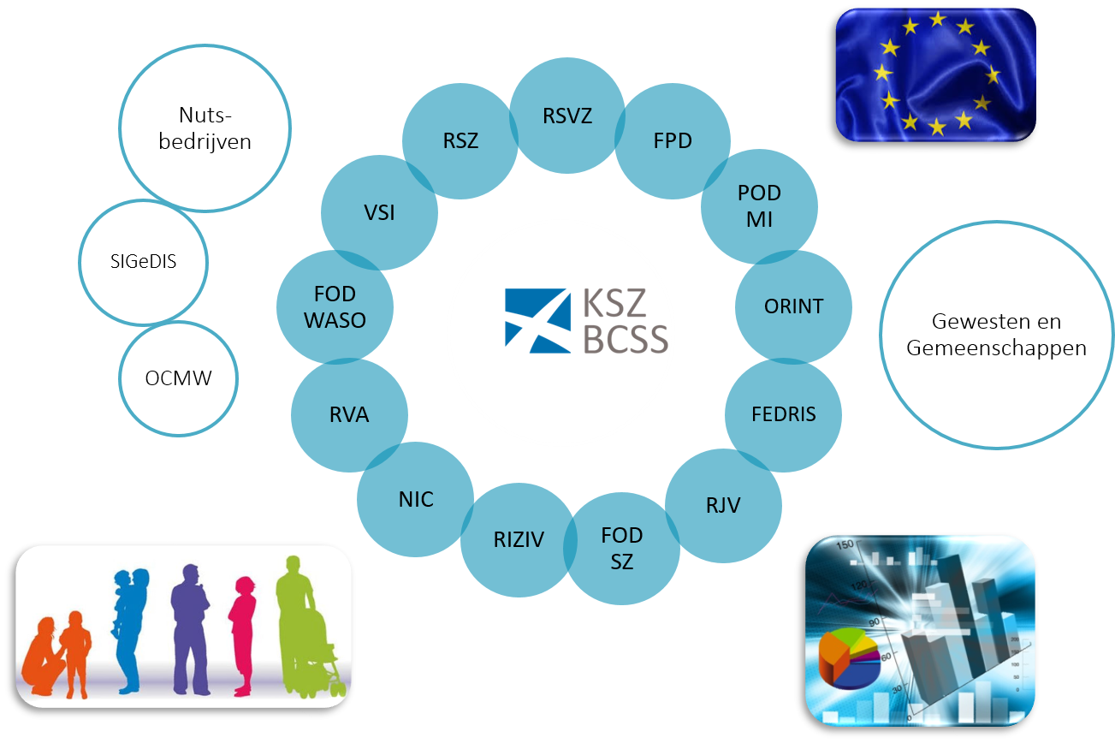
Kruispuntbank van de Sociale Zekerheid (KSZ)

Slide 39
Crossroads Bank of Social Security (CBSS)
Internet
R
FedMAN
Users
R
Isabel
FW
R
…
R
Backbone
FW
FW
FW
FW
FW
R
R
R
R
R
RVA
KSZ
RSZ
R
R
NIC
…

Slide 40
Results
a network between all 3,000 social sector actors with a secure connection to the internet, the federal MAN, regional extranets, extranets between local authorities and the Belgian interbanking network
a unique identification key
for every citizen
for every company
for every establishment of a company
an agreed division of tasks between the actors within and outside the social sector with regard to collection, validation and management of information and with regard to electronic storage of information in authentic sources

Slide 41
Results
220 electronic services for mutual information exchange amongst actors in the social sector, defined after process optimization
nearly all direct or indirect (via citizens or companies) paper-based information exchange by > 800 paper forms between actors in the social sector has been abolished
in 2023, > 1,81 billion electronic messages were exchanged amongst actors in the social sector, which saved as many paper exchanges
electronic services for citizens
maximal automatic granting of benefits based on electronic information exchange between actors in the social sector
25 electronic services via an integrated portal and/or mobile applications

Slide 42
Results
more than 50 electronic services for employers, either based on the electronic exchange of structured messages or via an integrated portal site
50 social security declaration forms for employers have been abolished
in the remaining 30 (electronic) declaration forms the number of headings has on average been reduced to a third of the previous number
declarations are limited to 3 events
immediate declaration of recruitment and discharge (only electronically)
quarterly declaration of salary and working time (only electronically)
occurrence of a social risk (electronically or on paper)
in 2022, more than 45 million electronic declarations were made by all 230,000 employers, 98 % of which from application to application

Slide 43
Quartely declaration salary & working time
simplification
Activity 3
Activity 2
Activity 1
employer
one electronic
declaration
RSZ
RIZIV
RVA
old age pension
FPD
Orint
holiday pay
RJV

Slide 44
Declaration of social risks
types of social risks
child benefits
incapacity for work ((labour) accident, (occupational) disease, …)
unemployment
old age pension
3 possible moments of declaration
start of the social risk
recurrence or continuation of the social risk
end of the social risk
structure of the declaration
identification data
if necessary, salary and working time data not yet declared via a quarterly declaration (mini-declaration)
specific data concerning the social risk

Slide 45
Results
an integrated portal site and mobile applications containing
electronic transactions for citizens, employers and professionals
simulation environments
information about the entire social security system
harmonized instructions and information model relating to all electronic transactions
a personal page for each citizen, each company and each professional
an integrated multimodal contact centre supported by a customer relationship management tool
a data warehouse containing statistical information with regard to the labour market and all branches of social security

Slide 46
Distributed information servers
information servers
directory of data subjects at the KSZ
basic identification data of citizens at the National Register and the complementary KSZ Register
basic identification data of companies at the Company Register
employers directory (WGR) at the RSZ
work force register at the RSZ
salary and working time database at the RSZ
database of contribution certificates
services offered
interactive consultation
batch consultation
automatic communication of updates

Slide 47
Pre-processed messages
pre-processed messages
beginning/end of labour contract, beginning/end of self-employed activity
contribution certificates medical care (employees, self-employed, beneficiaries of social security allowances)
unemployment benefits
benefits in case of career break
benefits in case of incapacity for work ((labour) accident, (occupational) disease)
reimbursement of health care costs
child benefits
old age pensions
holiday pay
benefits for the disabled
guaranteed minimum income – social welfare
derived rights (e.g. tax reduction/exemption, free public transport, ...)
migrant workers
…
services offered
interactive consultation
batch consultation
automatic communication of messages

Slide 48
Useful tool: the reference directory
reference directory
directory of available services/information
which information/services are available at any actor depending on the capacity in which a person/company is registered at each actor
directory of authorized users and applications
list of users and applications
definition of authentication means and rules
definition of authorization profiles: which kind of information/service can be accessed, in what situation and for what period of time depending on in which capacity the person/company is registered with the actor that accesses the information/service
directory of data subjects
which persons/companies have personal files at which actors for which periods of time, and in which capacity they are registered
subscription table
which users/applications want to automatically receive what information/services in which situations for which persons/companies in which capacity

Slide 49
Common vision on information management
information is being modelled
in such a way that the model fits in as closely as possible with the real world
in order to allow multifunctional use of information
information is collected from citizens and companies only once by the public sector as a whole
via a channel chosen by the citizens and the companies
preferably from application to application
and with the possibility of quality control by the supplier before the transmission of the information
the collected information is validated once
according to established task sharing criteria
by the actor that is most entitled to it or by the actor which has the greatest interest in correctly validating it

Slide 50
Common vision on information management
a task sharing model is established indicating which actor stores which information as an authentic source, manages the information and maintains it at the disposal of the authorized users
information can be flexibly assembled according to ever changing legal concepts
every actor has to report probable errors of information to the actor that is designated to validate the information
every actor that has to validate information according to the agreed task sharing model, has to examine the reported probable errors, to correct them when necessary and to communicate the correct information to every known interested actor
once collected and validated, information is stored, managed and exchanged electronically to avoid transcribing and re-entering it manually

Slide 51
Common vision on information management
electronic information exchange can be initiated by
the actor that disposes of information
the actor that needs information
the organisation that manages the interoperability framework
electronic information exchanges take place on the base of a functional and technical interoperability framework that evolves permanently but gradually according to open market standards, and is independent from the methods of information exchange
available information is used for
the automatic granting of benefits
prefilling when collecting information

Slide 52
Common vision on information security
security, availability, integrity and confidentiality of information is ensured by integrated structural, institutional, organizational, HR, technical and other security measures according to agreed policies
personal information is only used for purposes compatible with the purposes of the collection of the information
personal information is only accessible to authorized actors and users according to business needs, legislative or policy requirements
the access authorization to personal information is granted by an Information Security Committee, designated by Parliament, after having checked whether the access conditions are met
the access authorizations are public

Slide 53
Common vision on information security
every actual electronic exchange of personal information has to pass an independent trusted third party and is preventively checked on compliance with the existing access authorizations by that trusted third party
every actual electronic exchange of personal information is logged, to be able to trace possible abuse afterwards
every time information is used to take a decision, the information used is communicated to the person concerned together with the decision
every person has right to access and correct his/her own personal data
every actor in the social sector disposes of an information security officer with an advisory, stimulating, documentary and control task

Slide 54
Maximale automatische toekenning aanvullende rechten
‘sociaal statuut’ voor ca. 2 miljoen burgers in België
beperkt inkomen
handicap, fysieke of mentale beperking
kind met bijzondere noden
burgers met sociaal statuut krijgen ‘aanvullende rechten’
sociaal tarief voor gas, elektriciteit, water, telecom
openbaar vervoer (NMBS, De Lijn, TEC…)
huisvesting
belastingvermindering, gratis huisvuilophaling
korting voor socioculturele activiteiten, sport
…
2

Slide 55
Aanvullende rechten
vaststelling van non-take up
intransparantie: mensen zijn weinig of niet op de hoogte van hun rechten
Mattheüseffect: rechten komen niet bij de beoogde (kwetsbare) doelgroep terecht
drempel: de aanvraag- en toekenningsprocedure voor sociale rechten is vaak omslachtig en tijdsintensief
ineffectiviteit: sociale maatregelen bereiken hun doel niet
status quo van de armoederatio ipv sociale inclusie: het aantal armen daalt verhoudingsgewijs niet
doelstellingen
voor de burgers
burgers maximaal automatisch laten genieten van de aanvullende sociale rechten
administratieve formaliteiten tot een minimum beperken
voor de instellingen / actoren die het aanvullend sociaal toekennen
vlot alle nodige informatie ter beschikking stellen voor de toekenning (sociaal statuut, domicilieadres…) => beperking van werklast en kosten
vermijden van eventueel misbruik
3

Slide 56
Principes
feitelijke informatie beschikbaar bij één of meerdere actor(en) wordt ter beschikking gesteld van andere actoren die op basis daarvan automatisch rechten toekennen aan de burger zonder dat hij/zij daartoe een aanvraag moet doen
gestandaardiseerde diensten om zoveel mogelijk te antwoorden op informatieaanvragen en meervoudige ontwikkelingen te vermijden/beperken, zowel voor de gegevensleveranciers (authentieke bronnen) als voor de instanties die voordelen toekennen
vermindering van het aantal gebruikte statuten en van de complexiteit ervan, een vermindering van de gegevensuitwisselingen
vermindering van het aantal administratieve formaliteiten en papieren attesten die aan deze kwetsbare bevolkingsgroep wordt gevraagd
5

Slide 57
Gestandaardiseerde Sociale Statuten (GSS)
batch-raadpleging van de gegevensbank GSS (bufferdatabank)
wordt driemaandelijks gevoed door de 11 authentieke bronnen : POD MI, DGPH, ziekenfondsen, FPD, VSB, Agentschap Opgroeien, AViQ, OAW, IrisCare, DSL en MDG
hierdoor kunnen de rechten van een categorie van personen (die op voorhand is gekend bij de toekennende instantie) worden geautomatiseerd
vb. alle inwoners van een gemeente, een provincie
vb. alle gezinnen aangesloten op gas
enkele voorbeelden
sociaal tarief gas / elektriciteit in België
sociaal tarief water in Vlaanderen
vrijstelling verkeersbelasting in Brussels Gewest
gemeenten en provincies (vb. verminderd tarief buitenschoolse kinderopvang, verminderde heffing voor huisvuilophaling, korting belasting)
1
7

Slide 58
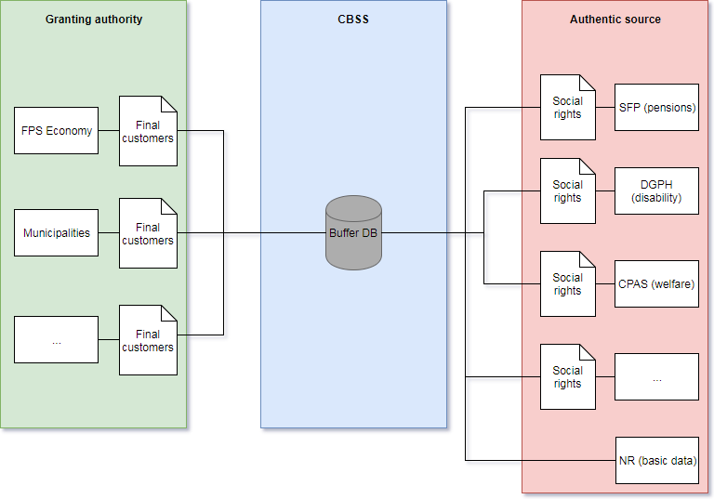
Bufferdatabank
8

Slide 59
11 Authentieke bronnen
Federaal
POD Maatschappelijke Integratie (POD MI) en OCMWs (vb. leefloon ((e)LL)
DG Personen met een Handicap (DGPH) (vb. erkende handicap, inkomensvervangende tegemoetkoming (IVT))
ziekenfondsen (vb. recht op een verhoogde verzekeringstegemoetkoming (RVV))
Federale PensioenDienst (FPD) (vb. inkomensgarantie voor ouderen (IGO))
Vlaanderen
Vlaamse Sociale Bescherming (VSB) (vb. tegemoetkoming hulp aan bejaarden ((THAB)
Agentschap Opgroeien (vb. kinderen met specifieke ondersteuningsbehoefte (P1-4))
Wallonië
Agence wallonne pour une Vie de Qualité (AViQ) (vb. erkende handicap kinderen)
Organismes Assureur Wallon (OAW) (vb. vermindering zelfredzaamheid)
Brussel
IrisCare (vb. tegemoetkoming hulp aan bejaarden (THAB))
Duitstalige gemeenschap
Dienststelle für Selbstbestimmtes Leben (DSL) (vb. erkende handicap kinderen)
Ministerium der Deutschsprachigen Gemeinschaft (MDG) (vb. tegemoetkoming hulp aan bejaarden (THAB))

Slide 60
Bufferdatabank - voordelen
voor gebruikers van gegevens
geheel van informatie is op gecoördineerde en gevalideerde wijze beschikbaar
mogelijkheid tot toepassing van beslissingsregels door de KSZ in functie van de concrete behoeften van elke gebruiker (waarborg proportionaliteitsbeginsel)
voor de beheerders van authentieke bronnen
vermijden van ad hoc ontwikkelingen voor elke gegevensaanvraag
vermijden van terbeschikkingstelling van gegevens volgens behoeften van elke gebruiker
voor het systeem
aanzet tot standaardisatie van de feitelijke gegevens waarmee rekening wordt gehouden bij de vaststelling van aanvullende rechten en het tijdstip of periode waarover ze beschikbaar moeten zijn (‘legoblokjesfilosofie’)

Slide 61
Vereenvoudiging van de reglementering
vb. Don’t
vb. Do
Een premie is toegekend aan de referentie- persoon van het gezin ingeschreven in de gemeente waarvan ten minste 1 of meerdere gezinsleden op 1 januari van het betreffende dienstjaar genieten van de
Voorkeurtarieven inzake gezondheidszorgen
Inkomensgarantie voor ouderen (IGO)
Tegemoetkoming aan gehandicapten
Verhoogde kinderbijslag (regeling loonarbeiders of zelfstandigen)
Een premie is toegekend aan de referentie-
persoon van het gezin ingeschreven in de
gemeente waarvan ten minste 1 of meerdere gezinsleden op 1 januari van het betreffende dienstjaar genieten van de
verhoogde tegemoetkoming van de zorgverzekering (bedoeld in artikel 37, §19, van de wet betreffende de verplichte verzekering voor geneeskundige verzorging en uitkeringen, gecoördineerd op 14 juli 1994)

Slide 62
Legoblok filosofie
Authentieke bron (RR & KSZ)
Geboorte-datum
Verblijfplaats
Gezins-samenstelling
Sociale statuten
FOD of OISZ
Aanvullend recht
Toekennende instanties
IGO
GI
THAB
…
Vermindering provinciebelasting
Provincie Oost-Vlaanderen
OCMW
LL
AF - EQ - LL
DGPH
P1-4
…
Ziekenfondsen
Inkomsten
VT

Slide 63
Legoblok filosofie
Authentieke bron (RR & KSZ)
Geboorte-datum
Verblijfplaats
Gezins-samenstelling
Sociale statuten
FOD of OISZ
Aanvullend recht
Toekennende instanties
IGO
GI
THAB
…
Sociaal tarief gas & elektriciteit
FOD Economie & nutsbedrijven
OCMW
LL
AF - EQ - LL
DGPH
P1-4
…
Ziekenfondsen
Inkomsten
VT

Slide 64
Gestandaardiseerde sociale statuten
2
online raadpleging van 10 authentieke bronnen door de toekennende instanties (1 authentieke bron momenteel in voorbereiding)
aan het loket voor specifieke dossiers
hierdoor kan een recht worden toegekend aan elke potentiële rechthebbende die niet op voorhand gekend is
vb. gebruiker van het openbaar vervoer
enkele voorbeelden
aanvullende gezinsbijslag in de Duitstalige Gemeenschap en in het Waals Gewest
bijkomende dienstencheques (WSE)
kaart verhoogde tegemoetkoming en kaart kosteloze begeleider (NMBS)
brussel’Air premie (Brussel Mobiliteit)

Slide 65
MyBenefits
sinds februari 2019 MyBEnefits.fgov
mobiele app & webtoepassing
waarmee de burger zijn sociale statuten op de datum van de dag zelf kan raadplegen en aantonen om zijn rechten te laten gelden bij de verschillende instanties die aanvullende voordelen toekennen
waarmee de toekennende instantie de sociale statuten kan controleren
actoren die typisch niet rechtstreeks met de KSZ samenwerken (vb sport, kinderopvang, musea, vrijetijdscentra, pretparken, …)
actoren die (nog) niet over een automatische gegevensstroom beschikken (vb pro deo rechtsbijstand, korting gemeentebelasting, …)
waarmee de instanties die aanvullende voordelen toekennen in de sector van cultuur, sport en ontspanning deze kunnen melden, en de burger deze kan raadplegen
3

Slide 66
Veilig aanmelden
burger : identificatie nodig
statuut raadplegen: privacy-gevoelige informatie => voldoende hoog veiligheidsniveau
e-ID
ITSME
Time-based One-Time Password (TOTP)
Token
QR-code aanmaken / evt. afdrukken (enkel via website)
professional : geen identificatie nodig
QR-code / unieke code, aangeboden door burger, uitlezen
minimale informatie: statuut, postcode, controlegetal INSZ

Slide 67
Mobiele App
De toepassing MyBEnefits is beschikbaar in mobiele en in webversie.
beschikbaar voor Android vanuit Google Play
beschikbaar voor Apple vanuit App store
beschikbaar via de website mybenefits.fgov.be

Slide 68
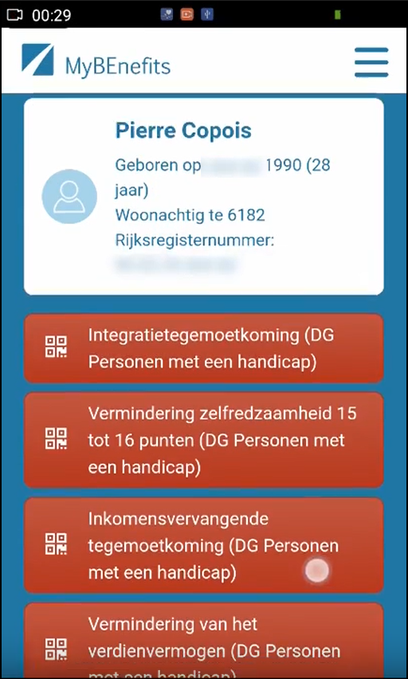
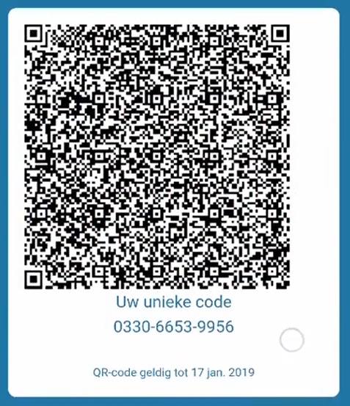
Burger - raadplegen & code creëren

Slide 69
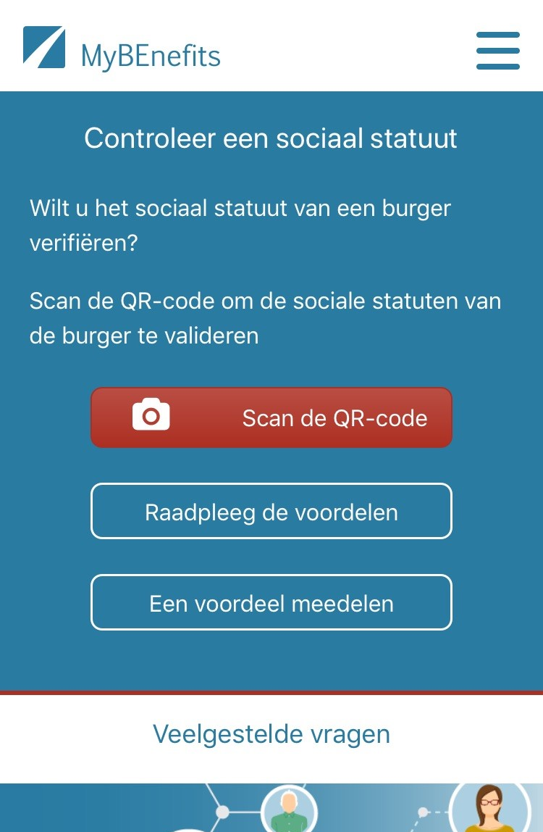
Professional - raadplegen

Slide 70
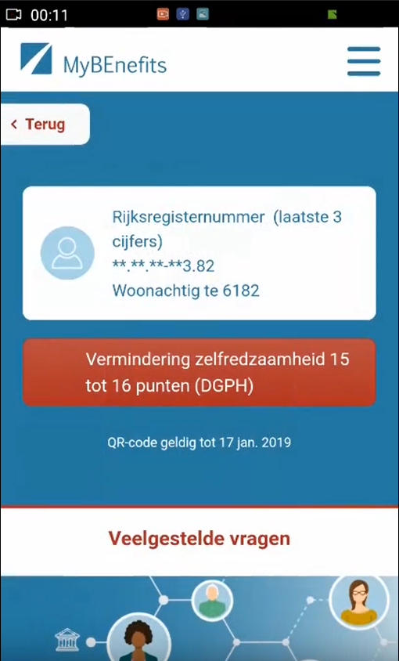
Professional - resultaat

Slide 71
Een voordeel melden

Slide 72
De voordelen raadplegen

Slide 73
De voordelen filteren

Slide 74
Webapp
www.mybenefits.fgov.be

Slide 75
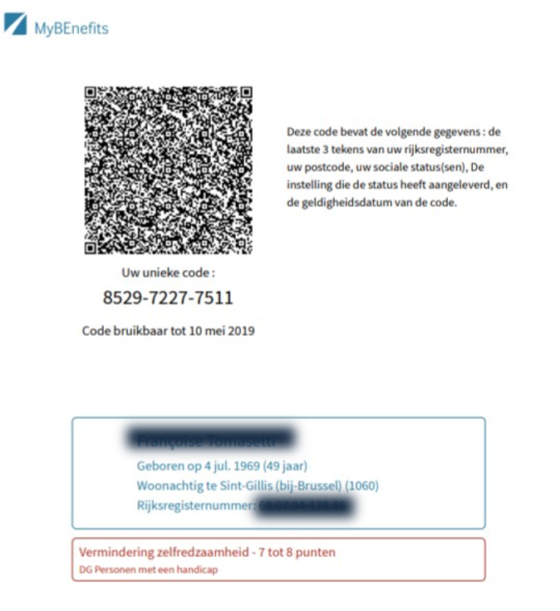
Attest

Slide 78
Useful legislative changes
legal translation of
the common vision on information management
the common vision on information security and privacy protection
the obligation to use unique identification keys
creation of a public institution (KSZ) that acts as a driving force
mission and tasks
governance
financing principles
creation of a control committee on information security and privacy protection
probative value of electronic information storage and exchange
punishment of abuse of the system
gradually, coordination or harmonisation of basic legal concepts
gradually, adaptation of business processes set out in the law

Slide 79
Advantages
gains in efficiency
in terms of cost: services are delivered at a lower total cost due to
a unique information collection using a common information model and administrative instructions
a lesser need to re-encoding of information by stimulating electronic information exchange
a drastic reduction of the number of contacts between actors in the social sector on the one hand and companies or citizens on the other
a functional task sharing concerning information management, information validation and application development
a minimal administrative burden
according to a study of the Belgian Planning Bureau, rationalization of the information exchange processes between the employers and the social sector implies an annual saving of administrative costs of about 1.7 billion € a year for the companies

Slide 80
Advantages
gains in efficiency
in terms of quantity: more services are delivered
services are available at any time, from anywhere and from several devices
services are delivered in an integrated way according to the logic of the customer
in terms of speed: the services are delivered in less time
benefits can be allocated quicker because information is available faster
waiting and travel time is reduced
companies and citizens can directly interact with the competent actors in the social sector with real time feedback

Slide 81
Advantages
gains in effectiveness: better social protection
in terms of quality: same services at same total cost in same time, but to a higher quality standard
in terms of type of services: new types of services, e.g.
push system: automated granting of benefits
active search of non-take-up using data warehousing techniques
controlled management of own personal information
personalized simulation environments
better support of social policy
more efficient combating of fraud

Slide 82
frank.robben@mail.fgov.be
@FrRobben
https://www.frankrobben.be
https://www.ksz.fgov.be
https://www.ehealth.fgov.be

