Slide 1
Stakeholders of the Belgian health care sector
11,500,000 citizens
health care providers
  21,600 general practicioners
  28,000 specialist doctors
  9,000 dentists
  4,900 pharmacies
  31,000 physiotherapists
  186,000 nursing practicioners
  11,000 midwives
  55,900 paramedics (dietitians, ergotherapists, speech therapists, …)
health care institutions
  120 hospitals
  60 psychiatric hospitals
  1,400 residential care centers

Slide 2
Some evolutions in health care
more chronic care instead of merely acute care
remote care (monitoring, assistance, consultation, diagnosis, operation, ...), and home care
multidisciplinary, transmural and integrated care
patient-centric care and patient empowerment
rapidly evolving knowledge => need for reliable and coordinated management and access to knowledge
threat of excessively time-consuming administrative processes
thorough support of health care policy and research requires thorough, integrated and anonymized information
cross-border mobility
need for cost control

Slide 3
The reported evolutions require...
cooperation between all actors in health care
efficient and secure electronic communication amongst all actors in health care
high quality, multidisciplinary electronic health records
care pathways
pptimized administrative processes
technical and semantic interoperability
guarantees with regard to
  information security
  privacy protection
  respect for the professional secrecy of health care providers

Slide 4
Electronic communication also stimulates …
quality of care and patient safety
  avoidance of wrong care and medication
    incompatibility between medicines
    contra-indications against certain medicines or treatments for a specific patient (eg allergies, diseases, …)
  avoidance of errors in concrete care provision and administration of medicines
  availability of reliable databases on good treatment practices and decision support scripts
  more opportunity for multidisciplinary consultations and second opinions
avoidance of unnecessary multiple examinations => less stress for the patient and avoidance of unnecessary additional costs

Slide 5
Objectives of the eHealth-platform
how?
  through a well organized, mutual electronic service provision and information exchange amongst all actors in health care
  with the necessary guarantees on the level of information security, privacy protection and professional secrecy
what?
  optimization of the quality and continuity of the provision of health care
  optimization of the patient safety
  simplification of the administrative formalities for all actors in health care
  proper support of health care policy and research

Slide 6







eHealth: architecture
Patients, health care providers
and health care institutions
Site Ministry
Software health care professional
Software health care institution
VAS
Site RIZIV
VAS
eHealth-portal
MyCareNet
VAS
VAS
VAS
Users
Basic services
eHealth-platform
Network
AS
AS
AS
AS
AS
AS
Suppliers

Slide 7
eHealth-platform: basic services & API’s
Coordination of the electronic processes
Portal
Integrated user and access management system
Management of loggings
System for end-to-end encryption
eHealthBox
Timestamping
Coding and anonymising
Consultation of National register and CBSS registers
Reference directories (hub-metahub system)

Slide 8
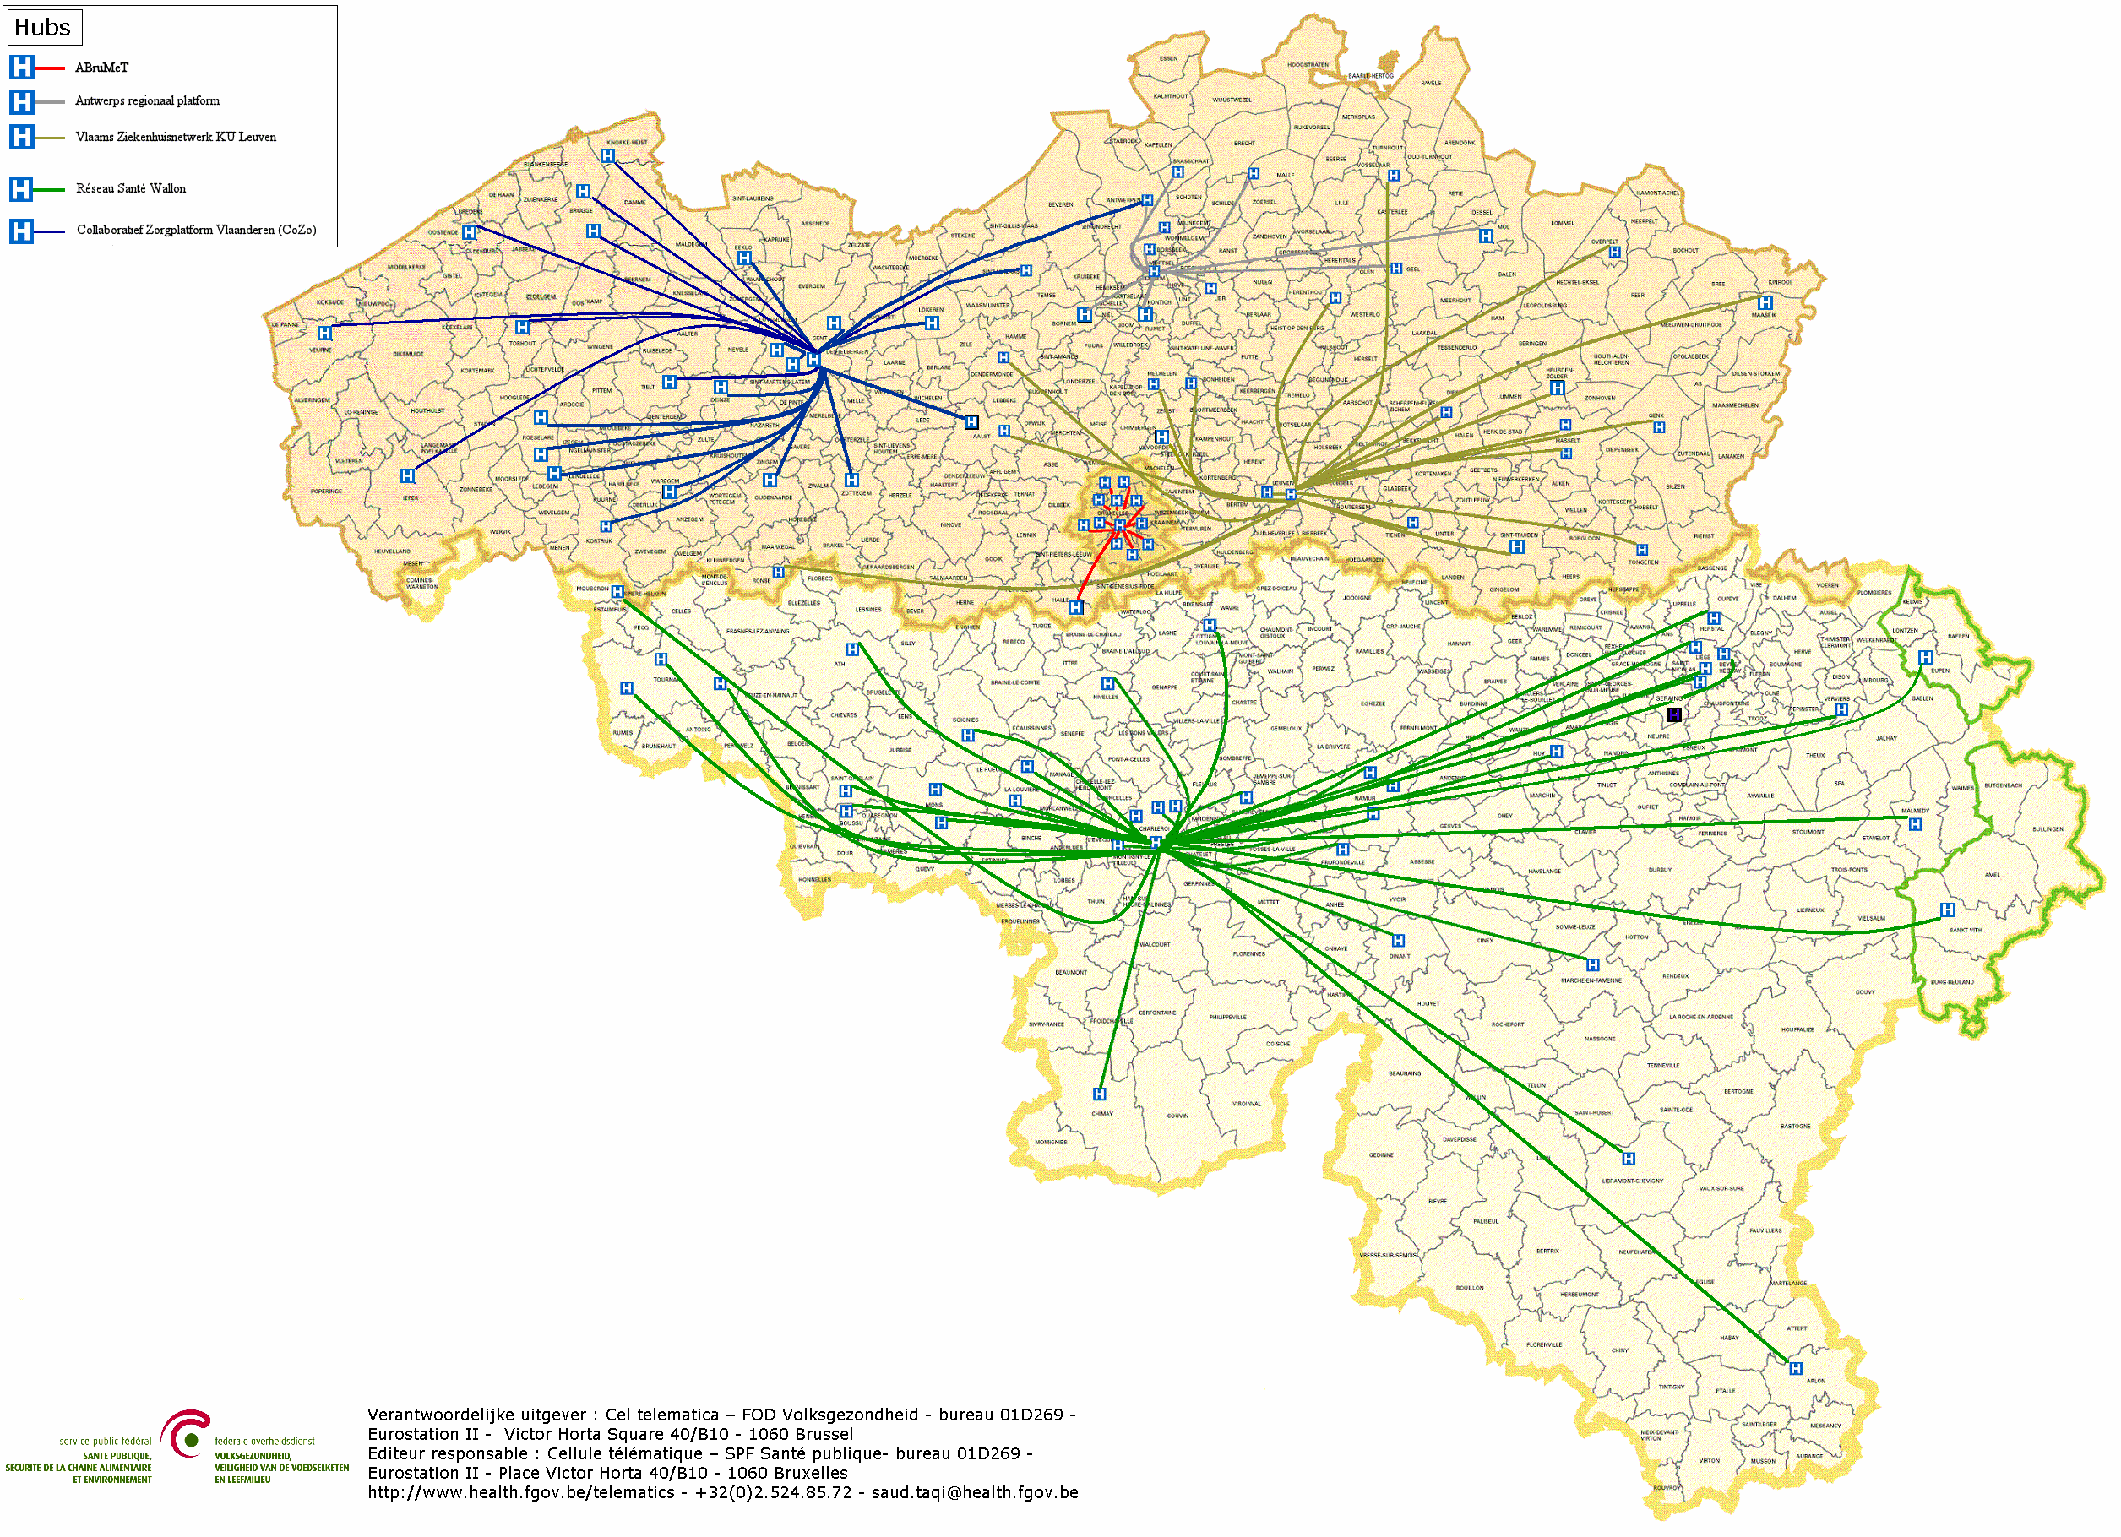

Hubs & metahub
        5 hubs
        Collaboratief Zorgplatform (Cozo)
        Antwerpse Regionale Hub (ARH)
        Vlaams Ziekenhuisnetwerk KU Leuven (VZN)
        Réseau Santé Wallon (RSW)
        Réseau Santé Bruxellois (RSB)

Slide 9








Hubs & metahub
3. Retrieve data from hub A
A
1: Where can we find data?
4:
All data available
2: In hub A and C
3: Retrieve data from hub C
C
B

Slide 10





Health vaults
A
InterMed
BruSafe
C
B

Slide 11












eHealth: some results
Medical history search via SumEHR
Guidelines and advice available online
Medication schedule
Health
advantages
Electronic prescriptions
Consultation of laboratory results
Electronic referral letters

Slide 12





eHealth: some results
Pricing,
billing
Updating the SumEHR, the medication schedule, ...
Adminis- trative
advantages
Creating and sending certificates
Registrations
Sending a report to the GMF holder

Slide 13










eHealth: some results
> 91,3 %
of Belgian citizens have given
an informed consent for data sharing
+97%
of GPs make use
of eHealth services
149 millions
messages/year
via eHealthBox
Electronic prescriptions
2022
16 million/month
20.260.000.000
digital transactions
4.835.690
Belgian patients with
Summary Electronic Health Records in health vaults
> 29.000
> 4000
  220 million
  electronic documents available
  at hospitals and clinical labs
13

Slide 14



frank.robben@mail.fgov.be
@FrRobben
https://www.frankrobben.be
https://www.ksz.fgov.be
https://www.ehealth.fgov.be

