Slide 1

ReUse and collaboration for better eGov services

Slide 2

About me (°1961)
education: law, ICT, ICT auditing, management, personal coaching
professional activities
  Crossroads Bank for Social Security
    1986-1991: originator as an advisor to the Minister of Social Affairs and the Prime Minister
    since 1991: CEO
  Data Protection Authority
    1991-2022: external member
  Federal Ministry of ICT
    2000-2001: originator as an advisor to the Minister of ICT (ao conception of electronic identity card)
  Smals (non for profit operational ICT association of public institutions of social security and health)
    since 2004: CEO (ao originator of G-Cloud initiative)
  eHealth platform
    2007-2008: originator as an advisor to the Minister of Public Health
    since 2008: CEO
    2020-2021: enterprise architect of Belgian information systems to fight the COVID-19 pandemic (testing, tracing, vaccination) and contributor to development of components on EU and WHO level
2

Slide 3

The ReUse initiative
What is it?
What do we want to achieve ?
Enablers to achieve our goals
How does it work ?
What are the benefits ?
Some results
What’s next: European perspective
ReUse and collaboration for better eGov services

Slide 4


ReUse: what is it?

Slide 5

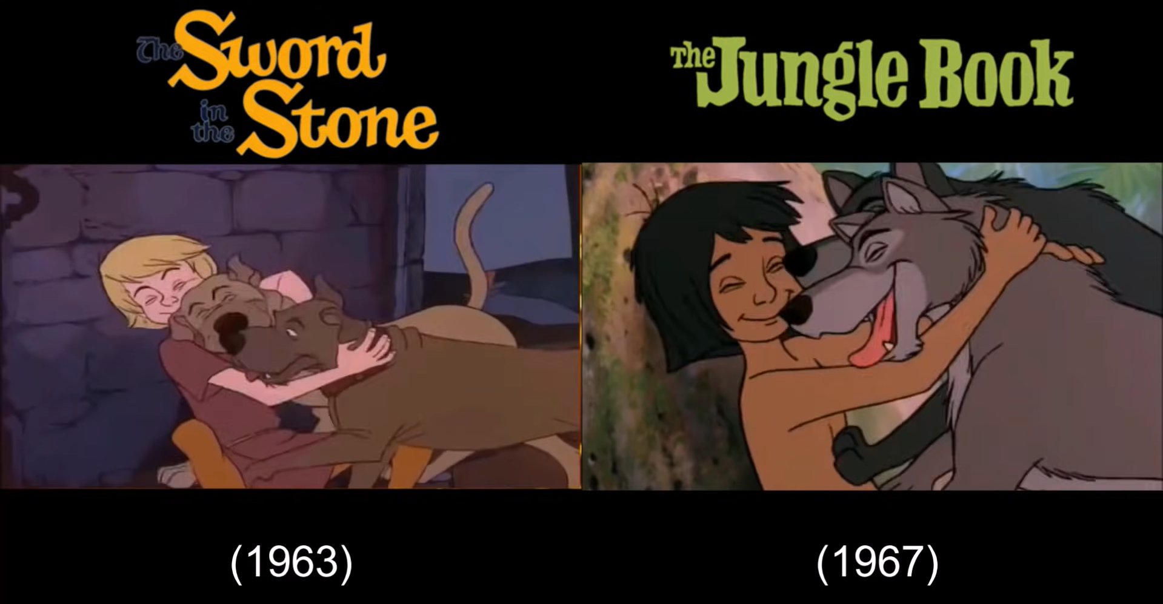
What is it?

Slide 6
What do we want to achieve?

Slide 7




To provide better
digital services to the public
Goal
Companies
Europe
Private Partners
Citizens
Belgian
Governments
Health actors
  by working together
  by sharing and reusing what already has proven to be successful
Other countries
Civil servants
Service providers
ReUse and collaboration for better eGov services

Slide 8




The ‘government’ is a complex ecosystem
Challenges
  The experience with the government is not always optimal
??
ReUse and collaboration for better eGov services

Slide 9

The world is
changing FAST
Challenges
  Societal challenges
  Technological challenges
  Ecological challenges …
ReUse and collaboration for better eGov services

Slide 10

Budgets are under
severe pressure
Challenges
  and skilled people are hard to find
ReUse and collaboration for better eGov services

Slide 11







Expectations of citizens & enterprises
Effective services
Integrated services
With a minimum of costs and administrative formalities
Provided automatically, if possible
Reliable, safe and permanently available
ReUse and collaboration for better eGov services

Slide 12




Expectations of citizens & enterprises
With active user participation
Offered in a performant and user friendly way
Using the media of their choice
Adjusted to their own processes
Respecting their privacy
ReUse and collaboration for better eGov services

Slide 13
Enablers to achieve our goals

Slide 14

Let’s NOT reinvent the wheel…
Share and reuse existing assets
  Business processes
  Software components and API’s
  Procurement and licences
  Infrastructure
  Other types of building blocks…
ReUse and collaboration for better eGov services

Slide 15

Let’s work together…
Align and collaborate
  Promote and rely on mature business concepts
  Enforce proven standards
  Share knowledge and techniques
  Exchange good practices
  Co-creation with all actors involved
ReUse and collaboration for better eGov services

Slide 16





























Who is already involved?
FEDERAL PUBLIC SERVICE
Employment, Labour and
Social Dialogue
And many more…
Notes:
Checken & aanvullen

Slide 17
How does it work?

Slide 18
Basic principles
Maximum synergy when possible and when generating efficiency gains and/or savings while maintaining or improving the quality of the services provided to the customer
In line with the synergy program: assignment to the one who is the most capable of proposing a form of shared services
Synergy based on result orientation, sense of responsibility and trust
ReUse and collaboration for better eGov services

Slide 19
Some initiatives
ICT infrastructure: G-Cloud initiative launched in 2015
  Focus on hardware, infrastructure services, platforms…
Software: ReUse program for public institutions accelerated in 2019
  Focus on components, authentic data sources, API’s
Full stack: Enterprise Architecture approach across institutions since 2021
  Focus on architectural principles, processes, building blocks, …
Near future: Public cloud computing ?
  Sufficiently secure, multi-vendor use
  Strong governance, avoiding lock-in
ReUse and collaboration for better eGov services
Notes:
OVERZICHT-SLIDE: De verschillende onderwerpen worden hierna verder uitgewerkt…
-> Concrete initiatieven komen verderop aan bod

Slide 20

G-Cloud – Sharing ICT infrastructure
Program of synergy-driven projects
  Strong participation of private sector suppliers
Joint government ICT platform
  Mainly federal
  Expandable to other governments if interested
Hybrid community cloud model
  Reliance on public cloud where possible
  Partly private community cloud running from government-managed datacenters
  Operational implementation with broad reliance on external suppliers
ReUse and collaboration for better eGov services

Slide 21
What is “cloud” ?
On Demand
Broad network access
Resource pooling
Measured service
Rapid elasticity
Source: National Institute for Standards and Technology, USA
ReUse and collaboration for better eGov services

Slide 22

Virtualisation
Consolidation of physical resources
> 70% “easy consolidation”
First step to Cloud (“dematerialisation”)
ReUse and collaboration for better eGov services

Slide 23
Cloud Service Models
IaaS
Infrastructure as a Service
PaaS
SaaS
Basic IT infrastructure components (e.g. Amazon virtual machines)
Platform as a Service
Platforms to build applications
Software as a Service
Full applications (e.g. O365, Google Apps, ...)
ReUse and collaboration for better eGov services

Slide 24








Cloud deployment types
Hybrid
Public Cloud
Shared
Access/Control
Community Cloud on-premise
Outsourced Community Cloud (= off-premise)
Private Cloud on-premise
Outsourced Private Cloud (= off-premise)
Dedicated
Location
Customer
Service Provider

Slide 25
As a service : major characteristics
Self-service: industrialised & automated
Available: immediate availability
Extensible/elastic: scale up or down
Shared: multiple users for scale effects
Use based invoicing: based on real use of resources
Low entry barrier: complexity is hidden for user
Incremental service changes
ReUse and collaboration for better eGov services

Slide 26
G-Cloud – Sharing ICT infrastructure
G-Cloud = coalition
  G-Cloud ≠ central organization
Governance
G-Cloud service
Offered by
Service owner
Delivered by
Service provider
ReUse and collaboration for better eGov services

Slide 27
G-Cloud – Sharing ICT infrastructure
Government
G-Cloud Operations & Programme Board
G-Cloud Strategic Board
FPS
(Horizontal FPS, FPS FIN, Belnet, …)
PSSI/IPB
(CBSS, ...)
Association of FPS/PSSI/IPB
Private ICT companies directed by FPS/PSSI/...
3 Colleges
Federal Public Services (FPS)
Public Social Security Institutions (PSSI)
Institutions of Public Benefit (IPB)
SIT: ICT managers from
Federal Public Services (FPS)
Public Social Security Institutions (PSSI)
Institutions of Public Benefit (IPB)
Service
owners
ReUse and collaboration for better eGov services

Slide 28
G-Cloud – Sharing ICT infrastructure
Horizontal software (Solutions)
Website - HR - Finance - Access Control - …
Application platforms
Soft infrastructure
Virtualisation - Security - E-mail - VoIP - …
Hard infrastructure
Computing - Network - Storage
ReUse and collaboration for better eGov services

Slide 29
G-Cloud – Sharing ICT infrastructure
www.gcloud.belgium.be

Slide 30




G-Cloud ‘products’
Procurement
Cooperationá
Efficiencyá
Projects
Synergy
Services
Costsâ
Qualityá
Know-how & Expertise
ReUse and collaboration for better eGov services

Slide 31
Public Cloud vs Community Cloud on premise
Active ‘Community Cloud on premise synergies first’ policy
  comply or explain approach
No ‘Public Cloud first’ policy
  rational approach (smart choices) based on a risk evaluation considering data sovereignty, data residence, EU/BE law, business continuity, vendor lock in, pricing guarantees, …
Hybrid cloud approach
  combination of on premise traditional/cloud services and public cloud services
  choices are made based on the context and roadmap of each government agency
  focus on the ‘value proposition’ (business benefit/capability/value) we aim to realize
G-Cloud shared procurement
ReUse and collaboration for better eGov services

Slide 32
Public Cloud use: current situation
Public Cloud services already in use
  workplace services
    chat, mail, videoconferencing, newsletters, translation services, contact enter services, …
  datacenter Services (minimal footprint, mainly for non-critical business applications)
    website hosting, DDOS protection services, IT Service Management tool, DNS, …
Task Force active on the G-Cloud level
  to work on a global policy & strategy
  transversal collaboration between DPO’s and IT managers of different government agencies
  sovereign cloud initiatives and confidential compute are considered
  several proof-of-concepts and pilots are ongoing
ReUse and collaboration for better eGov services

Slide 33

G-Cloud success factors
Efficiency
Adequate security measures (risk↘)
Optimal cooperation and trust between the institutions
Differentiation of the offer: neither ‘one size fits all’ nor tailor-made work
Capacity management
A phased approach, no ‘big bang’
Quality of service: respect of SLAs
ReUse and collaboration for better eGov services

Slide 34
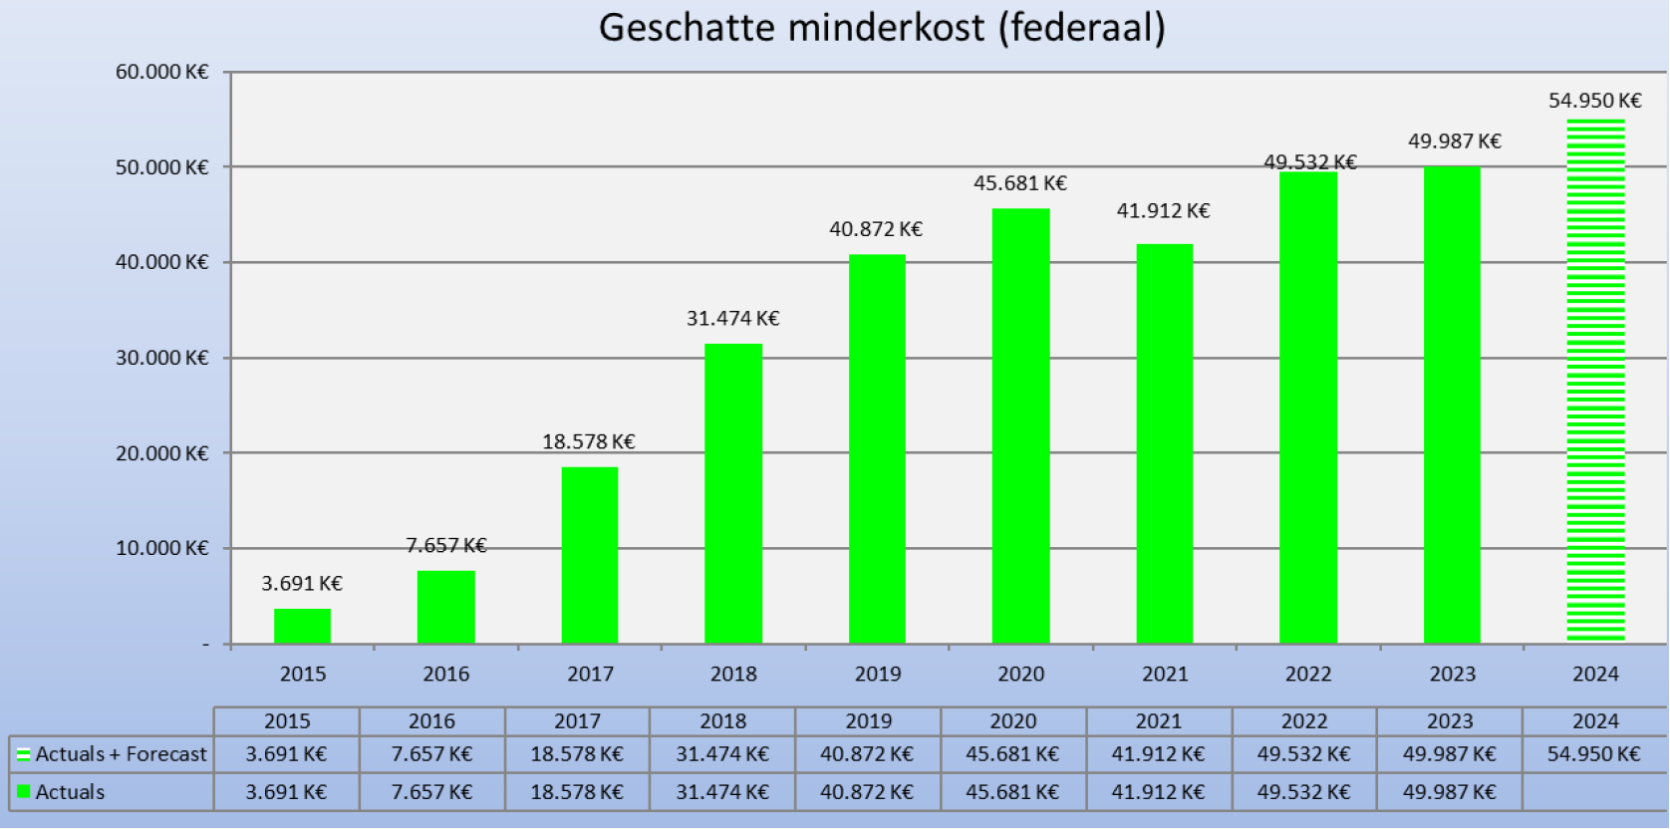
G-Cloud ROI
Avoided spending (federal)

Slide 35

Sharing infrastructure – software – business components
Business components
Core business (declarations, administrative processes, …)
+
SHIFT
SHIFT
Horizontal software (Solutions)
Website - HR - Finance - Access Control - …
Application platforms
Soft infrastructure
Virtualisation - Security - E-mail - VoIP - …
Hard infrastructure
Computing - Network - Storage

Slide 36
Reuse of software & business components
Initiative
  Orginated within Belgian public social security institutions & Smals
  Open to federal public services & other
Purpose
  Synergy around (technical) business components
  Save costs by avoiding multiple development of redundant components
Regardless of whether development takes place by
  The institution's own ICT department
  Smals
  Subcontractors
How ?
  Consult the catalogue of reusable components and get in contact with networks
ReUse and collaboration for better eGov services

Slide 37



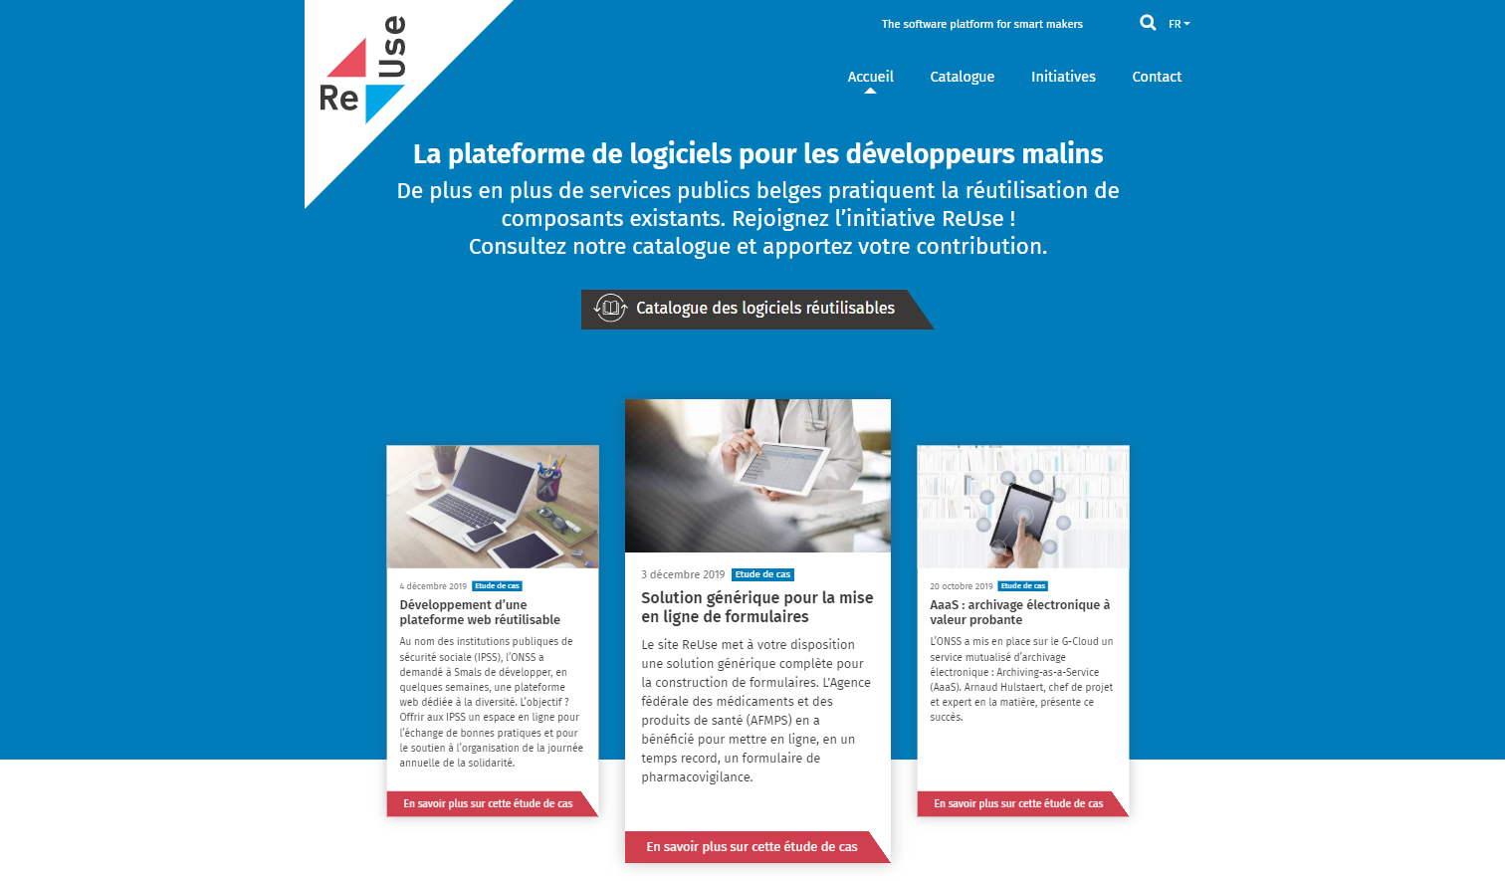
Software reuse – how does it work?
Network A
Governance by the ReUse Competency Center
Quality Assurance based on
Enterprise Architecture principles
Project 2
Project 3
Knowledge &
expertise
Project 4
Project 1
Network C
Software Reuse Catalog
reuse
offer reusable
consult & align
Network B
104 components and counting….
Project X
Knowledge &
expertise
Knowledge &
expertise
www.ict-reuse.be
info@ict-reuse.be
Project 5
Project 6

Slide 38
Software reuse – how does it work?
Take aways
  Make visible what already exists
  Integrate reuse in the project life cycle
  Measure the benefits (ROI)
  Use networks to detect missing components or future opportunities
  Provide mature governance around reusable components
And most of all… dare to share!
  Learn fast & adjust (and don’t give up too easily)
ReUse and collaboration for better eGov services
Notes:
Provide mature governance around reusable components : (onboarding, documentation, release management, …

Slide 39
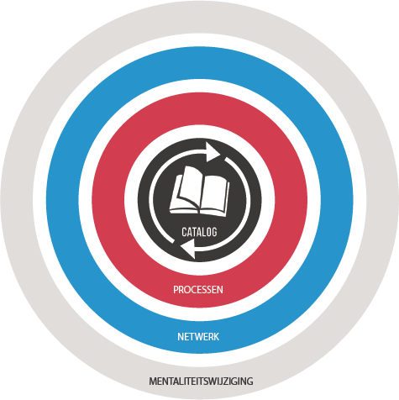
ReUse – Vision
Every stakeholder
can easily find the most common reusable elements in a centralized catalogue
Processes
and tools are put in place to identify, register, implement, monitor and measure reuse throughout the project lifecycle
Human
networks are maintained and developed on all levels (CEO’s, CIO’s, business owners, business analysts, architects) in order to keep maximum visibility on reuse potential
A culture
develops where
reuse is adopted and the creation of reusable products is promoted,
39

Slide 40
Building blocks for a “generic public service”
(Partial view)
Request / declaration
Forms / Batch
Data flows
Incoming / outbound
Webservices / batch
Communications
Archiving
Support services
Procurement
Human resources
Translation services
Legal
Logistics
Communications
Helpdesk
Forms
DSP - Document Service Provider
Document Orchestration Service
e-Box - Electronic mailbox
Govapp
PrintManager
AAAS - Archiving-as-a-Service
Multifunctional declarations
API Gateway
Payments received
Automated data treatments
Call center
Supporting software
Office automation
eMail / telephony
Basissystemen
eAcademy
Management of commitees
Coda reader
Event notifications
Sepia document signer
Timestamping
Data quality tools
CMS - Web Content Management System
CSAM – Log on to online public services
Identity and Access Management
User Access Management
Payments
Case management
Reporting
Process management
Task management
Work environment
BI Platform

Slide 41


Public & private sector opportunities
The government is NOT an island
Invitation to private sector parties to get involved
ReUse and collaboration for better eGov services

Slide 42





Public & private sector opportunities
Existing,
Valuable
Services
Made available as APIs
Self service use
by developers
To create new innovative apps and services
Differentiated services,
Better experience
ReUse and collaboration for better eGov services

Slide 43



Enterprise Architecture : framework
Holistic
Vision & strategy
Vertical
Domains
Social security
Health
Other
Customer Centricity
Only Once
Employment
Illnes
Health care
Taxes
…
Services
Holiday
Pension
Medical costs
Family allowance
Care
Health risks
Medicines
Defense
Mobility
Horizontal
Processes
Generic & reusable
Interopera-bility
Architectural-principles
Building Blocks
Generic & reusable
Standards
Legacy vs innovation
Privacy by design
Notes:
Horizontale benadering
Enterprise Architectuur (EA) zorgt voor een geheel van principes, blauwdrukken en concrete bouwstenen die de samenhang van systemen en informatiestromen kunnen verhogen. EA focust daarom niet op één enkele organisatie of systeem, maar tracht de interoperabiliteit tussen de betrokken systemen te verhogen en silo’s tegen te gaan
verticale benadering.
EA is geen technische aangelegenheid. Door een integratie van strategie, business en technologie komen we tot een betere, permanente wisselwerking. Strategische bouwstenen worden zorgvuldig gekozen in functie van hun reële toegevoegde waarde. Een doordachte visie rond digitalisering is de drijfveer voor een robuuste ICT-ondersteuning
holistische benadering
EA helpt om de complexiteit van het ecosysteem beter te beheersen en proactief in te spelen op nieuwe maatschappelijke uitdagingen. We verlaten de ad-hoc-projectbenadering voor een overkoepelende investering in bouwstenen en fundamenten van een klantgerichte dienstverlening. We hebben oog voor innovatie maar zoeken ook naar oplossingen voor de onvermijdelijke “legacy” in het overheidslandschap.

Slide 44
What are the benefits ?

Slide 45




What are the benefits of a reuse mindset and more collaboration?
Faster | Flexible
Cheaper | Higher maturity
ReUse and collaboration for better eGov services
Notes:
Faster
Ready to use components
Reduced time to market
Flexible
Functional requirements changing fast
High pressure on timing (ex. Covid)
Cheaper
Don’t develop twice
Don’t waste our taxpayers’ money
Maintenance & maturity
Highly used components with solid support
Software quality and security

Slide 46

Benefits
Improving quality of
life for citizens and enterprises
ReUse and collaboration for better eGov services
Notes:
EXAMPLES
eHealth: Nierschade vermijden door operaties efficiënter & korter te maken, dankzij digitale info in EMD
(Avoiding kidney failure / damage through faster & more efficient surgery, using information from patients’ Electronic medical records)

Slide 47
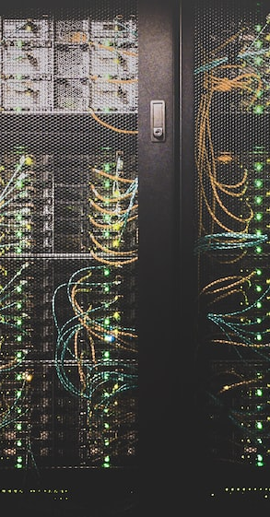
Offering excellence in digital services
Benefits
  Reliability
  Performance
  Added value
ReUse and collaboration for better eGov services

Slide 48

Some results

Slide 49


Results
50%
66%
ROI
6%
Reused
reusable
Business specific
custom code:
28%
Average ROI / ReUsed component (2019) : € 27.000
Total ROI 2022 (Projects by Smals, approx.): € 32.000.000
ReUse and collaboration for better eGov services
Notes:
- 66% van alle functionaliteit in onze applicaties wordt geleverd dankzij hergebruik van bestaande componenten (cf software reuse catalog).
- van het residu (34%) wordt 6% (de resterende 28% is custom ontwikkeling) zo geschreven dat het nieuwe reusable componenten oplevert voor onze software reuse catalog.
- dankzij deze hoge mate van reuse realiseren we een globale kostenreductie (“ROI”) van 50%.

Slide 50
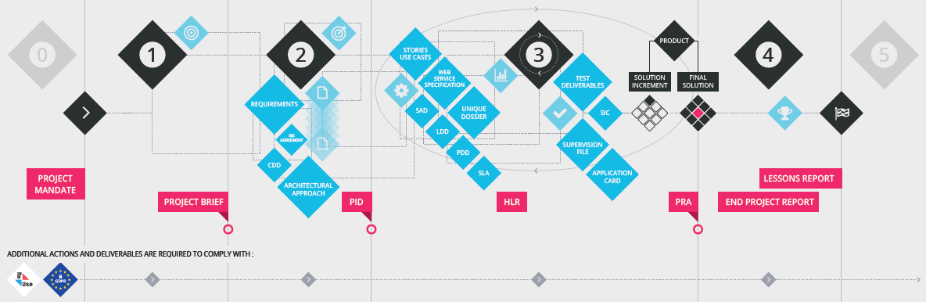
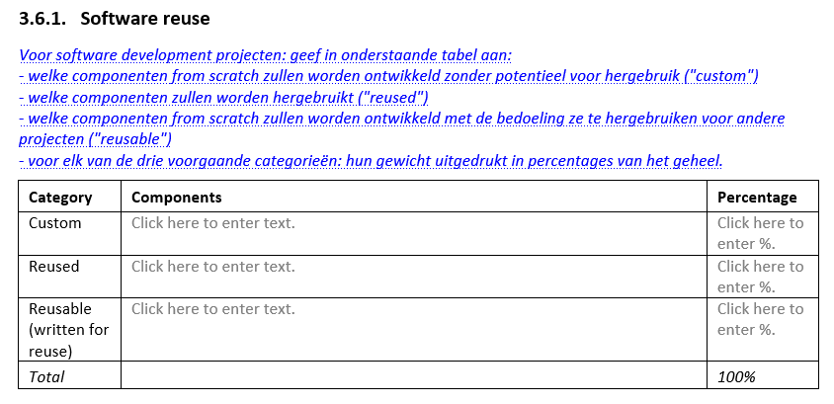
ReUse is part of project lifecycle
4
1
2
3
5
Standard project methodology @Smals
  Detect ReUse opportunities as soon as possible
  ReUse embedded in Project Lifecycle

Slide 51
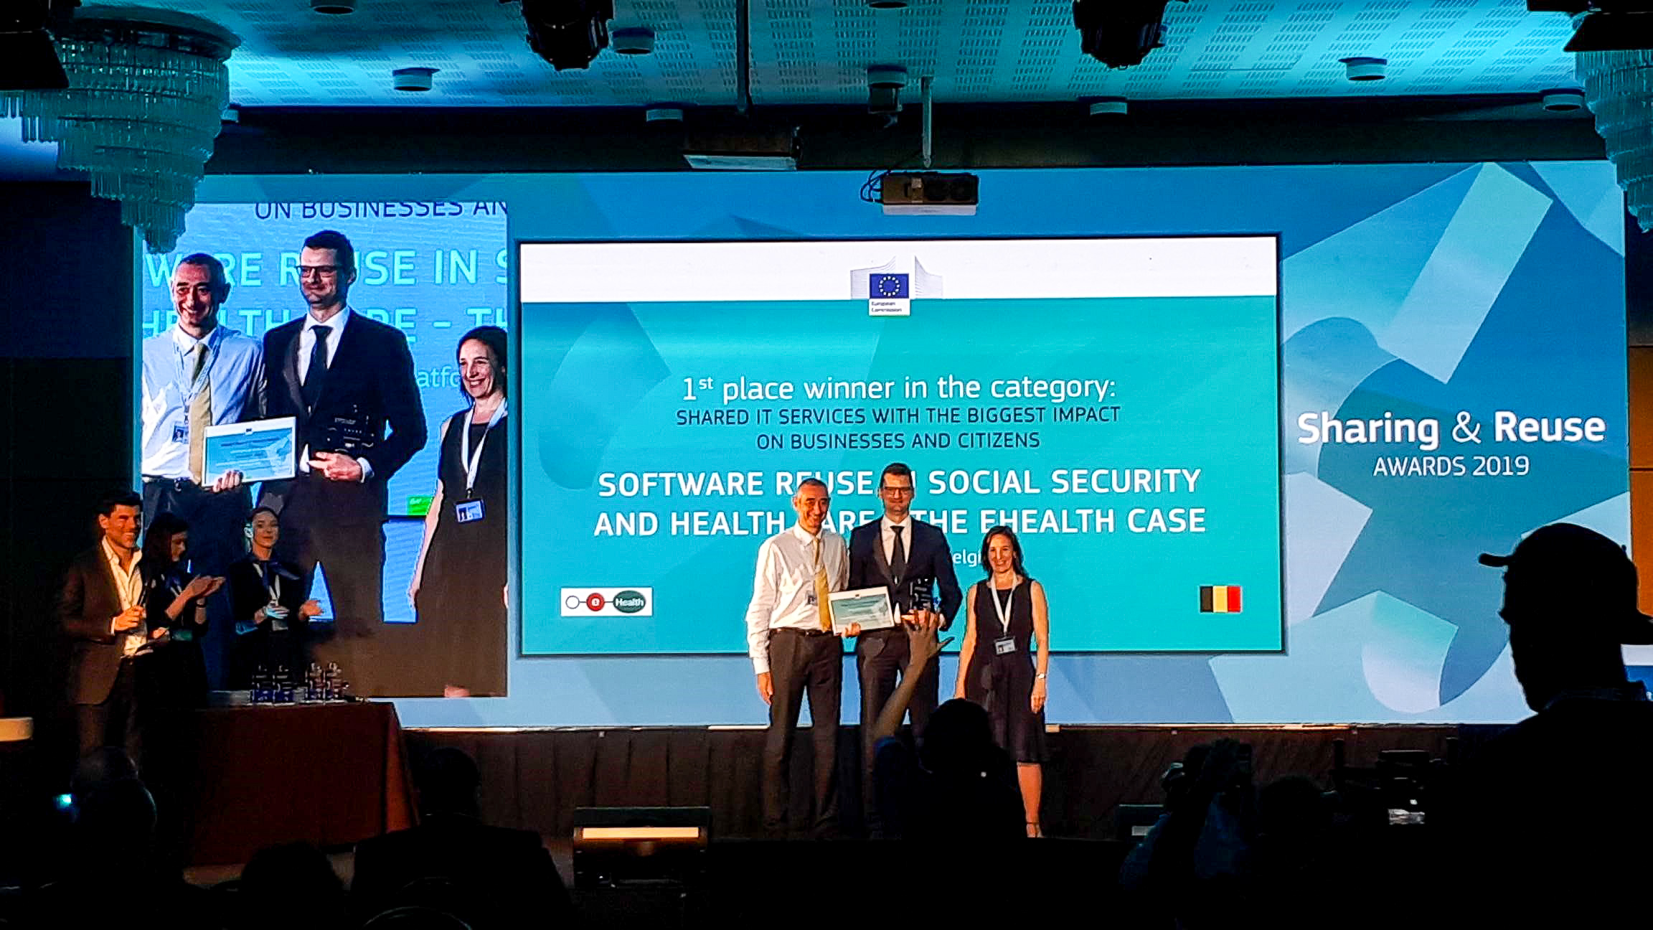

EU Sharing & ReUse Award
EU Sharing & ReUse Awards – 2019
  Shared IT services (commonly developed or shared)
  with the biggest impact on citizens or businesses
  Winner: eHealth-platform & Belgian social security
ReUse and collaboration for better eGov services

Slide 52

What’s next ?

Slide 53

European context
Interoperable Europe Act
  Secure cross-border exchange & interoperability
Open Data Directive
  High value datasets to be made available for re-use
EU Health Data Space
  Interoperability & security
  Strong regulation needed
  Share best practices – Sumehr, ePrecription…
JoinUp initiative
  joinup.ec.europa.eu
ReUse and collaboration for better eGov services
Notes:
AAN TE VULLEN…

Slide 54
European context
eIDAS – v2
  New: Quality Attributes
  Still missing: Relationships (ex. Therapeutic)
EU Health Insurance Card
EU Digital Identity Wallet
  DC4EU Consortium - www.dc4eu.eu
ReUse and collaboration for better eGov services
Notes:
AAN TE VULLEN…

Slide 55






frank.robben@mail.fgov.be
@FrRobben
www.frankrobben.be
www.gcloud.belgium.be
www.smals.be
Subscribe here
www.ict-reuse.be
info@ict-reuse.be
twitter.com/ictreuse
www.linkedin.com/company/reuse-ict/

