Slide 1
Sound electronic information management as a critical success factor for effective and efficient social protection and health care

Slide 2
About me (°1961)
education: law, ICT, ICT auditing, management, personal coaching
professional activities
  Crossroads Bank for Social Security
    1986-1991: originator as an advisor to the Minister of Social Affairs and the Prime Minister
    since 1991: CEO
  Data Protection Authority
    1991-2022: external member
  Federal Ministry of ICT
    2000-2001: originator as an advisor to the Minister of ICT (ao conception of electronic identity card)
  Smals (non for profit operational ICT association of public institutions of social security and health)
    since 2004: CEO (ao originator of G-Cloud initiative)
  eHealth platform
    2007-2008: originator as an advisor to the Minister of Public Health
    since 2008: CEO
    2020-2021: enterprise architect of Belgian information systems to fight the COVID-19 pandemic (testing, tracing, vaccination) and contributor to development of components on EU and WHO level

Slide 3
Setting the scene

Slide 4


Slide 5


Slide 6


Slide 7
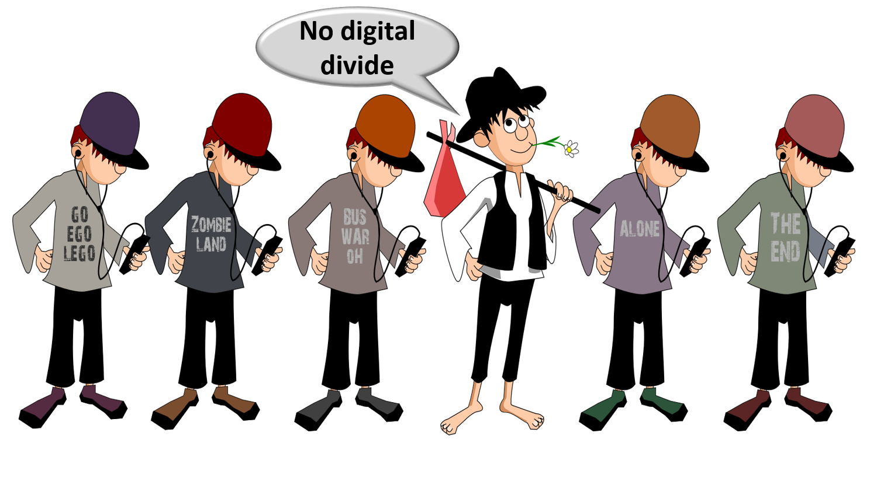

Slide 8


Slide 9


Slide 10


Slide 11


Slide 12


Slide 13


Slide 14
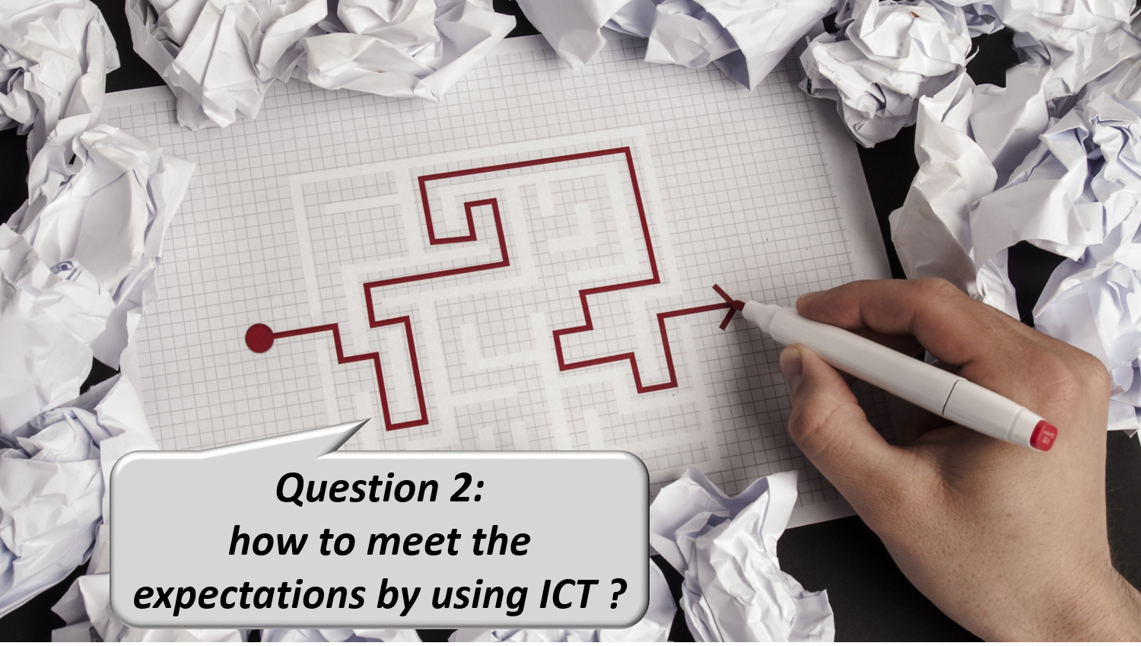

Slide 15


Slide 16


Slide 17


Slide 18


Slide 19
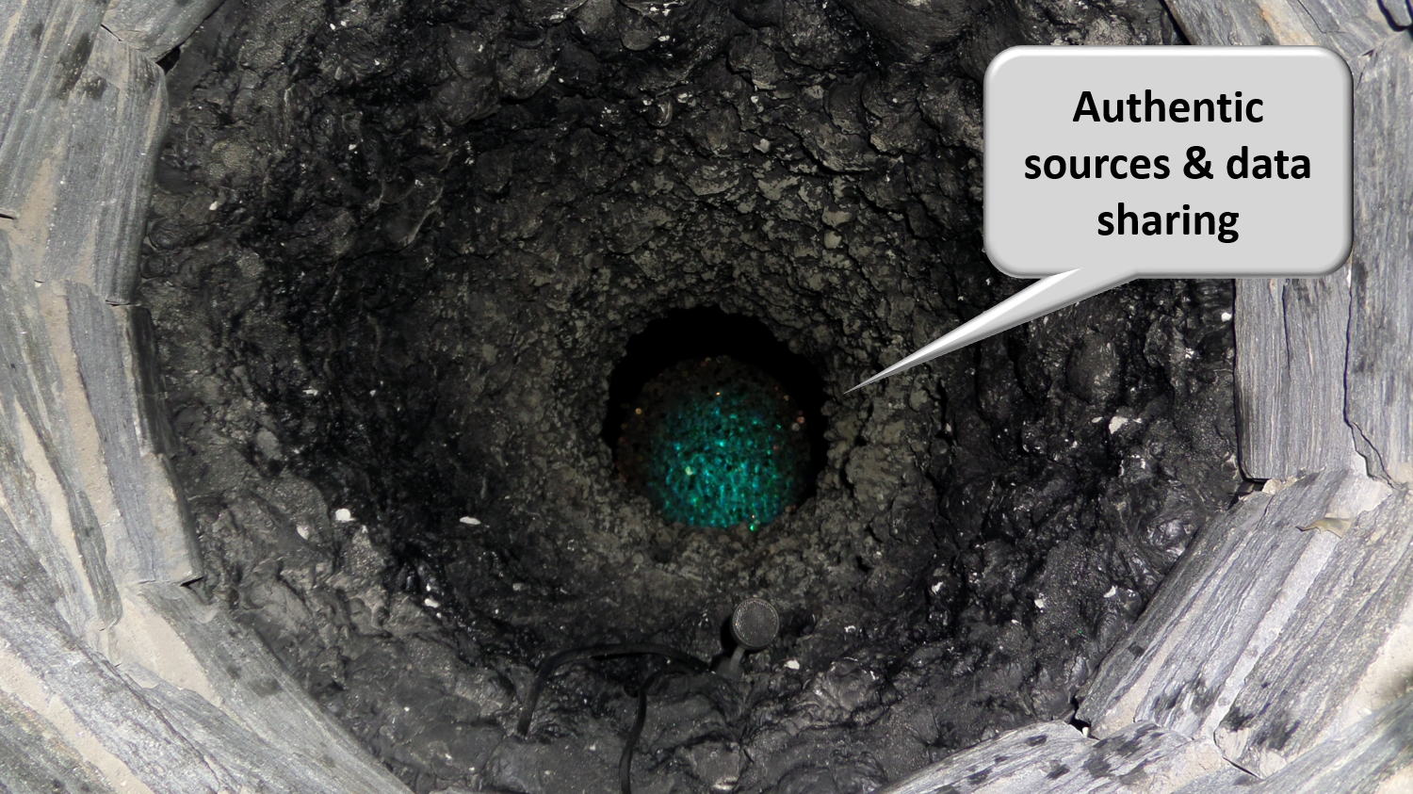

Slide 20


Slide 21


Slide 22


Slide 23


Slide 24


Slide 25


Slide 26
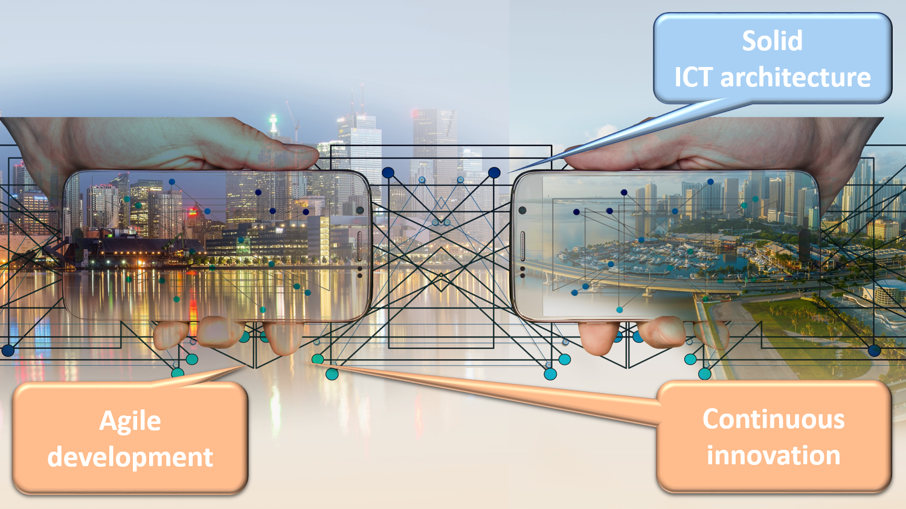

Slide 27


Slide 28
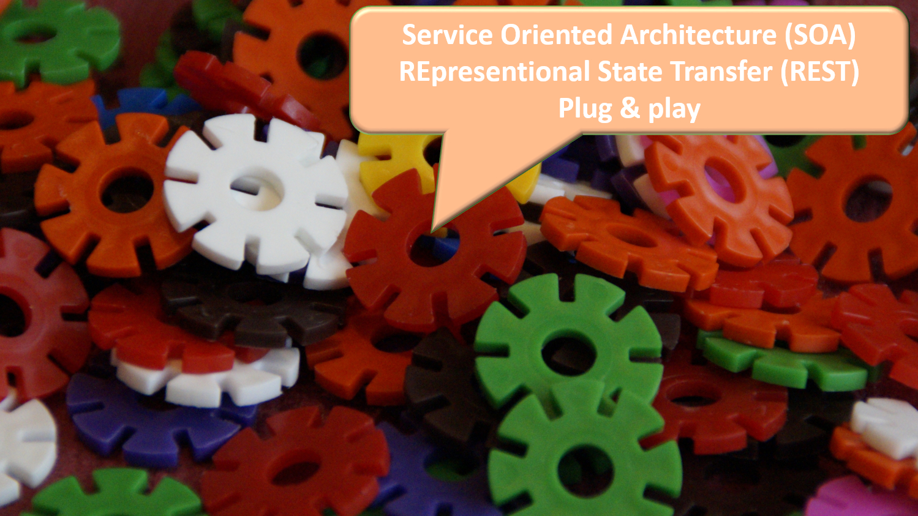

Slide 29


Slide 30


Slide 31


Slide 32


Slide 33


Slide 34


Slide 35

Notes:
Let the computer do what it is good at and thereby make time available for human support where necessary. And remember: the network always wins

Slide 36
Application in the Belgian social sector

Slide 37
Stakeholders of the Belgian social sector
> 11,500,000 citizens
> 230,000 employers
about 3,000 public and private institutions (actors) at several levels (federal, regional, local) dealing with
  collection of social security contributions
  delivery of social security benefits
    child benefits
    unemployment benefits
    benefits in case of incapacity for work
    benefits for the disabled
    re-imbursement of health care costs
    holiday pay
    old age pensions
    guaranteed minimum income
  delivery of supplementary social benefits
  delivery of supplementary benefits based on the social security status of a person

Slide 38




Crossroads Bank of Social Security (CBSS)
Public interest companies
INASTI
ONSS
SFP
AIS
SPP IS
SIGeDIS
Regions and Communities
SPF E&TO
ORINT
Cities Municipalities Public social welfare centres
ONEM
FEDRIS
CIN
ONVA
INAMI
SPF SS

Slide 39
Crossroads Bank of Social Security (CBSS)
Internet
R
FedMAN
Users
R
Isabel
FW
R
…
R
Backbone
FW
FW
FW
FW
FW
R
R
R
R
R
RVA
KSZ
RSZ
R
R
NIC
…

Slide 40
Results
a network between all 3,000 social sector actors with a secure connection to the internet, the federal MAN, regional extranets, extranets between local authorities and the Belgian interbanking network
a unique identification key
  for every citizen
  for every company
  for every establishment of a company
an agreed division of tasks between the actors within and outside the social sector with regard to collection, validation and management of information and with regard to electronic storage of information in authentic sources

Slide 41
Results
220 electronic services for mutual information exchange amongst actors in the social sector, defined after process optimization
  nearly all direct or indirect (via citizens or companies) paper-based information exchange by > 800 paper forms between actors in the social sector has been abolished
  in 2022, > 1,93 billion electronic messages were exchanged amongst actors in the social sector, which saved as many paper exchanges
electronic services for citizens
  maximal automatic granting of benefits based on electronic information exchange between actors in the social sector
  25 electronic services via an integrated portal and/or mobile applications

Slide 42
Results
more than 50 electronic services for employers, either based on the electronic exchange of structured messages or via an integrated portal site
  50 social security declaration forms for employers have been abolished
  in the remaining 30 (electronic) declaration forms the number of headings has on average been reduced to a third of the previous number
  declarations are limited to 3 events
    immediate declaration of recruitment and discharge (only electronically)
    quarterly declaration of salary and working time (only electronically)
    occurrence of a social risk (electronically or on paper)
  in 2022, more than 45 million electronic declarations were made by all 230,000 employers, 98 % of which from application to application

Slide 43
Maximum automatic granting of additional rights
‘social statute' for about 2 million citizens in Belgium
  limited income
  handicap, physical or mental disability
  child with special needs
citizens with social statute receive 'additional rights‘
  social rate for gas, electricity, water, telecom
  public transport
  housing
  tax reduction, free waste collection
  reduction for socio-cultural activities, sports
  ...
2

Slide 44
Additional rights
determination of non-take up
  intransparency: people have little or no knowledge of their rights
  Matthew effect: rights do not reach the intended (vulnerable) target group
  threshold: the application and granting procedure for social rights is often cumbersome and time-intensive
  ineffectiveness: social measures do not achieve their goal
  status quo of poverty ratio instead of social inclusion: the number of poor people does not decrease proportionally
objectives
  for citizens
    maximizing automatic granting of additional rights
    keeping administrative formalities to a minimum
  for institutions / actors who grant the additional social rights
    quickly providing all necessary information for granting (social status, domicile address ...) => reduction of workload and costs
    avoiding possible abuse
3

Slide 45
Principles
factual information available from one or more actor(s) is made available to other actors who, on that basis, automatically grant rights to the citizen without him/her having to submit an application for this
standardized services to respond as much as possible to information requests and avoid/reduce multiple developments, both for the data providers (authentic sources) and for the entities granting benefits
reduction in the number of statutes used and their complexity
reduction in data exchanges
reduction in the number of administrative formalities and paper certificates requested from this vulnerable population group
5

Slide 46
Standardized Social Statutes (SSS)
batch consultation of the SSS database (buffer database)
  is fed quarterly by 10 authentic sources : insurability status health insurance, living wage, allowances for the disabled, old age pension, ...
  this allows to automate the rights of a category of persons (known in advance by the awarding authority)
    e.g. all residents of a municipality or province
    e.g. all households connected to gas
  some examples
    social rate for gas / electricity in Belgium
    social rate for water in Flanders
    traffic tax exemption in Brussels Region
    municipalities and provinces (e.g. reduced rate for out-of-school care, reduced levy for waste collection, reduced tax rate)
1
7

Slide 47
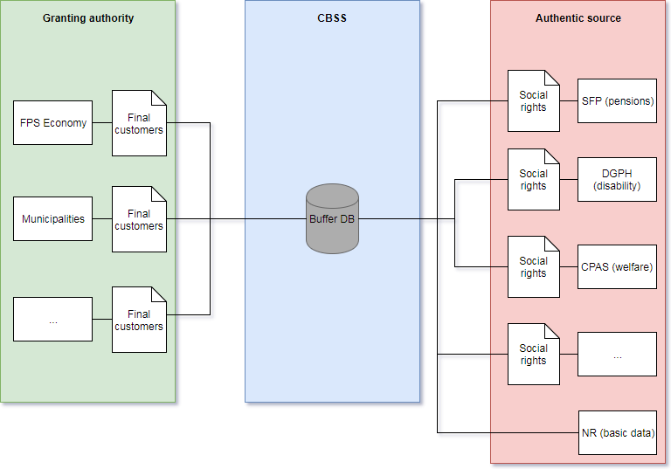
Buffer database
8

Slide 48
Buffer database - advantages
for data users
  all information is available in a coordinated and validated way
  possibility of the application of decision rules by the CBSS according to the concrete needs of each user (guarantee of proportionality)
for the administrators of authentic sources
  avoiding ad hoc developments for each data request
  avoiding making data available according to the needs of each user
for the system
  encouraging standardization of the factual data that is taken into account when determining additional rights and the time or period over which they must be available ('Lego brick philosophy')

Slide 49
Lego brick philosophy
Authentic source (NR & CBSS)
Date of birth
Residence
Family composition
Social statutes
FPS or PSSI
Additional right
Granting authorities
IGO
GI
THAB
…
Reduction of provincial tax
Province of East Flanders
CPAS
Living wage
AF - EQ - LL
DGPH
P1-4
…
Health insurance funds
Income
VT

Slide 50
Lego brick philosophy
Authentic source (NR & CBSS)
Date of birth
Residence
Family composition
Social statutes
FPS or PSSI
Additional right
Granting authorities
IGO
GI
THAB
…
Social rate for gas & electricity
FPS Economy & utilities
CPAS
Living wage
AF - EQ - LL
DGPH
P1-4
…
Health insurance funds
Income
VT

Slide 51
MyBenefits
since February 2019 MyBEnefits.fgov
  mobile app & web application
  which allows citizens to consult and prove their social statuses on the date of the day itself in order to assert their rights with the various authorities that grant additional benefits
  which allows the awarding authority to verify the social statutes
    actors who typically do not cooperate directly with the CBSS (e.g. sports, child care, museums, leisure centers, amusement parks, etc.)
    actors who do not (yet) have an automatic data flow (e.g. pro bono legal assistance, municipal tax reduction, ...)
  which allows authorities granting additional benefits in the culture, sports and entertainment sector to report them, and citizens to consult them
2

Slide 52


Secure login
citizen : identification needed
  consult statute : privacy-sensitive information => sufficiently high level of security
    e-ID
    ITSME
    Time-based One-Time Password (TOTP)
    Token
  create QR code / possibly print (only via website)
professional : no identification required
  read QR code / unique code offered by citizen
  minimum information: statute, zip code, control number INSS

Slide 53

Mobile App
  The MyBEnefits application is available in mobile and web versions.
  available for Android from Google Play
  available for Apple from App store
  available via the website mybenefits.fgov.be

Slide 54
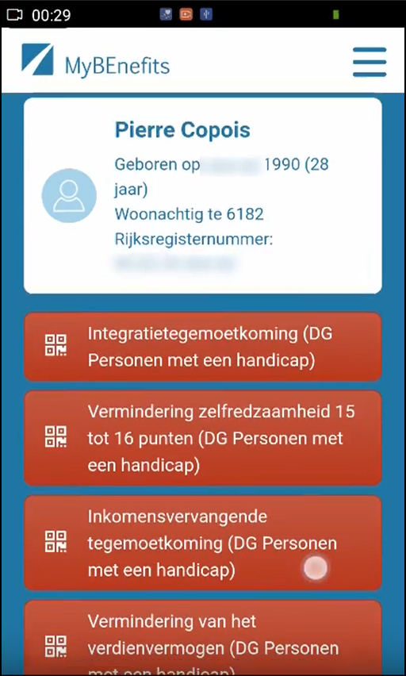
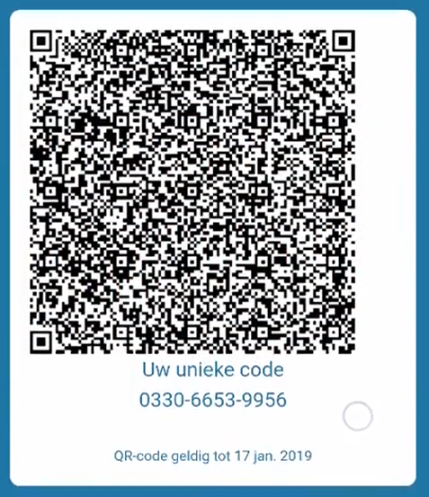
Citizen - consult & create code

Slide 55
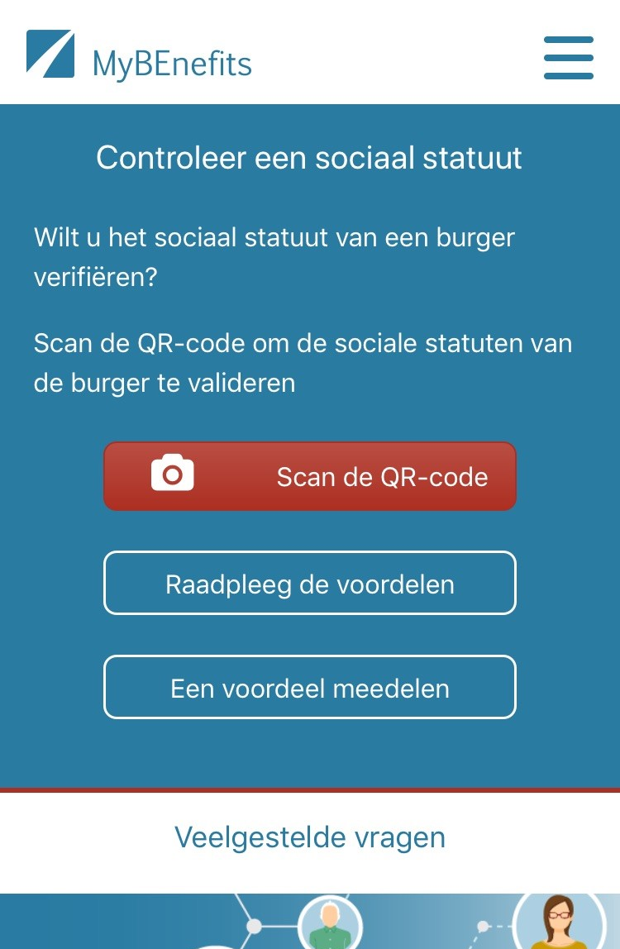
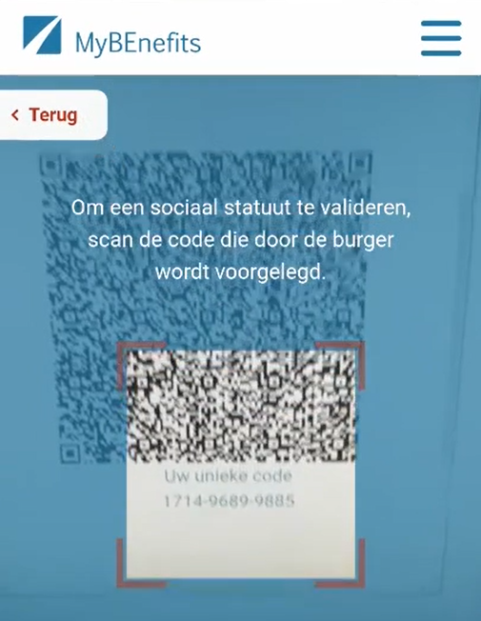
Professional - consult

Slide 56
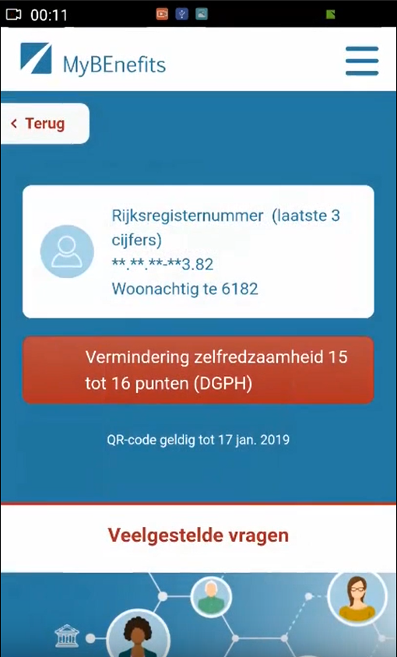
Professional - result

Slide 57


Slide 58


Slide 59
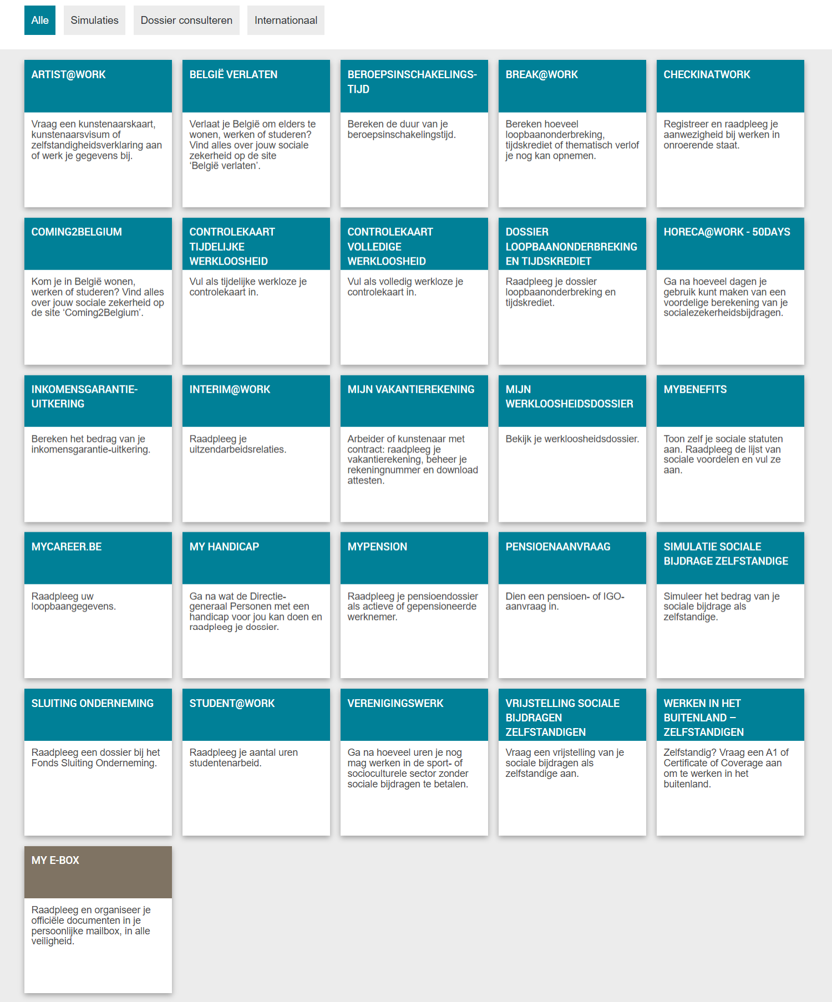
Social security portal for citizens

Slide 60
Results
more than 50 electronic services for employers, either based on the electronic exchange of structured messages or via an integrated portal site
  50 social security declaration forms for employers have been abolished
  in the remaining 30 (electronic) declaration forms the number of headings has on average been reduced to a third of the previous number
  declarations are limited to 3 events
    immediate declaration of recruitment and discharge (only electronically)
    quarterly declaration of salary and working time (only electronically)
    occurrence of a social risk (electronically or on paper)
  in 2022, more than 45 million electronic declarations were made by all 230,000 employers, 98 % of which from application to application

Slide 61









Quartely declaration salary & working time
simplification
Activity 3
Activity 2
Activity 1
employer
one electronic
declaration
RSZ
RIZIV
RVA
old age pension
FPD
Orint
holiday pay
RJV

Slide 62
Declaration of social risks
types of social risks
  child benefits
  incapacity for work ((labour) accident, (occupational) disease, …)
  unemployment
  old age pension
3 possible moments of declaration
  start of the social risk
  recurrence or continuation of the social risk
  end of the social risk
structure of the declaration
  identification data
  if necessary, salary and working time data not yet declared via a quarterly declaration (mini-declaration)
  specific data concerning the social risk

Slide 63
Results
an integrated portal site and mobile applications containing
  electronic transactions for citizens, employers and professionals
  simulation environments
  information about the entire social security system
  harmonized instructions and information model relating to all electronic transactions
  a personal page for each citizen, each company and each professional
an integrated multimodal contact centre supported by a customer relationship management tool
a data warehouse containing statistical information with regard to the labour market and all branches of social security

Slide 64
Useful legislative changes
legal translation of
  the common vision on information management
  the common vision on information security and privacy protection
  the obligation to use unique identification keys
creation of a public institution (KSZ) that acts as a driving force
  mission and tasks
  governance
  financing principles
creation of a control committee on information security and privacy protection
probative value of electronic information storage and exchange
punishment of abuse of the system
gradually, coordination or harmonisation of basic legal concepts
gradually, adaptation of business processes set out in the law

Slide 65
Distributed information servers
information servers
  directory of data subjects at the KSZ
  basic identification data of citizens at the National Register and the complementary KSZ Register
  basic identification data of companies at the Company Register
  employers directory (WGR) at the RSZ
  work force register at the RSZ
  salary and working time database at the RSZ
  database of contribution certificates
services offered
  interactive consultation
  batch consultation
  automatic communication of updates

Slide 66
Pre-processed messages
pre-processed messages
  beginning/end of labour contract, beginning/end of self-employed activity
  contribution certificates medical care (employees, self-employed, beneficiaries of social security allowances)
  unemployment benefits
  benefits in case of career break
  benefits in case of incapacity for work ((labour) accident, (occupational) disease)
  reimbursement of health care costs
  child benefits
  old age pensions
  holiday pay
  benefits for the disabled
  guaranteed minimum income – social welfare
  derived rights (e.g. tax reduction/exemption, free public transport, ...)
  migrant workers
  …
services offered
  interactive consultation
  batch consultation
  automatic communication of messages

Slide 67
Useful tool: the reference directory
reference directory
  directory of available services/information
    which information/services are available at any actor depending on the capacity in which a person/company is registered at each actor
  directory of authorized users and applications
    list of users and applications
    definition of authentication means and rules
    definition of authorization profiles: which kind of information/service can be accessed, in what situation and for what period of time depending on in which capacity the person/company is registered with the actor that accesses the information/service
  directory of data subjects
    which persons/companies have personal files at which actors for which periods of time, and in which capacity they are registered
  subscription table
    which users/applications want to automatically receive what information/services in which situations for which persons/companies in which capacity

Slide 68
EESSI
IT system that helps social security institutions across the EU exchange information related to different branches like
  sickness, maternity and equivalent paternity benefits
  family benefits
  benefits in respect of accidents at work and occupational diseases
  unemployment benefits
  old-age pensions, pre-retirement and invalidity benefits
  survivor’s benefits and death grants
  applicable legislation
more rapidly and securely
as required by the EU rules on social security coordination

Slide 69
EESSI
all communication between national institutions on social security files are to take place through EESSI
social security institutions exchange structured electronic documents and follow commonly agreed procedures to process them
these documents are routed through EESSI to the correct destination in the right institutions in another Member State
staff in social security institutions are able to find the correct destination in participating countries by consulting a repository of national institutions (see https://ec.europa.eu/social/social-security-directory/pai/select-country/language/en)

Slide 70
EESSI
32 participating countries
  27 EU Member States
  Iceland
  Liechtenstein
  Norway
  United Kingdom
  Switzerland
> 5.000 participating institutions

Slide 71
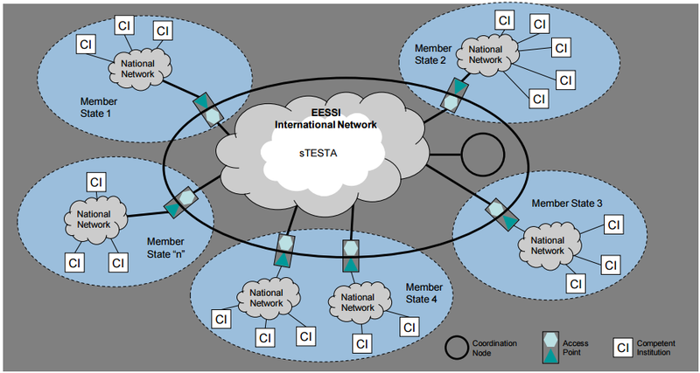
EESSI architecture

Slide 72
Advantages
gains in efficiency
  in terms of cost: services are delivered at a lower total cost due to
    a unique information collection using a common information model and administrative instructions
    a lesser need to re-encoding of information by stimulating electronic information exchange
    a drastic reduction of the number of contacts between actors in the social sector on the one hand and companies or citizens on the other
    a functional task sharing concerning information management, information validation and application development
    a minimal administrative burden
  according to a study of the Belgian Planning Bureau, rationalization of the information exchange processes between the employers and the social sector implies an annual saving of administrative costs of about 1.7 billion € a year for the companies

Slide 73
Advantages
gains in efficiency
  in terms of quantity: more services are delivered
    services are available at any time, from anywhere and from several devices
    services are delivered in an integrated way according to the logic of the customer
  in terms of speed: the services are delivered in less time
    benefits can be allocated quicker because information is available faster
    waiting and travel time is reduced
    companies and citizens can directly interact with the competent actors in the social sector with real time feedback

Slide 74
Advantages
gains in effectiveness: better social protection
  in terms of quality: same services at same total cost in same time, but to a higher quality standard
  in terms of type of services: new types of services, e.g.
    push system: automated granting of benefits
    active search of non-take-up using data warehousing techniques
    controlled management of own personal information
    personalized simulation environments
better support of social policy
more efficient combating of fraud

Slide 75
Application in the Belgian health care sector

Slide 76
Stakeholders of the Belgian health care sector
11,500,000 citizens
health care providers
  21,600 general practicioners
  28,000 specialist doctorsArtsen-specialisten
  9,000 dentists
  4,900 pharmacies
  31,000 physiotherapists
  186,000 nursing practicioners
  11,000 midwives
  55,900 paramedics (dietitians, ergotherapists, speech therapists, …)
health care institutions
  120 hospitals
  60 psychiatric hospitals
  1,400 residential care centers

Slide 77
Some evolutions in health care
more chronic care instead of merely acute care
remote care (monitoring, assistance, consultation, diagnosis, operation, ...), and home care
multidisciplinary, transmural and integrated care
patient-centric care and patient empowerment
rapidly evolving knowledge => need for reliable and coordinated management and access to knowledge
threat of excessively time-consuming administrative processes
thorough support of health care policy and research requires thorough, integrated and anonymized information
cross-border mobility
need for cost control

Slide 78
The reported evolutions require...
cooperation between all actors in health care
efficient and secure electronic communication amongst all actors in health care
high quality, multidisciplinary electronic health records
care pathways
pptimized administrative processes
technical and semantic interoperability
guarantees with regard to
  information security
  privacy protection
  respect for the professional secrecy of health care providers

Slide 79
Electronic communication also stimulates …
quality of care and patient safety
  avoidance of wrong care and medication
    incompatibility between medicines
    contra-indications against certain medicines or treatments for a specific patient (eg allergies, diseases, …)
  avoidance of errors in concrete care provision and administration of medicines
  availability of reliable databases on good treatment practices and decision support scripts
  more opportunity for multidisciplinary consultations and second opinions
avoidance of unnecessary multiple examinations => less stress for the patient and avoidance of unnecessary additional costs

Slide 80
Objectives of the eHealth-platform
how?
  through a well organized, mutual electronic service provision and information exchange amongst all actors in health care
  with the necessary guarantees on the level of information security, privacy protection and professional secrecy
what?
  optimization of the quality and continuity of the provision of health care
  optimization of the patient safety
  simplification of the administrative formalities for all actors in health care
  proper support of health care policy and research

Slide 81












eHealth: some results
Medical history search via SumEHR
Guidelines and advice available online
Medication schedule
Health
advantages
Electronic prescriptions
Consultation of laboratory results
Electronic referral letters

Slide 82





eHealth: some results
Pricing,
billing
Updating the SumEHR, the medication schedule, ...
Adminis- trative
advantages
Creating and sending certificates
Registrations
Sending a report to the GMF holder

Slide 83










eHealth: some results
> 91,3 %
of Belgian citizens have given
an informed consent for data sharing
+97%
of GPs make use
of eHealth services
149 millions
messages/year
via eHealthBox
Electronic prescriptions
2022
16 million/month
20.260.000.000
digital transactions
4.835.690
Belgian patients with
Summary Electronic Health Records in health vaults
> 29.000
> 4000
  220 million
  electronic documents available
  at hospitals and clinical labs
83

Slide 84







eHealth: architecture
Patients, health care providers
and health care institutions
Site Ministry
Software health care professional
Software health care institution
VAS
Site RIZIV
VAS
eHealth-portal
MyCareNet
VAS
VAS
VAS
Users
Basic services
eHealth-platform
Network
AS
AS
AS
AS
AS
AS
Suppliers

Slide 85
eHealth-platform: basic services & API’s
Coordination of the electronic processes
Portal
Integrated user and access management system
Management of loggings
System for end-to-end encryption
eHealthBox
Timestamping
Coding and anonymising
Consultation of National register and CBSS registers
Reference directories (hub-metahub system)

Slide 86
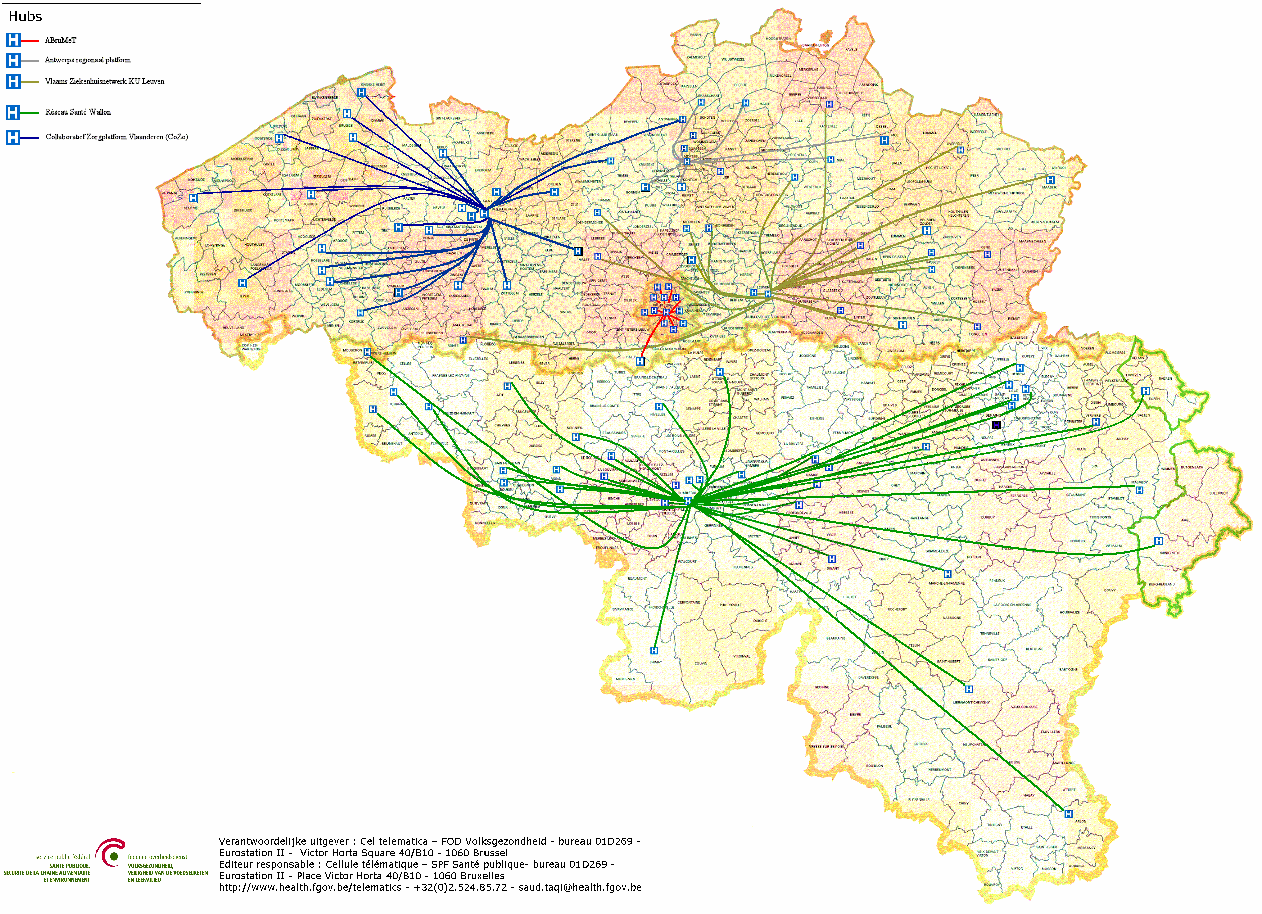

Hubs & metahub
        5 hubs
        Collaboratief Zorgplatform (Cozo)
        Antwerpse Regionale Hub (ARH)
        Vlaams Ziekenhuisnetwerk KU Leuven (VZN)
        Réseau Santé Wallon (RSW)
        Réseau Santé Bruxellois (RSB)

Slide 87








Hubs & metahub
3. Retrieve data from hub A
A
1: Where can we find data?
4:
All data available
2: In hub A and C
3: Retrieve data from hub C
C
B

Slide 88





Health vaults
A
InterMed
BruSafe
C
B

Slide 89


Slide 90
https://www.mijngezondheid.belgie.be
https://www.masante.belgique.be
https://www.status.ehealth.fgov.be

Slide 91
How to meet the expectations by using ICT ?

Slide 92
Common vision & cooperation

Slide 93
Common vision on information management
information is being modelled
  in such a way that the model fits in as closely as possible with the real world
  in order to allow multifunctional use of information
information is collected from citizens and companies only once by the public sector as a whole
  via a channel chosen by the citizens and the companies
  preferably from application to application
  and with the possibility of quality control by the supplier before the transmission of the information
the collected information is validated once
  according to established task sharing criteria
  by the actor that is most entitled to it or by the actor which has the greatest interest in correctly validating it

Slide 94
Common vision on information management
a task sharing model is established indicating which actor stores which information as an authentic source, manages the information and maintains it at the disposal of the authorized users
information can be flexibly assembled according to ever changing legal concepts
every actor has to report probable errors of information to the actor that is designated to validate the information
every actor that has to validate information according to the agreed task sharing model, has to examine the reported probable errors, to correct them when necessary and to communicate the correct information to every known interested actor
once collected and validated, information is stored, managed and exchanged electronically to avoid transcribing and re-entering it manually

Slide 95
Common vision on information management
electronic information exchange can be initiated by
  the actor that disposes of information
  the actor that needs information
  the organisation that manages the interoperability framework
electronic information exchanges take place on the base of a functional and technical interoperability framework that evolves permanently but gradually according to open market standards, and is independent from the methods of information exchange
available information is used for
  the automatic granting of benefits
  prefilling when collecting information

Slide 96
Common vision on information security
security, availability, integrity and confidentiality of information is ensured by integrated structural, institutional, organizational, HR, technical and other security measures according to agreed policies
personal information is only used for purposes compatible with the purposes of the collection of the information
personal information is only accessible to authorized actors and users according to business needs, legislative or policy requirements
the access authorization to personal information is granted by an Information Security Committee, designated by Parliament, after having checked whether the access conditions are met
the access authorizations are public

Slide 97
Common vision on information security
every actual electronic exchange of personal information has to pass an independent trusted third party and is preventively checked on compliance with the existing access authorizations by that trusted third party
every actual electronic exchange of personal information is logged, to be able to trace possible abuse afterwards
every time information is used to take a decision, the information used is communicated to the person concerned together with the decision
every person has right to access and correct his/her own personal data
every actor in the social sector disposes of an information security officer with an advisory, stimulating, documentary and control task

Slide 98
Entrepreneurship, corporate culture & teamwork

Slide 99
Entrepeneurship vs management
Entrepreneurship
adaptations, change
"fuzzy" challenges
solutions not known
adjusting habits
changing value system
taking responsibility, going beyond formal competences
Management
stability, order, security
technical challenges: problems & solutions known
within own competence

Slide 100
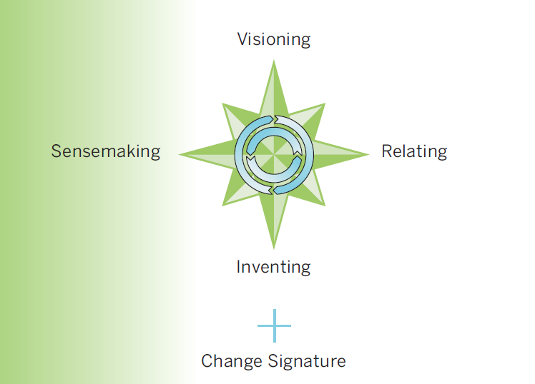
Entrepreneurship by leadership
Model: MIT Leadership Center

Slide 101
Visioning
why ?
  creating an attractive image of the eventual new situation promotes commitment by others
  the vision keeps moving, even in the face of resistance, setbacks, fear or uncertainty
  is the emotional side of leadership
how ?
  clear goal and direction
  radiating enthusiasm, commitment, faith and support
  encourage staff to be involved and loyal
  challenge staff to do and achieve things themselves
  highlighting the unique strengths, values and culture of the organization
  help staff to believe that they are part of something bigger than their daily work
  stimulate a feeling of belonging to a group
  communicate a lot

Slide 102
Methodology
define a long term vision on
  integrated, customer-oriented service delivery
  management of information as a strategic resource for all activity
  interoperability
make the vision enforceable by citizens and companies, and amongst government institutions and health care providers/institutions, by formalizing it in regulations
combine long term vision, profound process optimization and quick wins
do not look at it as a pure ICT event, but put the emphasis on an improvement of services and use a multidisciplinary approach
optimize processes within each social actor, at each government level and across government levels before their automatization

Slide 103
Methodology
standardize concepts and, where necessary, adapt regulations in order to introduce those concepts
also regulate aspects such as privacy protection, information security, the protection against ICT crime, unique identification keys, the probative value of electronic information, the electronic signature, the equal access to public services, the transparency of administrations, …
see to a close cooperation with policymakers, other government departments, other governmental levels, users, mandated intermediaries and interest groups
attune the service offer maximally to the needs and the logic of the users and involve them actively in the development of the services
match the governmental processes with the own processes of the users and assure user-friendliness

Slide 104
Methodology
concentrate on a qualitative and interactive service offering, instead of a mere presence on the web
support users by the implementation of data quality controls, before these are transmitted to the government authorities, and use the available data proactively for an automatic granting of rights, prefilling of information in forms during data collection and a targeted provision of information to the users
make sure that available ICT components and information (networks, data bases, …) are re-used to a maximum; through this, the efforts can be directed towards developing added value services
also develop multifunctional components yourself, conform open standards, and based on a flexible, modular, expandable and service-oriented architecture, so that other developers of services can re-use your components

Slide 105
Methodology
pay attention to change management, communications and training
see to a good project management
work incrementally and with prototyping, and give special attention to the roll-out by providing test and simulation environments, training and coaching for the users, and a multimodal contact centre for the personal support of end-users
see to it that proper measuring facilities are available, so as to assure permanent monitoring and improvement
make sure that the users have confidence in the electronic services that are provided; develop an information security policy, which is designed to guarantee the availability, confidentiality, integrity, authenticity and auditability of the information systems
create an institution that stimulates and coordinates

Slide 106
Methodology
strive for an appropriate corporate culture
  networks rather than hierarchy
  services should be geared to the needs of the users and not to the internal organizational structure of the government or of the organizations providing the servicesempowerment instead of mere service
  rewarding entrepreneurship
  ex post evaluation of the output, rather than ex ante control of the input

Slide 107
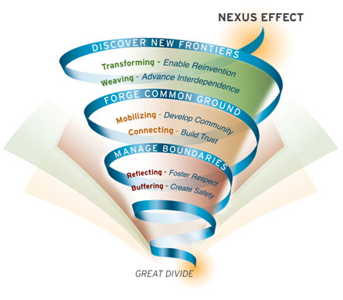
Nexus effect
Source: MIT Sloan

Slide 108
Solid architecture, re-use & agile development

Slide 109
Principles for durable and economically viable ICT solutions
avoid duplication
  anything that is duplicated (if not strictly necessary)
  is a waste of time and money
  and will result in a lower quality of service
enable the right level of execution
  decisions and actions should be dealt with
  at the most immediate (or local) level that is consistent with their resolution
  to enable lean and cost effective operations

Slide 110
Service Oriented Architecture (SOA)
what ?
  “Service Oriented Architecture (SOA) is a paradigm for organizing and utilizing distributed capabilities that may be under the control of different ownership domains. It provides a uniform means to offer, discover, interact with and use capabilities to produce desired effects consistent with measurable preconditions and expectations. This style of architecture promotes reuse at the macro (service) level rather than micro levels (eg. objects). It also makes interconnection of existing ICT assets trivial” (OASIS Reference Group)
characteristics
  service-oriented
  modular
  interoperable (based on open standards or open specifications)
  extensible
  layered
  based on reuse of components and data

Slide 111
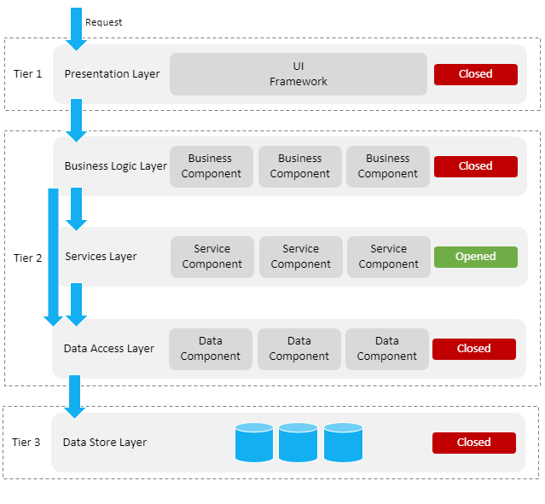
ICT: layered, service oriented architecture
presentation layer, eg
  web applications
  mobile applications
business logic layer, eg
  workflow
services layer, eg
  user & access management service
  communication service
  blockchain
data store layer, eg
  authentic sources
  personal vaults
  local storage on mobile device

Slide 112
ICT: across layers
interoperability standards
  technical: oa APIs (Application Programming Interface)
  semantic
security, eg
  access authorisation
  logging
  business continuity
configuration, eg
  capacity management
  load balancing

Slide 113
Advantages of layered, service oriented architecture
multifunctional reuse possibility
  lower cost
  higher quality
  quicker time to market
  better user experience
loosely coupled => reduced dependency of components
  easier and less costly maintenance
easier unit testing because each component can be tested individually
  but need for sound integration and performance testing

Slide 114



Different types of sharing & reuse
infrastructure
  hard infrastructure
  soft infrastructure
  platforms
common vendor contracts
federal ICT community
business
  knowledge & experiences
  business functionality
  business data
  complete business services
Important to know what already exists
→ catalogues!

Slide 115
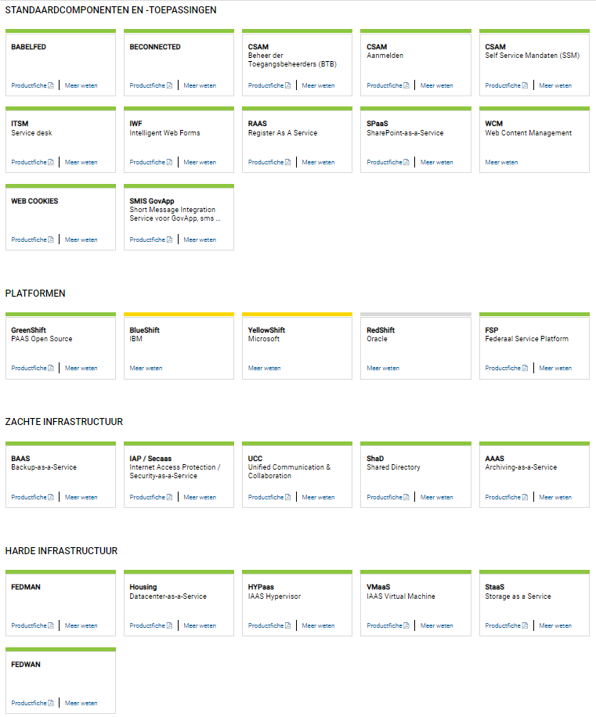
www.gcloud.belgium.be

Slide 116

ReUse – Vision
Every stakeholder
can easily find the most common reusable elements in a centralized catalogue
Processes
and tools are put in place to identify, register, implement, monitor and measure reuse throughout the project lifecycle
Human
networks are maintained and developed on all levels (CEO’s, CIO’s, business owners, business analysts, architects) in order to keep maximum visibility on reuse potential
A culture
develops where
reuse is adopted and the creation of reusable products is promoted,
116

Slide 117
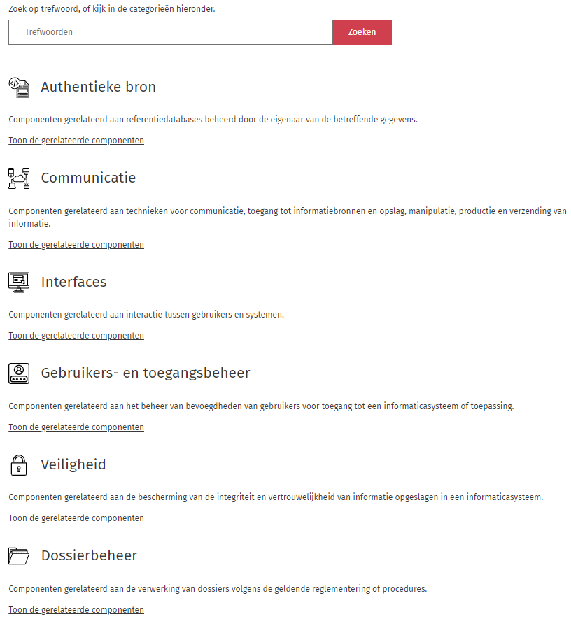
https://reuse.smals.be/nl

Slide 118
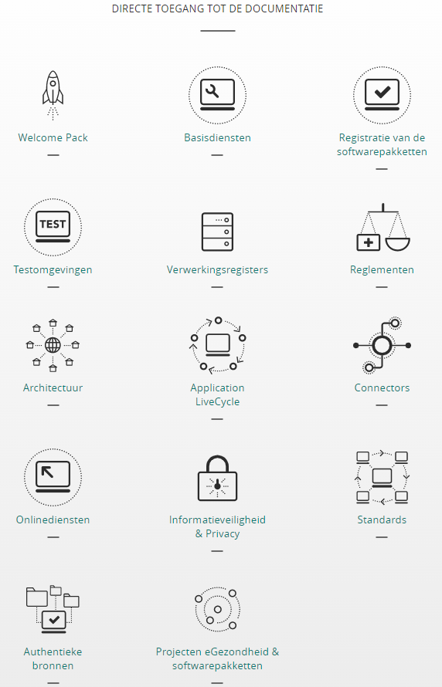
https://www.ehealth.fgov.be/ehealthplatform/nl

Slide 119
Example of reusable service: identity, user and access management (IUAM) according to the international standard XACML

Slide 120
IUAM: objectives to be reached
be able to (electronically)
  identify all relevant entities (physical persons, companies, applications, machines, …)
  authenticate the identity of all entities
  know the relevant characteristics of the entities
  know the relevant relationships between entities
  know that an entity has been mandated by another entity to perform a legal action
  know the authorizations of the entities
in a sufficiently certain and secure way
in as much relations as possible (C2C, C2B, C2G, B2B, B2G, …)
multichannel (web application, mobile application, …)
using open interoperability standards

Slide 121
User expectations
one-time registration of identity, characteristics, relationships and mandates
possibility of auto registration/bootstrap and auto recovery of credentials once a top level authentication (eg eID) is available
single sign on for as many public and private sector applications as possible
  authentication of the identity
  verification of relevant characteristics, relationships and mandates
electronic means for authentication of identity that can be used on as much devices as possible
minimal cost of
  registration procedures
  electronic means for authentication of identity
  use of electronic means for authentication of identity

Slide 122
Critical success factors
meeting user expectations
simplicity in use
taking advantage of opportunities of technological evolution => evolutionary, future proof solutions
accordance with the European regulatory framework
sufficient applications for which electronic user management can be used

Slide 123
Policy Enforcement Model (XACML)
Action on application
DENIED
Policy
Enforcement
(PEP)
Action on application
PERMITTED
User
Application
Action on application
Decision
request
Decision
reply
Policy
Decision
(PDP)
Information
request/reply
Policy
retrieval
Information
request/reply
Policy management
Policy
Administration
(PAP)
Policy
Information
(PIP)
Policy
Information
(PIP)
Manager
Policy repository
Authentic source
Authentic source

Slide 124
Example of reusable component: digital wallet

Slide 125
Existing components
every MS has a responsive web application and/or native mobile app for downloading electronic COVID-19 vaccination, test and recovery certificates according to common EU standards
  see https://health.ec.europa.eu/ehealth-digital-health-and-care/ehealth-and-covid-19_en for the detailed specifications and the legal framework)
every electronic certificate is a structured electronic document
  based on a common JSON (JavaScript Object Notation) description
  that contains a QR-code with the content of the electronic certificate
  the QR-code is electronically signed by the issuer
the European Commission manages a database containing the public signature keys of the issuers of the electronic certificates
every MS has a responsive web application and/or native mobile app that is/are able
    to scan the QR-code
    to check the validity of the QR-code
    to send the content of the electronic certificates to other applications via an API

Slide 126
Eg: possible reuse for eEHIC
definition of a common JSON description for the eEHIC
every MS capitalizes on the responsive web application and/or native mobile app used for the COVID-19 certificates, by which a citizen
  can download an eEHIC
  after authentication of its identity based on an electronic authentication means of eIDAS level ‘high’ and
  locally store and/or print the eEHIC
advantages
  immediate possibility to obtain an eEHIC online
  with the same content as the (actual) EHIC
  anywhere and anytime
  that can be electronically authenticated and read by
    the holder
    every health care provider throughout the EU

Slide 127
Examples of re-use

Slide 128
Example: COVID testing
happy flow: 5 phases
  determination of a cause for performing a COVID-19 test on a patient and delivery of a corona test prescription code (CTPC) from a central database CTPC
  reservation of a sampling moment
  sampling
  execution of the test and analysis of the test result
  making the test results available
very modular, event driven and rule based information system

Slide 129









COVID-19 testing: process
CTPC Code
EMF software
Doctors
Nurses
CTPC
Test location
Collectivities
eHealth Box
Laboratories
Tracing business process engine

Slide 130




COVID-19 testing: re-use
CTPC Code
Integrated software
IUAM
API gateway
IUAM
API gateway
eHealthBox
ETEE
Doctors
Nurses
CTPC
Test centers
DataEncryptor
Seals
Entities prescriptions
Addressbook
ConsultRN
DossierNumberGeneration
CentralPersonnelFile
DmfA
Laboratories
Mandate

Slide 131
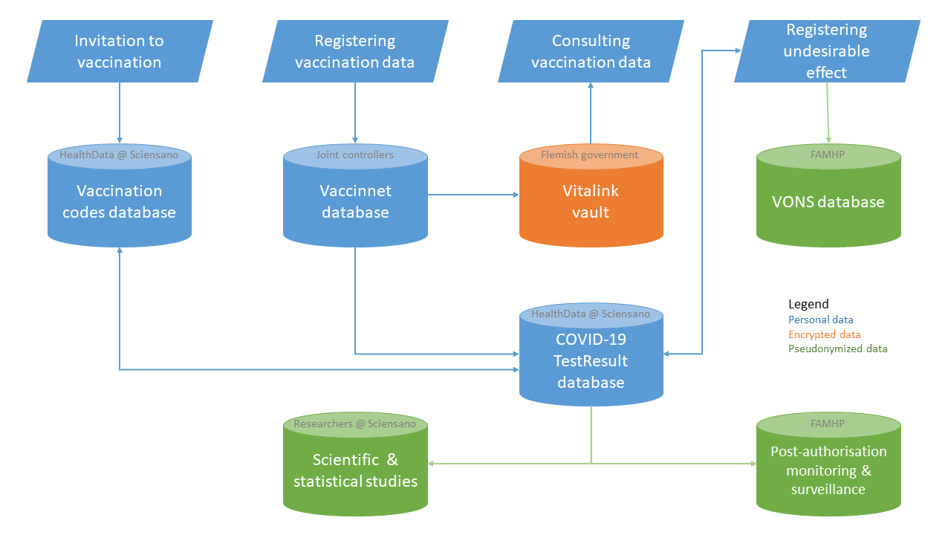
Example: COVID vaccination

Slide 132
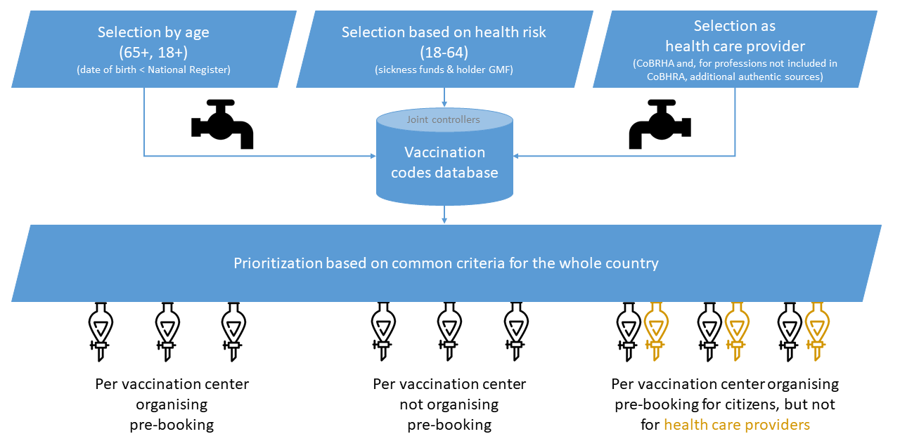
Example: COVID vaccination

Slide 133
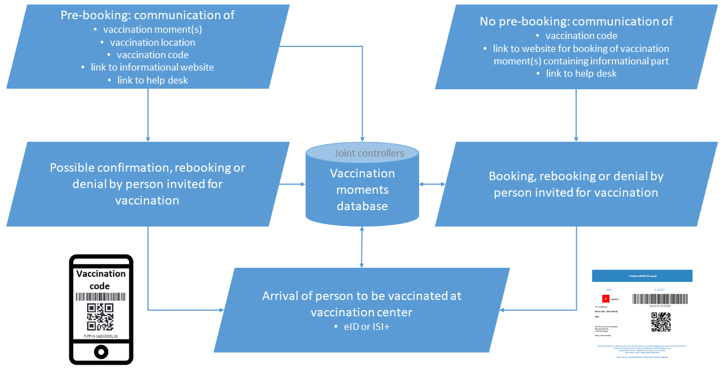
Example: COVID vaccination

Slide 134


Vaccination: simplified integration
Sciensano
Vaccinnet
National Register
IUAM
API gateway
ConsultRN
CoBRHA
Regions
National Intermutual College
Doctors
Vaccination Codes Database
Inivitation & booking
system
Vaccination centers
Hospitals
Pharmacies
Last minute
invitation system

Slide 135
Agile development

Slide 136
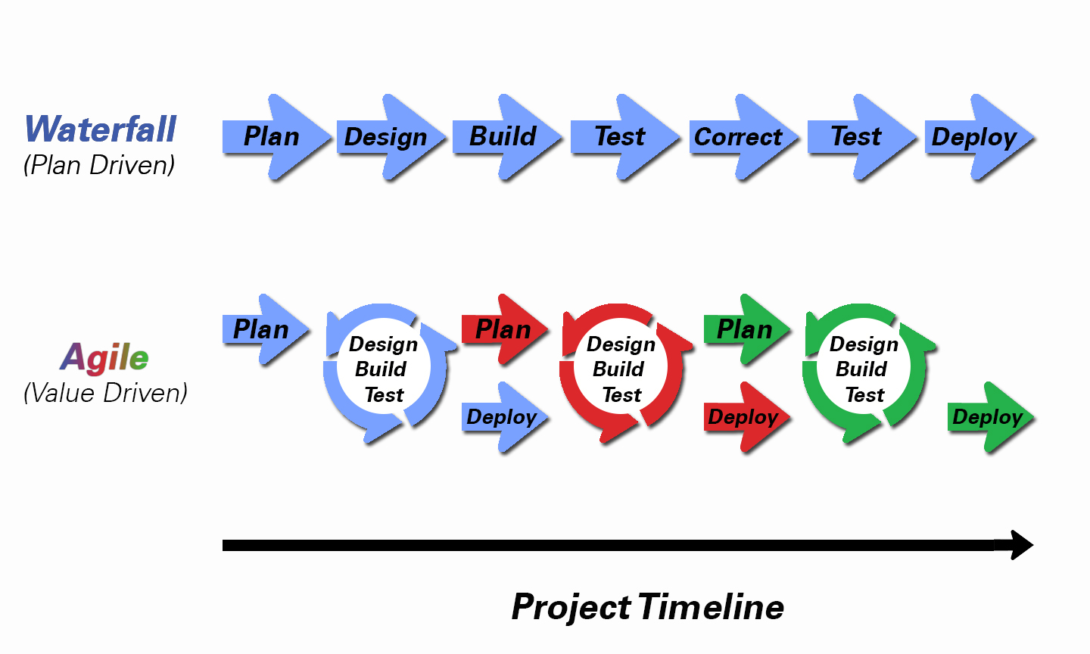
Agile development

Slide 137
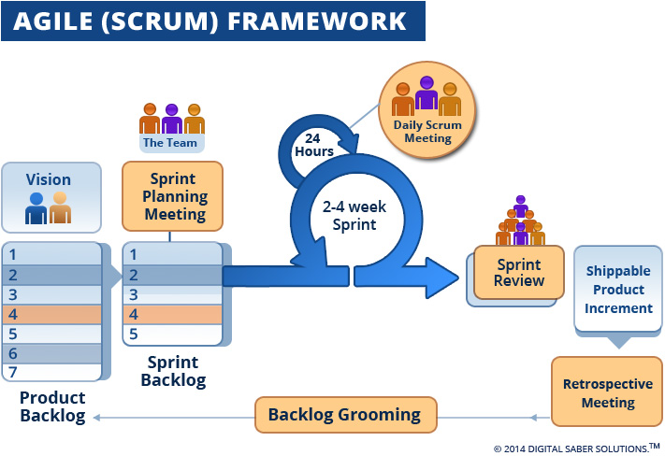
Agile development

Slide 138
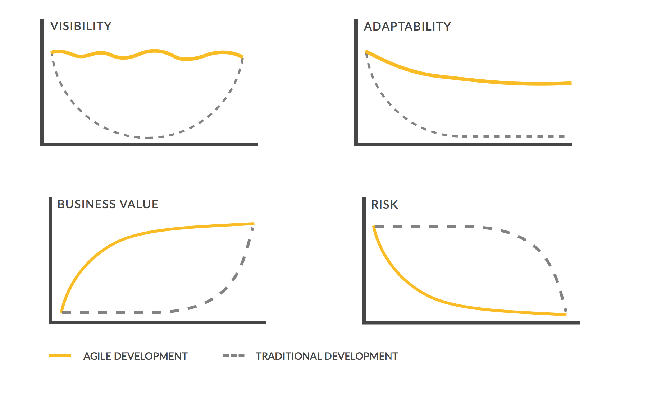
Traditional vs agile development

Slide 139
Security: confidentiality, availability, integrity

Slide 140
Global vision
modern technologies can bring enormous benefits and added value, but they must be deployed with the right safeguards for the fundamental right to data protection
international treaties and national constitutions provide for a whole series of fundamental rights: in addition to the right to data protection, there is also the right to a fair trial, the right to social protection, the right to high-quality healthcare, ...
citizens can expect the government to ensure their right to data protection in a way that also respects their other fundamental rights
possible drawbacks should be avoided, but benefits should not be unnecessarily obstructed
risk management and data protection-by-design and a multidisciplinary approach are key concepts in this

Slide 141
Holistic approach
legal framework
minimal information security standards
structural and institutional measures
organisational measures
technical measures

Slide 142
Legal framework: General Data Protection Regulation (GDPR)
Regulation (EU) 2016/679 of the European Parliament and of the Council of 27 April 2016 on the protection of natural persons with regard to the processing of personal data and on the free movement of such data, and repealing Directive 95/46/EC
directly applicable without the need for transposition into national law
applicable as from 25 May 2018
see https://eur-lex.europa.eu/legal-content/EN/TXT/?uri=celex%3A32016R0679

Slide 143
Minimal information security standards
developed by information security working party composed of Data Protection Officers (DPOs) of the actors => buy in !
approved by an independent Information Security Committee designated by Parliament
based on ISO 27000 standards, adapted for social security and health care (see https://en.wikipedia.org/wiki/ISO/IEC_27000-series)
defines 15 areas of security
enforced for all actors in the social sector
extended with policy guidelines
  minimal standards refer to policy guidelines for more detail
  policy guidelines provide support for concrete implementation

Slide 144
Topics covered by minimal information security standards
basic principles
information security policies
organisation of information security
  internal organisation
  mobile equipment and remote working
security measures for employees and co-workers
management of company assets
physical and environmental security
access control (physical and logical)
encryption

Slide 145
Topics covered by minimal information security standards
operations management
protecting communications
procurement, design, development and maintenance of systems
supplier management
incident management
business continuity
compliance

Slide 146
Structural and institutional measures
no unnecessary central data storage
availability of free of charge, basic information security services
  user- & access management
  encryption
  logging
  reference directories
  …
independent Information Security Committee designated by the Parliament that authorizes data exchange
a preventive control of the legitimacy of personal data exchange by an trusted third party (TTP) according to the authorizations of the independent Information Security Committee

Slide 147
Considerations in the deliberations
lawfulness and purpose limitation
  is the processing serving a legitimate purpose?
  are the purposes of the processing well defined ?
data minimization
  is the processing using the minimal dataset to achieve the purposes ?
  storage limitation
integrity and confidentiality
  measures on how to guarantee both parameters
transparency for the data subjects
information security standards

Slide 148
Organisational measures
Information Security Department headed by Data Protection Officer (DPO) with each actor in the social sector
specialized information security service providers
need for compliance with minimal information security and data protection standards (Minimale normen / Normes minimales)
information security working parties developing information security policies
Data Protection Impact Assessments (DPIA)
unique file

Slide 149
Organisational measures
yearly assessment of compliance with minimal security standards
  questionnaire sent out to all institutions connected to the network
  checked by the security service of the TTP
  reviewed in the Information Security work group
security requirements reviewed on regular basis
internal audits with continuous improvement plans => independent auditor reporting on findings

Slide 150
Circles of trust
agreements between actors about
  who is responsible of carrying out which authentications and verifications on the basis of which means
  how the results of the authentications and verifications are securely stored and exchanged electronically between the actors involved
  who is responsible of logging access (attempts) to the services and applications
  how it is ensured that a complete reconstruction of loggings can take place to determine which natural person has used which service in relation to which person, when and for what purposes
  the retention period of the loggings, as well as the way in which these can be consulted by those who are entitled to do so

Slide 151
Conclusion on information security
focus has to be put on a good balance between
  effectiveness and efficiency of information systems
  information security and data protection
  => based on risk analysis
information security and data protection need a holistic approach and are translated into a number of measures
  structural measures
  organizational measures
  technical measures
  legal measures
promoting information security and data protection by design

Slide 152
Designate an institution as a driving force

Slide 153
Mission of institution acting as driving force
definition of the vision and the strategy on information management in the social sector
definition of the common principles related to information management, information security and privacy protection
definition, implementation and management of an interoperability framework
  technical: secure messaging of several types of information (structured data, documents, images, metadata, …)
  semantic: harmonization of concepts and co-ordination of necessary legal changes
  business logic and orchestration support

Slide 154
Mission of institution acting as driving force
coordination of business process reengineering
stimulation of service oriented applications
driving force of the necessary innovation and change
program and project management
consultancy and coaching

Slide 155
Co-operative governance
Board of Directors
  consists of representatives of the stakeholders (employers associations, trade unions, social security institutions, …)
  approves the strategic, operational and financial plans of the CBSS
General Coordination Committee with representation of all users acts as debating platform for the elaboration and implementation of digitalisation initiatives within the sector
permanent or ad hoc working groups are instituted within the General Coordination Committee in order to co-ordinate the execution of programs and projects
the chairmen of the various working groups meet regularly as a Steering Committee
besides project planning and follow-up, proper measuring facilities are available to assure permanent monitoring and improvement after the implementation of the electronic services

Slide 156
Management and control techniques
annual priority plan debated with all users within the General Coordination Committee
cost accounting and zero-based budgeting resulting in financial transparency, an informed budget and a good evaluation of the management contract with the government
internal control based on the COSO-methodology (see www.coso.org) in order to provide reasonable assurance regarding the achievement of objectives with regard to
  effectiveness and efficiency of operations
  reliability of financial reporting
  compliance with applicable laws and regulations
external audit with regard to the correct functioning of the internal control system

Slide 157
Management and control techniques
program management through the whole sector
issue management during the management of each program
use of a system of project management combined with a time keeping system to follow up projects that are realized by all partners
frequent reports to all users which describe the progress of the various projects and eventual adjustment measures
use of balanced scorecards and a dashboard to measure, follow-up and evaluate the performance of the electronic services
use of ITIL (see https://www.axelos.com/certifications/itil-service-management) for ICT-service delivery
use of a coherent set of monitoring techniques to guarantee an optimal control and transparency of the electronic services

Slide 158
Useful legislative changes

Slide 159
Useful legislative changes
legal translation of
  the common vision on information management
  the common vision on information security and privacy protection
  the obligation to use unique identification keys
creation of a public institution (KSZ) that acts as a driving force
  mission and tasks
  governance
  financing principles
creation of a control committee on information security and privacy protection
probative value of electronic information storage and exchange
punishment of abuse of the system
gradually, coordination or harmonisation of basic legal concepts
gradually, adaptation of business processes set out in the law

Slide 160



frank.robben@mail.fgov.be
@FrRobben
https://www.frankrobben.be
https://www.ksz.fgov.be
https://www.ehealth.fgov.be

