Slide 1
Efficient and secure transborder exchange of personal data in the social and health sector

Slide 2











A

Slide 3
Basic requirements
Correct identification of the citizen
Correct routing of information request
Privacy and information security management
  identity, user and access management (IUAM)
  end-to-end encryption
Interoperability
  technical
  semantic

Slide 4
Identification of a citizen in Belgium
Obligatory use prescribed by law of social security identification number (SSIN) in the social and health sector
Procedures are available in order to guarantee unicity of SSIN
SSIN is available on electronic identity card or ISI+-card
Link register is available in order to link the Belgian SSIN with one or more identification numbers in other countries

Slide 5
Routing in Belgium: reference directory
directory of available services/information
  which information/services are available at any actor depending on the capacity in which a person/company is registered at each actor
directory of authorized users and applications
  list of users and applications
  definition of authentication means and rules
  definition of authorization profiles: which kind of information/service can be accessed, in what situation and for what period of time depending on in which capacity the person/company is registered with the actor that accesses the information/service
directory of data subjects
  which persons/companies have personal files at which actors for which periods of time, and in which capacity they are registered
subscription table
  which users/applications want to automatically receive what information/services in which situations for which persons/companies in which capacity

Slide 6
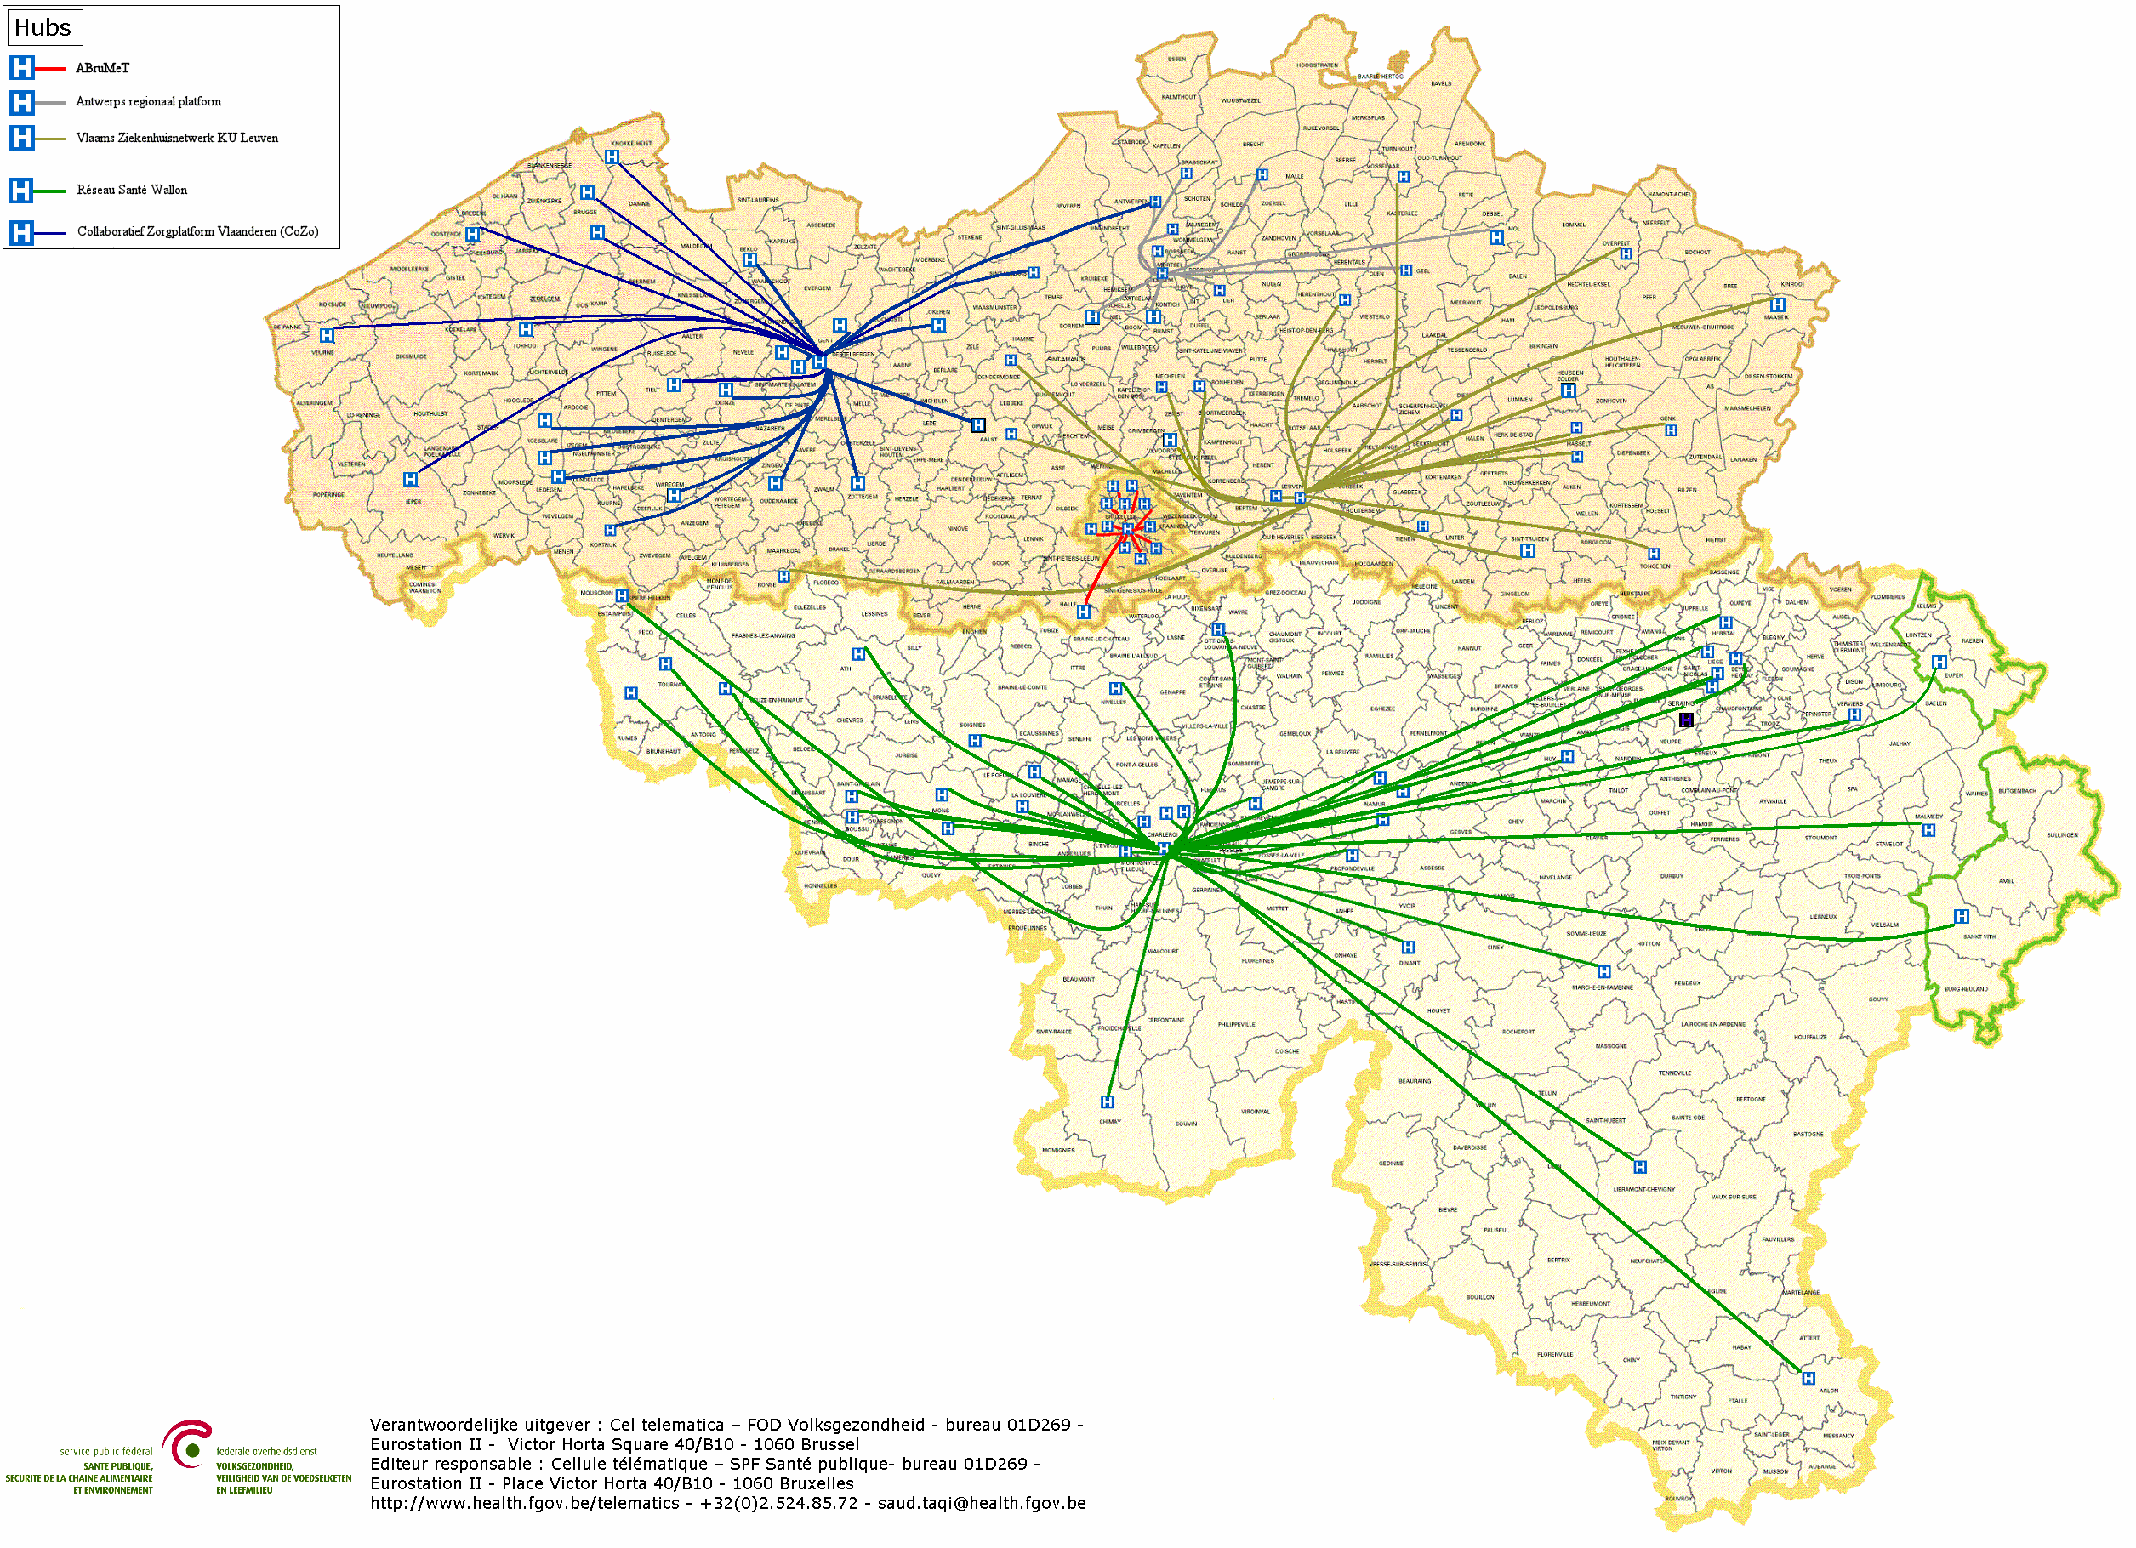
Example in health sector: hubs & metahub system
5 hubs
Metahub at eHealth-platform
All Belgian hospitals, clinical labs and health vaults connected

Slide 7



Example in health sector: hubs & metahub system
3. Retrieve data from hub A
A
1: Where can we find data?
2: In hub A and C
4:
All data available
3: Retrieve data from hub C
C
B

Slide 8
Example in health sector: health vaults
A
InterMed
BruSafe
C
B

Slide 9
IUAM: objectives to be reached
be able to (electronically)
  identify all relevant entities (physical persons, companies, applications, machines, …)
  authenticate the identity of all entities
  know the relevant characteristics of the entities
  know the relevant relationships between entities
  know that an entity has been mandated by another entity to perform a legal action
  know the authorizations of the entities
in a sufficiently certain and secure way
in as much relations as possible (C2C, C2B, C2G, B2B, B2G, …)
multichannel (web application, mobile application, …)
using open interoperability standards

Slide 10
User expectations
one-time registration of identity, characteristics, relationships and mandates
possibility of auto registration/bootstrap and auto recovery of credentials once a top level authentication (e.g. eID) is available
single sign on for as many public and private sector applications as possible
  authentication of the identity
  verification of relevant characteristics, relationships and mandates
electronic means for authentication of identity that can be used on as much devices as possible
minimal cost of
  registration procedures
  electronic means for authentication of identity
  use of electronic means for authentication of identity

Slide 11
Critical success factors
meeting user expectations
simplicity in use
taking advantage of opportunities of technological evolution => evolutionary, future proof solutions
accordance with the European regulatory framework
sufficient applications for which electronic user management can be used

Slide 12
Policy Enforcement Model (XACML)
Action on application
DENIED
Policy
Enforcement
(PEP)
Action on application
PERMITTED
User
Application
Action on application
Decision
request
Decision
reply
Policy
Decision
(PDP)
Information
request/reply
Policy
retrieval
Information
request/reply
Policy management
Policy
Administration
(PAP)
Policy
Information
(PIP)
Policy
Information
(PIP)
Manager
Policy repository
Authentic source
Authentic source

Slide 13
User and access management

Slide 14
Actual organization of IUAM in Belgium: CSAM
policy enforcement model has been applied in CSAM
  see https://www.csam.be/en/index.html
  coordinated by G-Cloud board (see https://www.gcloud.belgium.be/nl/home)
FAS (Federal Authentication Service)
  one of the components of CSAM
  tackles authentication of the identity
  by different means
    electronic identity card
    mobile wallet (available by the end of 2023)
    Itsme
    user-id, password & one time password (OTP)
    user-id & password

Slide 15






Authentication means FAS
Strong
 | eID + PIN-code with connected card reader
 | eID + PIN-code with wireless card reader
Mobile wallet with
PIN-code (by end 2023)
 | SIM card with PIN-code
Security code
via mobile app,
user-id + OTP
 | Security code via email, user-id + OTP
 | Security code on paper (paper token), user-id + password
 | User-id + password
Weak

Slide 16
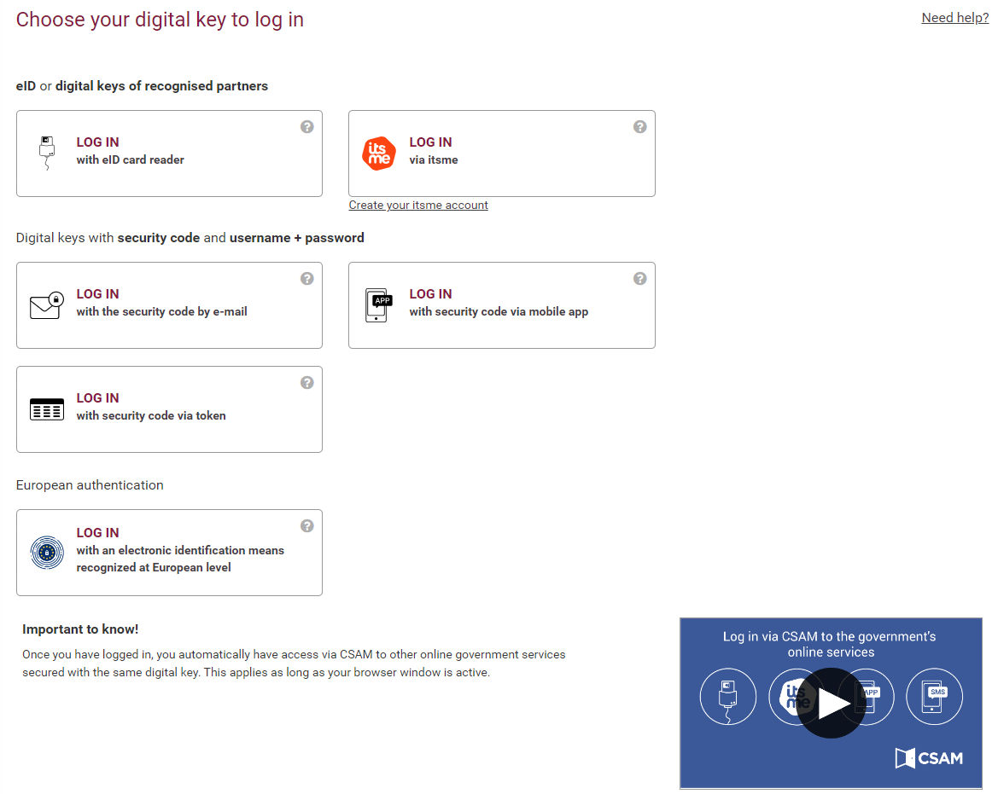

Slide 17
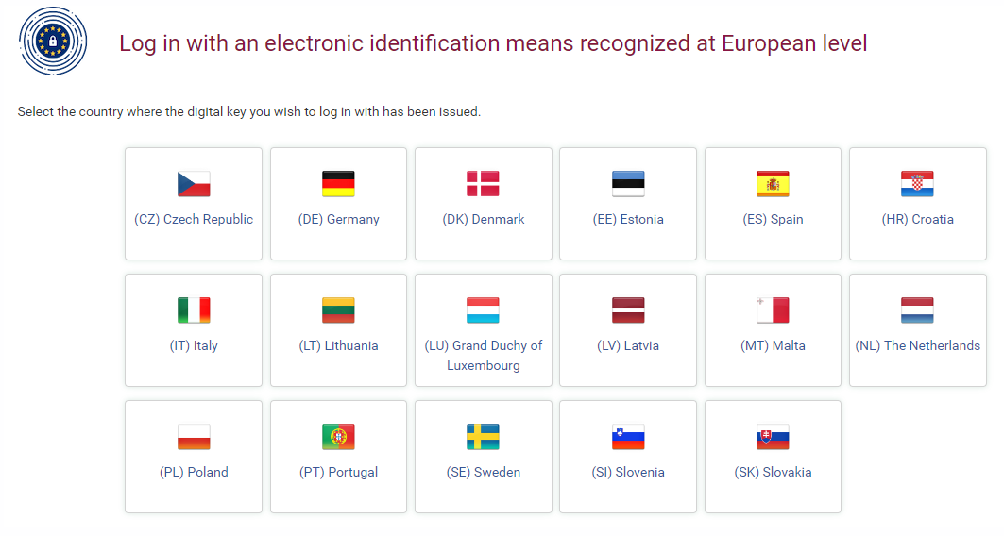

Slide 18
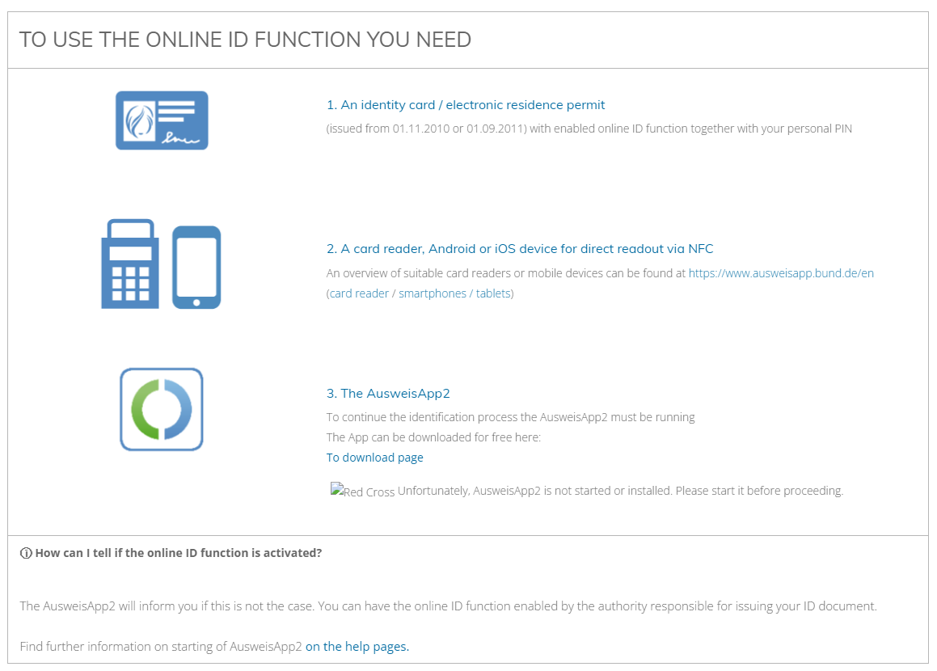

Slide 19
Classification of applications
by Board of Directors of Crossroads Bank of Social Security
  composed of representatives of trade unions, self employed persons, companies and social security institutions
laid down in a formal regulation
see https://www.socialsecurity.be/site_de/general/rules/rules_citizen_D.pdf

Slide 20
End-to-end encryption
2 methods:
    In the case of a known recipient: use of an asymmetric encryption system (2 keys)
    In the case of an unknown recipient: use of symmetric encryption (the information is encrypted and stored outside the eHealth platform; the decryption key can only be obtained through the eHealth platform)

Slide 21
Asymmetric end-to-end encryption
Healthcare actor
Person or entity
eHealth platform
Internet
1
3
Connector or
other software to
generate key pair
Authenticates sender
2
4
Sends
public key
Identification
certificate
Identificatieoncertificate
Stores
public key
Web service
Register key
2
Public keys
repository
Stores private key
in a secure way

Slide 22
Asymmetric end-to-end encryption
Message originator
CBSS / eHealth platform
Internet
1
Identification certificate
Web service
Ask public key
Identification
certificate
Asks for public key of addressee
2
Authenticates sender
Send message
Any protocol
3
4
Sends
public key
Encrypts
message
Identification
certificate
Message recipient
Public keys
repository
5
Stored
private
key
Decrypts message

Slide 23
Symmetric end-to-end encryption
Key
management
/depot
Encrypted with public key of user 1
Encrypted with public key of user 2
Symmetric key
Symmetric key
2 sends key
5 receives key
User 1
Originator
1 asks for key
User 2
Recipient
4 justifies right to
obtain key
4 justifies right to
obtain message
3 sends encrypted message
Encrypted with public key of Message depot
5 receives message
Encrypted with public key of User 2
Message encrypted with
symmetric key
Messages
Depot
Message encrypted with
symmetric key
Message encrypted with
symmetric key

Slide 24
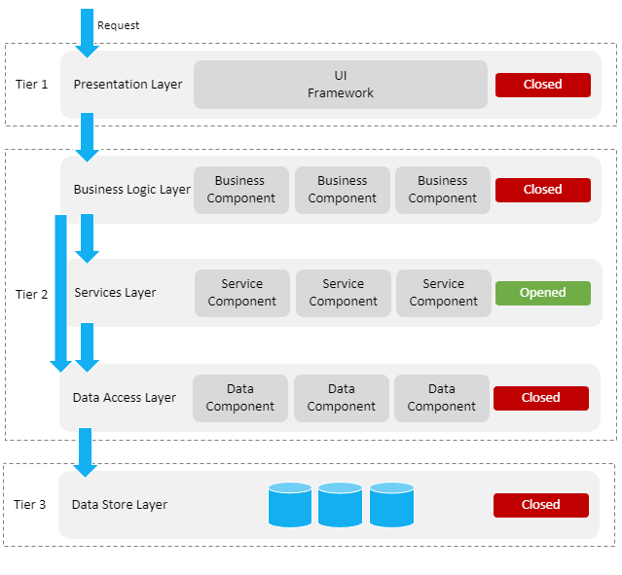
Layered, service oriented architecture
presentation layer, e.g.
  web applications
  mobile applications
business logic layer, e.g.
  workflow
services layer, e.g.
  user & access management service
  communication service
  blockchain
data store layer, e.g.
  authentic sources
  personal vaults
  local storage on mobile device

Slide 25
Across layers
security, e.g.
  access authorization
  logging
  business continuity
configuration, e.g.
  capacity management
  load balancing

Slide 26
Advantages of layered, service oriented architecture
multifunctional reuse possibility
  lower cost
  higher quality
  quicker time to market
  better user experience
reduced dependency of components
  easier and less costly maintenance
easier unit testing because each component can be tested individually
  but need for sound integration and performance testing

Slide 27
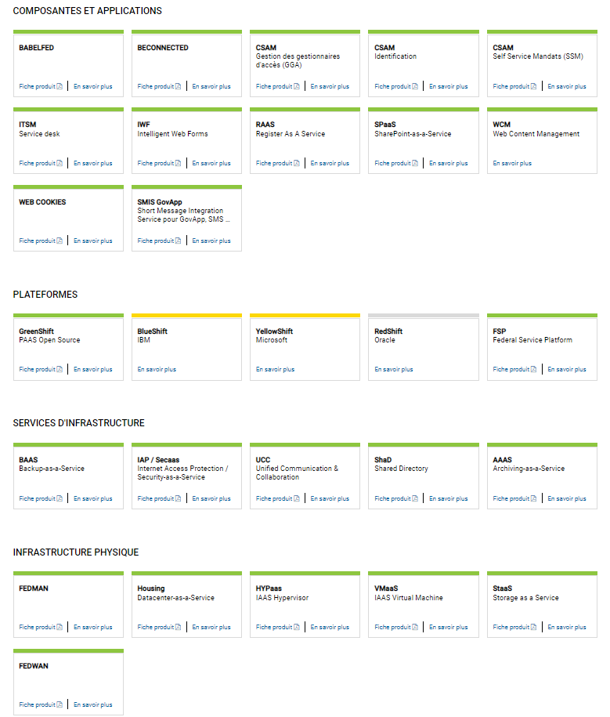
www.gcloud.belgium.be

Slide 28
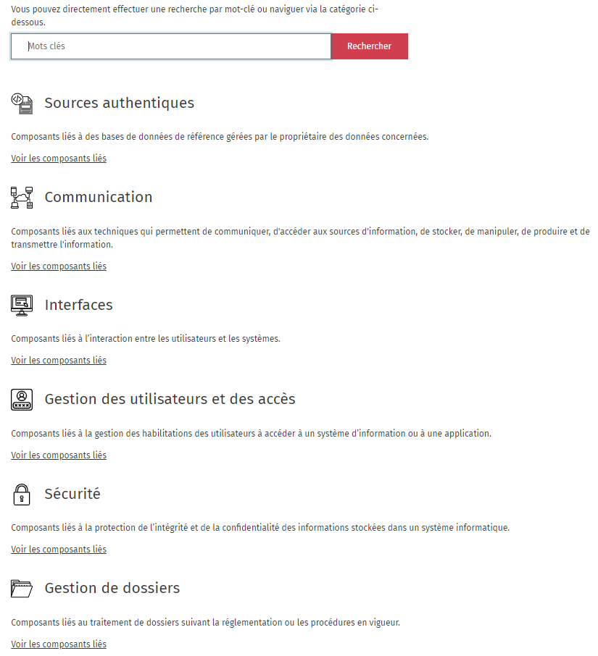
www.reuse.smals.be

Slide 29
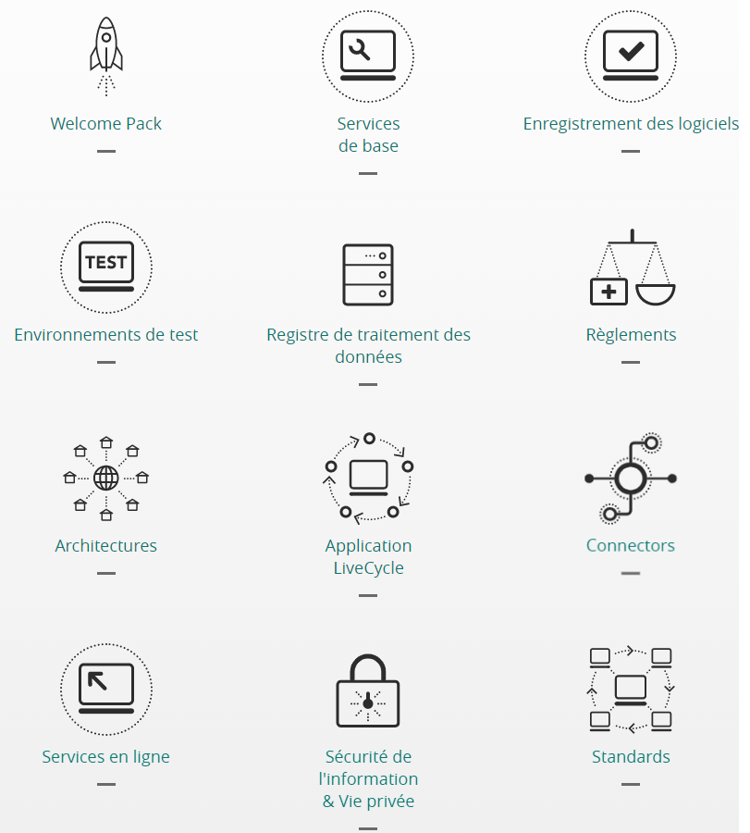
https://www.ehealth.fgov.be/ehealthplatform/fr

Slide 30
Thank you !
Any questions ?

