Slide 1
SOLID
Overview – Specifications – Use cases
Fabien Petitcolas, Kristof Verslype – April 2023

Slide 2
Content
Concluding remarks on SOLID
Background information:
  About the SOLID project
  Key SOLID draft specifications
  Main data sharing patterns
  Data sharing examples
    with SOLID only (experiment at Smals Research)
    with SOLID and verifiable credentials (Flanders PoC)

Slide 3
Concluding remarks on SOLID
Compelling vision for
  Handling personal data
  Giving back control to users/citizens
Early stage project
  Active area of research
  Many different experimental open-source libraries and tools
  One claimed “enterprise ready” offering
  Enterprise offering tested with only a small number of customers
  No evidence of existing applications in production
Technically SOLID can support different data exchange patterns
  Including a “sluis” model, but some GDPR-based legal arguments have been made against
SOLID builds on top of the OpenID Connect standard for authentication
  Compatibility with several identification mechanisms

Slide 4

About the SOLID project

Slide 5
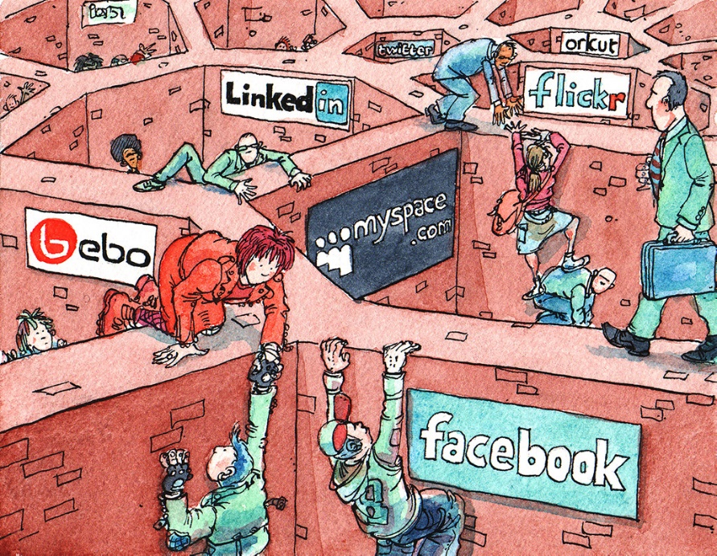
SOLID’s context and motivation
Social Linked Data
Context for SOLID
  Data is centralised in handful of Web platforms with far reaching privacy consequences
  Data locked in siloes, not available for innovation
  Web’s universality is threatened
SOLID is an ecosystem to “take back control”
SOLID enables interoperable data storages through standardisation
App. 1
Specific API
Data source 1
App. 2
Specific API
Data source 2
Image: Social Networking Sites as Walled Gardens by David Simonds, The Economist, 19 March 2008

Slide 6
SOLID
Vision:
Separate data from application to create independent choice
Combination of existing W3C standards to define how agents should interact
Strong use of the Resource Description Framework (RDF) to capture semantic information
SOLID protocol specification covers:
  Data storage servers
  Applications or services
  Identity
A SOLID server is a regular Web server, with support for access control, that hosts one or more data stores
A user can have several data stores on several servers
SOLID
Data store 1
App. 1
SOLID
Data store 2
Data store 3
App. 2
SOLID
SOLID
SOLID
Data store 4

Slide 7
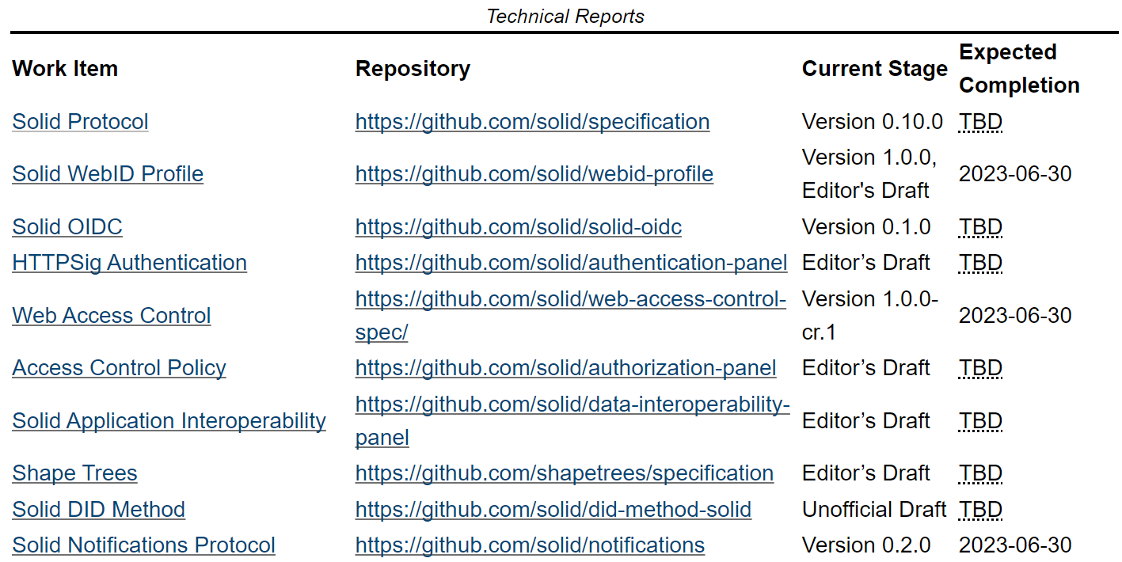
Current state of the SOLID specifications
SOLID is set of draft specifications combining mature technologies
Source: https://solidproject.org/TR/

Slide 8
Solid project code base
Relatively small project
Several open-source projects for SOLID servers
  CommunitySolidServer
    https://github.com/CommunitySolidServer/CommunitySolidServer
    Language: TypeScript
    About 17 contributors with >1000 lines of code (esp. from U of Ghent)
  node-solid-server
    https://github.com/nodeSolidServer/node-solid-server
    Language: JavaScript
    Last update over a year ago
  solid-nextcloud
    https://github.com/pdsinterop/solid-nextcloud
    Language: PHP
    4 contributors with > 1000 lines of code
  php-solid-server
    https://github.com/pdsinterop/php-solid-server
    2 contributors with > 1000 lines of code, last update about a year go
    Language: PHP

Slide 9


Companies providing SOLID-based products
We found only two companies providing SOLID products:
  Boston-based company
  About 50 employees mostly in USA and UK
  Founded by Tim Berners-Lee
  https://www.inrupt.com/
  Brussels-based start-up
  Founded by Wouter Janssens and Lauro Vanderborght
  https://www.digita.ai/

Slide 10

Key specifications

Slide 11

Personal online data-stores
Data containers are called “POD” in the SOLID context
  Store data as web resources (e.g., identified by URI) in a hierarchical manner
    Container could be a folder in file system
    Resource could be a file
  Store structured, semi-structured or unstructured data
  End-user applications provide a view on the data
Communication is governed by the “SOLID” protocol
SOLID plug-in
Storage
Apps
(e.g., file system, database)
(view)

Slide 12
POD example
https:/​/frank.pod/ (container)
  people/ (container)
    paul.ttl (RDF document)
    johan.ttl (RDF document)
    …
  private/ (container)
    photos/ (container )
      2023-01/ (container)
        IMG_1.jpg (non-RDF document)
        IMG_2.jpg (non-RDF document)
        …
  …
https:/​/frank.pod/
people/
paul.ttl
johan.ttl
private/
photos/
IMG_1.jpg
IMG_2.jpg
Source: Ruben Dedecker, et al. “ What’s in a Pod?, https://github.com/SolidLabResearch/WhatsInAPod

Slide 13




POD and data browsers
Frank’s virtual data vault
The virtual data vault does not store data. It is an application that gathers information from different POD and combines them in a single interface. This allows the user to see all data about themselves in one place.
Directory of POD stores
POD Store
POD Store
POD Store
POD Store
Paul’s POD
Paul’s POD
Paul’s POD
Paul’s POD
Johan’s POD
Johan’s POD
Johan’s POD
Johan’s POD
Frank’s POD
Frank’s POD
Frank’s POD
Frank’s POD
Data that Paul can read and write
Data that Paul can read and write
Data that Paul can read and write
Data that Paul can read and write
Data that Paul can read and write
Data that Paul can read and write
Data that Paul can read and write
Data that Paul can read and write
Data that Frank can read and write
Data that Frank can read and write
Data that Frank can read and write
Data that Frank can read and write
Data that Paul can read only
Data that Paul can read only
Data that Paul can read only
Data that Paul can read only
Data that Paul can read only
Data that Paul can read only
Data that Paul can read only
Data that Paul can read only
Data that Frank can read only
Data that Frank can read only
Data that Frank can read only
Data that Frank can read only
Government
University
Bank
Employer
Ref: https://www.youtube.com/watch?v=hbqSyU6cqFQ

Slide 14
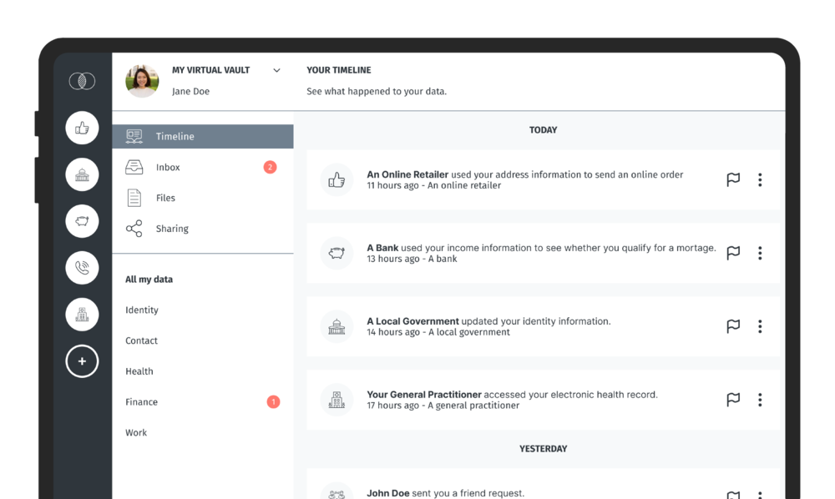
Example of data browser
Data browser in development by Digita.ai:

Slide 15
List of key SOLID related specifications
SOLID constrains HTTP with authentication and authorisation:
Authentication:
  WebID: URL that identifies an agent (person, organisation, app, device, etc.)
    Dereferenced WebID: document describing various details of the agent
  Solid-OIDC: OpenID-Connect based protocol to authenticate agent with given WebID
Authorisation:
  Web Access Control (WAC): access control list (ACL) mechanism
  Access Control Policy (ACP): policy-mechanisms to facilitate use of WAC

Slide 16
Solid protocol requirements
Support HTTP/1.1 protocol for client server interoperability based on existing:
  RFC7230 “Message Syntax and Routing”
  RFC7231 “Semantics and content”
  RFC7235 “Authentication”
SOLID server to provide storage:
  Has storage for hierarchical “containers”
  Container + metadata (type, modified, size)
Auxiliary resources:
  Web Access Control
  Description resource
SOLID actions (via HTTP/1.1) on resources:
  Create: PUT or PATCH
  Read: GET, HEAD, OPTIONS
  Write: PUT, POST, PATCH
  Modify: PATCH
  Delete: DELETE
Identity:
  Use WebID as identifier for persons, organisations or software
Authentication:
  SOLID-OIDC standard (based on OpenID)

Slide 17

WebID example
WebID
URL | Meaning
https://example.org/ | Identity provider
https://example.org/People/Robben/card | URI refers to document describing person
https://example.org/People/Robben/card#me | URI is identifier denoting the person
https://example.org/People/Robben/card#me
Denotes (refers to)
example.org
Denotes
(refers to)
</People/Robben/card>
Sense
(meaning)
<#me>
foaf:name “Frank Robben”
foaf:mbox frank.robben@smals.be
foaf:knows <https://gov.be/Vandenbroucke#>
cert:key [public key]
foaf:img
Describes
Source: https://www.w3.org/2005/Incubator/webid/spec/

Slide 18
Web access control (WAC)
Can enable applications to discover authorisations associated with a given resource
Similar to Linux file access control, but with WebIDs
.acl file per resource
  Advertised in “link rel” response
  Link: <http://example.org/Frank/.acl>; rel="acl"
  If payslip is a file (resource), only the full payslip can be shared
Authorisation
  acl:accessTo
  acl:mode
  acl:agent / acl:agentGroup / acl:agentClass
Access modes:
  Read
  Write
  Append
  Control
Agent classes:
  foaf:Agent
  acl:AuthenticatedAgent

Slide 19
POD and access control example
https:/​/frank.pod/ (container)
  .acl (RDF document for access control)
  people/ (container)
    .acl (RDF document for access control)
    paul.ttl (RDF document)
    johan.ttl (RDF document)
    …
  private/ (container)
    .acl (RDF document for access control)
    photos/ (container )
      2023-01/ (container)
        IMG_1.jpg (non-RDF document)
        IMG_2.jpg (non-RDF document)
        …
  …
https:/​/frank.pod/
.acl
people/
.acl
paul.ttl
johan.ttl
private/
photos/
.acl
IMG_1.jpg
IMG_2.jpg
Source: Ruben Dedecker, et al. “ What’s in a Pod?, https://github.com/SolidLabResearch/WhatsInAPod

Slide 20
Solid-OIDC specification
Solid-OIDC defines how resource server verifies:
  Identity of the relying party
  Identity of end users
Solid-OIDC uses authentication mechanism of an OpenID provider
Solid-OIDC extends OpenID Connect with:
  Resource and authorisation server that have no existing trust relationship with identity provider
  Ephemeral clients
WebID profile lists the OpenID Providers that can issue tokens on behalf of the agent who controls the WebID
Access token for use within SOLID only
Source: https://solid.github.io/solid-oidc/

Slide 21

Sharing of personal data
Main patterns

Slide 22
Personal data exchange patterns compatible with SOLID
Direct data exchange (preferred)
Direct with feedback
Source
Recipient
Source
Recipient
3. Share data
2. Share data
1. Ask access to data
2. Instruct source to share data with recipient
1. Ask for access to data Subject
Indirect data exchange
3. Inform about exchange
Source
Recipient
Subject
Subject
4. Share data
3. Share data
2. Ask for access to data
1. Ask for access to data Subject
Subject
Source: Dirk De Bot, Tom Haegemans, “Data Sharing Patterns as a Tool to Tackle Legal Considerations about Data Reuse with Solid: Theory and Applications in Europe”, http://go.digita.ai/reuse-patterns

Slide 23

Authentic sources
Direct data sharing with SOLID

Slide 24

Sharing authentic data
Original data source adds a SOLID compatible layer
Data subject can add viewers to the data but cannot modify the data
SOLID plug-in with ACL
3. Read data
Relying party
Existing authentic data storage
2. Give access
1. Request access
Citizen apps

Slide 25
Sharing authentic data with SOLID only (1/3)
Experiment done at Smals Research
Use of CommunitySolidServer
  https://github.com/CommunitySolidServer/CommunitySolidServer
  4 SOLID servers: http://solid1.smalsrech.be/, http://solid2.smalsrech.be/ etc.
Created 3 agents authenticated on 3 different SOLID servers
  First agent (e.g., KULeuven)
    Has full control on a file (e.g., a diploma) on its SOLID server
    Gives read access to a second agent
  Second agent (e.g., Frank)
    Can add other agents to the list of agents who can view the file
  Third agent (e.g., Smals)
    Can view file on first agent’s data store

Slide 26
Sharing authentic data with SOLID only (2/3)
POD of KULeuven
Resource content:
Masters of Law
1984
Group:
Smals
Resource name:
diploma.txt
viewers.ttl
ACL resource content:
ACL:
KULeuven: Read, Write, Control
Frank: Read
viewers:Group: Read
ACL:
KULeuven: Read, Write, Control
Frank: Read, Write
All: Read
ACL resource name:
diploma.txt.acl
readers.ttl.acl
Limitation of current implementation of CommunitySolidServer: list of allowed readers has to be public.

Slide 27
Sharing authentic data with SOLID only (3/3)
Experiment shows that it is technically possible to use solid as a “Sluis”:
  A SOLID layer can be added to an existing server containing authentic data
  A citizen can be granted permission to give read access to other agents
According to discussion with Raf Buyle (Information Architect, Digitaal Vlaanderen)
  Above-mentioned solution was the initial intention of Flanders
  However a legal argument based on GDPR was made
  This prompted Flanders to look at an alternative implementation using verifiable credential (see next slides)

Slide 28
Authentic sources
Indirect data sharing with SOLID and verifiable credentials
PoC from Flanders

Slide 29
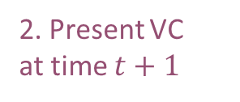
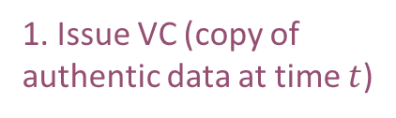
Sharing authentic data with verifiable credentials
Original data source delivers verifiable credential (VC) to citizen
Citizen keeps the VC in their SOLID POD or Digital Wallet
Requires additional infrastructure for VC verification (e.g., revocation)
Citizen POD
VC issuer
Relying party
1. Issue VC (copy of authentic data at time $t$)
2. Present VC
at time $t+1$
Existing authentic data storage
3. Verification of VC

Slide 30



Proof of concept in Flanders
Authentication and identity management (ACM/IDM) offered by “Vlaamse Overheid”
MAGDA platform
(VC issuer)
“Datanutsbedrijf”
(Citizen POD / Wallet)
(verifier)
1. Issue VC
2. Present VC
Verify identifiers and use schemas
Verifiable data register
(authentic source)
Verify identifiers and use schemas
Verify identifiers and schemas
Remarks
POD offered by “datanutsbedrijf”
Access via eIDAS authentication level “substantial”
WebID managed by ACM/IDM
ICON Project: “Selective disclosure” & “ZK proofs”
Private parties could provide data to POD in the form of VC
MAGDA – Gegevensdelingsplatform:
https://overheid.vlaanderen.be/informatie-vlaanderen/producten-diensten/gegevensdelingsplatform-magda
ACM/IDM: Toegangs- (ACM) en Gebruikersbeheer (IDM) van de Vlaamse overheid
https://www.vlaanderen.be/acm-idm-standaard-aansluitingsproces
Vlaams Datanutsbedrijf
https://www.vlaanderen.be/digitaal-vlaanderen/het-vlaams-datanutsbedrijf
Source: https://www.youtube.com/watch?v=jZIzLmnBB98 (16:25)

Slide 31
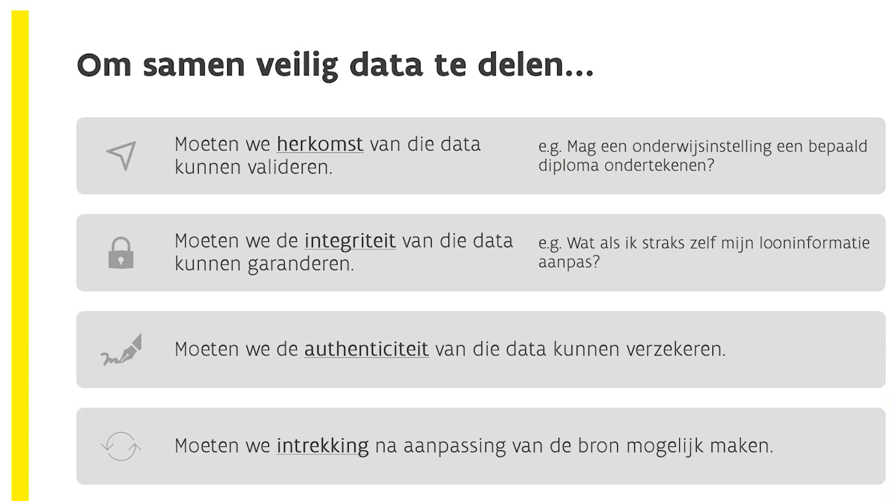
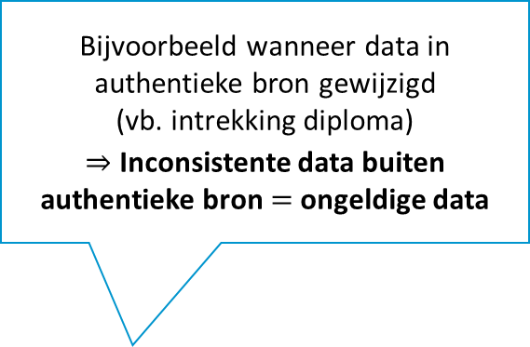
PoC Flanders – Diplomas
Bijvoorbeeld wanneer data in authentieke bron gewijzigd
(vb. intrekking diploma)
$⇒$ Inconsistente data buiten authentieke bron $=$ ongeldige data
Source: https://www.youtube.com/watch?v=jZIzLmnBB98 (16:25)

Slide 32
Verifiable credentials
Open standard for digital credentials
Can represent:
  Information found in physical credentials (e.g., passport, driving license)
  Things with no physical equivalent (e.g., ownership of a bank account)
Issuer
Issues VCs
Holder
Acquires, stores, presents VCs
Verifier
Verifies VCs
W3C standard [1]
Issue credentials
Send presentation
Verify identifiers and use schemas
Verify identifiers and use schemas
Verify identifiers and schemas
Verifiable Data Registry
Maintains identifiers and schemas
Source: https://www.w3.org/TR/vc-data-model/
[1] https://www.w3.org/TR/vc-data-model/
Notes:
Registry: schemas, revocation registries, issuer public keys, …

Slide 33
Verifiable credential example
  {
  "@context": [
  "https://www.w3.org/2018/credentials/v1",
  "https://www.w3.org/2018/credentials/examples/v1",
  "https://w3id.org/security/suites/ed25519-2020/v1"
  ],
  "id": "http://example.edu/credentials/3732",
  "type": [
  "VerifiableCredential",
  "UniversityDegreeCredential"
  ],
  "issuer": "https://example.edu/issuers/14",
  "issuanceDate": "2010-01-01T19:23:24Z",
  "credentialSubject": {
  "id": "did:example:ebfeb1f712ebc6f1c276e12ec21",
  "degree": {
  "type": "BachelorDegree",
  "name": "Bachelor of Science and Arts"
  }
  },
  "credentialStatus": {
  "id": "https://example.edu/status/24",
  "type": "CredentialStatusList2017"
  },
  "proof": {
  "type": "Ed25519Signature2020",
  "created": "2022-02-25T14:58:43Z",
  "verificationMethod": "https://example.edu/issuers/14#key-1",
  "proofPurpose": "assertionMethod",
  "proofValue": "z3BXsFfx1qJ5NsTkKqREjQ3AGh6RAmCwvgu1HcDSzK3P
  5QEg2TAw8ufktJBw8QkAQRciMGyBf5T2AHyRg2w13Uvhp"
  }
  }

