Slide 1
Visit of the European Labour Agency

Slide 2
About me (°1961)
education: law, ICT, ICT auditing, management, personal coaching
professional activities
  Crossroads Bank for Social Security
    1986-1991: originator as an advisor to the Minister of Social Affairs and the Prime Minister
    since 1991: CEO
  Data Protection Authority
    1991-2022: external member
  Federal Ministry of ICT
    2000-2001: originator as an advisor to the Minister of ICT (ao conception of electronic identity card)
  Smals (non for profit operational ICT association of public institutions of social security and health)
    since 2004: CEO (ao originator of G-Cloud initiative)
  eHealth platform
    2007-2008: originator as an advisor to the Minister of Public Health
    since 2008: CEO
    2020-2021: enterprise architect of Belgian information systems to fight the COVID-19 pandemic (testing, tracing, vaccination) and contributor to development of components on EU and WHO level

Slide 3
Proposal of agenda
optimal architecture of information systems and example
brief presentation of the Belgian Crossroads Bank for Social Security
ICT-based combating fraud in Belgium
overview EU digital programs and possible improvement
crossborder collaboration and data exchange for risk management
G-Cloud and reuse
visit of the data center

Slide 4
Optimal architecture of information systems and example

Slide 5
Service Oriented Architecture (SOA)
what ?
  “Service Oriented Architecture (SOA) is a paradigm for organizing and utilizing distributed capabilities that may be under the control of different ownership domains. It provides a uniform means to offer, discover, interact with and use capabilities to produce desired effects consistent with measurable preconditions and expectations. This style of architecture promotes reuse at the macro (service) level rather than micro levels (e.g. objects). It also makes interconnection of existing ICT assets trivial” (OASIS Reference Group)
characteristics
  service-oriented
  modular
  interoperable (based on open standards or open specifications)
  extensible
  layered
  based on reuse of components and data

Slide 6
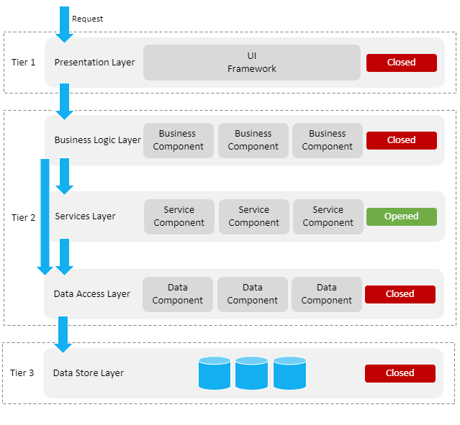
ICT: layered, service oriented architecture
presentation layer, e.g.
  web applications
  mobile applications
business logic layer, e.g.
  workflow
services layer, e.g.
  user & access management service
  communication service
  blockchain
data store layer, e.g.
  authentic sources
  personal vaults
  local storage on mobile device

Slide 7
ICT: across layers
interoperability standards
  technical: oa APIs (Application Programming Interface)
  semantic
security, e.g.
  access authorisation
  logging
  business continuity
configuration, e.g.
  capacity management
  load balancing

Slide 8
Principles for durable and economically viable ICT solutions
avoid duplication
  anything that is duplicated (if not strictly necessary)
  is a waste of time and money
  and will result in a lower quality of service
enable the right level of execution
  decisions and actions should be dealt with
  at the most immediate (or local) level that is consistent with their resolution
  to enable lean and cost effective operations

Slide 9
Example: identity, user and access management (IUAM) according to the international standard XACML

Slide 10
IUAM: objectives to be reached
be able to (electronically)
  identify all relevant entities (physical persons, companies, applications, machines, …)
  authenticate the identity of all entities
  know the relevant characteristics of the entities
  know the relevant relationships between entities
  know that an entity has been mandated by another entity to perform a legal action
  know the authorizations of the entities
in a sufficiently certain and secure way
in as much relations as possible (C2C, C2B, C2G, B2B, B2G, …)
multichannel (web application, mobile application, …)
using open interoperability standards

Slide 11
User expectations
one-time registration of identity, characteristics, relationships and mandates
possibility of auto registration/bootstrap and auto recovery of credentials once a top level authentication (e.g. eID) is available
single sign on for as many public and private sector applications as possible
  authentication of the identity
  verification of relevant characteristics, relationships and mandates
electronic means for authentication of identity that can be used on as much devices as possible
minimal cost of
  registration procedures
  electronic means for authentication of identity
  use of electronic means for authentication of identity

Slide 12
Critical success factors
meeting user expectations
simplicity in use
taking advantage of opportunities of technological evolution => evolutionary, future proof solutions
accordance with the European regulatory framework
sufficient applications for which electronic user management can be used

Slide 13
Policy Enforcement Model (XACML)
Action on application
DENIED
Policy
Enforcement
(PEP)
Action on application
PERMITTED
User
Application
Action on application
Decision
request
Decision
reply
Policy
Decision
(PDP)
Information
request/reply
Policy
retrieval
Information
request/reply
Policy management
Policy
Administration
(PAP)
Policy
Information
(PIP)
Policy
Information
(PIP)
Manager
Policy repository
Authentic source
Authentic source

Slide 14
Brief presentation of the
Belgian Crossroads Bank for Social Security

Slide 15
Stakeholders of the Belgian social sector
> 11,500,000 citizens
> 230,000 employers
about 3,000 public and private institutions (actors) at several levels (federal, regional, local) dealing with
  collection of social security contributions
  delivery of social security benefits
    child benefits
    unemployment benefits
    benefits in case of incapacity for work
    benefits for the disabled
    re-imbursement of health care costs
    holiday pay
    old age pensions
    guaranteed minimum income
  delivery of supplementary social benefits
  delivery of supplementary benefits based on the social security status of a person

Slide 16
What do citizens, employers and policy makers expect ?
effective policy execution
avoiding and combating fraud
appropriate policy support
integrated services across government levels and organisations of public interest
delivered at key life events (birth, going to school, starting to work, moving, illness, retirement, starting up a company…)
addressing citizens’ individual situation, personalized and user oriented
benefits as much as possible automatically granted according to a ‘happy flow’
minimal costs and minimal administrative burden for all parties involved
multichannel service delivery
self service
to be helped globally wherever they contact: no wrong door

Slide 17
What do citizens, employers and policy makers expect ?
social inclusion without a digital divide
reliable, secure and permanently available services with respect of the user’s privacy
transparency on use of personal data
legal certainty and legal rules that promote fair competition

Slide 18
Common vision on information management
information is being modelled
  in such a way that the model fits in as closely as possible with the real world
  in order to allow multifunctional use of information
information is collected from citizens and companies only once by the public sector as a whole
  via a channel chosen by the citizens and the companies
  preferably from application to application
  and with the possibility of quality control by the supplier before the transmission of the information
the collected information is validated once
  according to established task sharing criteria
  by the actor that is most entitled to it or by the actor which has the greatest interest in correctly validating it

Slide 19
Common vision on information management (ctd)
a task sharing model is established indicating which actor stores which information as an authentic source, manages the information and maintains it at the disposal of the authorized users
information can be flexibly assembled according to ever changing legal concepts
every actor has to report probable errors of information to the actor that is designated to validate the information
every actor that has to validate information according to the agreed task sharing model, has to examine the reported probable errors, to correct them when necessary and to communicate the correct information to every known interested actor
once collected and validated, information is stored, managed and exchanged electronically to avoid transcribing and re-entering it manually

Slide 20
Common vision on information management (ctd)
electronic information exchange can be initiated by
  the actor that disposes of information
  the actor that needs information
  the organisation that manages the interoperability framework
electronic information exchanges take place on the base of a functional and technical interoperability framework that evolves permanently but gradually according to open market standards, and is independent from the methods of information exchange
available information is used for
  the automatic granting of benefits
  prefilling when collecting information

Slide 21
Common vision on information security
security, availability, integrity and confidentiality of information is ensured by integrated structural, institutional, organizational, HR, technical and other security measures according to agreed policies
personal information is only used for purposes compatible with the purposes of the collection of the information
personal information is only accessible to authorized actors and users according to business needs, legislative or policy requirements
the access authorization to personal information is granted by an Information Security Committee, designated by Parliament, after having checked whether the access conditions are met
the access authorizations are public

Slide 22
Common vision on information security (ctd)
every actual electronic exchange of personal information has to pass an independent trusted third party and is preventively checked on compliance with the existing access authorizations by that trusted third party
every actual electronic exchange of personal information is logged, to be able to trace possible abuse afterwards
every time information is used to take a decision, the information used is communicated to the person concerned together with the decision
every person has right to access and correct his/her own personal data
every actor in the social sector disposes of an information security officer with an advisory, stimulating, documentary and control task

Slide 23




Crossroads Bank of Social Security (CBSS)
Public Interest Companies
INASTI
ONSS
SFP
AIS
SPP IS
SIGeDIS
Regions and Communities
SPF E&TO
ORINT
Cities Municipalities Public social welfare centres
ONEM
FEDRIS
CIN
ONVA
INAMI
SPF SS

Slide 24
Crossroads Bank of Social Security (CBSS)
Internet
R
FedMAN
Users
R
Isabel
FW
R
…
R
Backbone
FW
FW
FW
FW
FW
R
R
R
R
R
ONEM
CBSS
ONSS
R
R
CIN
…

Slide 25
Results
a network between all 3,000 social sector actors with a secure connection to the internet, the federal MAN, regional extranets, extranets between local authorities and the Belgian interbanking network
a unique identification key
  for every citizen
  for every company
  for every establishment of a company
an agreed division of tasks between the actors within and outside the social sector with regard to collection, validation and management of information and with regard to electronic storage of information in authentic sources => no central information storage

Slide 26
Results
220 electronic services for mutual information exchange amongst actors in the social sector, defined after process optimization
  nearly all direct or indirect (via citizens or companies) paper-based information exchange by > 800 paper forms between actors in the social sector has been abolished
  in 2022, > 1,93 billion electronic messages were exchanged amongst actors in the social sector, which saved as many paper exchanges
electronic services for citizens
  maximal automatic granting of benefits based on electronic information exchange between actors in the social sector
  25 electronic services via an integrated portal and/or mobile applications

Slide 27
Results
more than 50 electronic services for employers, either based on the electronic exchange of structured messages or via an integrated portal site
  50 social security declaration forms for employers have been abolished
  in the remaining 30 (electronic) declaration forms the number of headings has on average been reduced to a third of the previous number
  declarations are limited to 3 events
    immediate declaration of recruitment and discharge (only electronically) (DIMONA)
    quarterly declaration of salary and working time (only electronically) (DMFA)
    occurrence of a social risk (electronically or on paper)
  in 2022, more than 45 million electronic declarations were made by all 230,000 employers, 98 % of which from application to application

Slide 28








Quartely declaration salary & working time
simplification
Activity 3
Activity 2
Activity 1
employer
one electronic
declaration
ONSS
INAMI
ONEM
old age pension
SFP
Famifed
holiday pay
ONVA

Slide 29
Declaration of social risks
types of social risks
  child benefits
  incapacity for work ((labour) accident, (occupational) disease, …)
  unemployment
  old age pension
3 possible moments of declaration
  start of the social risk
  recurrence or continuation of the social risk
  end of the social risk
structure of the declaration
  identification data
  if necessary, salary and working time data not yet declared via a quarterly declaration (mini-declaration)
  specific data concerning the social risk

Slide 30
Results
an integrated portal site and mobile applications containing
  electronic transactions for citizens, employers and professionals
  simulation environments
  information about the entire social security system
  harmonized instructions and information model relating to all electronic transactions
  a personal page for each citizen, each company and each professional
an integrated multimodal contact centre supported by a customer relationship management tool
a data warehouse containing statistical information with regard to the labour market and all branches of social security

Slide 31
Distributed information servers
information servers
  directory of data subjects at the Crossroads Bank
  basic identification data of citizens at the National Register and the complementary Crossroads Bank Register
  basic identification data of companies at the Company Register
  employers directory (WGR) at the ONSS
  work force register at the ONSS
  salary and working time database at the ONSS
  database of contribution certificates
services offered
  interactive consultation
  batch consultation
  automatic communication of updates

Slide 32
Pre-processed messages
pre-processed messages
  beginning/end of labour contract, beginning/end of self-employed activity
  contribution certificates medical care (employees, self-employed, beneficiaries of social security allowances)
  unemployment benefits
  benefits in case of career break
  benefits in case of incapacity for work ((labour) accident, (occupational) disease)
  reimbursement of health care costs
  child benefits
  old age pensions
  holiday pay
  benefits for the disabled
  guaranteed minimum income – social welfare
  derived rights (e.g. tax reduction/exemption, free public transport, ...)
  migrant workers
  …
services offered
  interactive consultation
  batch consultation
  automatic communication of messages

Slide 33
Useful tool: the reference directory
reference directory
  directory of available services/information
    which information/services are available at any actor depending on the capacity in which a person/company is registered at each actor
  directory of authorized users and applications
    list of users and applications
    definition of authentication means and rules
    definition of authorization profiles: which kind of information/service can be accessed, in what situation and for what period of time depending on in which capacity the person/company is registered with the actor that accesses the information/service
  directory of data subjects
    which persons/companies have personal files at which actors for which periods of time, and in which capacity they are registered
  subscription table
    which users/applications want to automatically receive what information/services in which situations for which persons/companies in which capacity

Slide 34
Useful legislative changes
legal translation of
  the common vision on information management
  the common vision on information security and privacy protection
  the obligation to use unique identification keys
creation of a public institution (CBSS) that acts as a driving force
  mission and tasks
  governance
  financing principles
creation of a control committee on information security and privacy protection
probative value of electronic information storage and exchange
punishment of abuse of the system
gradually, coordination or harmonisation of basic legal concepts
gradually, adaptation of business processes set out in the law

Slide 35
Co-operative governance
Board of Directors
  consists of representatives of the stakeholders (employers associations, trade unions, social security institutions, …)
  approves the strategic, operational and financial plans of the CBSS
General Coordination Committee with representation of all users acts as debating platform for the elaboration and implementation of digitalisation initiatives within the sector
permanent or ad hoc working groups are instituted within the General Coordination Committee in order to co-ordinate the execution of programs and projects
the chairmen of the various working groups meet regularly as a Steering Committee
besides project planning and follow-up, proper measuring facilities are available to assure permanent monitoring and improvement after the implementation of the electronic services

Slide 36
Advantages
gains in efficiency
  in terms of cost: services are delivered at a lower total cost due to
    a unique information collection using a common information model and administrative instructions
    a lesser need to re-encoding of information by stimulating electronic information exchange
    a drastic reduction of the number of contacts between actors in the social sector on the one hand and companies or citizens on the other
    a functional task sharing concerning information management, information validation and application development
    a minimal administrative burden
  according to a study of the Belgian Planning Bureau, rationalization of the information exchange processes between the employers and the social sector implies an annual saving of administrative costs of about 1.7 billion € a year for the companies

Slide 37
Advantages
gains in efficiency
  in terms of quantity: more services are delivered
    services are available at any time, from anywhere and from several devices
    services are delivered in an integrated way according to the logic of the customer
  in terms of speed: the services are delivered in less time
    benefits can be allocated quicker because information is available faster
    waiting and travel time is reduced
    companies and citizens can directly interact with the competent actors in the social sector with real time feedback

Slide 38
Advantages
gains in effectiveness: better social protection
  in terms of quality: same services at same total cost in same time, but to a higher quality standard
  in terms of type of services: new types of services, e.g.
    push system: automated granting of benefits
    active search of non-take-up using data warehousing techniques
    controlled management of own personal information
    personalized simulation environments
better support of social policy
more efficient combating of fraud

Slide 39
ICT-based combating fraud in Belgium

Slide 40
Combating fraud
effects arising from implemented principles
  unique identification of every citizen and company
  it is impossible to enter in the reference directory one and the same person in the same capacity for the same period with several institutions belonging to the same branch of social security
  immediate, or even prior, declaration of the facts to the actors in the social sector (DIMONA/LIMOSA)
  use of the same information to calculate contributions and benefits
  access by actors granting rights to information on rights in other branches of social security (avoidance of unlawful accumulation of benefits)
  public access to information on companies' social security debts in the construction sector, coupled with joint and several liability for potential clients and a withholding obligation for clients of companies with social security debts
  …

Slide 41
Combating fraud
DOLSIS cooperation platform
  secure and task-related access to various basic information on companies and socially insured people, e.g.
    determine the list of persons employed by an employer
    determine whether the employer employs one or more foreigners
    check whether the employer is in compliance (e.g. entry into service of a worker in accordance with the validity period of the work permit)
  access strictly limited to certain employees of federal, regional and Community services responsible for various checks to combat fraud
  originally developed for the traditional inspection services and now used by more than 90 institutions

Slide 42
Combating fraud
My Digital Inspection Assistant (MyDIA): mobile application for inspection services to consult identification data, fed by
  the national register and the CBSS registers
  the personnel register
  unemployment data
  salary data
  the database of self-employed persons
  attendance registers (Checkin@Work)
  the compulsory and prior declaration of works
  the LIMOSA register
  the directory of employers
  the Crossroads Bank of Enterprises (CBE)
  FPS Mobility (number plates)

Slide 43
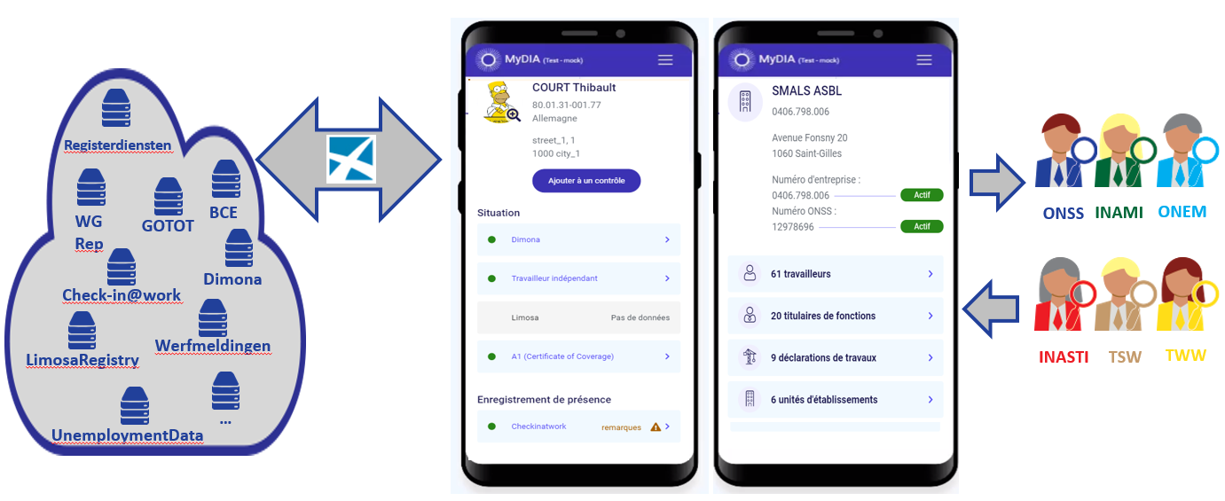
Combating fraud
My Digital Inspection Assistant (MyDIA)
  offers a web-based FieldInpectionService to share metadata with other inspectors in relation to an inspection performed
  integration with the professional eBox

Slide 44
Combating fraud
ePV cooperation platform
  allows you to complete, item by item, an official report (PV)
  offers a series of drop-down lists and references to facilitate the drafting of the PV
  uses authentic data sources (e.g. national register, company register to guarantee data quality and facilitate the drafting)
  performs a check to ensure the completeness of the report
  allows the addition of annexes
  manages the electronic signature
  guarantees the date of signature by means of a timestamp

Slide 45



ePV
Offender
Auditors, prosecutors, judges
Administrative fines officers
Batch
From_gin
Ginaa
ePV
Batch
To_Institutions
ePV
BCSS
WS Report Associated Document
HFS
Dolsis
IRIS
ALC
Inspection services: inspectors, chief inspectors, secretaries

Slide 46
Combating fraud
eDossier
  implementation of an integrated platform for managing the entire life cycle of an electronic official report (ePV)
  actors and processes
    inspection services within and outside the social sector for the introduction of electronic minutes (ePV)
    FPS Justice - auditorates regarding the decision whether or not to prosecute on the occasion of an official report (eDecision)
    FPS Employment - Administrative fines and regional services regarding the decision whether or not to impose an administrative fine (eAvis)
    police for management of the pro justitia
    notifications between actors
    eViewer allows to consult a file and all its annexes
    integration into the eBox

Slide 47
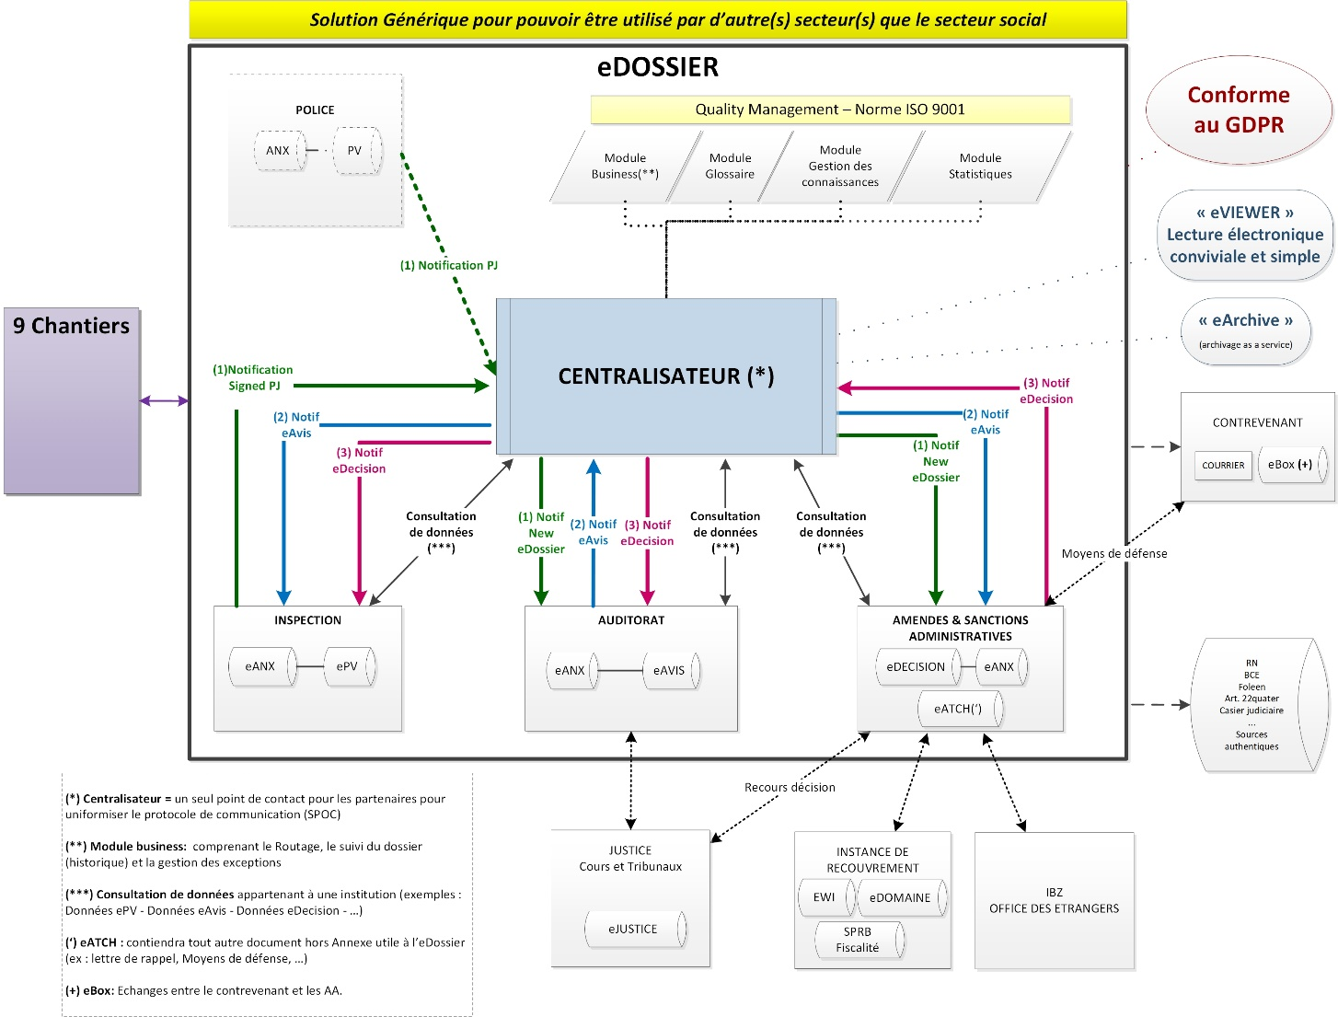

Slide 48
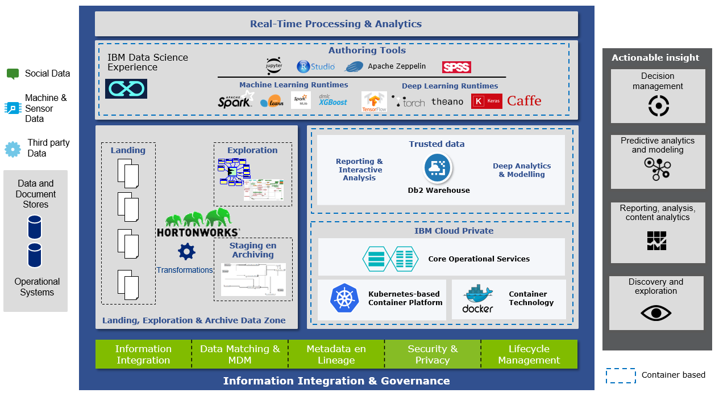



Combating fraud
collaboration platform for datamining
IBM Watson
Studio

Slide 49
Datamining: OASIS
fraud hidden
in mass
information
possible fraud
highlighted by
analysis
cases to be treated and
explanation
decisions on actions
immediate instruction
administrative review
Nr
Score
communication to regional service
X
993
Y
945
new periodic review
Z
674
…
…
no specific action
Identification
Action
Management

Slide 50
Datamining: OASIS
examples of OASIS indicators
  number of days assimilated due to illness, accident or career break >> sector average
  high number of days assimilated due to economic unemployment and unemployment due to bad weather in combination with the hiring of new workers during the same period
  days assimilated due to economic unemployment and bad weather are not the same as the days actually reimbursed by the ONEm
  number of days assimilated due to economic unemployment or bad weather or compensation days / number of working days >> sector average
  massive hiring of workers during a short period
  increase in turnover but reduction in the number of workers
  number of staff cancellations reported during the quarter above a certain threshold

Slide 51
Datamining: OASIS
examples of OASIS indicators
  turnover/number of workers >> sector average over the quarter
  turnover (number of new and departing workers) >> sector average
  large difference between a quarterly wage and working time declaration and the latest version
    variation in total wage bill > ceiling
    variation in the number of workers > minimum number

Slide 52
Datamining: process analysis
Iterative
« learning
by doing »
FEEDBACK
Actions on the field
Visualisation of the analysis
Prediction list
Visualisation
Understanding the business !
Motor
Analysis of the model
d1
d1
d1
d1
F?
Algorithm PA
Model
Predict
Prediction
Analysis of the databases
Datasets
Transformation
d1
d1
d1
d1
F?
limosa
dimona
…
Business analysis (with business experts, collaboration with partners and data exchange)

Slide 53
Datamining: priority areas
#1
#2
#3
Contributions fraud
Fail carousels
Legal infractions
Social benefits fraud
Ex. social kits
(ficticious employment)
Crossborder fraud
Ex. social dumping

Slide 54


Spider star constructions
Database X
Organisateurs
bankruptcy
Visualisation of the analysis
Employer 1
Analysis of the model
Analysis of the databases
Database Y
Employer 2
Business analysis
Employer 3
bankruptcy

Slide 55
Databases
Network modelling
Local variables
E.g. size, sector
Visualisation of the analysis
Direct network attributes
Indirect network attributes
Analysis of the model
Relations between different actors
Influence of the whole network
Analysis of the databases
Business analysis
Risk rating

Slide 56



Social kits
(Fictitious) company
…
ONSS
DMFA
Dimona
Payment from 500 to 2000 euros
IPSS
Visualisation of the analysis
Analysis of the model
Workers
(fictitious benefits)
Abusive rights (social, economic,...)
Analysis of the databases
Business analysis

Slide 57
Database X
Database Y
Database Z
Data-preprocessing
Payment fraud model
Sudden change in behaviour
Visualisation of the analysis
Network
info
Start of
lifecycle
Parameter
change
Consecutive events
Analysis of the model
Analysis of the databases
Modelling
Business analysis
Risk rating

Slide 58
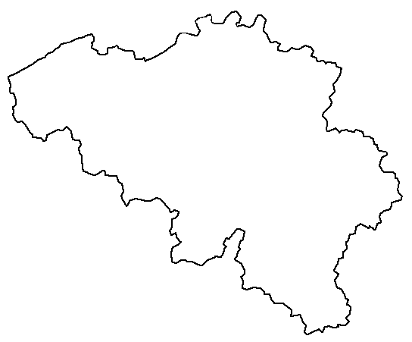
Social dumping – scenario 1
Employer
(Foreign) workers
Visualisation of the analysis
Ex-employer
Employeur
Analysis of the model
User
May be the same
Analysis of the databases
Business analysis
Dimona
Limosa

Slide 59
Social dumping – scenario 2
Main subcontracting chain analysis
Main contractor
Subcontractor
Subcontractor
Visualisation of the analysis
Subcontractor
Analysis of the model
Subcontractor
Subcontractor
Analysis of the databases
Subsequent modelling of
risk based on :
- Attendance record
- Repeat offenders, network
- Temporary unemployment
- Field feedback, input of sectors & specialists
Subcontractor
Business analysis

Slide 60
Scenario 2 - structure of the subcontracting chain
Main contractor
Subcontractors
Depth &
structure
@
Foreign subcontractor clusters deep in the chain
@’Cluster organiser':
+Temporary unemployment (1° POC DmfA, 2° ONEm...)

Slide 61
Social dumping : scenario 3
Complaints
Findings Social Inspection & CLS
Dimona
X
Limosa
X
Declarations of work
X
X
Fuzzy Matching
Datamatching
Data quality
issues!
Workers, employers,
active & risky workplaces
Successors of known/recidivist fraudsters are detected
Prioritisation
The type of target address can be:
workplace, home, registered office address
address (Be, Eu)
List of addresses at risk (by region)

Slide 62
Organisation
Analysis
Control
Signals
Inspection platform
(Dolsis)
SIRS
(Service d’Information et de Recherche Sociale)
Signal selection
Feedback
Debriefing
Inspection cells in the field

Slide 63
Datamining: results
>1d for complex network
320d
6 CC
1d
1Q
faster
Double
complexity
Numerous performance gains
228d
3 CC
1h
Speed
Complexity
Efficiency
« Thanks to the analyses, we find the cases 1 quarter earlier compared to manual detection »
« Thanks to the analyses, we find twice as many complex cases with less effort »
« Thanks to analysis and visualization, networks can be mapped more quickly »

Slide 64











Datamining tools
Graph DB (NoSQL)
Visualisation
g= Graph(nodes, edges);
g.add_node(x);
p=g.shortest_path(a, b);
Development

Slide 65
Data analytics & network analytics
Data analytics :
outlier detection
Network analytics :
detection of structures/patterns

Slide 66
Use case: superbonus
with TaxShift (2016), benefits are given to new employers
many existing employers are recreating themselves to take advantage of these benefits
“network analytics” can identify most of these cases

Slide 67
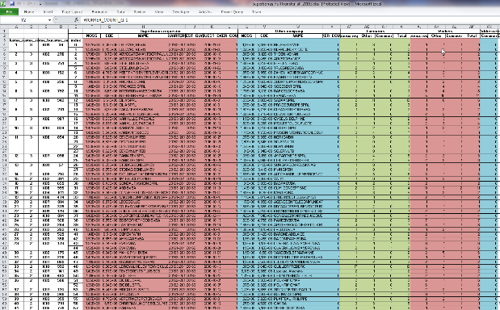

Use case: superbonus
Dimona
W
W
Em
W
SB
DmfA
W
A
Ex
KBO
W
Worker
Em
Employer without Superbonus
SB
Employer with Superbonus
A
Address
Ex
Executor

Slide 68
Table vs visualisation
SB req. | Other | Common workers
 |  | 5
 |  | 4
 |  | 4
One table …
two schemes
A
W
B
A
B
A
C
W
C
D
W
C
D
W
W
W
W
W
W
B
W
A
W
C
W
D
W
W
W
W
W
W
W
Worker

Slide 69
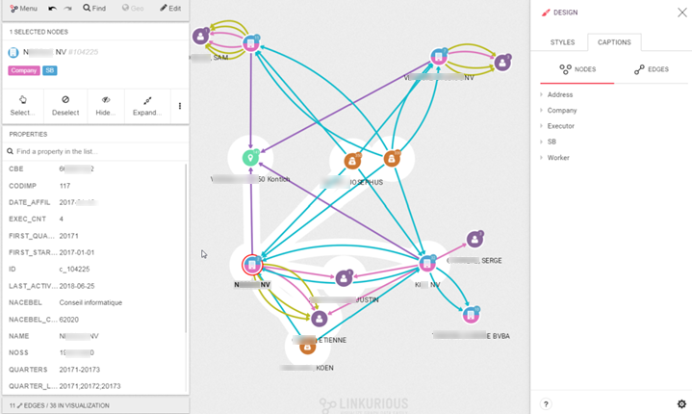
Linkurious
graph database visualisation tool
usable by end users

Slide 70
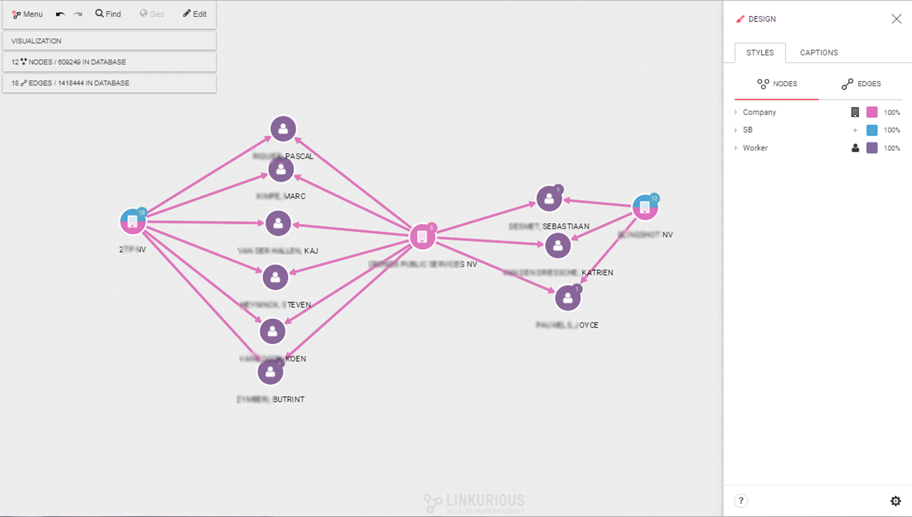

Slide 71
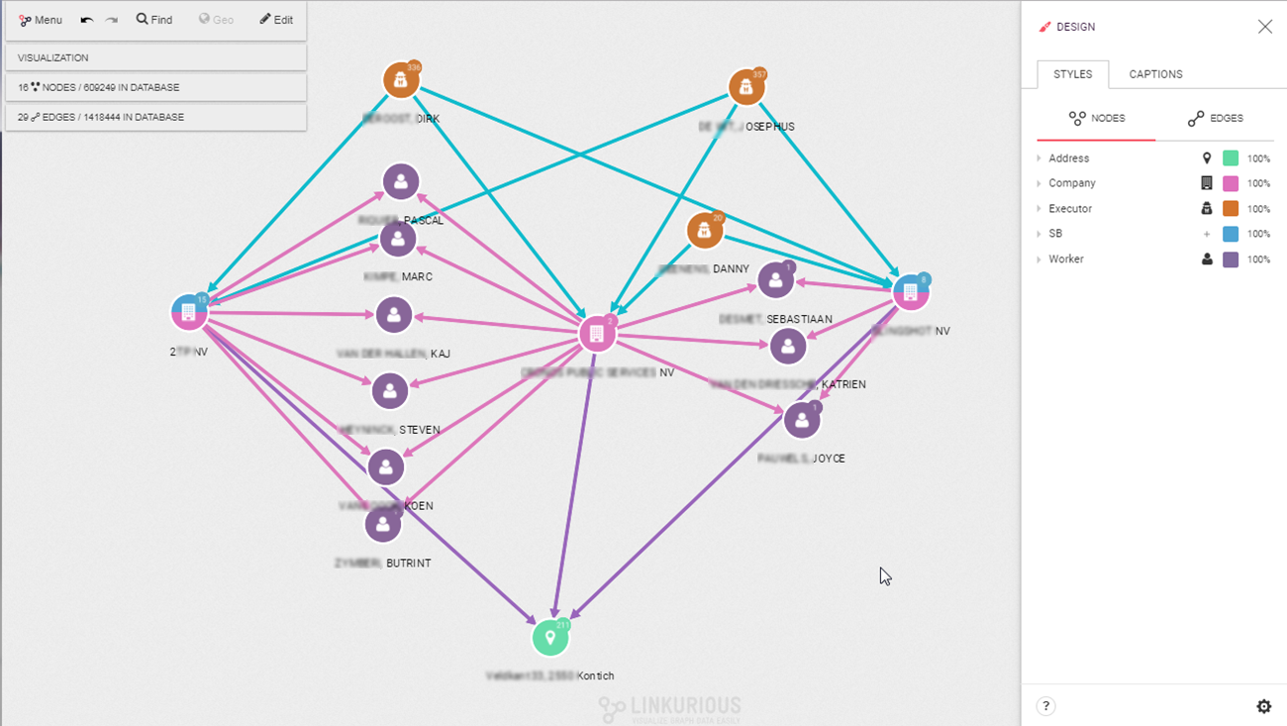
Notes:
S’il avait fallu utiliser des techniques classique : quasi impossible
Workers, puis admins/Adresses

Slide 72
Combating fraud
webscraping (proof of concept)
  technique of extracting content from websites, by means of scripts/programs, with the aim of using it in another context
  web crawling/scraping/harvesting
  without access to dedicated APIs (cf. Twitter, Facebook, RSS feeds...)
  in order to discover undeclared activities, for which traces could be found on classifieds sites (complementary activity, collaborative economy, ...)
non-sensitive
  identify the sectors for which there are the most requests/offers for "small jobs
  study the "parallel" pharmaceutical market (darkweb)
sensitive
  on 2ememain.fr, eBay... detect professional sellers
  on Airbnb, detect professional hosts

Slide 73
Overview EU digital programs and possible improvement

Slide 74
Several EC digital programs
Electronic Identification and Trust Services (eIDAS)
European Blockchain Services Infrastructure (EBSI)
  Conformant Wallets
  Verifiable Credentials Playbook
Single Digital Gateway (OOTS)
Electronic Exchange of Social Security Information (EESSI)
European Social Security Pass (ESSPass)
EU Digital COVID Certificate (EU DCC)
European Health Data Space (EHDS)
European Health Data Evidence Network (EHDEN)
Digital Credentials for Europe (DC4EU) Consortium
EU Digital Identity Wallet Consortium
...

Slide 75
Need for a global, integrated architecture
need for
  global, integrated architecture across DGs of the European Commission
  based on a common conceptual framework
need for modular, generic, domain agnostic, interoperable and reusable components/services: develop once, use many
no technology driven choice of components and services used, but use of ICT components and services as enabler and means for meeting business requirements
need for the organisation of a set of integrated services on a paneuropean level

Slide 76
Example: digital wallet (e.g. for eEHIC)

Slide 77
Existing components
every MS has a responsive web application and/or native mobile app for downloading electronic COVID-19 vaccination, test and recovery certificates according to common EU standards
  see https://health.ec.europa.eu/ehealth-digital-health-and-care/ehealth-and-covid-19_en for the detailed specifications and the legal framework)
every electronic certificate is a structured electronic document
  based on a common JSON (JavaScript Object Notation) description
  that contains a QR-code with the content of the electronic certificate
  the QR-code is electronically signed by the issuer
the European Commission manages a database containing the public signature keys of the issuers of the electronic certificates
every MS has a responsive web application and/or native mobile app that is/are able
    to scan the QR-code
    to check the validity of the QR-code
    to send the content of the electronic certificates to other applications via an API

Slide 78
E.g.: possible reuse for eEHIC
definition of a common JSON description for the eEHIC
every MS capitalizes on the responsive web application and/or native mobile app used for the COVID-19 certificates, by which a citizen
  can download an eEHIC
  after authentication of its identity based on an electronic authentication means of eIDAS level ‘high’ and
  locally store and/or print the eEHIC
advantages
  immediate possibility to obtain an eEHIC online
  with the same content as the (actual) EHIC
  anywhere and anytime
  that can be electronically authenticated and read by
    the holder
    every health care provider throughout the EU

Slide 79
Implementation: open method of coordination (OMC)
a form of intergovernmental policy-making that does not result in binding EU legislative measures and it does not require EU countries to introduce or amend their laws
framework for cooperation between the EU countries, whose national policies can thus be directed towards certain common objectives
EU countries are evaluated by one another (peer pressure), with the EC's role being limited to surveillance; the European Parliament and the Court of Justice play virtually no part in the OMC process
OMC is principally based on
  jointly identifying and defining objectives to be achieved (adopted by the Council);
  jointly established measuring instruments (statistics, indicators, guidelines)
  benchmarking, i.e. comparison of EU countries' performance and the exchange of best practices (monitored by the EC)
.

Slide 80
Crossborder collaboration and data exchange for risk management

Slide 81
Risk management
what risks ?
  people do not get (proper) social rights
  people do not pay (correct) contributions
aspects of risk management
  prevention of risks
  detection (assessment) of risks
  organising and taking appropriate actions
number of critical success factors for efficient and effective risk assessment & risk management

Slide 82
Critical success factors
unambiguous identification, across all countries, of all entities
  natural persons
  companies and organisations
  places of employment
  …
availability, across countries, of some factual data
  technically and semantically interoperable
  respecting basic data protection principles
    purpose limitation
    proportionality
  type of information
    characteristics of entities (e.g. date of birth, place of residence, …)
    relationships between entities (e.g. employer, place of employment, …) and characteristics of these relationships (e.g. start & end date, …)
    mandates

Slide 83
Critical success factors
possibility to authenticate the several types of information
usefulness of a trusted third party (TTP) for organising the interconnection of information in compliance with the data protection regulations
multiple ways of transporting information
  initiative of
    the institution that disposes of information (push) or
    the institution that needs information (pull)
    the TTP
  synchronous and/or asynchronous
  on line (e.g. databases) and/or off line (e.g. electronically signed certificates in a digital wallet of the holder (e.g. EU DCC certificates))
  application to application (APIs) or web applications

Slide 84
Critical success factors
common architecture and basic components/services on EU level (e.g. user and access management (XACML))
internal national organisation of social sector should not be deemed to be known by institutions abroad => need for single point of contact (SPOC) per country
probably need for certain information available at EU level (e.g. data on transnational corporations)

Slide 85
G-Cloud and reuse

Slide 86



Different types of G-Cloud & reuse
infrastructure
  hard infrastructure
  soft infrastructure
  platforms
common vendor contracts
federal ICT community
business
  knowledge & experiences
  business functionality
  business data
  complete business services
https://www.gcloud.belgium.be/
Important to know what already exists
→ catalogues!
https://reuse.smals.be/

Slide 87






Cloud deployment types
Hybrid
Public Cloud
Shared
Access/Control
Outsourced Community Cloud (= off-premise)
Community Cloud on-premise
Private Cloud on-premise
Outsourced Private Cloud (= off-premise)
Dedicated
Location
Customer
Service Provider

Slide 88




G-Cloud ‘products’
Procurement
Cooperationá
Efficiencyá
Projects
Synergy
Services
Costsâ
Qualityá
Know-how & Expertise

Slide 89



Why G-Cloud?
Creation of economies of scale: efficiency and high quality/availability
Respect of confidentiality and data protection
Bigger focus on business applications and flexibility in order to realize them

Slide 90

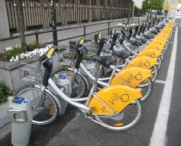

Why G-Cloud?
Greater weight
during negotiations with suppliers
Pooling of knowledge and resources
Technological evolution faster available for everyone

Slide 91
G-Cloud portfolio

Slide 92

Shifting focus
towards synergies in the area of business components
Business components
Stronger centrally coordinated approach to offering platforms

Slide 93
About the reuse initiative
initiative within the public social security institutions & Smals
purpose
  synergy around (technical) business components
  and thus save costs by avoiding multiple development of components
regardless of whether development takes place by
  the institution's own ICT department
  Smals
  subcontractors
a competence center within Smals aims to maximally integrate and support the reuse of business components within Smals, its members, partners and domains in which Smals is active
93

Slide 94

ReUse – Vision
Every stakeholder
can easily find the most common reusable elements in a centralized catalogue
Processes
and tools are put in place to identify, register, implement, monitor and measure reuse throughout the project lifecycle
Human
networks are maintained and developed on all levels (CEO’s, CIO’s, business owners, business analysts, architects) in order to keep maximum visibility on reuse potential
A culture
develops where
reuse is adopted and the creation of reusable products is promoted,
94

Slide 95



frank.robben@mail.fgov.be
@FrRobben
https://www.frankrobben.be
https://www.ksz.fgov.be
https://www.ehealth.fgov.be

