Slide 1
and beyond

Slide 2
Agenda
Context
G-Cloud …
  what & why
  organization and service model
  portfolio
  impact
… and beyond
  some ICT-trends rising and their impact on G-Cloud
  API economy
  re-use of business components

Slide 3


Slide 4
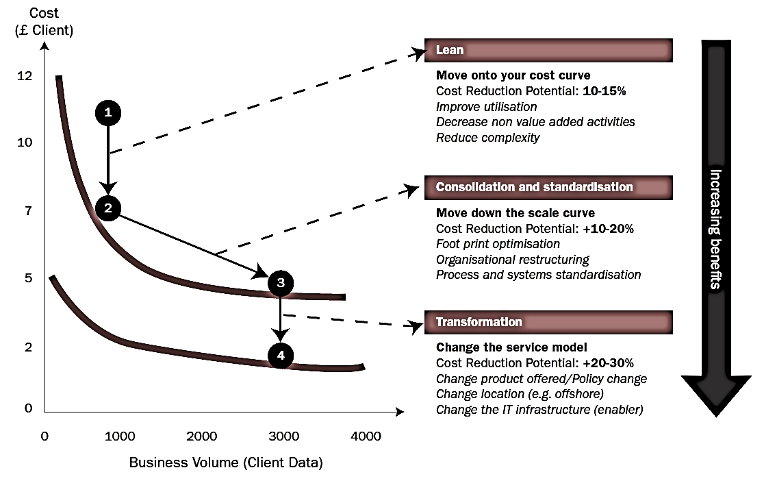
Synergies - transformations
Bron: Booz Allen Hamilton

Slide 5
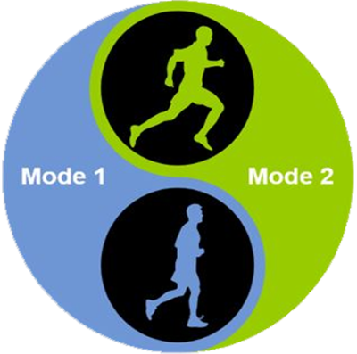
Trends
Sprint
Agility
User centricity
Continuous changes
New / uncertainties
Short cycles
Marathon
Reliability
Price / performance
Planning
Standard processes
Long cycles

Slide 6
Trends
Sprint
Marathon
Need to do both

Slide 7
What is “cloud” ?
On Demand
Broad network access
Resource pooling
Measured service
Rapid elasticity
Source: National Institute for Standards and Technology, USA

Slide 8
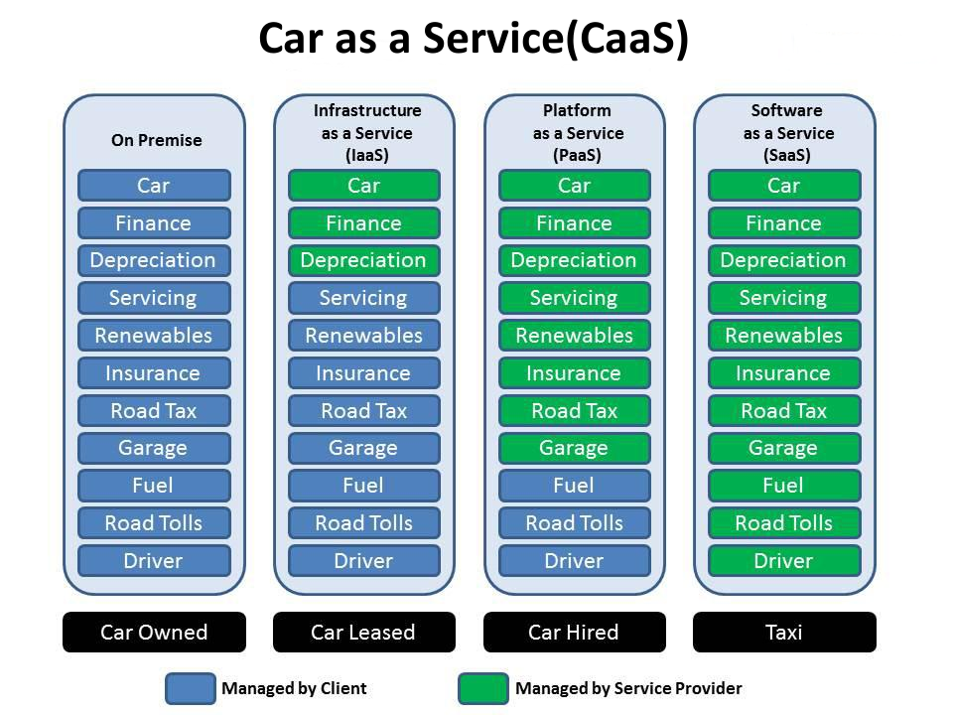

Slide 9
As a service : major characteristics
Self-service: industrialised & automated
Available: immediate availability
Extensible/elastic: scale up or down
Shared: multiple users for scale effects
Use based invoicing: based on real use of resources
Low entry barrier: complexity is hidden for user
Incremental service changes

Slide 10
Cloud Service Models
IaaS
Infrastructure as a Service
PaaS
SaaS
Basic IT infrastructure components (e.g. Amazon virtual machines)
Platform as a Service
Platforms to build applications
Software as a Service
Full applications (e.g. O365, Google Apps, ...)

Slide 11

Virtualisation
Consolidation of physical resources
> 70% “easy consolidation”
First step to Cloud (“dematerialisation”)

Slide 12








Cloud deployment types
Hybrid
Public Cloud
Shared
Access/Control
Outsourced Community Cloud (= off-premise)
Community Cloud on-premise
Private Cloud on-premise
Outsourced Private Cloud (= off-premise)
Dedicated
Location
Customer
Service Provider

Slide 13

Dem Zielbild im Schwerpunktthema Digitale Infrastruktur liegen drei
Säulen für die erfolgreiche föderale Multi-Cloud-Transformation zugrunde
Transformationspfad
Deutsche Verwaltungscloud-Welt
Säule 1:
Hyperscaler-Umgebung
Säule 2:
DVS
Säule 3:
Bestehende IT-Systeme
Transformation durch sukzessive Reduktion existierender Systeme
Rollen- und Aufgabenverlagerung der öffentl. IT-DL mit Fokus auf Cloud-Integration und strategisch-fachlicher Steuerung
Standard-Software
(z.B. SAP / ERP, MS-Office)
Zentraler [Intermediär] für
Bund, Länder und Kommunen
mit einem Marktakteur
1. Bereitstellung von Diensten nach gemeinsamen Kriterien der DVS
2. Gemeinsame Infrastruktur für Dienste und IT-Vorhaben
Bund, Länder und Kommunen mit zu definierenden Sourcing-Modellen
Nicht migrierfähige bestehende Dienste
Bund, Länder und Kommunen mit ihren jeweiligen IT-Dienstleistern
Fokus
Akteure

Slide 14





What is G-Cloud ?
A program including synergy projects
Synergy for existing as well as new services
For public services
Managed by public services
In cooperation with the private sector

Slide 15
What is G-Cloud ?
Shared public ICT platform
  current target: federal state (FPS, PPS, public institutions of social security, institutions of public benefit)
  can be extended to other interested authorities
Hybrid community cloud model
  use of public cloud if possible
  private community cloud hosted in data centres, managed by the government
  operational implementation with strong involvement of the private sector

Slide 16
Public Cloud vs Community Cloud on premise
Active ‘Community Cloud on premise synergies first’ policy
  comply or explain approach
No ‘Public Cloud first’ policy
  rational approach (smart choices) based on a risk evaluation considering data sovereignty, data residence, EU/BE law, business continuity, vendor lock in, pricing guarantees, …
Hybrid cloud approach
    combination of on premise traditional/cloud services and public cloud services
    choices are made based on the context and roadmap of each government agency
    focus on the ‘value proposition’ (business benefit/capability/value) we aim to realize
G-Cloud shared procurement

Slide 17
Public Cloud use: current situation
Public Cloud services already in use
  workplace services
    chat, mail, videoconferencing, newsletters, translation services, contact enter services, …
  datacenter Services (minimal footprint, mainly for non-critical business applications)
    website hosting, DDOS protection services, IT Service Management tool, DNS, …
Task Force active on the G-Cloud level
  to work on a global policy & strategy
  transversal collaboration between DPO’s and IT managers of different government agencies
  sovereign cloud initiatives and confidential compute are considered
  several proof-of-concepts and pilots are ongoing

Slide 18
Basic principles
Maximum synergy when possible and when generating efficiency gains and/or savings while maintaining or improving the quality of the services provided to the customer
In line with the synergy program: assignment to the one who is the most capable of proposing a form of shared services
Synergy based on result orientation, sense of responsibility and trust

Slide 19




G-Cloud ‘products’
Procurement
Cooperationá
Efficiencyá
Projects
Synergy
Services
Costsâ
Qualityá
Know-how & Expertise

Slide 20
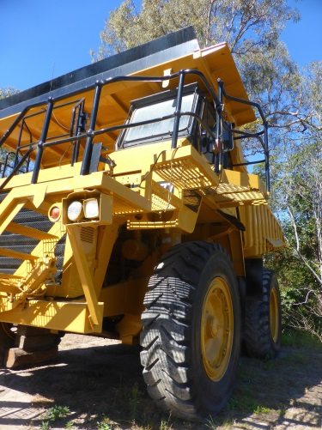


Why G-Cloud?
Creation of economies of scale: efficiency and high quality/availability
Respect of confidentiality and data protection
Bigger focus on business applications and flexibility in order to realize them

Slide 21

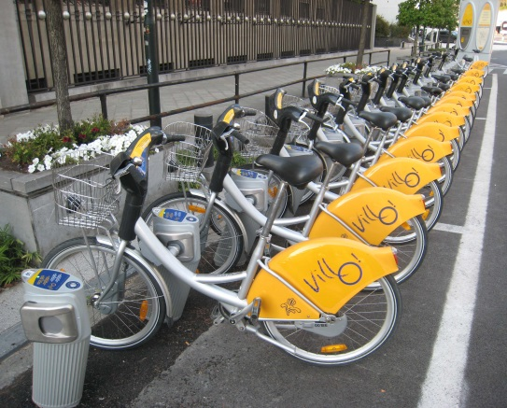

Why G-Cloud?
Greater weight
during negotiations with suppliers
Pooling of knowledge and resources
Technological evolution faster available for everyone

Slide 22
G-Cloud organization
Government
G-Cloud Operations & Program Board
G-Cloud Strategic Board
FPS/PPS
(Horizontal FPS, SPF FIN, Belnet, …)
PIOSS/IPB
(CBSS, ...)
Association of FPS/PPS/IPB
Private ICT companies directed by FPS/PIOSS/...
3 Colleges
FPS
Public Institutions of Social Security (PIOSS)
Institutions of Public Benefit (IPB)
SIT: ICT managers from
FPS
Public Institutions of Social Security
Institutions of Public Benefit
Service
owners

Slide 23


G-Cloud organization
G-Cloud Strategic Board: strategic direction by senior officials
G-Cloud Operations & Program Board:
CIOs for operational direction

Slide 24
G-Cloud service model
G-Cloud = coalition
G-Cloud ≠ central organization
G-Cloud service
Offered by
Service owner
Delivered by
Service provider
Governance

Slide 25
G-Cloud service model
Service Owner
  organization responsible for the service
  develops the service and its further evolution
  provides SLA, financial model, support model...
  “contract” with clients
Service Provider
  “contract” with Service Owner
  provides the service as agreed upon in the specifications/SLA
Sometimes: Service Owner = Service Provider

Slide 26
G-Cloud P&O
3500 IT professionals in the federal government
War for talent & reversed age pyramid
Cooperation model across institutional boundaries

Slide 27
Opportunities and challenges
Challenges
Security
Confidentiality
Continuity
Strategic management
Opportunities
Cost management
Cooperation
Self-service
Economies of scale
Flexibility
Quality
Know-how

Slide 28

G-Cloud success factors
Efficiency
Adequate security measures (risk↘)
Optimal cooperation and trust between the institutions
Differentiation of the offer: neither ‘one size fits all’ nor tailor-made work
Capacity management
A phased approach, no ‘big bang’
Quality of service: respect of SLAs

Slide 29
G-Cloud portfolio

Slide 30
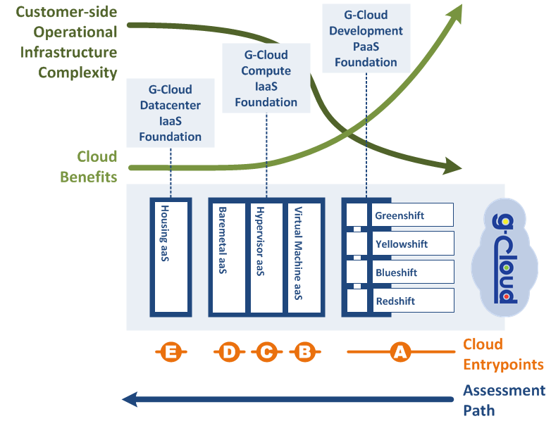
Possible entrypoints

Slide 31
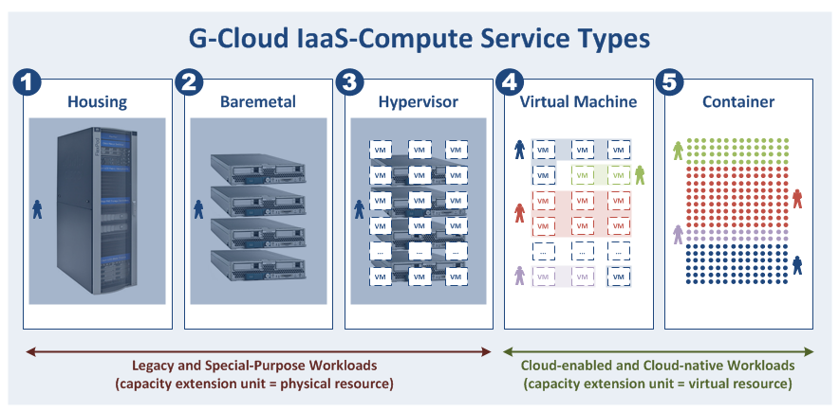
Compute types versus workloads
Users here typically want more control over the lower layers of the technology stack (servers, network appliances, hypervisor, OS, ...)

Slide 32
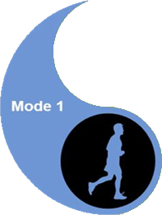

Compute types versus workloads

Slide 33
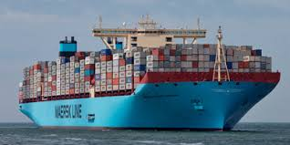
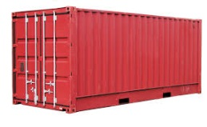
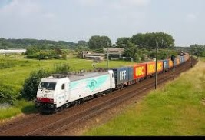
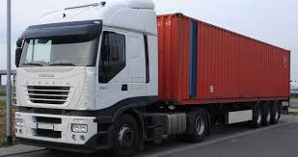






PaaS in G-Cloud - Containers
Introducing container technology
Translated into modern technology such as Platform-as-a-Service
Individual content
Isolated storage
Easy to move around
Geïsoleerd opgeslagen
En makkelijk verplaatsbaar
Monitoring
Security
Logging
Coming
soon

Slide 34
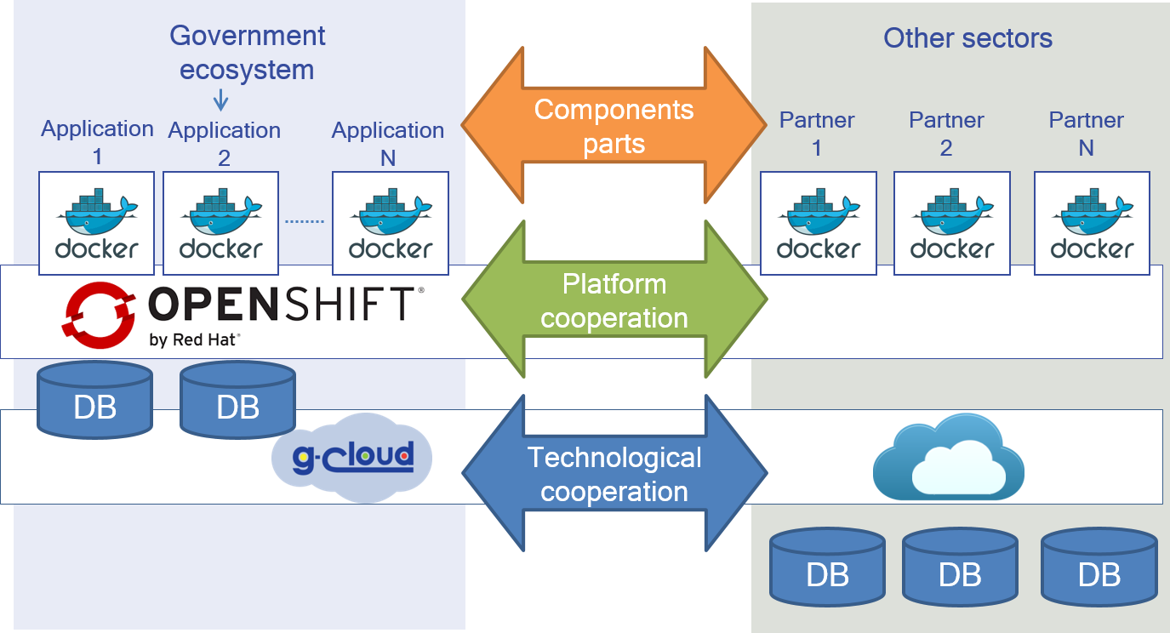
New ways of cooperation

Slide 35
G-Cloud and the private sector
G-Cloud ≠ ICT insourcing
Public procurement
translation tool, converged infrastructure, unified communications, network security, storage, back-up, ...
In consultation with the sector for several specific platforms
IBM, Microsoft, Oracle, RedHat, SAS, ...

Slide 36
G-Cloud impact - examples
Centralized license negotiations with Microsoft & standardization initiative : obtain additional discounts on O365 licenses (-10%)
Economies of scale => decreasing cost price G-Cloud services: compute -12%, storage -40% in 9 months’ time
Inventory of “procurement centres” (Dutch: opdrachtencentrales) ➔ large-scale reuse of “procurement centres”

Slide 37
G-Cloud impact - examples
Unified Communications as a Service (UCaaS)
  local examples: NWOW, better/faster communication between employees
  global advantages: standardization, better communication between public services
Communities / knowledge sharing
  knowledge exchange through SIT
  mixed O365 team
  Sharepoint online / BeConnected as supporting platform
  group for the management of work stations / Windows 10 migration
  “user groups” for G-Cloud services
    Sharepoint, Greenshift, VMaaS
  translators community (Babelfed)

Slide 38
G-Cloud impact - shared procurement
Cooperation regarding the public procurements
  juridical: central procurement agency clause
  know-how: specialized in ICT purchases
  simplicity: less administrative work for the private sector and the state
  possibility to accelerate the purchases and to avoid double specifications procedures
  price reductions thanks to the volume
Software licences
  negotiations with the providers
  mutual exchange of unused licences

Slide 39
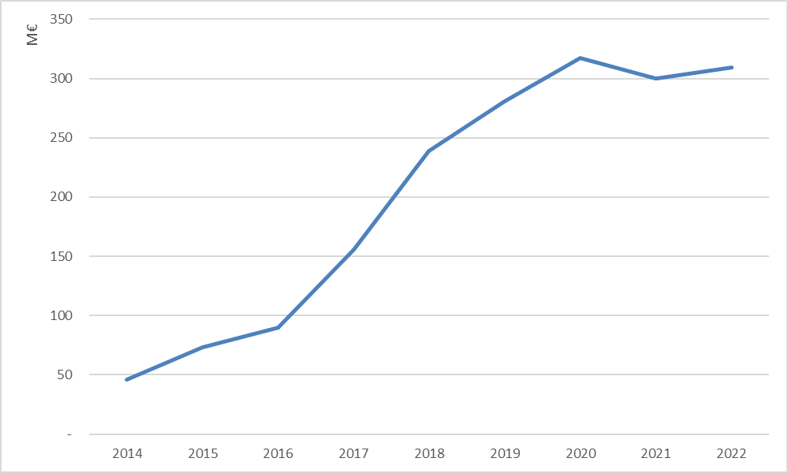
G-Cloud impact - reuse of contracts
Source: Smals

Slide 40
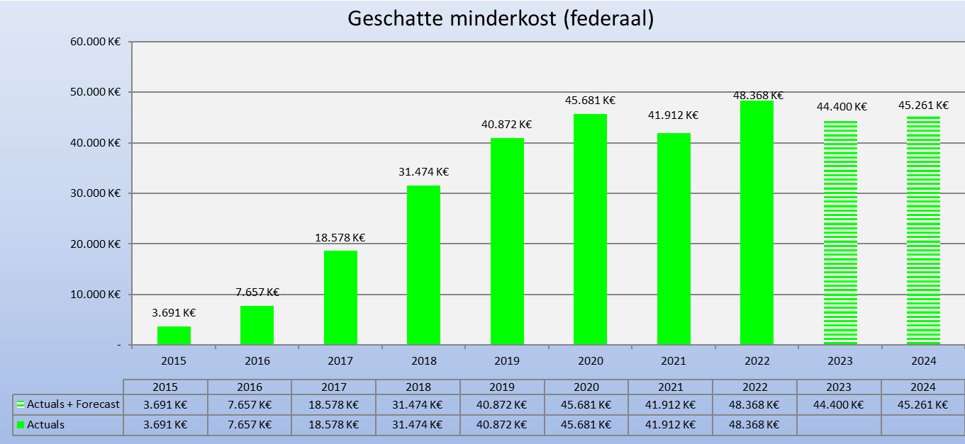
G-Cloud ROI
Avoided spending (federal)

Slide 41
and beyond

Slide 42

Digital is the new normal: society needs to evolve
Public & private sector cooperation regarding
  vision
  common components & services
  synergies in order to meet user expectations
  offering according to strengths
Not only about competitive, yet also cooperative strategic advantages

Slide 43
Expectations of citizens & enterprises
Effective services
Integrated services
  adjusted to their specific situation, customized if possible
  life events (birth, school, work, moving, illness, retirement, decease, setting up an enterprise, …)
  across government levels, public services and private bodies
Adjusted to their own processes
With a minimum of costs and administrative formalities

Slide 44
Expectations of citizens & enterprises
Provided automatically, if possible
With active user participation (self-service – self-empowerment – follow-up)
Always up to date
Offered in a performant and user friendly way
Reliable, safe and permanently available
Using the media of their choice (internet, mobile data, telephone, direct contact, …)
Respecting their privacy

Slide 45
Cloud-native vs Cloud-enabled ?
Cloud-enabled applications
  traditional applications can benefit of some cloud capabilities
    iso-functional and iso-architectural migrations (cloud-wrapping)
  more modest ‘cloud’ architectures
    use features needed by internet-scale applications
    for augmenting your quality of service
    our workloads are not at the extreme end of the cloud spectrum
  to realize full cloud potential: cloud software architecture needed!
Cloud-native applications
  horizontal scaling for internet-scale applications
  high availability from an application perspective
  single container availability option (restart downtime)
  transportability (move to different clouds)
    worldwide availability zones, multi-cloud strategy, …
  continuous delivery and automated staging
  frequent deployments (e.g. very 5 minutes)
  micro services architectures
  A/B testing and feature toggles
  unpredictable loads, …
What is the maturity level of your organization?
What are the benefits of cloud technology you want to maximize?
What are the characteristics of your (traditional) workloads?
What is your current IT landscape?
...
Why Cloud?
Notes:
Shifting to cloud native features will demand reengineering/modernisation

Slide 46

Focus on business
ICT enables business, effectiveness, efficiency, innovation
Business drives, empowers and
invests in ICT

Slide 47
Shift of focus / Added value
Business components

Slide 48
Some ICT trends
Public Cloud
API Economy
Artificial Intelligence
Blockchain
…
Re-use
Conver-sational Interfaces
Big data analytics

Slide 49

Open government services
Building mutual trust
Through specific cooperation
With consistent delivery, results and ROI
Examples
  digital user management
  eBox citizen & eBox enterprise
  eHealth platform

Slide 50








Example: eHealth platform
Patients, health care providers,
health facilities
Health portal
Software
HC provider
Software health facility
VAS
Site NIHDI
VAS
eHealth
portal
MyCareNet
VAS
VAS
VAS
Users
Basic services eHealth platform
Network
VAD
VAD
VAD
VAD
VAD
VAD
Suppliers

Slide 51

Example: eHealth platform
Coordination of digital subprocesses
Portal
Integrated user and access management
Management of logs
System for end-to-end encryption
eHealthBox
Timestamping
Encryption and anonymization
Consultation of the National Register and the CBSS Registers
Reference directory (metahub)

Slide 52

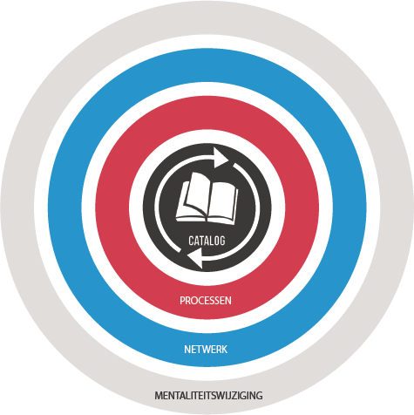
ReUse – Vision
Every stakeholder
can easily find the most common reusable elements in a centralized catalogue
Processes
and tools are put in place to identify, register, implement, monitor and measure reuse throughout the project lifecycle
Human
networks are maintained and developed on all levels (CEO’s, CIO’s, business owners, business analysts, architects) in order to keep maximum visibility on reuse potential
A culture
develops where
reuse is adopted and the creation of reusable products is promoted,

Slide 53
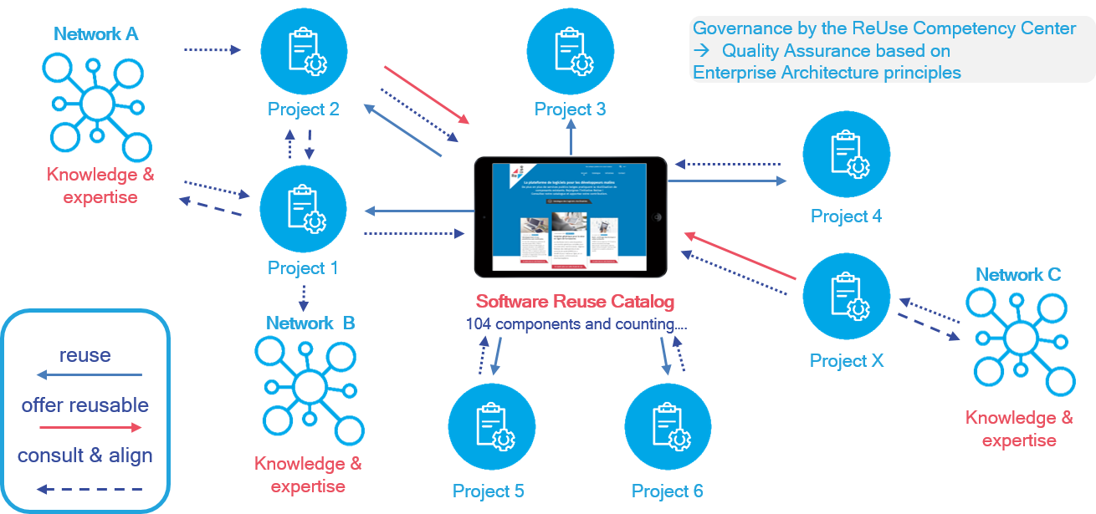
Software reuse – how does it work?
www.ict-reuse.be
info@ict-reuse.be

Slide 54

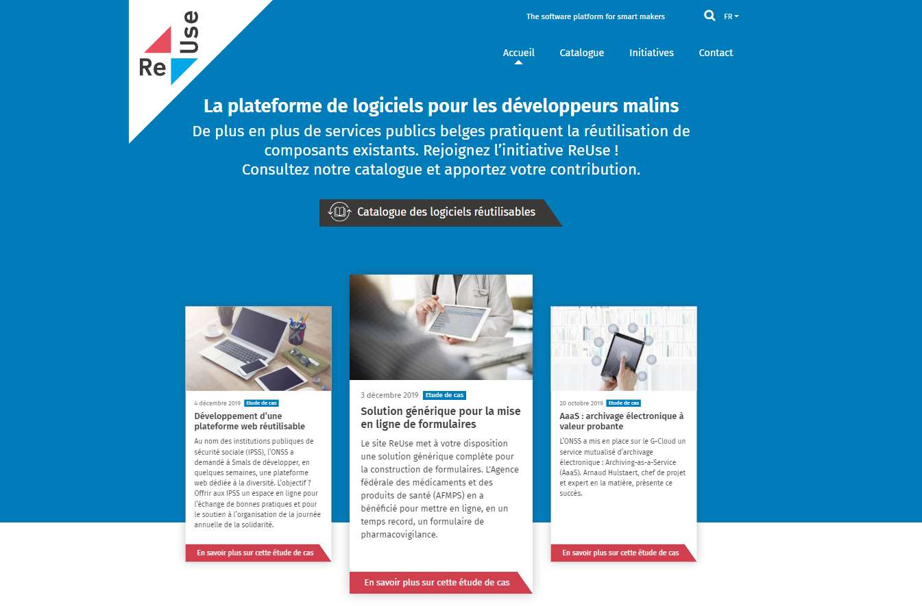
info@ict-reuse.be
Questions on?
components
new initiatives
webinars
collaboration
…
Ask me…
strategic issues
roadblocks
www.ict-reuse.be
54
Notes:
Vragen over componenten -> info@reuse
Strategische blokkering + Esclareren naar Frank indien nodig

Slide 55


Results
50%
Business specific
custom code:
28%
66%
ROI
6%
Reused
reusable
Average ROI / ReUsed component (2019) : € 27.000
Total ROI 2022 (Projects by Smals, approx.): € 32.000.000

Slide 56


Want to know more?
http://www.gcloud.belgium.be
info@gcloud.belgium.be

Slide 57



frank.robben@mail.fgov.be
@FrRobben
https://www.frankrobben.be
https://www.gcloud.belgium.be

