Slide 1

ReUse and collaboration for better eGov services
How can private companies participate in this initiative?

Slide 2

The ReUse initiative
What is it?
Why is it important?
Some examples & results
How can private sector companies join?
  Align with public sector strategy
  ReUse existing elements
  Develop for ReUse
ReUse and collaboration for better eGov services

Slide 3


What is it?

Slide 4


What do we want to achieve?

Slide 5





To provide better
digital services to the public
Goal
Companies
Europe
Private Partners
Citizens
Belgian
Governments
Health actors
  by working together
  by sharing and reusing what already has proven to be successful
Other countries
Civil servants
Service providers
ReUse and collaboration for better eGov services

Slide 6




The ‘government’ is a complex ecosystem
Challenges
  The experience with the government is not always optimal
??
ReUse and collaboration for better eGov services

Slide 7

The world is
changing FAST
Challenges
  Societal challenges
  Technological challenges
  Ecological challenges …
ReUse and collaboration for better eGov services

Slide 8

Budgets are under
severe pressure
Challenges
  and skilled people are hard to find
ReUse and collaboration for better eGov services

Slide 9







Expectations of citizens & enterprises
Effective services
Integrated services
With a minimum of costs and administrative formalities
Provided automatically, if possible
Reliable, safe and permanently available
ReUse and collaboration for better eGov services

Slide 10




Expectations of citizens & enterprises
With active user participation
Offered in a performant and user friendly way
Using the media of their choice
Adjusted to their own processes
Respecting their privacy
ReUse and collaboration for better eGov services

Slide 11
Enablers to achieve our goals

Slide 12
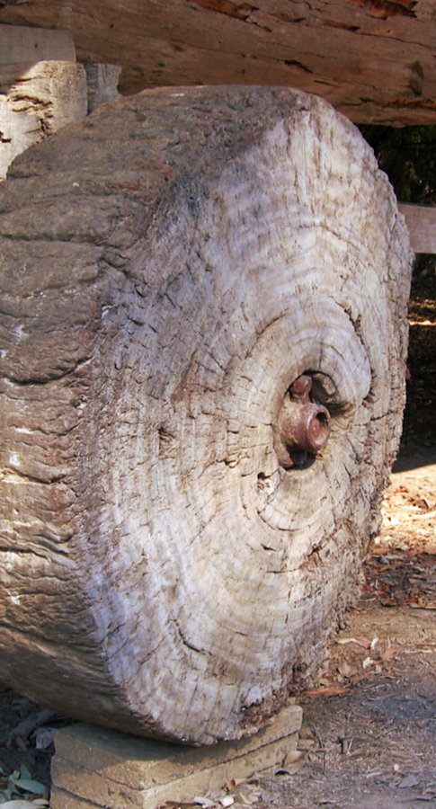
Let’s NOT reinvent the wheel…
Share and reuse existing assets
  Business processes
  Software components and API’s
  Procurement and licences
  Infrastructure
  Other types of building blocks…
ReUse and collaboration for better eGov services

Slide 13

Let’s work together…
Align and collaborate
  Promote and rely on mature business concepts
  Enforce proven standards
  Share knowledge and techniques
  Exchange good practices
  Co-creation with all actors involved
ReUse and collaboration for better eGov services

Slide 14





























Who is already involved?
FEDERAL PUBLIC SERVICE
Employment, Labour and
Social Dialogue
And many more…
Notes:
Checken & aanvullen

Slide 15
How does it work?

Slide 16
Some initiatives
ICT infrastructure: G-Cloud initiative launched in 2015
  Focus on hardware, infrastructure services, platforms…
Software: ReUse program for public institutions accelerated in 2019
  Focus on components, authentic data sources, API’s
Full stack: Enterprise Architecture approach across institutions since 2021
  Focus on architectural principles, processes, building blocks, …
Near future: Public cloud computing ?
  Sufficiently secure, multi-vendor use
  Strong governance, avoiding lock-in
ReUse and collaboration for better eGov services
Notes:
OVERZICHT-SLIDE: De verschillende onderwerpen worden hierna verder uitgewerkt…
-> Concrete initiatieven komen verderop aan bod

Slide 17

G-Cloud – Sharing ICT infrastructure
Program of synergy-driven projects
  Strong participation of private sector suppliers
Joint government ICT platform
  Mainly federal
  Expandable to other governments if interested
Hybrid community cloud model
  Reliance on public cloud where possible
  Partly private community cloud running from government-managed datacenters
  Operational implementation with broad reliance on external suppliers
ReUse and collaboration for better eGov services

Slide 18
G-Cloud – Sharing ICT infrastructure
G-Cloud = coalition
  G-Cloud ≠ central organization
Governance
G-Cloud service
Offered by
Service owner
Delivered by
Service provider
ReUse and collaboration for better eGov services

Slide 19
G-Cloud – Sharing ICT infrastructure
Government
G-Cloud Operations & Programme Board
G-Cloud Strategic Board
FPS
(Horizontal FPS, FPS FIN, Belnet, …)
PSSI/IPB
(CBSS, ...)
Association of FPS/PSSI/IPB
Private ICT companies directed by FPS/PSSI/...
3 Colleges
Federal Public Services (FPS)
Public Social Security Institutions (PSSI)
Institutions of Public Benefit (IPB)
SIT: ICT managers from
Federal Public Services (FPS)
Public Social Security Institutions (PSSI)
Institutions of Public Benefit (IPB)
Service
owners
ReUse and collaboration for better eGov services

Slide 20
G-Cloud – Sharing ICT infrastructure
Horizontal software (Solutions)
Website - HR - Finance - Access Control - …
Application platforms
Soft infrastructure
Virtualisation - Security - E-mail - VoIP - …
Hard infrastructure
Computing - Network - Storage
ReUse and collaboration for better eGov services

Slide 21
G-Cloud – Sharing ICT infrastructure
www.gcloud.belgium.be

Slide 22

Sharing infrastructure – software – business components
Business components
Core business (declarations, administrative processes, …)
+
SHIFT
SHIFT
Horizontal software (Solutions)
Website - HR - Finance - Access Control - …
Application platforms
Soft infrastructure
Virtualisation - Security - E-mail - VoIP - …
Hard infrastructure
Computing - Network - Storage

Slide 23
Reuse of software & business components
Initiative
  Orginated within Belgian public social security institutions & Smals
  Open to federal public services & other
Purpose
  Synergy around (technical) business components
  Save costs by avoiding multiple development of redundant components
Regardless of whether development takes place by
  The institution's own ICT department
  Smals
  Subcontractors
How ?
  Consult the catalogue of reusable components and get in contact with networks
ReUse and collaboration for better eGov services

Slide 24



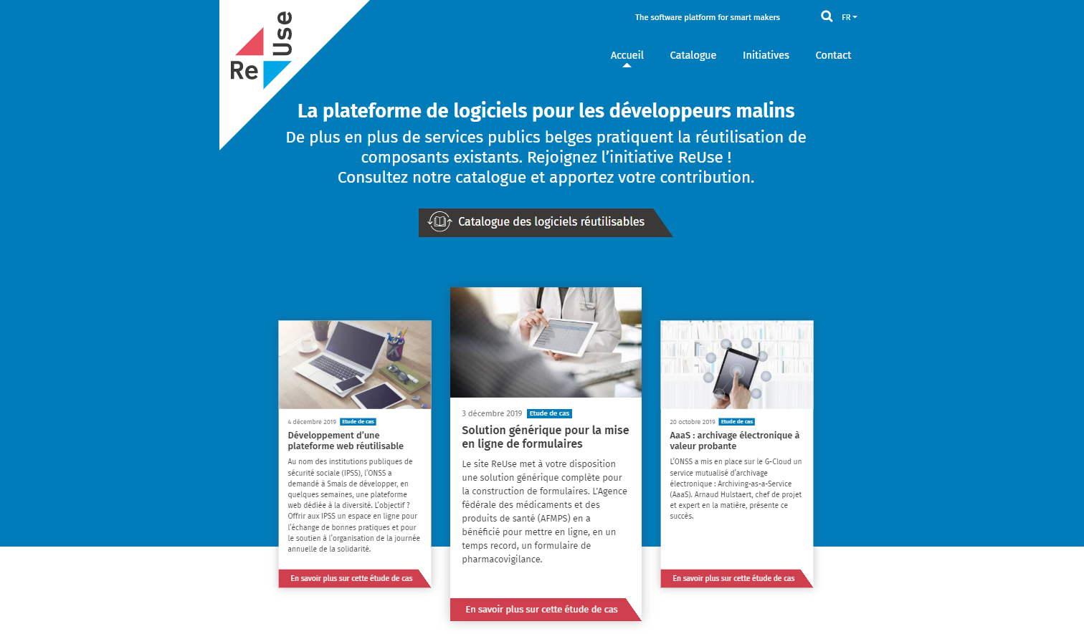
Software reuse – how does it work?
Network A
Governance by the ReUse Competency Center
Quality Assurance based on
Enterprise Architecture principles
Project 2
Project 3
Knowledge &
expertise
Project 4
Project 1
Network C
Software Reuse Catalog
reuse
offer reusable
consult & align
Network B
104 components and counting….
Project X
Knowledge &
expertise
Knowledge &
expertise
www.ict-reuse.be
info@ict-reuse.be
Project 5
Project 6

Slide 25
Software reuse – how does it work?
Take aways
  Make visible what already exists
  Integrate reuse in the project life cycle
  Measure the benefits (ROI)
  Use networks to detect missing components or future opportunities
  Provide mature governance around reusable components
And most of all… dare to share!
  Learn fast & adjust (and don’t give up too easily)
ReUse and collaboration for better eGov services
Notes:
Provide mature governance around reusable components : (onboarding, documentation, release management, …

Slide 26
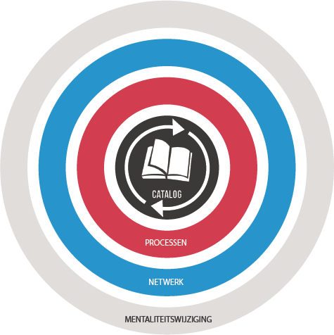
ReUse – Vision
Every stakeholder
can easily find the most common reusable elements in a centralized catalogue
Processes
and tools are put in place to identify, register, implement, monitor and measure reuse throughout the project lifecycle
Human
networks are maintained and developed on all levels (CEO’s, CIO’s, business owners, business analysts, architects) in order to keep maximum visibility on reuse potential
A culture
develops where
reuse is adopted and the creation of reusable products is promoted,
26

Slide 27
Software reuse - possible collaboration models
Organic model
  Component financed by initial requesting party
  Free to use
  Improvements financed by a requesting party (of the improvement)
  Co-financed maintenance
Sponsorship model
  Component financed by a sponsor
  Made available on a cost-based model (Free or fee)
Co-financed model
  Collaborative financing and maintenance based on a distribution key
ReUse and collaboration for better eGov services

Slide 28
Building blocks for a “generic public service”
(Partial view)
Request / declaration
Forms / Batch
Data flows
Incoming / outbound
Webservices / batch
Communications
Archiving
Support services
Procurement
Human resources
Translation services
Legal
Logistics
Communications
Helpdesk
Forms
DSP - Document Service Provider
Document Orchestration Service
e-Box - Electronic mailbox
Govapp
PrintManager
AAAS - Archiving-as-a-Service
Multifunctional declarations
API Gateway
Payments received
Automated data treatments
Call center
Supporting software
Office automation
eMail / telephony
Basissystemen
eAcademy
Management of commitees
Coda reader
Event notifications
Sepia document signer
Timestamping
Data quality tools
CMS - Web Content Management System
CSAM – Log on to online public services
Identity and Access Management
User Access Management
Payments
Case management
Reporting
Process management
Task management
Work environment
BI Platform

Slide 29
Example:“Re-usable components for contact tracing”
Citizens fill out “passenger locator form” or “Coronalert form”
Centralized case treatment
Supporting software / Communications
CMS - Web Content Management System
Case management
Contact center employees register contactdata
e-Box - Electronic mailbox
Process management
CSAM – Log on to online public services
Supporting software
Request / declaration
Forms / Batch
CSAM – Log on to online public services
Lab sending test results
Forms
Supporting software / Communications
eHealthBox
IAM - Identity & Access Management - eHealth
Notes:
BOODSCHAP = ASSEMBLEREN ipv ontwikkelen (snel, goedkoop, matuur)
-> Concrete voorbeelden komen verderop nog aan bod !

Slide 30

The API Economy
> 90% of the reusable components in software reuse catalogue are API’s
How can API’s contribute to create added value for all actors that are active in public services?
ReUse and collaboration for better eGov services
Notes:
90% -> 75% ?

Slide 31







The API economy
Frontend Systems
Web, mobile, speech, IoT, services, partners
API Gateway: mediation, monitoring, security, traffic management, …
Service
Service
Service
Service
Backend Systems
Services with databases
Legacy
ReUse and collaboration for better eGov services

Slide 32


Public & private sector opportunities
The government is NOT an island
Invitation to private sector parties to get involved
ReUse and collaboration for better eGov services

Slide 33





Public & private sector opportunities
Existing,
Valuable
Services
Made available as APIs
Self service use
by developers
To create new innovative apps and services
Differentiated services,
Better experience
ReUse and collaboration for better eGov services

Slide 34

Enterprise architecture in the public sector
Enterprise architecture = a holistic approach
  Starting from a common business vision
Covering the 3 layers
  Business – Applications – Infrastructure
Defining good architecture principles that are applicable across institutions & ecosystems
  Only once data collection
  Customer centricity
  Digital inclusion
  Privacy and security concepts
  …
ReUse and collaboration for better eGov services

Slide 35

Enterprise Architecture : strategy (1/4)
  How can citizens and businesses perceive their governments as a coherent, efficient whole?
By promoting unity of vision as well as cooperation among public institutions and the private sectors
ReUse and collaboration for better eGov services

Slide 36

Enterprise Architecture : strategy (2/4)
  How can we ensure that applications can last for years, yet can be quickly adapted to new needs?
By making the right architecture choices, share common services and respect standards
ReUse and collaboration for better eGov services

Slide 37

Enterprise Architecture : strategy (3/4)
  How can we provide electronic government services than are less vulnerable to incidents?
By offering guarantees of quality and continuity
ReUse and collaboration for better eGov services

Slide 38

Enterprise Architecture : strategy (4/4)
  How can we make ICT a catalyst of change, and not a stumbling block or jammer.
By bringing together policy makers and ICT in making strategic decisions
ReUse and collaboration for better eGov services

Slide 39



Enterprise Architecture : framework
Holistic
Vision & strategy
Vertical
Domains
Sociale Zekerheid
Gezondheid
Andere
Customer Centricity
Only Once
Employment
Illnes
Health care
Taxes
…
Services
Holiday
Pension
Medical costs
Family allowance
Care
Health risks
Medicines
Defense
Mobility
Horizontal
Processes
Generic & reusable
Interopera-bility
Architectural-principles
Building Blocks
Generic & reusable
Standards
Legacy vs innovation
Privacy by design
Notes:
Horizontale benadering
Enterprise Architectuur (EA) zorgt voor een geheel van principes, blauwdrukken en concrete bouwstenen die de samenhang van systemen en informatiestromen kunnen verhogen. EA focust daarom niet op één enkele organisatie of systeem, maar tracht de interoperabiliteit tussen de betrokken systemen te verhogen en silo’s tegen te gaan
verticale benadering.
EA is geen technische aangelegenheid. Door een integratie van strategie, business en technologie komen we tot een betere, permanente wisselwerking. Strategische bouwstenen worden zorgvuldig gekozen in functie van hun reële toegevoegde waarde. Een doordachte visie rond digitalisering is de drijfveer voor een robuuste ICT-ondersteuning
holistische benadering
EA helpt om de complexiteit van het ecosysteem beter te beheersen en proactief in te spelen op nieuwe maatschappelijke uitdagingen. We verlaten de ad-hoc-projectbenadering voor een overkoepelende investering in bouwstenen en fundamenten van een klantgerichte dienstverlening. We hebben oog voor innovatie maar zoeken ook naar oplossingen voor de onvermijdelijke “legacy” in het overheidslandschap.

Slide 40
What are the benefits ?

Slide 41




What are the benefits of a reuse mindset and more collaboration?
Faster | Flexible
Cheaper | Higher maturity
ReUse and collaboration for better eGov services
Notes:
Faster
Ready to use components
Reduced time to market
Flexible
Functional requirements changing fast
High pressure on timing (ex. Covid)
Cheaper
Don’t develop twice
Don’t waste our taxpayers’ money
Maintenance & maturity
Highly used components with solid support
Software quality and security

Slide 42

Benefits
Improving quality of
life for citizens and enterprises
ReUse and collaboration for better eGov services
Notes:
EXAMPLES
eHealth: Nierschade vermijden door operaties efficiënter & korter te maken, dankzij digitale info in EMD
(Avoiding kidney failure / damage through faster & more efficient surgery, using information from patients’ Electronic medical records)

Slide 43
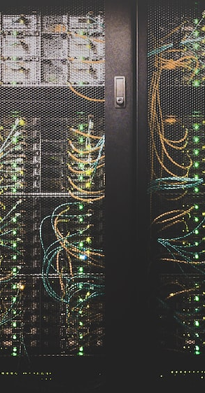
Offering excellence in digital services
Benefits
  Reliability
  Performance
  Added value
ReUse and collaboration for better eGov services

Slide 44
Examples

Slide 45
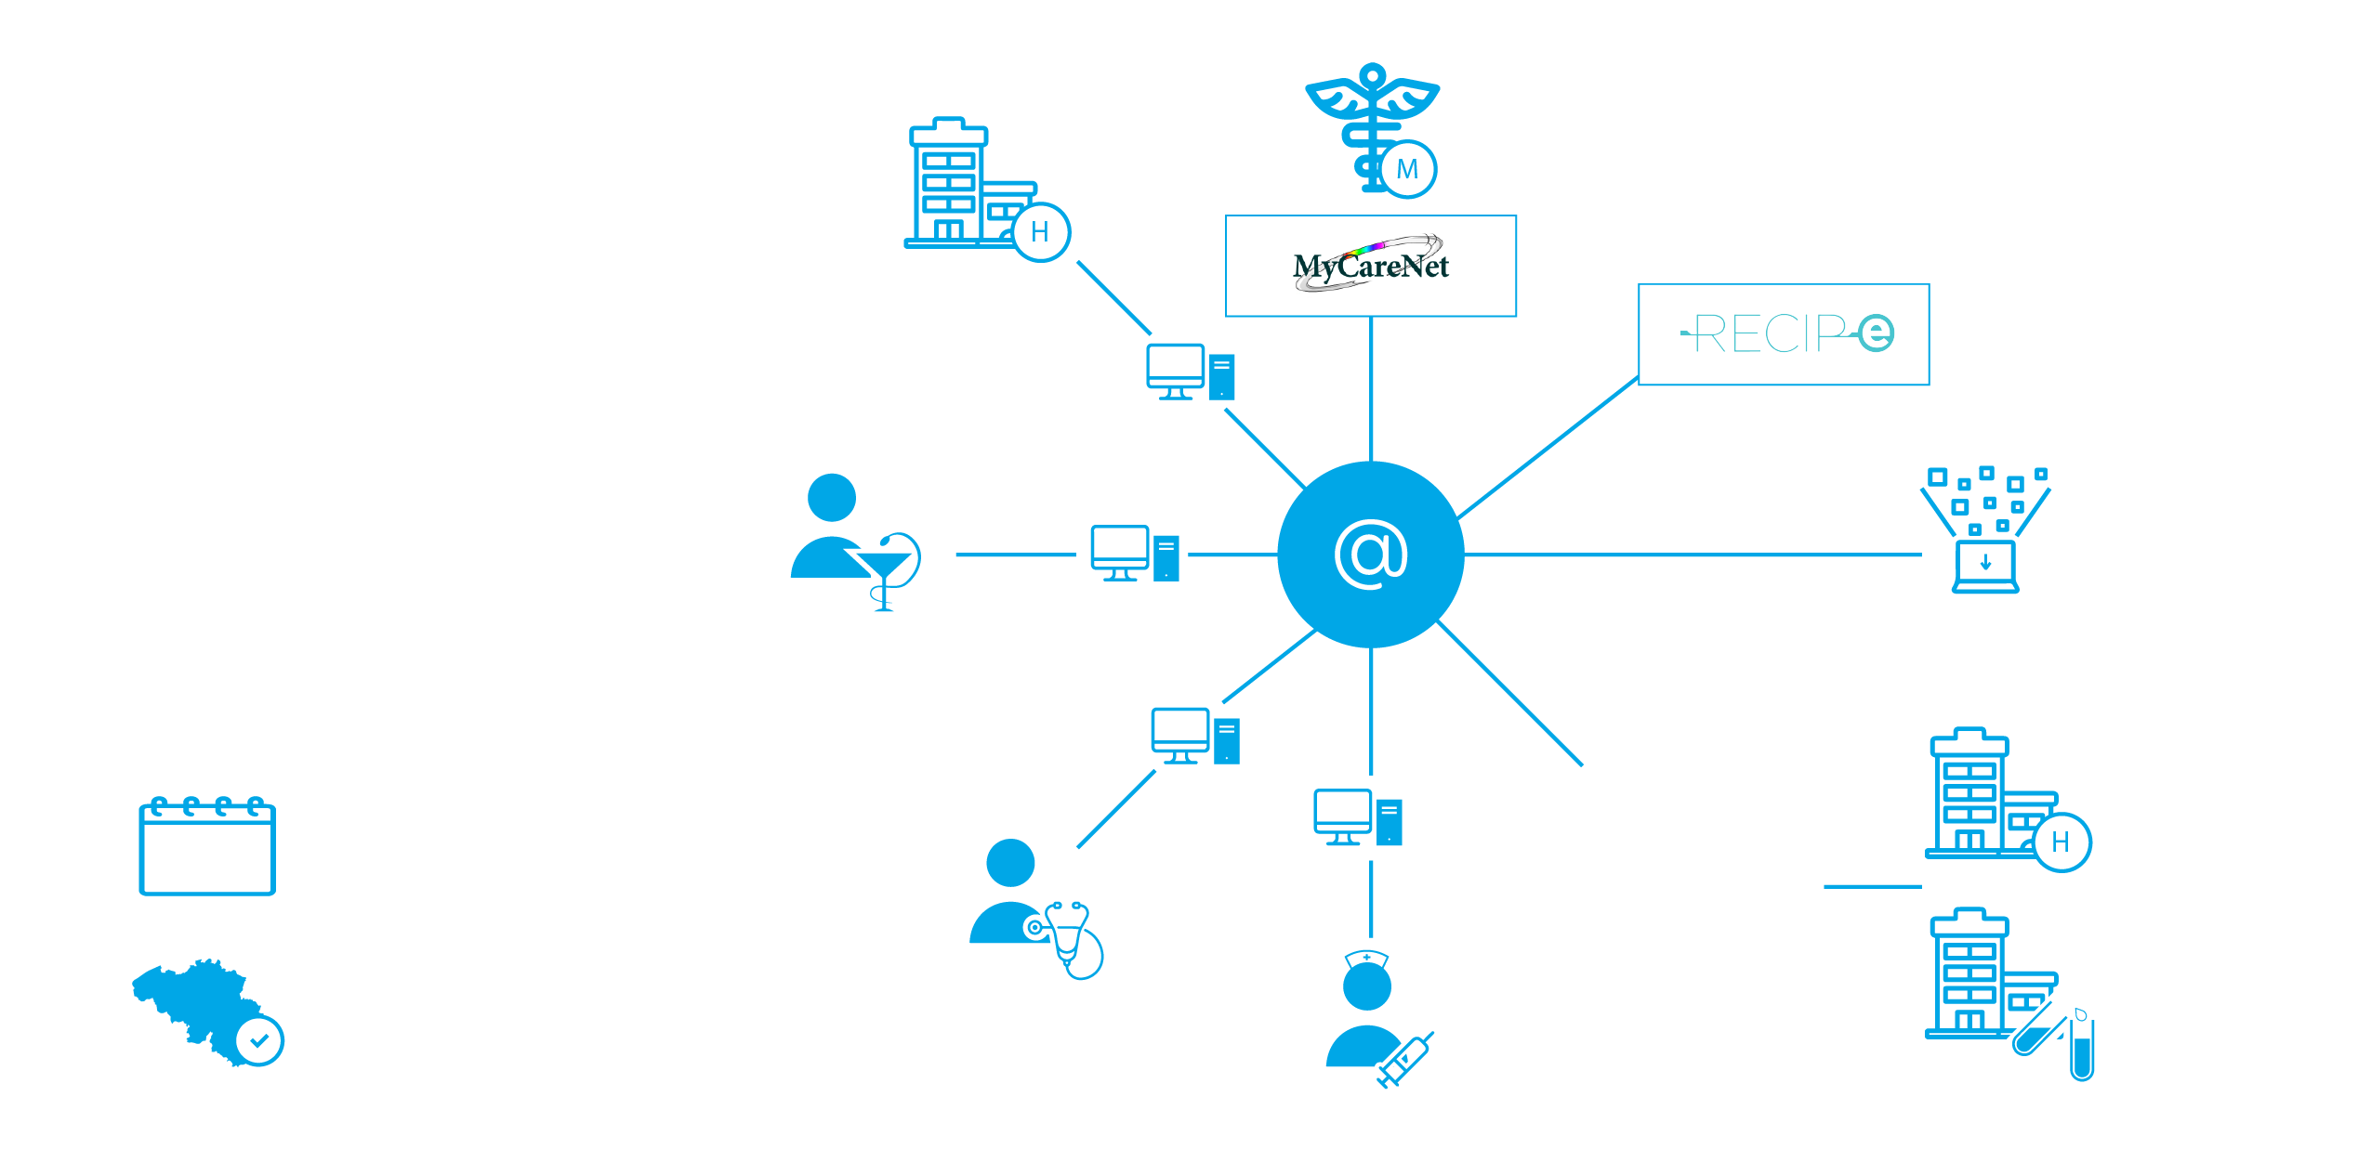



EXAMPLE: the eHealth ecosystem
>20.000.000.000
digital transactions
2022
> 90 %
of Belgian citizens have given
an informed consent for data sharing
ReUse and collaboration for better eGov services

Slide 46










EXAMPLE: eHealth basic services & API’s
Coordination of the electronic processes & API gateway
Portal
Integrated user and access management system (IUAM)
Management of logs
System for end-to-end encryption (ETEE)
eHealthBox
Timestamping
Coding and anonymising
Consultation of National register and CBSS registers (ConsultRN)
Reference directories (hub-metahub system)
ReUse and collaboration for better eGov services

Slide 47

EXAMPLE: Intelligent forms & workflows
Covid-19: NSSO offered Belgian employers (semi-) automated delay in social security contributions
VERY fast time to market (1 week)
  ReUse Forms interface
  ReUse BillRetainment webservice
  Integrate with existing workflows in WorkEnvironment
Online self-service
  >100.000 employers concerned
  Online self-service crucial to avoid flooding NSSO services
ReUse and collaboration for better eGov services

Slide 48










EXAMPLE: COVID-19 Vaccination
National Register
Sciensano
Vaccinnet
IUAM
API gateway
ConsultRN
CoBRHA
Regions
National Intermutual College
Doctors
Inivitation & booking
system
Vaccination centers
Vaccination
Codes Database
Hospitals
Pharmacies
Last minute
invitation system
ReUse and collaboration for better eGov services

Slide 49
EXAMPLE: The Only Once principle
Legal basis: One-time information gathering
  Public services should not request information that is already known by another public institution (5/5/2014)
Authentic data sources
  National Register, Belgian Street Address
  Employers Register, Crossroads Bank for Enterprises
  Multifunctional Declaration (DmfA)
  …
Public services should integrate, not duplicate existing information flows
Future developments
  Digital Wallet? SOLID? Blockchain?
ReUse and collaboration for better eGov services

Slide 50
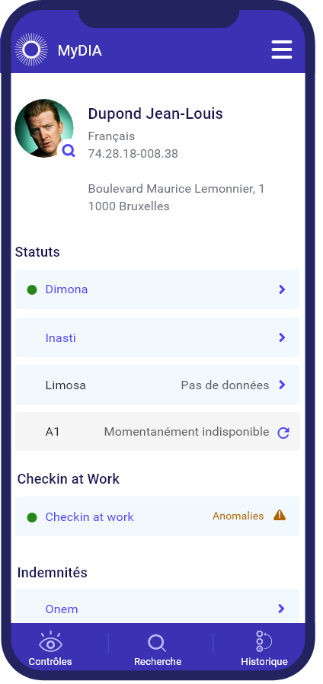


My Digital inspection assistant
Example
My DIA
  Real-time information for Social Inspection services
  Rapid identification of a person’s identity
  Sharing information with other inspectors on site
ReUse and collaboration for better eGov services

Slide 51


My Digital inspection assistant
Dimona
Example
Employers directory
BCE
Check-in@work
LimosaRegistry
Person
How?
  Integrating 11 existing API’s
  More time & budget for front-end design
Result
  Faster & more reliable inspections
  Less burden for employers
  Strong results in fighting social fraud & social dumping
ReUse and collaboration for better eGov services

Slide 52


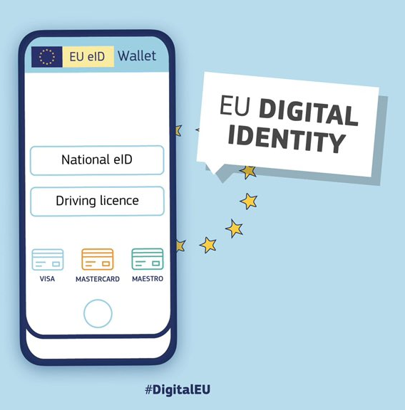
Example
Innovative communication channels for citizens & enterprises
eBox Enterprise
  Digital alternative for official government communications
  Delegation of roles within the company
  Less paper administration – www.totaaldigitaal.be
GovApp
  Instant messaging based on citizens’ mobile number (Opt-in)
  Cheaper, longer rich media alternative for SMS
Near future: Digital Identity Wallet
  …
ReUse and collaboration for better eGov services

Slide 53

Some results

Slide 54


Results
50%
66%
ROI
6%
Reused
reusable
Business specific
custom code:
28%
Average ROI / ReUsed component (2019) : € 27.000
Total ROI 2022 (Projects by Smals, approx.): € 32.000.000
ReUse and collaboration for better eGov services
Notes:
- 66% van alle functionaliteit in onze applicaties wordt geleverd dankzij hergebruik van bestaande componenten (cf software reuse catalog).
- van het residu (34%) wordt 6% (de resterende 28% is custom ontwikkeling) zo geschreven dat het nieuwe reusable componenten oplevert voor onze software reuse catalog.
- dankzij deze hoge mate van reuse realiseren we een globale kostenreductie (“ROI”) van 50%.

Slide 55
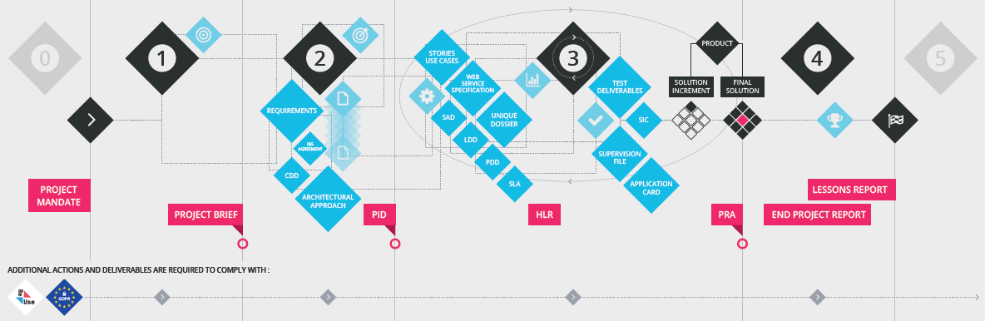
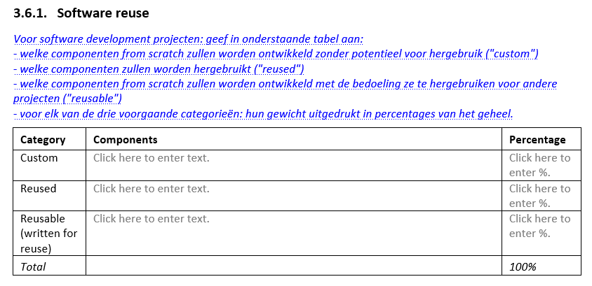
ReUse is part of project lifecycle
4
1
2
3
5
Standard project methodology @Smals
  Detect ReUse opportunities as soon as possible
  ReUse embedded in Project Lifecycle

Slide 56
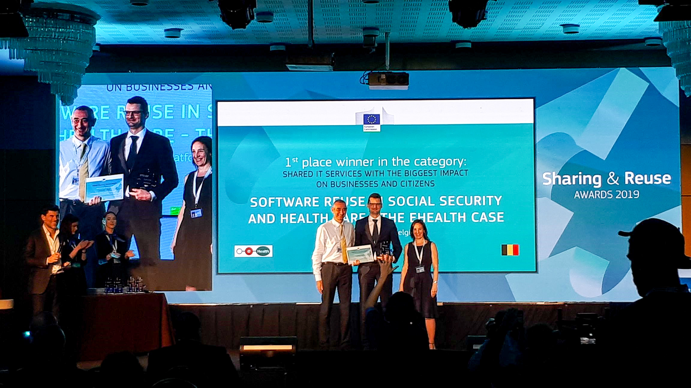

EU Sharing & ReUse Award
EU Sharing & ReUse Awards – 2019
  Shared IT services (commonly developed or shared)
  with the biggest impact on citizens or businesses
  Winner: eHealth-platform & Belgian social security
ReUse and collaboration for better eGov services

Slide 57

What’s next?

Slide 58

European context
Interoperable Europe Act
  Secure cross-border exchange & interoperability
Open Data Directive
  High value datasets to be made available for re-use
EU Health Data Space
  Interoperability & security
  Strong regulation needed
  Share best practices – Sumehr, ePrecription…
JoinUp initiative
  joinup.ec.europa.eu
ReUse and collaboration for better eGov services
Notes:
AAN TE VULLEN…

Slide 59
European context
eIDAS – v2
  New: Quality Attributes
  Still missing: Relationships (ex. Therapeutic)
EU Health Insurance Card
EU Digital Identity Wallet
  DC4EU Consortium - www.dc4eu.eu
ReUse and collaboration for better eGov services
Notes:
AAN TE VULLEN…

Slide 60
What’s in it for you?

Slide 61


Expectations towards suppliers
External ICT-people working for the government must align with the government’s strategy
  Software developed with taxpayers’ money should be Re-Usable
  Help us fill the ReUse catalog
  ReUse check will be part of recurrent evaluations
Speed up your e-Gov projects and avoid costly development
  Be aware of existing re-usable components, services…
  Check out the ReUse catalog
  Use existing API’s, services, components…
Align with strategy
ReUse and collaboration for better eGov services

Slide 62

Opportunities for suppliers (1/2)
Use best practices, insights and create higher added value to
  society
  other clients
  other countries
Gain exposure by showing the results
Find reusable
components
ReUse and collaboration for better eGov services

Slide 63

Opportunities for suppliers (2/2)
Build generic components
Offer them to the ReUse community
Inspire others to do the same
Become a partner of Belgium’s eGovernment ecosystem
Help deliver better online services to society!
Share your reusable
components
ReUse and collaboration for better eGov services

Slide 64



Join the initiative!
Find reusable components
Share your reusable components
Share on ReUse on evenments
Stay informed with the newsletter
Share success stories
ReUse and collaboration for better eGov services

Slide 65

info@ict-reuse.be
Questions on?
Components
New initiatives
Webinars
Collaboration
…
Ask me…
Strategic issues
Roadblocks
www.ict-reuse.be
Notes:
Vragen over componenten -> info@reuse
Strategische blokkering + Esclareren naar Frank indien nodig

Slide 66






frank.robben@mail.fgov.be
@FrRobben
www.frankrobben.be
www.gcloud.belgium.be
www.smals.be
Subscribe here
www.ict-reuse.be
info@ict-reuse.be
twitter.com/ictreuse
www.linkedin.com/company/reuse-ict/

