Slide 1
Digitalisation of social security: critique and prospects for EU action

Slide 2
About me (°1961)
education: law, ICT, ICT auditing, management, personal coaching
professional activities
  Crossroads Bank for Social Security
    1986-1991: originator as an advisor to the Minister of Social Affairs and the Prime Minister
    since 1991: CEO
  Data Protection Authority
    1991-2022: external member
  Federal Ministry of ICT
    2000-2001: originator as an advisor to the Minister of ICT (ao conception of electronic identity card)
  Smals (non for profit operational ICT association of public institutions of social security and health)
    since 2004: CEO (ao originator of G-Cloud initiative)
  eHealth platform
    2007-2008: originator as an advisor to the Minister of Public Health
    since 2008: CEO
    2020-2021: enterprise architect of Belgian information systems to fight the COVID-19 pandemic (testing, tracing, vaccination) and contributor to development of components on EU and WHO level

Slide 3

Notes:
Hello every one ! Information is crucial in the organization of a social protection system. If you do not know the social, family or income situation of a socially insured person, you cannot design and deliver social protection effectively and efficiently. That is why sound information management is a key factor for a frictionless social security.

Slide 4

Notes:
effective social protection
to avoid and combat fraud
appropriate policy support

Slide 5

Notes:
benefits as much as possible automatically granted according to a ‘happy flow’

Slide 6
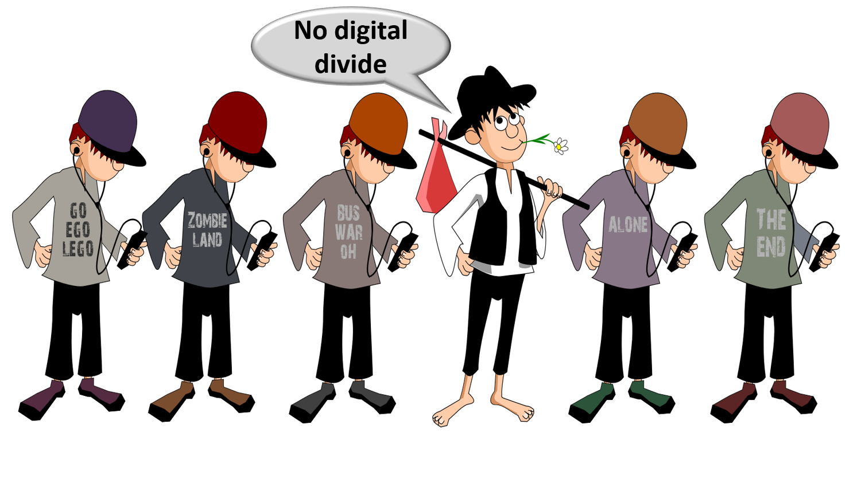
Notes:
social inclusion without a digital divide

Slide 7

Notes:
integrated services across government levels and social security organisations

Slide 8

Notes:
delivered at key life events (birth, going to school, starting to work, moving, illness, retirement, starting up a company…)
addressing citizens’ individual situation, personalized and user oriented

Slide 9

Notes:
minimal costs and minimal administrative burden for all parties involved

Slide 10

Notes:
self service
multichannel service delivery

Slide 11

Notes:
to be helped globally wherever they contact: no wrong door

Slide 12
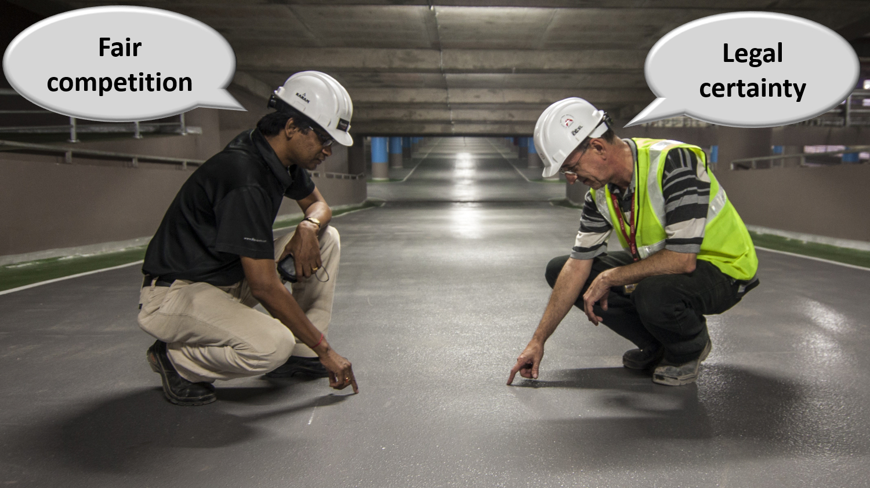
Notes:
reliable, secure and permanently available services with respect of the user’s privacy
legal certainty and legal rules that promote fair competition

Slide 13
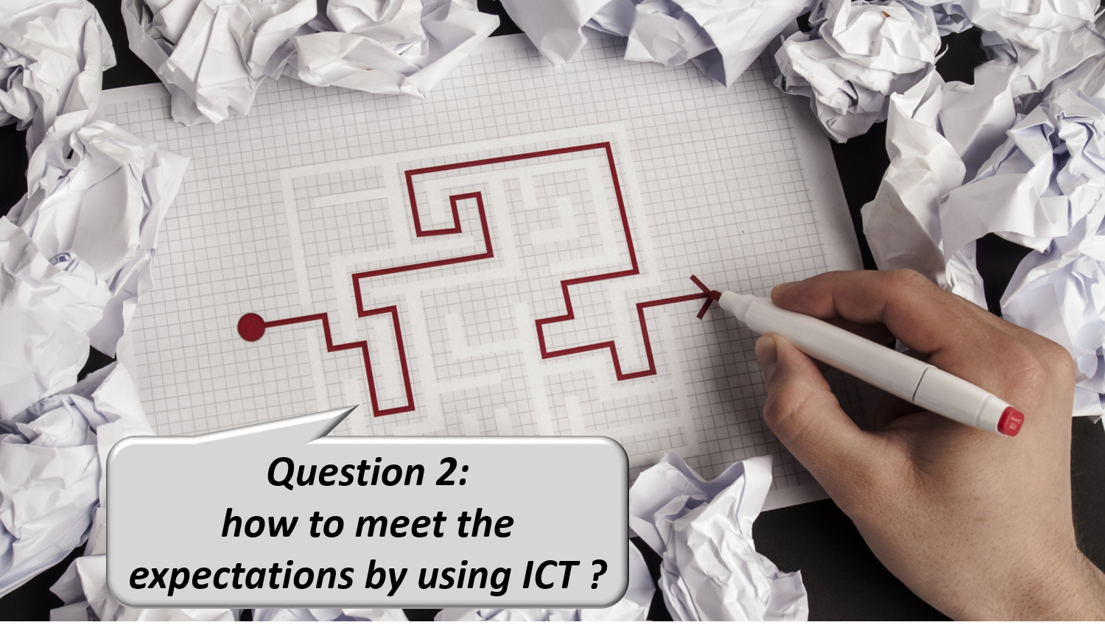
Notes:
How can information management and ICT help us to meet those expectations ?

Slide 14

Notes:
1. Common vision, trust and co-operation
common vision on electronic service delivery, information management and information security between all stakeholders
co-operation based on task sharing, rather than centralization; continuous detection of opportunities for synergy

Slide 15

Notes:
examples of common principles regarding information management
only once collection of factual data
data quality guarantees

Slide 16
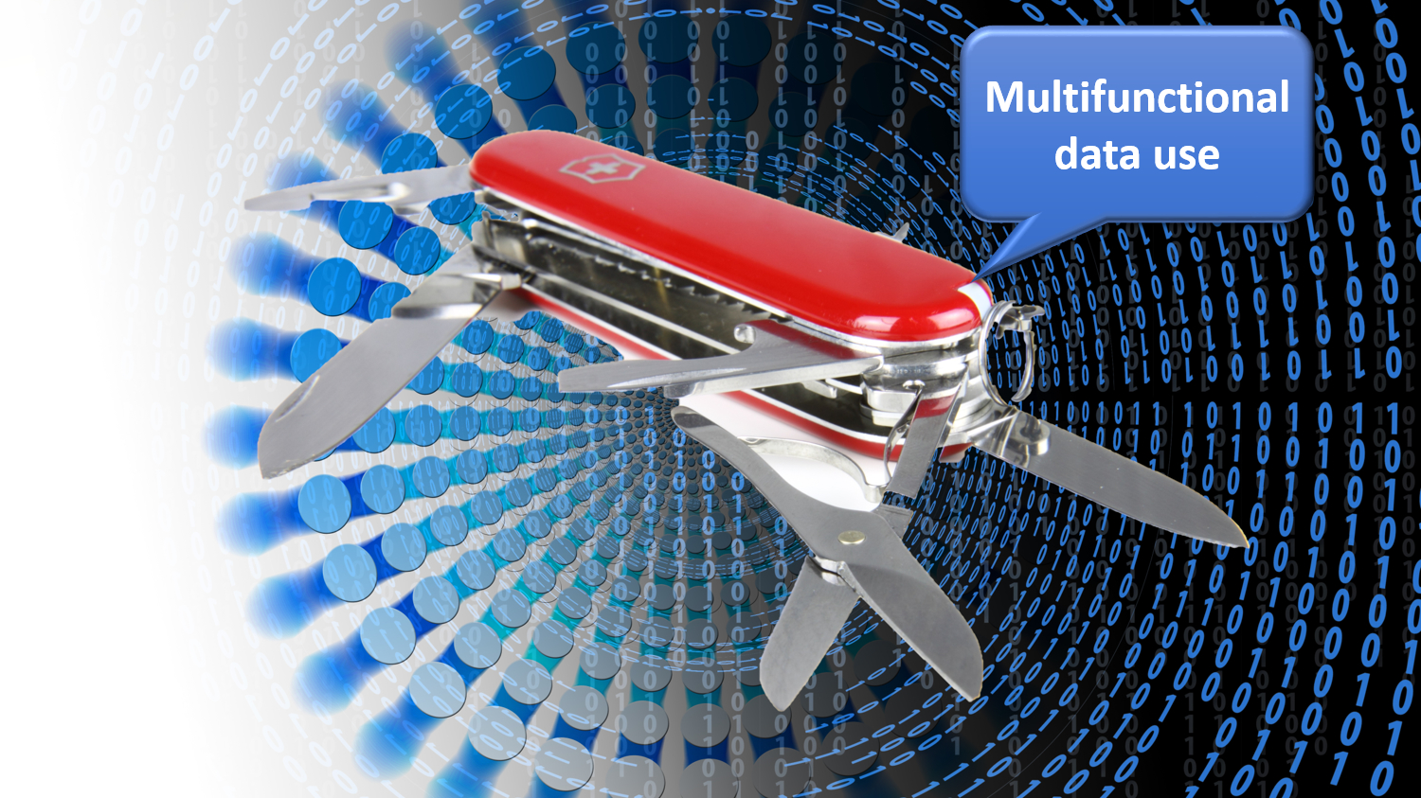
Notes:
multifunctional use of data

Slide 17

Notes:
reengineering of business processes

Slide 18
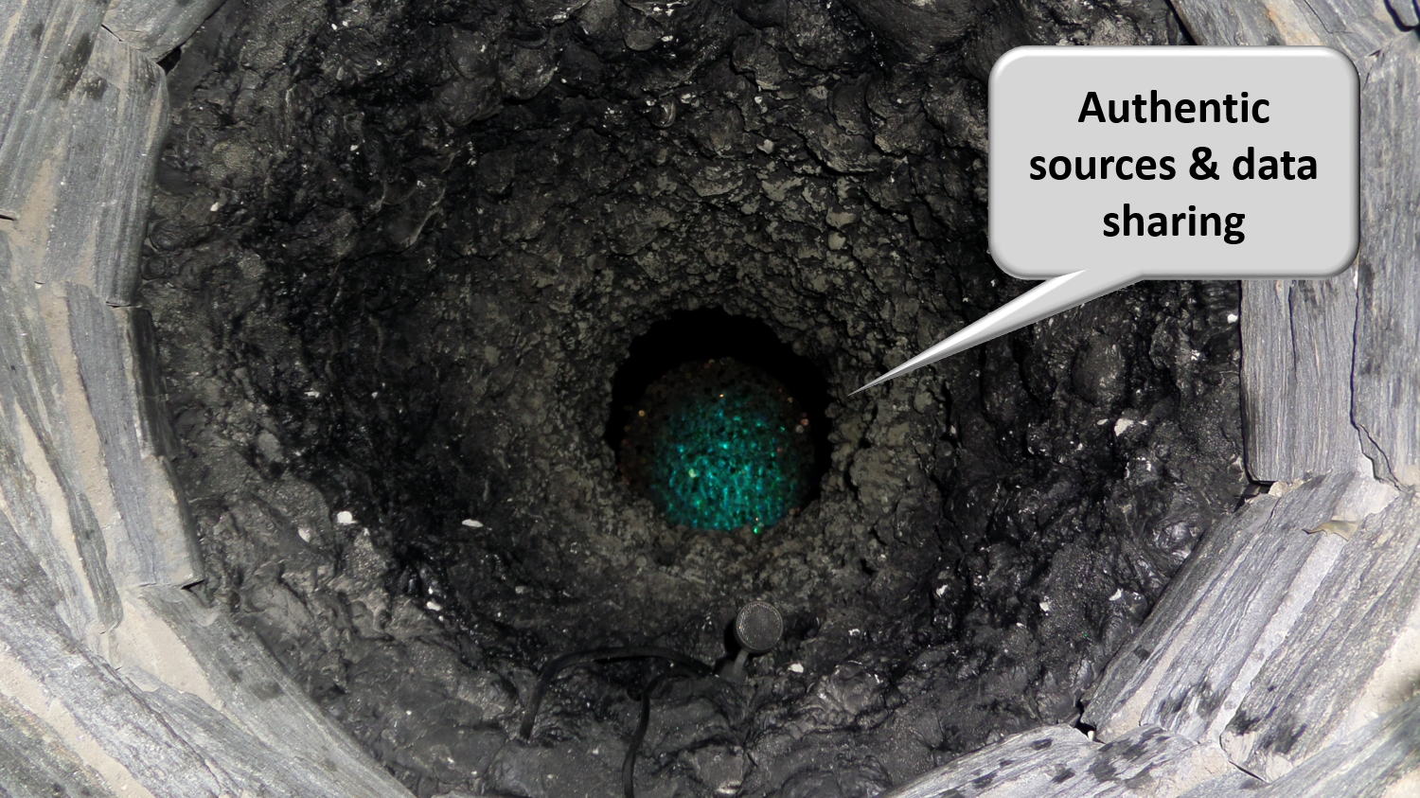
Notes:
authentic sources

Slide 19

Notes:
avoiding loss of confidence due to information security incidents
security, availability, integrity and confidentiality of information is ensured by integrated structural, institutional, organizational, legal (GDPR), HR, technical and other security measures according to agreed policies

Slide 20

Notes:
access authorization to personal information is granted by an independent Information Security Comittee, designated by Parliament, after having checked whether the access conditions are met
the access authorizations are public
every actual electronic exchange of personal information has to pass an independent trusted third party (TTP) and is preventively checked on compliance with the existing access authorizations by that TTP
every actual electronic exchange of personal information is logged, to be able to trace possible abuse afterwards
long term vision combined with continuous delivery of new services (agile development)

Slide 21

Notes:
paying attention to computer literacy of collaborators and users

Slide 22

Notes:
2. Appropriate corporate culture
from hierarchy to participation, communities and team work
in the first place meeting the needs of the customer, not the social security institutions
rewarding entrepreneurship
ex post evaluation on output, not ex ante control of every input

Slide 23
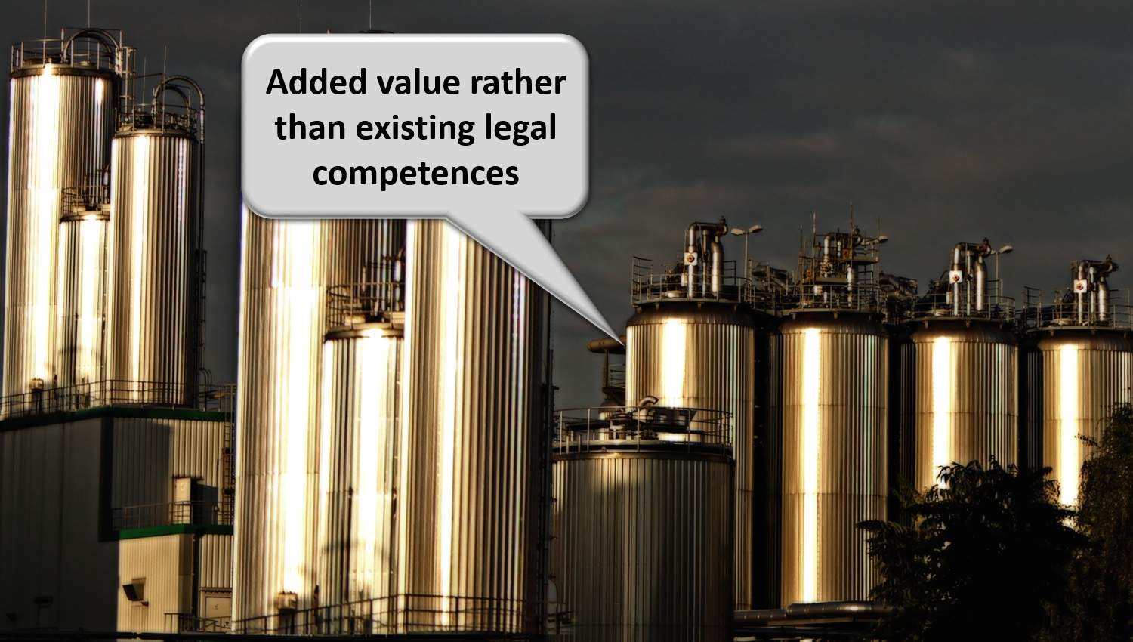
Notes:
reasoning in terms of added value for citizens and companies rather than in terms of legal competences
focus on more efficient and effective service delivery and on cost control
appropriate balance between efficiency on the one hand and information security and privacy protection on the other

Slide 24
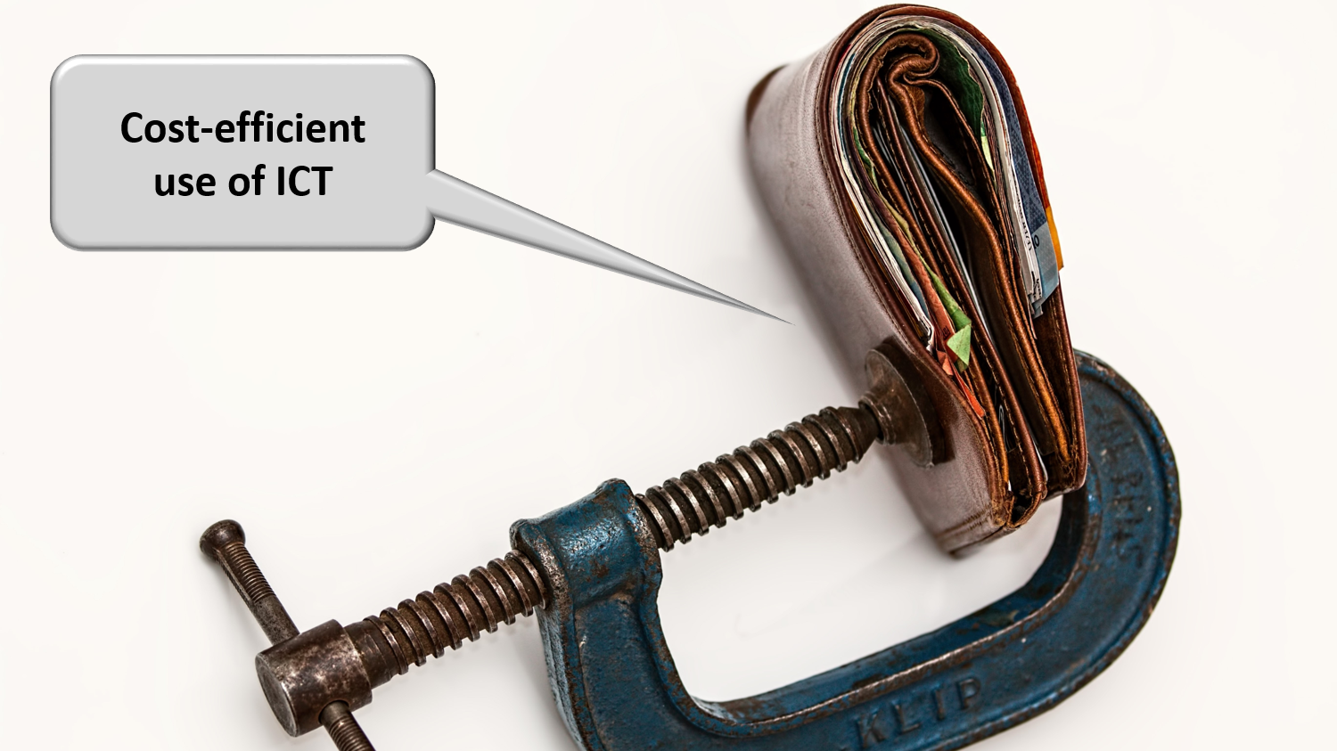
Notes:
sufficient financial means for permanent change and innovation: agreed possibility to re-invest efficiency gains in innovation

Slide 25
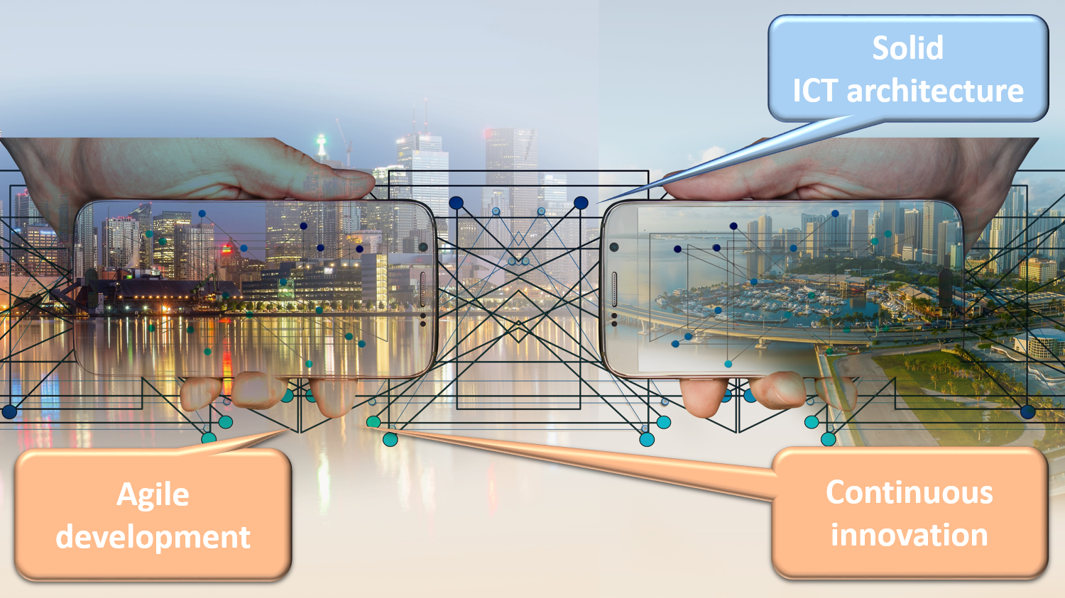
Notes:
3. Solid ICT architecture and continuous innovation
API-approach (application programming interface) and (worldwide) reuse of components, services and best practices

Slide 26
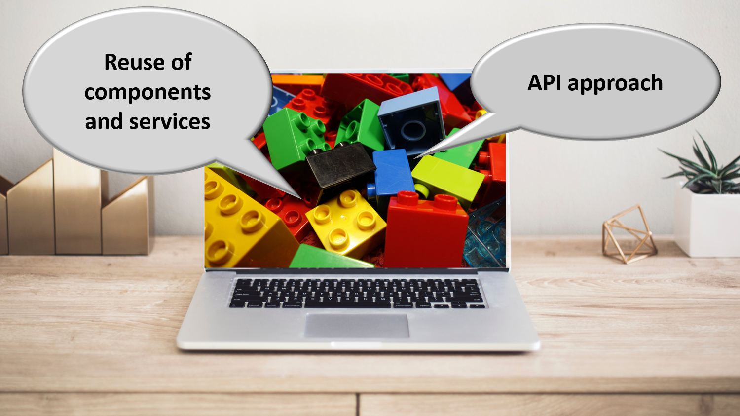
Notes:
sharing ICT infrastructure, platforms, basic services, applications and expertise in order to reduce costs, increase reliability and speed up time to market

Slide 27
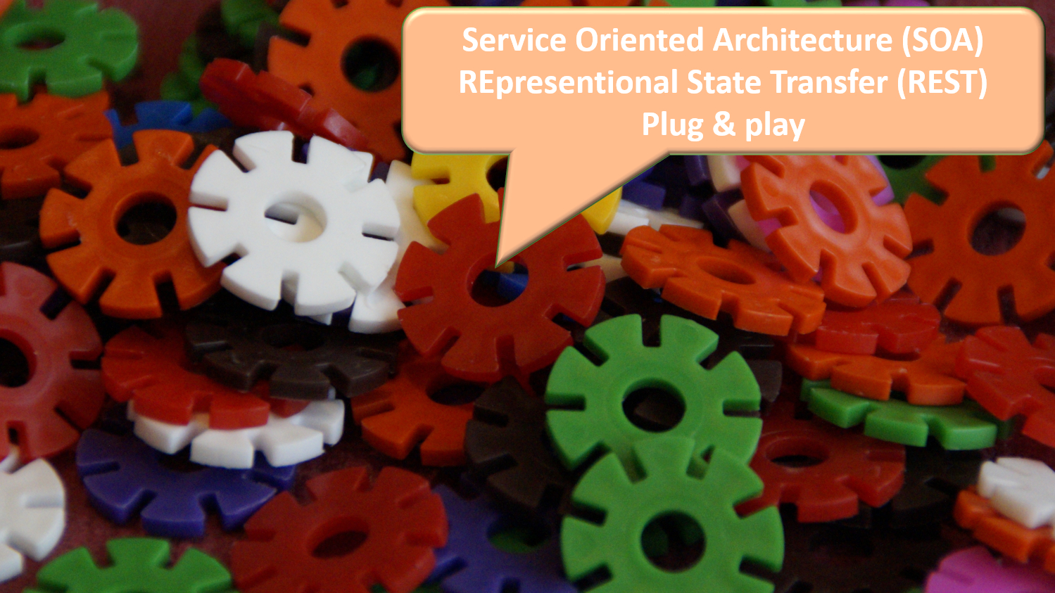
Notes:
service oriented architecture based on REST-full services in a plug and play mode

Slide 28
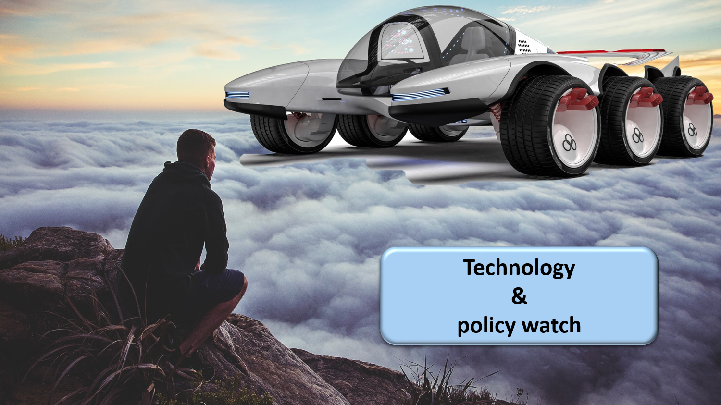
Notes:
technology an policy watch; latest subjects of investigation are

Slide 29

Notes:
mobile applications

Slide 30

Notes:
cloud computing, combining public cloud, for non sensitive information and applications with a community cloud designed and managed by the public sector => cost reduction and faster time to market

Slide 31
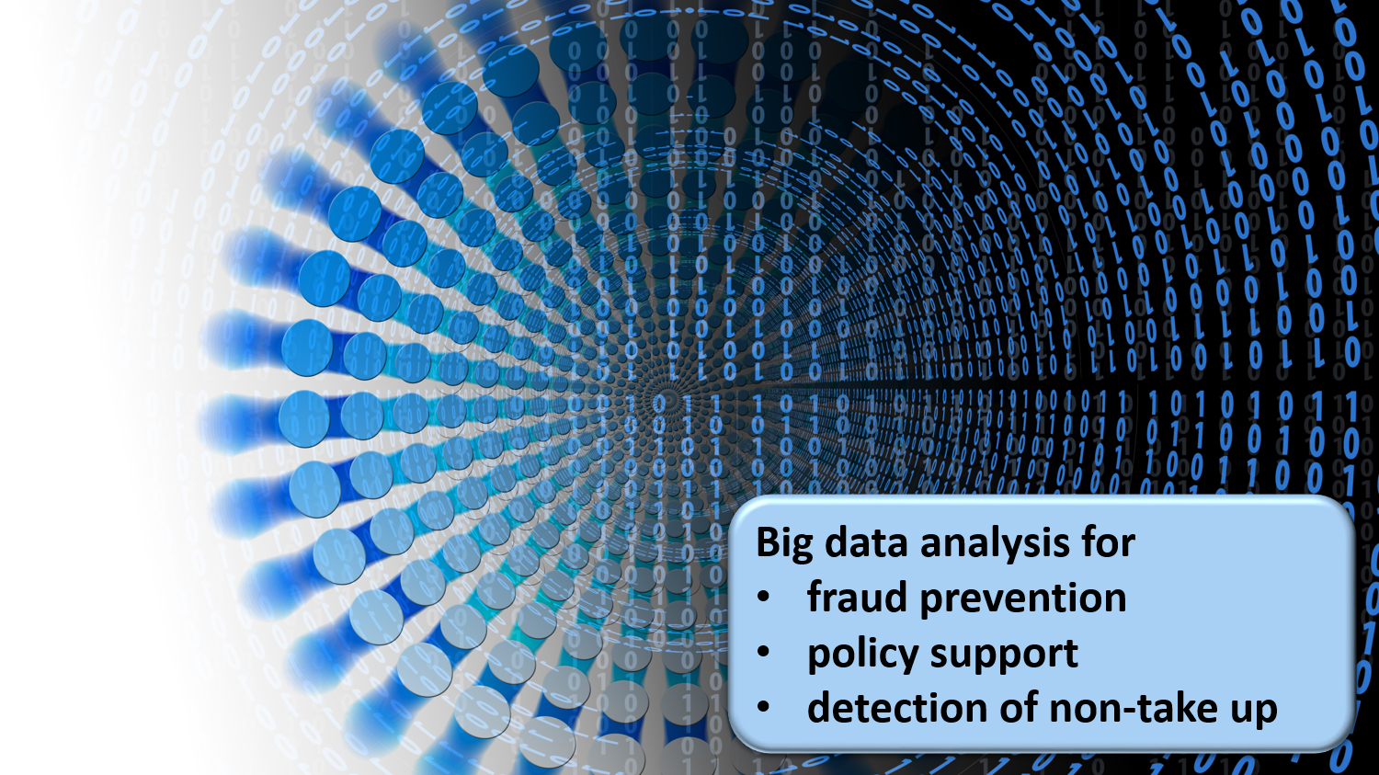
Notes:
big data analysis for fraud prevention, policy support and detection of non take up of benefits

Slide 32
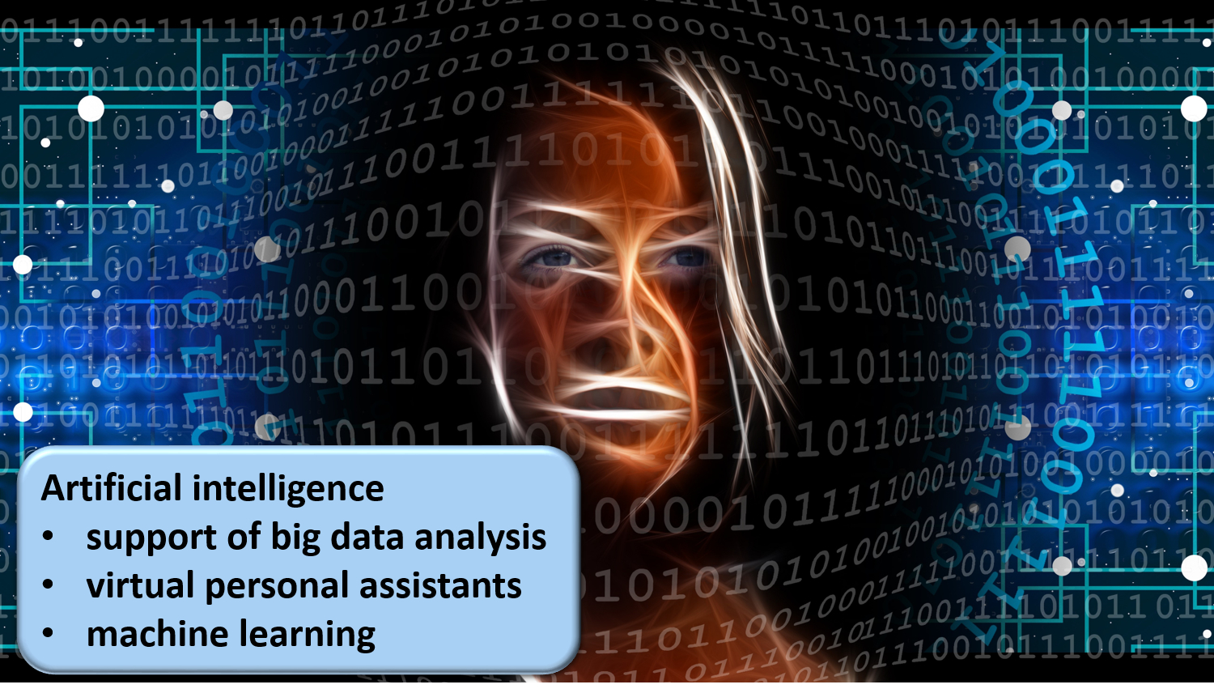
Notes:
artificial intelligence in support of big data analysis, for virtual personal assistants and machine learning
continuous attention for evolution of laws and the politics in the fields of social security, new technologies and information security

Slide 33

Notes:
4. Designating an institution that acts as a driving force is useful
business process re-engineering within and across actors
being a mediator and enabler setting out a long term roadmap for e-services
proactively looking for opportunities in technology and innovation to benefit citizens and enterprises
ensuring continuous delivery of shared ICT services and the retention of crucial skills
program, project and service management
co-operative governance

Slide 34

Notes:
Let the computer do what it is good at and thereby make time available for human support where necessary. And remember: the network always wins

Slide 35
Need for solid architecture

Slide 36
Principles for durable and economically viable ICT solutions
avoid duplication
  anything that is duplicated (if not strictly necessary)
  is a waste of time and money
  and will result in a lower quality of service
enable the right level of execution
  decisions and actions should be dealt with
  at the most immediate (or local) level that is consistent with their resolution
  to enable lean and cost effective operations

Slide 37
Service Oriented Architecture (SOA)
what ?
  “Service Oriented Architecture (SOA) is a paradigm for organizing and utilizing distributed capabilities that may be under the control of different ownership domains. It provides a uniform means to offer, discover, interact with and use capabilities to produce desired effects consistent with measurable preconditions and expectations. This style of architecture promotes reuse at the macro (service) level rather than micro levels (eg. objects). It also makes interconnection of existing ICT assets trivial” (OASIS Reference Group)
characteristics
  service-oriented
  modular
  interoperable (based on open standards or open specifications)
  extensible
  layered
  based on reuse of components and data

Slide 38
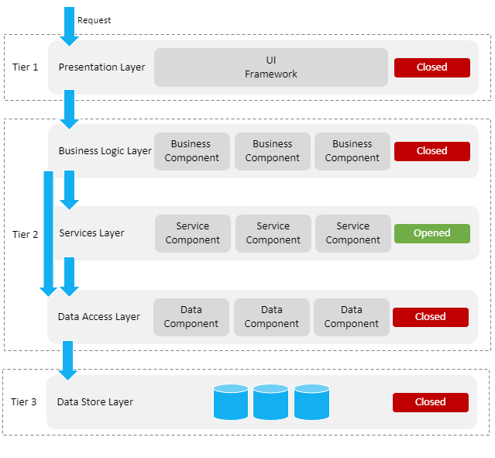
ICT: layered, service oriented architecture
presentation layer, eg
  web applications
  mobile applications
business logic layer, eg
  workflow
services layer, eg
  user & access management service
  communication service
  blockchain
data store layer, eg
  authentic sources
  personal vaults
  local storage on mobile device

Slide 39
ICT: across layers
interoperability standards
  technical: oa APIs (Application Programming Interface)
  semantic
security, eg
  access authorisation
  logging
  business continuity
configuration, eg
  capacity management
  load balancing

Slide 40
Some basic paneuropean requirements
correct identification of every entity (citizens, companies, organisations, …)
correct routing of information request/provision
privacy and information security management
  user and access management
  end-to-end encryption
interoperability standards
  technical
  semantic

Slide 41
Several EC digital programs
Electronic Identification and Trust Services (eIDAS)
European Blockchain Services Infrastructure (EBSI)
  Conformant Wallets
  Verifiable Credentials Playbook
Single Digital Gateway (OOTS)
Electronic Exchange of Social Security Information (EESSI)
European Social Security Pass (ESSPass)
EU Digital COVID Certificate (EU DCC)
European Health Data Space (EHDS)
European Health Data Evidence Network (EHDEN)
...

Slide 42
Need for a global, integrated architecture
need for
  global, integrated architecture across DGs of the European Commission
  based on a common conceptual framework
need for modular, generic, domain agnostic, interoperable and reusable components/services: develop once, use many
no technology driven choice of components and services used, but use of ICT components and services as enabler and means for meeting business requirements
need for the organisation of a set of integrated services on a paneuropean level

Slide 43
Eg RINA: current repartition of responsabilities
MS as APv
Many MS do APv to their end-users with …
… different requirements for SD
… many people to be trained
… big demand for support
EC does Software Delivery
Lot of requirements by different APv
Lot of support to different APv
MS
SD
Software
Delivery
APv
Application Provisioning
inst
EC
inst
MS
inst
MS
inst
inst
“everything needed to deliver a qualitative workable Software Product (SP)”
“everything needed to ensure the SP can be used, qualitatively, by the target audience”
I believe that the nature of deviation in requirements
between MS and institutions does not justify the current amount of duplication of application provisioning (APv)
MS
MS
inst
inst
inst
inst
inst
inst
inst
MS
Institution as APv
Some MS delegate APv to the institution level
MS
inst
Most disparaties arise from technical differences in APv not from business differences

Slide 44
Eg RINA: more optimal repartition of responsabilities
RINA product delivery puts a lot of effort in “middleware” and deployment
EC+
APv
MS
inst
clerks
Multitenancy should be implemented in the product so that administration levels can be divided in:
Institution level admin.
MS(AP) level admin
APv level admin
All MS put a lot of effort in middleware, deployment & infrastructure, service delivery
Current repartition
RaaS repartition
Case handling
Case handling
User mgmt
Usergroup & policy mgmt
Institution ( = tenant )
level configurations
Institution ( = tenant )
level configurations
Institution mgmnt
Related to “IR” mgmt
Related to “AP” mgmt
Member State ( or AP )
level configurations
Member State ( or AP )
level configurations
All service delivery aspects
RINA service delivery
APv Service Delivery
Quality MS management tools should decouple
“software configuration mgmt” from “platform mgmt”
Software components
Installation & user guides
Support & bugfixes
Rqrmnts, change, release mgmt
Rina product delivery
Rina product delivery
Postgress, Holodeck, Bonita, Elastic Search, Tomcat, FileShare
Logbased troubleshooting
Rina middleware
Rina middleware
Because of highly skilled APv team
The SD team should be able to diminish the effort to put into “middleware” and “deployment”
Installation scripts & guides
Technical certificates
Deployment testing
Rina deployment
Rina deployment
Servers
Network, storage
Monitoring, back-up
Rina Infrastructure
Rina Infrastructure

Slide 45
Eg RINA: meeting the principles
Clerks manage their cases
Institutions manage their users
MS manage their institutions
Software Delivery makes the software
APv manages the RaaS platform
EC+
APv
MS
inst
clerks
Enable right level of execution
Avoid Duplication
RaaS deployment
Landscape
Current deployment
Landscape
Close collaboration with SD should lead to a “perfect match” between Software product / middleware and deployment layer
MS 1
MS 2
MS 3
A’
Less diversity in technical setup should lead to less - TOTAL -effort in the middleware and deployment layers for SD
‘
‘‘
‘’‘
A’
‘
‘’
‘’’
A
X
Y
Z
MS 1
MS 2
MS 3
RaaS platform

Slide 46
Example: identity, user and access management (IUAM) according to the international standard XACML

Slide 47
IUAM: objectives to be reached
be able to (electronically)
  identify all relevant entities (physical persons, companies, applications, machines, …)
  authenticate the identity of all entities
  know the relevant characteristics of the entities
  know the relevant relationships between entities
  know that an entity has been mandated by another entity to perform a legal action
  know the authorizations of the entities
in a sufficiently certain and secure way
in as much relations as possible (C2C, C2B, C2G, B2B, B2G, …)
multichannel (web application, mobile application, …)
using open interoperability standards

Slide 48
User expectations
one-time registration of identity, characteristics, relationships and mandates
possibility of auto registration/bootstrap and auto recovery of credentials once a top level authentication (eg eID) is available
single sign on for as many public and private sector applications as possible
  authentication of the identity
  verification of relevant characteristics, relationships and mandates
electronic means for authentication of identity that can be used on as much devices as possible
minimal cost of
  registration procedures
  electronic means for authentication of identity
  use of electronic means for authentication of identity

Slide 49
Critical success factors
meeting user expectations
simplicity in use
taking advantage of opportunities of technological evolution => evolutionary, future proof solutions
accordance with the European regulatory framework
sufficient applications for which electronic user management can be used

Slide 50
Policy Enforcement Model (XACML)
Action on application
DENIED
Policy
Enforcement
(PEP)
Action on application
PERMITTED
User
Application
Action on application
Decision
request
Decision
reply
Policy
Decision
(PDP)
Information
request/reply
Policy
retrieval
Information
request/reply
Policy management
Policy
Administration
(PAP)
Policy
Information
(PIP)
Policy
Information
(PIP)
Manager
Policy repository
Authentic source
Authentic source

Slide 51
Example: digital wallet (eg for eEHIC)

Slide 52
Existing components
every MS has a responsive web application and/or native mobile app for downloading electronic COVID-19 vaccination, test and recovery certificates according to common EU standards
  see https://health.ec.europa.eu/ehealth-digital-health-and-care/ehealth-and-covid-19_en for the detailed specifications and the legal framework)
every electronic certificate is a structured electronic document
  based on a common JSON (JavaScript Object Notation) description
  that contains a QR-code with the content of the electronic certificate
  the QR-code is electronically signed by the issuer
the European Commission manages a database containing the public signature keys of the issuers of the electronic certificates
every MS has a responsive web application and/or native mobile app that is/are able
    to scan the QR-code
    to check the validity of the QR-code
    to send the content of the electronic certificates to other applications via an API

Slide 53
Eg: possible reuse for eEHIC
definition of a common JSON description for the eEHIC
every MS capitalizes on the responsive web application and/or native mobile app used for the COVID-19 certificates, by which a citizen
  can download an eEHIC
  after authentication of its identity based on an electronic authentication means of eIDAS level ‘high’ and
  locally store and/or print the eEHIC
advantages
  immediate possibility to obtain an eEHIC online
  with the same content as the (actual) EHIC
  anywhere and anytime
  that can be electronically authenticated and read by
    the holder
    every health care provider throughout the EU

Slide 54



frank.robben@mail.fgov.be
@FrRobben
https://www.frankrobben.be
https://www.ksz.fgov.be
https://www.ehealth.fgov.be

Slide 55
Infotheque

Slide 56
Common vision & cooperation

Slide 57
Common vision on information management
information is being modelled
  in such a way that the model fits in as closely as possible with the real world
  in order to allow multifunctional use of information
information is collected from citizens and companies only once by the social sector as a whole
  via a channel chosen by the citizens and the companies
  preferably from application to application
  and with the possibility of quality control by the supplier before the transmission of the information
the collected information is validated once
  according to established task sharing criteria
  by the actor that is most entitled to it or by the actor which has the greatest interest in correctly validating it

Slide 58
Common vision on information management
a task sharing model is established indicating which actor stores which information as an authentic source, manages the information and maintains it at the disposal of the authorized users
information can be flexibly assembled according to ever changing legal concepts
every actor has to report probable errors of information to the actor that is designated to validate the information
every actor that has to validate information according to the agreed task sharing model, has to examine the reported probable errors, to correct them when necessary and to communicate the correct information to every known interested actor
once collected and validated, information is stored, managed and exchanged electronically to avoid transcribing and re-entering it manually

Slide 59
Common vision on information management
electronic information exchange can be initiated by
  the actor that disposes of information
  the actor that needs information
  the organisation that manages the interoperability framework
electronic information exchanges take place on the base of a functional and technical interoperability framework that evolves permanently but gradually according to open market standards, and is independent from the methods of information exchange
available information is used for
  the automatic granting of benefits
  prefilling when collecting information

Slide 60
Common vision on information security
security, availability, integrity and confidentiality of information is ensured by integrated structural, institutional, organizational, HR, technical and other security measures according to agreed policies
personal information is only used for purposes compatible with the purposes of the collection of the information
personal information is only accessible to authorized actors and users according to business needs, legislative or policy requirements
the access authorization to personal information is granted by an Information Security Committee, designated by Parliament, after having checked whether the access conditions are met
the access authorizations are public

Slide 61
Common vision on information security
every actual electronic exchange of personal information has to pass an independent trusted third party and is preventively checked on compliance with the existing access authorizations by that trusted third party
every actual electronic exchange of personal information is logged, to be able to trace possible abuse afterwards
every time information is used to take a decision, the information used is communicated to the person concerned together with the decision
every person has right to access and correct his/her own personal data
every actor in the social sector disposes of an information security officer with an advisory, stimulating, documentary and control task

Slide 62
Blockchain

Slide 63


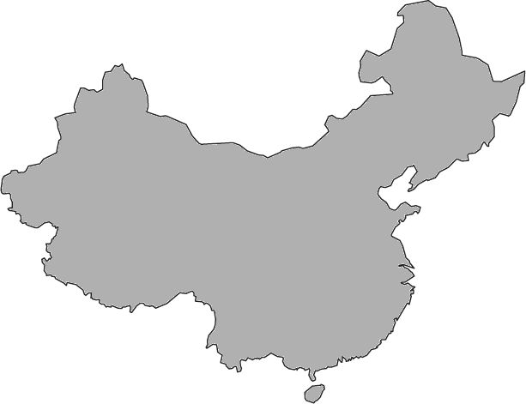
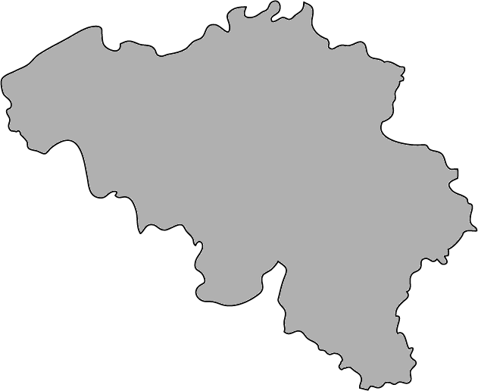




Traditional international transaction
Bob
Alice

Slide 64







Idea
Ok!
Transactions
5,1 BTC →
0,7 BTC →
I transfer
0,4 BTC to .
Dave
0,4 BTC →
Transactions
5,1 BTC →
0,7 BTC →
Ok!
Transactions
5,1 BTC →
0,7 BTC →
0,4 BTC →
Bob
0,4 BTC →
Charlie
Ok!
Transactions
5,1 BTC →
0,7 BTC →
Alice
0,4 BTC →

Slide 65

A chain of blocks
Block 50
Block 51
Block 52
Block 53
Block 54
Header
Header
Header
Header
Header
5,10 BTC →
0,40 BTC →
0,70 BTC →
Concatenation of blocks, which contain transactions
At predetermined frequency, the network appends new block with most recent transactions
Blockchain contains ALL transactions
Transaction in blockchain cannot be removed
Many entities possess same copy of the blockchain

Slide 66







Traditional contract
Text
Contract enforced by legislation
Trusted authority may be required

Slide 67
Smart contract
More complex reality
Code
Text
Contract enforced by technology
Quicker &
more efficient
No trusted authority required

Slide 68


Smart contract
Ether (Ξ) is the crypto-
currency on Ethereum
getMoney()
Contract Auction{
function bid()
function getMoney()
HighestBid: Ξ
HighestBidder:
Beneficiary: Charlie
}
Charlie
20 Ξ
bid(), 10 Ξ
0
10
20
10 Ξ
Bob
bid(), 20 Ξ
Alice
Alice
Bob
Can receive, block and spend value
No single entity can influence correct functioning
Reactive
Deaf and blind

Slide 69
Smart Contracts
Publishing a contract, calling its functions & destroying it happens through transactions
Block 50
Block 51
Block 52
Block 53
Block 54
Block 55
Block 56
Header
Header
Header
Header
Header
Header
Header
Publish contr.
Bid Bob
getMoney
Destroy contr.
Bid Alice

Slide 70




Blockchain is about organizing trust
Blockchain network can help with
Registration of facts
Transfer of assets
Enforcement of rules

Slide 71





Blockchain network
Distributed
Robust
Scalable
Many nodes possible
Append-only

Slide 72
Everything that can be done with a blockchain, can be done with a centralized approach, and even more efficiently
Why blockchain?
A centralized approach might not be desirable
Politics
(E.g. cross-border exchanges, privacy)
Absence of trusted authorities
(E.g. Bitcoin in 2009)
Abuse (quasi-) monopoly positions
Illegal activities
(E.g. Dark Web)
Other blockchain advantages also feasible with other technologies
Process automation
Consistency
Streamlined processes
Real-time updates
Insight in decision proces

Slide 73
Blockchain is about Trust
In case of a centralized approach,
is it an issue that a central entity needs to be trusted?
Blockchain is a bad idea
Blockchain might be an option

Slide 74
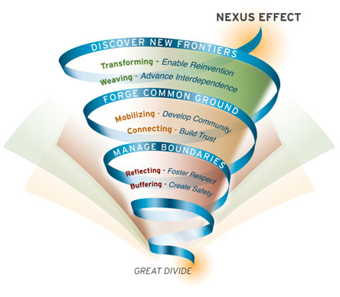
Nexus effect
Source: MIT Sloan

