Slide 1
Draft regulation on European Health Data Space (EHDS)
Main Belgian suggestions

Slide 2
Objectives of the European Health Data Space
Notes:
As a citizen
You will have control over health data:
You will have access to your health data in electronic form immediately and without any cost.
You will be able to share your data with health professionals nationally or crossborder.
You will be able to add information, rectify errors, restrict access and obtain information on how your data are used.
You will have a right to health data, issued and accepted, in a common European format.
Your security and privacy will be ensured
Researchers, industry or public institutions will have access to health data only for specific purposes that benefit individuals and society.
The researcher, industry or public institution may only access data that do not reveal the identity of the individual.
The data may only be accessed and processed in closed, secure environments.
As a researcher
You will have access to large amounts of health data, of higher quality, in order to carry out research.
You will be able to know what data is available, where, and of what quality.
You will be able to access the data cheaper and more effectively.
As regulators and policy-makers
You will have easier, more transparent and less costly access to non-identifiable health data for the benefit of public health and the overall functioning of healthcare systems and to ensure patient safety.
As industry
Thanks to standardization, you could more easily enter into new markets for electronic health records in other Member States.
You will benefit from the greater availability of non-identifiable electronic health data, enabling the use of data for innovation.

Slide 3
Evaluation EHDS Regulation
great opportunity for EU-wide eHealth environment
remarks
  too detailed regulation => risk of slowing down evolution
  too extensive delegations to the European Commission on implementation methodologies
  too little directly adressing to health care providers and health care organisations
  need for a commitment from European Commission to develop and provide (free) pan-european ICT components and services
proposal of amendments have been sent to the European Commission

Slide 4
Less detailed regulation
the EHDS regulation should be limited to the basic objectives and principles of the EHDS
it must not go into such detail that it prevents appropriate response to
  social and technological evolutions or
  new scientific insights

Slide 5
Need for clarification of relationship between regulations
the relationship between the EHDS Regulation and other regulations such as the General Data Protection Regulation needs to be clarified precisely
Belgium is not in favor for
  restricting the possibilities for processing health data provided for in the General Data Protection Regulation or
  providing for additional formalities

Slide 6
Direct adressing to healthcare providers & software providers
the EHDS requires minimum common standards and functionalities throughout the European Union
a regulation is an appropriate legal instrument for this purpose
it is desirable that the regulation, subject to compliance with articles 16, 114 and 168 TFEU, is aimed directly at healthcare providers, healthcare institutions and software providers and does not make compliance with the common standards and functionalities unnecessarily dependent on interventions by the MS

Slide 7
Need for paneuropean basic services offered by the EC
the regulation aims to organize a EHDS throughout the European Union
article 168 of the Treaty on the Functioning of the European Union (TFEU) provides that the EC should support the MS in this regard
the objectives laid down in this regulation can only be optimally achieved if the EC itself offers a number of pan-European basic services free of charge
examples of such services are
  a coordinated system of user and access management
  an end-to-end encryption system
  an electronic time stamping system
  test environments for checking compliance with established standards
  …
the principle of the free provision of such pan-European services by the European Commission as controller, and the listing of the minimum services offered must be included in the regulation

Slide 8
Paneuropean services

Slide 9
Some basic paneuropean requirements
correct identification of the patient
correct routing of information request
privacy and information security management
  user and access management
  end-to-end encryption
interoperability
  technical
  semantic

Slide 10
Example of paneuropean service: identity, user and access management according to the international standard XACML

Slide 11
Functional requirements
reliable exchange of personal data requires sufficient certainty about the identity of the data subjects
adequate access control requires sufficient certainty about
  the identity of the users
  the authentication of the identity of the users
  the verification of the relevant characteristics of the users
  the verification of relevant relationships
    between the users and the data subjects
    between the users and other entities
  the verification of relevant mandates of the users

Slide 12
IUAM: objectives to be reached
be able to (electronically)
  identify all relevant entities (physical persons, companies, applications, machines, …)
  know the relevant characteristics of the entities
  know the relevant relationships between entities
  know that an entity has been mandated by another entity to perform a legal action
  know the authorizations of the entities
in a sufficiently certain and secure way
in as much relations as possible (C2C, C2B, C2G, B2B, B2G, …)
multichannel (web application, mobile application, …)
using open interoperability standards

Slide 13
User expectations
one-time registration of identity, characteristics, relationships and mandates
possibility of auto registration/bootstrap and auto recovery of credentials once a top level authentication (e.g. eID) is available
single sign on for as many public and private sector applications as possible
  authentication of the identity
  verification of relevant characteristics, relationships and mandates
electronic means for authentication of identity that can be used on as much devices as possible
minimal cost of
  registration procedures
  electronic means for authentication of identity
  use of electronic means for authentication of identity

Slide 14
Critical success factors
meeting user expectations
simplicity in use
taking advantage of opportunities of technological evolution => evolutionary, future proof solutions
accordance with the European regulatory framework
sufficient applications for which electronic user management can be used

Slide 15
Policy Enforcement Model (XACML)
Action on application
DENIED
Policy
Enforcement
(PEP)
Action on application
PERMITTED
User
Application
Action on application
Decision
request
Decision
reply
Policy
Decision
(PDP)
Information
request/reply
Policy
retrieval
Information
request/reply
Policy management
Policy
Administration
(PAP)
Policy
Information
(PIP)
Policy
Information
(PIP)
Manager
Policy repository
Authentic source
Authentic source

Slide 16
Policy Enforcement Point (PEP)
intercepts the request for authorization with all available information about the user, the requested action, the resources and the environment
passes on the request for authorization to the Policy Decision Point (PDP) and extracts a decision regarding authorization
grants access to the application and provides relevant credentials
Action on application
DENIED
Policy
Enforcement
(PEP)
Action on application
PERMITTED
User
Application
Action on application
Decision
request
Decision
reply
Policy
Decision
(PDP)

Slide 17
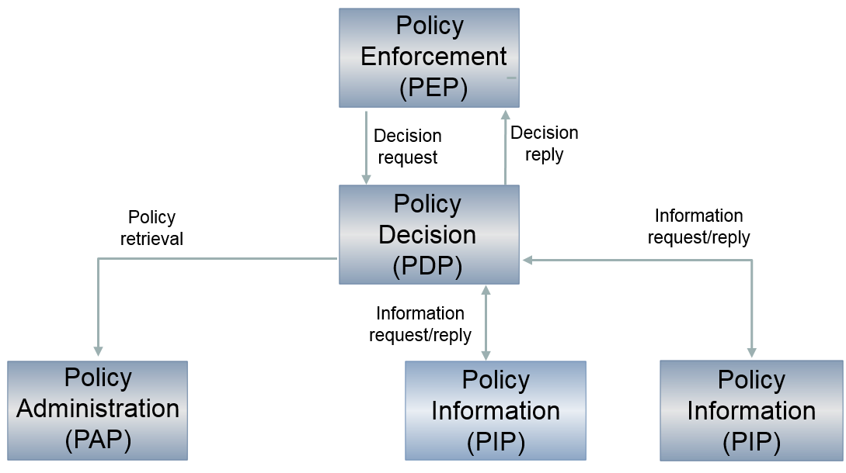
Policy Decision Point (PDP)
based on the request for authorization received, retrieves the appropriate authorization policy from the Policy Administration Point(s) (PAP)
evaluates the policy and, if necessary, retrieves the relevant information from the Policy Information Point(s) (PIP)
takes the authorization decision (permit/deny/not applicable) and sends it to the PEP

Slide 18
Policy Administration Point (PAP)
environment to store and manage authorization policies by authorized person(s) appointed by the application managers
puts authorization policies at the disposal of the PDP
Policy
Decision
(PDP)
Policy
retrieval
Policy management
Policy
Administration
(PAP)
Manager
Policy repository

Slide 19
Policy Information Point (PIP)
puts information at the disposal of the PDP in order to evaluate authorization policies (authentic sources with characteristics, relationships, mandates, etc.)
Policy
Decision
(PDP)
Information
request/reply
Information
request/reply
Policy
Information
(PIP)
Policy
Information
(PIP)
Authentic source
Authentic source

Slide 20
Transborder aspects
Country A
Country B

Slide 21
Example of paneuropean service: end-to-end encryption

Slide 22
End-to-end encryption
2 methods:
  in the case of a known recipient: use of an asymmetric encryption system (2 keys)
  in the case of an unknown recipient: use of symmetric encryption
    the information is encrypted and stored outside the trusted third party system
    the decryption key can only be obtained through the trusted third party system

Slide 23
Asymmetric end-to-end encryption
Healthcare actor
Person or entity
Certification authority
Internet
1
3
Connector or
other software to
generate key pair
Authenticates sender
2
4
Sends
public key
Identification
certificate
Identification certificate
Stores
public key
Web service
Register key
2
Public keys
repository
Stores private key
in a secure way

Slide 24
Asymmetric end-to-end encryption
Message originator
Certification authority
Internet
1
Identification certificate
Web service
Ask public key
Identification
certificate
2
Asks for public key
Authenticates sender
Send message
Any protocol
3
4
Sends
public key
Encrypts
message
Identification
certificate
Message recipient
Public keys
repository
5
Stored
private
key
Decrypts message

Slide 25
Symmetric end-to-end encryption
Key
management
/ depot
Encrypted with public key of user 1
Encrypted with public key of user 2
Symmetric key
Symmetric key
2 sends key
5 receives key
User 1
Originator
1 asks for key
User 2
Recipient
4 justifies right to
obtain key
4 justifies right to
obtain message
3 sends encrypted message
Encrypted with public key of Message depot
5 receives message
Encrypted with public key of User 2
Message encrypted with
symmetric key
Messages
depot
Message encrypted with
symmetric key
Message encrypted with
symmetric key

Slide 26
Several EC digital programs
GAIA-X
Electronic Identification and Trust Services (eIDAS)
European Blockchain Services Infrastructure (EBSI)
  Conformant Wallets
  Verifiable Credentials Playbook
Single Digital Gateway (OOTS)
Electronic Exchange of Social Security Information (EESSI)
European Social Security Pass (ESSPass)
EU Digital COVID Certificate (EU DCC)
European Health Data Space (EHDS)
European Health Data Evidence Network (EHDEN)
...

Slide 27
Need for a global, integrated architecture
need for
  global, integrated architecture across DGs of the European Commission
  based on common conceptual framework
need for modular, generic, domain agnostic, interoperable and reusable services and components: develop once, use many
no technology driven choice of components and services used, but use of ICT components and services as enabler and means for meeting business requirements

Slide 29
Proposal of conclusion
common feeling that we are discussing a legal text , but don’t have the possibility to have a discussion on more conceptual points (organisational, technical)
we don’t want to slow down EHDS, but we want to be it a success
themes
  clarity on division of decision-making power between MS and EC
  evaluation of existing components/services
    what is working well ? what is lacking ?
    what has to be done by MS and what preferably by EC ?
  definition of needed paneuropean services (high level)
  relationship to GDPR
  what obligations should be adressed to the MS and what obligations to the health care providers and/or software industry
  funding

