Slide 1
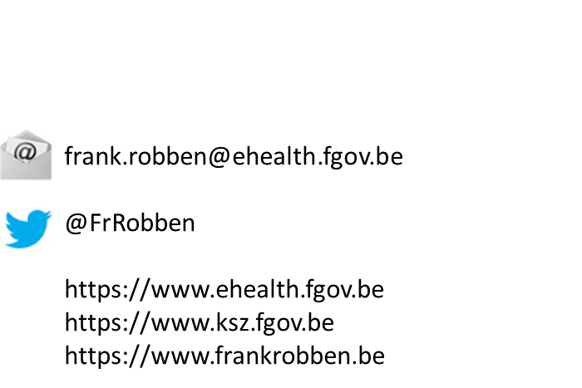
eHealth network ICT systems: an improvement for endoscopic management ?
Notes:
NL

Slide 2

















Overview of the online healthcare landscape in Belgium
Authentic sources

Slide 3














Medical benefits
Consultation of medical history via SumEHR
Online guidelines and decision support
Medical benefits
Electronic
prescriptions
Medication
schedule
Results and reports of examinations
Electronic
referral letters

Slide 4





Benefits at the end of the consultation
Insurance status, pricing, billing
Update of SumEHR, medication schedule,
...
Benefits at the end of the consultation
Creation and sending of certificates
Registration
Sending a report to the holder of the GMF

Slide 5











Some key figures
2021
> 90 %
of Belgian citizens
have given their informed consent
for the sharing of data
19.600.000.000
electronic transactions
193 million
messages/year
using the eHealthBox
Electronic prescriptions
13,4 million/month
> 28 million
consultations of Personal Health Viewer
> 5,5 million
Belgian patients with
Summary Electronic Health Records
in health vaults
> 29.000
> 4000
  +/- 500 million
  electronic documents available
  in hospitals and clinical laboratories
> 12 million
eAttest
5

Slide 6









Basic architecture
Patients, healthcare providers
and healthcare institutions
Health portal
Software healthcare provider
Users
Software healthcare institution
AVS
Website NIHDI
AVS
eHealth portal
MyCareNet
AVS
AVS
AVS
Basic services
eHealth platform
Network
Suppliers
VAS
VAS
VAS
VAS
VAS
VAS
Notes:
6
6

Slide 7
Objectives of the eHealth platform
How?
  by means of a well organized, mutual electronic service delivery and information exchange between all healthcare actors
  with the necessary guarantees with regard to information security, privacy protection and professional secrecy
On which purpose?
  optimization of healthcare quality and continuity
  optimization of patient safety
  simplification of paperwork for all healthcare actors
  offering a thorough support to healthcare policy

Slide 8
10 missions
To develop a vision and a strategy with regard to online health
To organize the cooperation with other public authorities in charge of the coordination of electronic services
To act as a key driver for the necessary changes in order to carry out the vision and strategy with regard to online health
To establish the functional and technical norms, standards and specifications and the basic ICT architecture
To register software for the management of electronic patient files
To create, develop and manage a cooperative platform for a secure electronic data exchange, and also the corresponding basic services

Slide 9
10 missions
To agree on a division of tasks and quality standards and to verify whether these standards are complied with
As an independent trusted third party (TTP), being in charge of the coding and anonymization of personal health data for the benefit of specific agencies, as established by law, in order to support scientific research and policy
To promote and coordinate the development of programmes and projects
To manage and coordinate the ICT aspects of data exchange within the framework of electronic patient records and electronic medical prescriptions

Slide 10
Basic services & API’s
Coordination of the electronic processes
Portal
Integrated user and access management system
Management of loggings
System for end-to-end encryption
eHealthBox
Timestamping
Coding and anonymising
Consultation of National register and CBSS registers
Reference directories (hub-metahub system)

Slide 11
Integrated user and access management
Ensures that only healthcare providers and institutions have access to
  the services they may access
  regarding the people for whom they have been granted access
Access rules are set by law and by authorisations from the Information Security Committee
Steps
  identification of the user
  authentication of the user’s identity
  quality control (e.g. physician, pharmacist)
  relationship checks (e.g. therapeutic relationship with the patient)
  authorisation

Slide 12
Integrated user and access management

Slide 13
Reference directory (hub-metahub)
The service “Reference directory” (Metahub) of the eHealth platform and the complementary services 'Consent', 'Therlink' and 'Exclusions' are a set of services for managing access to a patient's medical data
Services are accessible, depending on the case, to hubs, individual care providers, some care institutions such as hospitals or pharmacies and finally to patients
In other words, it is an index of personal health data of patients
Such an index is the keystone for the implementation of any decentralised system of health data sharing between healthcare providers and organisations

Slide 14






Reference directory (hub-metahub)
3 Retrieve data from hub A
A
1 : Where can we find data?
2 : In hub A and C
4 :
All data available
3 : Retrieve data from hub C
C
B

Slide 15




Extramural data : health vaults
A
InterMed
BruSafe
C
B

Slide 16
eHealthBox
Secure electronic mailbox, particularly developed for the healthcare providers and institutions
Goal: to ensure a secure electronic communication of medical and confidential data between the Belgian healthcare actors
Available as
  a web service (accessible through a medical software)
    for which the eHealth platform has developed a web service allowing to send messages to the eBox Citizen and the eBox Enterprise from the software of the healthcare provider
  a web application (accessible through a computer and an eID/ITSME or TOTP)

Slide 17
6 Clusters in eHealth roadmap
1. Quality, continuity and safety of care
2. Citizen empowerment and access to health data and services
3. Health care provider empowerment and access to health data and services
4. Facilitate the exchange of data on care and health
5. Innovation and stimulation of research and development
6. Digitizing and optimizing administrative processing

Slide 18
Some of the accents
Quality, continuity and safety of care
  integrated & multidisciplinary care, BelRAI
  electronic prescription and referrals
  decision support: prescribing antibiotics (AMR), lab tests, medical imaging, …
  VIDIS (shared medication scheme)
  structured exchange of results of examinations
  home care: teleconsultation, mHealth, health technology assessment
  regions
    Flanders: DZOP, BelRAI, Vitalink, data space
    Wallonia: platform patient/citizen & health care provider, ‘Wall in health’ data space)
    Brussels

Slide 19
VIDIS (Virtual Integrated Drug Information System)
Organise and stimulate the sharing of data and information between all parties involved in the medical process
  the patient and his entourage
  ambulatory healthcare providers between them (doctors, pharmacists, etc.)
  the ambulatory care providers and the hospital environment
Objectives
  to harmonise all processes associated with medicines
  prescription and delivery of medicines
  medication review
  encourage collaboration between medication data sharing systems
  optimise the quality of the available medicines

Slide 20
VIDIS (Virtual Integrated Drug Information System)
For the patient
  development of the web application 'MyMedication‘
  the medication chart and diary notes are already available for patients in Flanders (if a medication chart and/or diary notes are available for this patient)
For the healthcare provider
  since February 2021, healthcare providers can view their patients' data via the MyInami portal (ProSanté/ProGezondheid - to be)
    if they have the right to view the medication record according to the access matrix of the eHealth platform

Slide 21
Results of examinations: focus on semantic standards
Currently, several coding systems co-exist
Objective: general use of
  results in structured digital format
  LOINC codes
Planning
  phase 1: exchange of structured LOINC lab results in between labs and GPs
  phase 2: exploitation of structured LOINC lab results via the hubs-metahub system by all care providers and patients
  phase 3 in progress (not yet approved): reflection on the possibility for research purposes
    work volume of data > introduction of artificial intelligence tools

Slide 22
Some of the accents
Empowerment of citizens and access to health data and services
  access management: informed consent (IC), therapeutic relationship (TR), health care provider exclusion, mandates, logging -> still need for paradigm shift (access by health care providers having TR is default) ?
  education & literacy
  Personal Health Viewer (PHV) -> Personal Health Record (PHR)
    user friendliness
    direct data access
    in line with European Health Data Space
  participative & active citizen/patient
    journal
    possibility to suggest improvements
    Patient Reported Outcome/Experience Measures (PROM/PREM)

Slide 23
Some of the accents
Empowerment of caregivers and access to health data and services
  Electronic Patient Record (EPR) for every healthcare provider
    Quality-Law
    registration of software
  EPR in each healthcare institution
    Belgian Meaningful Use Criteria (BMUC)
    registration
    funding of specific domains
  training and literacy health care providers: use of standards, application of legislation
  integrated care, multidisciplinary cooperation: BelRAI
  portal health care provider
  incentives

Slide 24
Some of the accents
Facilitating the exchange of care and health data
  care sets
    definition
    good governance
  standards
    semantic interoperability: Snomed CT, ICD-11
    technical interoperability: FHIR
    guidance on implementation
  metadata definition and use
  MyHealth@EU
    cross border patient summary & prescription
  authentic sources
    COBRHA+
    SAM

Slide 25
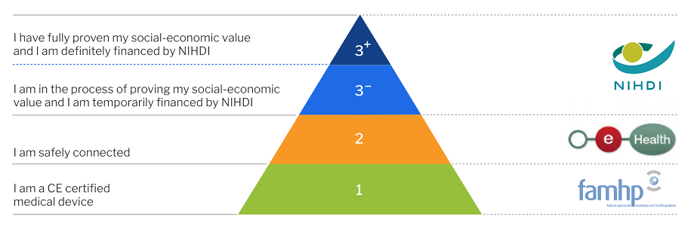
Some of the accents
Innovation and promotion of research and development
  secondary use of data (Health Data Authority)
    access to anonymized and pseudonymised data
    FAIR-principle (findable, accessible, interoperable, reusable)
  telecare, homecare
  artificial intelligence (AI) (AI4Health)
  health technologies in general (KCE study HTA), oa mHealth -> need for review of validation pyramid ?
Notes:
Link met Wallet (EU-SocSec-Pass, MyBenefits, …)
Mult-eMediatt, Herintegratie, … hoe deze projecten laten slagen …
Administratieve vereenvoudiging
Verdere verplichting gebruik elektronische MyCarenet diensten ?

Slide 26
Data sources
Supporting/facilitating secondary use
Role of the Health Data Authority (HDA)
Detect secondary use needs
Determine access strategy
Master data management
Document data sources
Document disclosure processes
Organization data validation
Organization of separation of functions
Training of users and analysts
Organization small cell risk analysis
Organization FAIR portal data catalogue
Advocacy and communication
Coordination of access infrastructure
Legal support
Assure security & Privacy
deal with bottlenecks
Secondary use
Healthdata.be
HCP / HCI
DB
HCP / HCI
EPD
Research institutions
FPS PH, Food Chain Safety, Environment
MCD & MND & MPD
Industry
Government
(KCE, NIHDI, Sciensano, Federated Entities)
Health Insurance Fund
IMA
Role of the eHealth platform
Availability of basic services
Trusted Third Pary
…
DB
DB
Health Insurance Funds
Role of the Information Safety Comité
generic deliberations to validate standard working practices
specific deliberations on data exchanges
Citizens
Socio-economic actors
CBSS
DB
DWH
EU / International
Notes:
Andere bronnen/gebruikers: Deelstaten, RIZIV
Master data management (MDM) is a technology-enabled discipline in which business and information technology work together to ensure the uniformity, accuracy, stewardship, semantic consistency and accountability of the enterprise's official shared master data assets.
Doelstellingen:
Roadmap
Innovatie en stimuleren van onderzoek en ontwikkeling (secundary use)
Toegang tot geanonimiseerde en gepseudonimiseerde gegevens
FAIR-principe (findable, accessible, interoperable, reusable)
open data en big data
Health Data Authority
faciliterende instantie
Master Data Management
Documentatie van gegevensbronnen, datacataloog
Opleiding van gebruikers en analisten
Waarborgen transparante, vertrouwensvolle, deontologisch en ethisch correcte verwerking
…

Slide 27
Some of the accents
Digitising and optimising administrative processing
  Mult-eMediatt -> overall implementation (private sector – FEB/Agoria)
  Mediprima -> taking charge of medical care costs by OCMW (no priority for software providers)
  eBirth
  continuation of MyCarenet (sickness funds)
    eFac, eAttest, eTarif, eGMD, …
    extension to other sectors and provision of service packages
    implementations for the regionalised sectors
    integration in hospital EPDs mandatory (eg Hst IV / CIVARS)
  professional reintegration
  good governance of projects and roadmap

Slide 28
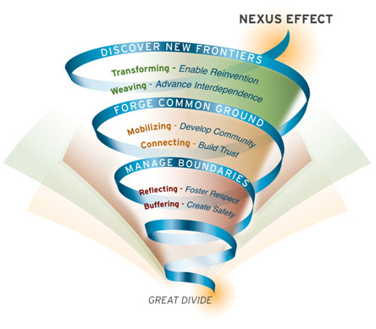
Source: MIT Sloan

Slide 29




