Slide 1

SMIS
Short Message Integration Service

Slide 2
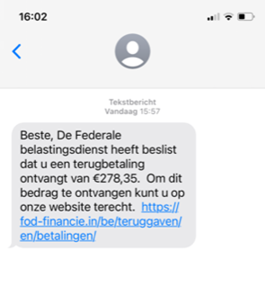

Why GovApp
Mobile phones are a valuable communication channel to citizens
SMS are
  Not user-friendly
    (Very) Short
    Poor (Text only)
  Costly
  Potentially not safe
CovidSafe is hugely installed (~ 8,5 million)

Slide 3
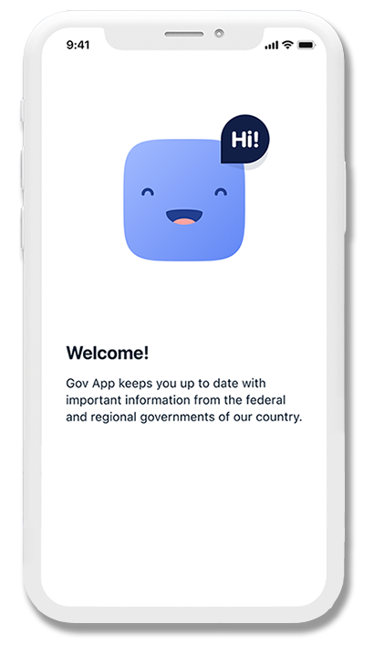
GovApp
GovApp
  Mobile application
  For short notifications
    Supporting html rendering (images, embedded videos, …)
  From the authorities (exact scope to be defined)
    Integrated with SMIS (Short Message Integration Service)
  To the citizen
    Identified with his phone number
  In a secure way
    Validation of the citizen’s phone number
    End to End Encryption (E2EE) of the message’s private body
    Strong authentication of the authorities
  In 4 languages
  More information on https://www.govapp.be/

Slide 4
SMIS
Short Message Integration Service (SMIS)
  Synchronous REST API with added value
  For the transmission of short messages
    With GovApp via Digitaal Vlaanderen
    With SMS via RingRing (Proximus)
  From the integrated authorities
  To the citizen
    Identified with his phone number
  With predefined strategies (GovApp first & SMS fallback, GovApp only, …)
  With a synchronous feedback status about the sending
  With E2EE manageable by the sending authority or SMIS

Slide 5







High Level Architecture
Smals
covid applications
Citizen’s (smart)phone
Short Messaging
Integration Service
Mobile App
GovApp
eHealth API GW
Other API GWs
Mobile App
Messaging service
Current standards for users are applied in their domain
In-depth knowledge of sector & users by the
API GW owner
Wider specific domain users recognition
Application of an
health authority
Other notification application ?

Slide 6
Benefits
For the authorities
  A simple and unique way to send short notifications to the citizen
  With free transactions (with GovApp)
For the citizen
  All short notifications of authorities are available in one mobile application
  With the guarantee that the messages are genuine
  With strong GDPR protection
    The private body is encrypted
  Messages are more user-friendly

Slide 7

GovApp as a service
Availability as G-Cloud service
Published on https://www.gcloud.belgium.be/nl/services
Service mode
  Joint service owners: Digitaal Vlaanderen (GovApp) & Smals (SMIS)
  SLA : 24/7 99%
  Active monitoring
  Internal support chain between service owners & integrated authorities
  Technical & business metrics for internal use
  Integration guideline available

Slide 8
Accessible for all authorities & relevant business cases
Who is allowed to send messages to GovApp ?
  Any public authority and social security institution
    At any level (federal, regional, local …)
    Including their subcontractors
    For public interest business cases
  Other recognized field actors with public interest
    No commercial purpose
    Defined by the G-Cloud Operational Board (unanimity) or G-Cloud Strategic Board (escalation)
    Ex : health care providers, …
Who controls the access and the business cases ?
  For pre-approved actors & public interest business cases : Smals & API GW provider
  For new actors or potential non public interest business cases : G-Cloud Operational Board (unanimity) or G-Cloud Strategic Board (escalation)

Slide 9
High level onboarding process
Define business case
  Validate the access and business case with Smals
Consult & follow integration guideline
Begin API GW integration process
  CAB IAM (For eHealth or SocSec)
  Unique dossier (For eHealth or SocSec)
  Access configuration & validation
Begin SMIS Integration process
  End user support organization
  Volumetric estimations
  Financial participation organization
  Acceptance tests
Optional : For SMS, obtain RingRing “invoice” key

Slide 10
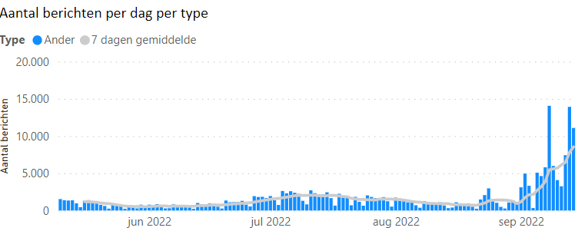
Some figures
600,000 downloads from app stores
510,000 unique mobile phone numbers active
225,000 messages sent, significant recent increase in messages sent
Promotion via CovidSafe.be, Corona Test Prescription Code (CTPC) and QVAX
Current Message Types

Slide 11
More info about GovApp & SMIS on
https://www.govapp.be/ and
https://www.gcloud.belgium.be/nl/services

