Slide 1
EU

Slide 2
Objectives of the European Health Data Space
Notes:
As a citizen
You will have control over health data:
You will have access to your health data in electronic form immediately and without any cost.
You will be able to share your data with health professionals nationally or crossborder.
You will be able to add information, rectify errors, restrict access and obtain information on how your data are used.
You will have a right to health data, issued and accepted, in a common European format.
Your security and privacy will be ensured
Researchers, industry or public institutions will have access to health data only for specific purposes that benefit individuals and society.
The researcher, industry or public institution may only access data that do not reveal the identity of the individual.
The data may only be accessed and processed in closed, secure environments.
As a researcher
You will have access to large amounts of health data, of higher quality, in order to carry out research.
You will be able to know what data is available, where, and of what quality.
You will be able to access the data cheaper and more effectively.
As regulators and policy-makers
You will have easier, more transparent and less costly access to non-identifiable health data for the benefit of public health and the overall functioning of healthcare systems and to ensure patient safety.
As industry
Thanks to standardization, you could more easily enter into new markets for electronic health records in other Member States.
You will benefit from the greater availability of non-identifiable electronic health data, enabling the use of data for innovation.

Slide 3
Evaluation EHDS Regulation
great opportunity for EU-wide eHealth environment
remarks
  too detailed regulation => risk of slowing down evolution
  too extensive delegations to the European Commission on implementation methodologies
  too little directly adressing to health care providers and health care organisations
  need for a commitment from European Commission to develop and provide (free) pan-european ICT components and services
proposal of amendments have been sent to the European Commission

Slide 4
Several EC digital programs
GAIA-X
Electronic Identification and Trust Services (eIDAS)
European Blockchain Services Infrastructure (EBSI)
  Conformant Wallets
  Verifiable Credentials Playbook
Single Digital Gateway (OOTS)
Electronic Exchange of Social Security Information (EESSI)
European Social Security Pass (ESSPass)
EU Digital COVID Certificate (EU DCC)
European Health Data Space (EHDS)
European Health Data Evidence Network (EHDEN)
...

Slide 5
Need for a global, integrated architecture
need for
  global, integrated architecture across DGs of the European Commission
  based on common conceptual framework
need for modular, generic, domain agnostic, interoperable and reusable services and components: develop once, use many
no technology driven choice of components and services used, but use of ICT components and services as enabler and means for meeting business requirements

Slide 6
Status eHealth Belgium

Slide 7

















Overview of the eHealth ecosystem in Belgium
Authentic sources

Slide 8








Basic architecture
Patients, healthcare providers
and healthcare institutions
Health portal
Software healthcare provider
Users
Software healthcare institution
AVS
Website NIHDI
AVS
eHealth portal
MyCareNet
AVS
AVS
AVS
Basic services
eHealth platform
Network
Suppliers
VAS
VAS
VAS
VAS
VAS
VAS
Notes:
8
8

Slide 9
Basic services & API’s
Coordination of the electronic processes
Portal
Integrated user and access management system
Management of loggings
System for end-to-end encryption
eHealthBox
Timestamping
Coding and anonymising
Consultation of National register and CBSS registers
Reference directories (hub-metahub system)

Slide 10














eHealth in practice
Consultation of medical history via SumEHR
Online guidelines and decision support
Medical
Electronic
prescriptions
Medication
schedule
Consultation of lab results
Electronic
referral letters

Slide 11





eHealth in practice
Insurability status, pricing,
billing
Update of SumEHR, medication schedule,
...
Administrative
Creation and sending of certificates
Registrations
Sending a report to the holder of the GMF

Slide 12






Reference directory (hub-metahub)
3. Retrieve data from hub A
A
1: Where can we find data?
2: In hub A and C
4:
All data available
3: Retrieve data from hub C
C
B

Slide 13




Extramural data: health vaults
A
InterMed
BruSafe
C
B

Slide 14











Some key figures
2021
19.600.000.000
electronic transactions
193 million
messages/year
using the eHealthBox
> 90 %
of Belgian citizens
have given their informed consent
for the sharing of data
Electronic prescriptions
13,4 million/month
> 28 million
Consultations of Personal Health Viewer
> 5,5 million
Belgian patients with
Summary Electronic Health Records
in health vaults
> 29.000
> 4000
  +/- 500 million
  electronic documents available
  in hospitals and clinical laboratories
> 12 million
eAttest
14

Slide 15
Importance of a layered, service oriented architecture

Slide 16
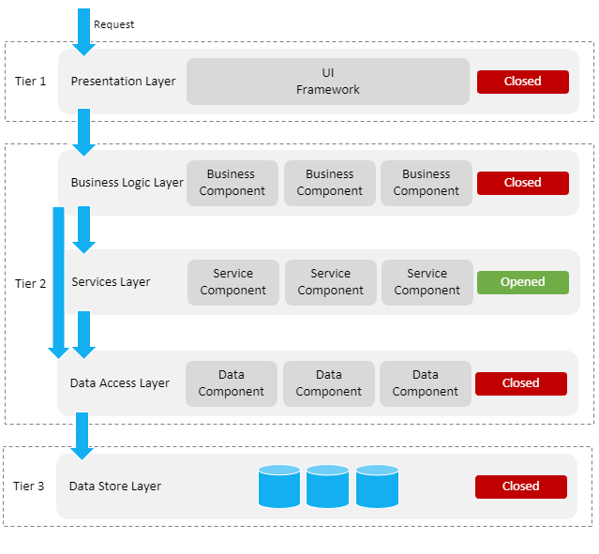
ICT: layered, service oriented architecture
presentation layer, eg
  web applications
  mobile applications
business logic layer, eg
  workflow
services layer, eg
  user & access management service
  communication service
  blockchain
data store layer, eg
  authentic sources
  personal vaults
  local storage on mobile device

Slide 17
ICT: across layers
interoperability standards
  technical: oa APIs (Application Programming Interface)
  semantic
security, eg
  access authorisation
  logging
  business continuity
configuration, eg
  capacity management
  load balancing

Slide 18
Advantages of layered, service oriented architecture
multifunctional reuse possibility
  lower cost
  higher quality
  quicker time to market
  better user experience
loosely coupled => reduced dependency of components
  easier and less costly maintenance
easier unit testing because each component can be tested individually
  but need for sound integration and performance testing

Slide 19
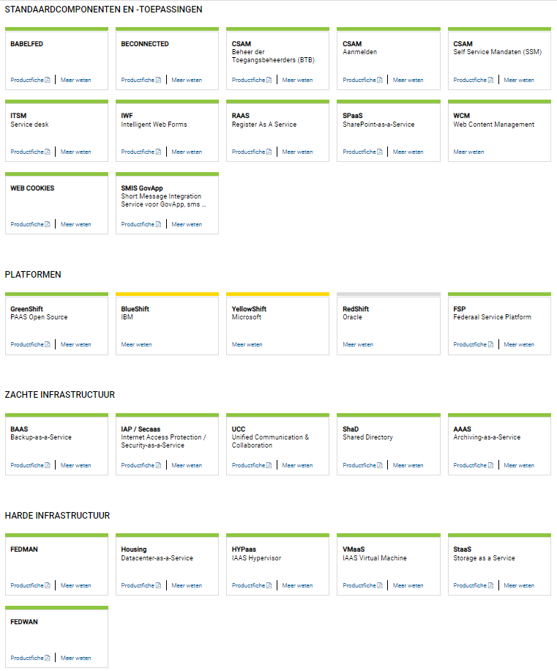
www.gcloud.belgium.be

Slide 20
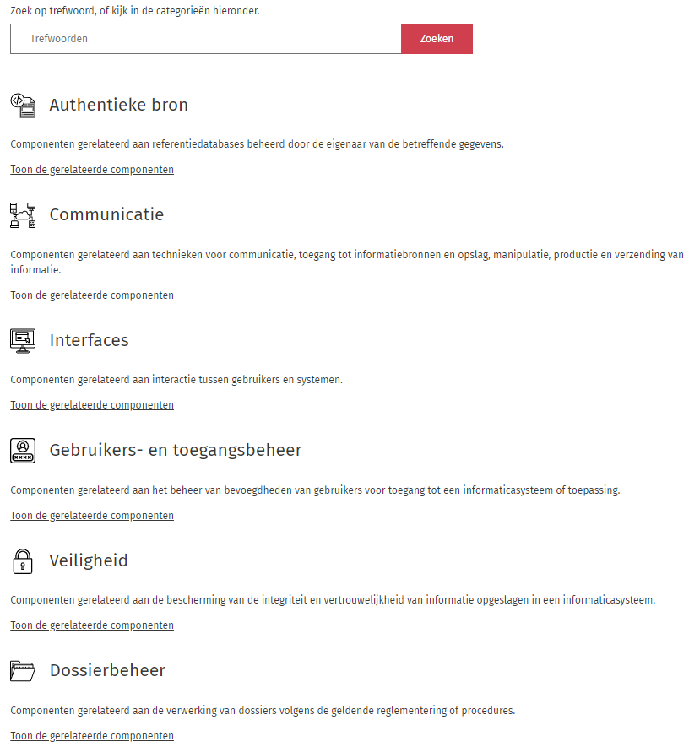
www.reuse.smals.be

Slide 21
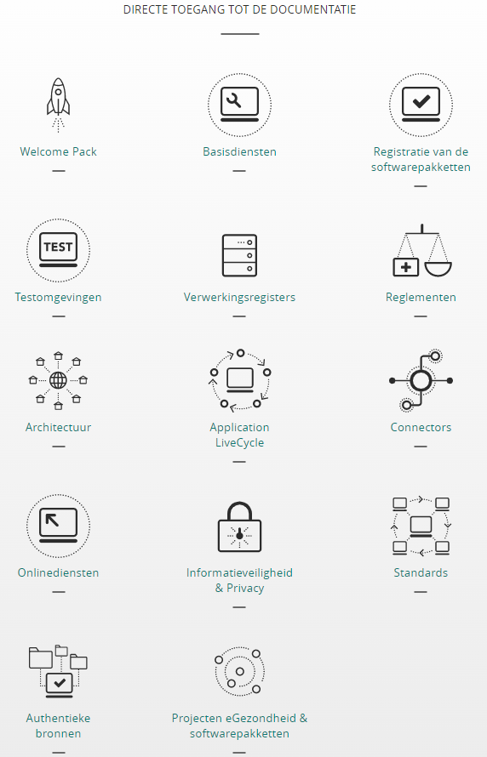
https://www.ehealth.fgov.be/ehealthplatform/fr

Slide 22
Concreet voorbeeld: organisatie testen COVID-19
5 stappen
  bepalen van reden om COVID-19-test af te nemen bij een patiënt en toekennen van een “Corona Test Prescription Code” (CTPC) vanuit centrale CTPC-database
  reserveren van tijdstip voor staalafname
  staalafname
  uitvoeren van test en analyse van testresultaat
  beschikbaar stellen van testresultaten
uiterst modulair, event driven en regelgebaseerd informatiesysteem

Slide 23









Testen COVID-19: proces
CTPC Code
EMF software
Doctors
Nurses
CTPC
Test location
Collectivities
eHealth Box
Laboratories
Tracing business process engine

Slide 24




Testen COVID-19: hergebruik
CTPC Code
Integrated software
IUAM
API gateway
IUAM
API gateway
eHealthBox
ETEE
Doctors
Nurses
CTPC
Test centers
DataEncryptor
Seals
Entities prescriptions
Addressbook
ConsultRN
DossierNumberGeneration
CentralPersonnelFile
DmfA
Laboratories
Mandate

