Slide 1
Sound electronic information management as a critical success factor for effective and efficient social protection and health care

Slide 2
About me (°1961)
education: law, ICT, ICT auditing, management, personal coaching
professional activities
  Crossroads Bank for Social Security
    1986-1991: originator as an advisor to the Minister of Social Affairs and the Prime Minister
    since 1991: CEO
  Data Protection Authority
    1991-2022: external member
  Federal Ministry of ICT
    2000-2001: originator as an advisor to the Minister of ICT (ao conception of electronic identity card)
  Smals (non for profit operational ICT association of public institutions of social security and health)
    since 2004: CEO (ao originator of G-Cloud initiative)
  eHealth platform
    2007-2008: originator as an advisor to the Minister of Public Health
    since 2008: CEO
    2020-2021: enterprise architect of Belgian information systems to fight the COVID-19 pandemic (testing, tracing, vaccination) and contributor to development of components on EU and WHO level

Slide 3
Social protection

Slide 4
Stakeholders of the Belgian social sector
> 11,500,000 citizens
> 230,000 employers
about 3,000 public and private institutions (actors) at several levels (federal, regional, local) dealing with
  collection of social security contributions
  delivery of social security benefits
    child benefits
    unemployment benefits
    benefits in case of incapacity for work
    benefits for the disabled
    re-imbursement of health care costs
    holiday pay
    old age pensions
    guaranteed minimum income
  delivery of supplementary social benefits
  delivery of supplementary benefits based on the social security status of a person

Slide 5
What do citizens, employers and policy makers expect ?
effective policy execution
avoiding and combating fraud
appropriate policy support
integrated services across government levels and organisations of public intrest
delivered at key life events (birth, going to school, starting to work, moving, illness, retirement, starting up a company…)
addressing citizens’ individual situation, personalized and user oriented
benefits as much as possible automatically granted according to a ‘happy flow’
minimal costs and minimal administrative burden for all parties involved
multichannel service delivery
self service
to be helped globally wherever they contact: no wrong door

Slide 6
What do citizens, employers and policy makers expect ?
social inclusion without a digital divide
reliable, secure and permanently available services with respect of the user’s privacy
transparency on use of personal data
legal certainty and legal rules that promote fair competition

Slide 7
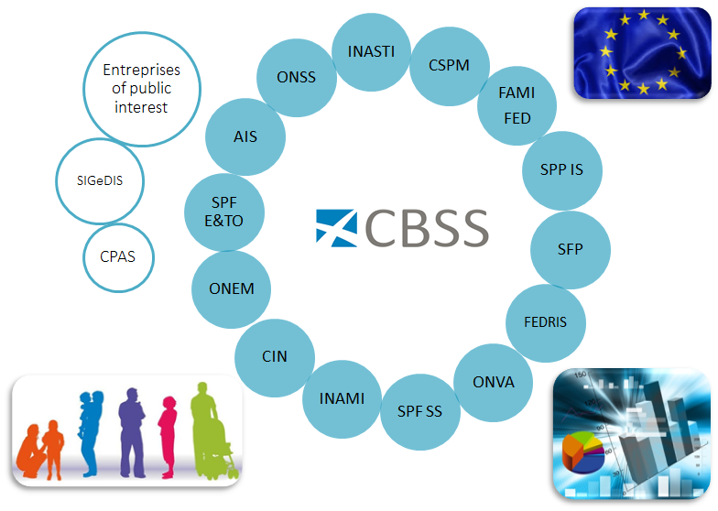
Crossroads Bank of Social Security (CBSS)

Slide 8
Crossroads Bank of Social Security (CBSS)
Internet
R
FedMAN
Users
R
Isabel
FW
R
…
R
Backbone
FW
FW
FW
FW
FW
R
R
R
R
R
ONEM
CBSS
ONSS
R
R
CIN
…

Slide 9
Results
a network between all 3,000 social sector actors with a secure connection to the internet, the federal MAN, regional extranets, extranets between local authorities and the Belgian interbanking network
a unique identification key
  for every citizen
  for every company
  for every establishment of a company
an agreed division of tasks between the actors within and outside the social sector with regard to collection, validation and management of information and with regard to electronic storage of information in authentic sources

Slide 10
Results
220 electronic services for mutual information exchange amongst actors in the social sector, defined after process optimization
  nearly all direct or indirect (via citizens or companies) paper-based information exchange by > 800 paper forms between actors in the social sector has been abolished
  in 2021, > 1,5 billion electronic messages were exchanged amongst actors in the social sector, which saved as many paper exchanges
electronic services for citizens
  maximal automatic granting of benefits based on electronic information exchange between actors in the social sector
  24 electronic services via an integrated portal and/or mobile applications

Slide 11


Slide 12


Slide 13
Results
more than 50 electronic services for employers, either based on the electronic exchange of structured messages or via an integrated portal site
  50 social security declaration forms for employers have been abolished
  in the remaining 30 (electronic) declaration forms the number of headings has on average been reduced to a third of the previous number
  declarations are limited to 3 events
    immediate declaration of recruitment and discharge (only electronically)
    quarterly declaration of salary and working time (only electronically)
    occurrence of a social risk (electronically or on paper)
  in 2021, more than 45 million electronic declarations were made by all 230,000 employers, 98 % of which from application to application

Slide 14









Quartely declaration salary & working time
simplification
Activity 3
Activity 2
Activity 1
employer
one electronic
declaration
ONSS
INAMI
ONEM
old age pension
SFP
Famifed
holiday pay
ONVA

Slide 15
Declaration of social risks
types of social risks
  child benefits
  incapacity for work ((labour) accident, (occupational) disease, …)
  unemployment
  old age pension
3 possible moments of declaration
  start of the social risk
  recurrence or continuation of the social risk
  end of the social risk
structure of the declaration
  identification data
  if necessary, salary and working time data not yet declared via a quarterly declaration (mini-declaration)
  specific data concerning the social risk

Slide 16
Results
an integrated portal site and mobile applications containing
  electronic transactions for citizens, employers and professionals
  simulation environments
  information about the entire social security system
  harmonized instructions and information model relating to all electronic transactions
  a personal page for each citizen, each company and each professional
an integrated multimodal contact centre supported by a customer relationship management tool
a data warehouse containing statistical information with regard to the labour market and all branches of social security

Slide 17
Useful legislative changes
legal translation of
  the common vision on information management
  the common vision on information security and privacy protection
  the obligation to use unique identification keys
creation of a public institution (CBSS) that acts as a driving force
  mission and tasks
  governance
  financing principles
creation of a control committee on information security and privacy protection
probative value of electronic information storage and exchange
punishment of abuse of the system
gradually, coordination or harmonisation of basic legal concepts
gradually, adaptation of business processes set out in the law

Slide 18
Distributed information servers
information servers
  directory of data subjects at the Crossroads Bank
  basic identification data of citizens at the National Register and the complementary Crossroads Bank Register
  basic identification data of companies at the Company Register
  employers directory (WGR) at the ONSS
  work force register at the ONSS
  salary and working time database at the ONSS and the ONSSAPL
  database of contribution certificates
services offered
  interactive consultation
  batch consultation
  automatic communication of updates

Slide 19
Pre-processed messages
pre-processed messages
  beginning/end of labour contract, beginning/end of self-employed activity
  contribution certificates medical care (employees, self-employed, beneficiaries of social security allowances)
  unemployment benefits
  benefits in case of career break
  benefits in case of incapacity for work ((labour) accident, (occupational) disease)
  reimbursement of health care costs
  child benefits
  old age pensions
  holiday pay
  benefits for the disabled
  guaranteed minimum income – social welfare
  derived rights (e.g. tax reduction/exemption, free public transport, ...)
  migrant workers
  …
services offered
  interactive consultation
  batch consultation
  automatic communication of messages

Slide 20
Useful tool: the reference directory
reference directory
  directory of available services/information
    which information/services are available at any actor depending on the capacity in which a person/company is registered at each actor
  directory of authorized users and applications
    list of users and applications
    definition of authentication means and rules
    definition of authorization profiles: which kind of information/service can be accessed, in what situation and for what period of time depending on in which capacity the person/company is registered with the actor that accesses the information/service
  directory of data subjects
    which persons/companies have personal files at which actors for which periods of time, and in which capacity they are registered
  subscription table
    which users/applications want to automatically receive what information/services in which situations for which persons/companies in which capacity

Slide 21
EESSI
IT system that helps social security institutions across the EU exchange information related to different branches like
  sickness, maternity and equivalent paternity benefits
  family benefits
  benefits in respect of accidents at work and occupational diseases
  unemployment benefits
  old-age pensions, pre-retirement and invalidity benefits
  survivor’s benefits and death grants
  applicable legislation
more rapidly and securely
as required by the EU rules on social security coordination

Slide 22
EESSI
all communication between national institutions on social security files are to take place through EESSI
social security institutions exchange structured electronic documents and follow commonly agreed procedures to process them
these documents are routed through EESSI to the correct destination in the right institutions in another Member State
staff in social security institutions are able to find the correct destination in participating countries by consulting a repository of national institutions (see https://ec.europa.eu/social/social-security-directory/pai/pai/select-country/language/en)

Slide 23
EESSI
32 participating countries
  27 EU Member States
  Iceland
  Liechtenstein
  Norway
  United Kingdom
  Switzerland
> 5.000 participating institutions

Slide 24
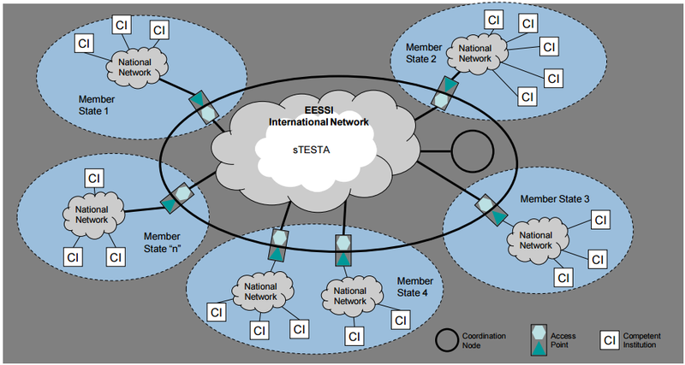
EESSI architecture

Slide 25
Advantages
gains in efficiency
  in terms of cost: services are delivered at a lower total cost due to
    a unique information collection using a common information model and administrative instructions
    a lesser need to re-encoding of information by stimulating electronic information exchange
    a drastic reduction of the number of contacts between actors in the social sector on the one hand and companies or citizens on the other
    a functional task sharing concerning information management, information validation and application development
    a minimal administrative burden
  according to a study of the Belgian Planning Bureau, rationalization of the information exchange processes between the employers and the social sector implies an annual saving of administrative costs of about 1.7 billion € a year for the companies

Slide 26
Advantages
gains in efficiency
  in terms of quantity: more services are delivered
    services are available at any time, from anywhere and from several devices
    services are delivered in an integrated way according to the logic of the customer
  in terms of speed: the services are delivered in less time
    benefits can be allocated quicker because information is available faster
    waiting and travel time is reduced
    companies and citizens can directly interact with the competent actors in the social sector with real time feedback

Slide 27
Advantages
gains in effectiveness: better social protection
  in terms of quality: same services at same total cost in same time, but to a higher quality standard
  in terms of type of services: new types of services, e.g.
    push system: automated granting of benefits
    active search of non-take-up using data warehousing techniques
    controlled management of own personal information
    personalized simulation environments
better support of social policy
more efficient combating of fraud

Slide 28
Health care

Slide 29
Stakeholders of the Belgian health care sector
11,500,000 citizens
health care providers
  21,600 general practicioners
  28,000 specialist doctorsArtsen-specialisten
  9,000 dentists
  4,900 pharmacies
  31,000 physiotherapists
  186,000 nursing practicioners
  11,000 midwives
  55,900 paramedics (dietitians, ergotherapists, speech therapists, …)
health care institutions
  120 hospitals
  60 psychiatric hospitals
  1,400 residential care centers

Slide 30
Some evolutions in health care
more chronic care instead of merely acute care
remote care (monitoring, assistance, consultation, diagnosis, operation, ...), and home care
multidisciplinary, transmural and integrated care
patient-centric care and patient empowerment
rapidly evolving knowledge => need for reliable and coordinated management and access to knowledge
threat of excessively time-consuming administrative processes
thorough support of health care policy and research requires thorough, integrated and anonymized information
cross-border mobility
need for cost control

Slide 31
The reported evolutions require...
cooperation between all actors in health care
efficient and secure electronic communication amongst all actors in health care
high quality, multidisciplinary electronic health records
care pathways
pptimized administrative processes
technical and semantic interoperability
guarantees with regard to
  information security
  privacy protection
  respect for the professional secrecy of health care providers

Slide 32
Electronic communication also stimulates …
quality of care and patient safety
  avoidance of wrong care and medication
    incompatibility between medicines
    contra-indications against certain medicines or treatments for a specific patient (eg allergies, diseases, …)
  avoidance of errors in concrete care provision and administration of medicines
  availability of reliable databases on good treatment practices and decision support scripts
  more opportunity for multidisciplinary consultations and second opinions
avoidance of unnecessary multiple examinations => less stress for the patient and avoidance of unnecessary additional costs

Slide 33
Objectives of the eHealth-platform
how?
  through a well organized, mutual electronic service provision and information exchange amongst all actors in health care
  with the necessary guarantees on the level of information security, privacy protection and professional secrecy
what?
  optimization of the quality and continuity of the provision of health care
  optimization of the patient safety
  simplification of the administrative formalities for all actors in health care
  proper support of health care policy and research

Slide 34












eHealth: some results
Medical history search via SumEHR
Guidelines and advice available online
Medication schedule
Health
advantages
Electronic prescriptions
Consultation of laboratory results
Electronic referral letters

Slide 35





eHealth: some results
Pricing,
billing
Updating the SumEHR, the medication schedule, ...
Adminis- trative
advantages
Creating and sending certificates
Registrations
Sending a report to the GMF holder

Slide 36










eHealth: some results
> 88,5 %
of Belgian citizens have given
an informed consent for data sharing
+97%
of GPs make use
of eHealth services
193 millions
messages/year
via eHealthBox
Electronic prescriptions
2021
13,4 millions/month
19.600.000.000
digital transactions
4.346.796
Belgian patients with
Summary Electronic Health Records in health vaults
> 29.000
> 4000
  215 millions
  electronic documents available
  at hospitals and clinical labs
36

Slide 37







eHealth: architecture
Patients, health care providers
and health care institutions
Site Ministry
Software health care professional
Software health care institution
VAS
Site RIZIV
VAS
eHealth-portal
MyCareNet
VAS
VAS
VAS
Users
Basic services
eHealth-platform
Network
AS
AS
AS
AS
AS
AS
Suppliers

Slide 38
eHealth-platform: basic services & API’s
Coordination of the electronic processes
Portal
Integrated user and access management system
Management of loggings
System for end-to-end encryption
eHealthBox
Timestamping
Coding and anonymising
Consultation of National register and CBSS registers
Reference directories (hub-metahub system)

Slide 39
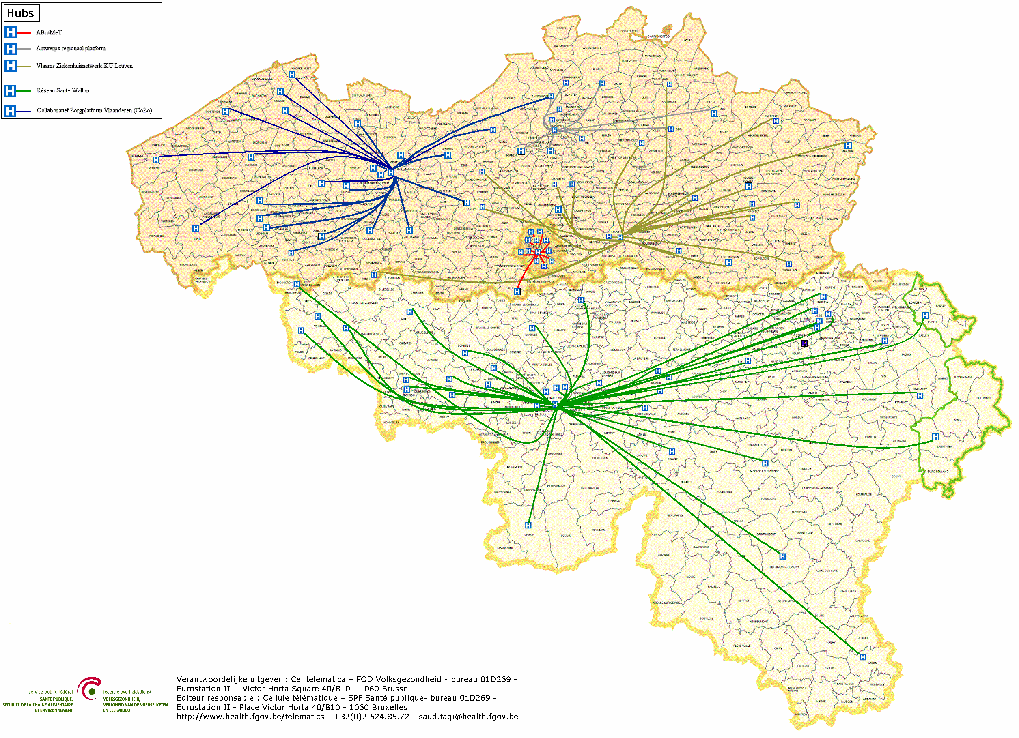

Hubs & metahub
        5 hubs
        Collaboratief Zorgplatform (Cozo)
        Antwerpse Regionale Hub (ARH)
        Vlaams Ziekenhuisnetwerk KU Leuven (VZN)
        Réseau Santé Wallon (RSW)
        Réseau Santé Bruxellois (RSB)

Slide 40








Hubs & metahub
3. Retrieve data from hub A
A
1: Where can we find data?
4:
All data available
2: In hub A and C
3: Retrieve data from hub C
C
B

Slide 41





Health vaults
A
InterMed
BruSafe
C
B

Slide 42


Slide 43
How to meet the expectations by using ICT ?

Slide 44

Notes:
1. Common vision, trust and co-operation
common vision on electronic service delivery, information management and information security between all stakeholders
co-operation based on task sharing, rather than centralization; continuous detection of opportunities for synergy

Slide 45

Notes:
examples of common principles regarding information management
only once collection of factual data
data quality guarantees

Slide 46
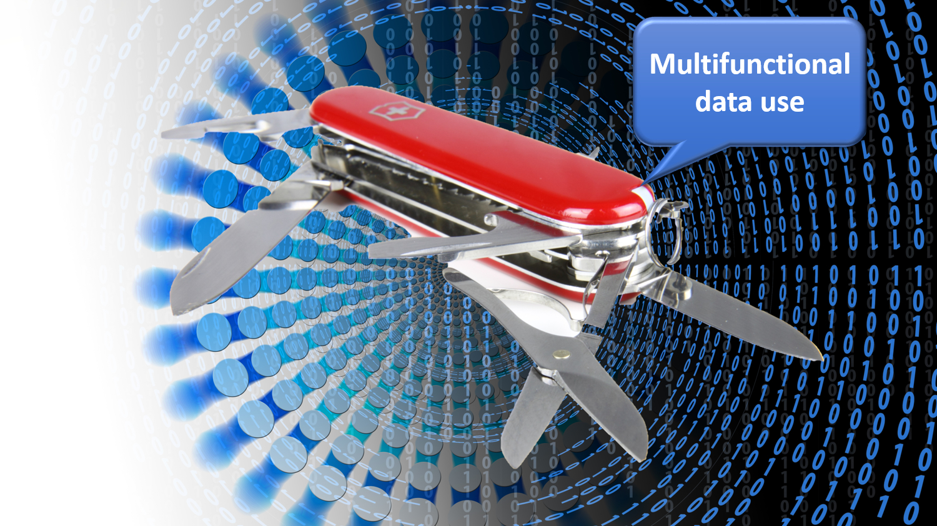
Notes:
multifunctional use of data

Slide 47

Notes:
reengineering of business processes

Slide 48
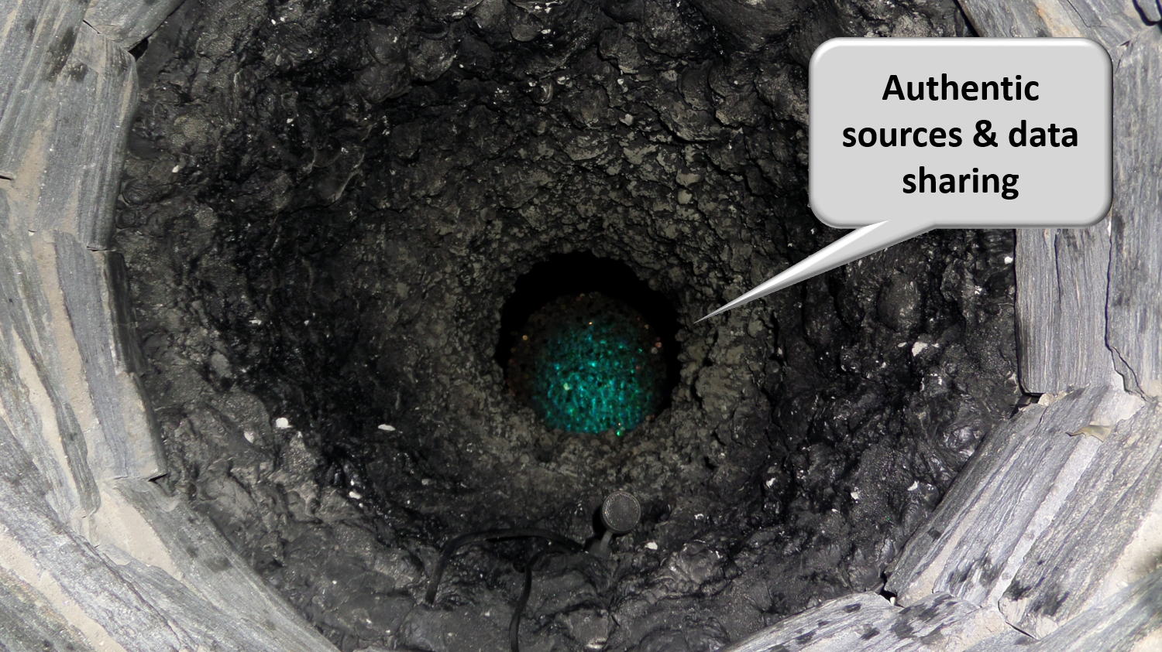
Notes:
authentic sources

Slide 49
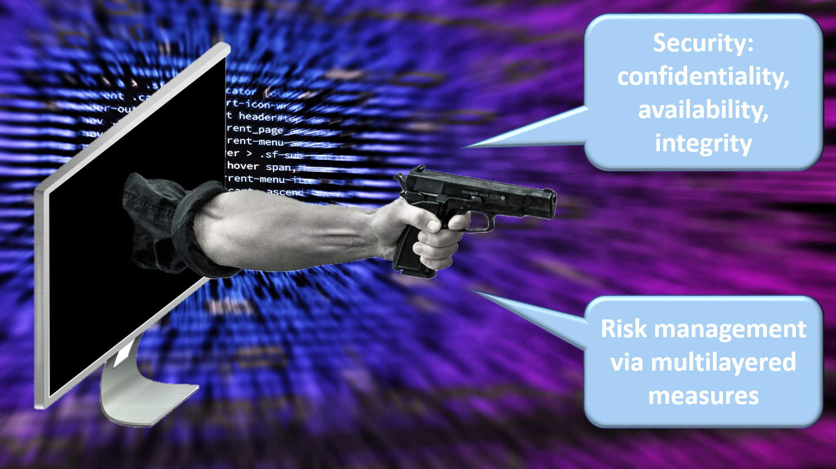
Notes:
avoiding loss of confidence due to information security incidents
security, availability, integrity and confidentiality of information is ensured by integrated structural, institutional, organizational, legal (GDPR), HR, technical and other security measures according to agreed policies

Slide 50

Notes:
access authorization to personal information is granted by an independent Information Security Comittee, designated by Parliament, after having checked whether the access conditions are met
the access authorizations are public
every actual electronic exchange of personal information has to pass an independent trusted third party (TTP) and is preventively checked on compliance with the existing access authorizations by that TTP
every actual electronic exchange of personal information is logged, to be able to trace possible abuse afterwards
long term vision combined with continuous delivery of new services (agile development)

Slide 51

Notes:
paying attention to computer literacy of collaborators and users

Slide 52

Notes:
2. Appropriate corporate culture
from hierarchy to participation, communities and team work
in the first place meeting the needs of the customer, not the social security institutions
rewarding entrepreneurship
ex post evaluation on output, not ex ante control of every input

Slide 53
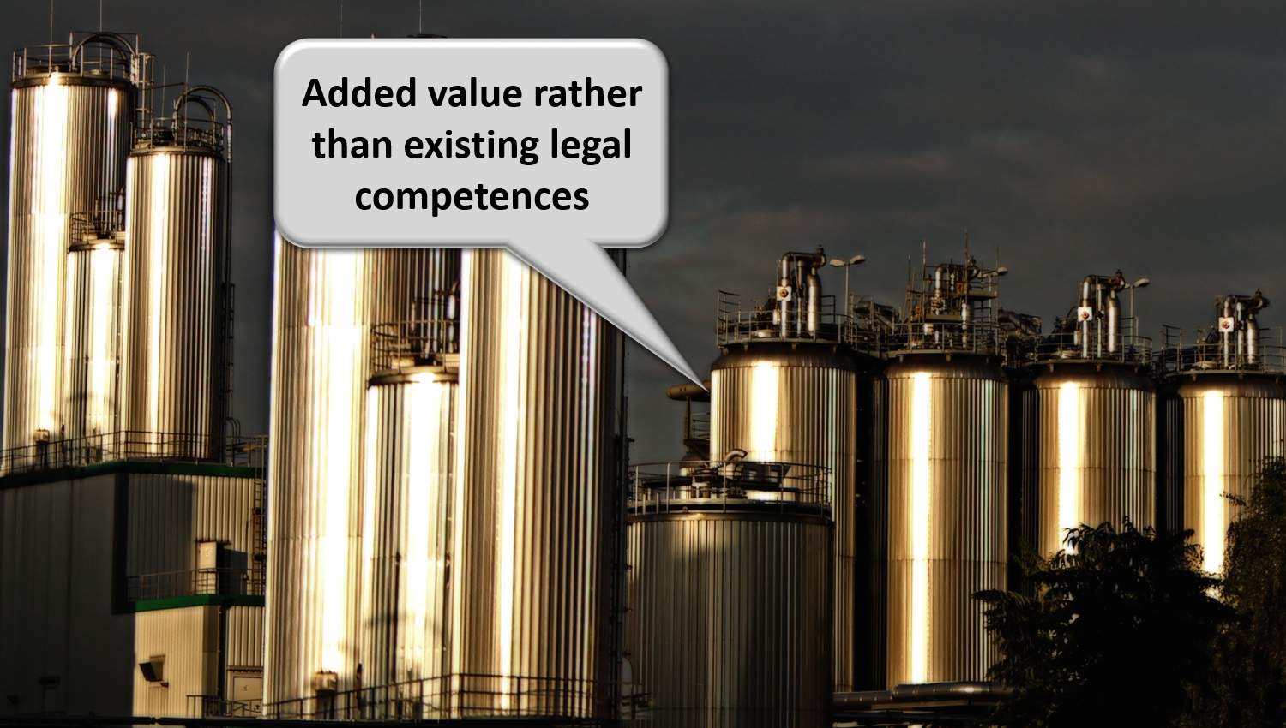
Notes:
reasoning in terms of added value for citizens and companies rather than in terms of legal competences
focus on more efficient and effective service delivery and on cost control
appropriate balance between efficiency on the one hand and information security and privacy protection on the other

Slide 54
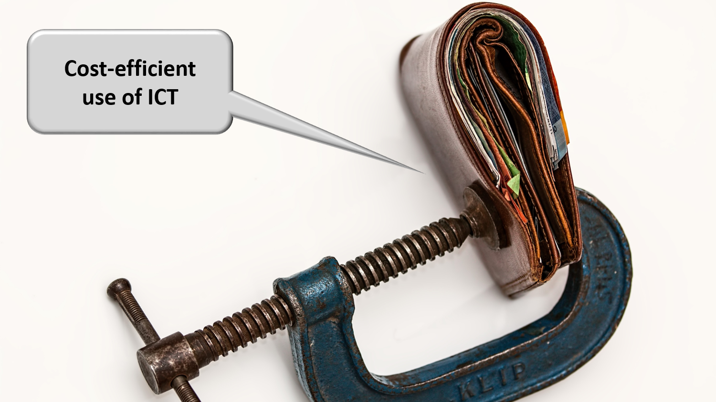
Notes:
sufficient financial means for permanent change and innovation: agreed possibility to re-invest efficiency gains in innovation

Slide 55
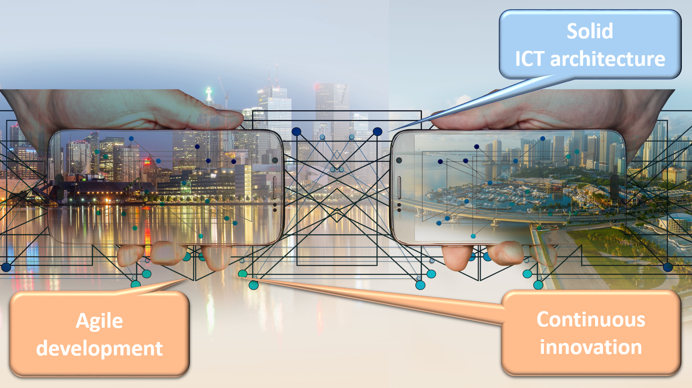
Notes:
3. Solid ICT architecture and continuous innovation
API-approach (application programming interface) and (worldwide) reuse of components, services and best practices

Slide 56
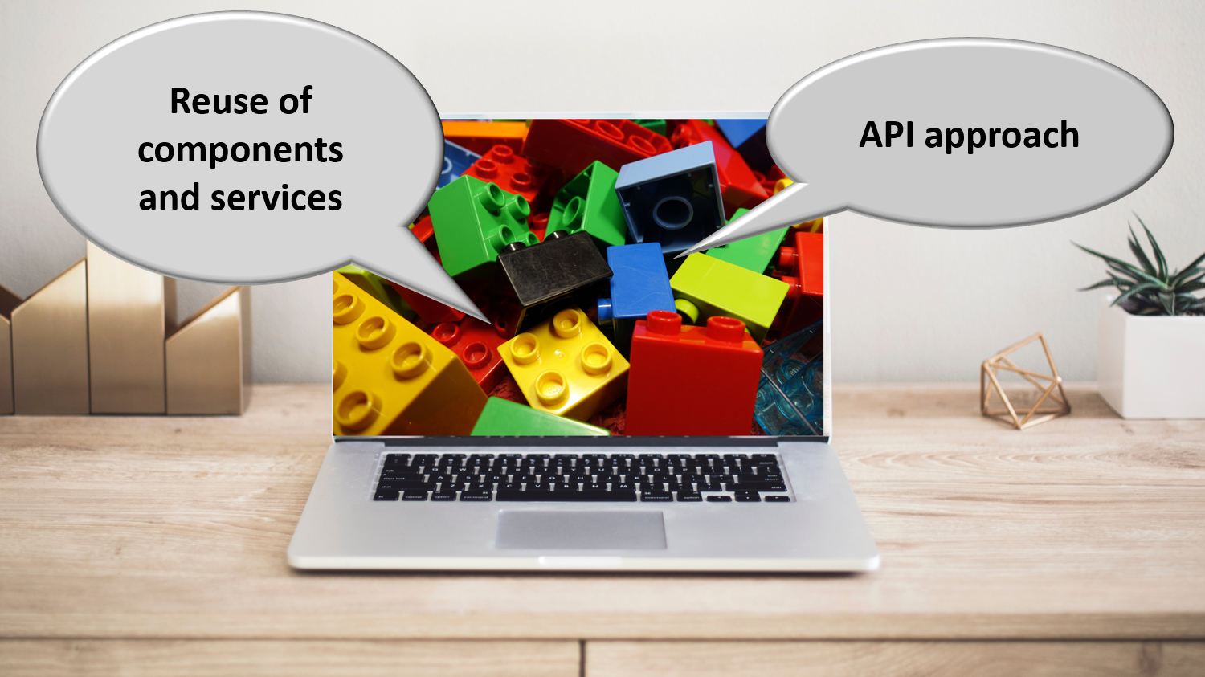
Notes:
sharing ICT infrastructure, platforms, basic services, applications and expertise in order to reduce costs, increase reliability and speed up time to market

Slide 57
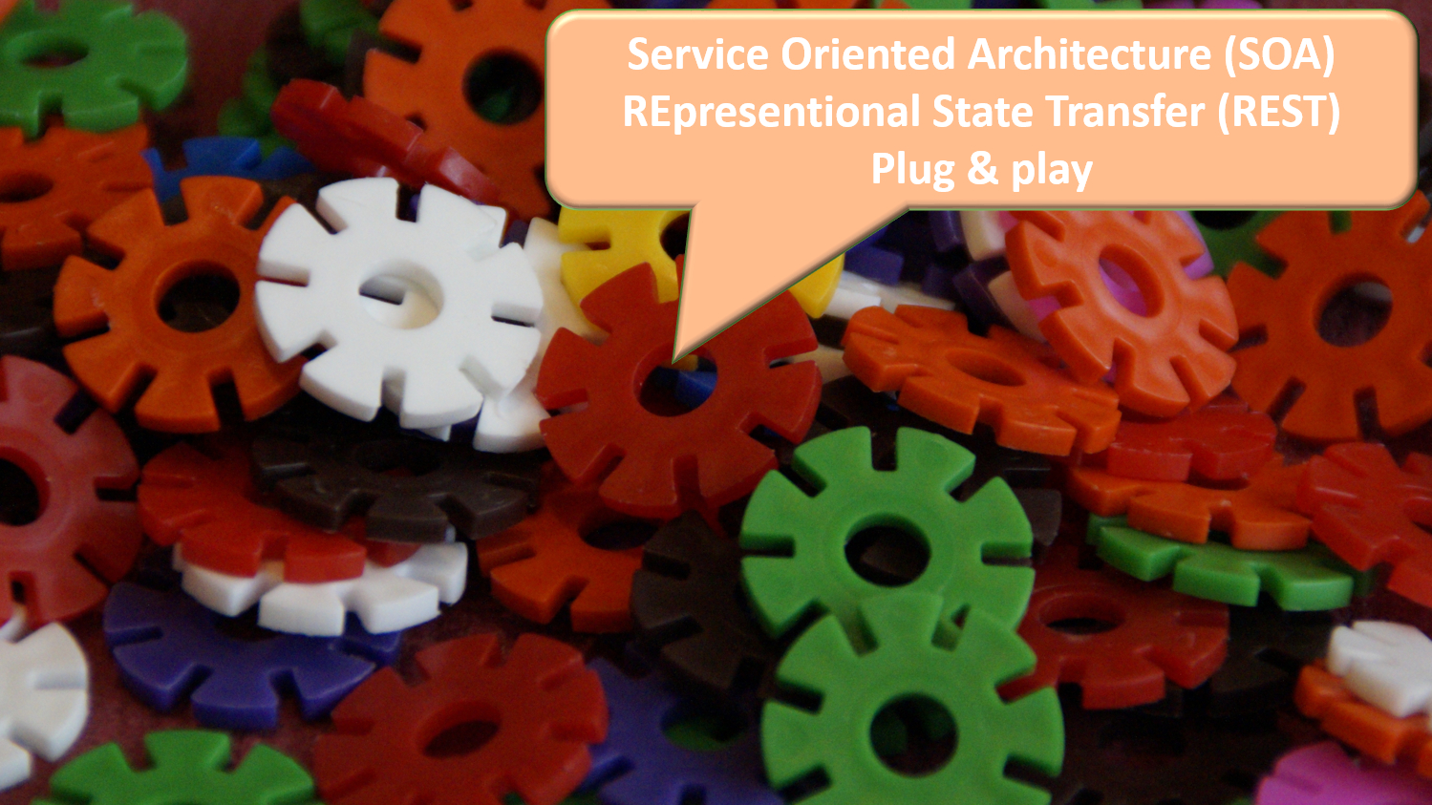
Notes:
service oriented architecture based on REST-full services in a plug and play mode

Slide 58
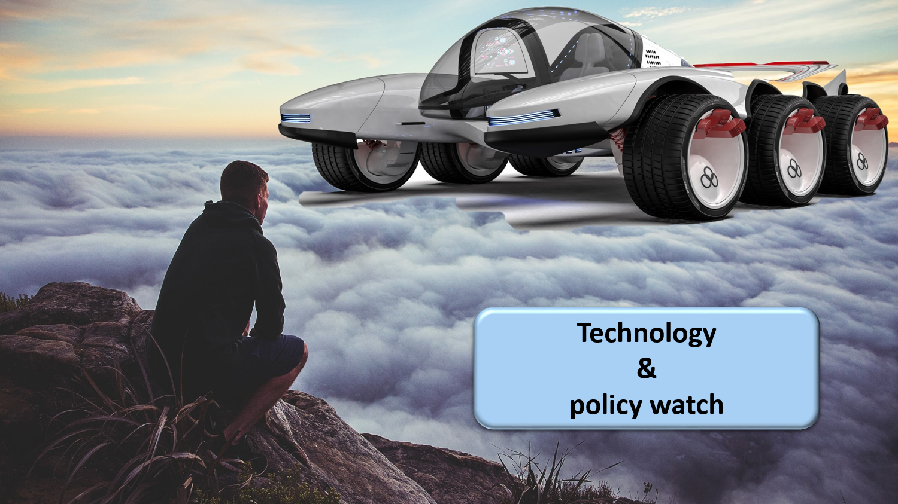
Notes:
technology an policy watch; latest subjects of investigation are

Slide 59
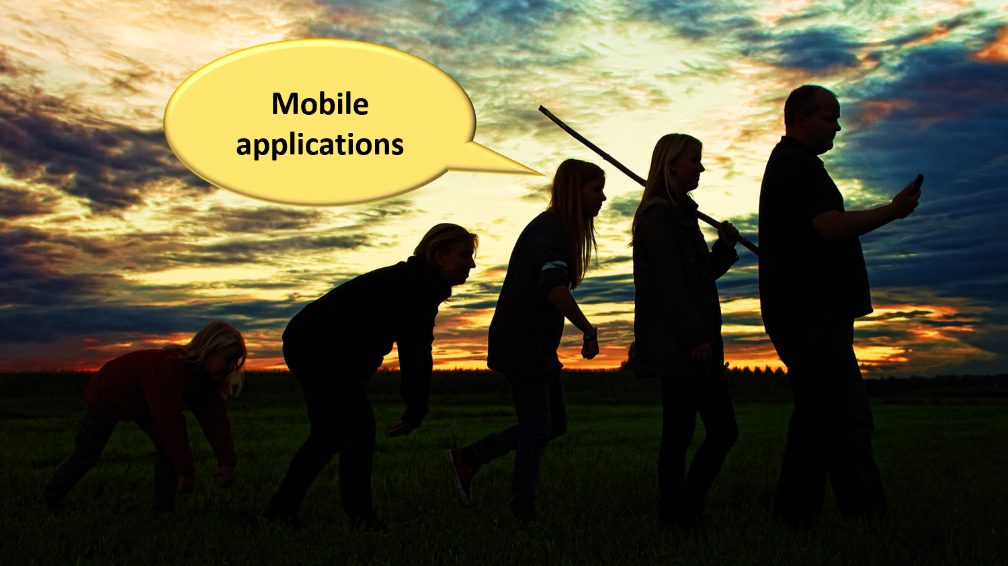
Notes:
mobile applications

Slide 60

Notes:
cloud computing, combining public cloud, for non sensitive information and applications with a community cloud designed and managed by the public sector => cost reduction and faster time to market

Slide 61
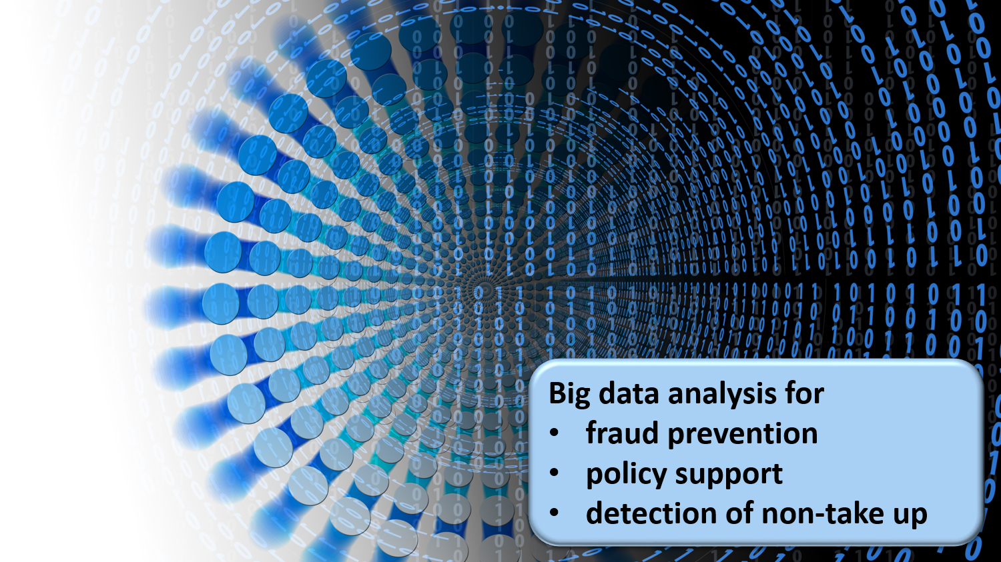
Notes:
big data analysis for fraud prevention, policy support and detection of non take up of benefits

Slide 62
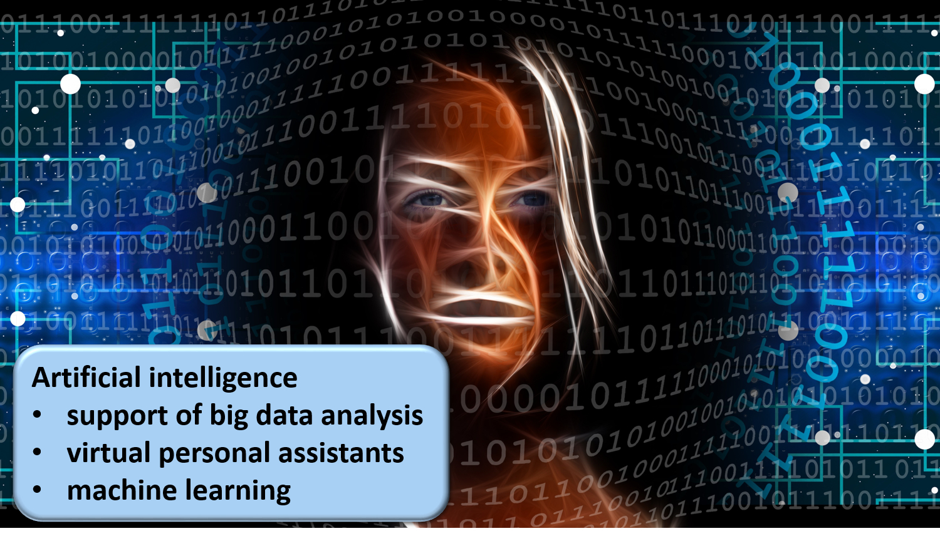
Notes:
artificial intelligence in support of big data analysis, for virtual personal assistants and machine learning
continuous attention for evolution of laws and the politics in the fields of social security, new technologies and information security

Slide 63
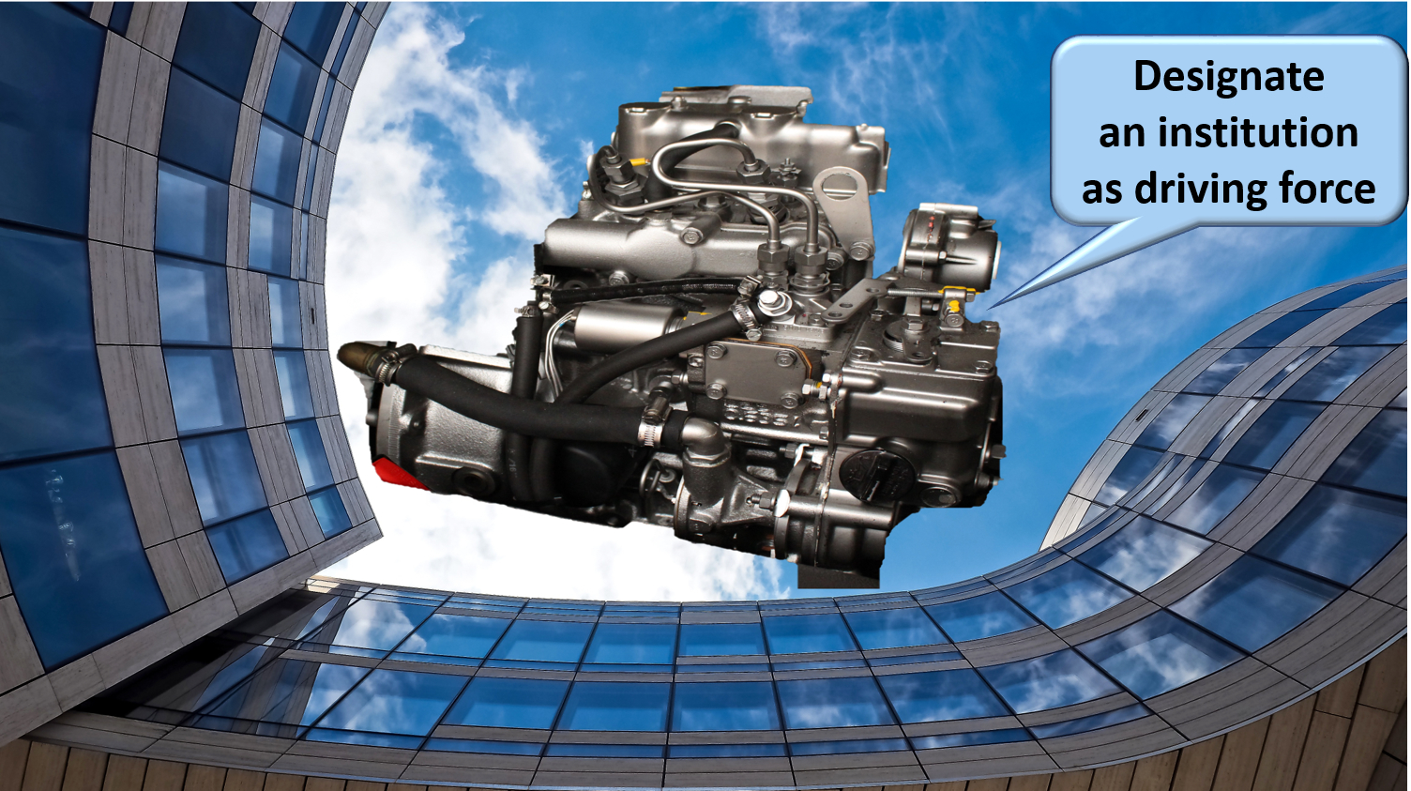
Notes:
4. Designating an institution that acts as a driving force is useful
business process re-engineering within and across actors
being a mediator and enabler setting out a long term roadmap for e-services
proactively looking for opportunities in technology and innovation to benefit citizens and enterprises
ensuring continuous delivery of shared ICT services and the retention of crucial skills
program, project and service management
co-operative governance

Slide 64

Notes:
Let the computer do what it is good at and thereby make time available for human support where necessary. And remember: the network always wins

Slide 65
Common vision & cooperation

Slide 66
Common vision on information management
information is being modelled
  in such a way that the model fits in as closely as possible with the real world
  in order to allow multifunctional use of information
information is collected from citizens and companies only once by the public sector as a whole
  via a channel chosen by the citizens and the companies
  preferably from application to application
  and with the possibility of quality control by the supplier before the transmission of the information
the collected information is validated once
  according to established task sharing criteria
  by the actor that is most entitled to it or by the actor which has the greatest interest in correctly validating it

Slide 67
Common vision on information management
a task sharing model is established indicating which actor stores which information as an authentic source, manages the information and maintains it at the disposal of the authorized users
information can be flexibly assembled according to ever changing legal concepts
every actor has to report probable errors of information to the actor that is designated to validate the information
every actor that has to validate information according to the agreed task sharing model, has to examine the reported probable errors, to correct them when necessary and to communicate the correct information to every known interested actor
once collected and validated, information is stored, managed and exchanged electronically to avoid transcribing and re-entering it manually

Slide 68
Common vision on information management
electronic information exchange can be initiated by
  the actor that disposes of information
  the actor that needs information
  the organisation that manages the interoperability framework
electronic information exchanges take place on the base of a functional and technical interoperability framework that evolves permanently but gradually according to open market standards, and is independent from the methods of information exchange
available information is used for
  the automatic granting of benefits
  prefilling when collecting information

Slide 69
Common vision on information security
security, availability, integrity and confidentiality of information is ensured by integrated structural, institutional, organizational, HR, technical and other security measures according to agreed policies
personal information is only used for purposes compatible with the purposes of the collection of the information
personal information is only accessible to authorized actors and users according to business needs, legislative or policy requirements
the access authorization to personal information is granted by an Information Security Committee, designated by Parliament, after having checked whether the access conditions are met
the access authorizations are public

Slide 70
Common vision on information security
every actual electronic exchange of personal information has to pass an independent trusted third party and is preventively checked on compliance with the existing access authorizations by that trusted third party
every actual electronic exchange of personal information is logged, to be able to trace possible abuse afterwards
every time information is used to take a decision, the information used is communicated to the person concerned together with the decision
every person has right to access and correct his/her own personal data
every actor in the social sector disposes of an information security officer with an advisory, stimulating, documentary and control task

Slide 71
Entrepreneurship, corporate culture & teamwork

Slide 72
Entrepeneurship vs management
Entrepreneurship
adaptations, change
"fuzzy" challenges
solutions not known
adjusting habits
changing value system
taking responsibility, going beyond formal competences
Management
stability, order, security
technical challenges: problems & solutions known
within own competence

Slide 73
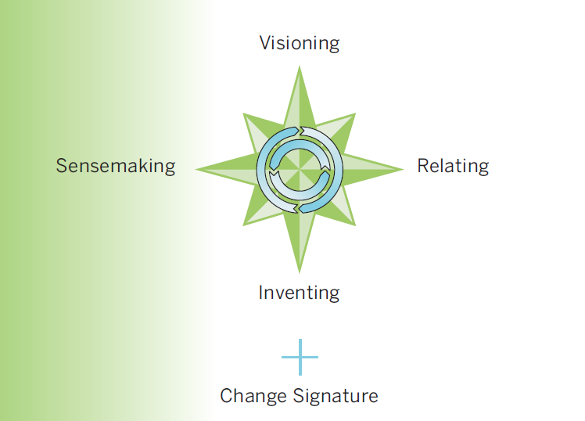
Entrepreneurship by leadership
Model: MIT Leadership Center

Slide 74
Visioning
why ?
  creating an attractive image of the eventual new situation promotes commitment by others
  the vision keeps moving, even in the face of resistance, setbacks, fear or uncertainty
  is the emotional side of leadership
how ?
  clear goal and direction
  radiating enthusiasm, commitment, faith and support
  encourage staff to be involved and loyal
  challenge staff to do and achieve things themselves
  highlighting the unique strengths, values and culture of the organization
  help staff to believe that they are part of something bigger than their daily work
  stimulate a feeling of belonging to a group
  communicate a lot

Slide 75
Methodology
define a long term vision on
  integrated, customer-oriented service delivery
  management of information as a strategic resource for all activity
  interoperability
make the vision enforceable by citizens and companies, and amongst government institutions and health care providers/institutions, by formalizing it in regulations
combine long term vision, profound process optimization and quick wins
do not look at it as a pure ICT event, but put the emphasis on an improvement of services and use a multidisciplinary approach
optimize processes within each social actor, at each government level and across government levels before their automatization

Slide 76
Methodology
standardize concepts and, where necessary, adapt regulations in order to introduce those concepts
also regulate aspects such as privacy protection, information security, the protection against ICT crime, unique identification keys, the probative value of electronic information, the electronic signature, the equal access to public services, the transparency of administrations, …
see to a close cooperation with policymakers, other government departments, other governmental levels, users, mandated intermediaries and interest groups
attune the service offer maximally to the needs and the logic of the users and involve them actively in the development of the services
match the governmental processes with the own processes of the users and assure user-friendliness

Slide 77
Methodology
concentrate on a qualitative and interactive service offering, instead of a mere presence on the web
support users by the implementation of data quality controls, before these are transmitted to the government authorities, and use the available data proactively for an automatic granting of rights, prefilling of information in forms during data collection and a targeted provision of information to the users
make sure that available ICT components and information (networks, data bases, …) are re-used to a maximum; through this, the efforts can be directed towards developing added value services
also develop multifunctional components yourself, conform open standards, and based on a flexible, modular, expandable and service-oriented architecture, so that other developers of services can re-use your components

Slide 78
Methodology
pay attention to change management, communications and training
see to a good project management
work incrementally and with prototyping, and give special attention to the roll-out by providing test and simulation environments, training and coaching for the users, and a multimodal contact centre for the personal support of end-users
see to it that proper measuring facilities are available, so as to assure permanent monitoring and improvement
make sure that the users have confidence in the electronic services that are provided; develop an information security policy, which is designed to guarantee the availability, confidentiality, integrity, authenticity and auditability of the information systems
create an institution that stimulates and coordinates

Slide 79
Methodology
strive for an appropriate corporate culture
  networks rather than hierarchy
  services should be geared to the needs of the users and not to the internal organizational structure of the government or of the organizations providing the servicesempowerment instead of mere service
  rewarding entrepreneurship
  ex post evaluation of the output, rather than ex ante control of the input

Slide 80
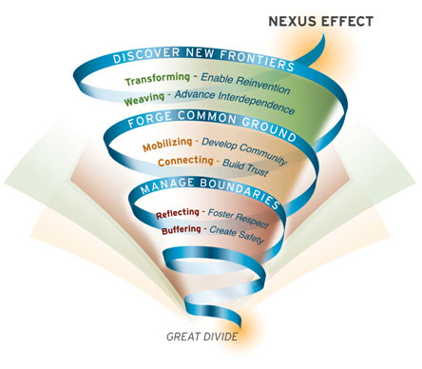
Nexus effect
Source: MIT Sloan

Slide 81
Solid architecture & agile development

Slide 82
Service Oriented Architecture (SOA)
what ?
  “Service Oriented Architecture (SOA) is a paradigm for organizing and utilizing distributed capabilities that may be under the control of different ownership domains. It provides a uniform means to offer, discover, interact with and use capabilities to produce desired effects consistent with measurable preconditions and expectations. This style of architecture promotes reuse at the macro (service) level rather than micro levels (eg. objects). It also makes interconnection of existing IT assets trivial” (OASIS Reference Group)
characteristics
  service-oriented
  modular
  interoperable (based on open standards or open specifications)
  extensible
  layered
  based on reuse of components and data

Slide 83
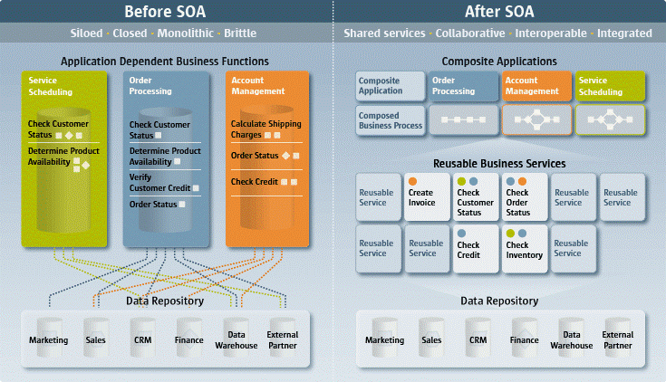
Service Oriented Architecture (SOA)

Slide 84
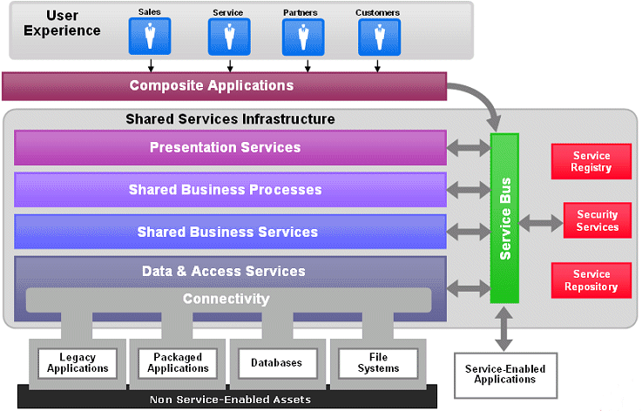
Service Oriented Architecture (SOA)

Slide 85
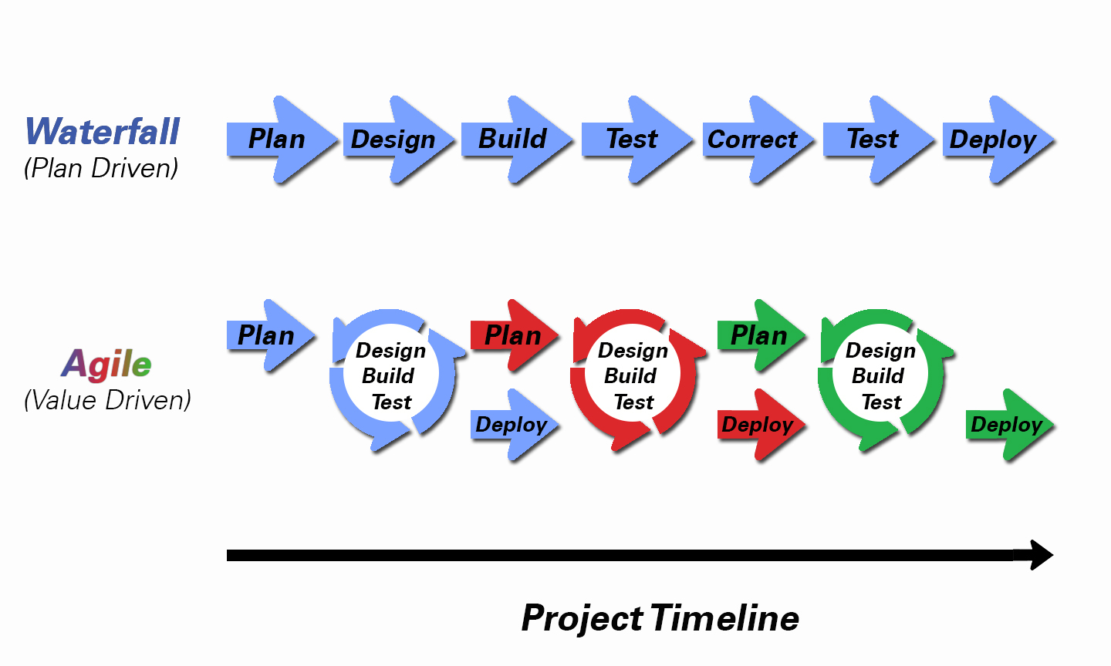
Agile development

Slide 86
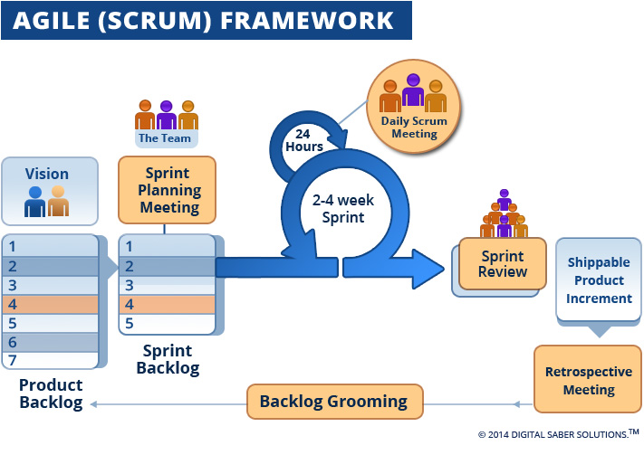
Agile development

Slide 87
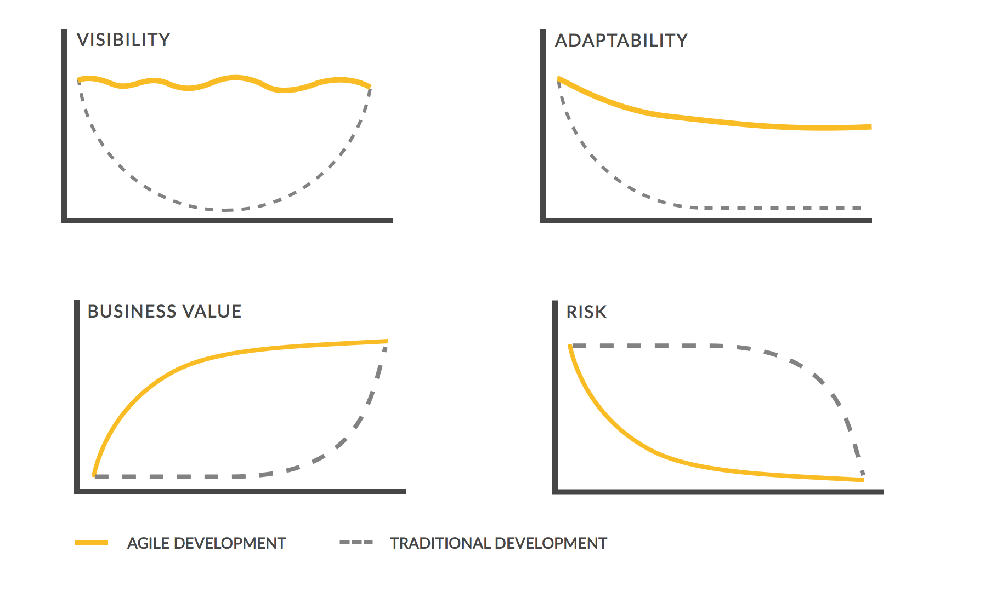
Traditional vs agile development

Slide 88
Sharing and reuse

Slide 89



Different types of sharing & reuse
infrastructure
  hard infrastructure
  soft infrastructure
  platforms
common vendor contracts
federal ICT community
business
  knowledge & experiences
  business functionality
  business data
  complete business services
Important to know what already exists
→ catalogues!

Slide 90
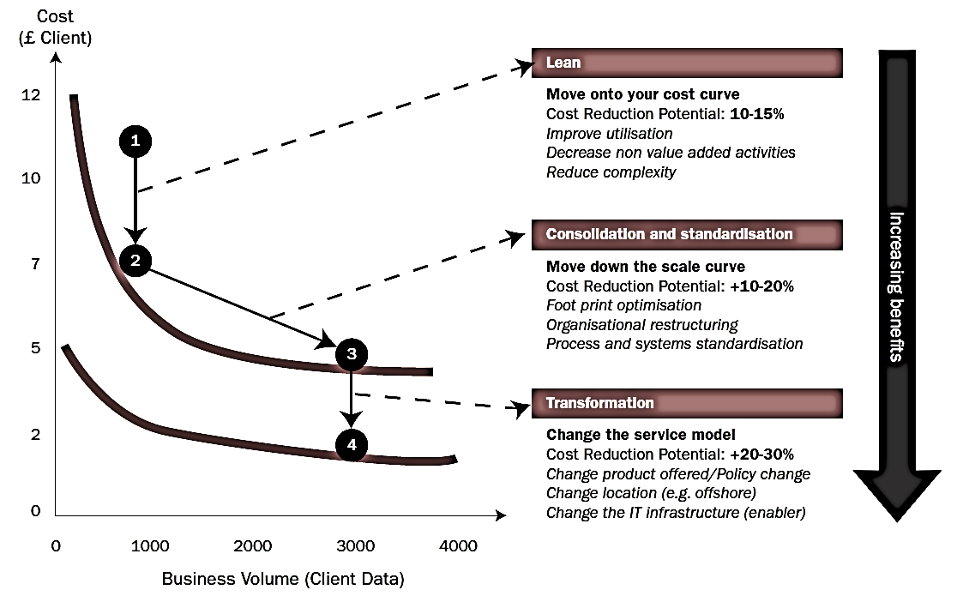
Synergies - transformations

Slide 91
What is “cloud” ?
On Demand
Broad network access
Resource pooling
Measured service
Rapid elasiticity
Source: National Institute for Standards and Technology, USA

Slide 92
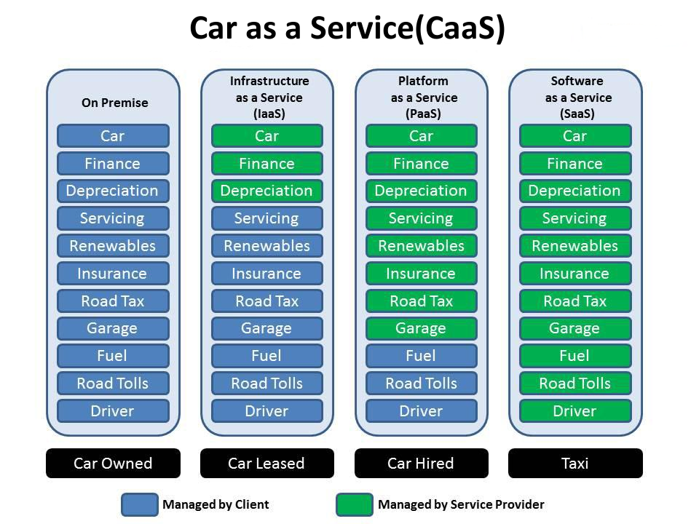

Slide 93
As a service : major characteristics
self service: industrialised & automated
available: immediate availability
extensible/elastic: scale up or down
shared: multiple users for scale effects
use based invoicing: based on real use of resources
low entry barrier: complexity is hidden for user
incremental service changes

Slide 94

Virtualisation
consolidation of physical resources
> 70% “easy consolidation”
first step to cloud (“dematerialisation”)

Slide 95
Cloud advantages
any place, any time, anywhere : mobile
safeguarded with backups
high level of security if well implemented
lower Total Cost of Ownership (TCO)
stability & incremental updates
collaboration
should provide portability
community cloud solutions
  can be open for integration with other services
  trust relationship / data protection (e.g. Vitalink)

Slide 96






Cloud deployment types
Hybrid
Public Cloud
Shared
Access/Control
Outsourced Community Cloud (= off-premise)
Community Cloud on-premise
Private Cloud on-premise
Outsourced Private Cloud (= off-premise)
Dedicated
Location
Customer
Service Provider

Slide 97
Public cloud - main issues
longitudinal confidentiality of personal data
  need for comprehensive longitudinal encryption of personal data
  in motion, at rest and in use
performant continuous availability of applications and data
easy migration of applications and data
compliance with GDPR / Schrems II

Slide 98

Intermediate solution
need for overall government positioning
  eGov public cloud policy
  based on information classification
  appropriate organizational, technical & contractual measures
  hybrid approach
    pure public cloud not suited for sensitive use cases
    secure private cloud on-premise for secret and top secret
    hybride (community on-premise and public) cloud for other levels
      Belgian example

Slide 99





What is G-Cloud ?
A program including synergy projects
Synergy for existing as well as new services
For public services
Managed by public services
In cooperation with the private sector

Slide 100




G-Cloud ‘products’
Procurement
Cooperationá
Efficiencyá
Projects
Synergy
Services
Costsâ
Qualityá
Know-how & Expertise

Slide 101



Why G-Cloud?
Creation of economies of scale: efficiency and high quality/availability
Respect of confidentiality and data protection
Bigger focus on business applications and flexibility in order to realize them

Slide 102

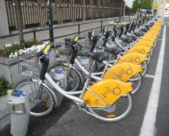

Why G-Cloud?
Greater weight
during negotiations with suppliers
Pooling of knowledge and resources
Technological evolution faster available for everyone

Slide 103
G-Cloud organization
Government
G-Cloud Operations & Programme Board
G-Cloud Strategic Board
FPS/PPS
(Horizontal FPS, FPS FIN, Belnet, …)
PSSI/IPB
(CBSS, ...)
Association of FPS/PPSI/IPB
Private ICT companies directed by FPS/PSSI/...
3 Colleges
FPS
Public Institutions of Social Security (PIOSS)
Institutions of Public Benefit (IPB)
SIT: ICT managers from
FPS
Public Institutions of Social Security
Institutions of Public Benefit
Service
owners

Slide 104


G-Cloud organization
G-Cloud Strategic Board: strategic direction by senior officials
G-Cloud Operations & Program Board:
CIOs for operational direction

Slide 105
G-Cloud service model
G-Cloud = coalition
G-Cloud ≠ central organization
G-Cloud service
Offered by
Service owner
Delivered by
Service provider
Governance

Slide 106
G-Cloud service model
Service Owner
  organization responsible for the service
  develops the service and its further evolution
  provides SLA, financial model, support model...
  “contract” with clients
Service Provider
  “contract” with Service Owner
  provides the service as agreed upon in the specifications/SLA
Sometimes: Service Owner = Service Provider

Slide 107
G-Cloud portfolio (www.gcloud.belgium.be)

Slide 108





Data classification
information classification model drafted within « Federal Information Security Policy » (FISP)
  https://dt.bosa.be/nl/federaal beleid_voor_informatiebeveiliging_fisp
definition of levels
classification based on the impact of the loss or dissemination of information
  impact for government (agencies)
  impact on privacy rights
practical classification explained in privacy vademecum
  https://dt.bosa.be/sites/default/files/fisp_-_privacy_vademecum_nl.pdf

Slide 109
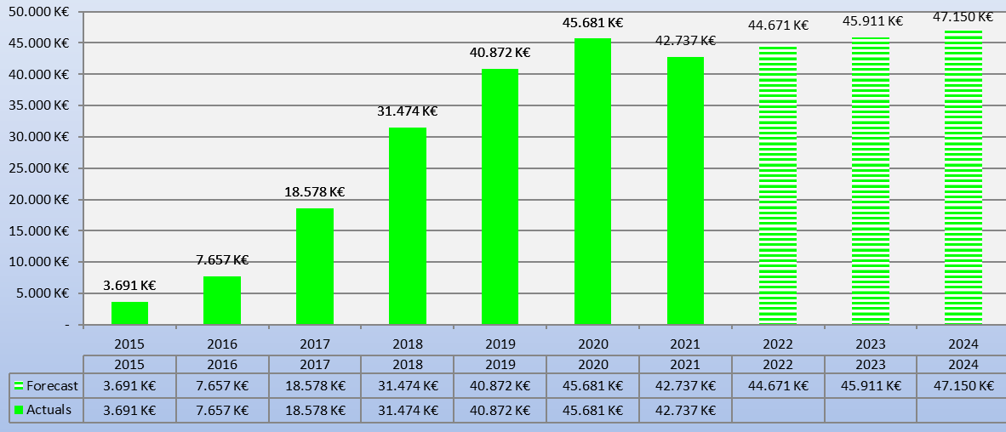
G-Cloud ROI
Avoided spending

Slide 110

Shifting focus
towards synergies in the area of business components
Business components
Stronger centrally coordinated approach to offering platforms

Slide 111
activiteitenrapporten
beheer van comités
Besturingprocessen
parlementaire vragen
sealing
timestamping
verwijzings-
repertoria
logging
GDPR
2. Dossierbeheer
beheer bronnen
3. Beveiligings-
componenten
dossierbeheer
contactbeheer
4. Authentieke
Bronnen
rapportering
processturing
procesopvolging
handtekening
documentopslag
archivering
ontsluiting bronnen
OCR
codelijsten &
glossaria
encryptie
documenttransformatie
Primaire
Processen
Intake & Inform
Verwerking
Leveren van dienst
portaal
aangiftes verrichten
onderzoeken beheren
factureren
attesten leveren
frontoffice
invorderen
gegevens distribueren
activiteiten traceren
dossiers beheren
gestuctureerd
Chatbot
1. Gebruikers- en toegangsbeheer
eBox
niet-gestuctureerd
Interactieve
formulieren
5. Interfaces
6. Communicatie
mandaatbeheer
identificatie personen
ondernemingen/buitenlanders
CMS
burger, onderneming,
overheden, interationaal
styleguides
devices
gebruikersbeheer
toegangsbeheer
rollenbeheer
personeel
vertaling
boekhouding
Ondersteunende Processen
intranet
e-learning
software factory
logistiek
kadercontracten

Slide 112
About the reuse initiative
initiative within the public social security institutions & Smals
purpose
  synergy around (technical) business components
  and thus save costs by avoiding multiple development of components
regardless of whether development takes place by
  the institution's own ICT department
  Smals
  subcontractors
a competence center within Smals aims to maximally integrate and support the reuse of business components within Smals, its members, partners and domains in which Smals is active
112

Slide 113

ReUse – Vision
Every stakeholder
can easily find the most common reusable elements in a centralized catalogue
Processes
and tools are put in place to identify, register, implement, monitor and measure reuse throughout the project lifecycle
Human
networks are maintained and developed on all levels (CEO’s, CIO’s, business owners, business analysts, architects) in order to keep maximum visibility on reuse potential
A culture
develops where
reuse is adopted and the creation of reusable products is promoted,
113

Slide 114

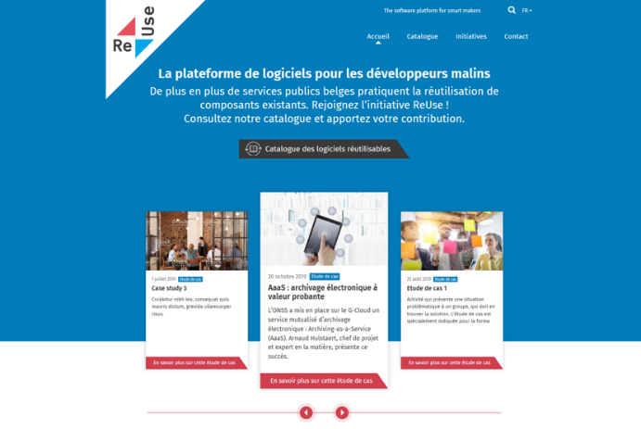
How? With Software Reuse Platform! https://www.ict-reuse.be
114

Slide 115
ROI 2021 for projects carried out by Smals
7%
63%
48%
rEUSABLE
rEUSED
ROI
28.700.000 €
115

Slide 116

API - Application Programming Interface
an API is a programmatic interface to data or some set of functionality
thanks to API’s it is possible to use the data or functionality behind it and continue to build on it
API = a software building block

Slide 117
About API - Application Programming Interface
providers vs consumers
  when an API is offered over a network, the service that offers the API is called the “provider”
  the “consumer” of the API is often a software application
the consumer may outsource the requirement for data or functionality by “calling” API’s
  billing
  identity
  storing
  image processing
  all sort of (authentic) data sources
  …

Slide 118
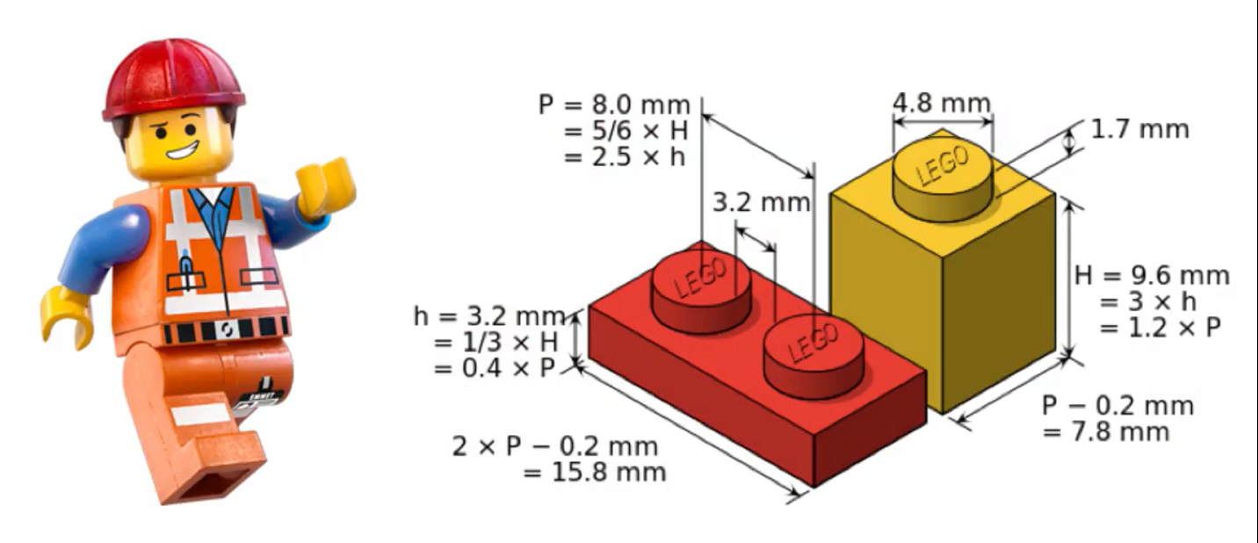
About API - Application Programming Interface
consumers can connect to an API of a provider and use its data or functionality as long as the “technical contract” has been respected
consumers don’t need to know the technical details behind the functionality
API’s can be written in any possible programming language

Slide 119
Why are API’s important?
cost reduction by reusability: consumers don’t need to rewrite what already exists!
complexity reduction: no more big, monolithic systems
decoupling: consumers and providers can continue to connect as long as the technical contract is followed → ex. less impact in case of migrations
driver of innovation: new products raise, based on existing API capability
stimulation of partnerships
stimulation of standardization

Slide 120
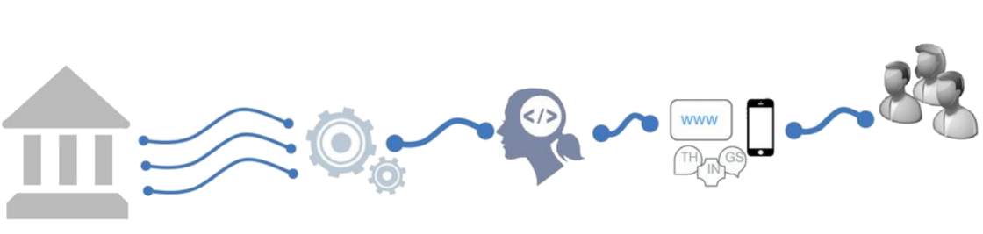
Shifting to an API economy: the value chain
APIs drive today's business processes in eGovernment and eHealth
APIs are key in real-time information exchange between public - private sector & citizens
Existing
Systems
Made available as APIs
Self service
used by developers
To create new innovative apps and services
Differentiated
services
Notes:
Deel van verhaal “Meer naar buiten toe openstellen”

Slide 121
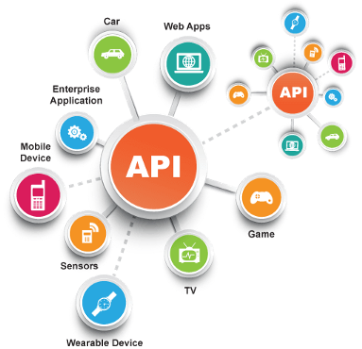
Today the API economy is a becoming a reality
Everything connects to everything

Slide 122
Example: COVID testing
happy flow: 5 phases
  determination of a cause for performing a COVID-19 test on a patient and delivery of a corona test prescription code (CTPC) from a central database CTPC
  reservation of a sampling moment
  sampling
  execution of the test and analysis of the test result
  making the test results available
very modular, event driven and rule based information system

Slide 123









Example: COVID testing
CTPC Code
EMF software
Doctors
Nurses
CTPC
Test location
Collectivities
eHealth Box
Laboratories
Tracing business process engine

Slide 124




Example: COVID testing
CTPC Code
Integrated software
IUAM
API gateway
IUAM
API gateway
eHealthBox
ETEE
Doctors
Nurses
CTPC
Test centers
DataEncryptor
Seals
Entities prescriptions
Addressbook
ConsultRN
DossierNumberGeneration
CentralPersonnelFile
DmfA
Laboratories
Mandate

Slide 125
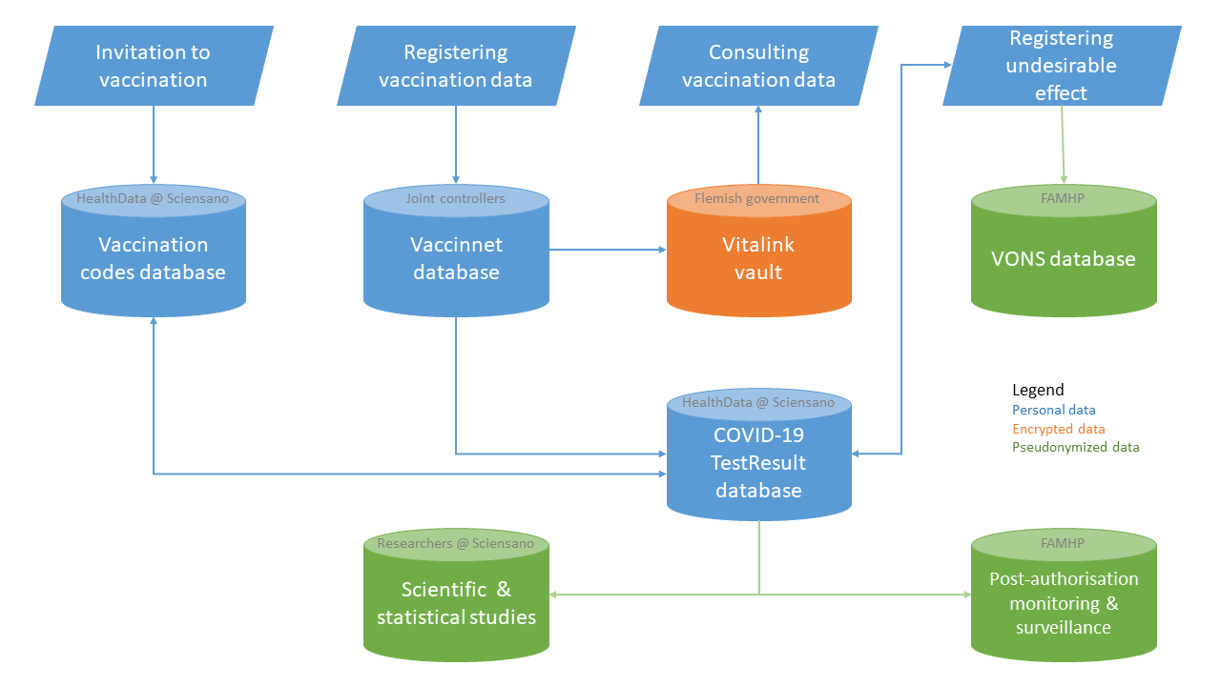
Example: COVID vaccination

Slide 126
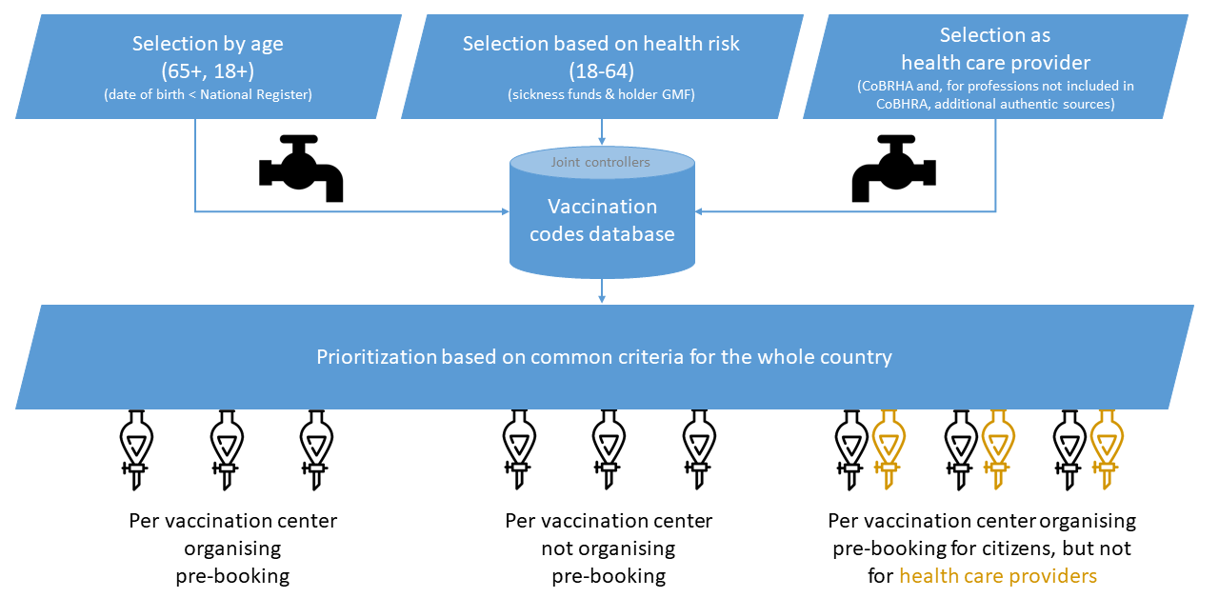
Example: COVID vaccination

Slide 127
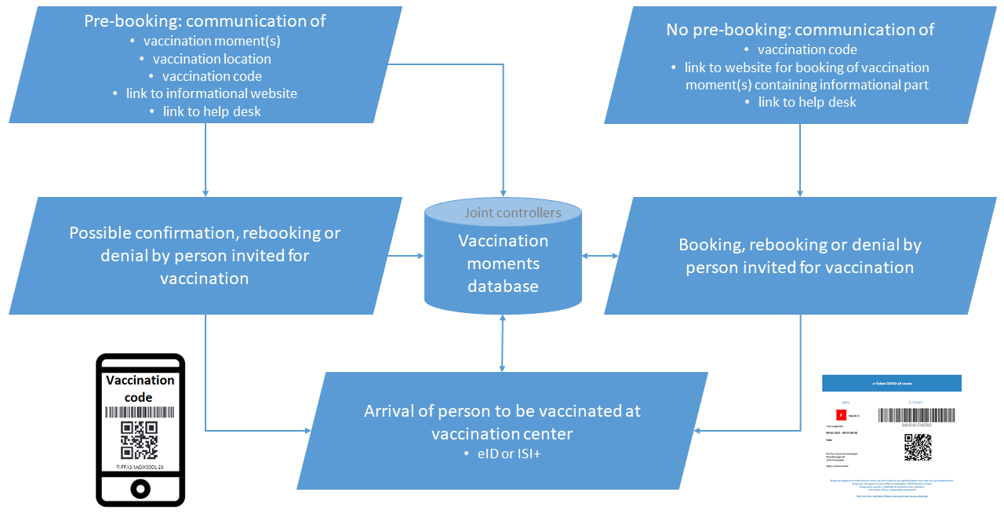
Example: COVID vaccination

Slide 128


Vaccination: (Simplified) integration
Sciensano
Vaccinnet
National Register
IUAM
API gateway
ConsultRN
CoBRHA
Regions
National Intermutual College
Doctors
Vaccination Codes Database
Inivitation & booking
system
Vaccination centers
Hospitals
Pharmacies
Last minute
invitation system

Slide 129
Security: confidentiality, availability, integrity

Slide 130
Global vision
modern technologies can bring enormous benefits and added value, but they must be deployed with the right safeguards for the fundamental right to data protection
international treaties and national constitutions provide for a whole series of fundamental rights: in addition to the right to data protection, there is also the right to a fair trial, the right to social protection, the right to high-quality healthcare, ...
citizens can expect the government to ensure their right to data protection in a way that also respects their other fundamental rights
possible drawbacks should be avoided, but benefits should not be unnecessarily obstructed
risk management and data protection-by-design and a multidisciplinary approach are key concepts in this

Slide 131
Holistic approach
legal framework
minimal information security standards
structural and institutional measures
organisational measures
technical measures

Slide 132
Legal framework: General Data Protection Regulation (GDPR)
Regulation (EU) 2016/679 of the European Parliament and of the Council of 27 April 2016 on the protection of natural persons with regard to the processing of personal data and on the free movement of such data, and repealing Directive 95/46/EC
directly applicable without the need for transposition into national law
applicable as from 25 May 2018
see https://eur-lex.europa.eu/legal-content/EN/TXT/?uri=celex%3A32016R0679

Slide 133
Minimal information security standards
developed by information security working party composed of Data Protection Officers (DPOs) of the actors => buy in !
approved by an independent Information Security Committee designated by Parliament
based on ISO 27000 standards, adapted for social security and health care (see https://en.wikipedia.org/wiki/ISO/IEC_27000-series)
defines 15 areas of security
enforced for all actors in the social sector
extended with policy guidelines
  minimal standards refer to policy guidelines for more detail
  policy guidelines provide support for concrete implementation

Slide 134
Topics covered by minimal information security standards
basic principles
information security policies
organisation of information security
  internal organisation
  mobile equipment and remote working
security measures for employees and co-workers
management of company assets
physical and environmental security
access control (physical and logical)
encryption

Slide 135
Topics covered by minimal information security standards
operations management
protecting communications
procurement, design, development and maintenance of systems
supplier management
incident management
business continuity
compliance

Slide 136
Structural and institutional measures
no unnecessary central data storage
availability of free of charge, basic information security services
  user- & access management
  encryption
  logging
  reference directories
  …
independent Information Security Committee designated by the Parliament that authorizes data exchange
a preventive control of the legitimacy of personal data exchange by an trusted third party (TTP) according to the authorizations of the independent Information Security Committee

Slide 137
Considerations in the deliberations
lawfulness and purpose limitation
  is the processing serving a legitimate purpose?
  are the purposes of the processing well defined ?
data minimization
  is the processing using the minimal dataset to achieve the purposes ?
  storage limitation
integrity and confidentiality
  measures on how to guarantee both parameters
transparency for the data subjects
information security standards

Slide 138
Organisational measures
Information Security Department headed by Data Protection Officer (DPO) with each actor in the social sector
specialized information security service providers
need for compliance with minimal information security and data protection standards (Minimale normen / Normes minimales)
information security working parties developing information security policies
Data Protection Impact Assessments (DPIA)
unique file

Slide 139
Organisational measures
yearly assessment of compliance with minimal security standards
  questionnaire sent out to all institutions connected to the network
  checked by the security service of the TTP
  reviewed in the Information Security work group
security requirements reviewed on regular basis
internal audits with continuous improvement plans => independent auditor reporting on findings

Slide 140
Circles of trust
agreements between actors about
  who is responsible of carrying out which authentications and verifications on the basis of which means
  how the results of the authentications and verifications are securely stored and exchanged electronically between the actors involved
  who is responsible of logging access (attempts) to the services and applications
  how it is ensured that a complete reconstruction of loggings can take place to determine which natural person has used which service in relation to which person, when and for what purposes
  the retention period of the loggings, as well as the way in which these can be consulted by those who are entitled to do so

Slide 141
Technical measures, eg User & Access Management (UAM)
objectives
  be able to (electronically)
    identify all relevant entities (physical persons, companies, applications, machines, …)
    know the relevant characteristics of the entities
    know the relevant relationships between entities
    know that an entity has been mandated by another entity to perform a legal action
    know the authorizations of the entities
  in a sufficiently certain and secure way
  in as much relations as possible (C2C, C2B, C2G, B2B, B2G, …)
  using open interoperability standards

Slide 142
UAM: user expectations
one-time registration of identity, characteristics, relationships and mandates
single sign on for as many public and private sector applications as possible
  authentication of the identity
  verification of relevant characteristics, relationships and mandates
electronic means for authentication of identity that can be used on as much devices as possible
minimal cost of
  registration procedures
  electronic means for authentication of identity
  use of electronic means for authentication of identity

Slide 143
UAM: Policy Enforcement Model
Action on application
DENIED
Policy
Enforcement
(PEP)
Action on application
PERMITTED
User
Application
Action on application
Decision
request
Decision
reply
Policy
Decision
(PDP)
Information
request/reply
Policy
retrieval
Information
request/reply
Policy management
Policy
Administration
(PAP)
Policy
Information
(PIP)
Policy
Information
(PIP)
Manager
Policy repository
Authentic source
Authentic source

Slide 144
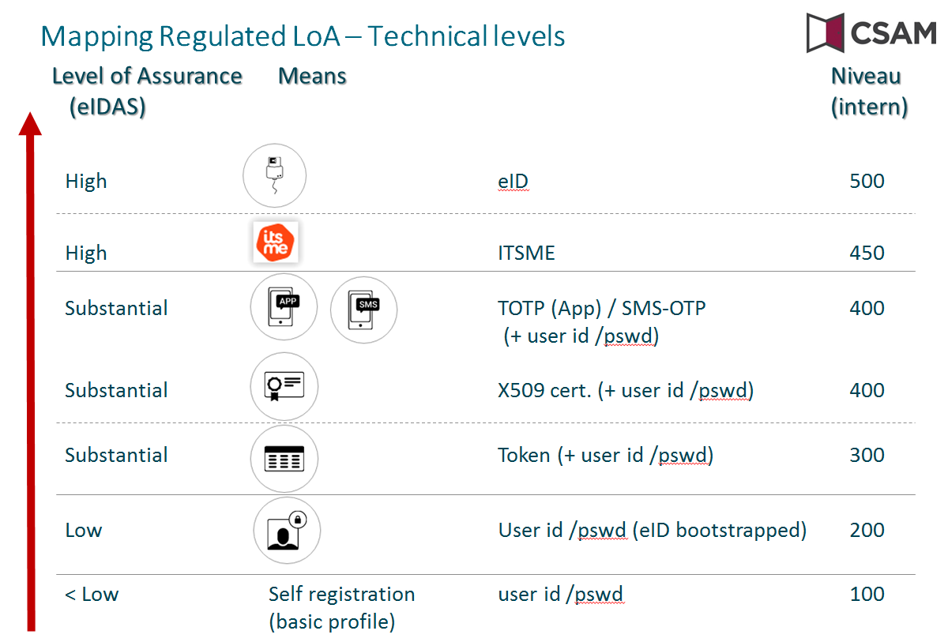
Authentication of identity: different levels

Slide 145
Technical measures, eg encryption of health data
Healthcare actor
Person or entity
eHealth platform
Internet
1
3
Connector or
other software to
generate key pair
Authenticates sender
2
4
Identification
certificate
Identificationcertificate
Stores
public key
Sends
public key
Web service
Register key
2
Public keys
repository
Stores private key
in a secure way

Slide 146
Technical measures, eg encryption of health data
Message originator
eHealth platform
Internet
1
Identification certificate
Web service
Ask public key
2
Identification
certificate
Asks for public key
Authenticates sender
Send message
Any protocol
3
4
Sends
public key
Encrypts
message
Identification
certificate
Message recipient
Public keys
repository
5
Stored
private
key
Decrypts message

Slide 147
Technical measures, eg encryption of health data
Key
Management
/ Depot
Encrypted with public key of user 1
Encrypted with public key of user 2
Symmetric key
Symmetric key
2 sends key
5 receives key
User 1
Originator
1 asks for key
User 2
Recipient
4 justifies right to
obtain key
4 justifies right to
obtain message
3 sends encrypted message
Encrypted with public key of Message depot
5 receives message
Encrypted with public key of user 2
Message encrypted with
symmetric key
Messages
Depot
Message encrypted with
symmetric key
Message encrypted with symmetric key

Slide 148
Conclusion on information security
focus has to be put on a good balance between
  effectiveness and efficiency of information systems
  information security and data protection
  => based on risk analysis
information security and data protection need a holistic approach and are translated into a number of measures
  structural measures
  organizational measures
  technical measures
  legal measures
promoting information security and data protection by design

Slide 149
Business intelligence and big data analysis

Slide 150
Business intelligence
characteristics of the data
  4 v’s
    volume
    variety
    velocity
    veracity
  distributed: multiple data sources
  data is too extensive and/or complex to be handled by traditional software
characteristics of the analytical methods
  "data driven ", looking for patterns and correlations
  rather than "hypothesis driven", looking for causes

Slide 151
Big data analysis
value chain
iterative, rather than sequential process
result can be used
  descriptively
  predictively
  prescriptively
need for appropriate information security measures in each phase
data collection
storage & preprocessing
analysis
use

Slide 152
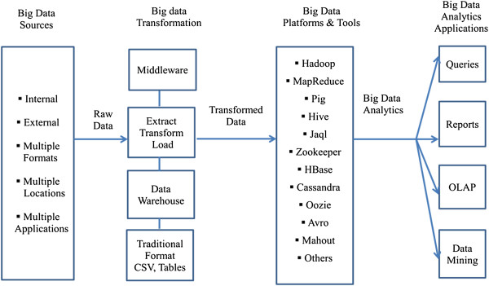
Big data analysis components
Source: https://www.ncbi.nlm.nih.gov/pmc/articles/PMC4341817/

Slide 153
Big data analysis
Domain | Description
Research | - Phenomenon analysis - (Big) data exploration - Trend analysis
Fraud detection | - Data mining, machine learning, AI - Predictive analytics, predictive modelling
Process support | - Data visualization - Network visualization - Automated searches, calculations, real-time applications of predictive analytics - Detection of non take up of benefits
Policy support | - Reporting, KPI, balanced scorecard - Evaluation of the success measures have - Simulations
Infrastructure management | - Capacity planning - Predictive maintenance
Data protection | - Security Information & Event Management (SIEM)
…

Slide 154
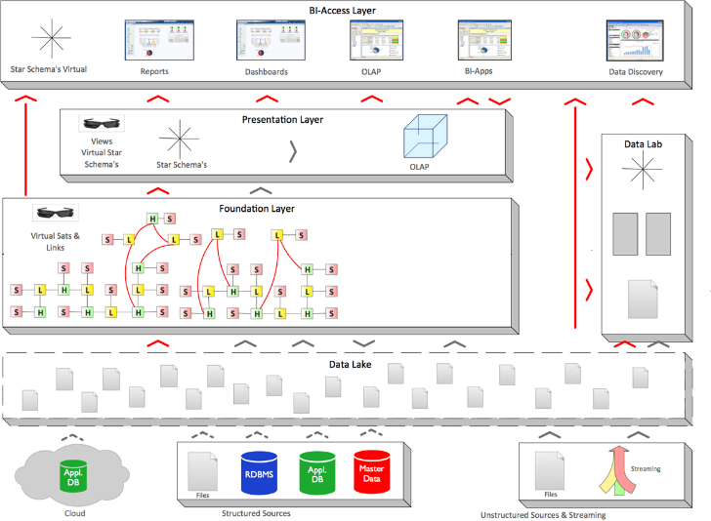

Big data analysis - architecture
BDAP
front-end
All forms of analytical and business value generating re-use of data
BDAP
front-end
Data Mining
AI
Big Data Analytics Platform (Foundation)
Delivers “Bring compute to the data” paradigm:
calculations from front-end tools are pushed to the foundation
Data Integration
Data Warehousing
(ETL—ELT—TEL)
Information Management
Business Glossary
Data Management
Data Quality
Data Governance
Data Protection
Enterprise-ready
Big Data Management solution
(Hadoop, NoSQL)
Relational
Analytical Database
Management System (accelerator)
Computing Power
Connectors
Structured Sources
Unstructured Sources & Streaming
Notes:
BDAP Foundation: sometimes called “Data Lake”, but in this context it’s a Data Lake++ with governance

Slide 155
Technology watch and continuous innovation

Slide 156
Innovation watch and R&D
actively follow the technological evolutions
make a selection of evolutions with potential for your own organization
not a university: technology must exist and work
gradually build up knowledge and insights
quickly switch from testing to experimentation to first application
choice is important, but at least as important is acquiring the competences in-house
must be tailored to own situation, cannot just be outsourced
not all projects succeed, there are better years and worse years
R&D staff can also work on other projects, but there must be sufficient time for R&D projects

Slide 157
Some promising new technologies
artificial intelligence
  natural language processing
  conversational interfaces
  machine learning
mobile applications & internet of things
robotic process automation (RPA)
blockchain

Slide 158
Artificial intelligence

Slide 159
What is Artificial Intelligence (AI) ?
an area of computer science concerned with the creation of machines that can reproduce human cognitive functions such as reasoning, planning, learning, language understanding, vision,…
weak or narrow AI
  simulates intelligence
  is limited to specific areas
  all current implementations of AI are narrow AI
strong or general AI
  still debated, includes philosophical considerations such as consciousness, intentionality, …
  has real intelligence
  has mental states and beliefs like humans
  holy grail !

Slide 160
Some AI subfields
Knowledge representa-tion
Natural language generation
Sensors/
internet of things
Audio/
speech analytics
Machine learning
Graph analysis
Simulation modelling
Natural language processing
Deep Q&A systems
(cognitive computing)
Robotics
Image analytics
Deep learning
Social network analysis
Visualisa-tion
Deep causal reasoning
Virtual personal assistants
Recommen-der systems
Machine translation
Source: PWC via @mikeuindazzi

Slide 161


Natural Language Processing (NLP)
processing of natural language in order to communicate with humans and extract information from written texts
some applications of NLP are:
  machine translation
  text classification
  information extraction
  speech recognition:
    Google Assistant/Home
    Siri
    Alexa
    Cortana
    ….

Slide 162
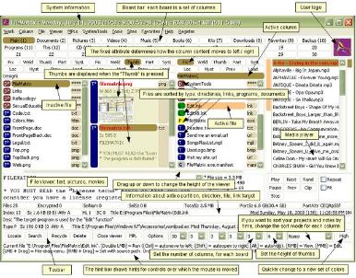
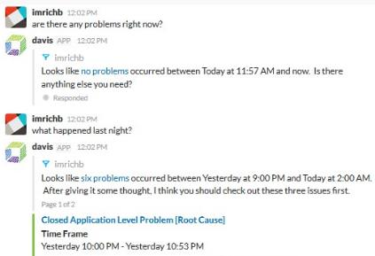
Conversational interfaces
A conversational interface is a user interface which allows interacting with the computer based on conversations in natural language (text or speech)
Lowers the threshold: users do not have to learn how to work with the (graphical) interface
versus

Slide 163
Voorbeeld: chatbot Student@Work
automatisch antwoord op algemene vragen over studentenarbeid
  inhoudelijke vragen
  technische vragen (toegang, foutmeldingen)
beschikbaar via contactpagina https://www.studentatwork.be/
24/7 beschikbaar (studenten zijn vaak buiten kantooruren actief)
onmiddellijk antwoord
schaalbaar

Slide 164
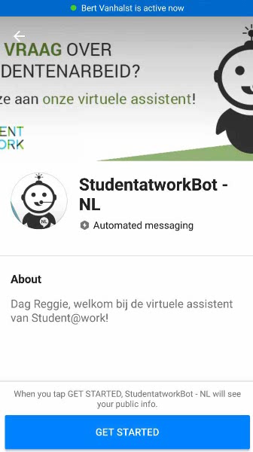
Voorbeeld: chatbot Student@Work
DEMO

Slide 165
Voorbeeld: Dimona via Google Assistant
Dimona: aangifte van begin en einde van een arbeidsrelatie
  werkgeversnummer
  werknemersnummer
  datum van begin/einde van tewerkstelling
integratie met Google Assistant, de virtuele assistent van Google
via Google Home (slimme luidspreker)
via smartphone
spraakinterface
Engels (en Nederlands prototype)

Slide 166
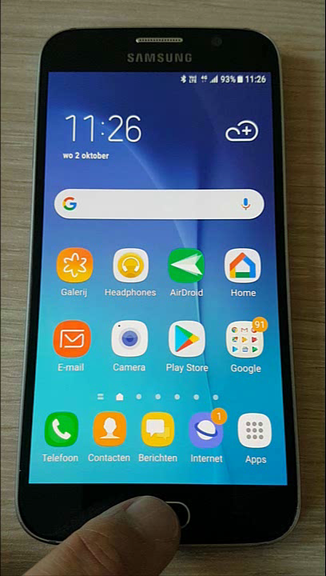

Voorbeeld: Dimona via Google Assistant

Slide 167
Machine learning
design of algorithms that automatically learn from example data with no or minimal need for human intervention
at the intersection of computer science and statistics
advantages
  no need to code explicitly all possible situations the machine will have to deal with, the machine adapts to change in conditions or unseen situations
  can learn a solution to a problem by itself where it would be hard for a human to explicitly instruct the machine
Notes:
Machine Learning uses Data Mining techniques and other learning algorithms to build models of what is happening behind some data so that it can predict future outcomes. A computer program is said to learn some task from experience if its performance at the task improves with experience, according to some performance measure. Machine learning involves the study of algorithms that can extract information automatically (i.e., without on-line human guidance). Most tasks that require intelligence require an ability to induce new knowledge from experiences. Thus machine learning is a large area within AI.

Slide 168
Machine learning approaches
Supervised learning
learns from examples of pairs of input-output
feedback from a ‘teacher’ which provides the correct answer for example inputs
Unsupervised learning
no feedback from a ‘teacher’
learns patterns in the input
Reinforcement learning
very efficient for complex problems in unknown environment
no feedback from a ‘teacher’
particularly used in Robotics (film robot)
receives a reward if successful at executing a task or punishment otherwise
most common approach
used mainly for clustering
eg chatbot
Notes:
Source: « Artificial Intelligence: A moder approach » Russel, Norvig

Slide 169
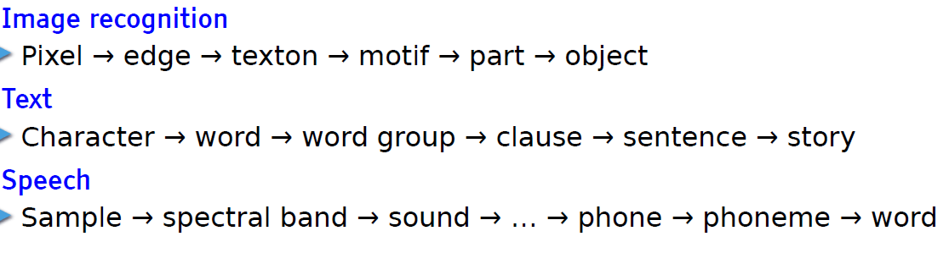
Deep learning
= deep neural network
  neurons or units are organised on more than one layer hence the word « deep»
state of the art: achieves outstanding performance in areas such as speech recognition
learn hierarchical representations
Leçon inaugurale au Collège de France, Yann LeCun, 04 avril 2016

Slide 170
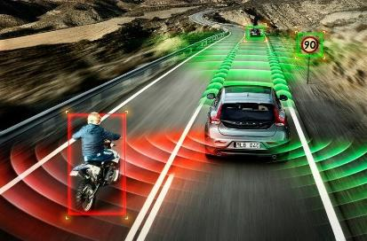
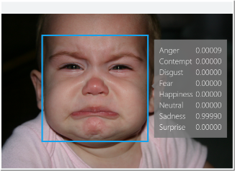
AI applications
automotive:
  self-driving/-flying robots
finance and economics:
  automatic trading
  fraud detection
video games
  non-playable characters
  VR world generation
communication & social media
  spam filters
  smart email categorization
  face recognition
  speech recognition
human resources
  resume screening
  recruiting chatbots

Slide 171
AI applications - social sector
where does it apply?
  when there are lot of administrative and repetitive tasks
  where the workload is too important for the available resources
  for large and complex datasets to analyse
potential use cases
  understanding and answering citizen questions
  search documents
  document classification
  translation
  legal service: find related case laws
  fraud detection / anomaly detection
  case management / process management
  next best action
  decision support

Slide 172

Example: fraud detection
Database X
Database Y
Database Z
Data-preprocessing
Sudden change in behaviour
(type 1 fraud) network
t
Fraud type 2 symptoms
& profit
Start of
lifecycle
Parameter
change
Consecutive or complex events
Network
info
Predictive model

Slide 173
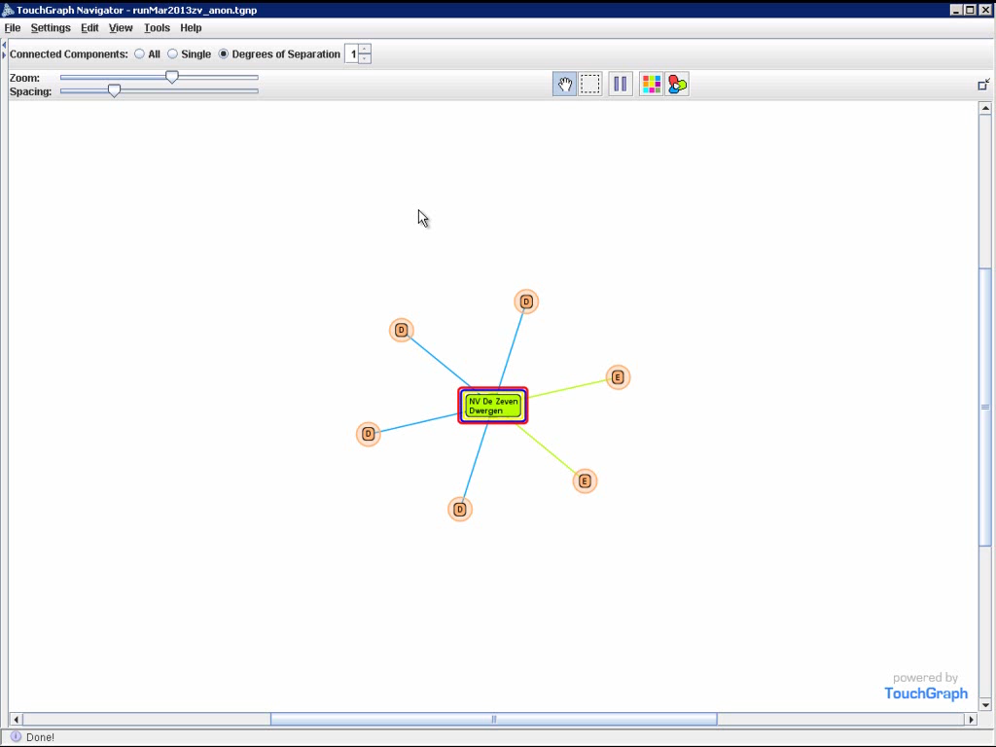
Example: fraud detection

Slide 174
Mobile applications and internet of things

Slide 175

Present and future interfaces
growth of mobile user interfaces
mobile applications with added value, not "mobile for mobile"
how do we ensure user-friendly, maintainable and secure applications ?
what is acceptable to the target audience?

Slide 176
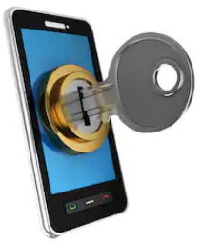
Importance of means of authentication
correct registration procedure to establish identity, qualities and relationships
as simple as possible for end users
tiered levels of authentication
  according to level of registration: how certain are we of identity?
  according to application needs: what are the risks in case of abuse?
protection of data / functionality according to entitlements
take into account technological evolution
  eg eID -> security code (mobile / SMS) -> Itsme
cooperation initiative between government and private sector

Slide 177
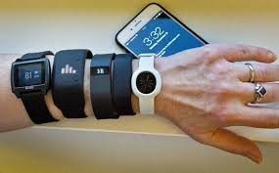



Mobile devices & wearables
abundance of new mobile devices & wearables
  smart phone
  smart watch
  bodycam
  sensor that captures health data (vb Vivalink
  monitors)
  smart glasses (= augmented
  reality, adds info to observable reality)
  smart ring (eg Motiv ring fitness tracker)
  clothing (eg Vitali Sport BH)
GPS based

Slide 178

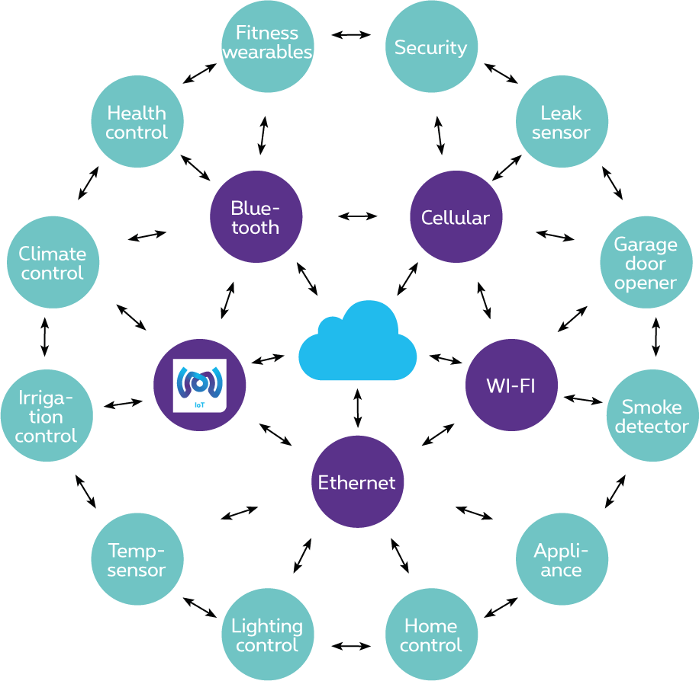


Internet of Things (IoT)
The “things"
Objects and sensors that send/receive data
The connectivity
Data transport
The application
Combining data, adding logic

Slide 179
Where does IoT stand today ?
Doing the same thing, better/faster/cheaper
IoT: eg sensor network instead of human intervention
Doing something that cannot be done without a new technology
eg introduction GPS → navigation
IoT: eg wearable monitors constantly measure your heart rate
eg smart tags continuously know where package is
Surprising innovation thanks to widespread adoption of technology
vb internet + smartphones → mobile apps
IoT: ???
What if all devices are on the Internet? What if there were sensors everywhere?

Slide 180
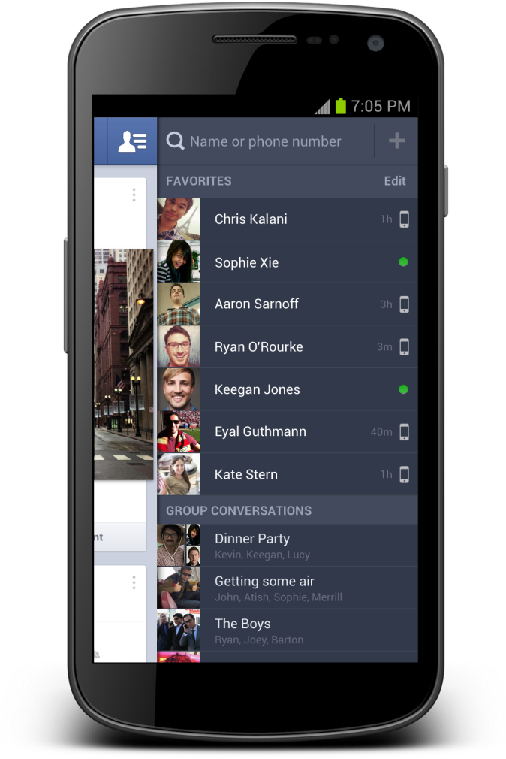
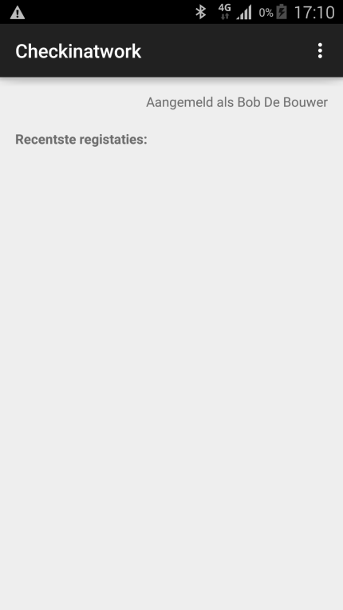




Internet of Things: experiment with beacons
Notificatie:
Beacon present at the workplace
Beacons are easy, inexpensive and quick to integrate with mobile applications and can help to provide context-specific information to the application
Notes:
In dit experiment werd een scenario uitgebouwd op basis van eenvoudige beacons (zendertjes die een uniek identificatienummer hebben).
Het scenario veronderstelt dat de betrokken ondernemer de beacon aangemeld heeft met de relevante informatie: voor welk bedrijf? Voor welke werf?
Een werknemer of een onderaannemer die de werf bezoekt beschikt over een app op zijn mobiel device die de activiteit van de beacon kan oppikken, de identiteit kan uitlezen en dan vervolgens ia zijn app een melding doet dat hij op die bouwwerf aanwezig is. Op die manier krijg je een low-cost, snel te implementeren mogelijkheid om aanwezigheidsmeldingen te doen.
Dit scenario is nuttig voor veiligheid op het werk (accurate registratie van aanwezigheden in seveso bedrijven bvb) of voor fraudebestrijding.

Slide 181
Robotic Process Automation (RPA)

Slide 182

Robotic Process Automation (RPA)
automation technology based on software robots
mimicking the work of humans across applications
using the app’s UI, and not requiring deeper (more costly) integration
Designed by Freepik

Slide 183
Comparison with other automation options
software robots simulate manual clicks and keystrokes, performing actions and business logic on existing software
ormal automation requires new systems to be built and integrated => normal automation is usually costly and time consuming
Automation Options
process requiring intelligence
AI based solutions
BPM based
solutions
Traditional
Applications
or Services
RPA
deterministic process
cheap
expensive

Slide 184
Use Case: Covid-19-related temporary unemployment benefits
results
  actual development effort 10 days; 5 more days in maintenance during the first 3 months; project entourage cost another 5 days.
  surprisingly stable since
  first 4 months (peak period): 668,000 payments automated, saving 222 days of manual labour
  business (and employees) saved, while a more profound solution can be worked on in the background
  quicker payout for the socially ensured
  still 2 robots in use today (using regular license)
  movie on https://www.frankrobben.be/wp-content/uploads/2022/04/RPA-HVW.wmv

Slide 185
Blockchain

Slide 186








Traditional international transaction
Bob
Alice

Slide 187







Idea
Ok!
Transactions
5,1 BTC →
0,7 BTC →
I transfer
0,4 BTC to .
Dave
0,4 BTC →
Transactions
5,1 BTC →
0,7 BTC →
Ok!
Transactions
5,1 BTC →
0,7 BTC →
0,4 BTC →
Bob
0,4 BTC →
Charlie
Ok!
Transactions
5,1 BTC →
0,7 BTC →
Alice
0,4 BTC →

Slide 188

A chain of blocks
Block 50
Block 51
Block 52
Block 53
Block 54
Header
Header
Header
Header
Header
5,10 BTC →
0,40 BTC →
0,70 BTC →
Concatenation of blocks, which contain transactions
At predetermined frequency, the network appends new block with most recent transactions
Blockchain contains ALL transactions
Transaction in blockchain cannot be removed
Many entities possess same copy of the blockchain

Slide 189







Traditional contract
Text
Contract enforced by legislation
Trusted authority may be required

Slide 190
Smart contract
More complex reality
Code
Text
Contract enforced by technology
Quicker &
more efficient
No trusted authority required

Slide 191


Smart contract
Ether (Ξ) is the crypto-
currency on Ethereum
getMoney()
Contract Auction{
function bid()
function getMoney()
HighestBid: Ξ
HighestBidder:
Beneficiary: Charlie
}
Charlie
20 Ξ
bid(), 10 Ξ
0
10
20
10 Ξ
Bob
bid(), 20 Ξ
Alice
Alice
Bob
Can receive, block and spend value
No single entity can influence correct functioning
Reactive
Deaf and blind

Slide 192
Smart Contracts
Publishing a contract, calling its functions & destroying it happens through transactions
Block 50
Block 51
Block 52
Block 53
Block 54
Block 55
Block 56
Header
Header
Header
Header
Header
Header
Header
Publish contr.
Bid Bob
getMoney
Destroy contr.
Bid Alice

Slide 193




Blockchain is about organizing trust
Blockchain network can help with
Registration of facts
Transfer of assets
Enforcement of rules

Slide 194





Blockchain network
Distributed
Robust
Scalable
Many nodes possible
Append-only

Slide 195
Everything that can be done with a blockchain, can be done with a centralized approach, and even more efficiently
Why blockchain?
A centralized approach might not be desirable
Politics
(E.g. cross-border exchanges, privacy)
Absence of trusted authorities
(E.g. Bitcoin in 2009)
Abuse (quasi-) monopoly positions
Illegal activities
(E.g. Dark Web)
Other blockchain advantages also feasible with other technologies
Process automation
Consistency
Streamlined processes
Real-time updates
Insight in decision proces

Slide 196
Blockchain is about Trust
In case of a centralized approach,
is it an issue that a central entity needs to be trusted?
Blockchain is a bad idea
Blockchain might be an option

Slide 197











Registration of facts
(Official)
documents
Driving license
Marriage
Diploma
Identity
Will
History/
Overview
Medical
records
Vaccination
Supply chain
Tracking
Taxes
Political
mandates
5f 3b fa 41 9c 63 be 2a 3a 09 ad bd 06 30 c5 1f
64 5e b0 3a ba fc d5 f2 ad 39 63 7a 30 6b 41 77
Will

Slide 198









Transfer of assets
Crypto currencies
(Virtuele assets)
Bitcoin
Monero
Ethereum
.bit
Untangible
assets
Tickets
Domain names
Electricity
Copyright
Tangible
assets
Land registry
Cars
Diamonds

Slide 199











Enforcements of agreements
Permissions
access PII
Flight Delay
Insurance
Auction
Transport
conditions
Processing
medical prescriptions
Elections
Smart locks
Application & Payment
of subsidies / benefits
Blocking
rent guarantee
Crowdfunding
Agreements between parties that do not trust each other,
without trusted intermediary

Slide 200





Future blockchain landscape
Community BaaS
Public BaaS
BaaS
Provider
BaaS
Provider
A
BaaS
Provider
B
BaaS
Provider
C
Own infrastructure
Private
BaaS

Slide 201









Concrete ideas government
Therapeutic relations
Generic traceability service
History cadastre & major works to the home
Identity management
Registration & access management medical data
Tracing food for food safety & sustainability
Government transparency
Cross-border data exchange: who pays social security contributions where?
Prevention/Detection of double or unjustified payments
Tender-calling procedure

Slide 202
Designate an institution as a driving force

Slide 203
Mission of institution acting as driving force
definition of the vision and the strategy on information management in the social sector
definition of the common principles related to information management, information security and privacy protection
definition, implementation and management of an interoperability framework
  technical: secure messaging of several types of information (structured data, documents, images, metadata, …)
  semantic: harmonization of concepts and co-ordination of necessary legal changes
  business logic and orchestration support

Slide 204
Mission of institution acting as driving force
coordination of business process reengineering
stimulation of service oriented applications
driving force of the necessary innovation and change
program and project management
consultancy and coaching

Slide 205
Co-operative governance
Board of Directors
  consists of representatives of the stakeholders (employers associations, trade unions, social security institutions, …)
  approves the strategic, operational and financial plans of the CBSS
General Coordination Committee with representation of all users acts as debating platform for the elaboration and implementation of digitalisation initiatives within the sector
permanent or ad hoc working groups are instituted within the General Coordination Committee in order to co-ordinate the execution of programs and projects
the chairmen of the various working groups meet regularly as a Steering Committee
besides project planning and follow-up, proper measuring facilities are available to assure permanent monitoring and improvement after the implementation of the electronic services

Slide 206
Management and control techniques
annual priority plan debated with all users within the General Coordination Committee
cost accounting and zero-based budgeting resulting in financial transparency, an informed budget and a good evaluation of the management contract with the government
internal control based on the COSO-methodology (see www.coso.org) in order to provide reasonable assurance regarding the achievement of objectives with regard to
  effectiveness and efficiency of operations
  reliability of financial reporting
  compliance with applicable laws and regulations
external audit with regard to the correct functioning of the internal control system

Slide 207
Management and control techniques
program management through the whole sector
issue management during the management of each program
use of a system of project management combined with a time keeping system to follow up projects that are realized by all partners
frequent reports to all users which describe the progress of the various projects and eventual adjustment measures
use of balanced scorecards and a dashboard to measure, follow-up and evaluate the performance of the electronic services
use of ITIL (see https://www.axelos.com/certifications/itil-service-management) for ICT-service delivery
use of a coherent set of monitoring techniques to guarantee an optimal control and transparency of the electronic services

Slide 208



frank.robben@mail.fgov.be
@FrRobben
https://www.frankrobben.be
https://www.ksz.fgov.be
https://www.ehealth.fgov.be

