Slide 1

SMIS
Short Message Integration Service
General information
25/05/2022

Slide 2
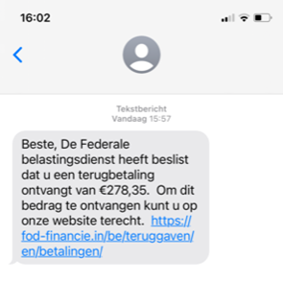

Why GovApp
Mobile phones are a valuable communication channel to citizens
SMS are
  Not user-friendly
    (Very) Short
    Poor (Text only)
  Costly
  Potentially not safe
CovidSafe is hugely installed (~ 8,5 million)

Slide 3
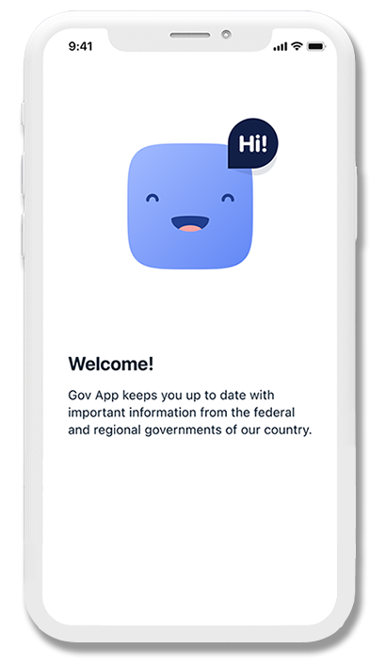
GovApp
GovApp
  Mobile application
  For short notifications
    Supporting html rendering (images, embedded videos, …)
  From the authorities (exact scope to be defined)
    Integrated with SMIS (Short Message Integration Service)
  To the citizen
    Identified with his phone number
  In a secure way
    Validation of the citizen’s phone number
    End to End Encryption (E2EE) of the message’s private body
    Strong authentication of the authorities
  In 4 languages
  More information on https://www.govapp.be/

Slide 4
SMIS
Short Message Integration Service (SMIS)
  Synchronous REST API with added value
  For the transmission of short messages
    With GovApp via Digitaal Vlaanderen
    With SMS via RingRing (Proximus)
  From the integrated authorities
  To the citizen
    Identified with his phone number
  With predefined strategies (GovApp first & SMS fallback, GovApp only, …)
  With a synchronous feedback status about the sending
  With E2EE manageable by the sending authority or SMIS

Slide 5







High Level Architecture
PLF
Citizen’s (smart)phone
CTPC
Short Messaging
Integration Service
Mobile App
GovApp
Mobile App
Messaging service
Tracing business
process engine
Application of an authority

Slide 6
Benefits
For the authorities
  A simple and unique way to send short notifications to the citizen
  With free transactions (with GovApp)
For the citizen
  All authorities short notifications in one mobile application
  With the guarantee that the messages are genuine
  With strong GDPR protection
    The private body is encrypted
  Messages are more user-friendly

Slide 7
Current situation
Accessibility
  Hosted by Smals
  Accessible from eHealth’s API GW for health organizations
Service mode
  Owner : Smals
  SLA : 24/7 99%
  Active monitoring
  Technical & business metrics for internal use
  Integration Guideline available
Published on ICT-ReUse

Slide 8

Next steps (on-going)
Proposed by Smals as G-Cloud service
Accessible for all authorities
  Access for non-health organizations still must be defined
Definition of the cost model
  Onboarding costs
  Recurrent costs
Formal definition of “full” service mode
  Internal support chain with Digitaal Vlaanderen & integrated authorities
  …

Slide 9
More info about GovApp & SMIS on
https://www.govapp.be/ and ICT-ReUse

