Slide 1


Need for an integrated architecture on EU level
frank.robben@mail.fgov.be
@FrRobben
https://www.frankrobben.be
https://www.ksz.fgov.be
https://www.ehealth.fgov.be

Slide 2
Several EC digital programs
Electronic Identification and Trust Services (eIDAS)
European Blockchain Services Infrastructure (EBSI)
Electronic Exchange of Social Security Information (EESSI)
European Social Security Pass (ESSPass)
Single Digital Gateway (OOTS)
EU Digital COVID Certificate (EU DCC)
...

Slide 3
Need for an integrated architecture
global architecture
modular, generic, domain agnostic, interoperable and reusable services and components: develop once, use many
no technology driven choice of components and services used, but use of ICT components and services as enabler and means for meeting business requirements

Slide 4
Digital wallet: an umbrella term
intended features
  mobile authentication of identity
  secure access to personal information
  secure access to applications
  local storage of authentic documents (MyCertificates)
  personalized communication
  …
=> need for a common conceptual framework in order to avoid Babylonian confusion

Slide 5
Common conceptual framework in order to avoid confusion

Slide 6
Distinction between IUAM and storage
need for modular approach and clear distinction between
  identity, user and access management (IUAM)
    identification
    authentication of identity
    verification of characteristics, relationships and mandates
    authorization
  storage of electronic data and documents
    authentic data(base)
    personal data vault (e.g. SOLID)
    local storage of authentic documents (MyCertificates)
    blockchain
  applications

Slide 7
Conceptual framework IUAM
entity
  someone or something that has to be identified
  e.g. a physical person, a company, a computer application, …
attribute
  a piece of information about an entity
identity
  a number or a set of attributes of an entity that allows to know precisely who or what the entity is
  an entity has only one identity, but this identity can be determined by several numbers or sets of attributes

Slide 8
Conceptual framework IUAM
characteristic
  an attribute of an entity, other than an attribute determining its identity
  an entity can have several characteristics
  e.g. a capacity, a function, a professional qualification, ...
relationship
  a link between two or more entities
  an entity can have several relationships
  e.g. a therapeutic relationship between a health care provider and a patient

Slide 9
Conceptual framework IUAM
mandate
  a right granted by an identified entity to another identified entity to perform well-defined legal actions in her name and for her account
  an entity can have several mandates
registration
  the process of determining the identity, a characteristic, a relationship or a mandate of an entity with sufficient certainty
  before putting at the disposal means by which the identity can be authenticated, or the characteristic, the relationship or the mandate can be verified

Slide 10
Conceptual framework IUAM
authentication of the identity
  the process of checking whether the identity that an entity pretends to have, corresponds to the real identity
  authentication of the identity can be done based on the verification of
    knowledge (e.g. a password)
    possession (e.g. an electronic card)
    biometrical characteristics
    a combination of those

Slide 11
Conceptual framework IUAM
verification of a characteristic, a relationship or a mandate
  the process of checking whether a characteristic, a relationship or a mandate that an entity pretends to have, corresponds to a real characteristic, relationship or mandate of that entity
  the verification of a characteristic, a relationship or a mandate can be done by
    the same kind of means as those used for the authentication of the identity
    or, after the authentication of the identity, by consulting reliable databases (‘authentic sources’) that contain information about characteristics, relationships or mandates related to identified entities

Slide 12
Conceptual framework IUAM
authorization
  a permission to an entity to perform a defined action or to use a defined service
authorization group
  a group of authorizations
role
  a collection of authorizations or authorization groups linked to (a number of) service(s) and linked to the execution of a certain mission by an entity
role based access
  a method of assigning authorizations to entities by means of authorization groups and roles, in order to simplify the management of authorizations and their assignment to entities

Slide 13
Conceptual framework storage
authentic data(base)
  reliable data stored in a tamper-resistant database
  that is accessible according to an authorization by or in pursuance of a law
  to every authorized user that needs the data with respect of the principle of proportionality
personal data vault
  reliable data stored in a tamper-resistant database
  that is accessible according to an authorization by the data subject
  to every authorized user that needs the data with respect of the principle of proportionality

Slide 14
Conceptual framework storage
local storage of authentic electronic documents (MyCertificates)
  an application that allows a citizen to store electronic documents locally in a temper-resistant manner
  the content of which can be read without network connectivity
  the authenticity of which can be determined without network connectivity
blockchain
  a method of recording information in a duplicated and distributed way across information systems in a network
  that permits to determine the authenticity of information by consulting the duplicated and distributed information and checking its consistency

Slide 15
Concrete needs

Slide 16
Clear positioning of components in relation to each other
several types of components
  identity, user & access management
  authentic data(bases)
  personal data vaults
  local storage of authentic electronic documents (MyCertificates)
  blockchain
  applications
modular and domain agnostic architecture is crucial to be future proof
integrated services to citizens can be provided perfectly on the basis of a modular architecture
basic components used in the public sector must be available
  on the basis of open APIs and/or open libraries and
  (quasi) free of charge

Slide 17
Basic principles
once only data collection by public sector as a whole
preferably direct data exchange between public sector actors (authentic data(bases)) if they need information from each other, based on authorizations by or in pursuance of a law
personal data vault can be a means for the citizen to make information available according to his/her decision
a local storage of authentic electronic documents is useful in situations where the addressee has not the possibility to obtain the data by direct access to the authentic data(bases) or the personal data vault

Slide 18
Identity, user and access management according to the international standard XACML

Slide 19
Functional requirements
reliable exchange of personal data requires sufficient certainty about the identity of the data subjects
adequate access control requires sufficient certainty about
  the identity of the users
  the authentication of the identity of the users
  the verification of the relevant characteristics of the users
  the verification of relevant relationships
    between the users and the data subjects
    between the users and other entities
  the verification of relevant mandates of the users

Slide 20
IUAM: objectives to be reached
be able to (electronically)
  identify all relevant entities (physical persons, companies, applications, machines, …)
  know the relevant characteristics of the entities
  know the relevant relationships between entities
  know that an entity has been mandated by another entity to perform a legal action
  know the authorizations of the entities
in a sufficiently certain and secure way
in as much relations as possible (C2C, C2B, C2G, B2B, B2G, …)
multichannel (web application, mobile application, …)
using open interoperability standards

Slide 21
User expectations
one-time registration of identity, characteristics, relationships and mandates
possibility of auto registration/bootstrap and auto recovery of credentials once a top level authentication (e.g. eID) is available
single sign on for as many public and private sector applications as possible
  authentication of the identity
  verification of relevant characteristics, relationships and mandates
electronic means for authentication of identity that can be used on as much devices as possible
minimal cost of
  registration procedures
  electronic means for authentication of identity
  use of electronic means for authentication of identity

Slide 22
Critical success factors
meeting user expectations
simplicity in use
taking advantage of opportunities of technological evolution => evolutionary, future proof solutions
accordance with the European regulatory framework
sufficient applications for which electronic user management can be used

Slide 23
Identification number
identification number for every citizen and every company, having following characteristics
  unicity
    one entity – one identification number
    same identification number is not assigned to several entities
  exhaustivity
    every entity to be identified has an identification number
  stability through time
    identification number should not contain variable characteristics of the identified entity
    identification number should not contain references to the identification number or characteristics of other entities
    identification number should not change when a quality or characteristic of the identified entity changes

Slide 24
Policy Enforcement Model (XACML)
Action on application
DENIED
Policy
Enforcement
(PEP)
Action on application
PERMITTED
User
Application
Action on application
Decision
request
Decision
reply
Policy
Decision
(PDP)
Information
request/reply
Policy
retrieval
Information
request/reply
Policy management
Policy
Administration
(PAP)
Policy
Information
(PIP)
Policy
Information
(PIP)
Manager
Policy repository
Authentic source
Authentic source

Slide 25
Policy Enforcement Point (PEP)
intercepts the request for authorization with all available information about the user, the requested action, the resources and the environment
passes on the request for authorization to the Policy Decision Point (PDP) and extracts a decision regarding authorization
grants access to the application and provides relevant credentials
Action on application
DENIED
Policy
Enforcement
(PEP)
Action on application
PERMITTED
User
Application
Action on application
Decision
request
Decision
reply
Policy
Decision
(PDP)

Slide 26
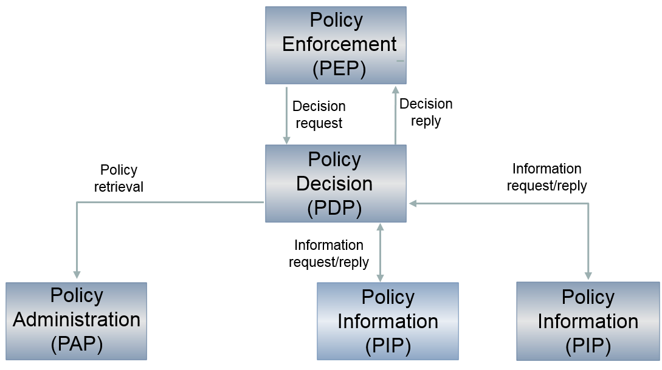
Policy Decision Point (PDP)
based on the request for authorization received, retrieves the appropriate authorization policy from the Policy Administration Point(s) (PAP)
evaluates the policy and, if necessary, retrieves the relevant information from the Policy Information Point(s) (PIP)
takes the authorization decision (permit/deny/not applicable) and sends it to the PEP

Slide 27
Policy Administration Point (PAP)
environment to store and manage authorization policies by authorized person(s) appointed by the application managers
puts authorization policies at the disposal of the PDP
Policy
Decision
(PDP)
Policy
retrieval
Policy management
Policy
Administration
(PAP)
Manager
Policy repository

Slide 28
Policy Information Point (PIP)
puts information at the disposal of the PDP in order to evaluate authorization policies (authentic sources with characteristics, relationships, mandates, etc.)
Policy
Decision
(PDP)
Information
request/reply
Information
request/reply
Policy
Information
(PIP)
Policy
Information
(PIP)
Authentic source
Authentic source

Slide 29
Transborder aspects
Country A
Country B

