Slide 1
Principles of good eletronic information management in the social sector

Slide 2
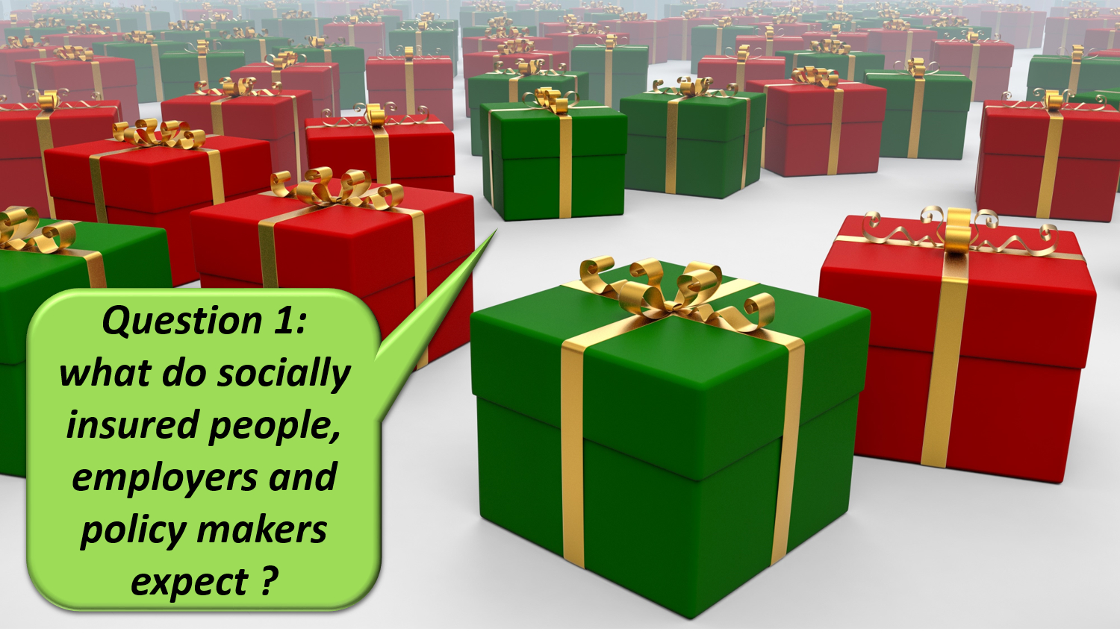
Notes:
Hello every one ! Information is crucial in the organization of a social protection system. If you do not know the social, family or income situation of a socially insured person, you cannot design and deliver social protection effectively and efficiently. That is why sound information management is a key factor for a frictionless social security.

Slide 3
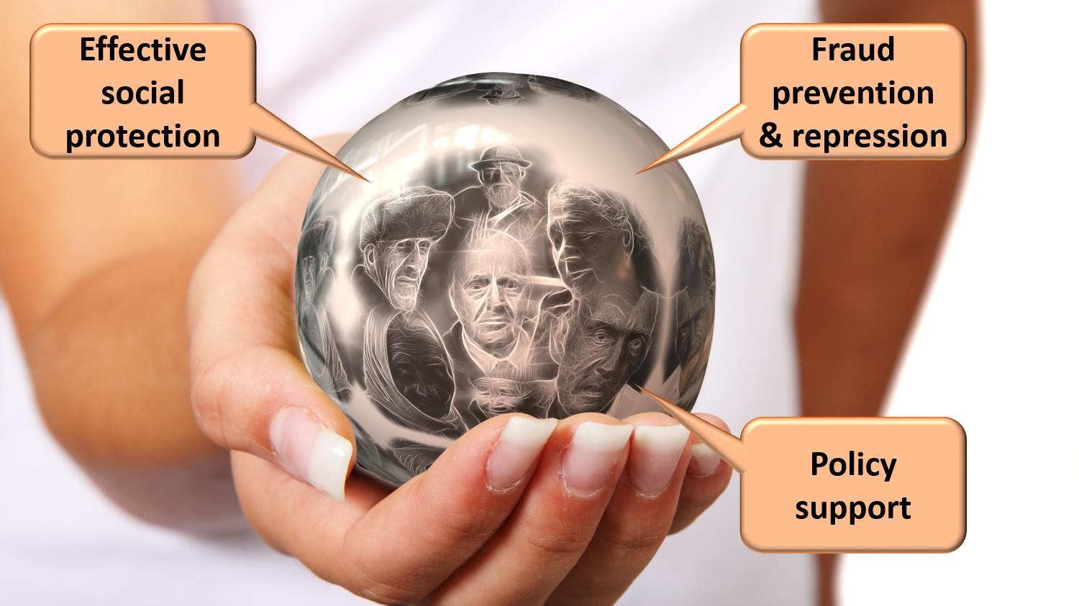
Notes:
effective social protection
to avoid and combat fraud
appropriate policy support

Slide 4

Notes:
benefits as much as possible automatically granted according to a ‘happy flow’

Slide 5
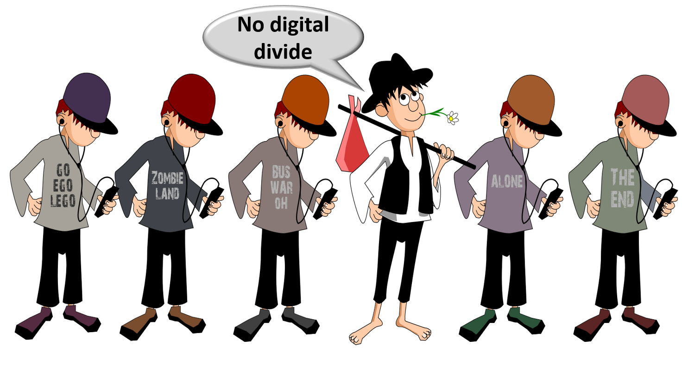
Notes:
social inclusion without a digital divide

Slide 6

Notes:
integrated services across government levels and social security organisations

Slide 7

Notes:
delivered at key life events (birth, going to school, starting to work, moving, illness, retirement, starting up a company…)
addressing citizens’ individual situation, personalized and user oriented

Slide 8

Notes:
minimal costs and minimal administrative burden for all parties involved

Slide 9

Notes:
self service
multichannel service delivery

Slide 10
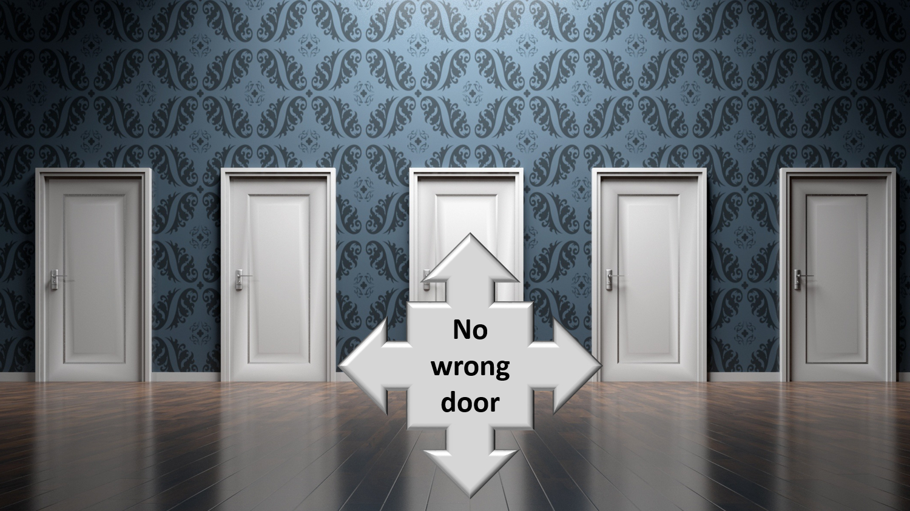
Notes:
to be helped globally wherever they contact: no wrong door

Slide 11
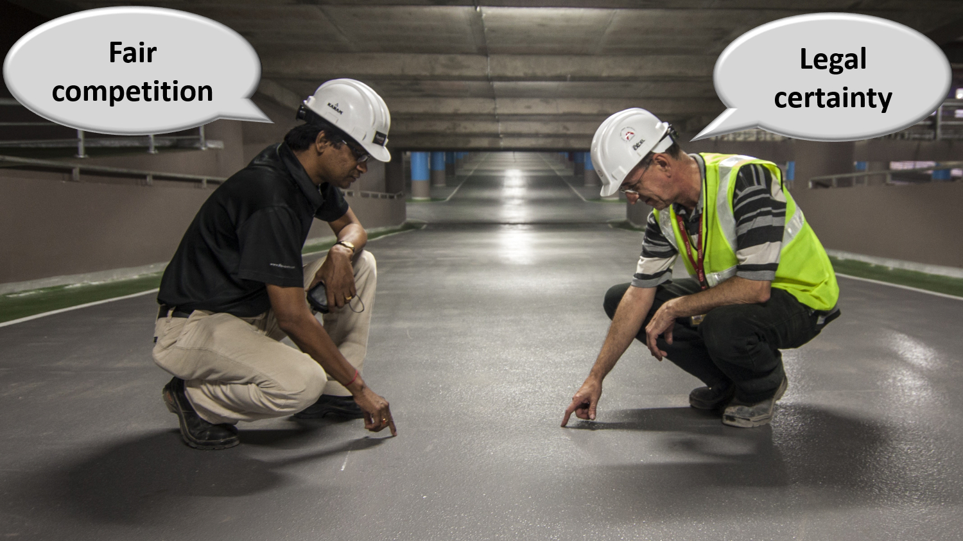
Notes:
reliable, secure and permanently available services with respect of the user’s privacy
legal certainty and legal rules that promote fair competition

Slide 12
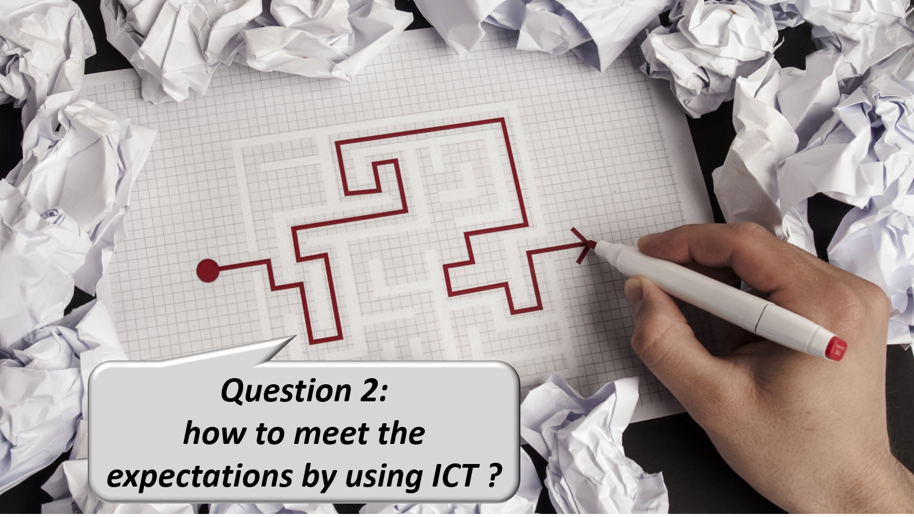
Notes:
How can information management and ICT help us to meet those expectations ?

Slide 13

Notes:
1. Common vision, trust and co-operation
common vision on electronic service delivery, information management and information security between all stakeholders
co-operation based on task sharing, rather than centralization; continuous detection of opportunities for synergy

Slide 14

Notes:
examples of common principles regarding information management
only once collection of factual data
data quality guarantees

Slide 15

Notes:
multifunctional use of data

Slide 16

Notes:
reengineering of business processes

Slide 17
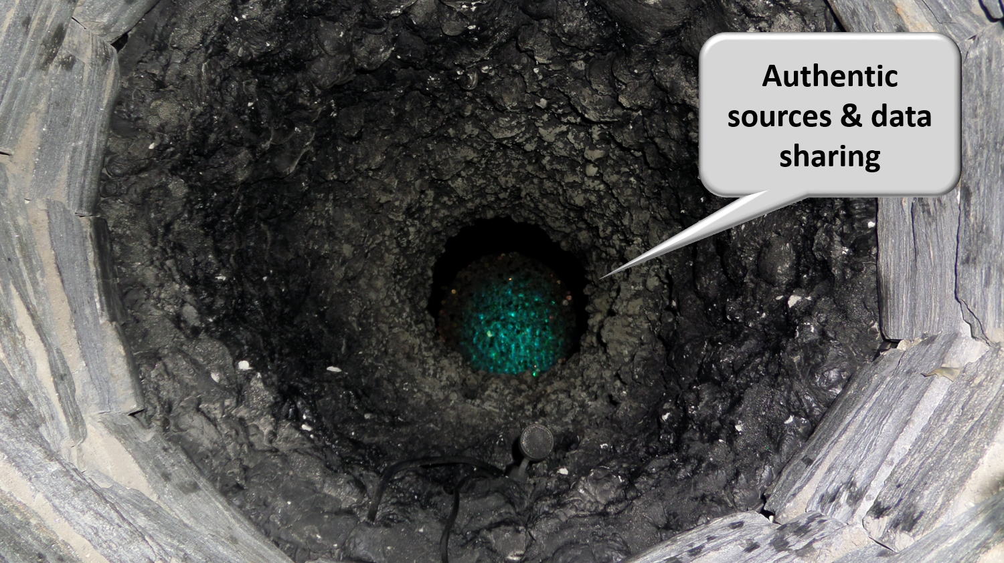
Notes:
authentic sources

Slide 18

Notes:
avoiding loss of confidence due to information security incidents
security, availability, integrity and confidentiality of information is ensured by integrated structural, institutional, organizational, legal (GDPR), HR, technical and other security measures according to agreed policies

Slide 19

Notes:
access authorization to personal information is granted by an independent Information Security Comittee, designated by Parliament, after having checked whether the access conditions are met
the access authorizations are public
every actual electronic exchange of personal information has to pass an independent trusted third party (TTP) and is preventively checked on compliance with the existing access authorizations by that TTP
every actual electronic exchange of personal information is logged, to be able to trace possible abuse afterwards
long term vision combined with continuous delivery of new services (agile development)

Slide 20

Notes:
paying attention to computer literacy of collaborators and users

Slide 21

Notes:
2. Appropriate corporate culture
from hierarchy to participation, communities and team work
in the first place meeting the needs of the customer, not the social security institutions
rewarding entrepreneurship
ex post evaluation on output, not ex ante control of every input

Slide 22
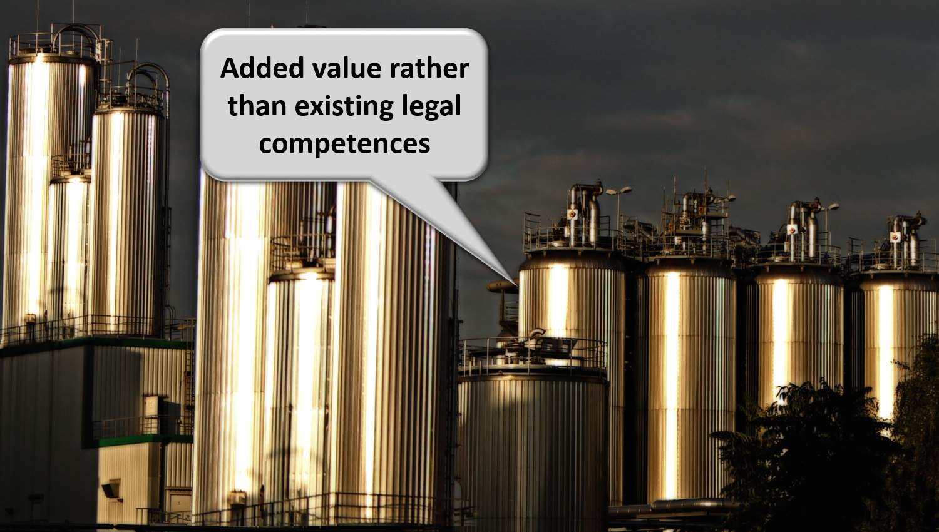
Notes:
reasoning in terms of added value for citizens and companies rather than in terms of legal competences
focus on more efficient and effective service delivery and on cost control
appropriate balance between efficiency on the one hand and information security and privacy protection on the other

Slide 23
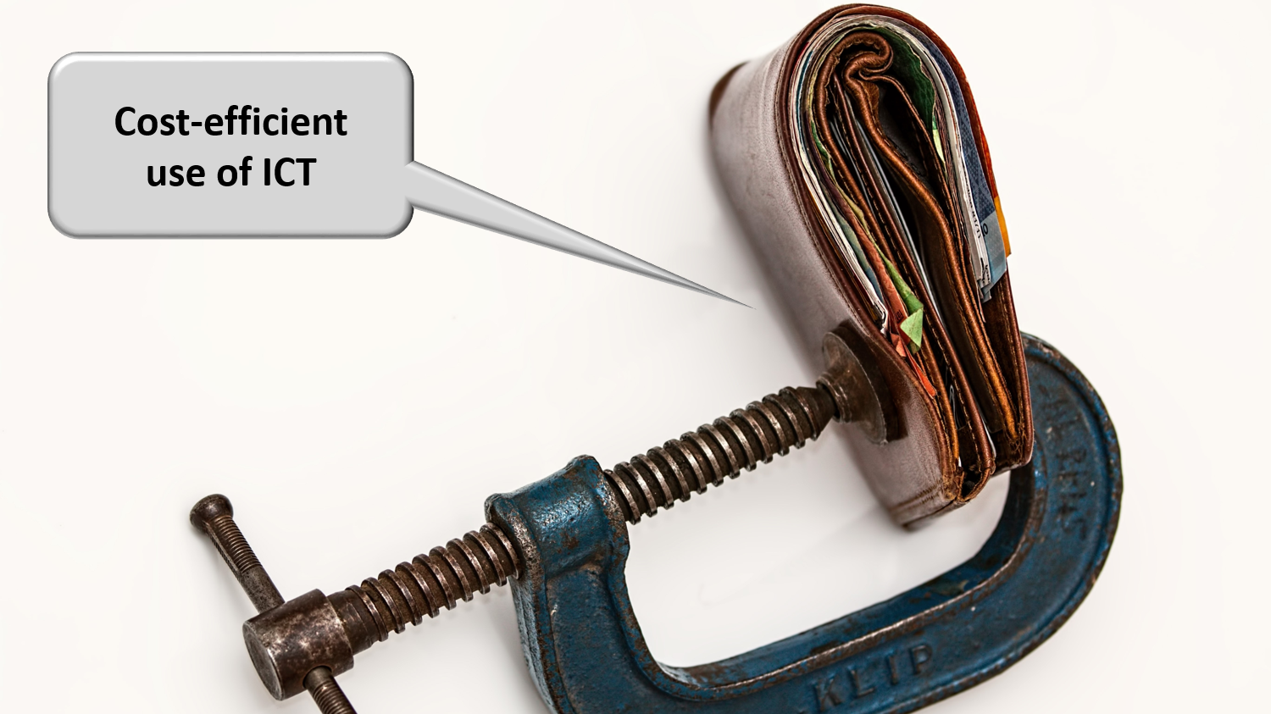
Notes:
sufficient financial means for permanent change and innovation: agreed possibility to re-invest efficiency gains in innovation

Slide 24
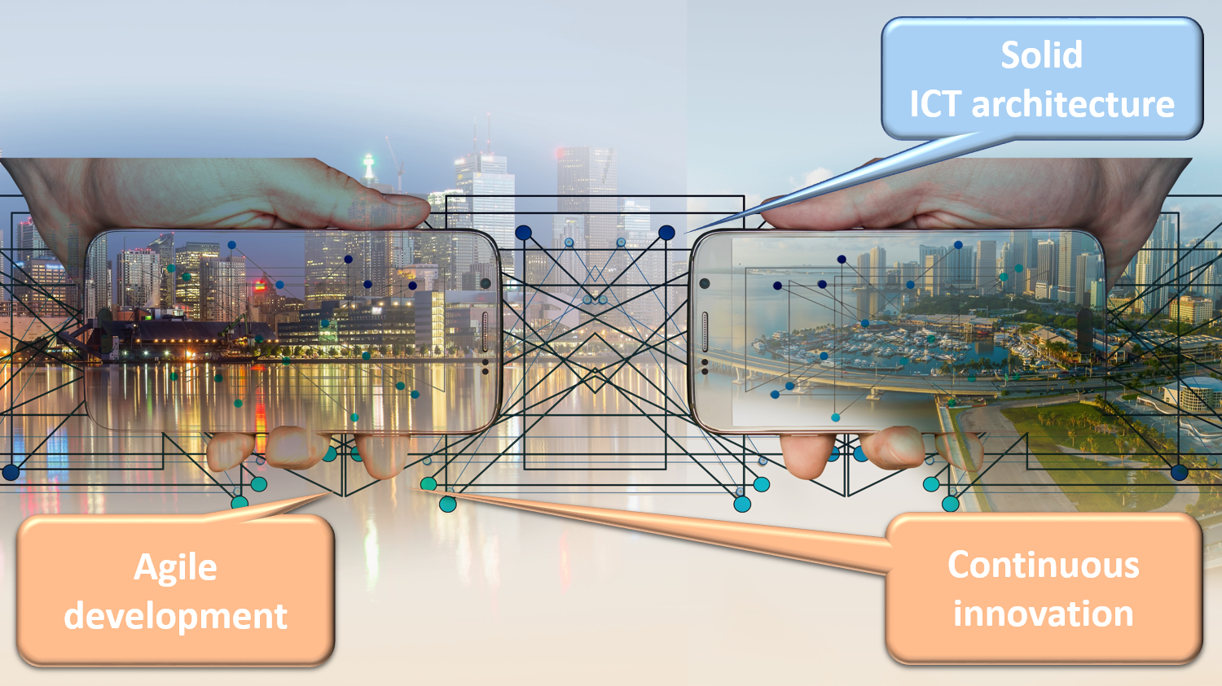
Notes:
3. Solid ICT architecture and continuous innovation
API-approach (application programming interface) and (worldwide) reuse of components, services and best practices

Slide 25
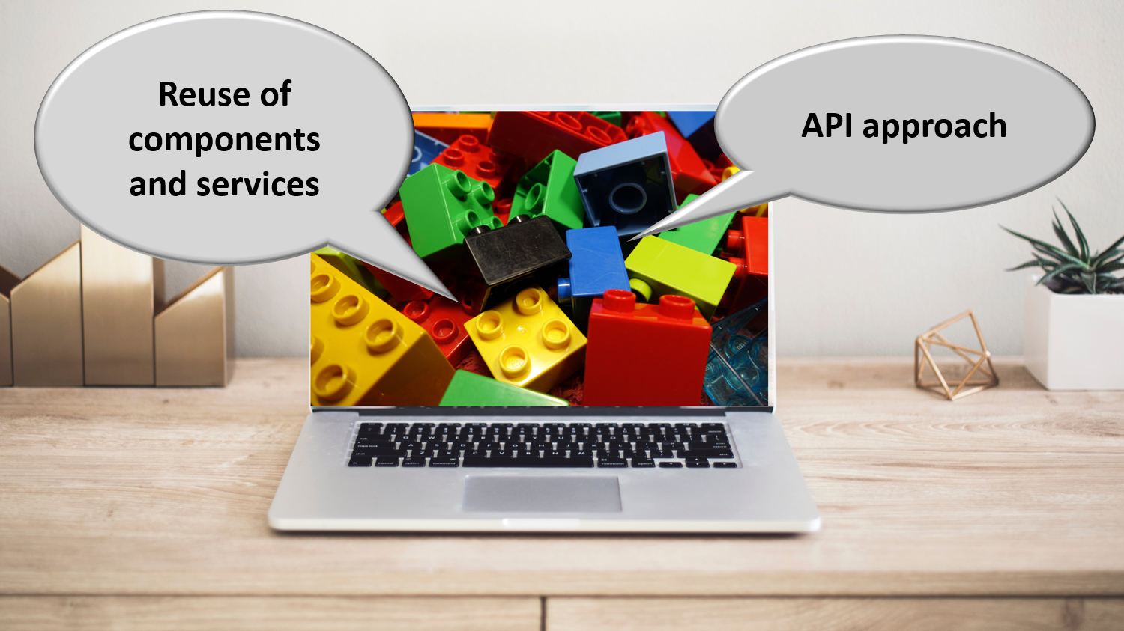
Notes:
sharing ICT infrastructure, platforms, basic services, applications and expertise in order to reduce costs, increase reliability and speed up time to market

Slide 26
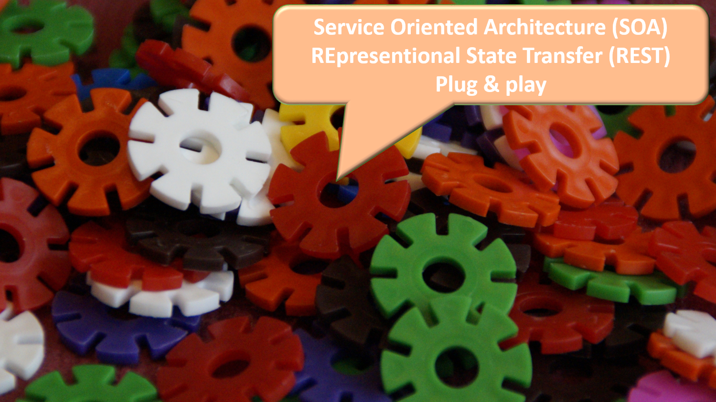
Notes:
service oriented architecture based on REST-full services in a plug and play mode

Slide 27
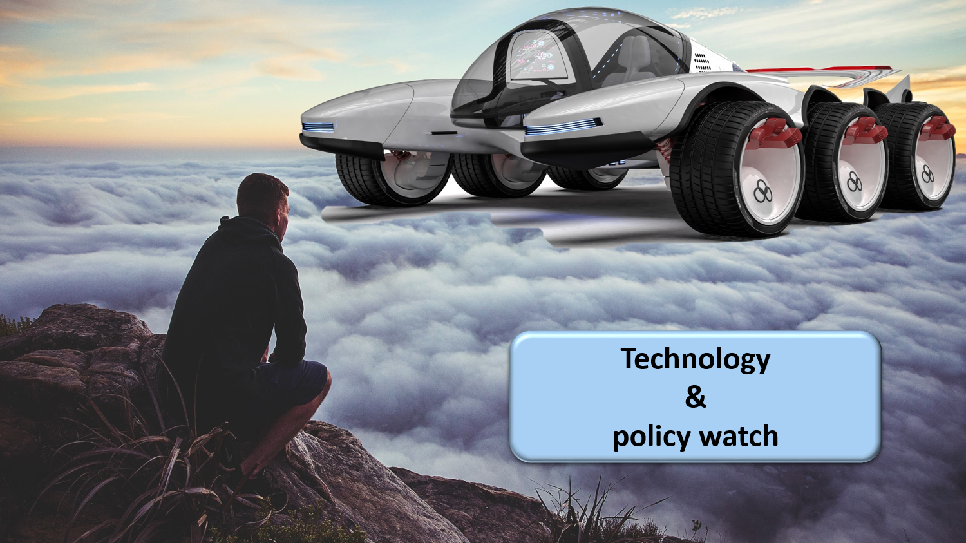
Notes:
technology an policy watch; latest subjects of investigation are

Slide 28

Notes:
mobile applications

Slide 29

Notes:
cloud computing, combining public cloud, for non sensitive information and applications with a community cloud designed and managed by the public sector => cost reduction and faster time to market

Slide 30
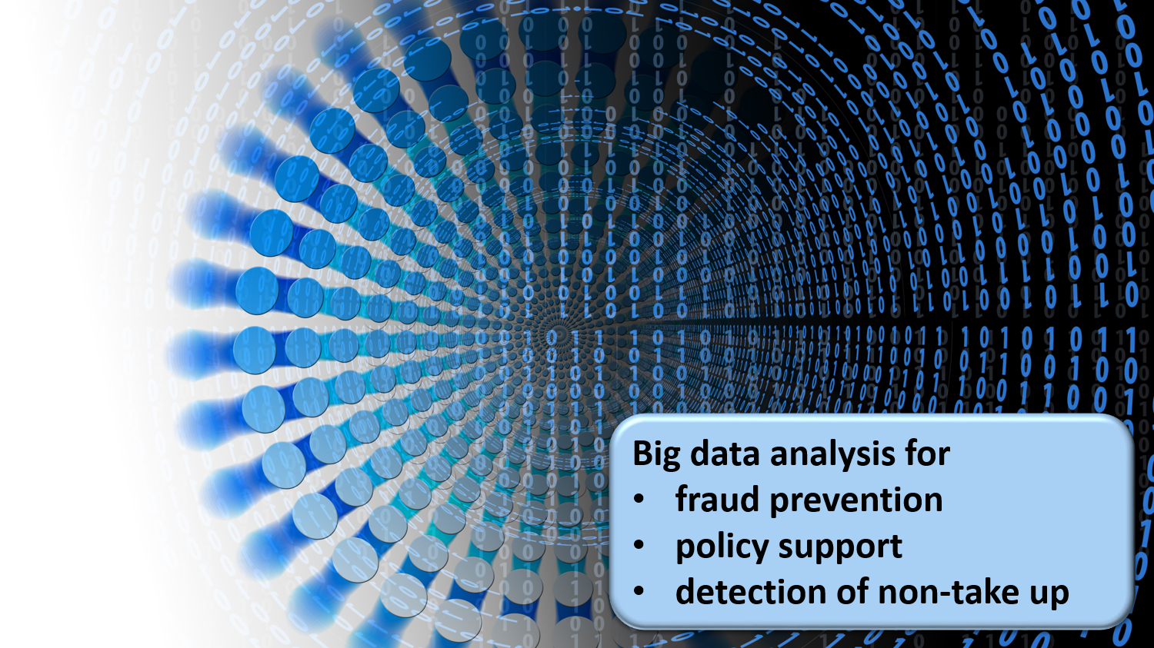
Notes:
big data analysis for fraud prevention, policy support and detection of non take up of benefits

Slide 31

Notes:
artificial intelligence in support of big data analysis, for virtual personal assistants and machine learning
continuous attention for evolution of laws and the politics in the fields of social security, new technologies and information security

Slide 32

Notes:
4. Designating an institution that acts as a driving force is useful
business process re-engineering within and across actors
being a mediator and enabler setting out a long term roadmap for e-services
proactively looking for opportunities in technology and innovation to benefit citizens and enterprises
ensuring continuous delivery of shared ICT services and the retention of crucial skills
program, project and service management
co-operative governance

Slide 33

Notes:
Let the computer do what it is good at and thereby make time available for human support where necessary. And remember: the network always wins

Slide 34
Importance of good information management
Policy effectiveness
information systems for
  policy support
  research
  policy evaluation
strategic use of information systems for
  avoidance of non-take-up (automatic awarding)
  social inclusion
  fraud avoidance and control
  continuity in granting rights
  …
Efficiency of policy implementation
operational excellence
information management and information security
  collected and validated once
  correct and timely available
  reusable and shared (authentic sources)
processes
  event-driven
  process chains
  division of tasks between actors in function of competence
architecture
  Service Oriented Architecture
  modularity and encapsulation
  synergies via cloud and container technology

Slide 35
Origins of the CBSS initiative
stakeholders of the Belgian social sector
  > 11,560,000 citizens
  > 230,000 employers
  about 3,000 public and private institutions (actors) at several levels (federal, regional, local) dealing with
    collection of social security contributions
    delivery of social security benefits
      child benefits
      unemployment benefits
      benefits in case of incapacity for work
      benefits for the disabled
      re-imbursement of health care costs
      holiday pay
      old age pensions
      guaranteed minimum income
    delivery of supplementary social benefits
    delivery of supplementary benefits based on the social security status of a person

Slide 36
Origins of the CBSS initiative
a lack of well coordinated service delivery processes and of a lack of well coordinated information management led to
  a huge avoidable administrative burden and related costs for
    the citizens
    the employers/companies
    the actors in the social sector
  service delivery that didn’t meet the expectations of the citizens and the companies
  suboptimal effectiveness of social protection
  insufficient social inclusion
  too high possibilities of fraud
  suboptimal support of social policy
at the same moment there were
  a clear political will to solve those problems
  a scientifically well-founded solution based on the creation of a Crossroads Bank stimulating and coordinating business process re-engineering and electronic co-operation

Slide 37
Common vision on information management
information is being modelled
  in such a way that the model fits in as closely as possible with the real world
  in order to allow multifunctional use of information
information is collected from citizens and companies only once by the social sector as a whole
  via a channel chosen by the citizens and the companies
  preferably from application to application
  and with the possibility of quality control by the supplier before the transmission of the information
the collected information is validated once
  according to established task sharing criteria
  by the actor that is most entitled to it or by the actor which has the greatest interest in correctly validating it

Slide 38
Common vision on information management
a task sharing model is established indicating which actor stores which information as an authentic source, manages the information and maintains it at the disposal of the authorized users
information can be flexibly assembled according to ever changing legal concepts
every actor has to report probable errors of information to the actor that is designated to validate the information
every actor that has to validate information according to the agreed task sharing model, has to examine the reported probable errors, to correct them when necessary and to communicate the correct information to every known interested actor
once collected and validated, information is stored, managed and exchanged electronically to avoid transcribing and re-entering it manually

Slide 39
Common vision on information management
electronic information exchange can be initiated by
  the actor that disposes of information
  the actor that needs information
  the organisation that manages the interoperability framework
electronic information exchanges take place on the base of a functional and technical interoperability framework that evolves permanently but gradually according to open market standards, and is independent from the methods of information exchange
available information is used for
  the automatic granting of benefits
  prefilling when collecting information

Slide 40
Common vision on information security
security, availability, integrity and confidentiality of information is ensured by integrated structural, institutional, organizational, HR, technical and other security measures according to agreed policies
personal information is only used for purposes compatible with the purposes of the collection of the information
personal information is only accessible to authorized actors and users according to business needs, legislative or policy requirements
the access authorization to personal information is granted by an Information Security Committee, designated by Parliament, after having checked whether the access conditions are met
the access authorizations are public

Slide 41
Common vision on information security
every actual electronic exchange of personal information has to pass an independent trusted third party and is preventively checked on compliance with the existing access authorizations by that trusted third party
every actual electronic exchange of personal information is logged, to be able to trace possible abuse afterwards
every time information is used to take a decision, the information used is communicated to the person concerned together with the decision
every person has right to access and correct his/her own personal data
every actor in the social sector disposes of an information security officer with an advisory, stimulating, documentary and control task

Slide 42
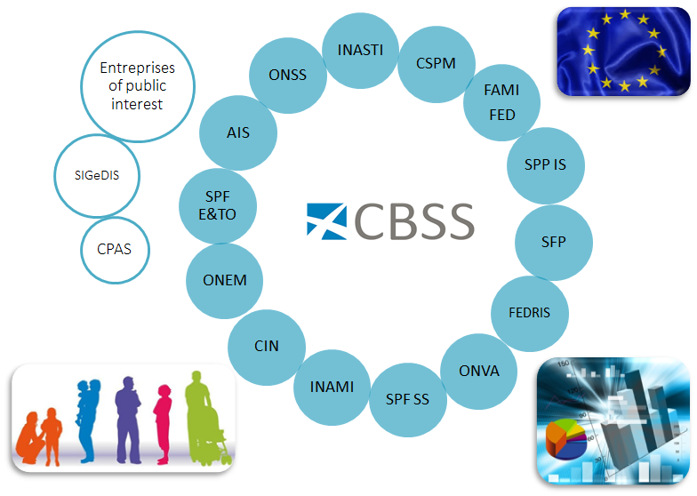
The solution – the network

Slide 43
The solution – the network
Internet
R
FedMAN
Users
R
Isabel
FW
R
…
R
Backbone
FW
FW
FW
FW
FW
R
R
R
R
R
ONEM
CBSS
ONSS
R
R
CIN
…

Slide 44
The solution - Business Process Reengineering (BPC)
first process optimisation, then computerization; otherwise risk to consolidate suboptimal processes
building of integrated value chains through
  mutual coordination between internal business processes and processes of suppliers, partners, customers, …
  provision of basic and business services for integration into global applications, offered by third parties to end users
importance of standardisation importance of involvement of users of processes (no wrong door)

Slide 45
The solution – concrete results and impact
a network between all 3,000 social sector actors with a secure connection to the internet, the federal MAN, regional extranets, extranets between local authorities and the Belgian interbanking network
a unique identification key
  for every citizen
  for every company
  for every establishment of a company
an agreed division of tasks between the actors within and outside the social sector with regard to collection, validation and management of information and with regard to electronic storage of information in authentic sources

Slide 46
The solution – concrete results and impact
220 electronic services for mutual information exchange amongst actors in the social sector, defined after process optimization
  nearly all direct or indirect (via citizens or companies) paper-based information exchange between actors in the social sector has been abolished
  in 2021, > 1,5 billion electronic messages were exchanged amongst actors in the social sector, which saved as many paper exchanges
electronic services for citizens
  maximal automatic granting of benefits based on electronic information exchange between actors in the social sector
  24 electronic services via an integrated portal and/or mobile applications

Slide 47
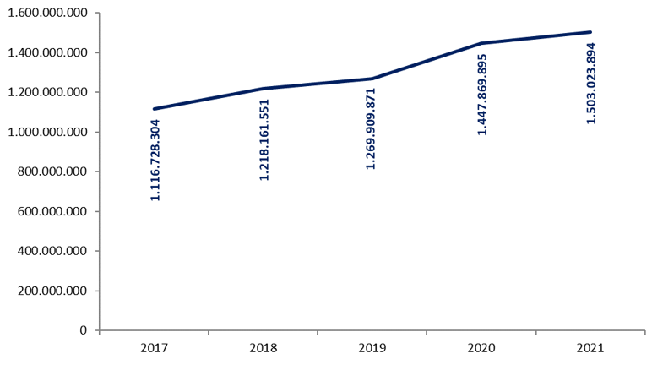
The solution – concrete results and impact
1.503.023.894 electronic messages were exchanged in 2021

Slide 48
The solution – concrete results and impact
more than 50 electronic services for employers, either based on the electronic exchange of structured messages or via an integrated portal site
  50 social security declaration forms for employers have been abolished
  in the remaining 30 (electronic) declaration forms the number of headings has on average been reduced to a third of the previous number
  declarations are limited to 3 events
    immediate declaration of recruitment and discharge (only electronically)
    quarterly declaration of salary and working time (only electronically)
    occurrence of a social risk (electronically or on paper)
  in 2021, more than 35 million electronic declarations were made by all 230,000 employers, 98 % of which from application to application

Slide 49
The solution – concrete results and impact
an integrated portal site and mobile applications containing
  electronic transactions for citizens, employers and professionals
  simulation environments
  information about the entire social security system
  harmonized instructions and information model relating to all electronic transactions
  a personal page for each citizen, each company and each professional
an integrated multimodal contact centre supported by a customer relationship management tool
a data warehouse containing statistical information with regard to the labour market and all branches of social security

Slide 50
Useful tool: the reference directory
reference directory
  directory of available services/information
    which information/services are available at any actor depending on the capacity in which a person/company is registered at each actor
  directory of authorized users and applications
    list of users and applications
    definition of authentication means and rules
    definition of authorization profiles: which kind of information/service can be accessed, in what situation and for what period of time depending on in which capacity the person/company is registered with the actor that accesses the information/service
  directory of data subjects
    which persons/companies have personal files at which actors for which periods of time, and in which capacity they are registered
  subscription table
    which users/applications want to automatically receive what information/services in which situations for which persons/companies in which capacity

Slide 51
Useful tool: the electronic identity card
identification of the holder
  name
  Christian names
  nationality
  date and place of birth
  sex
  identification number of the National Register
  main residence
  manual signature
electronic authentication of the identity of the holder (private key and certificate)
possibility for the holder to sign electronically (private key and certificate)
no encryption certificate
no electronic purse
no biometric data

Slide 52
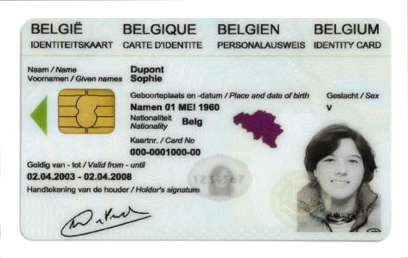
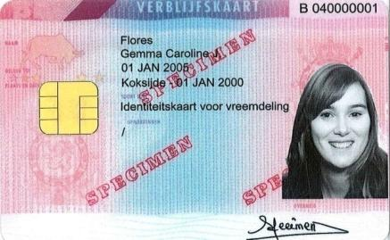
Integrated user and access management
Electronic identity card (eID): statutory electronic identity card for Belgians over the age of twelve
Kids-ID: on demand for children below the age of twelve
Foreigners card: for both EU and non-EU citizens with residence in Belgium

Slide 53
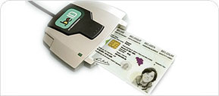
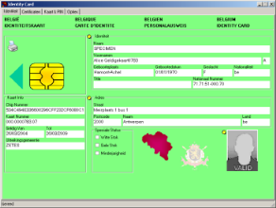
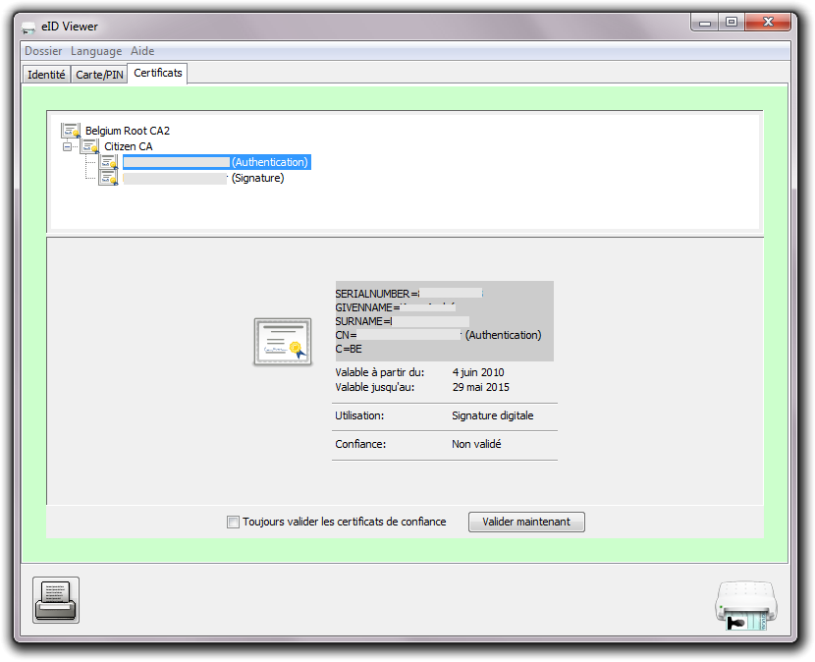
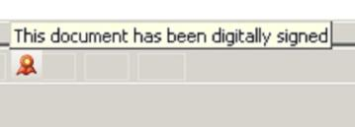
Electronic identity card (eID)
read data
authenticate identity
digital signatures

Slide 54

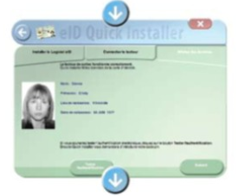
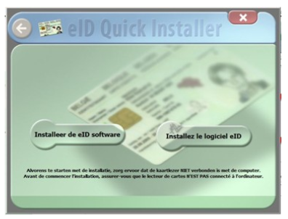
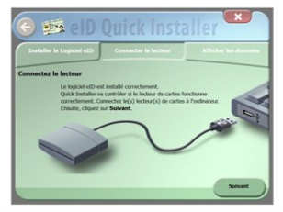
Electronic identity card (eID)
install eID software
connect the card reader with the computer
consult your data

Slide 55
Distributed information servers
information servers
  directory of data subjects at the Crossroads Bank
  basic identification data of citizens at the National Register and the complementary Crossroads Bank Register
  basic identification data of companies at the Company Register
  employers directory (WGR) at the ONSS
  work force register at the ONSS
  salary and working time database at the ONSS and the ONSSAPL
  database of contribution certificates
services offered
  interactive consultation
  batch consultation
  automatic communication of updates

Slide 56
Pre-processed messages
pre-processed messages
  beginning/end of labour contract, beginning/end of self-employed activity
  contribution certificates medical care (employees, self-employed, beneficiaries of social security allowances)
  unemployment benefits
  benefits in case of career break
  benefits in case of incapacity for work ((labour) accident, (occupational) disease)
  reimbursement of health care costs
  child benefits
  old age pensions
  holiday pay
  benefits for the disabled
  guaranteed minimum income – social welfare
  derived rights (e.g. tax reduction/exemption, free public transport, ...)
  migrant workers
  …
services offered
  interactive consultation
  batch consultation
  automatic communication of messages

Slide 57









Quartely declaration salary & working time
simplification
Activity 3
Activity 2
Activity 1
employer
one electronic
declaration
ONSS
INAMI
ONEM
old age pension
SFP
Famifed
holiday pay
ONVA

Slide 58
Declaration of social risks
types of social risks
  child benefits
  incapacity for work ((labour) accident, (occupational) disease, …)
  unemployment
  old age pension
3 possible moments of declaration
  start of the social risk
  recurrence or continuation of the social risk
  end of the social risk
structure of the declaration
  identification data
  if necessary, salary and working time data not yet declared via a quarterly declaration (mini-declaration)
  specific data concerning the social risk

Slide 59
LIMOSA
integrated electronic service delivery based on a single, mandatory declaration in case of temporary or partial professional activities of foreign employees and self-employed persons in Belgium
800.000 declarations per year
reduction of process time from 7 days to 5 minutes
integrated service throughout 8 types of institutions (750 concrete institutions)
gains in effectiveness
  improvement of social protection of migrant workers
  enhancement of free movement of workers and services
gains in efficiency
  lower cost due to single, multifunctional and electronic information collection and integrated information processing
  shortening of clearance times with immediate return of receipt
  availability of integrated services according to the logic of the user at any time and from anywhere
gains in transparency
  permanent access for the user to the processing status of its declaration

Slide 60
Useful legislative changes
legal translation of
  the common vision on information management
  the common vision on information security and privacy protection
  the obligation to use unique identification keys
creation of a public institution (CBSS) that acts as a driving force
  mission and tasks
  governance
  financing principles
creation of a control committee on information security and privacy protection
probative value of electronic information storage and exchange
punishment of abuse of the system
gradually, coordination or harmonisation of basic legal concepts
gradually, adaptation of business processes set out in the law

Slide 61
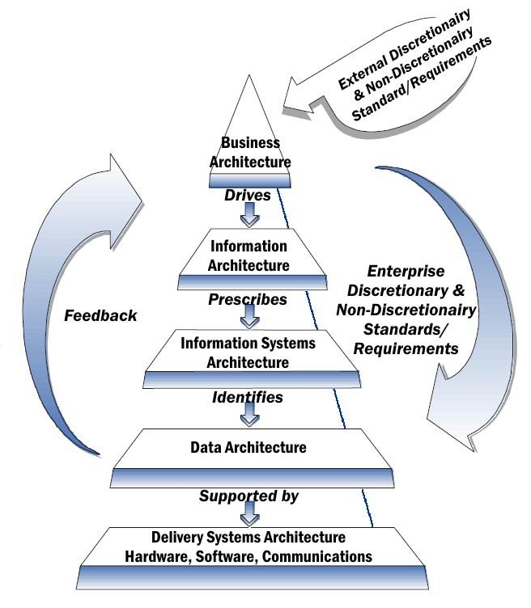
Architecture layers
way to
  understand how the information provision and ICT is structured and why
  describe how the various components are built up and interlinked
  control how this evolves over time
goals
  cost control: poor architecture and many changes increases costs exponentially
  faster time to market
  better maintainability
  greater flexibility
  greater mobility
  greater security
  higher availability of resources

Slide 62
Service Oriented Architecture (SOA)
what ?
  “Service Oriented Architecture (SOA) is a paradigm for organizing and utilizing distributed capabilities that may be under the control of different ownership domains. It provides a uniform means to offer, discover, interact with and use capabilities to produce desired effects consistent with measurable preconditions and expectations. This style of architecture promotes reuse at the macro (service) level rather than micro levels (eg. objects). It also makes interconnection of existing IT assets trivial” (OASIS Reference Group)
characteristics
  service-oriented
  modular
  interoperable (based on open standards or open specifications)
  extensible
  layered
  based on reuse of components and data

Slide 63
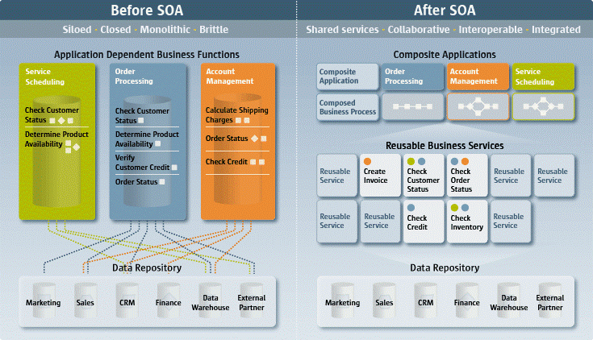
Service Oriented Architecture (SOA)

Slide 64
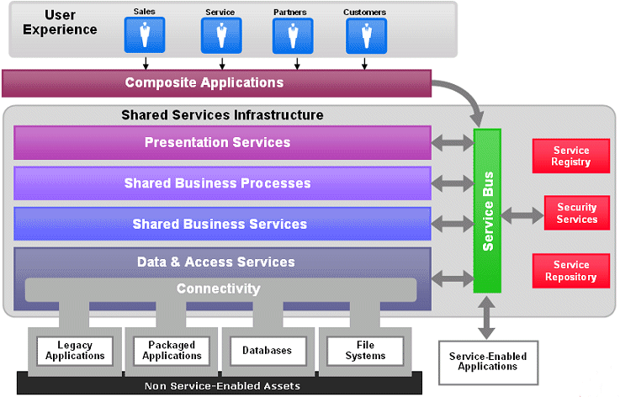
Service Oriented Architecture (SOA)

Slide 65
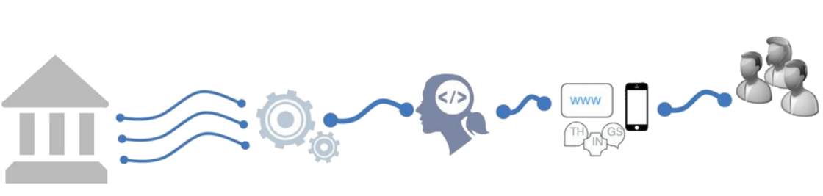
Shifting to an API economy: the value chain
API = Application Programming Interface
APIs are key in real-time information exchange between software of several actors
APIs drive today's business processes in eGovernment
Existing
Systems
Made available as APIs
Self service
used by developers
To create new innovative apps and services
Differentiated
services
Notes:
Deel van verhaal “Meer naar buiten toe openstellen”

Slide 66
Advantages of API approach
cost reduction by reusability: consumers don’t need to rewrite what already exists!
complexity reduction: no more big, monolithic systems
decoupling: consumers and providers can continue to connect as long as the technical contract is followed → ex. less impact in case of migrations
driver of innovation: new products raise, based on existing API capability
stimulation of partnerships
stimulation of standardization

Slide 67





API management solution
from ESB-technology to API Gateway
  parallel platform
  zero-impact migration
ready for today's technology, but supports our legacy as well
flexible to extend and customize
accelerates time-to-market
API Manager
API Portal
API
API Registration & Lifecycle
Application Developers
API Catalog
Partner & Policy Administration
REST
API
API Gateway
SOAP
Policy Enforcement
Notes:
Waarop slaat legacy?? B.v. soap verhaal
Zero impact slaat hier op niet-breken van contracten, backwards compatibility

Slide 68



Beyond tooling: API management throughout the organization’s soul
API Ecosystem eHeath
API Ecosystem Soc Sec
100+ APIs
1.200M transactions / month
250+ APIs
600M transactions / month
API Consumers
Client& Partners Applications
API Communication
reUse Catalogue
various Presentations
API Consumption
API Portal
API Gateway
API Management
API Manager
API Gateway
tool API Gateway
API Catalogue
API Governance
API Architecture
REST Board
Integration Competency Center
(ICC)
G-Cloud Platform is the reference
Smals Governance
Smals API’s Application & Tools
API Reporting
API Development
API Metrics
REST
SOAP
development Guidelines
API Trainings
API Operations
Help Center
API Providers

Slide 69
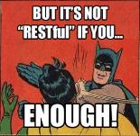
G-Cloud REST style guide
based on industry standards and best practices
a pragmatic approach to designing RESTful APIs
collaborative effort organized in several workgroups:
  REST API modelling
  security (OAuth)
  functional/business vocabularies (temporal, location, person, enterprises)
work in progress
https://www.gcloud.belgium.be/rest/

Slide 70

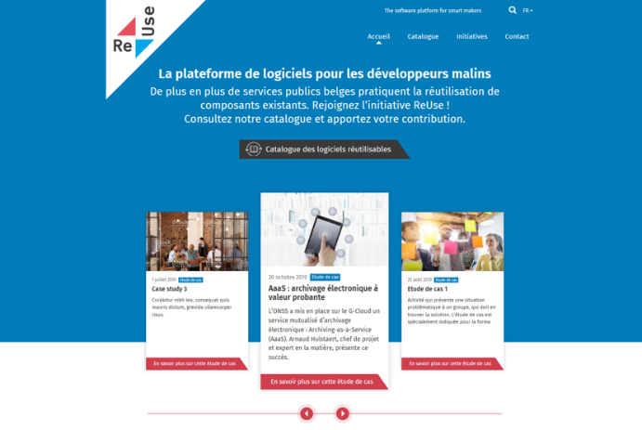
Software Reuse Platform: https://www.ict-reuse.be
70

Slide 71
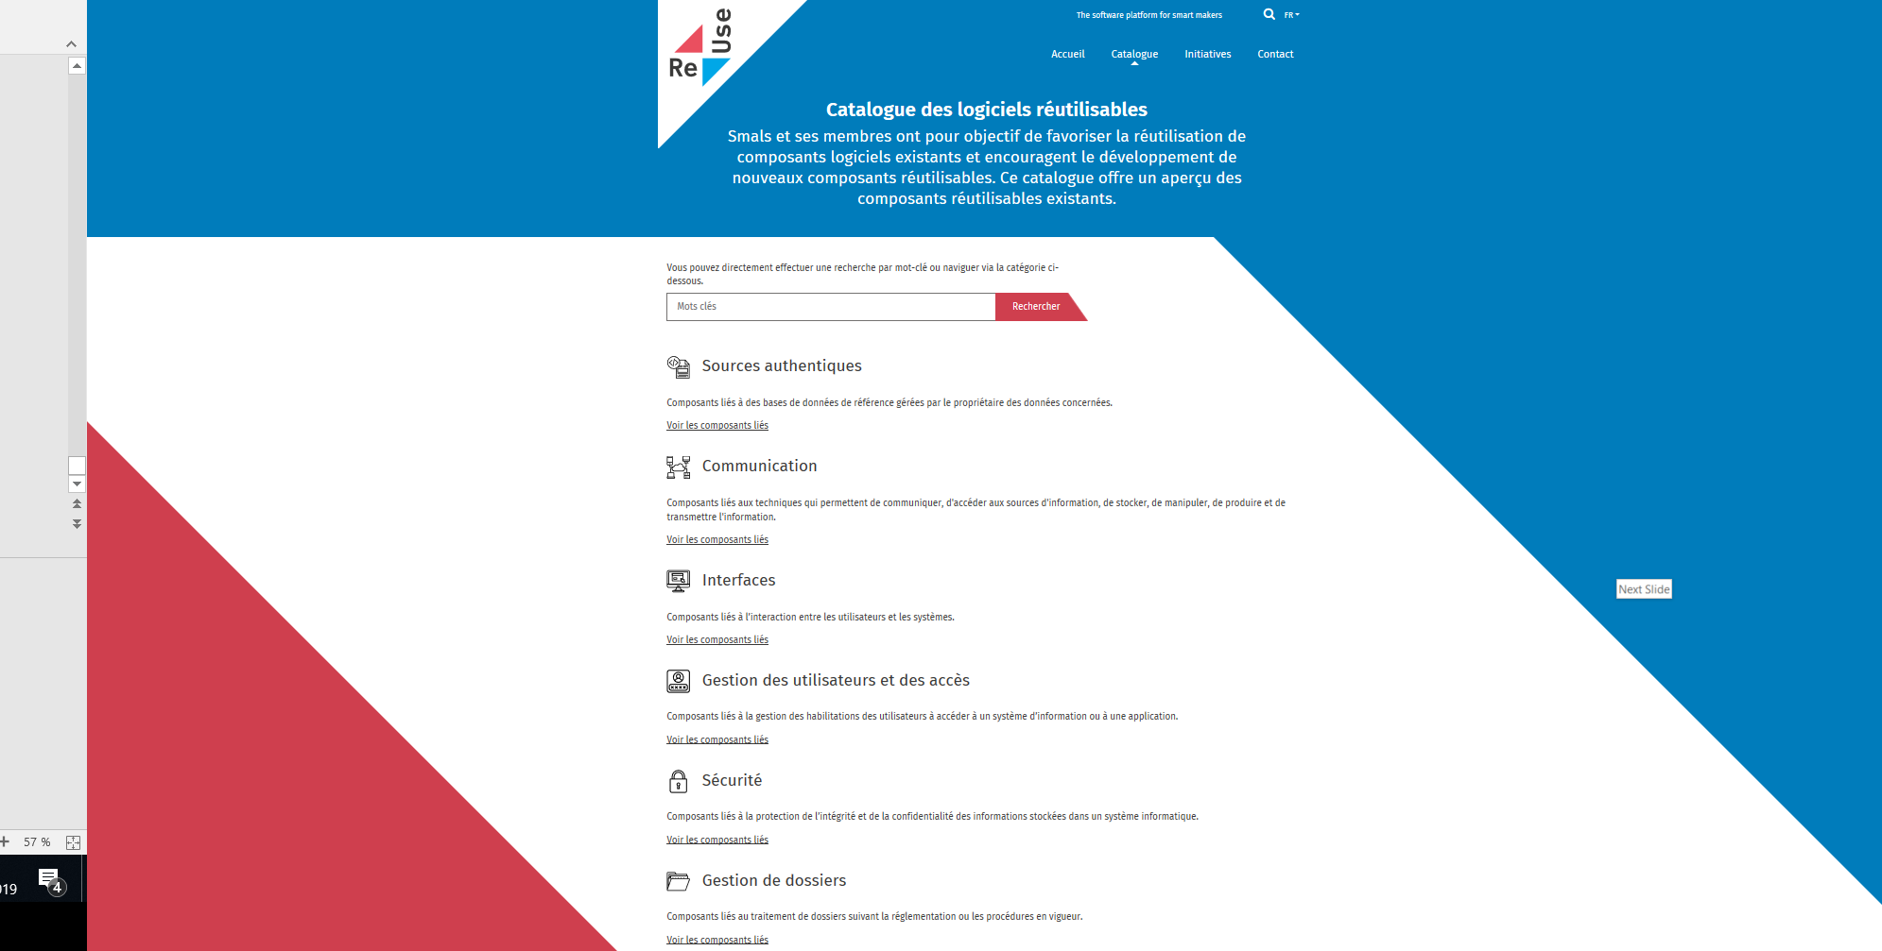
New project?
consult the
Software Reuse
Catalogue

Slide 72
CBSS as driving force
coordination by the Crossroads Bank for Social Security
  Board of Directors consists of representatives of the companies, the citizens and the actors in the social sector
  mission
    definition of the vision and the strategy on eGovernment in the social sector
    definition of the common principles related to information management, information security and privacy protection
    definition, implementation and management of an interoperability framework
      technical: secure messaging of several types of information (structured data, documents, images, metadata, …)
      semantic: harmonization of concepts and co-ordination of necessary legal changes
      business logic and orchestration support
    coordination of business process reengineering
    stimulation of service oriented applications
    driving force of the necessary innovation and change
    consultancy and coaching

Slide 73
Co-operative governance
CBSS has an innovative model of governance, steering the business process re-engineering with complex interdependencies between all actors involved
Board of Directors of the CBSS
  consists of representatives of the stakeholders (employers associations, trade unions, social security institutions, …)
  approves the strategic, operational and financial plans of the CBSS
General Coordination Committee with representation of all users acts as debating platform for the elaboration and implementation of eGovernment initiatives within the social sector
permanent or ad hoc working groups are instituted within the General Coordination Committee in order to co-ordinate the execution of programs and projects
the chairmen of the various working groups meet regularly as a Steering Committee
besides project planning and follow-up, proper measuring facilities are available to assure permanent monitoring and improvement after the implementation of the electronic services

Slide 74
Critical success factors and obstacles
common vision on electronic service delivery, information management and information security amongst all stakeholders
support of and access to policymakers at the highest level
trust of all stakeholders, especially partners and intermediaries, based on
  mutual respect
  real mutual agreement
  transparency
respect for legal allocation of competences between actors
co-operation between all actors concerned based on distribution of tasks rather than centralization of tasks
focus on more efficient and effective service delivery and on cost control
reasoning in terms of added value for citizens and companies rather than in terms of legal competences

Slide 75
Critical success factors and obstacles
electronic service delivery as a structural reform process
  process re-engineering within and across actors
  back-office integration for unique information collection, re-use of information and automatic granting of benefits
  integrated and personalized front-office service delivery
multidisciplinary approach
  business process optimization
  legal coordination
  ICT coordination
  information security and privacy protection
  change management
  communication
  coaching and training

Slide 76
Critical success factors and obstacles
lateral thinking when needed
appropriate balance between efficiency on the one hand and information security and privacy protection on the other
quick wins combined with long term vision
technical and semantic interoperability
legal framework
adaptability to an ever changing societal and legal environment
creation of an institution that stimulates, co-ordinates and assures a sound program and project management

Slide 77
Critical success factors and obstacles
availability of skills and knowledge => creation of an association that hires ICT-specialists at normal market conditions and puts them at the disposal of the actors in the social sector
sufficient financial means for innovation: agreed possibility to re-invest efficiency gains in innovation
service oriented architecture (SOA)
need for radical cultural change within government, e.g.
  from hierarchy to participation and team work
  meeting the needs of the customer, not the government
  empowering rather than serving
  rewarding entrepreneurship within government
  ex post evaluation on output, not ex ante control of every input

Slide 78
Advantages
gains in efficiency
  in terms of cost: services are delivered at a lower total cost
    due to
      a unique information collection using a common information model and administrative instructions
      a lesser need to re-encoding of information by stimulating electronic information exchange
      a drastic reduction of the number of contacts between actors in the social sector on the one hand and companies or citizens on the other
      a functional task sharing concerning information management, information validation and application development
      a minimal administrative burden
    according to a study of the Belgian Planning Bureau, rationalization of the information exchange processes between the employers and the social sector implies an annual saving of administrative costs of about 1.7 billion € a year for the companies

Slide 79
Advantages
gains in efficiency
  in terms of quantity: more services are delivered
    services are available at any time, from anywhere and from several devices
    services are delivered in an integrated way according to the logic of the customer
  in terms of speed: the services are delivered in less time
    benefits can be allocated quicker because information is available faster
    waiting and travel time is reduced
    companies and citizens can directly interact with the competent actors in the social sector with real time feedback

Slide 80
Advantages
gains in effectiveness: better social protection
  in terms of quality: same services at same total cost in same time, but to a higher quality standard
  in terms of type of services: new types of services, e.g.
    push system: automated granting of benefits
    active search of non-take-up using data warehousing techniques
    controlled management of own personal information
    personalized simulation environments
better support of social policy
more efficient combating of fraud

Slide 81



frank.robben@mail.fgov.be
@FrRobben
https://www.frankrobben.be
https://www.ksz.fgov.be
https://www.ehealth.fgov.be

Slide 82
Additional information

Slide 83
Belgian Crossroads Bank for Social Security

Slide 84
Implementation order used in Belgium
common vision on information management and information security
demonstration of feasibility
political and public support, support of the social partners, support of the social security institutions
basic legislation
  creating an institution as a driving force and a control committee
  translating the common vision on information management and information security
integration of unique identification key in all information systems
implementation of the ICT architecture and the basic ICT services
controlled access to databases with authentic data
re-engineering of processes between actors in the social sector at all government levels
re-engineering of processes between actors in the social sector and companies
re-engineering of processes between actors in the social sector and citizens
always combined with the necessary legislative changes

Slide 85
Gaining support
a clear long term vision combined with quick wins
federal Minister of Social Affairs as a political sponsor
demonstration of organisational and technical feasibility
gradual implication of
  the general managers of all public social security institutions
  the social partners managing the public social security institutions
  the general managers of the private social security institutions
successive formal approval of the vision and the initiative by
  all federal Ministers dealing with aspects of social security
  the federal Council of Ministers
  the National Labour Council (highest consultative body between the government and the social partners)
  the federal Parliament

Slide 86
Gaining support
small team in direct support of the federal Minister of Social Affairs
  consisting of
    experienced civil servants with a sound human network within all levels of the social sector
    scientific experts
    political advisors
  with multidisciplinary skills
    business process re-engineering
    change management
    legal
    ICT
    information security and privacy protection
    communication
    program and project management
gradually, co-operation agreements with other government levels (regions, local authorities, …)

Slide 87
Institutional structure & financing of the CBSS
cooperative governance
adequate management and control techniques
financing principles
internal organization

Slide 88
Management and control techniques
annual priority plan debated with all users within the General Coordination Committee of the CBSS
cost accounting and zero-based budgeting resulting in financial transparency, an informed budget and a good evaluation of the management contract with the Belgian federal government
internal control based on the COSO-methodology (see www.coso.org) in order to provide reasonable assurance regarding the achievement of objectives with regard to
  effectiveness and efficiency of operations
  reliability of financial reporting
  compliance with applicable laws and regulations
external audit with regard to the correct functioning of the internal control system

Slide 89
Management and control techniques
program management through the whole social sector
issue management during the management of each program
use of a system of project management combined with a time keeping system to follow up projects that are realized by the CBSS and its partners
frequent reports to all users which describe the progress of the various projects and eventual adjustment measures
use of balanced scorecards and a dashboard to measure, follow-up and evaluate the performance of the electronic services and the CBSS
use of ITIL (see www.itil-itsm-world.com) for ICT-service delivery
use of a coherent set of monitoring techniques to guarantee an optimal control and transparency of the electronic services

Slide 90
Financing principles
annual cost of the CBSS, its network and its services: 17.500.000 euro
financed by a withholding on the social security contributions paid by the employers, the employees and the self-employed before the distribution of these contributions to the social security sectors
no direct charge for the actors in the social sector in case of use of the CBSS services
  stimulation of the use of the system
  no additional accounting and administration costs for the social sector as a whole
charge per electronic message (0,0055 euro) exchanged for actors outside the social sector, with possibility of settlement on mutual terms in case of reciprocal information exchange

Slide 91
Internal organization CBSS
internal
  90 people
  General Management
  6 divisions
    R&D, Legal and External Communication
    Client, Program, Project and Services Management
    Application Development and Management
    ICT Management
    Information Security and Internal Audit
    Resources Management (HR, finance, logistics, …)
co-sourced with association owned by the public social security institutions
  physical network
  some basic services (e.g. portal, contact centre, …)

Slide 92
Electronic Exchange of Social Security Information (EESSI)

Slide 93
EESSI
IT system that helps social security institutions across the EU exchange information related to different branches like
  sickness, maternity and equivalent paternity benefits
  family benefits
  benefits in respect of accidents at work and occupational diseases
  unemployment benefits
  old-age pensions, pre-retirement and invalidity benefits
  survivor’s benefits and death grants
  applicable legislation
more rapidly and securely
as required by the EU rules on social security coordination

Slide 94
EESSI
all communication between national institutions on social security files are to take place through EESSI
social security institutions exchange structured electronic documents and follow commonly agreed procedures to process them
these documents are routed through EESSI to the correct destination in the right institutions in another Member State
staff in social security institutions are able to find the correct destination in participating countries by consulting a repository of national institutions (see https://ec.europa.eu/social/social-security-directory/pai/pai/select-country/language/en)

Slide 95
EESSI
32 participating countries
  27 EU Member States
  Iceland
  Liechtenstein
  Norway
  United Kingdom
  Switzerland
> 5.000 participating institutions

Slide 96
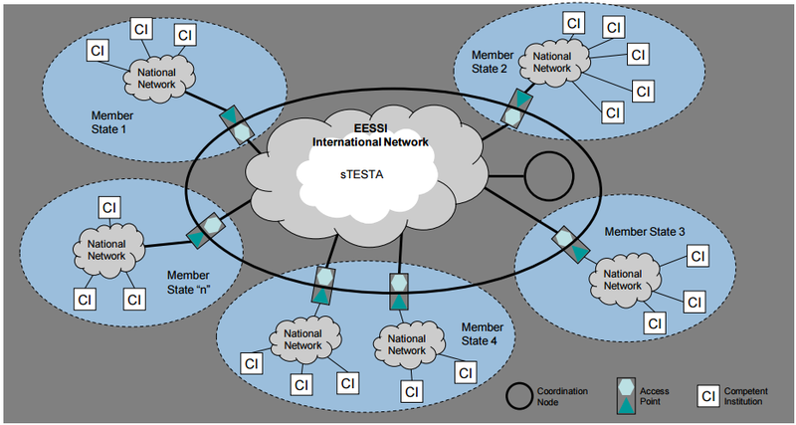
EESSI architecture

Slide 97
EESSI architecture
135 Business Use Cases (BUCs), eg family benefits
  FB BUC 01 – Determining competences
  FB BUC 02 – Discharge of Family Benefits
  FB BUC 03 – Additional Family Benefits for orphans
  FB BUC 04 – Information about payment regarding priority right
276 Structured Electronic Documents (SED), eg FB BUC 03
  F018 – request for insurance length period of additional benefits
  F019 – reply for insurance length period of additional benefits
  F020 – information on priority for additional benefits
  F021 – application for additional benefits
complete overview on https://www.frankrobben.be/wp-content/uploads/2022/04/EESSI-List-of-BUCs-SEDs.xlsx

Slide 98
EESSI type of data exchanged
identification (name, unique identification number, …)
basic attributes of a person (date/place of birth/death, gender, nationality, …)
address
bank account number
civil status and family composition
professional relations
working regime
working periods and assimilated periods
income
circumstances of occurance of a social risk
competent social security institutions

Slide 99
Benefits of EESSI
quicker and more efficient processing of social security benefits
more correct and complete data and case handling thanks to standard electronic forms and procedures
more efficient implementation of social security coordination rules
social security institutions across the EU use standardised electronic documents translated into their own language, improving multilingual communication

Slide 100
Benefits of EESSI
combating fraud and error
secure handling of personal data
enabling statistics on the message exchanges between social security institutions
social security institutions across Europe can exchange relevant information also to verify the social security rights of mobile citizens

Slide 101
Security: confidentiality, availability, integrity

Slide 102
Global vision
modern technologies can bring enormous benefits and added value, but they must be deployed with the right safeguards for the fundamental right to data protection
international treaties and national constitutions provide for a whole series of fundamental rights: in addition to the right to data protection, there is also the right to a fair trial, the right to social protection, the right to high-quality healthcare, ...
citizens can expect the government to ensure their right to data protection in a way that also respects their other fundamental rights
possible drawbacks should be avoided, but benefits should not be unnecessarily obstructed
risk management and data protection-by-design and a multidisciplinary approach are key concepts in this

Slide 103
Holistic approach
legal framework
minimal information security standards
structural and institutional measures
organisational measures
technical measures

Slide 104
Legal framework: General Data Protection Regulation (GDPR)
Regulation (EU) 2016/679 of the European Parliament and of the Council of 27 April 2016 on the protection of natural persons with regard to the processing of personal data and on the free movement of such data, and repealing Directive 95/46/EC
directly applicable without the need for transposition into national law
applicable as from 25 May 2018
see https://eur-lex.europa.eu/legal-content/EN/TXT/?uri=celex%3A32016R0679

Slide 105
Basic principles GDPR (article 5)
Personal data shall be
processed lawfully, fairly and in a transparent manner in relation to the data subject (‘lawfulness, fairness and transparency’)
collected for specified, explicit and legitimate purposes and not further processed in a manner that is incompatible with those purposes (‘purpose limitation’)
adequate, relevant and limited to what is necessary in relation to the purposes for which they are processed (‘data minimisation’)
accurate and, where necessary, kept up to date; every reasonable step must be taken to ensure that personal data that are inaccurate, having regard to the purposes for which they are processed, are erased or rectified without delay (‘accuracy’)

Slide 106
Basic principles GDPR (article 5)
Personal data shall be
kept in a form which permits identification of data subjects for no longer than is necessary for the purposes for which the personal data are processed (‘storage limitation’)
processed in a manner that ensures appropriate security of the personal data, including protection against unauthorised or unlawful processing and against accidental loss, destruction or damage, using appropriate technical or organisational measures (‘integrity and confidentiality’)

Slide 107
Lawfullness of processing (article 6 GDPR)
Processing shall be lawful only if and to the extent that at least one of the following applies
the data subject has given consent to the processing of his or her personal data for one or more specific purposes
processing is necessary for the performance of a contract to which the data subject is party or in order to take steps at the request of the data subject prior to entering into a contract
processing is necessary for compliance with a legal obligation to which the controller is subject
processing is necessary in order to protect the vital interests of the data subject or of another natural person

Slide 108
Lawfullness of processing (article 6 GDPR)
Processing shall be lawful only if and to the extent that at least one of the following applies
processing is necessary for the performance of a task carried out in the public interest or in the exercise of official authority vested in the controller
processing is necessary for the purposes of the legitimate interests pursued by the controller or by a third party, except where such interests are overridden by the interests or fundamental rights and freedoms of the data subject which require protection of personal data, in particular where the data subject is a child

Slide 109
Other basic concepts GDPR
risk analysis as a basis
privacy by design
privacy by default
records of processing activities
data protection impact assessment (DPIA)
notification of personal data breach
rights of the data subject
data protection officer
possibility of codes of conduct and certification
sanctions

Slide 110


No “one-size-fits-all” approach

Slide 111
Risk-based approach: common thread
the controller must objectively assess the likelihood and severity of the risks to the rights and freedoms of individuals when carrying out processing (common thread throughout the Regulation)
some obligations always apply regardless of the risk; the risk can be taken into account in its implementation
some obligations do not apply if the risk is not high
some obligations only apply if the risk is high

Slide 112
Privacy by design
the controller shall
  take into account the state of the art, the cost of implementation and the nature, scope, context and purposes of processing
  as well as the risks of varying likelihood and severity for rights and freedoms of natural persons posed by the processing
  implement appropriate technical and organisational measures
  in order to meet the requirements of this Regulation and protect the rights of data subjects
both at the time of the determination of the means for processing and at the time of the processing itself

Slide 113
Privacy by default
the controller shall implement appropriate technical and organisational measures for ensuring that, by default, only personal data which are necessary for each specific purpose of the processing are processed
that obligation applies to
  the amount of personal data collected
  the extent of their processing
  the period of their storage
  their accessibility

Slide 114
Privacy by default: examples of measurres
minimising the processing of personal data
pseudonymising personal data as soon as possible
transparency with regard to the functions and processing of personal data
enabling the data subject to monitor the data processing
enabling the controller to create and improve security features

Slide 115
Records of processing activities (article 30 GDPR)
each controller and processor shall maintain a record of processing activities under its responsibility
content
  the name and contact details of the controller
  the purposes of the processing
  the categories of data subjects and of the categories of personal data
  the categories of recipients of the personal data
  the envisaged time limits for erasure of the different categories of data
  a general description of the technical and organisational security measures
available to the supervisory authority on request

Slide 116
Data Protection Impact Assessment (article 35-36 GDPR)
where a type of processing
  in particular using new technologies
  and taking into account the nature, scope, context and purposes of the processing
  is likely to result in a high risk to the rights and freedoms of natural persons
the controller shall, prior to the processing, carry out an assessment of the impact of the envisaged processing operations on the protection of personal data (Data Protection Impact Assessment (DPIA))
a single assessment may address a set of similar processing operations that present similar high risks

Slide 117
Data Protection Impact Assessment (article 35-36 GDPR)
a DPIA is in particular required in the case of
  a systematic and extensive evaluation of personal aspects relating to natural persons which is based on automated processing, including profiling, and on which decisions are based that produce legal effects concerning the natural person or similarly significantly affect the natural person
  processing on a large scale of special categories of data
  a systematic monitoring of a publicly accessible area on a large scale
where appropriate, the controller shall seek the views of data subjects or their representatives on the intended processing, without prejudice to the protection of commercial or public interests or the security of processing operations

Slide 118
Data Protection Impact Assessment (article 35-36 GDPR)
a Data Protection Impact Assessment is a process to help the controller identify and minimize the data protection risks
a DPIA is completed for every processing that is likely to result in a high risk to individuals
it is also good practice to do a DPIA for any other major project which requires the processing of personal data
the DPIA must
  describe the nature, scope, context and purposes of the processing
  assess necessity and proportionality of the processing in relation to the purposes
  identify and assess risks to the rights and freedoms of data subjects
  identify measures envisaged to address the risks, including safeguards, security measures and mechanisms to ensure the protection of personal data and to demonstrate compliance with the GDPR

Slide 119
Data Protection Impact Assessment (DPIA)
to assess the level of risk, one must consider both the likelihood and the severity of any impact on individuals. High risk could result from
  a high probability of some harm
  a lower probability of serious harm
the DPIA implicates the DPO and, where appropriate, individuals and relevant experts; any processors may also need to assist
if a high risk is identified, the supervisory authority must be implicated before starting the processing

Slide 120
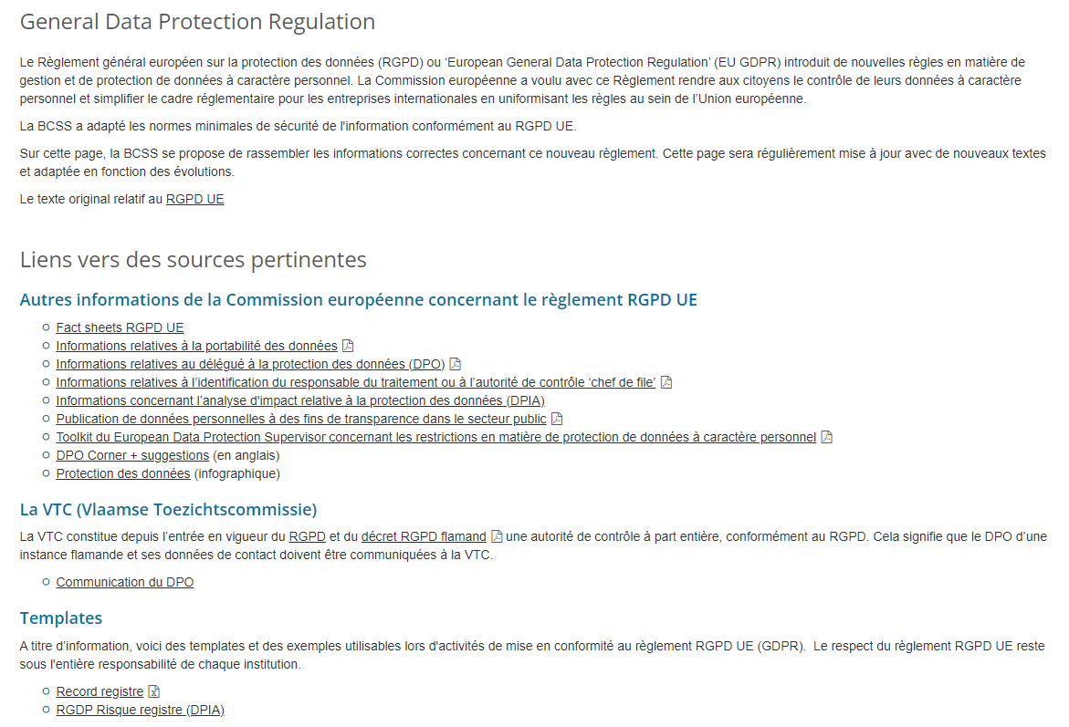
Executing the DPIA: example of Belgian CBSS
CBSS has developed a template for executing the DPIA
https://www.ksz-bcss.fgov.be/fr/protection-des-donnees/en-pratique/reglement-general-relatif-a-la-protection-des-donnees

Slide 121
First sheet: basic screening
basic screening determines whether a DPIA is required
developed based on following criteria
  article 35 GDPR
  consideration 75 GDPR
  recommendation of the Belgian Data Protection Authority
  Working Party 29 – guidelines for DPIA
as soon as 2 risks are present, the DPIA is required

Slide 122
Second sheet: risk assessment & management
if a DPIA is required, perform a risk assessment of the processing
  check what risks in the tool are relevant for the processing
  the controller participates in this part of the exercise
next, describe the existing information security and data protection measures in the DPIA
consider the residual risks
if the residual risks are above the acceptable level, try to apply additional information security and data protection measures in order to get the residual risk under the acceptable level of risk
in case residual risks above acceptable level cannot be remediated, the controller has to consult the Data Protection Authority before starting the processing

Slide 123
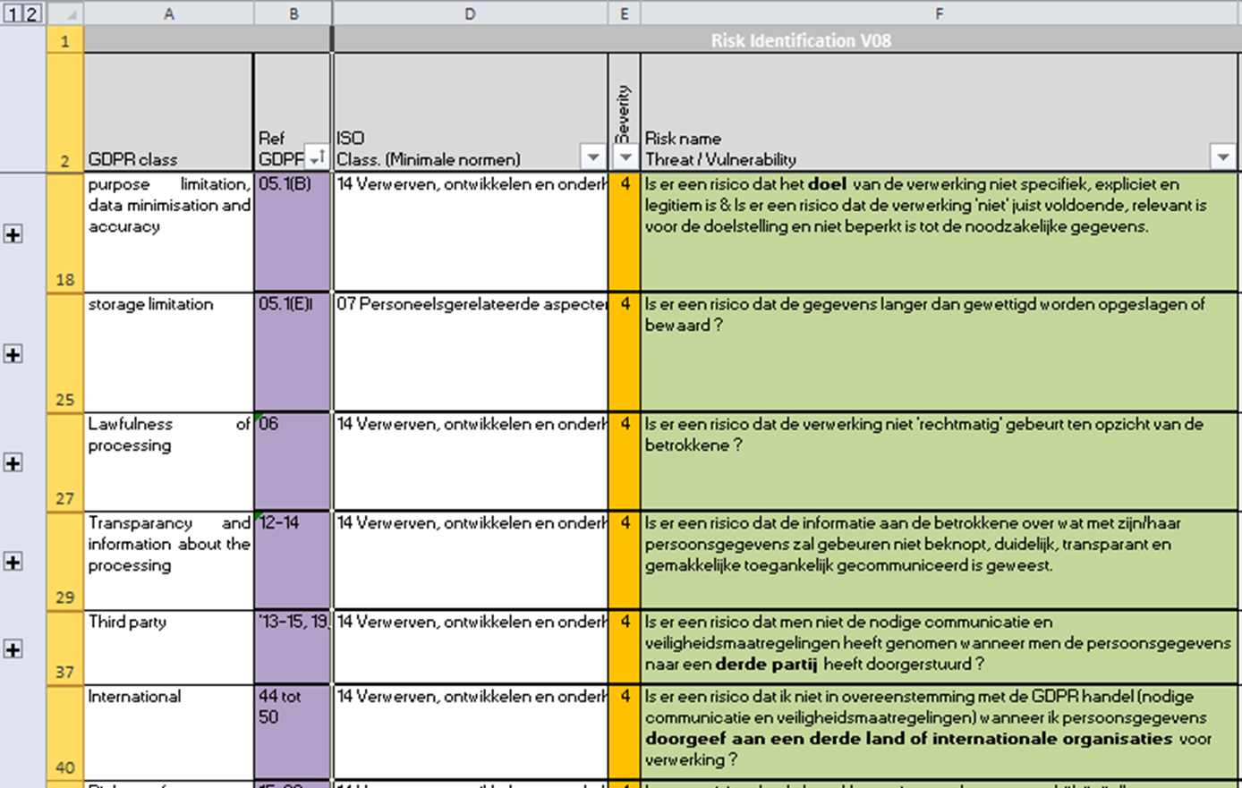
Template: list of risks based on GDPR

Slide 124
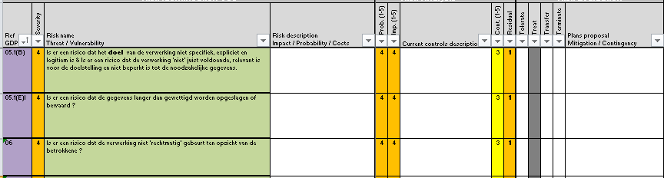
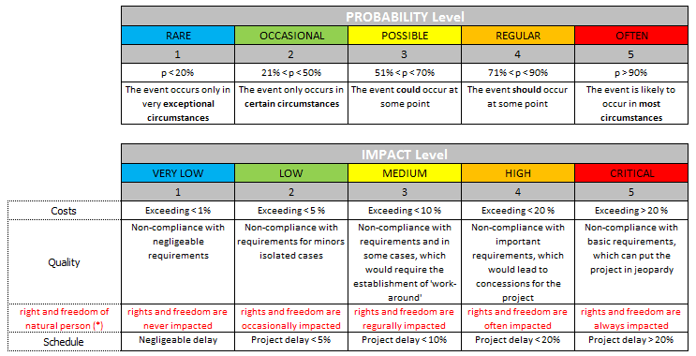
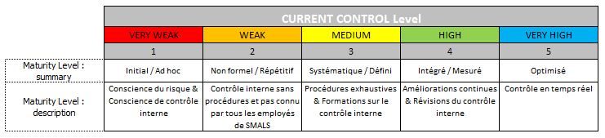
Template: risk evaluation
Initial risks and risk mitigation
(security controls)
Remaining risks

Slide 125
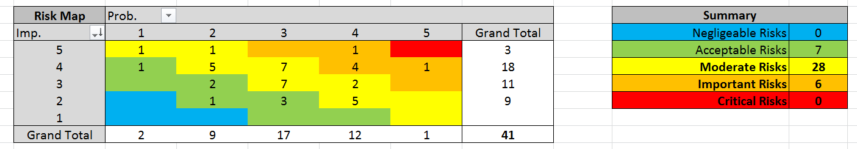
Template: heat maps initial risk

Slide 126
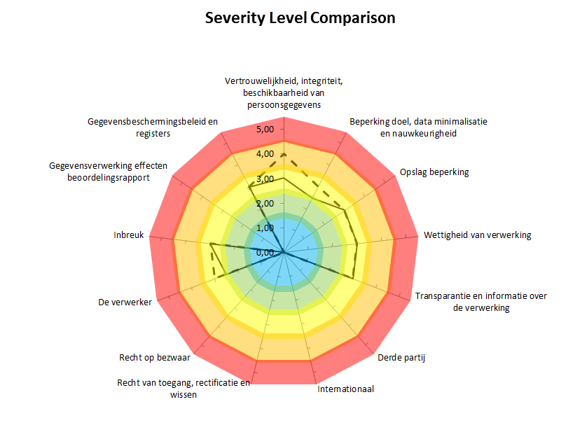
Template: intermediate result

Slide 127
Template: end result

Slide 128
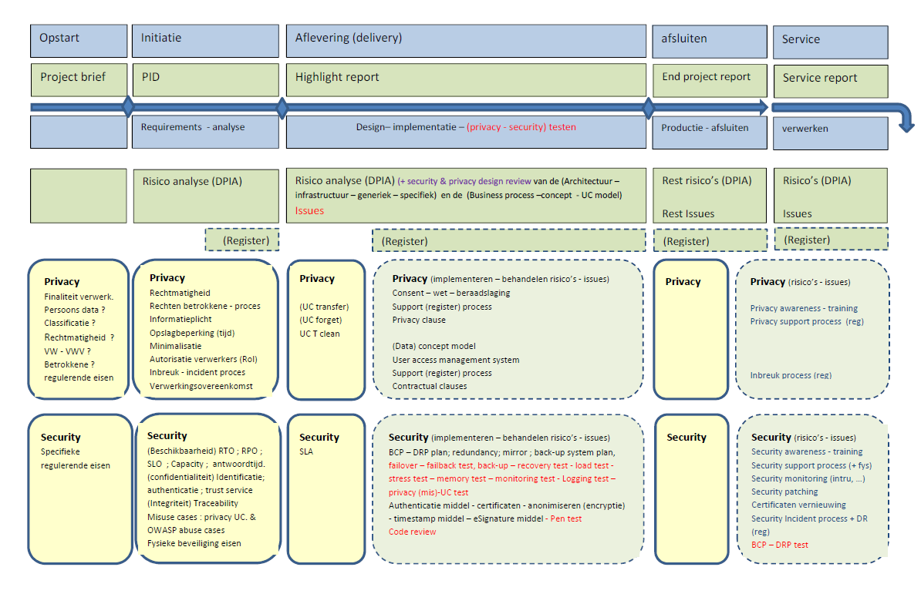
DPIA: as from start up of project to delivery

Slide 129
DPIA and production services
during the lifecycle of a service, it is advised to regularly review the DPIA
  changing conditions
  major changes to technology
  changing risks on the market
CBSS do review the DPIAs every 3 years

Slide 130
Notification of personal data breach (article 33-34 GDPR)
in case of a personal data breach, the controller shall without undue delay and, where feasible, not later than 72 hours after having become aware of it, notify the personal data breach to the supervisory authority, unless the personal data breach is unlikely to result in a risk to the rights and freedoms of natural persons
when the personal data breach is likely to result in a high risk to the rights and freedoms of natural persons, the controller shall communicate the personal data breach to the data subject without undue delay

Slide 131
Notification of personal data breach (article 33-34 GDPR)
the communication to the data subject is not required if
  the controller has implemented appropriate technical and organisational protection measures, and those measures were applied to the personal data affected by the personal data breach, in particular those that render the personal data unintelligible to any person who is not authorised to access it, such as encryption, or
  the controller has taken subsequent measures which ensure that the high risk to the rights and freedoms of data subjects is no longer likely to materialize, or
  it would involve disproportionate effort; in such a case, there shall instead be a public communication or similar measure whereby the data subjects are informed in an equally effective manner

Slide 132
Rights of the data subject (article 12-22 GDPR)
right to be informed
right of access
right to rectification
right to erasure (right to be forgotten)
right to restriction of processing
notification obligation regarding rectification or erasure of personal data or restriction of processing
right to data portability
right to object
right not to be subject to a decision based solely on automated processing, including profiling

Slide 133
Data Protection Officer (DPO) (article 37-39 GDPR)
mandatory if
  controller is a public authority
  controller’s core activities consist of processing operations which, by virtue of their nature, their scope and/or their purposes, require regular and systematic monitoring of data subjects on a large scale
  controller’s core activities consist of processing on a large scale of special categories of data
optional in other situations
independency, no conflict of interests
expert knowledge of information security and data protection

Slide 134
Data Protection Officer (DPO) (article 37-39 GDPR)
tasks of the Data Protection Officer (DPO)
  to inform and advise the controller or the processor and the employees who carry out processing of their obligations pursuant to the GDPR
  to monitor compliance with GDPR and with the policies of the controller or processor in relation to the protection of personal data, including
    the assignment of responsibilities
    awareness-raising and training of staff involved in processing operations
    related audits
  to provide advice where requested as regards the DPIA and monitor its performance
  to cooperate with the supervisory authority and to act as the contact point for the supervisory authority on issues relating to processing

Slide 135
Data Protection Officer (DPO) (article 37-39 GDPR)
controller ensures that
  the DPO is involved, properly and in a timely manner, in all issues which relate to the protection of personal data
  the DPO does not receive any instructions regarding the exercise of those tasks
  is not dismissed or penalised by the controller or the processor for performing his tasks
controller supports the DPO in performing its tasks
  by providing resources necessary to carry out those tasks
  by providing access to personal data and processing operations
  by maintaining his or her expert knowledge
the DPO directly reports to the highest management level of the controller or the processor
the DPO is bound by secrecy or confidentiality concerning the performance of his or her tasks

Slide 136
Minimal information security standards
developed by information security working party composed of Data Protection Officers (DPOs) of the actors => buy in !
approved by an independent Information Security Committee designated by Parliament
based on ISO 27000 standards, adapted for social security and health care (see https://en.wikipedia.org/wiki/ISO/IEC_27000-series)
defines 15 areas of security
enforced for all actors in the social sector
extended with policy guidelines
  minimal standards refer to policy guidelines for more detail
  policy guidelines provide support for concrete implementation

Slide 137
Topics covered by minimal information security standards
basic principles
information security policies
organisation of information security
  internal organisation
  mobile equipment and remote working
security measures for employees and co-workers
management of company assets
physical and environmental security
access control (physical and logical)
encryption

Slide 138
Topics covered by minimal information security standards
operations management
protecting communications
procurement, design, development and maintenance of systems
supplier management
incident management
business continuity
compliance

Slide 139
Minimal standards: data classification
5 levels of data sensitivity classification
  4 -> top secret
  3 -> secret, high classified
  2 -> confidential, classified
  1 -> unclassified, sensitive
  0 -> unclassified, public
each type of data is linked to a sensitivity classification
  see next slide
each type of classification has the data handling guidelines
  how to transport,
  use in test, development, acceptance,
  authentication level for access,
  ….

Slide 140
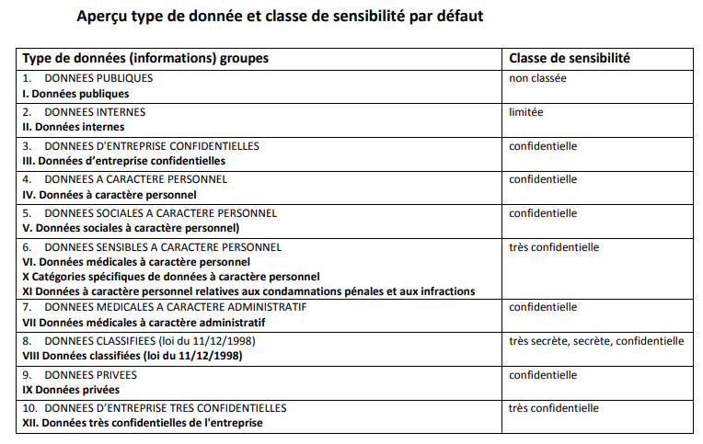
Minimal standards: data classification

Slide 141
Structural and institutional measures
no unnecessary central data storage
availability of free of charge, basic information security services
  user- & access management
  encryption
  logging
  reference directories
  …
independent Information Security Committee designated by the Parliament that authorizes data exchange
a preventive control of the legitimacy of personal data exchange by an trusted third party (TTP) according to the authorizations of the independent Information Security Committee

Slide 142
Considerations in the deliberations
lawfulness and purpose limitation
  is the processing serving a legitimate purpose?
  are the purposes of the processing well defined ?
data minimization
  is the processing using the minimal dataset to achieve the purposes ?
  storage limitation
integrity and confidentiality
  measures on how to guarantee both parameters
transparency for the data subjects
information security standards

Slide 143
Organisational measures
information security department headed by Data Protection Officer (DPO) with each actor in the social sector
specialized information security service providers
need for compliance with minimal information security and data protection standards (Minimale normen / Normes minimales)
information security working parties developing information security policies
Data Protection Impact Assessments (DPIA)
unique file

Slide 144
Organisational measures
yearly assessment of compliance with minimal security standards
  questionnaire sent out to all institutions connected to the network
  checked by the security service of the TTP
  reviewed in the Information Security work group
security requirements reviewed on regular basis
internal audits with continuous improvement plans => independent auditor reporting on findings

Slide 145
Information Security Department
legal obligation
  assignment of a DPO
  advices controller on privacy and security
  can be assigned additional tasks as long as this does not conflict with the mission of a DPO
role of the information security department
  each institution has to set up a security department
    stimulates information security (minimal security standards, awareness creation, education, …)
    documents the information security related topics (DPIA, registers)
    advises and checks on compliance (internal audits)
    reports on information security and privacy
  the DPO the is head of the security department

Slide 146
Unique file
goals
  centralizing all information required to approve the service prior to commissioning the service in line with guidelines regarding information security and data protection
  meeting the documentation requirement of GDPR
content
  purposes of the processing
  high level technical design
  categories of data subjects and data
  types of users
  security measures, ao
    user authentication level
    user authorization system
    user activity logging
  DPIA if available
elaborated for every new service
updated and approved for major changes to existing services

Slide 147
Circles of trust
agreements between actors about
  who is responsible of carrying out which authentications and verifications on the basis of which means
  how the results of the authentications and verifications are securely stored and exchanged electronically between the actors involved
  who is responsible of logging access (attempts) to the services and applications
  how it is ensured that a complete reconstruction of loggings can take place to determine which natural person has used which service in relation to which person, when and for what purposes
  the retention period of the loggings, as well as the way in which these can be consulted by those who are entitled to do so

Slide 148
G-Cloud

Slide 149
What is “cloud” ?
On Demand
Broad network access
Resource pooling
Measured service
Rapid elasiticity
Source: National Institute for Standards and Technology, USA

Slide 150
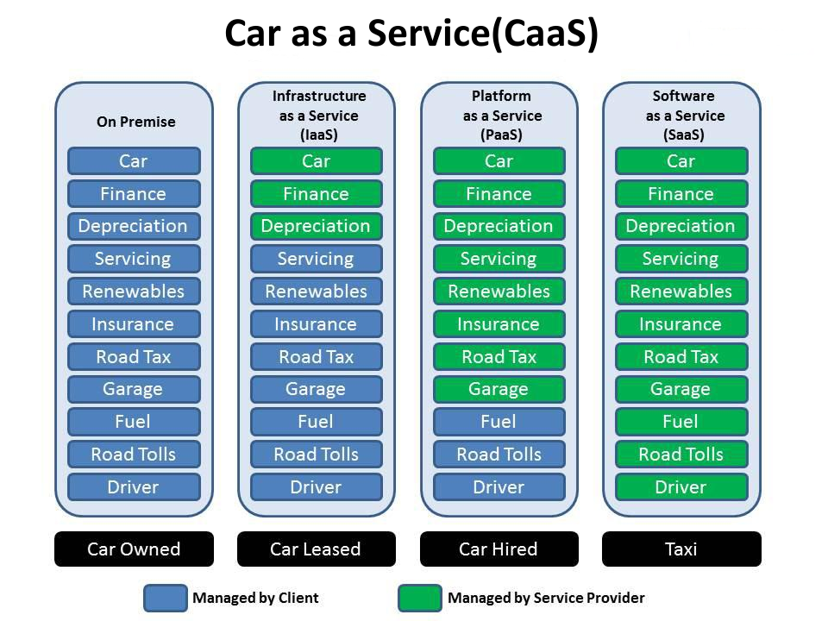

Slide 151
As a service : major characteristics
self service: industrialised & automated
available: immediate availability
extensible/elastic: scale up or down
shared: multiple users for scale effects
use based invoicing: based on real use of resources
low entry barrier: complexity is hidden for user
incremental service changes

Slide 152
Cloud service models
IaaS
Infrastructure as a Service
PaaS
SaaS
basic IT infrastructure components (e.g. Amazon virtual machines)
Platform as a Service
platforms to build applications
Software as a Service
full applications (e.g. O365, Google Apps, ...)

Slide 153

Virtualisation
consolidation of physical resources
> 70% “easy consolidation”
first step to cloud (“dematerialisation”)

Slide 154






Cloud deployment types
Hybrid
Public Cloud
Shared
Access/Control
Outsourced Community Cloud (= off-premise)
Community Cloud on-premise
Private Cloud on-premise
Outsourced Private Cloud (= off-premise)
Dedicated
Location
Customer
Service Provider

Slide 155
Cloud advantages
any place, any time, anywhere : mobile
safeguarded with backups
high level of security if well implemented
lower Total Cost of Ownership (TCO)
stability & incremental updates
collaboration
should provide portability
community cloud solutions
  can be open for integration with other services
  trust relationship / data protection (e.g. Vitalink)

Slide 156










PaaS in (G-)cloud - containers
introducing container technology
translated into modern technology such as Platform-as-a-Service
Individuele
inhoud
Easy to move around
Individual content
Isolated storage
Geïsoleerd opgeslagen
En makkelijk verplaatsbaar
Monitoring
Security
Logging
Coming
soon

Slide 157



New ways of cooperation
Government ecosystem
Other sectors
Components
parts
Application
1
Application
2
Application
N
Partner
1
Partner
2
Partner
N
Platform
cooperation
DB
DB
Technological cooperation
DB
DB
DB

Slide 158
Public cloud - main issues
longitudinal confidentiality of personal data
  need for comprehensive longitudinal encryption of personal data
  in motion, at rest and in use
performant continuous availability of applications and data
easy migration of applications and data
compliance with GDPR / Schrems II

Slide 159

Intermediate solution
need for overall government positioning
  eGov public cloud policy
  based on information classification
  appropriate organizational, technical & contractual measures
  hybrid approach
    pure public cloud not suited for sensitive use cases
    secure private cloud on-premise for secret and top secret
    hybride (community on-premise and public) cloud for other levels
      Belgian example

Slide 160





What is G-Cloud ?
A program including synergy projects
Synergy for existing as well as new services
For public services
Managed by public services
In cooperation with the private sector

Slide 161
What is G-Cloud ?
shared public ICT platform
  current target: federal state (FPS, PPS, public institutions of social security, institutions of public benefit)
  can be extended to other interested authorities
hybrid community cloud model
  use of public cloud if possible
  private community cloud hosted in data centers, managed by the government
  operational implementation with strong involvement of the private sector

Slide 162
Basic principles
maximum synergy when possible and when generating efficiency gains and/or savings while maintaining or improving the quality of the services provided to the customer
in line with the synergy program: assignment to the one who is the most capable of proposing a form of shared services
synergy based on result orientation, sense of responsibility and trust

Slide 163




G-Cloud ‘products’
Procurement
Cooperationá
Efficiencyá
Projects
Synergy
Services
Costsâ
Qualityá
Know-how & Expertise

Slide 164



Why G-Cloud?
Creation of economies of scale: efficiency and high quality/availability
Respect of confidentiality and data protection
Bigger focus on business applications and flexibility in order to realize them

Slide 165

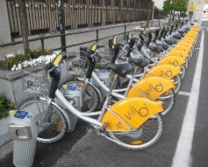

Why G-Cloud?
Greater weight
during negotiations with suppliers
Pooling of knowledge and resources
Technological evolution faster available for everyone

Slide 166
G-Cloud organization
Government
G-Cloud Operations & Programme Board
G-Cloud Strategic Board
FPS/PPS
(Horizontal FPS, FPS FIN, Belnet, …)
PSSI/IPB
(CBSS, ...)
Association of FPS/PPSI/IPB
Private ICT companies directed by FPS/PSSI/...
3 Colleges
FPS
Public Institutions of Social Security (PIOSS)
Institutions of Public Benefit (IPB)
SIT: ICT managers from
FPS
Public Institutions of Social Security
Institutions of Public Benefit
Service
owners

Slide 167


G-Cloud organization
G-Cloud Strategic Board: strategic direction by senior officials
G-Cloud Operations & Program Board:
CIOs for operational direction

Slide 168
G-Cloud service model
G-Cloud = coalition
G-Cloud ≠ central organization
G-Cloud service
Offered by
Service owner
Delivered by
Service provider
Governance

Slide 169
G-Cloud service model
Service Owner
  organization responsible for the service
  develops the service and its further evolution
  provides SLA, financial model, support model...
  “contract” with clients
Service Provider
  “contract” with Service Owner
  provides the service as agreed upon in the specifications/SLA
Sometimes: Service Owner = Service Provider

Slide 170
G-Cloud P&O
3500 IT professionals in the federal government
war for talent & reversed age pyramid
cooperation model across institutional boundaries

Slide 171
Opportunities and challenges
Challenges
Security
Confidentiality
Continuity
Strategic management
Opportunities
Cost management
Cooperation
Self-service
Economies of scale
Flexibility
Quality
Know-how

Slide 172

G-Cloud success factors
efficiency
adequate security measures (risk↘)
optimal cooperation and trust between the institutions
differentiation of the offer: neither ‘one size fits all’ nor tailor-made work
capacity management
a phased approach, no ‘big bang’
quality of service: respect of SLAs

Slide 173
G-Cloud portfolio (www.gcloud.belgium.be)

Slide 174





Data classification
information classification model drafted within « Federal Information Security Policy » (FISP)
  https://dt.bosa.be/nl/federaal beleid_voor_informatiebeveiliging_fisp
definition of levels
classification based on the impact of the loss or dissemination of information
  impact for government (agencies)
  impact on privacy rights
practical classification explained in privacy vademecum
  https://dt.bosa.be/sites/default/files/fisp_-_privacy_vademecum_nl.pdf

Slide 175
G-Cloud impact - shared procurement
cooperation regarding the public procurements
  juridical: central procurement agency clause
  know-how: specialized in ICT purchases
  simplicity: less administrative work for the private sector and the state
  possibility to accelerate the purchases and to avoid double specifications procedures
  price reductions thanks to the volume
software licences
  negotiations with the providers
  mutual exchange of unused licences

