Slide 1
Towards an interoperable open-source stack for social protection
A virtual workshop with open-source software providers contributing to social protection
24 March 2022 I 12:00–14:30 GMT
The Digital Convergence Initiative (DCI) is delighted to invite you to a virtual workshop being convened to bring together various open-source software providers (OSS) as part of its efforts to build consensus-based standards for interoperability in the social protection sector. The objectives of this workshop are to:
rrovide a forum to conceptualize a vision for a potential interoperable OSS stack for social protection delivery
collaboratively identify opportunities to define technical standards (e.g. process standards, data standards, APIs) for interoperability across the OSS ecosystem while learning about existing interoperability capabilities
explore synergies for OSS providers to pursue these opportunities in collaboration with the DCI
During the workshop, invited OSS providers will introduce their solutions and showcase existing and planned integration use cases along the SP delivery chain. The DCI will facilitate conversations to identify possible synergies across different providers. The workshop will culminate with a roadmap towards building a vision for a standards-based OSS stack.
OSS providers participating in the workshop

Slide 2
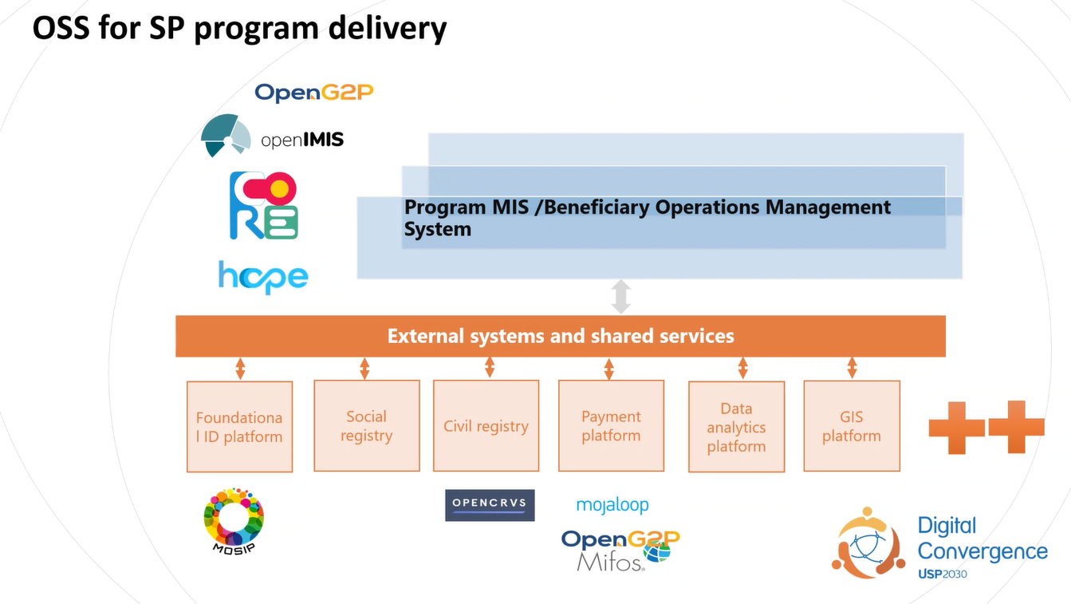

Slide 3
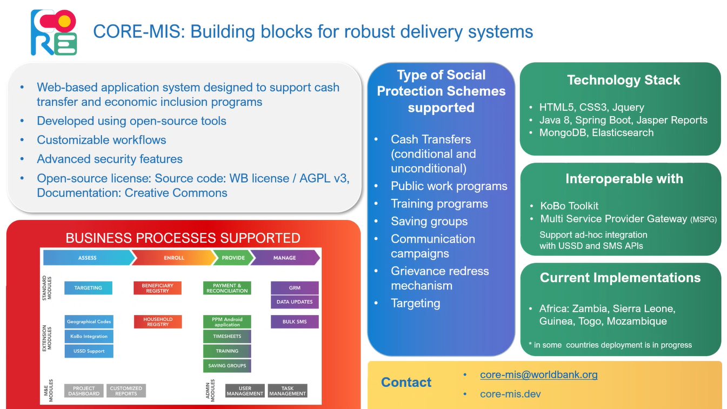

Slide 4
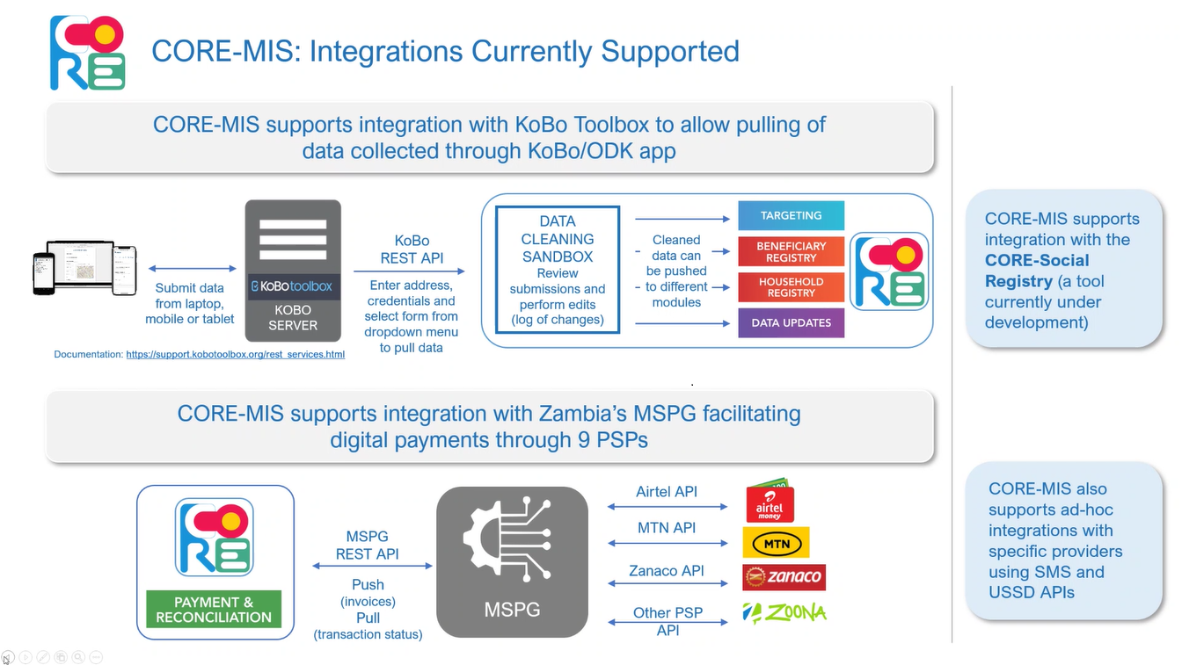

Slide 5
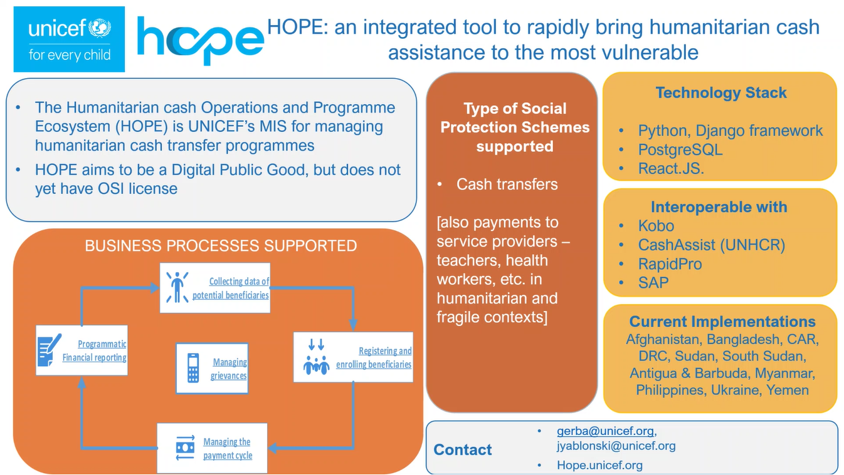

Slide 6
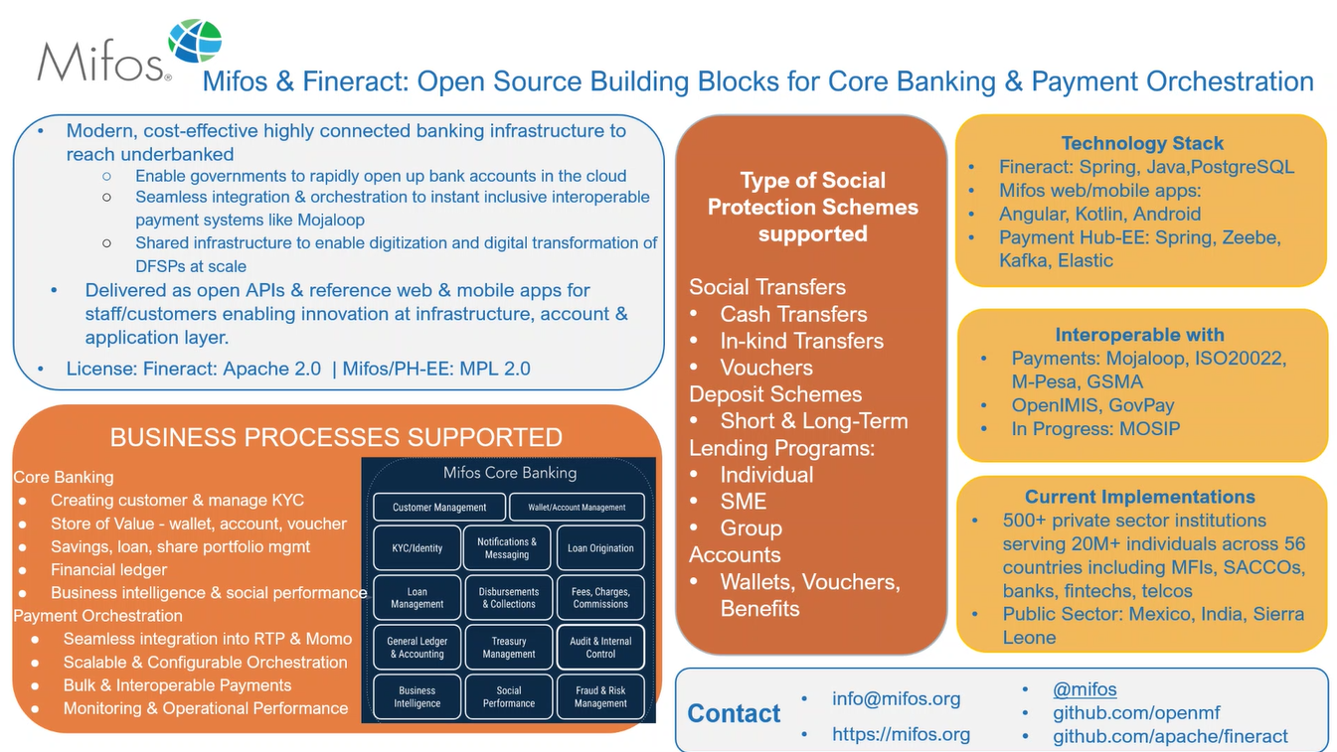

Slide 7
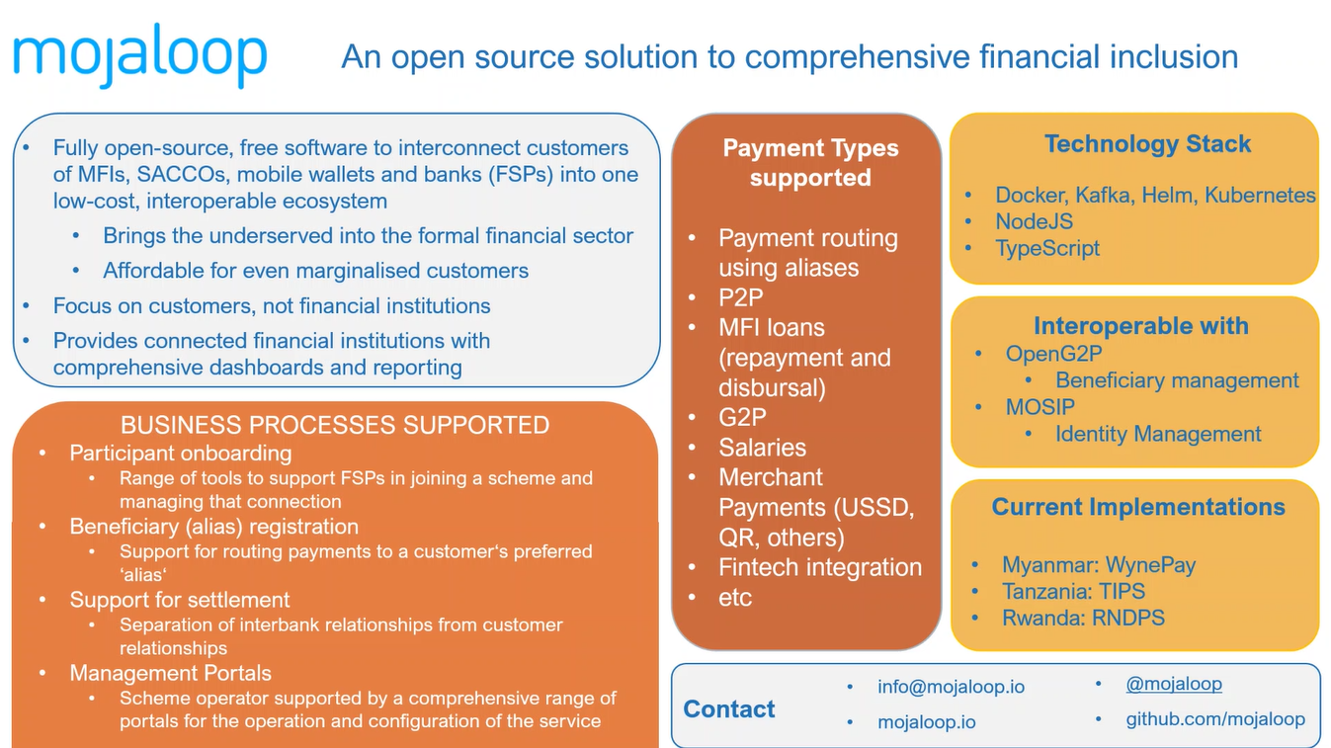

Slide 8
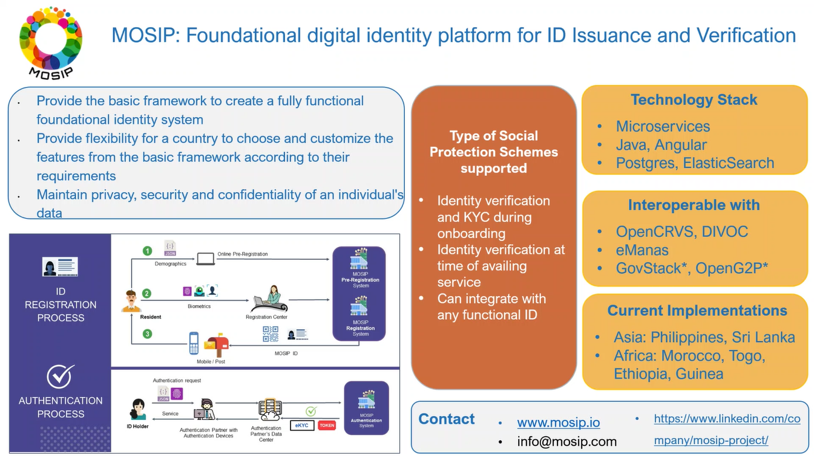

Slide 9
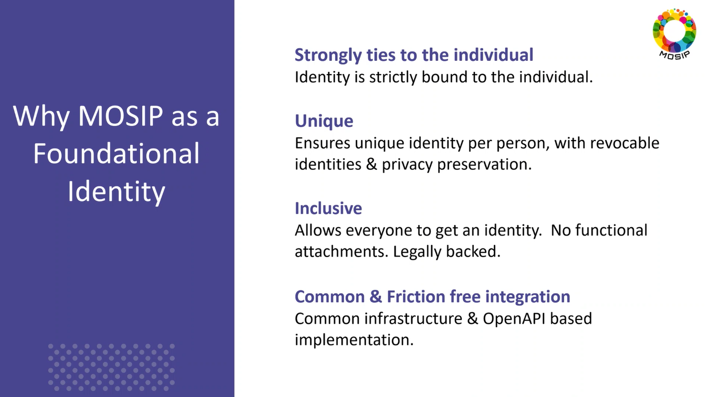

Slide 10
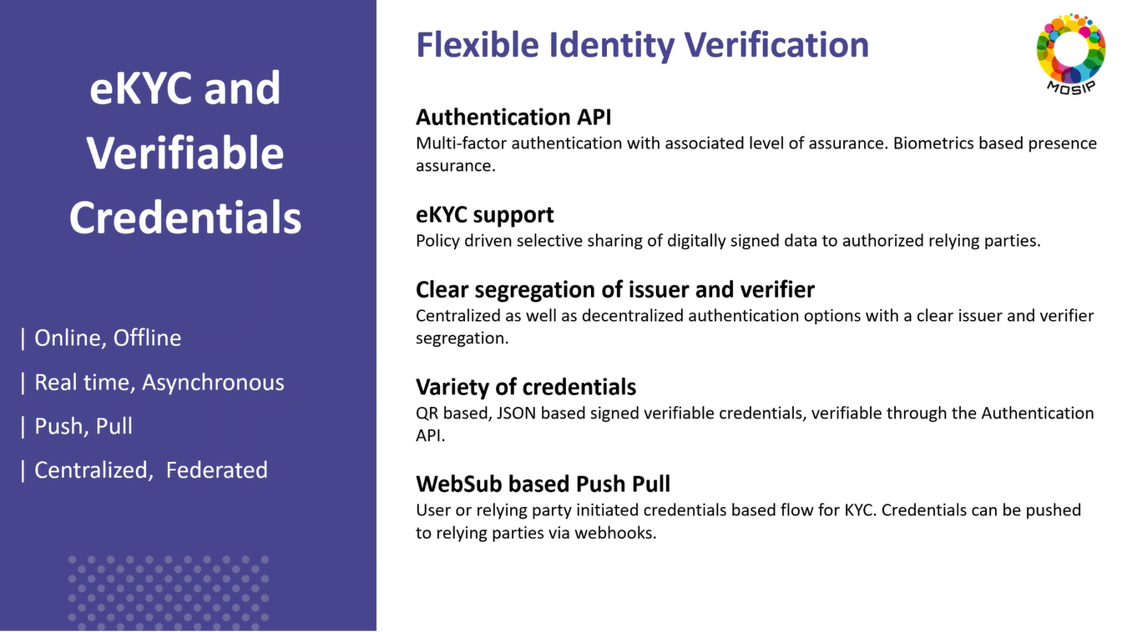

Slide 11
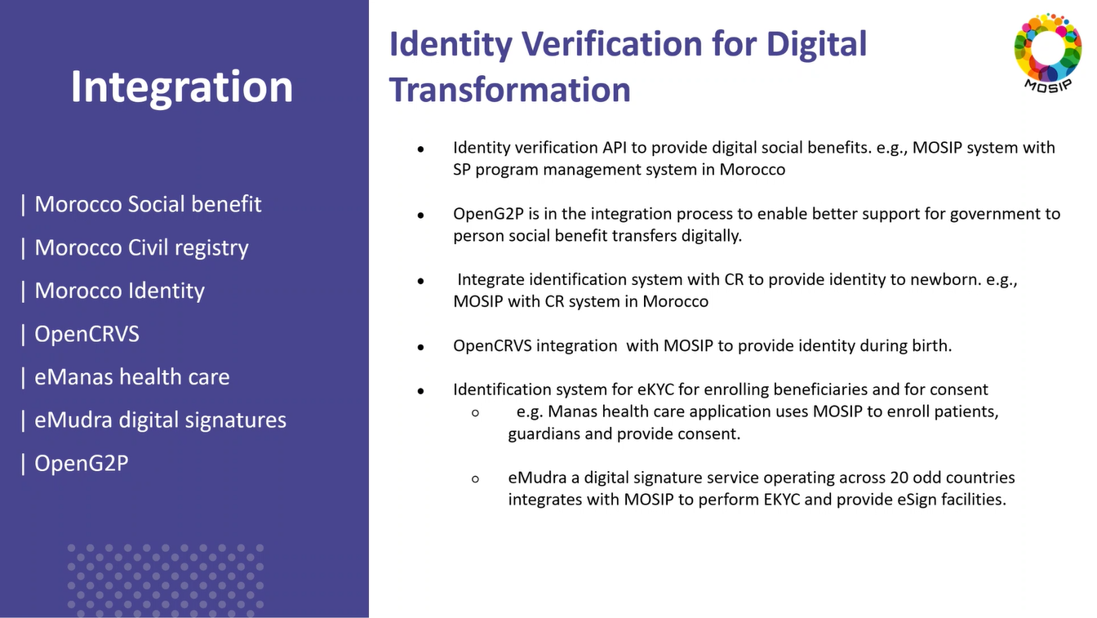

Slide 12
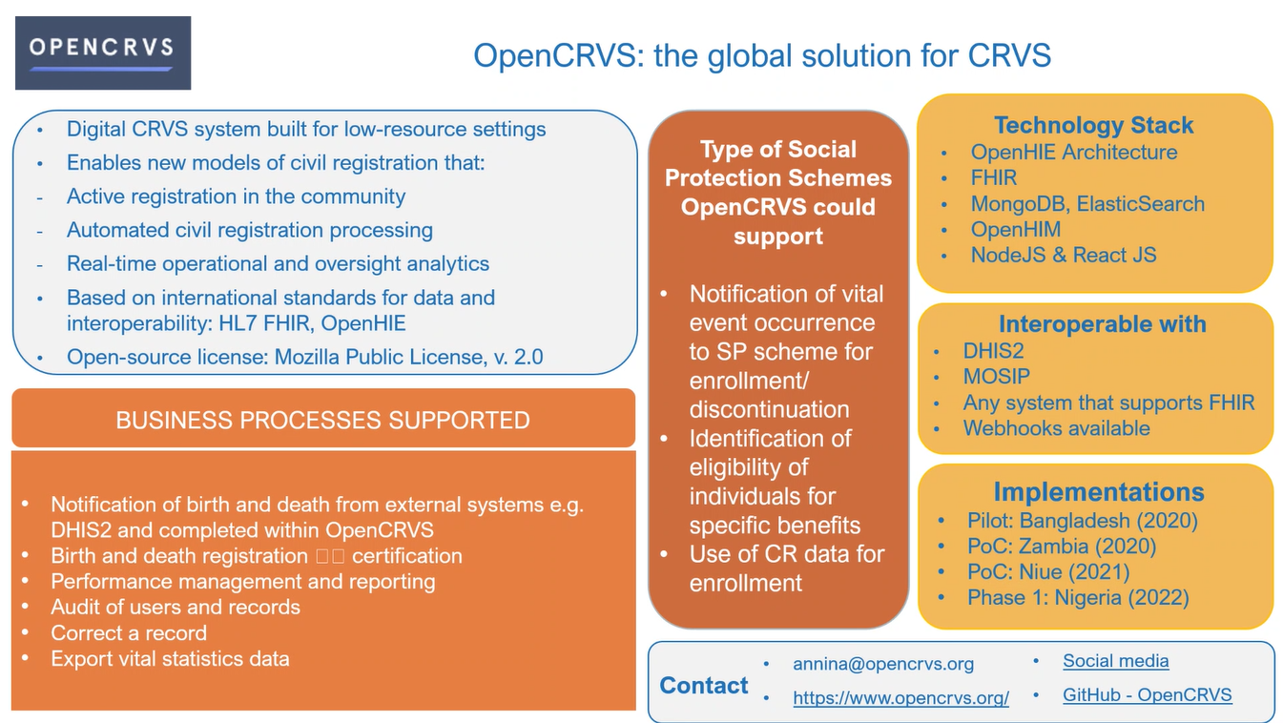

Slide 13
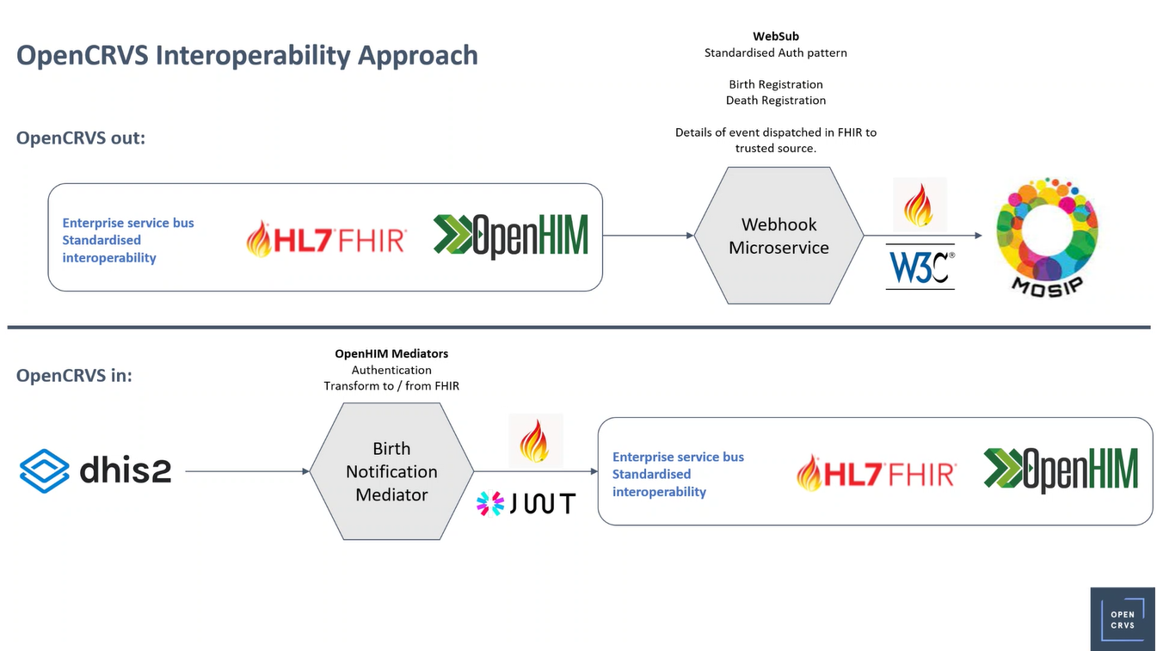

Slide 14
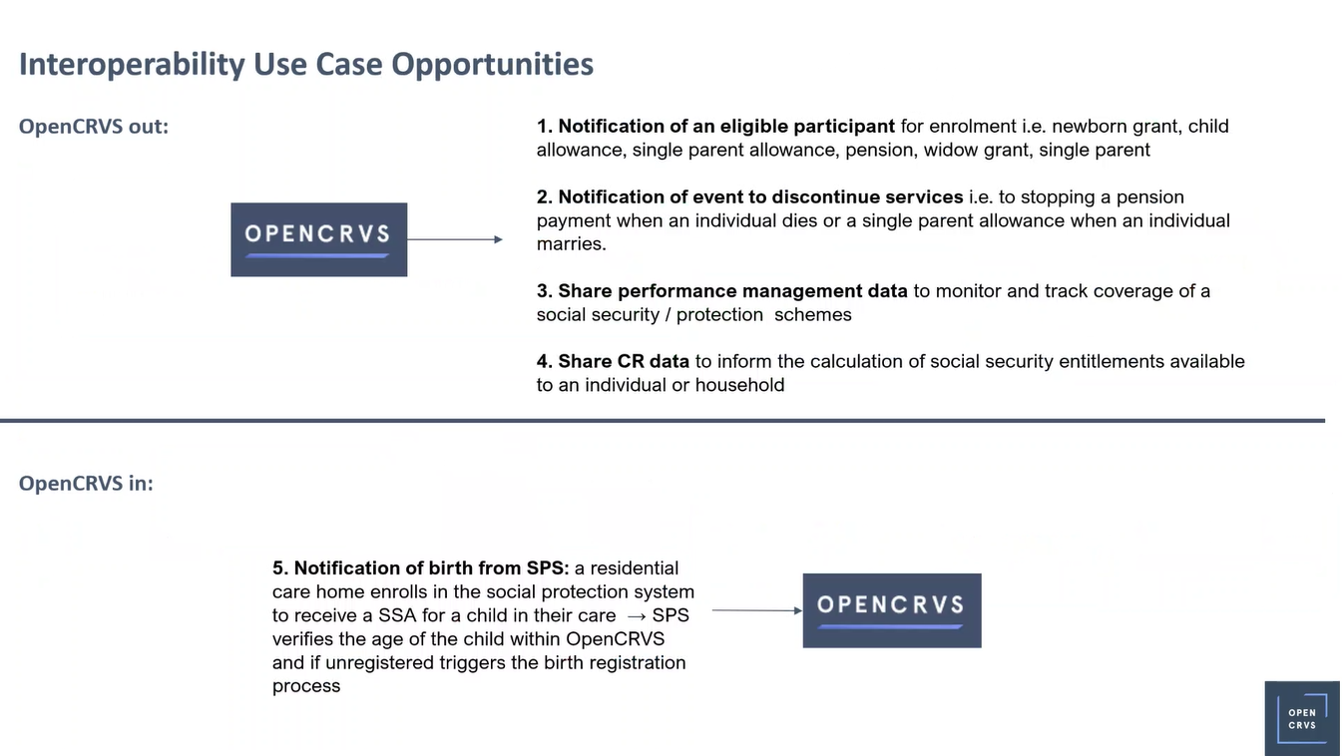

Slide 15
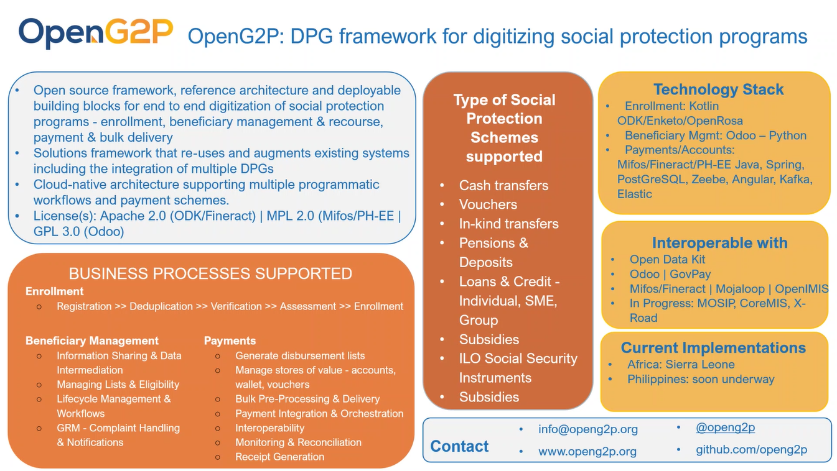

Slide 16
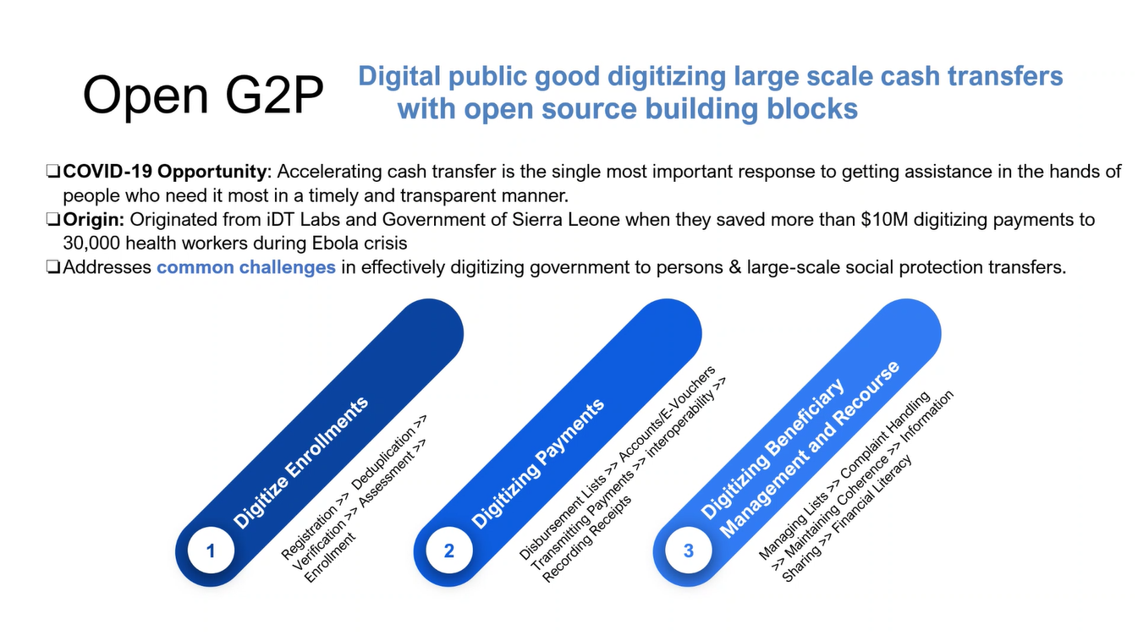

Slide 17
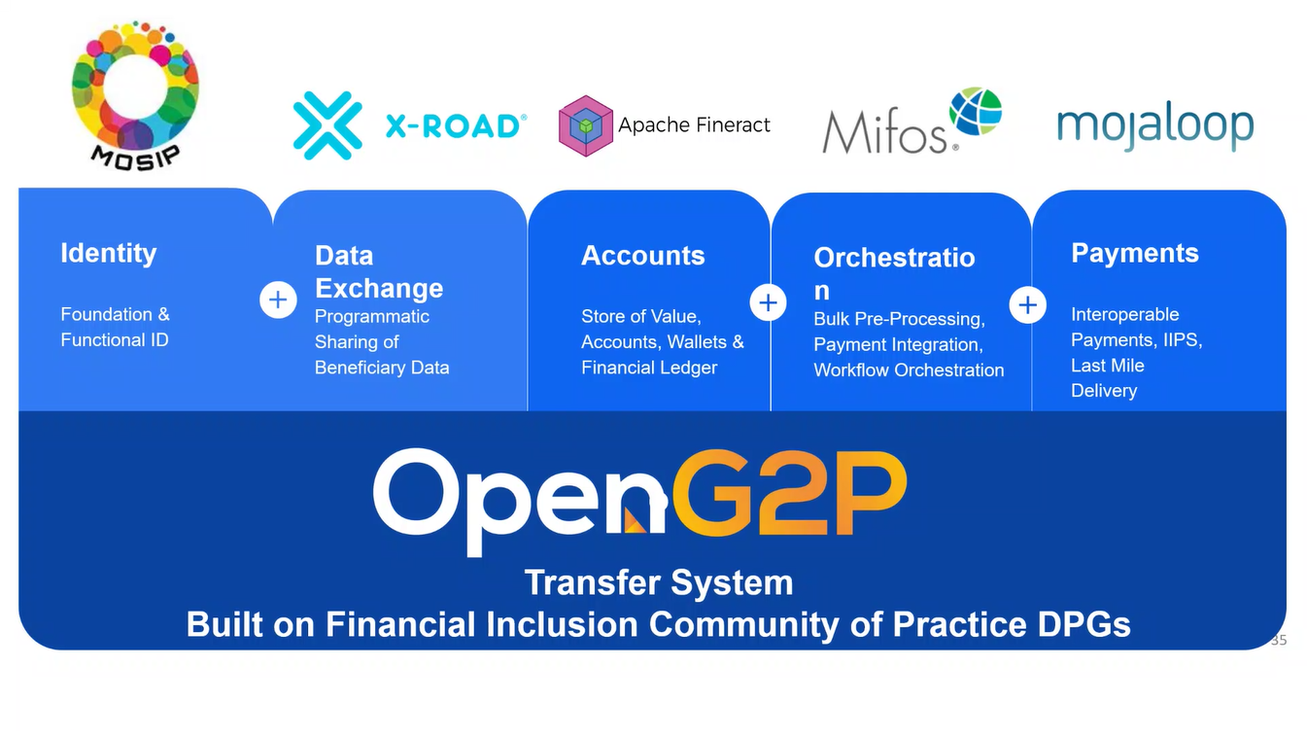

Slide 18
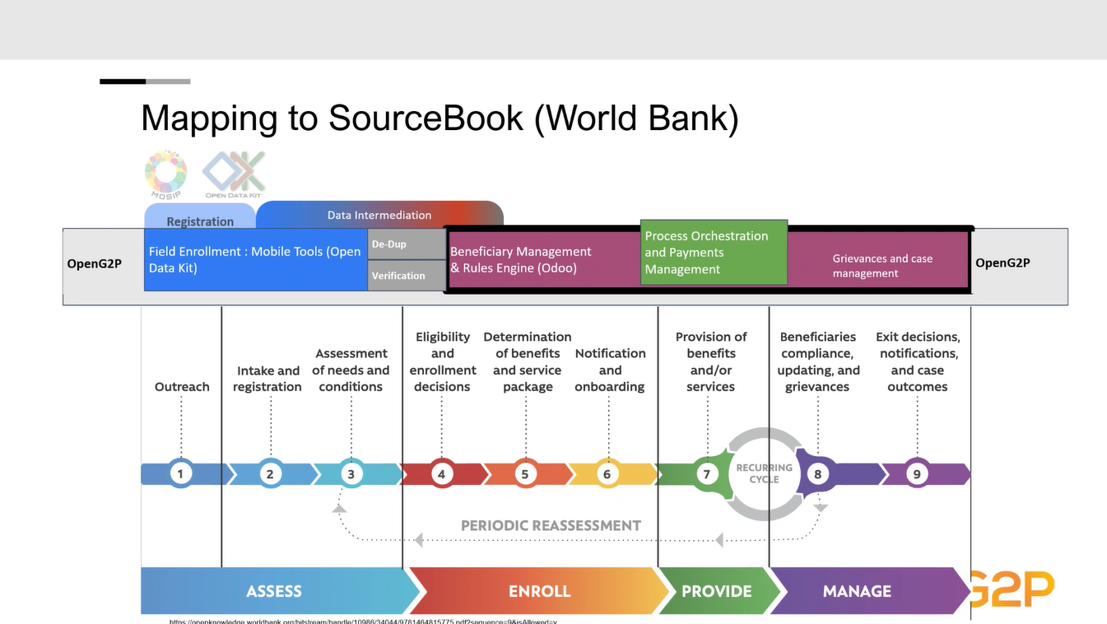

Slide 19
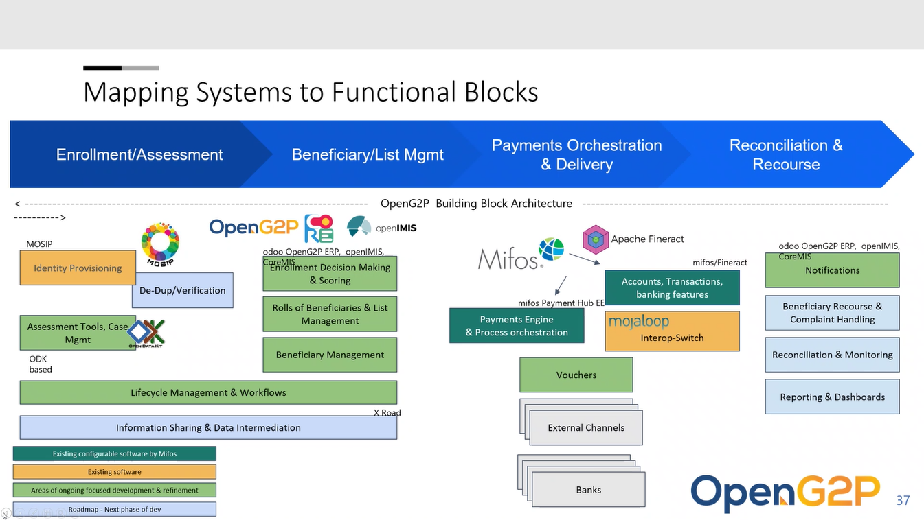

Slide 20
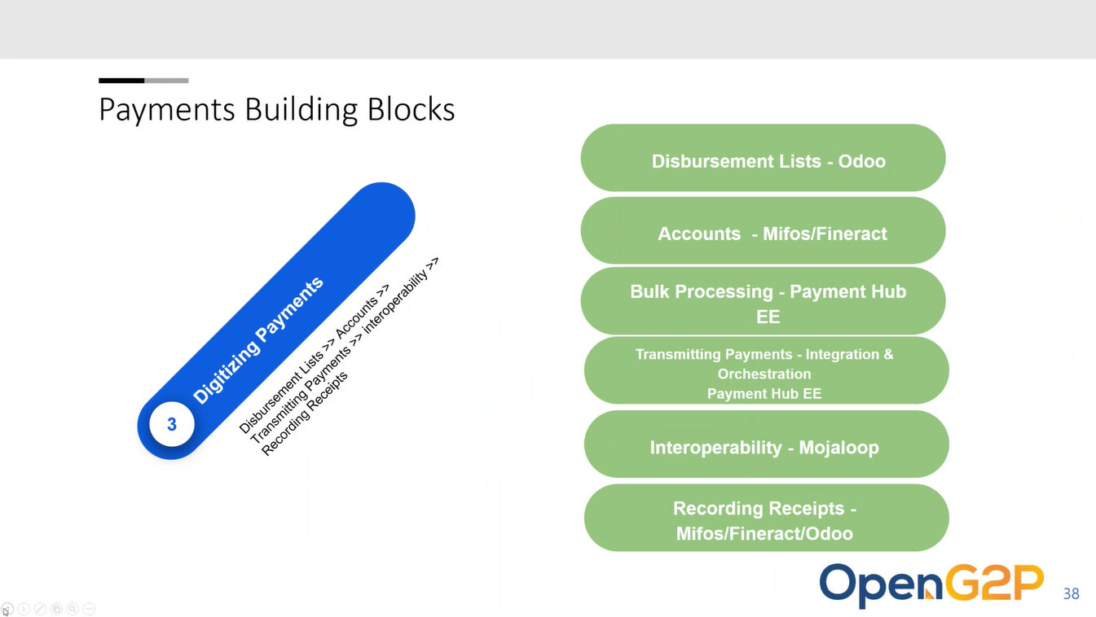

Slide 21
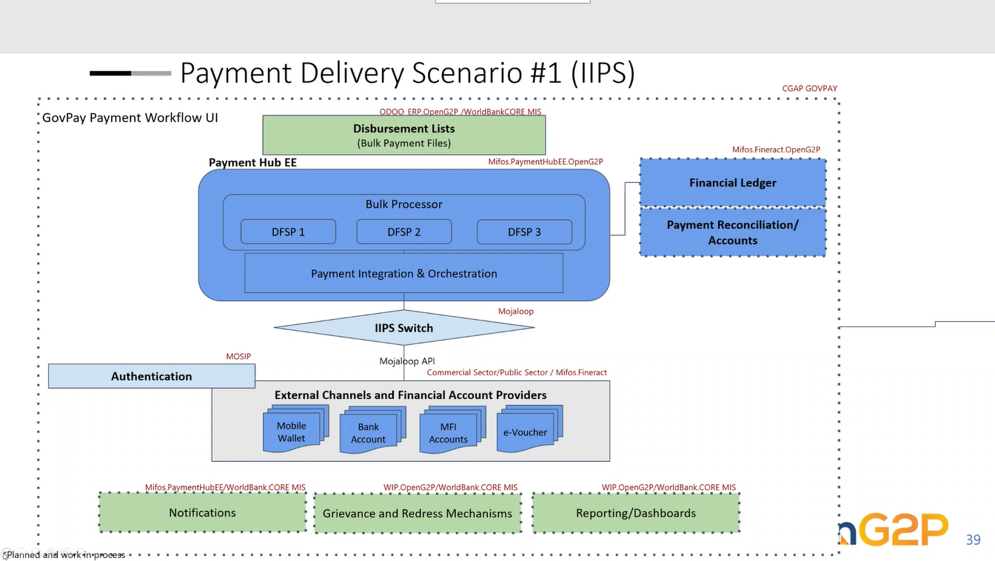

Slide 22
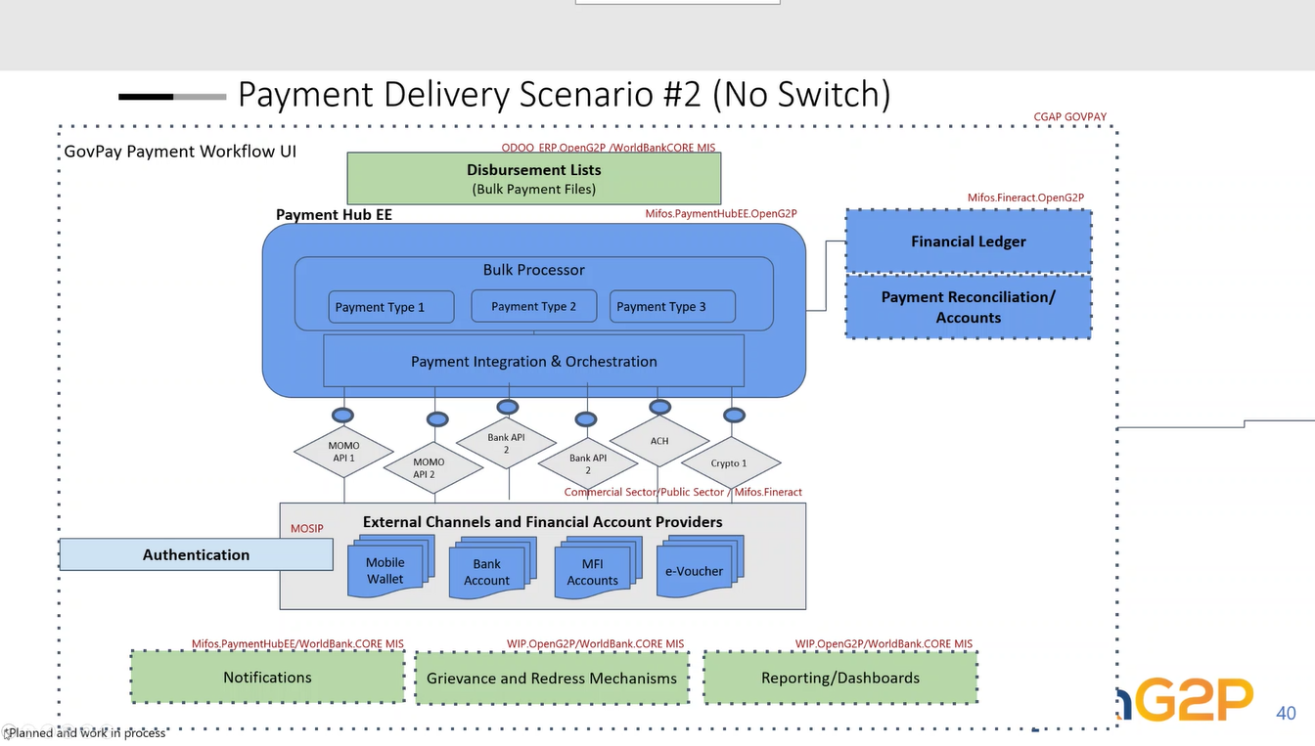

Slide 23
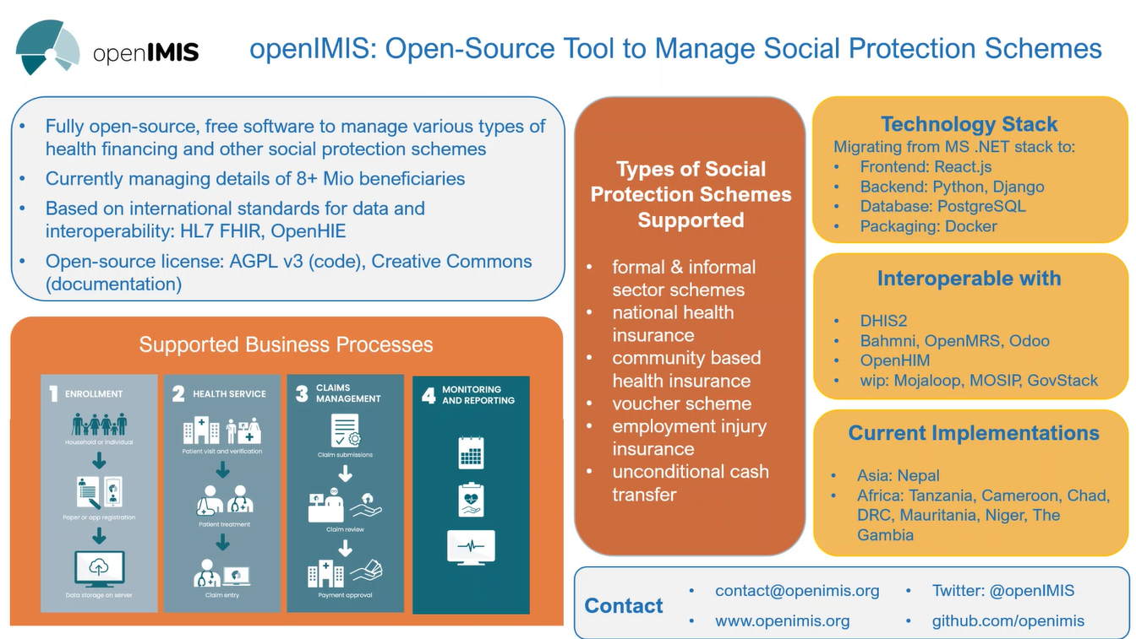

Slide 24
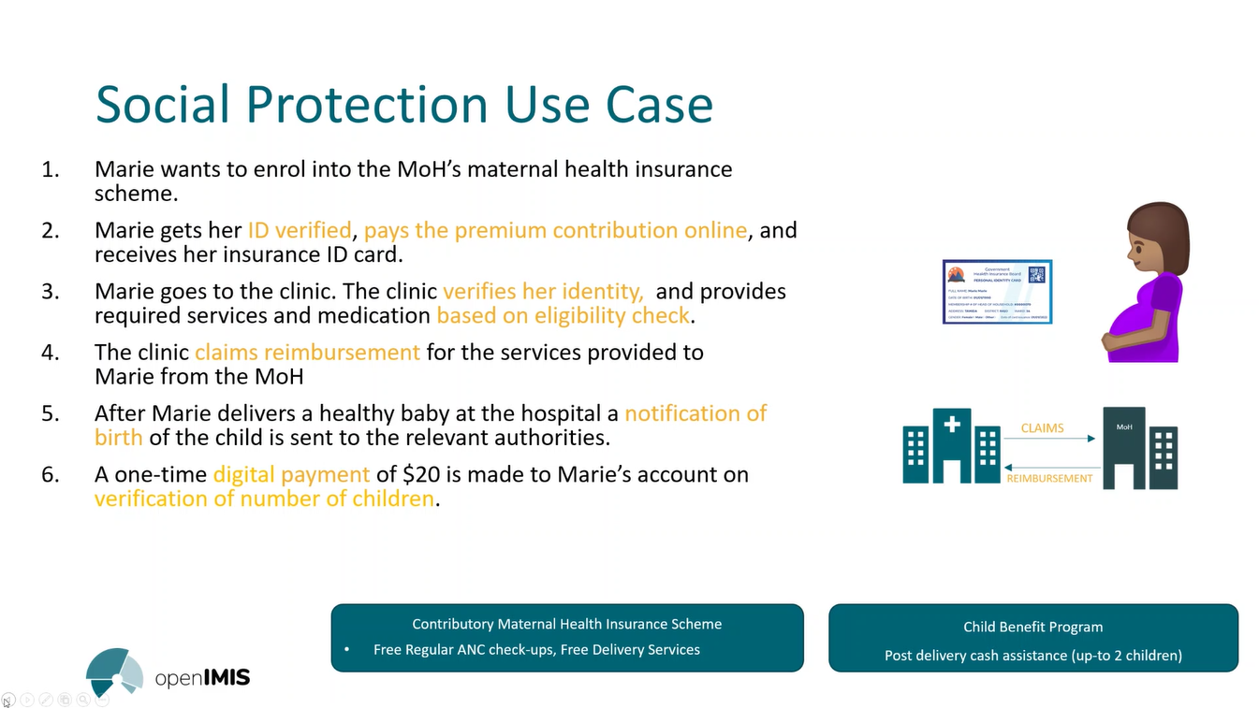

Slide 25
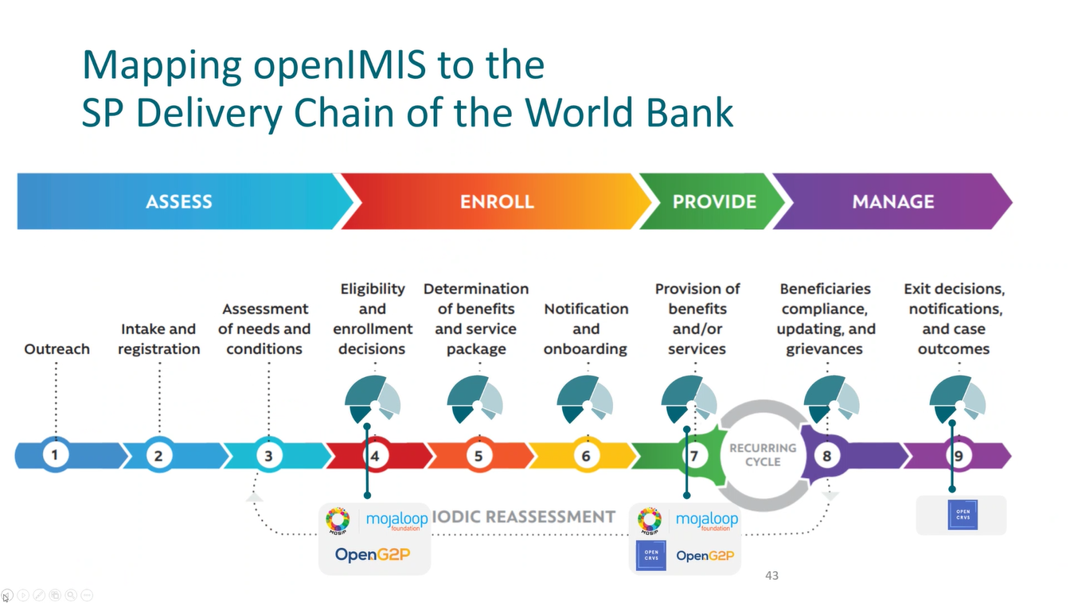

Slide 26
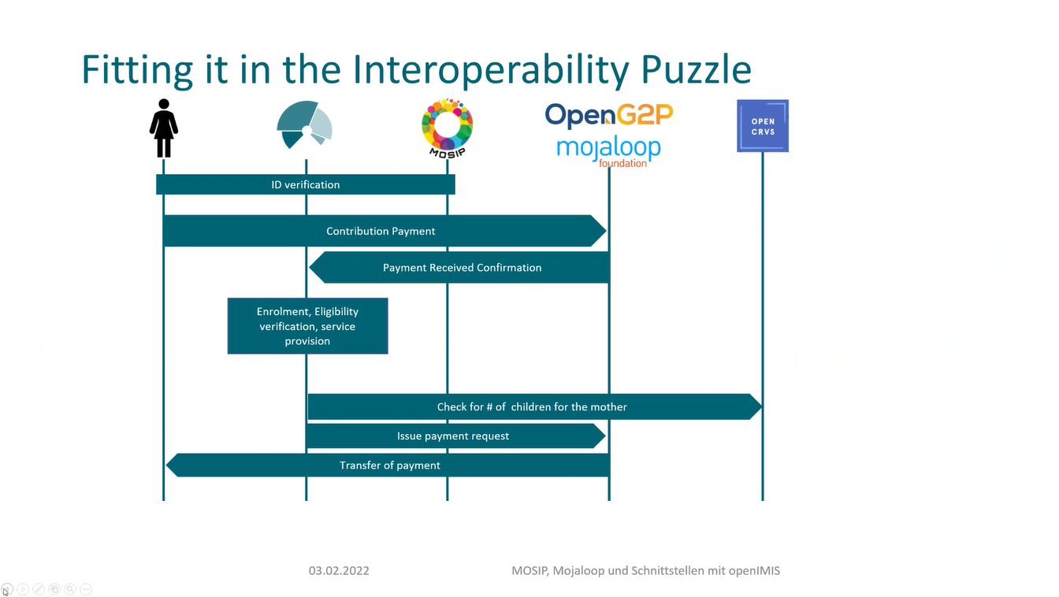

Slide 27
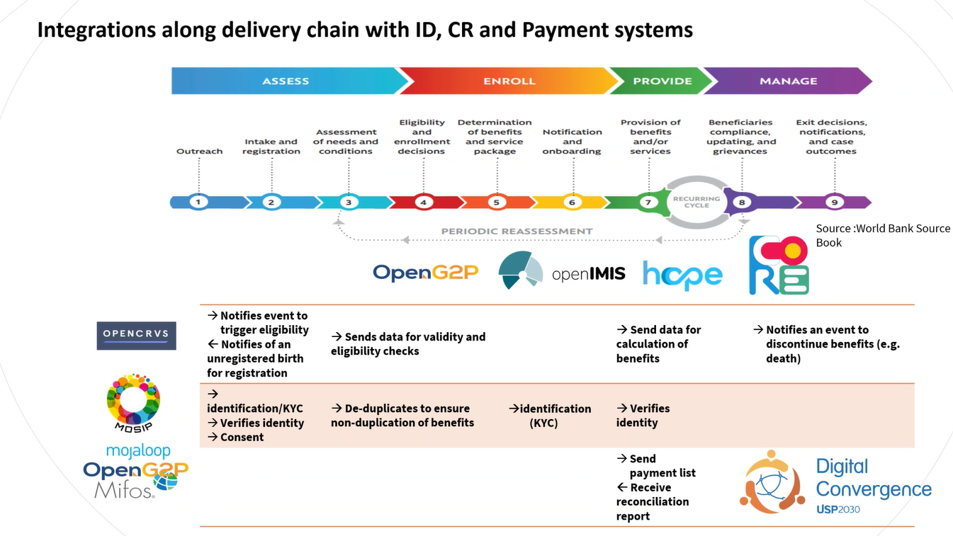

Slide 28
