Slide 1
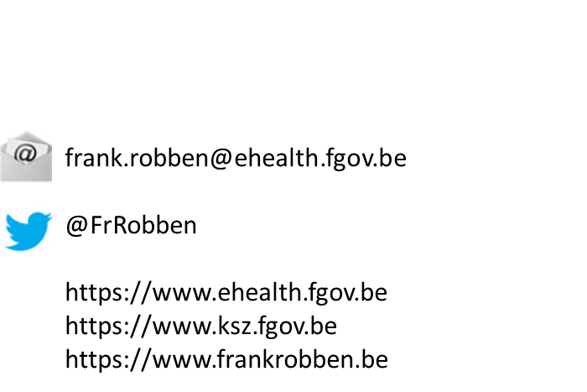
eHealth
Current situation & perspectives
Notes:
NL

Slide 2
















Overview of the online healthcare landscape in Belgium
Authentic sources

Slide 3














Medical benefits
Consultation of medical history via SumEHR
Online guidelines and decision support
Medical benefits
Electronic
prescriptions
Medication
schedule
Consultation of lab results
Electronic
referral letters

Slide 4





Benefits at the end of the consultation
Pricing,
billing
Update of SumEHR, medication schedule,
...
Benefits at the end of the consultation
Creation and sending of certificates
Registration
Sending a report to the holder of the GMF

Slide 5

www.mijngezondheid.belgie.be

Slide 6










Some figures
>87,5%
Belgian citizens have given
their consent for data sharing
+97%
general practitioners
use online health tools
620 million
messages/year
via eHealthBox
Electronic prescriptions
19 million/month
18.000.000.000
electronic transactions
3.9 million
Belgian patients with electronic health file in health vaults
29.019
4.800
  215 million
  electronic documents available at hospitals and clinical labs

Slide 7
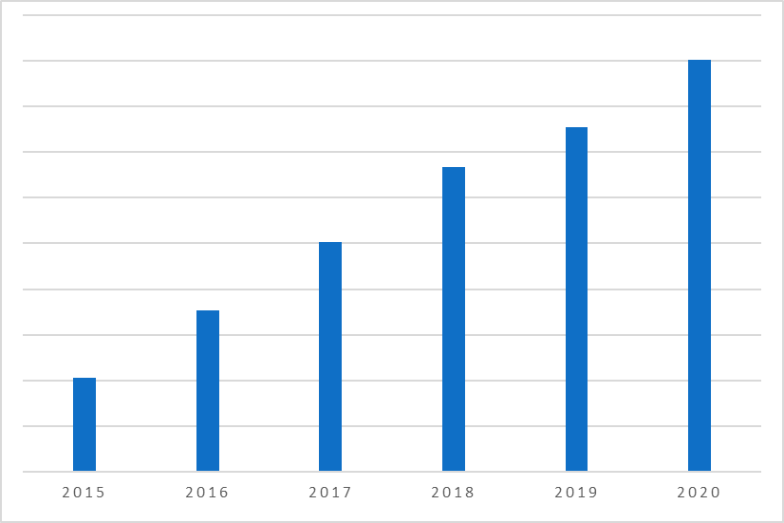
Basic services of the eHealth platform
Number of transactions through the eHealth basic services
  4.122.144.738 in 2015
  7.067.227.936 in 2016
  10.055.636.938 in 2017
  13.332.679.791 in 2018
  15.095.149.373 in 2019
  18.025.871.980 in 2020 (+ 19,41%)
Notes:
NL

Slide 8
Objectives of the eHealth platform
How?
  by means of a well organized, mutual electronic service delivery and information exchange between all healthcare actors
  with the necessary guarantees with regard to information security, privacy protection and professional secrecy
On which purpose?
  optimization of healthcare quality and continuity
  optimization of patient safety
  simplification of paperwork for all healthcare actors
  offering a thorough support to healthcare policy

Slide 9
10 missions
To develop a vision and a strategy with regard to online health
To organize the cooperation with other public authorities in charge of the coordination of electronic services
To act as a key driver for the necessary changes in order to carry out the vision and strategy with regard to online health
To establish the functional and technical norms, standards and specifications and the basic ICT architecture
To register software for the management of electronic patient files
To create, develop and manage a cooperative platform for a secure electronic data exchange, and also the corresponding basic services

Slide 10
10 missions
To agree on a division of tasks and quality standards and to verify whether these standards are complied with
As an independent trusted third party (TTP), being in charge of the coding and anonymization of personal health data for the benefit of specific agencies, as established by law, in order to support scientific research and policy
To promote and coordinate the development of programmes and projects
To manage and coordinate the ICT aspects of data exchange within the framework of electronic patient records and electronic medical prescriptions

Slide 11








Basic architecture
Patients, healthcare providers
and healthcare institutions
Health portal
Software healthcare provider
Users
Software healthcare institution
AVS
Website NIHDI
AVS
eHealth portal
MyCareNet
AVS
AVS
AVS
Basic services
eHealth platform
Network
Suppliers
VAS
VAS
VAS
VAS
VAS
VAS
Notes:
11
11

Slide 12
Basic services & API’s
Coordination of the electronic processes
Portal
Integrated user and access management system
Management of loggings
System for end-to-end encryption
eHealthBox
Timestamping
Coding and anonymising
Consultation of National register and CBSS registers
Reference directories (hub-metahub system)

Slide 13
eHealth certificates
Issued for free by the eHealth platform to
  the healthcare providers and institutions
  software developers for healthcare providers and institutions
Functions
  possibility for the healthcare provider or organisation to authenticate his software when using web services, especially by asking an access token to those services
  possibility to encrypt and decrypt messages, for example when using the eHealthBox
  at the same time with a corresponding password, fall-back for the authentication of a healthcare provider if he can’t authenticate himself with his eID, Itsme or TOTP
Can be requested and installed via a downloadable application on the portal of the eHealth platform

Slide 14
Integrated user and access management
Ensures that only healthcare providers and institutions have access to
  the services they may access
  regarding the people for whom they have been granted access
Access rules are set by law and by authorisations from the Information Security Committee
Steps
  identification of the user
  authentication of the user’s identity
  quality control (e.g. physician, pharmacist)
  relationship checks (e.g. therapeutic relationship with the patient)
  authorisation

Slide 15
Integrated user and access management

Slide 16
End-to-end encryption
Services used to encrypt messages for healthcare providers or institutions
Are used in the eHealthBox or in the electronic prescriptions (Recip-e)
2 services
  ETKDepot for the encryption to a known recipient (asymmetric encryption)
  KGSS for the encryption to a unknown recipient (symmetric encryption)

Slide 17
Encryption for a known recipient
Healthcare actor
Person or entity
eHealth platform
Internet
1
3
Connector or
other software to
generate key pair
Authenticates sender
2
4
Sends
public key
Identification
certificate
Identificationcertificate
Stores
public key
Web service
Register key
2
Public keys
repository
Stores private key
in a secure way

Slide 18
Encryption for a known recipient
Message originator
eHealth platform
Internet
1
Identification certificate
Web service
Ask public key
2
Identification
certificate
Asks for public key
Authenticates sender
Send message
Any protocol
3
4
Sends
public key
Encrypts
message
Identification
certificate
Message recipient
Public keys
repository
5
Stored
private
key
Decrypts message

Slide 19
Encryption for an unknown recipient
Key
Management
/ Depot
Encrypted with public key of user 1
Encrypted with public key of user 2
Symmetric key
Symmetric key
2 sends key
5 receives key
User 1
Originator
1 asks for key
User 2
Recipient
4 justifies right to
obtain key
4 justifies right to
obtain message
3 sends encrypted message
Encrypted with public key of Message depot
5 receives message
Encrypted with public key of user 2
Message encrypted with
symmetric key
Messages
Depot
Message encrypted with
symmetric key
Message encrypted with symmetric key

Slide 20
Timestamping
Timestamping (or electronic dating or certified time stamping) is a system that allows to keep the proof of the existence of a document and its content on a given date
The term ‘proof’ means that nobody neither the owner of the document, can modify the timestamping certificate

Slide 21


Timestamping: example
1
prescription A
prescription B
electronic
signature
5
2
Hashcode A
Hashcode B
3
6
Timestamp bag
4
Archive
Electronic
timestamping
6
Records

Slide 22
Reference directory (hub-metahub)
The service “Reference directory” (Metahub) of the eHealth platform and the complementary services 'Consent', 'Therlink' and 'Exclusions' are a set of services for managing access to a patient's medical data
Services are accessible, depending on the case, to hubs, individual care providers, some care institutions such as hospitals or pharmacies and finally to patients
In other words, it is an index of personal health data of patients
Such an index is the keystone for the implementation of any decentralised system of health data sharing between healthcare providers and organisations

Slide 23






Reference directory (hub-metahub)
3 Retrieve data from hub A
A
1 : Where can we find data?
2 : In hub A and C
4 :
All data available
3 : Retrieve data from hub C
C
B

Slide 24




Extramural data : health vaults
A
InterMed
BruSafe
C
B

Slide 25
eHealthBox
Secure electronic mailbox, particularly developed for the healthcare providers and institutions
Goal: to ensure a secure electronic communication of medical and confidential data between the Belgian healthcare actors
Available as
  a web service (accessible through a medical software)
    for which the eHealth platform has developed a web service allowing to send messages to the eBox Citizen and the eBox Enterprise from the software of the healthcare provider
  a web application (accessible through a computer and an eID/ITSME or TOTP)

Slide 26
eHealth Roadmap 3.0
(2019-2021)

Slide 27
Clusters
Cluster 0 Fundamentals
Cluster 1 Transversal
Cluster 2 Support
Cluster 3 Operational excellence
Cluster 4 healthcare providers and institutions
Cluster 5
Patient as co-pilot
Cluster 6 eHealth & health insurance funds

Slide 28
Cluster 0 – Clarify & Harmonize the concepts
Informed consent
  confirmation of the opt-in-logic
  only one consent for sharing the data in the whole country
    no granularity
    authentic source at the eHealth platform
    possibility of synchronized local copies
  possibility for the patient to be informed about the modification of his consent through his/her eBox citizen
  Covid 19 > agreement to publish the test results on the portals without the consent
    the patient can consult his results asap

Slide 29
Cluster 0 – Clarify & Harmonize the concepts (1/2)
Therapeutic relationships, healthcare relationships and exclusions
  authentic source for the exclusions: eHealth platform
    possibility of synchronized local copies
  better mutual harmonisation between the different portals and the personal health viewer (PHV)
    ongoing
Mandates and parent-child relationships
  need for better mutual harmonisation in the management of mandates between the different hubs/vaults
    as-is analysis and to-be proposals in progress

Slide 30
Cluster 0 – Clarify & Harmonize the concepts (2/2)
Access Matrix
  proposal and analysis of a change in the current paradigm
    the role of the access matrix would be reviewed and become indicative in order to make it accessible to all healthcare providers included in the royal decree n°78
    limited scope (some data would be excluded)
    reinforcement of existing concepts such as consent
    introduction of preventive and corrective measures

Slide 31
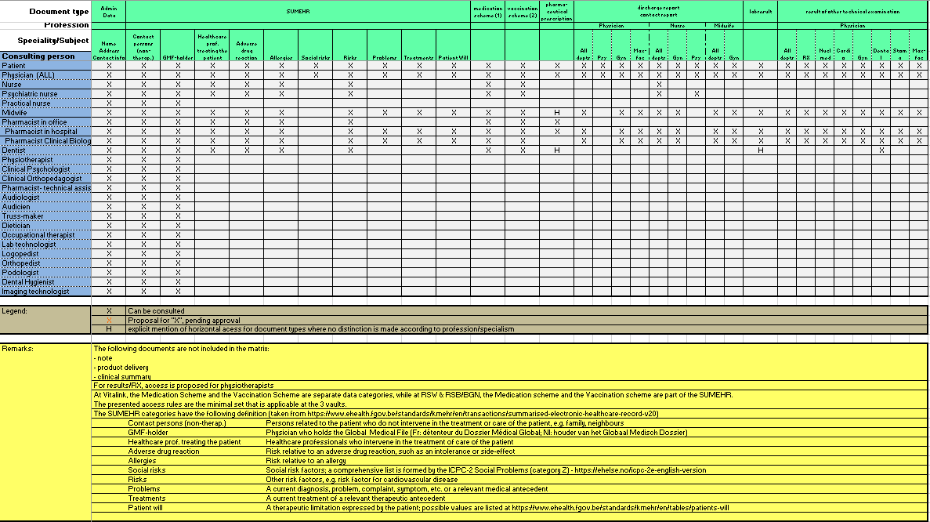
Current access matrix

Slide 32
Cluster 0 – Circles of trust
Circles of trust (CoT)
  defines objectively
    who performs which controls
    how to implement the fundamental principles of information security and privacy protection
    which control mechanisms should be implemented
  regulation approved
    by the eHealth platform Management Committee on 10th September 2019
    by the Information Security Committee on 1st October 2019
    see https://www.ehealth.fgov.be/ehealthplatform/fr/reglements
  1st use case implemented in the context of Covid-19
    clinical laboratories and hospitals must complete the declaration of honour in order to be able to delegate the consultation of the national register and the CBSS registers as well as the creation of a Bis number to the administrative staff

Slide 33
Cluster 4 – Electronic prescription
Full digitalisation of the prescription process
  free up more time for patient care greater patient autonomy through additional possibilities to manage their prescriptions
  development of user-friendly applications with which patients can pick up their prescribed medicines from the pharmacy
  bringing together all information on medicines (medication regimen, prescriptions, diary notes, etc.) in a virtual and digital way - VIDIS project
  ensure a better quality of care and a better relationship of trust between the patient and the care providers
  better view of treatment compliance for health care providers
  remote prescription, after which the patient can immediately go to the pharmacist

Slide 34
Cluster 4 – Electronic prescription
Since 15 September 2021, at the patient's request, the prescriber can send or make available by secure means the "electronic proof of prescription" in digital form, instead of handing it in paper form
The patient then no longer needs this electronic proof of prescription in paper form to collect his or her medicines from the pharmacy, the pharmacist can access a patient's "open" prescriptions on the basis of
  an electronic prescription proof in digital format
  the patient's e-ID cardthe patient's national register number and therapeutic link to that patient
  the patient who chooses to leave the prescriber's office without paper proof of electronic prescription, can obtain the proof of electronic prescription established by his prescriber in digital form via private tools linked to prescription software, he can also download them from: MaSanté.be & MyHealthViewer

Slide 35
Cluster 4 – VIDIS
(Virtual Integrated Drug Information System)
Organise and stimulate the sharing of data and information between all parties involved in the medical process
  the patient and his entourage
  ambulatory healthcare providers between them (doctors, pharmacists, etc.)
  the ambulatory care providers and the hospital environment
Objectives
  to harmonise all processes associated with medicines
  prescription and delivery of medicines
  medication review
  encourage collaboration between medication data sharing systems
  optimise the quality of the available medicines

Slide 36
Cluster 4 – VIDIS
(Virtual Integrated Drug Information System)
For the patient
  development of the web application 'MyMedication‘
  the medication chart and diary notes are already available for patients in Flanders (if a medication chart and/or diary notes are available for this patient)
For the healthcare provider
  since February 2021, healthcare providers can view their patients' data via the MyInami portal
    if they have the right to view the medication record according to the access matrix of the eHealth platform

Slide 37
Cluster 4 – BelRai
Access to therapeutic relationships
  creation of a therapeutic relationship between a healthcare provider and a patient in the BelRAI 2.0 web application
  access to control therapeutic exclusions
Integration into the reference directory
  aim: to inform healthcare providers about the existence of an assessment for their patient
BelRAI web service for target groups
  clinical psychologist
  clinical orthopedagogue
  individual healthcare providers (in progress)

Slide 38
Cluster 4 – BelRai
BelRAI Flanders
  web application for creating the BelRAI screener and making the results available- done
  web application to manage healthcare relationships for organisations and their employees-done
  creation of a database of healthcare relationships at the eHealth platform for healthcare institutions without an authentic source - done

Slide 39
Cluster 6 – eHealth and sickness funds
MyCarenet portal as an access point for healthcare providers to the web services of the CIN
  Member data
    allows any authorised healthcare institution or provider to consult the information (insurability and derived rights) of the care user that is necessary for correct invoicing or care or products providing
    will replace the insurability service
    a synchronous and asynchronous service that will be integrated into the practitioners' software is planned
    a web application is also available on the MyCarenet portal
  tarification
  consultation of GMF-holder
accessible for physicians, nurses, physiotherapists, dentists, midwives, orthopaedists, ...
extension to the centres for family planning, the centres for rehabilitation and the initiatives for protected housing

Slide 40
COVID-19 (see https://www.corona-tracking.info/)
Contact tracing
  contact centers
  Coronalert app (see https://coronalert.be/)
  collectivity tool
Testing
  PCR, RAT, self RAT, saliva test
  CTPC (corona test prescription code)
  reservation of sample collection
  execution of test
  accessibility of test results (database at Sciensano)
Passenger Locator Form

Slide 41
COVID-19 (see https://www.corona-tracking.info/)
Vaccination
  organisation of vaccination (Vaccination Codes Database)
  Vaccinnet+
  reporting of undesirable effects
Digital EU COVID-19 Certificates
  vaccination, test and recovery certificates
  CovidSafeBe (see https://covidsafe.be/)
  CovidScanBe (Corona Safe Ticket) (see https://www.covidscan.be/)

Slide 42
Conclusion
A lot of progress has been made in operational eHealth applications during the last decade
  coalition of the willing
  sound architecture and basic services
  trust of patients and health care providers
  high take up by hospitals, labs, GP’s, pharmacists, patients, …
Still evolution needed
  Inclusion of specialist doctors
    extension of GP software ?
    use of software of hospitals ?
    web portal ?
  secondary use of operational helath data for research and support of policy making
Valorization of new tools and processes developed within the context op the fight against the COVID-19 pandemic

Slide 43




