Slide 1


Digital shift within the public sector, G-Cloud and role of Smals
frank.robben@mail.fgov.be
@FrRobben
https://www.frankrobben.be
https://www.gcloud.belgium.be
https://www.smals.be

Slide 2
Agenda
Context
G-Cloud …
  what & why
  organization and service model
  portfolio
  impact
… and beyond
  some ICT-trends rising and their impact on G-Cloud
  innovative means of collaboration with private sector
Wrap up
Role of Smals

Slide 3
Expectations of citizens & enterprises
Effective services
Integrated services
  adjusted to their specific situation, customized if possible
  life events (birth, school, work, moving, illness, retirement, decease, setting up an enterprise…)
  across government levels, public services and private bodies
Adjusted to their own processes
With a minimum of costs and administrative formalities

Slide 4
Expectations of citizens & enterprises
Provided automatically, if possible
With active user participation ( self-service – self-empowerment – follow-up)
Always up to date
Offered in a performant and user friendly way
Reliable, safe and permanently available
Using the media of their choice (internet, mobile data, telephone, direct contact…)
Respecting their privacy

Slide 5


Slide 6
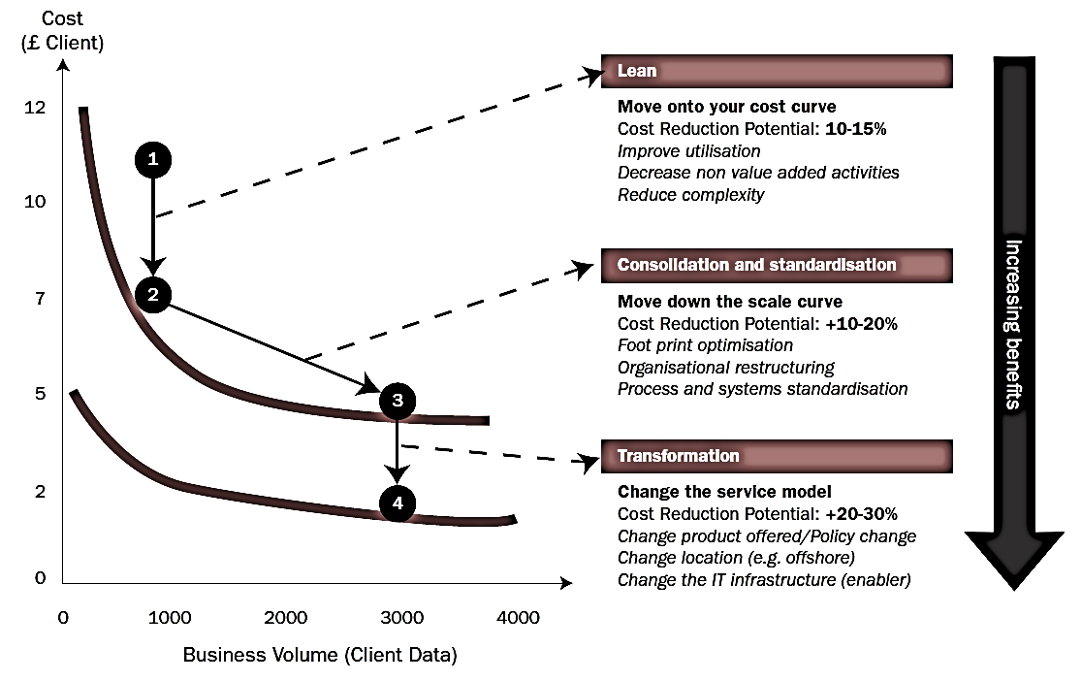
Synergies - transformations
Bron: Booz Allen Hamilton

Slide 7
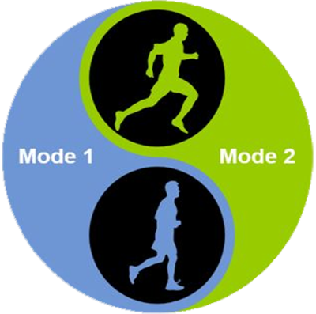
Trends
Sprint
Agility
User centricity
Continuous changes
New / uncertainties
Short cycles
Marathon
Reliability
Price / performance
Planning
Standard processes
Long cycles

Slide 8
Trends
Sprint
Marathon
Need to do both

Slide 9





What is G-Cloud ?
A program including synergy projects
Synergy for existing as well as new services
For public services
Managed by public services
In cooperation with the private sector

Slide 10
What is G-Cloud ?
Shared public ICT platform
  current target: federal state (FPS, PPS, public institutions of social security, institutions of public benefit)
  can be extended to other interested authorities
Hybrid community cloud model
  use of public cloud if possible
  private community cloud hosted in data centers, managed by the government
  operational implementation with strong involvement of the private sector

Slide 11






Cloud deployment types
Hybrid
Public Cloud
Shared
Access/Control
Outsourced Community Cloud (= off-premise)
Community Cloud on-premise
Private Cloud on-premise
Outsourced Private Cloud (= off-premise)
Dedicated
Location
Customer
Service Provider

Slide 12
Basic principles
Maximum synergy when possible and when generating efficiency gains and/or savings while maintaining or improving the quality of the services provided to the customer
In line with the synergy program: assignment to the one who is the most capable of proposing a form of shared services
Synergy based on result orientation, sense of responsibility and trust

Slide 13




G-Cloud ‘products’
Procurement
Cooperationá
Efficiencyá
Projects
Synergy
Services
Costsâ
Qualityá
Know-how & Expertise

Slide 14
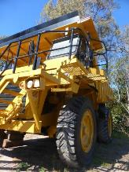


Why G-Cloud?
Creation of economies of scale: efficiency and high quality/availability
Respect of confidentiality and data protection
Bigger focus on business applications and flexibility in order to realize them

Slide 15

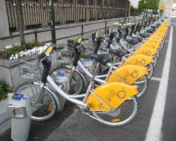

Why G-Cloud?
Greater weight
during negotiations with suppliers
Pooling of knowledge and resources
Technological evolution faster available for everyone

Slide 16
G-Cloud organization
Government
G-Cloud Operations & Programme Board
G-Cloud Strategic Board
FPS/PPS
(Horizontal FPS, FPS FIN, Belnet, …)
PSSI/IPB
(CBSS, ...)
Association of FPS/PPSI/IPB
Private ICT companies directed by FPS/PSSI/...
3 Colleges
FPS
Public Institutions of Social Security (PIOSS)
Institutions of Public Benefit (IPB)
SIT: ICT managers from
FPS
Public Institutions of Social Security
Institutions of Public Benefit
Service
owners

Slide 17


G-Cloud organization
G-Cloud Strategic Board: strategic direction by senior officials
G-Cloud Operations & Program Board:
CIOs for operational direction

Slide 18
G-Cloud service model
G-Cloud = coalition
G-Cloud ≠ central organization
G-Cloud service
Offered by
Service owner
Delivered by
Service provider
Governance

Slide 19
G-Cloud service model
Service Owner
  organization responsible for the service
  develops the service and its further evolution
  provides SLA, financial model, support model...
  “contract” with clients
Service Provider
  “contract” with Service Owner
  provides the service as agreed upon in the specifications/SLA
Sometimes: Service Owner = Service Provider

Slide 20
G-Cloud P&O
3500 IT professionals in the federal government
War for talent & reversed age pyramid
Cooperation model across institutional boundaries

Slide 21
Opportunities and challenges
Challenges
Security
Confidentiality
Continuity
Strategic management
Opportunities
Cost management
Cooperation
Self-service
Economies of scale
Flexibility
Quality
Know-how

Slide 22

G-Cloud success factors
Efficiency
Adequate security measures (risk↘)
Optimal cooperation and trust between the institutions
Differentiation of the offer: neither ‘one size fits all’ nor tailor-made work
Capacity management
A phased approach, no ‘big bang’
Quality of service: respect of SLAs

Slide 23
G-Cloud portfolio (www.gcloud.belgium.be)

Slide 24
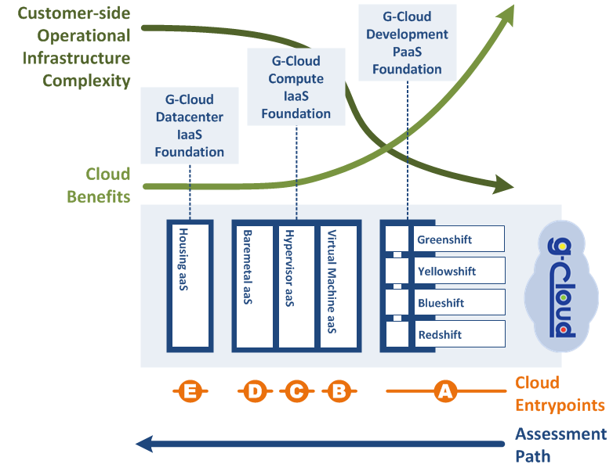
Possible entrypoints

Slide 25
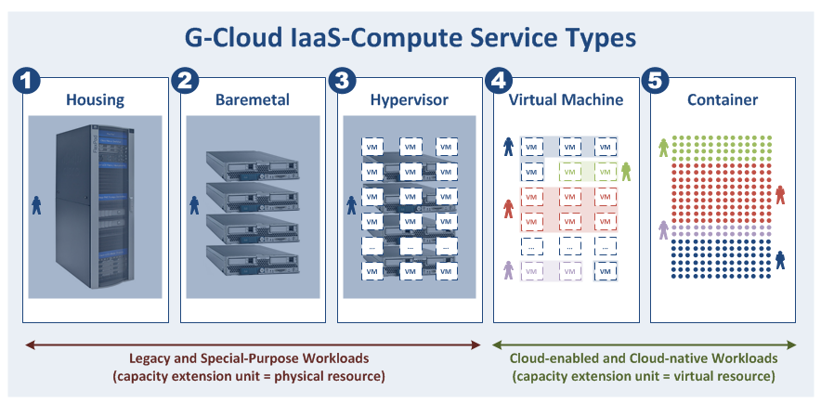
Compute Types versus Workloads
Gebruikers hier willen typisch meer controle over de onderste lagen van de technologiestack (servers, netwerkapparatuur, hypervisor, OS, ...)

Slide 26
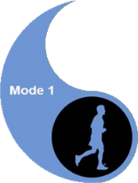

Compute Types versus Workloads

Slide 27





Data classification
Information classifification model drafted within « Federal Information Security Policy » (FISP)
  https://dt.bosa.be/nl/federaal beleid_voor_informatiebeveiliging_fisp
Definition of levels
Classification based on the impact of the loss or dissemination of information
  impact for government (agencies)
  impact on privacy rights
Practical classification explained in privacy vademecum
  https://dt.bosa.be/sites/default/files/fisp_-_privacy_vademecum_nl.pdf

Slide 28
G-Cloud and the private sector
G-Cloud ≠ ICT insourcing
Public procurement
translation tool, converged infrastructure, unified communications, network security, storage, back-up, ...
In consultation with the sector for several specific platforms
IBM, Microsoft, Oracle, RedHat, SAS, ...

Slide 29
G-Cloud impact - examples
Centralized license negotiations with Microsoft & standardization initiative : obtain additional discounts on O365 licenses (~ annual benefit of 3 M€ ).
Negotiations for “enterprise licences” / “perpetual licences” with Axway, Oracle, Redhat, SAS ...
Economies of scale => decreasing cost price G-Cloud services: compute -12%, storage -40% in 9 months’ time
Inventory of “procurement centres” (Dutch: opdrachtencentrales) ➔ large-scale reuse of “procurement centres”

Slide 30
G-Cloud impact - examples
Unified Communications as a Service (UCaaS)
  local examples: NWOW, better/faster communication between employees
  global advantages: standardization, better communication between public services
  much interest: 15+ public services took the step

Slide 31
G-Cloud impact - examples
Communities / knowledge sharing
  knowledge exchange through SIT
  mixed O365 team
  Sharepoint online / BeConnected as supporting platform
  group for the management of work stations / Windows 10 migration
  “user groups” for G-Cloud services
    Sharepoint, Greenshift, VMaaS
  translators community (Babelfed)

Slide 32
G-Cloud impact - shared procurement
Cooperation regarding the public procurements
  juridical: central procurement agency clause
  know-how: specialized in ICT purchases
  simplicity: less administrative work for the private sector and the state
  possibility to accelerate the purchases and to avoid double specifications procedures
  price reductions thanks to the volume
Software licences
  negotiations with the providers
  mutual exchange of unused licences

Slide 33
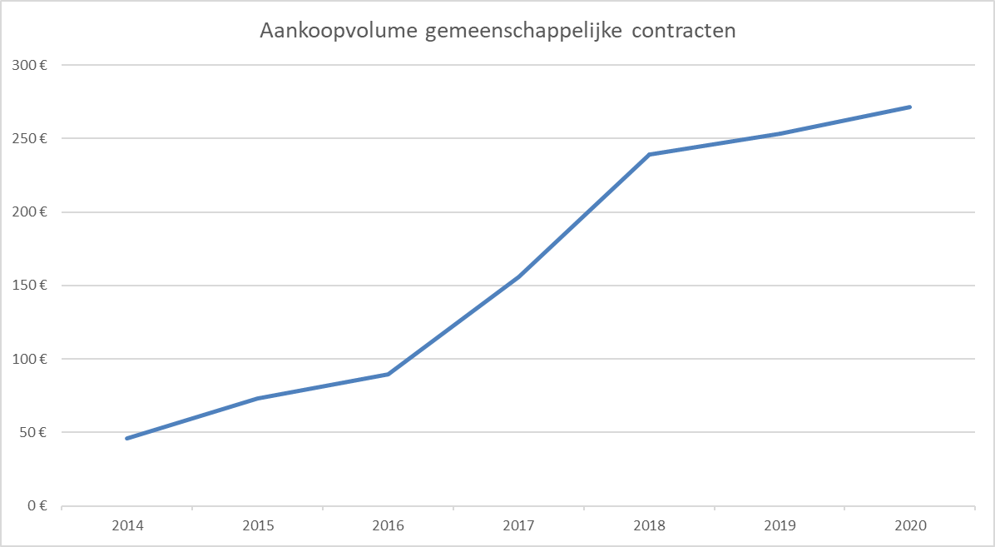
G-Cloud impact - reuse of contracts
Source: Smals

Slide 34
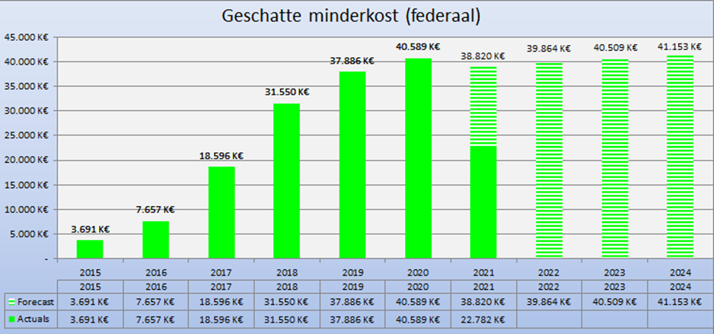
G-Cloud ROI

Slide 35
Beyond G-Cloud

Slide 36

Digital is the new normal: society needs to evolve
Public & private sector cooperation regarding
  vision
  common components & services
  synergies in order to meet user expectations
  offering according to strengths
Not only about competitive, yet also cooperative strategic advantages

Slide 37
Cloud-native vs Cloud-enabled ?
Cloud-enabled applications
  traditional applications can benefit of some cloud capabilities
    iso-functional and iso-architectural migrations (cloud-wrapping)
  more modest ‘cloud’ architectures
    use features needed by internet-scale applications
    for augmenting your quality of service
    our workloads are not at the extreme end of the cloud spectrum
  to realize full cloud potential: cloud software architecture needed!
Cloud-native applications
  horizontal scaling for internet-scale applications
  high availability from an application perspective
  single container availability option (restart downtime)
  transportability (move to different clouds)
    worldwide availability zones, multi-cloud strategy, …
  continuous delivery and automated staging
  frequent deployments (e.g. very 5 minutes)
  micro services architectures
  A/B testing and feature toggles
  unpredictable loads, …
What is the maturity level of your organization?
What are the benefits of cloud technology you want to maximize?
What are the characteristics of your (traditional) workloads?
What is your current IT landscape?
...
Why Cloud?
Notes:
Shifting to cloud native features will demand reengineering/modernisation

Slide 38

Focus on business
ICT enables business, effectiveness, efficiency, innovation
Business drives, empowers and
invests in ICT

Slide 39
Shift of focus / Added value
Business components

Slide 40
Some ICT trends
Public Cloud
API Economy
Artificial Intelligence
Blockchain
…
Re-use
Conver-sational Interfaces
Big data analytics

Slide 41
Some ICT trends
Re-use

Slide 42



Shifting focus
towards synergies in the area of business components
Business components
Stronger centrally coordinated approach to offering platforms

Slide 43
activiteitenrapporten
beheer van comités
Besturingprocessen
parlementaire vragen
sealing
timestamping
verwijzings-
repertoria
logging
GDPR
2. Dossierbeheer
beheer bronnen
3. Beveiligings-
componenten
dossierbeheer
contactbeheer
4. Authentieke
Bronnen
rapportering
processturing
procesopvolging
handtekening
documentopslag
archivering
ontsluiting bronnen
OCR
codelijsten &
glossaria
encryptie
documenttransformatie
Primaire
Processen
Intake & Inform
Verwerking
Leveren van dienst
portaal
aangiftes verrichten
onderzoeken beheren
factureren
attesten leveren
frontoffice
invorderen
gegevens distribueren
activiteiten traceren
dossiers beheren
gestuctureerd
Chatbot
1. Gebruikers- en toegangsbeheer
eBox
niet-gestuctureerd
Interactieve
formulieren
5. Interfaces
6. Communicatie
mandaatbeheer
identificatie personen
ondernemingen/buitenlanders
CMS
burger, onderneming,
overheden, interationaal
styleguides
devices
gebruikersbeheer
toegangsbeheer
rollenbeheer
personeel
vertaling
boekhouding
Ondersteunende Processen
intranet
e-learning
software factory
logistiek
kadercontracten

Slide 44
About the reuse initiative
Initiative within the public social security institutions & Smals
Purpose
  synergy around (technical) business components
  and thus save costs by avoiding multiple development of components
Regardless of whether development takes place by
  the institution's own ICT department
  Smals
  subcontractors
A competence center within Smals aims to maximally integrate and support the reuse of business components within Smals, its members, partners and domains in which Smals is active
44

Slide 45

ReUse – Vision
Every stakeholder
can easily find the most common reusable elements in a centralized catalogue
Processes
and tools are put in place to identify, register, implement, monitor and measure reuse throughout the project lifecycle
Human
networks are maintained and developed on all levels (CEO’s, CIO’s, business owners, business analysts, architects) in order to keep maximum visibility on reuse potential
A culture
develops where
reuse is adopted and the creation of reusable products is promoted,
45

Slide 46

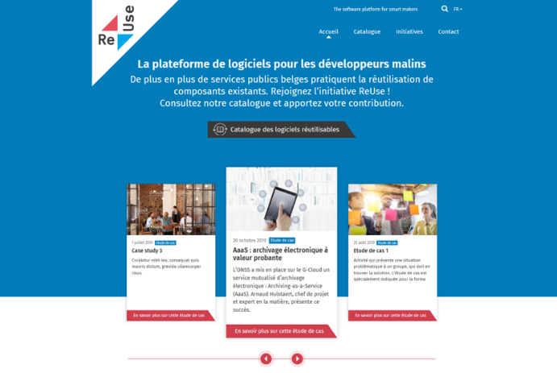
How? With Software Reuse Platform! https://www.ict-reuse.be
46

Slide 47
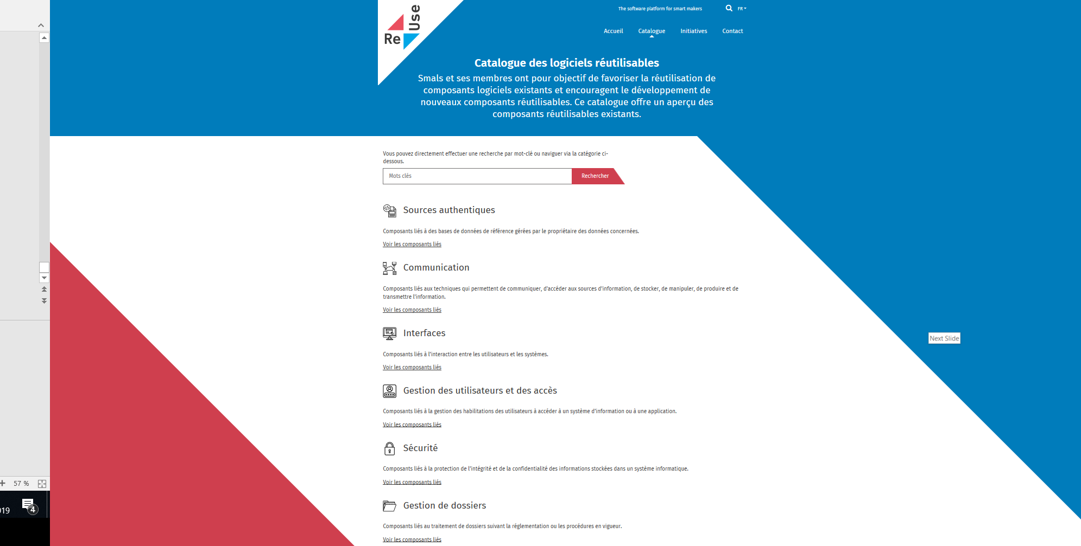
New project?
consult the
Software Reuse
Catalogue

Slide 48
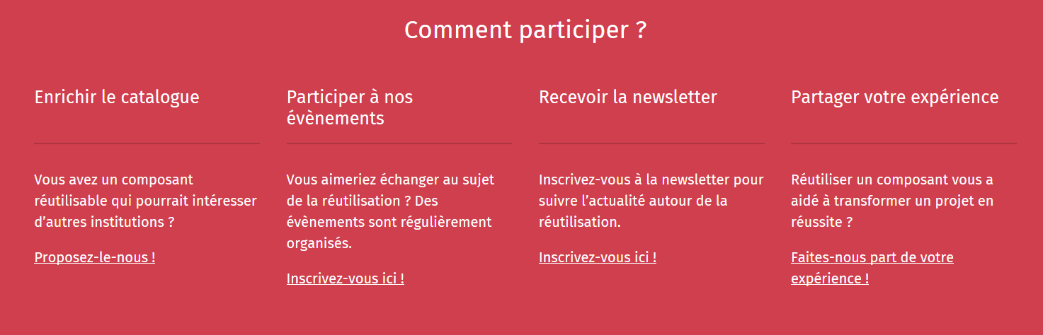
Share your success stories...and become an ambassador for reuse! https://www.ict-reuse.be
48

Slide 49





















Dare to share!
Framework
Library
Product
Service
System
49

Slide 50
ROI 2020 for projects carried out by Smals
14%
64%
46%
rEUSABLE
rEUSED
ROI
13.500.000 €
50

Slide 51
Some ICT trends
API Economy
Re-use

Slide 52
Why are API’s important?
Cost reduction by reusability: consumers don’t need to rewrite what already exists!
Complexity reduction: no more big, monolithic systems
Decoupling: consumers and providers can continue to connect as long as the technical contract is followed → ex. less impact in case of migrations
Driver of innovation: new products raise, based on existing API capability
Stimulation of partnerships
Stimulation of standardization

Slide 53

Good API ReUse = business ReUse
Potential
Value
Technical
Ease
Amount of “business” functionality
Library
Framework
Program
Notes:
Sweet spot

Slide 54
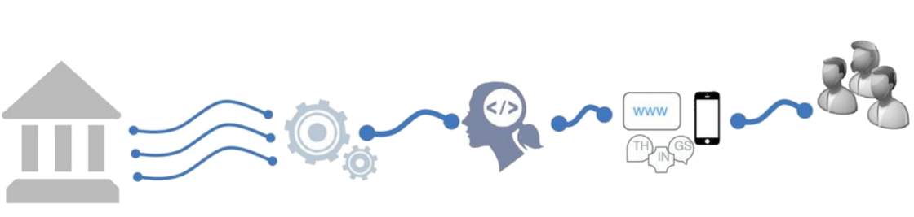
Shifting to an API economy: the value chain
APIs drive today's business processes in e-Government
APIs are key in real-time information exchange between public - private sector & citizens
Existing
Systems
Made available as APIs
Self service
used by developers
To create new innovative apps and services
Differentiated
services
Notes:
Deel van verhaal “Meer naar buiten toe openstellen”

Slide 55





G-Cloud service platform project
Service Synergy
Product
Financial
Standards
Governance
Business
Service owner, community, supplier contact, financial, organization
Vocabularies, procedures/processes, common services
Technical approach
Multi tenant
Self service
Concept, testing, definition
Enterprise license G-Cloud

Slide 56





API Management Solution
From ESB-technology to API Gateway
  parallel platform
  zero-impact migration
Ready for today's technology, but supports our legacy as well
Flexible to extend and customize
Accelerates time-to-market
API Manager
API Portal
API
API Registration & Lifecycle
Application Developers
API Catalog
Partner & Policy Administration
REST
API
API Gateway
SOAP
Policy Enforcement
Notes:
Waarop slaat legacy?? B.v. soap verhaal
Zero impact slaat hier op niet-breken van contracten, backwards compatibility

Slide 57



Beyond tooling: API management throughout the organization’s soul
API Ecosystem eHeath
API Ecosystem Soc Sec
100+ APIs
1.200M transactions / month
250+ APIs
600M transactions / month
API Consumers
Client& Partners Applications
API Communication
reUse Catalogue
various Presentations
API Consumption
API Portal
API Gateway
API Management
API Manager
API Gateway
tool API Gateway
API Catalogue
API Governance
API Architecture
REST Board
Integration Competency Center
(ICC)
G-Cloud Platform is the reference
Smals Governance
Smals API’s Application & Tools
API Reporting
API Development
API Metrics
REST
SOAP
development Guidelines
API Trainings
API Operations
Help Center
API Providers

Slide 58
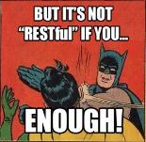
G-Cloud REST style guide
Based on industry standards and best practices
A pragmatic approach to designing RESTful APIs
Collaborative effort organized in several workgroups:
  REST API modelling
  security (OAuth)
  functional/business vocabularies (temporal, location, person, enterprises)
Work in progress
https://www.gcloud.belgium.be/rest/

Slide 59

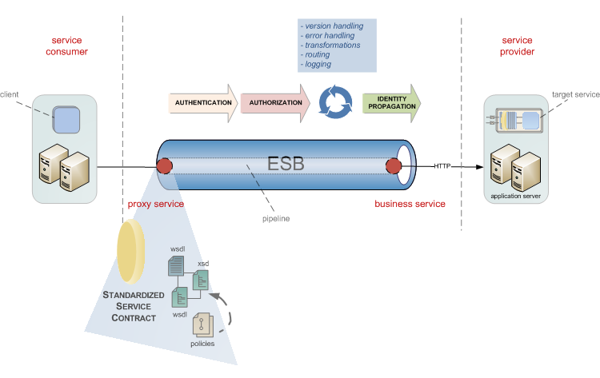
Example: socialsecurity.be portal services
The social security service platform was created in 2009 to support managing business processes in:
Temporal/Permanent employment
Unemployment
Work related risks and insurances
Child benefits
Social assistance and benefits
…
API
WEB

Slide 60



Example: realtime presence registration for construction workers
API
WEB
Notes:
Backend checks of the employment declaration, constructions sites, Limosa, (temporal work permits),
> 500.000 euro
Checkinatwork is de onlinedienst voor de aanwezigheidsregistratie bij werken in onroerende staat en activiteiten die behoren tot de vleessector. Het gaat om de registratie van:
iedereen die werken in onroerende staat uitvoert op een werkplaats waarvan de totale kost gelijk is aan of hoger is dan een specifiek drempelbedrag, en
iedereen die activiteiten uitvoert in verband met vleesbereidingen of vleesproducten en het slachten of uitsnijden van hoefdieren, gevogelte en konijnen in inrichtingen onderworpen aan de erkenning (erkenningen, toelatingen en voorafgaande registraties) van het Federaal Agentschap voor de Veiligheid van de Voedselketen (FAVV).
Via Checkinatwork registreren werkgevers en aannemers de aanwezigheid van hun eigen werknemers, van hun onderaannemers en van hun zelfstandige onderaannemers. De werknemers of zelfstandige onderaannemers kunnen zich ook zelf in het systeem aanmelden.
De registratie moet dagelijks gebeuren, en wel vóór de persoon die de werken uitvoert aan het werk gaat.
De werkplaatsen die vallen onder de verplichte aanwezigheidsregistratie via Checkinatwork moeten aangegeven zijn in de Aangifte van werken.

Slide 61





Example: eHealth-platform
Public Federal institution founded in 2008 for facilitating well-organized, mutual electronic service and information exchange between all actors in health care
The e-Health platform provides
necessary guarantees with regard to
information security, privacy protection
and professional secrecy
API
Connectors Standards
Online Authentic
services sources

Slide 62















eHealth: landscape
Authentic sources

Slide 63
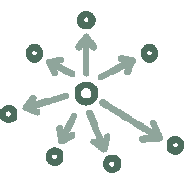



eHealth: technical choices
Decentralization
API
Security
Standardization
Integration
ReUse

Slide 64






eHealth: architecture
Patients, health care providers
and health care institutions
Site Ministry
Software health care professional
Software health care institution
VAS
Site RIZIV
VAS
eHealth-portal
MyCareNet
VAS
VAS
VAS
Users
Basic services
eHealth-platform
Network
AS
AS
AS
AS
AS
AS
Suppliers

Slide 65
eHealth-platform: basic services & API’s
Coordination of the electronic processes
Portal
Integrated user and access management system
Management of loggings
System for end-to-end encryption
eHealthBox
Timestamping
Coding and anonymising
Consultation of National register and CBSS registers
Reference directories (hub-metahub system)

Slide 66












eHealth: some results
Medical history search via SumEHR
Guidelines and advice available online
Medication schedule
Health
advantages
Electronic prescriptions
Consultation of laboratory results
Electronic referral letters

Slide 67





eHealth: some results
Pricing,
billing
Updating the SumEHR, the medication schedule, ...
Adminis- trative
advantages
Creating and sending certificates
Registrations
Sending a report to the GMF holder

Slide 68










eHealth: some results
>86,4%
of Belgian citizens have given
an informed consent for data sharing
+97%
of GPs make use
of eHealth services
620 millions
messages/year
via eHealthBox
Electronic prescriptions
19 millions/month
18.000.000.000
digital transactions
3,9 millions
Belgian patients with
Summary Electronic Health Records in health vaults
29.019
4.800
  215 millions
  electronic documents available
  at hospitals and clinical labs

Slide 69

API in health and social sector: some statistics and evolution
100+ APIs
Most consumers are external (# 20,000-24,000)
Peak load 2000-3000 req / s
1.200M transactions / month
200+ APIs
Consumers mostly internal applications/services (# 200-300)
Peak load 1000-1500 req / s
300M transactions / month
Disclaimer: metrics listed since 2016 are for all ESB + gateway platforms. Migration to Axway APIM in progress since Q3 2018.
(eHealth currently 30% APIs migrated, social security gradually does onboarding on APIM for all new APIs and API evolutions)
Notes:
Need for a rock-solid service platform that meets our SLA requirements and can scale easily, while keeping costs under control

Slide 70
API Challenges
More Top Management Involvement, across Government
  establish A Shared Vision, followed by a Strategy to achieve it
Don’t just ask yourself “What services and data do I need in my project / agency”, also consider “What can I offer the Governmental API Economy for the benefit of all (i.e., both institutions and citizens)”?
Use the power of the network of institutions
Deal with interdependencies
Focus on the essence, not on "bells and whistles"
Deal with the (un)availability of (critical) services
Strive for uniformity of technological solutions / use of site licenses

Slide 71

Platform as a Service (PaaS)
Abstraction of the underlying platform for developers
High automation degree (‘zero touch deployment’)
Higher productivity
DevOps way of working
Micro services

Slide 72










PaaS in G-Cloud - Containers
Introducing container technology
Translated into modern technology such as Platform-as-a-Service
Individuele
inhoud
Easy to move around
Individual content
Isolated storage
Geïsoleerd opgeslagen
En makkelijk verplaatsbaar
Monitoring
Security
Logging
Coming
soon

Slide 73



New ways of cooperation
Government ecosystem
Other sectors
Components
parts
Application
1
Application
2
Application
N
Partner
1
Partner
2
Partner
N
Platform
cooperation
DB
DB
Technological cooperation
DB
DB
DB

Slide 74

Open government services
Building mutual trust
Through specific cooperation
With consistent delivery, results and ROI
Examples
  digital user management
  eBox citizen & eBox enterprise
  eHealth platform

Slide 75

Example: eHealth platform
Government (eHealth platform)
  develop vision & strategy regarding eHealth
  organize cooperation & drive change
  establish functional & technical norms, standards, specifications, IT reference architecture
  certify software for electronic health records management to several health care actors
  design, elaborate and manage a common platform for secure digital data exchange & related basic services
  agree upon governance, quality standards and compliance
  promote and coordinate the creation of programmes & projects
Private sector
  develop & offer electronic health records management software in the health care sector

Slide 76

Example: recognition of electronic identification services
Royal Decree establishing the conditions, procedures and consequences of the recognition of electronic identification services for government applications was signed October 22th, 2017
Some provisions
  conditions and procedures for recognition of private providers of electronic identification services for inclusion in the FAS for access to government applications
  severe criteria: liability of the service provider, security, privacy protection
  recognition for anyone who meets the conditions
  technical integration with FAS standard protocols and European standards
  innovation support and cost control
  identifications means are not determined
  (mobile, biometrics, …)

Slide 77
Some ICT trends
Public Cloud
API Economy
Re-use

Slide 78


Rise of (public) cloud
Amazon vs Microsoft vs Google
&

Slide 79
Rise of (public) cloud
Need for overall government positioning
  eGov public cloud policy
  based on information classification
  appropriate organizational, technical & contractual measures
  hybrid approach
G-Cloud as broker
  knowledge & expertise on cloud offerings
  contracts & implementation partners
  tools

Slide 80
Public cloud - main issues
Longitudinal confidentiality of personal data
  need for comprehensive longitudinal encryption of personal data
  in motion, at rest and in use
Performant continuous availability of application and data
Easy migration of applications and data
Compliance with GDPR / Schrems II

Slide 81
Some ICT trends
Public Cloud
API Economy
Blockchain
Re-use

Slide 82




Blockchain is about organizing trust
Blockchain Network
Registration of facts
Transfer of assets
Enforcement of rules

Slide 83











Registration of facts
(Official)
documents
Driving license
Marriage
Diploma
Identity
Will
History/
Overview
Medical
records
Vaccination
Supply chain
Tracking
Taxes
Political
mandates
5f 3b fa 41 9c 63 be 2a 3a 09 ad bd 06 30 c5 1f
64 5e b0 3a ba fc d5 f2 ad 39 63 7a 30 6b 41 77
Will

Slide 84









Transfer of assets
Crypto currencies
(Virtuele assets)
Bitcoin
Monero
Ethereum
.bit
Untangible
assets
Tickets
Domain names
Electricity
Copyright
Tangible
assets
Land registry
Cars
Diamonds

Slide 85











Enforcements of agreements
Permissions
access PII
Flight Delay
Insurance
Auction
Transport
conditions
Processing
medical prescriptions
Elections
Smart locks
Application & Payment
of subsidies / benefits
Blocking
rent guarantee
Crowdfunding
Agreements between parties that do not trust each other,
without trusted intermediary

Slide 86



Integration
Blockchain ≠ a complete business solution, but a component of a larger system
Blockchain ≠ start from scratch (fortunately) => reuse of existing components
“CIOs should view the blockchain portion to be less than 5% of the total project development effort.”

Slide 87







Technological trends
Blockchain isn't the only trend
Multiple technologies combined offer new perspectives and are able to transform the business
Event-driven architecture
API economy
Microservices
Cloud
Containers
(Re)use can lead to fast(er) results

Slide 88




Blockchain as a Service (BaaS)
Setting up a simple blockchain infrastructure can be very complicated
Several cloud providers offer the possibility to set up a blockchain network in their cloud environment
Advantages
The infrastructure’s complexity is hidden
Focus on the applicative part
Faster and cheaper
More security
Disadvantages
Dependence BaaS provider
“We do not trust each other, but we do trust the BaaS provider”
Blockchain technology-specific
Recent development
In the long run government BaaS might be the best option

Slide 89




Future blockchain landscape
Community BaaS
Public BaaS
BaaS
Provider
BaaS
Provider
A
BaaS
Provider
B
BaaS
Provider
C
Own infrastructure
Private
BaaS

Slide 90









Concrete - ideas federal government
Therapeutic relations
Generic traceability service
History cadastre & major works to the home
Identity management
Registration & access management medical data
Tracing food for food safety & sustainability
Government transparency
Cross-border data exchange: who pays social security contributions where?
Prevention/Detection of double or unjustified payments
Tender-calling procedure

Slide 91
Some ICT trends
Public Cloud
API Economy
Blockchain
Re-use
Big data analytics

Slide 92
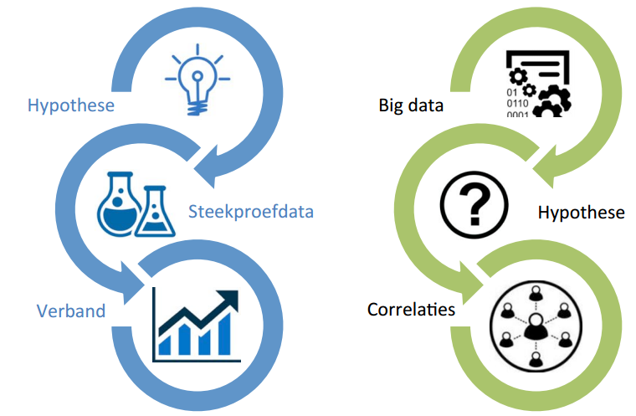
Big data analytics
Variety, velocity, volume, veracity

Slide 93
Big data analytics
Domain | Description
Research | - Phenomenon analysis - (Big) data exploration - Trend analysis
Fraud detection | - Data mining, machine learning, AI - Predictive analytics, predictive modelling
Process support | - Data visualization - Network visualization - Automated searches, calculations, real-time applications of predictive analytics
Policy support | - Reporting, KPI, balanced scorecard - Evaluation of the success measures have - Simulations
Infrastructure management | - Capacity planning - Predictive maintenance
Data protection | - Security Information & Event Management (SIEM)
…

Slide 94
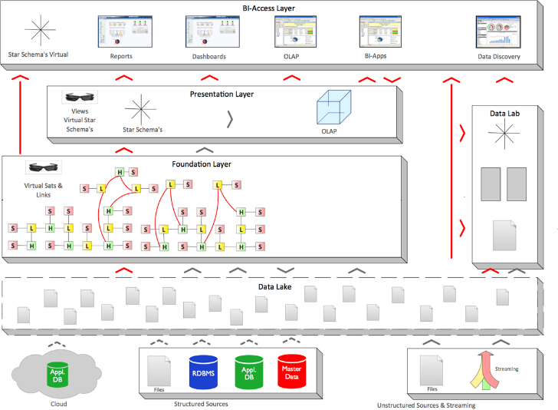

Big data analytics - architecture
BDAP
front-end
All forms of analytical and business value generating re-use of data
BDAP
front-end
Data Mining
AI
Big Data Analytics Platform (Foundation)
Delivers “Bring compute to the data” paradigm:
calculations from front-end tools are pushed to the foundation
Data Integration
Data Warehousing
(ETL—ELT—TEL)
Information Management
Business Glossary
Data Management
Data Quality
Data Governance
Data Protection
Enterprise-ready
Big Data Management solution
(Hadoop, NoSQL)
Relational
Analytical Database
Management System (accelerator)
Computing Power
Connectors
Structured Sources
Unstructured Sources & Streaming
Notes:
BDAP Foundation: sometimes called “Data Lake”, but in this context it’s a Data Lake++ with governance

Slide 95
Some ICT trends
Public Cloud
API Economy
Artificial Intelligence
Blockchain
Re-use
Big data analytics

Slide 96
What is Artificial Intelligence (AI) ?
An area of computer science concerned with the creation of machines that can reproduce human cognitive functions such as reasoning, planning, learning, language understanding, vision,…
Weak or narrow AI
  simulates intelligence
  is limited to specific areas
  all current implementations of AI are narrow AI
Strong or general AI
  still debated, includes philosophical considerations such as consciousness, intentionality, …
  has real intelligence
  has mental states and beliefs like humans
  holy grail !

Slide 97
Short history
Boom of AI
Rise of Expert Systems
Deep Blue
IBM’s … beats champion chess player Kasparov
Many AI successes
- Personal assistants e.g.Siri, Cortana…
- Semi-autonomous driving assistance systems
- Netflix recommender system
Birth of AI
John McCarthy coined the term Artificial Intelligence
The Dendral Program
Knowledge-based system
1950
1964
1980
1993
2000
1956
1969
1987
1997
The Turing Test
Can we distinguish intelligent behaviour from human behaviour?
First Chatbot (ELIZA)
First attempt to pass the Turing Test
1st AI winter
Less results, less funding
2nd AI winter
Expert systems are expensive to maintain and update
Big Data, Deep Learning and beyond
Availability of huge datasets
Increased computational power
Notes:
1950 - The Turing test: Alan Turing introduces in his article « Computing Machinery ad Intelligence » concepts as machine learning, genetic algorithms and reinforcement learning
1956 – Birth of AI: workshop organised by John McCarthy at Darmouth College around the question how to make machine use language, forms abstraction and concepts to solve problems reserved to humans
Dendral Program: knowledge-based systems use build in domain-specific knowledge to reason and solve problems in narrow areas of expertise

Slide 98
Concepts
Artificial Intelligence
Machine learning
Neuron based
Good Old-Fashioned AI: path finding, constraint satisfaction problems, planning, rule-based systems, expert systems, …
Decision trees, clustering, …
“Hot”
Random forests,
support vector machines, …
Data Mining
Deep learning (CNN, RNN, GAN)
Reinforcement learning
Deep reinforcement learning
Notes:
CNN: Convolution Neural Network (image, text)
RNN: Recurrent Neural Network (sequences, text, language)
GAN: Generative Adversarial Networks (https://deeplearning4j.org/generative-adversarial-network)

Slide 99
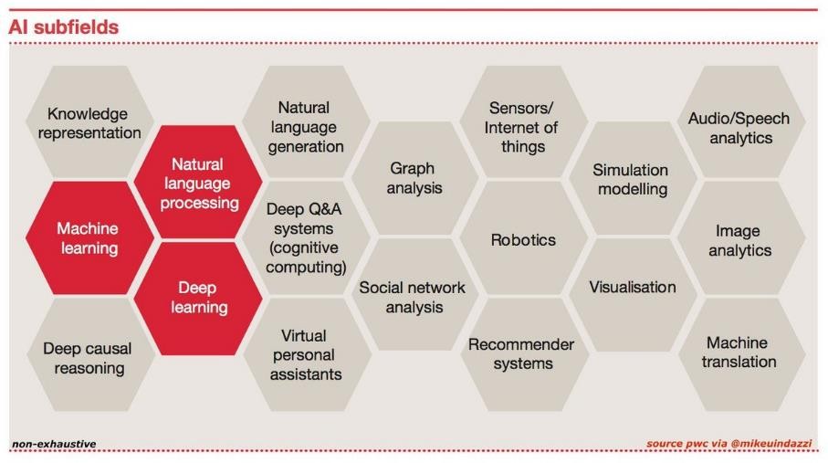
AI domains

Slide 100


Natural Language Processing (NLP)
Processing of natural language in order to communicate with humans and extract information from written texts
Some applications of NLP are:
  machine translation
  text classification
  information extraction
  speech recognition:
    Google Assistant/Home
    Siri
    Alexa
    Cortana
    ….

Slide 101
Machine learning
Design of algorithms that automatically learn from example data with no or minimal need for human intervention
At the intersection of computer science and statistics
Advantages
  no need to code explicitly all possible situations the machine will have to deal with, the machine adapts to change in conditions or unseen situations
  can learn a solution to a problem by itself where it would be hard for a human to explicitly instruct the machine
Notes:
Machine Learning uses Data Mining techniques and other learning algorithms to build models of what is happening behind some data so that it can predict future outcomes. A computer program is said to learn some task from experience if its performance at the task improves with experience, according to some performance measure. Machine learning involves the study of algorithms that can extract information automatically (i.e., without on-line human guidance). Most tasks that require intelligence require an ability to induce new knowledge from experiences. Thus machine learning is a large area within AI.

Slide 102
Machine learning approaches
Supervised learning
learns from examples of pairs of input-output
feedback from a ‘teacher’ which provides the correct answer for example inputs
Unsupervised learning
no feedback from a ‘teacher’
learns patterns in the input
Reinforcement learning
very efficient for complex problems in unknown environment
no feedback from a ‘teacher’
particularly used in Robotics (film robot)
receives a reward if successful at executing a task or punishment otherwise
most common approach
used mainly for clustering
eg chatbot
Notes:
Source: « Artificial Intelligence: A moder approach » Russel, Norvig

Slide 103
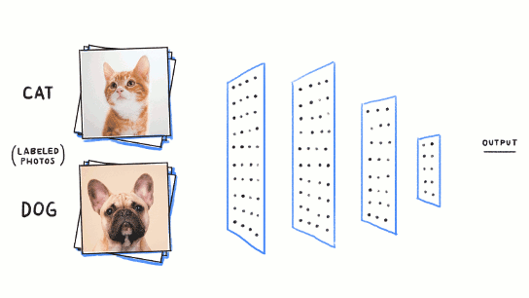
Neuron based machine learning
Initially built to mimic the brain, thousands of interconnected computing units or neurons
Neurons represent patterns
More neurons → richer and deeper insights

Slide 104
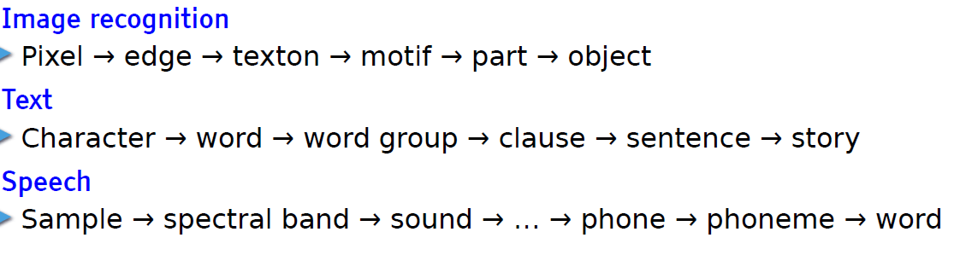
Deep learning
= deep neural network
  neurons or units are organised on more than one layer hence the word « deep»
State of the art: achieves outstanding performance in areas such as speech recognition
Learn hierarchical representations
Leçon inaugurale au Collège de France, Yann LeCun, 04 avril 2016

Slide 105
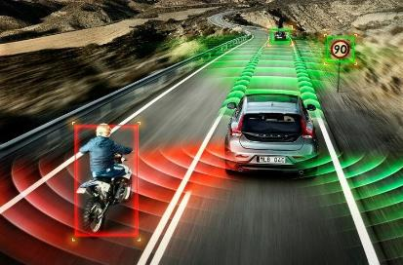
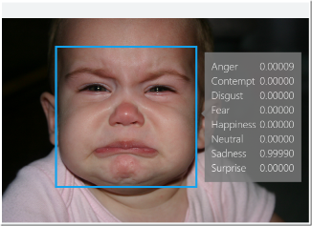
AI applications
Automotive:
  self-driving/-flying robots
Finance and economics:
  automatic trading
  fraud detection
Video games
  non-playable characters
  VR world generation
Communication & social media
  spam filters
  smart email categorization
  face recognition
  speech recognition
Human resources
  resume screening
  recruiting chatbots

Slide 106
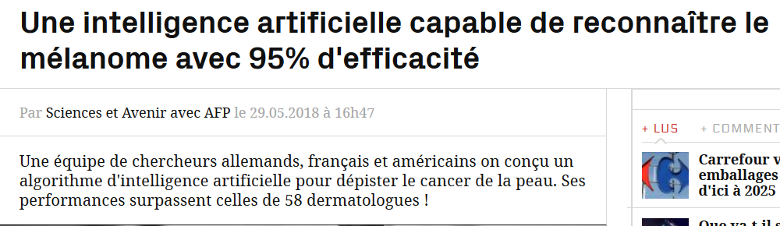
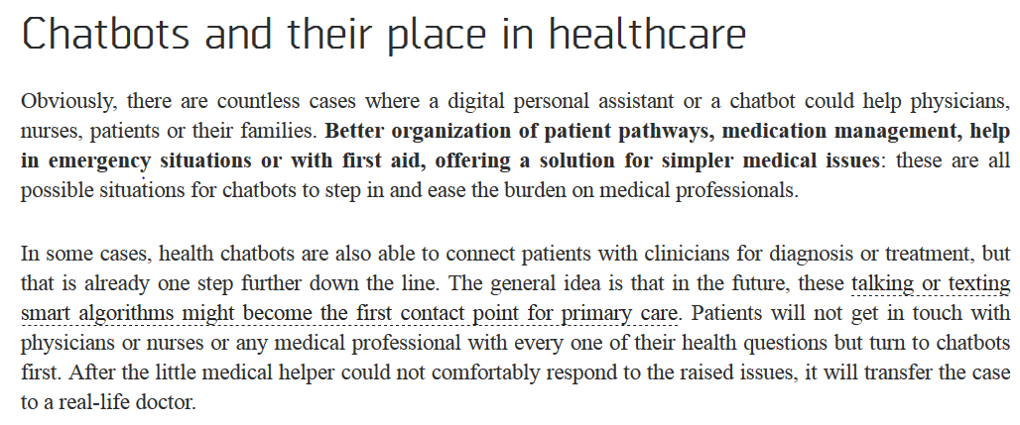
AI applications – healthcare
Notes:
Detection cancer de la peau: Utilisation des réseaux neuronaux convolutifs; 95% d’efficacité pour l’ AI contre 89% pour les dermatologues
Source chatbots and their place in healthcare: http://medicalfuturist.com/top-12-health-chatbots/

Slide 107
AI applications - public sector
Where does it apply?
  when there are lot of administrative and repetitive tasks
  where the workload is too important for the available resources
  for large and complex datasets to analyse
Potential use cases
  understanding and answering citizen questions
  search documents
  document classification
  translation
  legal service: find related case laws
  fraud detection / anomaly detection
  case management / process management
  next best action
  decision support

Slide 108
Points of attention
Where does it apply?
  when there are lot of administrative and repetitive tasks
  where the workload is too important for the available resources
  for large and complex datasets to analyse
Potential use cases
  understanding and answering citizen questions
  search documents
  document classification
  translation
  legal service: find related case laws
  fraud detection / anomaly detection
  case management / process management
  next best action
  decision support
Notes:
Black box versus white box: humans have no insight in the reasoning and the steps the machine has taken to give a particular output
Bias in AI: Bias is introduced when the data are not enough representative. Ex: In 2015, a google app tagged two black people as gorillas because it wasn’t trained with enough dark skinned people.

Slide 109
Cloud & data confidentiality
Big cloud vendors
  lots of support for AI
  innovative solutions
  easy to get started very quickly
  web based tools
  pre-trained AI models
  even specialized hardware (GPU)
But... in a government context, we must pay attention to
data confidentiality
?
AI-platform

Slide 110
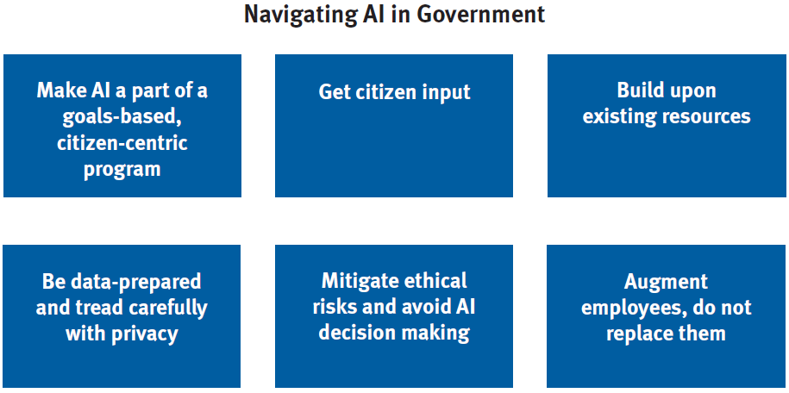
Guidelines for AI in the public sector
Artificial Intelligence for Citizen Services and Government, Ash Center for Democratic Governance and Innovation, Hila Mehr, August 2017
Notes:
Make AI a part of goals-based program: AI should not be implemented just because it is new, it should be the right tool for the problem it solves. citizen’s end-to-end
Journey.
Get citizen input: offer sessions for citizens to create an agenda for AI while addressing any potential concerns, educate everyone from citizens to policymakers so that they truly understand how it works and its tradeoffs.”
Build upon existing resources: do not build the systems from scratch, make use from open-source machine intelligence programs, integrating AI into existing platforms where there is existing data
Be data-prepared, and tread carefully with privacy: significant amount of data avalaible for training, good data management
Mitigate ethical risks and avoid AI decision making: AI is susceptible to bias, AI should only be used for analysis and process improvement
Augment employees, do not replace them: early research has found that AI works best in collaboration with humans

Slide 111

Ethical AI principles
Moral machines
Well-being
Autonomy
Privacy
Knowledge
Democracy
Responsi-bility
Justice
  https://www.montrealdeclaration-responsibleai.com/the-declaration

Slide 112
Some ICT trends
Public Cloud
API Economy
Artificial Intelligence
Blockchain
Re-use
Conver-sational Interfaces
Big data analytics

Slide 113
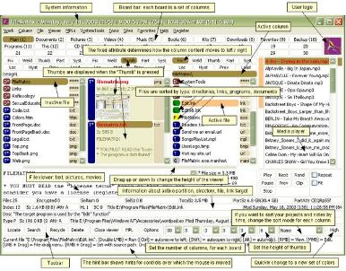
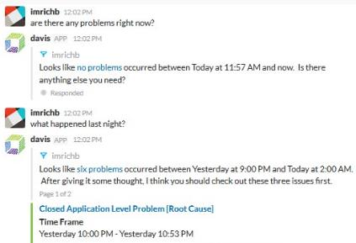
Conversational interfaces
A conversational interface is a user interface which allows interacting with the computer based on conversations in natural language (text or speech)
Lowers the threshold: users do not have to learn how to work with the (graphical) interface
versus

Slide 114
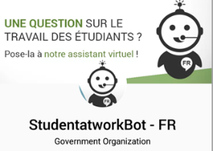
Conversational interfaces
Use of AI – technologies
On-premise <-> cloud
Rapid pace of innovation / improvements

Slide 115
Some ICT trends
Public Cloud
API economy
Artificial Intelligence
Blockchain
…
Reuse
Conversational interfaces
Big data analytics

Slide 116

G-Cloud = opportunities
Design by public sector with help from private sector
Built in cooperation with private sector
Run
  without heavy investment
  in a safe and familiar environment
  scalable
  easy to adjust
Concepts and components reusable outside the public sector
Drive/support innovation

Slide 117
PPP and concession as intended in ESA
Should the Oosterweel project be included in the national budget or not ? ESA (European System of Accounts) rules apply
Both PPP (government bearing the largest part of the costs through compensations) or concessions (government pays no or only limited compensations) can be used for ICT related project funding
Under correct (utterly strict) conditions, no impact or spread impact on the public budget
Traditionally used for buildings or large infrastructure works, but can also be used for projects using ICT

Slide 118

PPP and concession as intended in ESA
Mileage-based charges for lorries is a PPP project
DBFMO (Design, Build, Finance, Maintain and Operate) contract awarded to NV Satellic

Slide 119

PPP and concession as intended in ESA
Concession: distribution of debt collection missions to bailiffs
Government only creates XML messages
Concessionaire distributes to bailiffs and handles feedback about the evolution of the cases
Works for multiple governments
Each bailiff can participate

Slide 120

What about a platform economy ?
We are living in a platform economy:
eBay, Amazon
YouTube
Google, Baidu
Paypal, Alipay
iOS, Android
Airbnb, TripAdvisor
Uber
Linkedin, Glassdoor
Notes:
Glassdoor is a website where employees and former employees anonymously review companies and their management.^{[2]}
The site later also began focusing on CEOs and workplaces, as well as what it is like to work at jobs in general.^{[9]} Employee reviews are averaged for each company.^{[10]} Glassdoor ratings are based on user-generated reviews. Each year Glassdoor ranks overall company ratings to determine its annual Employees’ Choice Awards, also known as the Best Places to Work Awards.^{[11]}
Glassdoor heeft zich hierdoor ontwikkeld als een belangrijke website voor rekruteringen.
=>Baidu, Inc. (Chinese: 百度; pinyin: Bǎidù, anglicized /ˈbaɪduː/ "by-doo"), incorporated on January 18, 2000, is a Chinese web services company headquartered at the Baidu Campus in Beijing's Haidian District.^{[6]} It is one of the largest Internet companies in the world.
Baidu offers many services, including a Chinese search engine for websites, audio files and images. Baidu offers 57 search and community services including Baidu Baike (an online, collaboratively built encyclopedia) and a searchable, keyword-based discussion forum.^{[7]}Baidu was established in 2000 by Robin Li and Eric Xu.
Alipay.com is a third-party online payment platform. It was launched in China in 2004 byAlibaba Group and its founder Jack Ma. According to an analyst research report, Alipay had the biggest market share in China with 400 million users and control of just under half of China's online payment market in October 2016.

Slide 121
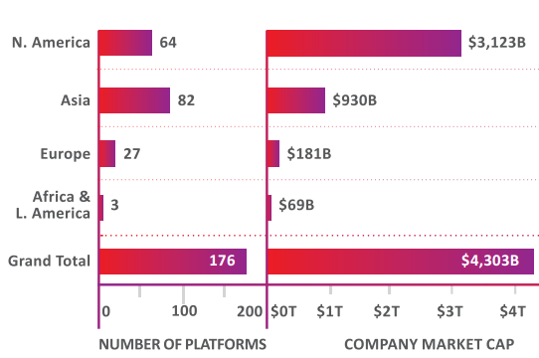
What about a platform economy ?
"A platform is a business that creates value by facilitating direct interactions between two or more distinct types of customers"*
Total value of platform companies >4,000 billion €
Europe < 5%
*
* Andrei Hagiu & Julian Wright – Multi-sided platforms

Slide 122
Creation of a geographic niche ?
Can we set up a platform based on the creation of a geographic niche ?
Combine & integrate elements already present or in preparation:
  eID and strong mobile authentication
  well integrated and innovative digital payments
  eBox citizens and enterprises
  strong authentic sources
  one single gateway to private interactions, purchases and transactions with the government
Trust in local actors & local enforcement
User centricity: focus on what local users prefer
Advantages for citizens, enterprises and authorities
Time for a systematic cooperation or PPP culture ?

Slide 123
Wrap up
Shift from basic ICT services -> value added (business) services
Focus on re-use
Rise of new technologies
  need for common solutions
  platform-approach
Innovative means of collaboration with private sector needed

Slide 124
Smals vzw asbl Smals
(2004- )

Slide 125
Doelstellingen – Objectifs
Voir l’article 3 des Statuts sur https://www.smals.be/fr/content/statuts
  l’asbl Smals se fixe comme objectif de soutenir ses membres en matière de gestion de l’information et questions connexes en faveur d’une prestation de services informatiques intégrée
  elle agit ici en association de frais à laquelle des missions peuvent être directement confiées en « internalisation » […]
Fondée en 1939 en tant qu’association pour des services partagés en matière de gestion de l'information par les institutions de sécurité sociale belges
Les institutions membres choisissent librement si elles souhaitent avoir recours aux services de Smals (pas de monopole)
Pour plus d’informations voir https://www.smals.be/fr/content/mission-structure-organisationnelle-et-fonctionnement-de-lasbl-smals
Zie artikel 3 van de Statuten op https://www.smals.be/nl/content/statuten
  de vzw Smals stelt zich tot doel haar leden te ondersteunen op het vlak van informatiebeheer en aanverwante materies ter bevordering van een geïntegreerde ICT- dienstverlening
  ze functioneert daarbij als een kostendelende vereniging waaraan opdrachten als inbesteding rechtstreeks kunnen worden toevertrouwd […]
Opgericht in 1939 als vereniging voor shared services op het vlak van informatiebeheer door de Belgische instellingen van sociale zekerheid
De lidinstellingen kiezen vrij of ze al dan niet een beroep wensen te doen op de diensten van Smals (geen monopolie)
Voor meer informatie zie https://www.smals.be/nl/content/missie-organisatiestructuur-en-werking-van-smals-vzw

Slide 126
Wettelijk kader – Cadre légal
Code des sociétés et des associations
Article 17bis de la loi BCSS (pour l’autorisation d’association des instances publiques, pour la forme d’asbl obligatoire, pour le principe du partage des coûts, pour l’autorisation légale du détachement de personnel spécialisé, …)
Article 30 de la loi sur les marchés publics (pour la possibilité d’attribution direct des marchés par les membres à l’asbl, ‘inhouse’)
Article 2, 1°, c) de la loi sur les marchés publics (pour la soumission de Smals à la loi sur les marchés publics)
Wetboek van vennootschappen en verenigingen
Artikel 17bis KSZ-wet (voor de machtiging tot vereniging van openbare instellingen, voor de verplichte vzw-vorm, voor het principe van de kostendeling, voor de wettelijke toelating tot detachering van gespecialiseerd personeel, …)
Artikel 30 Overheidsopdrachtenwet (voor de mogelijkheid van rechtstreekse toewijzing van opdrachten door de leden aan de vzw, ‘inhouse’)
Artikel 2, 1°, c) Overheidsopdrachtenwet (voor de onderworpenheid van Smals aan de overheidsopdrachtenwet)

Slide 127
Organen – Organes
Algemene vergadering
  alle 309 leden
  3 categorieën met degressief stemrecht in functie van belang/bijdrage, grosso modo
    A: OISZ
    B: FOD’s & gefedereerde entiteiten
    C: OCMW’s
Bestuursorgaan
  20 bestuurders, waarvan voordracht door
    leden van categorie A, B en C: resp 11, 2 en 1 bestuurders
    Algemene Vergadering als geheel: 4 bestuurders
    Minister van Sociale Zaken: 1 bestuurder
    Minister van Begroting: 1 bestuurder
Auditcomité, dat rapporteert aan het Bestuursorgaan
  6 bestuurders
  3 externe leden
Strategisch comité
  11 bestuurders
  Directiecomité
Assemblée générale
  les 309 membres
  3 catégories avec droit de vote dégressif en fonction de l’importance/contribution, grosso modo
    A: IPSS
    B: SPFs et entités fédérées
    C: CPAS
Organe d’administration
  20 membres, dont la proposition est faite par
    membres catégories A, B et C: resp 11, 2 et 1 administrateurs
    Assemblée générale dans son ensemble: 1 administrateur
    Ministre des Affaires sociales: 1 administrateur
    Ministre du Budget: 1 administrateur
Comité d’audit, rapportant à l’Organe d’administration
  6 administrateurs
  3 membres externes
Comité stratégique
  11 administrateurs
  Comité de direction

Slide 128
Controle - Contrôle
Les membres (essence du ‘in house’)
  directement via l’Assemblée générale (nomination des administrateurs, budget, prix, comptes, …)
  indirectement via l’Organe d’Administration
  sont eux-mêmes des institutions publiques avec Commissaire du Gouvernement ou des services publics sous l’autorité d’un ministre
Les 2 ministres (via les administrateurs proposés)
Commissaire (réviseur d’entreprise)
Procédures internes, e.a.
  service d’audit interne
  gestion des risques
  objectifs stratégiques
La Cour des comptes
  collaboration structurelle sur le plan financier et enquêtes thématiques, pe. marchés publics dans le Livre 2016 sur la Sécurité sociale
De leden (essentie van ‘inhouse’)
  rechtstreeks via de Algemene Vergadering (benoeming bestuurders, begroting, kostprijzen, rekeningen, …)
  onrechtstreeks via het Bestuursorgaan
  zijn zelf openbare instellingen met Regeringscommissaris of overheidsdiensten onder de bevoegdheid van een minister
De 2 ministers (via voorgedragen bestuurders)
Commissaris (bedrijfsrevisor)
Interne procedures, o.a.
  interne auditdienst
  risicobeheer
  strategische objectieven
Het Rekenhof
  structurele samenwerking op financieel vlak en thematische onderzoeken, bv. overheidsopdrachten in Boek 2016 over de Sociale Zekerheid

Slide 129
Enkele behaalde resultaten – Quelques résultats atteints
Le partage des coûts facilite la coopération entre les institutions publiques (data centers, portails, gestion des utilisateurs, monitoring 24/7 des services, ...).
Permet des économies d’échelle
Contribue de manière significative à la réutilisation de logiciels et au G-Cloud
Offre aux institutions une expertise difficile à trouver en matière de TIC et de sécurité de l'information
Offre une expertise dans les procédures de marchés publics liés aux TIC, facilitant l'accès des prestataires de services TIC privés au secteur public
Stimule l'innovation grâce à une petite section R&D (voir https://www.smalsresearch.be/)
De kostendeling vergemakkelijkt de samenwerking tussen de openbare instellingen (datacenters, portalen, gebruikersbeheer, 24/7 monitoring van diensten, ...).
Levert schaalvoordelen op
Draagt aanzienlijk bij tot hergebruik van software en de G-Cloud
Biedt de instellingen een moeilijk te vinden expertise op het vlak van ICT en informatieveiligheid
Biedt expertise aan op het vlak van ICT-overheidsopdrachten, waarbij de toegang van private ICT-dienstverleners tot de openbare sector vergemakkelijkt wordt
Stimuleert innovatie dankzij kleine R&D-afdeling (zie https://www.smalsresearch.be/)

Slide 130
Enkele behaalde resultaten – Quelques résultats atteints
RB
Evolutie van de prijzen op langere termijn tov index van de lonen
Op een periode van 10 jaar zijn de eenheidsprijzen 16,40 % gedaald tov de evolutie van de index van de lonen omwille van schaalvoordelen en zuinig beheer

Slide 131
Enkele behaalde resultaten – Quelques résultats atteints
Réutilisation le logiciels développés
  software déjà payé par un membre est gratuitement utilisé pour les autres membres
  à prouvé son utilité durant la crise COVID-19
  2020: ROI = 46%, concrètement plus de € 13 mio
  2020: sur 27 projets, 64% des nouvelles fonctionnalités réalisées grâce à la réutilisation
  l’investissement est souvent déjà rentable dès la première réutilisation
  voir https://reuse.smals.be/language-selection
Avantages d’échelle pour hardware et plate-formes
  83 institutions publiques
    dont 41 organisations fédérales
  nombre de services : 23
  voir les slides consacrés au G-Cloud
Hergebruik van ontwikkelde software
  software die reeds betaald is door een lid wordt gratis ingezet voor andere leden
  bewees nut tijdens COVID-19 crisis
  2020: ROI = 46%, concreet meer dan € 13 mio
  2020: op 27 projecten werd 64% van de nieuwe functionaliteit gerealiseerd dankzij hergebruik
  investering vaak al rendabel vanaf eerste hergebruik
  zie https://reuse.smals.be/language-selection
Schaalvoordelen inzake hardware en platformen
  83 overheidsinstellingen
    waarvan 41 federale organisaties
  aantal diensten: 23
  zie slides over G-Cloud

Slide 132
Enkele behaalde resultaten – Quelques résultats atteints
Méthodologie pour le développement de nouveaux services
  Smals a recours à des standards de gestion de projets modernes et avancés, telles Prince2, méthodologies agiles, …
  ceci permet un suivi professionnel des projets qui garantit les divers aspects fondamentaux, à savoir
    planning
    budget
    qualité
    scope (valeur ajoutée métier)
  tous les aspects importants sont pris en compte, notamment sécurité de l’information, stabilité, protection de la vie privée, réutilisation, réduction maximale des coûts opérationnels, ...
Methodologie voor ontwikkeling van nieuwe diensten
  Smals maakt gebruik van moderne project management standaarden die “state-of-the-art” zijn, zoals Prince2, agile methodologieën, …
  dit zorgt voor een professionele opvolging van de projecten door de verschillende fundamentele aspecten te borgen, zijnde
    planning
    budget
    kwaliteit
    scope (business toegevoegde waarde)
  alle belangrijke dimensies worden meegenomen o.a. informatieveiligheid, stabiliteit, privacy, reuse, minimalisering operationele kosten, …

Slide 133
Enkele behaalde resultaten – Quelques résultats atteints

Slide 134
Enkele behaalde resultaten – Quelques résultats atteints
Méthodologie de service management
  ITIL® - IT Infrastructure Library - est la méthodologie la plus courante pour la gestion de services ICT. ITIL® aide les organisations à gérer leurs services électroniques de manière qualitative et économique, en focalisant sur l’utilisateur final
  l’idée centrale d' ITIL® est que
    les services ICT doivent être axés sur les besoins des clients
    le fournisseur et le client s’accordent sur les KPI de la prestation de services en termes de disponibilité, performance, maintenance planifiée, ...
  ceci va de pair avec des processus effectifs, efficaces et clairement définis au sein de l’organisation ICT afin d'atteindre ces KPI
Methodologie voor service management
  ITIL® - the IT Infrastructure Library - is de meeste gebruikte methodologie om ICT-diensten te beheren. ITIL® helpt organisaties om hun elektronische diensten te beheren op een kwaliteitsgerichte en economische wijze waarbij de eindgebruiker centraal staat
  het kernidee achter ITIL® is
    ICT-diensten moeten gericht zijn op de klantenbehoeften
    leverancier en klant komen expliciet overeen welke de KPI’s van de dienstverlening moeten zijn bv. inzake beschikbaarheid, performantie, gepland onderhoud, …
  dit gaat gepaard met effectieve, efficiënte en duidelijk gedefinieerde processen binnen de ICT-organisatie teneinde deze KPI’s te bereiken

Slide 135
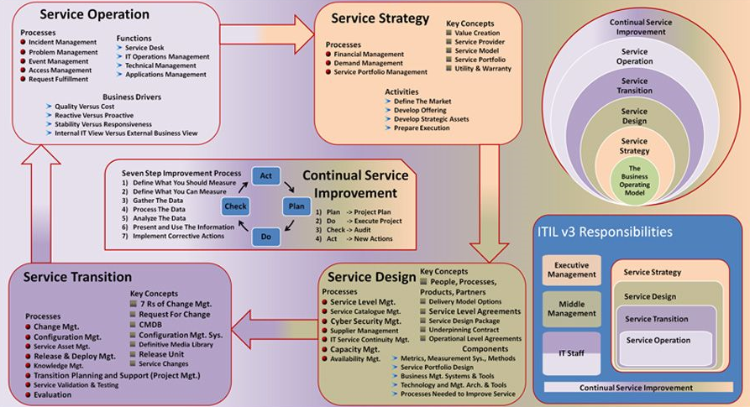
Enkele behaalde resultaten – Quelques résultats atteints

Slide 136
Enkele behaalde resultaten – Quelques résultats atteints
Attention portée à la responsabilité sociétale de l’entreprise
  22 nationalités différentes
  plus de 1/6 des spécialistes TIC et presque 50% de nos administrateurs sont des femmes
  88,7% de tous les collaborateurs se déplacent en transports en commun, à pied ou à velo
  recyclage durable du matériel informatique via Out Of Use au profit de Natuurpunt et de Natagora
  data centers durables grâce à des systèmes de refroidissement innovants
Aandacht voor maatschappelijk verantwoord ondernemen
  22 verschillende nationaliteiten
  meer dan 1/6 ICT-specialisten en bijna 50% van onze bestuurders is vrouwelijk
  88,7% van alle medewerkers komt met het openbaar vervoer, te voet of met de fiets
  duurzaam recycleren van ICT-materiaal met Out of Use ten voordele van Natuurpunt en Natagora
  duurzame datacenters via innovatieve koelsystemen

Slide 137
Transparantie - Transparence
Sur www.smals.be Smals fournit des informations détaillées sur son organisation, ses membres, les consultations de marché, ...
Le rapport d’activité donne de plus amples informations sur les services et projets réalisés pour les membres
Les travaux réalisés pour les membres sont précisés dans des modalités spéciales de collaboration avec indication du budget et du niveau de service
Les comptes annuels de Smals sont publiés auprès de la Centrale des bilans de la BNB
Op www.smals.be geeft Smals uitgebreide informatie inzake haar organisatie, leden, marktconsultaties, …
Het activiteitenverslag geeft meer gedetailleerde informatie over de diensten en projecten uitgevoerd voor de leden
De werkzaamheden uitgevoerd voor de leden zijn gedetailleerd in bijzondere samenwerkings-modaliteiten met aanduiding van budget en serviceniveau
De jaarrekeningen van Smals worden gepubliceerd bij de balanscentrale van de NBB

Slide 138
Gegevensbescherming – Protection de données
L’asbl Smals dispose d'un service de sécurité de l’information spécialisé agréé
  soutien des membres en matière de sécurité de l’information et de protection des données
  fonction interne de conseil, de stimulation, de documentation et de contrôle interne
La sécurité de l’information et la protection des données sont ancrées dans la méthodologie de développement de nouveaux services électroniques
Avant de développer un nouveau traitement ou d’adapter en profondeur un traitement existant
  un contrôle de base est effectué sur la base d'une check-list afin de vérifier si une analyse d’impact relative à la protection des données (AIPD) est nécessaire
  un ‘dossier unique’ est toujours constitué et, au besoin, soumis au Comité de sécurité de l’information; ce ‘dossier unique’ indique l’objectif du traitement, les types de données traitées concernant quels types de personnes, comment les données sont protégées, qui participe au traitement et la base juridique du traitement
Smals vzw beschikt over een erkende gespecialiseerde informatieveiligheidsdienst
  ondersteuning van de leden inzake informatieveiligheid en gegevensbescherming
  interne adviserende, stimulerende, documenterende en intern controlerende functie
Informatieveiligheid en gegevensbescherming zijn ingebed in de methodologie voor de ontwikkeling van nieuwe elektronische diensten
Vooraleer een nieuwe verwerking ontwikkeld wordt of een bestaande verwerking grondig aangepast wordt
  wordt een basisscreening uitgevoerd op basis van een checklist om na te gaan of een Gegevensbeschermings-effectbeoordeling (GEB) nodig is
  steeds een ‘uniek dossier’ opgesteld en, zo nodig, voorgelegd aan het Informatieveiligheidscomité; dit ‘uniek dossier’ geeft aan wat de doelstelling is van de verwerking, welke soorten gegevens verwerkt worden over welke soorten personen, hoe deze beveiligd worden, wie deelneemt aan de verwerking en wat de rechtsgrond ervan is

Slide 139
GEB – AIPD – DPIA
Une méthode standardisée est utilisée pour l’exécution de l’analyse d'impact relative à la protection des données (AIPD) chaque fois que celle-ci est requise conformément au Règlement général sur la protection des données
  lorsqu'une AIPD est nécessaire, une analyse des risques du traitement est établie
    check-list ouverte des risques possibles
    évaluation de la probabilité de survenance du risque et de l’impact lorsqu’il se produit
    en concertation avec les intéressés
  les mesures visant à éviter le risque ou, lorsqu’il se produit, à en limiter les conséquences sont déterminées
  les risques résiduels sont évalués
  si les risques résiduels sont acceptables, l’AIPD est terminée; si les risques résiduels sont élevés, un avis préalable de l’APD est nécessaire
  l’AIPD est actualisée au moins tous les 3 ans, afin de tenir compte de l’évolution technologique et des éventuels nouveaux risques
Een gestandaardiseerde methode wordt gebruikt voor de uitvoering van een Gegevens-beschermingseffectbeoordeling (GEB) telkens wanneer die overeenkomstig de Algemene Verordening Gegevensbescherming nodig is
  indien een GEB nodig is, wordt een risicoanalyse opgemaakt van de verwerking
    open checklist van mogelijke risico’s
    inschatting kans dat risico zich voordoet en impact als het zich voordoet
    in overleg met de betrokkenen
  er wordt bepaald welke maatregelen kunnen worden genomen om de risico’s te vermijden of, indien ze zich voordoen, de gevolgen ervan te beperken
  de restrisico’s worden geëvalueerd
  indien de restrisico’s aanvaardbaar zijn, is de GEB klaar; indien er hoge restrisico’s zijn, is een voorafgaand advies nodig van de GBA
  de GEB wordt minstens om de 3 jaar geactualiseerd, om rekening te houden met de technologische evolutie en mogelijke nieuwe risico’s

Slide 140
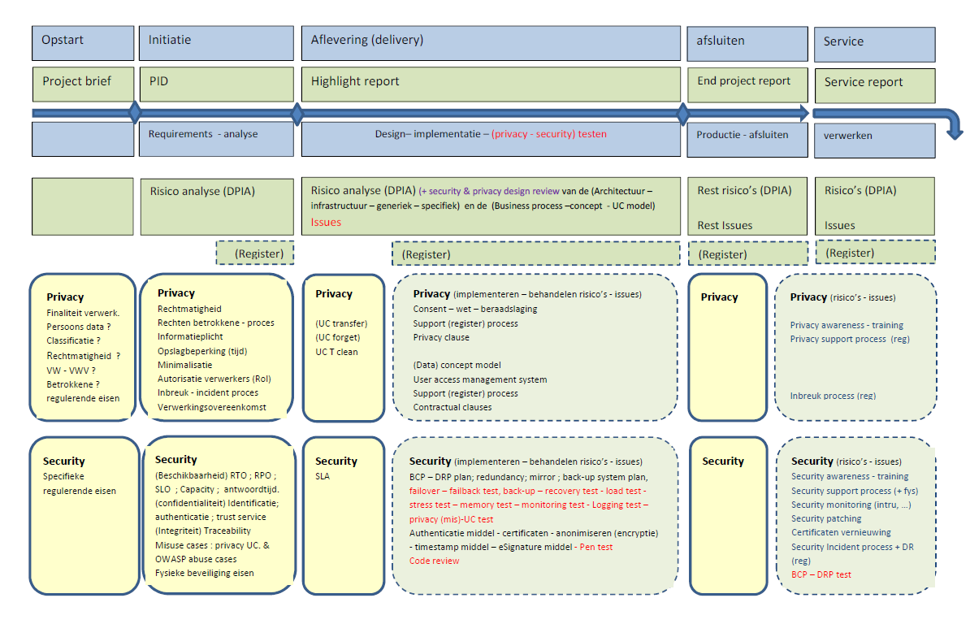
DPIA: as from start up of project to delivery

Slide 141
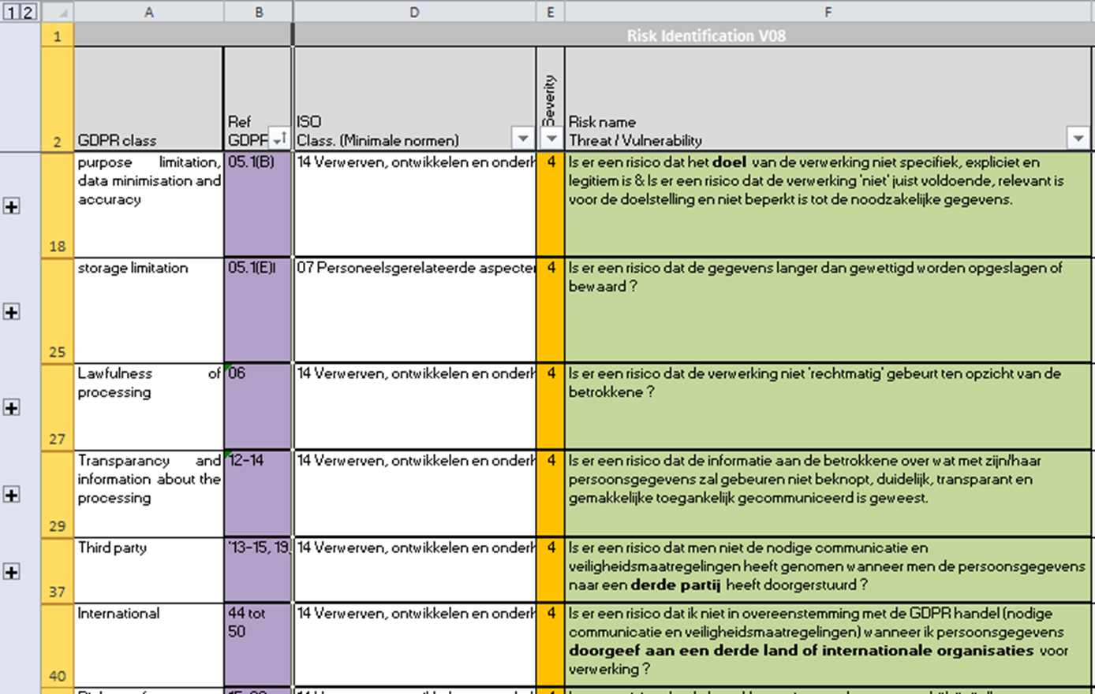
Template: list of risks based on GDPR

Slide 142
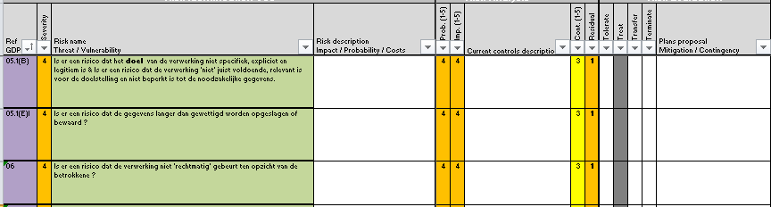
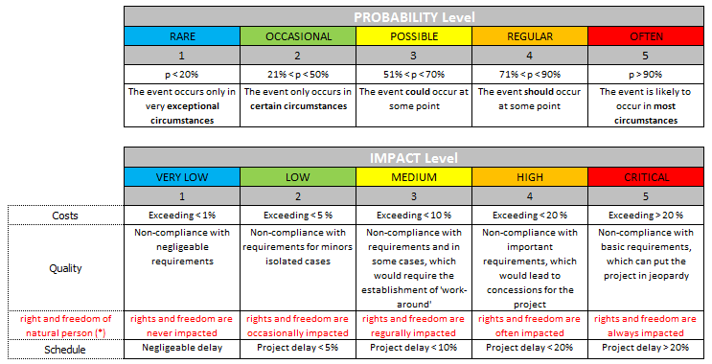
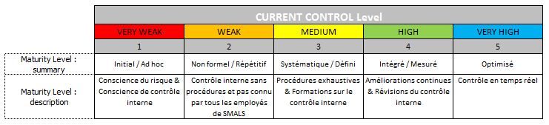
Template: risk evaluation
Initial risks and risk mitigation
(security controls)
Remaining risks

Slide 143
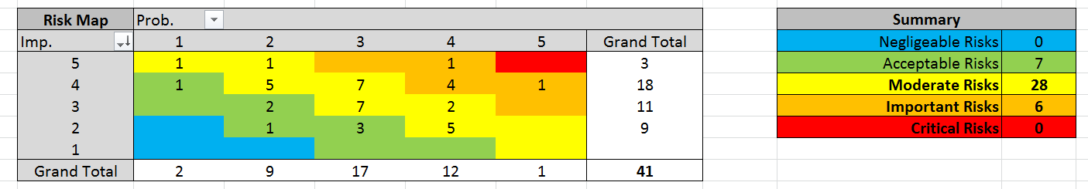
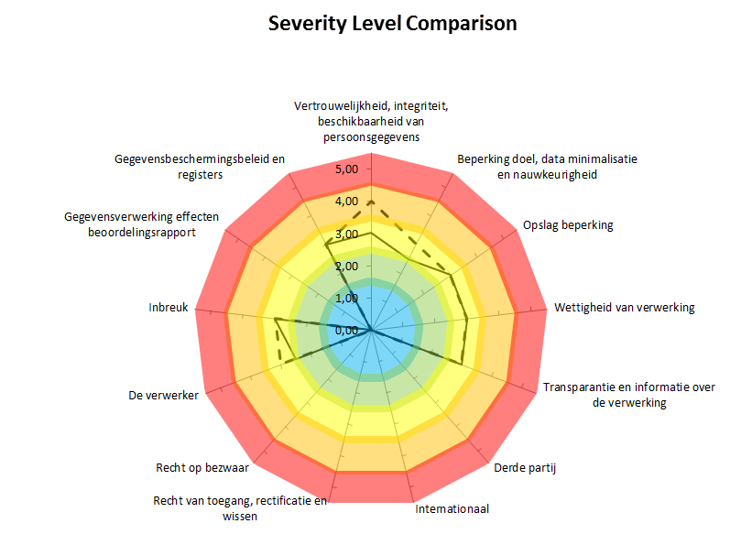
Template: intermediate result

Slide 144
Template: end result

Slide 145

frank.robben@mail.fgov.be
@FrRobben
https://www.frankrobben.be
https://www.gcloud.belgium.be
https://www.smals.be

