Slide 1
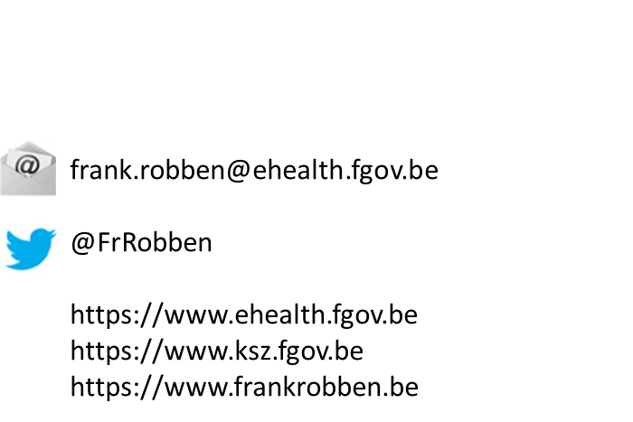
eHealth platform
Current situation & perspectives
23/04/2021
Notes:
NL

Slide 2
Structure of the presentation
Presentation of the eHealth platform
  online healthcare landscape in Belgium
  eHealth architecture
  some statistics
  objectives, mission, services & governance
Roadmap eHealth 3.0
  presentation
  overview of some ongoing projects
Overview of the realisations and projects within the scope of the Covid-19-crisis
  eHealthCreaBis
  contact tracing
    contact center
    Coronalert
    Passenger Locator Form
  testing
    test results database central reservation system
    Corona test prescription & consultation
  vaccination
    Vaccinnet
    reservation tools
  vaccination/test/recovery certificates

Slide 3
















Overview of the online healthcare landscape in Belgium
Authentic sources

Slide 4














Medical benefits
Consultation of medical history via SumEHR
Online guidelines and decision support
Medical benefits
Electronic
prescriptions
Medication
schedule
Consultation of lab results
Electronic
referral letters

Slide 5





Benefits at the end of the consultation
Pricing,
billing
Update of SumEHR, medication schedule,
...
Benefits at the end of the consultation
Creation and sending of certificates
Registration
Sending a report to the holder of the GMF

Slide 6








Basic architecture
Patients, healthcare providers
and healthcare institutions
Health portal
Software healthcare provider
Users
Software healthcare institution
AVS
Website NIHDI
AVS
eHealth portal
MyCareNet
AVS
AVS
AVS
Basic services
eHealth platform
Network
Suppliers
VAS
VAS
VAS
VAS
VAS
VAS
Notes:
6
6

Slide 7










Some figures
>86,4%
Belgian citizens have given
their consent for data sharing
+97%
general practitioners
use online health tools
620 million
messages/year
via eHealthBox
Electronic prescriptions
19 million/month
18.000.000.000
electronic transactions
3.9 million
Belgian patients with electronic health file in health vaults
29.019
4.800
  215 million
  electronic documents available at hospitals and clinical labs

Slide 8
Objectives of the eHealth platform
How?
  by means of a well organized, mutual electronic service delivery and information exchange between all healthcare actors
  with the necessary guarantees with regard to information security, privacy protection and professional secrecy
On which purpose?
  optimization of healthcare quality and continuity
  optimization of patient safety
  simplification of paperwork for all healthcare actors
  offering a thorough support to healthcare policy

Slide 9
10 missions
to develop a vision and a strategy with regard to online health
to organize the cooperation with other public authorities in charge of the coordination of electronic services
to act as a key driver for the necessary changes in order to carry out the vision and strategy with regard to online health
to establish the functional and technical norms, standards and specifications and the basic ICT architecture
to register software for the management of electronic patient files
to create, develop and manage a cooperative platform for a secure electronic data exchange, and also the corresponding basic services

Slide 10
10 missions
to agree on a division of tasks and quality standards and to verify whether these standards are complied with
as an independent trusted third party (TTP), being in charge of the coding and anonymization of personal health data for the benefit of specific agencies, as established by law, in order to support scientific research and policy
to promote and coordinate the development of programmes and projects
to manage and coordinate the ICT aspects of data exchange within the framework of electronic patient records and electronic medical prescriptions

Slide 11
Basic services of the eHealth platform
eHealth certificates
Integrated user and access management
Orchestration of electronic sub processes
Portal
System for end-to-end encryption
Logging management
Timestamping
Reference directory
Secure electronic mailbox (eHealthBox)
Coding & anonymization & trusted third party
Consultation of the National Register and of the Crossroads Bank Registers

Slide 12
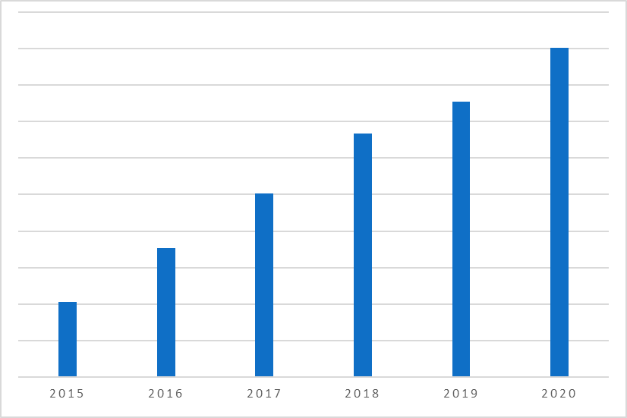
Basic services of the eHealth platform
Number of transactions through the eHealth basic services
  4.122.144.738 in 2015
  7.067.227.936 in 2016
  10.055.636.938 in 2017
  13.332.679.791 in 2018
  15.095.149.373 in 2019
  15.095.149.373 in 2019
  18.025.871.980 in 2020 (+ 19,41%)
Notes:
NL

Slide 13
eHealth certificates
Issued for free by the eHealth platform to
  the healthcare providers and institutions
  software developers for healthcare providers and institutions
Functions
  possibility for the healthcare provider or organisation to authenticate his software when using web services, especially by asking an access token to those services
  possibility to encrypt and decrypt messages, for example when using the eHealthBox
  at the same time with a corresponding password, fall-back for the authentication of a healthcare provider if he can’t authenticate himself with his eID, Itsme or TOTP
Can be requested and installed via a downloadable application on the portal of the eHealth platform

Slide 14
eHealth certificates
23.009 certificates created in 2020
43.429 active certificates linked to professionals on 31/12/2020
8.908 active certificates linked to organisations on 31/12/2020
Notes:
NL

Slide 15
Integrated user and access management
Ensures that only healthcare providers and institutions have access to
  the services they may access
  regarding the people for whom they have been granted access
Access rules are set by law and by authorisations from the Information Security Committee
Steps
  identification of the user
  authentication of the user’s identity
  quality control (e.g. physician, pharmacist)
  relationship checks (e.g. therapeutic relationship with the patient)
  authorisation

Slide 16
Integrated user and access management

Slide 17
End-to-end encryption
Services used to encrypt messages for healthcare providers or institutions
Are used in the eHealthBox or in the electronic prescriptions (Recip-e)
2 services
  ETKDepot for the encryption to a known recipient (asymmetric encryption)
  KGSS for the encryption to a unknown recipient (symmetric encryption)

Slide 18
Encryption for a known recipient
Healthcare actor
Person or entity
eHealth platform
Internet
1
3
Connector or
other software to
generate key pair
Authenticates sender
2
4
Sends
public key
Identification
certificate
Identificationcertificate
Stores
public key
Web service
Register key
2
Public keys
repository
Stores private key
in a secure way

Slide 19
Encryption for a known recipient
Message originator
eHealth platform
Internet
1
Identification certificate
Web service
Ask public key
2
Identification
certificate
Asks for public key
Authenticates sender
Send message
Any protocol
3
4
Sends
public key
Encrypts
message
Identification
certificate
Message recipient
Public keys
repository
5
Stored
private
key
Decrypts message

Slide 20
Encryption for an unknown recipient
Key
Management
/ Depot
Encrypted with public key of user 1
Encrypted with public key of user 2
Symmetric key
Symmetric key
2 sends key
5 receives key
User 1
Originator
1 asks for key
User 2
Recipient
4 justifies right to
obtain key
4 justifies right to
obtain message
3 sends encrypted message
Encrypted with public key of Message depot
5 receives message
Encrypted with public key of user 2
Message encrypted with
symmetric key
Messages
Depot
Message encrypted with
symmetric key
Message encrypted with symmetric key

Slide 21
Timestamping
Timestamping (or electronic dating or certified time stamping) is a system that allows to keep the proof of the existence of a document and its content on a given date
The term ‘proof’ means that nobody neither the owner of the document, can modify the timestamping certificate

Slide 22


Timestamping: example
1
prescription A
prescription B
electronic
signature
5
2
Hashcode A
Hashcode B
3
6
Timestamp bag
4
Archive
Electronic
timestamping
6
Records

Slide 23
Reference directory (hub-metahub)
The service “Reference directory” (Metahub) of the eHealth platform and the complementary services 'Consent', 'Therlink' and 'Exclusions' are a set of services for managing access to a patient's medical data
Services are accessible, depending on the case, to hubs, individual care providers, some care institutions such as hospitals or pharmacies and finally to patients
In other words, it is an index of personal health data of patients
Such an index is the keystone for the implementation of any decentralised system of health data sharing between healthcare providers and organisations

Slide 24






Reference directory (hub-metahub)
3 Retrieve data from hub A
A
1 : Where can we find data?
2 : In hub A and C
4 :
All data available
3 : Retrieve data from hub C
C
B

Slide 25




Extramural data : health vaults
A
InterMed
BruSafe
C
B

Slide 26
eHealthBox
Secure electronic mailbox, particularly developed for the healthcare providers and institutions
Goal: to ensure a secure electronic communication of medical and confidential data between the Belgian healthcare actors
Available as
  a web service (accessible through a medical software)
    for which the eHealth platform has developed a web service allowing to send messages to the eBox Citizen and the eBox Enterprise from the software of the healthcare provider
  a web application (accessible through a computer and an eID/ITSME or TOTP)

Slide 27
Governance bodies
eHealth platform Management Committee
  manages the institution
  composition
    representatives of healthcare providers and organisations
    representatives of the health insurance funds
    representatives of public health services from all authority levels
    representatives of the Federal Minister of Public Health and Agoria
User Consultation Committee
  advisory body
  assists the Management Committee of the eHealth platform in carrying out its tasks
  has permanent and thematic working groups

Slide 28
Governance bodies
Information Security Committee designated by Parliament (previously the sector committee for social security and health of the Privacy Commission)
  issues legally binding authorisations for the exchange of health data
  sets the rules for information security and privacy protection when processing health data
Interministerial conference on public health
  Ministers of Health of all authority levels
  preparation by the intercabinet working group (IWG)
  coordination of health policy

Slide 29
eHealth Roadmap 3.0
(2019-2021)

Slide 30
Clusters
Cluster 0 Fundamentals
Cluster 1 Transversal
Cluster 2 Support
Cluster 3 Operational excellence
Cluster 4 healthcare providers and institutions
Cluster 5
Patient as co-pilot
Cluster 6 eHealth & health insurance funds

Slide 31
Cluster 0 – Clarify & Harmonize the concepts
Informed consent
  confirmation of the opt-in-logic
  only one consent for sharing the data in the whole country
    no granularity
    authentic source at the eHealth platform
    possibility of synchronized local copies
  possibility for the patient to be informed about the modification of his consent through his/her eBox citizen
    in production (mid-December 2020)
  preparation of a communication campaign by the FPS
  Covid 19 > agreement to publish the test results on the portals without the consent
    the patient can consult his results asap

Slide 32
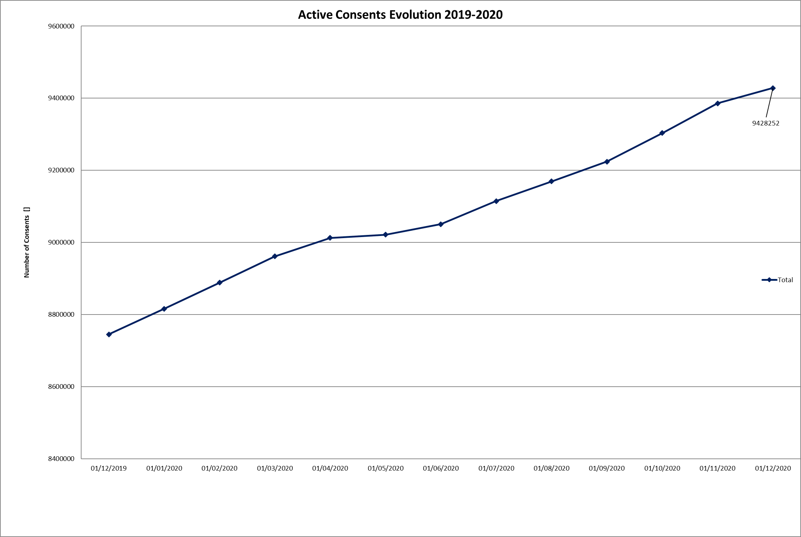
Cluster 0 – Data sharing consents
19/04/2021 > 9.687.484 people have given their informed consent for data sharing

Slide 33
Cluster 0 – Clarify & Harmonize the concepts (1/2)
Therapeutic relationships, healthcare relationships and exclusions
  authentic source for the exclusions: eHealth platform
    possibility of synchronized local copies
  better mutual harmonisation between the different portals and the personal health viewer (PHV)
    ongoing
Mandates and parent-child relationships
  need for better mutual harmonisation in the management of mandates between the different hubs/vaults
    as-is analysis and to-be proposals in progress

Slide 34
Cluster 0 – Clarify & Harmonize the concepts (2/2)
Access Matrix
  proposal and analysis of a change in the current paradigm
    the role of the access matrix would be reviewed and become indicative in order to make it accessible to all healthcare providers included in the royal decree n°78
    limited scope (some data would be excluded)
    reinforcement of existing concepts such as consent
    introduction of preventive and corrective measures

Slide 35
Cluster 0 – Healthcare relationships
2021
  development of services concerning the residual database that are useful for the BelRAI project and others projects in Flanders
  possible extension of the residual database to
    other applications
    by encrypting healthcare relationships from which health-related information can be deduced

Slide 36
Cluster 0 – Circles of trust
Circles of trust (CoT)
  defines objectively
    who performs which controls
    how to implement the fundamental principles of information security and privacy protection
    which control mechanisms should be implemented
  regulation approved
    by the eHealth platform Management Committee on 10th September 2019
    by the Information Security Committee on 1st October 2019
    see https://www.ehealth.fgov.be/ehealthplatform/fr/reglements
  1st use case implemented in the context of Covid-19
    clinical laboratories and hospitals must complete the declaration of honour in order to be able to delegate the consultation of the national register and the CBSS registers as well as the creation of a Bis number to the administrative staff

Slide 37
Cluster 3 – Business continuity
Optimal performance and availability of end-user applications
Method
  SLA
    for availability and performance
    difficulty: end-to-end (priority implementation in 2020)
  elimination of single points of failure (SPOF) in all environments (e.g. third data center for the eHealth platform)
  end-to-end monitoring
  central dashboard & supervision
  incident management
  problem management
  capacity planning
  release & intervention calendar accessible to the public
  exhaustiveness is important!

Slide 38
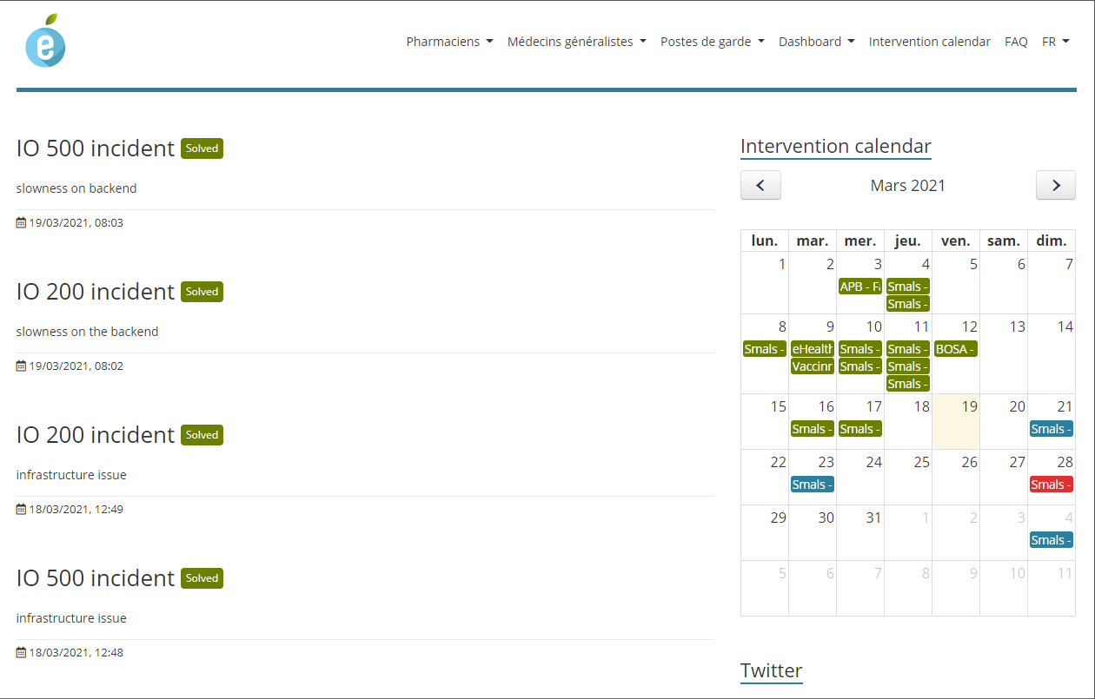
Cluster 3 – Business continuity
www.status.ehealth.fgov.be

Slide 39
Cluster 3 – Software registration
2020
  definition of the criteria for the software for nurses
    criteria approved
    documentation published
  additional tests for general practitioners
    postponement of some criteria until 2021
      LOINC Labo, Mult-eMediatt, …
  complete review of the criteria for the physiotherapists
    criteria approved
    documentation in progress

Slide 40
Cluster 3 – Software registration
2020
  creation of a working group to work out the criteria for software for dentists
    V0 of criteria list finalised and being validated
  evaluation of new Recip-e v4 services in the software
  support when evaluating the integration of the current medicines database (SAM v2) into the software
  support for the setup of criteria and tests on the medication scheme
    a test session on a simplified set was successful

Slide 41
Cluster 3 – Software registration
2021
  registration of software for nurses (to be continued in 2022)
  registration of software for physiotherapists (will continue in 2022)
    publication of documentation expected in Q1 2021
  finalisation and publication of criteria for software for dentists
  definition of criteria for midwives

Slide 42
Cluster 4 – Mult-eMediatt (e-CIT)
Implementation of a 'paperless' system of certificates of incapacity for work issued by general practitioners
3 drivers: NIHDI/CIN/eHealth platform
  phase 1 > agreement for the computerisation of certificates of incapacity for work by September/October 2021 for
    Medex, HR Rail
    flow to sickness funds
  phase 2 > extension to the private sector
    after approval by the National Labour Council
    timing still to be defined
  adaptation of business rules and technical documentation
    ongoing
  evaluation of mini-labs for integration in medical software
    2nd half of 2021
    project supported by medicomut

Slide 43
Cluster 4 – Electronic prescription
2020
  connector v4 implementation for all software
  allows prescribers to define a validity period of 1 day to 1 year for electronic medication prescriptions
    all prescriber and pharmacy software has been adapted for this purpose
    during a transition period, the validity period of 3 months has been applied for electronic medication prescriptions
    this transition period has lasted until 1st October 2020 due to priorities related to the Covid-19 crisis
  the eHealth platform has coordinated with the NIHDI the evaluation of the software in regard to the correct integration of the new Recip-e v4 services
  implementation of business continuity measures for the Recip-e services of pharmacies
    in case of technical problems, the emergency procedure allows pharmacies to download the electronic prescription from Recip-e

Slide 44
Cluster 4 – Electronic prescription
2021
  Recip-e dematerialisation
    probably from 15th September 2021, no more paper proof of electronic prescription
    in case of force majeure, it is possible to return to a paper prescription
    benefits
      more time available for patient care thanks to the digitalisation of administrative processes
      greater patient autonomy thanks to additional possibilities to manage his prescriptions
      better quality of care and a better relationship of trust between the patient and the healthcare providers
      more efficiency and more accessible healthcare information
      one medicine per prescription

Slide 45
Cluster 4 – Electronic prescription
2021
  mobile apps
    patient apps open prescriptions
    developments by partners: mobile app to consult the instructions for use of prescribed medication
  supplier hosting

Slide 46
Cluster 4 – BelRai
2019-2020
  access to therapeutic relationships
    creation of a therapeutic relationship between a healthcare provider and a patient in the BelRAI 2.0 web application
    access to control therapeutic exclusions
  ongoing integration into the reference directory
    aim: to inform healthcare providers about the existence of an assessment for their patient
  BelRAI web service for new target groups
    clinical psychologist
    clinical orthopedagogue
    individual healthcare providers (in progress)

Slide 47
Cluster 4 – BelRai
2020-2021
  MyBelRAI web application for patients
    phase 1: patient access to assessment results using a web application integrated in the MyHealth portal
    phase 2: extension of access to the patient's mandataries
  BelRAI web application for organisations
    use of CoT/no CoT concepts
  BelRAI Flanders
    web application for creating the BelRAI screener and making the results available
    web application to manage healthcare relationships for organisations and their employees
    creation of a database of healthcare relationships at the eHealth platform for healthcare institutions without an authentic source
    target group: PCSWs, care funds, social assistance services and complementary family and home care services

Slide 48
Cluster 4 – VIDIS
(Virtual Integrated Drug Information System)
2020
  possibility for patients to view their medication scheme in the Personal Health Viewer
  possibility of consultation of the medication scheme by healthcare providers (physicians, dentists, nurses, midwives and pharmacists) who have a therapeutic relationship with the patient, provided that the patient has given his or her informed consent for the data sharing

Slide 49
Cluster 4 – VIDIS
(Virtual Integrated Drug Information System)
2021
  mobile app with the basic VIDIS functionalities for citizens
    has been accelerated by the dematerialisation of the prescriptions which comes into force on 01/06/2021 (as set in the law)
  in the first phase, the mobile app should enable every Belgian citizen, without depending on commercial apps, to obtain his electronic prescriptions in dematerialised form from the pharmacist (continuity of healthcare)
  in later phases, this mobile application will be extended with other VIDIS functionalities such as consultation of the medication scheme, delivery of medicines, reimbursement authorisations, diary notes

Slide 50
eBirth v2: electronic birth declaration
2020-2021
  simplification of 3 flows
    automatic creation of a SSIN for the new-born
      need to modify the law
    health data sent to the competent authorities
      from the hospital’s electronic patient record (EPR)
      via the Healthdata connector (reuse)
    socio-economic and statistical data to the competent authorities
      via the datawarehouse of the CBSS (reuse)

Slide 51
Laboratory requests & results
2020-2021
  electronic transmission of test results
    in a structured (FHIR format) and
    coded way (LOINC format)
  electronic transmission of laboratory test requests
  need to adapt the software of physicians and laboratories
  2nd half of 2021
    for transmitting test results for the most common tests
    for electronic transmitting of the test request using a temporary solution until the project of the NIHDI concerning referral prescriptions is operational

Slide 52
Cluster 5 – Orgadon
In production since July 2020
Online registration of wills for organ donation on https://mijngezondheid.belgie.be/#/
How?
  at their general practitioner
  directly
  an organ donation for transplantation
  a donation of human body material (cells and tissues)
    to be used for transplantation in a patient who needs it;
    to be used for the production of innovative medicines or treatments
    to be used for scientific research, for example to better identify the cause of a disease or to find new treatments

Slide 53
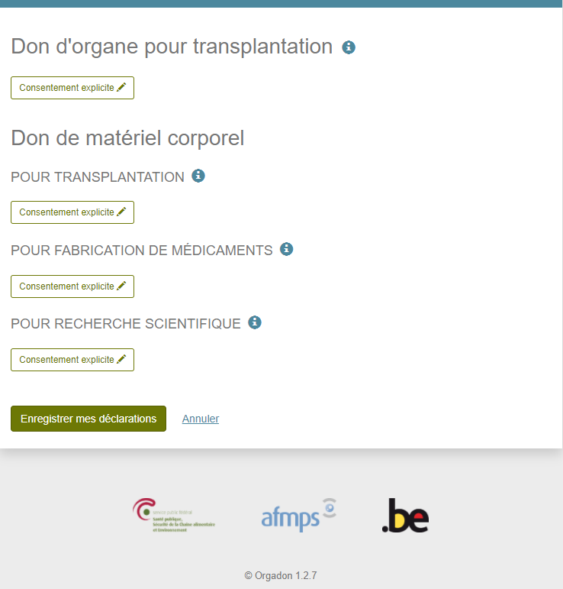
Cluster 5 – Orgadon
2021
  automation of access to the Orgadon database for the managers of human body material and the coordinators of biobanks
  use of a call center to answer questions from suppliers of human body material

Slide 54

Cluster 5 – MyHealth

Slide 55
Cluster 6 – eHealth and sickness funds
2019-2020
  MyCarenet portal as an access point for healthcare providers to the web services of the CIN
    MemberData
    tarification
    the GMR-holder
    accessible for physicians, nurses, physiotherapists, dentists, midwives, orthopaedists, ...
    extension to the centres for family planning, the centres for rehabilitation and the initiatives for protected housing
  “member data" service
    allows any authorised healthcare institution or provider to consult the information (insurability and derived rights) of the care user that is necessary for correct invoicing or care or products providing
    will replace the insurability service
    a synchronous and asynchronous service that will be integrated into the practitioners' software is planned
    a web application is also available on the MyCarenet portal

Slide 56
Cluster 6 – eHealth and sickness funds
2020
  eAgreement
    some treatments must be approved by a medical advisor of the sickness insurance fund in order to be reimbursed by the health insurance
    the current Chapter IV service will be replaced
      the authorized healthcare provider can send his requests for agreement by the digital way and consult the agreements by the digital way
      in a first phase, for physiotherapists whose requests for agreement are, at the moment, only submitted on paper
  eAttest extension
    extension to specialists in hospitals of the possibility to send certificates of treatment by the digital way to the sickness funds
  business messages in case of unavailability
    consultation between the NIC and the software suppliers in the context of the implementation of business continuity measures => error messages are sent as soon as problems are detected
    clear messages for users mentioning the actions to be taken

Slide 57
Cluster 6 – eHealth and sickness funds
2021
  eAttest and eFact for physiotherapists
    both services will be made available to physiotherapists
  physiotherapist pathology statistics
    electronic collection of pathologies treated by physiotherapists, for statistical purposes

Slide 58
Covid-19 projects & realisations

Slide 59
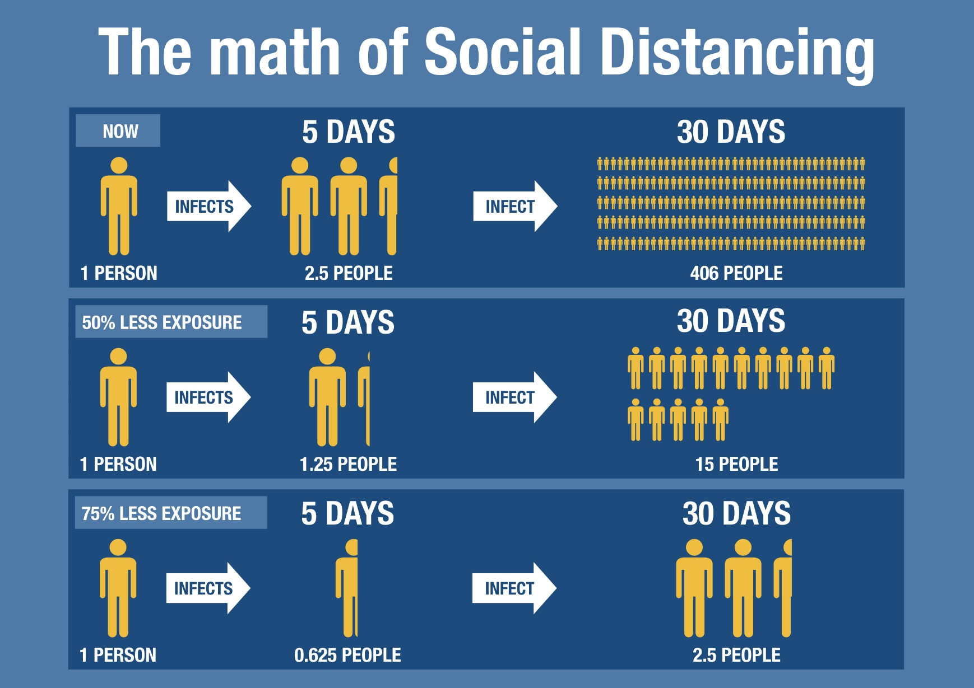
How to slow down the spread?
Source UNamur

Slide 60
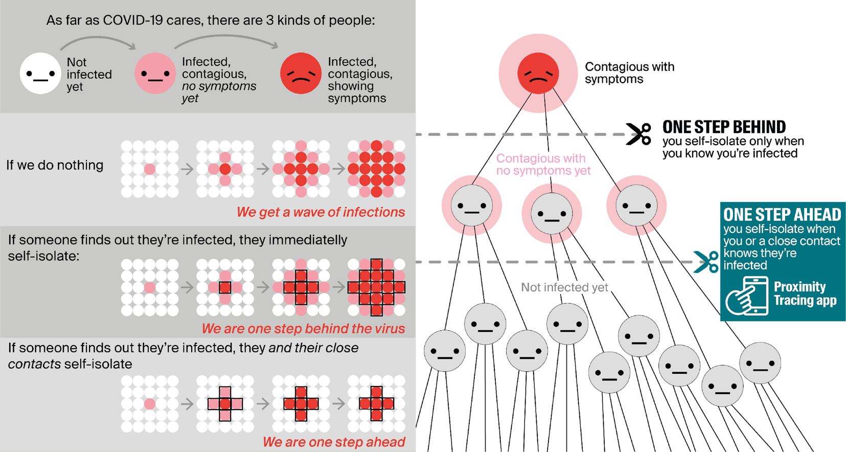
Importance of tracing

Slide 61
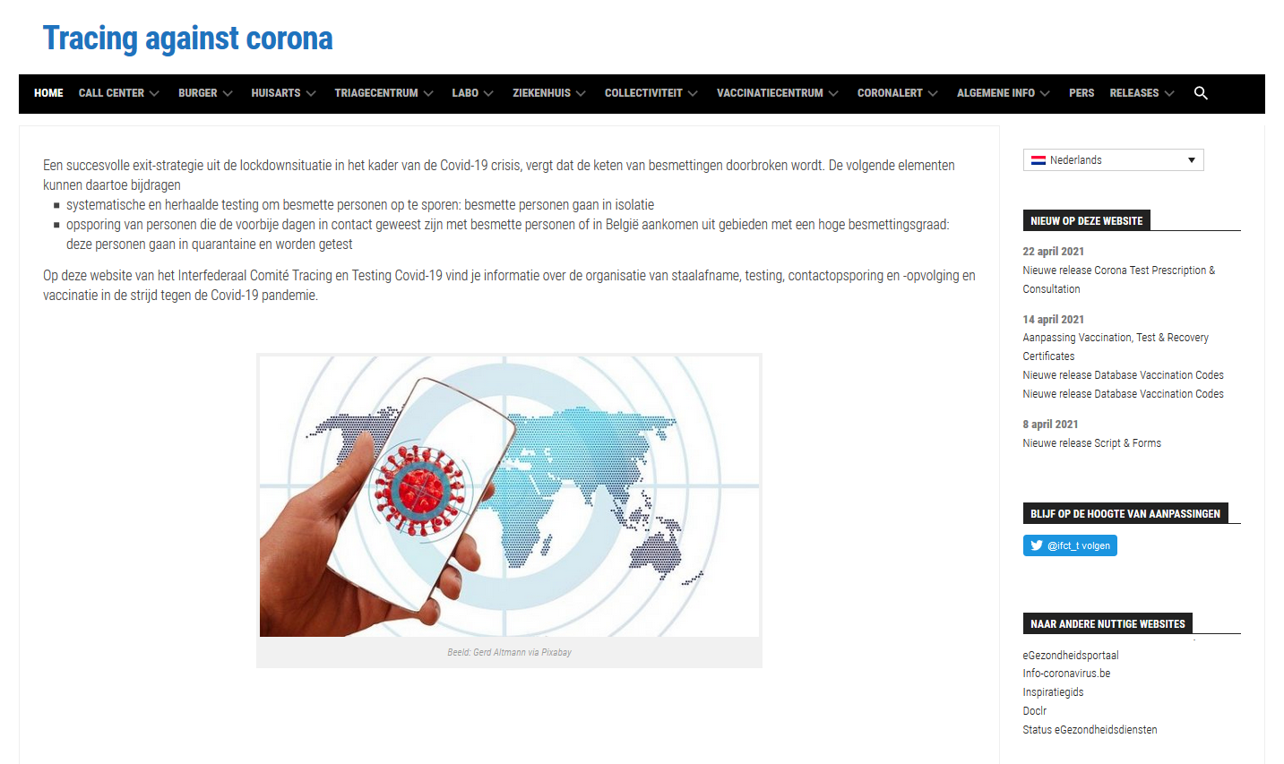
Tracing strategies & methods
https://www.corona-tracking.info

Slide 62
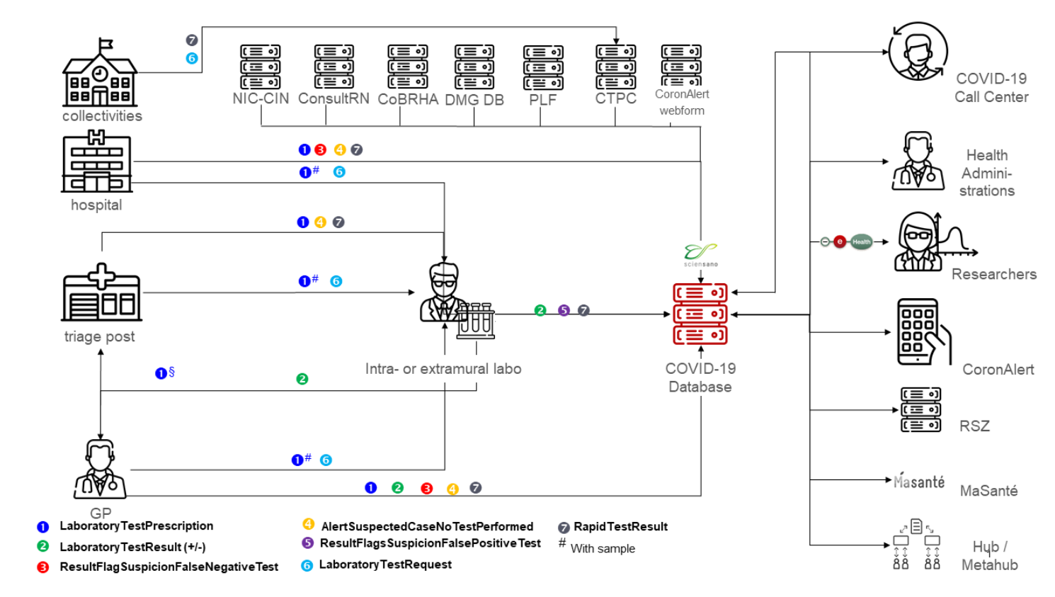
Healthdata (Sciensano)
Database COVID-19 TestResult created by the Belgian Interfederal Committee “Testing and Tracing”

Slide 63
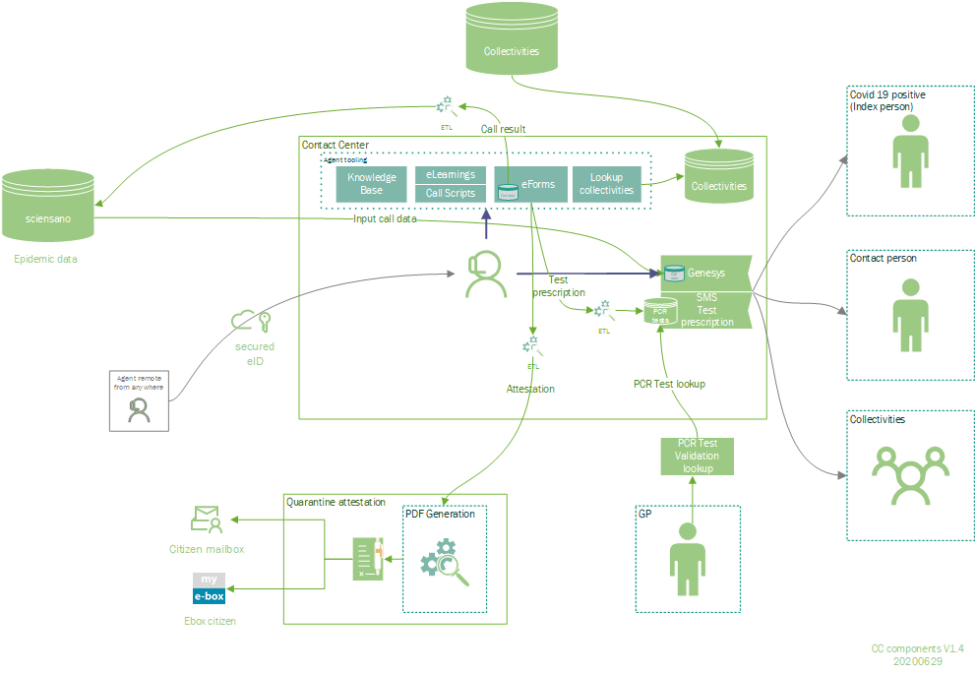
COVID-19 Call Center

Slide 64
Coronalert
Mobile app that helps the citizens to protect each other's and to stop the spread of the coronavirus (Covid-19) with the following features
  finding out if the user has been in close contact with another Coronalert user who has tested positive for the coronavirus, without knowing who he or she is
  warning anonymously the user's close contacts if the user has tested positive for the coronavirus
  accelerating together the detection of the contacts
  de facto help stopping the spread of the virus
Agoria Award 2020 in the category 'Best eGov project’

Slide 65
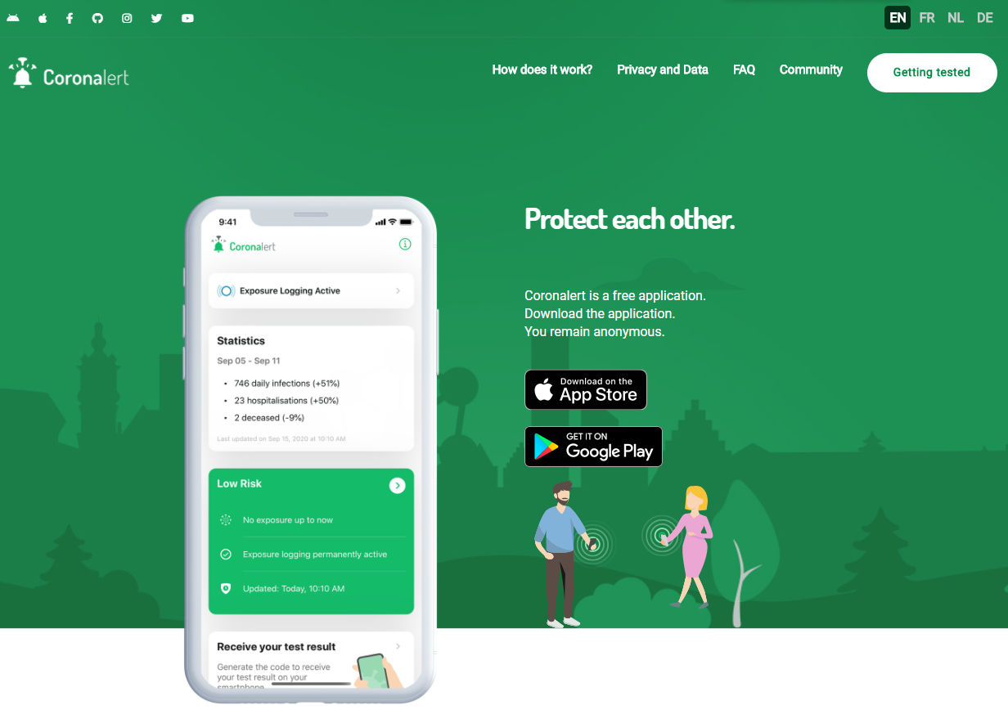

Slide 66
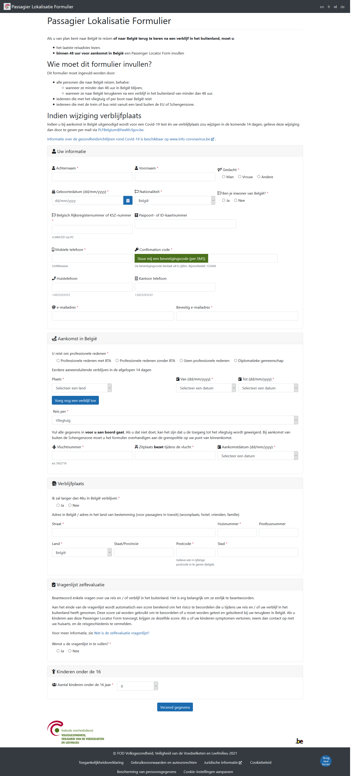
Passenger Locator Form
After a stay abroad a Passenger Locator Form must be completed within 48 hours before the arrival in Belgium

Slide 67
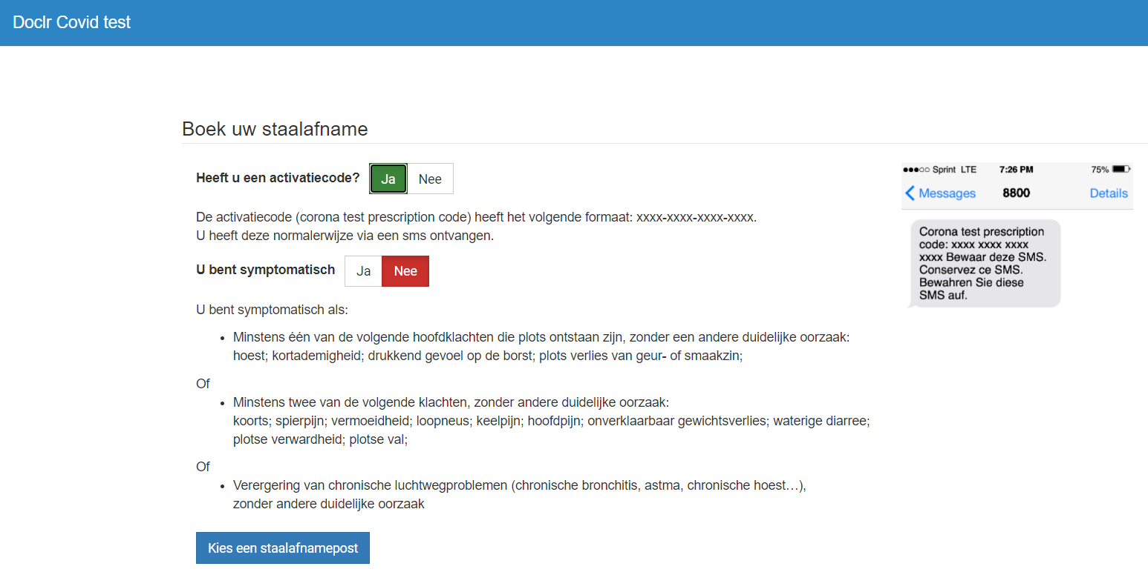
Central reservation system COV19
Webapp that allows to disclose, by testing centre, the slots still available for the taking of a test
  the test centres in the neighbourhood are visualised on a map so that a user can easily find a test centre
Users can then book a test directly (using the booking system of the test center)

Slide 68
eHealthCreaBis
In production since June 2020
In the context of the health crisis, the SSIN (Social Security Identification Number) is a necessary identifier for COVID test prescriptions
  a SSIN refers to
    either the national register number (assigned by the National Register)
    or a BIS number, assigned by the Crossroads Bank for Social Security for people who do not have a national register number (this BIS number is stored in the BIS register)
  it is therefore important that doctors who do not have medical software should be able to create BIS numbers

Slide 69
eHealthCreaBis
Who receives a BIS number?
  people who are not registered in the national register, but who nevertheless have close and stable relations with Belgium in various sectors (social security, health, etc.)
  this BIS number can only be created by the doctor in the presence of the patient and on the condition that the patient presents a valid identity document to the doctor
The created BIS number will then be used as a unique identification number in all relations of this person with the Belgian authorities, administrations, health actors

Slide 70
Corona Test prescription & Consultation
Permits company doctors and collectivity doctors to prescribe a COVID-19 test and consult the test results
Functions
  request for a COVID-19 test for people in the doctor's company or collectivity who are considered high-risk contacts for whom a test is required
  requesting a test from a laboratory; if the doctor collects the test himself, he can request the analysis from the laboratory
  communicating the result of a rapid test
  consultation: the doctor has access to a detailed list of all requests and results for patients linked to his/her company or collectivity

Slide 71
Saliva test form - Pilot project
Panel of 60 schools invited to participate in a regular saliva testing of their staff members
  40 in Flanders
  20 in Wallonia-Brussels
Objectives
  to ensure the safety of the collectivity by detecting as soon as possible any possible contamination or outbreak of a cluster
  to provide additional protection for teachers in order to limit school closures and ensure the continuity of school activities
Web form is made available for weekly registration of individual saliva tests
  some relevant data are requested in order to obtain the results
End of project: April 2021
  analysis of results being finalized but between 1 and 21/03
    24 positive cases detected on the basis of 6,636 samples
    2 clusters discovered: one in Wallonia and one in Brussels

Slide 72
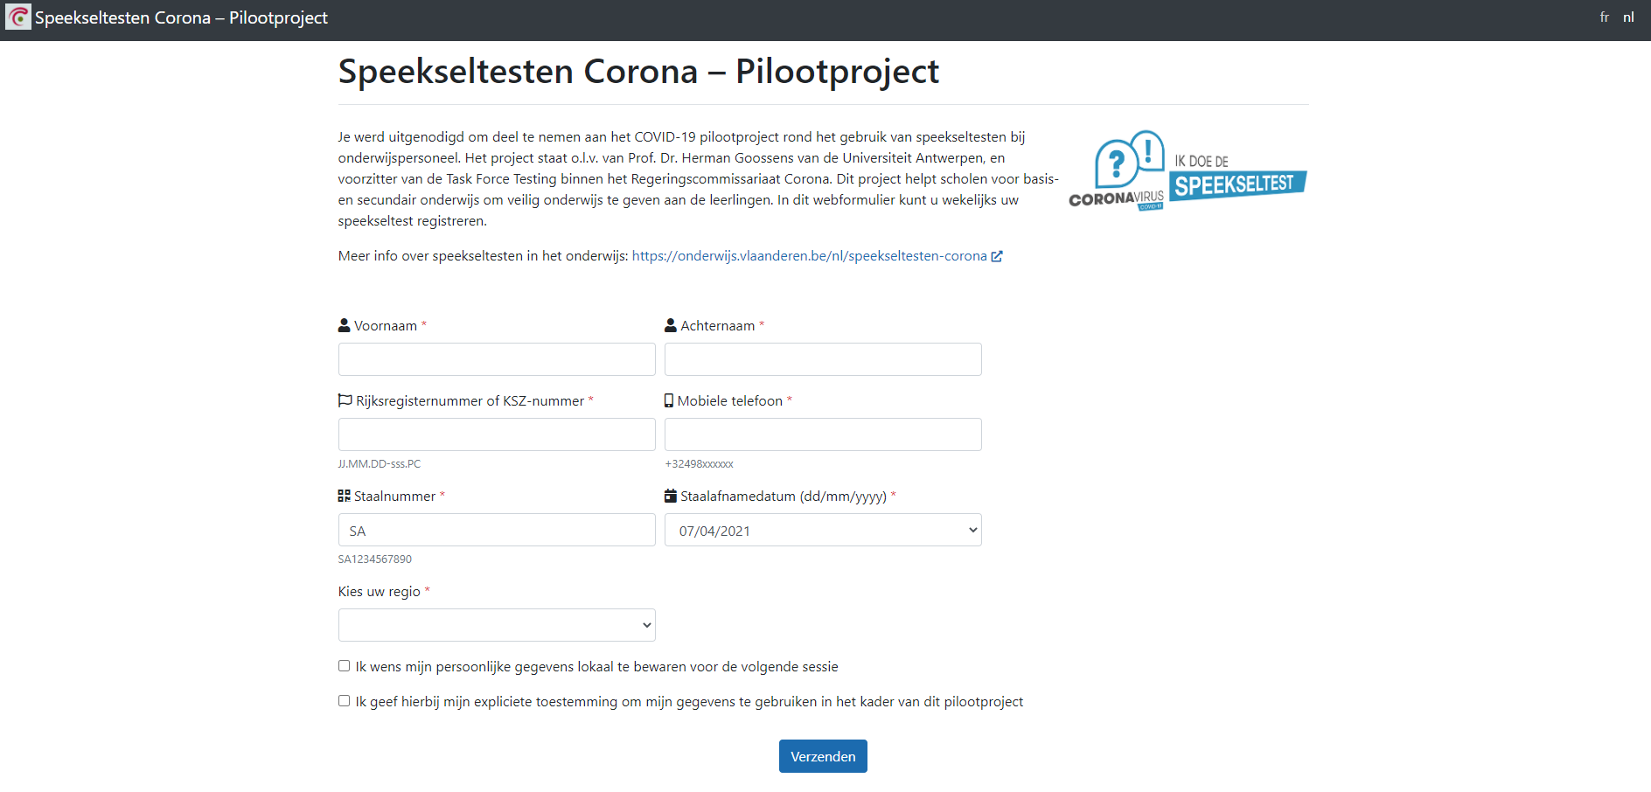
Saliva test form - Pilot project

Slide 73
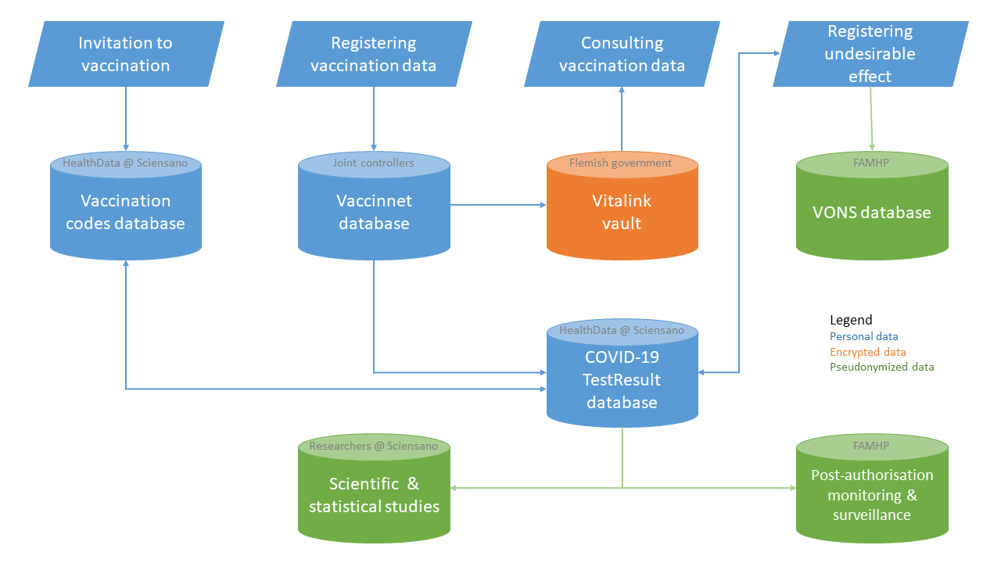
Vaccination

Slide 74
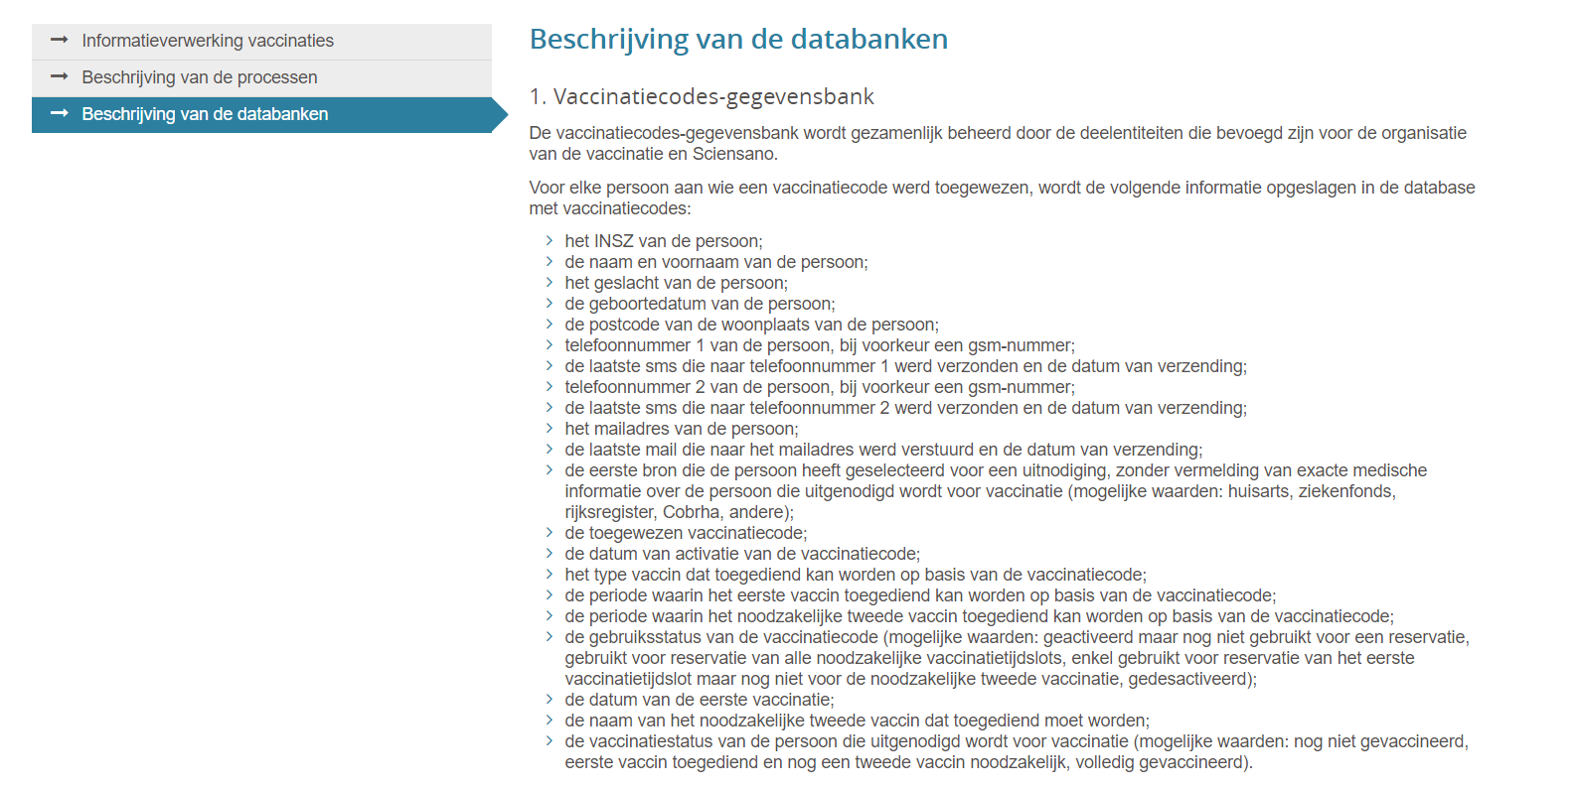
Vaccination
Registering and processing of the vaccination data
  on the eHealth portal: functional description of the systems and information flows for which the Security Information Committee has issued a deliberation concerning the recording and processing of data relating to vaccinations

Slide 75
Vaccination - Last minute booking solution
Qvax - in production since 06/04/2021
  Flanders & Wallonia
  gives citizens who have not been invited yet the possibility to indicate their availability in order to benefit from the surplus vaccines
  priority given according to the rules set up by the authorities > according to age
Bru-VAX – in production since 19/04/2021
  Brussels
  offers a simplified slot reservation system for vaccination, requiring less information from the citizen
  allows doctors to order vaccines, so that they can vaccinate people at home

Slide 76
Vaccination/Test/Recovery certificates
‘EU Digital Green Certificate’
June 2021 > each Member State of the European Union must be responsible for the issuing of 3 certificates
  vaccination certificate
    confirms that the holder has received a COVID-19 vaccine in the Member State issuing the certificate
  test certificate
    indicates the holder’s result and date of a NAAT test or a rapid antigen test listed in the common and updated list of COVID-19 rapid antigen tests established on the basis of Council Recommendation
  certificate of recovery
    confirms that the holder has recovered from a SARS-CoV-2 infection following a positive NAAT test or a positive rapid antigen test listed in the common and updated list of COVID-19 rapid antigen tests established on the basis of Council Recommendation

Slide 77
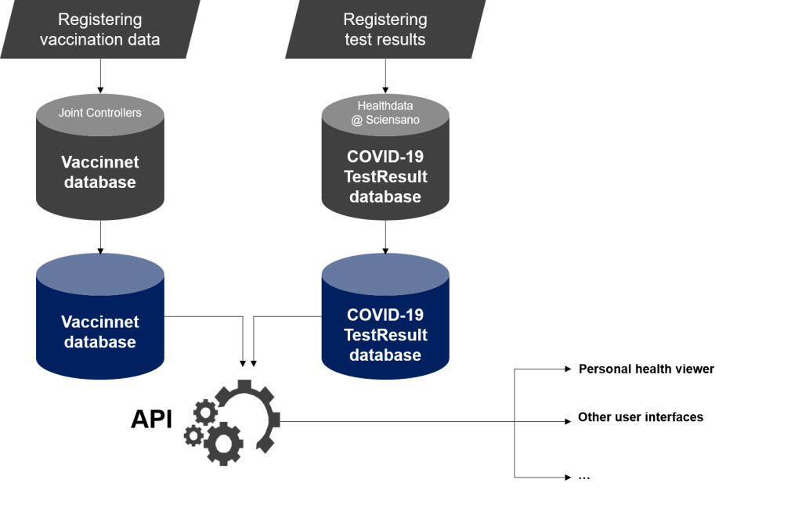
Vaccination/Test/Recovery certificates

Slide 78
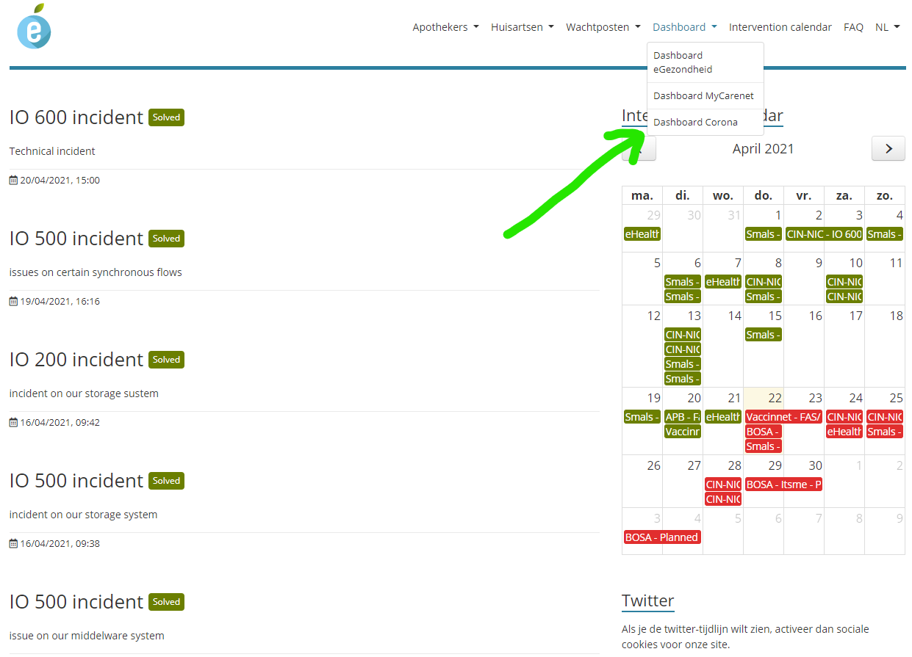
Dashboard Corona

Slide 79
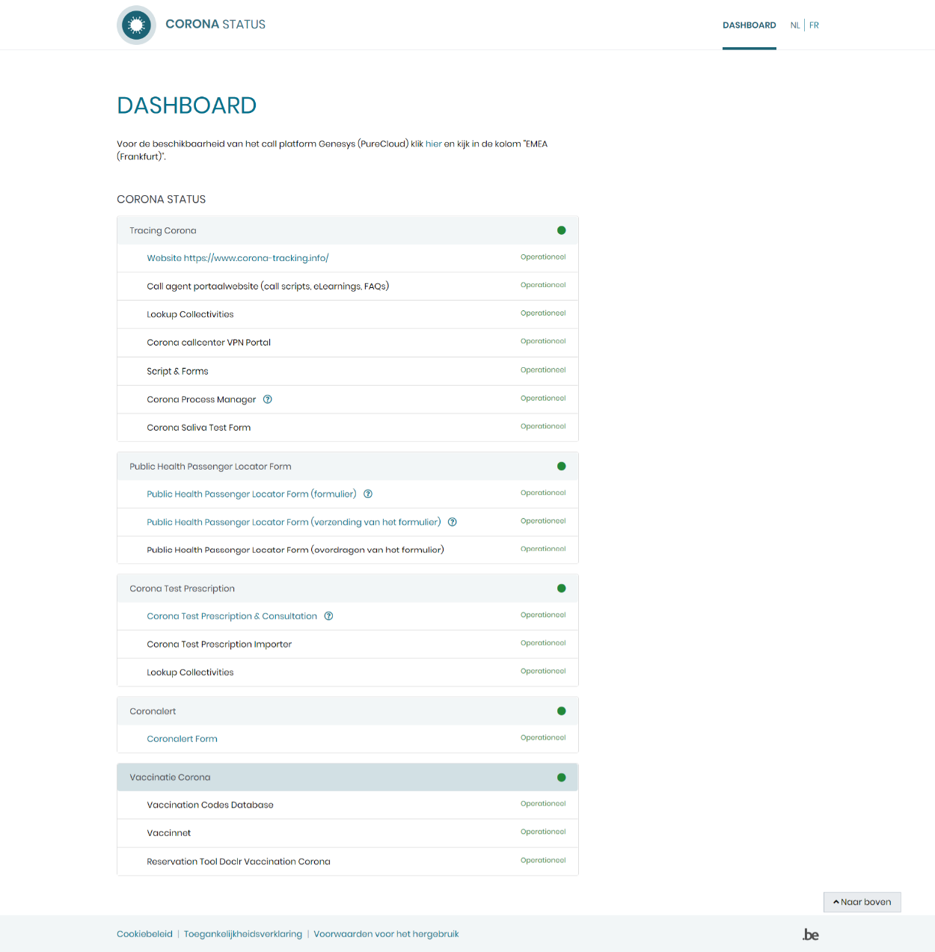
Dashboard Corona

Slide 80




