Slide 1

How data, processes and technology help us fighting the pandemy

Slide 2
0. Outline
Some basic concepts
Operational processes
  mobile applications
  testing
  passenger locator form & Paloma
  contact tracing
  integrated portal for citizens and health care providers
  vaccination
Big data analysis
Conclusions

Slide 3
1. Some basic concepts
incubation period
  the time between the exposure to the virus and the onset of symptoms
  Covid-19: on average 5-6 days, but can be as long as 10-14 days
  thus, quarantine should be in place for 10-14 days from the last exposure to an infected person
contagiousness
  the period during which an infected person can transmit the virus to other persons
  Covid-19: on average 2 days before the onset of symptoms and up to 7-10 days after the onset of symptoms
  thus, isolation should be respected for 7-10 days from the onset of symptoms

Slide 4
2 a. Mobile applications
several types of apps
  providing advice to patients
  providing advice to healthcare providers
  support the triage of patients
  monitoring of patients in the context of a care relationship with a care provider or a care institution
  organizing video or audio communication for a consultation without physical contact
evaluated by Task Force ‘Data & Technology against Corona’ (March-May 2020), afterwards according to validation pyramid mHealth Belgium
see https://www.ehealth.fgov.be/nl/egezondheid/task-force-data-technology-against-corona and https://mhealthbelgium.be/

Slide 5
2 b. Testing
ever changing testing strategy in function of
  evolving scientific insights
  available types of tests
  capacity
    sampling material
    test material
    personnel
many actors involved
  GPs, collectivity doctors, company doctors
  sampling posts
  hospitals
  labs
  …

Slide 6
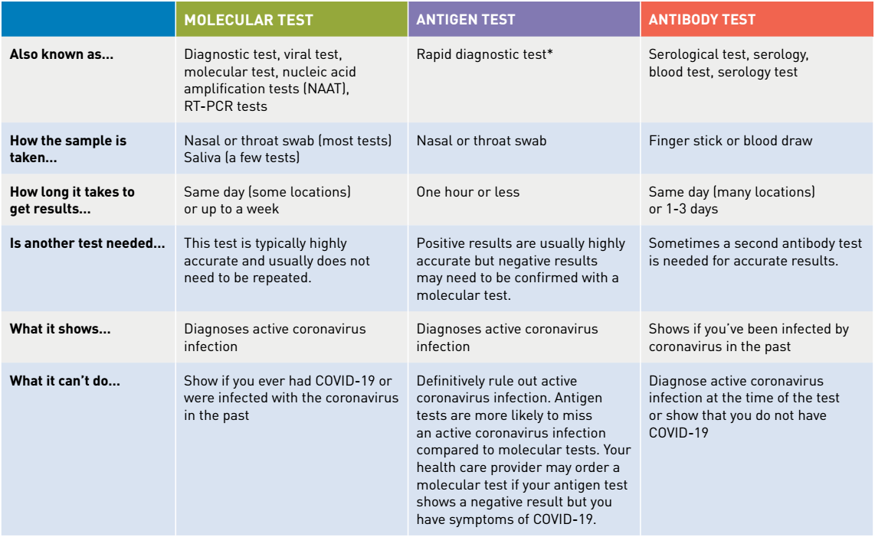
2 b. Testing: types of tests

Slide 7
2 b. Testing: happy flow
5 phases
  determination of a cause for performing a Covid-19 test on a patient and delivery of a corona test prescription code (CTPC) from a central database CTPC
  reservation of a sampling moment
  sampling
  execution of the test and analysis of the test result
  making the test results available
very modular, event driven and rule based information system

Slide 8
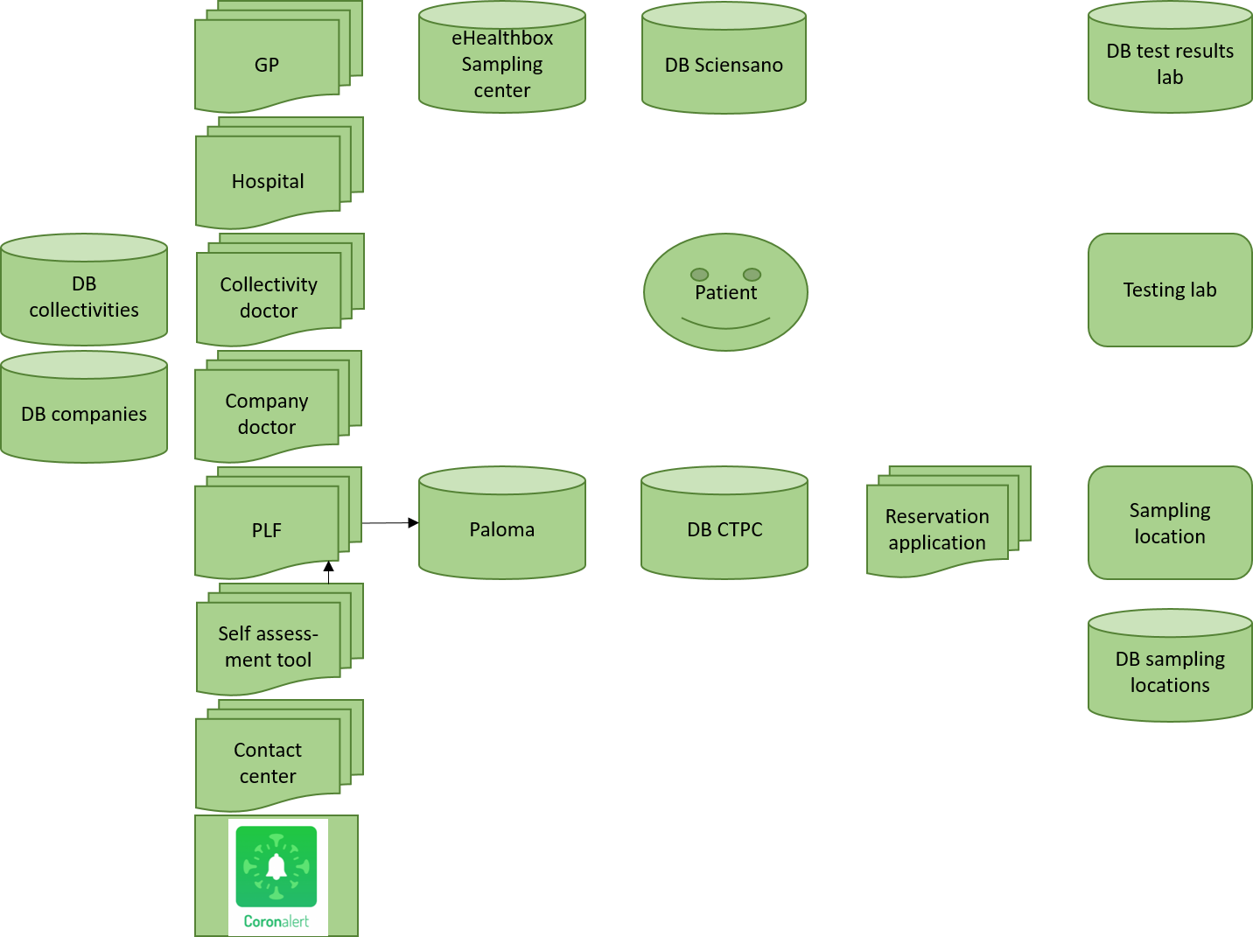
2 b. Testing: context diagram

Slide 9
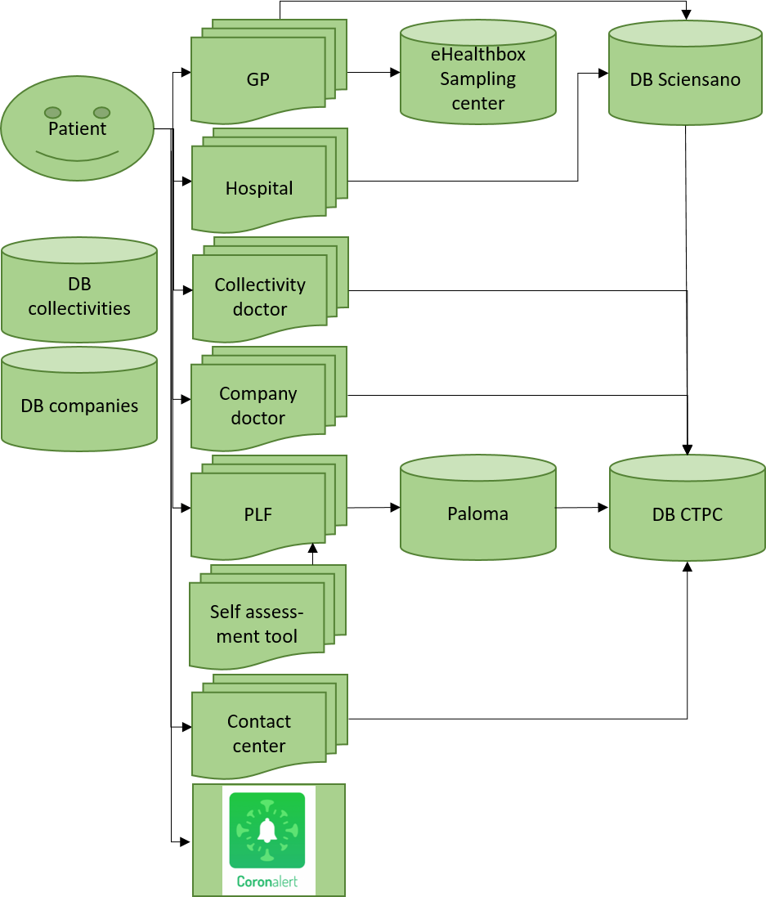
2 b. Testing: determination of a cause for performing a Covid-19 test

Slide 10
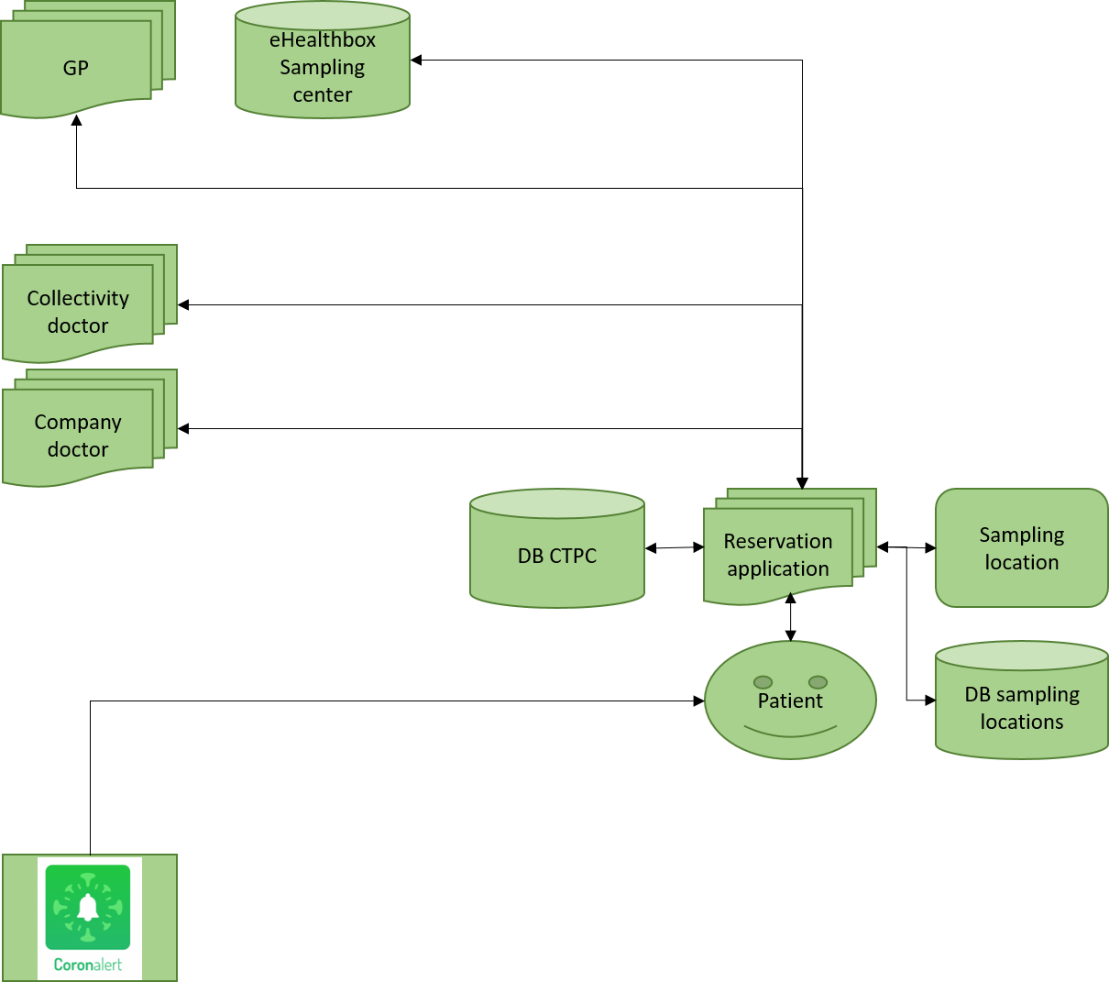
2 b. Testing: reservation of a sampling moment

Slide 11
2 b. Testing: sampling and execution of the test
Testing lab
DB CTPC
Sampling location
Patient

Slide 12
2 b. Testing: making the test results available
GP
DB Sciensano
DB test results lab
Patient
Testing lab
Collectivity doctor
Company doctor

Slide 13
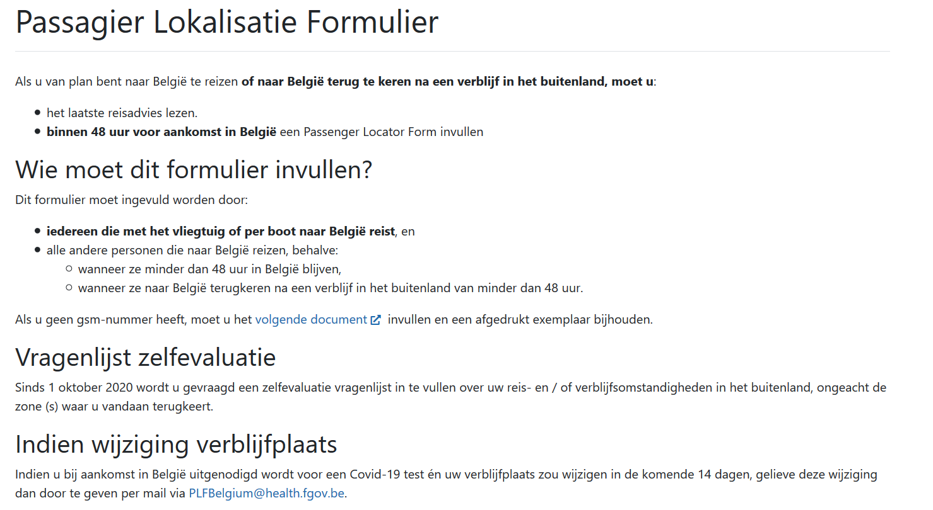
2 c. Passenger Locator Form
https://travel.info-coronavirus.be/nl/public-health-passenger-locator-form

Slide 14
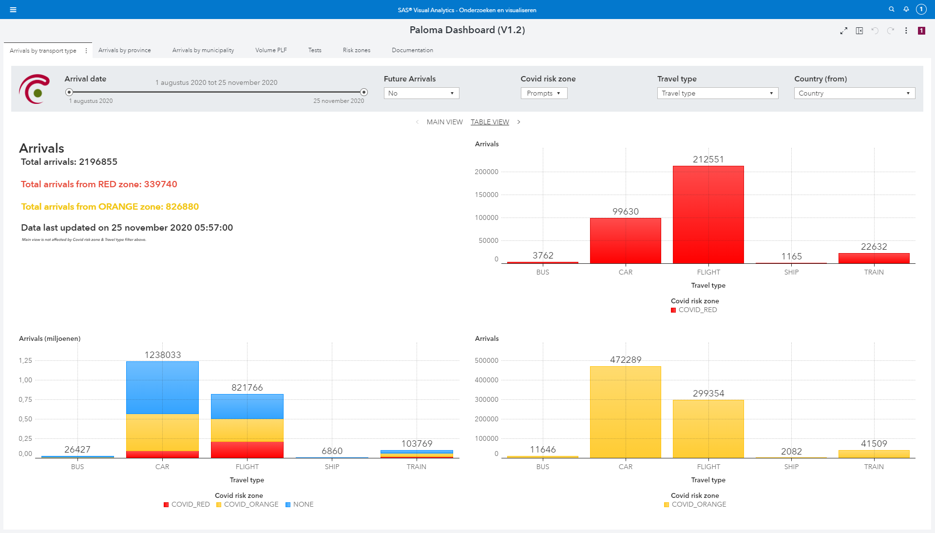
2 c. Paloma

Slide 15
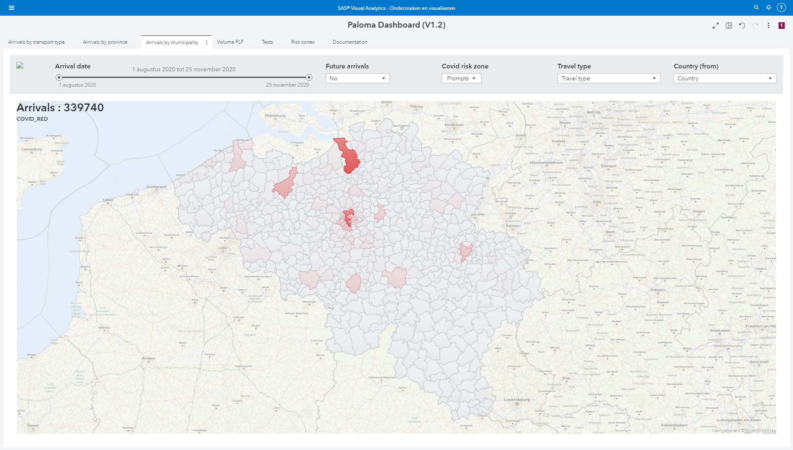
2 c. Paloma

Slide 16
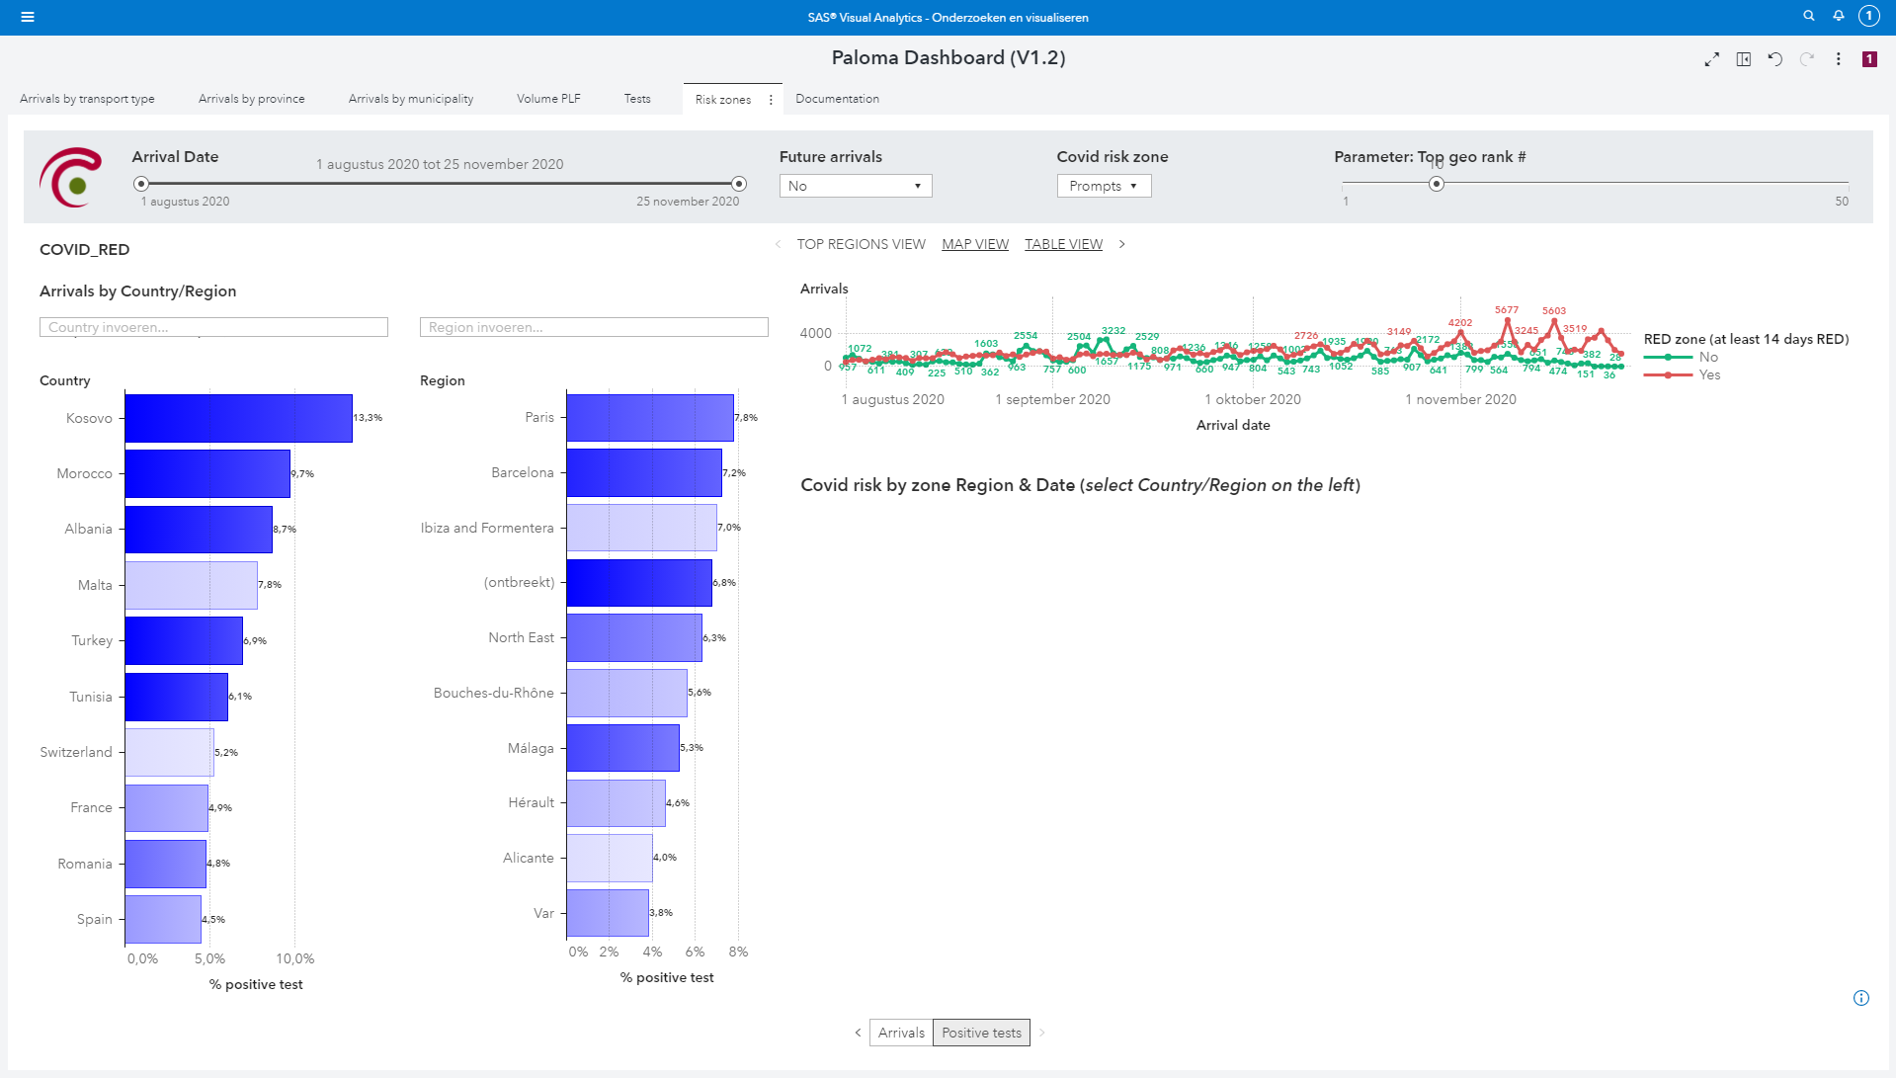
2 c. Paloma

Slide 17
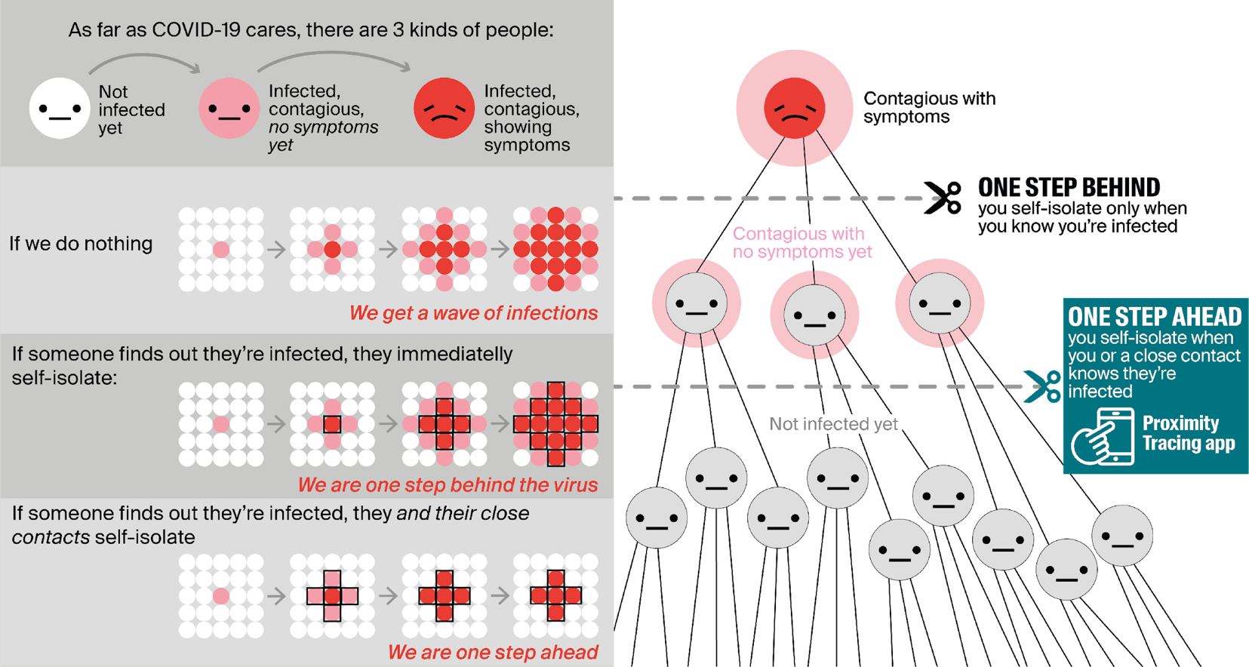
2 d. Contact tracing: why ?

Slide 18
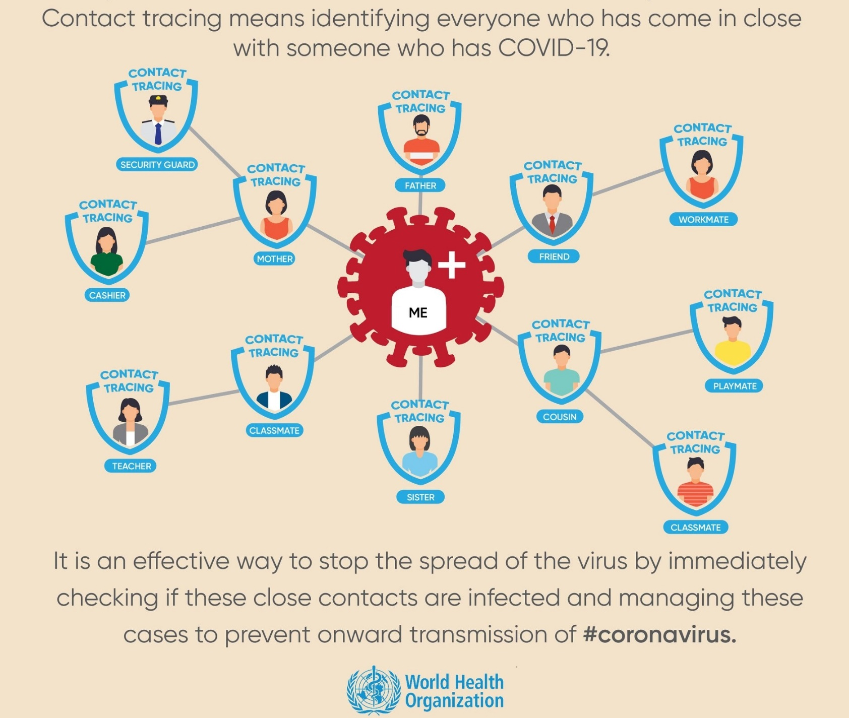
2 d. Contact tracing: what ?

Slide 19
2 d. How contact tracing is put in place ?
contact tracing by health care providers
contact tracing by contact centers
  see https://www.corona-tracking.info/
contact tracing within companies and collectivities
  see https://co-prev.be/nl/covid-19-informatie/ or https://co-prev.be/fr/covid-19-information/
contact tracing via app Coronalert
  see https://coronalert.be/

Slide 20
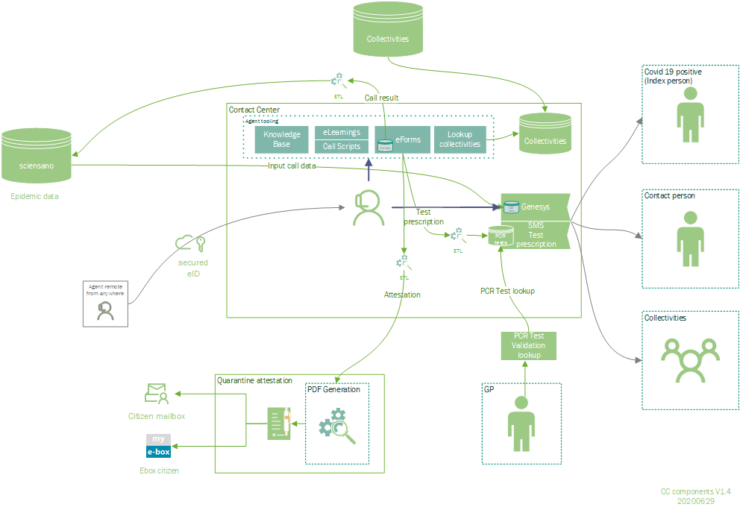
2 d. Contact tracing by contact centers

Slide 21
2 d. Contact tracing within companies and collectivities
call by contact center
identification of infected person (index case)
risk analysis
identification and triage of contacts (high risk – low risk)
contacting contacts
measures for contacts
  high risk: quarantine – telework/unemployment – vigilance for symptoms
  low risk: social distancing – vigilance for symptoms
resumption of work

Slide 22
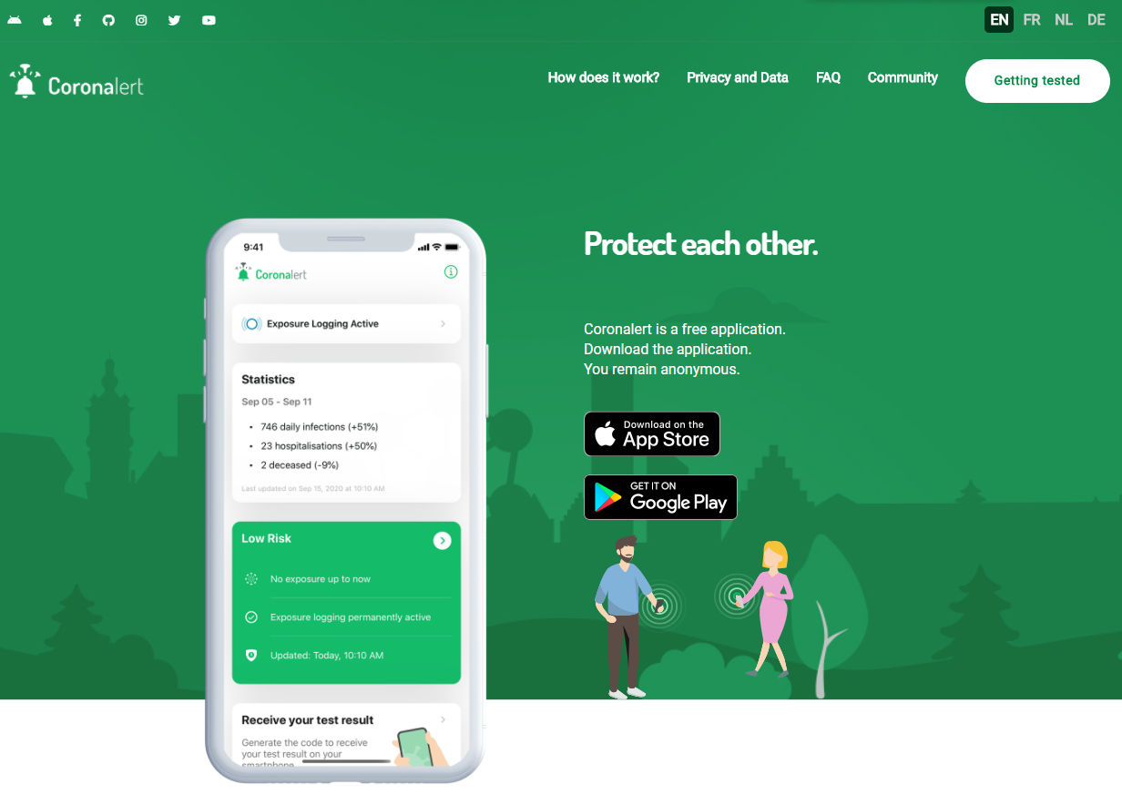
2 d. App Coronalert

Slide 23
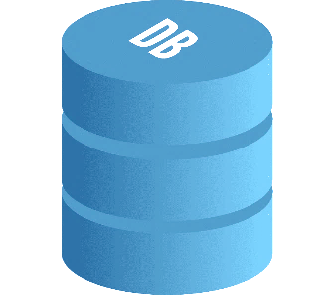


2 d. App Coronalert
installation
operation
RPIA3
RPIB4
RPIA1
RPIA2
RPIA3
RPIA4
RPIB1
RPIB2
RPIB3
RPIB4
Store
RPID1
RPIC2
TEKA
TEKB
TEKA
TEKB
RPID1
RPID2
RPIC1
RPIC2
RPIC3
RPIC4
RPID1
RPID2
RPID3
RPID4
store
RPIA3
RPIC2
TEKD
Store
RPIA3
RPID1
TEKD
TEKC
TEKC

Slide 24



2 d. App Coronalert
test
proximity tracing
TEKD
TEKD
TEKD
TEKD
TEKD
Store
RPID1
RPIC2
TEKA
TEKB
test result
TEKD
TEKD
Store
RPIA3
RPIC2
TEKD
Store
RPIA3
RPID1
TEK*
TEKC

Slide 25


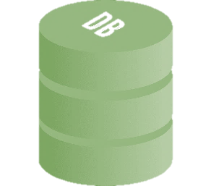




2 d. App Coronalert
overview
TEKD
RPIA3
TEKD
TEKD
TEKD
RPID1
RPIB5
RPID1
test result
test result
TEKA
RPIB5
RPIA3
RPIB5
TEKD
RPIA3RPID1
RPIA1
sample
TEKB

Slide 26
2 d. App Coronalert
Details: GP visit
RAG: Date patient became infectious
= two days before onset of symptoms
or = two days before day of test (if asymptomatic)
Do you have symptoms?
If yes: day of onset of symptoms?
test result
test result
Date (infectious)
Test number (15+2)
INSZ
Date (infectious)
Test number (15+2)
SPECIMEN
TEKD
2 check digits to detect typos

Slide 27
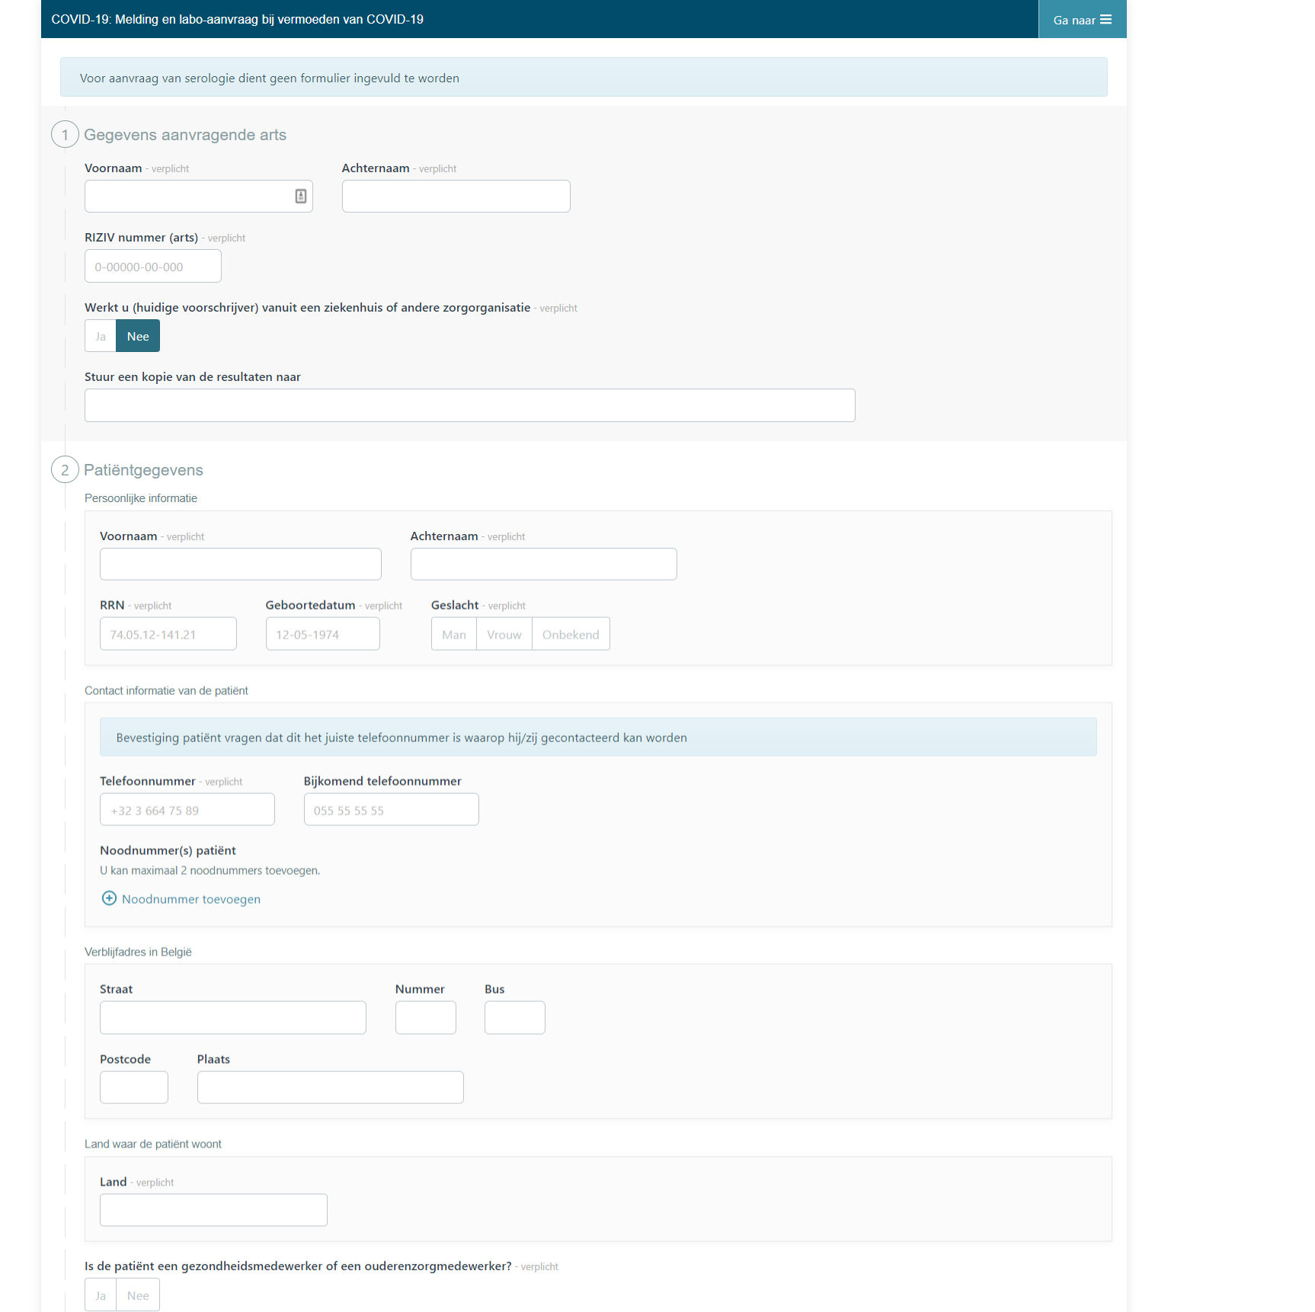
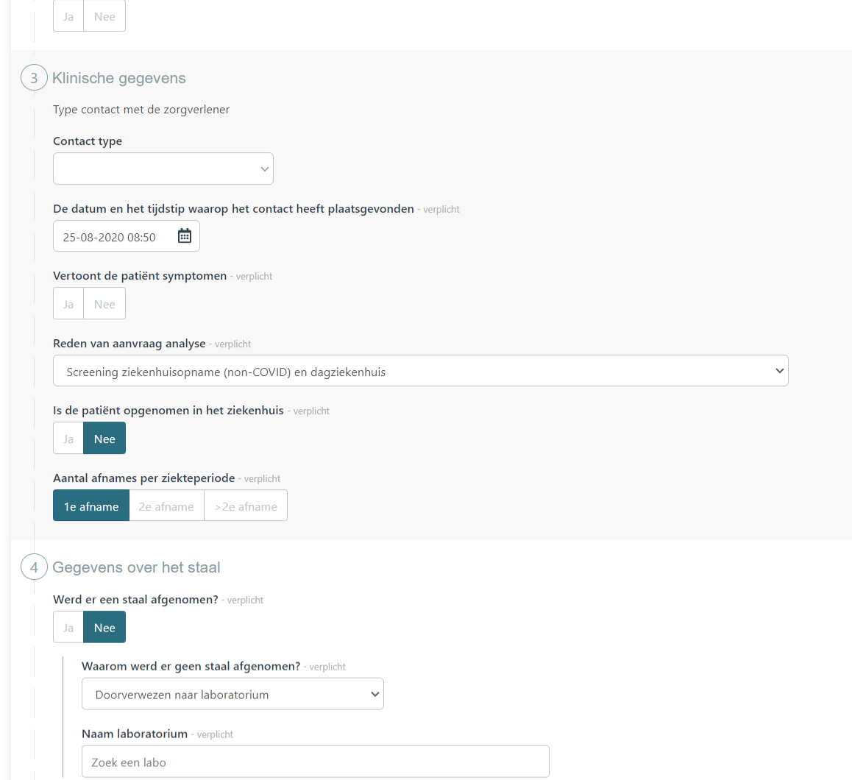
2 d. eForm COVID-19 lab request (1/2)

Slide 28
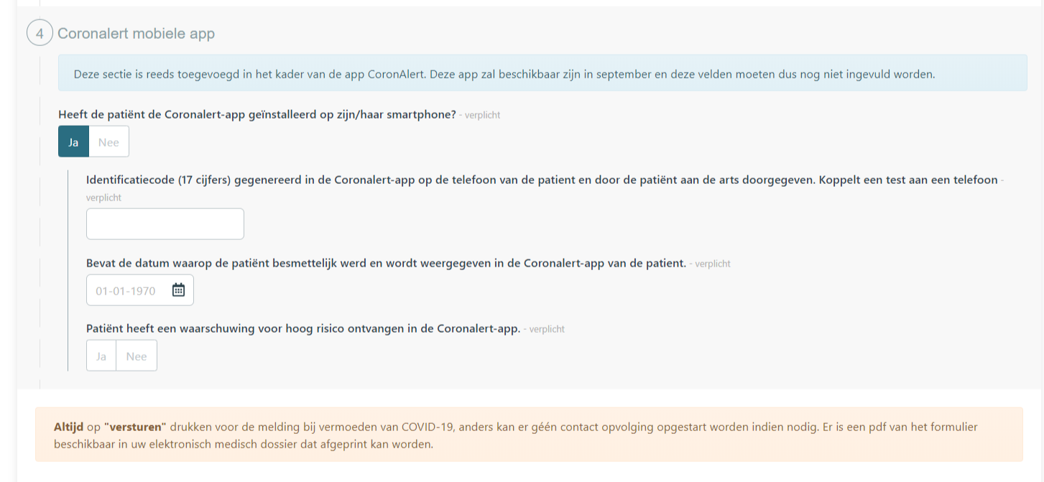
2 d. eForm COVID-19 lab request (2/2)

Slide 29
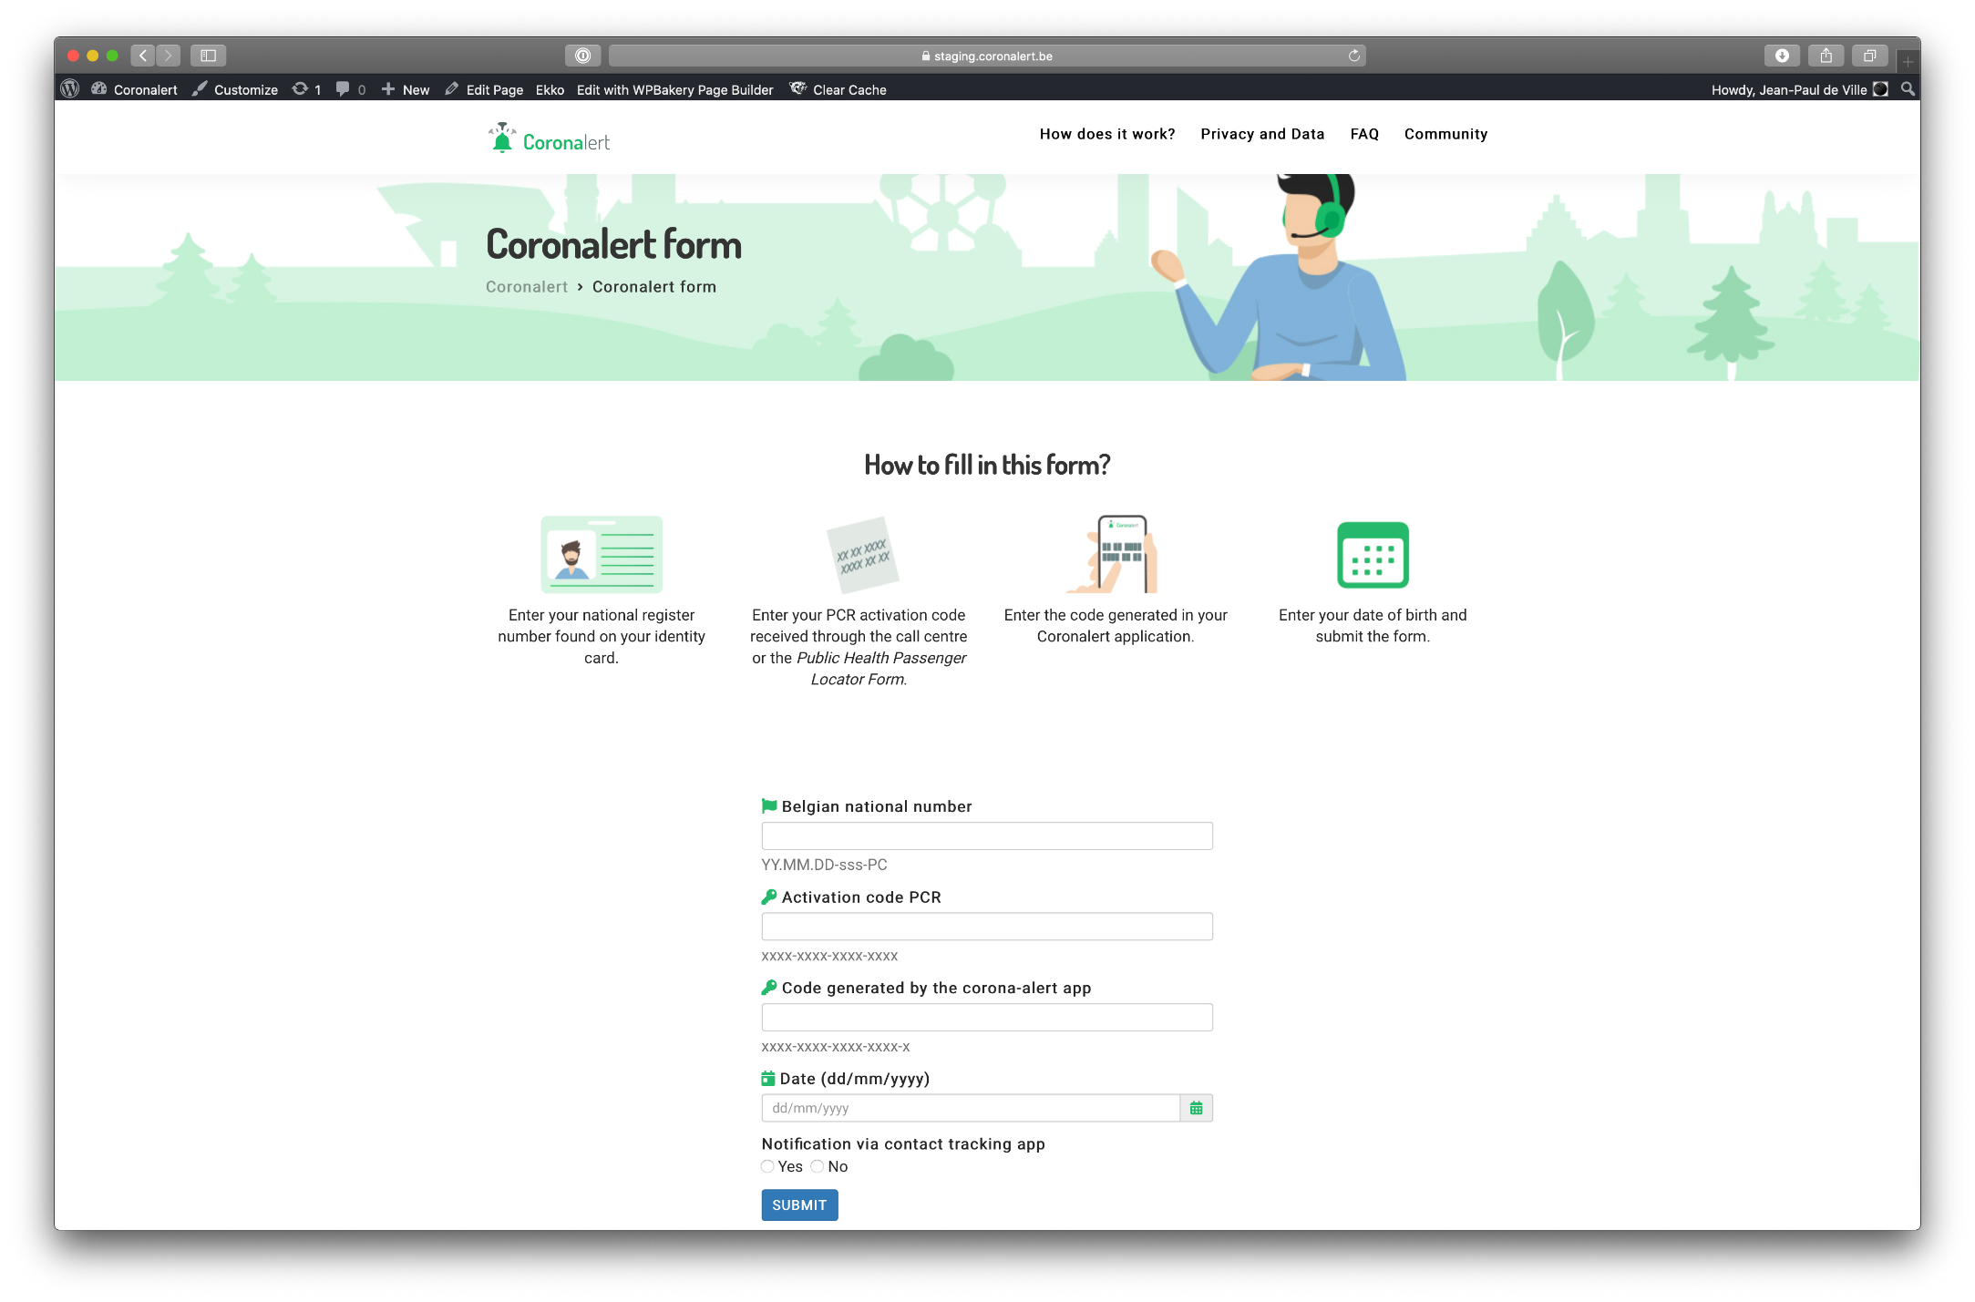
2 d. App Coronalert
Details: webform for user

Slide 30

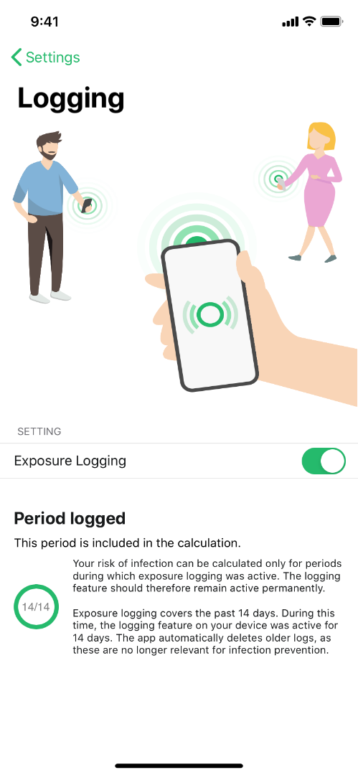
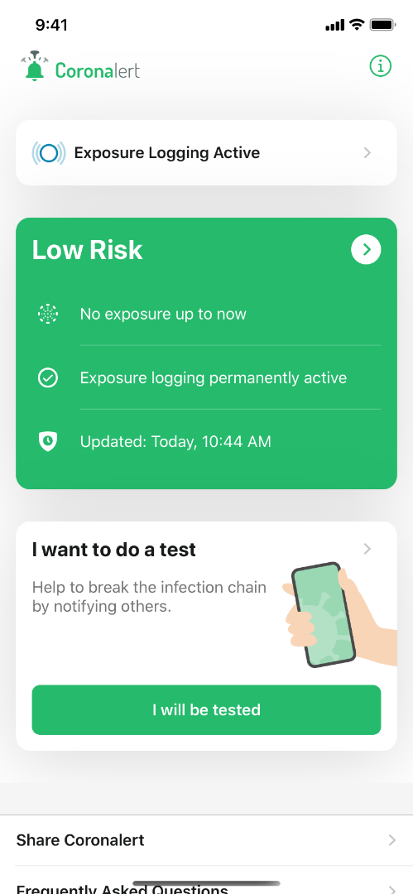
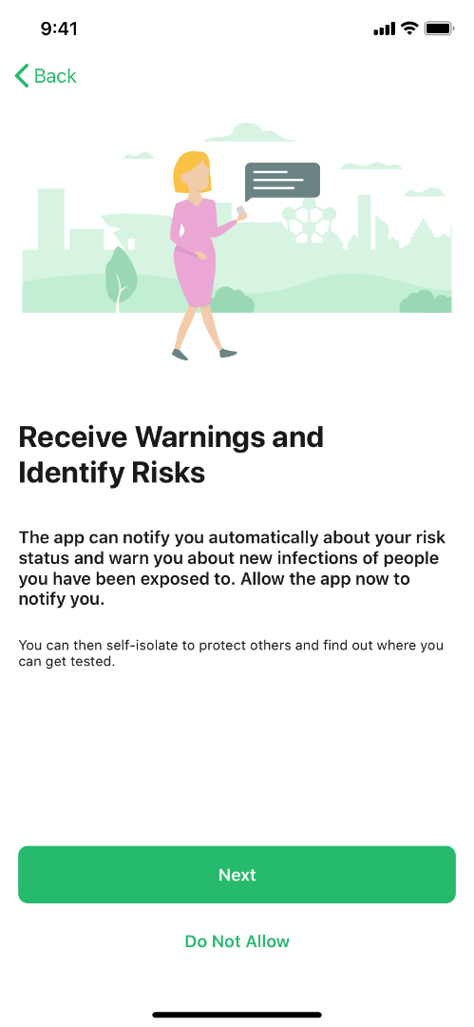
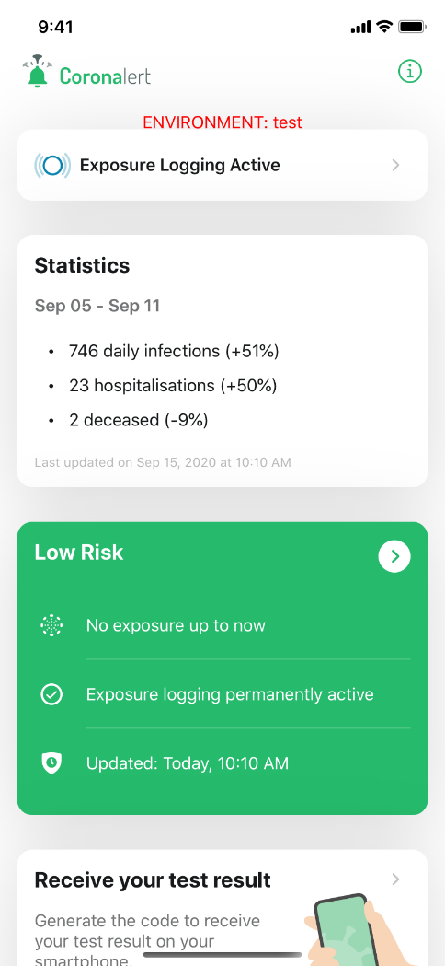
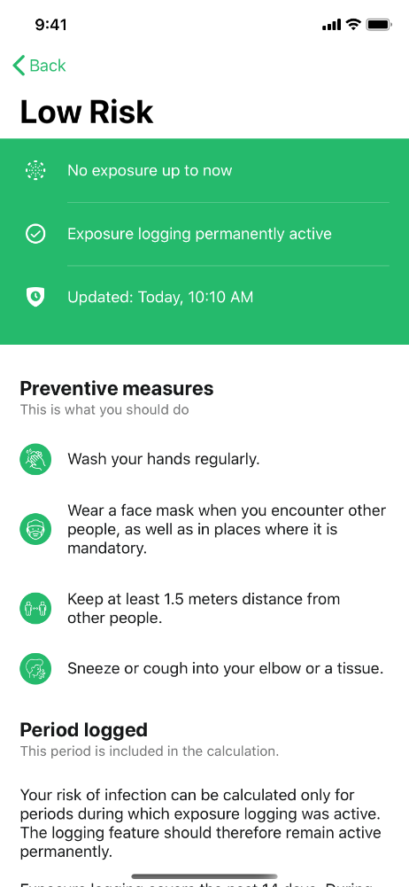
2 d. App Coronalert: put your phone to work

Slide 31
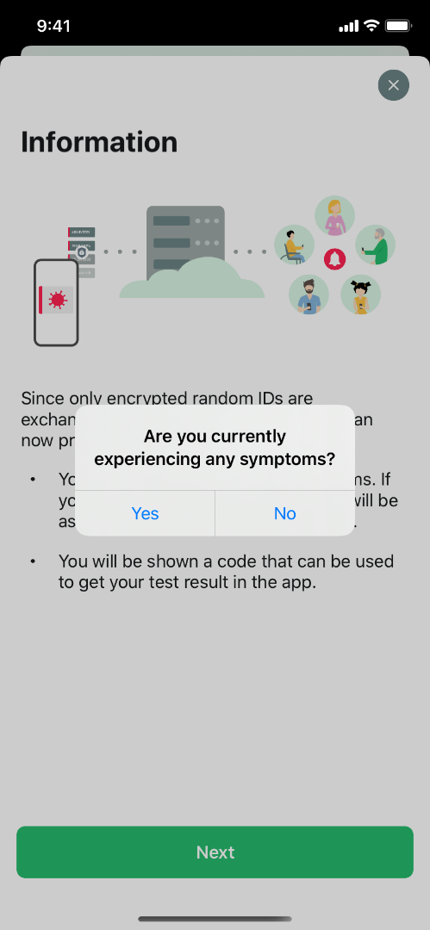
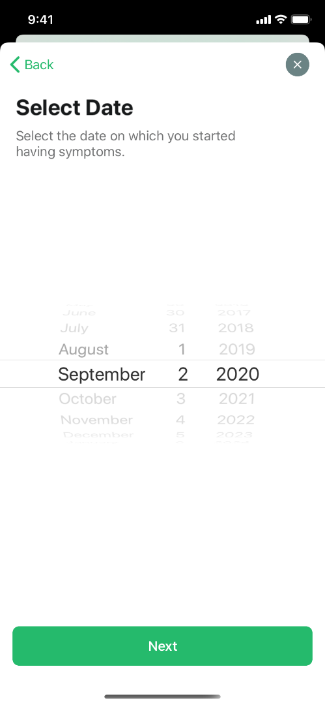
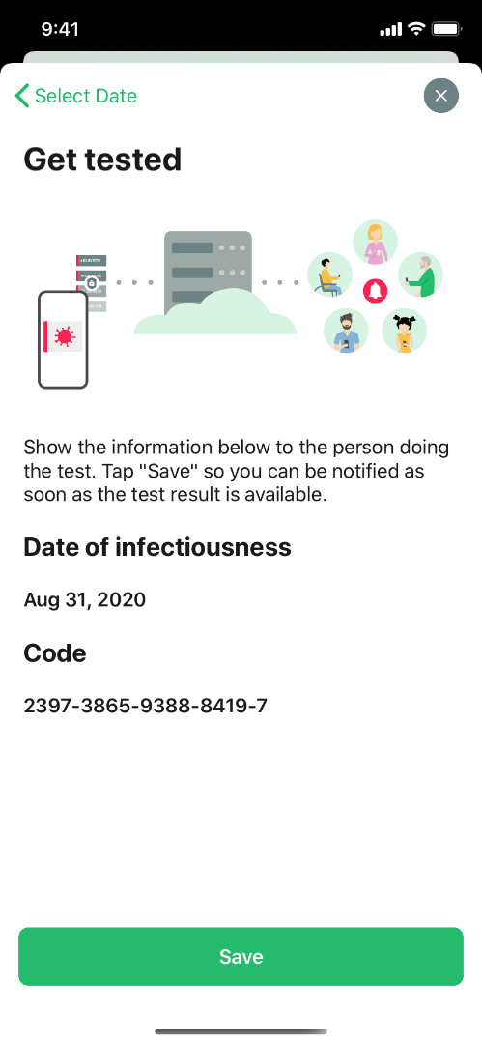
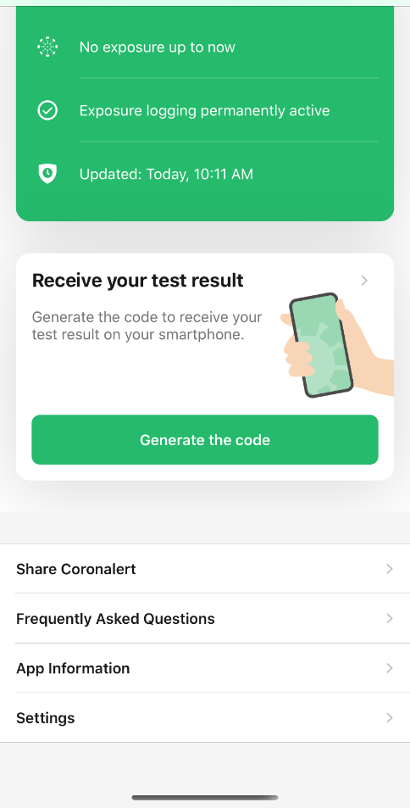
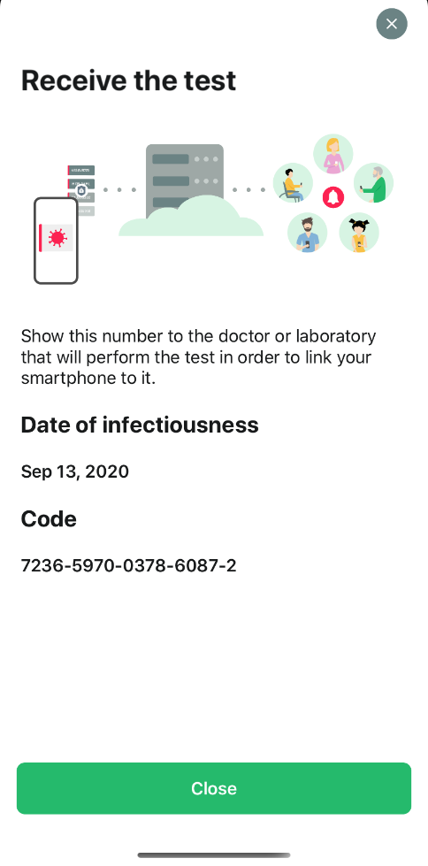
2 d. App Coronalert: get tested

Slide 32
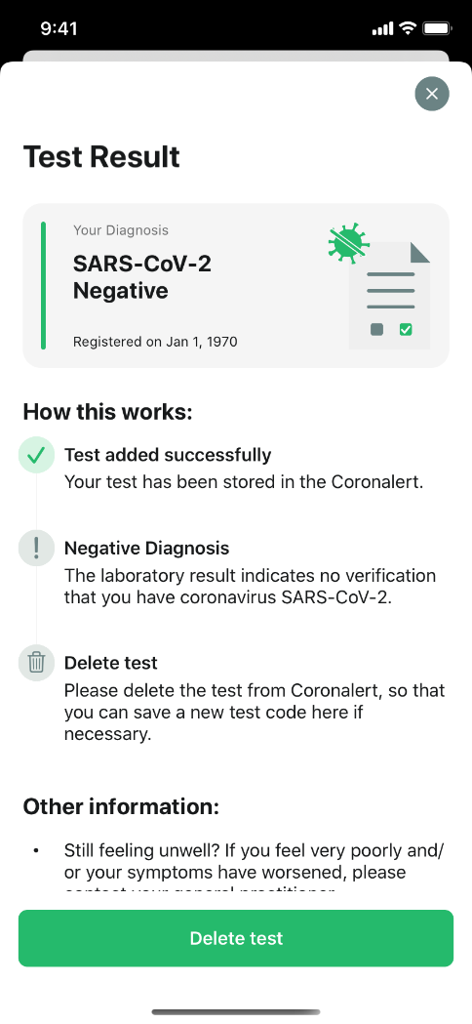
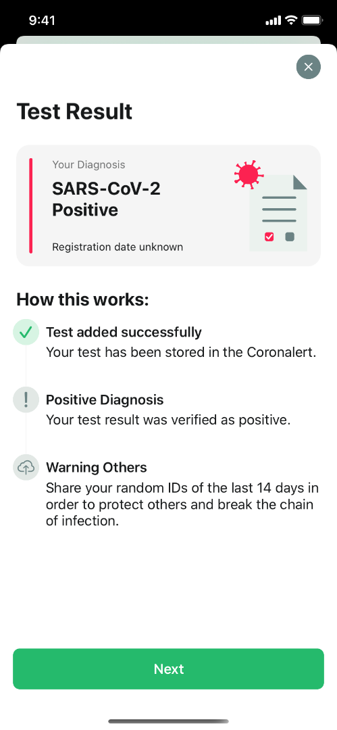
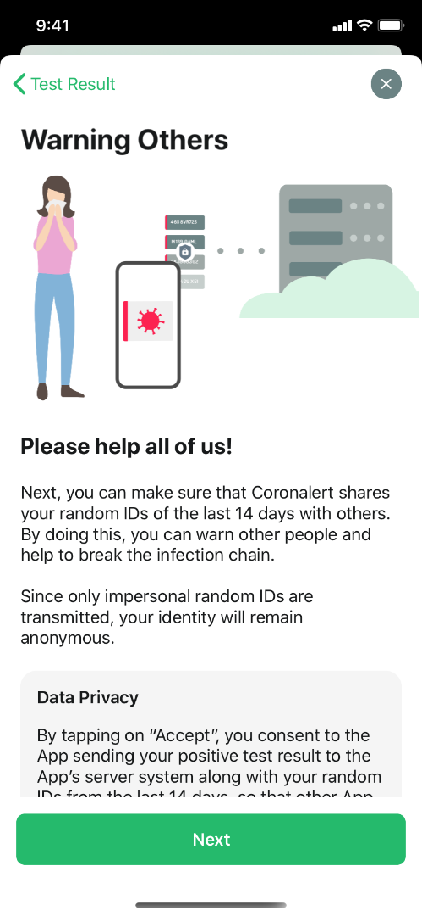
2 d. App Coronalert: test result

Slide 33
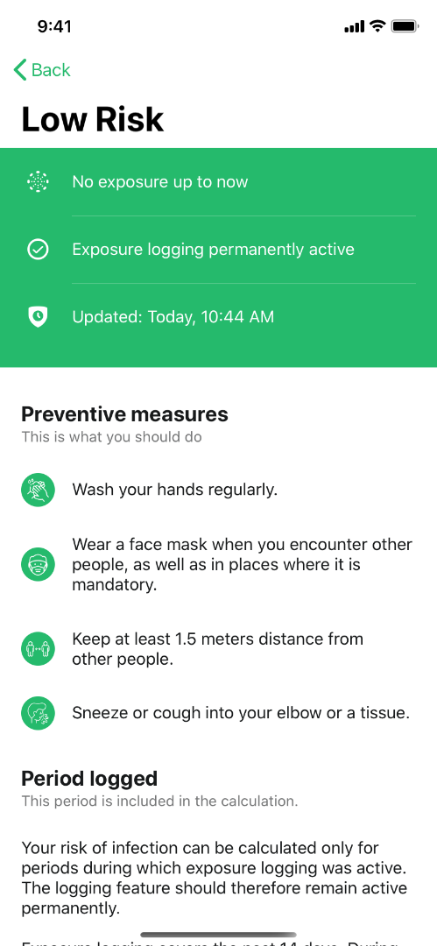
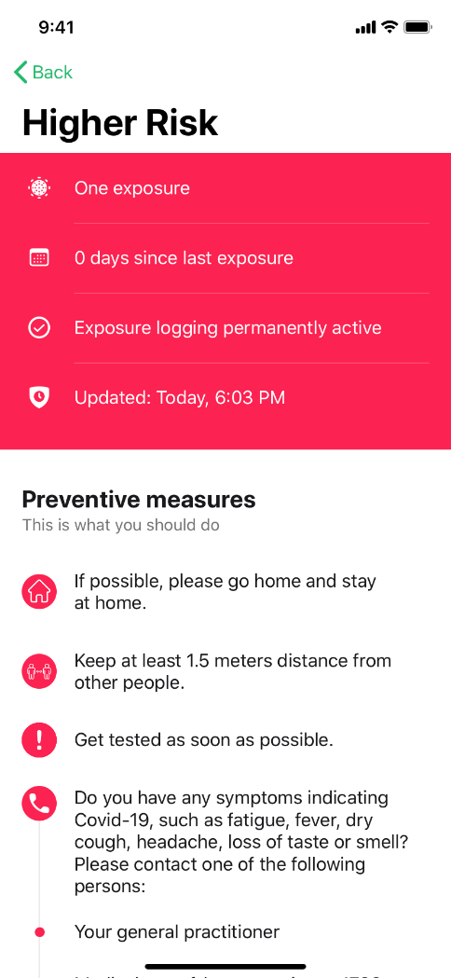
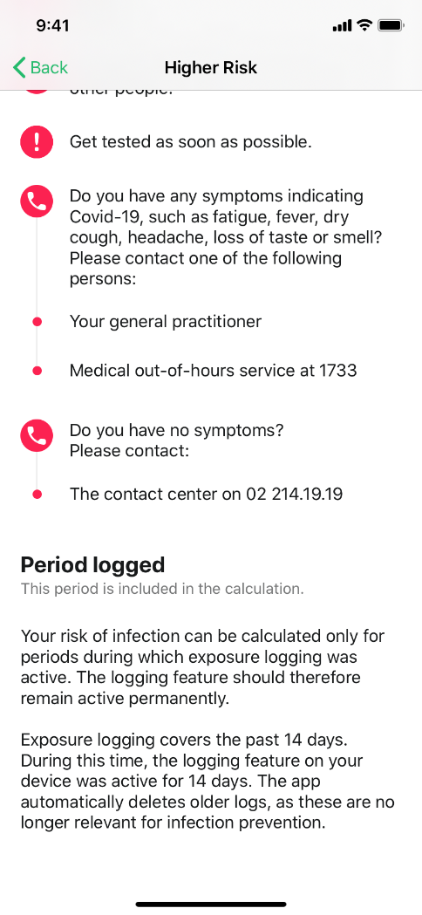
2 d. App Coronalert: be notified

Slide 34
2 d. App Coronalert
recommend the use of the app
exchange of anonymous codes by the app can be deactivated and reactivated
generate a test code with the app if you are tested and ensure that it ends up at Sciensano together with your social security identification number => you will receive your test result on the app as soon as it is available
  general practitioner via eForm LaboratoryTestPrescription
  person to be tested via webform (see https://coronalert.be/nl/coronalert-formulier/)
publish the transmitted anonymous codes if you test positively

Slide 35
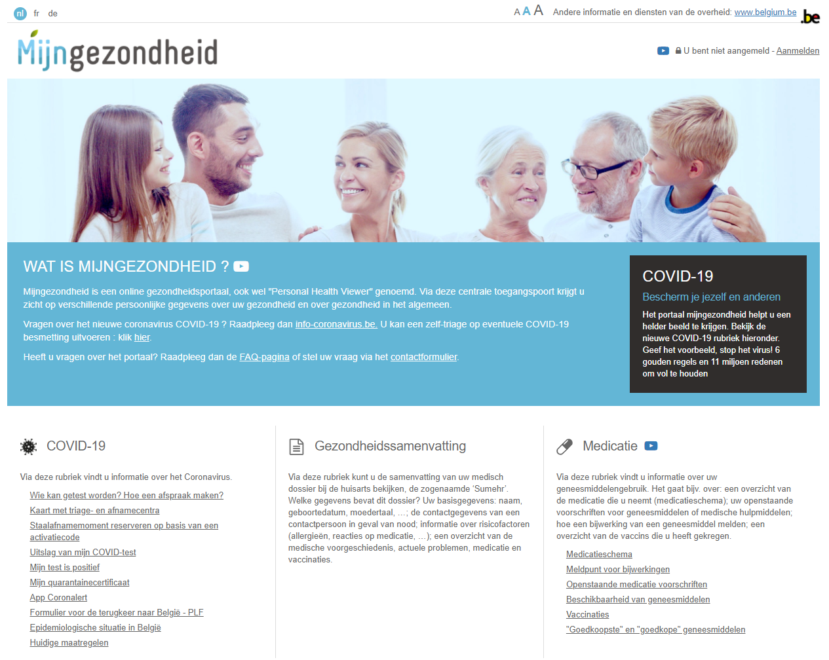
2 e. Integrated citizen portal

Slide 36
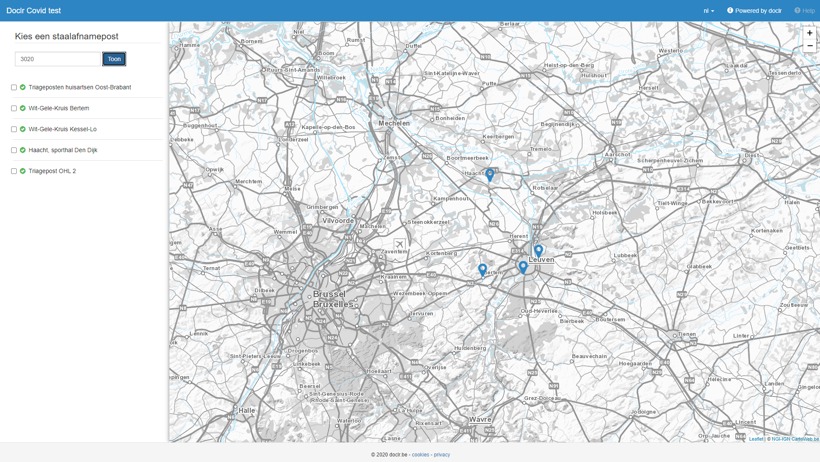
2 e. Integrated citizen portal

Slide 37
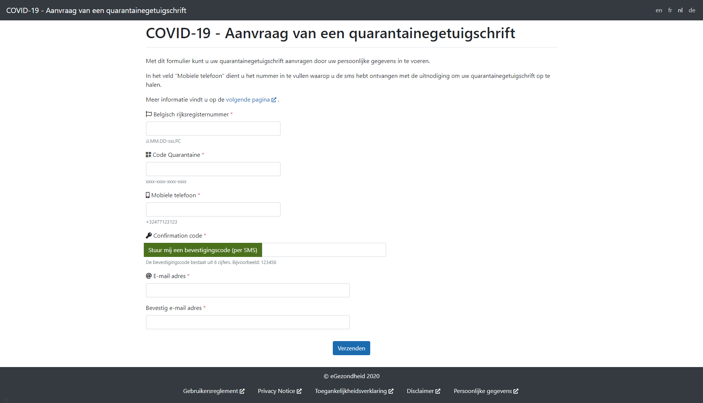
2 e. Integrated citizen portal

Slide 38
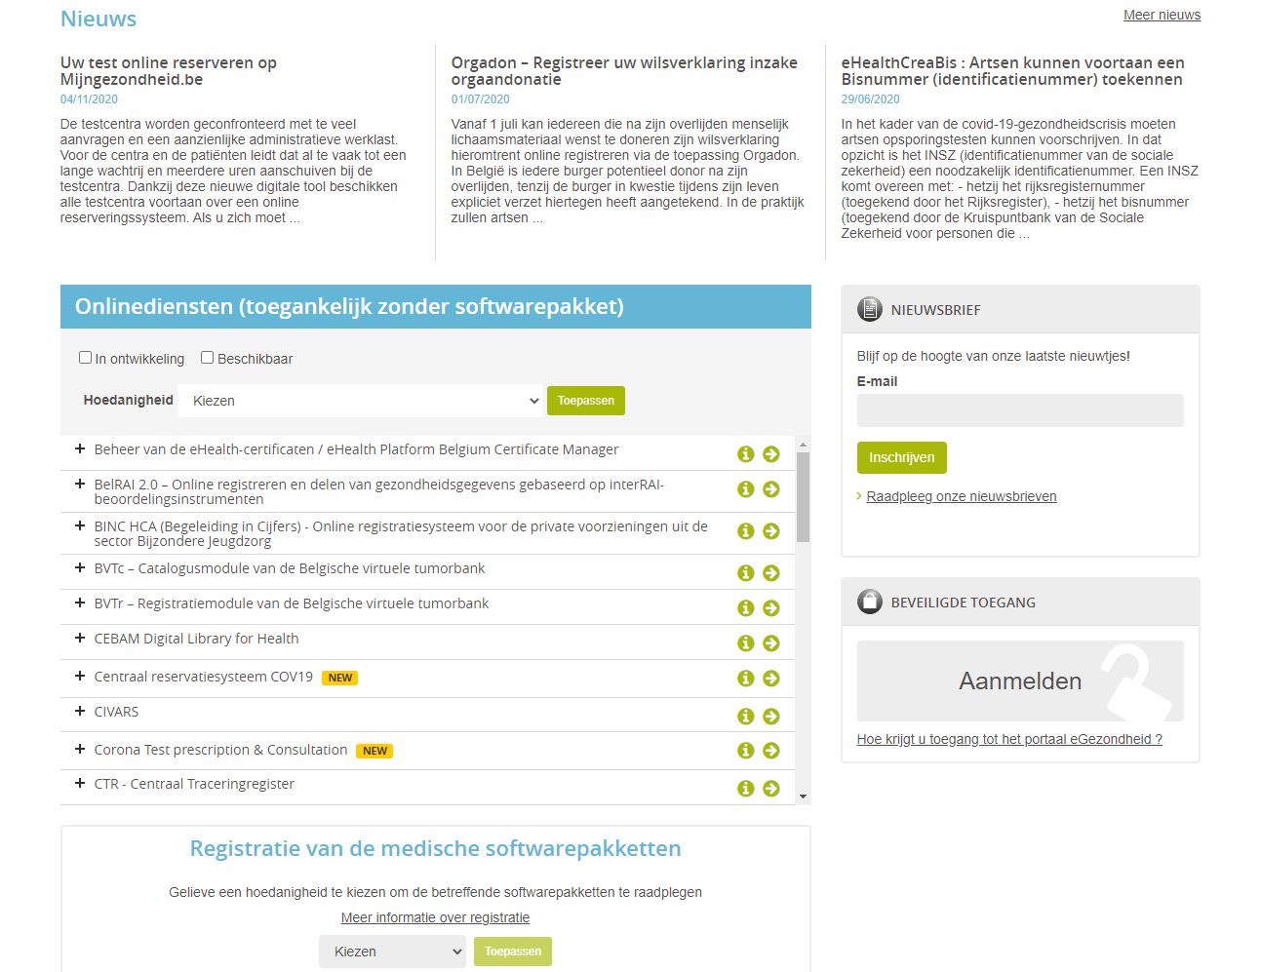
2 e. Integrated portal for health care providers

Slide 39
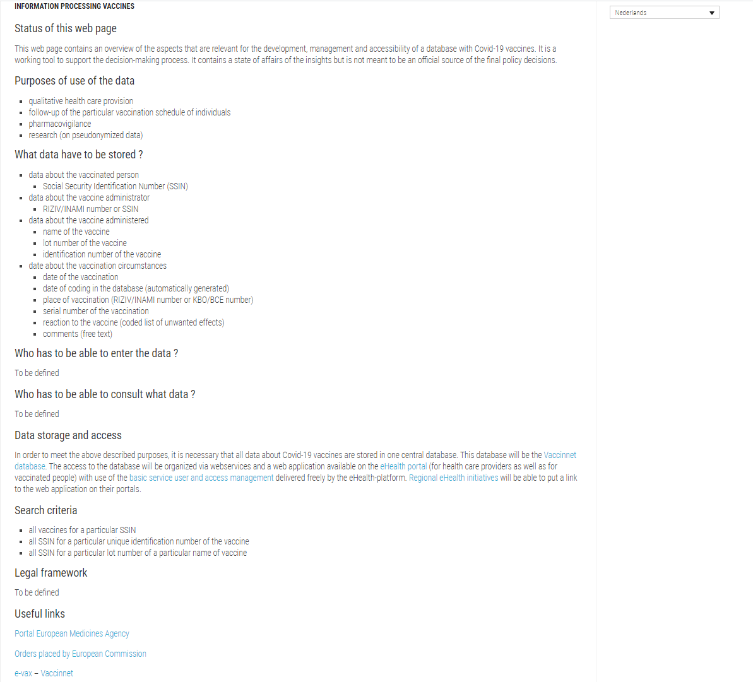
2 f. Vaccination

Slide 40
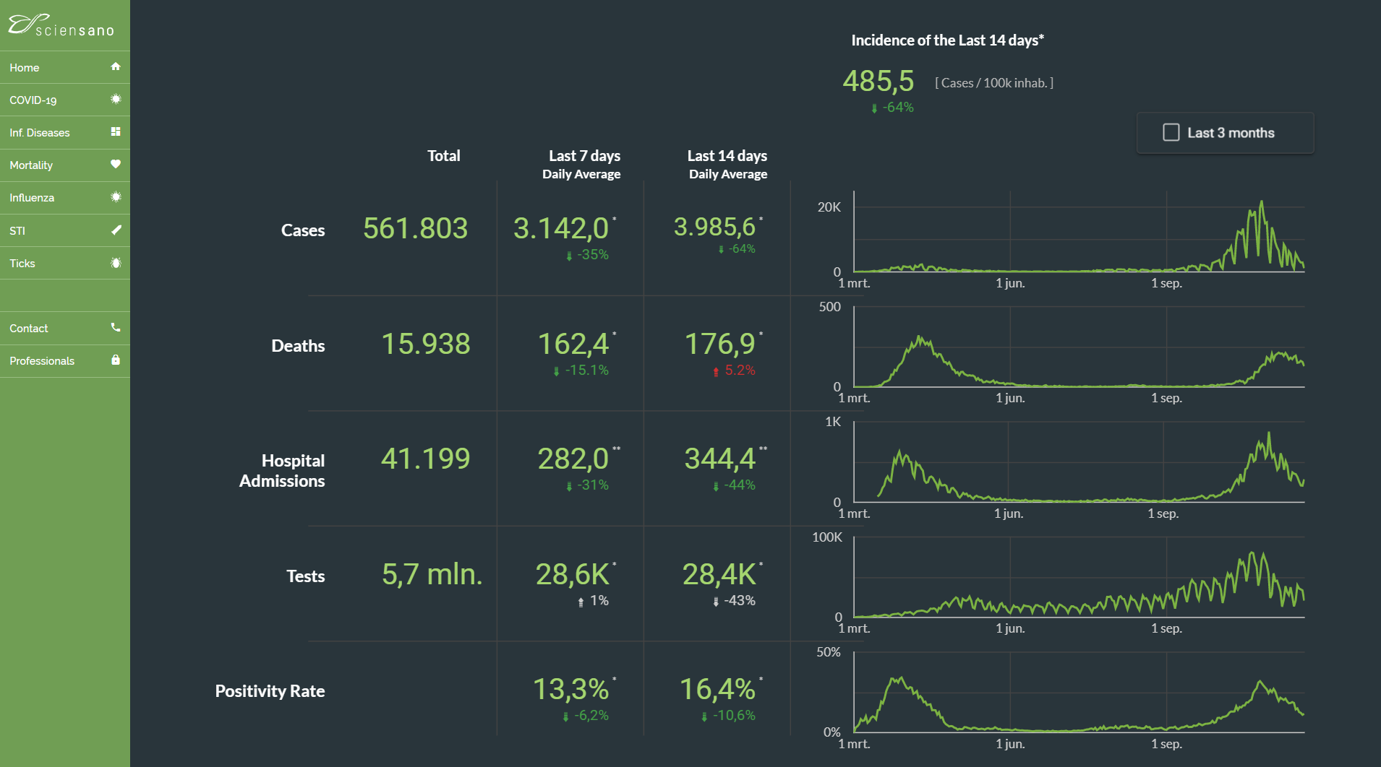
3. Big data analysis

Slide 41
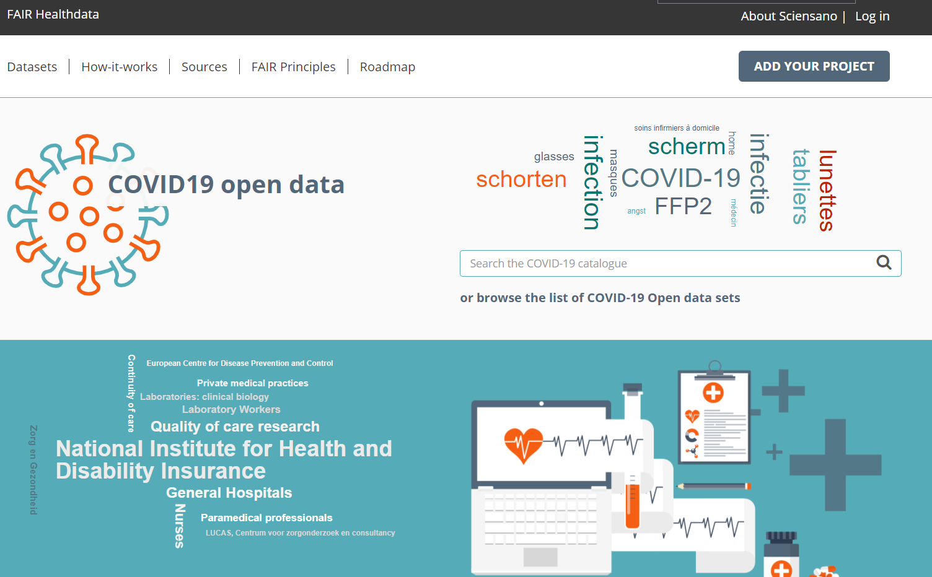
3. Big data analysis
https://fair.healthdata.be/

Slide 42
4. Conclusions
‘never waste a good crisis’: well-prepared improvements that were immersed in endless consultation for years suddenly become possible through the sense of urgency
a good balance between agility and quality is only possible if
  business-ICT fusion up to the highest level
  a solid architecture at all levels
  continuous, clear and precise communication
Belgian eHealth architecture and governance is very solid
  conceptual framework
  basic services and authentic sources
  quality of GP software and collaboration between suppliers
  technical and semantic standards
  governance structure

Slide 43



More information on www.corona-tracking.info
frank.robben@ehealth.fgov.be
@FrRobben
https://www.ehealth.fgov.be
https://www.ksz-bcss.fgov.be
https://www.frankrobben.be

