Slide 1
Rina as a Service: RaaS
A first proposal
Several impacts
How to get on: a poll

Slide 2
Rina as a Service: Agenda
Motto’s: “Avoid duplication” - “enable right level of execution”
RaaS in the full Service Spectrum
Current repartition of responsibilities
RaaS repartition of responsibilities
RaaS: how to get on … poll 1
RaaS what could it be: proposal overview
RaaS what could it be: closer look a different topics
RaaS: how to get on … polls 2

Slide 3
Rina as a Service: Avoid duplication - Enable Right level of execution
  MOTTO 1:
  Avoid duplication
  “Everything that is duplicated ,
  - if not strictly necessary -
  is a waste of effort and money,
  and will result in a lower quality of service.”
  MOTTO 2:
  Enable right level
  of execution
  “Decisions and actions should be dealt with
  at the most immediate (or local) level
  that is consistent with their resolution
  to enable lean and cost effective operations.”
We believe the above two principles are key drivers behind
durable and economically viable ICT solutions

Slide 4
Rina as a Service: RaaS in the full Service Spectrum
“Rina as a Service”:
Is a proposal to change the way the application is provisioned to the target audience.
“Rina hand-over”:
Is the project to transfer the Software Delivery Processes from the existing supplier to one or more new supplier(s)
RINA
SD
Software
Delivery
APv
Application Provisioning
“everything needed to deliver a qualitative workable Software Product (SP)”
“everything needed to ensure the SP can be used, qualitatively, by the target audience”
SD-APv overlap:
APv is bound to the product as delivered by SD.
SD needs to take into account the way APv wants to provision the application.
RaaS would require changes to the SP delivered by SD, depending on the “RaaS options” withhold.

Slide 5
Rina as a Service: Current repartition of responsibilties
MS as APv
many MS do APv to their end-users with …
… different requirements for SD
… many people to be trained
… big demand for support
EC does Software Delivery
Lot of requirements by different APv
Lot of support to different APv
RINA
SD
APv
MS
inst
EC
inst
MS
inst
MS
inst
inst
We believe that the nature of deviation in requirements
between Member States and Institutions does not justify the current amount of duplication of Application Provisioning
MS
MS
inst
inst
inst
inst
inst
inst
inst
MS
Institution as APv
Some MS delegate APv to the institution level.
MS
inst
Most disparaties arise from technical differences in Apv not from business differences

Slide 6
Rina as a Service: RaaS repartition of responsibilties 1/3
Software Delivery
Less but other requirements by APv
Less people of Apv to support and train
RaaS as APv for many MS
One (or a few ) RaaS Providers could provision the application
to institutions of many MS.
MS / Institutions that want to be their own APv could still do it, but …
… the more MS subscribed to RaaS the more benefits. (economy of scale)
Remark:
Even without RINA-handover RaaS could be implemented.
RINA
SD
APv
RaaS APv
Important:
Close collaboration between (new) SD partner and RaaS provider will be required.
EC+
MS
RaaS APv
@ RaaS provider
Less people in total, but highly skilled, should ensure a higher quality of APv.
Total amount of requirements for SD
➔ Reduced but changed
➔ because:
  - Software Product must fit for RaaS
  - less requirements for SD by 1 Apv
  - Apv more self-sufficient in terms of + support
  + “SD-add-ons” by APv.
What type of changes would be needed to the SP?
MS
What type of operational changes would it provoke for MS and Institutions?
What other constraints could prevent MS to subscribe on RaaS?

Slide 7
Rina as a Service: RaaS repartition of responsibilties 2/3
What type of operational changes would it provoke for MS and Institutions?
RINA product delivery puts a lot of effort in “middleware” and deployment
EC+
APv
MS
inst
clerks
Multitenancy should be implemented in the product so that administration levels can be divided in:
Institution level admin.
MS(AP) level admin
APv level admin
All Member States put a lot of effort in middleware, deployment & infrastructure, service delivery
Current repartition
RaaS repartition
Case handling
Case handling
User mgmt
usergroup & policy mgmt
Institution ( = tenant )
level configurations
Institution ( = tenant )
level configurations
Institution mgmnt
Related to “IR” mgmt
Related to “AP” mgmt
Member State ( or AP )
level configurations
Member State ( or AP )
level configurations
“All” Service delivery aspects.
RINA service delivery
APv Service Delivery
quality “Member State” management tools should decouple
“SW configuration mgmt” from “platform mgmt”
software components
Installation & user guides
Support & Bugfixes
Rqrmnts, change, release mgmt
Rina product delivery
Rina product delivery
Postgress, holodeck, bonita, Elastic Search, Tomcat, FileShare
Logbased troubleshooting
Rina “middleware”
Rina “middleware”
Because of highly skilled APv team
The SD team should be able to diminish the effort to put into “middleware” and “deployment”
Installation scripts & guides
Technical certificates
Deployment testing
Rina deployment
Rina deployment
Servers
network, storage,
Monitoring, back-up,
Rina Infrastructure
Rina Infrastructure

Slide 8
Rina as a Service: RaaS repartition of responsibilties 3/3
What type of operational changes would it provoke for MS and Institutions?
Clerks manage their cases
Institution manage their users.
Member States manage their institutions
Software Delivery makes the software
APv manages the RaaS platform
EC+
APv
MS
inst
clerks
Enable right level of execution
Avoid Duplication
RaaS deployment
Landscape
Current deployment
Landscape
Close collaboration with SD should lead to a “perfect match” between Software product / middleware and deployment layer
MS 1
MS 2
MS 3
A’
Less diversity in technical setup should lead to less - TOTAL -effort in the middleware and deployment layers for SD
‘
‘‘
‘’‘
A’
‘
‘’
‘’’
A
X
Y
Z
MS 1
MS 2
MS 3
RaaS platform

Slide 9
Rina as a Service: Raas
How to get on …
  Poll - 1:
  What Member States are interested in the RaaS Solution as subscriber?
  For how many Tenants?
  For what volumes?
  Poll - 2:
  Are the any big objections / constraints to this RaaS approach
  Poll - 3:
  Who would want to collaborate on the detailed technical feasability study for RaaS?
    From Software Delivery side
    From future RaaS side
    From subscribing MS side
Next Slides:
What type of changes would be needed to the SP?

Slide 10
Rina as a Service: RaaS what could it be… overview
Impact indicator
<
Legal Contractual Architectural
Privacy Operational Security
Clear and measurable guarantees
- Availability / service window
- Message delivery
- RTO / RPO
- Release & evolution mgmt, …
References of
topic elaboration
<
16
Multi-MemberState Multi-Tenant.
- RaaS Admin Level
- Member State Admin Level
- Tenant Admin Level
<
1
2
Clear reponsibilities RaaS/MS/Tenants
- During subscribe / unsubscribe:
- During service usage
17
One or Multiple physical deployments - depends on SD & implementation
- Depends on MS/tenant requirements
<
1
2
<
RaaS
FOCUS
Activity Reporting & statistics
- on cases/messages In&out
- Communication partners
- Buc & SED types /
- Response times
3
Securely accesible over Internet
- eIDAS authentication
- secure ICT stack
<
<
15
Self Institution & User Management
- Rina Authorizations,
- Manageable by MS / Tenant admin
4
<
Data Protection against loss
- Guaranteed back-up / restore
- Case Archiving
- Access Security logs
- Data exportability ( per tenant )
<
5
Integration with EESSI via “APaaS”
- Access Point(s) should be installed close to RaaS,
- Ops delegated by MS to RaaS provider
<
12
13
14
Business Data: cases, messages, notifs
- preserved on RaaS platform,
- access via portal for dataowner only
- Trust of RaaS Admins …
<
7
9
11
6
Integration with local tenant systems
- Secured via 2-way SSL connections
- Via standard RaaS interfaces ( CPI, … )
<

Slide 11
Rina as a Service: Raas
What does RaaS Application Provisioning mean … in general
1.
Multi Member State & Multi-Tenant Deployment:
A centrally deployed Rina environment deployed & managed by the RaaS provider.
Consists of one or multiple physical deployments of the software, depending on
  the nature and capabilities of the software
  The number of tenants / member states that subscribe to it
  The level of Tenant isolation that is required
  The level of Tenant flexibility and diversity that is required.
That is securely accessible over the internet for end-users and MS systems.
That integrates to the EESSI network through either
  a Member State AccessPoint
  a Common RaaS AccessPoint
elaborated
further
elaborated
further
elaborated
further
2.
Member State & Tenant Subsription:
Several Member States can subscribe to RaaS...
On which they can subscribe one or multiple tenants ( = institutions )
On which every tenant have following elements configured inside their own tenants
  their own users ( = clerks and admins * )
  the tenant groups
  The policies and authorizations for interacting on BUC’s
Some Rina parameters would be equal for all tenants of a Member State
elaborated
further
* Raas could have different levels of admininistration : MS level, Tenant level, Raas Level…

Slide 12
Rina as a Service: Raas
Institution and User Access Management
3.
Accessibility by users:
All users get access to RaaS over internet.
Ful ICT Stack needs to be “sufficiently secured”
They should “HARD” authenticate before logging in by integrating the CAS login component with eIDAS (level “high”)…
… and afterwards be authorised to their proper tenant, group(s) and useraccount
Authentication and authorization is obtained – on logon – from the RINA User & policy management system. ( see next topic )
Attack surface 
Software changes
Implementation caution 
Software changes
MS needs to be active on eIDAS “high”
4.
Self Institution Management - Self User & Policy Management:
Each MS can manage their own Institutions on the platform, as they can also manage them in the Institution repository, via the RaaS Admin portal
Each tenant can setup usergroups, related authorisations and policies are setup, via the RaaS Admin portal, with restricted access to their own tenant configurations only.
User assignments to groups should be manageable by the responsible Data Protection Officer ( DPO ) without giving him access to other administrative parameters.
Software changes
Software changes
Software
changes
* Current Belgian work Around: since a granular “per tenant” administration is currently not possible, the user/group assignment is externalized. Assignments are transmitted - upon logon - from a the external tool ( RMA ) to RINA via a custom development ( Rina Bridge ) and the Rina CPI interface.

Slide 13
Rina as a Service: Raas
Integration of RaaS in the EESSI network
5.
Integration with EESSI ecosystem:
RaaS needs to integrate with EESSI through connection via Access Point (AP).
Since multiple Member States, each with multiple tenants would be on RaaS, RaaS should also be able to connect – according to current architecture - to multiple AP’s.
Different AP@RaaS possibilities have impact on technical, operational & business level.
➔ 3 options explained on next slide

Slide 14


Rina as a Service: Raas
Integration of RaaS in the EESSI network
NA
RINA
NA
NA
NA
RINA
MS manages AP hosted @ RaaS provider remotely
AP
AP
AP
AP
International domain
International domain
AP
RINA
AP
AP
AP
RINA
AP
NA
RINA
NA
RINA
Current situation
RaaS option 1
NA
NA
internet
NA
NA
internet
AP
AP
AP
International domain
RINA
AP
AP
APraas
International domain
Delegation of AP management from MS to RaaS
AP
RINA
NA
RINA
AP
AP
Delegation of AP management from MS to RaaS
RINA
AP
NA
RINA
EESSI AP changes
“multi MS AP”
RINA
RaaS option 3
Functional impact:
Messages from different MS would get “stamped” by one common RaaS AP
RaaS option 2
unless

Slide 15
Rina as a Service: Raas
Integration of RaaS in the EESSI network
MS manages AP hosted @ RaaS provider remotely
Option 1:
All tenants currently connecting to one AP of a MS are grouped on a RaaS instance.
This RaaS instance connects to a new AP of the MS , that sits on the RaaS network
this AP is managed - over a secured connection - by the AP spoc of the MS.
This new AP connects directly to the EESSI network over TESTA
Delegation of AP management from MS to RaaS
Option 2:
All tenants currently connecting to one AP of a MS are grouped on a RaaS instance.
This RaaS instance connects to a “new” AP of the MS , that sits on the RaaS network
The management of the new AP is delegated from the MS to the RaaS provider
This new AP connects directly to the EESSI network over TESTA
Delegation of AP management from MS to RaaS
Option 3.
A new RaaS AP is created to which all RaaS tenants connect.
This RaaS AP is located on the RaaS network
the management of the new AP is under full responsibility of the RaaS provider
This new AP connects directly to the EESSI network over TESTA
Messages from different MS would get “stamped” by one common RaaS AP
or … EESSI architectural changes

Slide 16
Rina as a Service: Raas
Integration of RaaS in the MS network
6.
integration by local MS applications:
Local tenant systems could interact with the RaaS - in case necessary - for certain functionalities (TBD )
  Interaction with RINA on Business Cases via CPI
  through other standardized API’s … ( To Be Defined )
The integration could be setup - over the internet - via a secured 2-way-SSL connection between RaaS and the Local MS system.
Common MS requirements could be implemented as
“SP add-ons” by RaaS
Attack surface 
Certificate management between RaaS and MS / Tenants

Slide 17
Rina as a Service: Raas
Business Data
Legal
7.
EESSI BUSINESS DATA: ( Cases / SED’s / attachments )
Privacy
is preserved on RaaS, as long as un-archived…
is only visible for the specific case participants via the user portal
MS Integration via mail?
9.
EESSI BUSINESS NOTIFICATIONS: (notification upon any action on business data)
Software changes
Are preserved on RaaS, ( forever ? )
RaaS Add-on
Legal
11.
RaaS security logFiles:
Privacy
RaaS Security Logs ( “who accessed what data at what moment” ) are consultable via the Rina admin portal (? ) by means of a specific User profile (?)
Software changes
RaaS Add-on

Slide 18
Rina as a Service: Raas
Data protection against loss
12.
EESSI BUSINESS DATA BACKUP
Software changes
All business Data is safeguarded continously ( transaction logs + backup )
Remark: Current max backup frequency = 1 / day because system shutdown is required.
13.
EESSI BUSINESS DATA RECUPERATION
Eessi business data can be exported from RaaS on a tenant per tenant basis in a reusable format to be imported in another National Application
Software changes
14.
EESSI BUSINESS DATA ARCHIVING:
By default all EESSI Business data is archived on RaaS following a common RaaS archiving policy.
Member States could define their own archiving policy, as long as within the current SW capabilities.
Archived data could be regularly transferred to subscribing MS in the format kept by the RaaS system
Software changes
RaaS configure according to MS requirements
Common MS requirements could be implemented as SP add-ons by RaaS

Slide 19
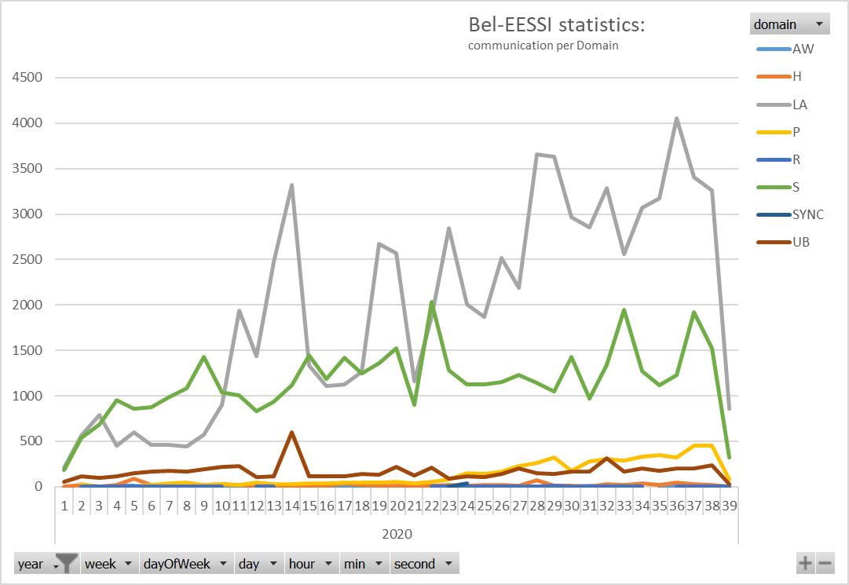
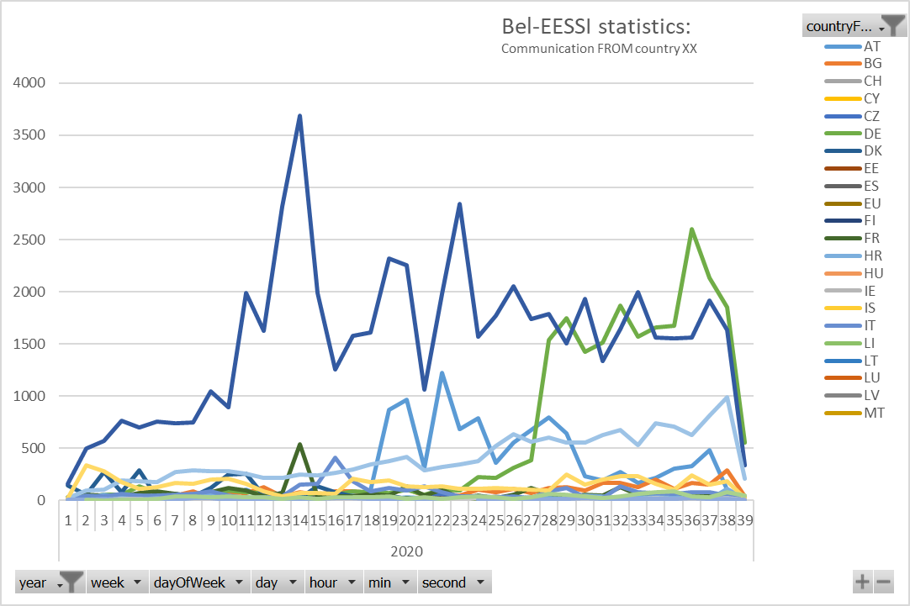
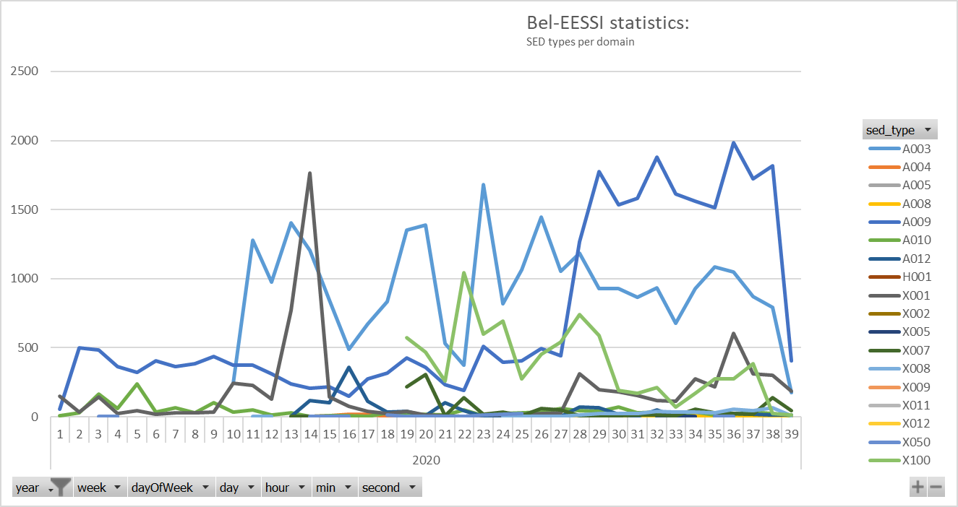
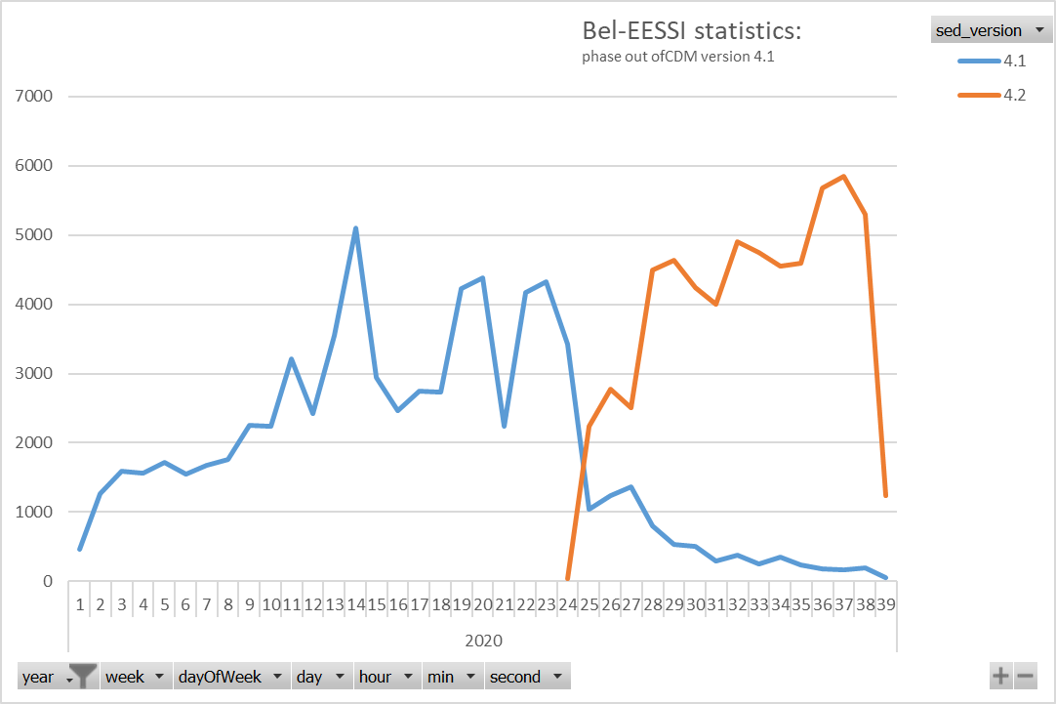
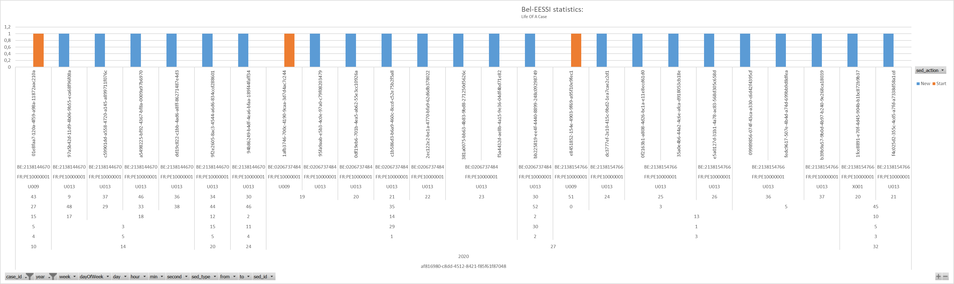
Rina as a Service: Raas
Activity Usage reporting and Statistics
15.
Activity Usage Reporting
Tenants should get insight in their EESSI activity via RaaS.
    Via RaaS admin portal
    RaaS Add-on reporting
Software changes
Common MS requirements could be implemented as SP add-ons by RaaS
Some examples: ( enlarge images for better view)
Message Exchange per domain
Message Exchange per country
SED categories for LA domain
Phase out of SCM 4.1
Life of a case: All SED’s related to one case: SED type, institution FROM / TO, type of action

Slide 20
Rina as a Service: Raas
Deployment & Operational Guarantees
1 Service Level Agreement should be sufficient for all Tenants
MS should agree on the required guarantees
16.
Service Level Agreement:
The RaaS solution should define a clear Service Level agreement on all deployment and operational aspects of the Service. This should be in accordance with the requirements of the subsribing Member States. Some of the aspects are.
Availablity & Performance: Example
Software Bug Follow-up
During this window, end-users get a guaranteed
  interaction performance on measured use cases.
  Speed of Message Delivery
The Service Level will be 99%.
…
Software change request follow-up
…
Service Window: Example
Escalation procedure
The solution will be available for End-users from xx h to yy h, during “work days” / 7 by 7.
…
Release management
RPO / RTO: Example
…
When, in case of a total loss, the application needs to be restored,
The recovery Time Objective is: 1 day
The recovery Point Objective is: 1 day
Incident management
…
DATA recuperation: Example
…
The business data of a tenant should – on demand - be able
  to be exported in format …
  Within a delay of …
…
…
…

Slide 21
Rina as a Service: Raas
Subscribing to the service & invoicing
17.
onboarding of a RINA Tenant
On subscription
the Raas Provider, sets up the tenant(s) on the platform. Meaning:
  Collecting the required setup information from tenant
  Creation of the tenant.
  Procurement of the tenant certificats
  Implementing required EBMS / SIGN ) certificats to establish communication
  Creation of the required Groups & Policies
Member states
  Provides the information regarding tenants / groups / policies
  Setup of tenant in IR ( institution repository )
  configures it’s proper user management tool with groups and policies
  Assigns the relevant users to the groups
Clear responsibilities should be defined for RaaS
Clear responsibilities
should be defined
For MS / Tenant

Slide 22
Rina as a Service: Raas
How to get on …
  Poll - 1:
  What Member States are interested in the RaaS Solution as subscriber?
  For how many Tenants?
  For what volumes?
  Poll - 2:
  Are the any big objections / constraints to this RaaS approach
  Poll - 3:
  Who would want to collaborate on the detailed technical feasability study for RaaS?
    From Software Delivery side
    From future RaaS side
    From subscribing MS side
  Poll - 4:
  Who would be RaaS provider candidate …
    Would RaaS provider also want to be Software Delivery Provider?
  Poll - 5:
  Would it be imaginable that EC still makes Software Changes to RINA to meet the requirements for solid RaaS solution?

Slide 23
Rina as a Service: Raas
Questions about the proposal?

