Slide 1

Sociale secretariaten: enkele focusthema’s

Slide 2
Algemeen

Slide 3
Wettelijke regeling erkende sociale secretariaten
art. 31ter wet 29 juni 1981 en artikel 27 wet 27 juni 1969):
  2 soorten mandatarissen van werkgevers voor sociale administratie
  sociale dienstverleners
  erkende sociale secretariaten (ESS): mogen sociale bijdragen van hun aangesloten werkgevers innen met oog op doorstorting aan de RSZ
onderscheid
  wettelijk geregelde ‘privilegie’ van erkende sociale secretariaten
  opdrachten in mededinging met andere sociale dienstverleners
hoe vermijden van kruissubsidiëring ?

Slide 4
Positionering sociale secretariaten tov sociale dienstverleners

Slide 5
Scope
inhoudelijk
  welke soorten diensten worden aangeboden ?
territoriaal
  wettelijk ‘privilegie’ erkend sociale secretariaat is typisch Belgisch
  rol van sociale dienstverlener kan op international vlak uitgeoefend worden
minder versnippering ?
  tussen erkende sociale secretariaten
  tussen erkende sociale secretariaten en andere organisaties, bvb. ondernemingsloketten

Slide 6
Kwaliteitsbarometer RSZ
doel
  opvolgen/monitoren van de kwaliteit van de functionering van een (erkende) sociale dienstverlener, via een systeem dat gebaseerd is op partnerschip en constant overleg
  kwaliteitsverbetering via coaching en zo nodig via datatracking
juridische context
  KB van 7 februari 2017
  onderrichtingen aan de ESS
kwaliteit: volledigheid/correctheid/tijdigheid van
  verwerken van LATG gegevens
  innen van bijdragen & financieren van de sociale zekerheid
  bijstand verlenen aan de werkgever

Slide 7
Kwaliteitsbarometer RSZ
doel
  opvolgen/monitoren van de kwaliteit van de functionering van een (erkende) sociale dienstverlener, via een systeem dat gebaseerd is op partnerschip en constant overleg
  kwaliteitsverbetering via coaching en zo nodig via datatracking
juridische context
  KB van 7 februari 2017
  onderrichtingen aan de ESS
kwaliteit: volledigheid/correctheid/tijdigheid van
  verwerken van LATG gegevens
  innen van bijdragen & financieren van de sociale zekerheid
  bijstand verlenen aan de werkgever

Slide 8
Kwaliteitsbarometer RSZ
6 controledomeinen
  stilzwijgerscontroles
  technische controles
  financiële controles
  automatische controles op anomalieën:
    prioritaire anomalieën
    niet-prioritaire anomalieën
    anomalieën crosscontrole (DIMONA/DMFA)
scores per deelcontrole gebaseerd op de gedefinieerde indicatoren en subindicatoren
bepaald door de verhouding van de resultaten van de ESS tov de resultaten van alle andere ESS

Slide 9
Globaal resultaat
stilzwijgerscontroles: geen enkel ESS bevindt zich in de oranje of rode zone
financiële controles: geen enkel ESS bevindt zich in de oranje of rode zone
prioritaire anomalieën : geen enkel ESS bevindt zich in de oranje of rode zone (behalve voor 2018/4 T+3 : 1 ESS in rode zone)
technische controles: 2 ESS in rode zone en 2 ESS in oranje zone

Slide 10
Globaal resultaat
  Niet prioritaire anomalieën:
Foto T originele aangifte (+ 4 weken) Foto T+9 aangifte
  2018/1 3 ESS in rode zone, 1 ESS in oranje zone 1 ESS in rode zone
  2018/2 1 ESS in rode zone, 3 ESS in oranje zone -
  2018/3 4 ESS in rode zone, 3 ESS in oranje zone -
  T+3 aangifte
  2018/4 2 ESS in oranje zone 1 ESS in rode zone
  T+9 aangifte
  2017/1 1 ESS in rode zone, 4 ESS in oranje zone -
  2017/2 1 ESS in rode zone, 3 ESS in oranje zone 1 ESS in rode zone
  2017/3 1 ESS in rode zone, 2 ESS in oranje zone -
  2017/4 2 ESS in rode zone, 5 ESS in oranje zone -

Slide 11
Globaal resultaat
Cross Controles
Tijdstip foto T originele aangifte ( + 4 weken) foto T+9 aangifte
  2018/1 16 ESS in rode zone, 7 ESS in oranje zone 11 ESS rood -13 oranje
  2018/2 17 ESS in rode zone, 9 ESS in oranje zone 10 ESS rood - 9 oranje
  2018/3 14 ESS in rode zone, 6 in oranje zone 11 ESS rood - 9 oranje
  2018/4 14 ESS in rode zone, 6 in oranje zone nog niet beschikbaar
  2017/1 14 ESS in rode zone, 7 ESS in oranje zone 9 ESS rood - 6 oranje
  2017/2 16 ESS in rode zone, 9 ESS in oranje zone 9 ESS rood - 9 oranje
  2017/3 17 ESS in rode zone, 12 ESS in oranje zone 12 ESS rood - 4 oranje
  2017/4 18 ESS in rode zone, 4 ESS in oranje zone 14 ESS rood - 7 oranje

Slide 12
Some relevant recent regulation

Slide 13
Relevant recent regulation on European level
eIDAS Regulation 910/2014
  Implementing regulation (EU) 2015/1501 on the interoperability framework
  Implementing regulation (EU) 2015/1502 on the assurance levels
  EU trusted list of trust service providers
General Data Protection Regulation 2016/679
Regulation 2018/1724 establishing a single digital gateway to provide access to information, to procedures and to assistance and problem-solving services

Slide 14
Relevant recent regulation on European level
eIDAS Regulation 910/2014
  Implementing regulation (EU) 2015/1501 on the interoperability framework
  Implementing regulation (EU) 2015/1502 on the assurance levels
  EU trusted list of trust service providers
General Data Protection Regulation 2016/679
Regulation 2018/1724 establishing a single digital gateway to provide access to information, to procedures and to assistance and problem-solving services

Slide 15
eIDAS regulation: objectives
Regulation (EU) No 910/2014 of 23 July 2014 on electronic identification and trust services for electronic transactions in the internal market (“eIDAS regulation” - electronic identification, authentication and trust services)
strengthen EU single market by boosting trust and convenience in secure and seamless cross-border electronic transactions
three important objectives
  increasing the effectiveness of public and private online services, electronic business and electronic commerce in the European Union, by eliminating (legal and technical) obstacles for the functioning of the internal market => choice for a regulation
  enhance trust in electronic transactions , in particular cross-border transactions, by providing a common foundation for secure electronic interaction between citizens, businesses and public authorities => high level of security and better information (EU trust mark)
  enhance legal certainty within the use of electronic identification means and trust services
regulation => direct effect on Belgian law

Slide 16

eIDAS regulation: overall content
mandatory recognition of some electronic identification means
electronic trust services
  scope
    electronic signatures, including validation and preservation services
    electronic seals, including validation and preservation services
    time stamping
    electronic registered service delivery
    website authentication
  horizontal principles: security requirements, trusted lists, EU trust mark, prior authorisation, qualified services, liability, data protection, supervision, international aspects
non-discrimination of electronic documents vis-à-vis paper documents as evidence in legal proceedings

Slide 17
eIDAS: electronic identification
possibility for MS’s to notify electronic identification schemes, provided that some conditions are met, e.g.
  issued by, under a mandate from or recognized by the notifying MS
  can be used to access at least one government service which requires electronic identification in the notifying MS
  meets the requirements of at least one of the assurance levels set out by the eIDAS regulation
    high
    substantial
    low
  notifying MS ensures that the person identification data uniquely representing a person is attributed in accordance with the requirements of the chosen assurance level
  party issuing electronic identification means ensures that electronic identification means is attributed according to the requirements of the chosen assurance level

Slide 18
eIDAS: electronic identification
when an electronic identification and authentication is required under national law or by administrative practice to access an online government service in a MS, the electronic identification means issued in another MS shall be recognized, provided that
  the electronic identification means has been notified by a MS and is included in the list of the European Commission AND
  the assurance level of the electronic identifications means is equal or higher than the assurance level required for online access to the online government service, provided that the assurance level is substantial or high AND (no obligatory recognition for electronic identification means of level low)
  the government service uses the assurance level substantial or high for access to its online service (no obligatory recognition of electronic identification means of another MS if the online government service can be accessed by electronic identification means of level low)

Slide 19
eIDAS: electronic identification
no obligation to implement or use a device for electronic identification on a national level, and no obligatory European notification for cross-border use
obligation for the notifying MS to provide free online authentication service in case of a government service (not obligatory in case of a private service or may be paying)
obligation to designate ‘points of single contact’ for cooperation with other MS’s
obligation to designate a node operator for interoperability with other MS’s
if security is compromised, the notifying MS has to suspend or recall the cross-border identification means and to inform other MS’s and the European Commission

Slide 20
eIDAS: electronic identification
liability of the notifying MS
  the notifying MS ensures that the person identification data uniquely representing the person in question is attributed, in accordance with the requirements of the chosen assurance level
  the notifying MS ensures the availability of authentication online, so that any relying party established in the territory of another MS is able to confirm the person identification data received in electronic form
  the notifying Member State has to organise supervision to the notified electronic identification schemes
possibility to set conditions to the private sector to use the notified electronic identification schemes

Slide 21
Belgian law on electronic identification
Belgian law on electronic identification of 18 July 2017 completes the eIDAS Regulation
some provisions:
  each Belgian public sector body determines the required assurance level for access to its services and informs DG DT about this
  DG DT determines the assurance level of the schemes to be notified to the European Commission, after consulting the Colleges of Presidents of the federal public services, the social security institutions and the federal public utility institutions
  DG DT is charged with offering electronic notification services within the federal authentication service (FAS)
  DG DT passes a minimum set of person identification data to the node of another MS (retrieved from by SSIN), when a user wants access to an online service in that other MS

Slide 22
Belgian law on electronic identification
some provisions
  the supervisory body consists of representatives of at least 3 government services and is responsible for monitoring the notified schemes and taking measures
  the ‘points of single contact’ and an operator of the Belgian node are designated by Royal Decree in accordance with the European Implementing Regulations
  private parties can provide electronic identification services recognized by DG DT after consulting Colleges of Presidents for access to Belgian government applications within the FAS (conditions for recognition are determined by Royal Decree)

Slide 23
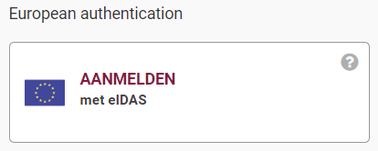

eIDAS
BE already connected with 6 other countries
Germany – Estonia – Spain – Croatia – Italy – Luxemburg

Slide 24
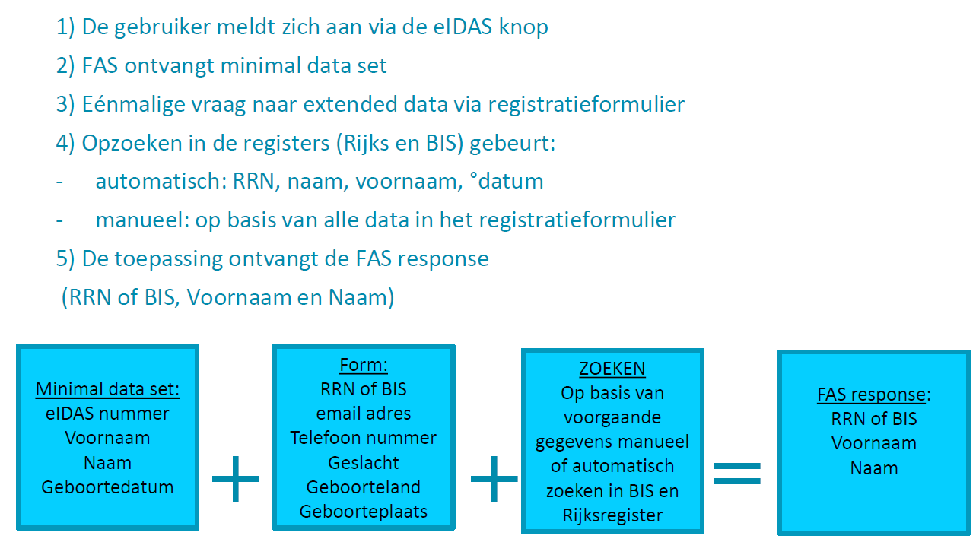
eIDAS flow (BOSA)
<- deze gevallen worden opgevangen door BOSA
<- zoals gewoonlijk

Slide 25
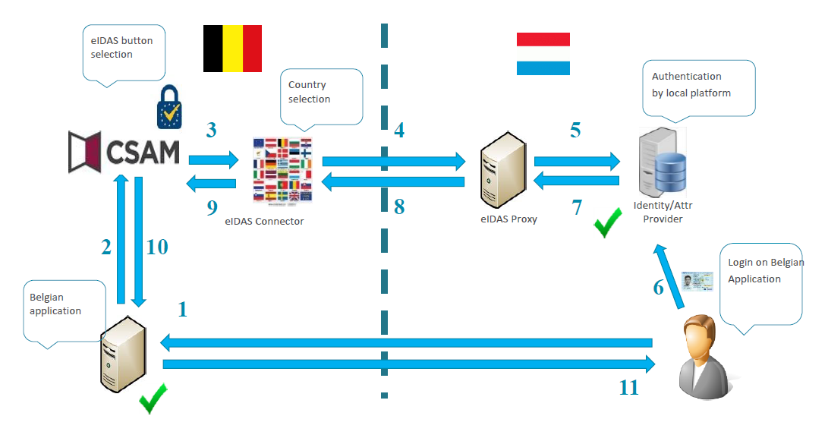
eIDAS flow

Slide 26
Single digital gateway (deadline 12/12/2023)
Europese digitale toegangspoort
waar alle burgers en ondernemingen uit een EU-land
  informatie
  online procedures
  diensten voor ondersteuning en oplossing van problemen
van een ander EU-land kunnen vinden
passerelle numérique européenne
où tous les citoyens et entreprises d'un pays de l’UE peuvent trouver
  des renseignements
  des procédures en ligne
  des services d’assistance et de soutien
en provenance d'un autre pays de l'UE

Slide 27
Why ?
administratieve lasten verminderen voor burgers en ondernemingen
werking van de interne markt verbeteren
discriminatie wegwerken
réduire les charges administratives pesant sur les citoyens et les entreprises
améliorer le fonctionnement du marché intérieur
élimination de la discrimination

Slide 28
Method
gebruikers gaan naar de “Your europe” portal
zoeken naar een life event of specifieke info
ontvangen een resultaat
starten onmiddellijk online procedure op
geven feedback over kwaliteit
ontvangen hulp als ze een probleem hebben
krijgen info aangeboden in de landsta(a)l(en) + Engels
einde
les utilisateurs vont sur le portail “Your Europe”
cherchent un événement de vie ou info spécifique
recoivent un résultat
peuvent lancer une procédure en ligne
peuvent donner leur avis sur la qualité du service
peuvent recevoir de l’aide si necessaire
dans leur langue nationale + en anglais
fin

Slide 29
Topics for citizens
reizen
werk en pensionering
voertuigen
verblijf
onderwijs of stage
gezondheidszorg
burger-en familierechten
consumentenrechten
bescherming van persoosgegevens
voyage
travail et pension
mobilité
séjour
études ou stage
soins de santé
droits concernant citoyens et famille
droits des consommateurs
protection des données à caractère personnel

Slide 30
Topics for companies
starten, exploiteren en sluiten van een bedrijf
werknemers
belastingen
goederen
diensten
démarrage, gestion, cessation d’activité
employés
fiscalité
biens
services

Slide 31
Principles
Europese verordening : rechtstreekse toepassing
digital first
niet-discriminerend op vlak van: identificatie/ondertekenen/ uitwisselen bewijs/betalen
only once
gemakkelijk te gebruiken/eenvoudig te begrijpen
beknopte uitleg centraal, referentie naar sites Lidstaten
user feedback !
règlement européen: application immediate
d’abord numérique
non discriminatoire en matière d’identification/signature/échange de preuves/paiement
only once
facile à utiliser/à comprendre
site central limité, redirection vers sites de référence par état membre
commentaires des utilisateurs !

Slide 32
Relevant recent regulation on Belgian federal level
Wet van 5 mei 2014 houdende verankering van het principe van de unieke gegevensinzameling in de werking van de diensten en instanties die behoren tot of taken uitvoeren voor de overheid en tot vereenvoudiging en gelijkschakeling van elektronische en papieren formulieren
Wet van 18 juli 2017 inzake elektronische identificatie
Wet van 27 februari 2019 inzake de elektronische uitwisseling van berichten via de eBox

Slide 33
Some focus areas ICT

Slide 34



Different types of sharing & reuse
infrastructure
  hard infrastructure
  soft infrastructure
  platforms
common vendor contracts
federal ICT community
business
  knowledge & experiences
  business functionality
  business data
  complete business services
Important to know what already exists
→ catalogues!

Slide 35
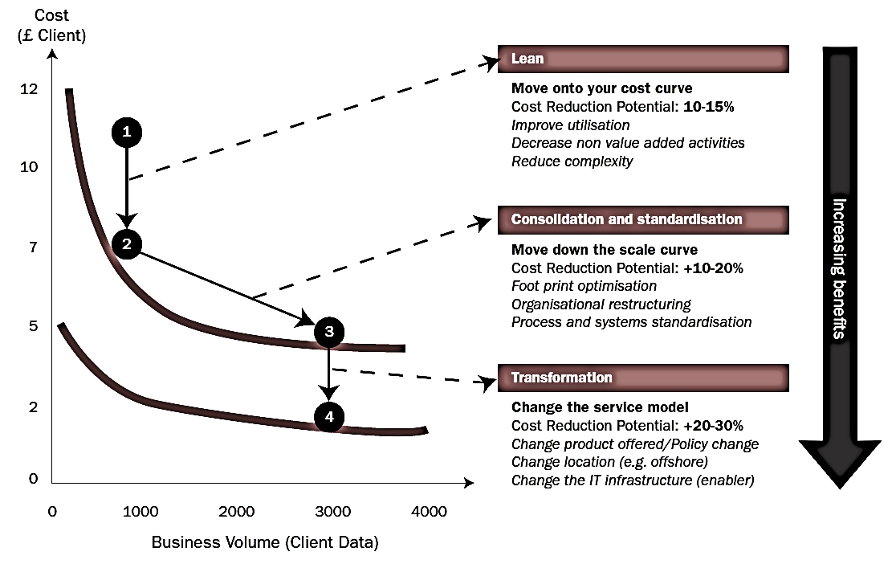
Synergies - transformations

Slide 36








Cloud deployment types
Hybrid
Public Cloud
Shared
Access/Control
Outsourced Community Cloud (= off-premise)
Community Cloud on-premise
Private Cloud on-premise
Outsourced Private Cloud (= off-premise)
Dedicated
Customer
Location
Service Provider

Slide 37
G-Cloud portfolio

Slide 38




G-Cloud
Procurement
Cooperationá
Efficiencyá
Projects
Synergy
Services
Costsâ
Qualityá
Know-how & Expertise
Notes:
Maximum synergy when possible and when generating efficiency gains and/or savings while maintaining or improving the quality of the services provided to the customer
In line with the synergy program: assignment to the one who is the most capable of proposing a form of shared services
Synergy based on result orientation, sense of responsibility and trust

Slide 39
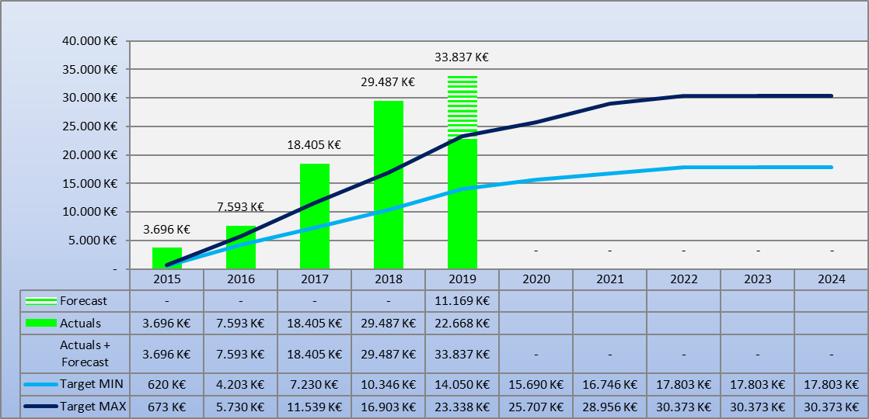
G-Cloud ROI
Total

Slide 40
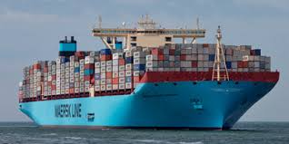
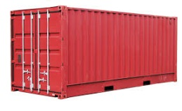
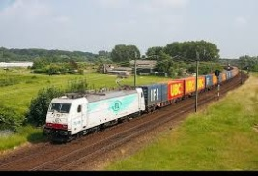
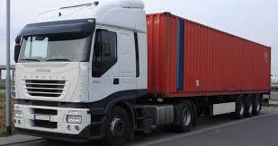






PaaS in G-Cloud - containers
introducing container technology
translated into modern technology such as Platform-as-a-Service
Individuele
inhoud
Easy to move around
Individual content
Isolated storage
Geïsoleerd opgeslagen
En makkelijk verplaatsbaar
Monitoring
Security
Logging
Coming
soon

Slide 41

New ways of cooperation
Government ecosystem
Other sectors
Components
parts
Application
1
Application
2
Application
N
Partner
1
Partner
2
Partner
N
Platform
cooperation
DB
DB
Technological cooperation
DB
DB
DB

Slide 42
Rise of (public) cloud
need for overall positioning
  public cloud policy
  based on information classification
  appropriate organizational, technical & contractual measures
  hybrid approach
G-Cloud as broker
  knowledge & expertise on cloud offerings
  contracts & implementation partners
  tools

Slide 43
Public cloud - main issues
longitudinal confidentiality of personal data
  need for comprehensive longitudinal encryption of personal data
  in motion, at rest and in use
performant continuous availability of application and data
easy migration of applications and data
compliance with GDPR

Slide 44

Shifting focus
towards synergies in the area of business components
Business components
Stronger centrally coordinated approach to offering platforms

Slide 45
About the initiative
initiative within the public social security institutions & Smals
purpose
  synergy around (technical) business components
  and thus save costs by avoiding multiple development of components
regardless of whether development takes place by
  the institution's own ICT department
  Smals
  subcontractors
creation of a competence center within Smals in order to maximally integrate and support the reuse of business components within Smals, its members, partners and domains in which Smals is active
45

Slide 46

Reuse: vision
Every stakeholder
can easily find the most common reusable elements in a centralized catalogue
Processes
and tools are put in place to identify, register, implement, monitor and measure reuse throughout the project lifecycle
Human
networks are maintained and developed on all levels (CEO’s, CIO’s, business owners, business analysts, architects) in order to keep maximum visibility on reuse potential
A culture
develops where
reuse is adopted and the creation of reusable products is promoted,
46

Slide 47

Value
Value
library
framework
product
system
Offered “business” functionality
47

Slide 48


























So… dare to share! ☺
Framework
Library
Product
Service
System
48

Slide 49

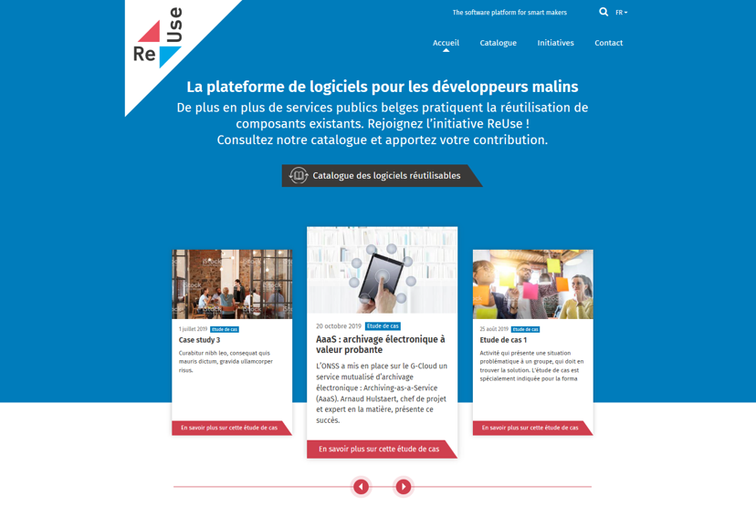
How ? with the new Software Reuse Platform !
https://www.ict-reuse.be
49

Slide 50
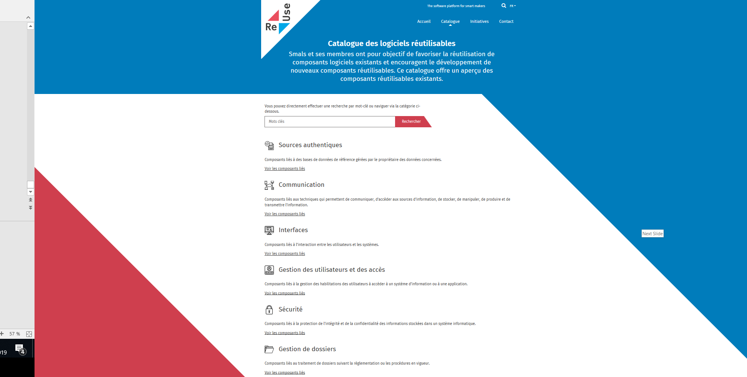
New project?
consult the
Software Reuse
Catalogue

Slide 51
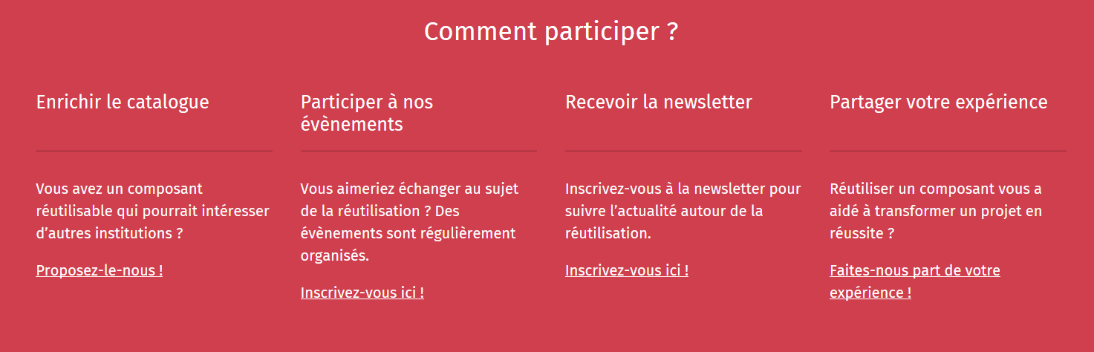
Share your success stories...and become an ambassador for reuse!
https://www.ict-reuse.be
51

Slide 52
ROI of reuse
you can only improve what you measure
reuse is embedded in the "project life cycle" of projects carried out by Smals
this makes it possible to compare the project cost without reuse and with reuse and to calculate the ROI
52

Slide 53
ROI 2019 for projects carried out by Smals
23%
54%
35%
reusable
Reused
ROI
10.000.000 €
53

Slide 54

API - Application Programming Interface
an API is a programmatic interface to data or some set of functionality
thanks to API’s it is possible to use the data or functionality behind it and continue to build on it
API = a software building block

Slide 55
About API - Application Programming Interface
providers vs consumers
  when an API is offered over a network, the service that offers the API is called the “provider”
  the “consumer” of the API is often a software application
the consumer may outsource the requirement for data or functionality by “calling” API’s
  billing
  identity
  storing
  image processing
  all sort of (authentic) data sources
  …

Slide 56
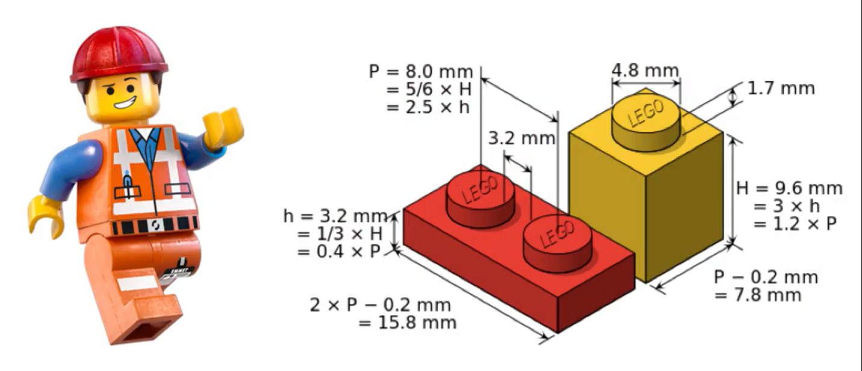
About API - Application Programming Interface
consumers can connect to an API of a provider and use its data or functionality as long as the “technical contract” has been respected
consumers don’t need to know the technical details behind the functionality
API’s can be written in any possible programming language

Slide 57
Why are API’s important ?
cost reduction by reusability: consumers don’t need to rewrite what already exists!
complexity reduction: no more big, monolithic systems
decoupling: consumers and providers can continue to connect as long as the technical contract is followed → ex. less impact in case of migrations
driver of innovation: new products arise, based on existing API capability
stimulation of partnerships
stimulation of standardization

Slide 58

Shifting to an API economy: the value chain
To create new innovative apps and services
Made available as API
Differentiated
services
Self service
use by developers
Existing
Systems

Slide 59
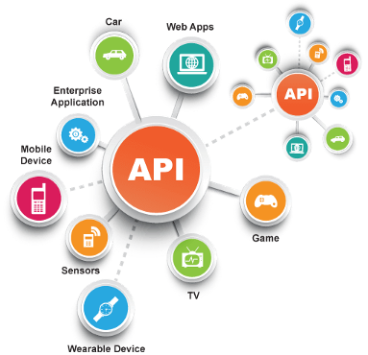
Today the API economy is a becoming a reality
Everything connects to everything

Slide 60



Example: realtime presence registration for construction workers
API
WEB
Notes:
Backend checks of the employment declaration, constructions sites, Limosa, (temporal work permits),
> 500.000 euro
Checkinatwork is de onlinedienst voor de aanwezigheidsregistratie bij werken in onroerende staat en activiteiten die behoren tot de vleessector. Het gaat om de registratie van:
iedereen die werken in onroerende staat uitvoert op een werkplaats waarvan de totale kost gelijk is aan of hoger is dan een specifiek drempelbedrag, en
iedereen die activiteiten uitvoert in verband met vleesbereidingen of vleesproducten en het slachten of uitsnijden van hoefdieren, gevogelte en konijnen in inrichtingen onderworpen aan de erkenning (erkenningen, toelatingen en voorafgaande registraties) van het Federaal Agentschap voor de Veiligheid van de Voedselketen (FAVV).
Via Checkinatwork registreren werkgevers en aannemers de aanwezigheid van hun eigen werknemers, van hun onderaannemers en van hun zelfstandige onderaannemers. De werknemers of zelfstandige onderaannemers kunnen zich ook zelf in het systeem aanmelden.
De registratie moet dagelijks gebeuren, en wel vóór de persoon die de werken uitvoert aan het werk gaat.
De werkplaatsen die vallen onder de verplichte aanwezigheidsregistratie via Checkinatwork moeten aangegeven zijn in de Aangifte van werken.

Slide 61


API in health and social sector: some statistics and evolution
social security
100+ APIs
Most consumers are external (# 20,000-24,000)
Peak load 2000-3000 req / s
1.200M transactions / month
200+ APIs
Consumers mostly internal applications/services (# 200-300)
Peak load 1000-1500 req / s
300M transactions / month
Disclaimer: metrics listed since 2016 are for all ESB + gateway platforms. Migration to Axway APIM in progress since Q3 2018.
(eHealth currently 30% APIs migrated, Social Security gradually does onboarding on APIM for all new APIs and API evolutions)
Notes:
Need for a rock-solid service platform that meets our SLA requirements and can scale easily, while keeping costs under control

Slide 62
API standards
API standards in eGovernment are based on industry standards and best practices
a pragmatic approach to designing RESTful APIs
collaborative effort organized in several workgroups
  REST API modelling
  security (OAuth)
  functional/business vocabularies (temporal, location, person, enterprises)
REST style guide
  https://www.gcloud.belgium.be/rest/

Slide 63





API management
importance of good API management
  transparent migration of legacy services
  ready for today's standards, but supports our legacy as well
  from ESB-technology to API gateway
  parallel platform
  zero-impact migration
faster implementation of new services
  flexible to extend and customize
  accelerates time-to-market
API Manager
API Portal
API
API Registration & Lifecycle
Application Developers
API Catalog
Partner & Policy Administration
REST
API
API Gateway
SOAP
Policy Enforcement
Notes:
https://unsplash.com/photos/vE3ZFtIhA4c?utm_source=unsplash&utm_medium=referral&utm_content=creditCopyText
Parallel platforms
Controlled migration growth
In service mode: close monitoring
Inevitable surprises: challenge
Defaults adapt to our volumes: lots of tweaking / DRP tests
Challenge rebuild existing standards to new Axway
SOAP-REST
New services on new platform

Slide 64
Challenges
use the power of the network of institutions
deal with interdependencies
focus on the essence, not on "bells and whistles"
deal with the (un)availability of (critical) services
strive for uniformity of technological solutions / use of site licenses

Slide 65
What is Artificial Intelligence (AI) ?
an area of computer science concerned with the creation of machines that can reproduce human cognitive functions such as reasoning, planning, learning, language understanding, vision,…
weak AI vs strong AI
  weak or narrow AI
    simulates intelligence
    is limited to specific areas
    all current implementations of AI are narrow AI
  strong or general AI
    still debated, includes philosophical considerations such as consciousness, intentionality, …
    has real intelligence,
    has mental states and beliefs like humans
    Holy grail !
Notes:
Weak AI: Weak AI simply acts upon and is bound by the rules imposed on it and it could not go beyond those rules
General or strong AI is still debated as it is hard to give a good definition of what intelligence is. Should the machine have consciousness (be aware of its mental states) ? Does it have intentionality?

Slide 66
AI subfields (non-exhaustive)
Knowledge representa-tion
Natural language generation
Sensors/
internet of things
Audio/
speech analytics
Machine learning
Graph analysis
Simulation modelling
Natural language processing
Deep Q&A systems
(cognitive computing)
Robotics
Image analytics
Deep learning
Social network analysis
Visualisa-tion
Deep causal reasoning
Virtual personal assistants
Recommen-der systems
Machine translation
Source: PWC via @mikeuindazzi

Slide 67


Natural Language Processing (NLP)
processing of natural language in order to communicate with humans and extract information from written texts
some applications of NLP are:
  machine translation
  text classification
  Information extraction (Named Entity Recognition (NER))
  information retrieval
  speech recognition:
    Google Assistant/Home
    Siri
    Alexa
    Cortana
    ….
Notes:
Information extraction . explain

Slide 68
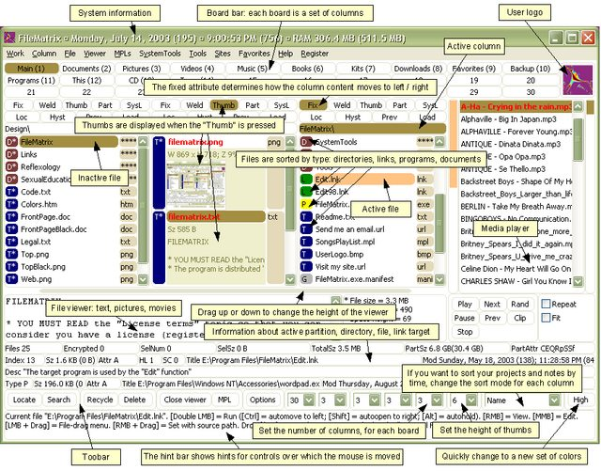
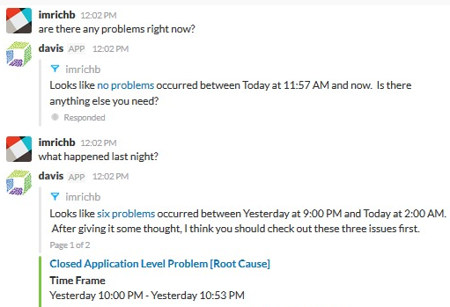
Conversational interfaces
A conversational interface is a user interface where the interaction is based on conversations in natural language (text or speech)
Threshold lowering: the user does not have to learn to work with the (graphical) interface
versus
Notes:
Een (extreem) voorbeeld van het verschil tussen de klassieke grafische interface (veel menu's, knoppen, invoervelden, etc.) en het voeren van een natuurlijke conversatie in eigen bewoordingen.
Je hoeft als gebruiker de interface niet meer te leren.
Rechtervoorbeeld is "davis", de virtuele assistent van Dynatrace voor performance management (wat is de status van de systemen).

Slide 69
Chatbot Student@Work
automatic answer to general questions about student labor
substantive questions
technical questions (access, error messages)
available via Student@work contact webpage
available 24/7 (students are often active outside office hours)
immediate reply
scalable
status: operational

Slide 70
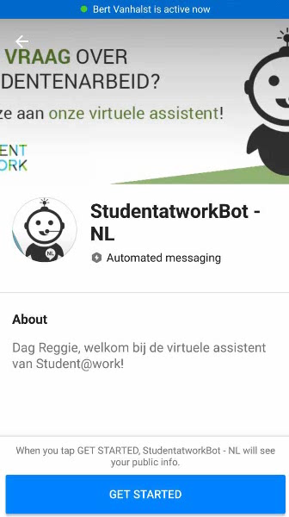
Chatbot Student@Work
DEMO

Slide 71
Dimona via Google Assistant
simplified employment declaration:
  employer number
  employee number
  date of employment
integration with Google Assistant, Google's virtual assistant
  via Google Home (smart speaker)
  via smartphone
voice interface
English (and Dutch prototype)
status: experiment

Slide 72
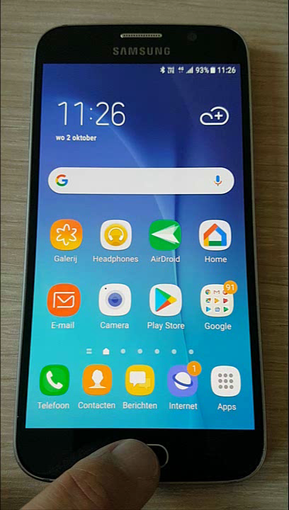

Dimona via Google Assistant

Slide 73
Machine learning
design of algorithms that automatically learn from example data with no or minimal need for human intervention
at the intersection of computer science and statistics
advantages
  no need to code explicitly all possible situations the machine will have to deal with, the machine adapts to change in conditions or unseen situations
  can learn a solution to a problem by itself where it would be hard for a human to explicitly instruct the machine
Notes:
Machine Learning uses Data Mining techniques and other learning algorithms to build models of what is happening behind some data so that it can predict future outcomes. A computer program is said to learn some task from experience if its performance at the task improves with experience, according to some performance measure. Machine learning involves the study of algorithms that can extract information automatically (i.e., without on-line human guidance). Most tasks that require intelligence require an ability to induce new knowledge from experiences. Thus machine learning is a large area within AI.

Slide 74
Machine learning approaches
Supervised learning
learns from examples of pairs of input-output
feedback from a « teacher » which provides the correct answer for example inputs
Unsupervised learning
no feedback from a « teacher »
learns patterns in the input
Reinforcement learning
suitable for complex problems in unknown environment
no feedback from a « teacher »
particularly used in robotics (film robot)
receives a reward if successful at executing a task or punishment otherwise
most common approach
used mainly for clustering
eg chatbot
Notes:
Source: « Artificial Intelligence: A moder approach » Russel, Norvig
Example chatbot: training data are pairs of texts and related intentions

Slide 75

Applied to fraud detection
Database X
Database Y
Database Z
Data-preprocessing
Sudden Change in Behaviour
(type 1 fraud) network
t
Fraud type 2 symptoms
& profit
Start of
Lifecycle
Parameter
Change
Consecutive or Complex Events
Network
Info
Predictive model

Slide 76
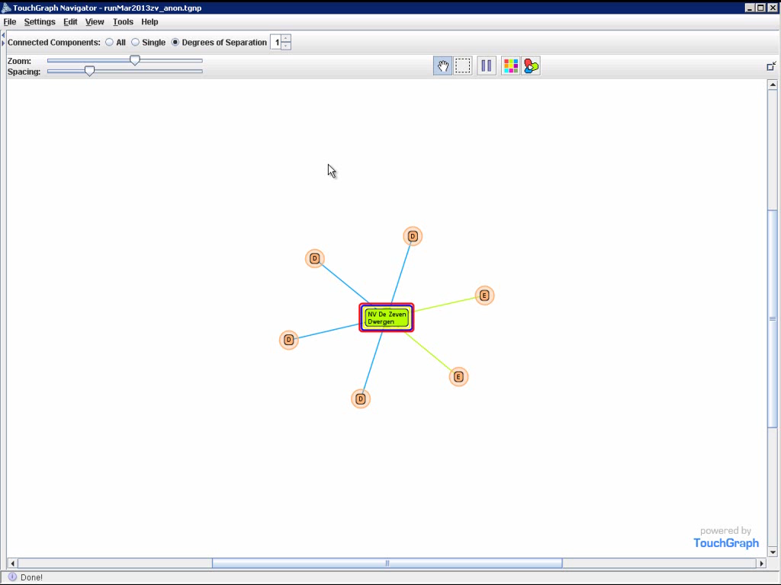
Example: spider constructions

Slide 77
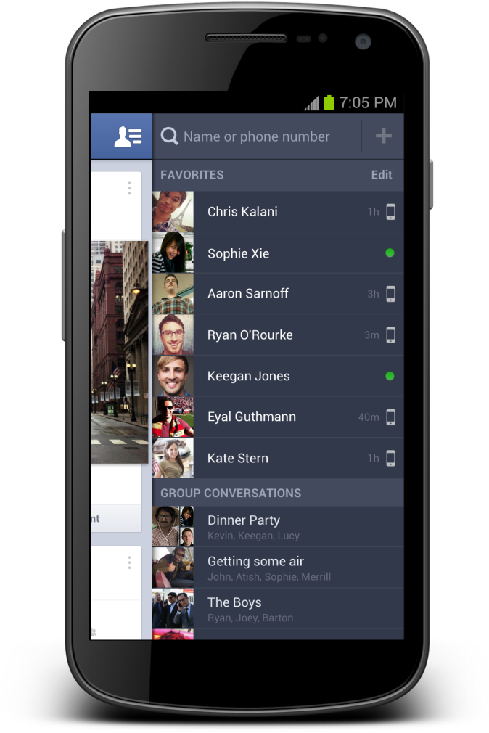
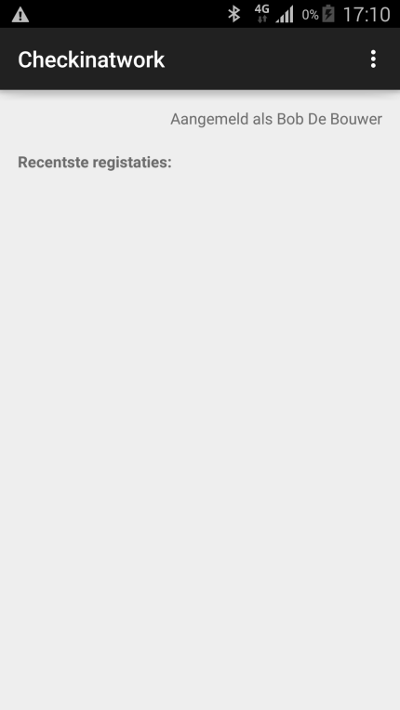
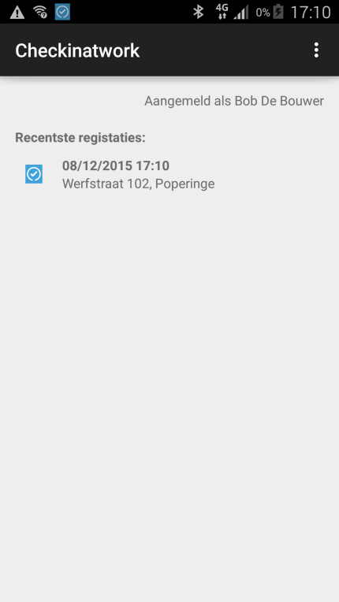



Internet of things: experiment with beacons
Notificatie:
Beacon present at the workplace
Beacons are easy, inexpensive and quick to integrate with mobile applications and can help to provide context-specific information to the application
Notes:
In dit experiment werd een scenario uitgebouwd op basis van eenvoudige beacons (zendertjes die een uniek identificatienummer hebben).
Het scenario veronderstelt dat de betrokken ondernemer de beacon aangemeld heeft met de relevante informatie: voor welk bedrijf? Voor welke werf?
Een werknemer of een onderaannemer die de werf bezoekt beschikt over een app op zijn mobiel device die de activiteit van de beacon kan oppikken, de identiteit kan uitlezen en dan vervolgens ia zijn app een melding doet dat hij op die bouwwerf aanwezig is. Op die manier krijg je een low-cost, snel te implementeren mogelijkheid om aanwezigheidsmeldingen te doen.
Dit scenario is nuttig voor veiligheid op het werk (accurate registratie van aanwezigheden in seveso bedrijven bvb) of voor fraudebestrijding.

Slide 78
Some reusable public sector components

Slide 79

CSAM: what ?
a cooperation framework, a set of agreements to organise every aspect of Identity & Access Management for e-government
therefore we need
  agreements and guidelines for:
    identification
    authentication
    authorization
    access Administration
  IT Services:
    FAS: service for identification and authentication of a person
    BTB: service to appoint access administrators within a company
    SSM: mandate management service
As a citizen, representing myself
Representing a company

Slide 80
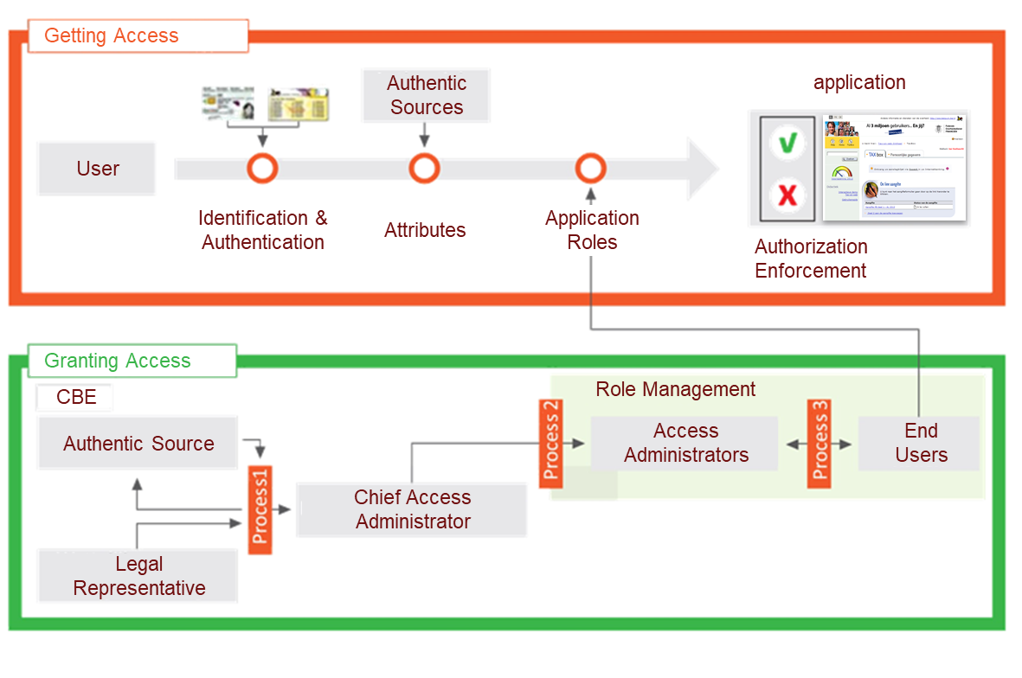
Process flow

Slide 81
BTB service
Legal Representative of Enterprise
  ➔ Defined in Authentic Source
  Crossroads Bank for Enterprises
CBE
Digital signature
with eID
Chief Access Admin
  ➔ Designated by Legal Repr.
  ➔ For Enterprise
Online procedure
BTB
Access Admin
➔ Appointed by Chief Access Admin
➔ For a group of applications
(in the same ‘domain’)
Online procedure
PIP
PIP
PIP
End Users
➔ Appointed by Access Admin
➔ For Role (which is active in Domain), within Enterprise
PIP

Slide 82
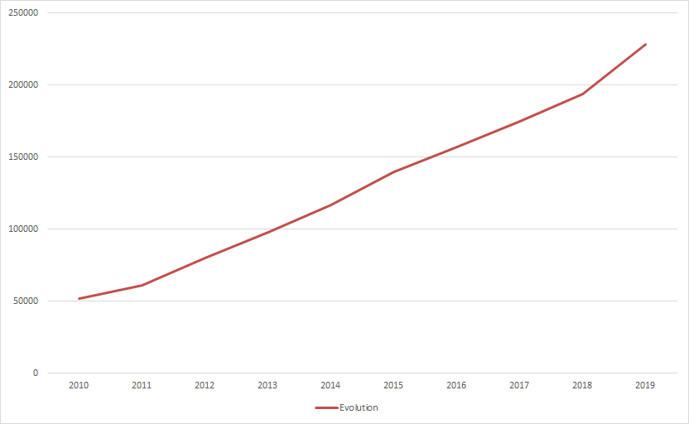
BTB: > 200,000 companies have appointed their access administrators

Slide 83

Mandate management
mandates between
  citizen – enterprise
  citizen – citizen
  enterprise – citizen
  enterprise - enterprise
focus on electronic flow
self Service
universally applicable: accountancy, health care, …

Slide 84
Advantages for end users
trusted and familiar environment
  familiar
  sonsistent security level
simpler
  no multiple registrations and similar procedures
a clear overview
  who holds which rights in my company?
user-friendly
  e.g. single sign-on
central management of authentication means
  One password, easy activation (or cancellation!)
support
  online documentation, consistent communication, contact center
privacy
  authentication and access <-> internal application business

Slide 85
Advantages for service providers
cost reduction
  standardization
  reuse of services and components
  economies of scale
Security
  global and strict security policies, clear rules of the game, traceability
support and service delivery
  standard onboarding procedures, common support, knowledge sharing
simpler and more clear
  oth regarding applications used by citizens c.q. companies and internal applications
  procedure alignment, increased consistency

Slide 86
Who uses CSAM ?
services for citizens:
  Tax-on-web
  Mypension
  Student@work
  Police on web
  municipalities (“e-loket”), provinces
  …
services for (representatives of) companies:
  Belgian social security (www.socialsecurity.be)
  mobility: webDIV, iFast
  finance: Tax-on-web, VAT, BizTax, Finprof
  Healthcare (eg eHealth)
  regions
  ...

Slide 87
e-Box, la boîte aux lettres électronique sécurisée de votre entreprise
04/12/2019 e-Box meeting VBO (overleg met providers)

Slide 88

L’e-Box aujourd’hui est une alternative électronique moderne et sécurisée aux échanges postaux

Slide 89
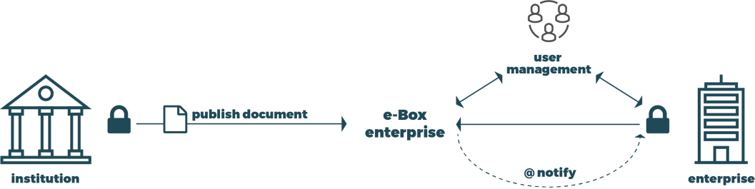
L’e-Box aujourd’hui est sécurisée, accessible et gratuite
Pour les institutions – Documents sender
Un canal sécurisé, officiel, gratuit pour mettre des documents à disposition de l’entreprise
Une adresse unique, le numéro BCE
Pour les entreprises
Espace protégé, réservé et garanti
par les institutions de Sécurité Sociale.
Boîte aux lettres électroniques
sécurisée et centralisée
Disponible sous forme d’application web

Slide 90
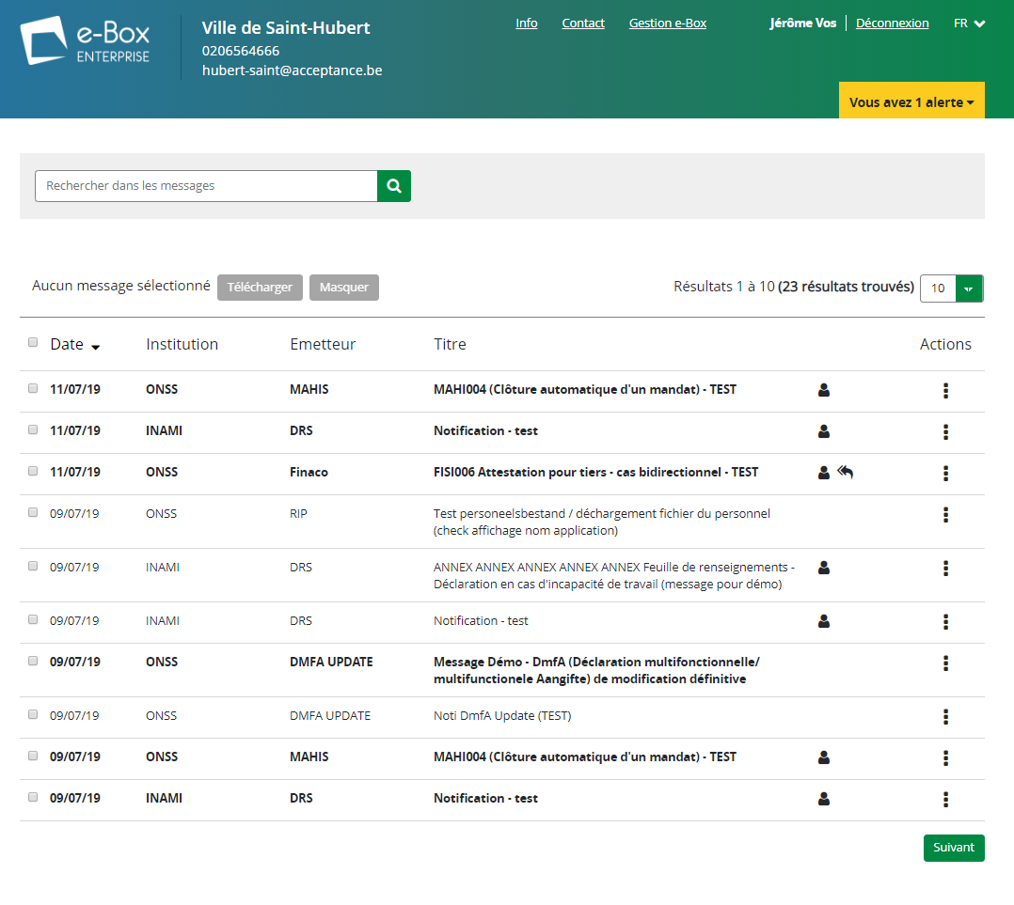
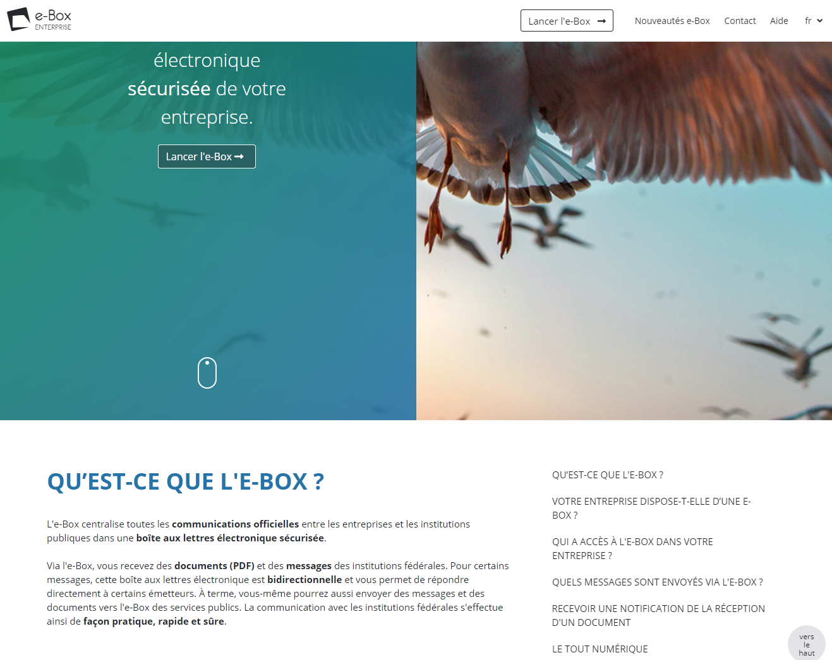
L’e-Box aujourd’hui

Slide 91












L’e-Box aujourd’hui
64.300
e-Box actives
27.900
tout digital
2018
5.000.000
De nouveaux documents
en continu
Confirmation de déclaration (accidents de travail, début d’un engagement, …)
Résumé des vacances annuelles
Maladie
Rappels de paiement
Pension anticipée
Crédit-temps
…
11
émettrices
Notes:
Stats 20/11/2019
#enterprises connectées les 6 derniers mois: 64,305
#enterprises connectées les 12 derniers mois: 85,099

Slide 92

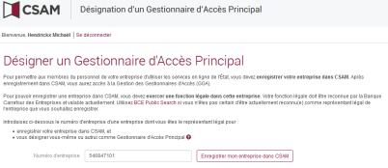


L’e-Box aujourd’hui est créée facilement
◆ Création de l’entreprise à la BCE
❖ Enregistrement de l’entreprise dans CSAM par un représentant légal
⬥ Création automatique de l’e-Box et accès direct pour le GAP (généralement le représentant légal)


Slide 93
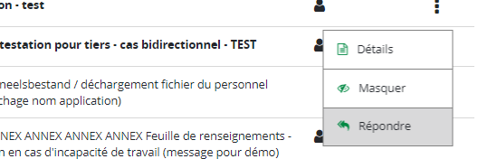
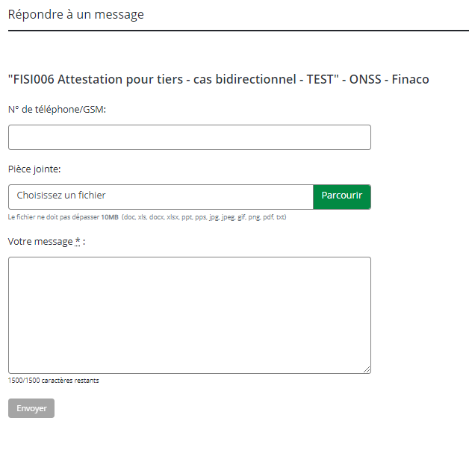
L’e-Box aujourd’hui est bidirectionnelle
L’e-Box est bidirectionnelle : Une entreprise peut répondre à un envoi e-Box (renvoi d’informations demandées, questions, …)
  Bientôt il sera aussi possible d’initier une conversation à partir de l’e-Box
Sous le contrôle de l’institution qui doit s’organiser pour accepter ces messages
  Accepte ou non les contacts des entreprises
  Active ou non par type de message
Permet de s’intégrer directement dans les workflows de traitement de l’institution
  Gestion des tâches
  Routage du message
Ne doit pas remplacer les applications métiers
  Le contact reste générique et simple

Slide 94
L’e-Box aujourd’hui offre des outils et des garanties aux expéditeurs
Savoir si l’entreprise est prête à accepter les documents de l’e-Box
Avoir la garantie que le document est délivré dans l’e-Box de l’entreprise
Avoir la garantie que le document est accessible pendant toute la durée de validité que l’institution a spécifiée
Avoir la garantie que seul les utilisateurs autorisés voient les documents
Connaître le statut de lecture du message par l’entreprise

Slide 95


La fédération d’e-Box
Un écosystème qui met en relation les Document Senders, les Document Providers et l’entreprise

Slide 96









La fédération
Document Senders
Document Providers
Document Consumers
Documented
API (contract)
DB Pension
MessageRegistry
Pension
Nouvelle Webapp e-Box
DB e-Box
(SocSec)
MessageRegistry
SocSec
Une seule API pour tous
DB Economie
MessageRegistry
FOD Economie

Slide 97
Types d’intégration possibles
DocSender (DS)
  Envoi des documents vers le DocProvider e-Box SocSec.
DocProvider (DP)
  Mise à disposition des documents via l’API RESTful standardisée. Les documents sont hébergés par le DP.
Doc.Service Provider (DSP)
  Orchestration de plusieurs services (ex: routage, enrichissiment…) pour traiter l’envoi d’un document, en supportant typiquement plusieurs canaux de distribution possible (ex: papier / e-Box).
  En pratique, integration e-Box en tant que DS
DocConsumer (DC)
  Récupération du contenu de l’e-Box de façon technique, en interrogeant directement les différents DP.
  Permet une integration automatisée avec des systèmes internes dans l’entreprise.
DS
DB e-Box
(SocSec)
DP
Message
Registry
e-Box
DSP
Papier
DC
Message
Registry
Notes:
Human Interface Provider (HIP): non-autorisé pour e-Box Enterprise (seulement possible pour eBox Citoyen)

Slide 98

Système ouvert à des partenaires pour l’ajout de fonctionnalités

Slide 99

Ouverture aux partenaires privés pour des services à valeur ajoutée
Besoins récoltés auprès des entreprises
  Routage interne du document
  Gestion des utilisateurs et droits d’accès avancé
  Intégration aux processus de l’entreprise
    Paiement
    Workflows
  Archivage
  Document service provider pour externaliser la génération et l’envoi des documents
  Recommandé eIDAS
  …

Slide 100
Ouverture aux partenaires privés pour des services à valeur ajoutée
Pour répondre aux besoins des entreprises, que vous manque-t-il pour réaliser ces services à valeur ajoutée?
  Fonctionnalité générique supplémentaire?
  Métadonnées?
  …

Slide 101
Routage de documents
Quelles métadonnées sont utiles pour le routage des documents?
  “messageTypeId”
  “senderOrganizationId”
  “forTheAttentionOf”
    Person?
    Departement?
  “businessDataList”
    ?
  “paymentData”
    ?
  ?
Voyez-vous d’autres mécanismes nécessaires?

Slide 102
Release management
API definition
  Consult / Publish
  Alignement eBox citizen
  Pour un DocProvider avec ses propres Senders :
    Votre avis sur l’interface de publication:
      Au choix?
      A standardiser en implémentant l’API « Publish »?
Release management
  Support multi-versions (min. 2)
  Timing acceptable?

Slide 103


L’e-Box continue d’évoluer… à l’écoute des utilisateurs et des partenaires

Slide 104
Les évolutions de l’e-Box
Sur base des retours utilisateurs
  User-groups
  Enquêtes
  Phase pilote
  Feedback au centre de contact
  …
En discussion avec les partenaires
  Doc Senders
  Doc Providers
  Partenaires privés
  …

Slide 105
Roadmap 2019-2020
2019-Q1
(suite 2018) GUI & WS REST Consult
2019-Q2
Phase Pilote GUI + site d’info
2019-Q3
Production visible (4/07): GUI + site d’info
2019-Q4
2020
Bidirectional 2.0 (e-Box to e-Box)
Amélioration résilience
Audit-trail WS
Widget e-Box (Polaris)
Bidirectional 1.1 (Modjur)
WS REST Publish
Bidirectional 1.2 (CR Modjur)
Events & notis fédérées
WS ebox-federation
Support envoi manuel
Aide à l’utilisation
…
GUI version fédérée

Slide 106

Actions parallèles et intégrations
Cadre légal – Règlement utilisateur (Laga)
Campagne de communication (Absoluut)
Demandes d’intégration (eBoxIntegration@smals.be)
DocProvider
FOD Economie
Speos
DocSender
EDE (ONSS)
eDecision/ePV
DocConsumer
Teal Partners
TRUSTO
FOD FIN
Artist@work
BOSA
Connect-Solutions
Pensions
Justice (Speos)
Intention de participation
Vlaanderen
eWBS/SPW
Fedris

