Slide 1
The Belgian eHealth case

Slide 2
Some evolutions in health care
More chronic care instead of merely acute care
Remote care (monitoring, assistance, consultation, diagnosis, operation, ...), and home care
Multidisciplinary, transmural and integrated care
Patient-centric care and patient empowerment
Rapidly evolving knowledge => need for reliable and coordinated management and access to knowledge
Threat of excessively time-consuming administrative processes
Thorough support of health care policy and research requires thorough, integrated and anonymized information
Cross-border mobility
Need for cost control

Slide 3
The reported evolutions require...
Cooperation between all actors in health care
Efficient and secure electronic communication amongst all actors in health care
High quality, multidisciplinary electronic health records
Care pathways
Optimized administrative processes
Technical and semantic interoperability
Guarantees with regard to
  information security
  privacy protection
  respect for the professional secrecy of health care providers

Slide 4
Electronic communication also stimulates …
Quality of care and patient safety
  avoidance of wrong care and medication
    incompatibility between medicines
    contra-indications against certain medicines or treatments for a specific patient (eg allergies, diseases, …)
  avoidance of errors in concrete care provision and administration of medicines
  availability of reliable databases on good treatment practices and decision support scripts
  more opportunity for multidisciplinary consultations and second opinions
Avoidance of unnecessary multiple examinations => less stress for the patient and avoidance of unnecessary additional costs

Slide 5
Objectives of the eHealth-platform
How?
  through a well organized, mutual electronic service provision and information exchange amongst all actors in health care
  with the necessary guarantees on the level of information security, privacy protection and professional secrecy
What?
  optimization of the quality and continuity of the provision of health care
  optimization of the patient safety
  simplification of the administrative formalities for all actors in health care
  proper support of health care policy and research

Slide 6














Status questionis
History via the SumEHR and hubs/metahub
Online advice and guidelines
Medical
Electronic prescriptions
Medication schedule
Lab results and results of medical imaging
Electronic referrals

Slide 7





Status questionis
Rate setting
& invoicing
SumEHR,
medication schedule,
... updates
Adminis-trative
Create and send certificates
Registrations
Send report to GMF holder

Slide 8
Basic services
Coordination of the electronic processes
Portal
Integrated user and access management system
Management of loggings
System for end-to-end encryption
eHealthBox
Timestamping
Coding and anonymising
Consultation of National register and CBSS registers
Reference directories (hub-metahub system)

Slide 9
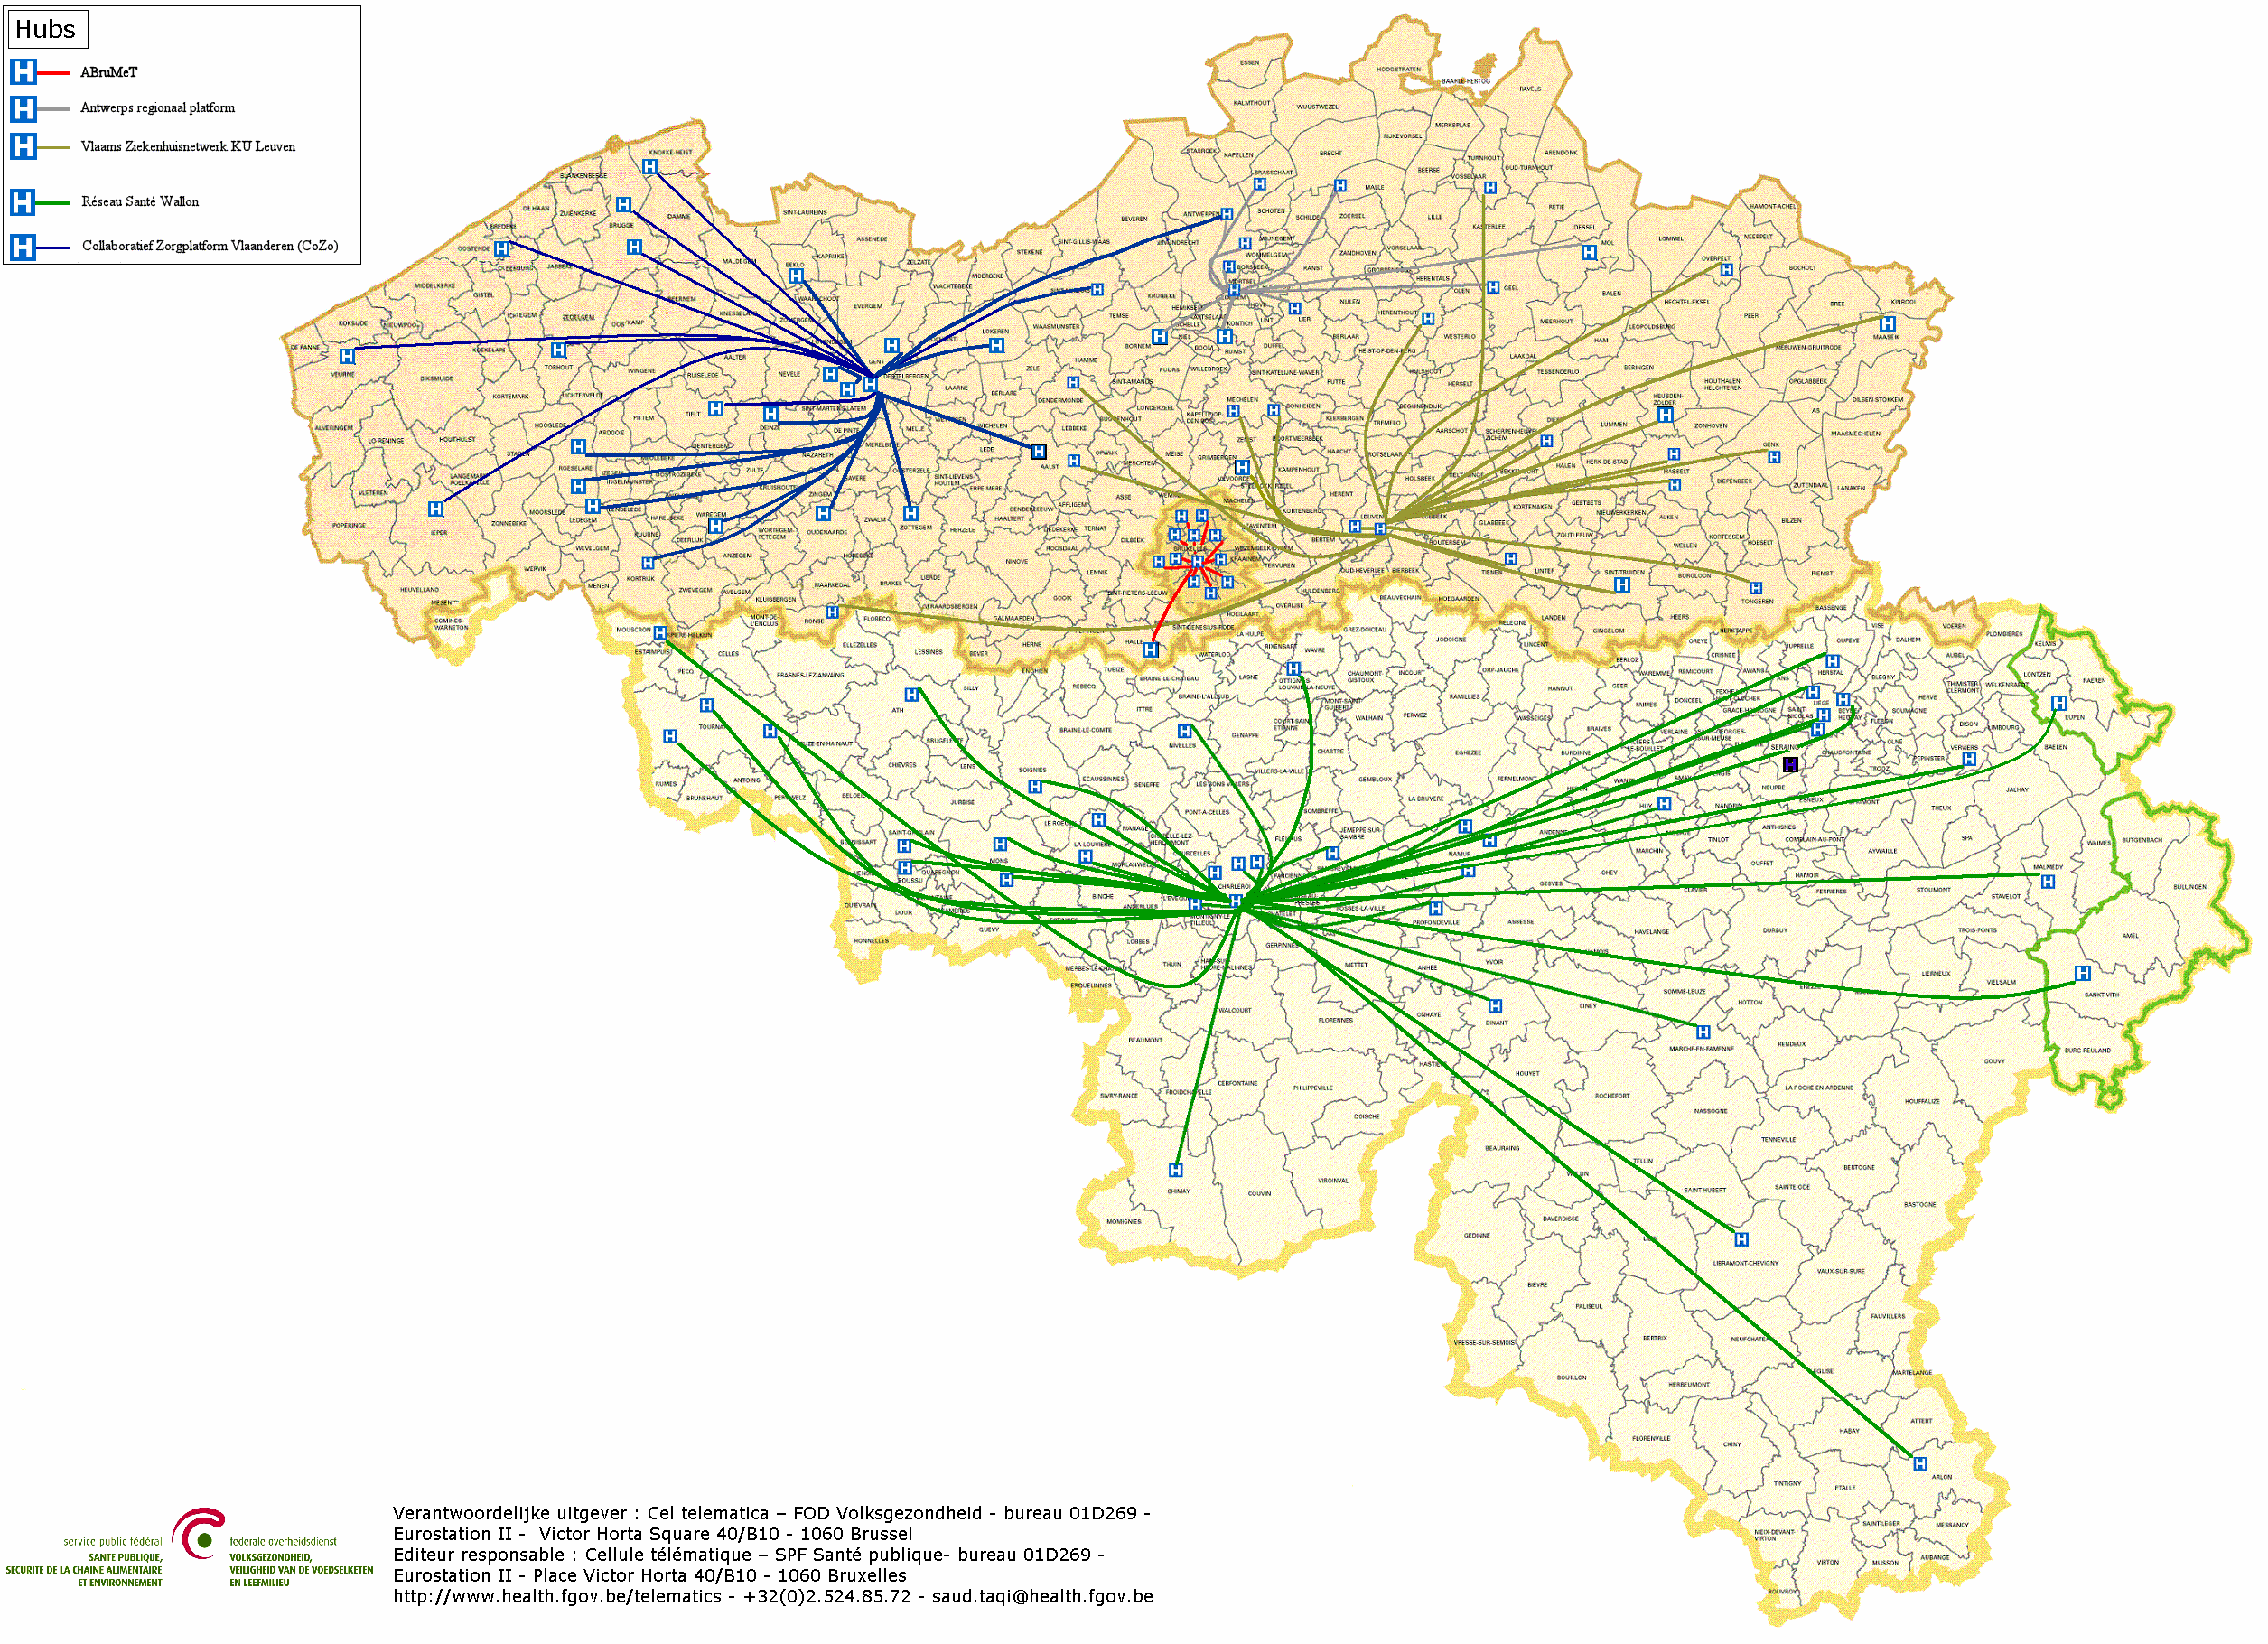

Hubs & metahub
        5 hubs
        Collaboratief Zorgplatform (Cozo)
        Antwerpse Regionale Hub (ARH)
        Vlaams Ziekenhuisnetwerk KU Leuven (VZN)
        Réseau Santé Wallon (RSW)
        Réseau Santé Bruxellois (RSB)

Slide 10








Hubs & metahub
3. Retrieve data from hub A
A
1: Where can we find data?
2: In hub A and C
4:
All data available
3: Retrieve data from hub C
C
B

Slide 11





Health vaults
A
InterMed
BruSafe
C
B

Slide 12

Personal health viewer: MaSanté

Slide 13
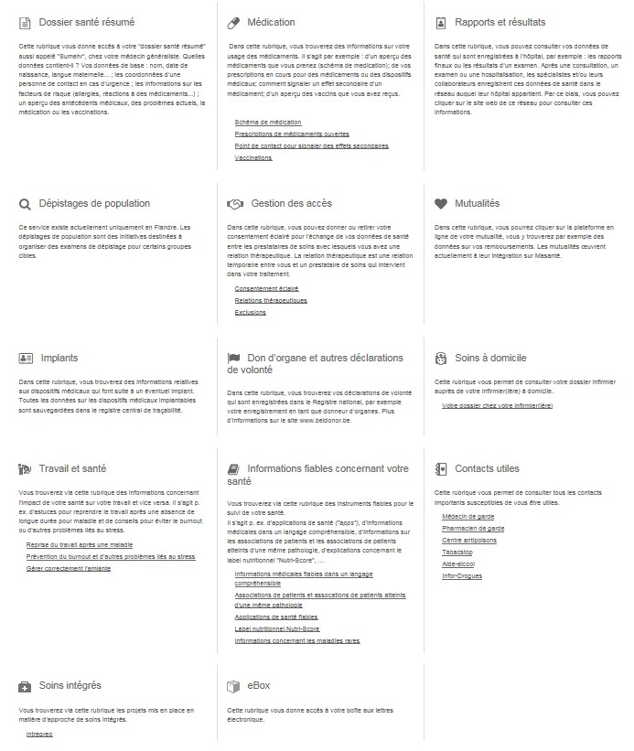
Personal health viewer: MaSanté

Slide 14









Some figures
>77%
of the citizens consented
to data sharing
> 74%
of the health care providers
daily use the system
84 millions
messages/year
via eHealthBox
Electronic prescriptions
15.000.000.000
electronic transactions
5 million/month
7,7 millions
of the citizens dispose
of an SumEHR in a
well-secured
electronic health vault
14.000
4.800
  210 million
  electronic documents available
  at hospitals and clinical labs

Slide 15
Governance of the eHealth-platform
eHealth platform
Users Committee
Board of Directors
Information Security Committee
(Parliament)
advice
decision
supervision
proposal for
decision
Administration
authorisation

Slide 16
Healthdata.be platform
Public service by Sciensano (formerly known as WIV-ISP)
Objective: re-use of digitalized information from clinical workflow (real world), and, preferably, from authentic sources or other validated databases (linked data) for research
Approach
  one technical architecture (free & open)
  one information architecture (independent from technical implementation)
  one set of business processes
Ambition: no administrative burden, higher efficiency, should result in
  more time for patient and thus higher quality of care
  more time for research and thus higher quality of research
  lower overall costs
Notes:
(1) Software application HD4DP (healthdata for data providers) installed in hospital: automatic capture of existing data (using webservices or csv polling) from operational systems (like EHR, LIMS, …) with possibility of manual input and validation in eform. In case of manual input remains available (structured and coded, according to [inter]national standard, based on CBBs) in local database of DP: Import in future upgrade of EPD/LIMS; Re-Use for internal BI & QI
Central digital catalogue with technical description of each data collection (variables, list of values, validation rules, help text). Catalogue communicates this description in real time to HD4DP. For each data collection, the National Registry number (NISS)is used as key ID of the patient.
(2) During transfer from data provider towards researcher, all registrations are encrypted. The ID of the patient (NISS) is pseudonomyzed by a Trused Third Party (the national eHealth platform).
(3) Using the web application HD4RES (healthdata for researchers), the researcher can monitor all registrations in all participating institutions, can view the submitted data, can comment on each submitted value, can return comment to data provider (e.g. a request for correction), …
(4) A generic « Data Quality Tool » facilitates the quality control, by the researcher (NOT by staff HD), of the submitted data.
(6) The researcher accesses his clean data set using a secured VPN connection and his electronic ID Card. Statistical tooling like SAS, STATA, R … are available for statistical analysis by the researcher (NOT by staff HD).
(7) Healthstat.be is the reporting platform of healthdata.be: first public and private reports will be available by March 2017. Researchers provide definition of reports, staff of HD develop the reports.

Slide 17
Healthdata.be platform
Guiding scientific principles of the Healthdata.be platform: the FAIR principles (cf Wilkinson et al. 2016): data and metadata should be
  Findable
  Accessible
  Interoperable
  Re-usable
Healthdata.be
  collects very diverse clinical data: vital signs, diagnoses, procedures, but also complex ‘Next Generation Sequence data’, and Patient Reported Outcomes and Patient Reported Experiences
  collaborates with other data warehouses: e.g. Crossroads Bank for Social Security for research on social impact of diseases and therapies

Slide 18






Healthdata.be architecture
One generic technical architecture for collection and management of real world data is in production in all Belgian hospitals and most laboratories
Healthdata.be
HD4DP
HD4RES
DATAWAREHOUSE (SAS)
HEALTHSTAT
⓿
❶
❷
❸
Registration
in Primary System
Data Collection
Secure
Data Transfer
& Encoding of ID’s
❸
❹
❺
❻
❼
Data Monitoring
Data Validation
Data Storage
Analysis
BI-Reporting
Annotation & Correction Request
Notes:
(1) Software application HD4DP (healthdata for data providers) installed in hospital: automatic capture of existing data (using webservices or csv polling) from operational systems (like EHR, LIMS, …) with possibility of manual input and validation in eform. In case of manual input remains available (structured and coded, according to [inter]national standard, based on CBBs) in local database of DP: Import in future upgrade of EPD/LIMS; Re-Use for internal BI & QI
Central digital catalogue with technical description of each data collection (variables, list of values, validation rules, help text). Catalogue communicates this description in real time to HD4DP. For each data collection, the National Registry number (NISS)is used as key ID of the patient.
(2) During transfer from data provider towards researcher, all registrations are encrypted. The ID of the patient (NISS) is pseudonomyzed by a Trused Third Party (the national eHealth platform).
(3) Using the web application HD4RES (healthdata for researchers), the researcher can monitor all registrations in all participating institutions, can view the submitted data, can comment on each submitted value, can return comment to data provider (e.g. a request for correction), …
(4) A generic « Data Quality Tool » facilitates the quality control, by the researcher (NOT by staff HD), of the submitted data.
(6) The researcher accesses his clean data set using a secured VPN connection and his electronic ID Card. Statistical tooling like SAS, STATA, R … are available for statistical analysis by the researcher (NOT by staff HD).
(7) Healthstat.be is the reporting platform of healthdata.be: first public and private reports will be available by March 2017. Researchers provide definition of reports, staff of HD develop the reports.

Slide 19
Key determinant: trust
All scientific projects are - before entering into production - subject to
  internal evaluation by responsible physician and Data Protection Officer (DPO)
  external evaluation by Steering Committee and Information Security Committee
Collected data becomes available for researchers only after small cell risk analysis by independent specialists, appointed by Information Security Committee

Slide 20
Key determinant: trust
Privacy by design: use of trusted third party (eHealth platform) for encryption, pseudonymisation, authentication, …
Applications are under supervision by key stakeholders (care providers, patients, governments, …) represented in Management Board eHealth platform
Functioning in community cloud on premise (G-Cloud) with appropriate information security measures for highly sensitive data
Monitoring and auditing: use of software that monitors all activity on infrastructure

Slide 21
Governance of the Healthdata.be platform
Sciensano (WIV-ISP )
Healthdata.be platform
Users Committee eHealth Platform
advice
Steering Committee
Information Security Committee
(Parliament)
ad hoc advice
Belgian Consultative Committee Bioethics
decision
supervision
proposal for
decision
Management Board eHealth Platform
Administration
authorisation
technological
supervision
Notes:
Steering Committee (MD’s, informaticians, patients) decides on eligibility of projects and supervises activities
Belgian Consultative Committee Bioethics is consulted ad hoc by Steering Committee
Sectoral Committee (Parliament) is requested for authorization for each project
Users Committee eHealth Platform supervises / aligns scope and activities of Steering Committee (eg. provides technical advice via Working Group Architecture)
Management Board eHealth Platform supervises all technical solutions, their management and hosting (VAS/G-Cloud)
Healthdata.be:
aligns its activities with the principles and methods adopted by the CIM/IMC Health and published in Action plan eHealth 2013-2018.
is coordinator of Action point 18 on scientific data collections.

Slide 22
#dataforbetterhealth initiative
the initiative #dataforbetterhealth aims to identify the existing impediments for a FAIR data (Findable, Accessible, Interoperable, Reusable) policy in public health and to formulate, test and implement solutions for these impediments in order to achieve an integrated data access policy
an integrated data access policy will lead to
  better support for scientific research and quality of care
  better support for clinical trials, personalized and patient centric care, and prevention
  more effective development of medicines and medical devices
  lower medical expenses
an initiative of the federal minister of Public health, the federal minister of Digital Agenda and Privacy
diverse activities: lectures, FAIR workshops for civil servants hosting data, development of metadata portals, hackathons, policy note, …

Slide 23
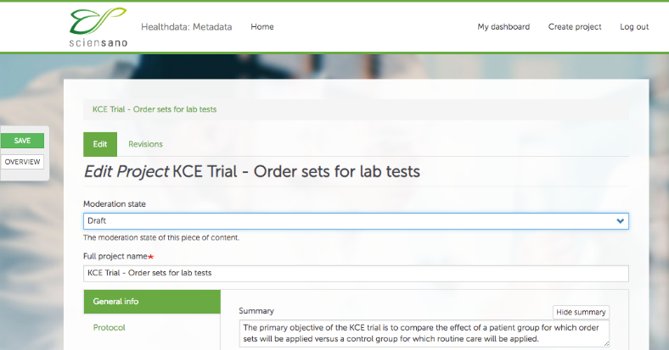
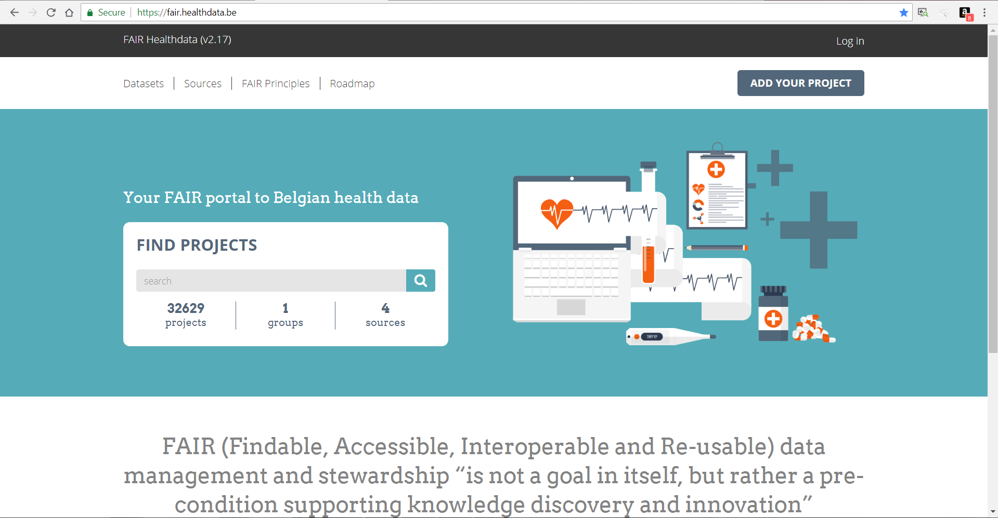
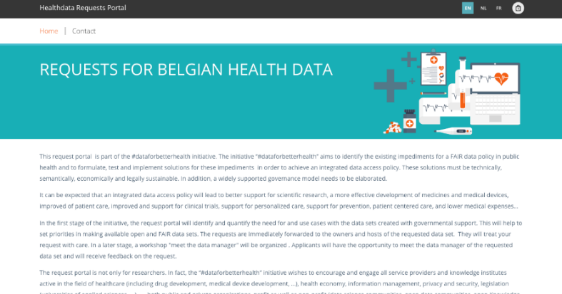
#dataforbetterhealth: from metadata to request
https://metadata.healthdata.be
data managers of public funded databases must describe in detail their project and database
descriptions needs to be updated once a year
https://fair.healthdata.be
the metadata description is automatically published in the publicly accessible FAIR data portal
a “request data” button is foreseen for each project, and redirects to the request portal
https://requests.healthdata.be
persons can submit their request using a detailed request form
the submitted request form is immediately forwarded towards the manager of the database in question
the data manager is responsible for processing the request

Slide 24
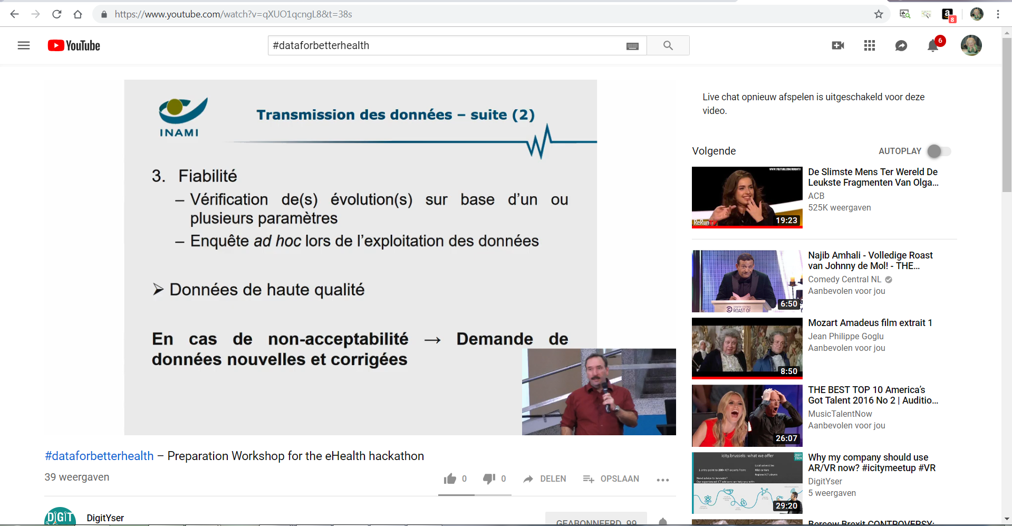
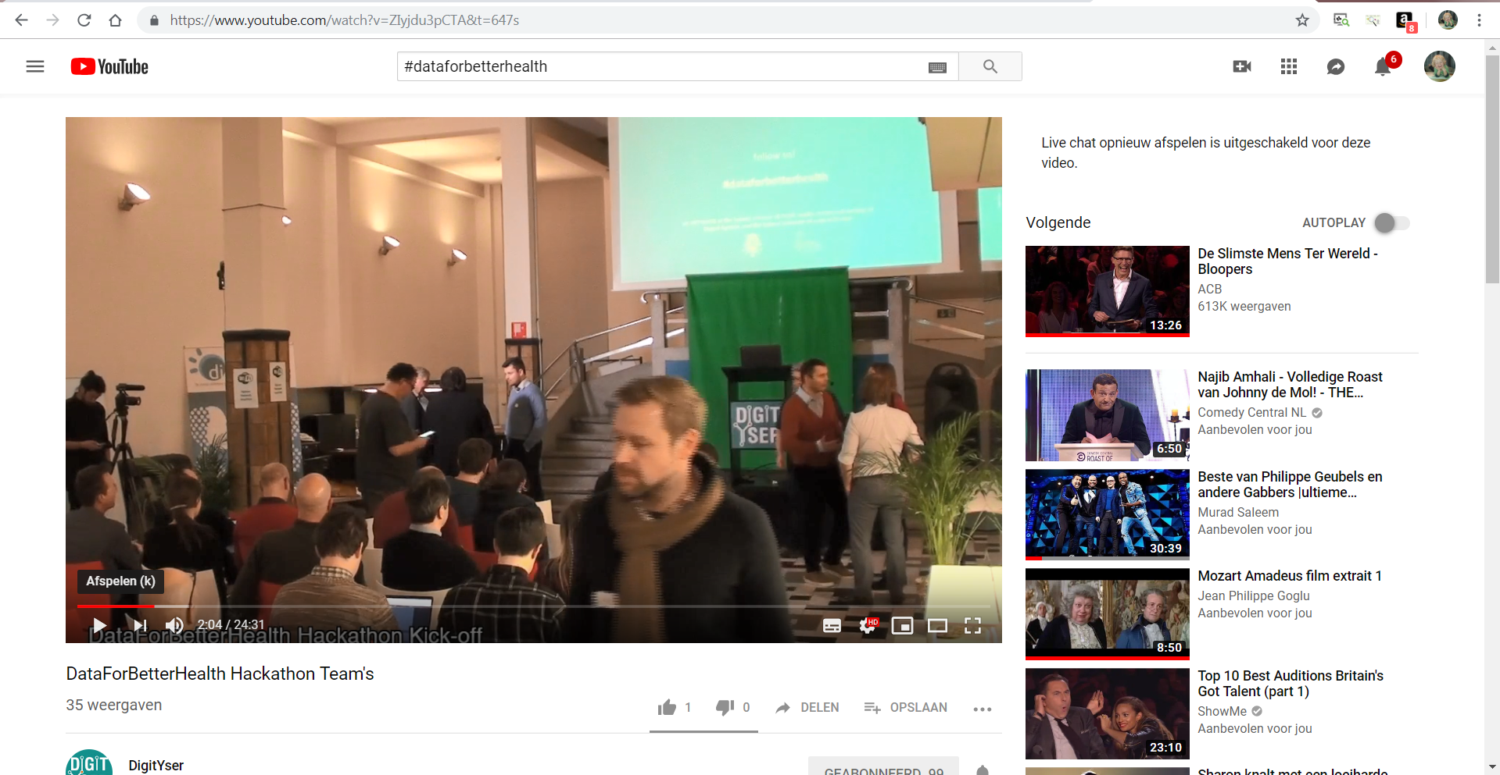

#dataforbetterhealth example: “DOC PH” hackathon
The National Institute for Health and Disability Insurance (NIHDI/RIZIV/INAMI) provided an anonymized version of the database “DOC PH”, a dataset containing information about medication delivery in all Belgian hospitals, since 1994 (unique open database worldwide)
Introductory workshop (10.01.2019)
Hackathon (25-26.01.2019)
Participants (n=70) University Research groups, Hospitals, Pharmaceutical companies, health analytics consultancy companies, ICT Companies, self-employed data scientists, entrepreneurs, …

Slide 25
European aspects
issues to be dealth with on a European level
  standards
    technical and semantic interoperability
    security
  secure cloud provisioning
  pan European basic services
    user & acces management
    encryption
    reference directories
    …
best practices of Member States can be used to develop pan European basic services
adequate legal framework: not imposing but facilitating

Slide 26
Empowering individuals to exercise their rights

Slide 27
Extract of the document
Empowering individuals to exercise their rights: Individuals value the high level of protection granted by the GDPR and ePrivacy legislation. However, they suffer from the absence of technical tools and standards that make the exercise of their rights simple and not overly burdensome. The potential of Article 20 of the GDPR to enable novel data flows and foster competition is recognised in reports for the Commission and Member State governments, not limited to the EU. Yet, as a result of its design to enable switching of service providers rather than enabling data reuse in digital ecosystems the right has practical limitations.
Since increasingly large amounts of data are generated by consumers when they use IoT devices and digital services, consumers may be faced with risks of discrimination, unfair practices and ‘lock-in’ effects. Considerations of consumer and innovation empowerment underlie the provisions on data access and reuse of the Payment Services Directive.
In response to this, there are calls to give individuals the tools and means to decide at a granular level what is done with their data (by the MyData movement and others). This promises significant benefits to individuals, including to their health and wellness, better personal finances, reduced environmental footprint, hassle-free access to public and private services and greater oversight and transparency over their personal data. Those tools and means include consent management tools, personal information management apps, including fully decentralised solutions building on blockchain, as well as personal data cooperatives or trusts acting as novel neutral intermediaries in the personal data economy. Currently such tools are still in their infancy, although they have significant potential and need a supportive environment.

Slide 28
Some remarks
too granular informed consent to share personal data for continuous and qualitative care provision by health care providers having a care relationship with the data subject is not suitable
  impossibility for patients to evaluate the relevance of data sharing
  risks for suboptimal care
  risks for “unilaterally imposed standard contracts” changing over time
  too complex to manage over time => lack of transparancy => lack of trust
modalities for an informed consent provided in article 7 GDPR are sometimes difficult to work with
blockchain also rises important information security and privacy protection issues
  multiple data storage
  longitudinal data storage

Slide 29
Main idea
need for balance between
  effective and efficient data processing with added value
  prevention of risks (unethical data use, privacy breaches, discrimination, …)
based on risk analysis and risk management
promoting information security and data protection by design
multidisciplinary approach
  structural and institutional measures
  organizational measures
  technical measures
  legal measures

Slide 30
Structural and institutional measures
no systematic central data storage
availability of free of charge, basic information security services
  user- & access management
  encryption
  logging
  reference directories
  …
independent Information Security Committee designated by the Parliament
in some cases, preventive control of the legitimacy of personal data exchange by the eHealth-platform according to the authorizations of the independent Information Security Committee

Slide 31
Information Security Committee (ISC)
not a supervisory authority as defined by GDPR
set up by law of September 5th 2018
composition
  Chamber Social Security and Health
  Chamber Federal Government
  independent members designated by Parliament
tasks
  delivering deliberations with normative value (=> legal certainty for the data controllers) regarding
    the exchange of personal data
    the processing of pseudonymised and anonymous data
  retaining and publishing of deliberations
  defining good practices
  supporting DPOs
  publishing a yearly activity report

Slide 32
Considerations in the deliberations of the ISC
lawfullness and purpose limitation
  is the processing serving a legitimate purpose?
  are the purposes of the processing well defined ?
data minimization
  is the processing using the minimal dataset to achieve the purposes ?
  storage limitation
integrity and confidentiality
  measures on how to guarantee both parameters
transparency for the data subjects

Slide 33
Organizational measures
information security department headed by DPO with each care institution
specialized information security service providers
information security working parties developing regularly actualized minimal information security and data protection standards (‘minimale normen/normes minimales’)
  developed by information security working parties => buy in !
  approved by the independent Information Security Committee
  based on ISO 27000 standards, adapted for health care
  defines 15 areas of security
  enforced for all health care institutions
  extended with policy guidelines
    minimal standards refer to policy guidelines for more detail
    policy guidelines provide support for concrete implementation

Slide 34
Organizational measures
yearly assessment of compliance with minimal information security and data protection standards
  questionnaire sent out to health care institutions
  checked by the security service of the eHealth platform
  reviewed in the information security working parties
Data Protection Impact Assessments (DPIA)
internal audits with continuous improvement plans

Slide 35
Organizational measures
definition of ‘circles of trust’: agreements between actors about
  who is responsible of carrying out which authentications and verifications on the basis of which means
  how the results of the authentications and verifications are securely stored and exchanged electronically between the actors involved
  who is responsible of logging access (attemps) to the services and applications
  how it is ensured that a complete reconstruction of loggings can take place to determine which natural person has used which service in relation to which person , when and for what purposes
  the retention period of the loggings, as well as the way in which these can be consulted by those who are entitled to do so

Slide 36
Organizational measures
clear distinction between several types of informed consent
  global informed consent to electronic sharing of personal data for continuous and qualitative care provision by health care providers having a care relationship with the data subject
  specific informed consent to be subject of a health research project based on personal data
  specific informed consent to be subject of a health treatment
structural platforms and methods to support health research based on anonymized or pseudonymised data

Slide 37
Health data research: some risks and measures taken
risk of singling out individuals without necessity
  aggregation, anonymisation and pseudonymisation of data
  small cells risk analysis
  legal obligation to not to attempt to re-identify data subjects
risk of data bias
  careful selection of data used
  reliable analysis methodologies (interative modelling)
  ‘equal opportunity by design’
  appropriate training
  transparancy

Slide 38
Health data research: some risks and measures taken
risk of violation of purpose limitation principle
  preliminary transparency about purposes of big data analysis
  respecting GDPR, especially in case of big data analysis for public health or scientific research purposes
risk of huge increase of data storage (quantity and duration)
  limitation of personal data storage to the extent and during the time useful for the foreseen legitimate purposes
  aggregation, anonymisation or pseudonymisation of personal data that are only stored for public health or scientific research purposes

