Slide 1

Digital agenda: some focus areas

Slide 2
Overview
relevant recent regulation
  European level
  Belgian federal level
some focus areas
  API
  sharing & reuse
  end-to-end automation
  artificial intelligence
  blockchain
some reusable public sector components
  CSAM
  eBox

Slide 3
Relevant recent regulation

Slide 4
Relevant recent regulation on European level
eIDAS Regulation 910/2014
  Implementing regulation (EU) 2015/1501 on the interoperability framework
  Implementing regulation (EU) 2015/1502 on the assurance levels
  EU trusted list of trust service providers
General Data Protection Regulation 2016/679
Regulation 2018/1724 establishing a single digital gateway to provide access to information, to procedures and to assistance and problem-solving services

Slide 5
eIDAS regulation: objectives
Regulation (EU) No 910/2014 of 23 July 2014 on electronic identification and trust services for electronic transactions in the internal market (“eIDAS regulation” - electronic identification, authentication and trust services)
strengthen EU single market by boosting trust and convenience in secure and seamless cross-border electronic transactions
three important objectives
  increasing the effectiveness of public and private online services, electronic business and electronic commerce in the European Union, by eliminating (legal and technical) obstacles for the functioning of the internal market => choice for a regulation
  enhance trust in electronic transactions , in particular cross-border transactions, by providing a common foundation for secure electronic interaction between citizens, businesses and public authorities => high level of security and better information (EU trust mark)
  enhance legal certainty within the use of electronic identification means and trust services
regulation => direct effect on Belgian law

Slide 6

eIDAS regulation: overall content
mandatory recognition of some electronic identification means
electronic trust services
  scope
    electronic signatures, including validation and preservation services
    electronic seals, including validation and preservation services
    time stamping
    electronic registered service delivery
    website authentication
  horizontal principles: security requirements, trusted lists, EU trust mark, prior authorisation, qualified services, liability, data protection, supervision, international aspects
non-discrimination of electronic documents vis-à-vis paper documents as evidence in legal proceedings

Slide 7
eIDAS: electronic identification
possibility for MS’s to notify electronic identification schemes, provided that some conditions are met, e.g.
  issued by, under a mandate from or recognized by the notifying MS
  can be used to access at least one government service which requires electronic identification in the notifying MS
  meets the requirements of at least one of the assurance levels set out by the eIDAS regulation
    high
    substantial
    low
  notifying MS ensures that the person identification data uniquely representing a person is attributed in accordance with the requirements of the chosen assurance level
  party issuing electronic identification means ensures that electronic identification means is attributed according to the requirements of the chosen assurance level

Slide 8
eIDAS: electronic identification
when an electronic identification and authentication is required under national law or by administrative practice to access an online government service in a MS, the electronic identification means issued in another MS shall be recognized, provided that
  the electronic identification means has been notified by a MS and is included in the list of the European Commission AND
  the assurance level of the electronic identifications means is equal or higher than the assurance level required for online access to the online government service, provided that the assurance level is substantial or high AND (no obligatory recognition for electronic identification means of level low)
  the government service uses the assurance level substantial or high for access to its online service (no obligatory recognition of electronic identification means of another MS if the online government service can be accessed by electronic identification means of level low)

Slide 9
eIDAS: electronic identification
no obligation to implement or use a device for electronic identification on a national level, and no obligatory European notification for cross-border use
obligation for the notifying MS to provide free online authentication service in case of a government service (not obligatory in case of a private service or may be paying)
obligation to designate ‘points of single contact’ for cooperation with other MS’s
obligation to designate a node operator for interoperability with other MS’s
if security is compromised, the notifying MS has to suspend or recall the cross-border identification means and to inform other MS’s and the European Commission

Slide 10
eIDAS: electronic identification
liability of the notifying MS
  the notifying MS ensures that the person identification data uniquely representing the person in question is attributed, in accordance with the requirements of the chosen assurance level
  the notifying MS ensures the availability of authentication online, so that any relying party established in the territory of another MS is able to confirm the person identification data received in electronic form
  the notifying Member State has to organise supervision to the notified electronic identification schemes
possibility to set conditions to the private sector to use the notified electronic identification schemes

Slide 11
Belgian law on electronic identification
Belgian law on electronic identification of 18 July 2017 completes the eIDAS Regulation
some provisions:
  each Belgian public sector body determines the required assurance level for access to its services and informs DG DT about this
  DG DT determines the assurance level of the schemes to be notified to the European Commission, after consulting the Colleges of Presidents of the federal public services, the social security institutions and the federal public utility institutions
  DG DT is charged with offering electronic notification services within the federal authentication service (FAS)
  DG DT passes a minimum set of person identification data to the node of another MS (retrieved from by SSIN), when a user wants access to an online service in that other MS

Slide 12
Belgian law on electronic identification
some provisions
  the supervisory body consists of representatives of at least 3 government services and is responsible for monitoring the notified schemes and taking measures
  the ‘points of single contact’ and an operator of the Belgian node are designated by Royal Decree in accordance with the European Implementing Regulations
  private parties can provide electronic identification services recognized by DG DT after consulting Colleges of Presidents for access to Belgian government applications within the FAS (conditions for recognition are determined by Royal Decree)

Slide 13
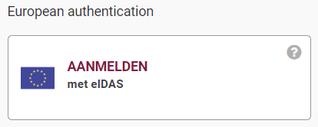

eIDAS
BE already connected with 6 other countries
Germany – Estonia – Spain – Croatia – Italy – Luxemburg

Slide 14
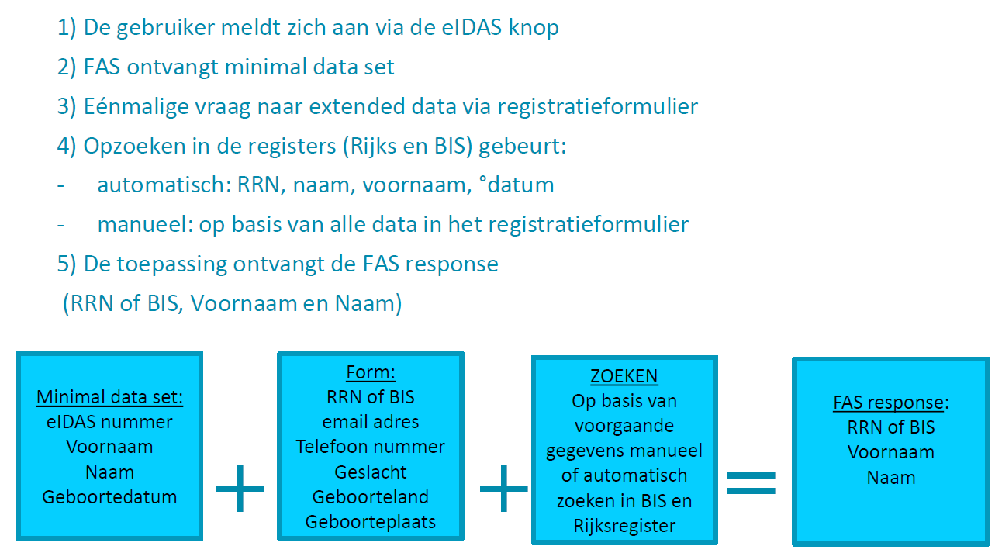
eIDAS flow (BOSA)
<- deze gevallen worden opgevangen door BOSA
<- zoals gewoonlijk

Slide 15
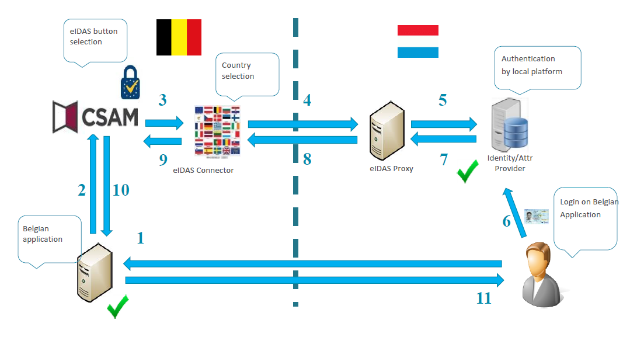
eIDAS flow

Slide 16
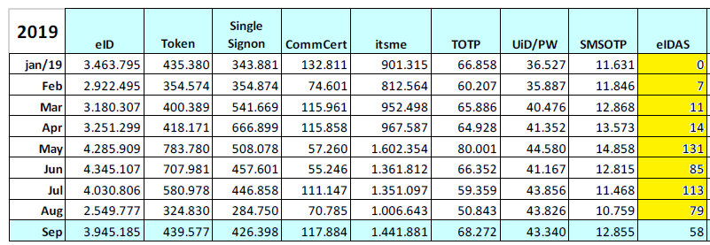
eIDAS
Activated for FPS Finance since 2/2019 (eg Tax-on-web)
# authentications via eIDAS

Slide 17
Single digital gateway (deadline 12/12/2023)
Europese digitale toegangspoort
waar alle burgers en ondernemingen uit een EU-land
  informatie
  online procedures
  diensten voor ondersteuning en oplossing van problemen
van een ander EU-land kunnen vinden
passerelle numérique européenne
où tous les citoyens et entreprises d'un pays de l’UE peuvent trouver
  des renseignements
  des procédures en ligne
  des services d’assistance et de soutien
en provenance d'un autre pays de l'UE

Slide 18
Why ?
administratieve lasten verminderen voor burgers en ondernemingen
werking van de interne markt verbeteren
discriminatie wegwerken
réduire les charges administratives pesant sur les citoyens et les entreprises
améliorer le fonctionnement du marché intérieur
élimination de la discrimination

Slide 19
Method
gebruikers gaan naar de “Your europe” portal
zoeken naar een life event of specifieke info
ontvangen een resultaat
starten onmiddellijk online procedure op
geven feedback over kwaliteit
ontvangen hulp als ze een probleem hebben
krijgen info aangeboden in de landsta(a)l(en) + Engels
einde
les utilisateurs vont sur le portail “Your Europe”
cherchent un événement de vie ou info spécifique
recoivent un résultat
peuvent lancer une procédure en ligne
peuvent donner leur avis sur la qualité du service
peuvent recevoir de l’aide si necessaire
dans leur langue nationale + en anglais
fin

Slide 20
Topics for citizens
reizen
werk en pensionering
voertuigen
verblijf
onderwijs of stage
gezondheidszorg
burger-en familierechten
consumentenrechten
bescherming van persoosgegevens
voyage
travail et pension
mobilité
séjour
études ou stage
soins de santé
droits concernant citoyens et famille
droits des consommateurs
protection des données à caractère personnel

Slide 21
Topics for companies
starten, exploiteren en sluiten van een bedrijf
werknemers
belastingen
goederen
diensten
démarrage, gestion, cessation d’activité
employés
fiscalité
biens
services

Slide 22
Principles
Europese verordening : rechtstreekse toepassing
digital first
niet-discriminerend op vlak van: identificatie/ondertekenen/ uitwisselen bewijs/betalen
only once
gemakkelijk te gebruiken/eenvoudig te begrijpen
beknopte uitleg centraal, referentie naar sites Lidstaten
user feedback !
règlement européen: application immediate
d’abord numérique
non discriminatoire en matière d’identification/signature/échange de preuves/paiement
only once
facile à utiliser/à comprendre
site central limité, redirection vers sites de référence par état membre
commentaires des utilisateurs !

Slide 23
Relevant recent regulation on Belgian federal level
Wet van 5 mei 2014 houdende verankering van het principe van de unieke gegevensinzameling in de werking van de diensten en instanties die behoren tot of taken uitvoeren voor de overheid en tot vereenvoudiging en gelijkschakeling van elektronische en papieren formulieren
Wet van 18 juli 2017 inzake elektronische identificatie
Wet van 27 februari 2019 inzake de elektronische uitwisseling van berichten via de eBox

Slide 24
Focus area: API

Slide 25

API - Application Programming Interface
an API is a programmatic interface to data or some set of functionality
thanks to API’s it is possible to use the data or functionality behind it and continue to build on it
API = a software building block

Slide 26
About API - Application Programming Interface
providers vs consumers
  when an API is offered over a network, the service that offers the API is called the “provider”
  the “consumer” of the API is often a software application
the consumer may outsource the requirement for data or functionality by “calling” API’s
  billing
  identity
  storing
  image processing
  all sort of (authentic) data sources
  …

Slide 27
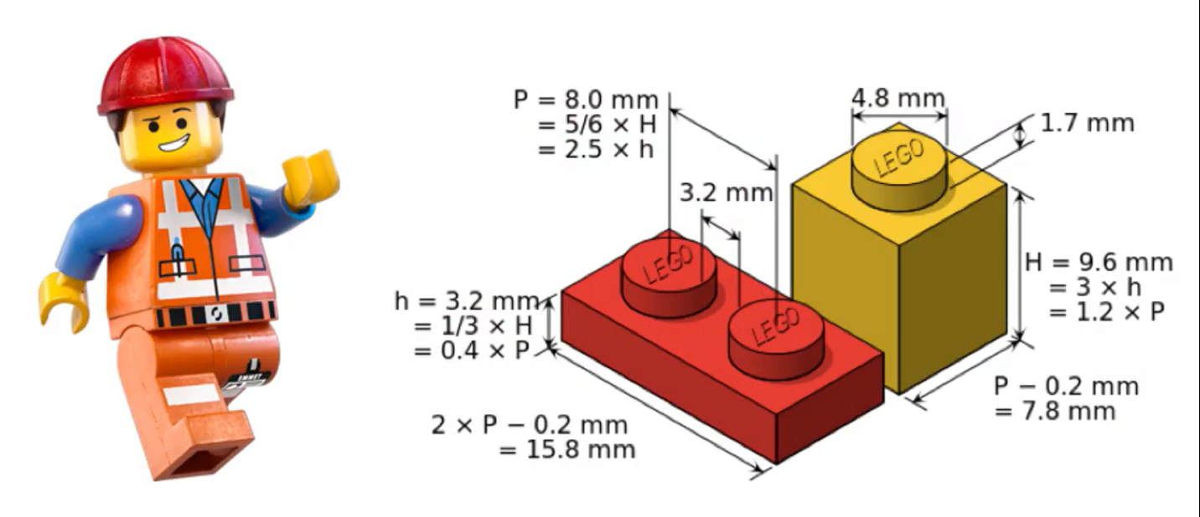
About API - Application Programming Interface
consumers can connect to an API of a provider and use its data or functionality as long as the “technical contract” has been respected
consumers don’t need to know the technical details behind the functionality
API’s can be written in any possible programming language

Slide 28
Why are API’s important ?
cost reduction by reusability: consumers don’t need to rewrite what already exists!
complexity reduction: no more big, monolithic systems
decoupling: consumers and providers can continue to connect as long as the technical contract is followed → ex. less impact in case of migrations
driver of innovation: new products arise, based on existing API capability
stimulation of partnerships
stimulation of standardization

Slide 29
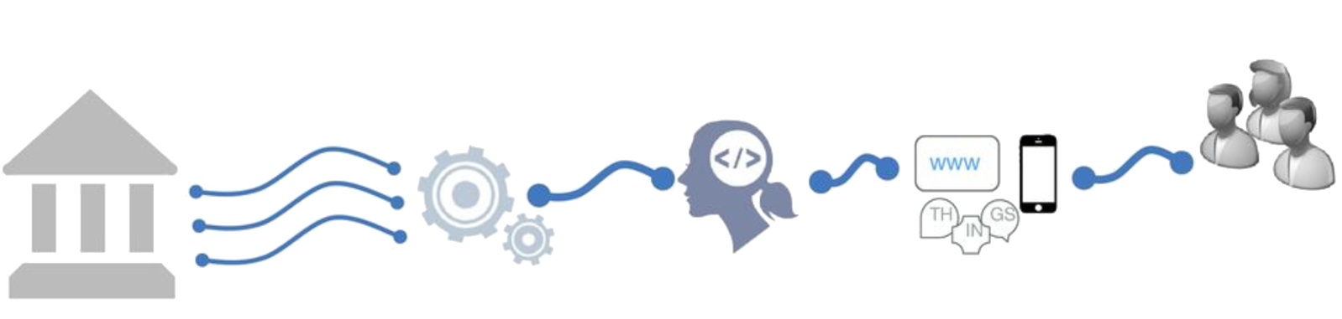
Shifting to an API economy: the value chain
To create new innovative apps and services
Made available as API
Differentiated
services
Self service
use by developers
Existing
Systems

Slide 30
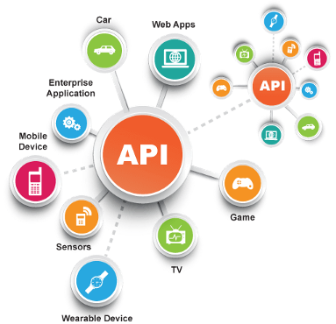
Today the API economy is a becoming a reality
Everything connects to everything

Slide 31

API’s & Belgian eGovernment
API’s drive today's business processes
API’s are key in real-time information sharing between partners
  public institutions
  companies & social secretariats
  citizens
with a strong focus on
  API management
  standardization
  security

Slide 32









Example: CSAM authentication services
Strong
 | eID + PIN-code with connected card reader
 | eID + PIN-code with wireless card reader
 | SIM card with PIN-code
 | Security code via mobile app, user-id + password
 | Security code via SMS, user-id + password
 | Helena (only as a citizen)
 | Security code on paper (paper token), user-id + password
 | User-id + password
Weak

Slide 33

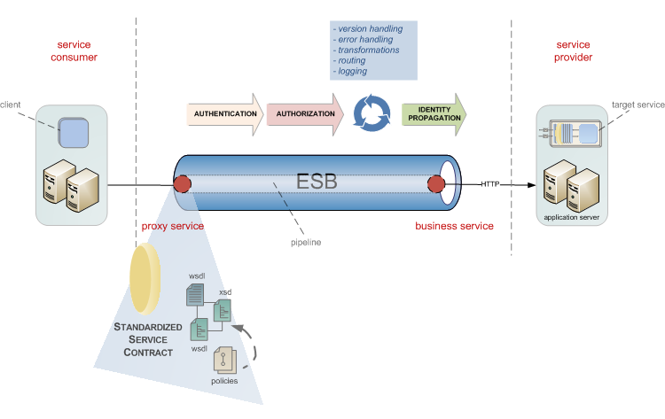
Example: SocialSecurity.be portal services
The Social Security service platform was created in 2009 to support managing business processes in
temporal/permanent employment
unemployment
work related risks and insurances
child benefits
social assistance and benefits
…
API
WEB

Slide 34



Example: realtime presence registration for construction workers
API
WEB
Notes:
Backend checks of the employment declaration, constructions sites, Limosa, (temporal work permits),
> 500.000 euro
Checkinatwork is de onlinedienst voor de aanwezigheidsregistratie bij werken in onroerende staat en activiteiten die behoren tot de vleessector. Het gaat om de registratie van:
iedereen die werken in onroerende staat uitvoert op een werkplaats waarvan de totale kost gelijk is aan of hoger is dan een specifiek drempelbedrag, en
iedereen die activiteiten uitvoert in verband met vleesbereidingen of vleesproducten en het slachten of uitsnijden van hoefdieren, gevogelte en konijnen in inrichtingen onderworpen aan de erkenning (erkenningen, toelatingen en voorafgaande registraties) van het Federaal Agentschap voor de Veiligheid van de Voedselketen (FAVV).
Via Checkinatwork registreren werkgevers en aannemers de aanwezigheid van hun eigen werknemers, van hun onderaannemers en van hun zelfstandige onderaannemers. De werknemers of zelfstandige onderaannemers kunnen zich ook zelf in het systeem aanmelden.
De registratie moet dagelijks gebeuren, en wel vóór de persoon die de werken uitvoert aan het werk gaat.
De werkplaatsen die vallen onder de verplichte aanwezigheidsregistratie via Checkinatwork moeten aangegeven zijn in de Aangifte van werken.

Slide 35





Example: eHealth-platform
Public Federal institution founded in 2008 for facilitating well-organized, mutual electronic service and information exchange between all actors in health care
The e-Health platform provides necessary guarantees with regard to information security, privacy protection and professional secrecy
API
WEB
Connectors Standards
Online Authentic
services sources

Slide 36















eHealth: landscape
Authentic sources

Slide 37
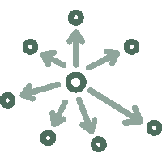





eHealth: technical choices
Decentralization
API
Security
Standardization
Integration
ReUse

Slide 38







eHealth: architecture
Patients, health care providers
and health care institutions
Site Ministry
Software health care professional
Software health care institution
VAS
Site RIZIV
VAS
eHealth-portal
MyCareNet
VAS
VAS
VAS
Users
Basic services
eHealth-platform
Network
AS
AS
AS
AS
AS
AS
Suppliers

Slide 39
eHealth-platform : basic services & API’s
Coordination of the electronic processes
Portal
Integrated user and access management system
Management of loggings
System for end-to-end encryption
eHealthBox
Timestamping
Coding and anonymising
Consultation of National register and CBSS registers
Reference directories (hub-metahub system)

Slide 40







Electronic information sharing: some figures
>77%
Belgian citizens’
informed consent to share data
+74%
went digital
84 million
Messages / year
via secure eHealthBox
API
WEB
Electronic Prescriptions
> 15.000.000.000
digital transactions annually
5 million / month
7,7 million
Belgian patients with
Summary Electronic Health Records in health vaults
  211 million
  electronic documents available
  at hospitals and clinical labs
14.000
4.800

Slide 41


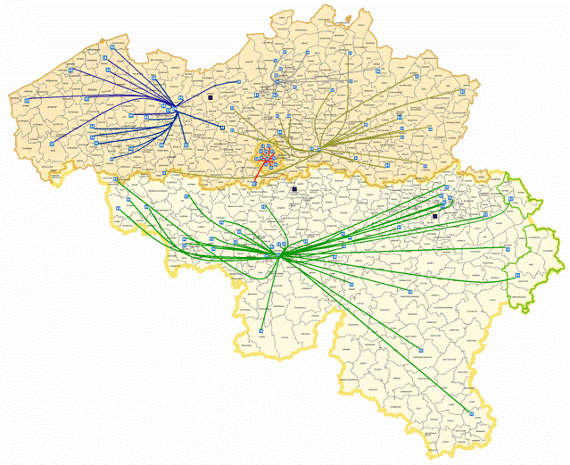

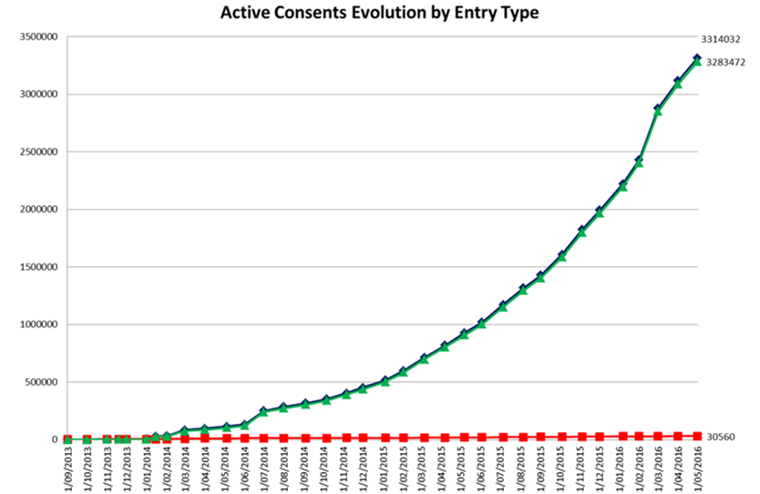
Global medical file & patient consent
via Consent
API
via e-Health website

Slide 42

API in health and social sector: some statistics and evolution
social security
100+ APIs
Most consumers are external (# 20,000-24,000)
Peak load 2000-3000 req / s
1.200M transactions / month
200+ APIs
Consumers mostly internal applications/services (# 200-300)
Peak load 1000-1500 req / s
300M transactions / month
Disclaimer: metrics listed since 2016 are for all ESB + gateway platforms. Migration to Axway APIM in progress since Q3 2018.
(eHealth currently 30% APIs migrated, Social Security gradually does onboarding on APIM for all new APIs and API evolutions)
Notes:
Need for a rock-solid service platform that meets our SLA requirements and can scale easily, while keeping costs under control

Slide 43
API standards
API standards in eGovernment are based on industry standards and best practices
a pragmatic approach to designing RESTful APIs
collaborative effort organized in several workgroups
  REST API modelling
  security (OAuth)
  functional/business vocabularies (temporal, location, person, enterprises)
REST style guide
  https://www.gcloud.belgium.be/rest/

Slide 44





API management
importance of good API management
  transparent migration of legacy services
  ready for today's standards, but supports our legacy as well
  from ESB-technology to API gateway
  parallel platform
  zero-impact migration
faster implementation of new services
  flexible to extend and customize
  accelerates time-to-market
API Manager
API Portal
API
API Registration & Lifecycle
Application Developers
API Catalog
Partner & Policy Administration
REST
API
API Gateway
SOAP
Policy Enforcement
Notes:
https://unsplash.com/photos/vE3ZFtIhA4c?utm_source=unsplash&utm_medium=referral&utm_content=creditCopyText
Parallel platforms
Controlled migration growth
In service mode: close monitoring
Inevitable surprises: challenge
Defaults adapt to our volumes: lots of tweaking / DRP tests
Challenge rebuild existing standards to new Axway
SOAP-REST
New services on new platform

Slide 45


Focus area: sharing & reuse

Slide 46
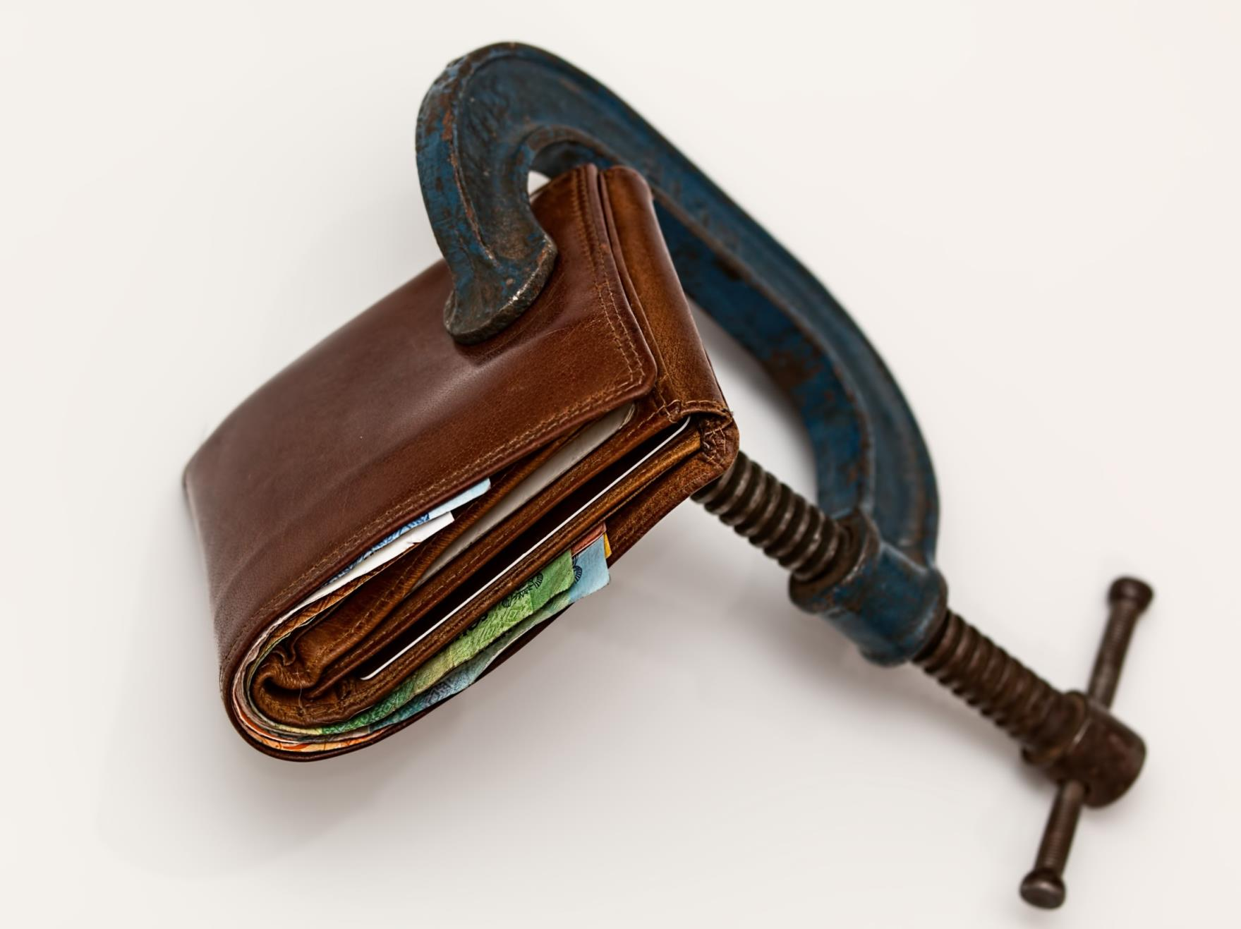
Notes:
No objective to make money
Main objective to save money

Slide 47
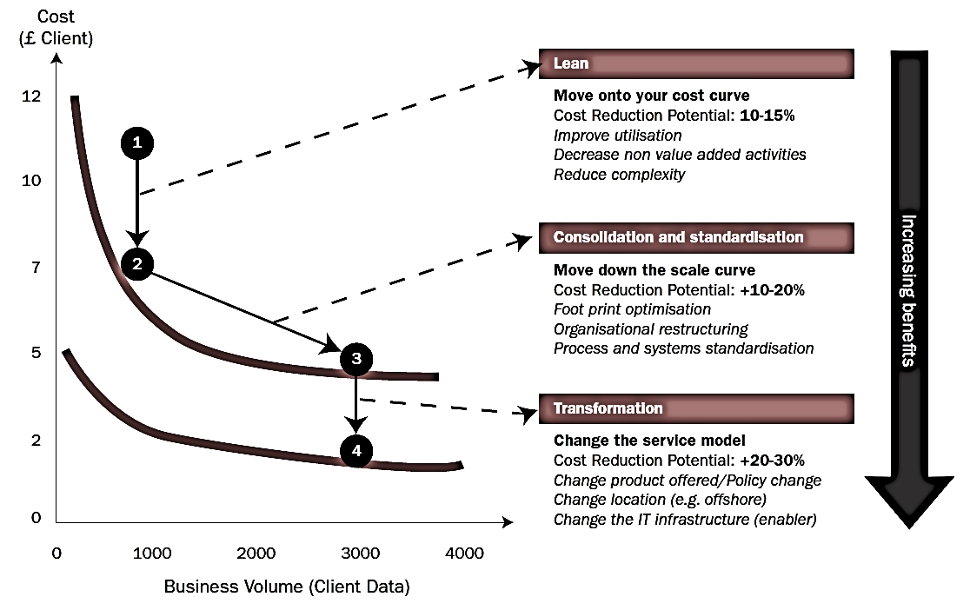
Synergies - transformations

Slide 48

Different types of sharing & reuse
infrastructure
  hard infrastructure
  soft infrastructure
  platforms
common vendor contracts
federal ICT community
business
  knowledge & experiences
  business functionality
  business data
  complete business services
Important to know what already exists
→ catalogues!

Slide 49








Cloud deployment types
Hybrid
Public Cloud
Shared
Access/Control
Outsourced Community Cloud (= off-premise)
Community Cloud on-premise
Private Cloud on-premise
Outsourced Private Cloud (= off-premise)
Dedicated
Customer
Location
Service Provider

Slide 50
G-Cloud portfolio

Slide 51




G-Cloud
Procurement
Cooperationá
Efficiencyá
Projects
Synergy
Services
Costsâ
Qualityá
Know-how & Expertise
Notes:
Maximum synergy when possible and when generating efficiency gains and/or savings while maintaining or improving the quality of the services provided to the customer
In line with the synergy program: assignment to the one who is the most capable of proposing a form of shared services
Synergy based on result orientation, sense of responsibility and trust

Slide 52
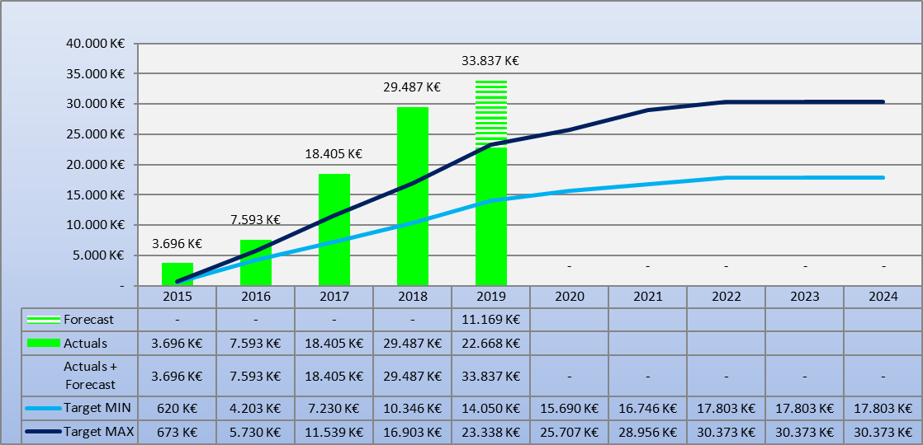
G-Cloud ROI
Total

Slide 53
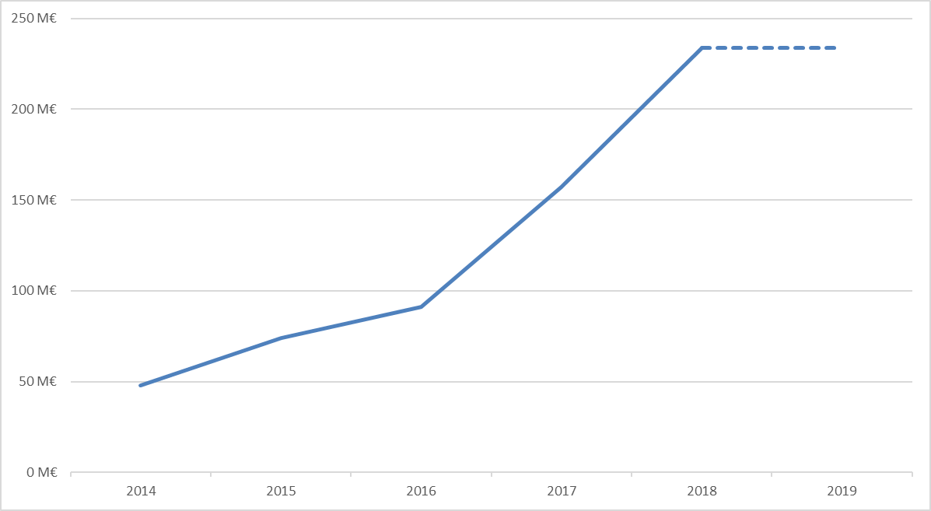
G-Cloud - reuse of contracts
Purchase volume of common contracts
Source: Smals

Slide 54
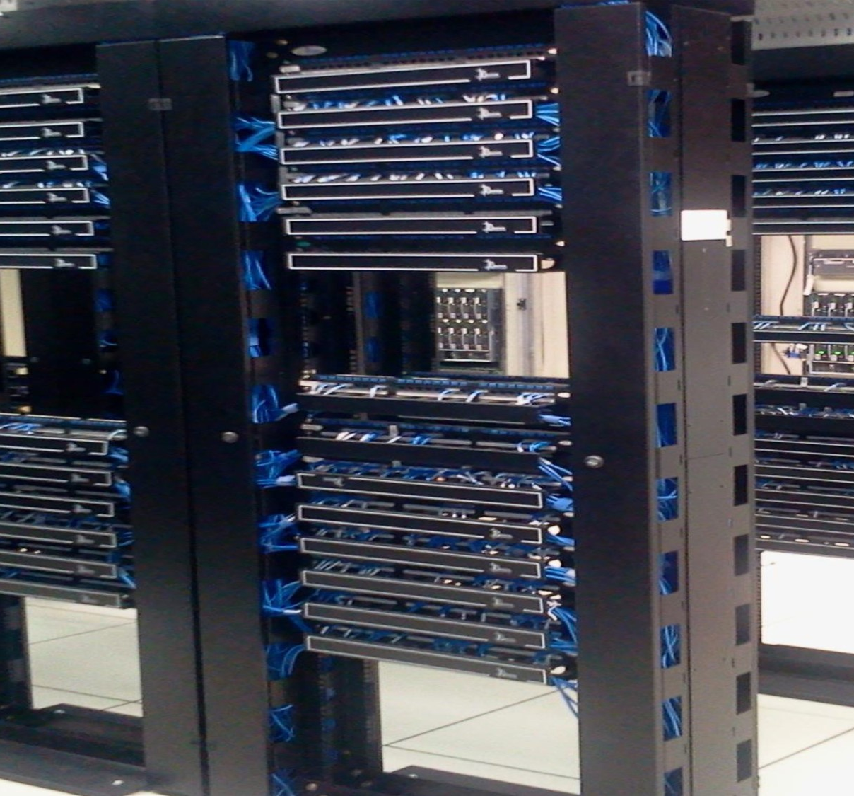
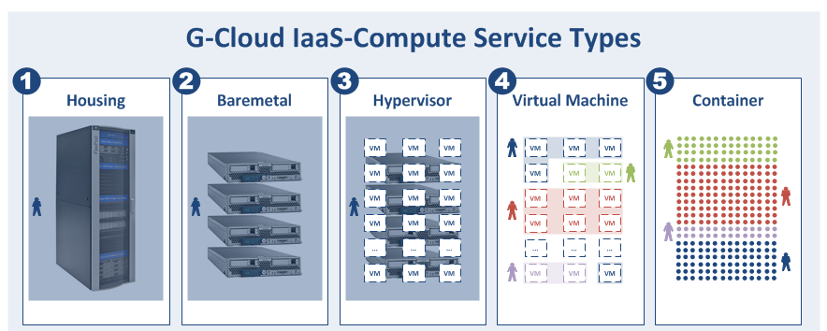
G-Cloud IAAS/PAAS in numbers
4 datacenters
46 tenants
1009 compute nodes
10198 virtual machines
12508 docker containers

Slide 55
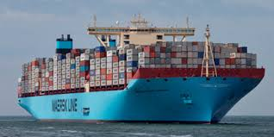
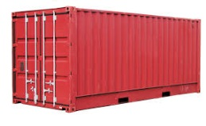
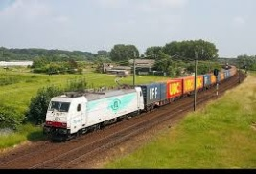
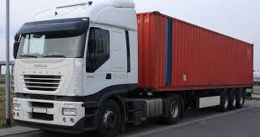






PaaS in G-Cloud - containers
introducing container technology
translated into modern technology such as Platform-as-a-Service
Individuele
inhoud
Easy to move around
Individual content
Isolated storage
Geïsoleerd opgeslagen
En makkelijk verplaatsbaar
Monitoring
Security
Logging
Coming
soon

Slide 56

New ways of cooperation
Government ecosystem
Other sectors
Components
parts
Application
1
Application
2
Application
N
Partner
1
Partner
2
Partner
N
Platform
cooperation
DB
DB
Technological cooperation
DB
DB
DB

Slide 57
Rise of (public) cloud
need for overall positioning
  public cloud policy
  based on information classification
  appropriate organizational, technical & contractual measures
  hybrid approach
G-Cloud as broker
  knowledge & expertise on cloud offerings
  contracts & implementation partners
  tools

Slide 58
Public cloud - main issues
longitudinal confidentiality of personal data
  need for comprehensive longitudinal encryption of personal data
  in motion, at rest and in use
performant continuous availability of application and data
easy migration of applications and data
compliance with GDPR

Slide 59
Shifting focus
towards synergies in the area of business components
Business components
Stronger centrally coordinated approach to offering platforms

Slide 60
About the initiative
initiative within the public social security institutions & Smals
purpose
  synergy around (technical) business components
  and thus save costs by avoiding multiple development of components
regardless of whether development takes place by
  the institution's own ICT department
  Smals
  subcontractors
creation of a competence center within Smals in order to maximally integrate and support the reuse of business components within Smals, its members, partners and domains in which Smals is active
60

Slide 61

Reuse: vision
Every stakeholder
can easily find the most common reusable elements in a centralized catalogue
Processes
and tools are put in place to identify, register, implement, monitor and measure reuse throughout the project lifecycle
Human
networks are maintained and developed on all levels (CEO’s, CIO’s, business owners, business analysts, architects) in order to keep maximum visibility on reuse potential
A culture
develops where
reuse is adopted and the creation of reusable products is promoted,
61

Slide 62

Value
Value
library
framework
product
system
Offered “business” functionality
62

Slide 63

























So… dare to share! ☺
Framework
Library
Product
Service
System
63

Slide 64

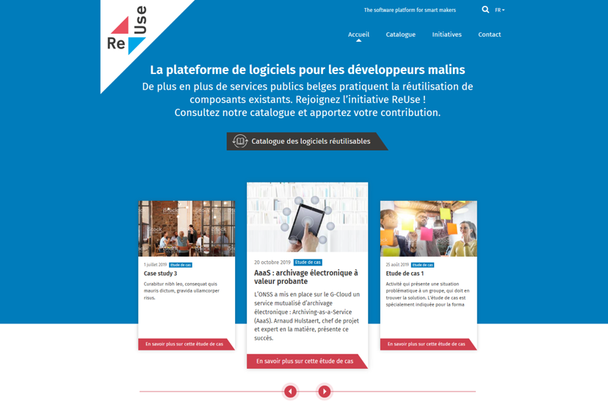
How ? with the new Software Reuse Platform !
https://www.ict-reuse.be
64

Slide 65
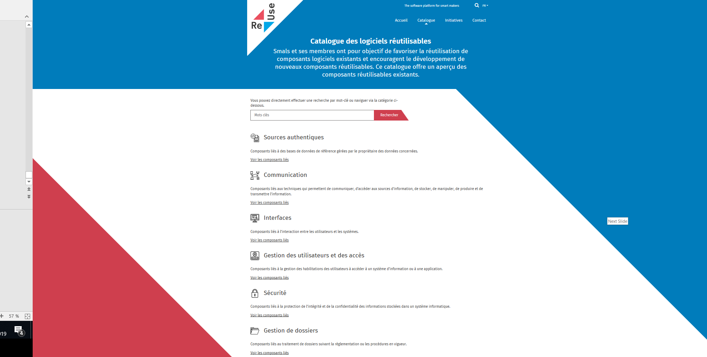
New project?
consult the
Software Reuse
Catalogue

Slide 66
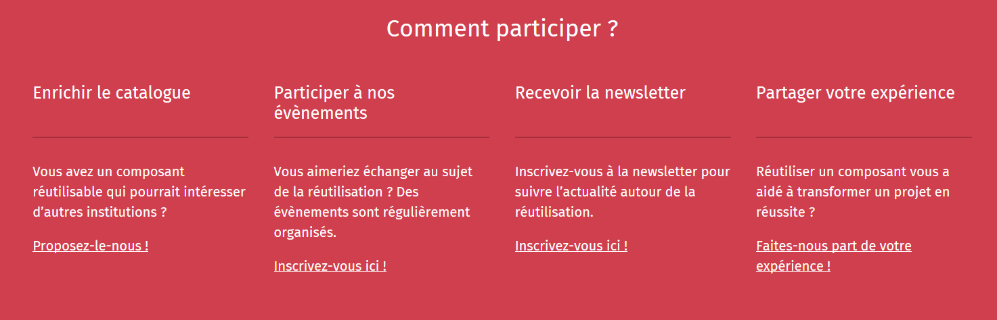
Share your success stories...and become an ambassador for reuse!
https://www.ict-reuse.be
66

Slide 67
ROI of reuse
you can only improve what you measure
reuse is embedded in the "project life cycle" of projects carried out by Smals
this makes it possible to compare the project cost without reuse and with reuse and to calculate the ROI
67

Slide 68
ROI 2019 for projects carried out by Smals
23%
54%
35%
reusable
Reused
ROI
10.000.000 €
68

Slide 69
Challenges
use the power of the network of institutions
deal with interdependencies
focus on the essence, not on "bells and whistles"
deal with the (un)availability of (critical) services
strive for uniformity of technological solutions / use of site licenses

Slide 70

Future opportunities – Government as a Platform (GAAS)
We live in a platform economy:
eBay, Amazon
YouTube
Google, Baidu
Paypal, Alipay
iOS, Android
Airbnb, TripAdvisor
Uber
Linkedin, Glassdoor

Slide 71
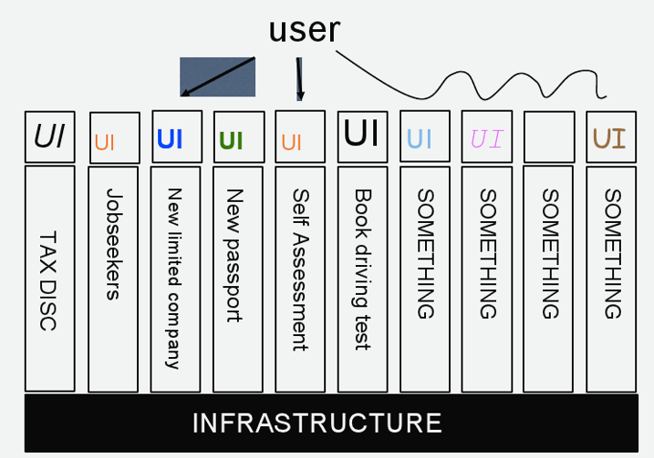
Future opportunities – Government as a Platform (GAAS)
governments still have many diverse and complex legacy systems and processes, too many of them still operating in silos
as a consequence, government often looks something like this

Slide 72
Future opportunities – Moving to the platform model
the real mark of success for government will be when government establishes the baseline set of things that it absolutely needs to do and then exposes a robust, rich set of service end points that will let people in the private sector add value to that minimal “must do” set
then we can hit some real magic because we will get more and more services for citizens with more and more ingenuity, without any procurement at all because the government made it possible for people outside to build interesting things

Slide 73
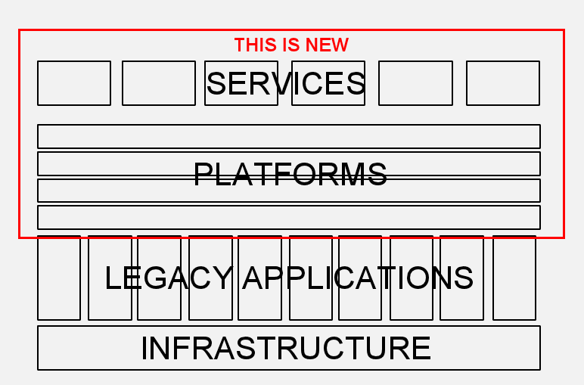

Future opportunities – Moving to the platform model
a platform provides essential technology infrastructure, including core applications that demonstrate the potential of the platform
the core platform provider enforces “rules of the road” (such as the open technical standards and processes to be used) to ensure consistency, and that applications based on the platform will work well together

Slide 74
Focus area: end-to-end automation

Slide 75
What ?
combination of
  (technical) mapping of business processes
  use of data from authentic and local sources
  API economy
  reusing available (business) components
  systems that orchestrate the whole
only contact with citizen / company when needed
automatic allocation of rights & handling of file (happy flow)
focus on exceptions, specific situations
tooling to facilitate automation (eg Robotic Process Automation (RPA))

Slide 76


Consequences
employees become "architects"
  which data / services are available ?
  which APIs offer this?
  give a plan to ICT
based on a global view of the processes
ICT serves to provide layered support for all types of customers
reusability requires a form of "generic thinking" (no "bells and whistles")
need for
  catalog of data and services
  use of the cross-institutional network (between managers, between ICT managers, between (business) analysts, etc)
  intelligence to assess the impact of changes on situations where it matters (social policy)

Slide 77
Consequences
Business App 1
Business App 2
Business App 3
Focus on product/service delivery
"DevOps" way of working
Product teams with end-end responsibility
Use of platform & tools
Maximum automation
Development platform
“Cloud & Container Services”
Infrastructure
Joint management of the platform

Slide 78

Present and future interfaces
growth of mobile user interfaces
mobile applications with added value, not "mobile for mobile"
how do we ensure user-friendly, maintainable and secure applications ?
what is acceptable to the target audience?

Slide 79
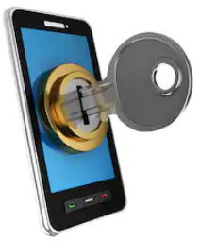
Importance of means of authentication
correct registration procedure to establish identity, qualities and
relationships
as simple as possible for end users
tiered levels of authentication
  according to level of registration: how certain are we of identity?
  according to application needs: what are the risks in case of abuse?
protection of data / functionality according to entitlements
take into account technological evolution
  eg eID -> security code (mobile / SMS) -> Itsme
cooperation initiative between government and private sector

Slide 80

Robotic Process Automation (RPA)
automation technology based on software robots
mimicking the work of humans across applications
using the app’s UI, and not requiring deeper (more costly) integration
Designed by Freepik

Slide 81
Difference with “normal” automation
software robots simulate manual clicks and keystrokes, performing actions and business logic
normal automation requires new systems to be built and integrated => normal automation is usually costly and time consuming
Automation Options
process requiring intelligence
AI based solutions
BPM based
solutions
Traditional
Applications
or Services
RPA
deterministic process
cheap
expensive

Slide 82
Kind of processes automated using RPA
repeatable, rules-driven software interactions by human users are low hanging fruits for RPA
especially high-volume / long-running
until the time a process can be automated within a more robust development effort, it can be automated with RPA
most RPA tools support recording actions on these applications, which can then be replayed many times:
  Web based
  Desktop
  Citrix
  SAP
  Excel

Slide 83
Better than humans ?
RPA is not meant to replace humans but to help human workers
software robots are good for tasks which are mundane, repetitive and disliked by most employees
for some kinds of applications, bots are better
  robots can run 24/7
  robot is not error-prone (completely deterministic behaviour, doesn’t “forget” a step in the process)
  robot actions can be logged in the background

Slide 84
RPA examples
search for certain files in an online document management system, extract relevant information, input this data in a desktop program, then move the original file to a different folder
perform an entire procedure to prepare, print, send and archive a document, requiring only 2 inputs at the start
login to twitter analytics to get statistics, download and clean them, analyze them in Excel
perform a check in several systems consecutively to see if a certain user’s credentials have been added / removed

Slide 85
Evaluation
Advantages
easier, faster than other options
usable by non-IT (power users)
quick ROI
can be used with legacy or otherwise difficult or inconvenient to integrate systems (eg no API available)
quick, temporary solution
Disadvantages
more work to accomodate branching / complex processes (easiest for “happy path” only)
sensitive to UI change in automated systems
less robust in general (greater stability requires more testing and exception handling, reducing ROI speed)
existence of RPA script may discourage building more robust/permanent solution
quick, temporary solution

Slide 86
Cognitive RPA ?
= RPA using AI
extends and improves the range of actions that are typically possible using RPA
leverages different AI technologies, such as natural language processing (NLP), text analytics and data mining, semantic technology and machine learning
helps bring automation to more processes, using not only structured data, but also the growing volumes of unstructured information.
with AI, unstructured data such as customer emails can be analyzed and transformed into data useful for the next step in a process; RPA takes then over from AI

Slide 87
Focus area: artificial intelligence

Slide 88
What is Artificial Intelligence (AI) ?
an area of computer science concerned with the creation of machines that can reproduce human cognitive functions such as reasoning, planning, learning, language understanding, vision,…
weak AI vs strong AI
  weak or narrow AI
    simulates intelligence
    is limited to specific areas
    all current implementations of AI are narrow AI
  strong or general AI
    still debated, includes philosophical considerations such as consciousness, intentionality, …
    has real intelligence,
    has mental states and beliefs like humans
    Holy grail !
Notes:
Weak AI: Weak AI simply acts upon and is bound by the rules imposed on it and it could not go beyond those rules
General or strong AI is still debated as it is hard to give a good definition of what intelligence is. Should the machine have consciousness (be aware of its mental states) ? Does it have intentionality?

Slide 89
Concepts
Artificial Intelligence
Machine learning
Neuron based
Good old-fashioned AI: path finding, constraint satisfaction problems, planning, rule-based systems, expert systems, …
Decision trees, clustering, …
“Hot”
Random forests,
support vector machines, …
Data Mining
Deep learning (CNN, RNN, GAN)
Reinforcement learning
Deep reinforcement learning
Notes:
CNN: Convolution Neural Network (image, text)
RNN: Recurrent Neural Network (sequences, text, language)
GAN: Generative Adversarial Networks (https://deeplearning4j.org/generative-adversarial-network)

Slide 90
AI subfields (non-exhaustive)
Knowledge representa-tion
Natural language generation
Sensors/
internet of things
Audio/
speech analytics
Machine learning
Graph analysis
Simulation modelling
Natural language processing
Deep Q&A systems
(cognitive computing)
Robotics
Image analytics
Deep learning
Social network analysis
Visualisa-tion
Deep causal reasoning
Virtual personal assistants
Recommen-der systems
Machine translation
Source: PWC via @mikeuindazzi

Slide 91

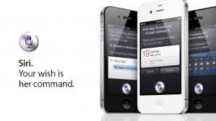
Natural Language Processing (NLP)
processing of natural language in order to communicate with humans and extract information from written texts
some applications of NLP are:
  machine translation
  text classification
  Information extraction (Named Entity Recognition (NER))
  information retrieval
  speech recognition:
    Google Assistant/Home
    Siri
    Alexa
    Cortana
    ….
Notes:
Information extraction . explain

Slide 92
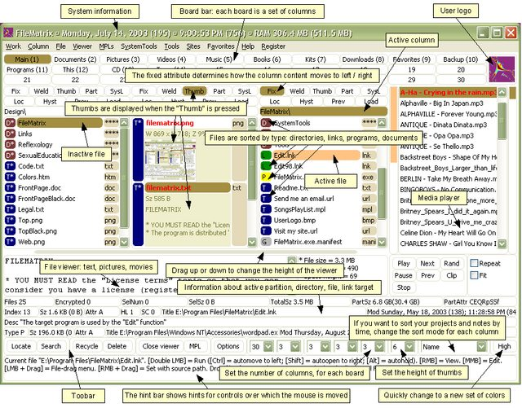
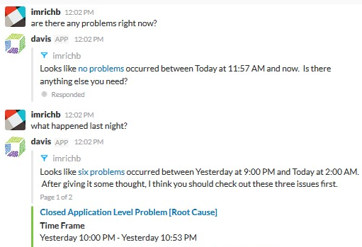
Conversational interfaces
A conversational interface is a user interface where the interaction is based on conversations in natural language (text or speech)
Threshold lowering: the user does not have to learn to work with the (graphical) interface
versus
Notes:
Een (extreem) voorbeeld van het verschil tussen de klassieke grafische interface (veel menu's, knoppen, invoervelden, etc.) en het voeren van een natuurlijke conversatie in eigen bewoordingen.
Je hoeft als gebruiker de interface niet meer te leren.
Rechtervoorbeeld is "davis", de virtuele assistent van Dynatrace voor performance management (wat is de status van de systemen).

Slide 93
Chatbot Student@Work
automatic answer to general questions about student labor
substantive questions
technical questions (access, error messages)
available via Student@work contact webpage
available 24/7 (students are often active outside office hours)
immediate reply
scalable
status: operational

Slide 94
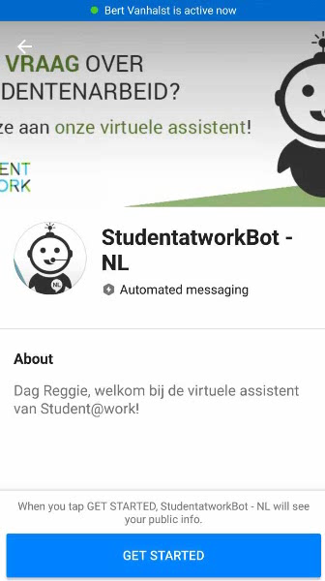
Chatbot Student@Work
DEMO

Slide 95
Dimona via Google Assistant
simplified employment declaration:
  employer number
  employee number
  date of employment
integration with Google Assistant, Google's virtual assistant
  via Google Home (smart speaker)
  via smartphone
voice interface
English (and Dutch prototype)
status: experiment

Slide 96
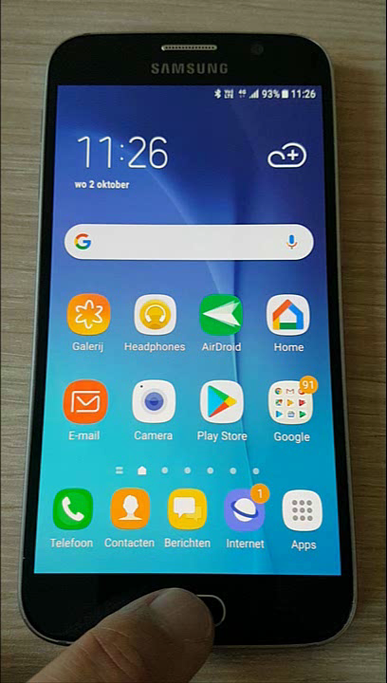

Dimona via Google Assistant

Slide 97
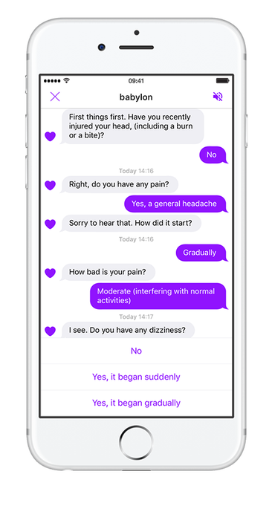
Examples of chatbots in health care
advice based on symptoms
  Babylon Health
  Your.MD
  Ada
  Sensely
  Buoy Health
  Symptomate
  Gyant
cancer chatbot
  help for patients, caregivers, family and friends
Belrai screener chatbot?
  support healthcare provider via speech for the Belrai screening

Slide 98
Machine learning
design of algorithms that automatically learn from example data with no or minimal need for human intervention
at the intersection of computer science and statistics
advantages
  no need to code explicitly all possible situations the machine will have to deal with, the machine adapts to change in conditions or unseen situations
  can learn a solution to a problem by itself where it would be hard for a human to explicitly instruct the machine
Notes:
Machine Learning uses Data Mining techniques and other learning algorithms to build models of what is happening behind some data so that it can predict future outcomes. A computer program is said to learn some task from experience if its performance at the task improves with experience, according to some performance measure. Machine learning involves the study of algorithms that can extract information automatically (i.e., without on-line human guidance). Most tasks that require intelligence require an ability to induce new knowledge from experiences. Thus machine learning is a large area within AI.

Slide 99
Machine learning approaches
Supervised learning
learns from examples of pairs of input-output
feedback from a « teacher » which provides the correct answer for example inputs
Unsupervised learning
no feedback from a « teacher »
learns patterns in the input
Reinforcement learning
suitable for complex problems in unknown environment
no feedback from a « teacher »
particularly used in robotics (film robot)
receives a reward if successful at executing a task or punishment otherwise
most common approach
used mainly for clustering
eg chatbot
Notes:
Source: « Artificial Intelligence: A moder approach » Russel, Norvig
Example chatbot: training data are pairs of texts and related intentions

Slide 100

Applied to fraud detection
Database X
Database Y
Database Z
Data-preprocessing
Sudden Change in Behaviour
(type 1 fraud) network
t
Fraud type 2 symptoms
& profit
Start of
Lifecycle
Parameter
Change
Consecutive or Complex Events
Network
Info
Predictive model

Slide 101
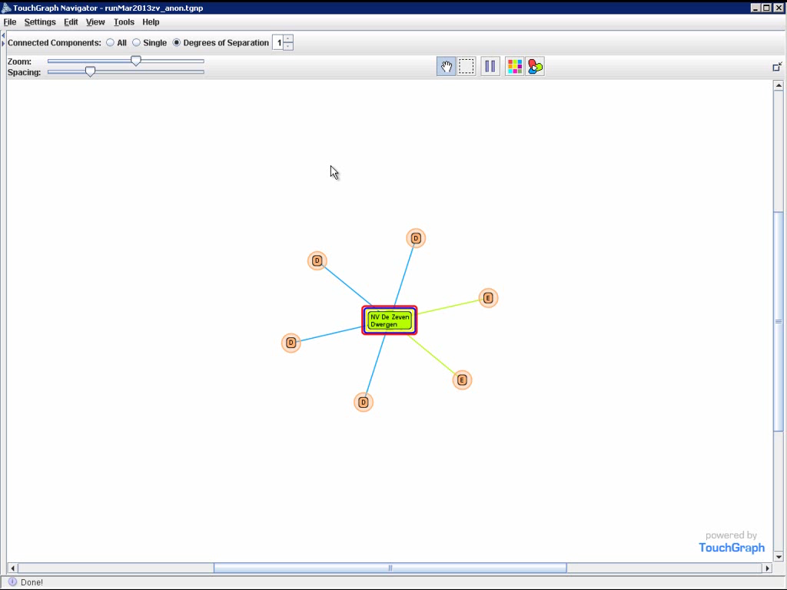
Example: spider constructions

Slide 102
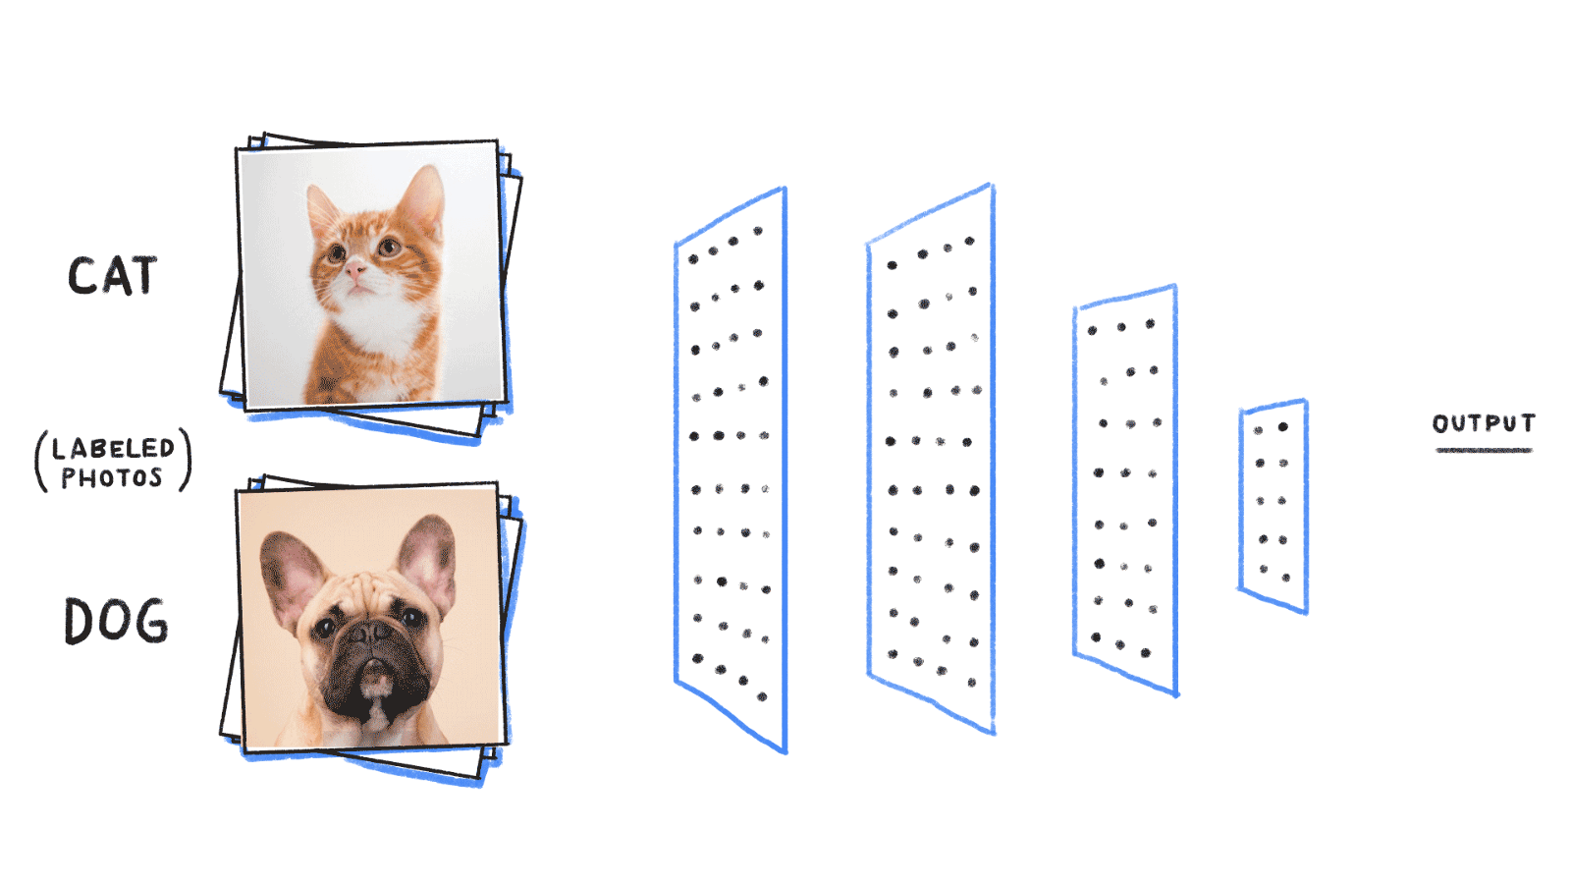
Neuron based machine learning
initially built to mimic the brain, thousands of interconnected computing units or neurons
neurons represent patterns
more neurons → richer and deeper insights

Slide 103
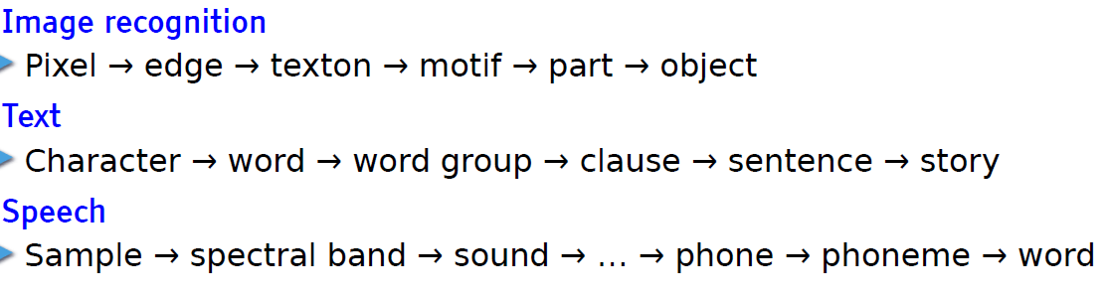
Deep learning
= deep neural network
  neurons or units are organised on more than one layer hence the word « deep»
state of the art: achieves outstanding performance in areas such as
  speech recognition
  image recognition/detection
  machine translation
learn hierarchical representations
Leçon inaugurale au Collège de France, Yann LeCun, 04 avril 2016

Slide 104
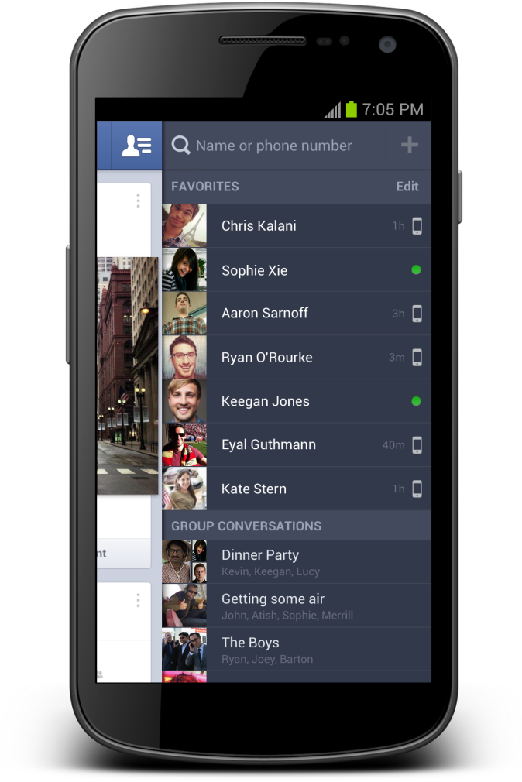

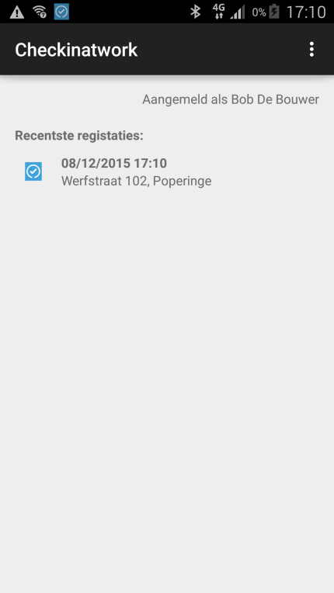



Internet of things: experiment with beacons
Notificatie:
Beacon present at the workplace
Beacons are easy, inexpensive and quick to integrate with mobile applications and can help to provide context-specific information to the application
Notes:
In dit experiment werd een scenario uitgebouwd op basis van eenvoudige beacons (zendertjes die een uniek identificatienummer hebben).
Het scenario veronderstelt dat de betrokken ondernemer de beacon aangemeld heeft met de relevante informatie: voor welk bedrijf? Voor welke werf?
Een werknemer of een onderaannemer die de werf bezoekt beschikt over een app op zijn mobiel device die de activiteit van de beacon kan oppikken, de identiteit kan uitlezen en dan vervolgens ia zijn app een melding doet dat hij op die bouwwerf aanwezig is. Op die manier krijg je een low-cost, snel te implementeren mogelijkheid om aanwezigheidsmeldingen te doen.
Dit scenario is nuttig voor veiligheid op het werk (accurate registratie van aanwezigheden in seveso bedrijven bvb) of voor fraudebestrijding.

Slide 105
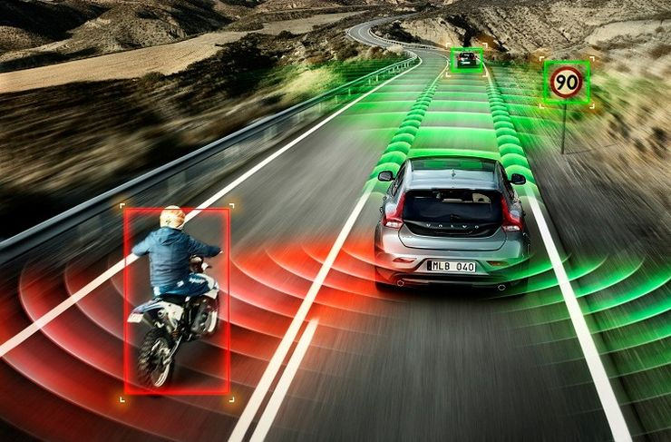
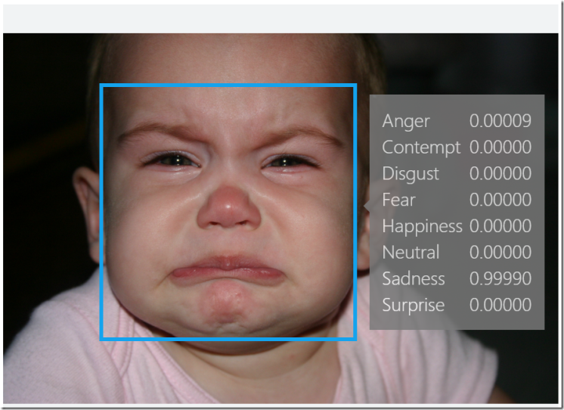
AI applications
automotive:
  Self-driving/-flying robots
finance and economics:
  automatic trading
  fraud detection
video games
  non-playable characters
  VR world generation
communication & social media
  spam filters
  smart email categorization
  face recognition
  speech recognition
human resources
  resume screening
  recruiting chatbots

Slide 106
AI applications
where does it apply?
  when there are lot of administrative and repetitive tasks
  where the workload is too important for the available resources
  for large and complex datasets to analyse
potential use cases
  understanding and answering citizen questions
    Ex: Chatbot student @work
  search documents
  document classification
  translation
  legal service: find related case laws
  fraud detection / anomaly detection
  case management / process management
  next best action
  decision support
Notes:
Chatbot: The next wave of AI in citizen services will be more predictive. AI platform will understand what the citizen is doing
or asking, and will prompt to take action on specific issues, asking whether a new driver’s license should be ordered. Artificial Intelligence for Citizen Services and Government, Mehr, Harvard Ash Center

Slide 107
Points of attention – AI possible issues
interpretability in decision making
  whoever undergoes the impact of a decision made by an AI System must be able to understand and challenge it
  black box versus white box
violation of rights and ethical principles
  autonomous weapons
  profiling & privacy
  discrimination (bias is one of the biggest problems in AI)
risk of loss of human knowledge
job losses ?
Notes:
Black box versus white box: humans have no insight in the reasoning and the steps the machine has taken to give a particular output
Bias in AI: Bias is introduced when the data are not enough representative. Ex: In 2015, a google app tagged two black people as gorillas because it wasn’t trained with enough dark skinned people.

Slide 108
Points of attention - cloud & data confidentiality
big cloud vendors
  lots of support for AI
  innovative solutions
  easy to get started very quickly
  web based tools
  pre-trained AI models
  even specialized hardware (GPU)
but... in a social security context, we must pay attention to
data confidentiality => respect of EU Ethics Guidelines for Trustworthy AI

Slide 109
Focus area: blockchain

Slide 110



Blockchain is about organizing trust
Blockchain Network
Registration of facts
Transfer of assets
Enforcement of rules

Slide 111











Idea
Ok!
Transactions
5,1 BTC →
0,7 BTC →
I transfer 0,4 BTC to .
Dave
0,4 BTC →
Ok!
Transactions
5,1 BTC →
0,7 BTC →
Transactions
5,1 BTC →
0,7 BTC →
Bob
0,4 BTC →
Charlie
0,4 BTC →
Ok!
Transactions
5,1 BTC →
0,7 BTC →
Alice
0,4 BTC →

Slide 112


A chain of blocks
Block 50
Block 51
Block 52
Block 53
Block 54
Header
Header
Header
Header
Header
5,10 BTC →
0,40 BTC →
0,70 BTC →
Concatenation of blocks, which contain transactions
At predetermined frequency, the network appends new block with most recent transactions
Blockchain contains ALL transactions
Transaction in blockchain cannot be removed
Many entities possess same copy of the blockchain

Slide 113
Properties
Robust
Consensus
(same version everywhere)
Integrity
Append-only
(Ledger)
Transparency, verifiability, auditability
Non-repudiability
(existence)
Distributed
(peer 2 peer)
Complies with rules
Authenticity
(≠ identifiability)

Slide 114








Permissionless
Permissioned
Public / open
Enterprise / Consortium
Compare with Internet
Compare with Intranet
Accessible & usable by whole world
Extra layer for access control
Ofter very inefficient
More efficient
Slower
Faster (more tx/s, more blocks/s)
Trust distributed
Trust decentralized
Crypto currency required
No cryptocurrency required

Slide 115
Smart contracts
Automating rules &
enforcement of agreements
Between parties that do not need to trust each other 100%
Without dependency on a single,
intermediate party

Slide 116


Smart contracts
Ether (Ξ) is the crypto-
currency on Ethereum
getMoney()
Contract Auction{
function bid()
function getMoney()
HighestBid: Ξ
HighestBidder:
Beneficiary: Charlie
}
20 Ξ
Charlie
bid(), 10 Ξ
0
10
20
10 Ξ
Bob
Alice
Alice
bid(), 20 Ξ
Bob
Can receive, block and spend value
No single entity can influence correct functioning
Reactive
Deaf and blind

Slide 117
Smart contracts
Publishing a contract, calling its functions & destroying it happens through transactions
Block 50
Block 51
Block 52
Block 53
Block 54
Block 55
Block 56
Header
Header
Header
Header
Header
Header
Header
Publish contr.
Bid Bob
getMoney
Destroy contr.
Bid Alice

Slide 118











Registration of facts
(Official)
documents
Driving license
Marriage
Diploma
Identity
Will
History/
Overview
Medical
records
Vaccination
Supply chain
Tracking
Taxes
Political
mandates
5f 3b fa 41 9c 63 be 2a 3a 09 ad bd 06 30 c5 1f
64 5e b0 3a ba fc d5 f2 ad 39 63 7a 30 6b 41 77
Will

Slide 119









Transfer of assets
Crypto currencies
(Virtuele assets)
Bitcoin
Monero
Ethereum
.bit
Untangible
assets
Tickets
Domain names
Electricity
Copyright
Tangible
assets
Land registry
Cars
Diamonds

Slide 120











Enforcements of agreements
Permissions
access PII
Flight Delay
Insurance
Auction
Transport
conditions
Processing
medical prescriptions
Elections
Smart locks
Application & Payment
of subsidies / benefits
Blocking
rent guarantee
Crowdfunding
Agreements between parties that do not trust each other,
without trusted intermediary

Slide 121
Experiences & lessons
Positive evolutions, but also considerable challenges
Provenance &
supply chain
Personal data
Financial sector
Considerable challenges
Cost reduction not always easy
Blockchain will need time to realize its full potential
Challenging to get all stakeholders on board
Need for a common project
Provenance & supply chain is most advanced use case, eg
  TradeLens container transport (Maersk & IBM)
  Carrefour
  Walmart
Importance of clear communication if personal data involved
Importance of privacy by design & security by design

Slide 122
Everything that can be done with a blockchain, can technologically also be done with a centralized approach, and often even more efficiently
Why blockchain?
A centralized approach might not be desirable
Politics
(e.g. cross-border exchanges, privacy)
Absence of trusted authorities
(e.g. Bitcoin in 2009)
Abuse of (quasi-) monopoly positions
Illegal activities
(e.g. Dark Web)
Other blockchain advantages also feasible with other technologies
Process automation
Consistency
Streamlined processes
Real-time updates
Insight in decision proces

Slide 123
Blockchain is about trust
In case of a centralized approach,
is it an issue that a central entity needs to be trusted ?
Blockchain is a bad idea
Blockchain might be an option

Slide 124
Avoid
to be a victim of the ‘PoC’-industry
  “we make abstraction of the GDPR”
  “given the limited budget, we do not do a prior analysis”
  “the blockchain PoC was not meant to run in a distributed way”
  => is there a real business case ?
  => make clear agreements (on paper) if you are planning to go further than a PoC
technology lock-in
  leading technologies tomorrow ? dominant technology today not necessarily dominant in 12 months
  no one-tech-suits-all => choice blockchain technology will depend on business case
  no standards
  => think about how to migrate away to avoid dependency of single technology

Slide 125










Example demonstrability service: BeSure
Creation & storage of proofs becomes collective process
Participants (organisations & eBox) do not need to trust each other (end users do trust their organisation)
eBox
Strong probative value
without central authority
Integrity, non-repudiability, no date tampering, authenticity
Demonstrability
proof-of-delivery & proof-of-receipt
storage period: 40-50 years
: Circle of trust

Slide 126
Example demonstrability service: BeSure
No sensitive data on blockchain
Only (salted) fingerprints
Simplicity
No complex blockchain functionality required
Fork of Bitcoin code
Extensively tested in practice
Secure
Key compromise or blockchain data breach no heavy repercussions
Migration
to other technology possible
clear added value
limited risk
taking into account the limitations of today

Slide 127



Example: therapeutic relation
Determines if care provider has access to health data of a patient
….
Problem
fragmentation: information dispersed
no overview for patient
Trust issues
participants are somehow each other’s competitors
centralized approach might raise privacy concerns

Slide 128




Example: cross-border processes
International
container traffic
Nuclear
waste transport
Food supply chain
Diplomas
Trust issues
what country could be primus inter pares?
centralized approach organisationally difficult

Slide 129



Integration
blockchain ≠ a complete business solution, but a component of a larger system
blockchain ≠ start from scratch (fortunately) => reuse of existing components
“CIOs should view the blockchain portion to be less than 5% of the total project development effort.”

Slide 130







Technological trends
Blockchain isn't the only trend
Multiple technologies combined offer new perspectives and are able to transform the business
Event-driven architecture
API economy
Microservices
Cloud
Containers
(Re)use can lead to fast(er) results

Slide 131





Blockchain as a Service (BaaS)
Setting up a simple blockchain infrastructure can be very complicated
Several cloud providers offer the possibility to set up a blockchain network in their cloud environment
Advantages
The infrastructure’s complexity is hidden
Focus on the applicative part
Faster and cheaper
More security
Disadvantages
Dependence BaaS provider
“We do not trust each other, but we do trust the BaaS provider”
Blockchain technology-specific
Recent development
In the long run government BaaS might be the best option

Slide 132




Future blockchain landscape
Community BaaS
Public BaaS
BaaS
Provider
BaaS
Provider
A
BaaS
Provider
B
BaaS
Provider
C
Own infrastructure
Private
BaaS

Slide 133
Some reusable public sector components

Slide 134
CSAM: what ?
a cooperation framework, a set of agreements to organise every aspect of Identity & Access Management for e-government
therefore we need
  agreements and guidelines for:
    identification
    authentication
    authorization
    access Administration
  IT Services:
    FAS: service for identification and authentication of a person
    BTB: service to appoint access administrators within a company
    SSM: mandate management service
As a citizen, representing myself
Representing a company

Slide 135
Objectives
transparency
  new applications are easily “plugged in”
consistency
  use of authentic sources
security
  reducing the risk of unauthorized access
  user identity and data integrity
efficiency
  centralized management (authentication means, authorizations)
  provide company representatives with a clear and accurate view on “who has which rights” on behalf of the company

Slide 136
Objectives
neutral and independent
  specificity and autonomy of each member
maximum stakeholder implication in the definition of strategy and priorities
open structure
CSAM offers trusted services for identification, authentication, authorization and access management, but is not a service integrator

Slide 137
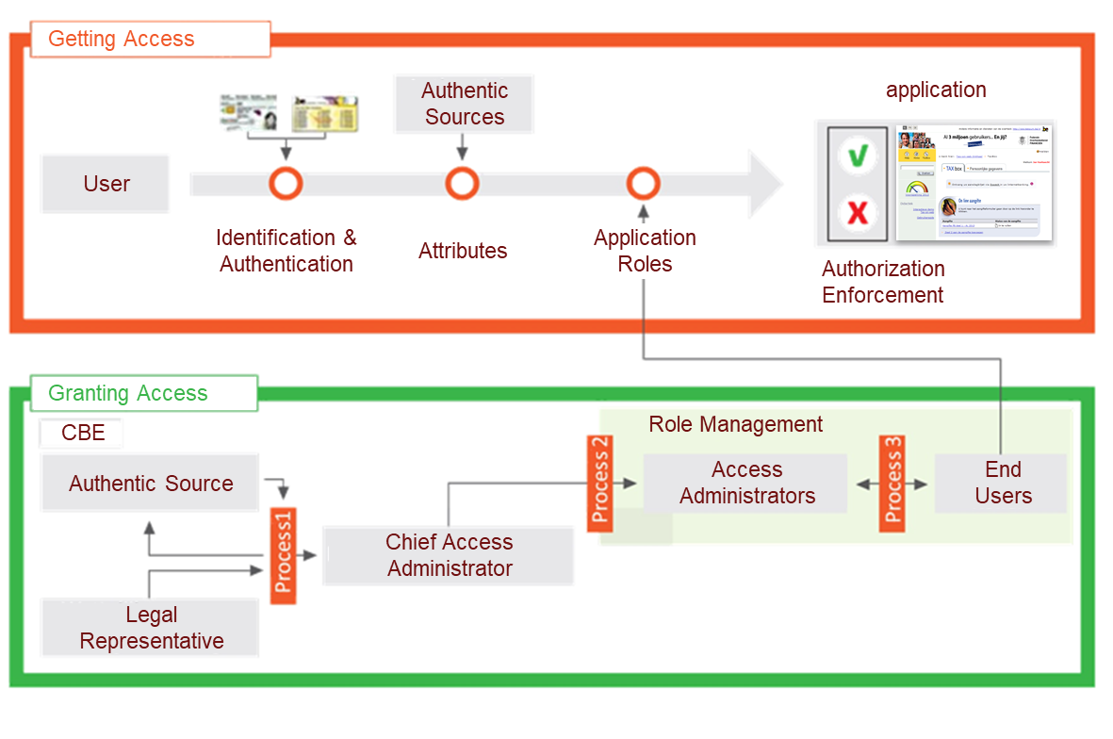
Process flow

Slide 138
BTB service
Legal Representative of Enterprise
  ➔ Defined in Authentic Source
  Crossroads Bank for Enterprises
CBE
Digital signature
with eID
Chief Access Admin
  ➔ Designated by Legal Repr.
  ➔ For Enterprise
Online procedure
BTB
Access Admin
➔ Appointed by Chief Access Admin
➔ For a group of applications
(in the same ‘domain’)
Online procedure
PIP
PIP
PIP
End Users
➔ Appointed by Access Admin
➔ For Role (which is active in Domain), within Enterprise
PIP

Slide 139
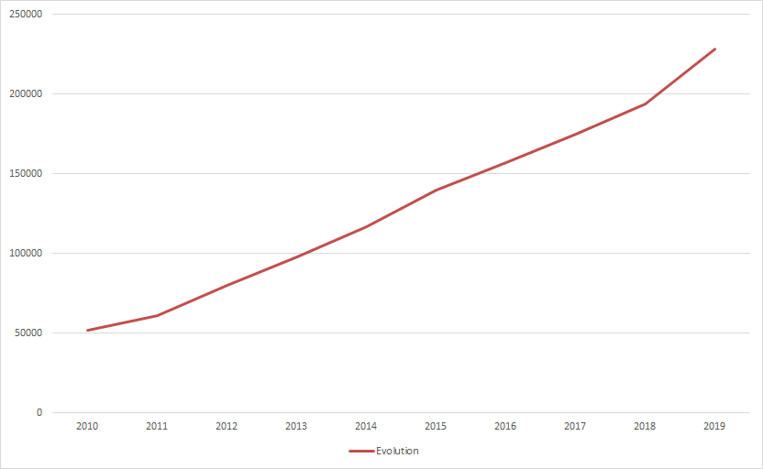
BTB: > 200,000 companies have appointed their access administrators

Slide 140

Mandate management
mandates between
  citizen – enterprise
  citizen – citizen
  enterprise – citizen
  enterprise - enterprise
focus on electronic flow
self Service
universally applicable: accountancy, health care, …

Slide 141
Advantages for end users
trusted and familiar environment
  familiar
  sonsistent security level
simpler
  no multiple registrations and similar procedures
a clear overview
  who holds which rights in my company?
user-friendly
  e.g. single sign-on
central management of authentication means
  One password, easy activation (or cancellation!)
support
  online documentation, consistent communication, contact center
privacy
  authentication and access <-> internal application business

Slide 142
Advantages for service providers
cost reduction
  standardization
  reuse of services and components
  economies of scale
Security
  global and strict security policies, clear rules of the game, traceability
support and service delivery
  standard onboarding procedures, common support, knowledge sharing
simpler and more clear
  oth regarding applications used by citizens c.q. companies and internal applications
  procedure alignment, increased consistency

Slide 143
Who uses CSAM ?
services for citizens:
  Tax-on-web
  Mypension
  Student@work
  Police on web
  municipalities (“e-loket”), provinces
  …
services for (representatives of) companies:
  Belgian social security (www.socialsecurity.be)
  mobility: webDIV, iFast
  finance: Tax-on-web, VAT, BizTax, Finprof
  Healthcare (eg eHealth)
  regions
  ...

Slide 144
e-Box, la boîte aux lettres électronique sécurisée de votre entreprise
04/12/2019 e-Box meeting VBO (overleg met providers)

Slide 145

L’e-Box aujourd’hui est une alternative électronique moderne et sécurisée aux échanges postaux

Slide 146
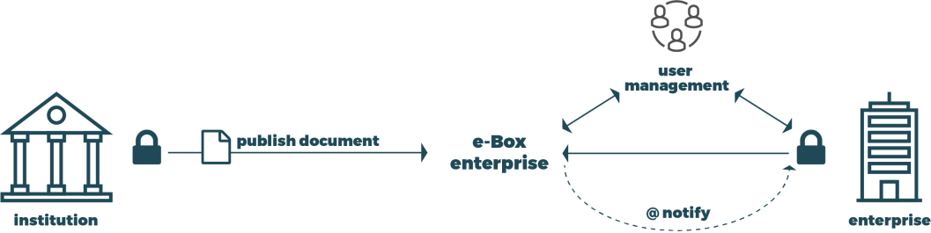
L’e-Box aujourd’hui est sécurisée, accessible et gratuite
Pour les institutions – Documents sender
Un canal sécurisé, officiel, gratuit pour mettre des documents à disposition de l’entreprise
Une adresse unique, le numéro BCE
Pour les entreprises
Espace protégé, réservé et garanti
par les institutions de Sécurité Sociale.
Boîte aux lettres électroniques
sécurisée et centralisée
Disponible sous forme d’application web

Slide 147
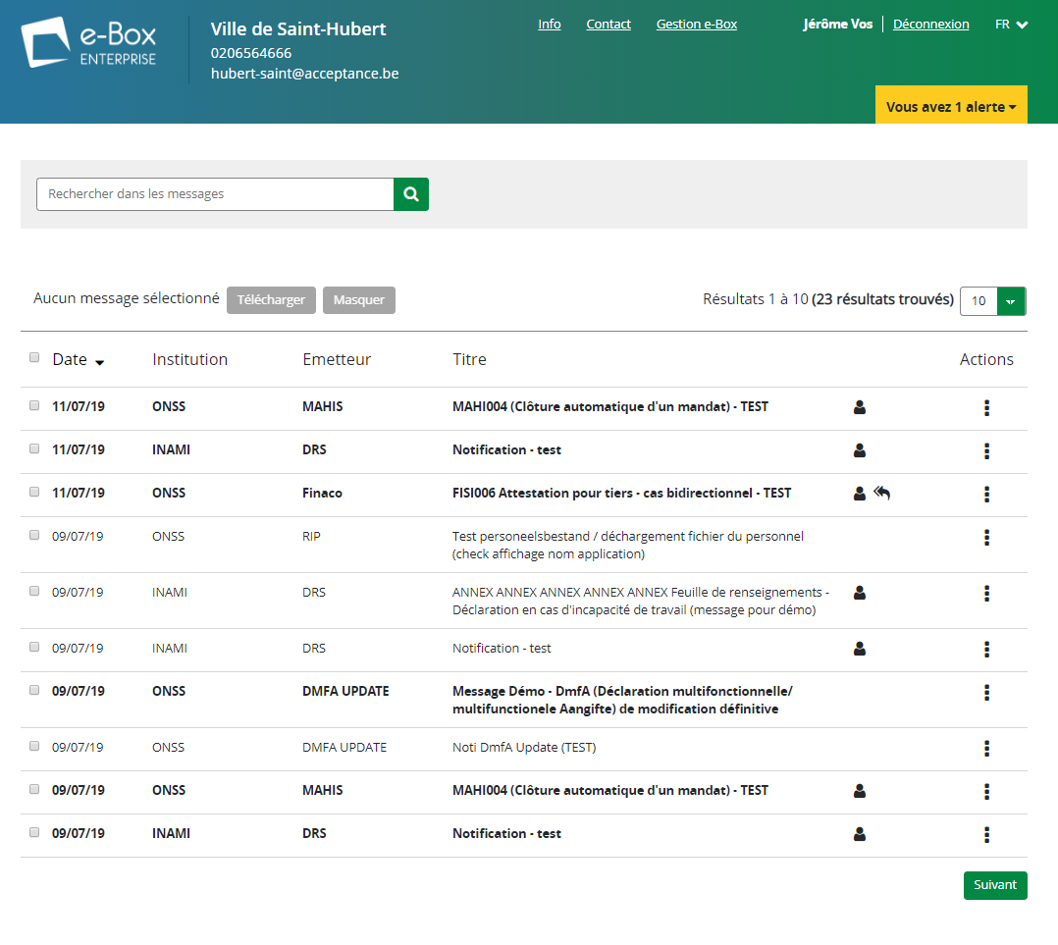
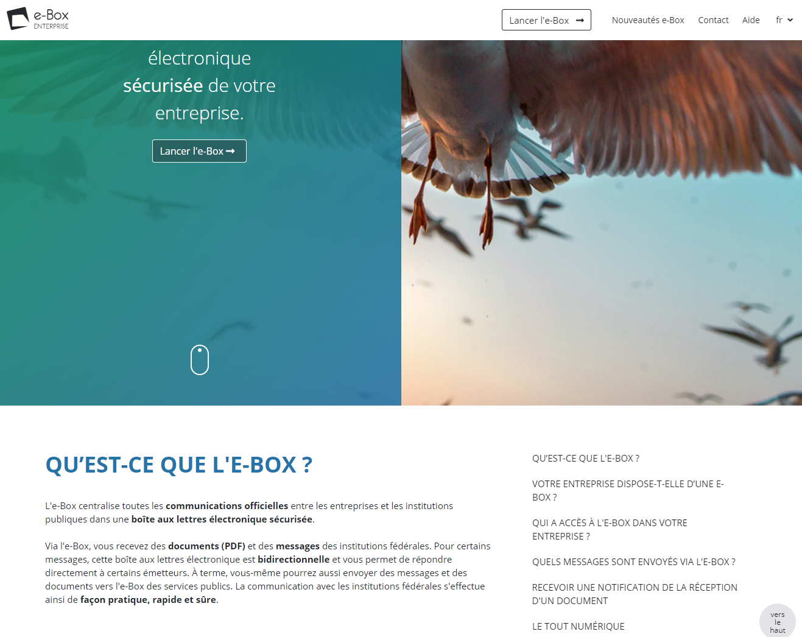
L’e-Box aujourd’hui

Slide 148












L’e-Box aujourd’hui
64.300
e-Box actives
27.900
tout digital
2018
5.000.000
De nouveaux documents
en continu
Confirmation de déclaration (accidents de travail, début d’un engagement, …)
Résumé des vacances annuelles
Maladie
Rappels de paiement
Pension anticipée
Crédit-temps
…
11
émettrices
Notes:
Stats 20/11/2019
#enterprises connectées les 6 derniers mois: 64,305
#enterprises connectées les 12 derniers mois: 85,099

Slide 149

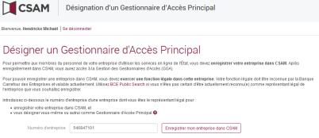


L’e-Box aujourd’hui est créée facilement
◆ Création de l’entreprise à la BCE
❖ Enregistrement de l’entreprise dans CSAM par un représentant légal
⬥ Création automatique de l’e-Box et accès direct pour le GAP (généralement le représentant légal)


Slide 150
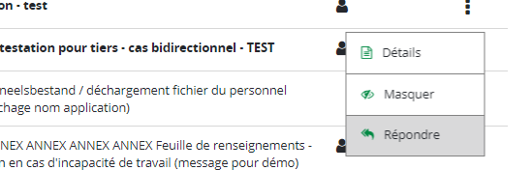
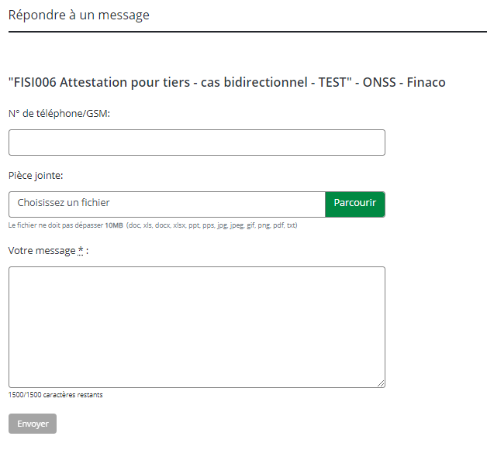
L’e-Box aujourd’hui est bidirectionnelle
L’e-Box est bidirectionnelle : Une entreprise peut répondre à un envoi e-Box (renvoi d’informations demandées, questions, …)
  Bientôt il sera aussi possible d’initier une conversation à partir de l’e-Box
Sous le contrôle de l’institution qui doit s’organiser pour accepter ces messages
  Accepte ou non les contacts des entreprises
  Active ou non par type de message
Permet de s’intégrer directement dans les workflows de traitement de l’institution
  Gestion des tâches
  Routage du message
Ne doit pas remplacer les applications métiers
  Le contact reste générique et simple

Slide 151
L’e-Box aujourd’hui offre des outils et des garanties aux expéditeurs
Savoir si l’entreprise est prête à accepter les documents de l’e-Box
Avoir la garantie que le document est délivré dans l’e-Box de l’entreprise
Avoir la garantie que le document est accessible pendant toute la durée de validité que l’institution a spécifiée
Avoir la garantie que seul les utilisateurs autorisés voient les documents
Connaître le statut de lecture du message par l’entreprise

Slide 152
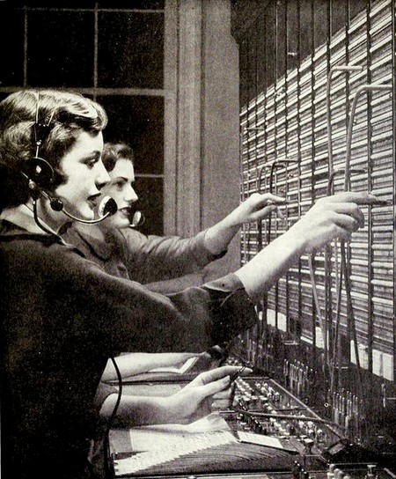

La fédération d’e-Box
Un écosystème qui met en relation les Document Senders, les Document Providers et l’entreprise

Slide 153









La fédération
Document Senders
Document Providers
Document Consumers
Documented
API (contract)
DB Pension
MessageRegistry
Pension
Nouvelle Webapp e-Box
DB e-Box
(SocSec)
MessageRegistry
SocSec
Une seule API pour tous
DB Economie
MessageRegistry
FOD Economie

Slide 154
Types d’intégration possibles
DocSender (DS)
  Envoi des documents vers le DocProvider e-Box SocSec.
DocProvider (DP)
  Mise à disposition des documents via l’API RESTful standardisée. Les documents sont hébergés par le DP.
Doc.Service Provider (DSP)
  Orchestration de plusieurs services (ex: routage, enrichissiment…) pour traiter l’envoi d’un document, en supportant typiquement plusieurs canaux de distribution possible (ex: papier / e-Box).
  En pratique, integration e-Box en tant que DS
DocConsumer (DC)
  Récupération du contenu de l’e-Box de façon technique, en interrogeant directement les différents DP.
  Permet une integration automatisée avec des systèmes internes dans l’entreprise.
DS
DB e-Box
(SocSec)
DP
Message
Registry
e-Box
DSP
Papier
DC
Message
Registry
Notes:
Human Interface Provider (HIP): non-autorisé pour e-Box Enterprise (seulement possible pour eBox Citoyen)

Slide 155

Système ouvert à des partenaires pour l’ajout de fonctionnalités

Slide 156

Ouverture aux partenaires privés pour des services à valeur ajoutée
Besoins récoltés auprès des entreprises
  Routage interne du document
  Gestion des utilisateurs et droits d’accès avancé
  Intégration aux processus de l’entreprise
    Paiement
    Workflows
  Archivage
  Document service provider pour externaliser la génération et l’envoi des documents
  Recommandé eIDAS
  …

Slide 157
Ouverture aux partenaires privés pour des services à valeur ajoutée
Pour répondre aux besoins des entreprises, que vous manque-t-il pour réaliser ces services à valeur ajoutée?
  Fonctionnalité générique supplémentaire?
  Métadonnées?
  …

Slide 158
Routage de documents
Quelles métadonnées sont utiles pour le routage des documents?
  “messageTypeId”
  “senderOrganizationId”
  “forTheAttentionOf”
    Person?
    Departement?
  “businessDataList”
    ?
  “paymentData”
    ?
  ?
Voyez-vous d’autres mécanismes nécessaires?

Slide 159
Release management
API definition
  Consult / Publish
  Alignement eBox citizen
  Pour un DocProvider avec ses propres Senders :
    Votre avis sur l’interface de publication:
      Au choix?
      A standardiser en implémentant l’API « Publish »?
Release management
  Support multi-versions (min. 2)
  Timing acceptable?

Slide 160


L’e-Box continue d’évoluer… à l’écoute des utilisateurs et des partenaires

Slide 161
Les évolutions de l’e-Box
Sur base des retours utilisateurs
  User-groups
  Enquêtes
  Phase pilote
  Feedback au centre de contact
  …
En discussion avec les partenaires
  Doc Senders
  Doc Providers
  Partenaires privés
  …

Slide 162
Roadmap 2019-2020
2019-Q1
(suite 2018) GUI & WS REST Consult
2019-Q2
Phase Pilote GUI + site d’info
2019-Q3
Production visible (4/07): GUI + site d’info
2019-Q4
2020
Bidirectional 2.0 (e-Box to e-Box)
Amélioration résilience
Audit-trail WS
Widget e-Box (Polaris)
Bidirectional 1.1 (Modjur)
WS REST Publish
Bidirectional 1.2 (CR Modjur)
Events & notis fédérées
WS ebox-federation
Support envoi manuel
Aide à l’utilisation
…
GUI version fédérée

Slide 163

Actions parallèles et intégrations
Cadre légal – Règlement utilisateur (Laga)
Campagne de communication (Absoluut)
Demandes d’intégration (eBoxIntegration@smals.be)
DocProvider
FOD Economie
Speos
DocSender
EDE (ONSS)
eDecision/ePV
DocConsumer
Teal Partners
TRUSTO
FOD FIN
Artist@work
BOSA
Connect-Solutions
Pensions
Justice (Speos)
Intention de participation
Vlaanderen
eWBS/SPW
Fedris

