Slide 1


Shifting to an API economy:
dare to share

Slide 2

About API - Application Programming Interface
An API is a programmatic interface to data or some set of functionality
Thanks to API’s it is possible to use the data or functionality behind it and continue to build on it
API = a software building block

Slide 3
About API - Application Programming Interface
Providers vs consumers
  when an API is offered over a network, the service that offers the API is called the “provider”
  the “consumer” of the API is often a software application
The consumer may outsource the requirement for data or functionality by “calling” API’s
  billing
  identity
  storing
  image processing
  all sort of (authentic) data sources
  …

Slide 4
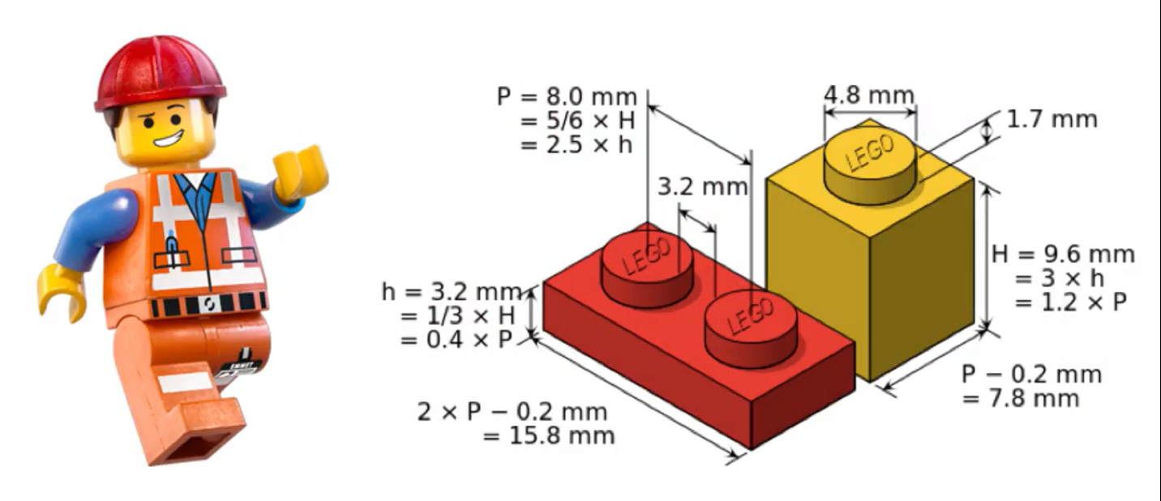
About API - Application Programming Interface
Consumers can connect to an API of a provider and use it’s data or functionality as long as the “technical contract” has been respected
Consumers don’t need to know the technical details behind the functionality
API’s can be written in any possible programming language

Slide 5
Why are API’s important ?
Cost reduction by reusability: consumers don’t need to rewrite what already exists!
Complexity reduction: no more big, monolithic systems
Decoupling: consumers and providers can continue to connect as long as the technical contract is followed → ex. less impact in case of migrations
Driver of innovation: new products raise, based on existing API capability
Stimulation of partnerships
Stimulation of standardization

Slide 6
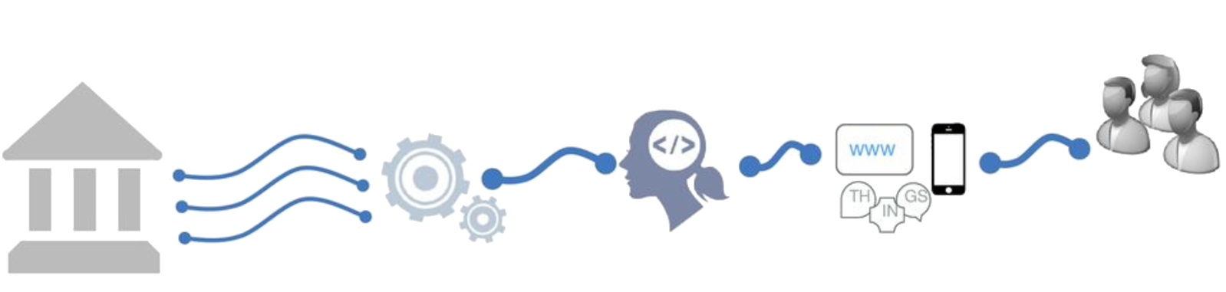
Shifting to an API economy: the value chain
To create new innovative apps and services
Made available as API
Differentiated
services
Self service
use by developers
Existing
Systems

Slide 7
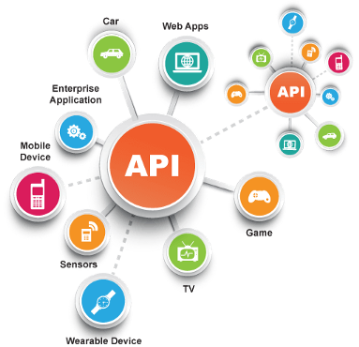
Today the API economy is a becoming a reality
Everything connects to everything

Slide 8

API’s & Belgian eGovernment
API’s drive today's business processes in
Belgian eGovernment
API’s are key in real-time information sharing between partners
  public institutions
  companies
  citizens
With a strong focus on
  API management
  standardization
  security

Slide 9








Example: CSAM authentication services
Strong
 | eID + PIN-code with connected card reader
 | eID + PIN-code with wireless card reader
 | SIM card with PIN-code
API
WEB
 | Security code via mobile app, user-id + password
 | Security code via SMS, user-id + password
 | Security code on paper (paper token), user-id + password
 | User-id + password
Weak

Slide 10

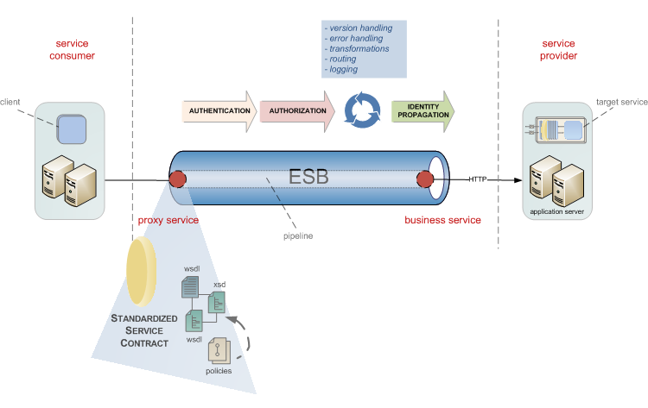
Example: SocialSecurity.be portal services
The Social Security service platform was created in 2009 to support managing business processes in
temporal/permanent employment
unemployment
work related risks and insurances
child benefits
social assistance and benefits
…
API
WEB

Slide 11



Example: realtime presence registration for construction workers
API
WEB
Notes:
Backend checks of the employment declaration, constructions sites, Limosa, (temporal work permits),
> 500.000 euro
Checkinatwork is de onlinedienst voor de aanwezigheidsregistratie bij werken in onroerende staat en activiteiten die behoren tot de vleessector. Het gaat om de registratie van:
iedereen die werken in onroerende staat uitvoert op een werkplaats waarvan de totale kost gelijk is aan of hoger is dan een specifiek drempelbedrag, en
iedereen die activiteiten uitvoert in verband met vleesbereidingen of vleesproducten en het slachten of uitsnijden van hoefdieren, gevogelte en konijnen in inrichtingen onderworpen aan de erkenning (erkenningen, toelatingen en voorafgaande registraties) van het Federaal Agentschap voor de Veiligheid van de Voedselketen (FAVV).
Via Checkinatwork registreren werkgevers en aannemers de aanwezigheid van hun eigen werknemers, van hun onderaannemers en van hun zelfstandige onderaannemers. De werknemers of zelfstandige onderaannemers kunnen zich ook zelf in het systeem aanmelden.
De registratie moet dagelijks gebeuren, en wel vóór de persoon die de werken uitvoert aan het werk gaat.
De werkplaatsen die vallen onder de verplichte aanwezigheidsregistratie via Checkinatwork moeten aangegeven zijn in de Aangifte van werken.

Slide 12


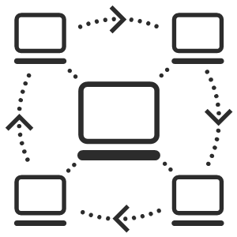

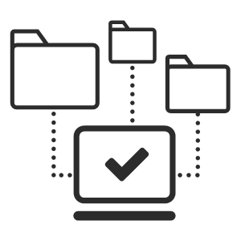
Example: eHealth-platform
Public Federal institution founded in 2008 for facilitating well-organized, mutual electronic service and information exchange between all actors in health care
The e-Health platform provides necessary guarantees with regard to information security, privacy protection and professional secrecy
API
WEB
Connectors Standards
Online Authentic
services sources

Slide 13















eHealth: landscape
Authentic sources

Slide 14
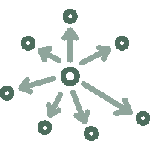





eHealth: technical choices
Decentralization
API
Security
Standardization
Integration
ReUse

Slide 15







eHealth: architecture
Patients, health care providers
and health care institutions
Site Ministry
Software health care professional
Software health care institution
VAS
Site RIZIV
VAS
eHealth-portal
MyCareNet
VAS
VAS
VAS
Users
Basic services
eHealth-platform
Network
AS
AS
AS
AS
AS
AS
Suppliers

Slide 16
eHealth-platform : basic services & API’s
Coordination of the electronic processes
Portal
Integrated user and access management system
Management of loggings
System for end-to-end encryption
eHealthBox
Timestamping
Coding and anonymising
Consultation of National register and CBSS registers
Reference directories (hub-metahub system)

Slide 17







Electronic information sharing: some figures
>76%
Belgian citizens’
Informed Consent
+62%
went digital
84 million
Messages / year
via secure eHealthBox
API
WEB
Electronic Prescriptions
13.300.000.000
Digital transactions annually
5 million / month
3,5 million
Belgian patients with
Summary Electronic Health Records in health vaults
  200 million
  electronic documents available
  at hospitals and clinical labs
14.000
4.800

Slide 18


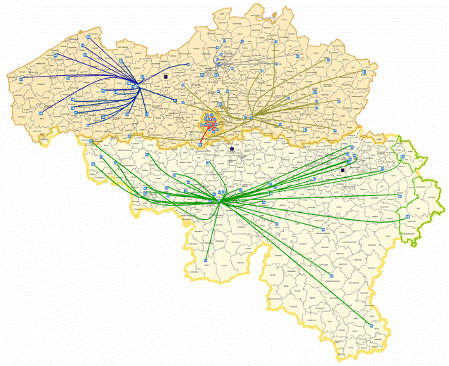
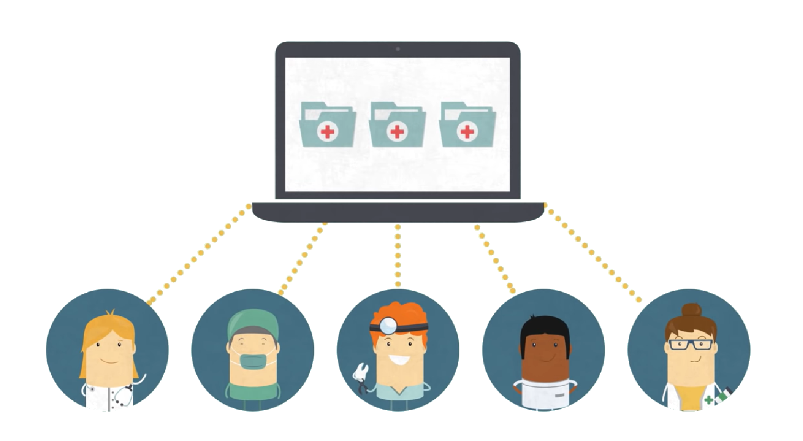
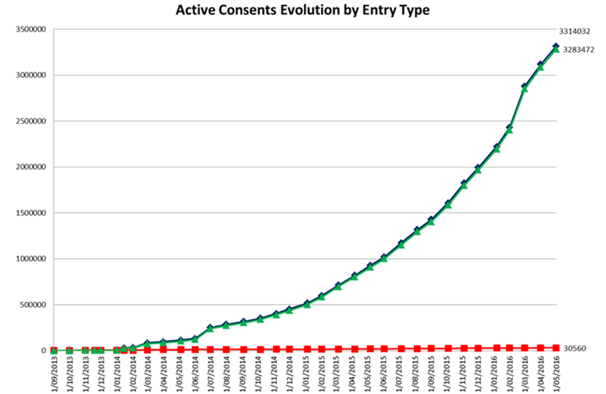
Global medical file & patient consent
via Consent
API
via e-Health website

Slide 19
API in health and social sector: some statistics and evolution
social security
100+ APIs
Most consumers are external (# 20,000-24,000)
Peak load 2000-3000 req / s
1.200M transactions / month
200+ APIs
Consumers mostly internal applications/services (# 200-300)
Peak load 1000-1500 req / s
300M transactions / month
Disclaimer: metrics listed since 2016 are for all ESB + gateway platforms. Migration to Axway APIM in progress since Q3 2018.
(eHealth currently 30% APIs migrated, Social Security gradually does onboarding on APIM for all new APIs and API evolutions)
Notes:
Need for a rock-solid service platform that meets our SLA requirements and can scale easily, while keeping costs under control

Slide 20
API standards
API standards in eGovernment are based on industry standards and best practices
A pragmatic approach to designing RESTful APIs
Collaborative effort organized in several workgroups
  REST API modelling
  security (OAuth)
  functional/business vocabularies (temporal, location, person, enterprises)
REST style guide
  https://www.gcloud.belgium.be/rest/

Slide 21





API management
Importance of good API management
  transparent migration of legacy services
  ready for today's standards, but supports our legacy as well
  from ESB-technology to API gateway
  parallel platform
  zero-impact migration
Faster implementation of new services
  flexible to extend and customize
  accelerates time-to-market
API Manager
API Portal
API
API Registration & Lifecycle
Application Developers
API Catalog
Partner & Policy Administration
REST
API
API Gateway
SOAP
Policy Enforcement
Notes:
https://unsplash.com/photos/vE3ZFtIhA4c?utm_source=unsplash&utm_medium=referral&utm_content=creditCopyText
Parallel platforms
Controlled migration growth
In service mode: close monitoring
Inevitable surprises: challenge
Defaults adapt to our volumes: lots of tweaking / DRP tests
Challenge rebuild existing standards to new Axway
SOAP-REST
New services on new platform

Slide 22

Different types of sharing & reuse
Infrastructure
  hard infrastructure
  soft infrastructure
  platforms
Common vendor contracts
Federal ICT Community
Business
  knowledge & experiences
  business functionality
  business data
  complete business services
Important to know what already exists
→ catalogues!

Slide 23

Notes:
No objective to make money
Main objective to save money

Slide 24
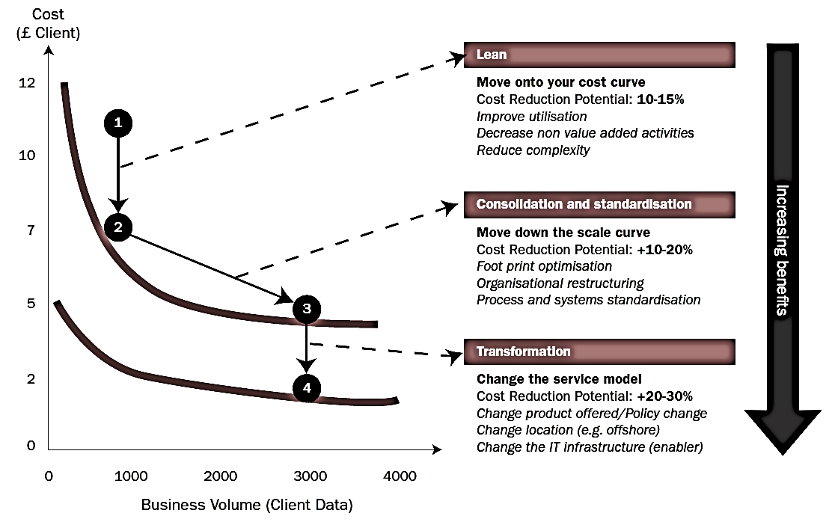
Synergies - transformations

Slide 25
G-Cloud Portfolio

Slide 26




G-Cloud
Procurement
Cooperationá
Efficiencyá
Projects
Synergy
Services
Costsâ
Qualityá
Know-how & Expertise
Notes:
Maximum synergy when possible and when generating efficiency gains and/or savings while maintaining or improving the quality of the services provided to the customer
In line with the synergy program: assignment to the one who is the most capable of proposing a form of shared services
Synergy based on result orientation, sense of responsibility and trust

Slide 27
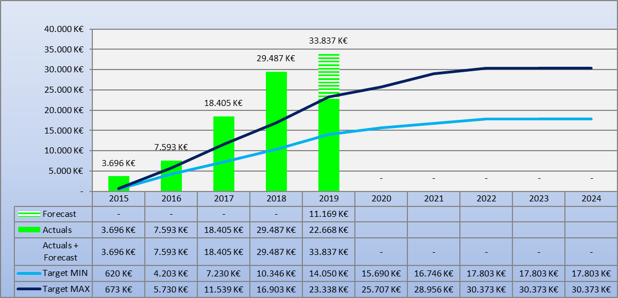
G-Cloud ROI
Total

Slide 28
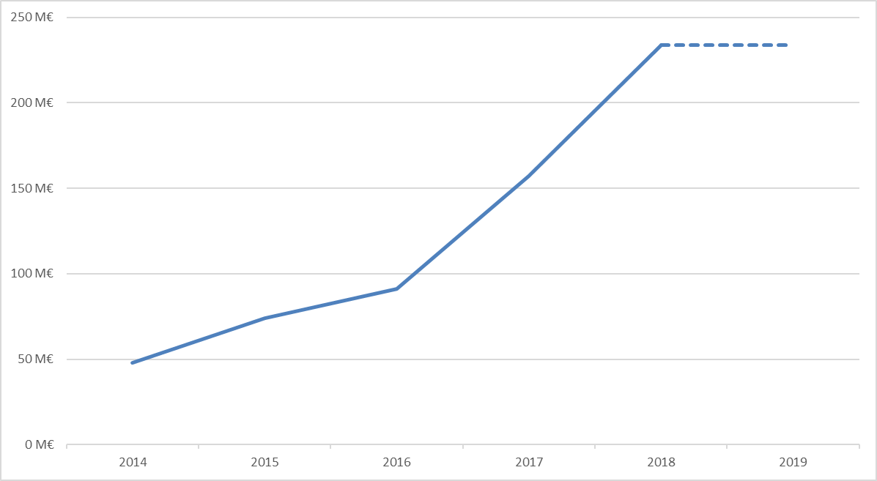
G-Cloud - reuse of contracts
Purchase volume of common contracts
Source: Smals

Slide 29
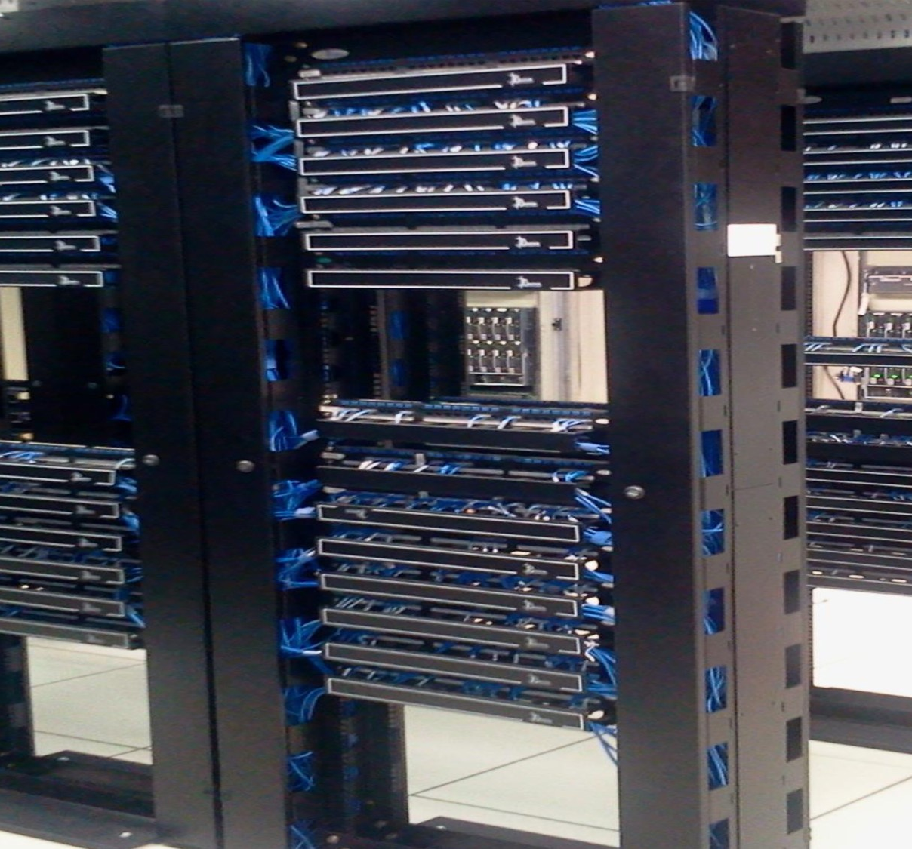
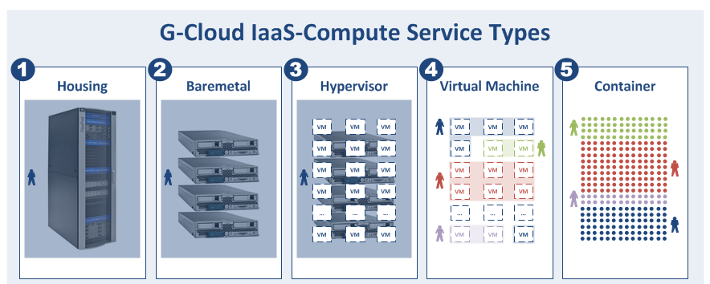
G-Cloud IAAS/PAAS in numbers
4 datacenters
24 tenants
834 compute nodes
7843 virtual machines
8039 docker containers

Slide 30
Shifting focus
towards synergies in the area of business components
Business components
Stronger centrally coordinated approach to offering platforms

Slide 31
Reuse of business components

Slide 32
About the initiative
Initiative within the public social security institutions & Smals
Purpose
  synergy around (technical) business components
  and thus save costs by avoiding multiple development of components
Regardless of whether development takes place by
  the institution's own ICT department
  Smals
  subcontractors
Creation of a competence center within Smals in order to maximally integrate and support the reuse of business components within Smals, its members, partners and domains in which Smals is active
32

Slide 33
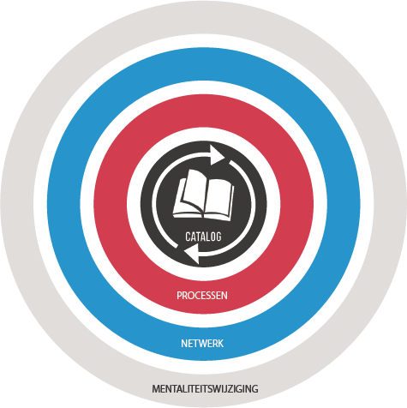
ReUse – Vision
Every stakeholder
can easily find the most common reusable elements in a centralized catalogue
Processes
and tools are put in place to identify, register, implement, monitor and measure reuse throughout the project lifecycle
Human
networks are maintained and developed on all levels (CEO’s, CIO’s, business owners, business analysts, architects) in order to keep maximum visibility on reuse potential
A culture
develops where
reuse is adopted and the creation of reusable products is promoted,
33

Slide 34
Value
Value
library
framework
product
system
Offered “business” functionality
34

Slide 35

























So… dare to share! ☺
Framework
Library
Product
Service
System
35

Slide 36

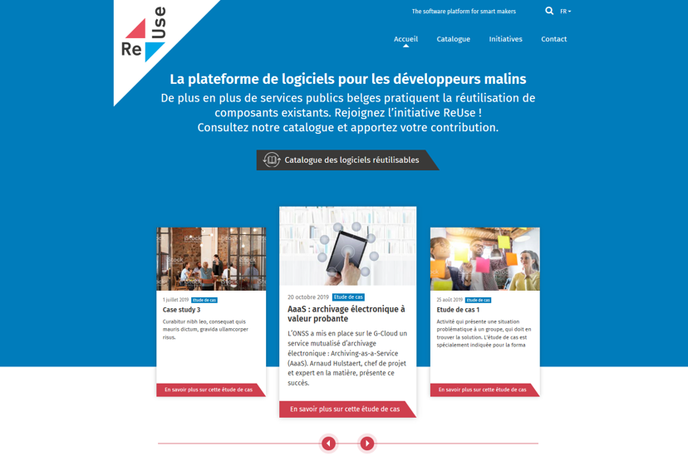
How? with the new Software Reuse Platform! https://www.ict-reuse.be
36

Slide 37
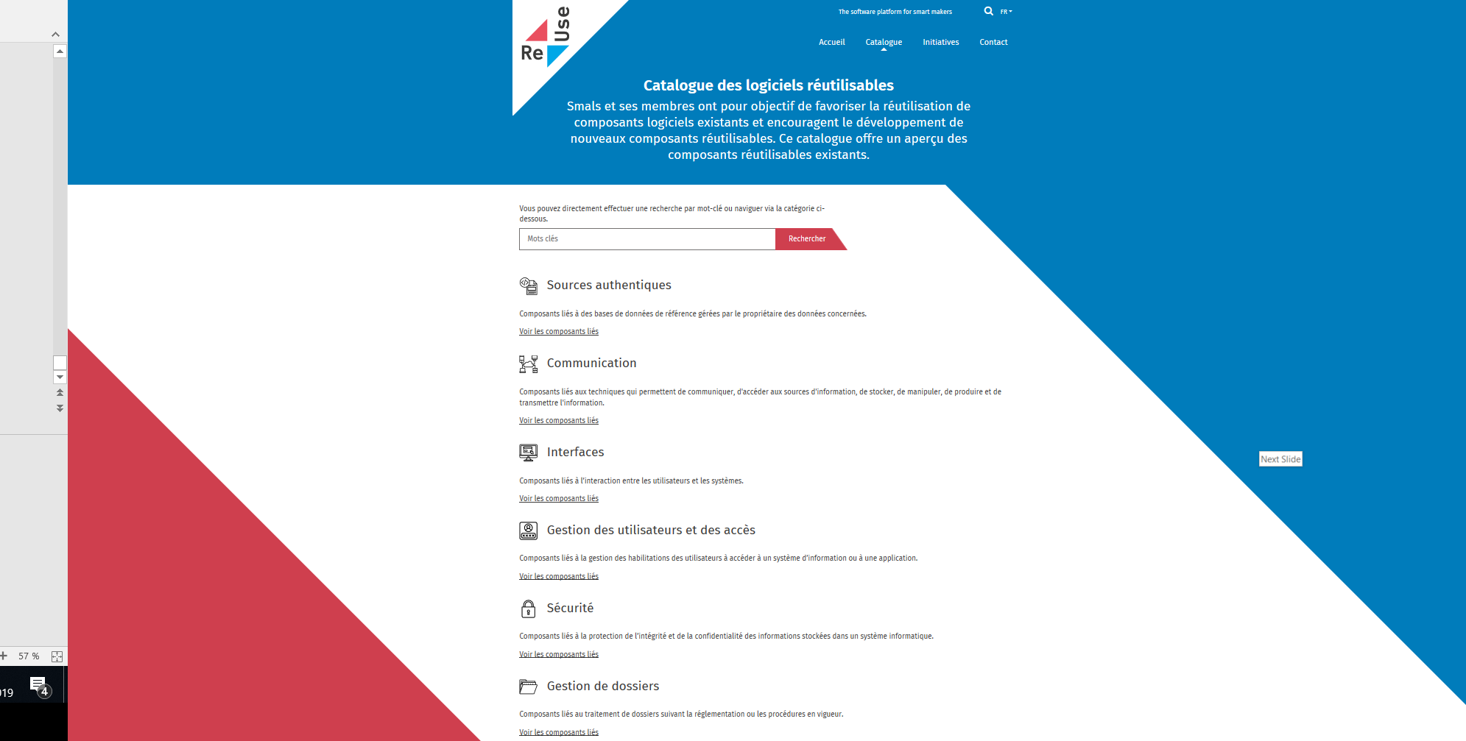
New project?
consult the
Software Reuse
Catalogue

Slide 38
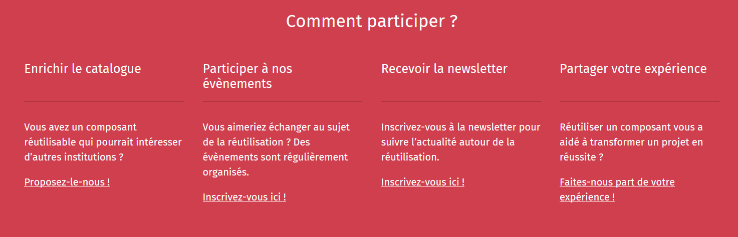
Share your success stories...and become an ambassador for reuse! https://www.ict-reuse.be
38

Slide 39
ROI of reuse
You can only improve what you measure
Reuse is embedded in the "project life cycle" of projects carried out by Smals
This makes it possible to compare the project cost without reuse and with reuse and to calculate the ROI
39

Slide 40
ROI 2019 for projects carried out by Smals
23%
54%
35%
reusable
Reused
ROI
10.000.000 €
40

Slide 41
Challenges
Use the power of the network of institutions
Deal with interdependencies
Focus on the essence, not on "bells and whistles"
Deal with the (un)availability of (critical) services
Strive for uniformity of technological solutions / use of site licenses

Slide 42

Future opportunities – Government as a Platform (GAAS)
We live in a platform economy:
eBay, Amazon
YouTube
Google, Baidu
Paypal, Alipay
iOS, Android
Airbnb, TripAdvisor
Uber
Linkedin, Glassdoor

Slide 43
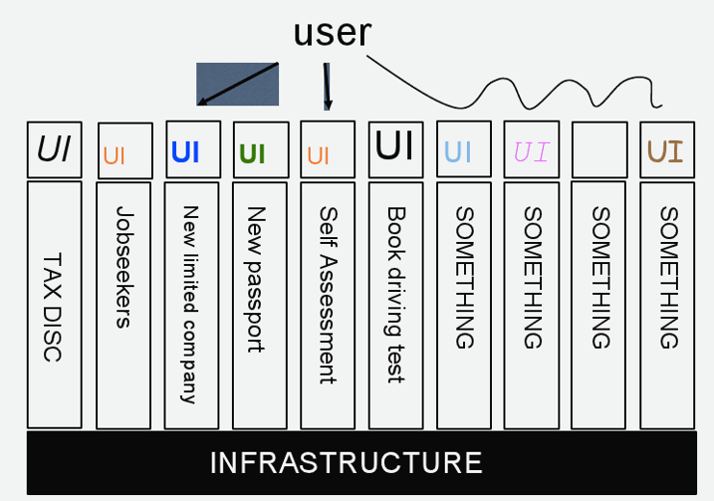
Future opportunities – Government as a Platform (GAAS)
Governments still have many diverse and complex legacy systems and processes, too many of them still operating in silos
As a consequence, government often looks something like this

Slide 44
Future opportunities – Moving to the platform model
The real mark of success for government will be when government establishes the baseline set of things that it absolutely needs to do and then exposes a robust, rich set of service end points that will let people in the private sector add value to that minimal “must do” set
Then we can hit some real magic because we will get more and more services for citizens with more and more ingenuity, without any procurement at all because the government made it possible for people outside to build interesting things

Slide 45
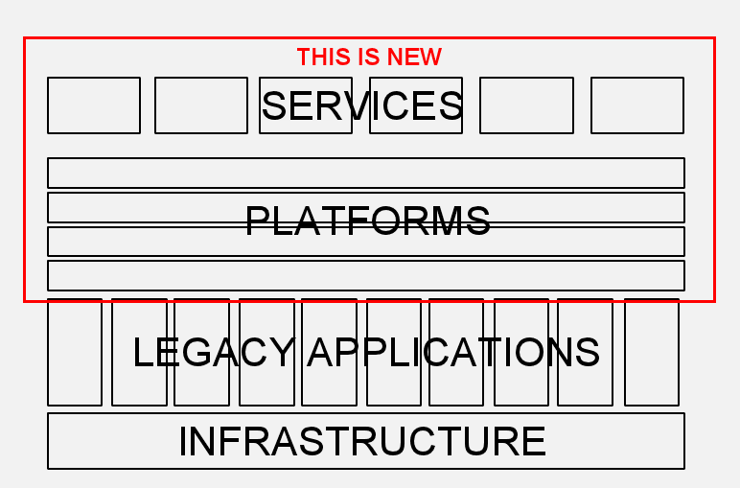
Future opportunities – Moving to the platform model
A platform provides essential technology infrastructure, including core applications that demonstrate the potential of the platform
The core platform provider enforces “rules of the road” (such as the open technical standards and processes to be used) to ensure consistency, and that applications based on the platform will work well together

