Slide 1


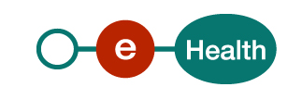

Dare to share
frank.robben@ehealth.fgov.be
@FrRobben
https://www.ehealth.fgov.be
https://www.ksz-bcss.fgov.be
https://www.frankrobben.be

Slide 2









Electronic information sharing: some figures
>76%
Belgian citizens’
Informed Consent
+62%
went digital
84 million
Messages / year
via secure eHealthBox
Electronic Prescriptions
13.300.000.000
Digital transactions annually
5 million / month
3,5 million
Belgian patients with
Summary Electronic Health Records in health vaults
14.000
4.800
  200 million
  electronic documents available
  at hospitals and clinical labs

Slide 3
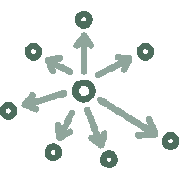





Technical choices
Decentralization
API
Security
Standardization
Integration
ReUse

Slide 4
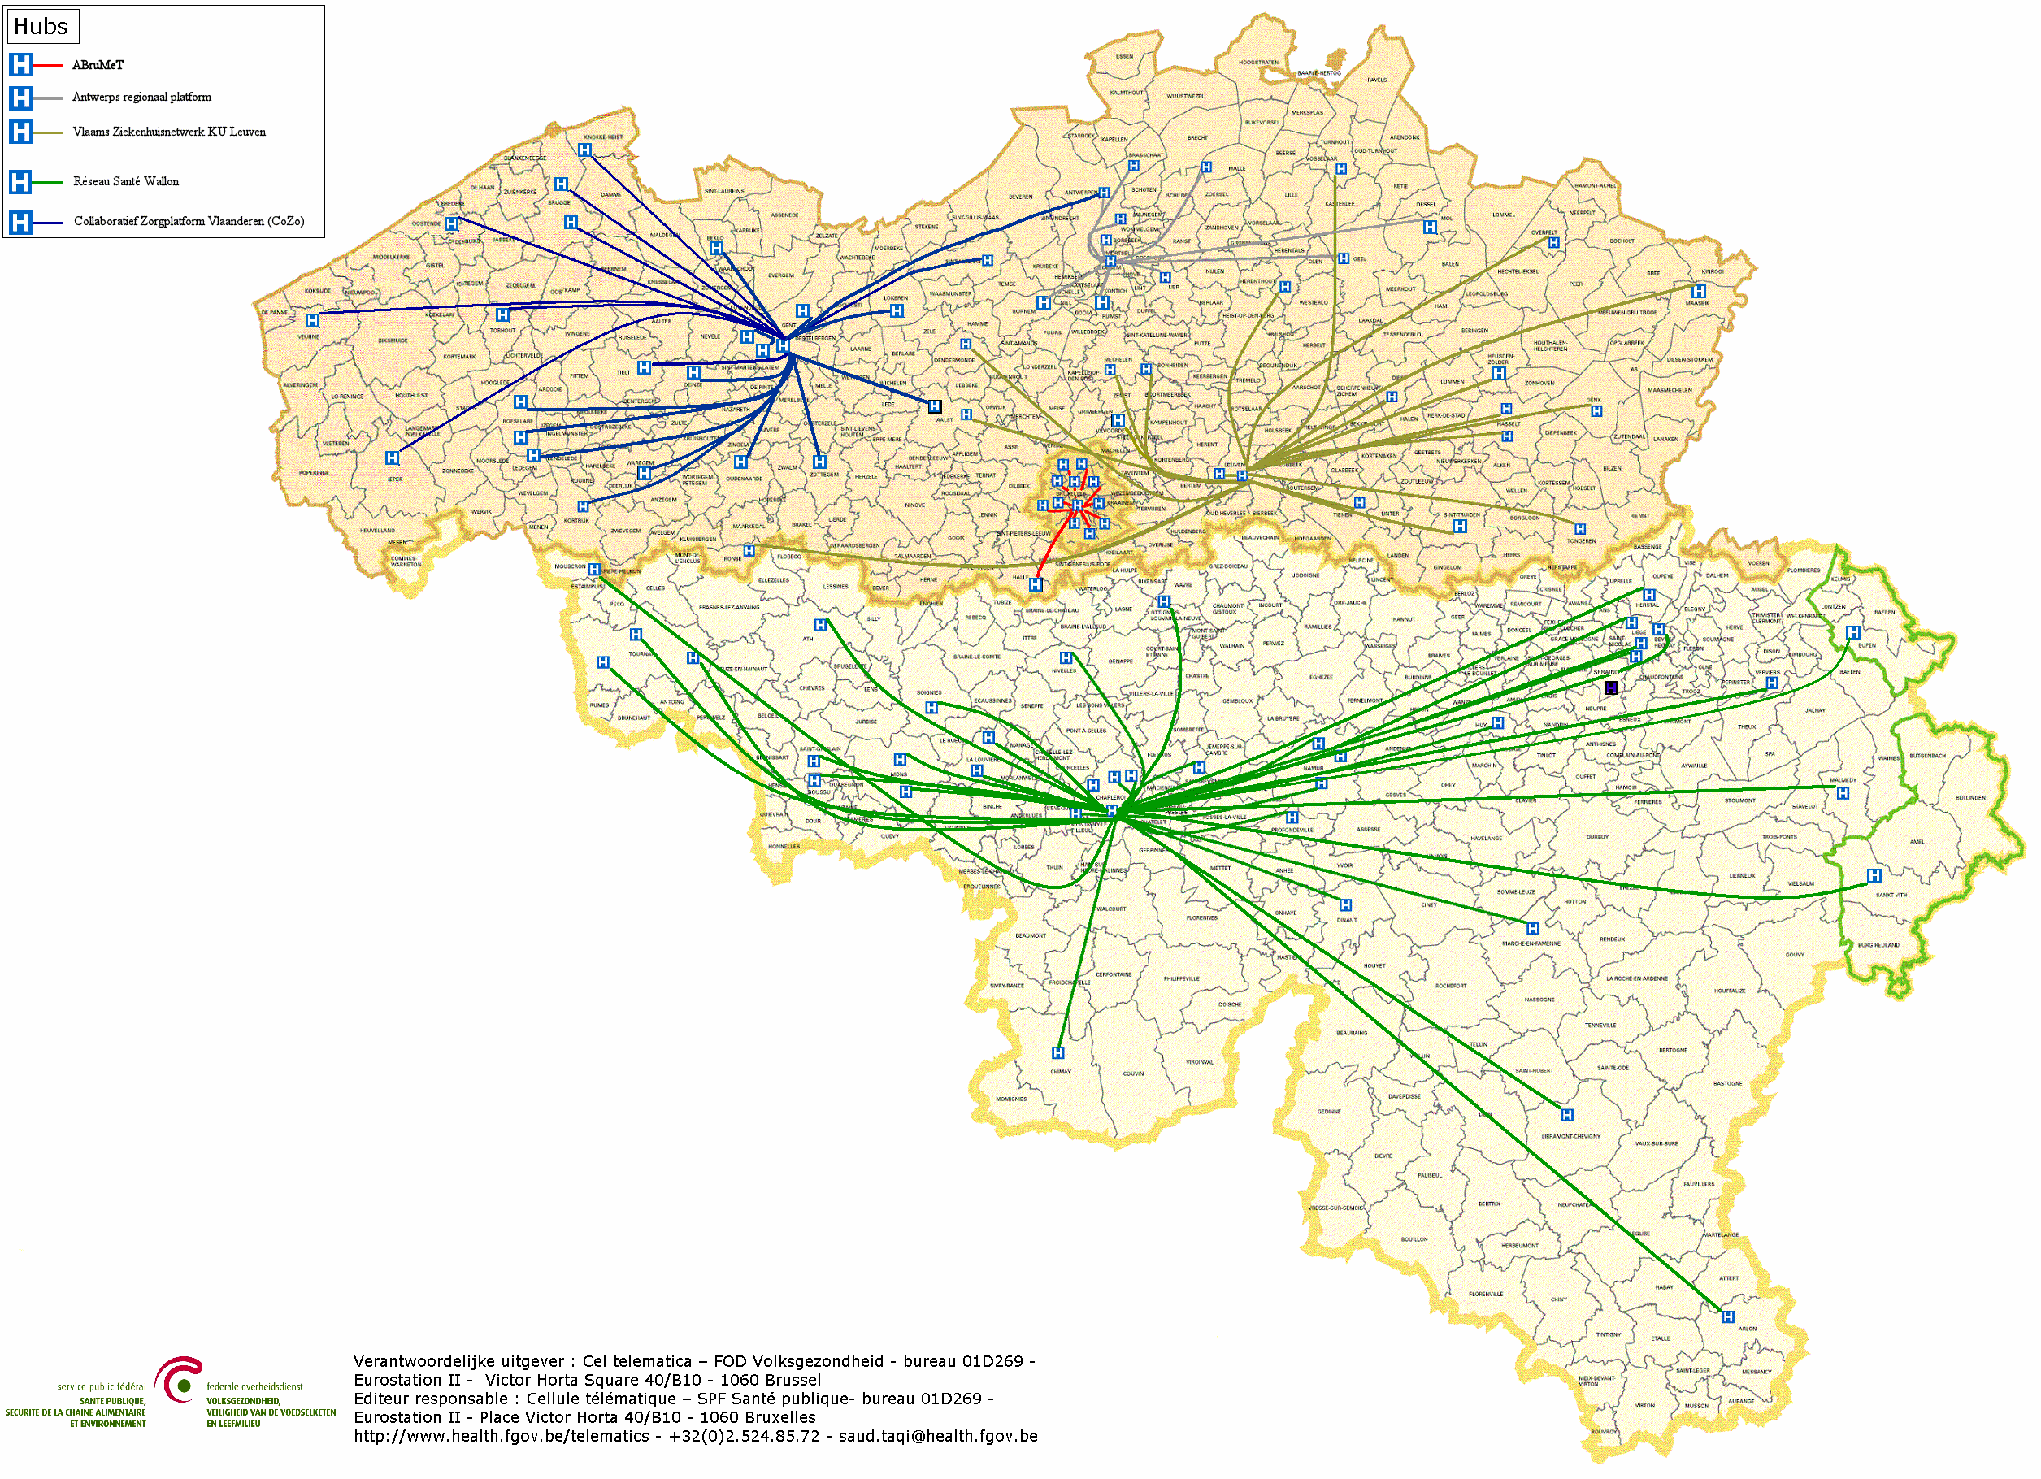

Hubs & metahub
        5 hubs
        Collaboratief Zorgplatform (Cozo)
        Antwerpse Regionale Hub (ARH)
        Vlaams Ziekenhuisnetwerk KU Leuven (VZN)
        Réseau Santé Wallon (RSW)
        Réseau Santé Bruxellois (RSB)

Slide 5








Hubs & metahub
3. Retrieve data from hub A
A
1: Where can we find data?
2: In hub A and C
4:
All data available
3: Retrieve data from hub C
C
B

Slide 6





Health vaults
A
InterMed
BruSafe
C
B

Slide 7
Roadmap 2.0
Every hospital, psychiatric institution and laboratory makes certain documents available electronically with a reference in the hub & metahub system and can access relevant data from the secure health vaults
Every hospital has an integrated, multi-disciplinary Electronic Patient Record (EPR)
  77 % of the hospitals have a strategic ICT plan
  75% of the hospitals have a long-range ICT budget
  85% of the hospitals have an ICT governance structure
  Remains an action item (4.9) in the roadmap 3.0

Slide 8
Hospitals: Belgian Meaningful Use Criteria
Functionalities | Step 1 | Step 2 | Step 3 | Step 4
1. Unique patient identification and description | 80% | 90% | 95% | 98%
2. List of problems (active and passive) | 20% | 50% | 80% | 98%
3. List of allergies and intolerances | 30% | 60% | 90% | 98%
4. Electronic prescription of medicines | 30% | 60% | 90% | 98%
5. Drug interactions | No | No | No | Yes
6. Electronic register of administered medicines | 30% | 60% | 90% | 98%
7. Module for nursing care planning | 0% | 30% | 60% | 98%
8. Management of appointments | >0 | >0 | >0 | >0
9. Electronic submission of requests for medical imaging, laboratory tests or advice | 1 out of 3 (RX, lab, consultation) at a rate of 50%. | 2 out of 3 (RX, lab, consultation) at a rate of 50%. | 3 out of 3 (RX, lab, consultation) at a rate of 50%. | 3 out of 3 (RX, lab, consultation) at a rate of 98%.
10. Electronic letter of discharge | 80% | 90% | 95% | 98%
11. Registration of vital parameters | 50% | 65% | 80% | 98%
12. Registration of the informed consent | >0 | >0 | >0 | >0
13. Registration of therapeutic will | >0 | >0 | >0 | >0
14. Medical results server | 80% | 90% | 95% | 98%
15. Electronic communication with hubs and interaction with eHealth | 80% | 90% | 95% | 98%

Slide 9
Hospital EPR
  Early Adopters Progressive Budget
  from 0% to 5%
  Accelerator budget:
  = evolutive
  Bed based = degressive
  from 25% to 10%
  Hospital based = degressive
  from 20% to 5%

Slide 10
Impact on businesses and citizens
eHealth makes high-quality medical information available for medical practitioners, resulting in many benefits
  Faster, better diagnostics
  Avoidance of life-threatening situations (ex. pre-existing conditions, patients’ known allergies to medicine/substance…)
  Less administration, faster reimbursements
  Avoidance of redundant treatments / examinations
  Fact-based medicine & policy development
  Cost reduction
  Easy third-party payments
  Transparency for patients: online access to your own medical data / history – www.mijngezondheid.belgie.be

Slide 11


Slide 12
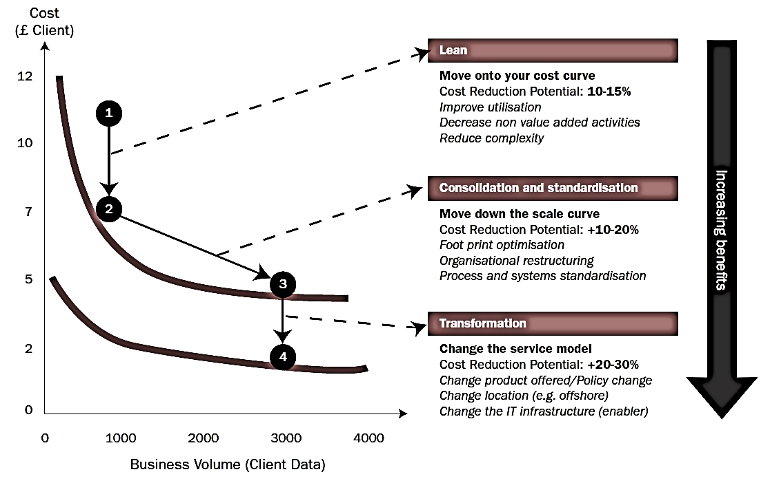
Synergies - transformations
Bron: Booz Allen Hamilton
12

Slide 13
Example: G-Cloud portfolio
13

Slide 14
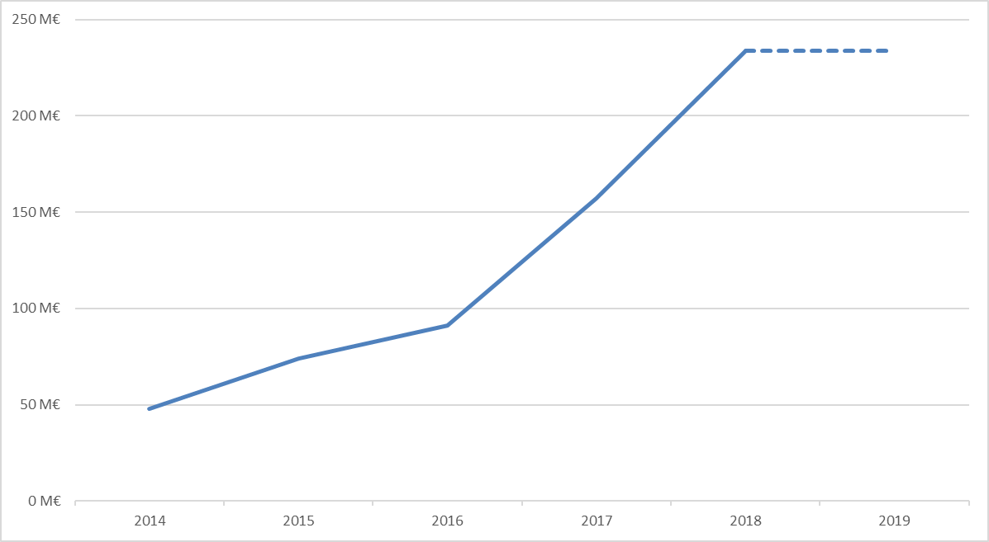
Example: G-Cloud - reuse of contracts
Purchase volume of common contracts
Source: Smals
14

Slide 15
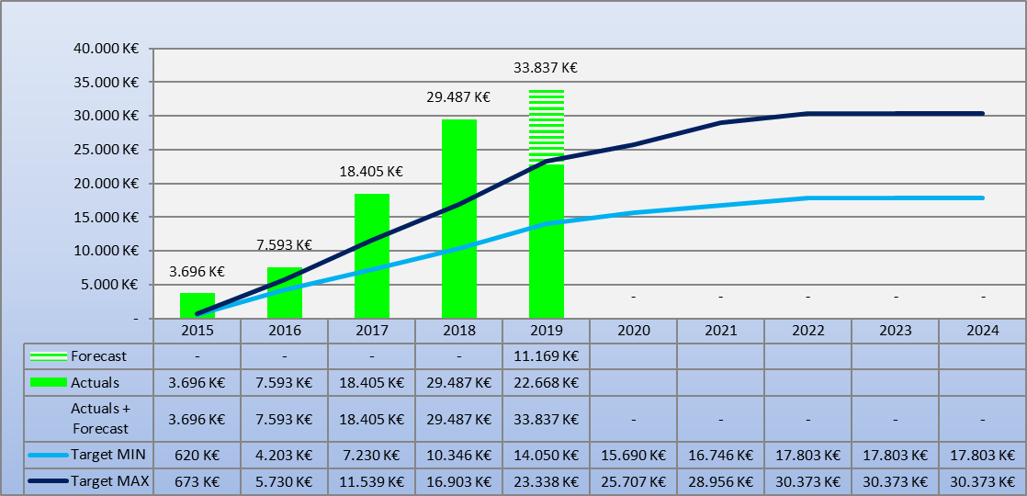
Example: G-Cloud ROI
Total
15

Slide 16
Shift of focus / Added value
Business components
16

Slide 17
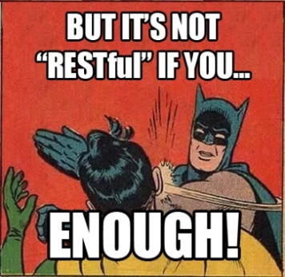
Example: G-Cloud REST style guide
Based on industry standards and best practices
A pragmatic approach to designing RESTful APIs
Collaborative effort organized in several workgroups:
  REST API modelling
  Security (OAuth)
  Functional/business vocabularies (temporal, location, person, enterprises)
Work in progress
https://www.gcloud.belgium.be/rest/
17

Slide 18
Re-use
Knowledge transfer & communities
  Share competences, best practices, collaborate on implementations
  User groups and different fora within federal government
Software-components
  Don’t re-invent the wheel
  Design & adapt for re-use
(micro)services
  Autonomous micro-services
  Service assembly
  API economy
Products & services
  Standardized common solutions
18

Slide 19
Re-use
Value
library
framework
product
service
system
Offered “business” functionality

Slide 20








Overall architecture
Patients, health care providers
and health care institutions
Site Ministry
Software health care professional
Software health care institution
VAS
Site RIZIV
VAS
eHealth-portal
MyCareNet
VAS
VAS
VAS
users
Basic services
eHealth-platform
Network
AS
AS
AS
AS
AS
AS
Suppliers
Notes:
20
20

Slide 21
Basic services eHealth-platform
Coordination of the electronic processes
Portal
Integrated user and access management system
Management of loggings
System for end-to-end encryption
eHealthBox
Timestamping
Coding and anonymising
Consultation of National register and CBSS registers
Reference directories (hub-metahub system)

Slide 22







Authentication resources
Strong
 | eID + PIN-code with connected card reader
 | eID + PIN-code with wireless card reader
 | SIM card with PIN-code
 | Security code via mobile app, user-id + password
 | Security code via SMS, user-id + password
 | Security code on paper (paper token), user-id + password
 | User-id + password
Weak

Slide 23

MijnGezondheid

Slide 24
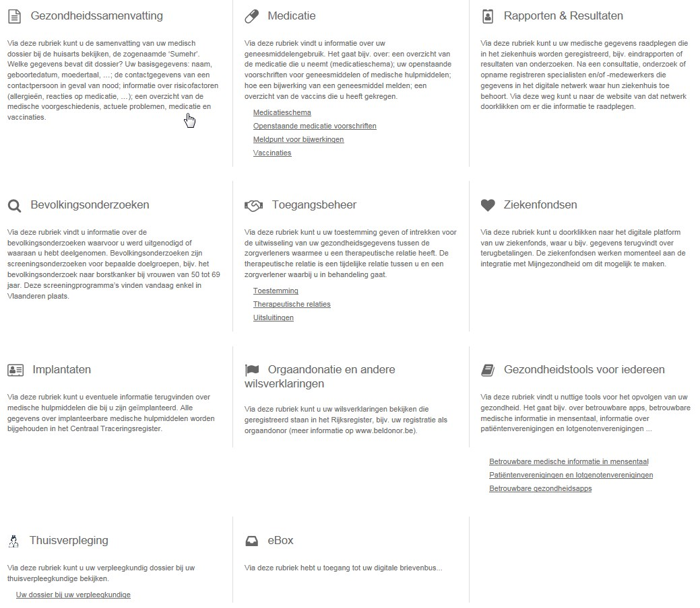
MijnGezondheid

Slide 25




ReUse – Vision
Processes and tools are put in place to identify, register, implement, monitor and measure reuse throughout the project lifecycle
Every stakeholder can easily find the most common reusable elements in a centralized catalogue
CATALOG
Human networks are maintained and developed on all levels (CEO’s, CIO’s, business owners, business analysts, architects) in order to keep maximum visibility on reuse potential
PROCESSES
A culture develops where reuse is adopted and the creation of reusable products is promoted,
NETWORK
MINDSET

Slide 26
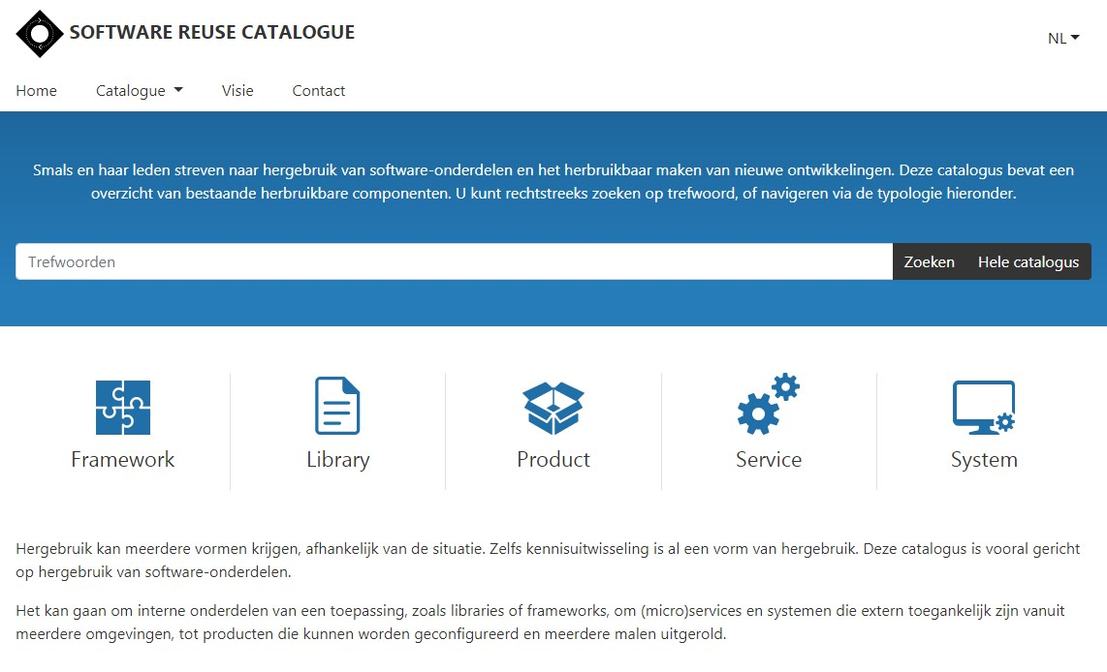
reuse.smals.be
Notes:
NICOLAS

Slide 27

API economy value chain
API economy value chain
To create new innovative apps and services
Make available as API
Differentiated G2C, G2E, G2G service
Self service use by developers
Existing
systems

Slide 28
Leverage cost-efficient use of ICT
Understand the costs
Understand the cost drivers
Understand the needs
Understand the keys to success
And how about
  The return on investment (ROI) ?
  The cloud ?

Slide 29
Understand the costs
Concept of total cost of ownership (TCO)
  The average start-up cost of a business application is 8% of the lifetime cost over 15 years
    Integration in own environment
    Corrective maintenance
    Evolutive maintenance
    Operation
    Regular new major releases
    New modules
    Customization
    Training
    Helpdesk
  Need for a clear understanding of cost drivers

Slide 30
Understand the cost drivers
Design for maintainability
  Standardization in code writing, in documentation, in release management
  Modular service oriented architecture
When purchasing software
  Customize as little as possible
  Good architecture reduces costs by > 50% => include this in requirements
Limit the number of changes
  High number of changes multiplies costs by a factor of 2 to 3
Conclusion: adequate architecture, little customization and limitation of changes reduces cost by a factor of 6

Slide 31
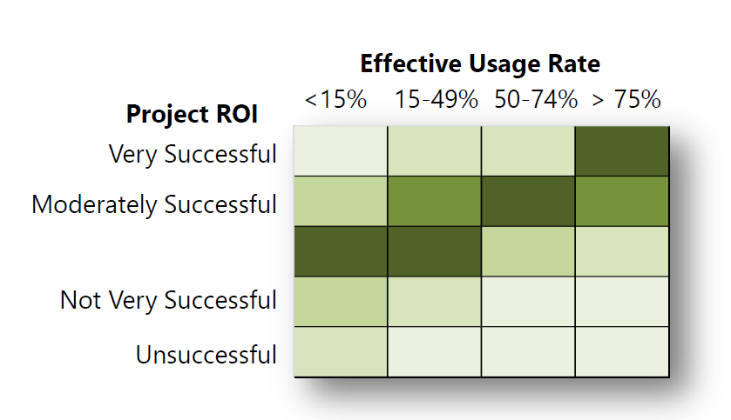
Understand the needs

Slide 32
Understand the needs
There are no ICT projects, only business projects
When purchasing software, pay only for the modules used (often up to 90% of the functions are not used)
No big bang, but incremental development and implementation (agile development)
  Develop a small part
  Implement
  Evaluate and adjust
  Repeat this (agile approach)

Slide 33
Understand the keys to success
Ensure the buy-in of care providers
  Inside hospital
  Outside hospital
Focus on clinical processes
Provide sufficient training and support

Slide 34
Understand the keys to success
Cooperate with other hospitals and care providers
  Good governance structure
  Good expectation management: economies of scale require standardization => avoid too many specific aspects
  Delegate process determination to a single steering committee and align your own processes with it
Tune decision-making authority and financing responsibility: pass on costs to the party causing the problem
  Moderates demand
  Limits changes
  Provides the right people with insight into ICT costs and what causes them

Slide 35
And how about the ROI ?
Rough estimate
  Investment in ICT: 50%
  Time of staff and doctors: 50%
Social return is rarely direct financial return for individual hospital
Becomes positive when productivity gains are taken into account, but depends on
  Good handling of cost drivers
  A good feel for the keys to success
  The degree of cooperation and re-use
  Therefore: requires change management and time

Slide 36
How about cloud?
Transition from own investments to the use of services
  Infrastructure as a Service (IaaS)
  Platform as a Service (PaaS)
  Software as a Service (SaaS)
Challenges
Security
Opportunities
Flexibility
Quality
Economy of scale
Self service
Cooperation
Cost control
Confidentiality
Continuity
Knowledge
Strategic control

Slide 37







Cloud types
Public Cloud
Shared
Hybrid
Access/Control
Outsourced Community Cloud (= off-premise)
Community Cloud on-premise
Private Cloud on-premise
Outsourced Private Cloud (= off-premise)
Dedicated
Location
Customer
Service Provider

Slide 38
Cloud: success factors
Efficiency
Appropriate protection (risk ↘)
Optimal cooperation and trust between institutions
Differentiation of offer: no "one size fits all" but also no "customization" per customer
Capacity management
Phased approach, no "big bang”
Quality of service: service / SLA

Slide 39
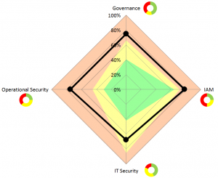
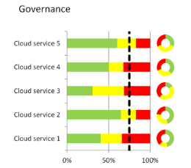
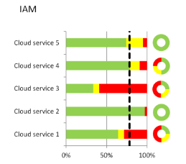
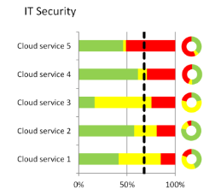
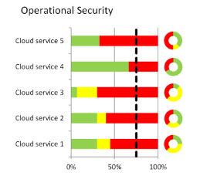
Cloud security evaluation model (Smals)
Available at
www.SmalsResearch.be
Section “tools’

