Slide 1
EESSI
CBSS implementation and ways to move forward

Slide 2
Agenda
Regulatory framework
CBSS implementation
Ways to move forward - Make EESSI future proof
Congratulations!

Slide 3
Regulatory Framework

Slide 4
Regulatory framework
Regulation (EC) No 987/2009 of the European Parliament and of the Council of 16 September 2009 laying down the procedure for implementing Regulation (EC) No 883/2004 on the coordination of social security systems
Grant Agreement between the Innovation and Networks Executive Agency (INEA) and the Federal Public Service Social Security (SPF SS) determines the activities to be performed
Protocol Agreement between the Crossroads Bank for Social Security (CBSS) and the Federal Public Service Social Security (FPS SS) defines the responsibilities
Deliberation No 19/126 on the communication of personal data by Belgian social security institutions to social security institutions of other member states of het European Union under the EESSI project

Slide 5
CBSS implementation

Slide 6
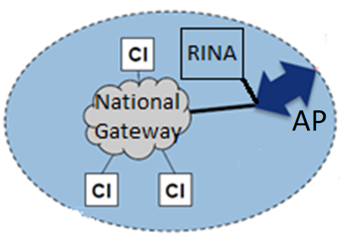
Access Point-National Gateway-RINA
Access Point (AP) - Package (delivered by EU):
  archiving system & Statistics
  intelligent routing
National Gateway (NG) - Based on Business Messaging Interface (BMI) web services (delivered by EU):
  transport layer between the EESSI’s network and the National Applications (NA of the Competent Institutions (CI)
  respect existing communication standards between CI / CBSS
RINA - Case management software (delivered by EU):
  implementation in multi-tenant & multi-server
  integration with RMA for a strong authentication
Integration with CBSS Link Register for unique identification
AP : Access Point
CI: Competent Institutions

Slide 7
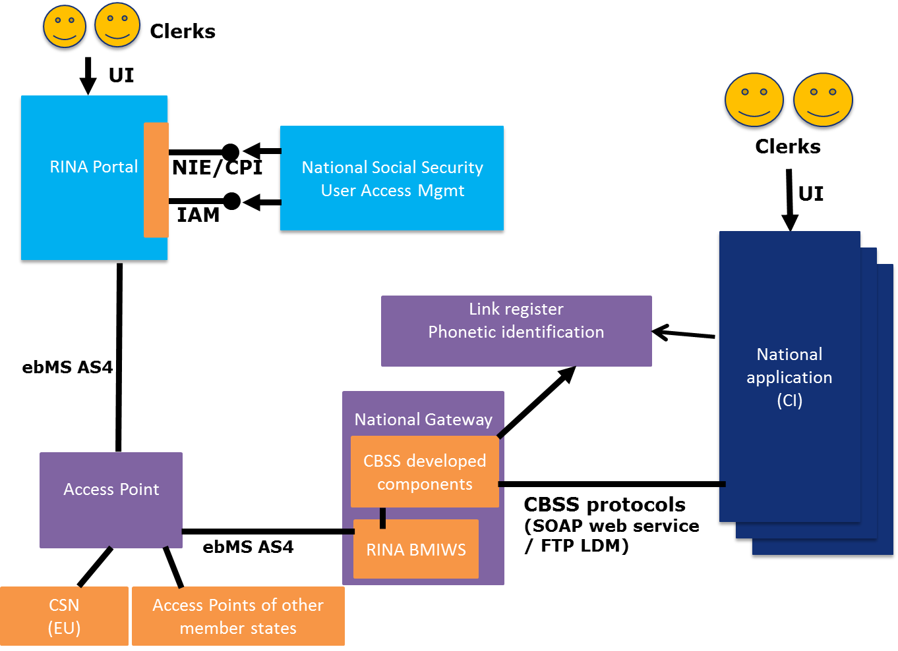
High level architectural view

Slide 8
Intended usage of NA versus RINA
NA
  4 institutions
    National Social Security Office (NSSO)
    National Institute for Health and Disability Insurance (NIHDI)
    National Institute for the Social Security of the Self-employed (NISSE)
    Federal Pensions Service (FPS)
  18 Business Use Cases
  up to 2 million Structured Electronic Documents annually
RINA
  129 institutions
  +/- 110 Business Use Cases
  +/- 500,000 Structured Electronic Documents annually
  estimated + 5,000 institution/Business Use Case combination averaging less than 100 Structured Electronic documents per institution/Business Use Case annually

Slide 9
Issues raised by the BE delegation during implementation
Delivery planning not respected by EC due to quality issues
  many quality issues with initial version of RINA
  necessity to apply major changes
  still some blocking issues to be delivered (Belgian solution waiting EU release)
Deployments are not cost effective
RINA lacks adequate support for integration with national identification and authentication systems
Helpdesk overflow

Slide 10
Issues raised by the BE delegation during implementation
Complexity of the solution
  number of Business Use Cases
  exotic technologies used (e.g. holodeck)
  User Management
Lacking features
  tenants are not entirely isolated
  audit log
Weak documentation
  e.g. holodeck
Robustness and performance of the solution
  e.g. back-up restore not working
  too much (machine) resources required in function of the kind of application
  the solution is unstable

Slide 11
Ways to move forward –
Make EESSI future proof

Slide 12
Needed solution
Central hosting of the solution by the EC
« RINA as a Service » respecting (private or community-) cloud principles
Allowing integration of eIDAS and national identification and authentication
RINA must allow configuration of its SAML calls for easy integration with national systems
Rina must handle SAML responses completely
  to achieve automatic creation of users and user sessions
  in order to know the roles and authorizations managed by the national systems
  in order to avoid value less technical subsystems
Privacy must be guaranteed by adequate measures (e.g. multitenancy)

Slide 13
Pending implementation of the needed solution
Enhanced support offered to national teams:
  by EC
  by experts in the RINA application
  adequately staffed
Enhanced usability in order to reduce support costs for the national teams
Enhanced documentation
No changes on BUCs and / or SEDs will be accepted until the EC offers a RINA-web aaS or a RINA-web 'plug & play‘ unless on specific demand of Belgian institutions
Standardized Belgian RINA-web application and 'frozen'
Specific adaptations for some institutions (eg CPI deployment for NIHDI) are supported by this institution
Centralized management of infrastructure and financing by the sector
Real multitenancy

Slide 14

Congratulations!

Slide 15
Congratulations to team Belgium!
Belgium has implemented EESSI in difficult circumstances
  difficult diplomatic track
  complex landscape of stakeholders (federal – regional)
  technical difficulties
  changes in planning
Belgium has been and will continue be a firm but fair partner of EU
Congratulations to the BeNAP pilot institutions, the Federal Public Service Social Security, all Belgian stakeholders, and Smals and CBSS collaborators!!

