Slide 1
Towards a frictionless social security
Frank Robben
Crossroads Bank for Social Security
Belgium

Slide 2
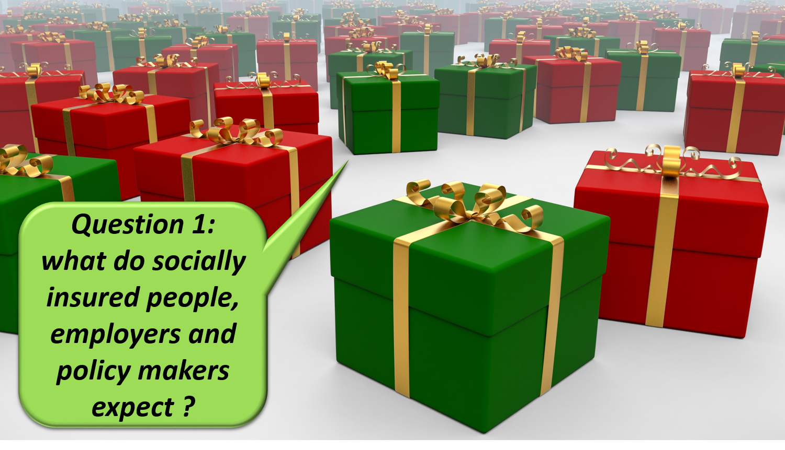
Notes:
Hello every one ! Information is crucial in the organization of a social protection system. If you do not know the social, family or income situation of a socially insured person, you cannot design and deliver social protection effectively and efficiently. That is why sound information management is a key factor for a frictionless social security.

Slide 3
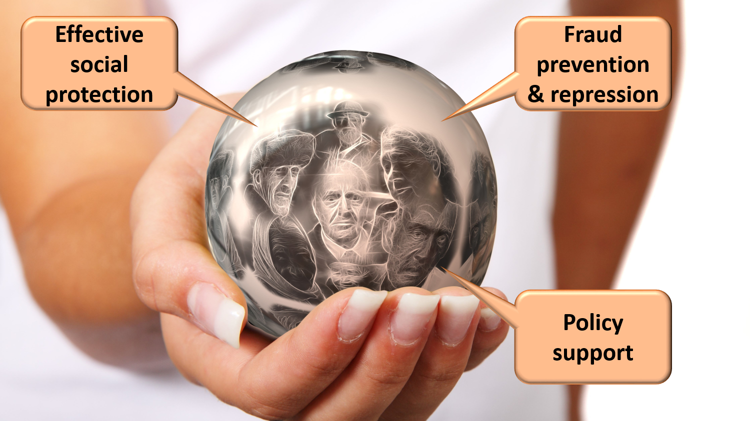
Notes:
effective social protection
to avoid and combat fraud
appropriate policy support

Slide 4
Notes:
benefits as much as possible automatically granted according to a ‘happy flow’

Slide 5
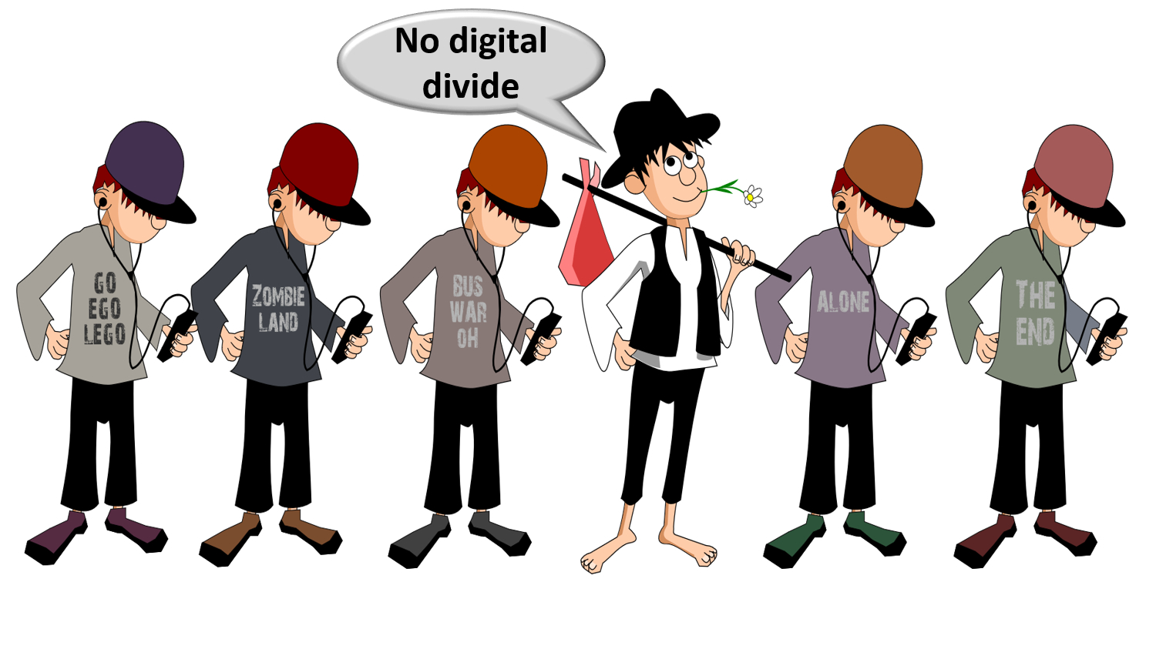
Notes:
social inclusion without a digital divide

Slide 6
Notes:
integrated services across government levels and social security organisations

Slide 7
Notes:
delivered at key life events (birth, going to school, starting to work, moving, illness, retirement, starting up a company…)
addressing citizens’ individual situation, personalized and user oriented

Slide 8
Notes:
minimal costs and minimal administrative burden for all parties involved

Slide 9
Notes:
self service
multichannel service delivery

Slide 10
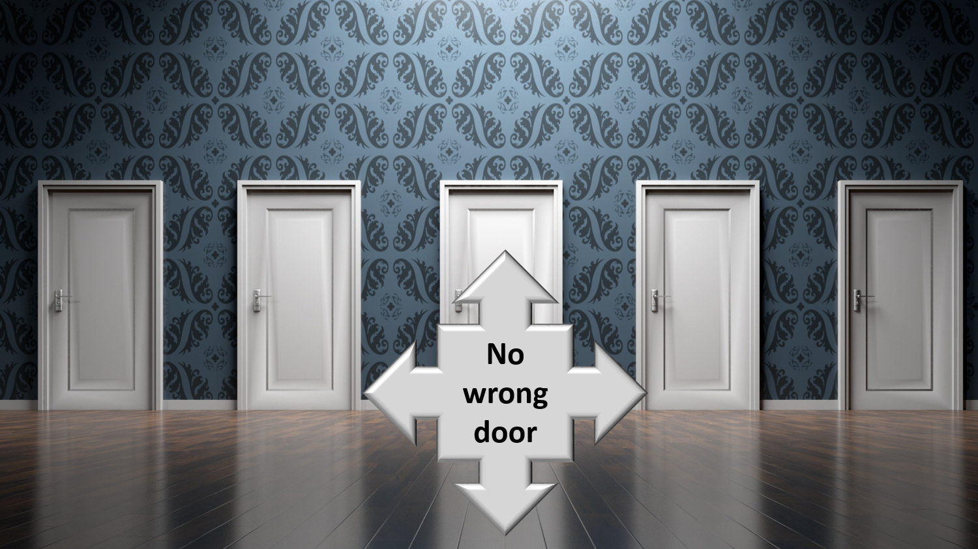
Notes:
to be helped globally wherever they contact: no wrong door

Slide 11
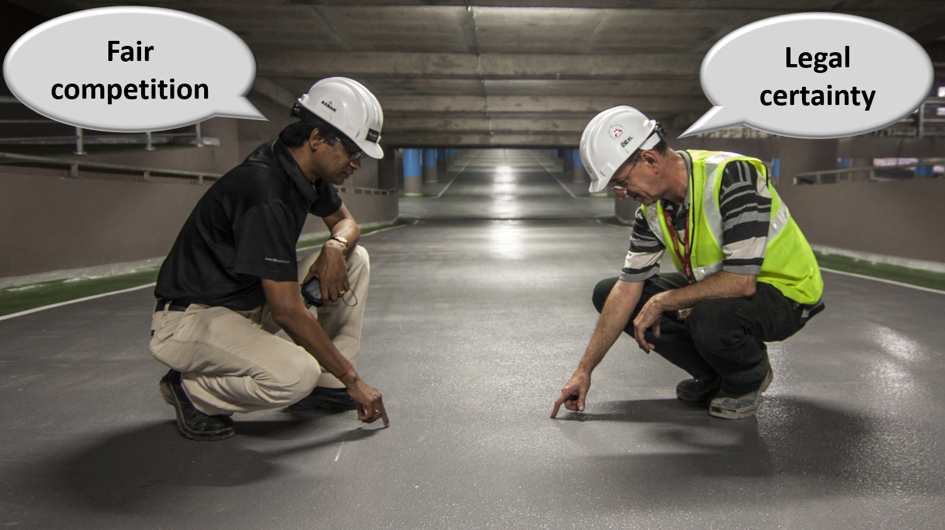
Notes:
reliable, secure and permanently available services with respect of the user’s privacy
legal certainty and legal rules that promote fair competition

Slide 12
Notes:
How can information management and ICT help us to meet those expectations ?

Slide 13
Notes:
1. Common vision, trust and co-operation
common vision on electronic service delivery, information management and information security between all stakeholders
co-operation based on task sharing, rather than centralization; continuous detection of opportunities for synergy

Slide 14
Notes:
examples of common principles regarding information management
only once collection of factual data
data quality guarantees

Slide 15
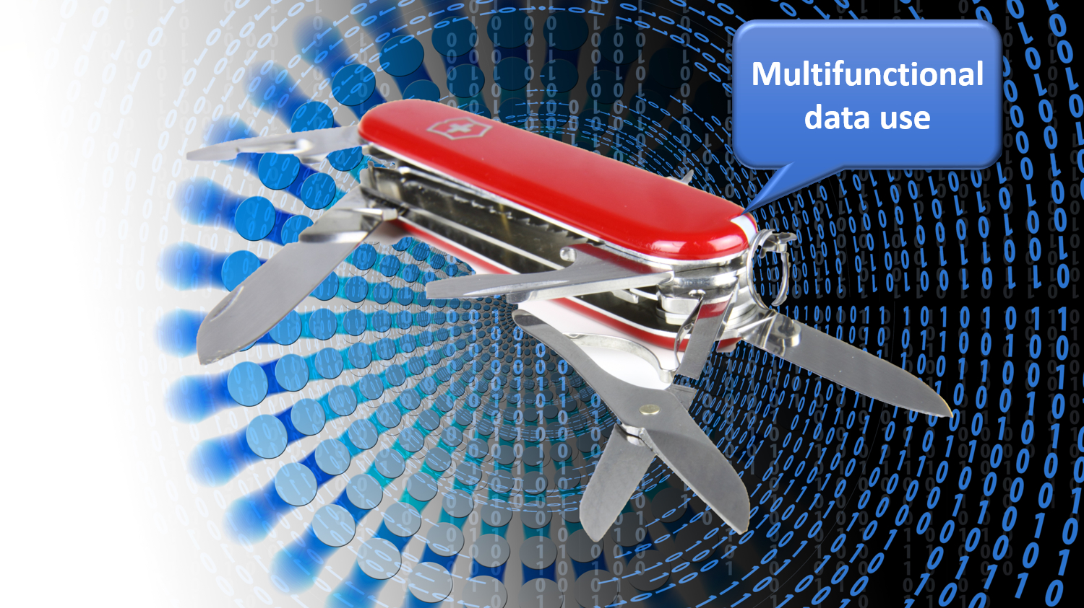
Notes:
multifunctional use of data

Slide 16
Notes:
reengineering of business processes

Slide 17
Notes:
authentic sources

Slide 18
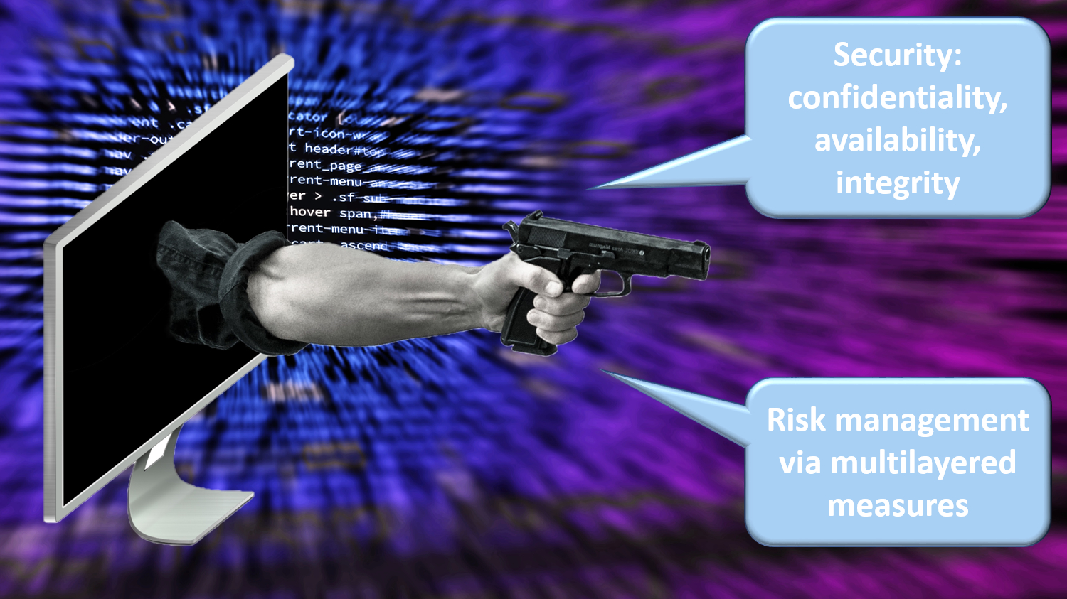
Notes:
avoiding loss of confidence due to information security incidents
security, availability, integrity and confidentiality of information is ensured by integrated structural, institutional, organizational, legal (GDPR), HR, technical and other security measures according to agreed policies

Slide 19
Notes:
access authorization to personal information is granted by an independent Information Security Comittee, designated by Parliament, after having checked whether the access conditions are met
the access authorizations are public
every actual electronic exchange of personal information has to pass an independent trusted third party (TTP) and is preventively checked on compliance with the existing access authorizations by that TTP
every actual electronic exchange of personal information is logged, to be able to trace possible abuse afterwards
long term vision combined with continuous delivery of new services (agile development)

Slide 20
Notes:
paying attention to computer literacy of collaborators and users

Slide 21
Notes:
2. Appropriate corporate culture
from hierarchy to participation, communities and team work
in the first place meeting the needs of the customer, not the social security institutions
rewarding entrepreneurship
ex post evaluation on output, not ex ante control of every input

Slide 22
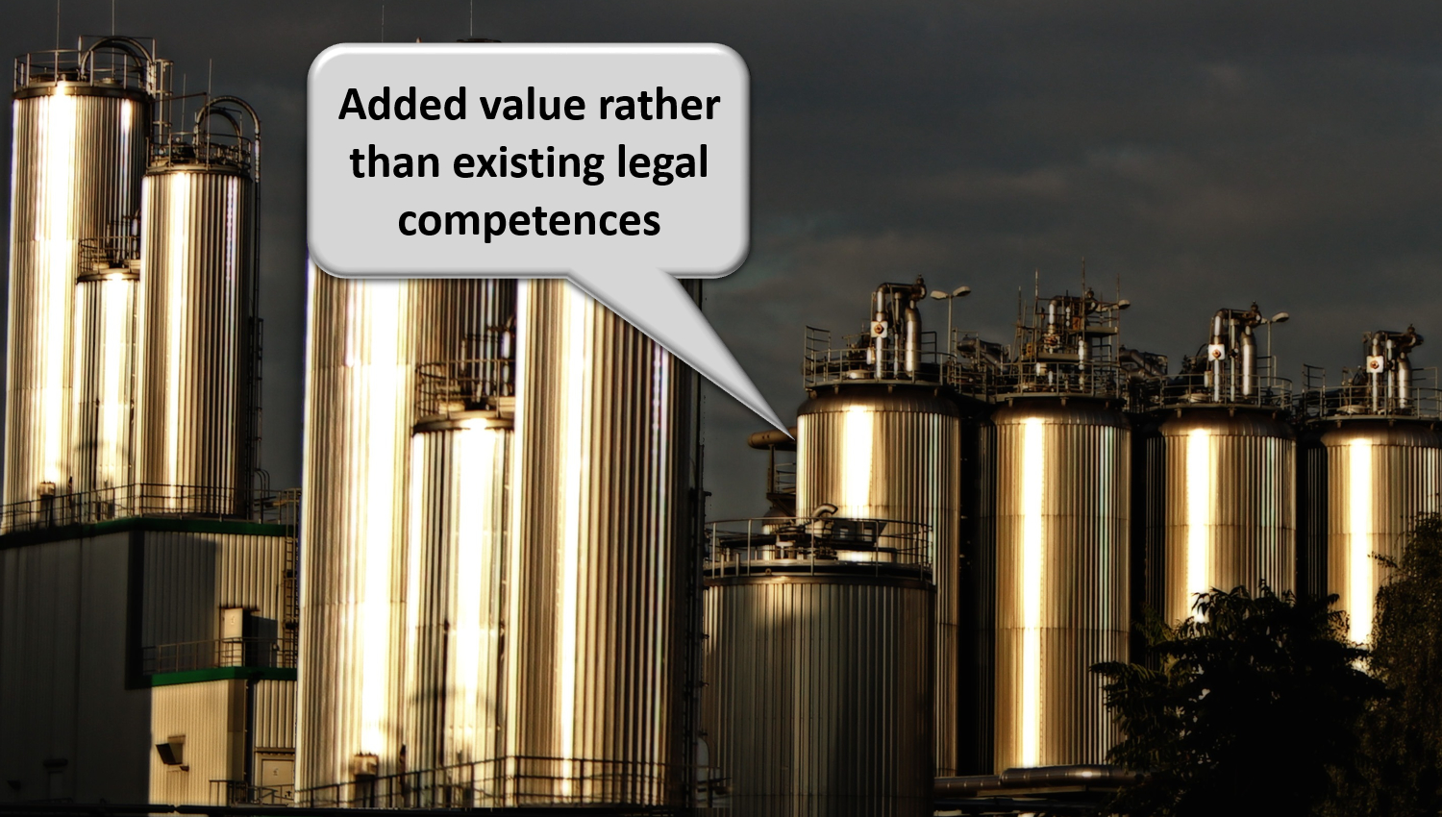
Notes:
reasoning in terms of added value for citizens and companies rather than in terms of legal competences
focus on more efficient and effective service delivery and on cost control
appropriate balance between efficiency on the one hand and information security and privacy protection on the other

Slide 23
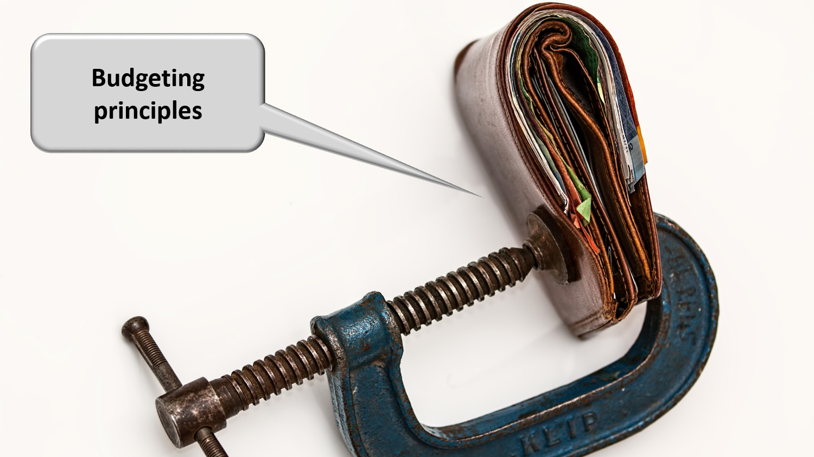
Notes:
sufficient financial means for permanent change and innovation: agreed possibility to re-invest efficiency gains in innovation

Slide 24
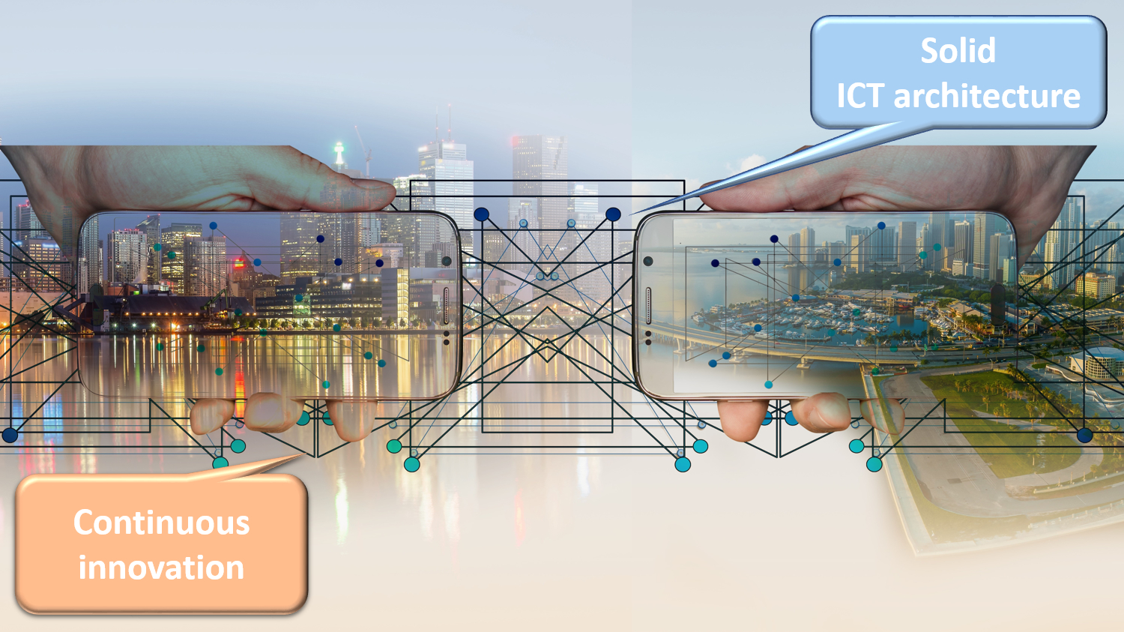
Notes:
3. Solid ICT architecture and continuous innovation
API-approach (application programming interface) and (worldwide) reuse of components, services and best practices

Slide 25
Notes:
sharing ICT infrastructure, platforms, basic services, applications and expertise in order to reduce costs, increase reliability and speed up time to market

Slide 26
Notes:
service oriented architecture based on REST-full services in a plug and play mode

Slide 27
Notes:
technology an policy watch; latest subjects of investigation are

Slide 28
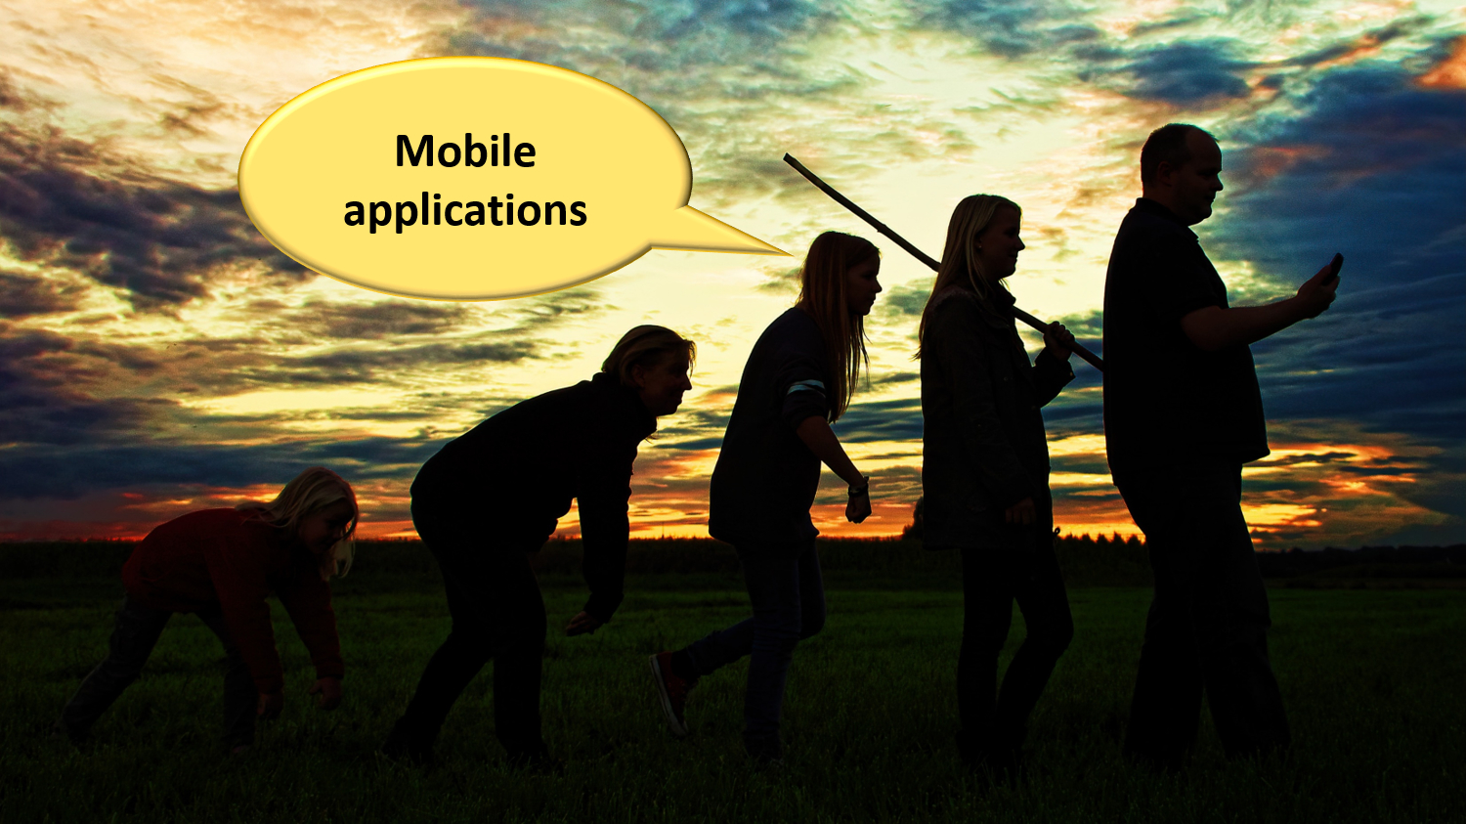
Notes:
mobile applications

Slide 29
Notes:
cloud computing, combining public cloud, for non sensitive information and applications with a community cloud designed and managed by the public sector => cost reduction and faster time to market

Slide 30
Notes:
big data analysis for fraud prevention, policy support and detection of non take up of benefits

Slide 31
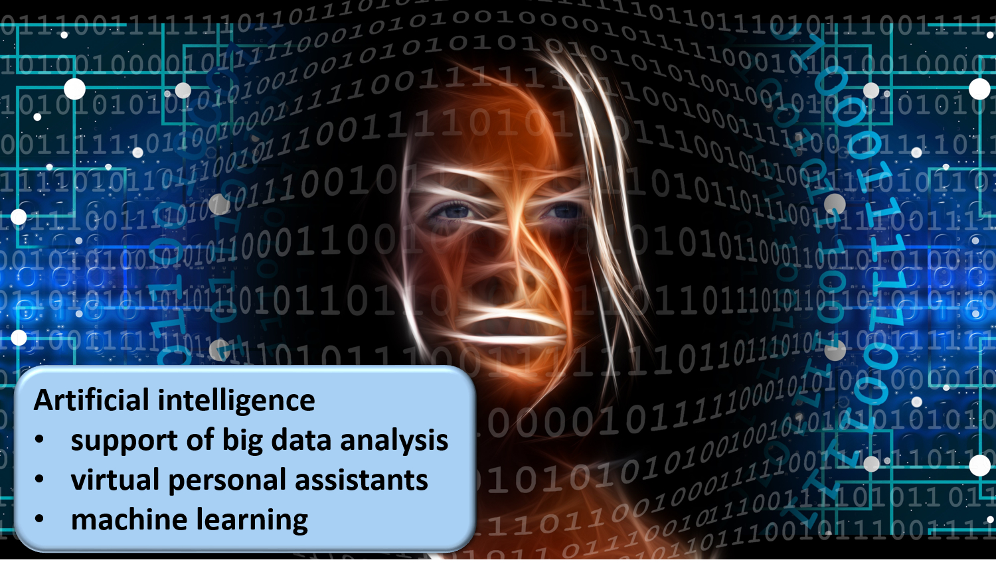
Notes:
artificial intelligence in support of big data analysis, for virtual personal assistants and machine learning
continuous attention for evolution of laws and the politics in the fields of social security, new technologies and information security

Slide 32
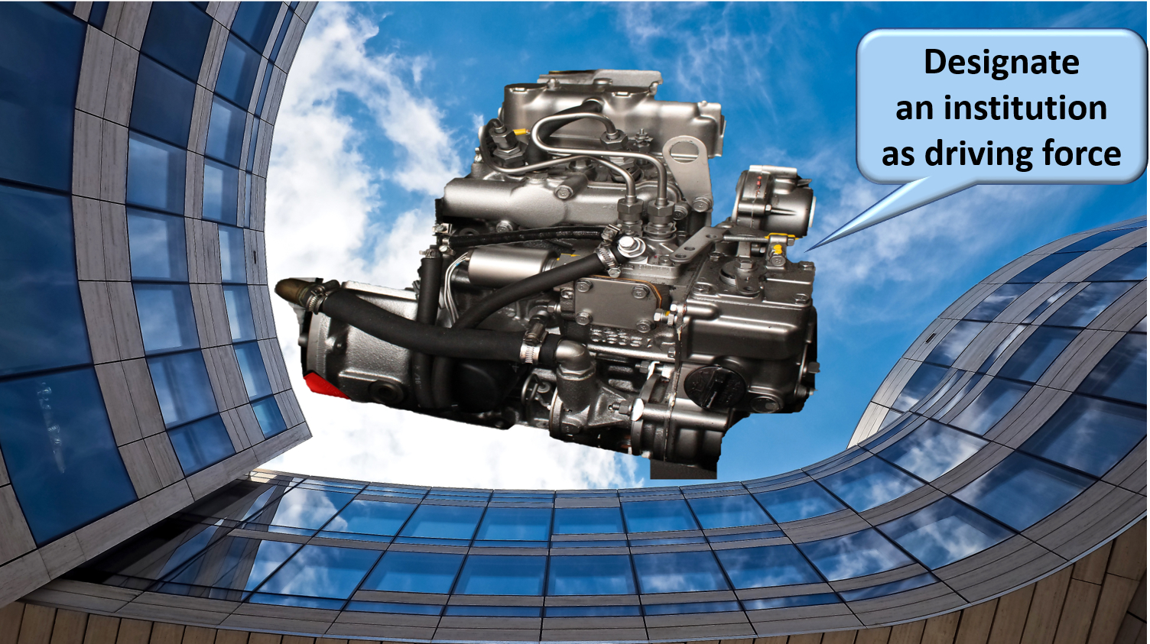
Notes:
4. Designating an institution that acts as a driving force is useful
business process re-engineering within and across actors
being a mediator and enabler setting out a long term roadmap for e-services
proactively looking for opportunities in technology and innovation to benefit citizens and enterprises
ensuring continuous delivery of shared ICT services and the retention of crucial skills
program, project and service management
co-operative governance

Slide 34
Notes:
Let the computer do what it is good at and thereby make time available for human support where necessary. And remember: the network always wins

Slide 35
Thank you ! Success !

