Slide 1
The eHealth plan 2019-2021: what are the eHealth achievements and what can we expect ?

Slide 2
Roadmap 3.0 (2019-2021) is interfederal

Slide 3
Roadmap 3.0 (2019-2021) with 7 clusters
Clustering of closely related projects
Cluster 0 Fundamentals
Cluster 1 Transversal
Cluster 2 Support
Cluster 3 Operational excellence
Cluster 4 Health care providers and institutions
Cluster 5 Patient as co-pilot
Cluster 6 eHealth and health insurance funds
Notes:
A cluster includes projects that each have their own specific objectives but which, together, add an extra dimension to the achievement of the program's strategic objectives.

Slide 4
Roadmap 3.0 (2019-2021) covers 44 projects
0 Fundamentals
1 Transversal
2 Support
0.1 Data sharing consent
0.2 Access matrix, therapeutic, care and other relationships
0.3 Basic service user and access management
0.4 Rules for ‘eHealth vaults’
0.5 Information standards
0.6 Terminology
0.7 Cobrha Next Generation & UPPAD
0.8 Strategic research on collaboration model with software providers
1.1 Communication
1.2 Program monitoring
2.1 Incentives
2.2 Code of conduct & guidelines on sharing personal health information
3 Operational excellence
4 Health care providers and institutions
5 Patient as co-pilot
3.1 Basic architecture
3.2 SLA and service management
3.3 Business continuity
3.4 Documentation, help desk & support
3.5 Test environments, flows, processes, data
3.6 Quality of health software
3.7 Education and training
3.8 Administrative workload reduction for healthcare providers
4.1 Multidisciplinary information exchange
4.2 Multidisciplinary functionalities
4.3 Electronic prescription
4.4 VIDIS – evolution electronic prescription
4.5 Decision support platform
4.6 BelRAI
4.7 Incapacity for work
4.8 MEDEX
4.9 EPR in all institutions
4.10 Publication of structured information
4.11 Registers
4.12 Communication about and planning of care
4.13 Connecting Europe Facility Patient Summary
4.14 Modulation of patient access by health care providers
5.1 Personal health portal
5.2 Digital referral platform
5.3 Orgadon
6 eHealth and health insurance funds
6.1 eAttest for specialists, dentists, physiotherapists & speech therapists
6.2 eFac for medical houses, physiotherapists & speech therapists
6.3 Consultation member data
6.4 Digitisation of rehabilitation agreements
6.5 Digitisation of Chapter IV agreements
6.6 Subscriptions to medical houses
6.7 Digitisation of physiotherapy agreements

Slide 5
The Roadmap 3.0 (2019-2021) has specific accents
Extension of existing concepts to other target groups or other applicable fields
Development of a framework and management model for the use of existing systems built by the government and/or the private sector
Focus on 'operational excellence': user support, usage reporting, availability and performance (KPIs), improvement of test facilities, ...
Improved connection with European and international initiatives and programs
Adjusting ongoing projects, with an extra focus on specific use in practice
Stopping projects that are no longer relevant
Launch of new projects to consolidate, harmonize and stabilize ongoing projects

Slide 6
The Roadmap 3.0 (2019-2021) involves continuity

Slide 7
Roadmap 2.0: health care providers
Each GP manages an Electronic Health Record (EHR) for each patient, and publishes and updates a SumEHR for each patient in the secure health vault (Vitalink, Intermed or BruSafe)
3.353.943 patients possess a SumEHR in a health vault
SumEHR v2 is being implemented
need to improve the quality of information in the SumEHR => adaptation of registration criteria for GP software

Slide 8
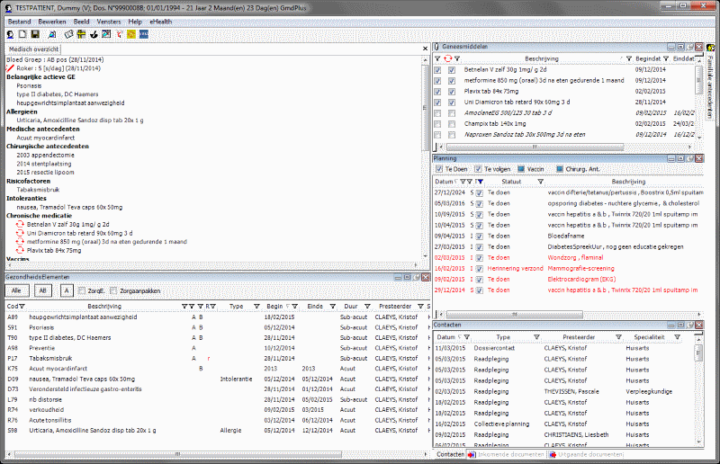
EHR structure

Slide 9
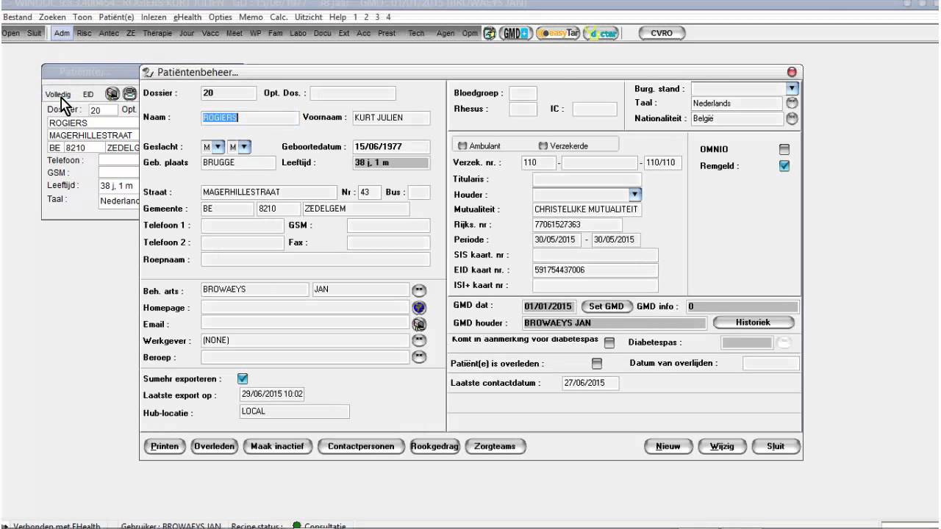
SumEHR

Slide 10
Roadmap 2.0: health care providers
Every hospital, psychiatric institution and laboratory makes certain documents available electronically with a reference in the hub & metahub system and can access relevant data from the secure health vaults
> 200 million documents available at general hospitals
> 57.000 documents available at psychiatric institutions
> 3 million documents available at extramural laboratories
about almost the entire population
documents were consulted > 4,5 million times in the 2nd quarter of 2019
by nearly 52.000 different health care providers

Slide 11
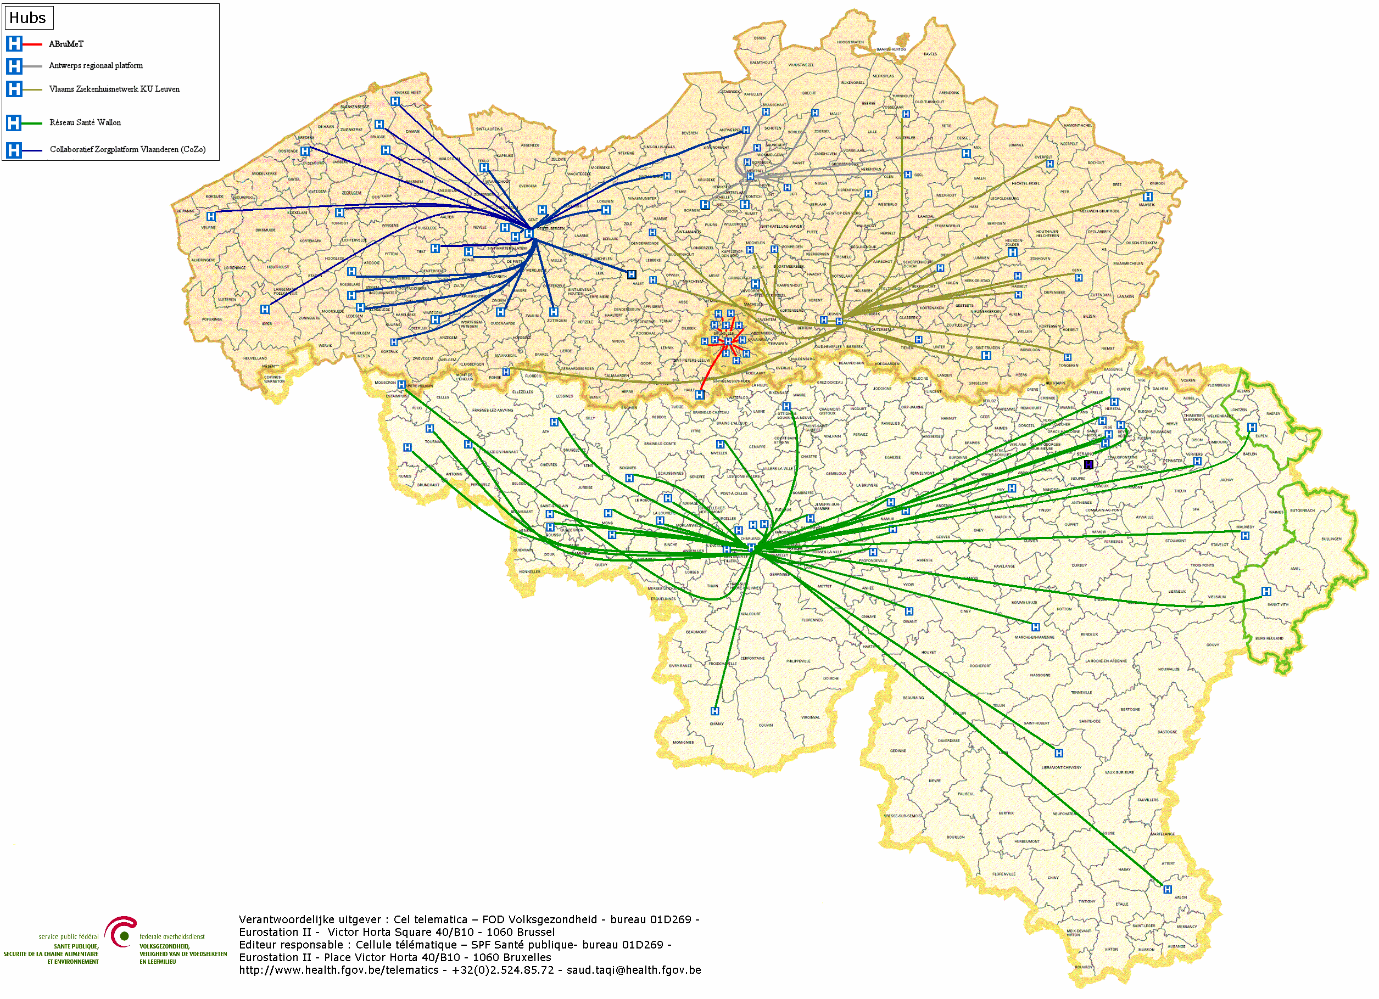
Hubs & metahub
5 hubs
Collaboratief Zorgplatform (Cozo)
Antwerpse Regionale Hub (ARH)
Vlaams Ziekenhuisnetwerk KU Leuven (VZN)
Réseau Santé Wallon (RSW)
Réseau Santé Bruxellois (RSB)

Slide 12
Hubs & metahub
3. Retrieve data from hub A
A
1: Where can we find data?
2: In hub A and C
4: All data available
3: Retrieve data from hub C
C
B

Slide 13
Health vaults
A
InterMed
BruSafe
C
B

Slide 14
Basic architecture
Patients, health care providers
and health care institutions
Health portal
Software health care provider
Software health care institution
AVS
Website NIHDI
AVS
eHealth portal
MyCareNet
AVS
AVS
AVS
Users
Basic services
eHealth platform
Network
VAS
VAS
VAS
VAS
VAS
VAS
Suppliers
Notes:
14
14

Slide 15
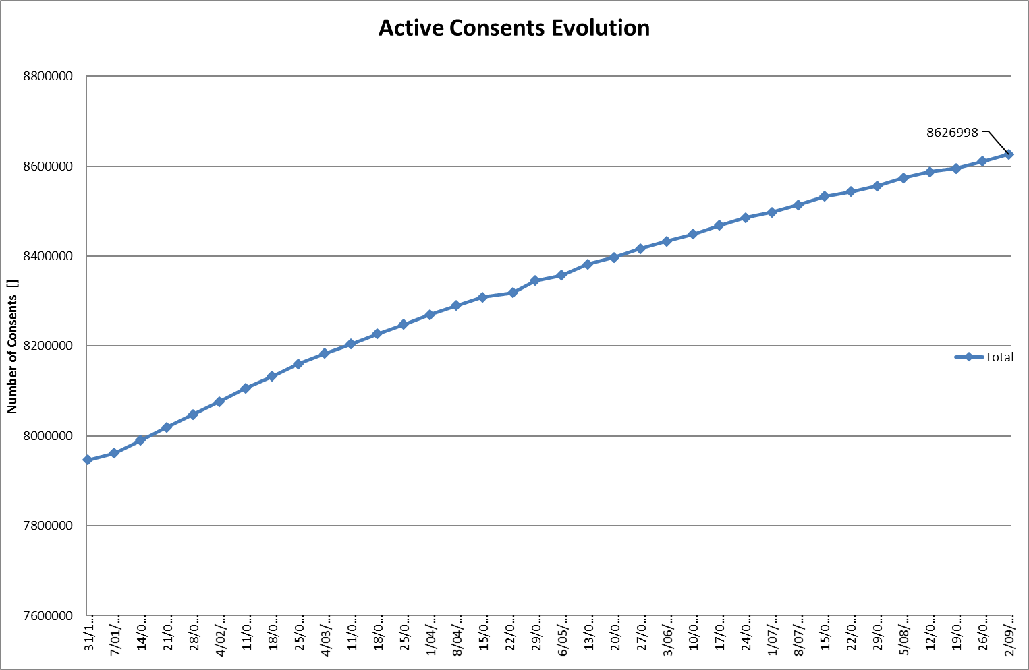
Data sharing consent
Notes:
NL

Slide 16
Roadmap 2.0: health care providers
Each hospital has an integrated, multi-disciplinary Electronic Patient Record (EPR)
77 % of the hospitals have a strategic ICT plan
75% of the hospitals have a long-range ICT budget
85% of the hospitals have an ICT governance structure
remains an action item (4.9) in the roadmap 3.0

Slide 17
Hospitals: Belgian Meaningful Use Criteria
Functionalities | Step 1 | Step 2 | Step 3 | Step 4
1. Unique patient identification and description | 80% | 90% | 95% | 98%
2. List of problems (active and passive) | 20% | 50% | 80% | 98%
3. List of allergies and intolerances | 30% | 60% | 90% | 98%
4. Electronic prescription of medicines | 30% | 60% | 90% | 98%
5. Drug interactions | No | No | No | Yes
6. Electronic register of administered medicines | 30% | 60% | 90% | 98%
7. Module for nursing care planning | 0% | 30% | 60% | 98%
8. Management of appointments | >0 | >0 | >0 | >0
9. Electronic submission of requests for medical imaging, laboratory tests or advice | 1 out of 3 (RX, lab, consultation) at a rate of 50%. | 2 out of 3 (RX, lab, consultation) at a rate of 50%. | 3 out of 3 (RX, lab, consultation) at a rate of 50%. | 3 out of 3 (RX, lab, consultation) at a rate of 98%.
10. Electronic letter of discharge | 80% | 90% | 95% | 98%
11. Registration of vital parameters | 50% | 65% | 80% | 98%
12. Registration of the informed consent | >0 | >0 | >0 | >0
13. Registration of therapeutic will | >0 | >0 | >0 | >0
14. Medical results server | 80% | 90% | 95% | 98%
15. Electronic communication with hubs and interaction with eHealth | 80% | 90% | 95% | 98%

Slide 18
Action 2: hospital EPR
Early Adopters Progressive Budget
from 0% to 5%
Accelerator budget:
= evolutive
Bed based = degressive
from 25% to 10%
Hospital based = degressive
from 20% to 5%

Slide 19
Roadmap 2.0: health care providers
An EPR has been defined for all other types of health care providers and they can also publish and update certain information from their EPR in the secure health vault
available for home nurses and physiotherapists, for whom an updated version is being developed
remains an action item (3.6) in the roadmap 3.0
Medicines and medical care are prescribed electronically
action items 4.3 and 4.4 in roadmap 3.0
complete dematerialisation
extension to other types of prescriptions
VIDIS

Slide 20
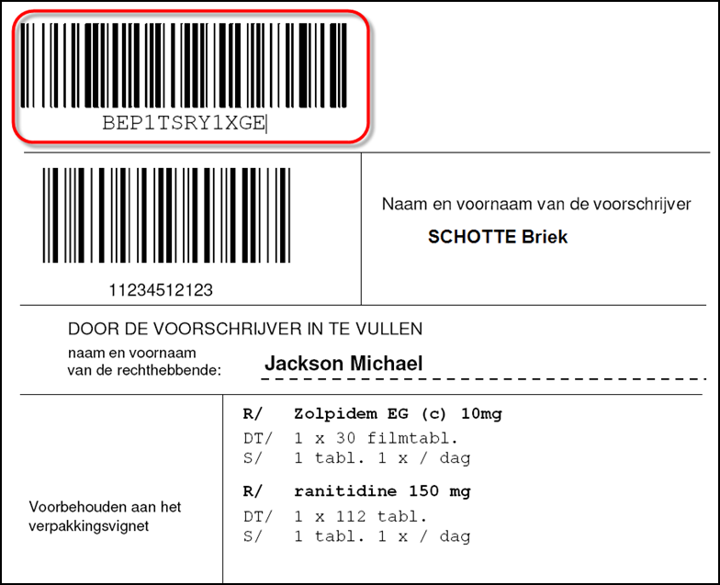
Electronic prescription with Recip-e code

Slide 21
Complete electronic prescription

Slide 22
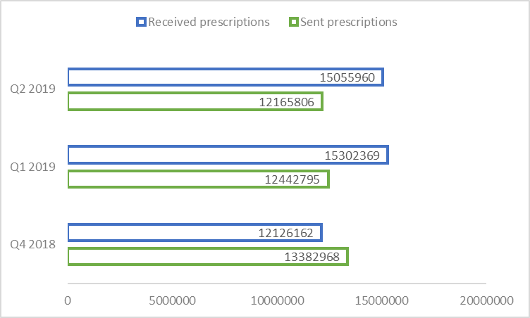
Electronic Medical Prescription

Slide 23
Roadmap 2.0: health care providers
Pharmacists publish information about the delivered medicines in the Shared Pharmaceutical Record (SPR), which feeds the medication schedule; the patient's medication schedule is also stored in the secure vault and is shared between physicians, pharmacists, home nurses and hospitals, among others
The general practitioner has access through his EMR to all relevant published medical information about his patients

Slide 24
Roadmap 2.0: health care providers
Any other health care provider has access to all relevant, published information on his/her patients; for this purpose, filters are defined; the information can also be completed in a multidisciplinary approach
remains an action item (4.1 and 4.2) in the roadmap 3.0
The aim is to ensure that a maximum of medical information is created and published in a structured and semantically interoperable way
remains an action item (0.5 and 0.6) in the roadmap 3.0

Slide 25
Roadmap 2.0: health care providers
All health care providers can communicate with each other through the eHealthbox; a number of electronic standard forms are made available for this purpose
evolution of functionalities of eHealthbox is planned, e.g. for sending to (health care providers in) health care institutions.

Slide 26
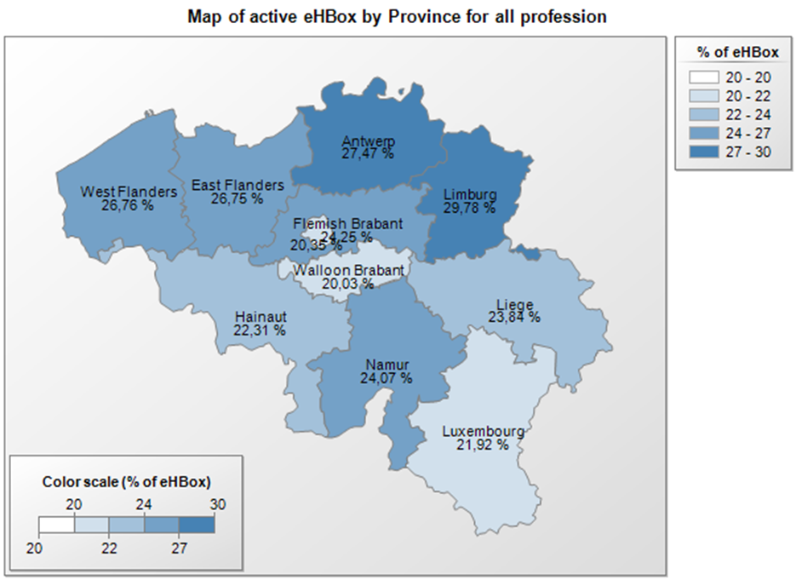
eHealthBox
29/07/2019

Slide 27
Roadmap 2.0: health care providers
Health care providers can apply telemedicine using officially registered mobile health applications; this registration is subject to a number of checks in terms of data protection, interoperability, EU label for medical devices and evidence-based medicine (EBM).
see https://mhealthbelgium.be/
6 apps are now registered on level M1

Slide 28
Mobile health apps

Slide 29
Mobile health apps - Validation pyramid
M3 Requires M2 Positioned within Belgian health system Conditional financing (expert committee)
CostBenefit Triple Aim
M2 Requires M1 Validated by agencies (or trusted third parties) Security - Authentication (eHP) Interoperability (eHP + SPF-FOD) Scientific evidence (publications)
BE mHealth Validation
CE
Medical device
M1 CE certified as Medical device (AFMPS-FAGG) GDPR compliant Belgian privacy law compliant

Slide 30
Roadmap 2.0: health care providers
The registers have been optimised and standardised and, if possible, registration is carried out automatically from the EMR/EPR
connectors are made available by HealthData
remains an action item (4.11) in the roadmap 3.0
there is a lack of insight into whether the information collected in the various registers has a quality-enhancing effect
provided data must support a public benefit

Slide 31
Roadmap 2.0: health care providers
Tracing of implants and medicines is done according to international standards
All data exchange between health care providers and health insurance funds is done electronically
carried out by general practitioners
consultation of the insurability
Chapter IV agreements
eFac (invoice files)
eAttest (certificates of care provided)
remain action items (6.1 until 6.7) in the roadmap 3.0

Slide 32
Roadmap 3.0: health insurance funds
eAttest for specialists, dentists, physiotherapists & speech therapists
eFac for medical houses, physiotherapists & speech therapists
consultation of member data
digitisation of rehabilitation agreements
digitisation of Chapter IV agreements
subscriptions to medical houses
digitisation of physiotherapy agreements

Slide 33
Roadmap 2.0: health care providers
The health care providers receive incentives for the use and meaningful application of eHealth; financial incentives can have both a federal component and a component from the different communities and regions
Every health care provider is trained in eHealth capabilities, both through the basic education package and through post-graduate training
Flanders: Eenlijn
Wallonia: eSanté Wallonie
Brussels: eHealth Academy
Each health care provider has a one-stop shop for the communication of all administrative information for the NIHDI, the FPS Public Health and the federal entities ("only once" principle).

Slide 34
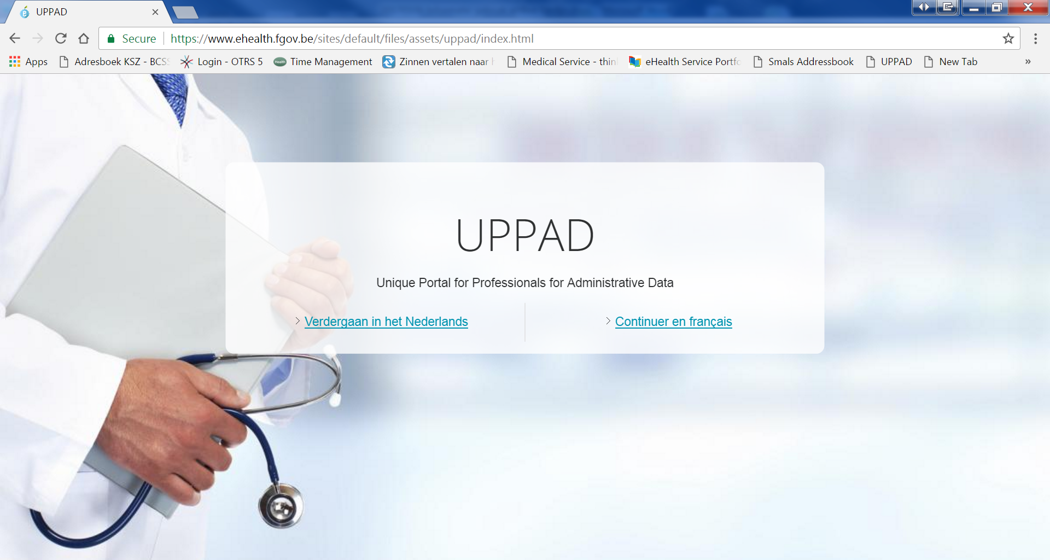
UPPAD

Slide 35
Roadmap 2.0: patients
The patient has access to the information about himself that is available in the secure health vaults and through the hub & metahub system
The feasibility of providing a consolidation platform where all patient information is aggregated with analysis tools and translation tools to facilitate the patient's understanding of his file is being explored; this will contribute to the patient's health literacy.

Slide 36
MijnGezondheid

Slide 37
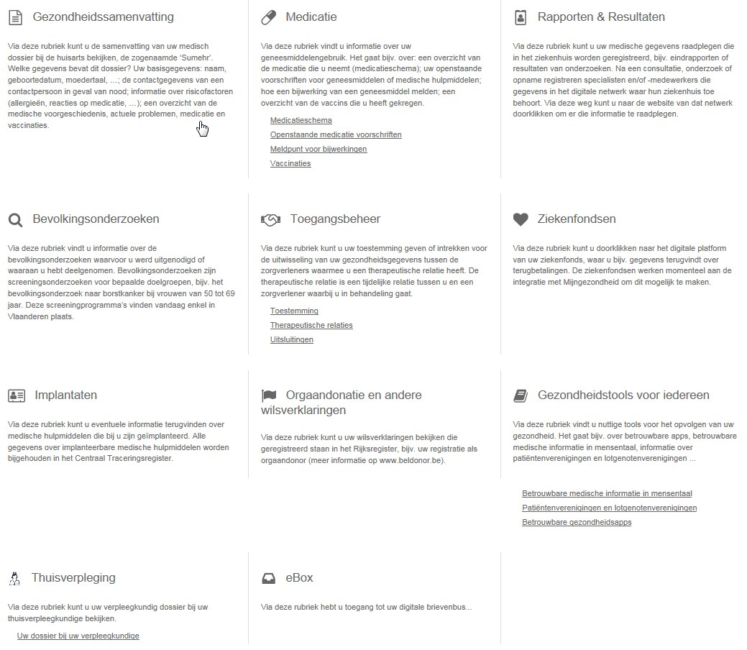
MijnGezondheid

Slide 38
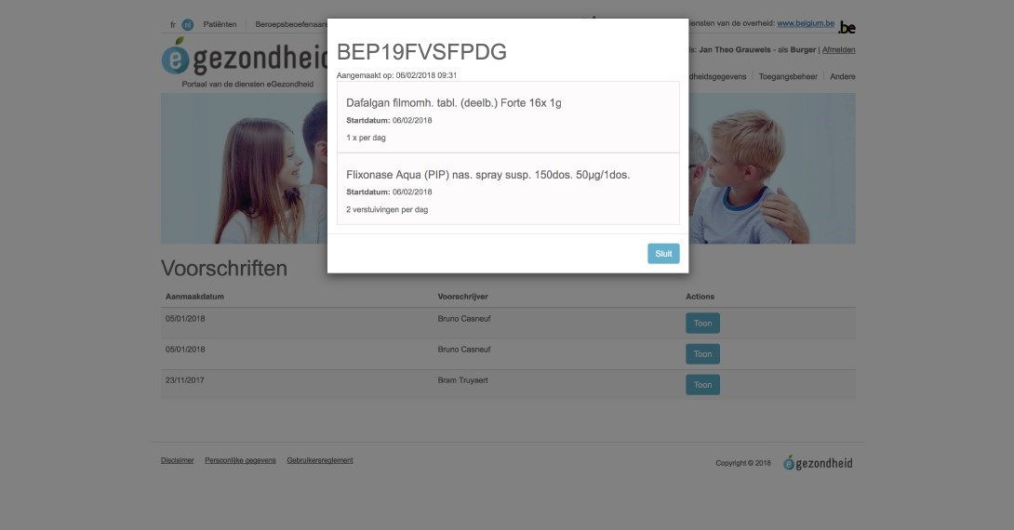
MijnGezondheid

Slide 39
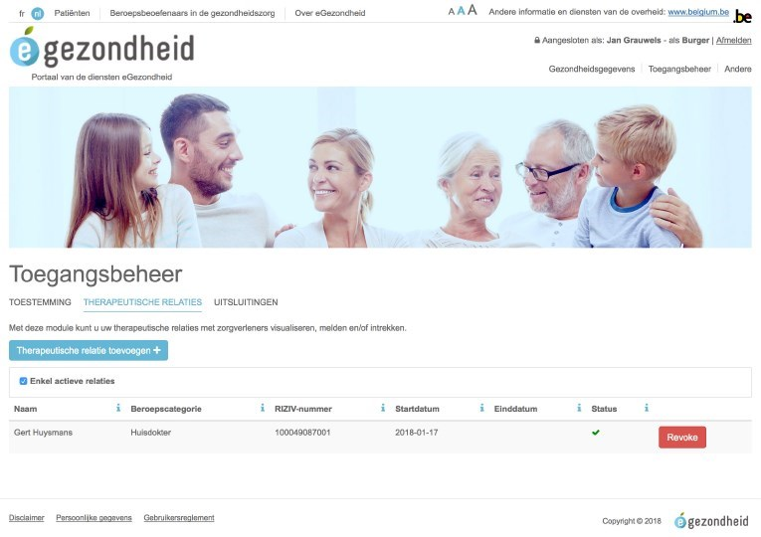
MijnGezondheid

Slide 40
Authentication resources
Strong
 | eID + PIN-code with connected card reader
 | eID + PIN-code with wireless card reader
 | SIM card with PIN-code
 | Security code via mobile app, user-id + password
 | Security code via SMS, user-id + password
 | Security code on paper (paper token), user-id + password
 | User-id + password
Weak

Slide 41
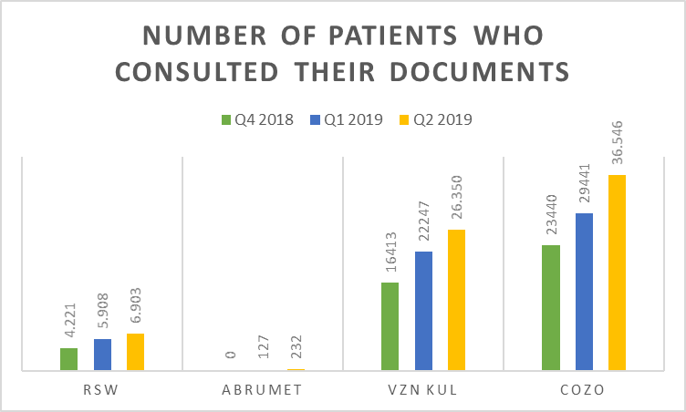
A few numbers

Slide 42
Roadmap 2.0: patients
The patient himself/herself can add information, through the consolidation platform, in the secure vault, through a hub or in a secure cloud.
All the information from the hubs, the vaults, the consolidation platform, and potentially the secure cloud constitutes the patient's PHR (Personal Health Record)
Through the consolidation platform, other relevant information is also available from the health insurance funds, the Crossroads Bank for Social Security and other relevant sources such as the declarations of will on organ donation or euthanasia.

Slide 43
Roadmap 2.0: patients
The patient has access to his PHR through various channels, e.g. through an app on his smartphone; this allows the patient to be informed of his actual condition and to play a leading role in his treatment

Slide 44
Roadmap 2.0: patients
In principle, the patient no longer receives any paper from the physician (except for exceptional demands)
The certificate of the provided care is sent electronically by the physician to the health insurance fund
the medication prescription is available through the Personal Health Viewer
…
Prior requirement for the above: the patient gives his data sharing consent

Slide 45
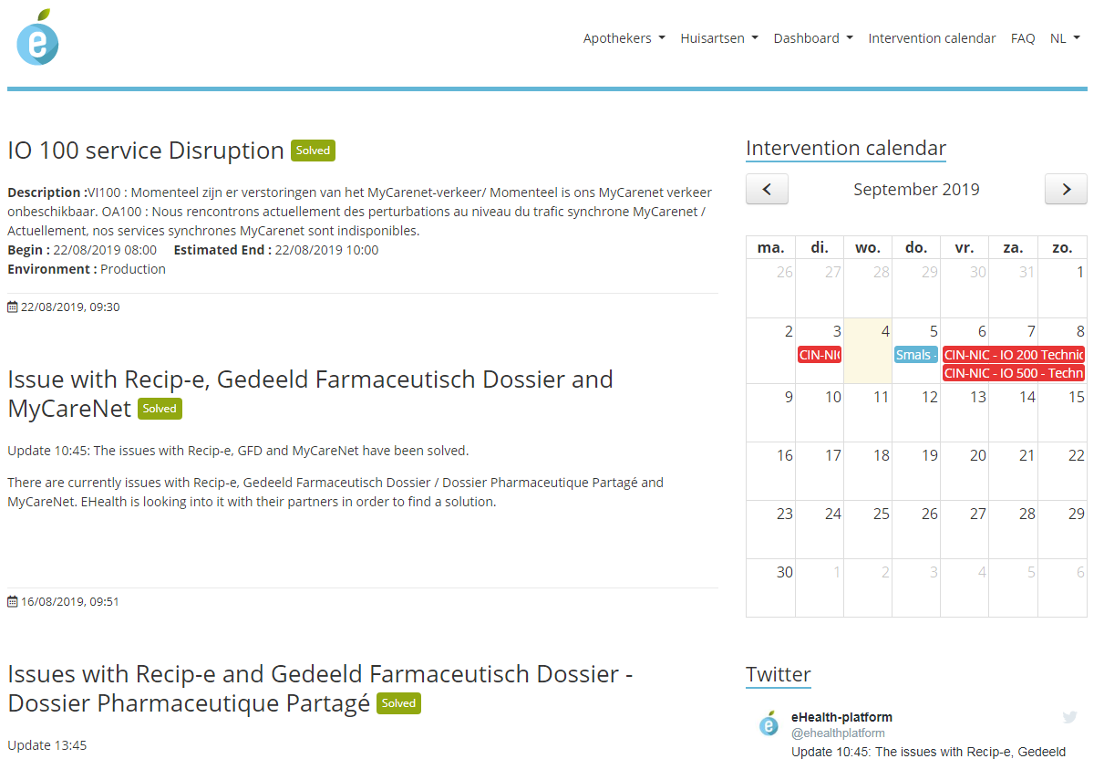
www.status.ehealth.fgov.be

Slide 46
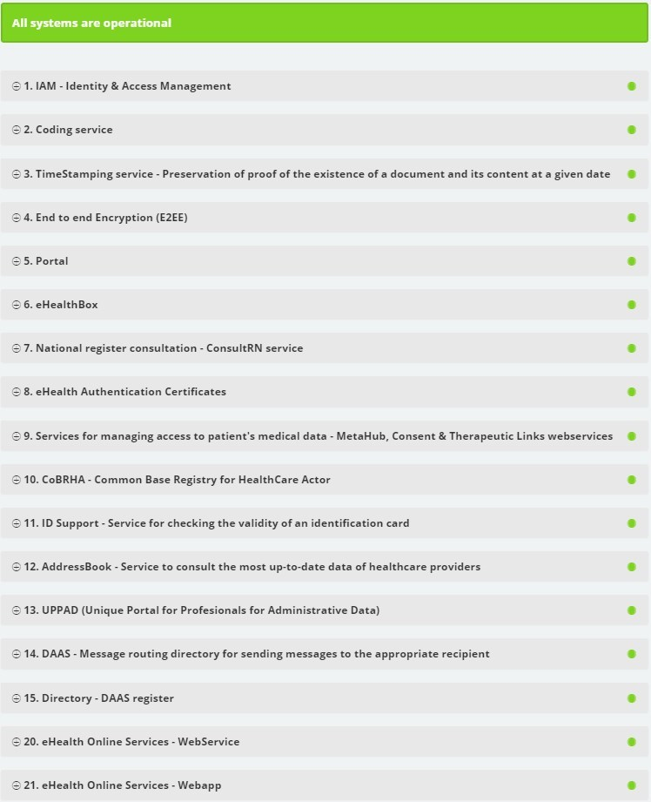

Slide 47
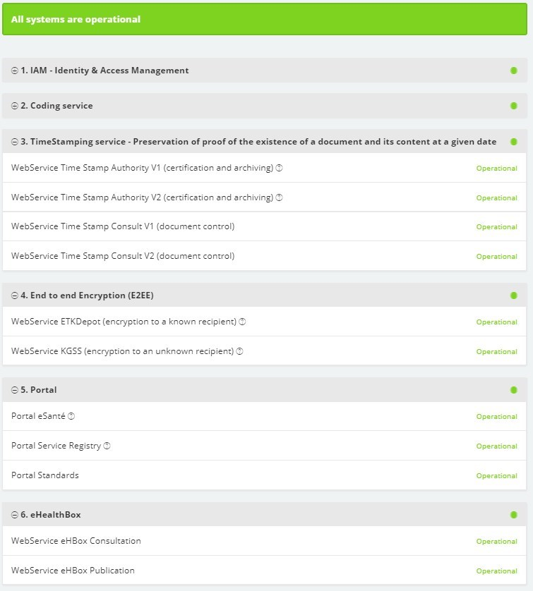

Slide 49
Interim conclusion
Data sharing between health care providers / institutions through the hub-metahub system, the health vaults and the eHealthBox reached cruising speed (> 13.3 billion transactions through the eHealth platform in 2018)
> 75% of the Belgian population has now given its consent for data sharing
Ensuring health data availability to the patient has started => attention for integrated access
Experience has been acquired with mobile eHealth applications

Slide 50
Roadmap 3.0 - Fundamentals (1/2)
0.1 Data sharing consent: should the existing data sharing consent evolve? what does this mean for the basic services and the organisational framework?
0.2 Access matrix, therapeutic, care and other relationships: should the existing access matrix and the electronic credentials of therapeutic, care or other relationships evolve? what does this mean for the basic services and the organisational framework?
0.3 Basic service user and access management: should the existing basic service user and access management evolve? what does this mean for the basic services and the organisational framework?
0.4 Rules for ‘eHealth vaults’ and separation of duties between authentic sources: should the existing division of tasks between the authentic sources and the rules for ‘eHealth vaults’ evolve? what does this mean for the basic services and the organisational framework?

Slide 51
Roadmap 3.0 - Fundamentals (2/2)
0.5 Information standards: the further development of eHealth will predominantly be based on open, state-of-the-art international standards, with reasonable safeguards on backward compatibility
0.6 Terminology: the information exchange between eHealth systems requires standardised information encodings
0.7 CoBRHA Next Generation & UPPAD: in order to increase the added value of the existing CobrHa system in terms of process quality and efficiency, additional functionalities such as history or publish-and-subscribe are required
0.8 Strategic research into efficient collaboration models with external stakeholders: the healthcare providers, the organisations operating in the healthcare sector and governments need to have a better and greater impact on the development of new and additional functionalities by the software suppliers of eHealth systems

Slide 52
Roadmap 3.0 - Transversal
1.1 Communication: this project focuses on external communication, i.e. communication towards health care actors, health care institutions, organisations operating in the health or care sector, software developers and citizens
1.2 Program monitoring: this project focuses on monitoring the use of the delivered systems by end users and eHealth services and aims to build a consistent and uniform collection of functional user data

Slide 53
Roadmap 3.0 - Support
2.1 Incentives: since the start of the 2013-2018 Action Plan, some groups of health care providers have received incentives for the use and meaningful application of eHealth; these incentives also remain a useful method of achieving the objectives in the eHealth Action Plan 2019-2021, e.g. to encourage the use of univocal terminology.
2.2 Code of conduct & guidelines on sharing personal health information: there is a need to develop codes of conduct and good practice for sharing personal health data

Slide 54
Roadmap 3.0 - Operational excellence (1/3)
3.1 Basic architecture: the basic architecture of the eHealth applications was elaborated 10 years ago; it is advised to evaluate the architectural choices and, if necessary, to adjust them
3.2 SLA and service management: eHealth services must be permanently and efficiently available, both for end-user applications and for the different sub-systems and services; this will be transparently reported
3.3 Business continuity: even if interventions are carried out on parts of the eHealth system or incidents occur, health care providers and health care institutions must have minimum functionalities at their disposal; the continuity of their basic functioning must be guaranteed by means of business continuity procedures

Slide 55
Roadmap 3.0 - Operational excellence (2/3)
3.4 Documentation, help desk & support: in case of problems with or questions about the use of eHealth services that are integrated into ICT solutions, there is a need to support eHealth services in order to solve problems in a smooth and adequate way; if several eHealth services or partners are involved, the need is mainly to coordinate the realisation of a solution
3.5 Test environments, flows, processes, data: the aim is to develop an integrated test environment for software suppliers, the ICT departments of health care institutions and the developers of value-added services
3.6 Quality of health software: in order to ensure the quality of commercial eHealth software, explicit and clear quality indicators and their validation are needed; the provider should supply, through appropriate tools, the necessary information that gives a clear view of the "quality" of the product offered

Slide 56
Roadmap 3.0 - Operational excellence (3/3)
3.7 Education and training: the federated entities offer education and training via partners, so that health care providers and social workers can apply eHealth in daily practice; they do this for specific projects of the federated entities, but also for projects of the federal government
3.8 Administrative workload reduction for health care providers: the adoption of eHealth services by health care providers and health care institutions is hampered by the increased reporting requirements of public services; this project is based on the perspective of the users, it identifies and reduces the existing reporting burden

Slide 57
Roadmap 3.0 - Health care providers and institutions (1/5)
4.1 Multidisciplinary information exchange: this project should ensure that patient information can be exchanged digitally between health care providers, both from the same profession and from different professions
4.2 Multidisciplinary functionalities: in addition to the multidisciplinary information exchange, there is a need for functionalities allowing an efficient multidisciplinary and transmural functioning of all health care providers involved, including the patient and informal carer: a journal, a multi-disciplinary care plan, ...
4.3 Electronic prescription: in order to ensure the generalised use of the electronic prescription, additional aspects such as dematerialisation and integration into the Personal Health Viewer must be developed

Slide 58
Roadmap 3.0 - Health care providers and institutions (2/5)
4.4 VIDIS – evolution of the electronic prescription : effective and efficient data and information sharing on all aspects of pharmaceutical treatment should be achieved by integrating the data available in existing systems and improving the orchestration of medicine related processes
4.5 Decision support platform: quality improvement through the use of decision support systems can be organised efficiently by a central platform
4.6 BelRAI in execution of the eHealth action plan 2015-2018, the web application BelRAI 2.0 was developed and made available to all health care providers; additional steps are needed in terms of use of the BelRAI instrument by health care providers, the use of BelRAI data outside a care context, training of users, the cooperation with software suppliers,...

Slide 59
Roadmap 3.0 - Health care providers and institutions (3/5)
4.7 Incapacity for work at present, various types of certificates must be sent to the employer, to an external company responsible for the administration of the certificates, to the employer's medical service or to the health insurance funds; Mult-eMediatt allows the GP's software to send an electronic standardised certificate of incapacity for work
4.8 MEDEX: MEDEX doesn’t use available eHealth systems; in terms of data and processes there are clear overlaps and additions to the Electronic Patient Record of every citizen
4.9 EPR in all institutions: a program was launched in 2016 to ensure that all hospitals would rapidly have an integrated EPR in production and use it, but the roll-out and use of an EPR in all hospitals has not yet been completed

Slide 60
Roadmap 3.0 - Health care providers and institutions (4/5)
4.10 Publication of structured information: the action plan 2013-2018 included the development of a mainly technical infrastructure (including a hub/meta-hub) allowing health care institutions to publish medical information about patients; the publication of patient-related information in a structured format is still insufficiently developed and used
4.11 Registers: there is a lack of insight into whether the data collected in the various registers allows to improve the quality; data that have to be supplied should in principle support a public utility
4.12 Communication about care and care planning: the objective of the Flemish government is to offer a shared digital care and support plan in order to support multidisciplinary cooperation and data sharing in the context of care and welfare

Slide 61
Roadmap 3.0 - Health care providers and institutions (5/5)
4.13 Connecting European Facility Patient Summary: to allow a cross-border exchange of a patient overview, structured and coded information must be available; this is a project conducted by Abrumet and financed by the European Commission in cofinancing with the Brussels-Capital Region
4.14 Modulation of patient access by health care providers: the health care provider’s software must be able to display the patient's accessibility status for a document published on a hub or vault

Slide 62
Roadmap 3.0 - The patient as co-pilot
5.1 Personal health portal: this project is a continuation and extension of the AP10 Personal Health Viewer project of the action plan 2013-2018; through this health portal we want to give people access to their health data that are available digitally, in a quick and easy way, so that they can make conscious choices
5.2 Digital Referral Platform: this project aims to increase the patient's involvement in referrals from one health care provider to another; the electronic referral must be accessible in the Personal Health Viewer so that the patient has the opportunity to change the suggestion or not
5.3 Orgadon: for the management and registration of the living wills concerning organ, tissue and cell donation, citizens will be able to manage their living will through various channels: the general practitioner's software, the municipality, an application available through Personal Health Viewer

Slide 63
Roadmap 3.0 - eHealth and health insurance funds (1/3)
6.1 eAttest for specialists, dentists, physiotherapists & speech therapists: the eAttest service offers the possibility to send the certificates of care provided electronically via the MyCareNet platform to the patient's health insurance fund
6.2 eFac for medical houses, physiotherapists & speech therapists: the eFac service (electronic invoicing) enables any institution or health care provider to transfer electronically via the network, the invoicing file established under the third payer system
6.3 Consultation member data: the 'member data' service offers each institution or care provider the possibility of consulting the information (insurability and derived rights) of the care beneficiary in order to carry out a correct invoicing in the context of the third party payer

Slide 64
Roadmap 3.0 - eHealth and health insurance funds (2/3)
6.4 Digitisation of rehabilitation agreements: in the case of functional rehabilitation of a patient, the responsible hospital must submit a request for agreement to the Medical Council of the insurance fund. In 2016/2017, the health insurance funds carried out an opportunity study to consider digitising some of these requests.
6.5 Digitisation of Chapter IV agreements: the service for the request and consultation of agreements on medicines in Chapter IV is available to general practitioners and specialists (requests and consultation) and to pharmacists and hospitals (consultation); the consultation service will be available to hospitals and will be adapted to the specific characteristics of the DB SAM V2 (NIHDI project)

Slide 65
Roadmap 3.0 - eHealth and health insurance funds (3/3)
6.6 Subscriptions to medical houses: an electronic service is made available to medical houses to register or deregister a patient
6.7 Digitisation of physiotherapy agreements: the aim is to offer the physiotherapy sector electronic services for the communication of notifications and requests for agreements

Slide 66
frank.Robben@ehealth.fgov.be
@FrRobben
https://www.ehealth.fgov.be
https://www.ksz.fgov.be
https://www.frankrobben.be

