Slide 1
eHealth in Belgium: status questionis and applied methodology

Slide 2














Status questionis
History via the SumEHR and hubs/metahub
Online advice and guidelines
Medical
Electronic prescriptions
Medication schedule
Lab results and results of medical imaging
Electronic referrals

Slide 3





Status questionis
Rate setting
& invoicing
SumEHR,
medication schedule,
... updates
Adminis-trative
Create and send certificates
Registrations
Send report to GMF holder

Slide 4








Overall architecture
Patients, health care providers
and health care institutions
Site Ministry
Software health care professional
Software health care institution
VAS
Site RIZIV
VAS
eHealth-portal
MyCareNet
VAS
VAS
VAS
users
Basic services
eHealth-platform
Network
AS
AS
AS
AS
AS
AS
Suppliers
Notes:
4
4

Slide 5
Basic services
Coordination of the electronic processes
Portal
Integrated user and access management system
Management of loggings
System for end-to-end encryption
eHealthBox
Timestamping
Coding and anonymising
Consultation of National register and CBSS registers
Reference directories (hub-metahub system)

Slide 6
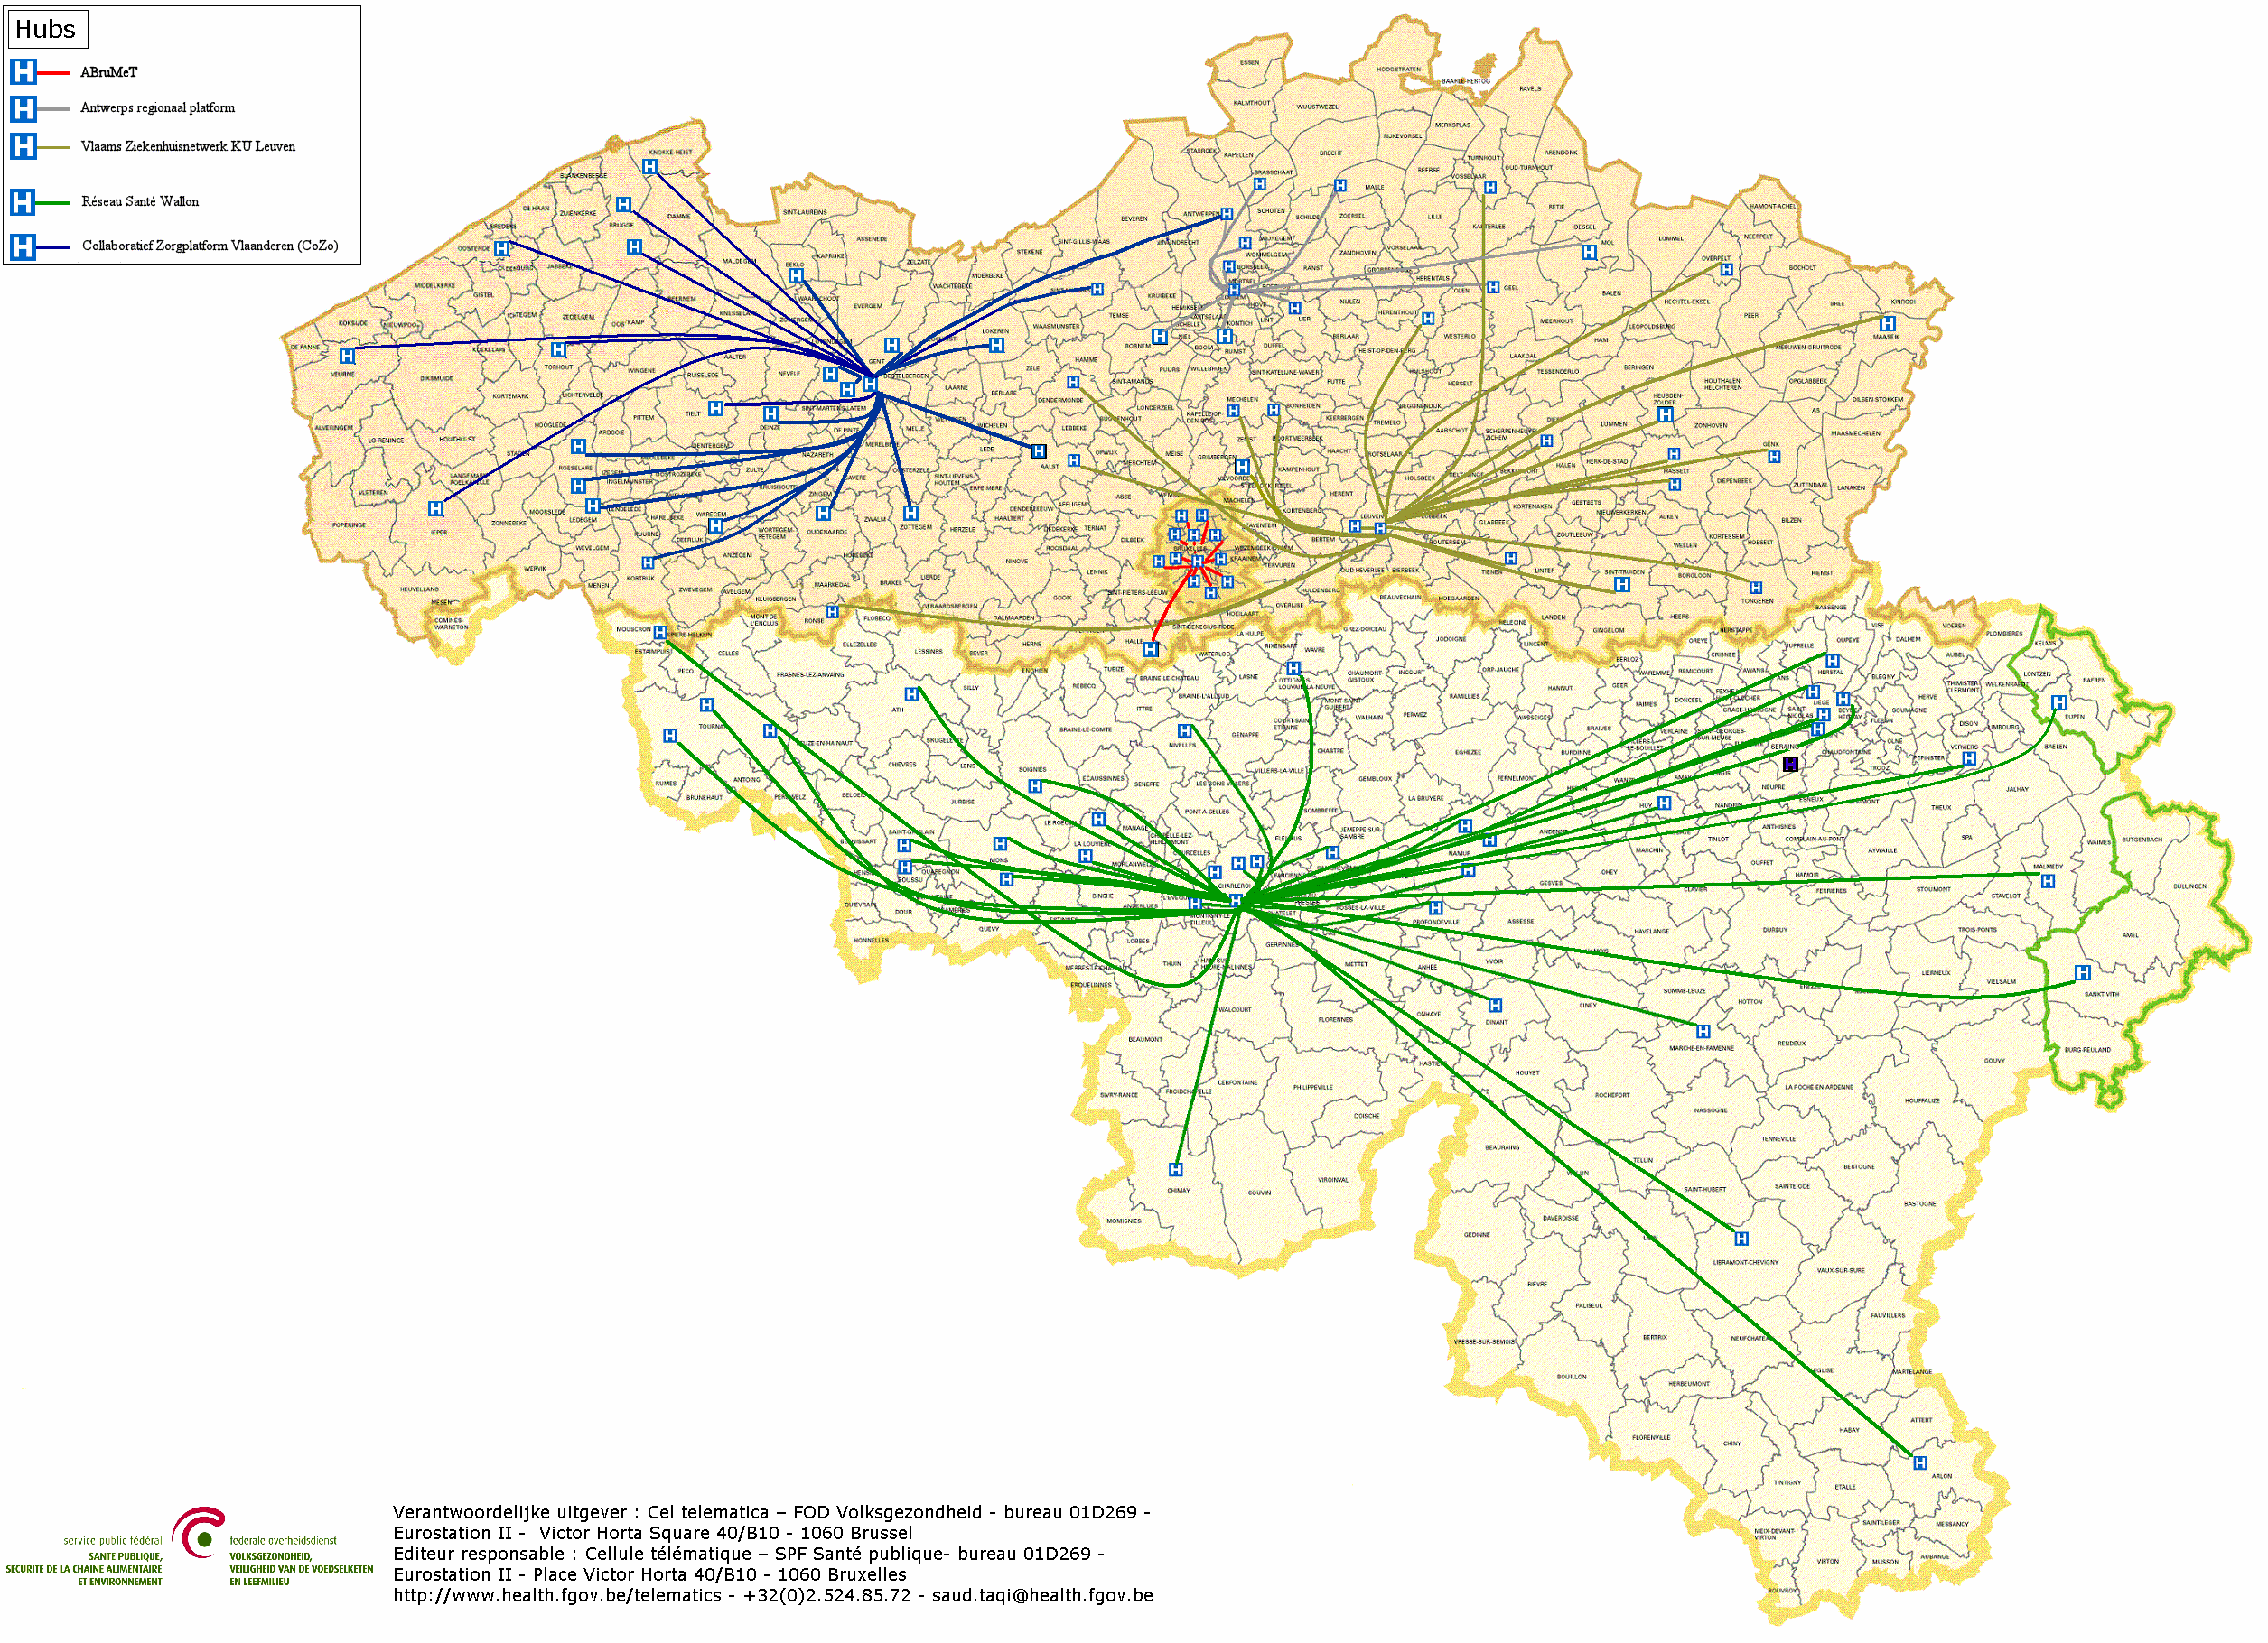

Hubs & metahub
        5 hubs
        Collaboratief Zorgplatform (Cozo)
        Antwerpse Regionale Hub (ARH)
        Vlaams Ziekenhuisnetwerk KU Leuven (VZN)
        Réseau Santé Wallon (RSW)
        Réseau Santé Bruxellois (RSB)

Slide 7








Hubs & metahub
3. Retrieve data from hub A
A
1: Where can we find data?
2: In hub A and C
4:
All data available
3: Retrieve data from hub C
C
B

Slide 8





Health vaults
A
InterMed
BruSafe
C
B

Slide 9

Personal health viewer: MaSanté

Slide 10
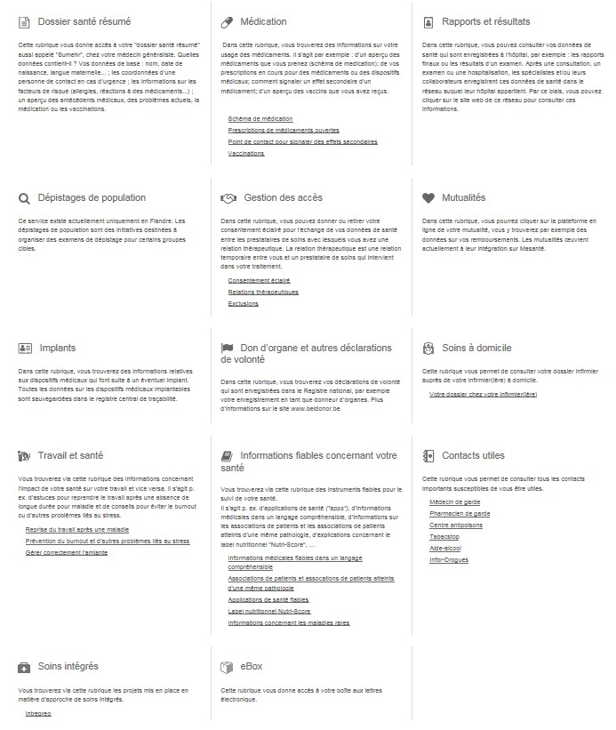
Personal health viewer: MaSanté

Slide 11

Personal health viewer: MaSanté

Slide 12
Triennial roadmaps
principles
  cooperation: coalition of the willing
  involvement of all stakeholders
  empowerment of all stakeholders
  reliable basic services and business continuity actions
  simplification where possible
  emphasis on concrete results rather than on everlasting discussions
  steady progress because of SMART goals and action points
  multidisciplinary approach, including training and financial aspects
  basis for synergies necessary for high-quality and affordable health care

Slide 13
Roadmap 2019-2021: 44 projects
0 Fundamentals
1 Transversal
2 Support
0.1 Data sharing consent
0.2 Access matrix, therapeutic, care and other relationships
0.3 Basic service user and access management
0.4 Rules for ‘eHealth vaults’
0.5 Information standards
0.6 Terminology
0.7 Cobrha Next Generation & UPPAD
0.8 Strategic research on collaboration model with software providers
1.1 Communication
1.2 Program monitoring
2.1 Incentives
2.2 Code of conduct & guidelines on sharing personal health information
3 Operational excellence
4 Health care providers and institutions
5 Patient as co-pilot
3.1 Basic architecture
3.2 SLA and service management
3.3 Business continuity
3.4 Documentation, help desk & support
3.5 Test environments, flows, processes, data
3.6 Quality of health software
3.7 Education and training
3.8 Administrative workload reduction for health care providers
4.1 Multidisciplinary information exchange
4.2 Multidisciplinary functionalities
4.3 Electronic prescription
4.4 VIDIS – evolution electronic prescription
4.5 Decision support platform
4.6 BelRAI
4.7 Incapacity for work
4.8 MEDEX
4.9 EPF in all institutions
4.10 Publication of structured information
4.11 Registers
4.12 Communication about and planning of care
4.13 Connecting Europe Facility Patient Summary
4.14 Modulation of patient access by health care providers
5.1 Personal health portal
5.2 Digital Reference Platform
5.3 Orgadon
6 eHealth with health insurance funds
6.1 eAttest for specialists, dentists, physiotherapists & speech therapists
6.2 eFac for medical houses, physiotherapists & speech therapists
6.3 Consultation member data
6.4 Digitisation of rehabilitation agreements
6.5 Digitisation of Chapter IV agreements
6.6 Subscriptions to medical houses
6.7 Digitisation of physiotherapy agreements

Slide 14
eHealth platform
cooperative management by all stakeholders
tasks
  development of a common vision and strategy for eHealth
  organization of the cooperation between all actors
  being the motor of the necessary changes
  determination of functional and technical norms, standards, specifications and basic architecture (API-economy)
  registration of software
  management of a cooperation platform for secure electronic data exchange with the relevant basic services
  divsions of tasks
  acting as an independent trusted third party (TTP) for the encoding and anonymisation of personal information regarding health in order to support scientific research and policymaking
  promoting and coordinating programmes and projects

Slide 15
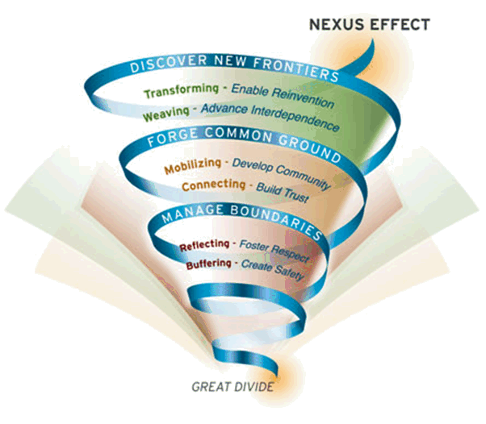
Nexus effect
Bron: MIT Sloan

Slide 16
Conclusion
data sharing between health care providers / institutions through the hub-metahub system, the health vaults and the eHealthBox reached cruising speed (> 13.3 billion transactions through the eHealth platform in 2018)
> 75% of the Belgian population has now given their consent for data sharing
the opening up of health data to the patient begins => attention for integrated access
experience has been acquired with mobile eHealth applications

Slide 17



frank.robben@ehealth.fgov.be
@FrRobben
https://www.ehealth.fgov.be
https://www.bcss.fgov.be
https://www.frankrobben.be

Slide 18
Annex: more detailed status questionis and lessons learned

Slide 19
Status questionis: health care providers
each GP manages an electronic medical file (EMF) for each patient, and publishes and updates a SumEHR (Summary Electronic Health Record) for each patient in a secure health vault (Vitalink, Intermed or BruSafe)
  3,24 million patients possess a SumEHR in a health vault
  SumEHR v2 is being implemented
medicines and medical care are prescribed electronically

Slide 20
Status questionis: health care providers
every hospital, psychiatric institution and laboratory makes certain documents available electronically with a reference in the hub & metahub system, and can access relevant data from the secure health vaults
  > 353 million documents available at general hospitals
  > 24.000 documents available at psychiatric institutions
  > 280.000 document available at extramural laboratories
  about almost the entire population
  documents were consulted > 3,4 million times in the 1st quarter of 2019
  by nearly 52.000 different health care providers

Slide 21
Status questionis: health care providers
each hospital has an integrated, multi-disciplinary electronic patient file (EPF)
  77 % of the hospitals have a strategic ICT plan
  75% of the hospitals have a long-range ICT budget
  85% of the hospitals have an ICT governance structure
an EPF has been defined for all other types of health care providers and they can also publish and update certain information from their EPF in the secure health vault
  available for home nurses and physiotherapists, for whom an updated version is being developed

Slide 22
Status questionis: health care providers
pharmacists publish information about the delivered medicines in the Shared Pharmaceutical File (SPF), which feeds the medication schedule; the patient's medication schedule is also stored in the secure vault and is shared between physicians, pharmacists, home nurses and hospitals, among others
the general practitioner has access through his EMF to all relevant published medical information about his patients

Slide 23
Status questionis: health care providers
any other health care provider has access to all relevant, published information on his/her patients; for this purpose, filters are defined; the information can also be completed in a multidisciplinary approach
the aim is to ensure that a maximum of medical information is created and published in a structured and semantically interoperable way

Slide 24
Status questionis: health care providers
all health care providers can communicate with each other through the eHealthbox; a number of electronic standard forms are made available for this purpose
health care providers can apply telemedicine using officially registered mobile health applications; this registration is subject to a number of checks in terms of data protection, interoperability, EU label for medical devices and evidence-based medicine (EBM)
  see https://mhealthbelgium.be/
  8 apps are now registered on level M1

Slide 25
Status questionis: health care providers
the registers have been optimised and standardised and, as far as possible, registration is carried out automatically from the EMF/EPF
  connectors are made available by HealthData
  remains an action point in the roadmap 2019-2021
    there is a lack of insight into whether the information collected in the various registers has a quality-enhancing effect
    provided data must support a public benefit

Slide 26
Status questionis: health care providers
tracing of implants and medicines is done according to international standards
all data exchange between health care providers and health insurance funds is done electronically
  carried out by general practitioners
    consultation of the insurability
    chapter IV agreements
    eFac (invoice files)
    eAttest (certificates of care provided)
  several action points in the roadmap 2019-2021

Slide 27
Status questionis: health care providers
the health care providers receive incentives for the use and meaningful application of eHealth; financial incentives can have both a federal component and a component from the different communities and regions
every health care provider is trained in eHealth, both through the basic education package and through post-graduate training
each health care provider has a one-stop shop for the communication of all administrative information for the NIHDI, the FPS Public Health and the federal entities ("only once" principle).

Slide 28
Status questionis: patients
the patient has access to the information about himself that is available in the secure health vaults and through the hub & metahub system
the feasibility of providing a consolidation platform where all patient information is aggregated with analysis tools and translation tools to facilitate the patient's understanding of his file is being explored; this will contribute to the patient's health literacy

Slide 29
Status questionis: patients
the patient can add information himself, through the consolidation platform, in the secure vault, through a hub or in a secure cloud
all the information from the hubs, the vaults, the consolidation platform, and potentially the secure cloud constitutes the patient's PHR (Personal Health Record)
through the consolidation platform, other relevant information is also available from the health insurance funds, the Crossroads Bank for Social Security and other relevant sources such as the declarations of will on organ donation or euthanasia

Slide 30
Status questionis: patients
the patient has access to his PHR through various channels, e.g. through an app on his smartphone; this allows the patient to be informed of his actual condition and to play a leading role in his treatment
in principle, the patient no longer receives any paper from the physician (except for exceptional demands)
  the certificate of the care provided is sent electronically by the physician to the health insurance fund
  the medication prescription is available through the Personal Health Viewer
  …
prior requirement for the above: the patient gives his data sharing consent

Slide 31
Lessons learned
define a long term vision on
  integrated, customer-oriented service delivery
  management of information as a strategic resource
  service oriented architecture
  interoperability
combine long term vision, profound process optimization and quick wins
do not look at eHealth as a pure ICT event, but put the emphasis on an improvement of services and use a multidisciplinary approach
optimize processes within each actor and between actors before their automatization

Slide 32
Lessons learned
see to a close cooperation with policymakers, health care providers, patient organizations, sickness funds, ICT-providers, government institutions at all levels, …
attune the service offer maximally to the needs and the logic of the users and involve them actively in the development of the services
match the governmental processes with the own processes of the actors and assure user-friendliness
concentrate on a qualitative and interactive service offering, instead of a mere presence on the web

Slide 33
Lessons learned
standardize concepts and, where necessary, adapt regulations in order to introduce those concepts
also regulate aspects such as
  privacy protection
  information security
  the protection against ICT crime
  unique identification keys
  the probative value of electronic information
  the electronic signature
  …

Slide 34
Lessons learned
make sure that available ICT components and information (networks, data bases, …) are re-used to a maximum; through this, the efforts can be directed towards developing added value services
also develop multifunctional components yourself, conform open standards, and based on a flexible, modular, expandable and service-oriented architecture, so that other developers of services can re-use your components
pay attention to change management, communications and training
see to a good project management

Slide 35
Lessons learned
work incrementally and with prototyping, and give special attention to the roll-out by providing test and simulation environments, training and coaching for the users, and a multimodal contact centre for the personal support of end-users
see to it that proper measuring facilities are available, so as to assure permanent monitoring and improvement
make sure that the users have confidence in the electronic services that are provided; develop an information security policy, which is designed to guarantee the availability, confidentiality, integrity, authenticity and auditability of the information systems

Slide 36
Lessons learned
create an institution that stimulates and coordinates
  business process re-engineering within and across actors
  being a mediator and enabler setting out a long term roadmap for eHealth services
  proactively looking for opportunities in technology and innovation to benefit health care providers and patients
  ensuring continuous delivery of shared ICT services and the retention of crucial skills
  program and project management
  co-operative governance (implication of all actors)

