Slide 1
eHealth: basic principles & achievements

Slide 2
Roadmaps on eHealth
2012: round table was organized on the further digitization of the health care sector
  about 300 people in the sector participated
  a concrete eHealth action plan was drawn up for 5 years: roadmap 2013-2018
2015 > update: roadmap 2.0 (2015-2018)
  20 action areas with concrete objectives
2019 > roadmap 3.0 (2019-2021) has been elaborated with a focus on, amongst others
  operational excellence: availability, performance, quality, chain supervision, usability, training…
  applications for citizens
  support for innovation
  international standards & terminology
  …

Slide 3



Roadmap eHealth 2.0

Slide 4
Roadmap eHealth 2.0
Systems & information flows between health care actors
  AP 1: GMF = EMF => SumEHR
  AP 3: medication schedule
  AP 4: electronic prescribing
  AP 5: data sharing via the system hubs & metahub by general and university hospitals
  AP 6: sharing data for improved cooperation
  AP 7: psychiatric and other institutions and the system hubs & metahub
  AP 8: implementation of a uniform assessment instrument (BelRAI)
  AP 14: MyCarenet

Slide 5
Roadmap eHealth 2.0
Optimization of processes
  AP 10: access to the data by the patient
  AP 15: administrative simplification
  AP 16: traceability of implants and medicines
  AP 19: mobile health
Information for research & policy support
  AP 18: inventory and consolidation of registers

Slide 6
Roadmap eHealth 2.0
Support & Incentives
  AP 2: hospital EPF
  AP 9: incentives for use
  AP 11: communication
  AP 12: training and IT support for health care providers
  AP 20: governance, roll out and monitoring
Basic systems
  AP 13: standards and terminology policy
  AP 17: general use of eHealthBox and data from health care providers available in CoBRHA

Slide 7
Roadmap eHealth 2.0
Focus on
  GMF = EMF => SumEHR
  hospital EPF
  data sharing / hubs & metahubs
  eHealthBox & UPPAD
  electronic prescribing
  MyCareNet
  access to the data by the patient
  mobile health

Slide 8
GMF = EMF => SumEHR
In order to guarantee the quality of the care and to inform the patient correctly, the general practitioner (GP) registers the medical data in an EMF (Electronic Medical File)
The EMF is the authentic source for data sharing by GPs
The SumEHR (SUMmarized Electronic Health Record) is a concise summary of the EMF in a structured and coded form that is stored in a well protected health vault with 24/7 availability

Slide 9
GMF = EMF => SumEHR
Each patient is entitled to having a SumEHR, if desired
The information in the SumEHR is, with the patient’s consent, accessible to any physician having a therapeutic relation with the patient, and to the patient himself
Use of the SumEHR for out-of-hours GPs and emergency departments is being prioritized

Slide 10
GMF = EMF => SumEHR
Objectives 01/01/2020
  GP’s: approval of the legal basis by The National Commission of Representatives of Physicians and Sickness Funds
    every general practitioner has to use a recognized software package with the possibility to register an EMF for each patient
  other health care providers
    definition of the EMF
    publication and update of certain information in the secure ‘health vaults’

Slide 11
Hospital EPF
EMF = electronic medical file > general practitioners
EPF = electronic patient file > health care providers in general
Integrated EPF is a tool that is necessary for
  better quality / continuity in the health care sector
  administrative simplification (paperless)
  cost reduction (avoiding unnecessary examinations)
  policy support for authorities and hospitals

Slide 12
Hospital EPF
Integrated EPF has to contain (para)medically relevant data on a patient (consultation, hospitalization, emergency admission), that is accessible everywhere (intramural and extramural) and at any time
Integrated EPF = interoperable system with
  clinical data on patients
  health care data on patients (medical, nursing)
  data on invoicing, pricing, reimbursement
  administrative data
  management of the planning of consultations, the operation theatre, …
  hotel service
  etc

Slide 13
Hospital EPF
Simplification of the previous ICT financing method in 3 parts
Phasing but rewarding early adopters
Impossible and imaginary to define the contents/categories of one single EPF for all hospitals at once (size, type of personnel, etc)
Working on the basis of functionalities/goals to be achieved (result commitment)
Use of eHealth value added services
  Belgian Meaningful Use Criteria (BMUC)

Slide 14
Hospital EPF
BMUC – general hospitals
Functionalities | Step 1 | Step 2 | Step 3 | Step 4
1. Unique patient identification and description | 80% | 90% | 95% | 98%
2 List of (active and passive) problems | 20% | 50% | 80% | 98%
3. List of allergies and intolerances | 30% | 60% | 90% | 98%
4. Electronic prescribing of medicines | 30% | 60% | 90% | 98%
5. Drug interactions | No | No | No | Yes
6. Electronic register of administered medicines | 30% | 60% | 90% | 98%
7. Module for nurse care planning | 0% | 30% | 60% | 98%
8. Management of appointments | >0 | >0 | >0 | >0
9. Electronic input of applications for medical imaging, laboratory or advice | 1 in 3 (X-Ray, labo, consultation) 50% pro rata | 2 in 3 (X-Ray, labo, consultation) 50% pro rata | 3 in 3 (X-Ray, labo, consultation) 50% pro rata | 3 in 3 (X-Ray, labo, consultation) 98% pro rata
10. Electronic discharge letter | 80% | 90% | 95% | 98%
11. Registration of vital parameters | 50% | 65% | 80% | 98%
12. Registration of informed consent | >0 | >0 | >0 | >0
13. Registration of the therapeutic consent | >0 | >0 | >0 | >0
14. Medical results server | 80% | 90% | 95% | 98%
15. Electronic communication with HUBs and interaction with eHealth | 80% | 90% | 95% | 98%

Slide 15
Hospital EPF
Contract or Action Plan
Step 1 Meaningful Use Model
Start of
Meaningful Use Model
Action Plan
2016/07
2017/06
2018/01
2019/01

Slide 16
Hospital EPF
  Early Adopters Progressive Budget
  from 0% to 5%
  Accelerator budget:
  = evolutive
  Base per bed = degressive
  from 25% to 10%
  Base per hospital = degressive
  from 20% to 5%

Slide 17
Hospital EPF
Situation 2018
  77 % strategic ICT plan
  75% multiannual budget
  85% governance structure
Objectives 2019
  most hospitals have an integrated EPF in production and are already using it, other hospitals are implementing an integrated EPF that meets the BMUC criteria
  a multiannual strategic ICT plan and budget, and an appropriate governance structure exists in each hospital
  immediate publication of important electronic documents via hubs

Slide 18
Hubs & Metahub
System to make medical data available between health care providers
  consultation and operation reports
  discharge letters
  protocols of medical imaging and results of lab tests
  SumEHRs, medication schedules, … in health vaults
  ...
Objective
  linking regional and local exchange systems of medical data (hubs)
  possibility for health care providers to retrieve and consult the available electronic medical files regarding a specific patient, irrespective of
    the location where these documents are stored
    the location where the health care provider logs into the system

Slide 19
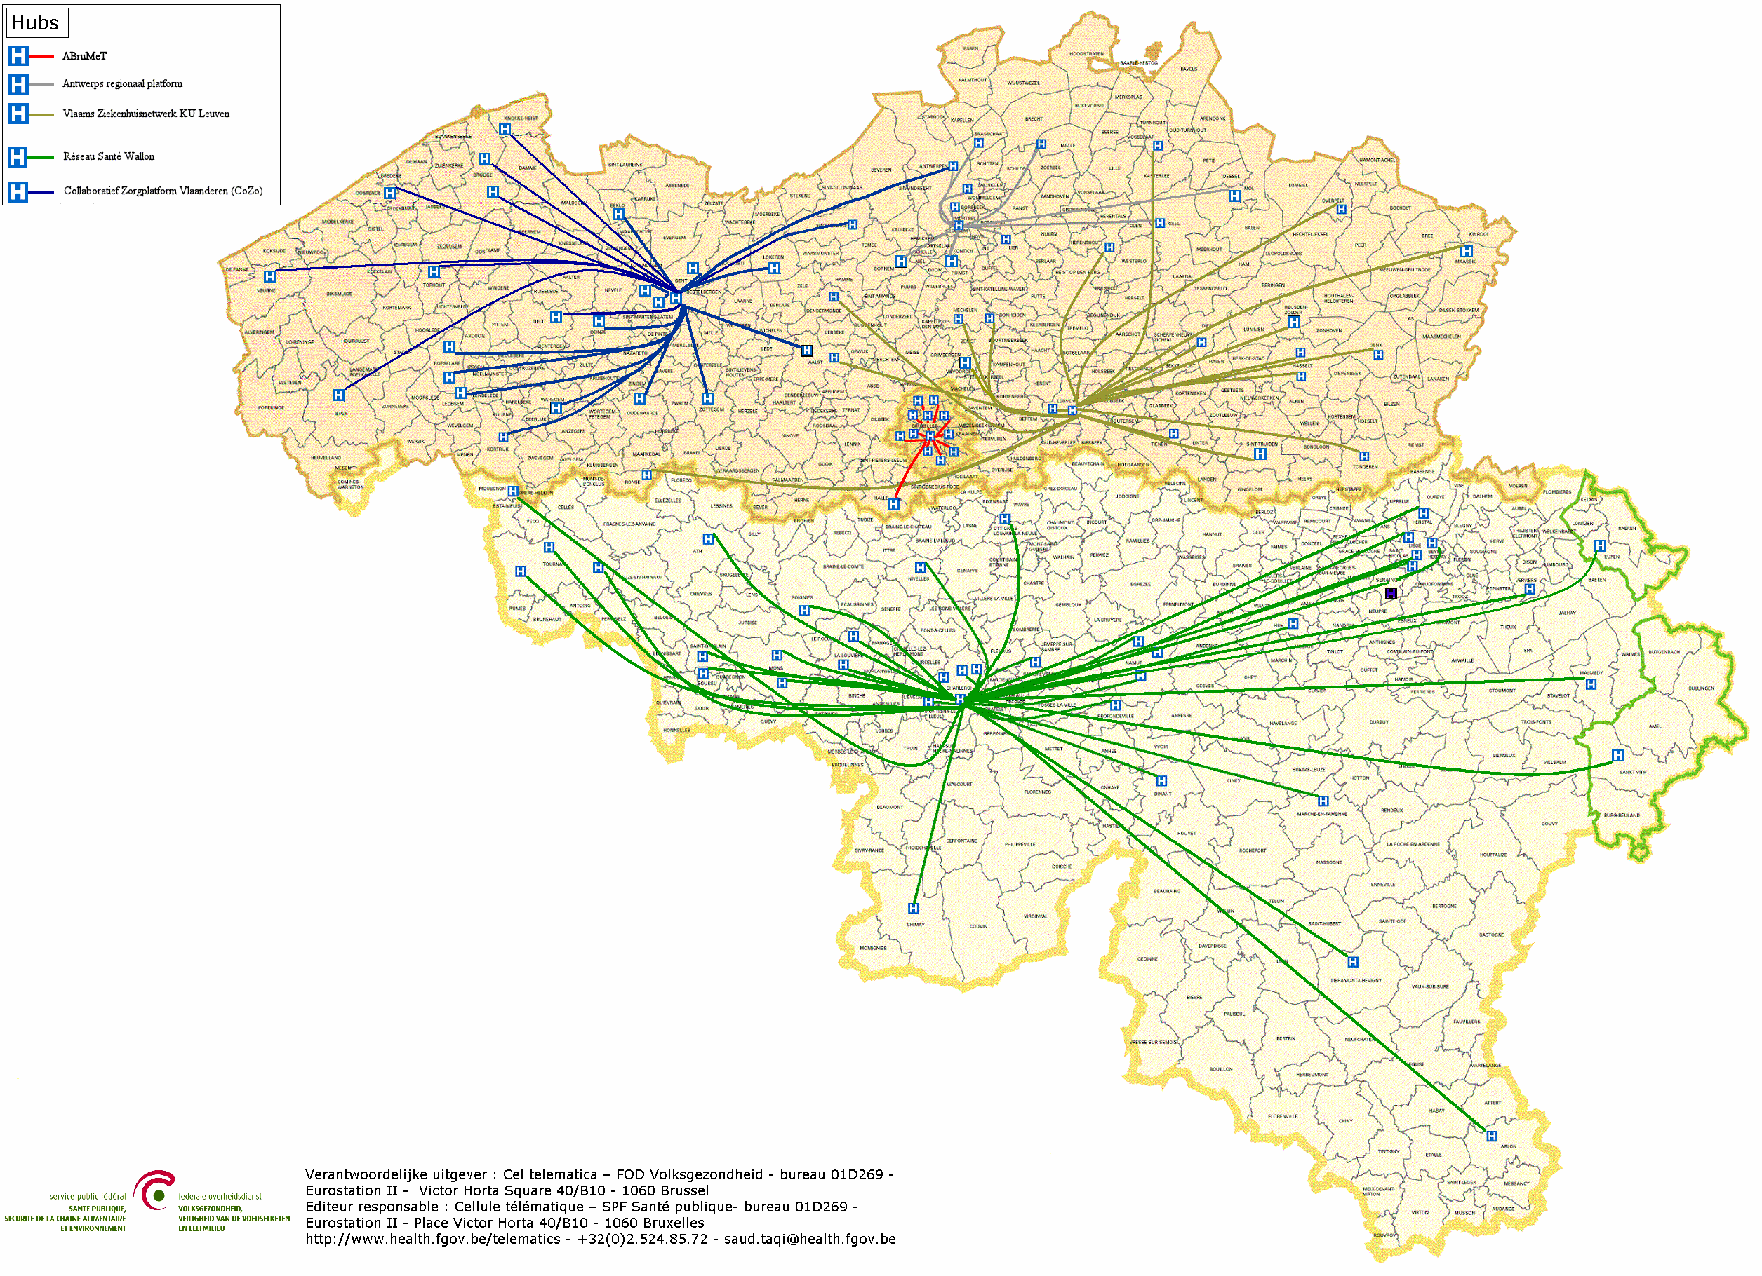

Hubs & Metahub - Scheme
        5 hubs
        The Collaborative Care Platform (in Dutch: Cozo)
        Antwerpian Regional Hub (ARH)
        Flemish Hospital Network KU Leuven (in Dutch: VZN)
        Health Network of Wallonia (in French: RSW)
        Brussels Health Network (in French: RSB)

Slide 20
Hubs & Metahub
Situation 2019
  system for sharing data and documents by general and psychiatric hospitals via the following 5 hubs
    the Collaborative Care Platform (in Dutch: Cozo)
    Antwerpian Regional Hub (ARH)
    Flemish Hospital Network KU Leuven (in Dutch: VZN)
    Health Network of Wallonia (in French: RSW)
    Brussels Health Network (in French: RSB)
  reference to first-line documents (SumEHR, medication schedules...) via the 3 health vaults/metahub
    Vitalink
    InterMed
    BruSafe

Slide 21




Hubs & Metahub – Past situation

Slide 22



Hubs & Metahub - Now
3. Retrieve data from hub A
A
1: Where can we find data?
2: In hub A and C
4:
All data available
3: Retrieve data from hub C
C
B

Slide 23




Extramural data: vaults
A
InterMed
BruSafe
C
B

Slide 24
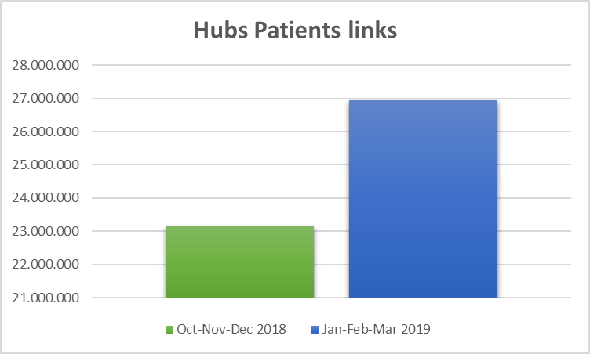
Hubs & Metahub

Slide 25
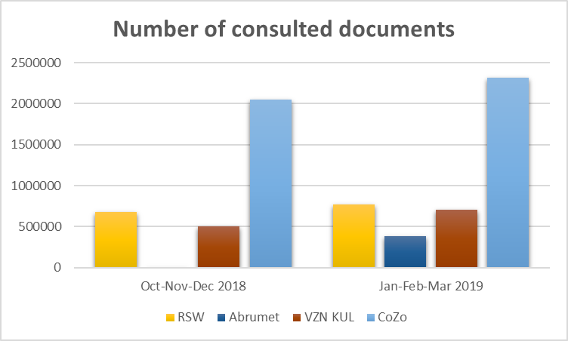
Hubs & Metahub

Slide 26
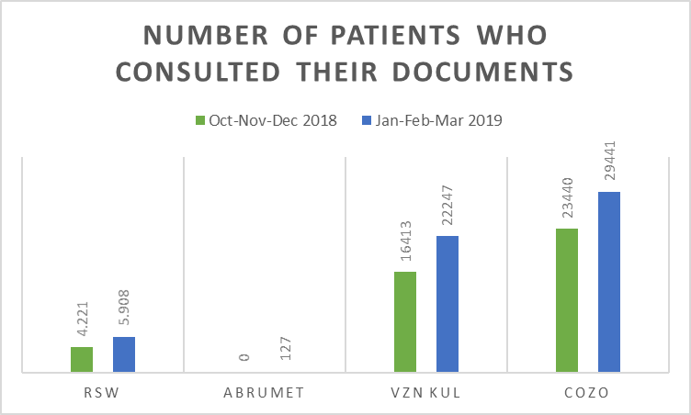
Hubs & Metahub

Slide 27
Data sharing consent
Required condition for the exchange of health data: patient has given his informed consent to share his health data electronically
  regulation has been approved by the various management and advisory bodies of the eHealth platform (Consultation Committee with the users, Board of Directors and Information Security Committee)
  only exchange between health care providers/institutions having a therapeutic/care relationship with the patient
  registration of the consent by the patient himself or through his doctor, pharmacist, health fund or hospital

Slide 28
Data sharing consent
Possibility to exclude a health care provider
Possibility to withdraw the consent
Possibility to modify his permission profile at any time, without any restrictions concerning the modifications
Possibility to see who has entered or modified the informed consent
Permanent support to encourage the registration of consents
    8.345.830 consents on 29/04/2019

Slide 29
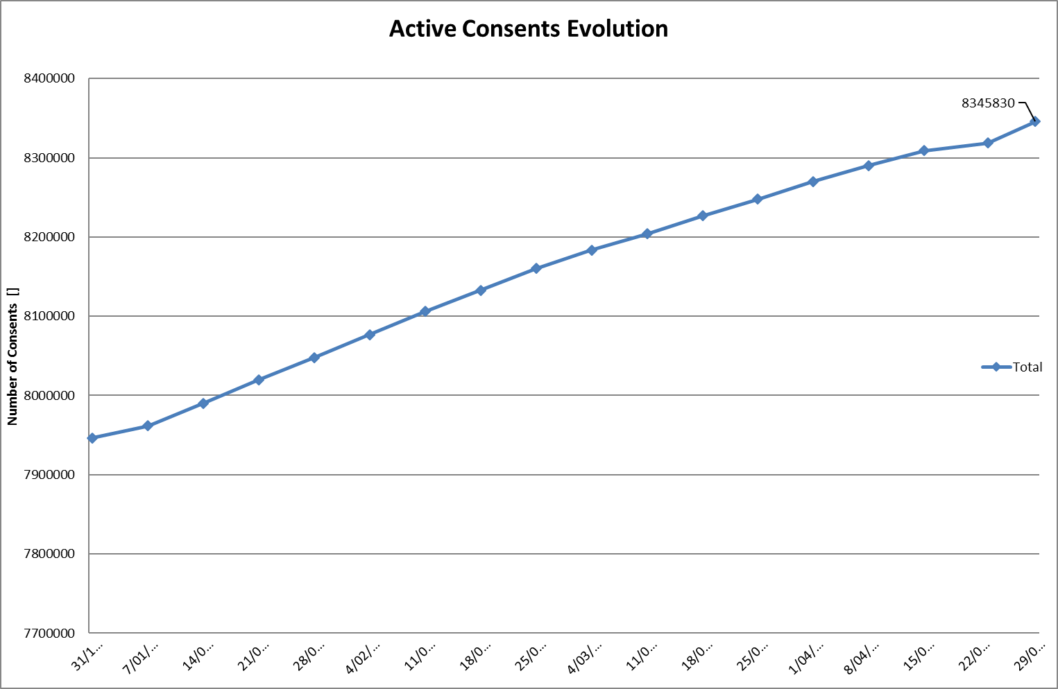
Data sharing consent
Notes:
NL

Slide 30
Therapeutic/care relationships
Definition: the relationship between a specific patient and one or more health care professionals involved in activities concerning diagnosis, prevention or care for the patient
Examples of evidence of a therapeutic/care relationship
  establishment of a GMF with a GP
  consultation with an individual health care provider
  hospitalization
  supply of a medicinal product in a pharmacy
  …

Slide 31
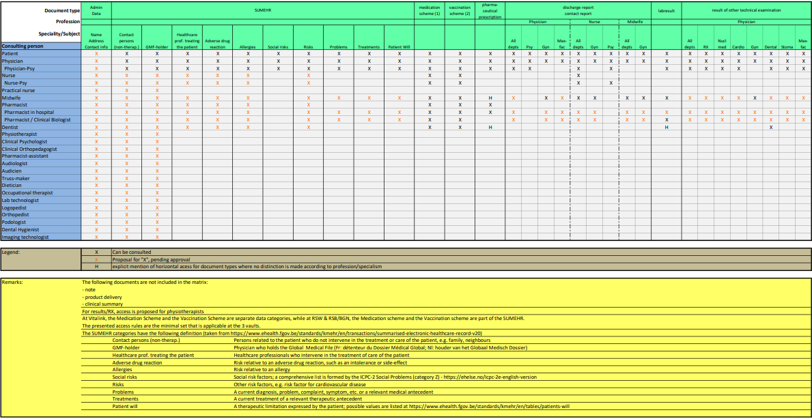
Access matrix

Slide 32
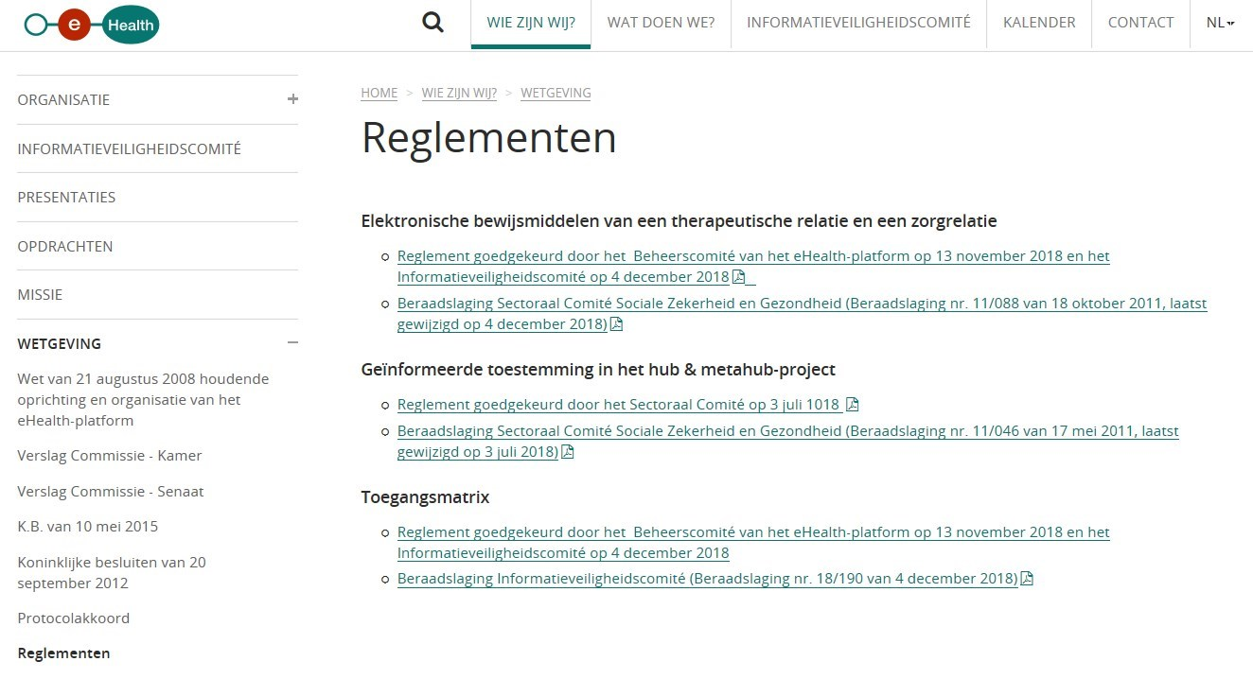
www.ehealth.fgov.be/ehealthplatform/nl/reglementen

Slide 33
eHealthBox, CoBRHA and UPPAD
eHealthBox
  enables secure asynchronic electronic communication of medical and confidential information between health care actors
  generally used by health care actors registered in CoBRHA
CoBHRA
  common database with information about health care providers and care institutions
UPPAD
  enables health care actors to consult / modify / complete specific information themselves
    unique electronic counter (UPPAD)
    address book (CoBRHA database)

Slide 34
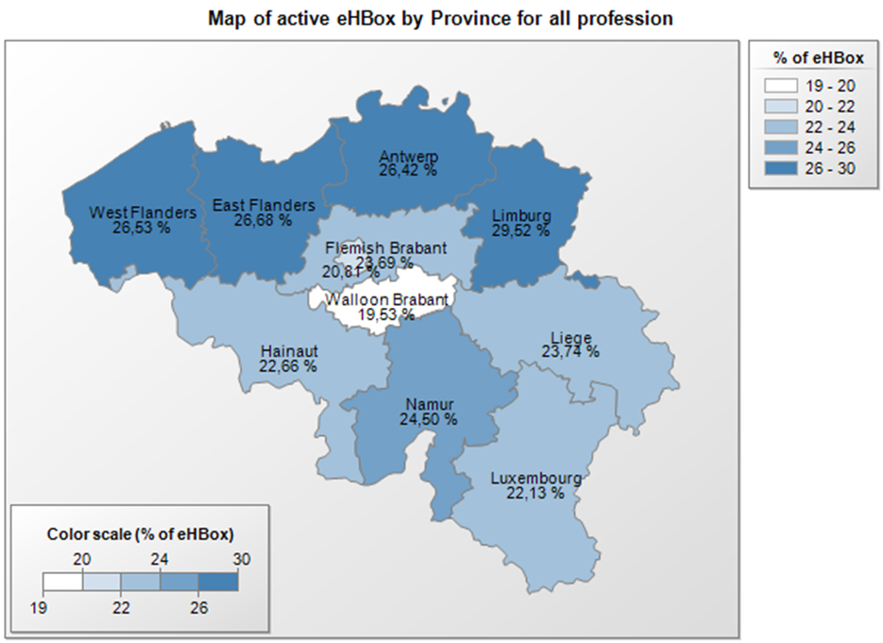
eHealthBox
figures on 29/04/2019

Slide 35
eHealthBox
Address book
  allows senders of messages to health care providers to decide which channel type and which information are the most appropriate
    for communicating medical data > mandatory use of eHealthBox
    for communicating administrative data (internship, recognition…) > using a regular e-mail address allowed and if no data available > shipment by mail (paper)
    available address book data comes from CoBRHA

Slide 36
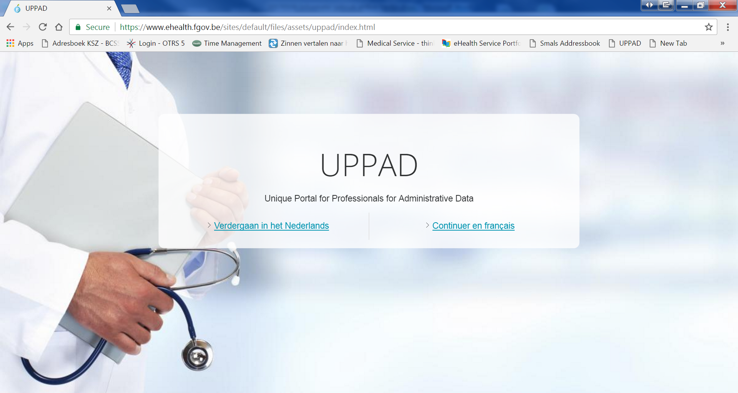
UPPAD

Slide 37
UPPAD
UPPAD → Unique Portal for Professionals for Administrative Data
Central hub (website) where individual health care providers can consult their administrative data (e.g. visa, recognition…) that are known to government bodies (authentic sources)
Information coming from CoBRHA

Slide 38
UPPAD
Possibility to modify specific Authentic Source data yourself (being a health care provider) using underlying applications
Possibility to start up administrative processes electronically (e.g. recognition request) or consult information pages (e.g. procedures on the FPS Public Health website)
UPPAD will not replace applications/procedures that currently exist in various ‘authentic sources’
Health care providers cannot update information directly in UPPAD
  UPPAD merely forwards health care providers to the right application / information available in the authentic sources (= gateway only)

Slide 39
Electronic prescribing (Recip-e)
Current situation
  physician, dentist or midwife who prescribes medication electronically (via software package and the Recip-e service) gives his patient a ‘proof of e-prescribing’ containing a barcode
  by scanning the barcode the pharmacist can download the electronic prescription → only the electronic prescription has legal value
Future situation
  no ‘proof of e-prescribing’ anymore
  authentication of the patient at the pharmacy
  pharmacist and patient have electronic access to all pending electronic descriptions of the patient

Slide 40
Electronic prescribing (Recip-e)
Advantages for pharmacists
  easily download the prescription
  know the reimbursement level of the prescribed medicine
  send feedback to the prescriber
Advantages for prescribers/health care providers
  draw up, consult, send and if needed modify prescriptions that haven’t been provided yet
  delete a prescription that hasn’t been provided yet (if he justifies his decision)
  receive feedback from the health care provider (pharmacist, physiotherapist, nurse)
Advantages for patients
  consult his prescriptions via secure internet access
  delete prescriptions which he finds to be useless

Slide 41
Electronic prescribing
A ‘protocol for the electronic prescription of drugs to ambulatory patients’ describes the conditions and situations allowing the use of paper prescriptions due to force majeure, e.g.
  the urgent need of medical assistance is indisputable
  the prescriber is a foreign citizen without a NISS (or bis) number
  the patient is a foreign citizen without a NISS (or bis) number
  the patient is a newborn waiting for a NISS number
  etc

Slide 42
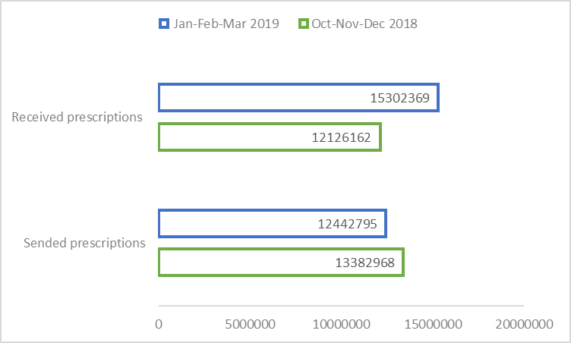
Electronic prescribing
Notes:
NL

Slide 43
PARIS
Prescription & Autorisation Requesting Information System
Free web application made available by software providers at INAMI’s request
  offering minimal service to prescribers for delivering electronic prescriptions outside the Electronic Medical File
  as an online service on the eHealth portal, with strong authentication
  no interaction with the electronic medical file or other data sharing systems

Slide 44
PARIS
Prescription & Autorisation Requesting Information System
Target groups
  prescribers (temporarily) not having access to the software for managing patient records, or to the hospital’s ICT systems
  prescribers not having any software (yet) for managing electronic medical files
    some specialist categories
    occasional prescribers (limited practice only, or no longer medical practitioner in the classic sense – working for insurance companies, administrations, educational organizations, clinical biologists, anatomist-pathologists…)
    older prescribers at the end of their career

Slide 45
MyCareNet
MyCareNet > several applications
  electronic consultation of insurance status by health care providers and institutions
  electronic transfer of third-party invoicing by health care providers and institutions
  medical-administrative flows for the home care sector
  electronic transfer of medical certificates given by health care providers to insurance companies

Slide 46
MyCareNet
MyCareNet ‘Insurance status’
  goal
    enable individual providers and institutions to check insurance information about their patients
  features
    request insurance information on a patient
MyCareNet ‘third-party invoicing’
  goal
    enable individual providers and institutions to transfer third-party invoices to health insurance funds
  features
    upload and transfer third-party invoicing files to a specific health insurance fund
    consult the refund decision for an invoice by a specific sickness fund

Slide 47
MyCareNet
MyCareNet ‘medical-administrative’ flows
  goal
    transfer of medical-administrative documents between health care providers of the home care sector (or their representatives) and insurance companies (medical advisors) to replace or supplement paper documents
  features
    flows concerning
      flat rate requests
      specific requests for palliative care patients
      requests for specific technical acts

Slide 48
MyCareNet
MyCareNet ‘eAttest’
  goal
    to enable care providers to electronically send their medical certificates to insurance companies for patients not making part of the third-party payment system
  features
    service directly linked with the service to check the insurance status
    concerning patients for whom the health care provider is not allowed / not willing to apply the third-party payment process
    service available via web services only > not available on a portal, health care providers need to use their own software

Slide 49
Access to data by patient
Objectives
  creating a framework for access management, consulting and/or adding health data by the patient
  creating a governance structure watching over the execution of the framework
  developing a communication strategy to inform citizens/patients about online health information access and other functions for patients regarding data sharing

Slide 50

Access to data by patient

Slide 51
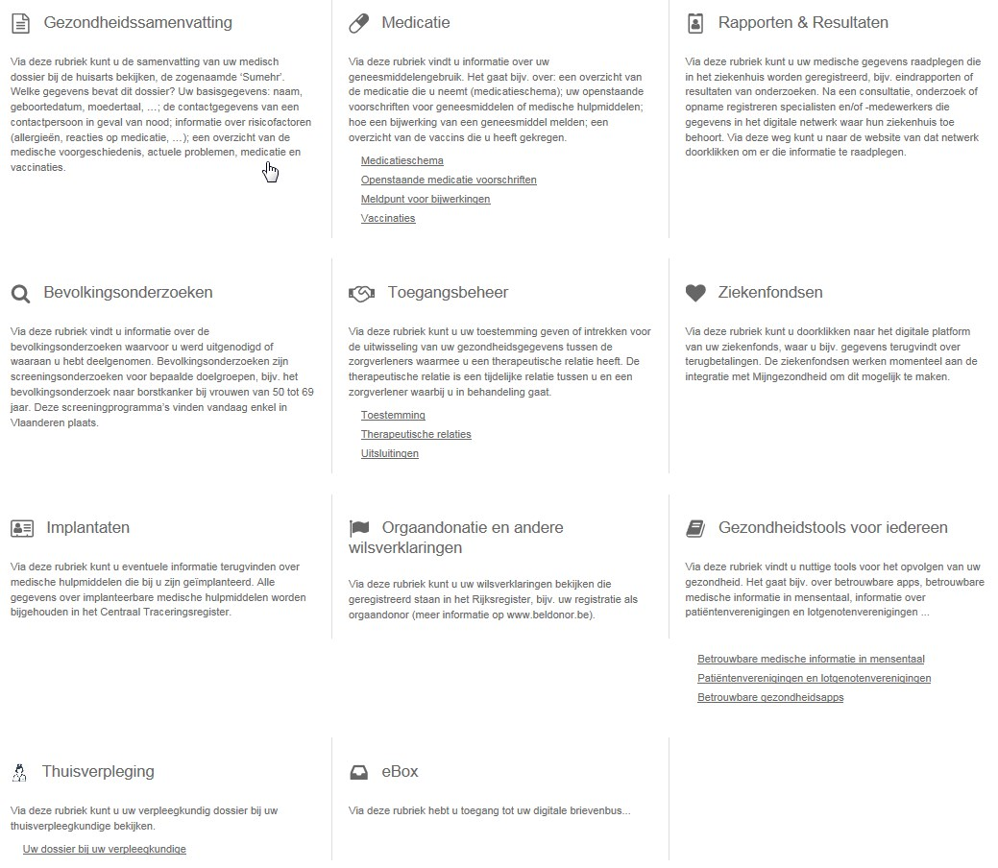
Access to data by patient

Slide 52
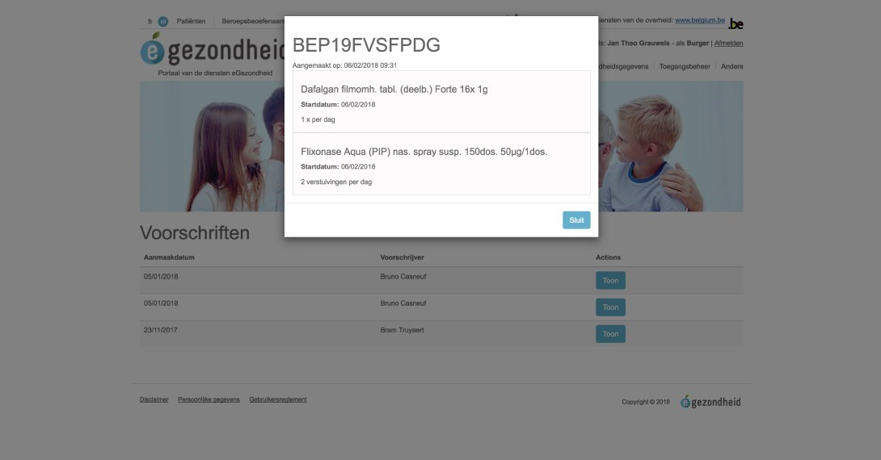
Access to data by patient

Slide 53
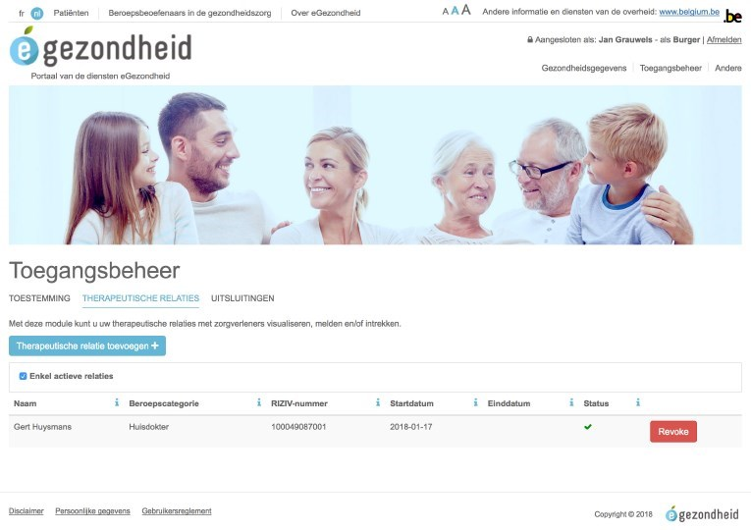
Access to data by patient

Slide 54







Currently approved means of authentication
Strong
 | eID + PIN-code with connected card reader
 | eID + PIN-code with wireless card reader
 | SIM card with PIN-code
 | Security code via mobile app, user-id + password
 | Security code via SMS, user-id + password
 | Security code on paper (paper token), user-id + password
 | User-id + password
Weak

Slide 55
Mobile Health
Objectives
  framework for mHealth actions > efficient implementation
  support when using mHealth applications
  integration of a legal, financial and organizational framework in new and existing care agreements
  integration of the eHealth services in mHealth
  support quality and accessibility of mHealth
  approach based on use cases (diabetes, cardiovascular...)

Slide 56
Mobile Health
5 priority use cases, selected based on their impact (number of patients x severity) and the availability of mHealth technical tools
    stroke
    diabetes
    chronic pain
    mental health
    cardiovascular disease

Slide 57
Mobile health applications - validation pyramid
M3
Requires M2
Positioned within Belgian health system
Conditional financing (expert committee)
CostBenefit
Triple Aim
M2
Requires M1
Validated by administrations (or trusted third parties)
Security - Authentication (eHP)
Interoperability (eHP + SPF -FOD)
Scientific evidence (publications)
BE mHealth Validation
CE
Medical device
M1
CE certified as Medical device AFMPS-FAGG)
GDPR compliant
Belgian privacy law compliant

Slide 58

Mobile health

Slide 59
Mobile health
Applications meeting the required criteria are published at www.mhealthbelgium.be for each level
Today people can already visit the website for more information about the policy on mobile health in Belgium
  presentations of the 24 pilot projects can be found here
  the first validated (level M1) health applications have recently been published
    an application to detect cardiac dysrhythmias
    a rehabilitation application for patients who have undergone knee or hip surgery
    an application to improve follow-up of cancer patients during chemo and
    an application for people with respiratory or sleep disorders

Slide 60

Role of the eHealth platform

Slide 61








Overall architecture
Patients, health care providers,
health facilities
Health portal
Software
HC provider
Software health facility
VAS
Site NIHDI
VAS
eHealth
portal
MyCareNet
VAS
VAS
VAS
Users
Basic services eHealth platform
Network
VAD
VAD
VAD
VAD
VAD
VAD
Suppliers

Slide 62
Basic services eHealth platform
Coordination of digital subprocesses
Portal
Integrated user and access management
Management of logs
System for end-to-end encryption
eHealthBox
Timestamping
Encryption and anonymization
Consultation of the National Register and the CBSS Registers
Reference directory (metahub)

Slide 63
10 Tasks
Development of a vision and of a strategy for eHealth
Organization of the cooperation between all governmental institutions which are charged with the coordination of the electronic service provision
The motor of the necessary changes for the implementation of the vision and the strategy with regard to eHealth
Determination of functional and technical norms, standards, specifications and basic architecture with regard to ICT

Slide 64
10 Tasks
Registration of software for the management of electronic patient files
Managing and coordinating the ICT aspects of data exchange within the framework of the electronic patient files and of the electronic medical prescriptions
Conceptualization, design and management of a cooperation platform for secure electronic data exchange with the relevant basic service

Slide 65
10 Tasks
Reaching an agreement about division of tasks and about the quality standards and checking that the quality standards are being fulfilled
Acting as an independent trusted third party (TTP) for the encoding and anonymisation of personal information regarding health for certain institutions summarized in the law for the support of scientific research and the policymaking
Promoting and coordinating programmes and projects

Slide 66
Conclusion
The sharing of data between healthcare providers / institutions via the hub-meta-hub system, the health safes and the eHealthBox reaches cruising speed
> 75% of the Belgian population has now given their data sharing consent
The opening up of health data for the patient starts => attention for integrated access
Experience is gained with mobile eHealth applications

Slide 67


Thank you
Any questions?
frank.robben@ehealth.fgov.be
@FrRobben
https://www.ehealth.fgov.be
https://www.frankrobben.be

